Slide 1
Nuclear charge radii vs. other experimental observables
Georgi Georgiev, IJCLab, Orsay, France
Largely inspired by
W. Nörtershäuser and I. D. Moore, "Nuclear Charge Radii", Handbook of Nuclear Physics and
I. Angeli and KP Marinova, "Correlations of nuclear charge radii with other nuclear observables”, JPG 42 2015) 055108

Slide 2
Charge radius – a zeroth order nuclear moment?
Magnetic dipole moments – for states with spin I ≥ 1/2
Electric quadrupole moments – for states with spin I ≥ 1
Magnetic octupole moments – for states with spin I ≥ 3/2
Charge radius – defined for any nuclear states (I=0 or higher)
$$µ= \sum_{i=1}^{A}{µ_{N}(g_{ℓ}^{i}ℓ+g_{s}^{i})}$$
$$Q= \sqrt{\frac{16π}{5}}\sum_{i=1}^{A}{e_{i}r_{i}^{2}Y_{2}^{0}(θ_{i},φ_{i})}$$
$$Ω= \sum_{i=1}^{A}{µ_{N}(g_{ℓ}^{i}ℓ+g_{s}^{i})}∗\vec{∇}\left(r_{i}^{3}\sqrt{\frac{7}{4π}}Y_{3}^{0}(θ_{i},φ_{i})\right)$$
$$R_{c}=\sqrt{\left\langle r_{c}^{2}\right\rangle }$$
$$\left\langle r_{c}^{2}\right\rangle = \frac{1}{Z}\int{d^{3}r r^{2} ρ_{c}(\vec{r})}$$

Slide 3
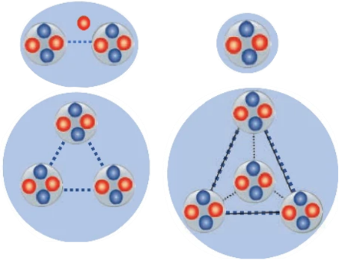
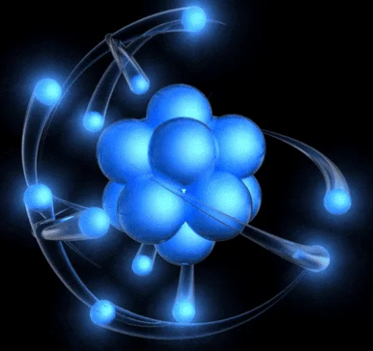
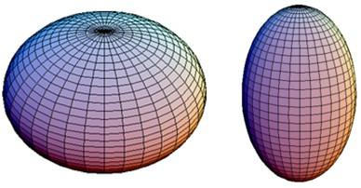
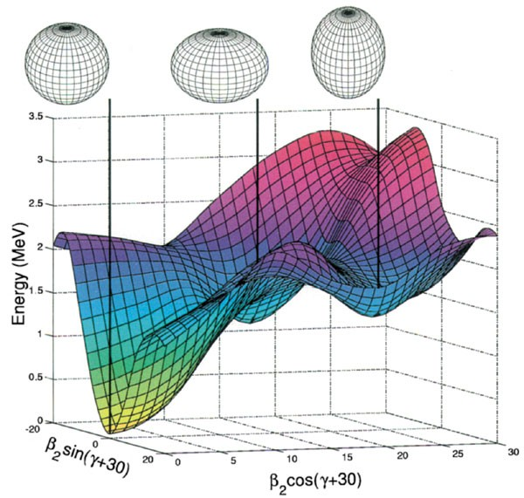
Trends in nuclear charge radii
Not quite the expected smooth behaviour of $\sqrt[3]{A}$
Light nuclei – predominant cluster and hallo effects
Medium mass nuclei - kinks around shell closures
Deformation and charge radii
Shape coexistence

Slide 4
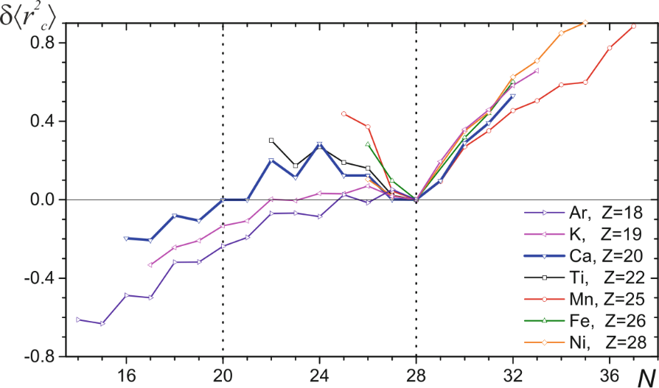
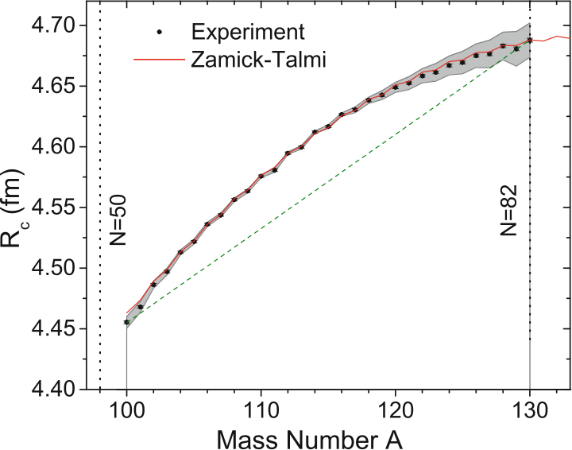
Charge radii at and in between shell closures
Parabolic behaviour between shell closures
4-parameter model (Zamick; Talmi), reproducing semi-magic nuclei (seniority picture)
Sufrace vibrations; configuration mixing; nucleonic pairing etc.
Changes in the nuclear deformation
Kinks observed for shell closures N ≥ 28!
Not (obvious) N/Z dependence
Cannot be used as a test of the “goodness” of the shell closures (comparison with µ and B(E2))
Odd-even staggering (OES)
Directly observable by the isotopes shifts
“normal” OES = odd-N has smaller ⟨r²_{c}⟩ compared to the neighbouring even-even isotopes
“inverse” OES observed as well (Ra isotopes) → sign for octupole deformation?

Slide 5
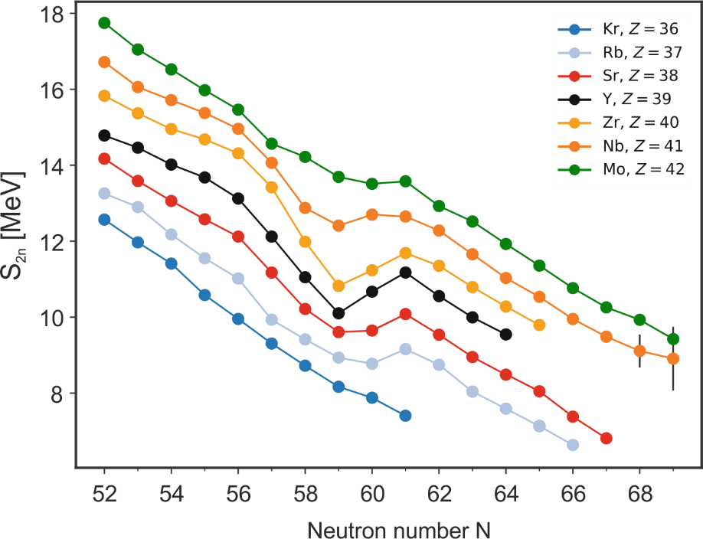
Charge radii vs. Deformation
Charge radius difference vs. →
static quadrupole deformation
$$δ{\left\langle r_{c}^{2}\right\rangle }^{A,A^{′} }=δ{\left\langle r_{c}^{2}\right\rangle }_{sph}^{A,A^{′}}+{\left\langle r_{c}^{2}\right\rangle }_{sph}∗\frac{5}{4π}δ{\left\langle β_{2}^{2}\right\rangle }^{A,A^{′} }$$
Quadrupole moments vs. →
nuclear deformation (strong coupling limit for I ≥ 1)
$$Q_{0}=Q_{s}\frac{(I+1)(2I+3}{3{\text{W}}^{2}−I(I+1)}$$
$$Q_{0}=\sqrt{\frac{5}{π}}Z{\left\langle r_{c}^{2}\right\rangle }_{sph}\left\langle β_{2}\right\rangle (1+0.36\left\langle β_{2}\right\rangle )$$
Change in the static nuclear quadrupole deformation can be extracted from charge radii for any nuclear state
Octupole deformation and triaxiality can still be explored through charge radii, however, these are second order effects (on the percent level, compared to the quadrupole deformation)

Slide 6
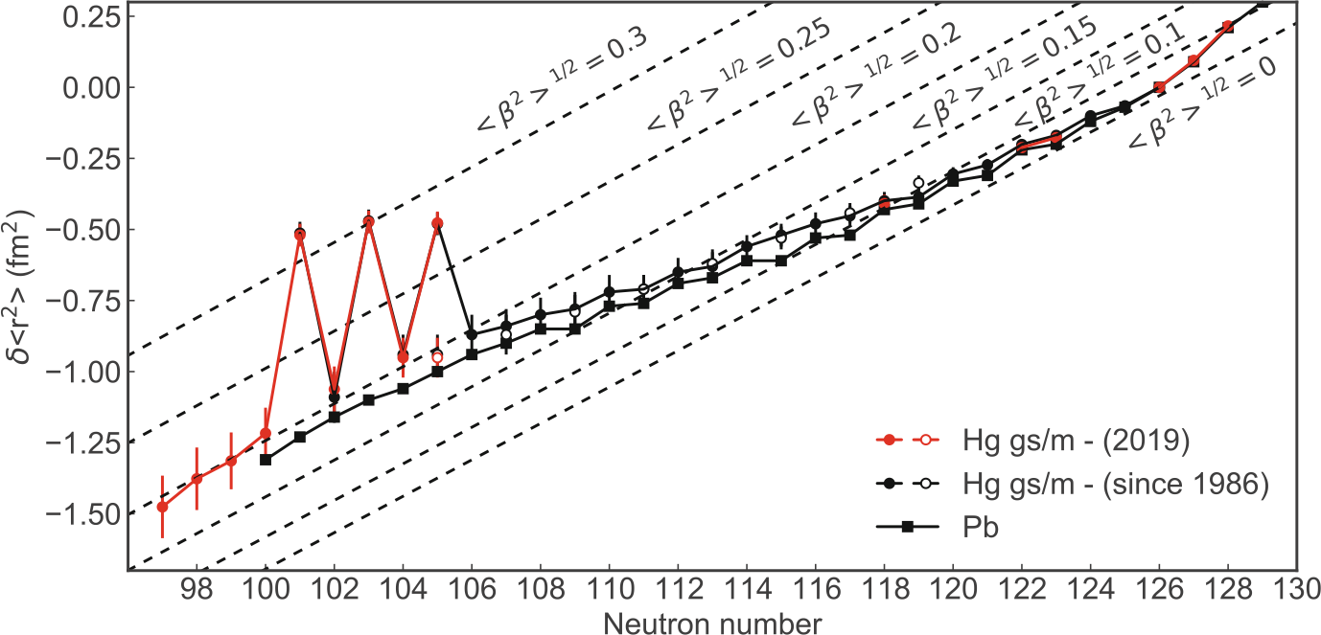
Shape coexistence – Hg’s
A textbook example of shape staggering in the Hg isotopes in a region where triple shape coexistence is observed (A.N. Andreyev et al., “A triplet of differently shaped spin-zero states in the atomic nucleus ¹⁸⁶Pb”, Nature, 405 (2000) 430)
The end of the region of shape staggering identified only 30 later with the advances of the RIB techniques (B.A. Marsh et al., “Characterization of the shape-staggering effect in mercury nuclei”, Nat. Phys. 14, 1163–1167 (2018))

Slide 7
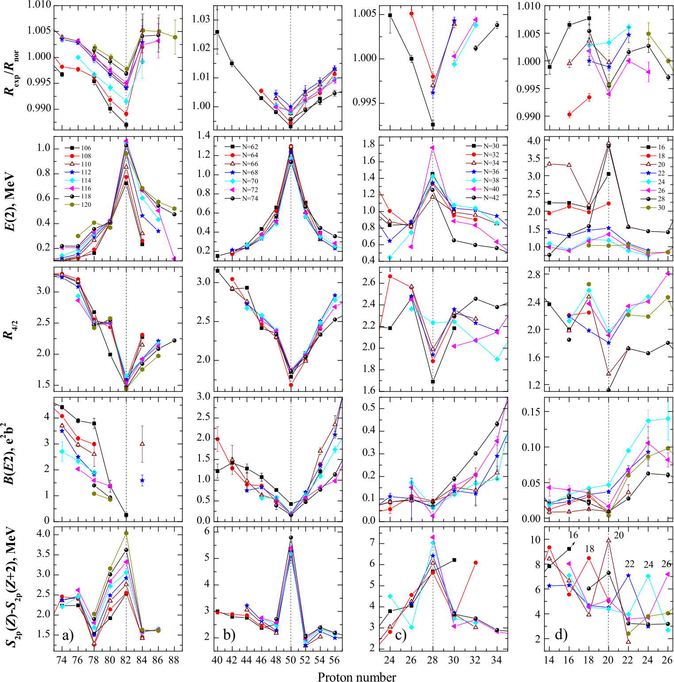
Global picture
I. Angeli and KP Marinova, JPG 42 (2015) 055108
Comparison of charge radii with other nuclear structure observables: interesting features very often can be pinned down when with a number of “key experimental observables”
Sensitivity of the different observables towards specific nuclear structure features – complementarity
The nuclear charge radii are part of the global picture and should be considered carefully when discussing it

