Slide 1
radbase and Correlations
Hunter Staiger

Slide 2
Steps of Evaluation
Optimization
Conversion
Measurement

Slide 3
Overview
Two talks for the price of one!
radbase: Optimization of Nuclear Radius Network
Correlations from Conversion to Radii

Slide 4
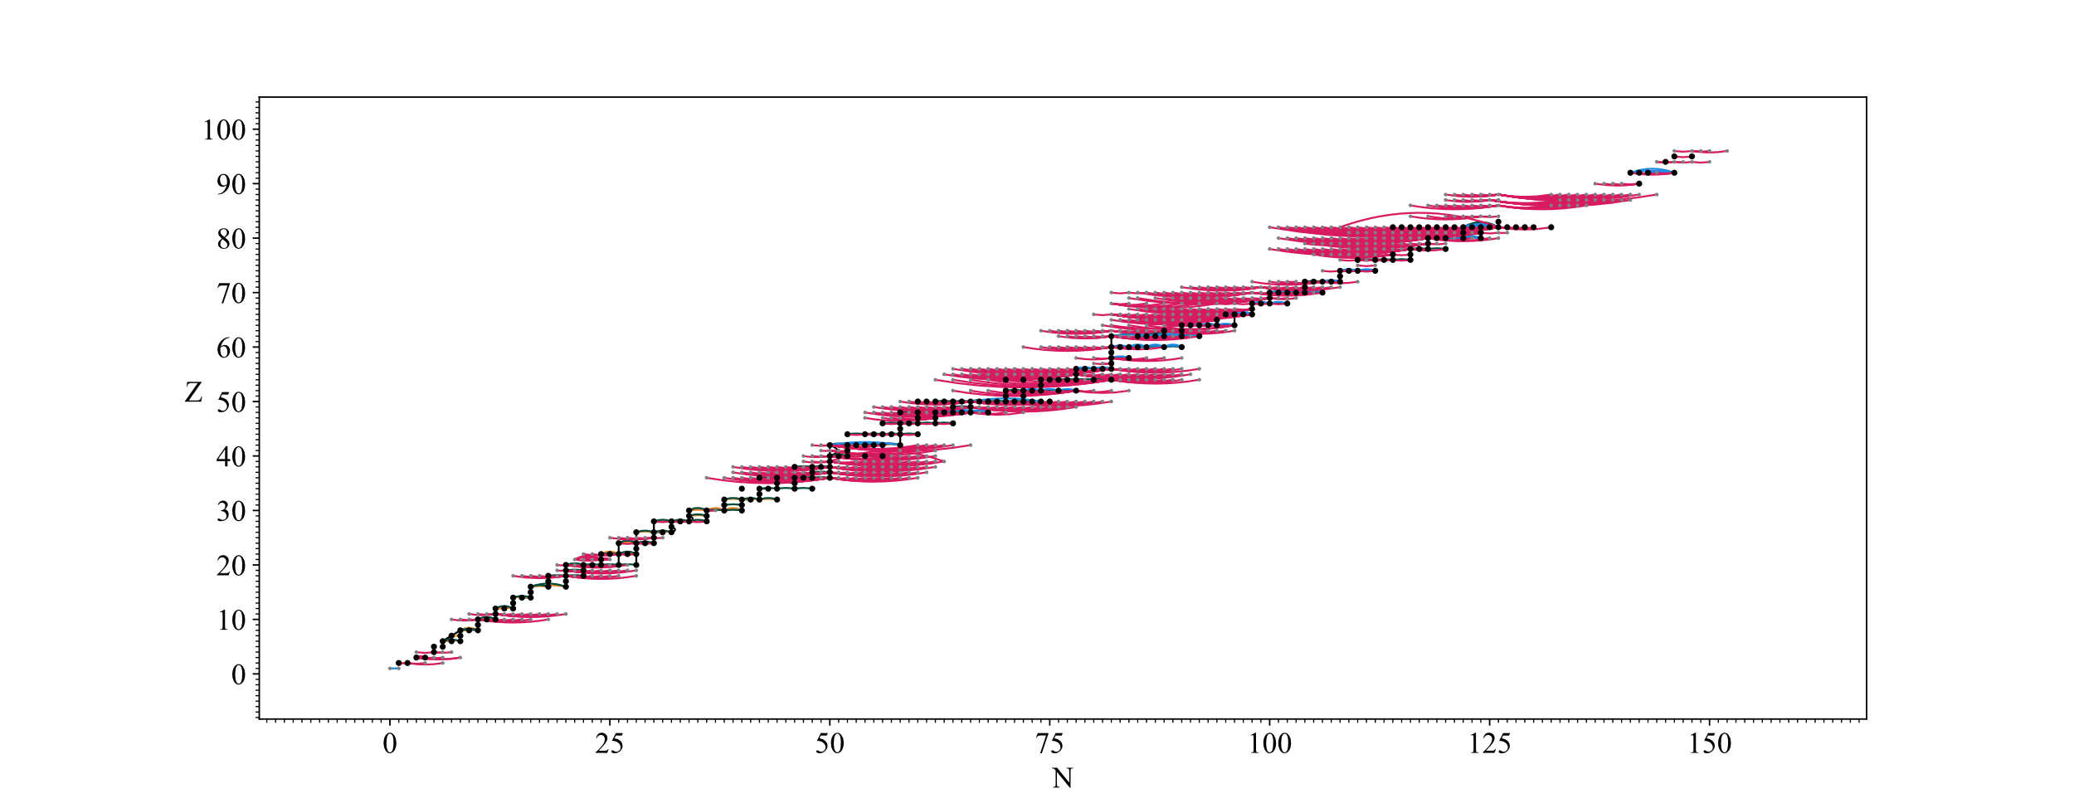
Nuclear Radius Network

Slide 5
Nuclear Radius Network - Snapshots

Slide 6
Optimization in Previous Works
Nadjakov, Marinova, Gangrsky 1994
For each element, explore all paths between every isotope pair
Take weighted average of results over all paths
Angeli 2004
Least squares fit over nuclear network
Internal and external uncertainties considered
Notes:
Spelling gangrsky

Slide 7
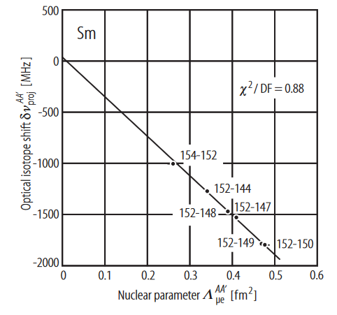
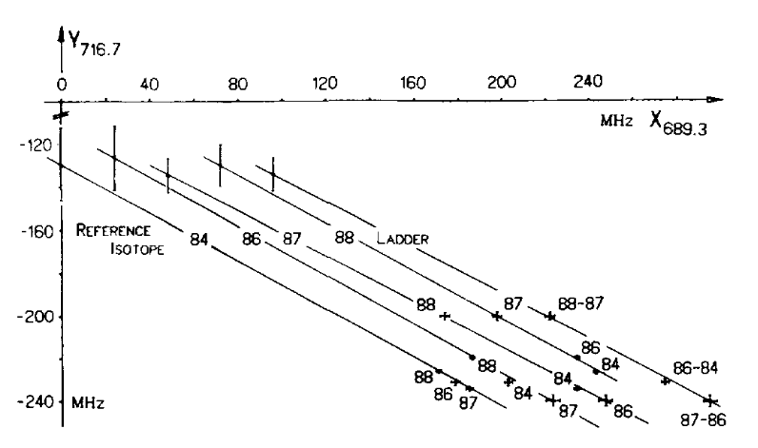
Optimization in Previous Works
Fricke 1995/2004
Multi-dimensional King Plot
Computing OIS parameters using
muonic and electronic data

Slide 8
Challenges of Optimization
Large number of parameters
Non-linear least squares problem
Correlations between different measurements require generalized least squares treatment
Detecting outliers in densely connected network

Slide 9
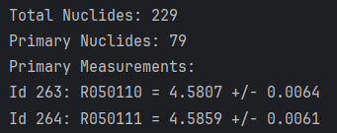
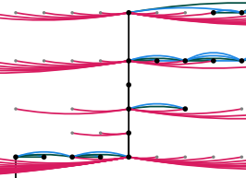
radbase
Open source set of Python codes that:
Quickly groups data according to measurement type, element, group in the network
Visualizes nuclear data network
Solves general least-squares problem given set of 3000+ measurements

Slide 10
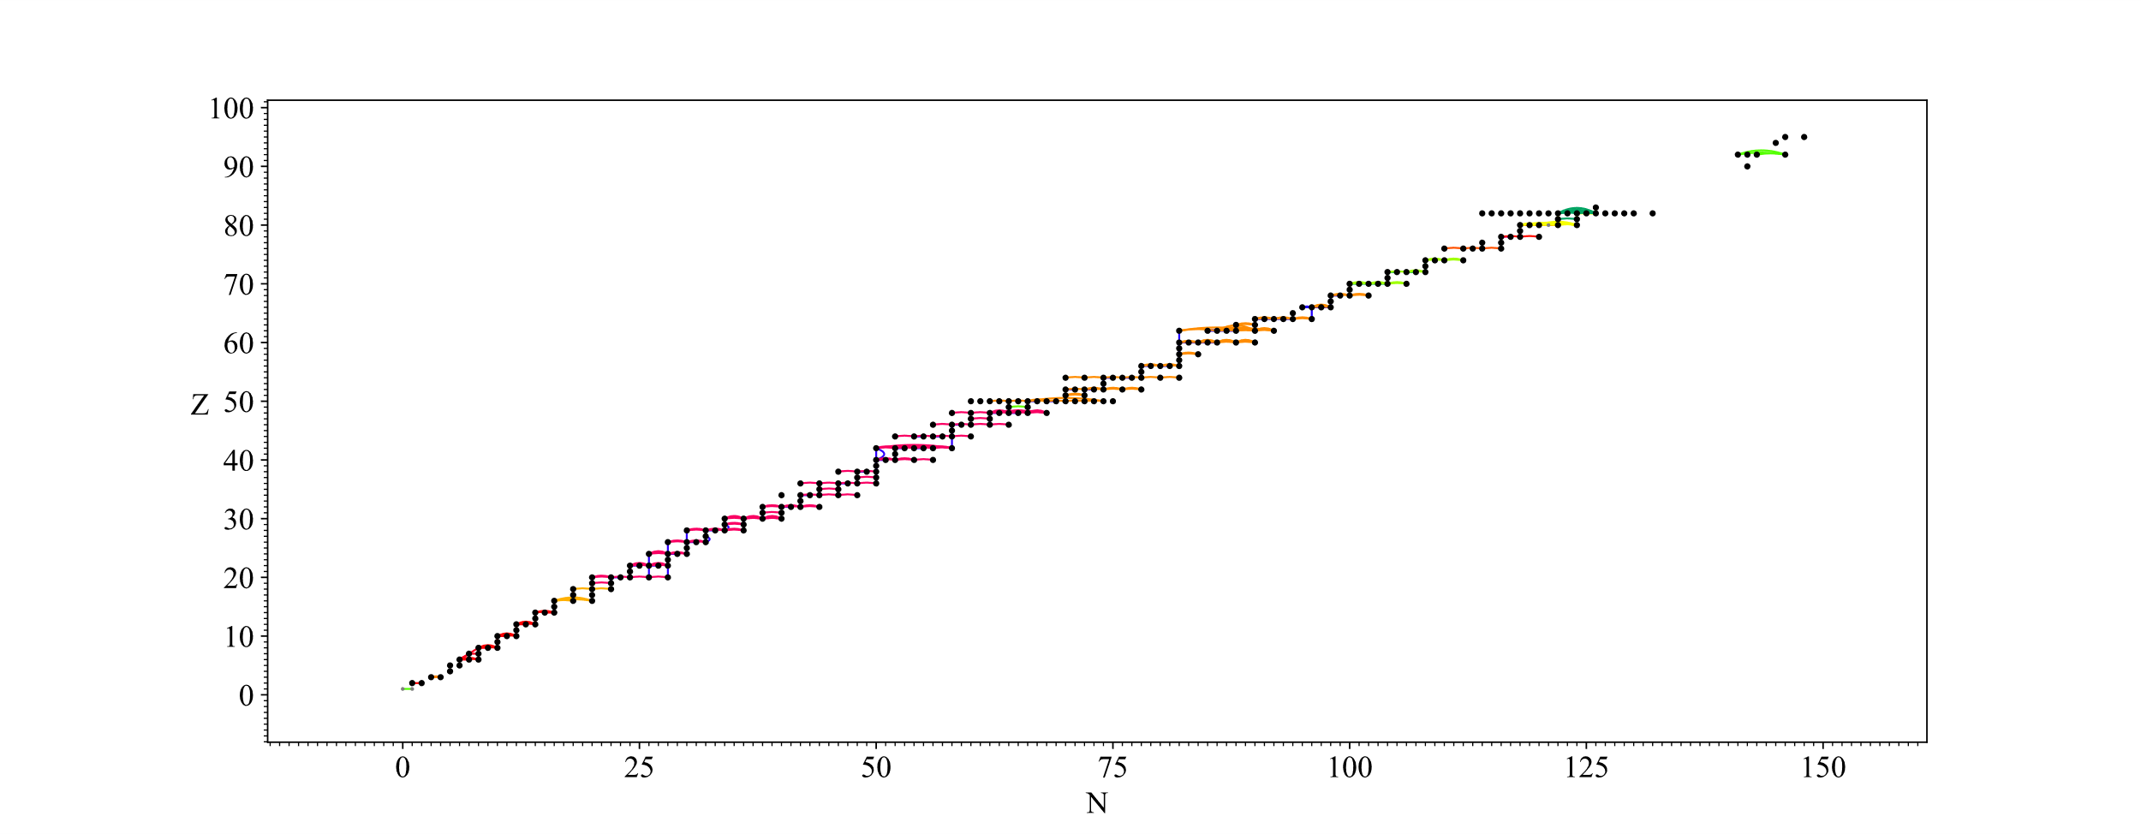
Objective 1: Grouping / Graph Exploration
Users should be able to group data quickly and flexibly!

Slide 11
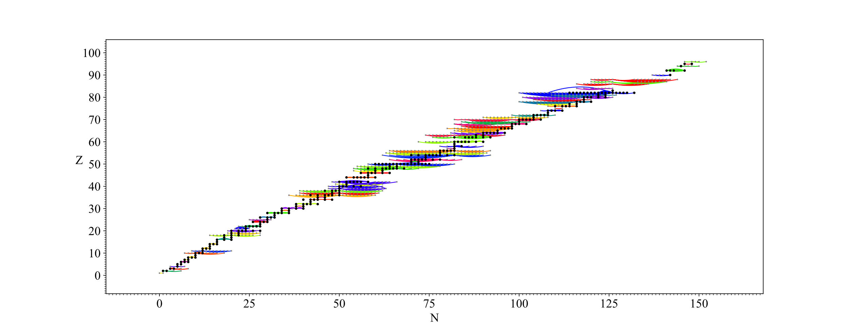
Objective 1: Grouping / Graph Exploration
Whether that be by element:

Slide 12
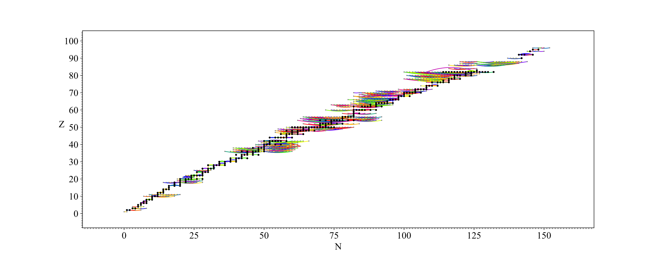
Objective 1: Grouping / Graph Exploration
Or by measured quantity:

Slide 13
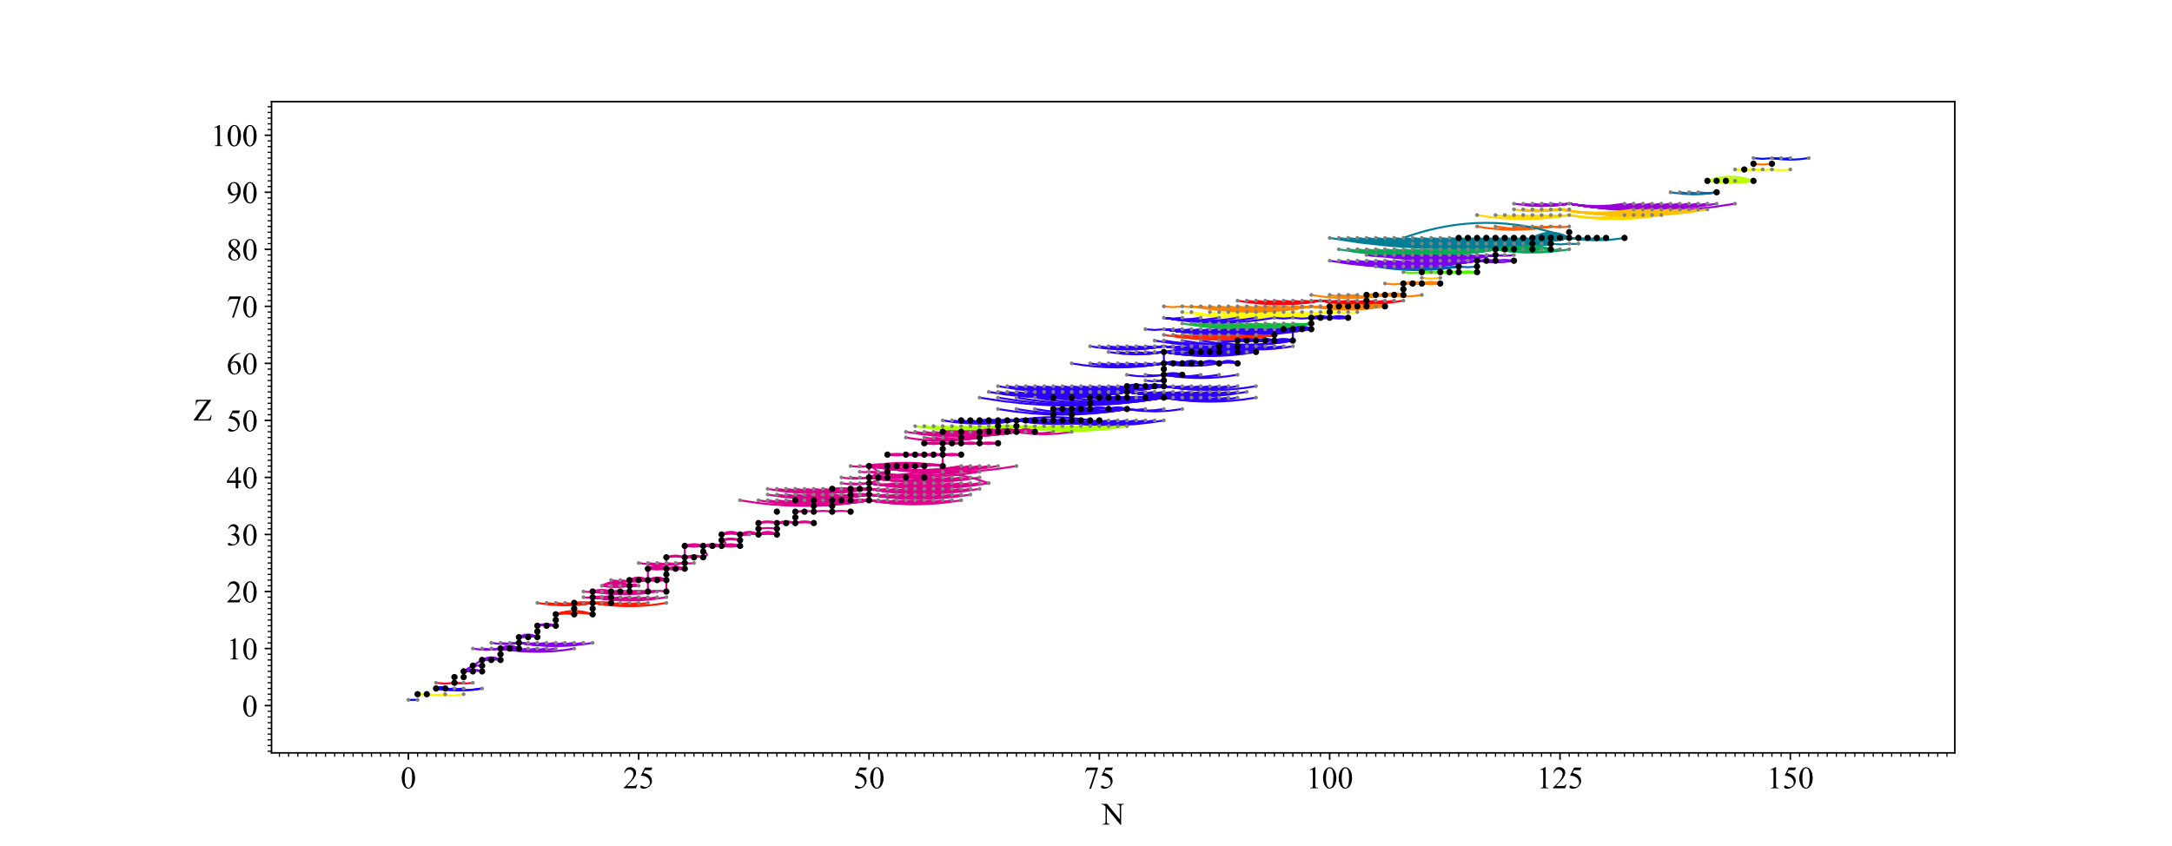
Objective 1: Grouping / Graph Exploration
Or by group in the network:

Slide 14
Objective 1: Grouping / Graph Exploration

Slide 15
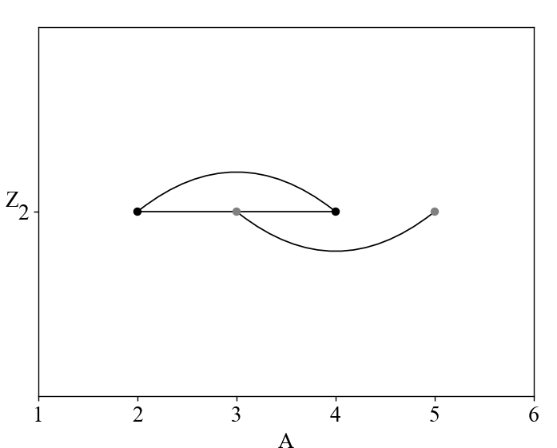
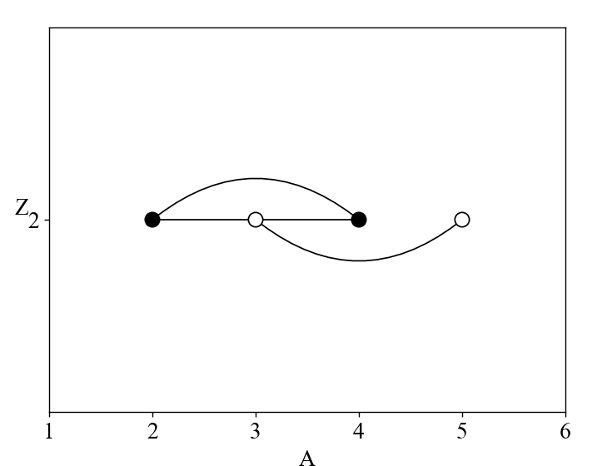
Objective 1: Graph Exploration
Backbone vs. Wing Measurements:
Backbone measurements affect the chi-squared
Wing measurements do not affect the chi-squared
Similar to “Primary” vs “Secondary” from Atomic Mass Evaluation 2020: W.J. Huang et al 2021 Chinese Phys. C 45 030002
Notes:
Mention backbone and wings explicitly!

Slide 16
Objective 1: Graph Exploration
Backbone vs. Wing Measurements:
Backbone measurements affect the chi-squared
Wing measurements do not affect the chi-squared
Key observation: Only measurements on a path between two absolute measurements are in the backbone.

Slide 17
Objective 1: Graph Exploration
This means we can split optimization of each group into two steps:
Optimize radii affected by backbone measurements
Fix these radii, then optimize each group of wing measurements
Net effect – Only have to vary 100 nuclides at a time, thousand fold reduction in computation time

Slide 18
Objective 2: Optimization
Least squares solving is handled by lmfit, a Python package from Matt Newville at the University of Chicago:
Matt Newville et. al. (2024). lmfit/lmfit-py: 1.3.2 (1.3.2)
Uncorrelated – Weighted Least Squares
Correlated Errors – Generalized Least Squares
Notes:
Add parenthesis to GLS formula

Slide 19
Objective 2: Optimization – W vs G (LS)
Weighted Least Squares assumes all input data is independent:

Slide 20
Objective 2: Optimization – W vs G (LS)

Slide 21
Correlations from Conversion

Slide 22
Correlations
Just as estimating uncertainties correctly is critical to an evaluation, so is estimating correlations correctly
Uncorrelated – Weighted Least Squares
Correlated Errors – Generalized Least Squares

Slide 23
Correlations: Example

Slide 24
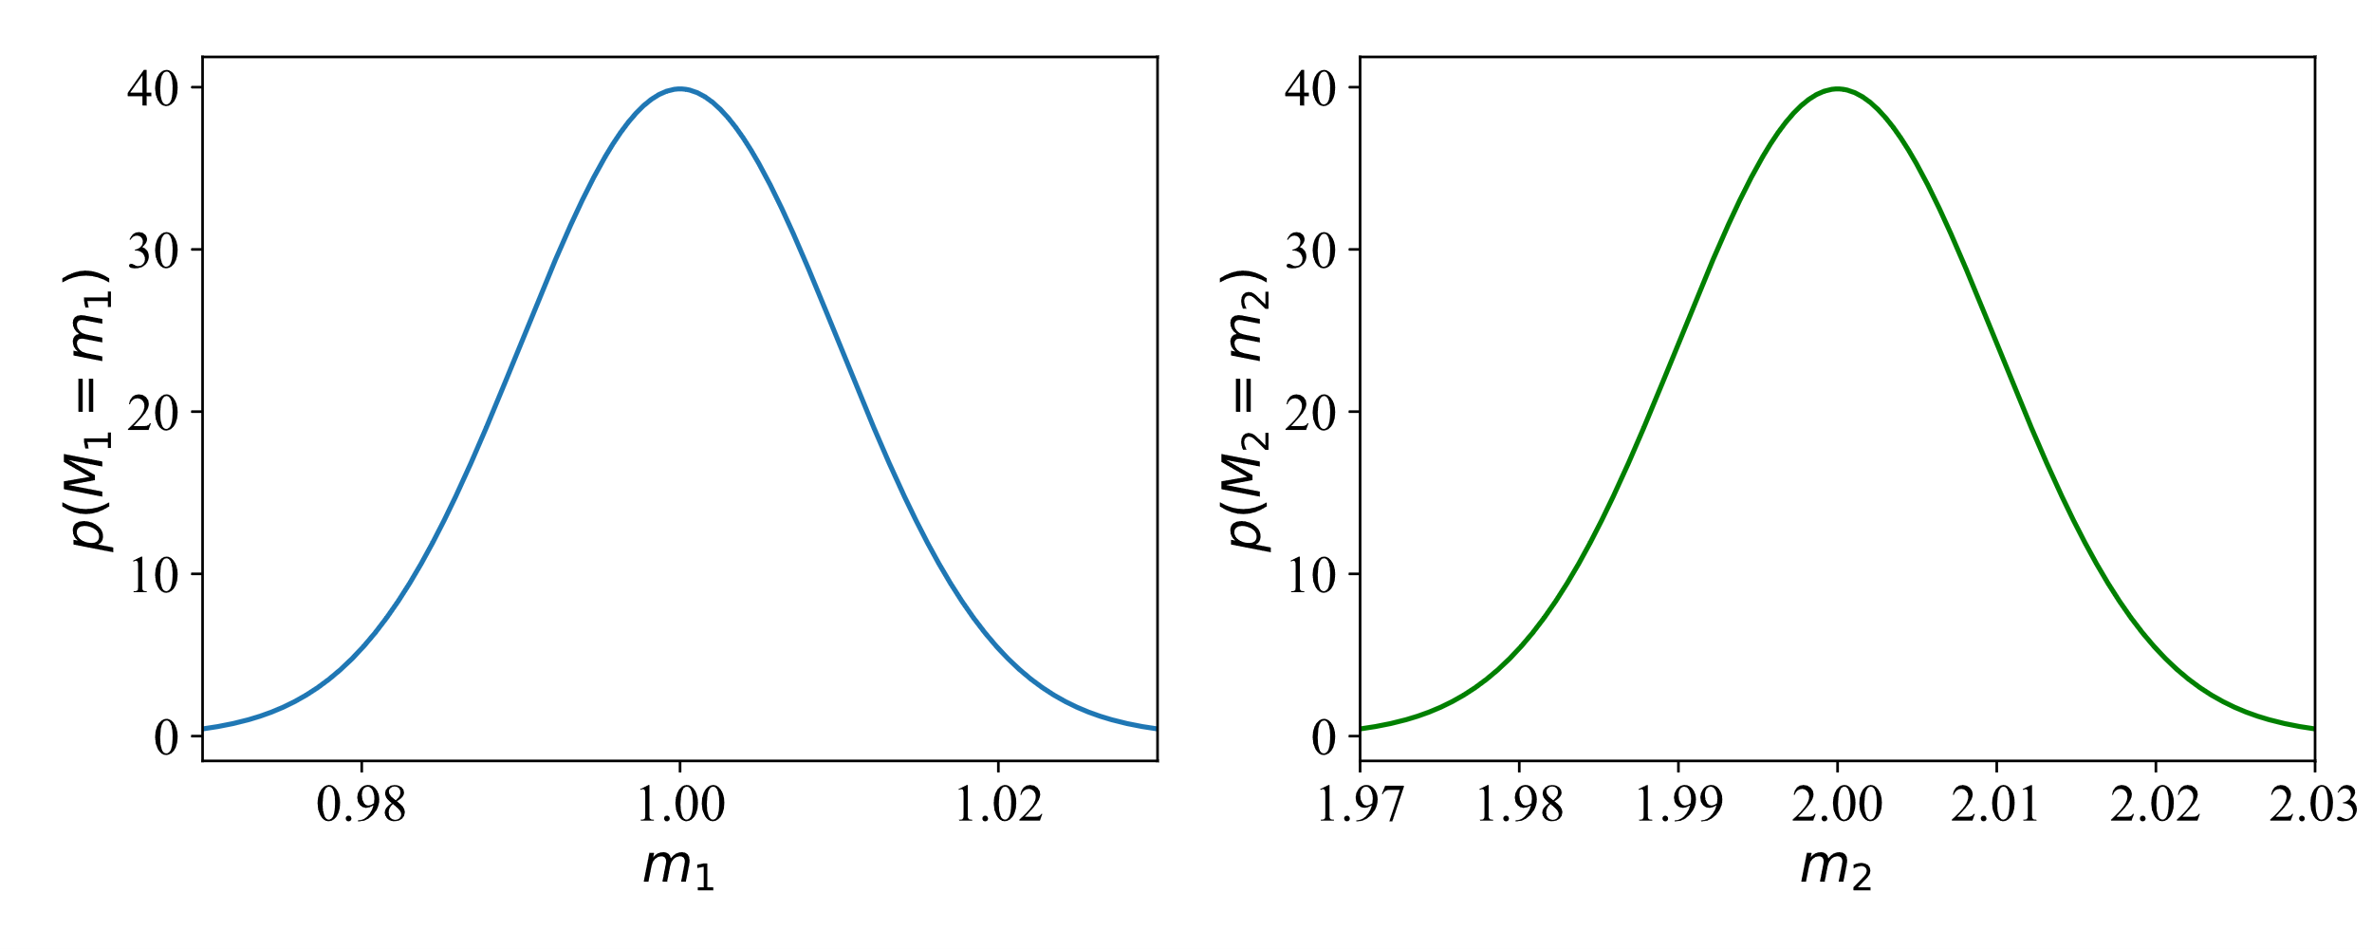
Correlations: Example

Slide 25
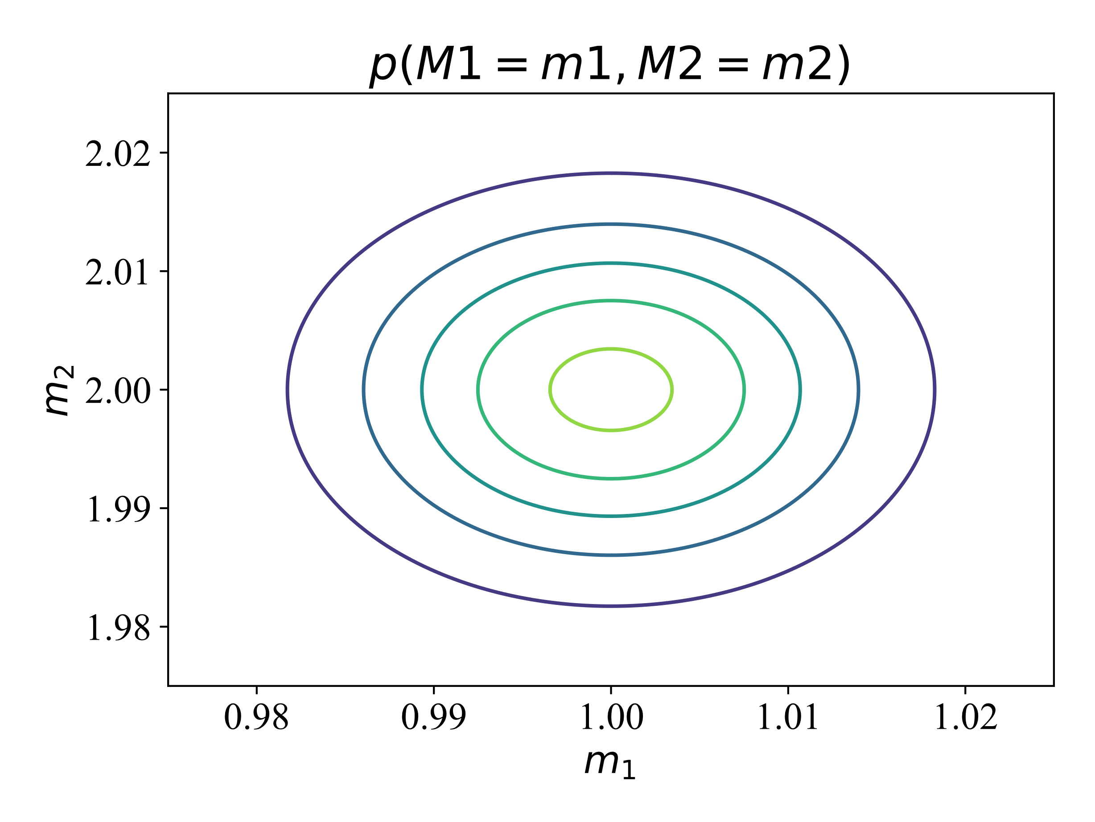
Correlations: Example
Represents joint pdf, probability of seeing a certain combination of M1 and M2

Slide 26
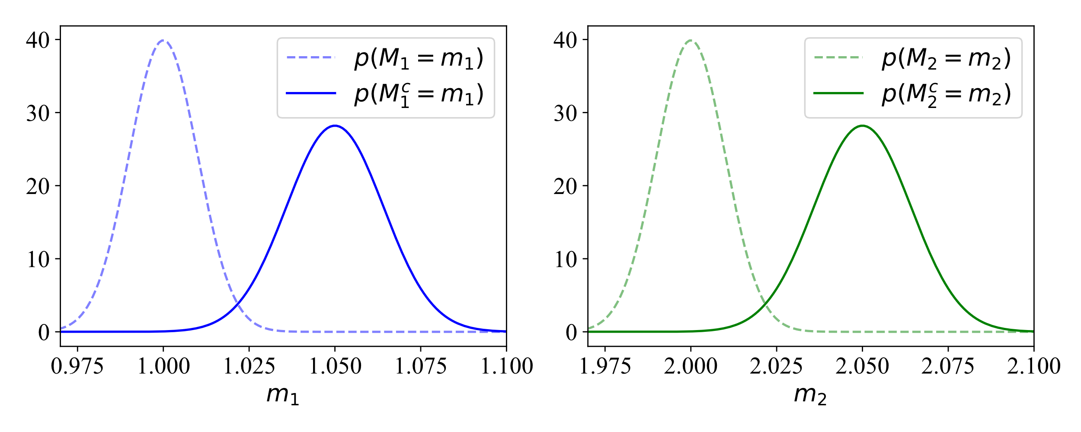
Correlations: Example

Slide 27
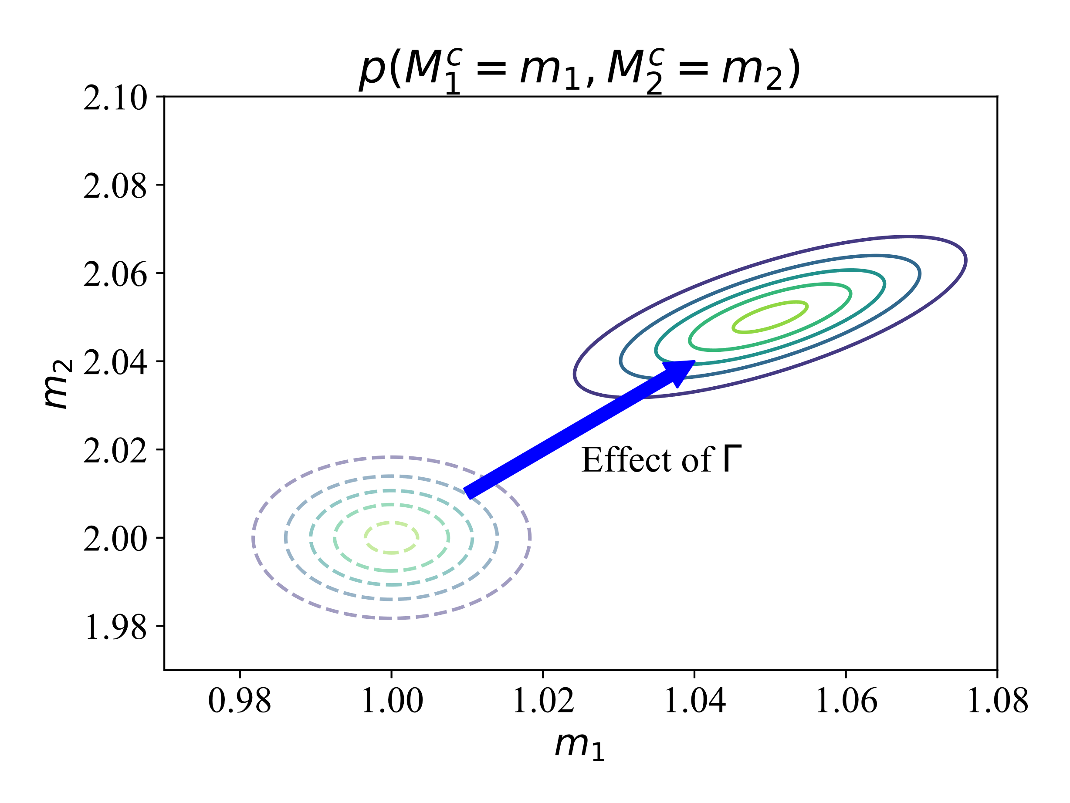
Correlations
The corrected measurements share a dependence on gamma, making them correlated

Slide 28
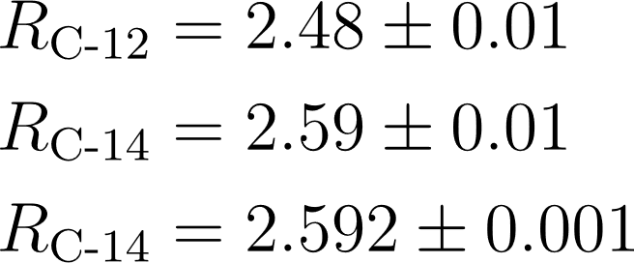
Correlations: Example
Weighted Least Squares
=0.7
Generalized Least Squares

Slide 29
Correlations from Conversion: Muonic Data
Different approaches for when e- data is unavailable:
Parameterize V and fit available data
Interpolate between known nuclides
Assume a nuclear model (similar to parameterization)
Notes:
TODO: Make different points fade in

Slide 30
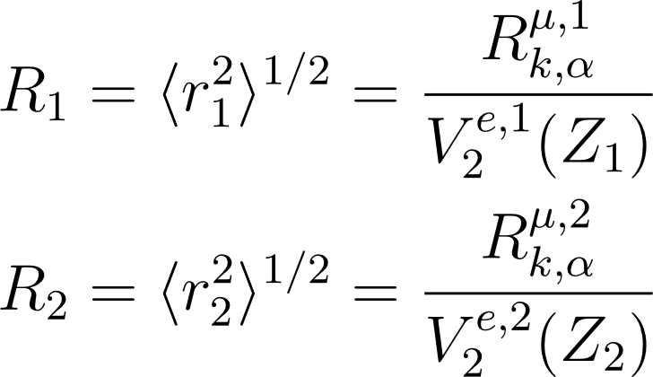
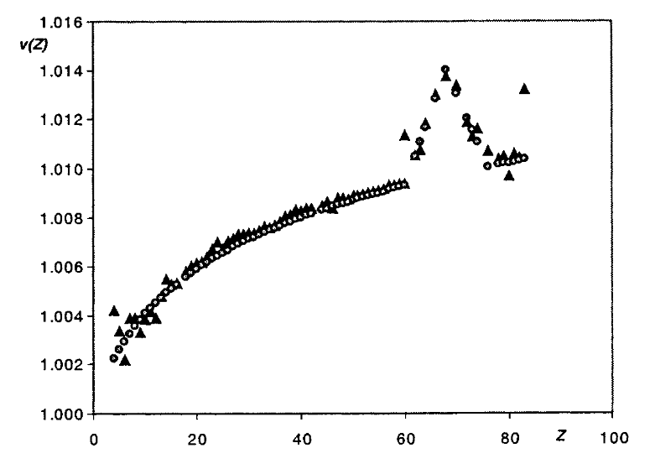
Correlations from Conversion: Muonic Data
Two muonic measurements with V parameterized by Z
Acta Physica Hungarica A 15, 87–102 (2002)

Slide 31
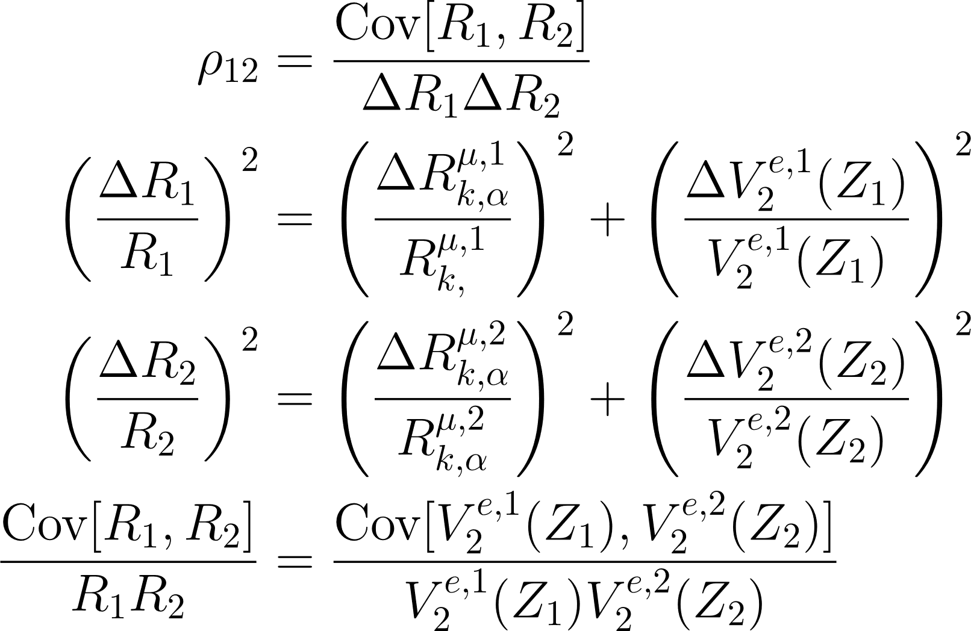
Correlations from Conversion: Muonic Data
Two muonic measurements with V parameterized by Z
Notes:
^2 on delta Rka1

Slide 32
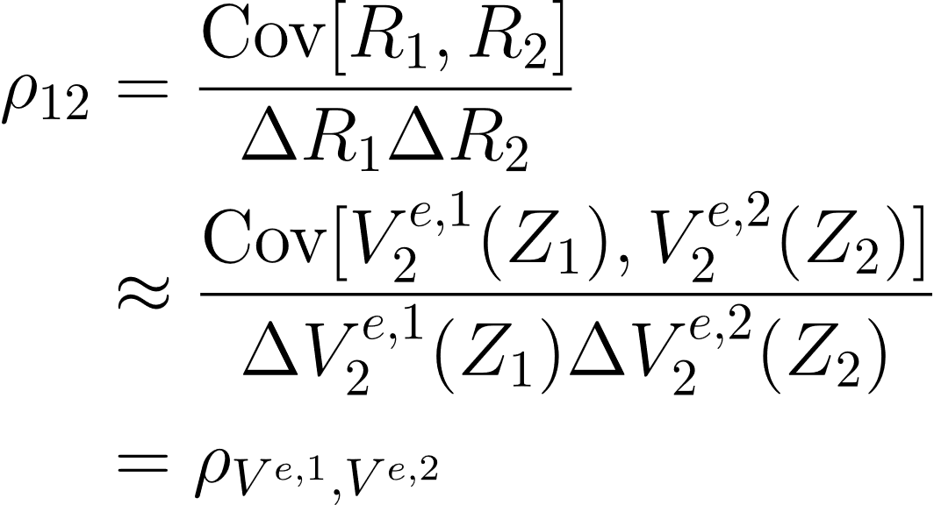
Correlations from Conversion: Muonic Data
Two muonic measurements with V parameterized by Z
If the uncertainties in Barrett radii are small compared to the uncertainties in the V factors:
Notes:
Change second unc to V^2(Z_2), wrong indexes atm!

Slide 33
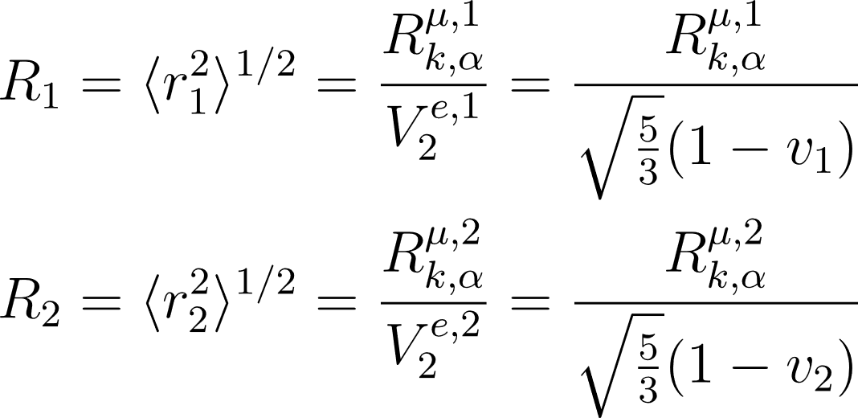
Correlations from Conversion: Muonic Data
Two muonic measurements done on different elements:
If no v measured for an element, interpolate and add uncertainty

Slide 34
Correlations from Conversion: Muonic Data
Two muonic measurements done on different isotopes:
What if v2 is unknown? Reasonable choice is:

Slide 35
Correlations from Conversion: Muonic Data
Correlations from model dependent conversions are trickier to evaluate:
Are all skin thicknesses assumed to be the same?
Are they all the same for the same isotope?
What about deformation parameters?

Slide 36
Correlations from Conversion: Muonic Data
Independent Barrett radii can lead to correlated rms data!

Slide 37
Correlation from Conversion: OIS
Where:
F_i: Transition specific electronic factor
M_i: Transition specific mass factor – includes normal and specific mass shifts
C_i: The Seltzer coefficients

Slide 38
Correlations from Conversion: OIS
Angeli 2004 / 2013 used a correction factor determined from comparing OIS radii differences to electronic and muonic radii differences.

Slide 39
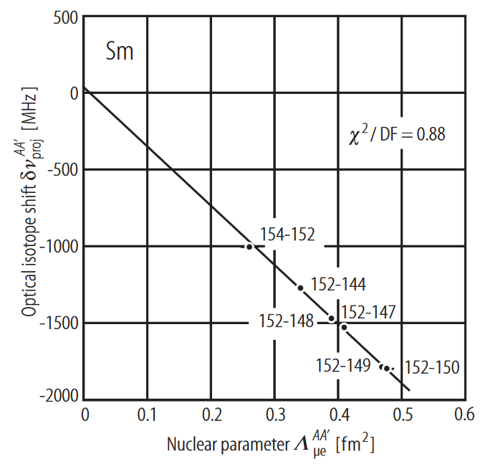
Correlations from Conversion: OIS
King plot was used in Fricke 2004 – directly fit parameters of OIS equation.
Notes:
Calculation Independence!

Slide 40
Correlations from Conversion: OIS
Covariance matrix elements:
Notes:
Correct this equation

Slide 41
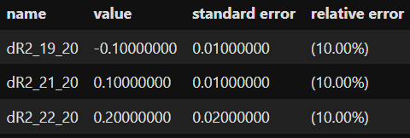
Correlations from Conversion: OIS
Notes:
Delta F = 10%, makes sense!

Slide 42
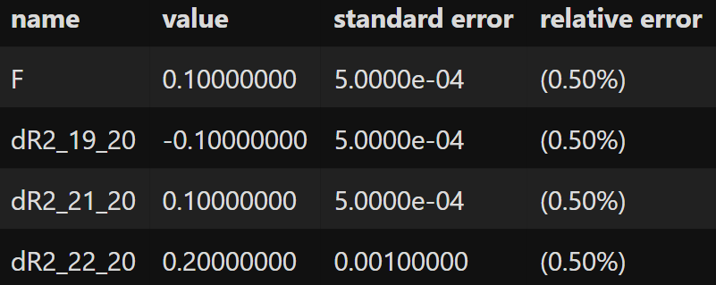
Correlations from Conversion: OIS
Standard weighted least-squares, vary F
Generalized least-squares, all radii are parameters
Notes:
Lower uncertainties are from the uncertainty on F limiting possible radii combinations.

Slide 43
Correlations from Conversion
Linear structure of OIS measurements can be encoded in covariance matrix!

Slide 44
Correlations: Advantages
Include all assumptions made in conversion process
Makes it more obvious when assumptions are violated!
Allows for uncertainties on theoretical parameters
Reproduces familiar results for OIS data
Allows for simultaneous usage of all information

Slide 45
Correlations: Disadvantages
King plots are easier to interpret, easier to identify outliers in
As with uncertainties, incorrect correlations -> incorrect results

Slide 46
Vision for the Future

Slide 47
Modernized Database
Traceability and Transparency
Store original measurement data, allow for flexibility with analysis
Bibliographic database, link between radius data and paper

Slide 48
Conversion Goals
Automatic conversion procedure!
Take in all raw measurement data and calculate radius data, accounting for correlations!
Converted radius data should link to the associated measurements
Use uncertainties Python package - Systematic uncertainties …

Slide 49
Critical Evaluation / Measurements
No analysis software will ever replace a thorough review of the original manuscripts.
Exploring alternative, independent types of measurements:
Highly Charged Ions?
g-factors?

Slide 50
Summary
radbase is open-source optimization software that assists in exploring and optimizing the nuclear radius network
github.com/hstaige/radbase
Strong correlations exist in rms radii data from muonic and OIS measurements
Exciting modernizations of nuclear charge radius evaluations!

