Slide 1
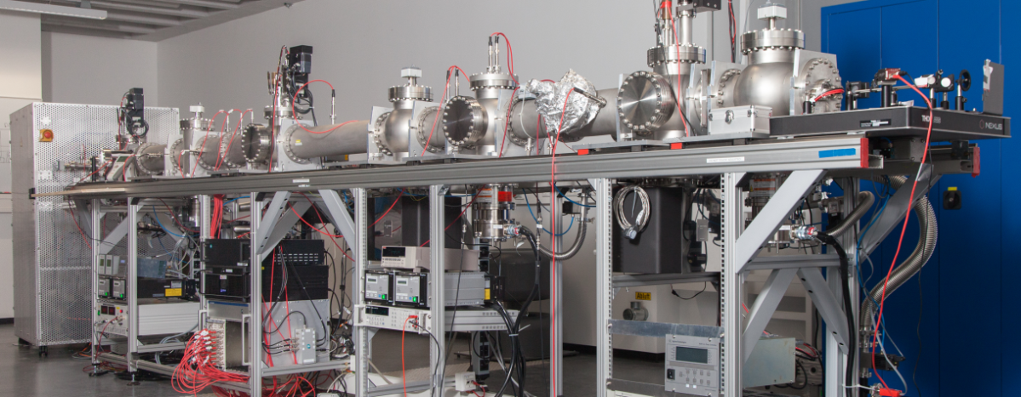
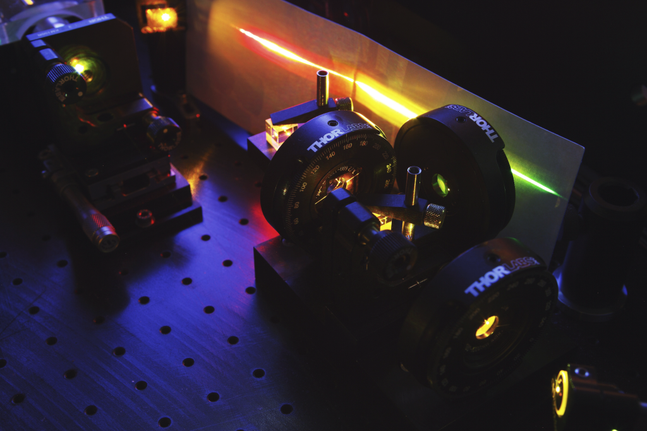




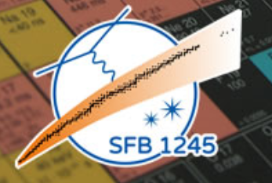

Charge Radii of Light Isotopes from Laser Spectroscopy of He-Like Atomic Systems
W. Nörtershäuser, P. Imgram, K. König, B. Maaß, P. Müller
SFB 1245
Atomic Nuclei: From Fundamental Interactions to Structure and Stars

Slide 2
Outline
Introduction
Motivation
Experimental Setup
Results
Summary and Outlook

Slide 3
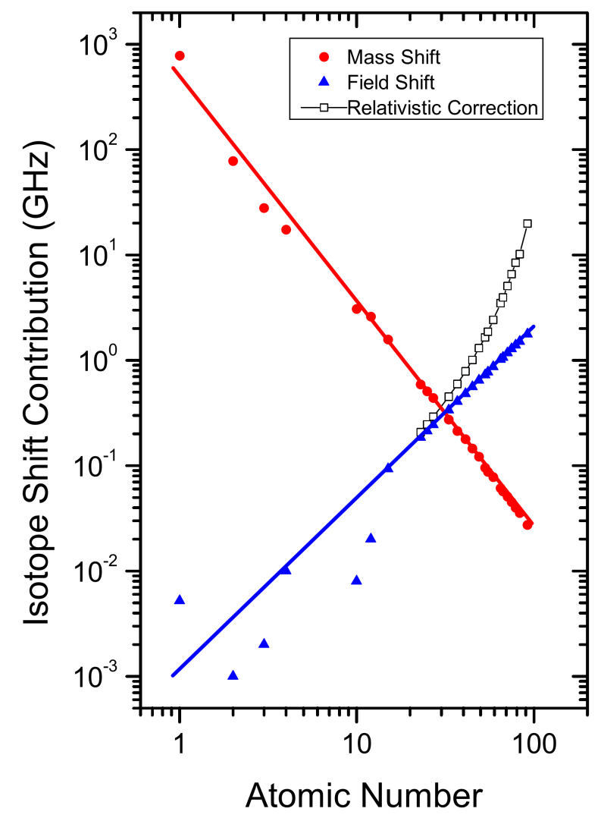

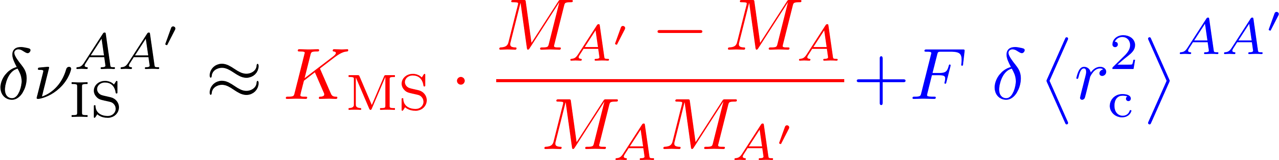
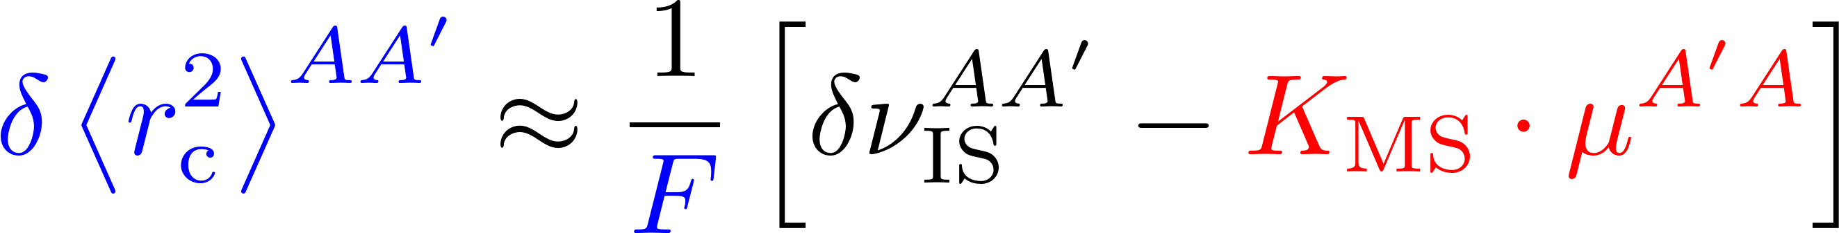
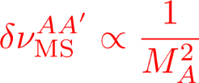
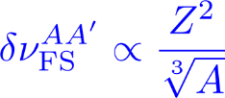
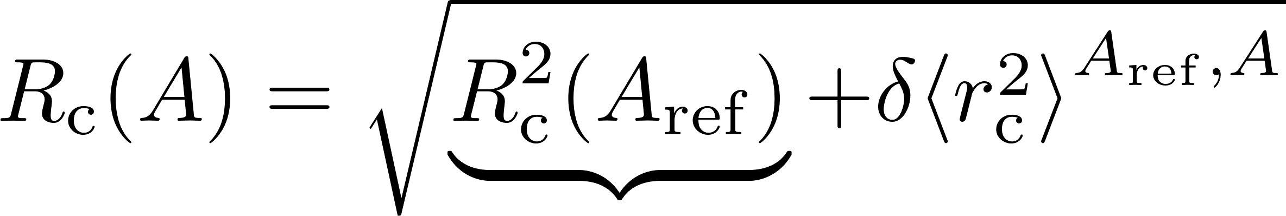
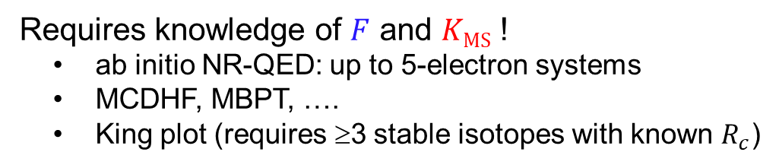
Isotope Shift in a Nutshell
Requires knowledge of $F$ and $K\text{MS}$ !
ab initio NR-QED: up to 5-electron systems
MCDHF, MBPT, ….
King plot (requires ≥3 stable isotopes with known $R_{c}$)
How to get a radius ?
Reference radius required from a different technique

Slide 4

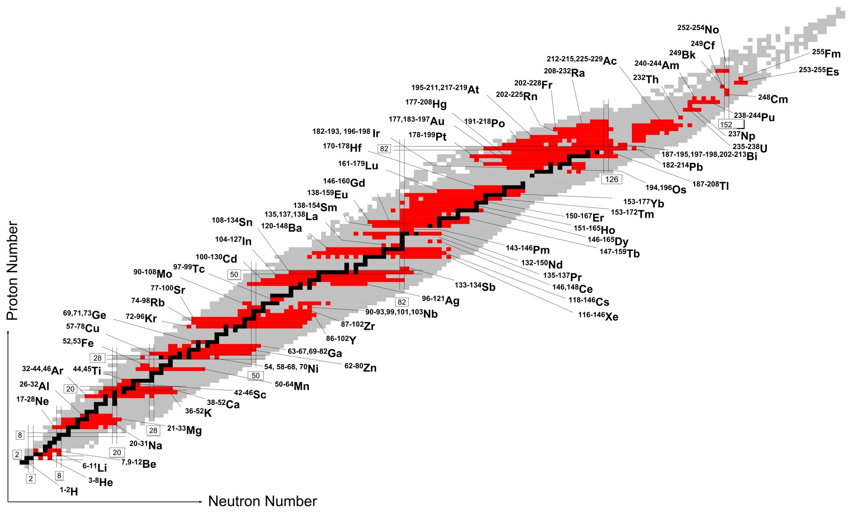

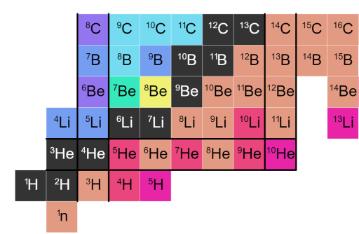

Nuclear Charge Radii
Stable Nuclei
Elastic electron scattering
Muonic atom spectroscopy
→
Laser spectroscopy
Radioactive Nuclei
Collinear Laser Spectroscopy
(Collinear) Resonance Ionization Spectroscopy
→

Slide 5
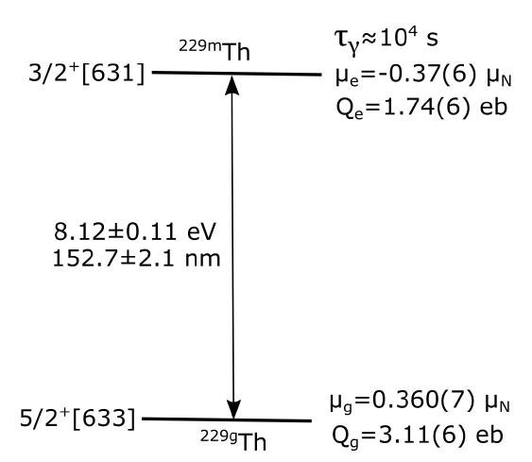

Additional Dimensions
Excited Nuclear States
Isomer
C
C⁺
C⁺⁺
C³⁺
C⁴⁺
C⁵⁺
C-I
C-II
C-III
C-IV
C-V
C-VI
Isonuclear Series

Slide 6
MOTIVATION

Slide 7
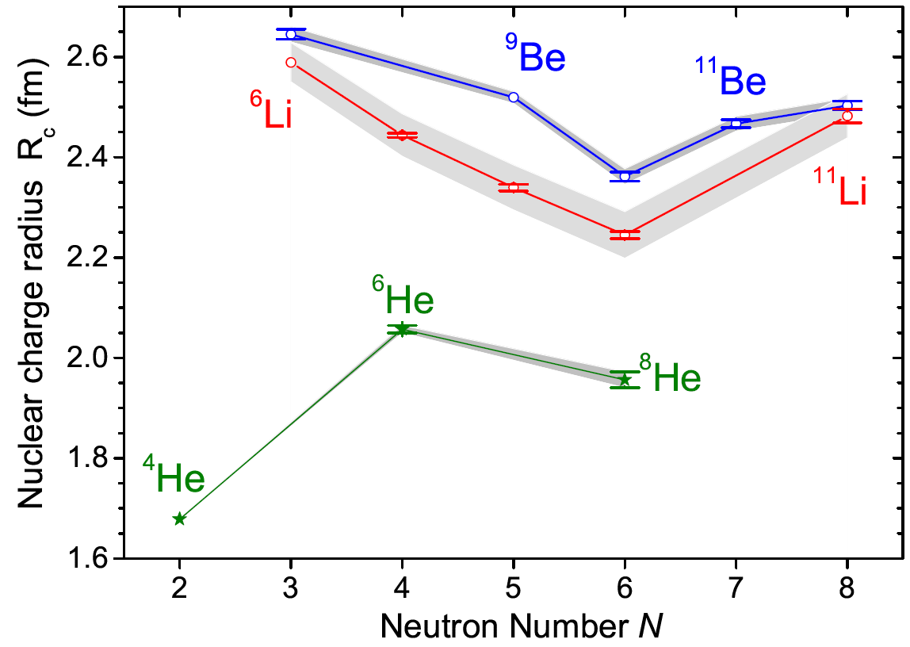


Nuclear Radii of the Lightest Isotopes
Error Bars: σ(δν_{IS})
A. Krieger et al., PRL 108, 142501 (2012)
R. Sanchez et al., PRL 96, 033002 (2006)
P. Müller et al., PRL 99, 252501 (2008)
Grey Regions: σ(R_{c})
J.A. Jansen et al., Nucl. Phys. A 188, 337 (1972)
W. Nörtershäuser et al., Phys. Rev. C 84, 024307 (2011)
Test of ab initio nuclear structure calculations
J.J. Krauth et al., Nature 589, 527 (2021)

Slide 8
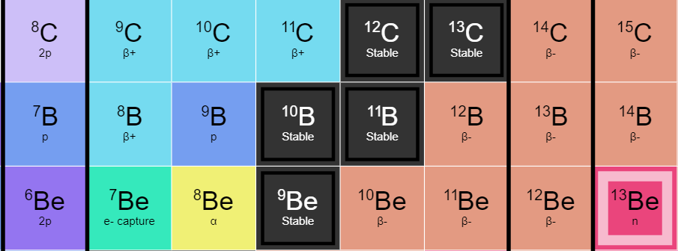
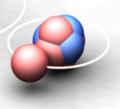

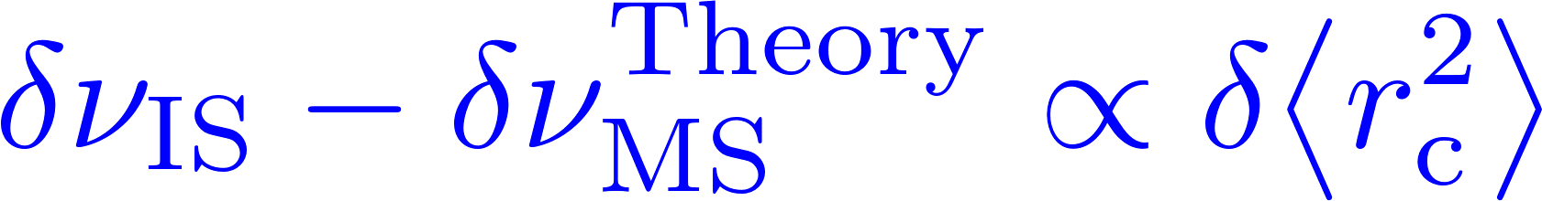
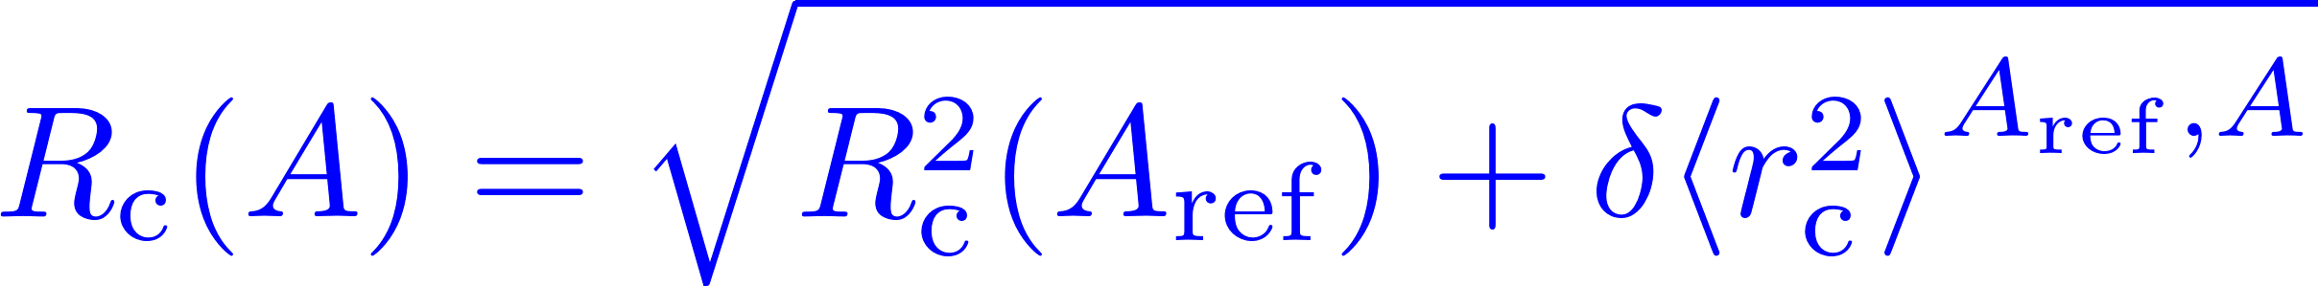
The Proton-Halo Nucleus ⁸B
⁸B?
¹¹Be
Reference Radii required
„Proton-halo size“:
Conclusion: To gain information about the proton halo of ⁸B, we need reliable reference radii for Be and B on equal footing !
Notes:
Alles über halos (?)
(Von Tanihata an)
Laserspektroskopie, He, Li, Be → Konsequente Erweiterung auf das nächstschwerere System
Ideales tool, um Kerngrößen modellunabhängig zu bestimmen.. –B8

Slide 9
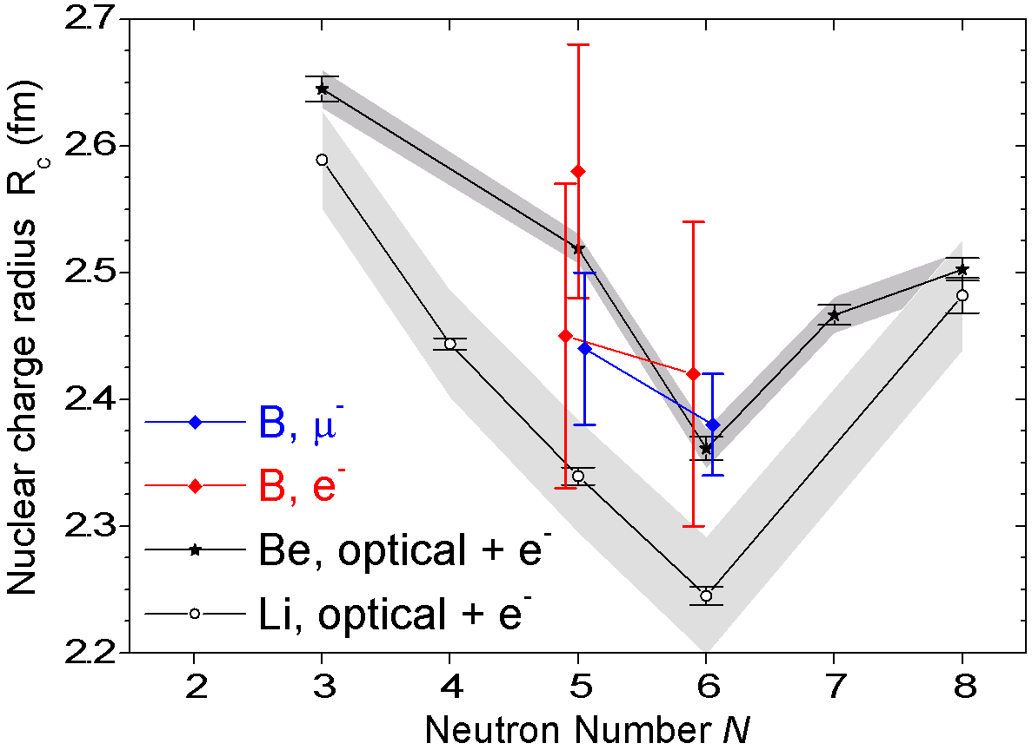
„Reference“ Radii of Boron
[1] Stovall, Nucl. Phys. 86, 225 (1966)
[2] Cichocki et al., PRC 51, 2406 (1995)
[3] Schaller et al., Nucl. Phys. A 343, 333 (1980)
[4] Olin et al., Nucl Phys A 360, 426 (1981)

Slide 10
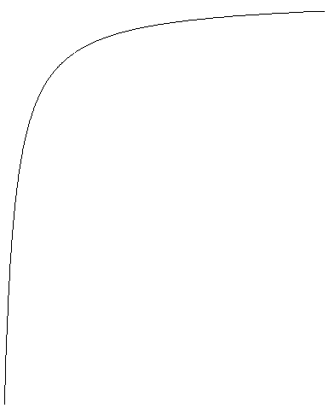
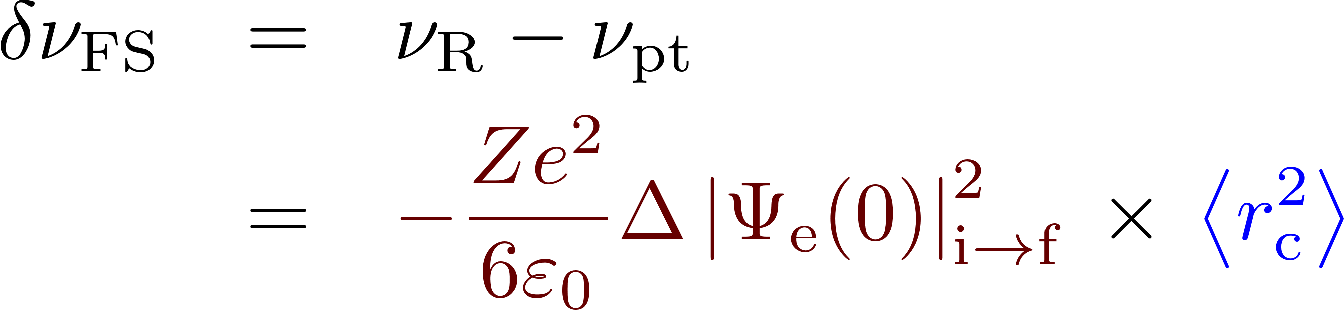

All-Optical Absolute Charge Radii
E
r
Measure transition frequency ν_{R}
Compare with high precision atomic calculation for a point-like nucleus ν_{pt}
Difference ν_{R} - ν_{pt} is finite-size effect and proportional to the ms charge radius
So far applied only for H-like systems, i.e., H, μH and μHe
  Two-electron system requires elaborate QED calculations, which have been improved considerably
V.A. Yerokhin, V. Patkóš & K. Pachucki, PRA 98, 032503 (2018)
V. Patkóš, V.A. Yerokhin &K. Pachucki, PRA 103, 042809 (2021)
V.A. Yerokhin, V. Patkóš & K. Pachucki, PRA 106, 022815 (2022)
p
ν_{R}
ν_{pt}
s
Electronic Factor
(→ Wavefunction)
Notes:
There are still problems but we expect Pachucki et al. To solve the problem at some point)

Slide 11
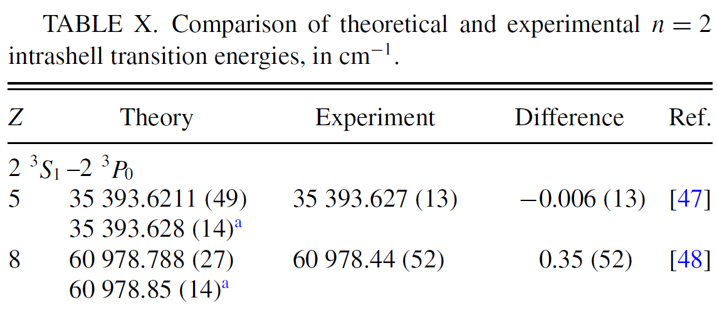
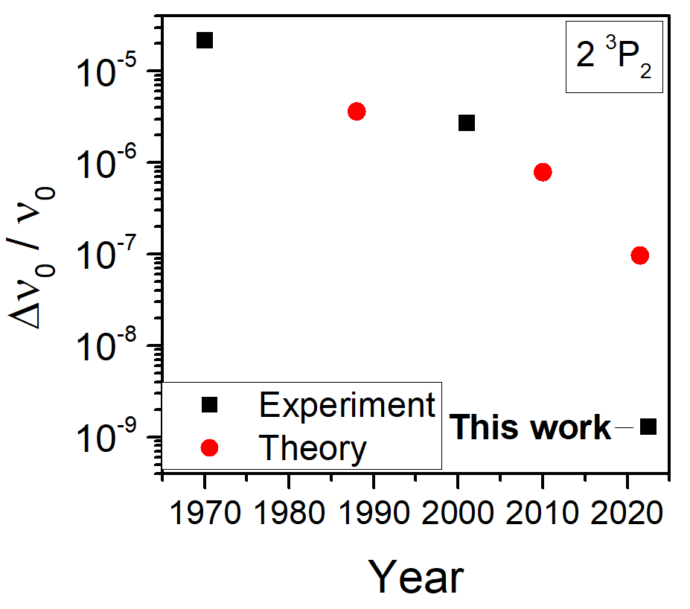
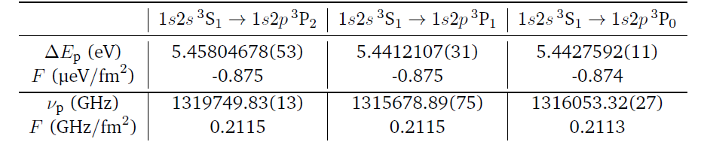
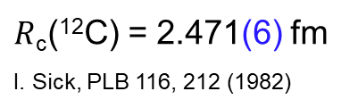
Theory
C⁴⁺
V.A. Yerokhin, V. Patkóš & K. Pachucki, PRA 106, 022815 (2022)
C⁴⁺
P. Imgram, Dissertation TU Darmstadt (2023)
P. Imgram, PRL131 243001 (2023)
Exp: S. Ozawa et al., Phys. Scr. T92, 195 (2001)
Beam-foil spectroscopy
$R$_{c}(¹²C) = 2.471(6) fm
I. Sick, PLB 116, 212 (1982)
Required accuracy for ${∆R}_{\text{c}}≤0.006$ fm: $∆ν≤6$ MHz

Slide 12
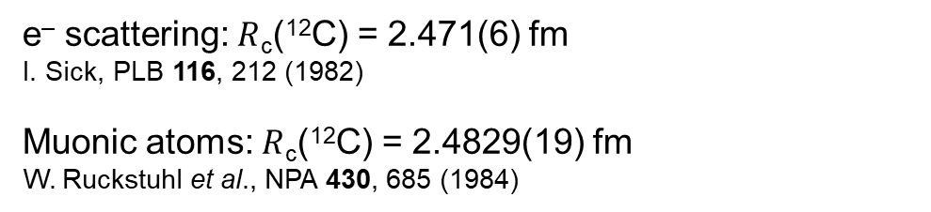
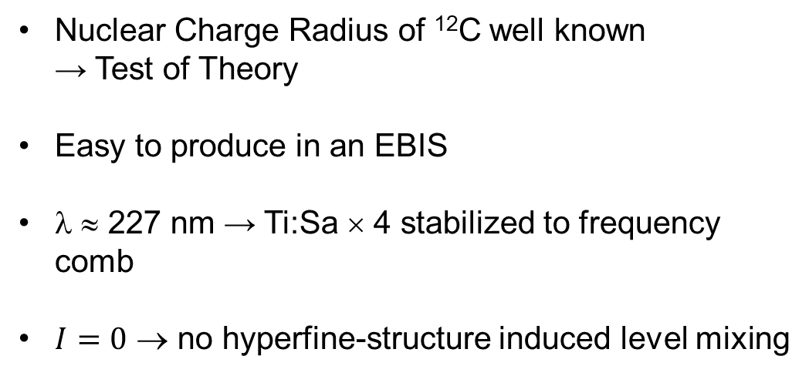
The Case of ¹²C⁴⁺
e– scattering: $R$_{c}(¹²C) = 2.471(6) fm
I. Sick, PLB 116, 212 (1982)
Muonic atoms: $R$_{c}(¹²C) = 2.4829(19) fm
W. Ruckstuhl et al., NPA 430, 685 (1984)
S=0
¹²C⁴⁺
S=1
E
1s2p ¹P₁
1s2p ³P_{J}
Nuclear Charge Radius of ¹²C well known
→ Test of Theory
Easy to produce in an EBIS
λ ≈ 227 nm → Ti:Sa × 4 stabilized to frequency comb
$I=0$ → no hyperfine-structure induced level mixing
λ ≈ 4 nm
A_{ik} ≈ 8.8E11 s⁻¹
λ ≈ 227 nm
A_{ik} ≈ 5.6E7 s⁻¹
1s2s ³S₁
≈
ΔE ≈ 299 eV
τ ≈ 21 ms
1s² ¹S₀
Notes:
There are still problems but we expect Pachucki et al. To solve the problem at some point)

Slide 13
EXPERIMENTAL SETUP

Slide 14
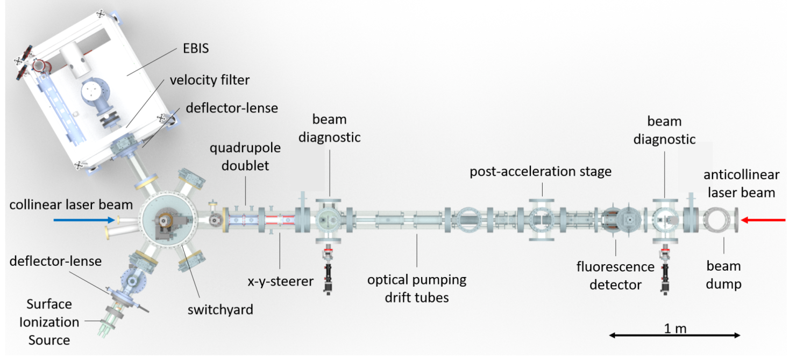
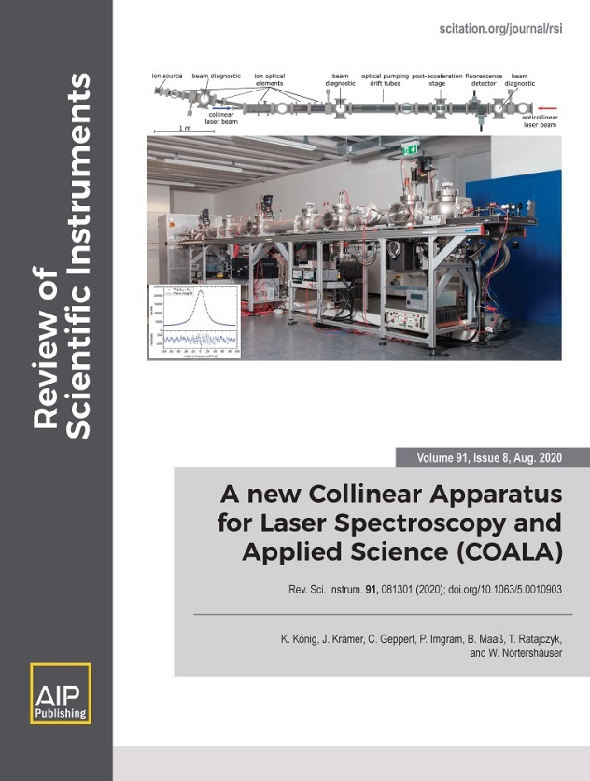
COALA = Collinear Apparatus for Laser Spectroscopy and Applied Physics
P. Imgram
B. Maaß
P. Müller
K. König

Slide 15


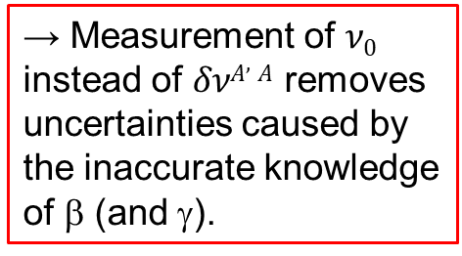
Measurement Scheme
→ Measurement of $ν0$ instead of $δνA,A$ removes uncertainties caused by the inaccurate knowledge of β (and γ).

Slide 16
LASER SPECTROSCOPY
Optimization and Results

Slide 17
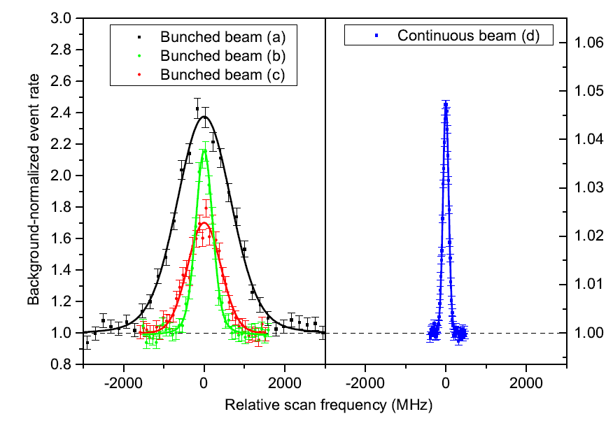
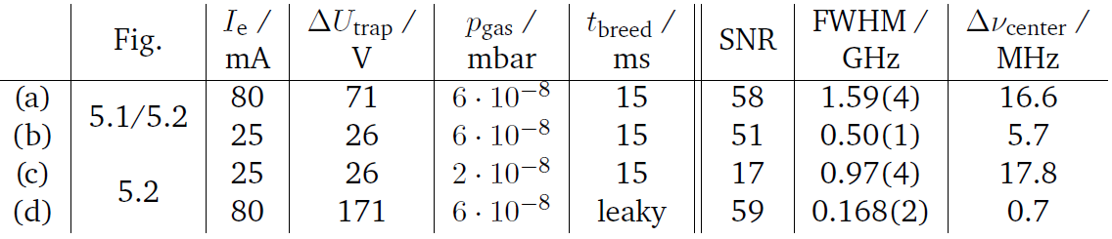
Comparison of Pulsed and Continuous Extraction
continuous extraction (leaky mode):
good signal/noise ratio (similar to pulsed)
smallest linewidth (gain factor 3)
smallest statistical uncertainty for line centre

Slide 18
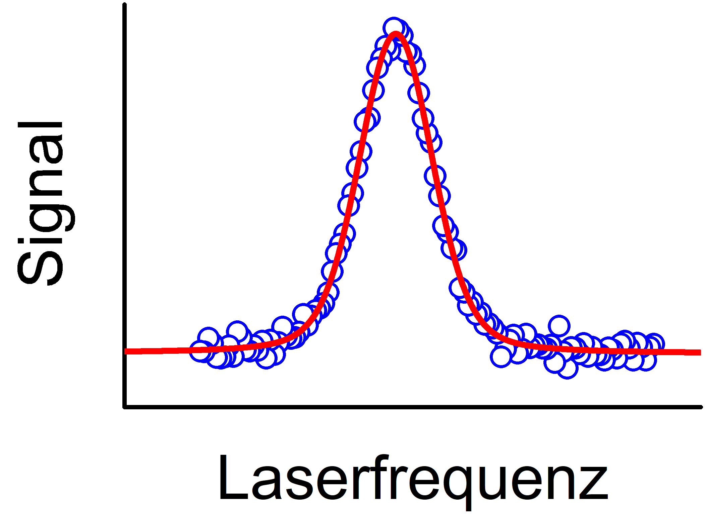
Laser spectroscopy of He-like ions
³P₂
³P₀
³P₁
~227nm
³S₁
Laser frequency

Slide 19
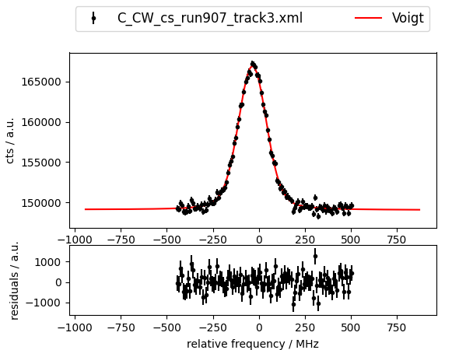
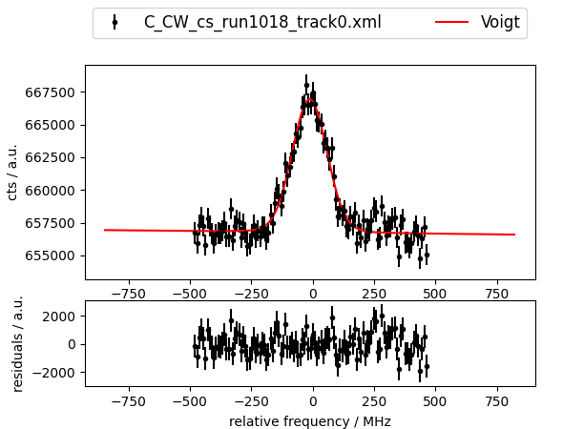
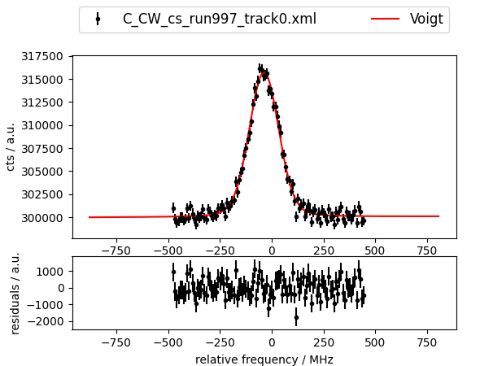
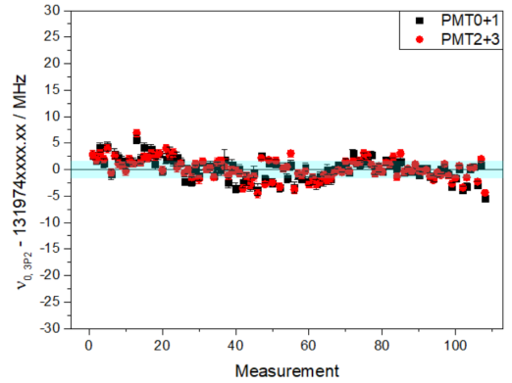
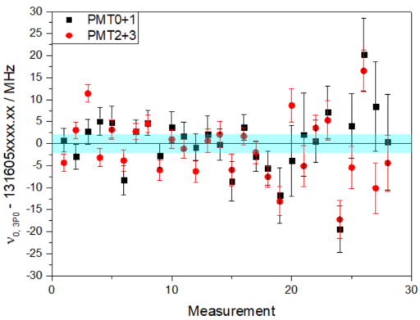
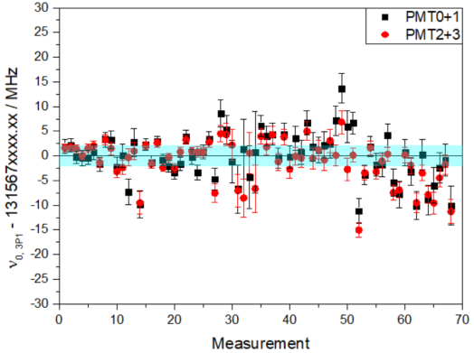
Laser spectroscopy results for ¹²C⁴⁺
³P₂
³P₀
³P₁
³P₂
³P₀
³P₁
~227nm
³S₁

Slide 20
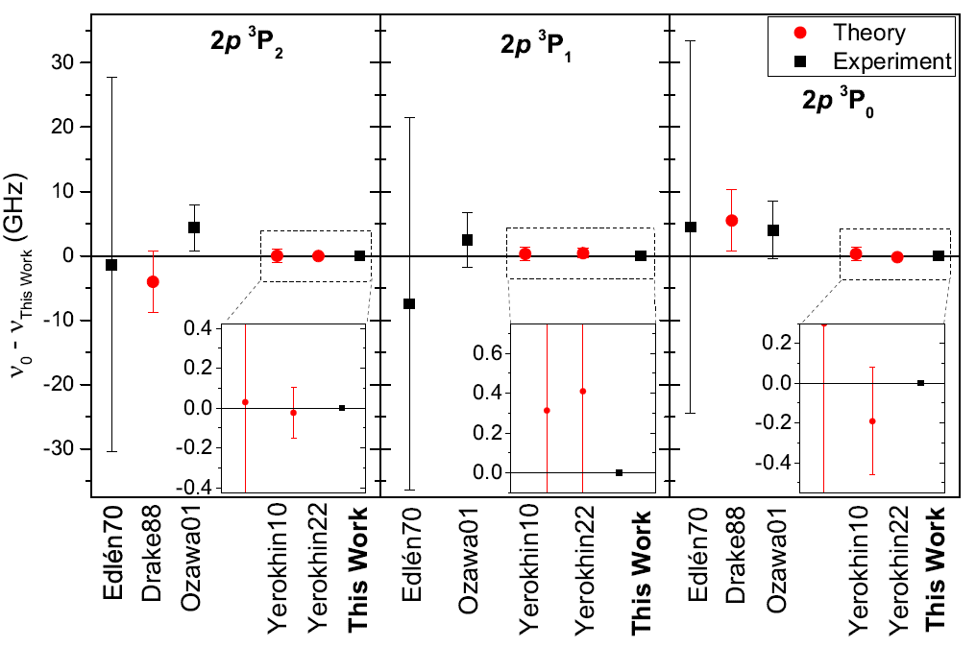
Transition Frequencies: Comparison to Literature

Slide 21
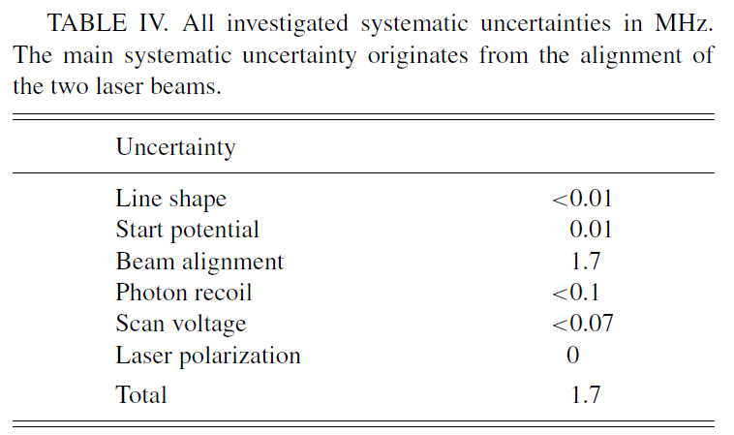
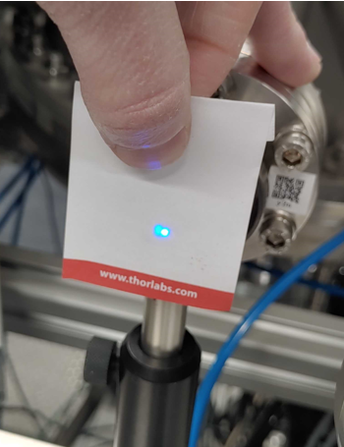
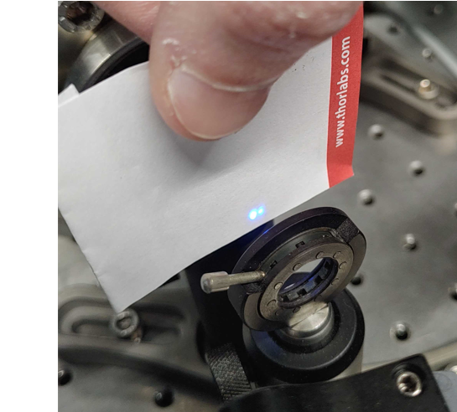
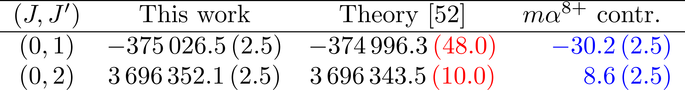
Uncertainty Budget and Fine Structure Splitting
Relatively large contribution of higher orders
⇒ may guide further QED calculations

Slide 22
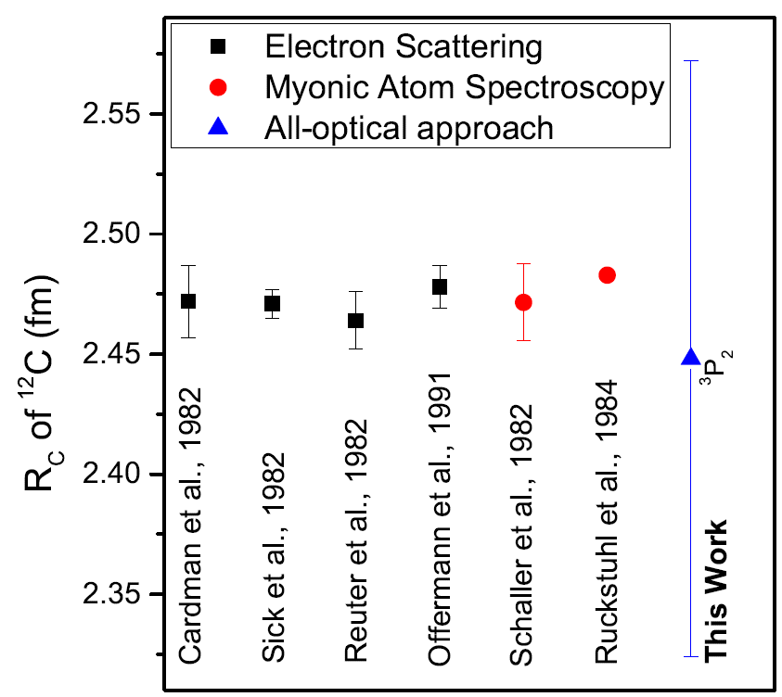
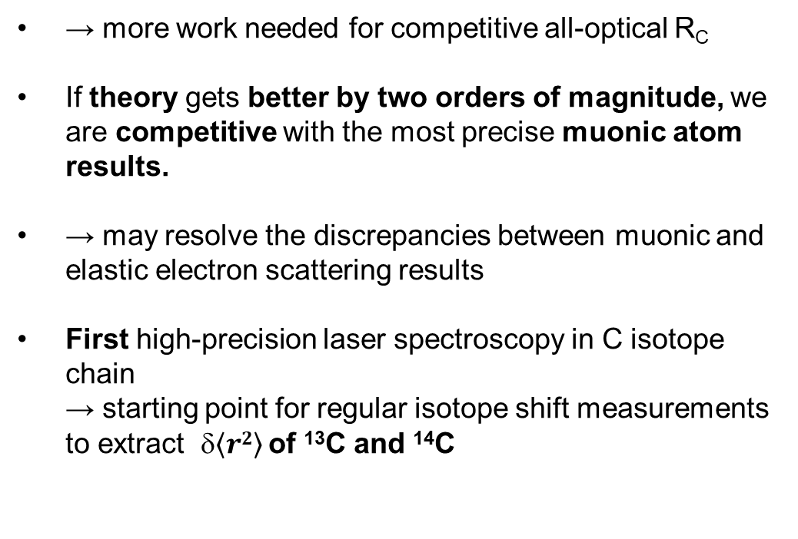
First all-optical nuclear charge radius of ¹²C
→ more work needed for competitive all-optical R_{C}
If theory gets better by two orders of magnitude, we are competitive with the most precise muonic atom results.
→ may resolve the discrepancies between muonic and elastic electron scattering results
First high-precision laser spectroscopy in C isotope chain
→ starting point for regular isotope shift measurements to extract $\left\langle r2\right\rangle$ of ¹³C and ¹⁴C

Slide 23
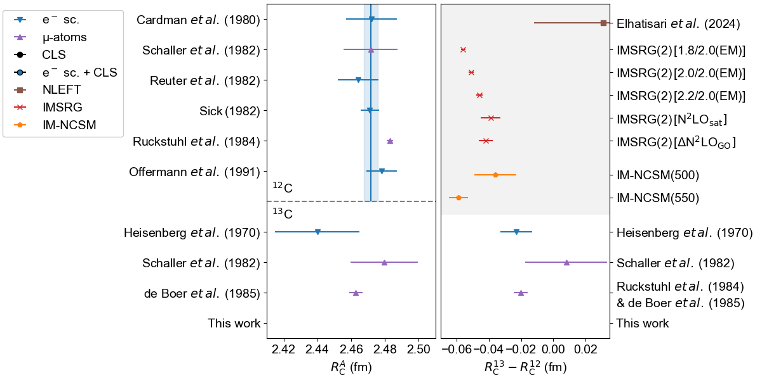
Motivation for ¹³C

Slide 24
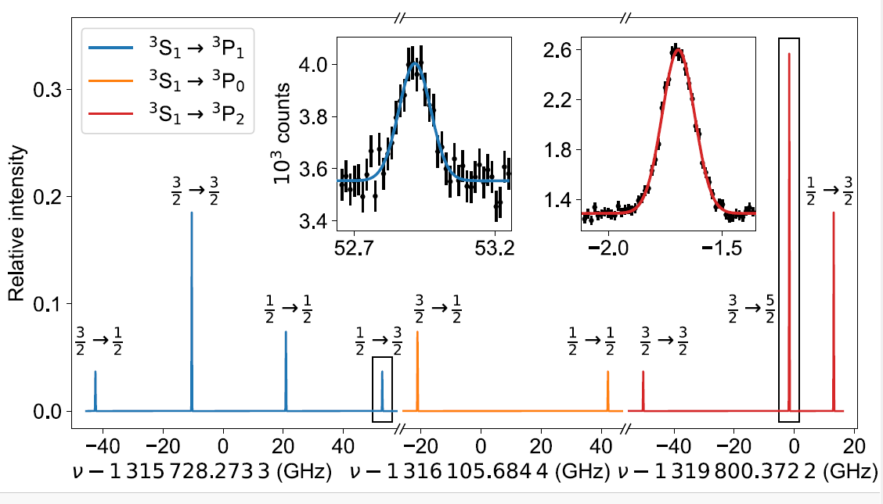
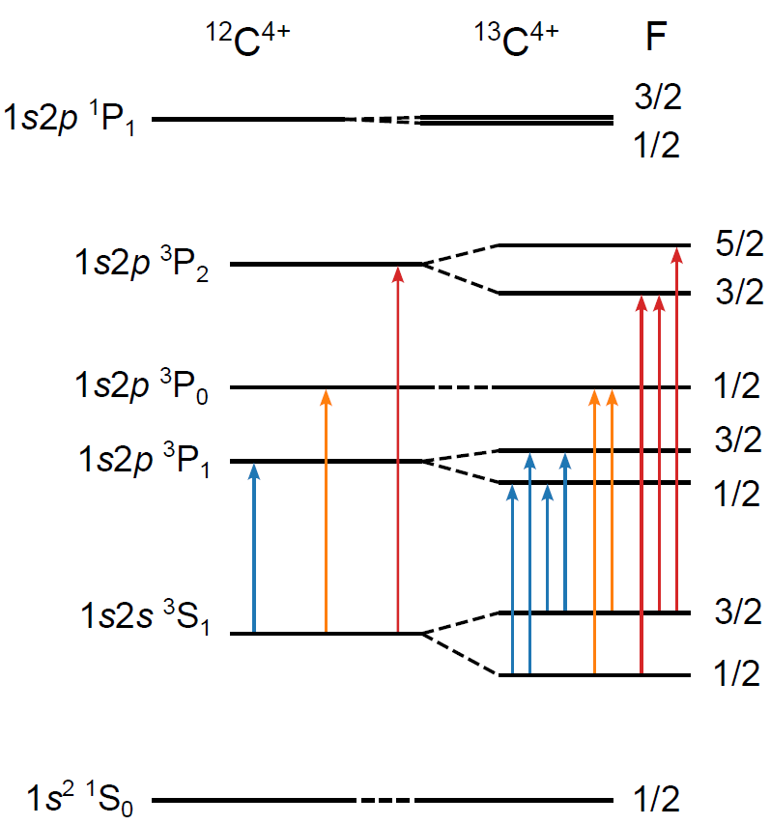
Spectrum of ¹³C
Isotope shift:
51 080.5 (2.0)
53 465.1 (2.3)
51 800.8 (2.1)
Mixed HFS calculated using matrix elements from
Johnson et al., Phys. Rev. A 55, 2728 (1997)
³S₁ → ³P_{J} c.g.: 51 745.6 (1.4) MHz

Slide 25
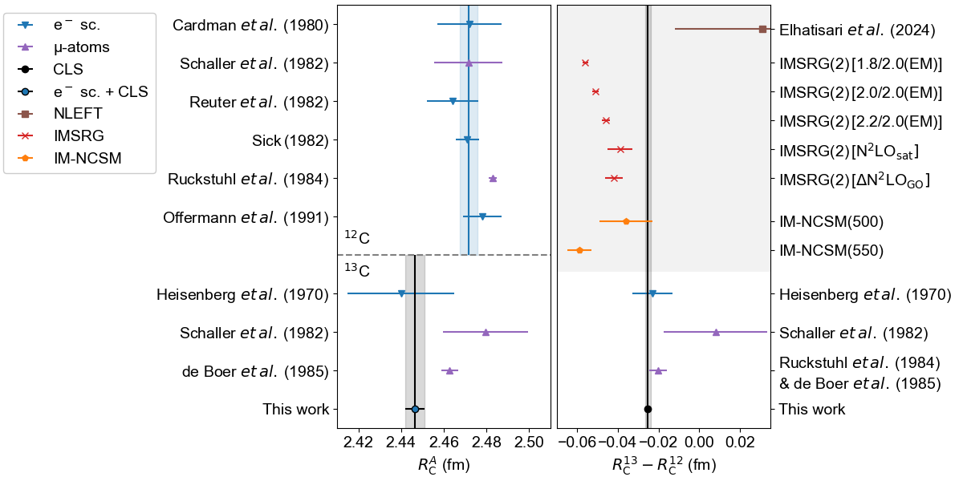
The Nuclear Charge Radius of ¹³C

Slide 26





Measurements of ¹⁴C
³P₀
³P₁
³P₂
¹⁴CO₂:¹²CO₂ = 1:1
1.4 l, 50 mbar,
2 mmol ¹⁴C, 50 mCi
Analysis ongoing … stay tuned
Determination of the ³S₁ → ³P_{J} transition frequencies in ¹⁴C⁴⁺ on a 2-MHz precision level
Extraction of the differential nuclear charge radius $δ〈r2〉$^{12,14} from the isotope shifts
Additional check of theory: Splitting Isotope Shift
³S₁ → ³P₂

Slide 27


















Measurement of the Proton-Halo of ⁸B
$ν_{0},{δν}_{IS}$ in ^{10,11}B²⁺
2s ²S_{1/2} → 2p ²P_{1/2,3/2}
$ν_{0},{δν}_{IS}$ in ^{10,11}B³⁺
1s2s ³S₁ → 1s2p ³P_{0,1,2}
(☑)
$ν_{0},{δν}_{IS}$ ⁹Be²⁺
1s2s ³S₁ → 1s2p ³P_{0,1,2}
Missing links
(NRQED needs to improved)
$$\frac{{δν}_{Exp}^{10,11}−{δν}_{MS, Theo}^{10,11}}{F_{transition}}$$
$$\frac{ν_{Exp(AB)}−ν_{Theo(AB)}}{Ftotal B}$$
p-Halo,
Halo-EFT
$$\frac{ν_{Exp(9Be)}−ν_{Theo(9Be)}}{Ftotal Be}$$
μ -atoms
μ -atoms
$$_{Hylleraas }$$
R_{c}(¹⁰B), R_{c}(¹¹B)
R_{c}(⁹Be)
check
R_{c}(⁸B)
R_{c}(⁷Be)
$${B: δ\left\langle r^{2}\right\rangle }^{10,11}$$
$${B: δ\left\langle r^{2}\right\rangle }^{11,8}$$
$${Be: δ\left\langle r^{2}\right\rangle }^{9,7}$$
☑
☑
in preparation
$$\frac{{δν}_{Exp}^{11,10}−{δν}_{MS, Theo}^{11,10}}{Ftransition}$$
$$\frac{{δν}_{Exp}^{11,8}−{δν}_{MS, Theo}^{11,8}}{Ftransition}$$
$$\frac{{δν}_{Exp}^{9,7}−{δν}_{MS, Theo}^{9,7}}{Ftransition}$$
$$_{Hylleraas }$$
$$_{ECG }$$
$$_{ECG }$$
B. Maaß, P. Müller, G. Savard, ..
$$_{Hylleraas }$$
^{10,11}B ^{8,11}B
2s² 2p ²P_{1/2,3/2} → 2s² 3s ²S_{1/2}
^{7,9}Be⁺:
2s ²S_{1/2} → 2p ²P_{3/2}
Experimental data, multiply charged
Conventional mass-shift calculations
Consistency Checks
Experimental data: neutral or singly charged
Theory of He-like systems
Goal

Slide 28

Outlook
Atomic structure theory
(NR-QED calculations)
He-like ions at COALA
Measurement of ¹⁴C⁴⁺ already completed
→ TBP
^{10,11}B³⁺ ongoing
@ 280 nm
^{10,11}B^{2+,0}
@ 206 nm, 250 nm
until June 2025
⁹Be²⁺ in 2025
→ Feeding of Be⁺ into EBIS needs
further development
Remaining uncertainty originating
from neglected higher order terms (mα⁸⁺)
→ Measured fine-structure splitting in ¹²C⁴⁺
will benchmark new calculations
This will improve the extraction of α from
fine-structure measurements in He
& (hopefully) as well the all-optical nuclear
charge radius determination
For Boron a factor 3 in improvement would
already be sufficient

Slide 29

Far-Reach: Measurements on Short-Lived Isotopes
(LOI INTC-I-265)
Physics cases:
⁷Be²⁺ (QP moment & Zemach radius)
→ influence in ⁷Be(p, γ)⁸B reaction rate
⁸B^{2+,3+} (QP moment & CR)
→ consistency check or even
improvement to Argonne experiment
^{12,13,14}B^{2+,3+} (CR & moments)
→ Radii across N=8 shell closure, important benchmarks for nuclear ab-initio calc.
^{15,16}C⁴⁺ (CR & moments)
→ similar to B
But first: Consider and find the most efficient way to produce
the ions and populate the ³S₁ state → LOI

Slide 30






Thank you!
Gerhard Herzberg Research Award
Giersch Outstanding Thesis Award
Best Dissertation in Physics @ TU Darmstadt (2020)
Disertation Prize of the DPG
(Section Matter & Cosmos)

Slide 31







King Fit
$$δν_{IS}^{A,A^{′}}=K⋅M+F⋅δ{\left\langle r^{2}\right\rangle }^{A,A^{′}}$$
$$\underset{↓}{\underbrace{δν_{IS}^{A,A^{′}}M^{−1}}}=K+F⋅\underset{ ↓}{\underbrace{δ{\left\langle r^{2}\right\rangle }^{A,A^{′}}M^{−1}}}$$
$${\tilde{δν}}^{A, A^{′}}=K+F{\tilde{δ\left\langle r_{c}^{2}\right\rangle }}^{A,A^{′}}$$
$${\tilde{δν}}^{A, A^{′}}=K_{α}+F\left({\tilde{δ\left\langle r_{c}^{2}\right\rangle }}^{A,A^{′}}−α\right)$$
$$K= K_{α}−Fα$$
α is chosen to remove the correlation between $K$ and $F$

Slide 32




Reference Radii from Muonic Atoms: Barret Radii
$${δ\left\langle r_{c}^{2}\right\rangle }_{μe}^{A,A^{′}}={\left(\frac{R_{kα}^{A}}{V_{2}^{A}}\right)}^{2}−{\left(\frac{R_{kα}^{A^{′}}}{V_{2}^{A^{′}}}\right)}^{2}$$
$$\sqrt{\left\langle r^{2}\right\rangle }=\frac{R_{kα}}{V_{2}}$$
Elastic electron scattering
Barret radii $R_{kα}$ and ratio of radial moments $V_{2}$ from Fricke (2004)
A | $R_{kα}$ [fm] | $$V_{2}$$ | ${δ\left\langle r_{c}^{2}\right\rangle }^{A,208}$ [fm²]
204 | 7.0036 | 1.27808 | -0,242
206 | 7.0169 | 1.27811 | -0,1293
207 | 7.0222 | 1.27809 | -0,0828
208 | 7.0316 | 1.27805 | 0

Slide 33





Radii Uncertainties
$${δ\left\langle r_{c}^{2}\right\rangle }^{A,A^{′}}={\left(\frac{R_{kα}^{A}}{V_{2}^{A}}\right)}^{2}−{\left(\frac{R_{kα}^{A^{′}}}{V_{2}^{A^{′}}}\right)}^{2}$$
$$=\left(\frac{R_{kα}^{A}}{V_{2}^{A}}−\frac{R_{kα}^{A^{′}}}{V_{2}^{A^{′}}}\right)\left(\frac{R_{kα}^{A}}{V_{2}^{A}}+\frac{R_{kα}^{A^{′}}}{V_{2}^{A^{′}}}\right)$$
$$=\frac{{δR}_{kα}^{A}}{V_{2}^{A}}\left(\frac{R_{kα}^{A}}{V_{2}^{A}}+\frac{R_{kα}^{A^{′}}}{V_{2}^{A^{′}}}\right)$$
${δR}_{kα}^{A}$ have often smaller uncertainties, due to calibration error cancelation
$R_{kα}^{A}$ errors can be neglected since the 2nd term is multiplied by a tiny term
$$∆{δ\left\langle r_{c}^{2}\right\rangle }^{A,A^{′}}≈\frac{∆δR_{kα}^{A,A^{′}}}{V_{2}^{A}}\left(\frac{R_{kα}^{A}}{V_{2}^{A}}+\frac{R_{kα}^{A^{′}}}{V_{2}^{A^{′}}}\right)$$
K. König et al., Phys. Rev. C 103, 054305 (2021)

Slide 34






King Plot with best α
$$α=2622.8 u {fm}^{2}$$
$$K_{α}=\left(55452 ±301\right)u GHz$$
$$→K=\left(6668 ±4992\right)u GHz$$
$$F=\left(18.6±1.9\right)GHz/{fm}^{2}$$
Fricke
$$F=18.6 GHz/{fm}^{2}$$
averaged
$$F=20.4 GHz/{fm}^{2}$$
averaged $V2$ factors significantly influence King plot
Frick95 - Ma92a, VJV: FB - Eu78, VJV: SOG Fr 77 & Fr83, VJV: SOG Fr 77b
referenced either in Fricke 1995 or
de Vries, de Jager, de Vries 1987

Slide 35


Influence on extracted $δ{\left\langle r_{c}^{2}\right\rangle }^{A,A^{′}}$

Slide 36




Advantage of Documentation:
Analysis can be Repeated
calculated from table:
A-A’ | δ<r²>^{A,A’}
72-70 | 121.4 (4.4)
74-72 | 126.5 (5.2)
76-74 | 55.4 (4.6)

Slide 37


King-plot using the Λ_{μe}
King-plot using the δ<r²>_{μe} re-calculated
 | F (MHz/fm²) | M (GHz)
Λ_{μe} | 317 [58] | -11 [22]
δ<r²>_{μe} | 1628 [944] | -409 [300]
The F and M are extremely large （unreasonable）

Slide 39

The „Tragedy of Boron“: Reference Radii
[2]
[1] Stovall, Nucl. Phys. 86, 225 (1966)
[2] Cichocki et al., PRC 51, 2406 (1995)
[3] Schaller et al., Nucl. Phys. A 343, 333 (1980)
[4] Olin et al., Nucl Phys A 360, 426 (1981)

Slide 40









Measurements in ¹³C⁴⁺
³P₂
³P₀
³P₁
³S₁
P. Müller (in preparation)

Slide 41









Statistics of ¹³C⁴⁺ Measurements
P. Müller (in preparation)

Slide 42


Hyperfine Structure in ¹³C⁴⁺
Use center of gravity to determine ${δ\left\langle r²\right\rangle }^{12,13}$
Use HFS mixing to benchmark magnetic field calculations
Mixed HFS calculated using matrix elements from
Johnson et al., Phys. Rev. A 55, 2728 (1997)
https://journals.aps.org/pra/abstract/10.1103/PhysRevA.55.2728
P. Müller (in preparation)

Slide 43
The „Tragedy of Boron“: Reference Radii
[2]
[1] Stovall, Nucl. Phys. 86, 225 (1966)
[2] Cichocki et al., PRC 51, 2406 (1995)
[3] Schaller et al., Nucl. Phys. A 343, 333 (1980)
[4] Olin et al., Nucl Phys A 360, 426 (1981)

Slide 44

The COALA Laser System
Ti:Sa (670 – 1000nm)
+ WT (335 – 500 nm)
+ WT (220 – 250 nm)
New:
Ti:Sa (670 – 1000 nm)
+ MixTrain
(480 – 600 nm)
+ WT (240 – 300 nm)

Slide 45






Production and Extraction of C⁴⁺ Ions
Electron Beam ion Source (EBIS):
PULSED
CONTINUOUS
Ion source

Slide 46

Spectroscopy with Pulsed Extraction from the EBIS
Optimization of extraction parameters

Slide 47



Thanks to ….
Phillip Imgram
28.10.2019
30.10.2023
Giersch Excellence Grant for his Ba⁺ measurements
Giersch Outstanding Thesis Award
Installation of the switchyard‘s diagnosis tower
Phillip has been selected as one of four finalists for the SMuK Dissertation Prize !
Spring Meeting of the German Physical Society (March 11th 2024).

Slide 48



Thanks to ….
Patrick Müller performed measurements of ¹³C⁴⁺
Gerhard-Herzberg-Master-Research Award 2021
Giersch Excellence Grant 2022
Connected with his measurements and solution of the „field-shift“ puzzle in Ca⁺ isotopes
Kristian König built the original KOALA beamline and demonstrated high-voltage measurements at 5 ppm accuracy.
Giersch Outstanding Thesis Award
GSI Doktorandenpreis
Gerhard Herzberg Research Award
Finalist in the SAMOP Dissertation Prize 2020
Jörg Krämer
Postdoc on the project in the early phase

Slide 49
Measurements in ¹³C⁴⁺
³P₂
³P₀
³P₁
³S₁
P. Müller (in preparation)

Slide 50
Statistics of ¹³C⁴⁺ Measurements
P. Müller (in preparation)

Slide 51







Route to All-Optical Charge Radii of Carbon
☑
δν_{IS}
$ν_{Exp}$ ¹²C⁴⁺: 1s2s ³S₁ → 1s2p ³P_{0,1,2}
$ν_{Exp}$ ¹³C⁴⁺: 1s2s ³S₁ → 1s2p ³P_{0,1,2}
$$\frac{{δν}_{Exp}^{12,13}−{δν}_{MS, Theo}^{12,13}}{F_{transition}}$$
$$\frac{ν_{Exp}(12C)−ν_{Theo}(12C)}{Ftotal }$$
$$\frac{ν_{Exp}(13C)−ν_{Theo}(13C)}{Ftotal}$$
check
$${δ\left\langle r^{2}\right\rangle }^{12,13}$$
R_{c}(¹²C)
R_{c}(¹³C)
Electron scattering: $\sqrt{{\left\langle r^{2}\right\rangle }_{e}}$=2.478(9) fm
Muonic: $\sqrt{{\left\langle r^{2}\right\rangle }_{Model}}$=2.4829 fm
R_{c}(¹²C) R_{c}(¹³C)
¹⁴C and other carbon isotopes online … (?)
Experimental data, multiply charged
Conventional mass-shift calculations
Consistency Checks
Theory of He-like systems
Goal

Slide 52
Measurement of the Proton-Halo of ⁸B
$ν_{0},{δν}_{IS}$ in ^{10,11}B²⁺
2s ²S_{1/2} → 2p ²P_{1/2,3/2}
$ν_{0},{δν}_{IS}$ in ^{10,11}B³⁺
1s2s ³S₁ → 1s2p ³P_{0,1,2}
(☑)
$ν_{0},{δν}_{IS}$ ⁹Be²⁺
1s2s ³S₁ → 1s2p ³P_{0,1,2}
$$\frac{{δν}_{Exp}^{10,11}−{δν}_{MS, Theo}^{10,11}}{F_{transition}}$$
$$\frac{ν_{Exp(AB)}−ν_{Theo(AB)}}{Ftotal B}$$
p-Halo,
Halo-EFT
$$\frac{ν_{Exp(9Be)}−ν_{Theo(9Be)}}{Ftotal Be}$$
$$_{Hylleraas }$$
R_{c}(¹⁰B), R_{c}(¹¹B)
R_{c}(⁹Be)
check
R_{c}(⁸B)
R_{c}(⁷Be)
$${B: δ\left\langle r^{2}\right\rangle }^{10,11}$$
$${B: δ\left\langle r^{2}\right\rangle }^{11,8}$$
$${Be: δ\left\langle r^{2}\right\rangle }^{9,7}$$
☑
☑
in preparation
$$\frac{{δν}_{Exp}^{11,10}−{δν}_{MS, Theo}^{11,10}}{Ftransition}$$
$$\frac{{δν}_{Exp}^{11,8}−{δν}_{MS, Theo}^{11,8}}{Ftransition}$$
$$\frac{{δν}_{Exp}^{9,7}−{δν}_{MS, Theo}^{9,7}}{Ftransition}$$
$$_{Hylleraas }$$
$$_{ECG }$$
$$_{ECG }$$
B. Maaß, P. Müller, G. Savard, ..
$$_{Hylleraas }$$
^{10,11}B ^{8,11}B
2s² 2p ²P_{1/2,3/2} → 2s² 3s ²S_{1/2}
^{7,9}Be⁺:
2s ²S_{1/2} → 2p ²P_{3/2}
Experimental data, multiply charged
Conventional mass-shift calculations
Consistency Checks
Experimental data: neutral or singly charged
Theory of He-like systems
Goal

