Slide 1
Isomeric mean-square charge-radius changes
and related quantities
on behalf of the collaboration

Slide 2
Outlook
1/20
Many-body problem
Nuclear electromagnetic observables
Atomic hyperfine structure
Methodology
Simple trends in nuclear moments and charge radii

Slide 3
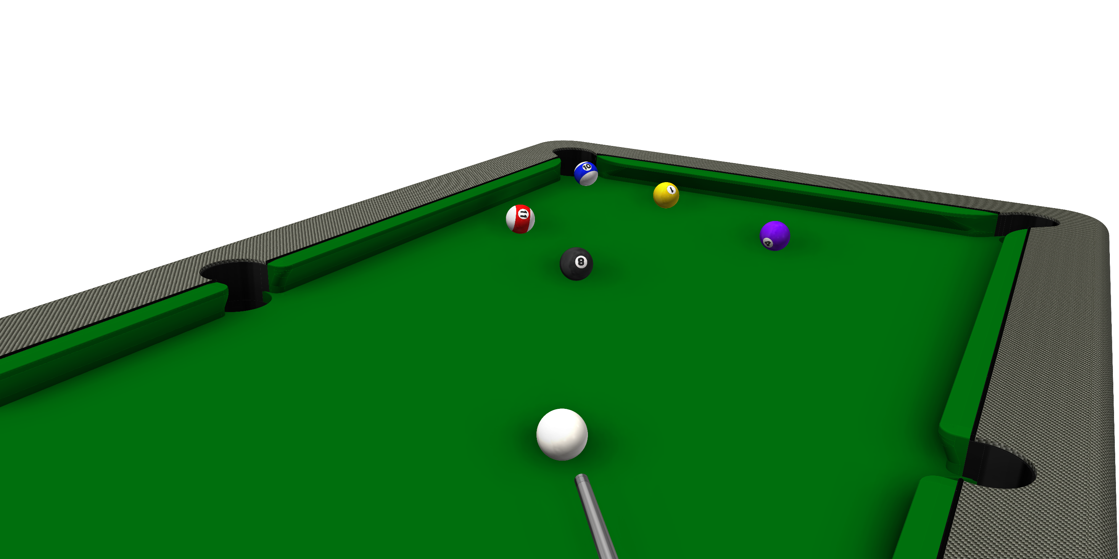
Many-body problem
2/20

Slide 4
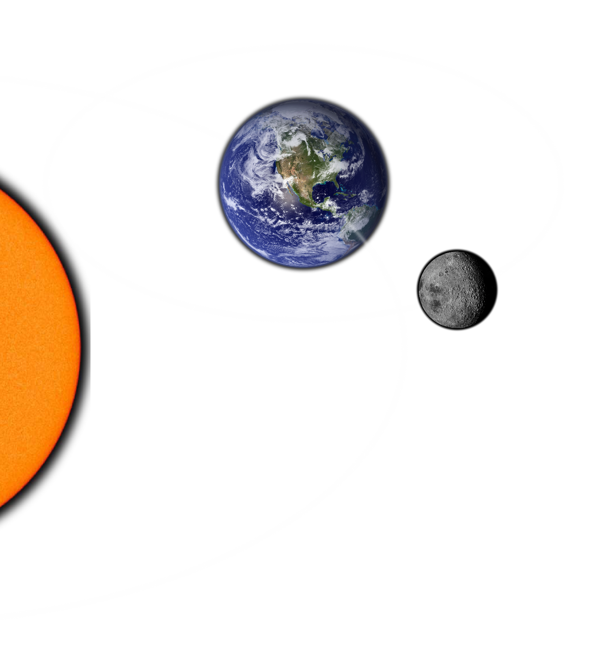
Many-body problem
3/20
Three-body problem
Principa, Newton 1687
Les méthodes nouvelles de la mécanique céleste, Poincaré 1892

Slide 5
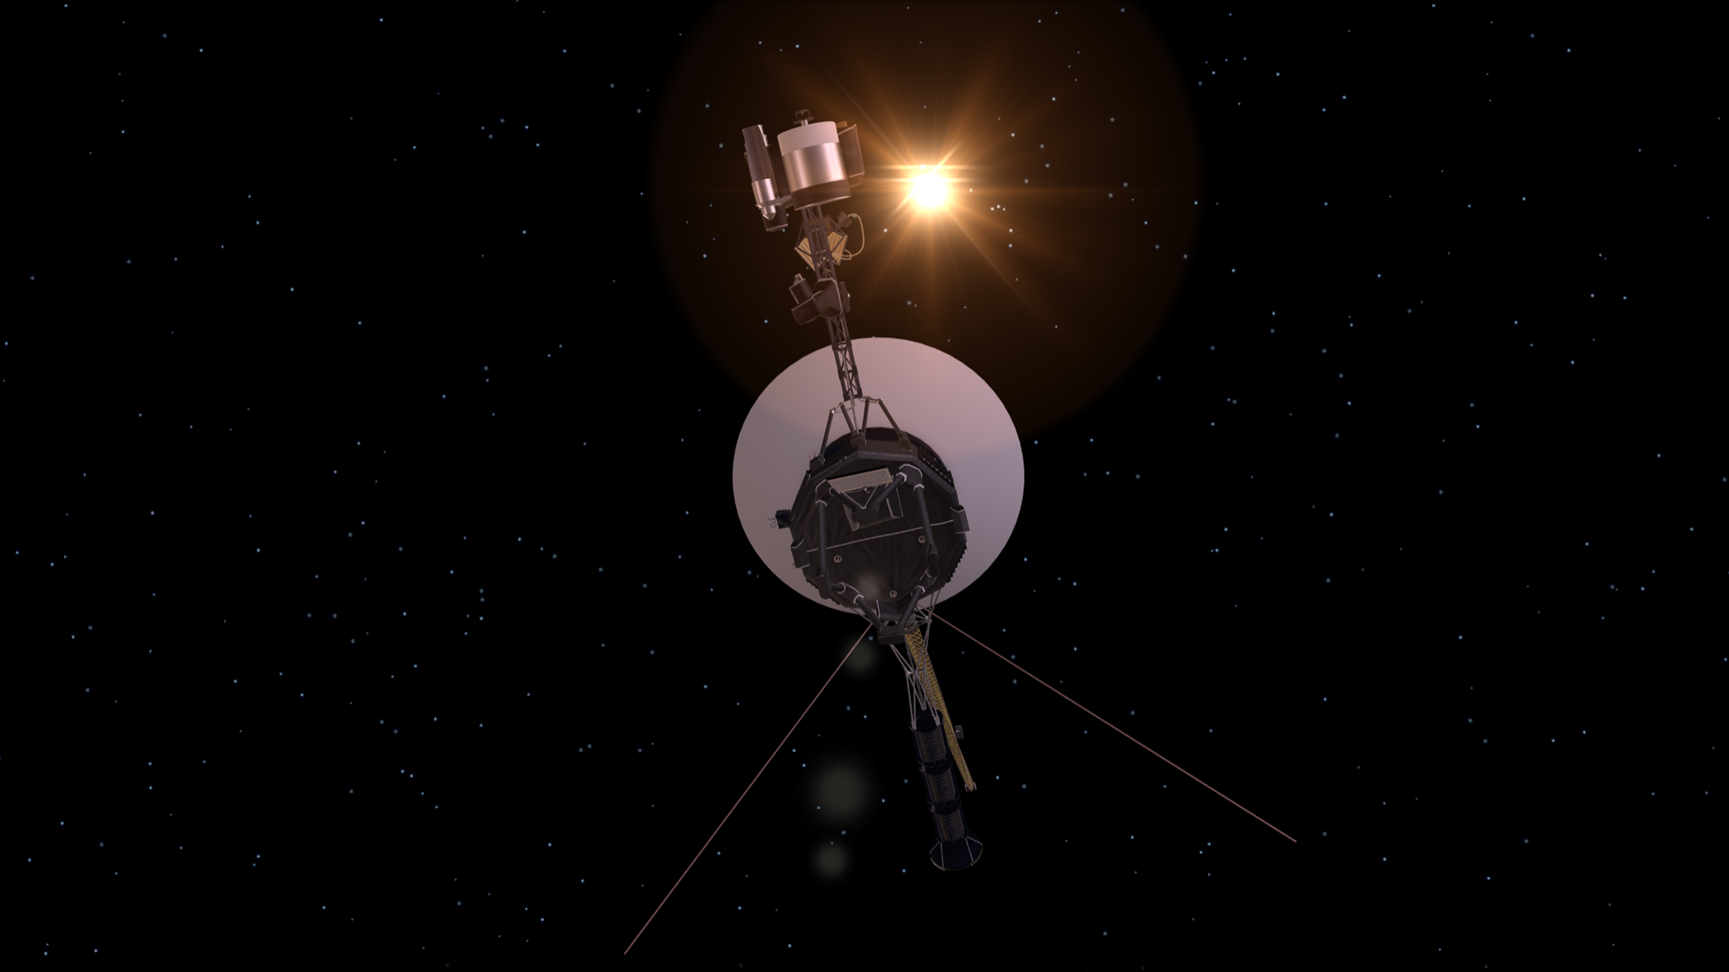
Many-body problem
4/20
“The three-body problem is arguably the oldest
open question in astrophysics and has resisted
a general analytic solution for centuries.”
Nature 576, 406 (2019)
It’s official-Voyager has left the solar system
Science 341, 1158 (2013)
voyager.jpl.nasa.gov

Slide 6
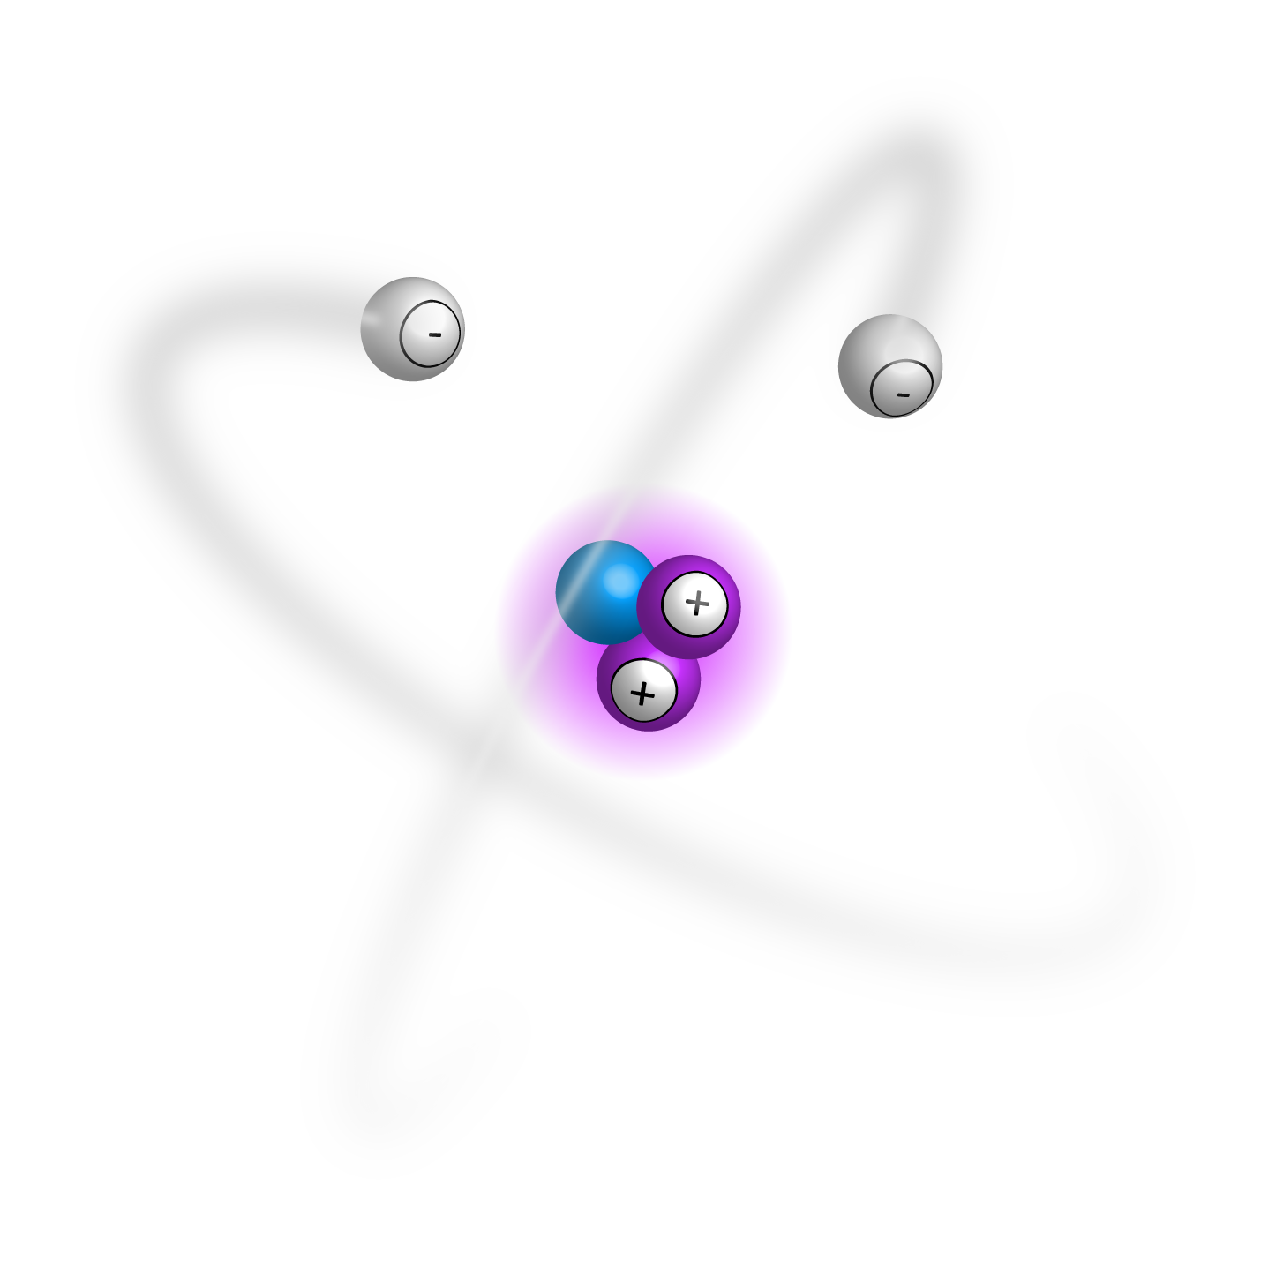
Many-body problem
5/20
Three-body problem: ³He I
z
y
$$\hat{H}ψ=Eψ$$
r₁₂
$$\hat{H}=−\sum_{k}{\left(\frac{ℏ^{2}}{2m}∆_{k}+\frac{2e^{2}}{4πε_{0}r_{k}}\right)+\underbrace{\frac{e^{2}}{4πε_{0}r_{12}}}}$$
r₂
r₁
x
non-separable
no analytical solution
approximations
variational methods
Hartree-Fock
perturbation theory
and beyond …

Slide 7
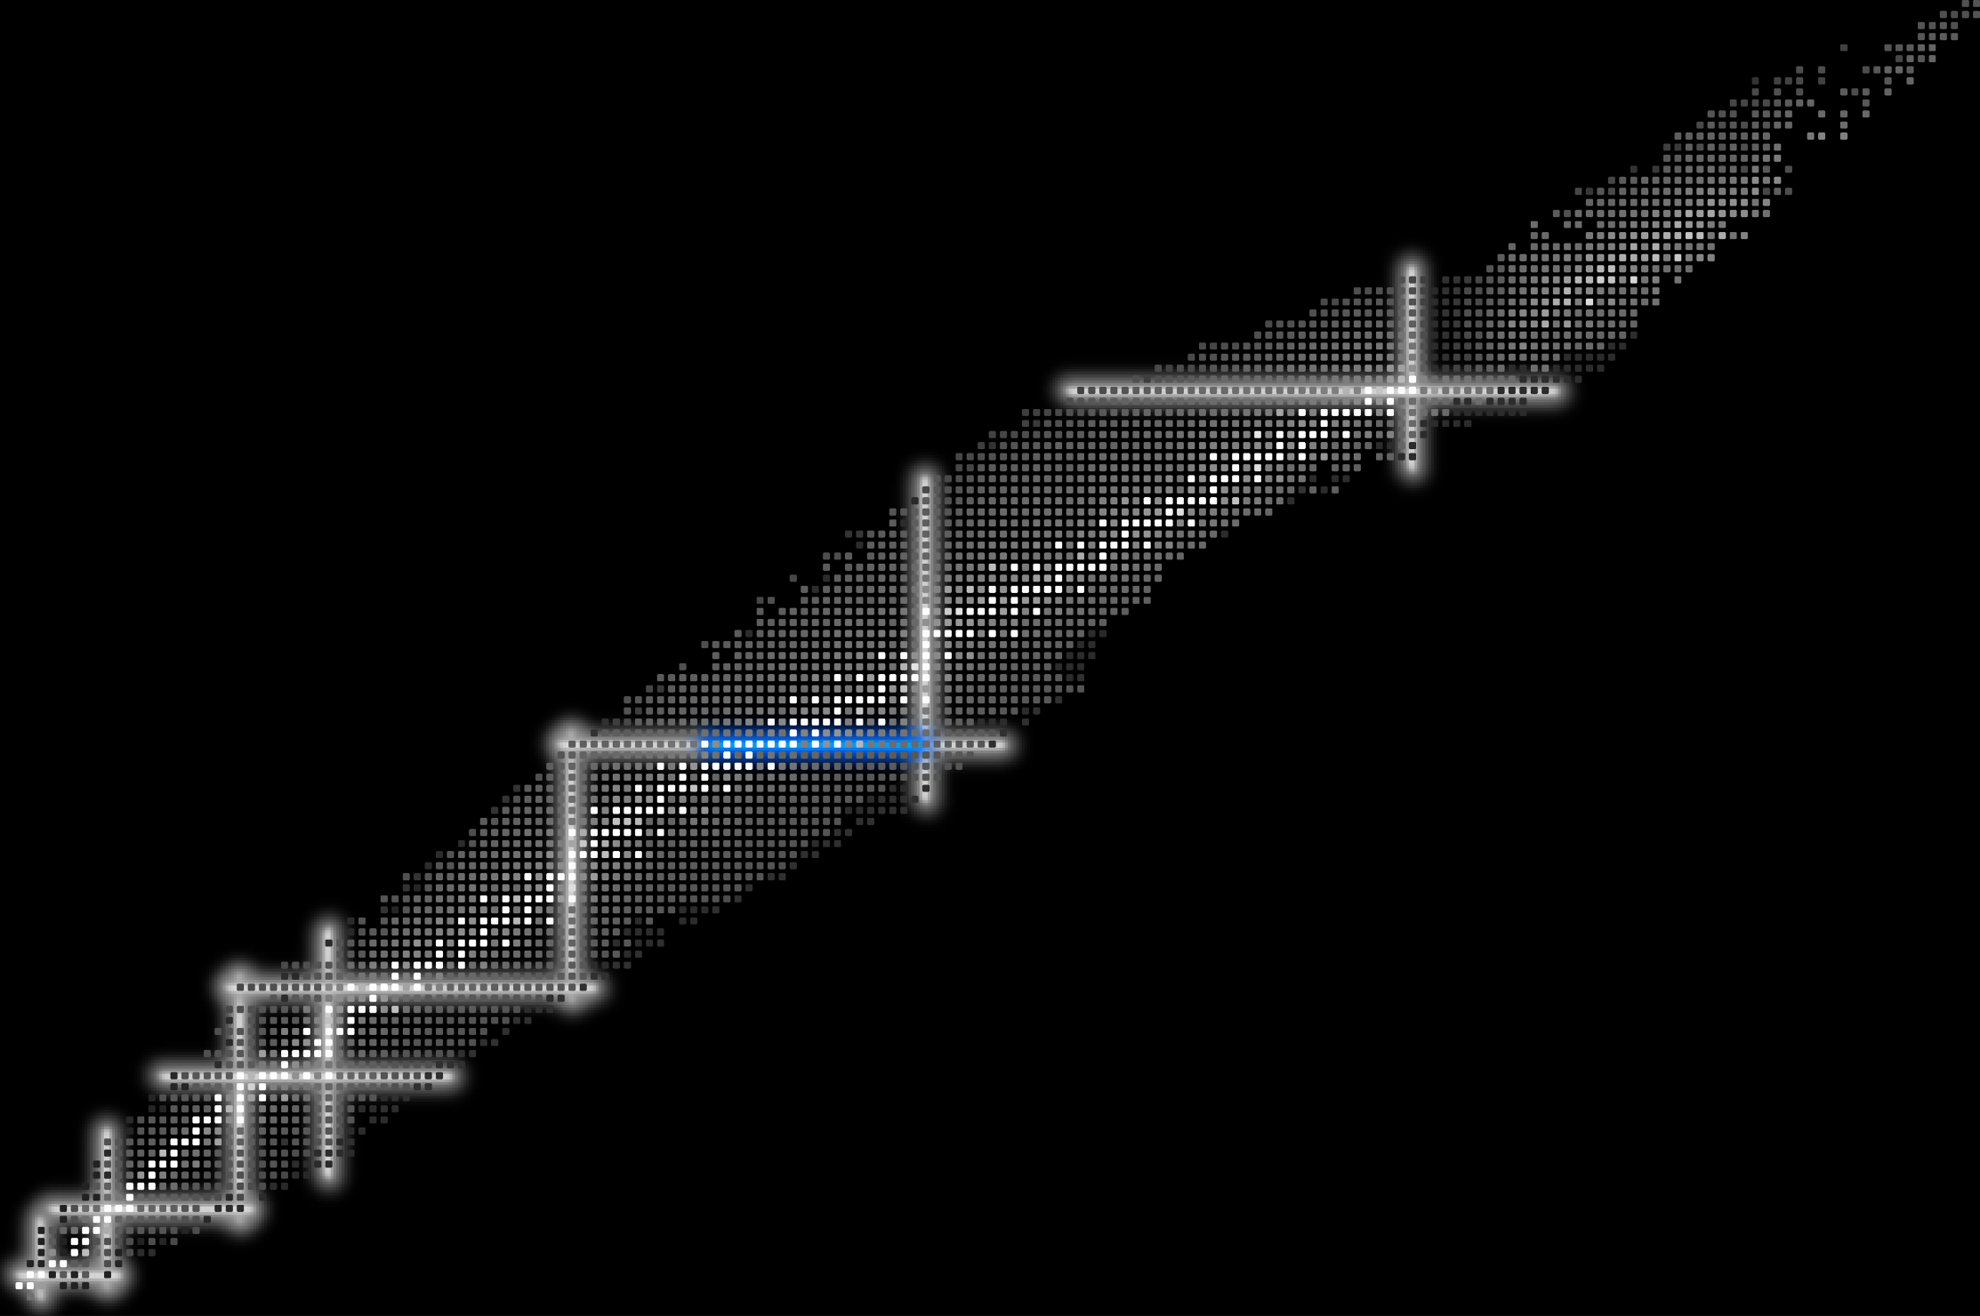
Many-body problem
6/20
Many-body problem: nuclei
On closed shells in nuclei II
Mayer 1949
Collective and individual particle aspects of nuclear structure
Bohr and Mottelson 1953
82
Binding states of individual nucleons in strongly deformed nuclei
Nilsson 1955
126
$$1h_{9/2}$$
Boson symmetries in vibrational nuclei
Iachello and Arima 1974
82
$$1h$$
50
82
$$1h_{11/2}$$
$$3s$$
$$3s_{1/2}$$
$$2d_{3/2}$$
28
$$2d$$
50
$$2d_{5/2}$$
20
Simple models of complex nuclei
Talmi 1993
$$1g_{7/2}$$
$$1g$$
50
8
28
2
20
$$1g_{9/2}$$
2
8

Slide 8
Electromagnetic moments
7/20
Dipole moment
(magnetic)
Radial moments
(charge)
Quadrupole moment
(electric)
$$\hat{μ}=μ_{N}\left(g_{l}^{t_{z}}\hat{l}+g_{s}^{t_{z}}\hat{s}\right)/ℏ$$
$$e\hat{Q}=e^{t_{z}}e\left(3z^{2}−r^{2}\right)$$
$$\left\langle r^{n}\right\rangle =\frac{\int{ρ\left(\hat{r}\right)r^{n}dV}}{\int{ρ\left(\hat{r}\right)dV}}$$
$$μ=m\left(g_{l}^{t_{z}}±\frac{g_{s}^{t_{z}}−g_{l}^{t_{z}}}{2l+1}\right)μ_{N}$$
$$eQ=\frac{j\left(j+1\right)−3m^{2}}{2j\left(j+1\right)}\left\langle r^{2}\right\rangle e^{t_{z}}e$$
j | j-1 |  |  | 3/2 | 1/2
-j | 1-j |  |  | -3/2 | -1/2
$μ\left(m\right)$+ $μ\left(−m\right)=0$
$$Q\left(m\right)=Q\left(−m\right)$$
j^{n} configurations, n - odd

Slide 9
Electromagnetic moments
8/20
Dipole moment
(magnetic)
Radial moments
(charge)
Quadrupole moment
(electric)
$$μ$$
$$δ\left\langle r^{2}\right\rangle$$
$$Q$$
$$N$$
$$N$$
$$N$$
$$μ=∓j\frac{3.8}{2l+1}μ_{N}$$
$$δ{\left\langle r^{2}\right\rangle }^{g,m}=\frac{5}{4π}\left\langle r_{0}^{2}\right\rangle \left(β_{m}^{2}−β_{g}^{2}\right)$$
$$Q=\frac{2j+1−2n}{2j−1}Q_{sp}$$
On the magnetic moments of atomic nuclei
Schmidt 1937
Configuration mixing and quadrupole moments
of odd nuclei, Horie and Arima 1955
j^{n} configurations, n - odd

Slide 10
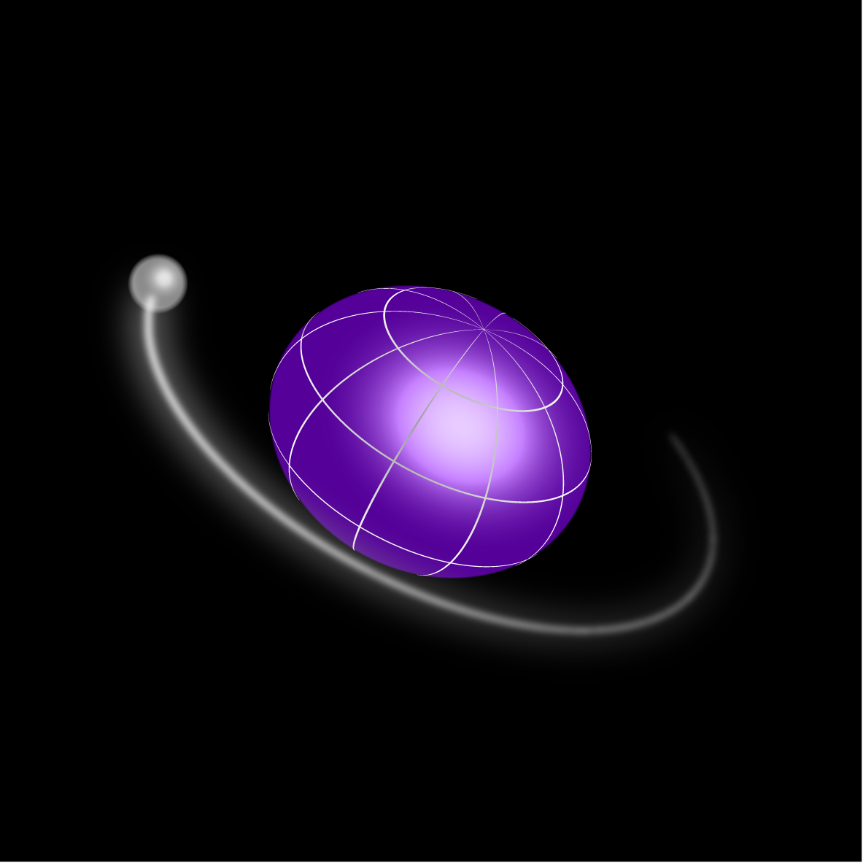
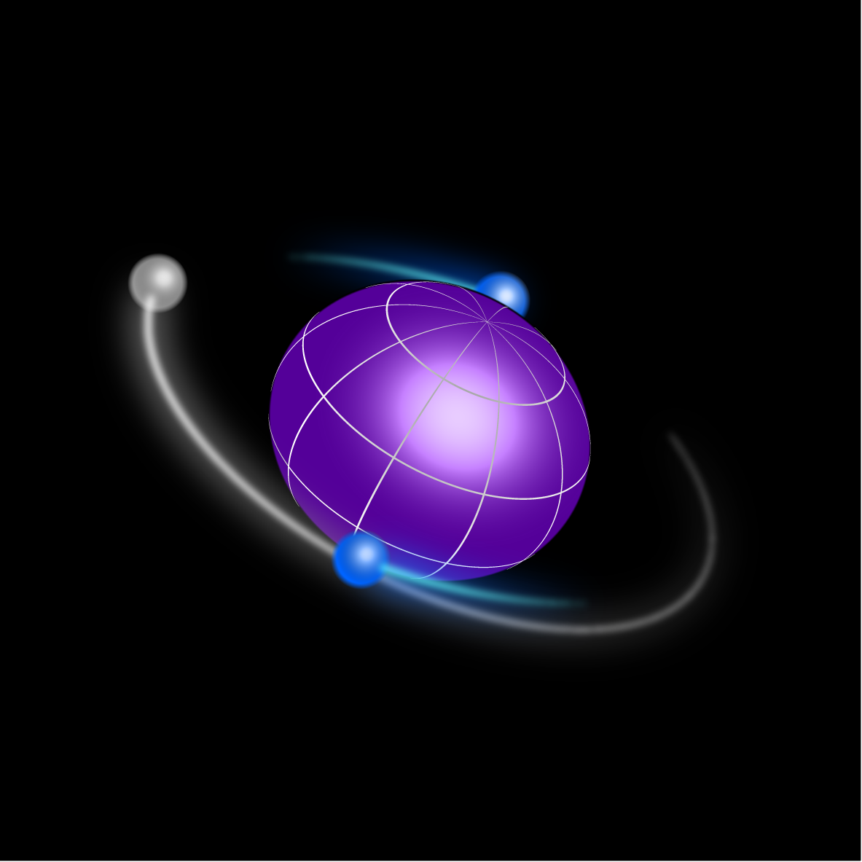
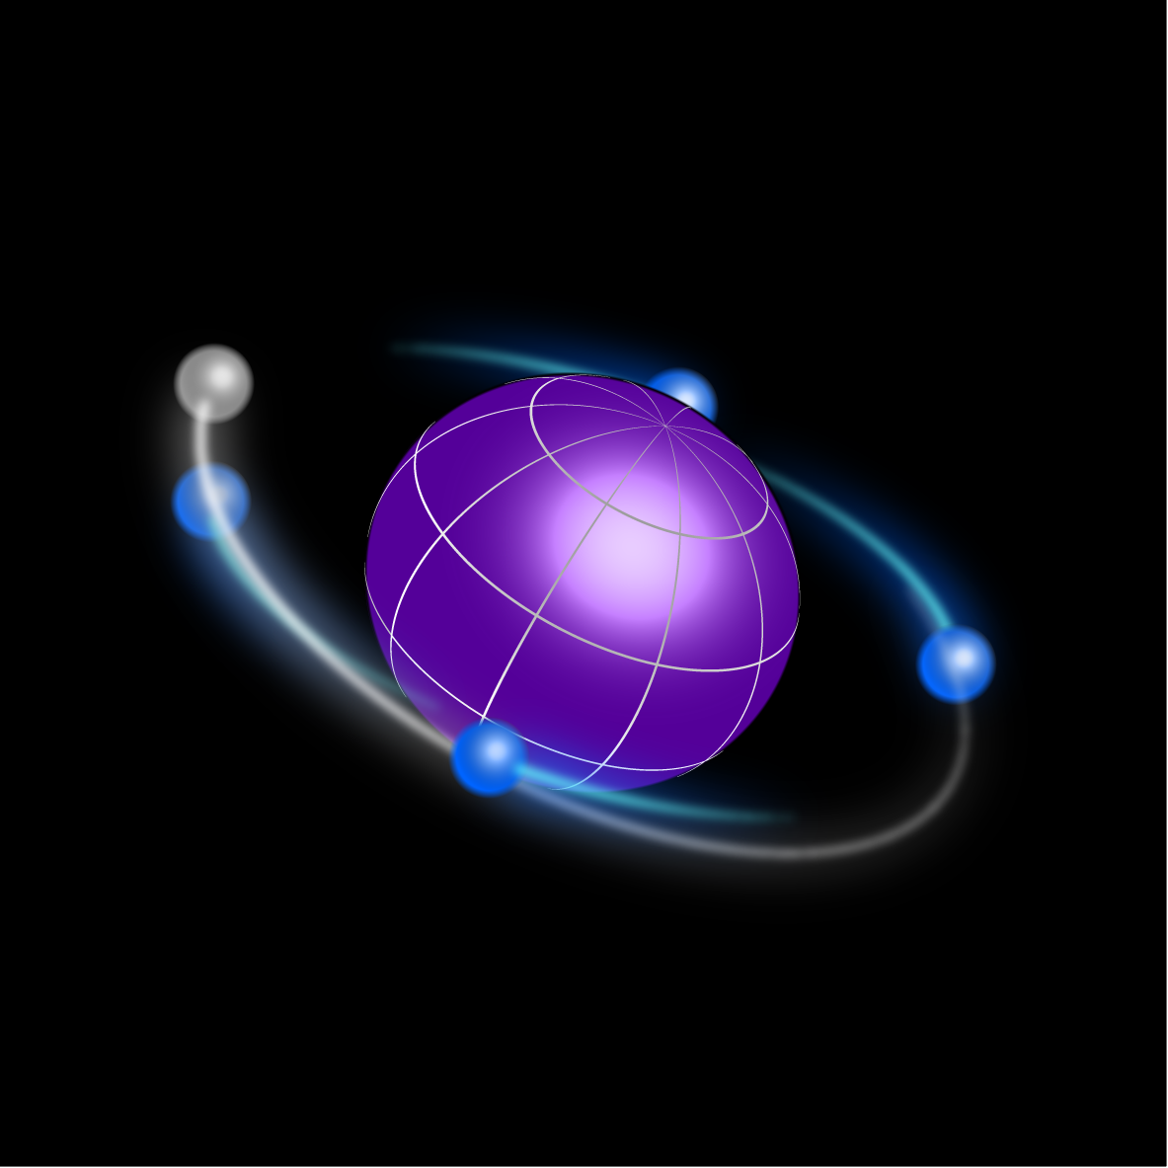
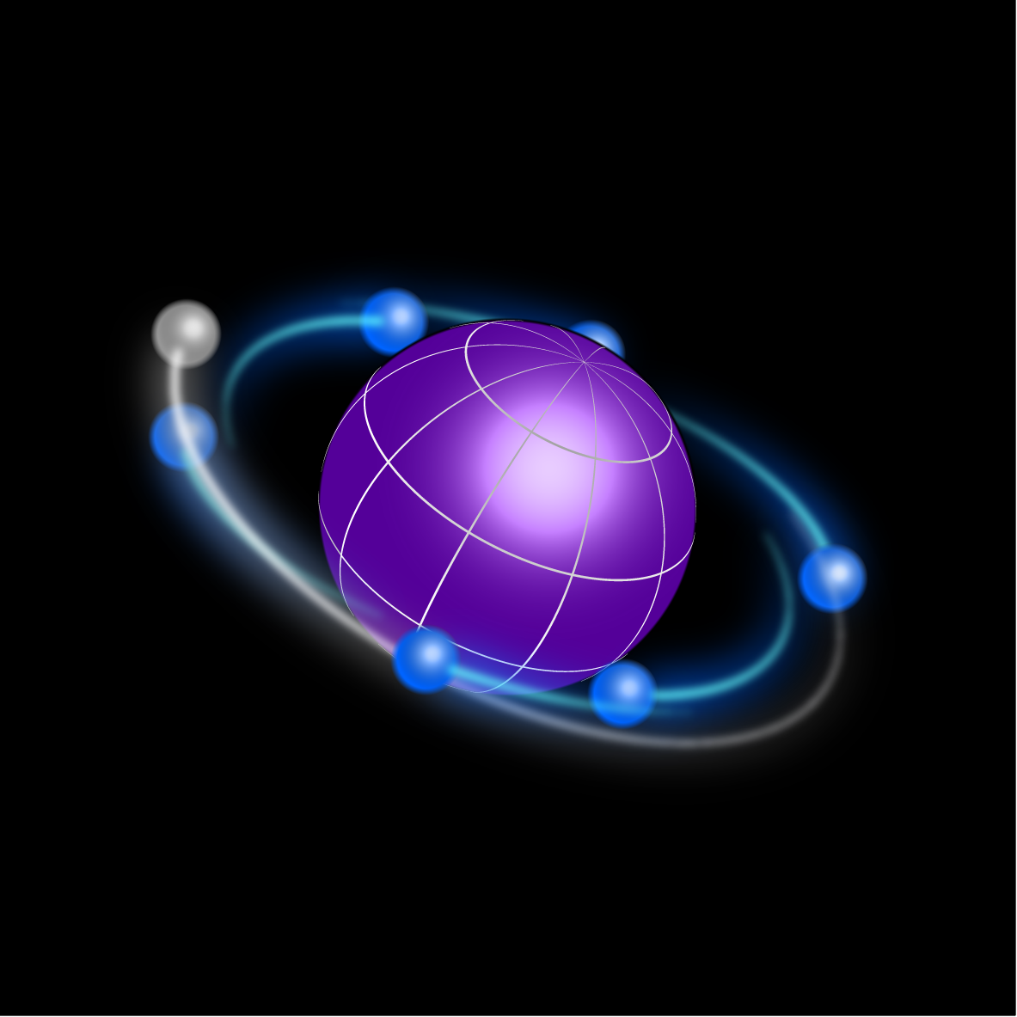
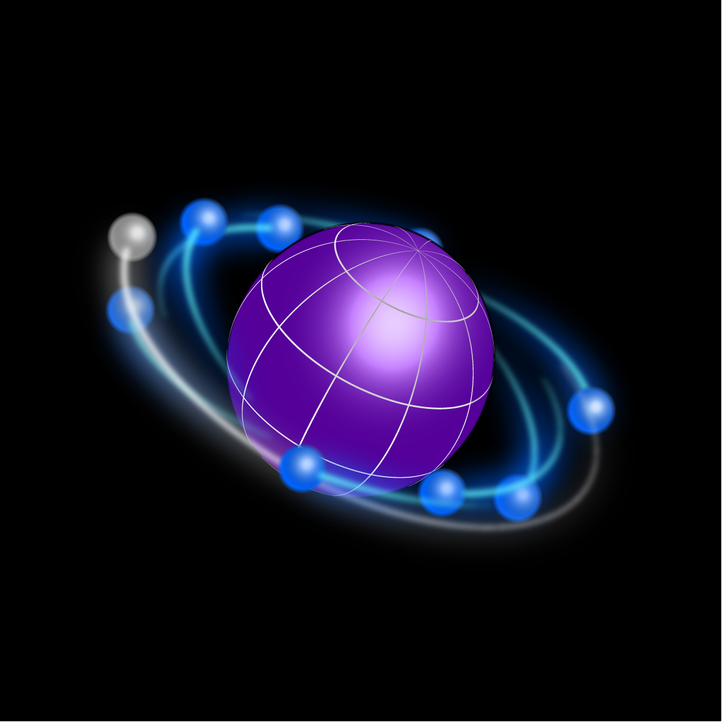
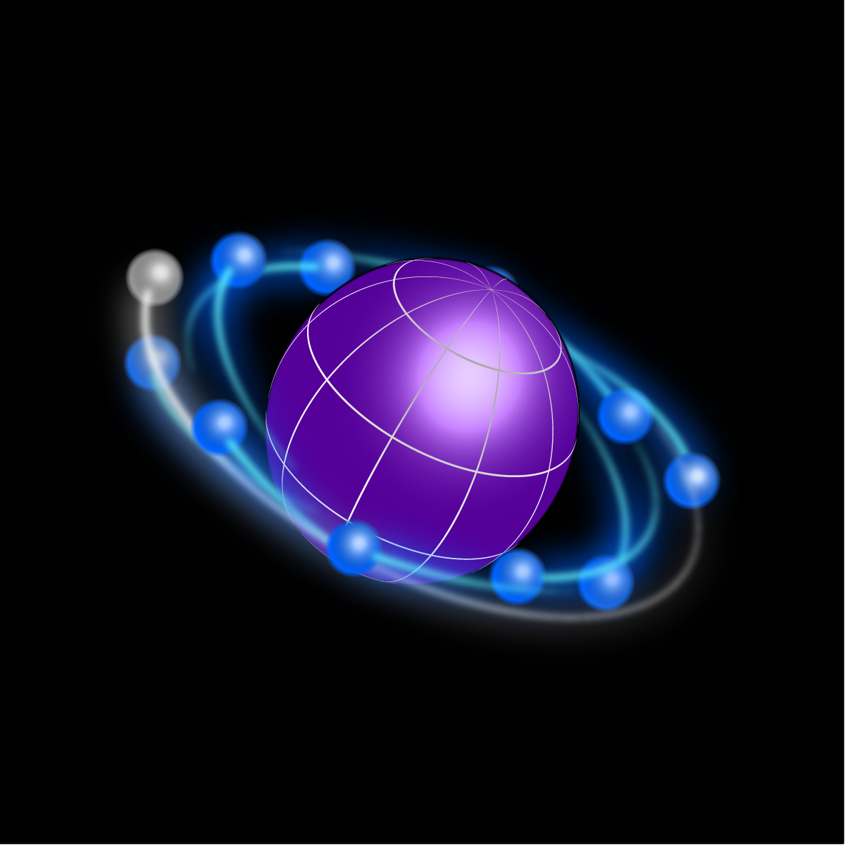
Electromagnetic moments
9/20
Nonscientific representation

Slide 11
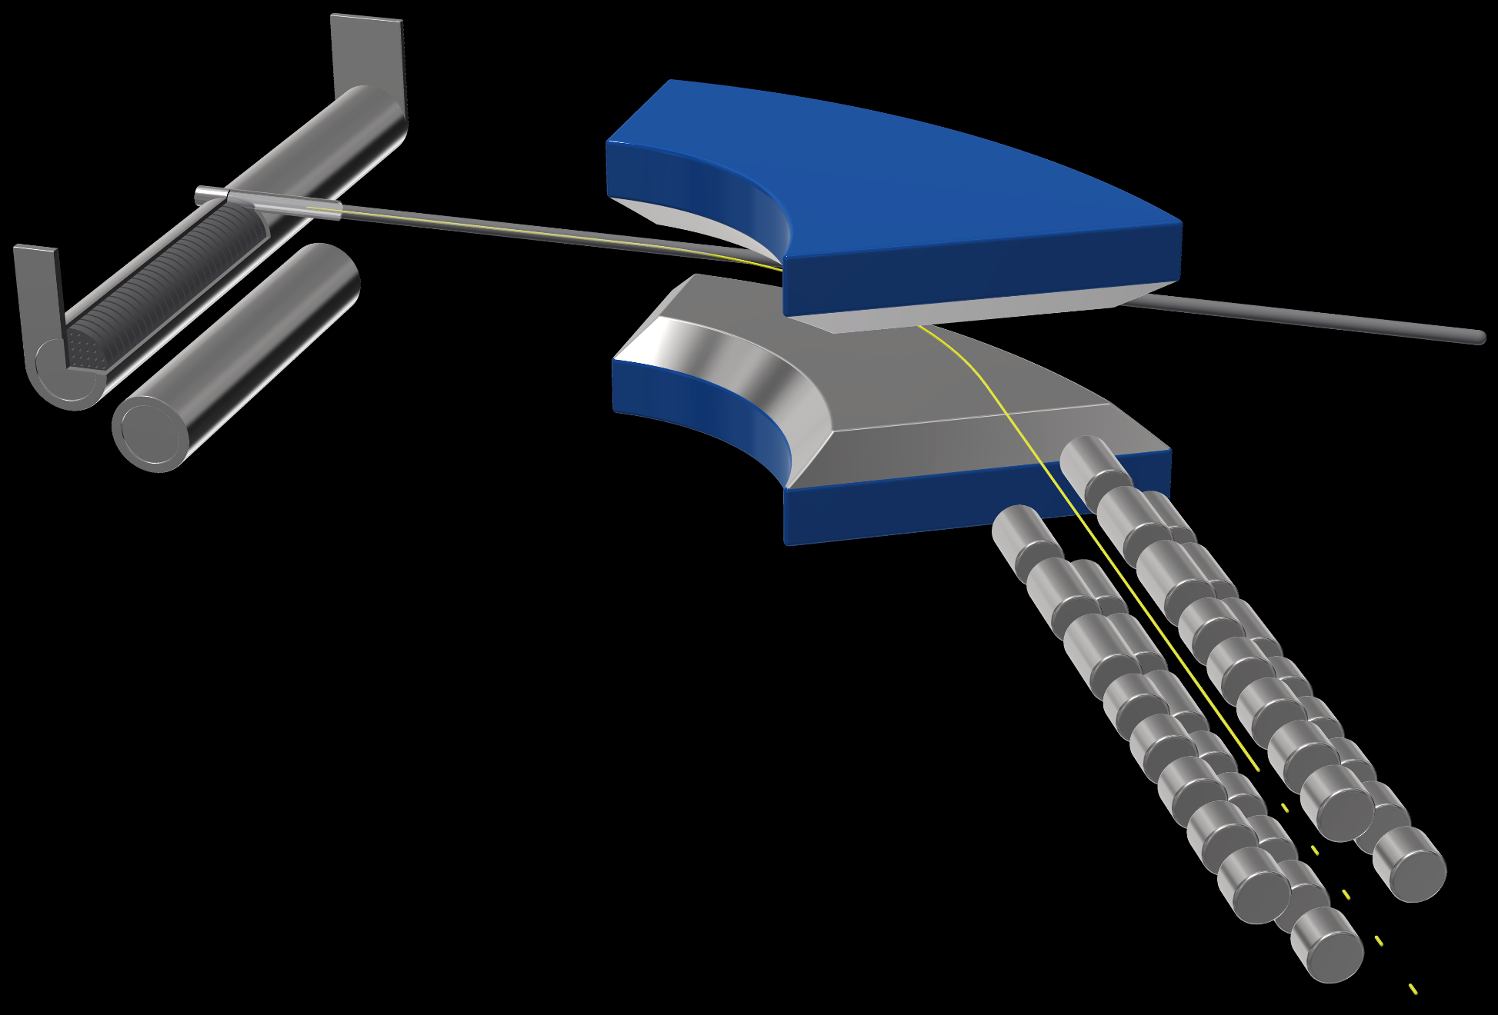
Methodology
10/20
The ISOL method
Target canister
Mass separator
Ionizing line
UC_{x}
Laser ion source
Neutron “converter”
Ion beam
Proton beam
Rf quadrupole

Slide 12
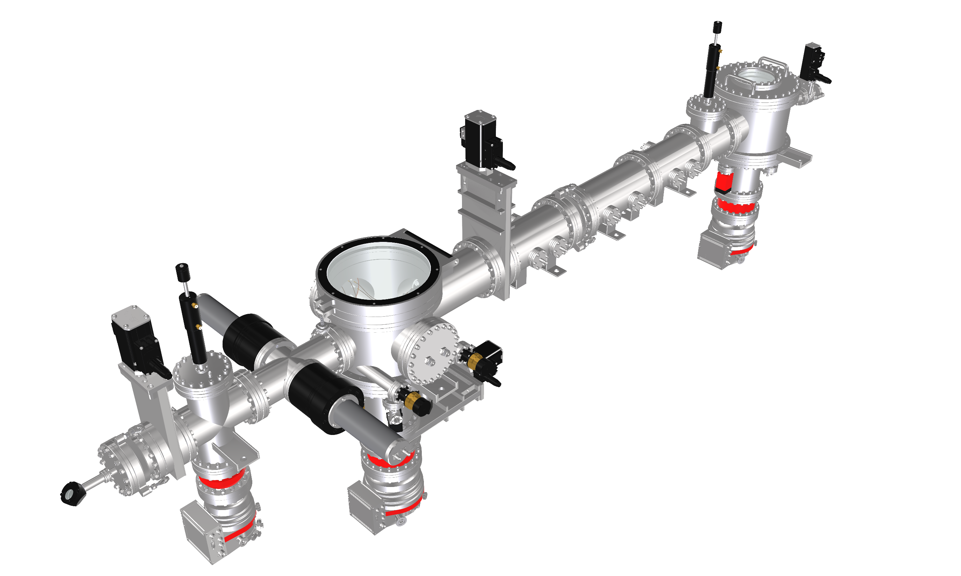
Methodology
11/20
Collinear spectroscopy
Laser/ion-beam
merging chamber
Post acceleration &
neutralization
Electrostatic optics
Laser exit
Fluorescence detection

Slide 13
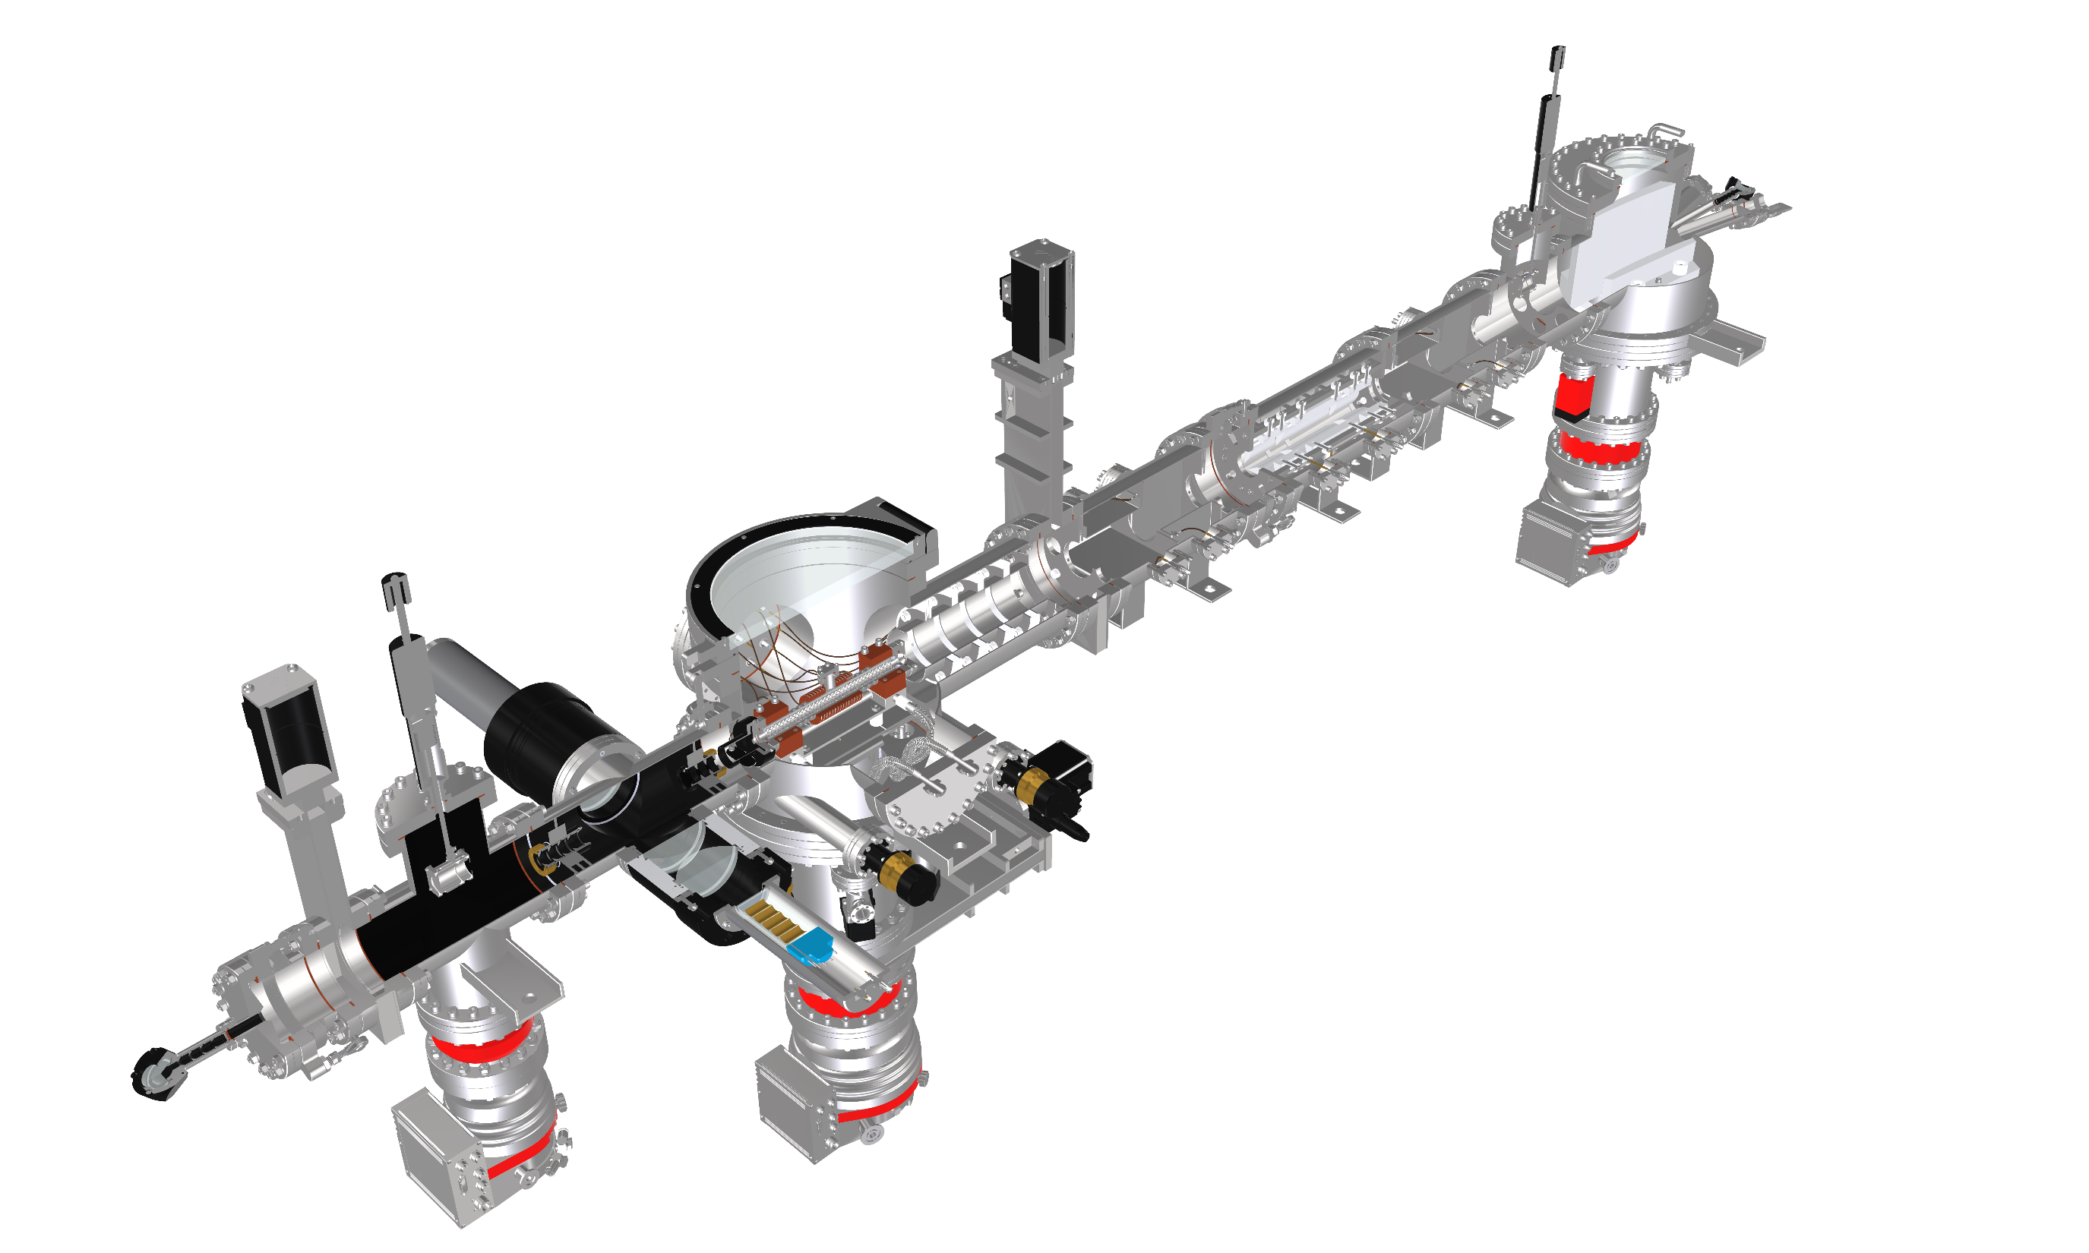
Methodology
12/20
Laser entrance
The COLLINEAR method
Ion entrance
Laser/ion-beam
merging chamber
Post acceleration &
neutralization
Electrostatic optics
Laser exit
Fluorescence detection

Slide 14
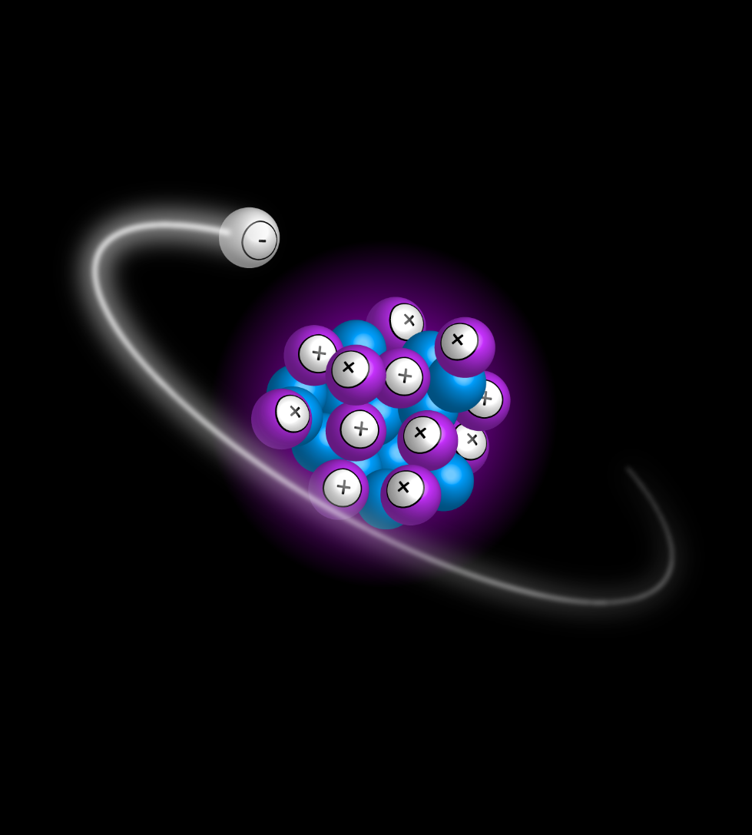
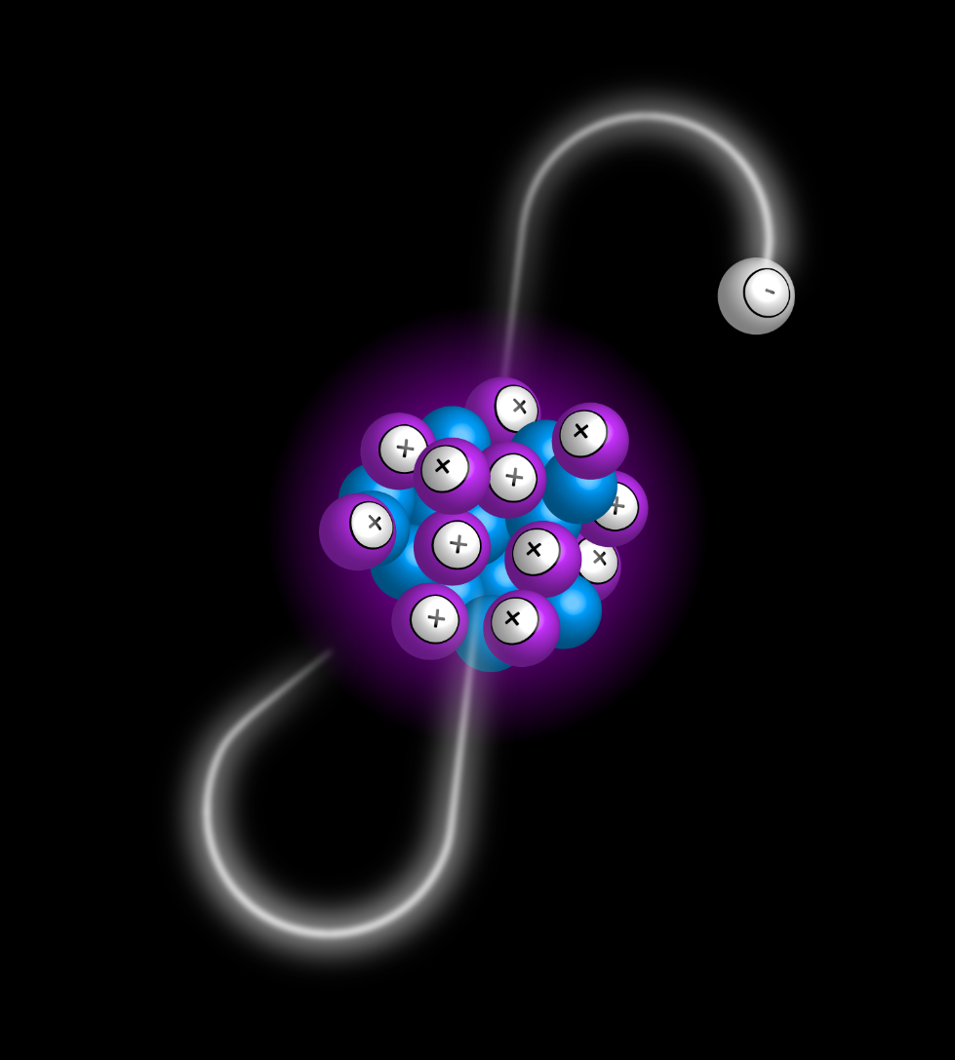
Hyperfine structure
13/20
²⁵Mg, 5/2⁺
3s
3p
279.6 nm
2
1
S_{1/2}
2
→
→
→
δ⟨r²⟩
F = J + I
ν × 10⁻⁶
μ
P_{3/2}
3
μ
Q
ν ≈ 10¹⁵ Hz
4
1

Slide 15
Hyperfine structure
14/20
Input from atomic theory
A
g₁
A₁
= const
=
( 1 + ¹Δ² )⁻¹
g
g₂
A₂
B
= const
B = e Q V_{JJ}
Q
δν = F δ⟨r²⟩
2
δ⟨r²⟩
3
S_{1/2}
P_{3/2}
ν × 10⁻⁶
μ
2
μ
Q
ν ≈ 10¹⁵ Hz
1
0
1

Slide 16
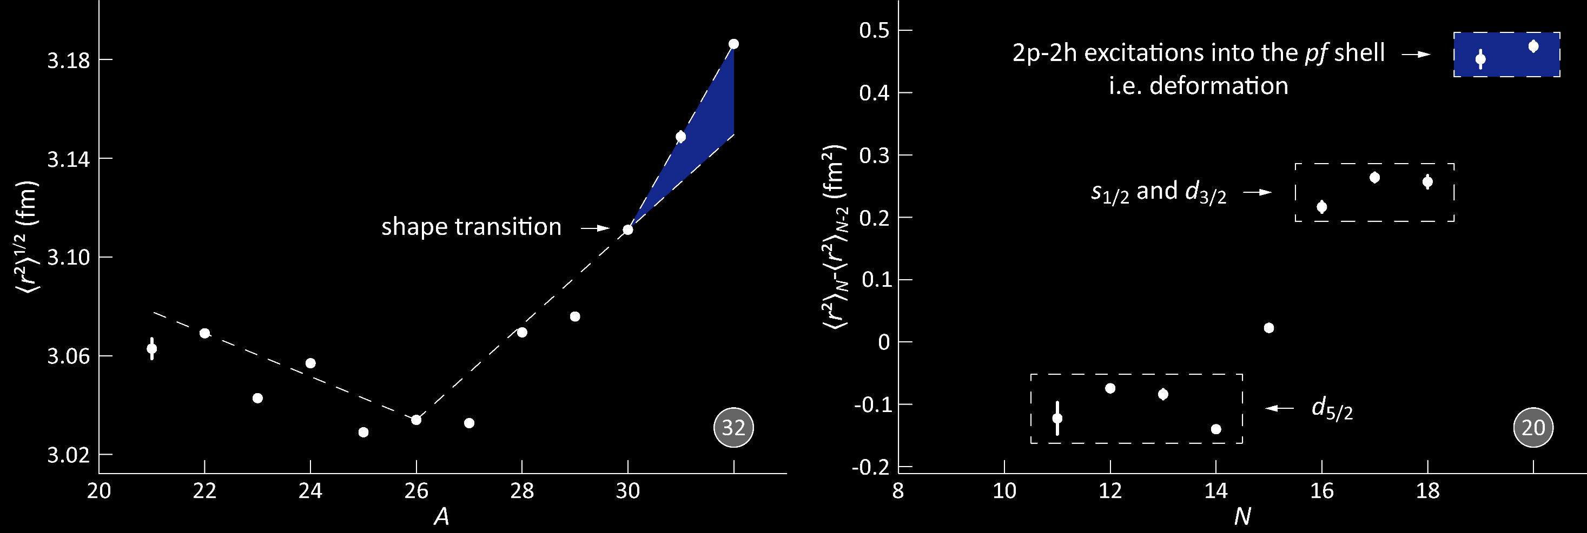
Mg rms radii
15/20
Phys. Rev. Lett. 108, 042504 (2012)

Slide 17
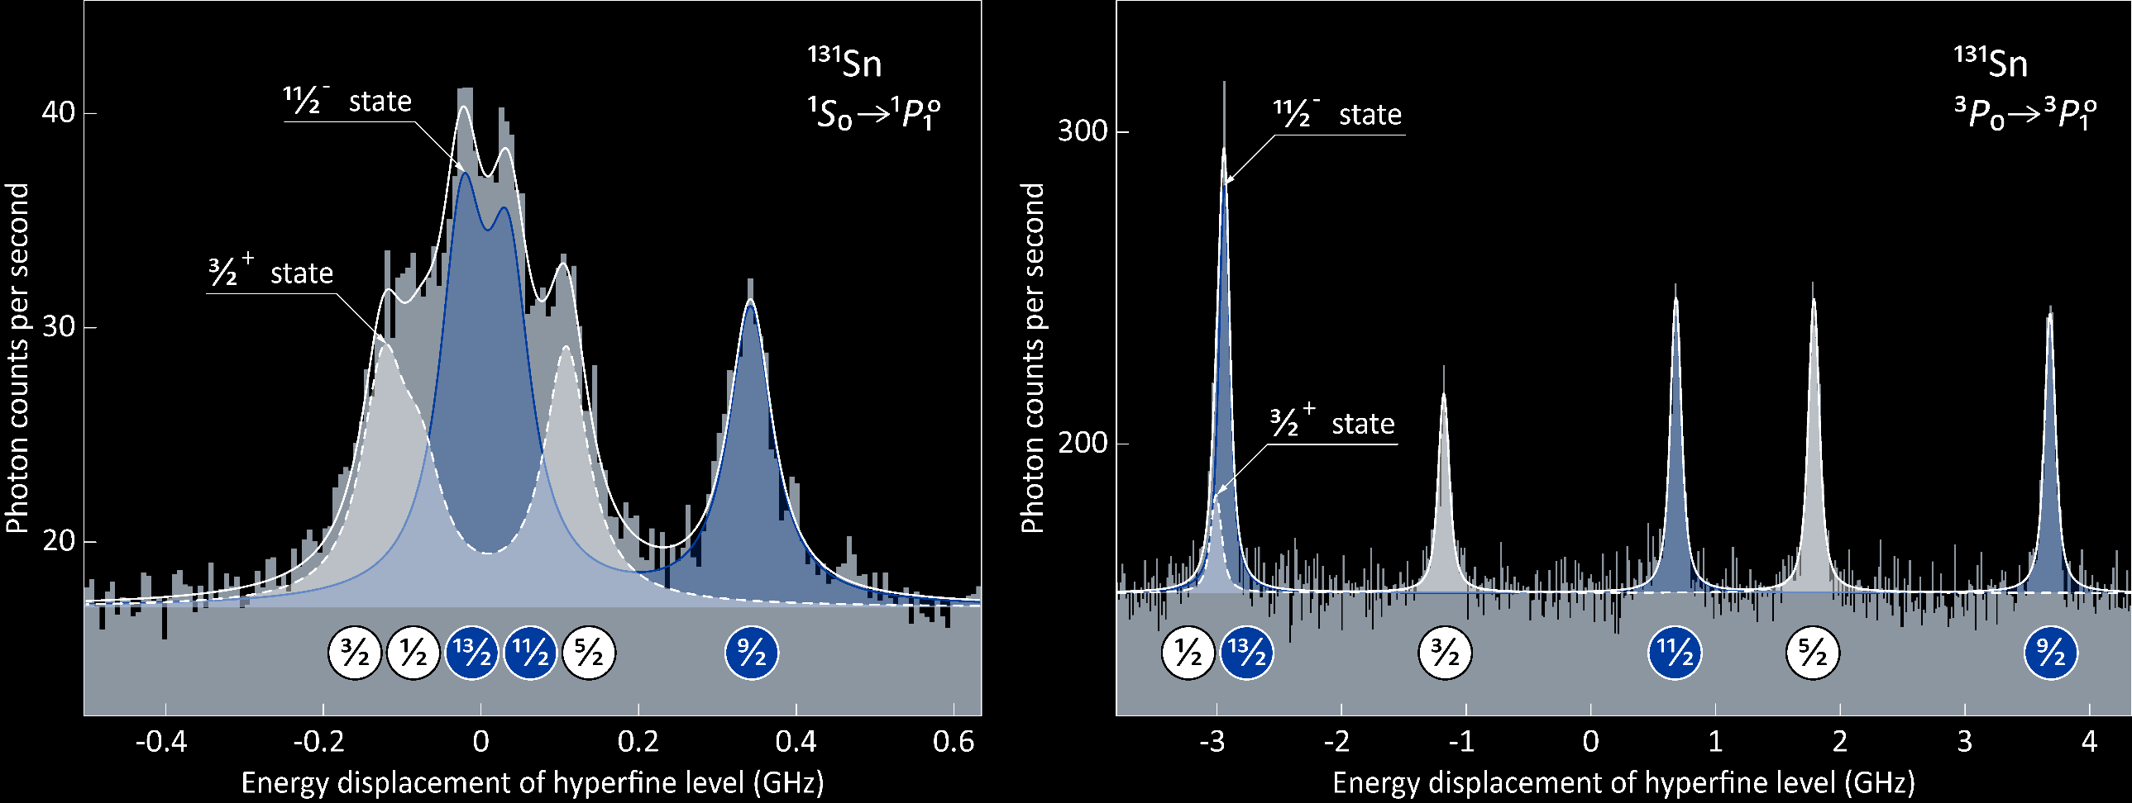
Simple trends in nuclei
16/20
Commun. Phys. 3, 107 (2020)

Slide 18
Simple trends in nuclei
17/20
Cd, 3/2⁺
Dipole moment
(magnetic)
Sn, 3/2⁺
$$μ$$
Cd, 1/2⁺
Cd, 11/2⁻
Sn, 1/2⁺
$$N$$
Sn, 11/2⁻
$$μ=∓j\frac{3.8}{2l+1}μ_{N}$$
Commun. Phys. 3, 107 (2020)
Phys. Rev. Lett. 110, 192501 (2013)

Slide 19
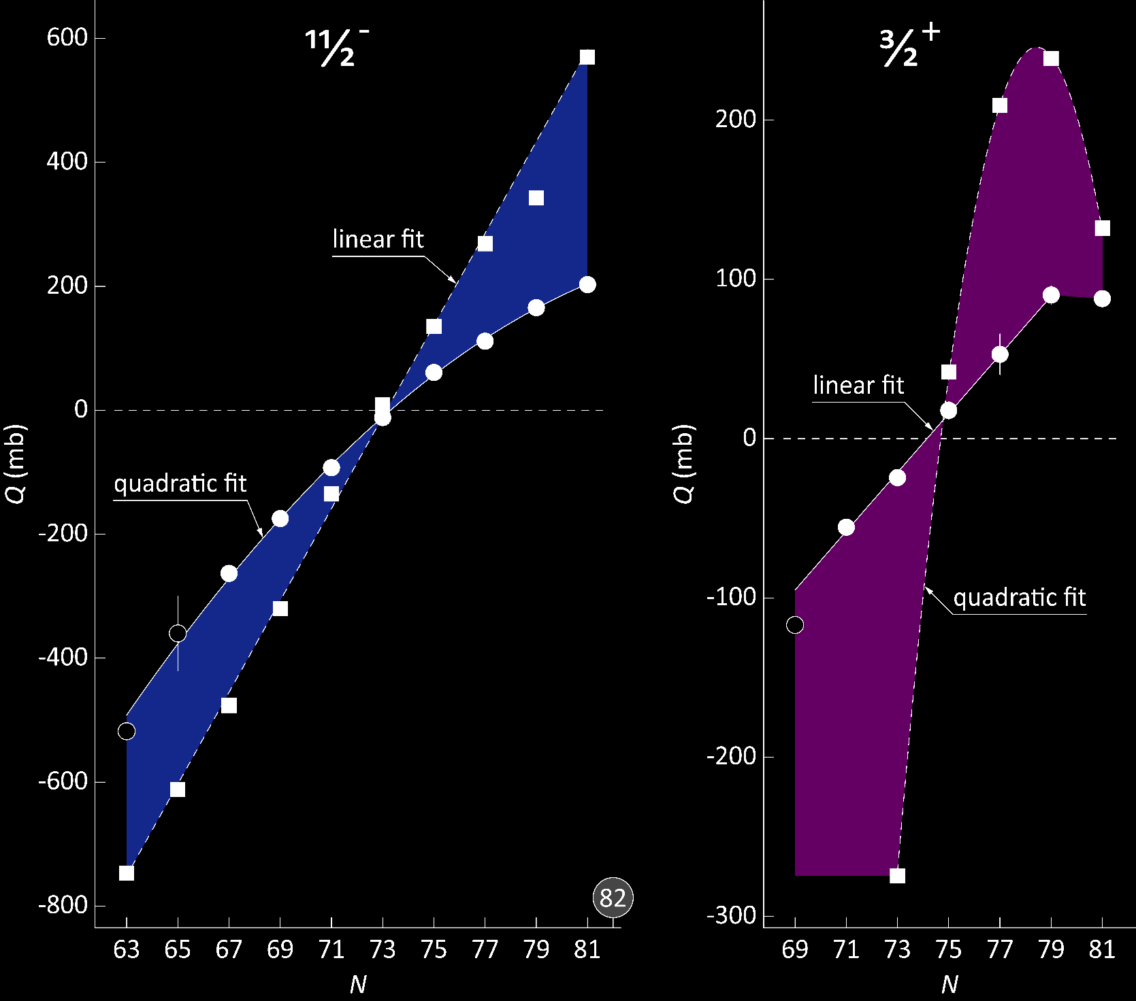
Simple trends in nuclei
18/20
Quadrupole moment
(electric)
Cd
Cd
$$Q$$
Sn
Sn
$$N$$
$$Q=\frac{2j+1−2n}{2j−1}Q_{sp}$$
Commun. Phys. 3, 107 (2020)
Phys. Rev. Lett. 110, 192501 (2013)

Slide 20
Simple trends in nuclei
19/20
Radial moments
(charge)
$$δ\left\langle r^{2}\right\rangle$$
Cd
$$N$$
$$δ{\left\langle r^{2}\right\rangle }^{g,m}=\frac{5}{4π}\left\langle r_{0}^{2}\right\rangle \left(β_{m}^{2}−β_{g}^{2}\right)$$
Sn
Commun. Phys. 3, 107 (2020)
Phys. Rev. Lett. 116, 032501 (2016)

Slide 21
Acknowledgements
20/20
Commun. Phys. 3, 107 (2020)

