Slide 1
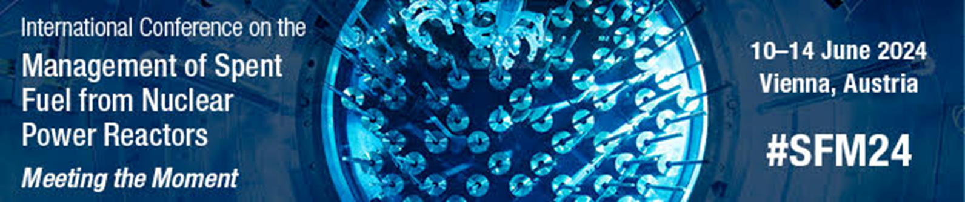

Operational Experiences and Challenges in Managing Spent Nuclear Fuel from Research Reactors EWA and MARIA in Poland
Krzysztof Madaj
Institute of Chemistry and Nuclear Technology

Slide 2
Introduction
Global Energy Challenges
Increasing focus on sustainable energy solutions
Need for effective management of SNF
Poland's Context
Activities focused on research reactors:
  EWA Research Reactor
    Launched: 1958
    Shut down: 1995
  MARIA Research Reactor
    Operational since: 1974
    Currently operational
SNF has been generated from the operation of two research reactors named EWA and MARIA.

Slide 3
EWA Research Reactor: General data
The name EWA is an acronym: Experimental, Water, Atomic.
2 MW pool type reactor with EK 10 Fuel
used for isotopes production and physical
experiments in horizontal channels
1974

Slide 4
Evolution of EWA RR Operations
1958-1964
1
EWA reactor operated at 2 MW using EK-10 fuel with 10% enrichment.
1964-1967
2
Reactor operated at 4 MW after core reconstruction
(EK-10 10% enrichment)
1967-1973
3
Reconstruction of the core and technological systems and use of WWR-SM fuel enriched 36%, Reactor operated at 8 MW
1973-1988
4
Reactor operated at 10 MW. In 1988 WWR-M2 fuel enriched 36% was introduced into operation
1988-1995
5
Total SFA
EK 10 : 2000 pcs.
WWR-SM: 2095 pcs.
WWR-M2 : 445 pcs.
Reactor operated at 10 MW using WWR-M2 fuel enriched 36% . Reactor was shut down and unloaded of fuel in 1995

Slide 5
EWA RR: Decommissioning Overview
Initiation of Decommissioning:
Began in 1997
IAEA Classification:
Reached "End of Phase 2" in 2002
All nuclear fuel and irradiated elements removed, eliminating radiological hazards
Current Status:
No radioactive emissions into the environment
Renovation of the biological shield building completed
Offices adapted for the Radioactive Waste Management Plant (RWMP)
Future Plans:
Further decommissioning work suspended
No plans for "green grass" state (Phase 3) due to potential use of biological shield for dry storage of SNF from the MARIA reactor

Slide 6
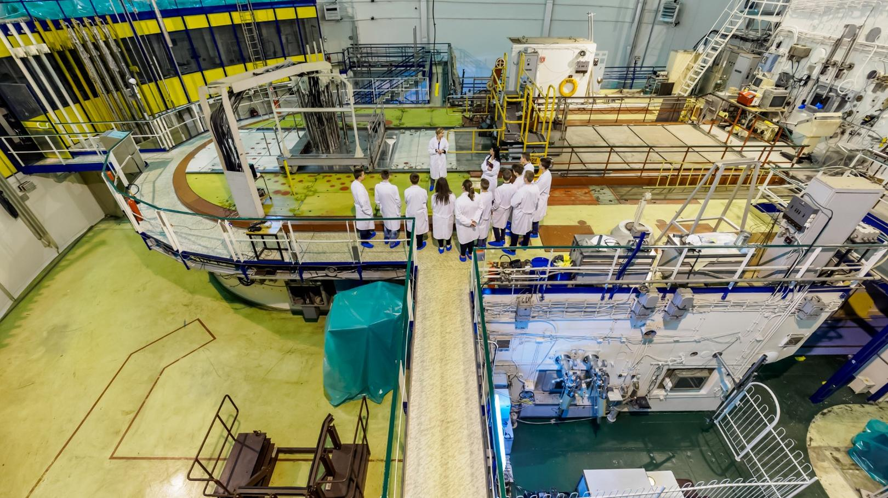
MARIA Research Reactor: General data
MARIA RR:
Type: High-flux pool-type reactor
Nominal Thermal Power: 30 MWt
National Centre for Nuclear Research (NCBJ)
Formation:
Merger of the Institute for Nuclear Problems and IEA
POLATOM on September 1, 2011
Role:
Operator of the MARIA research reactor,
Poland's only operational reactor

Slide 7
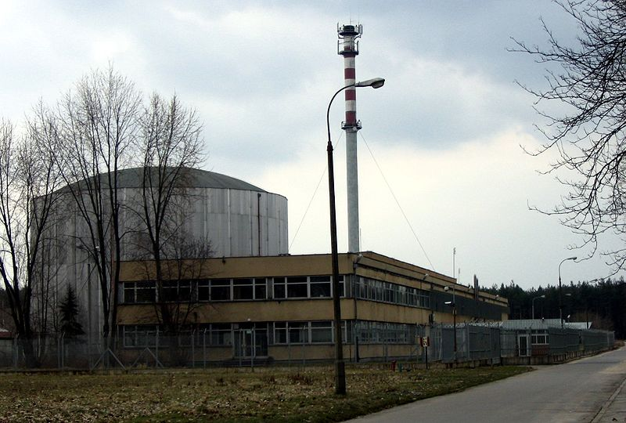

MARIA Reactor and Fuel Conversion
Operational since 1974, currently active
Modernization break from 1985-1993
Fuel enrichment was decreased from 80% to 36% (1999 to 2002)
Shipment of SNF type MR from MARIA reactor to 19a nuclear facility (1999 to 2002)
- Conversion from high-enriched uranium (HEU) to low-enriched
uranium (LEU) as part of the Global Threat Reduction
Initiative (GTRI) program in 2014
Fuel Enrichment
Gradual conversion from 36% to below 20% U-235 in 2014
Conversion Program-cooperation with ANL, USA
Associated with the GTRI close collaboration with Argonne
National Laboratory, USA

Slide 8



SNF Management Strategy - historical context
Initial Assumptions:
- Responsibility for SNF management was believed to rest with fuel suppliers (Soviet Union)
- Early plans included returning SNF to supplier post initial cooling in wet storage
Post-1991 Changes:
- Dissolution of the Soviet Union necessitated a reevaluation of SNF management strategy
- New political realities in Eastern and Central Europe required adaptation of existing frameworks
- Difficulties with costs, legal complexities, and technical
- Decision to adopt long-term storage (biological shield of the former EWA RR)
Initial Cooling
Reprocessing
Long-Term Storage
SNF cooled in wet storage
Transfer to Russian Federation, Great Britain, or France considered
Wet and dry storage in Poland adopted

Slide 9
SNF Management Strategy-Currently Approach
1
Stage 1: Wet Storage
10-50 years in wet storage facilities.
Reducing activity and heat production
2
Stage 2: Dry Storage
50-100 years in dry conditions
3
Stage 3: DGR Disposal
Disposal in a deep geological repository
Consider the retrieval option during the emplacement
SNF process
The results of analyses conducted by the Ministry of Economy indicated that in Poland's situation,
an open cycle would be more economically advantageous (from 30 to 50%) than a closed cycle. However, global trends in this area will be constantly monitored and, if necessary, if it is justified, appropriate changes will be introduced in the proposed solutions.

Slide 10
Wet Storage Facilities
Facility 19
Facility 19A
Operational since 1959, stored EK-10 fuel rods. Currently is using for solid waste from EWA decommissioning
Operational since 1968, stored WWR-SM and WWR-M2 SNF
Technological Pool
The MARIA reactor used fuel assemblies of the MR-5 and MR-6 types, which were placed in special channels ensuring their proper cooling. The MR assemblies from the MARIA reactor were stored in the reactor's technological pool
SNF from the EWA and Maria reactors was stored in wet
storage facilities for about 50 years

Slide 11
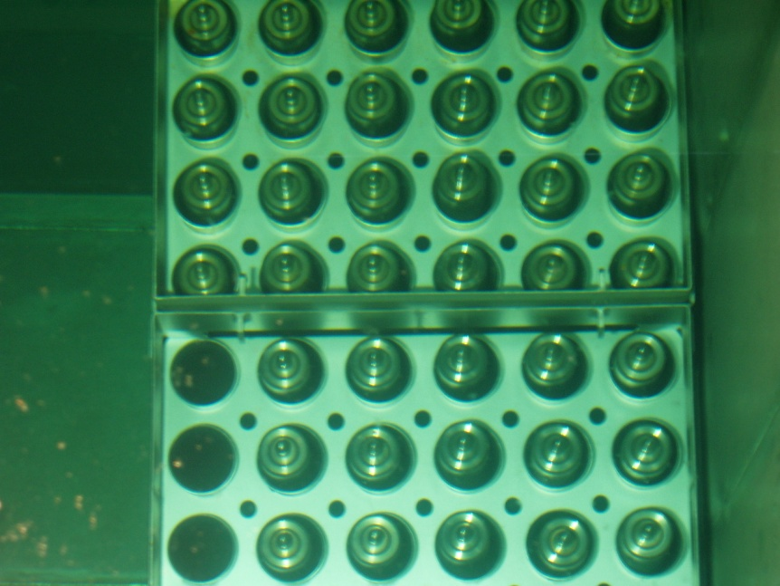
Key Considerations for Wet Storage
1
2
Tightness of SFA
Water Quality Monitoring
Parameters to monitor:
- pH
- Conductivity
- Radioactivity (isotopic composition)
- Chemical composition
Ensuring the integrity of fuel element casings
3
Recent development
Post-2016: No SNF stored in facilities 19 and 19A.
Fuel Export: All SNF elements exported to the Russian Federation under the GTRI Program.

Slide 12
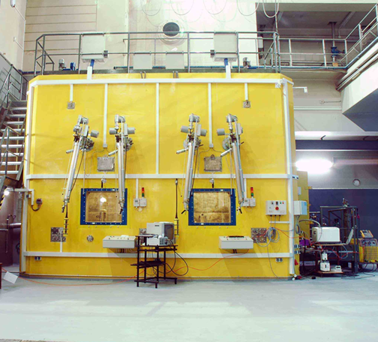
Transition to Dry Storage: Enhancing Safety
SNF MR
SNF EK-10, WWR
MR spent fuel capsule closing process were performed in hot chamber of MARIA reactor. SNFs were stored in helium-filled capsules in the MARIA reactor's technological pool
Encapsulation of EK-10 and WWR SNF was launched in 2008. By the end of 2009, EK-10 SNF rods were encapsulated into stainless steel capsules.
DRY STORAGE
Wet storage should not exceed 50 years due to corrosion. Dry storage involves placing dried fuel in airtight capsules filled with inert gas. Encapsulated SNF elements were shipped to the Russian Federation
.

Slide 13
Global Threat Reduction Initiative (GTRI) Program
In 2004, as part of the American Global Threat Reduction Initiative (GTRI) and a positive response from Poland to the project of returning fuel stored in Poland from research reactors to the producer country (Russian Research Reactor Fuel Return), as well as a declaration of the US government on financial participation in the project, its implementation began in 2009.

Slide 14
Challenges of the GTRI Program
Technical Challenges
1. Creation of Technical Base
- Ensuring safe reloading of spent nuclear fuel into transport containers suitable for public road transport in Poland and abroad.
2. Safe Storage Conditions
- Establishing secure, periodic storage for fuel containers, including physical protection measures at:
- at Swierk Centre, -Shipping yard, - Airport
Organizational Challenges
1. Technology Development
- Developing technology for reloading fuel into ŠKODA and TUK transport containers at RWMP facilities.
2. Safety Report Preparation
- Creating a Safety Report for the reloading of MR, EK-10, and WWR spent fuel to obtain necessary permissions from the President of the PAA.
3. Quality Assurance Program
- Establishing a quality assurance program related to the export of SNF.
4. Certification Acquisition
- Obtaining certification from the President of the PAA for the use of ŠKODA and TUK containers for transport within Poland.
5. International Arrangements
- Coordinating with IAEA and EUROATOM to establish conditions for monitoring the reloading of fuel into transport containers.
The successful implementation of the GTRI program in Poland hinged on overcoming these technical and organizational challenges to ensure the safe and efficient export of SNF

Slide 15
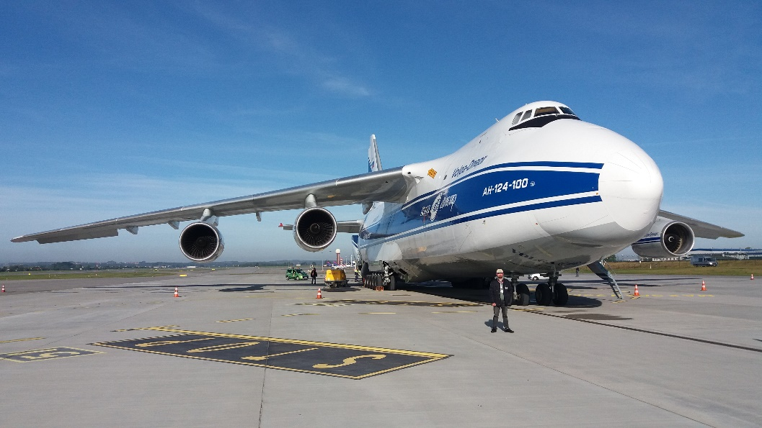
Transportation of SNF: Ensuring Security
2009-2016
1
Eight transports of SNF were carried out to the
Russian Federation.
Each transport required permission from the National Atomic Energy Agency (NAEA).
Different types of transport
2
Seven transports were by land and sea,
while the eighth was by land and air.
International Cooperation
3
International experts and anti-terrorist units
supervised the operation.

Slide 16
Disposal of Spent Nuclear Fuel
Current Status
- Research and Planning Stage: Disposal of SNF is still in the early phases.
- No Identified Location: A deep geological repository (DGR) has yet to be established
Historical Attempts to Identify DGR Locations
1. 1997-1999 Strategic Government Program:
- Conducted preliminary studies on potential DGR sites.
- Findings:
- Granite bedrock deemed unsuitable due to fractures.
- Identified homogeneous clay rock deposits and three salt domes for further study.
2. 2014 Polish Underground Research Laboratory (PURL):
- Initiated further studies on DGR locations.
- Objective: Continue research from the late 1990s.
- Status: Work suspended due to delays in nuclear power plant launch and lack of funding.
Future Plans
- National Plan for Management of Radioactive Waste: A DGR for radioactive waste, including SNF, is planned.
- Aligns with the Polish Nuclear Power Program, the key document for nuclear sector development. Management Strategy
for SNF:
- Preference for an open fuel cycle: Disposal of spent nuclear fuel in a DGR.
- Potential for a closed fuel cycle in future strategies, involving processing of SNF.

Slide 17
SUMMARY
Growing Interest in Nuclear Power
Further improve SNF management strategy to ensure safety for people and environment
Energy strategy
SNF is a key element of Poland's energy strategy
Transport, storage and disposal SNF must be carefully managed to minimize risk to people and environment
International Collaboration
Collaboration with international organizations helped shape and improve SNF management practices in Poland. Thanks to GTRI our country gained experience and developed a proper technology for handling with SNF

