Slide 1

A collaborative approach to the treatment of the Norwegian exotic HEU-materials
Thea Lyseid Authen and Tonje Sekse
Vienna 18-21 February 2025

Slide 2
Outline
Norwegian Nuclear History
National and international collaboration
Pilot Project
MMC

Slide 3
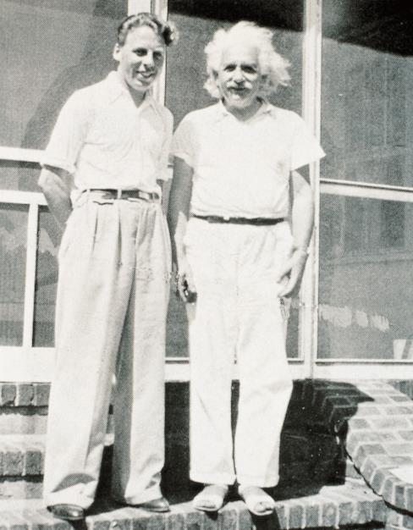
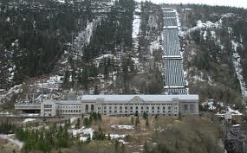
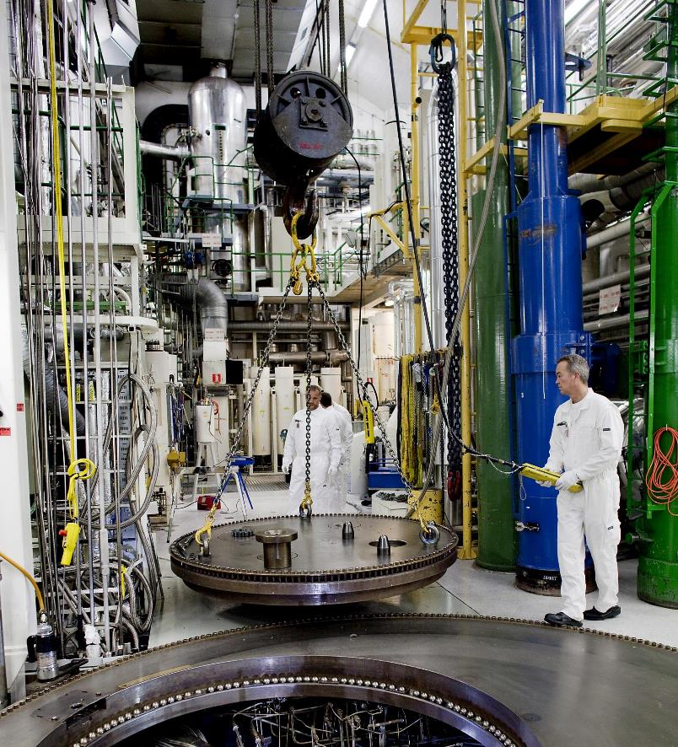
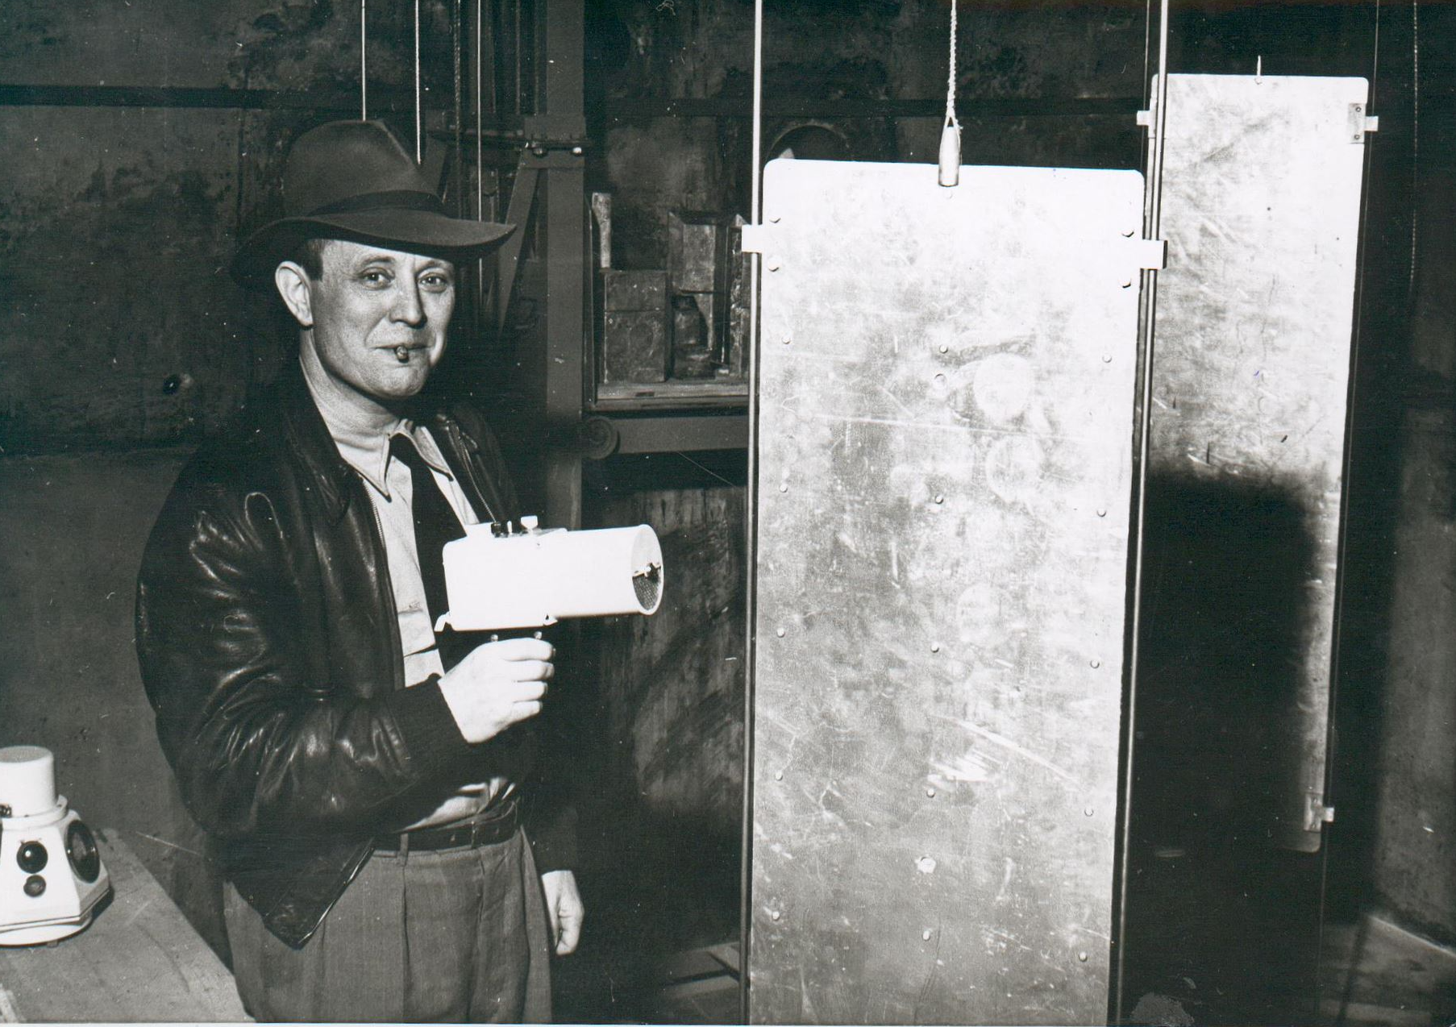
Norwegian Nuclear History
  1934-1988: Heavy water plant at Vemork
  1946: Norwegian nuclear research activities started at the Norwegian Defence Research Establishment (FFI)
  1948 IFA (later IFE) was founded
    1951-1967: JEEP I
    1959-2018: HBWR
    1961-1968: N0RA
    1966-2019: JEEP II
Notes:
During World War II, in order to stop the German program for development of nuclear weapons, the British Government decided to eliminate the heavy water supply by destroying the heavy water plant. Successful acts of sabotage were aimed at the Vemork power station at the Rjukan waterfall and the transport of heavy water to Germany.
Capacity 1941: 12 tons per year
During the post-war years Norway put strong efforts in the area of nuclear research. The Norwegian nuclear research activities were started at the Norwegian Defence Research Establishment (FFI) in 1946.
In 1948 the nuclear research activities were separated from the military establishment, with a focus on civil use of nuclear power.
First research reactor in operation after the Nuclear Weapon States and Canada

Slide 4
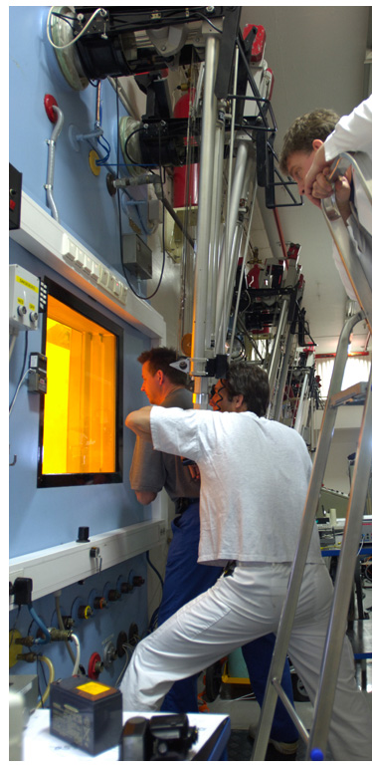
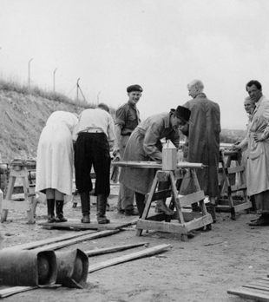
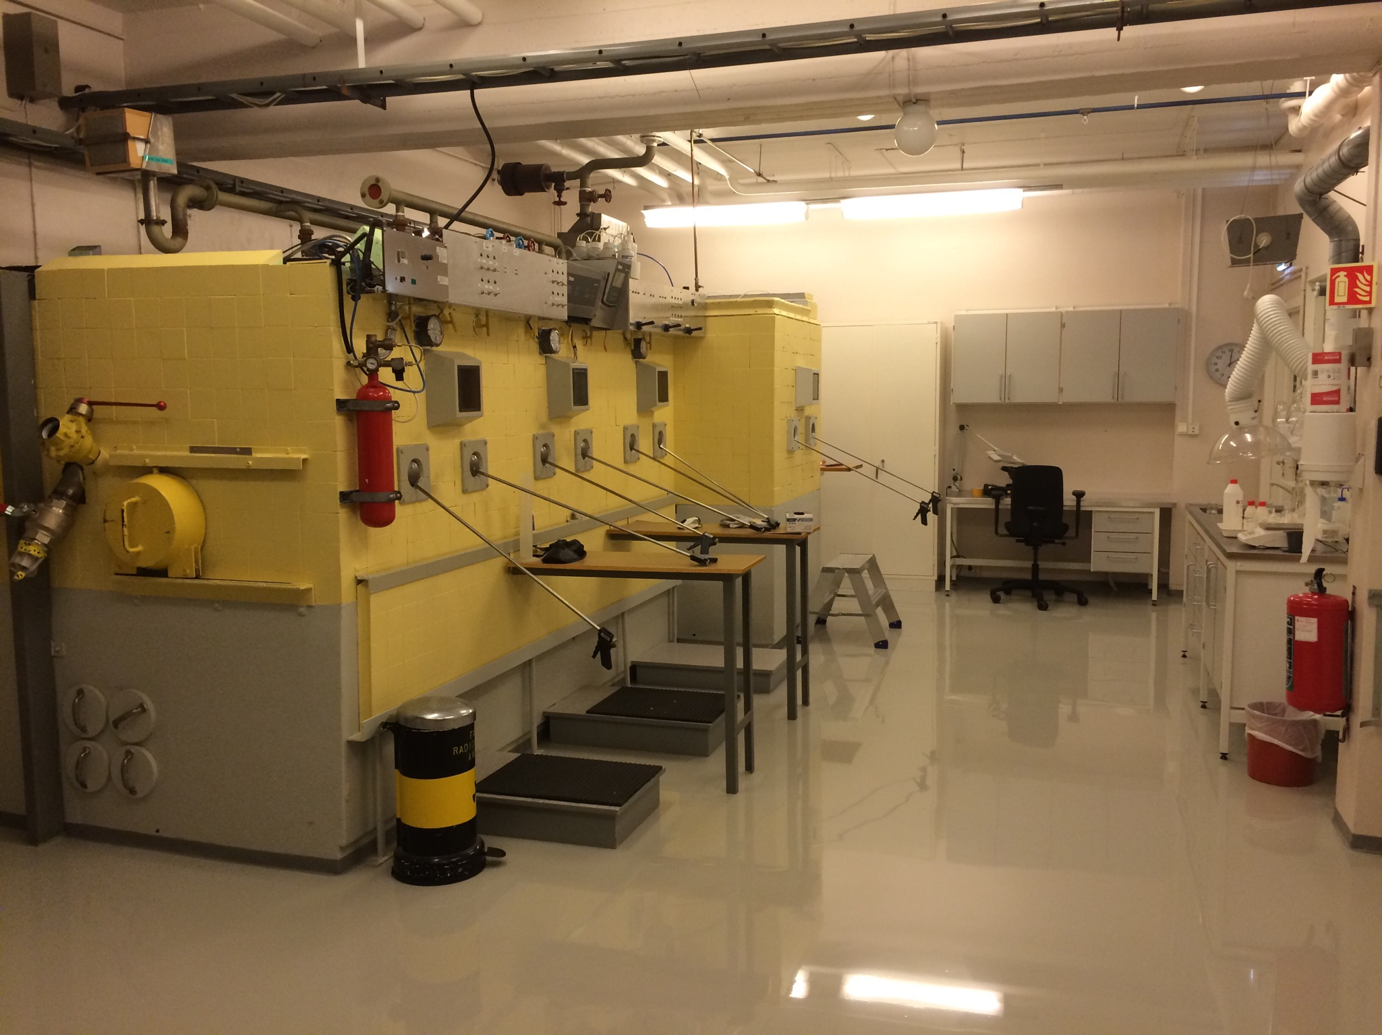
Norwegian Nuclear History
Fuel production facilities
Post irradiation examinations
A pilot reprocessing plant
Storages for fresh and spent fuel
National radiation waste handling facility
Only national hotcell facility

Slide 5
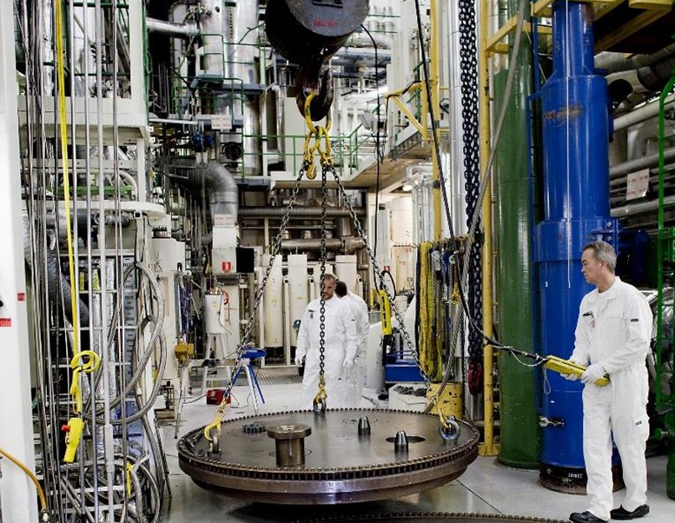
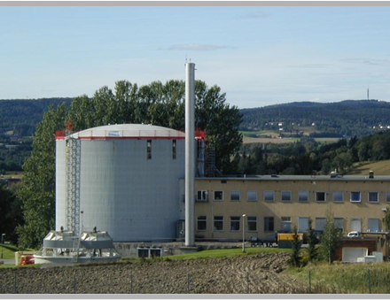
Norwegian Nuclear History
Halden
HBWR, 25 MW (1959 – 2018)
Operational license 2021-2030
Historical operations:
  OECD Halden Project,
  Material science research
  High burn-up fuel performance
Kjeller
JEEP II, 2 MW (1966 – 2019)
  JEEP I (1951 – 1967) & N0RA (1961 – 1968)
Operational license 2019-2028
Historical operations:
  Production of isotopes
  Neutron Transmutation Doping (NTD) of silicon

Slide 6
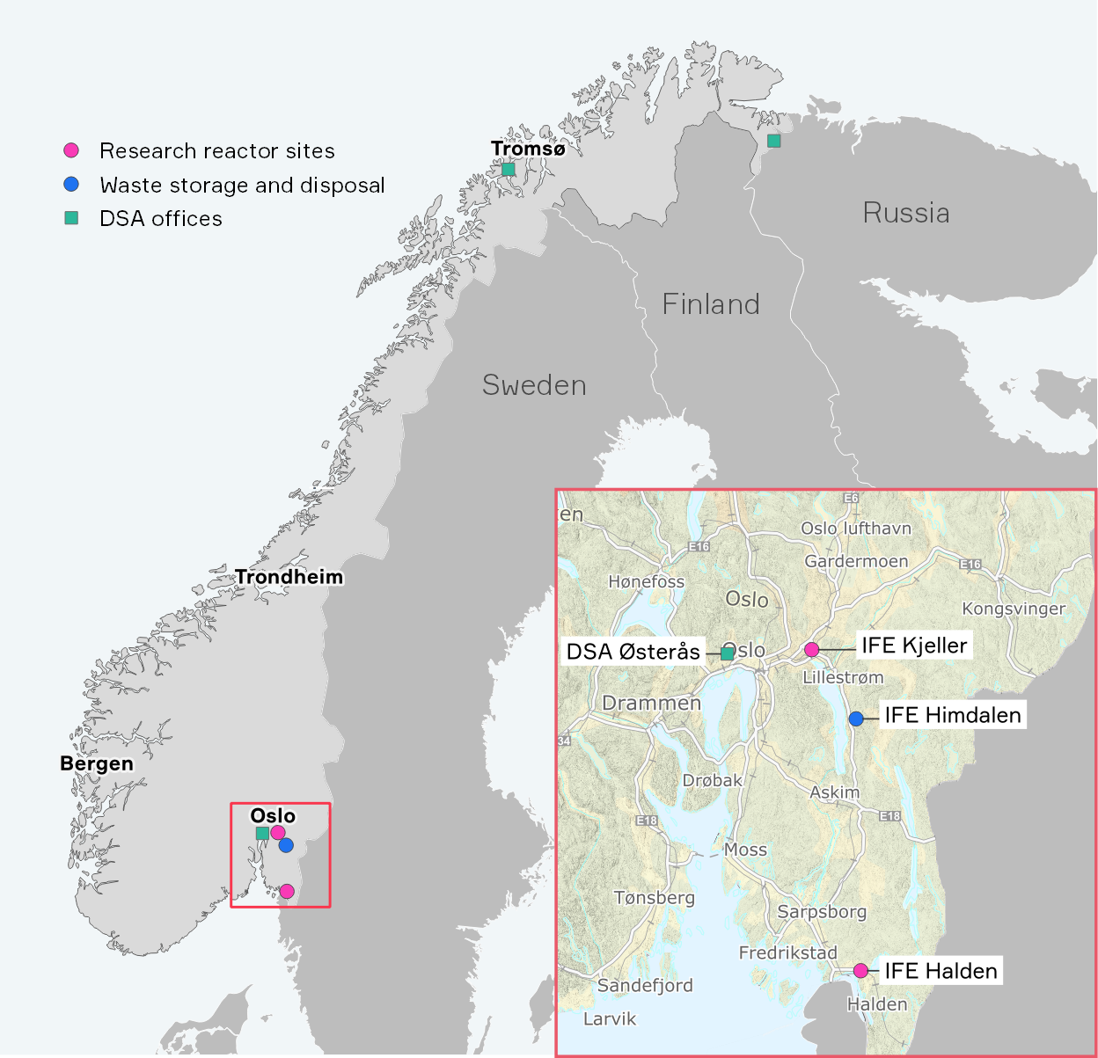
Nuclear facilities and regulators in Norway
Norwegian Radiation and Nuclear Safety Authority (DSA)
One reactor operator in Norway – Institute for Energy Technology (IFE)
New State owned company, Norwegian Nuclear Decommissioning (NND) established in 2018 will in the future be responsible for the nuclear sites and the materials on-site.

Slide 7



Government
Ministry of Health and Care Services
Ministry of Climate and Environment
Ministry of Foreign Affairs
Ministry of Defence
Ministry of Trade, Industry and Fisheries

Slide 8
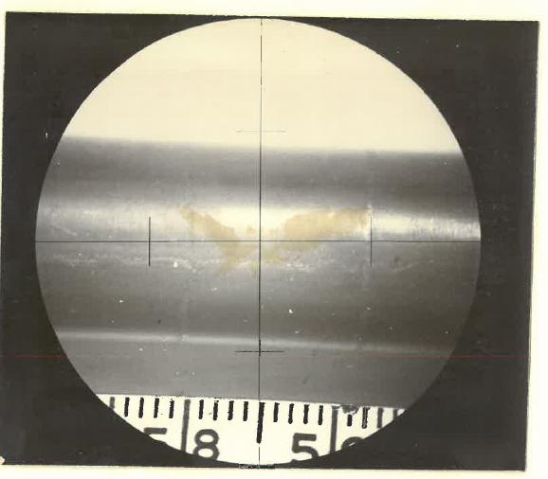
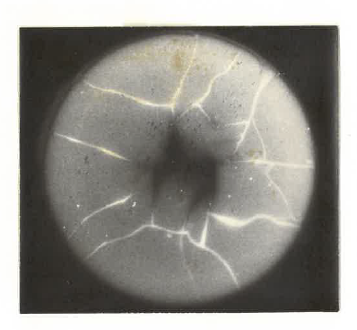
HEU in Norway
US-origin high enriched uranium (HEU), received in the 1960’s
Enrichment of around 90% U-235
Research on HEU/Th-fuels for various projects
Portions of the material have been used/analysed in Great Britain (Dounray), Denmark (Risø) and Italy (CNEN)
HEU-Th fuels were irradiated in IFEs Halden Boiling Water Reactor (HBWR)
Underwent post-irradiation examinations at the IFE Kjeller site

Slide 9

NTI Security Index
Norway is one of 22 countries with civilian HEU or separated plutonium over 1 kg, according to the Nuclear Threat Initiative (NTI) Security Index 2023
Norway has prioritised the elimination of its HEU stocks

Slide 10

Nuclear Security Summits
Several Nuclear Security Summits (2010, 2012, 2014 and 2016) have discussed minimizing stocks of HEU
At the Nuclear Security Summit in 2016 Norway offered a joint statement on minimization of HEU (InfCirc 912)
  committing to fulfilling the statement goals and voluntary reporting
  committed to organizing a symposium on HEU minimization in 2018

Slide 11
International meetings and symposiums on HEU minimizations
The MFA, DSA and IFE have organized several international meetings and symposiums in cooperation with the International Atomic Energy Agency (IAEA), in 2006, 2012 and 2018 where minimization of HEU was discussed
In 2019 Norway took initiative to organize a technical meeting together with other countries that have similar types of material, as well as the expertise and equipment to handle this type of material

Slide 12
International support
Norway has taken an active role in supporting the IAEA in minimization of HEU in developing countries, by replacing HEU with LEU in research reactors and enabling repatriation of weapon usable material back to its origin State
As Norway has had a focus on elimination of HEU internationally, it was natural to start discussions with the USA about return of HEU in Norway. This was in 2014 and was the starting point for the work with the Mobile Melt Consolidation (MMC) plant

Slide 13
Return to origin country?
Considered if the material could be returned through the US Global Threat Reduction Initiative (GTRI) and their Gap Materials Program
US facilities are unable to receive thorium-bearing fuels
  separation of the Th from the HEU would be necessary
As an alternative, the USDOE have proposed the Mobile-Melt Consolidate (MMC) system.
  In this treatment option, the HEU will be down-blended using natural or depleted uranium to achieve low enrichments (<20 % U-235), reduced to metallic fuel and melted together with stainless steel

Slide 14

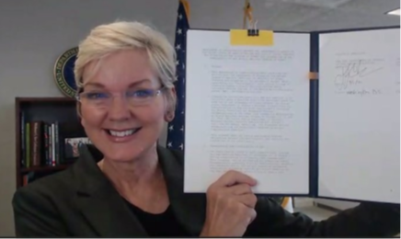
Memorandum of understanding between Norway and USA
In 2021, the Norwegian government signed a memorandum of understanding with USDOE to, in effect, employ the MMC for treatment and immobilising the Norwegian civilian HEU
The national mission of achieving HEU elimination was given jointly to IFE and DSA:
  IFE to implement and operate the MMC technology in Norway
  DSA to regulate the technology and facility

Slide 15
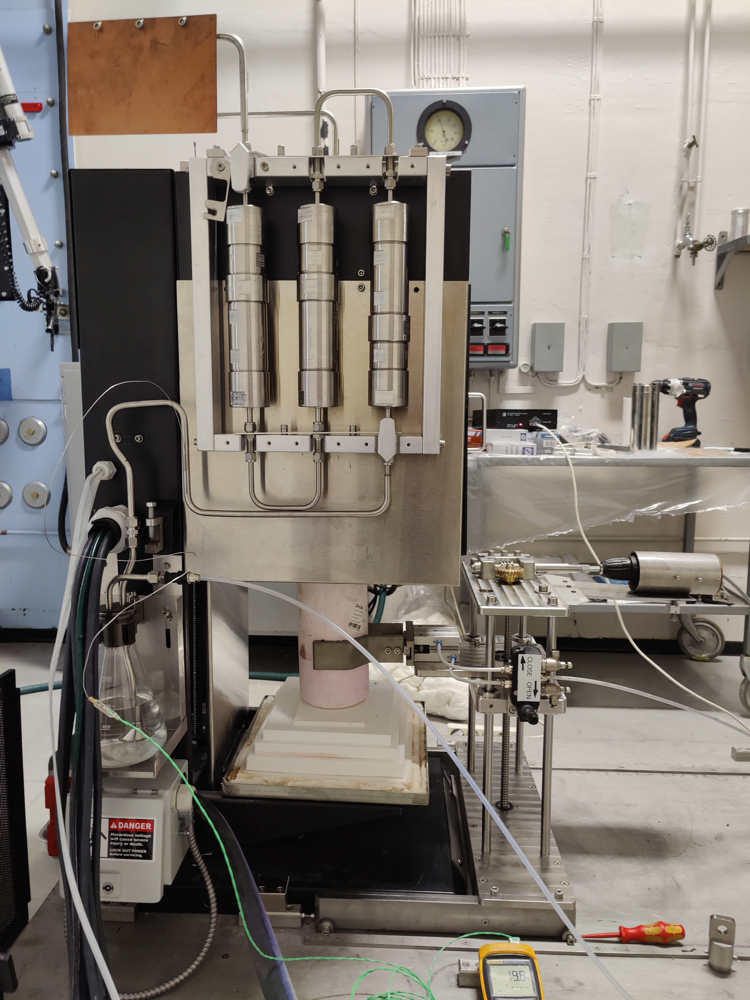
The Pilot Project
The pilot project: Small scale test of melting/downblending ​
Purpose:​
  Validate the melt technology
  Confirm downblending – analysis of the end-product​
  Confirm OGE system efficiency
Pilot Phase 1 – Cold Melts​
  Melting of stainless steel in nested crucibles. ​
  Glass flux added to reduce oxidation​
  Stirring applied. Addition of Tungsten to confirm mixing efficiency​
  Equipment set-up in JEEP-I building​
  8 Cold melts done so far​
  Issues with cracks in crucible resolved (geometry and thermal expansion)​

Slide 16
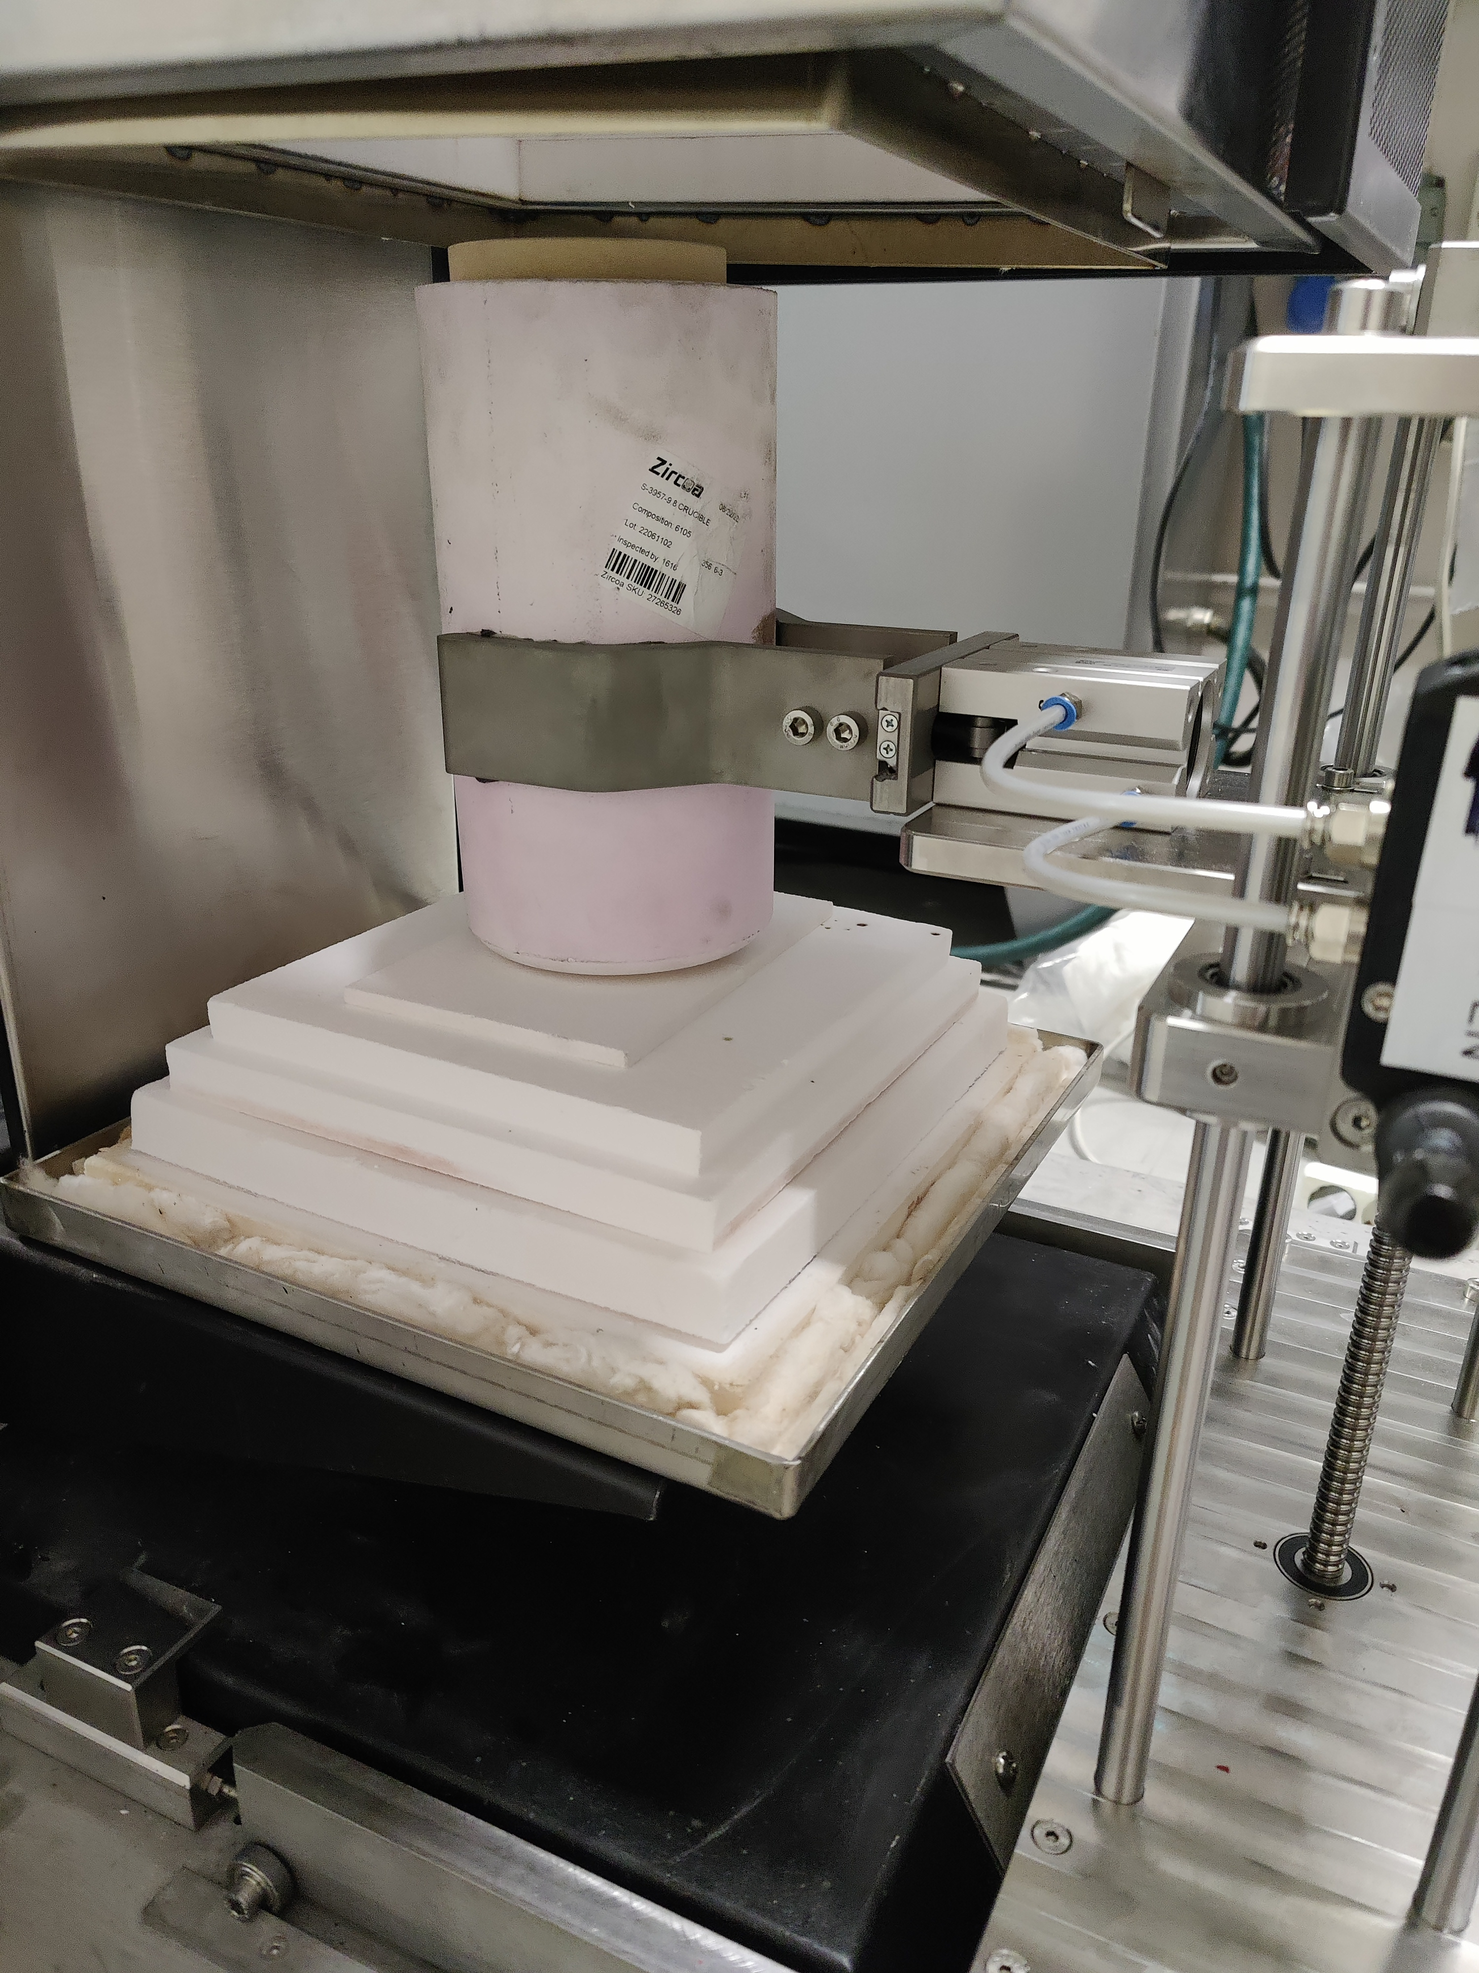
The Pilot Project
Pilot Phase 2 – Hot melts
Melt 1-4 uses non-irradiated HEU-Th​
Melt 5 with irradiated materiale (part of fuel rod)​
Facility modification license granted by DSA
Melt 1 planned Q1 2025​
IAEA and DSA will be invited

Slide 17
The Pilot Project
 | 1 | 2 | 3 | 4 | 5
HEU-Th | 2.7 g | 83.66 g | 83.66 g | 654.25
 | Al-foil | pellets | pellets | powder | Part of rod
U-nat | 13 g | 45 g | 45 g | 520 g
Master alloy (SS316) | 7000 g | 6800 g | 6800 g | 5100 g
YFe | 0 | 150 g | 150 g | 1200 g
Cs, I, Tc | x | x | x | x
Target date | Q1 20215 | Q2 2025 | Q2 2025 | Q2 2025

Slide 18
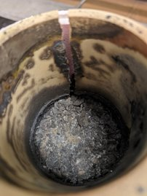
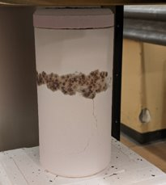
Cold melt experiences
​Melt 2: 11 December 2023, steel cylinder modified​
The TC installed to measure temperature in the melt failed when reaching 1300 C​
Probable cause: Insulation on wire melted​
Both inner and outer crucible exhibited cracks​
Probable cause: The steel cylinder applied pressure to crucible wall due to thermal expansion. The rounding off made to avoid this effect was not sufficient.​
Cracking in later tests due to thermal shock upon rapid cooling

Slide 19
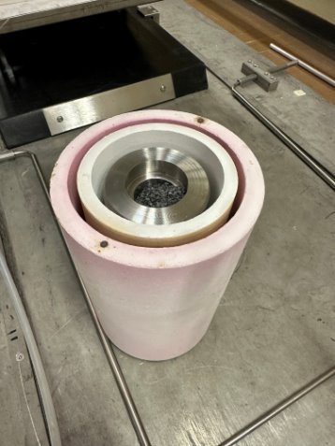
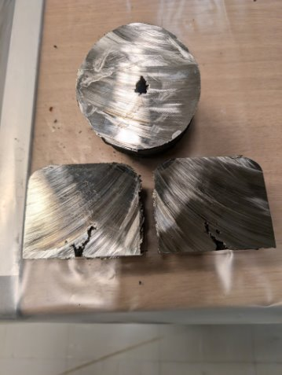
Cold melt experiences
Melt test #7 and #8 (Dec’24)
Improvement of operating procedure after input from HF team
Seal of air intake improved
Extension of cables

Slide 20
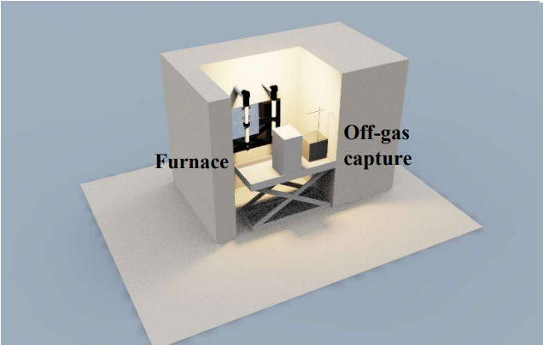
The Pilot Project – way forward
Installation in IFE hotcell
Cold tests
Notification to DSA and IAEA
Hot melt 1
Characterisation and analysis
HOT-CELLE modell (Kiteworks)

Slide 21
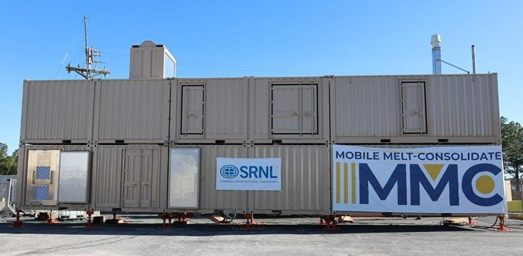
Mobile Melt Consolidate (MMC)

Slide 22
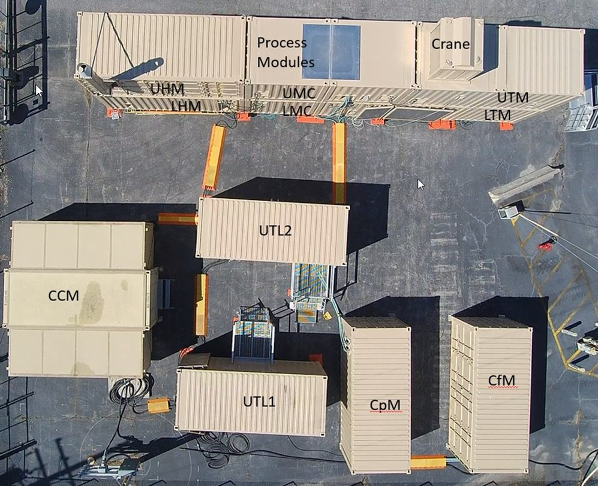
MMC Modules
  CCM: Control Module
  UTL1: Power
  UTL2: Furnace power
  CpM: Cooling liquid pump
  CfM: Cooling fan
  +: Diesel back-up power, Diesel storage tank

Slide 23
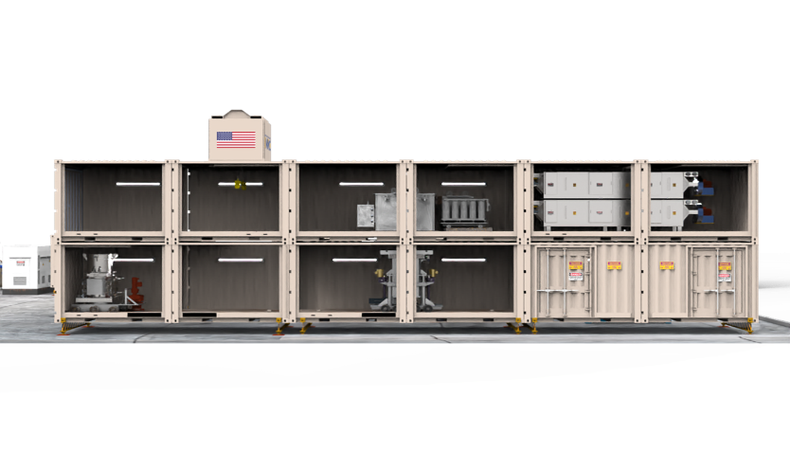

Process modules

Slide 24
2023
PILOT
MMC
Cold Melt
Construction SRNL
Dependencies:
2024
DSA 1 – Facility mod. non-irr. HEU
DSA 2 – Facility mod. irr. HEU
DSA 3 – Concession mod. -Installation and testing
DSA 4 – Concession mod. - Operation
LS build – Permit to set-up MMC on site (Lillestrøm)
Cold Melt SRNL
DSA 1
Hot Melt 1-4
2025
DSA 3
LS build
DSA 2
Construction IFE
Hot Melt 5
Cold Melt IFE
Decommissioning
2026
DSA 4
Full Scale Downblend
2027
2028
Decommissioning

Slide 26
Thank you for your attention!

