Slide 1
Some User' Feedbacks
and
Potential new Demands
Oscar Cabellos (UPM)
Professor Chair in Nuclear Engineering
Universidad Politécnica de Madrid (UPM), Madrid, Spain
E-mail: oscar.cabellos@upm.es

Slide 2
Abstract
The aim of this presentation is to present a collection of personal - failure and success - feedbacks with different nuclear data tools and nuclear data management systems (NDMS).
I hope, this presentation will stimulate the discussion on a broad range of issues in NDMS and retrieval/visualization tools, to identifying potential new features to enhance the usage and the quality of these systems.
A summary of dissemination/training activities with students and users will be presented within the UPM and the EU/ Gre@tPioneer project.
DISCLAIMER
The opinions expressed and arguments employed are those of the author. Without any intention to offend any work done by Institutions/people and/or to anyone.

Slide 3
Motivation of
this presentation…
(My) USER Needs:
What’s the aim of my work?
  comparison of experimental data with evaluated data (new and past releases)
  show evidences (plots, statistics,…) of the better evaluation
  show trends (outliers,…) in ND that may help to understand integral responses
What type of nuclear data?
  cross-sections
  angular distributions
  energy distributions
  differential cross-section
  multiplicities
  …
Then, I need tools to assess the quality (good/bad )
of experimental and evaluated data!!!

Slide 4
1. Main sources of information
1.1 Archiving – new and legacy evaluations
1.2 EXFOR files/formats

Slide 5
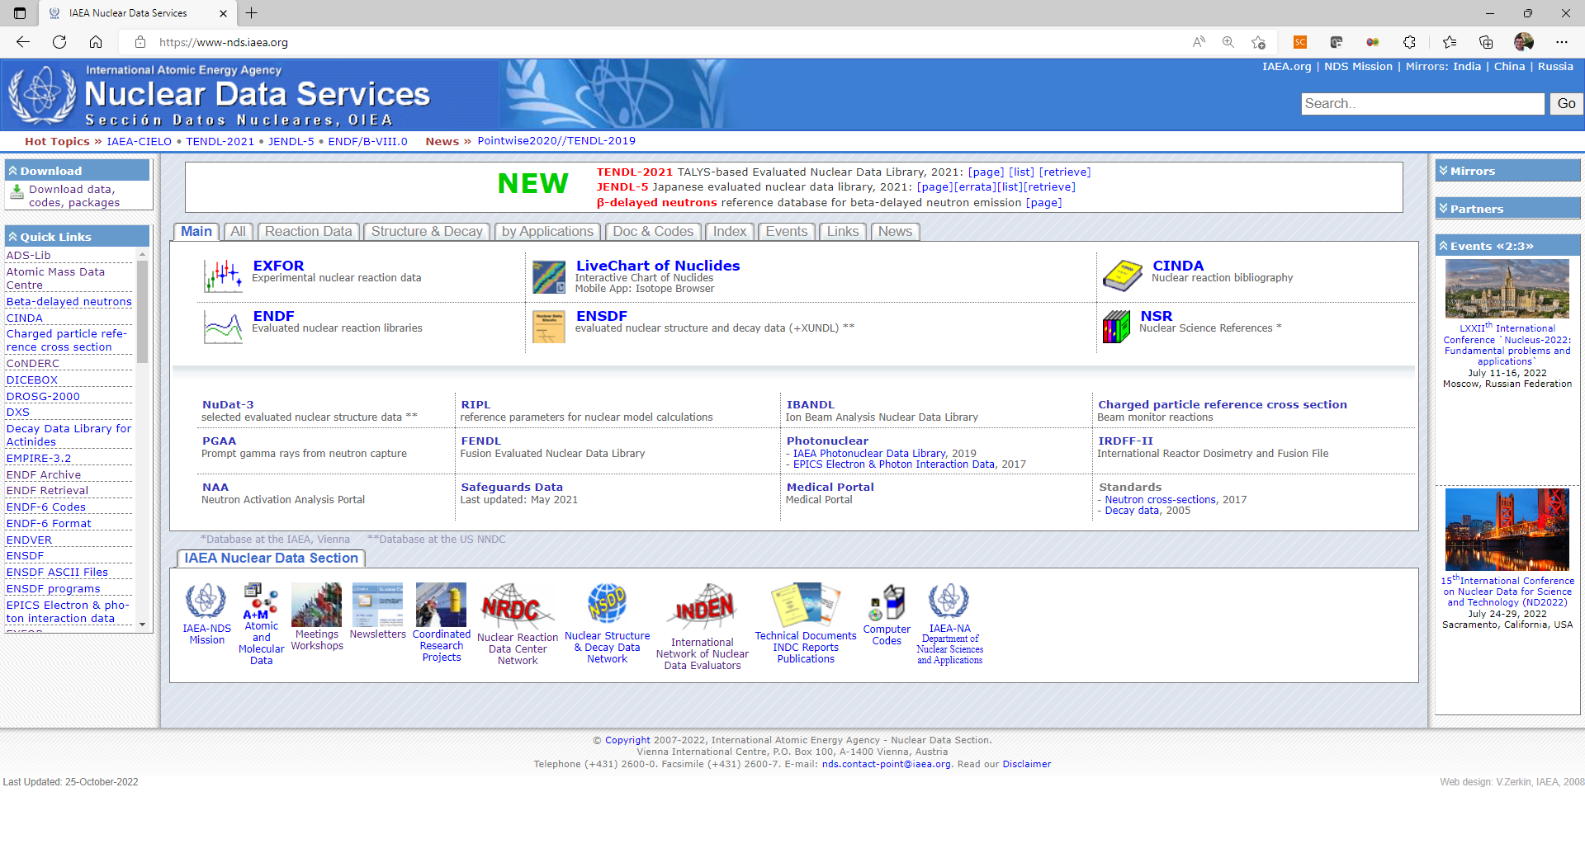
1. Databases:
-> ENDF Archive
IAEA/NDS – ENDF Archive
https://www-nds.iaea.org/public/download-endf/
Q/A: How many “mouse clicks” do you need from IAEA/NDS to find the “ENDF Archive”?

Slide 6
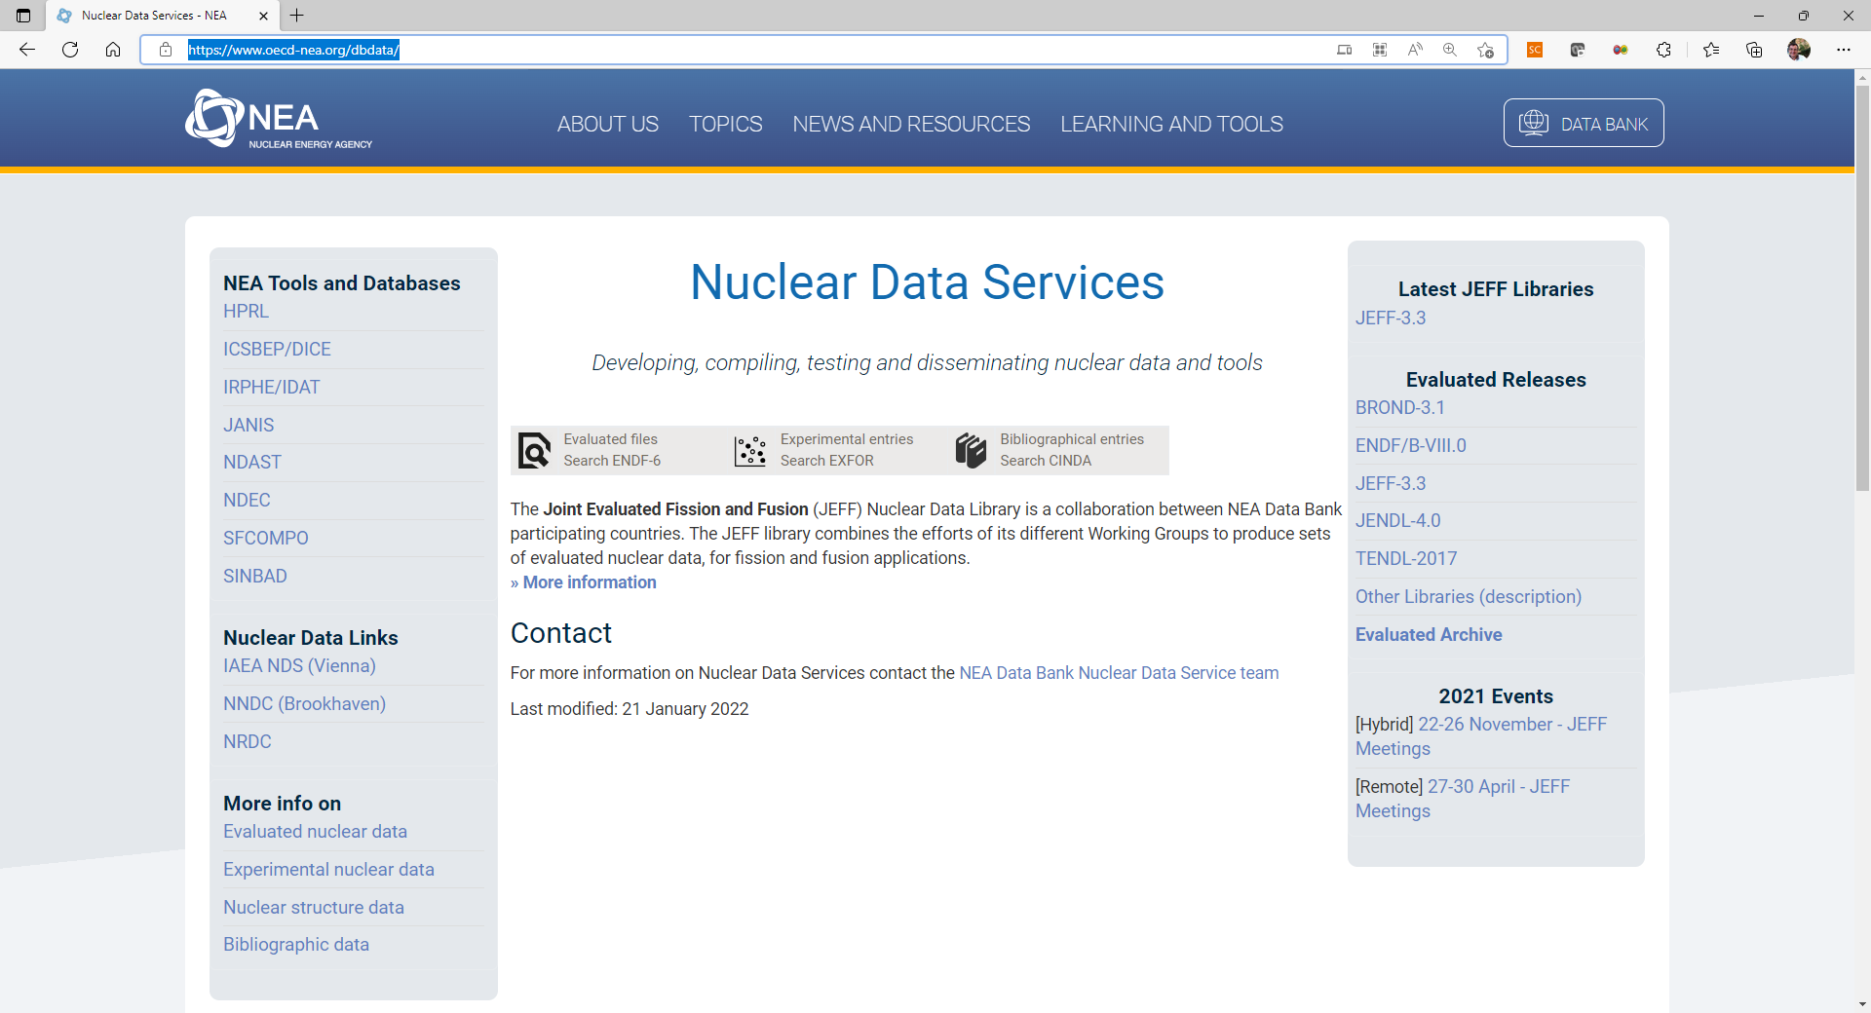
1. Databases:
-> ENDF Archive
OECD/NEA – Data Bank Archive
Q/A: How many “mouse clicks” do you need from OECD/NEA/Data Bank/ND Services to find the “ENDF Archive”?
https://www.oecd-nea.org/dbdata/

Slide 7
1. Databases:
-> ENDF Archive: “different content?”
Q/A: Will you have the same information for the JEFF-3.3 evaluation at https://ww-nds.iaea.org and at https://www.oecd-nea.org/dbdata/jeff/jeff33/ ? YES or NO
At https://www-nds.iaea.org/public/download-endf/ n-induced reactions (562) TSL libraries (20) Spontaneous Fission Yields (3) N-induced Fission Yields (19) Decay data (3852) At https://www.oecd-nea.org/dbdata/jeff/jeff33/ n-induced reactions (562) TSL libraries (20) Processed files in ACE format at different temperatures 293K, 600K, 900K, 1200K, 1500K and 1800K TSL at the temperatures available Neutron activation files Spontaneous Fission Yields (3) N-induced Fission Yields (19) Decay data (3852) Alpha induced reactions Deuteron induced reactions Gamma induced reactions He3 induced reactions Proton induced reactions DPA sub-library for atomic displacement
USERs should be careful searching data in those repositories

Slide 8
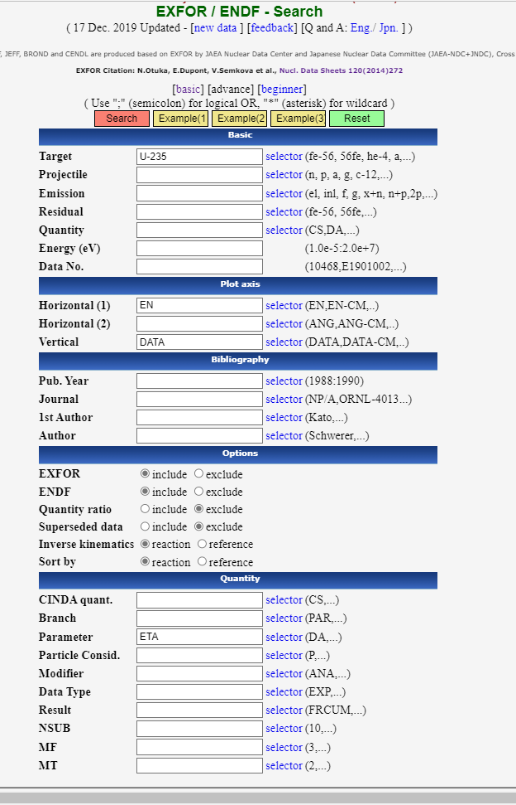
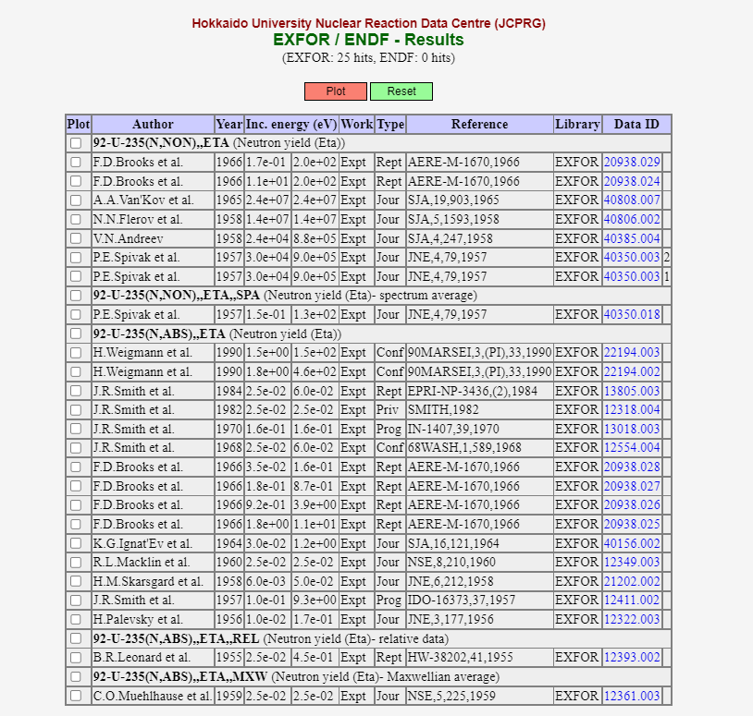
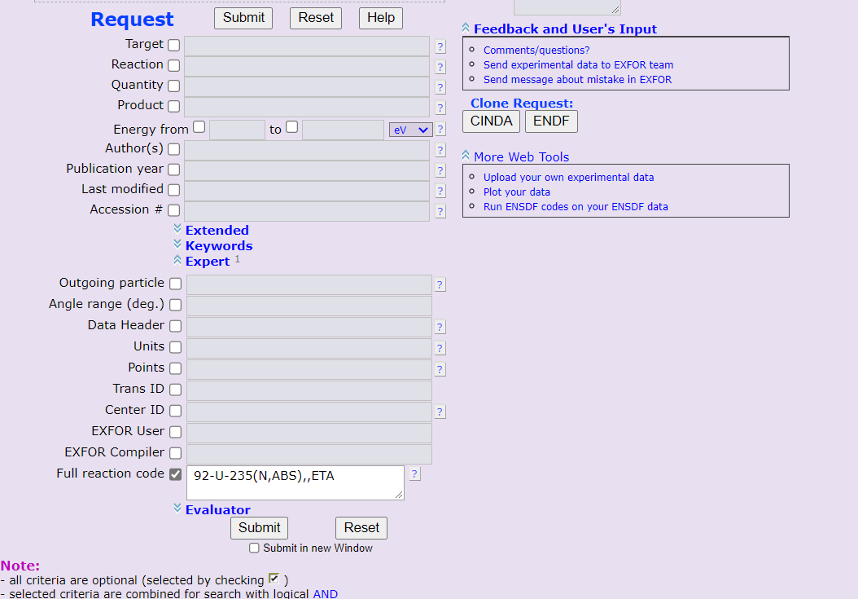
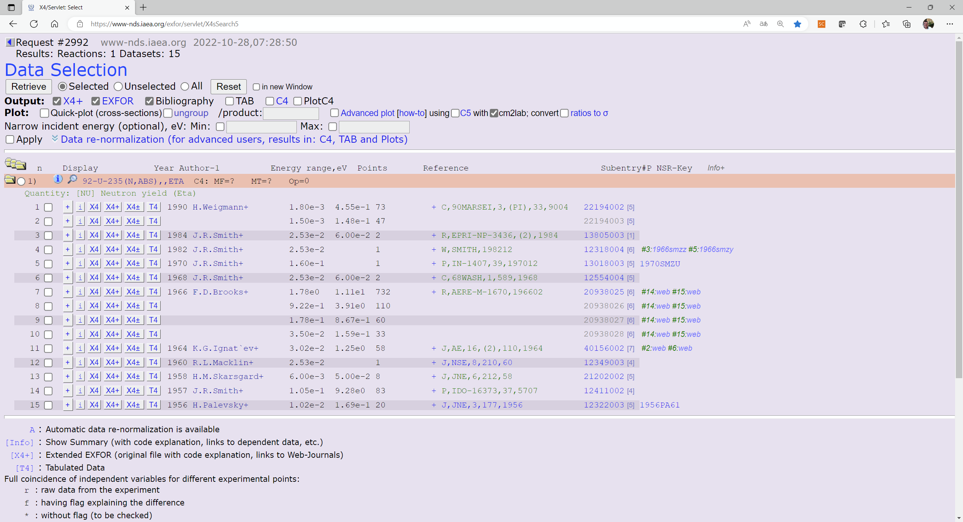
1. Databases:
-> Searching specific data?”
Q/A: Identify EXFOR entries for the eta-value in ²³⁵U. Search ETA data using https://www-nds.iaea.org/exfor/ (select: advance Expert) and/or using https://www.jcprg.org/exfor/ (select: advance user)
Q/A: How many entries do you find using https://www-nds.iaea.org/exfor/? 15 | Q/A: How many entries do you find using https://www.jcprg.org/exfor/ ? 15
Please, can you try it in JANIS (https://www.oecd-nea.org/janis) ? ….

Slide 9
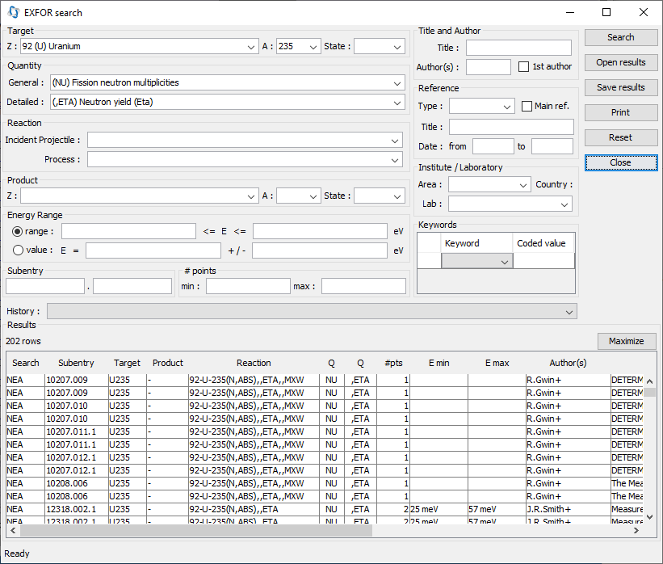
1. Databases:
-> Searching specific data?”
Q/A: Identify EXFOR entries for the eta-value in ²³⁵U. Search ETA data using searching tool in JANIS – “NEUTRON MULTIPLICITIES+ ETA” https://www.oecd-nea/janis/
Q/A: How many entries do you find using https://www-nds.iaea.org/exfor/? 15 | Q/A: How many entries do you find using https://www.oecd-nea/janis/ ? 25
USERs may need additional filtering of data depending on the NMDS

Slide 10
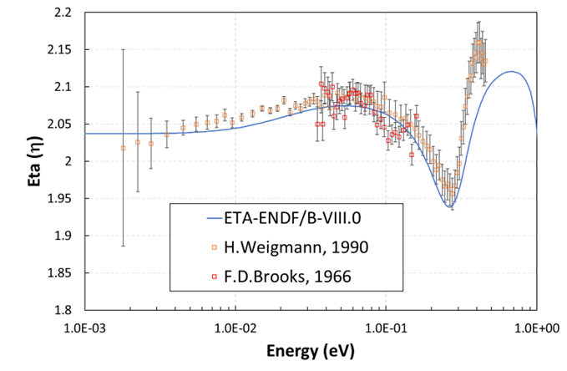
1. Databases:
-> Searching specific data?”
Figure 1. Eta (η) for ²³⁵U for thermal neutron energy.
EXFOR data are obtained using EXFOR retrieval tool for the reaction code: “92-U-235(N,ABS),,ETA.”
PENDF data with:
  PREPRO (see Sublet’s talk)
  JANIS (compute function)
USERs may need additional statistical information EXFOR vs ENDF (errors, χ2, etc…) during the visualization of this plot. Can we provide such statistical information on-the-fly?

Slide 11
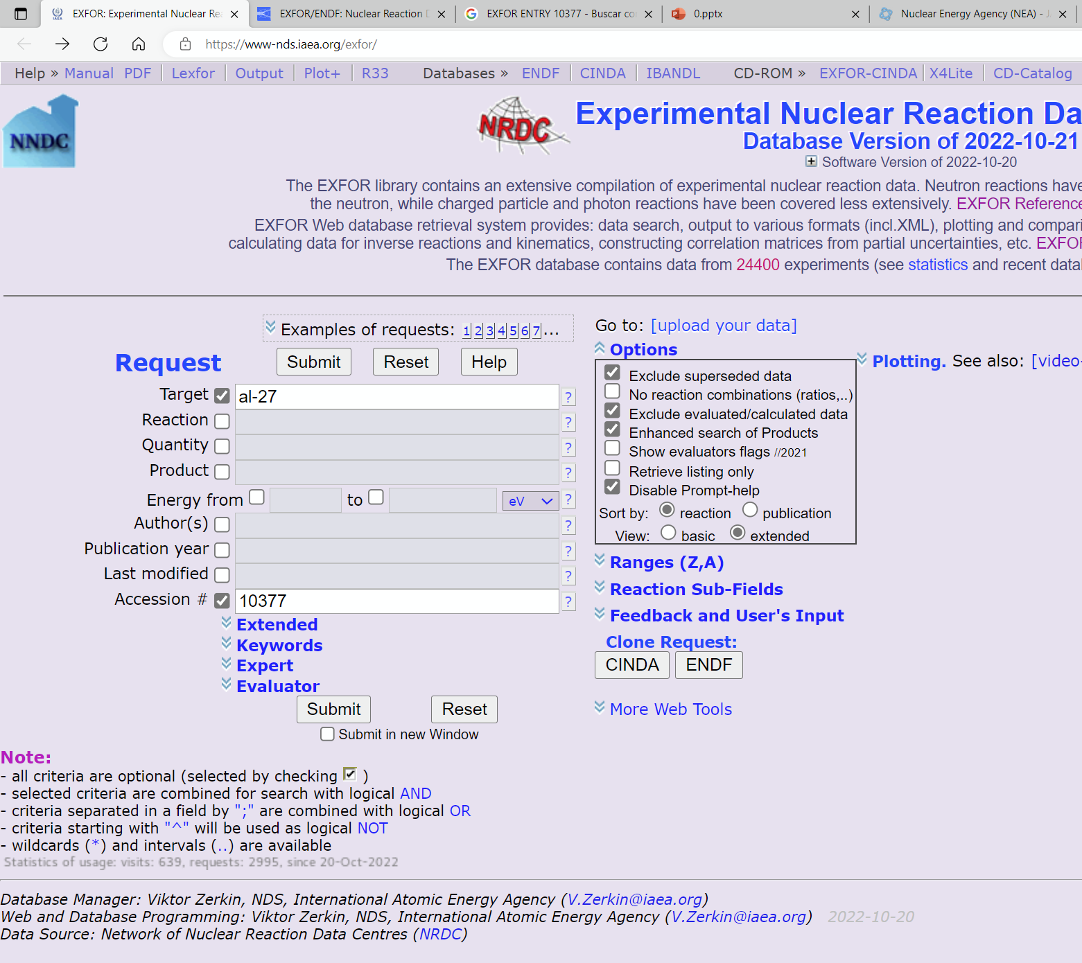
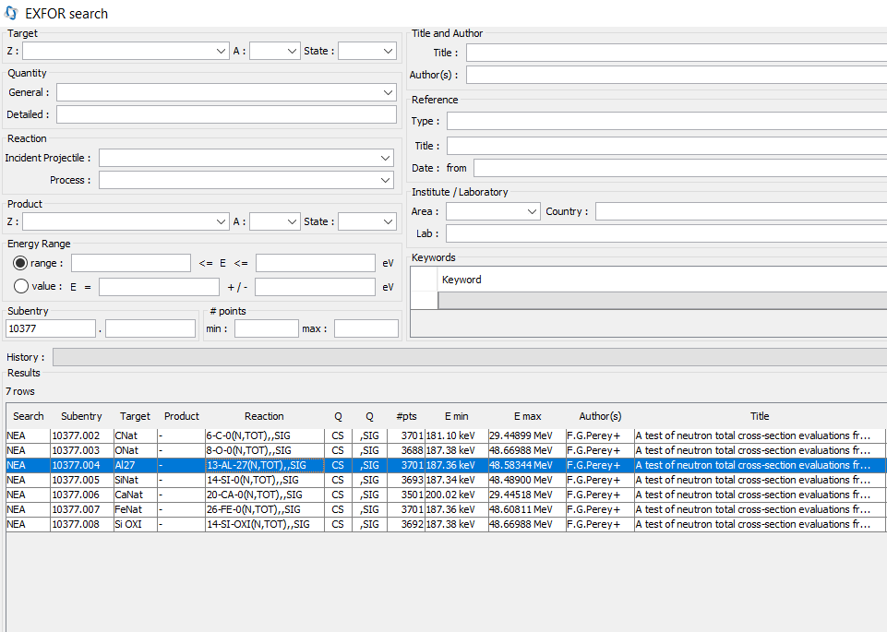
1. Databases:
-> Searching EXFOR raw data?”
Q/A: Search and download: EXFOR “ENTRY-10377” for Al-27 from using https://www-nds.iaea.org/exfor/ or https://www.oecd-nea.org/janis
Q/A: How many experimental point contains this entry using IAEA/EXFOR retrieval system? 3701 Q/A: Are you able to download X4 file using EXFOR retrieval system ? YES | Q/A: How many experimental point contains this entry using JANIS Tool? 3701 Q/A: Are you able to download X4 file using JANIS? NO
USERs may (or may not) find different sources of data in different retrieval systems

Slide 12
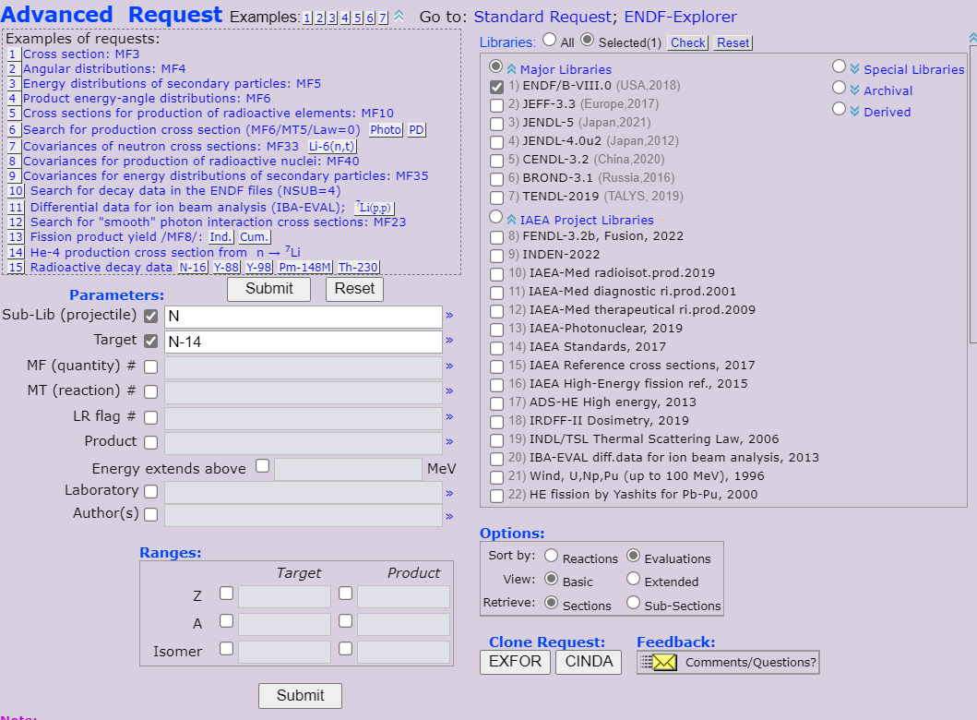
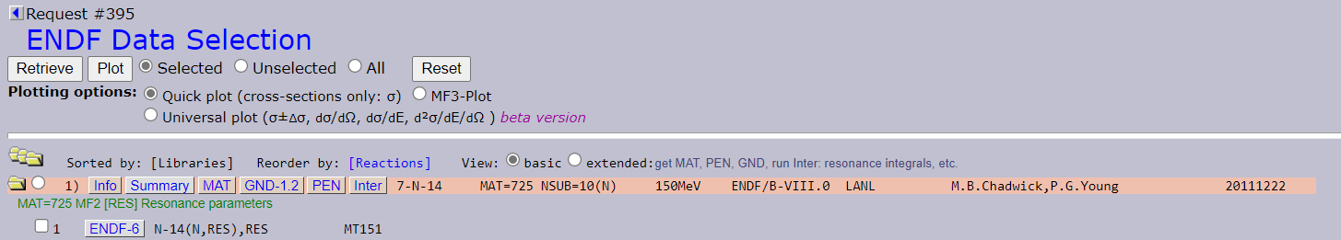
1. Databases:
-> Searching data in different formats?”
Q/A: Explore the different formats of the evaluated. Download libraries in different formats with: https://www-nds.iaea.org/exfor/endf.htm .How many formats do you find?
Downloaded formats….
MAT is ENDF-6 format - original
GNDS format
PENDF is pointwise at 293.16K
INTER is output of INTER code
…
JSON format
Plot
Tabulated – 293K
USERs may find different sources of data (formats) in different retrieval systems

Slide 13
Q&A – “Official” Databases
… should they give some “Disclaimers”?
This is just an example...
Fig 2. Databases and input/output info flow in JANIS
PENDF - Processing data
Official version of processing code (NJOY99.??, NJOY2016.??, PREPRO-20??,…)
Temp. Broadening : 293.6K?, 300K?
EXFOR Database
When do they update new entries?
    Loading finalized TRANS file one-by-one (IAEA/NDS, NNDC, JCPRG)
    Relying on “EXFOR Master File” (NEA/DB-JANIS)
ENDF Database
When do they update major libraries?
    See latest cases: JENDL-5 (2021) , TENDL(2023), and ENDF/B-VIII.1(2024)
… and beta-libraries? it relies on users?!
… Do they say any DISCLAIMER if there are errors?

Slide 14
2. Working with the data
2.1 The JANIS save mode JNS
2.1 The JANIS command line tool
2.2 The X4Pro and JANIS

Slide 15
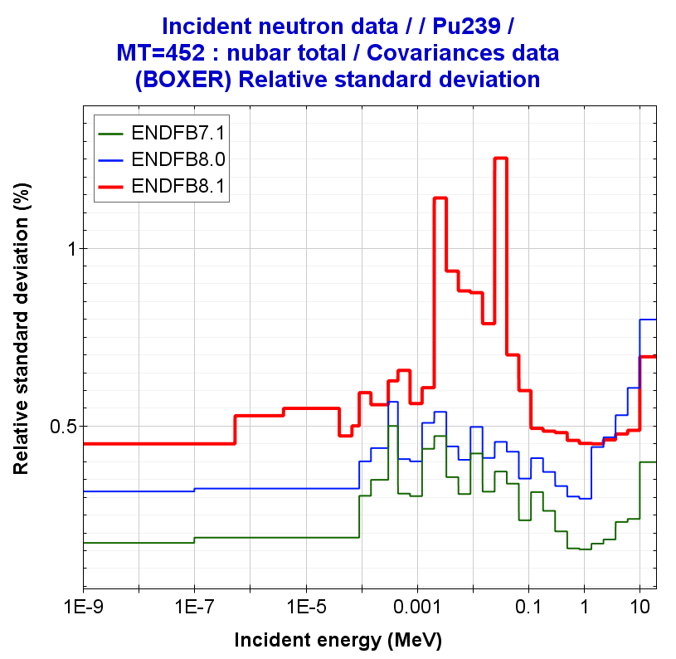
2.1 The JANIS save mode JNS
JANIS save workspace in “*.jns”
EXPORT (PNG, EPS) and SAVE (JNS) : “File > Save...”
...
<data refs="~N~ENDF/B-VII.1~SIG~Al27~MT1~xs">
<layer>
<color>#ff0000</color>
<stroke>1.0|2|0|10.0|null|0.0</stroke>
</layer>
</data>
<data refs="~N~JEFF-3.2~SIG~Al27~MT1~xs">
<layer>
<color>#00ff00</color>
<stroke>1.0|2|0|10.0|null|0.0</stroke>
</layer>
</data>
<data refs="~N~JENDL-4.0~SIG~Al27~MT1~xs">
<layer>
<color>#0000ff</color>
<stroke>1.0|2|0|10.0|null|0.0</stroke>
</layer>
</data>
...
Saving Workspace
It allows automatizing tasks
Figure 3. Relative standard deviation (in %) for the 239Pu(nubar) processed with NJOY2016 in 33 energy groups
JANIS identifiers
Ref.1: O. Cabellos, “ENDF/B-VIII.1 testing covariances”, CSEWG Nov 2024

Slide 16

2.2 The JANIS command line tool…
important for ML users?
JANIS in command-line: “the Great Unknown”
Since JANIS-4.2; Ref: JANIS/ND2016 paper, JEFDOC-2041, JEFDOC-2224 …)
Download: http://www.oecd-nea.org/janis/webstart/Janis_all_jars.zip
Run:
Examples:
Ref.1: Selecting & identifying “activation” data for branching calculations in NEA database for ${}_{}^{196}{Pt\left(n,p\right){}_{}^{196}{Ir}}$ , INDC-SPN-0004( https://nds.iaea.org/publications/indc/indc-spn-0004/ )
  Searching:
  Extracting “activation” data in 1D (X-Y) format:
C:\ java -jar janis.jar -help
C:\ java -jar janis.jar -renderer NEA N JEFF-3.1.2 SIG N15 MT1 xs
C:\ java -jar janis.jar -search NEA covariances inc=n lib=JEFF-3.3 fmt=BOXER
C:\ java -jar janis.jar -search NEA endf z=Pb a=206 inc=n mf=3 mt=102
C:\ java -jar janis.jar -render my_input.jns t0 csv
C:\ java -jar janis.jar -o OUTPUT.txt -list NEA N JEFF-3.3 SIG Pt-196 MT103 activation
covariances section_Ir196q section_Ir196 calc[Yield for Ir196] calc[Yield for Ir196q]
C:\ java -jar janis.jar -o PENDFg.txt -table NEA N JEFF-3.3 SIG Pt-196 MT103 activation section_Ir196
C:\ java -jar janis.jar -o PENDFm.txt -table NEA N JEFF-3.3 SIG Pt-196 MT103 activation section_Ir196q

Slide 17
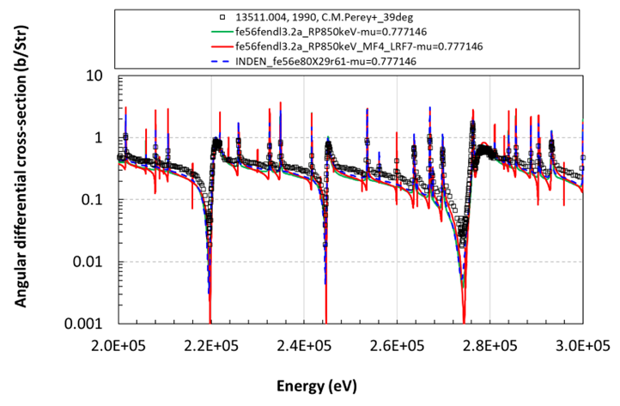
2.3 The X4Pro and JANIS
X4Pro vs JANIS for plotting angular differential cross-sections
The aim is to plot EXFOR + User’s PENDF angular differential cross-sections to assess new LRF7 evaluations:
JANIS:
  is able to plot σ(Ε,Ω) and EXFOR
  is not able to able to plot “EXFOR + PENDF” data in the same plot
  is very easy to plot own PENDF data
X4Pro :
  is able to plot/extract EXFOR data
  is able to plot PENDF data.
  comparison with JANIS showed differences between X4Pro and JANIS (~1/4p). This work allows Viktor Zerkin to correct a mistake in X4Pro!!
  is difficult to upload own data
…
Finally …I was plotting using EXCEL …, :-(
Figure 4. Angular differential cross-section ⁵⁶Fe(n,el) – ang=39º
Ref.1: JEFDOC-2211: Processing files with LRF7 option for the reconstruction of the MF4, pros and cons, Nov 2022
Ref.2: Technical Meeting on Nuclear Data Processing, 29November - 2 December 2022, IAEA Headquarters, Vienna, Austria

Slide 18
3. Formats
3.1 Visualization tools able to read/transform formats
  ACE files: ACELST - Summarize contents of ACE file and convert into PENDF
    https://www-nds.iaea.org/index-meeting-crp/CM_Data_Processing_2015/codes/acelst.for
  WIMSD/E: XnWlup within WLUP project: https://www-nds.iaea.org/wimsd/download/XnWlup.zip
3.2 Visualization of other Evaluated data
  GNDS ↔ ENDL (LLNL) → ENDF6
3.3 Full visualization of the evaluation
  Visualization of MF32(identify issue in MF32/Cu63 –ENDF/B-VIII.1?), MF34
3.4 Checking formats, anomalous values, etc… on-the-fly
  CHECKR, FIZCON,…. MODER …How to interpret warnings/errors? Logs in JANIS?
  Checking processed covariances: definite positive, very high values, etc…
How to use it? Use FRENDY -> perturbation/random n-ACE files -> run n-ACELST to create n-PENDF/WIMSD -> run “n-Burnup” WIMSD5 cases to assess sensitivity/uncertainty in reactivity loss.

Slide 19
4. Data Mining for Machine Learning
4.1 Outlier identification in EXFOR
  Some examples/efforts
4.2 ML to create new evaluations
  Can we implement this in current systems?
    Lack of features in the models with current databases
    Others? … the own ML models

Slide 20
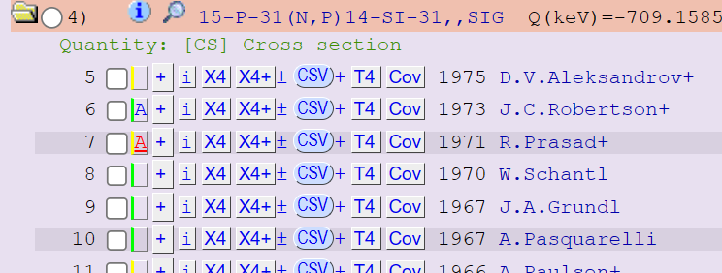
4.1. ML: Outlier detection
Ref.: A. Koning, “EXFOR and outliers”, JEFF meeting on Machine Learning, November 23, 2021, NEA, Paris. JEFDOC-2085
Technique: Traditional outlier detection in EXFOR
Quality scoring
Numerical goodness-of-fit estimators (F, χ²,…)
Graphical estimation
Figure 5. Cross-section ³¹P(n,p)³¹Si
Ref: Arjan Koning, “Statistical verification and validation of the EXFOR database: (n,gamma), (n,n’), (n,2n), (n,p), (n,alpha) and other neutron induced reaction cross sections”, NEA/DB/DOC(2017)1.
Objective: Outlier identification and quality assignment of EXFOR data
- Do we have any change with standards/normalization?
Figure 4. Screen-shot with “Quality Assignment” for cross-section ³¹P(n,p)³¹Si
Ref. Arjan Koning Statistical Verification of EXFOR neutron-ind. Reactions XS (2020)
#flag=R2 #[R]Reviewed #[2] Doubtful
https://www-nds.iaea.org/exfor/

Slide 21
4.1. ML: Outlier detection –
NEA Activities
Ref.: NEA Activities
Between 2011-2017
NEA (2011), “Statistical methods for the verification of databases”, NEA News, Volume 29, No. 1, OECD, Paris.
(2011) “Exploratory Data Analysis of the EXFOR Database”, E. Dupont, A. Koning, N . Otsuka, Journal of the Korean Physical Society, Vol. 59, No. 2, August 2011, pp. 1333∼1336
NEA (2012), “NEA contributions to the worldwide collection, compilation and dissemination of nuclear reaction data”, NEA News, Volume 30, No. 2, OECD, Paris
(2014) “Cross checking of large evaluated and experimental nuclear reaction databases”, ND2014, Nuclear Data Sheets, Volume 120, pp. 277-280.
(2014) EXFOR: Improving the quality of international databases, E. Dupont, News briefs, NEA News 2014 – No. 32.1/32.2
NEA (2014), “Statistical verification and validation of the EXFOR database”, NEA Data Bank Report,
  NEA/DB/ DOC(2014)3, OECD, Paris.
(2016) Verification of the databases EXFOR and ENDF, G. Berton et al., ND2016, EPJ Web Conf, Volume 146, 2017
(2016) JEFDOC-1778, Verification of the EXFOR and ENDF Databases, Gottfried Berton, Nov 2016
(2017) JEFDOC-1909, Checking the resolved resonance region in EXFOR database, Gottfried Berton, Nov 2017

Slide 22
4.1. ML: The Data Mining – An example: EXFOR and Evaluated Data
My own 1D (X-Y Data) generation
./EXFOR.ALL/
  001_H_000.c4
  001_H_001.c4
  …
  100_Fm_257.c4
  (626 Files)
./ENDFB71/
  (423 Files)
./JEFF32/
  (472 Files)
./TENDL-2014/
  (2488 Files)
./JENDL-4.0-2010/
  (406 Files)
RUN: .\python.exe parseC4.py C4-2015-01-07.xc4
“parseC4.py”Created by Caleb Mattoon on 2010-06-28.
start with .xc4 file containing full exfor library in one file
(obtain latest from http://www-nds.iaea.org/x4toc4-master/?C=M;O=D)
sorts the library by projectile, target, MF, MT and incident energy separate directories are created for each projectile, and separate files for each target
RUN: PREPRO (Linear, Recent, Sigma1, Activate, Legend , Fixup, Dictin, Merger, Mixer)
RUN: NJOY (covariances: MODER,GROUPR, ERRORR, COVR)
RUN: Utilities (ang_mu, mu_bar, sixtab, c4sort, lsttab, pltlst)
The set of reactions analysed:
MF3 for all isotopes and natural elements, except MT51 for natural elements
MF3/MT251 (mu-bar) processed with MU_MAR.exe program
MF4/MT2 for isotopes
MF10 for isotopes

Slide 23
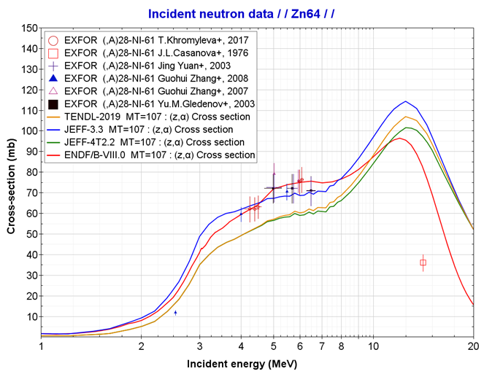
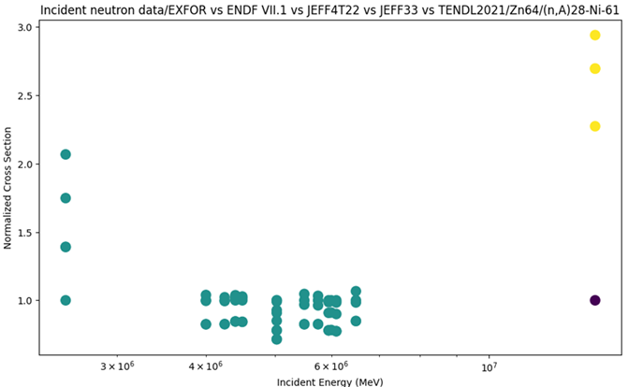
4.1. ML: Outlier detection -
UPM Students
Ref.: M. González-Torre et al., “Feedbacks on Processing and Verification for JEFF-4T2.2”, JEFF Nuclear Data Week April 2023.JEFDOC-224
Technique: Unsupervised ML algorithm - DBSCAN (Density-Based Spatial Clustering of Applications with Noise)
Objective: To identify anomalous data in EXFOR database
Figure 6. Comparison between EXFOR and some recent evaluated data for the ⁶⁴Zn(n,alpha) reaction cross-section as a function of neutron energy
Objective: Outlier identification

Slide 24
4.1. ML: Outlier detection -
UPM Students
Ref.: J.A. Monleon, “Enhancing the EXFOR Nuclear Data Library Using Machine Learning Techniques”, Master Thesis Project, 2023
Review of different Techniques for identifying outliers:
Statistical Techniques: Z-Score or Standard Score, Modified Z-Score Method, QR Method:
Machine Learning: Clustering Algorithms (K-Means or DBSCAN), Anomaly Detection Algorithms, Neural Networks
Preprocessing and Data Mining: “EXFORTABLES” :
data extraction, transformation (scaling)
encoding categorical data, manipulation and grouping the data
preparation to machine learning applications
Objective: To identify anomalous data in “EXFOR proton reactions”
After in-depth review by Expert Judgment (Naohiko Otsuka) …. many “potential” outliers were “false outliers”
Ref.: GitHub EXFOR-Proton Reactions Analysis Repository.:
https://github.com/monleon96/EXFOR-ProtonReactions-Analysis

Slide 25
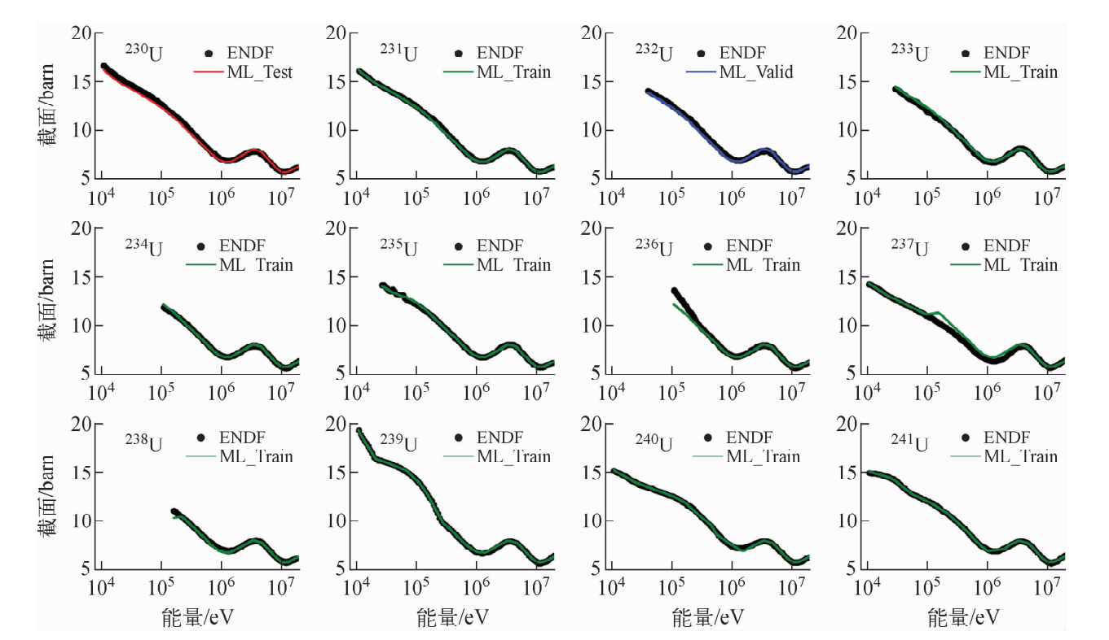
4.2. ML: ND Models –
nuclear reactions models
Ref.: HU Zehua et al. , “Learning Fast Neutron Cross Section by Deep Neural Network”, Atomic Energy Science and Technology ›› 2023, Vol. 57 ›› Issue (4): 812-817.
Technique: Deep neural networks
Objective: Evaluation Uranium files
Results: New U evaluations in the fast energy range
Features assessed in the model
  A, Z
  ENDF data at energy E
  Sn
Can we find this info in current ND Databases?
²³⁰U is used as test
²³²U is used for verification
other 10 U nuclides are used as training data
Figure 7. Calculation results, total cross-sections for U

Slide 26
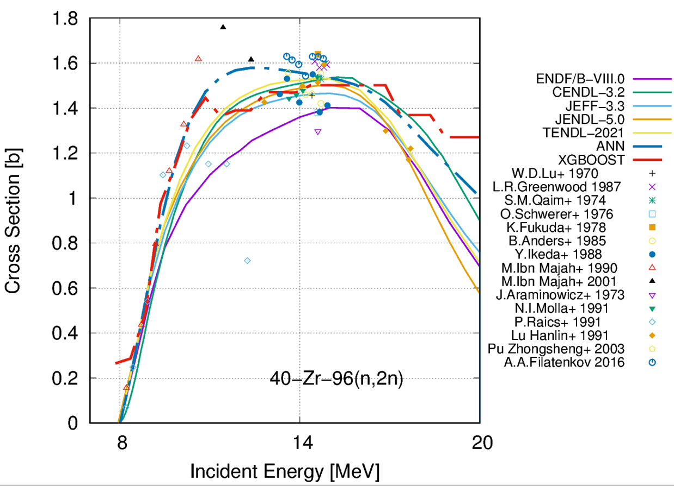
4.2. ML: ND Models –
nuclear reactions models
Ref.: X. Sun et al. , “Study of (n,2n) Reaction Cross Section of Fission Product based on Neural Network and Decision Tree Models”, WONDER 2023, June 5-9, 2023
Technique: Artificial neural network (ANN) and decision tree (DT) models
Objective: To predict the (n,2n) reaction cross section, especially those lack of experimental measurements
Importance of features assessed
  Z, A
  Sn and Sp
  Shell P-Casten factor, the level density
  the pairing correction, and the incident energy
Results: σ_{(n,2n)} = f(incident neutron energy)
“The ML model can predict the nuclear reaction cross section of a large number of nuclei without the requirement for manual and careful parameter optimization.”
Figure 8. Cross-section ⁹⁶Zr(n,2n)
Can we find this info in current ND Databases?

Slide 27
5. New updates and compilations in NDMS
5.1 Compilation of new ENDF Evaluations
The JEFF Mapping tool
5.2. Tool for merging ENDF files
The JANIS Hybrid format
5.3 User updates for visualization
The JANIS Wizard tool

Slide 28
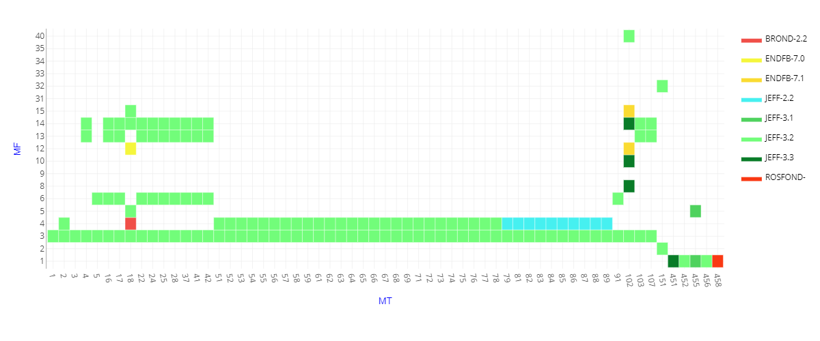
5.1 The origin of evaluated files
Total MFs/MTs | 146
Updated (changed from previous evaluations: JEFF-3.2) | 6
New (included in ENDF/B-VII.1) | 2
Unchanged | 138
Erased (from JEFF-3.2) | 2
The JEFF Mapping tool
Example: Explore the map of information of 95-AM-241g/JEFF-3.3
https://www.oecd-nea.org/dbdata/jeff/jeff33/Maps.html
This is very important to guaranty that legacy work is kept!! e.g. MF12/MF14 and MF15 in JEFF files

Slide 29
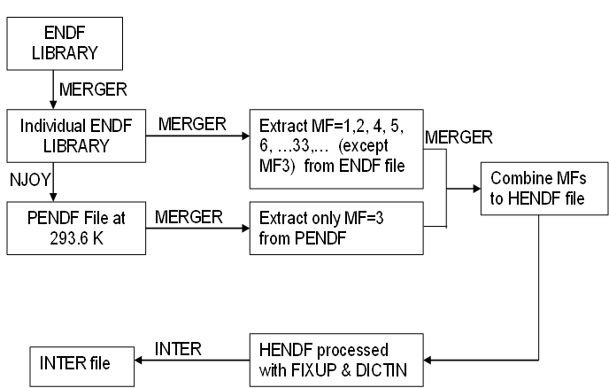
5.2 User’s updates for visualization:
Processing into JANIS format…
Processing ENDF/B-VIII.1 into JANIS format:
  HENDF + INTER + BOXER
Figure 2. Example of input deck to process in PENDF format
moder /tape20 from MERGER
20 -31
reconr /Reconstruct XS data
-31 -32
' PENDF tape ' /
9437 2 /
.005 /
' MAT=pu239 ENDF Library:JENDL-5.0upd' /
' Processed NJOY2016-UPM,2023 '
0/
broadr /Doppler broaden XS
-31 -32 -33
9437 1 /
.005 /
293.60
0/
thermr / Add thermal scattering data
0 -33 -34
0 9437 12 1 1 0 0 1 221 0
293.60
0.005 10.0
unresr
-31 -34 -35
9437 1 1 0 /
293.60
1.0e+10 /
0/
heatr / Add heating kerma and damage energy
-31 -35 -36 40/
9437 7 0 0 0 2/
302 303 304 318 401 403 407 /
heatr / Add heating kerma and damage energy
-31 -36 -37 41/
9437 6 0 0 0 2 0 1/
442 443 444 445 446 447 /
gaspr /Gas production
-31 -37 -38
moder
-38 26
stop
tape20 = ENDF file
=====================
Figure 1. Flowchart of processing JANIS database from ENDF tapes
NJOY2016.76
BOXER file
MF31/32/33/34 and MF35
VERSION 7.01

Slide 30
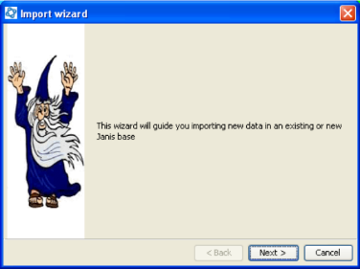
5.3 User’s updates for visualization:
The JANIS Wizard tool
Processing ND libraries into JANIS format:
JEFF-4T?, JENDL-5.0-upd, …
ENDF/B-VIII.1
  Logs reported when importing JANIS database
  # - HENDF: Hybrid format ENDF+PENDF including KERMA and DAMAGE cross-sections
  # - INTER
  # - BOXER: covariances MF31, MF32/MF33, MF34 and MF35
  Download at the following links – “UN-OFFICIAL JANIS Databases”:
    ENDF/B-VIII.1 with BOXER in 33g: https://drive.upm.es/s/mzGbRoZt5CBw20G
    password: janis
  “Readme.txt” file, it explains how to download and import the database in JANIS
Import WIZARD tool: Use the “Database > Import Wizard”
Steps:
- Use “JANIS toolbar -> Database –> Load” function
- Set “.h2.db file” to select the downloaded “h2.db” file
- Set “Root Folder” to the folder where the “h2.fb” is located
(Leave the other default options are they are)

Slide 31
6. Dissemination and training
6.1The EU/Gre@tPionner Project
6.2 The UPM/INGENIA - CDIO Course

Slide 32
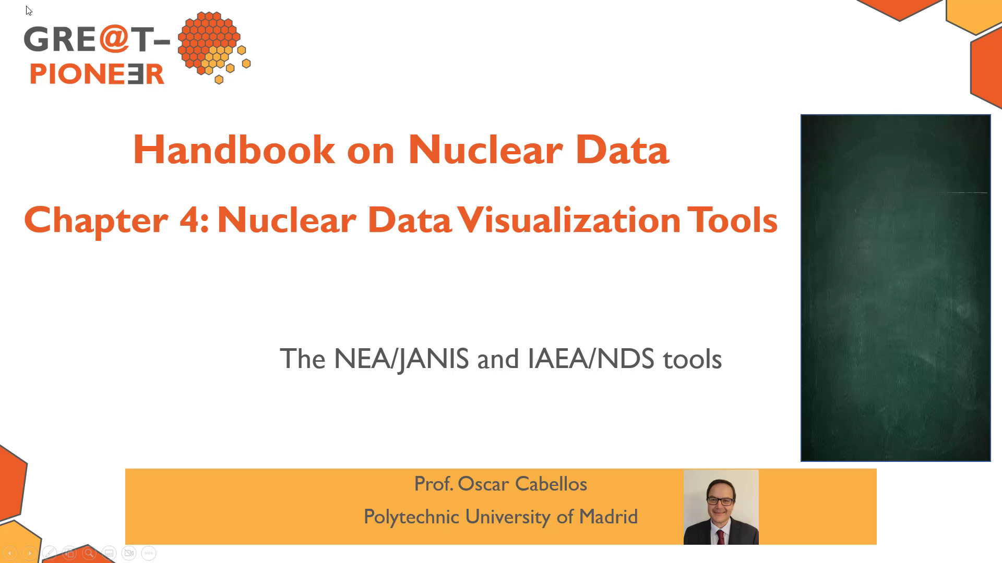
6.1 Dissemination and training:
The EU/Gre@tPionner course (https://great-pioneer.eu/)
Handbook on ND - Content
Chapter 1: Nuclear Data for Nuclear Applications (pp.1-70)
Chapter 2: The Experimental Nuclear Data (pp.1-43)
Chapter 3: Evaluated Data Libraries (pp. 1-55)
Chapter 4: Nuclear Data Visualization Tools (pp.1-24)
Chapter 5: Tools for Processing Nuclear Data (pp.1-84)
Chapter 6: Benchmarking and Validation (pp.1-35)
Chapter 7: Sensitivity Analysis and Uncertainty Quantification (pp. 1-27)
Chapter 8: Nuclear Data Adjustment Methodologies (pp. 1-21)
Chapter 9: Nuclear data needs (pp. 1-16)
Chapter 10: Overview of International Organizations (pp.1-13)
Quizzes/tests/videos + exercises
Methodology: Active Learning + Flipped Classes + Hybrid – onsite/online (3 ECTS – 30h + 30h)

Slide 33
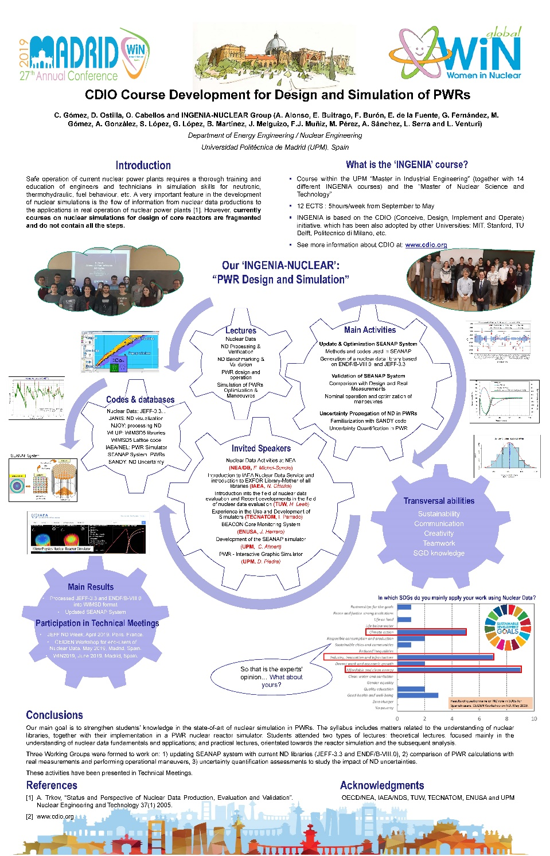
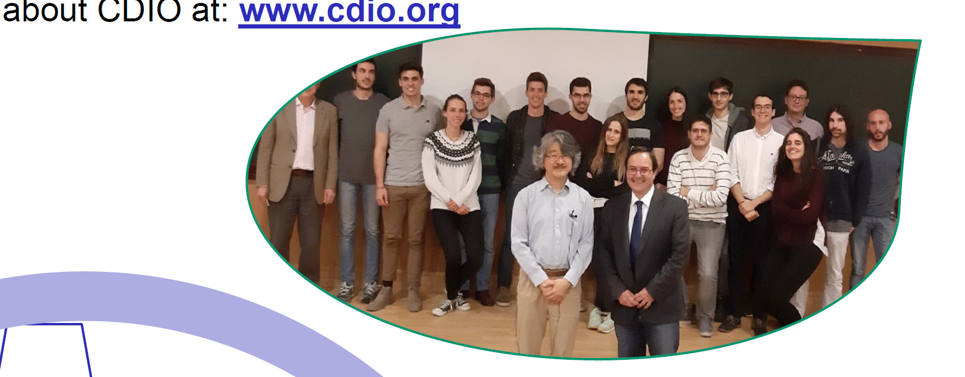
6.2 Dissemination and training:
“INGENIA/NUCLEAR” at the UPM since 2018
Methodology: CDIO – Conceive + Design + Implement + Operate (https://cdio.org/)
12 ECTS - 5h/week – 2 semesters
TOPICS “… from nuclear data to nuclear applications”
2018-2019: Design and simulations of PWRs
2019-2020: … ATFs
2020-2021: … ML
2021-2022: … SMRs
2022-2023: … Nuclear Data – P&V – B&V
2023-2024: … Space Applications
2024-2025: …Medical Applications

Slide 34
7. Conclusion

Slide 35
My Christmas wishes
for the nuclear data community…
The “manipulation” of ENDF data
ENDFtk (see Haeck’s talk)
ENDFparser_py (see Schnabel’s talk)
FRENDY (see Tada-san’s talk)
T. Kawano, DeCE: the ENDF-6 data interface and nuclear data evaluation assist code, Journal of Nuclear Science 439 and Technology 56 (2019) 1029–1035. doi:10.1080/00223131.2019.1637797
  facilitates all ENDF-6 data file manipulations, for example, add two data sections, renormalize data, add/delete data point,
  convert model calculation results into ENDF-6 format,
  reconstruct pointwise cross sections from resonance parameters,
  convert ENDF-6 formatted data file into more human friendly format.
  https://github.com/toshihikokawano/DeCE
Would we be able in a short-term playing as Evaluators to create “Frankenstein” files? with no–errors merging different data?

Slide 36
My Christmas wishes
for the nuclear data community…
The “compilation” of EXFOR data
Would we be able in a short-term playing as EXFOR consultants to create “EXFOR” files? with no–errors and/or lack of crucial experimental information?
EXFOR compilation of thermal neutron scattering data
Consultants’ Meeting, November 2015
The purpose of the meeting is to discuss the key characteristic of the thermal neutron scattering measurement and evaluation techniques to provide guidelines for compilation of such data in the EXFOR data library.
EXFOR Data in Resonance Region and Spectrometers' Response Function
Consultants’ Meeting, October 2013
Prepare templates that include the information required to be compiled in EXFOR and submit such information for different type of experiments and facilities based on the developed templates
“In an idyllic world any experimentalist could be an EXFOR compiler (at least with a 90% of the entry file completed with default templates).” O. Cabellos, Nov. 13th, 2024.
… in practice very very few experimentalists are doing it… how to increase these numbers?

Slide 37


Acknowledgments
This work is part of the APRENDE project (Addressing PRiorities of Evaluated Nuclear Data in Europe) that has received funding from the European Union’s HORIZON-EURATOM
under grant agreement No. 101164596

