Slide 1
From ENSDF to NuDat:
Search, Filter and Visualize Nuclear Data
Donnie Mason
National Nuclear Data Center
Elizabeth Ricard-McCutchan
Alejandro A. Sonzogni
11/12/2024

Slide 2
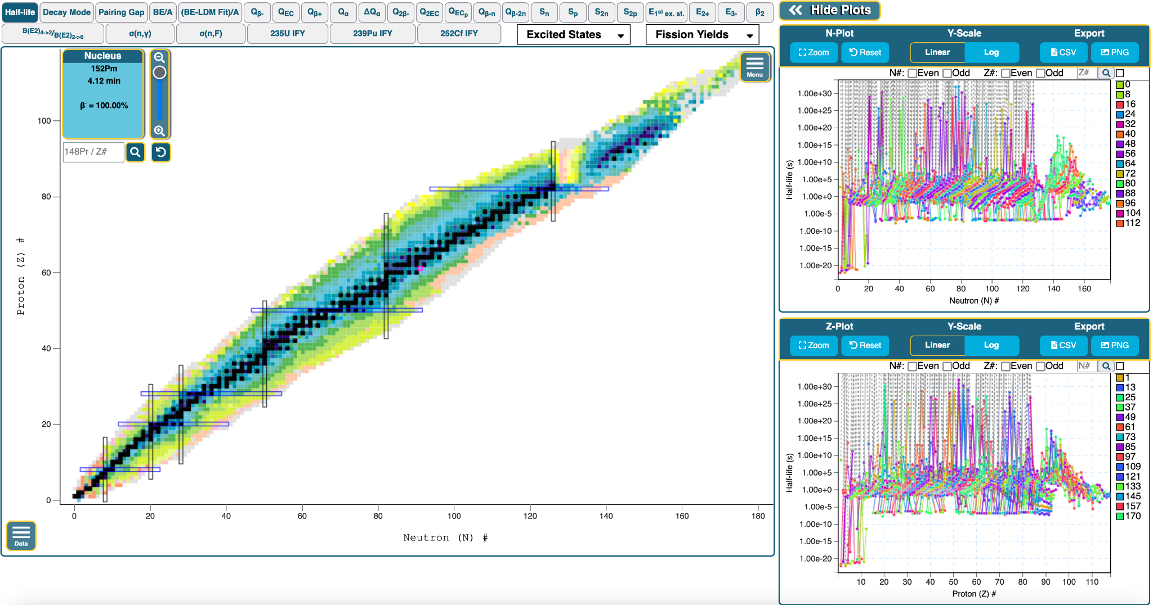
NuDat Overview
NuDat is the main application used to query and visualize nuclear data from ENSDF
Search and visualize:
Wallet Cards
Half-life
Decay Modes
Ground/Isomeric level energy, Jπ
ENSDF
Excited States
Β₂
Atomic Mass Evaluation
Q-Values/Separation Energies
ENDF
Fission Yields
Cross Sections
www.nndc.bnl.gov/nudat

Slide 3
NuDat 3.0
NuDat 3.0 supports exploring nuclear data using responsive visualizations
Fully interactive nuclide chart and 1-D plots
Smooth pan and zoom using intuitive gestures

Slide 4
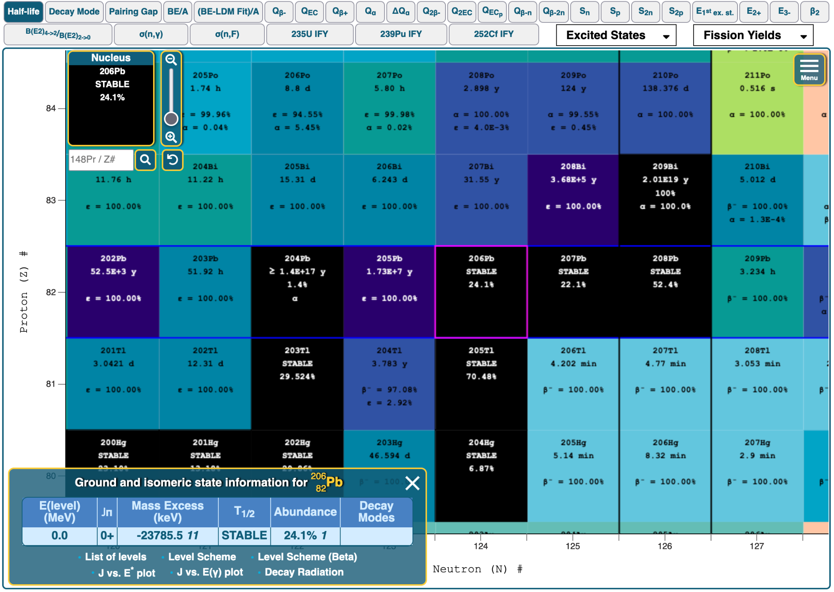
NuDat 3.0
NuDat 3.0 supports exploring nuclear data using responsive visualizations
Features:
Interactive chart of nuclides
1-D neutron and proton plots
Data Filtering
Export Data (CSV, PNG, Link)
Additional Resources

Slide 5
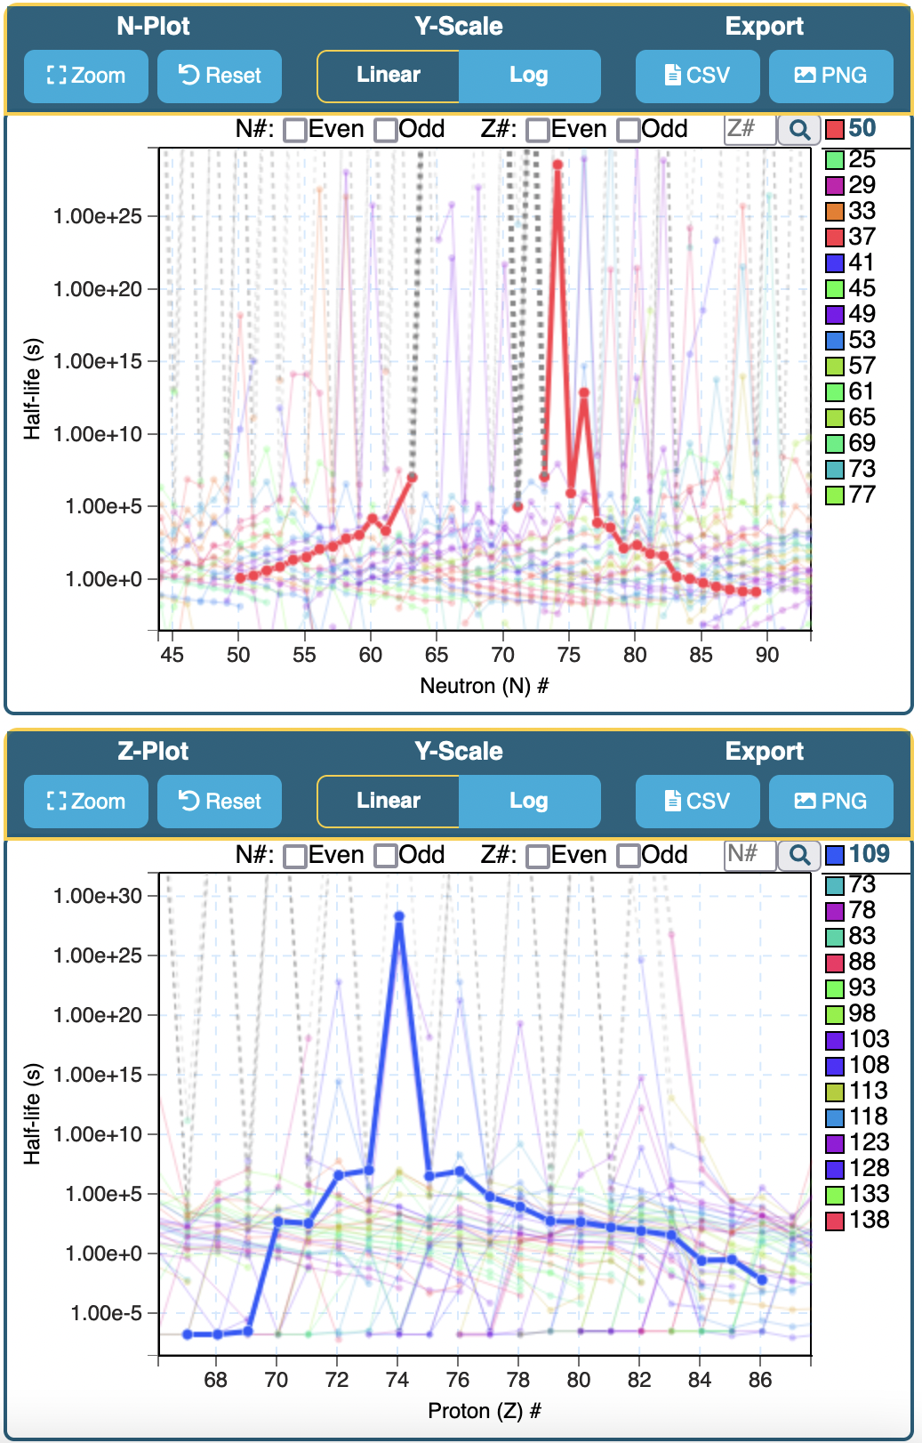
NuDat 3.0
NuDat 3.0 supports exploring nuclear data using responsive visualizations
Features:
Interactive chart of nuclides
1-D neutron and proton plots
Data Filtering
Export Data (CSV, PNG, Link)
Additional Resources

Slide 6
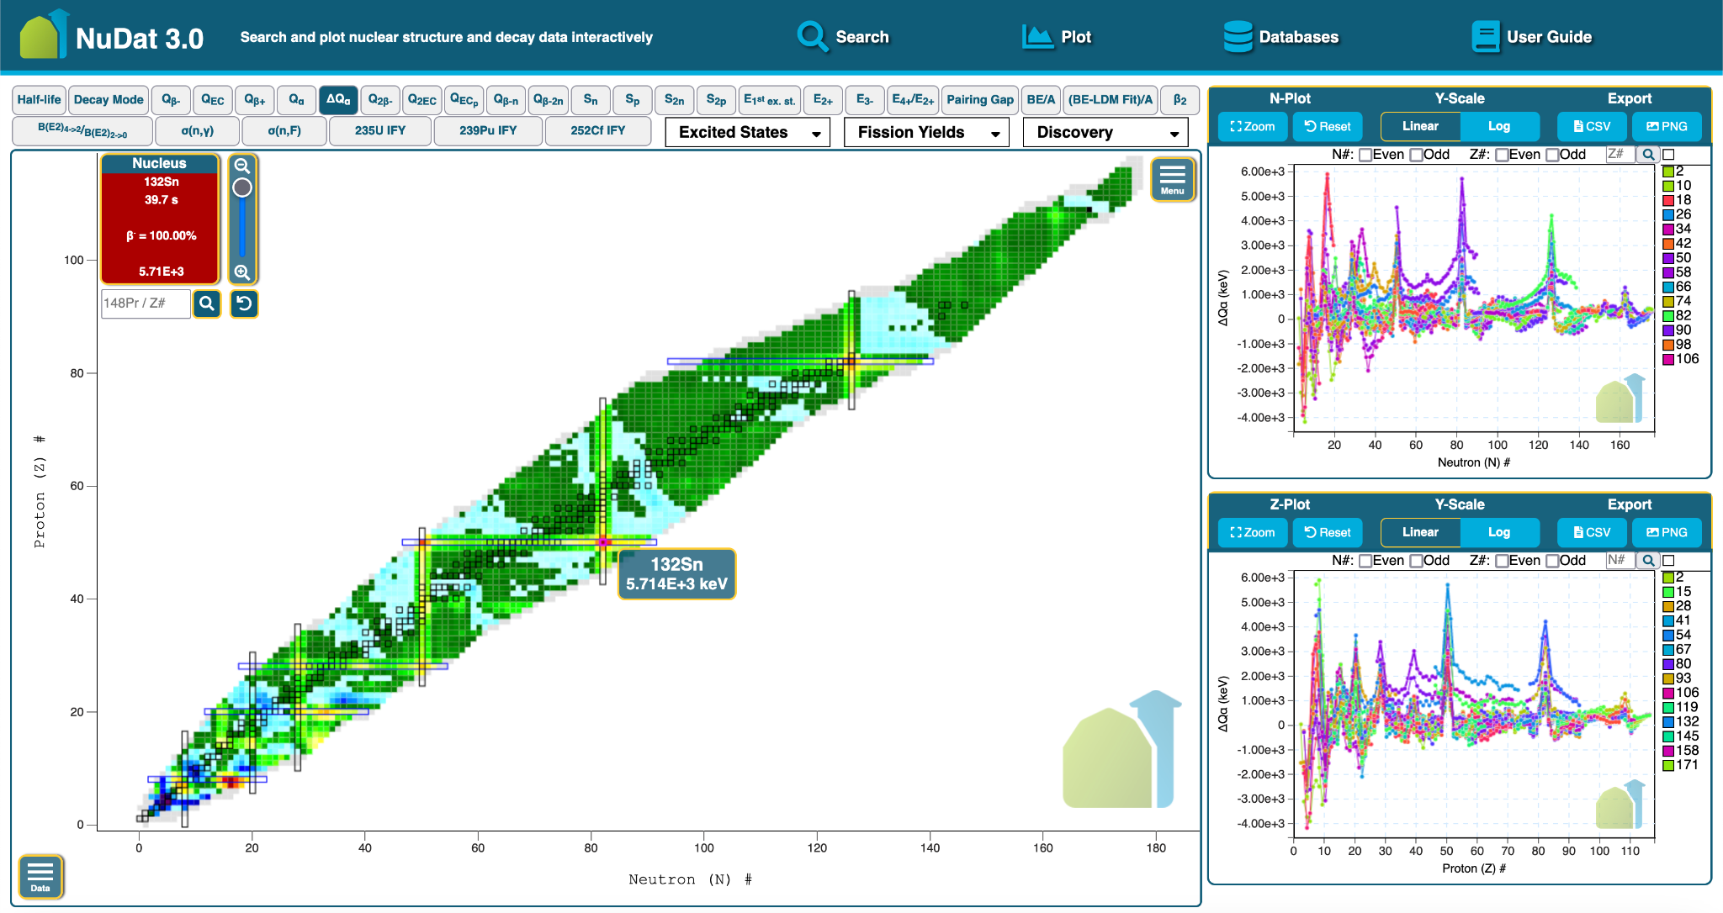
Synchronized 1-D Plots
ΔQ_{α}=0.5 x ( Q_{α}(Z+2, N+2) - Q_{α}(Z, N) ), in keV.
Optionally sync plots:
1-D plots update to the current view of the chart of nuclides
Visualize patterns in regions of chart, such as peaks

Slide 7
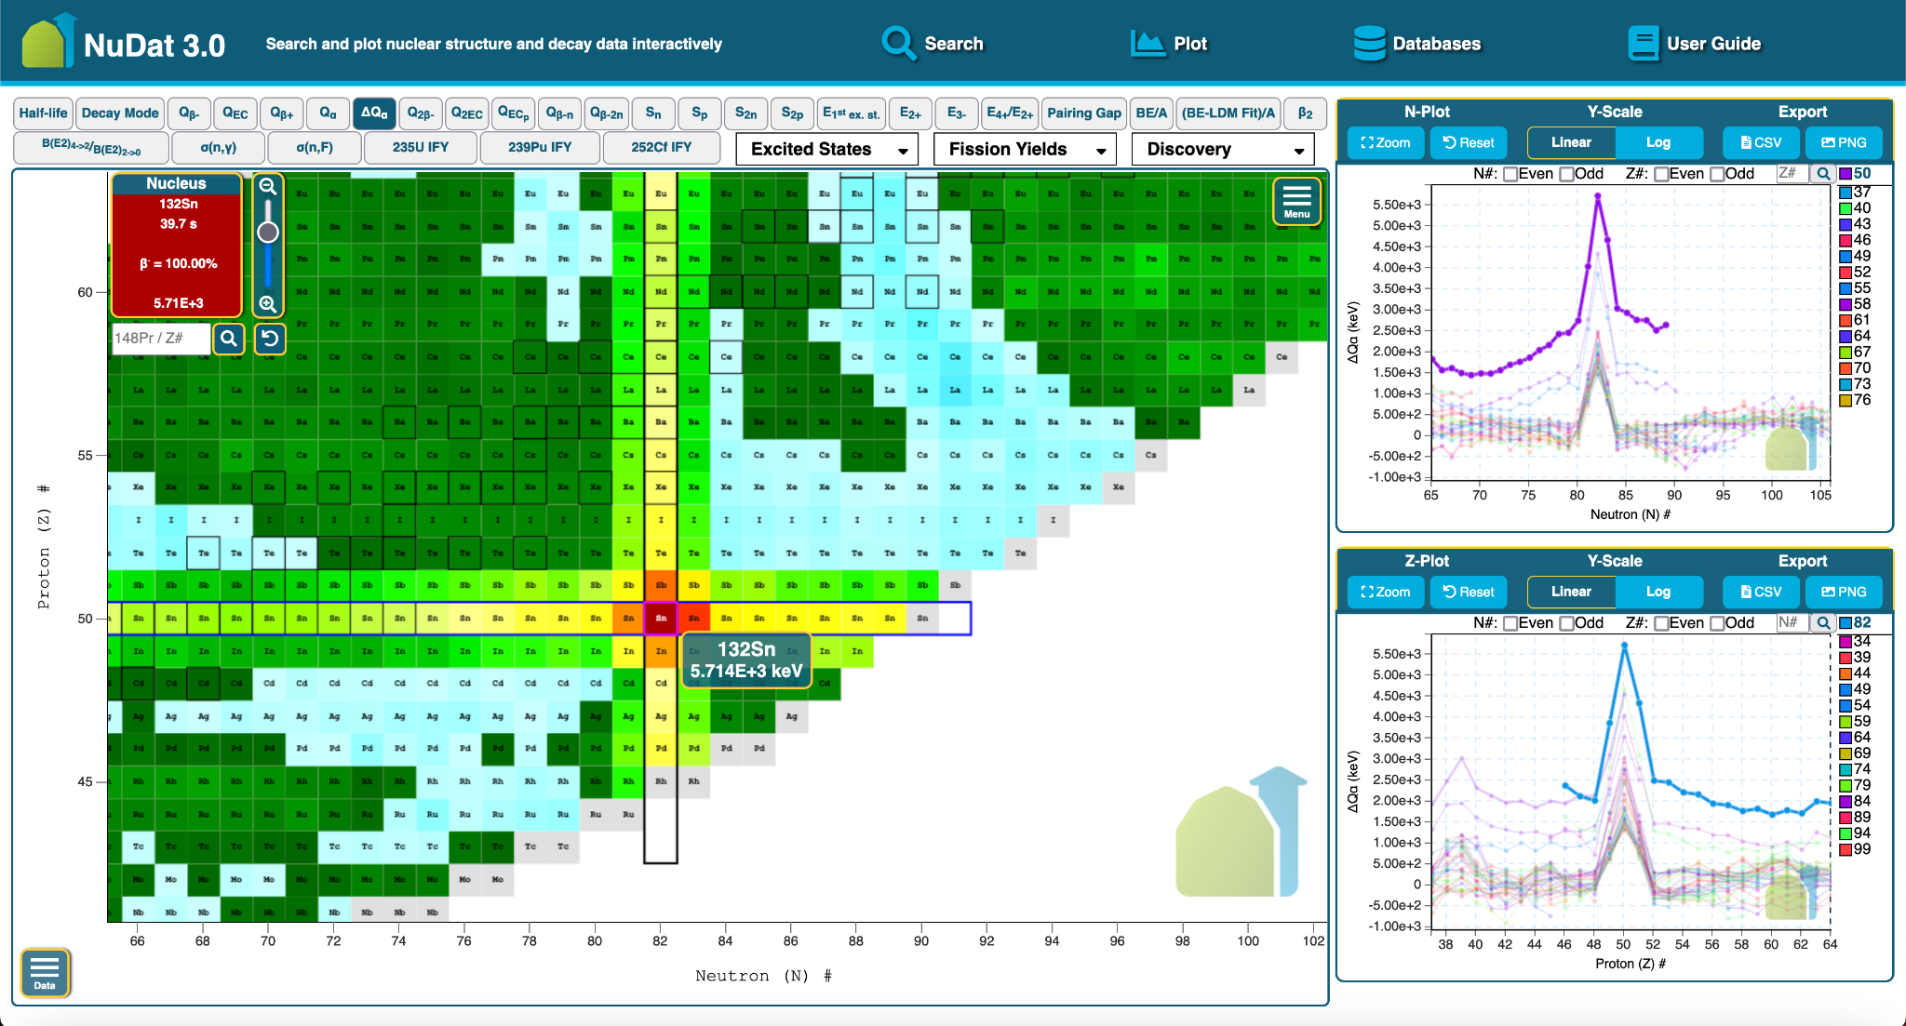
Synchronized 1-D Plots
ΔQ_{α}=0.5 x ( Q_{α}(Z+2, N+2) - Q_{α}(Z, N) ), in keV.
Optionally sync plots:
1-D plots update to the current view of the chart of nuclides
Visualize patterns in regions of chart, such as peaks

Slide 8
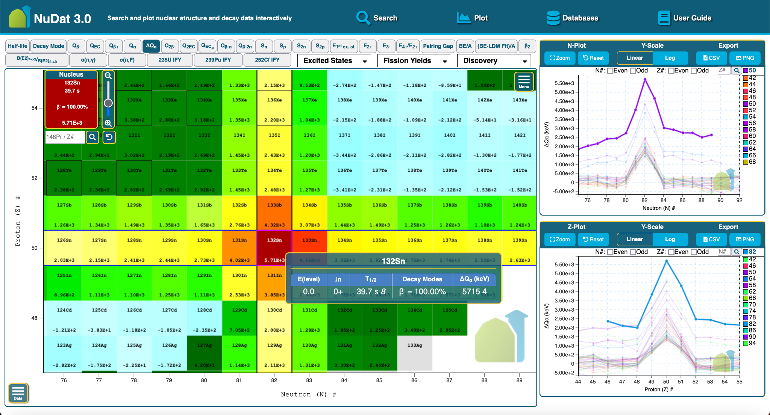
Synchronized 1-D Plots
ΔQ_{α}=0.5 x ( Q_{α}(Z+2, N+2) - Q_{α}(Z, N) ), in keV.
Optionally sync plots:
1-D plots update to the current view of the chart of nuclides
Visualize patterns in regions of chart, such as peaks

Slide 9
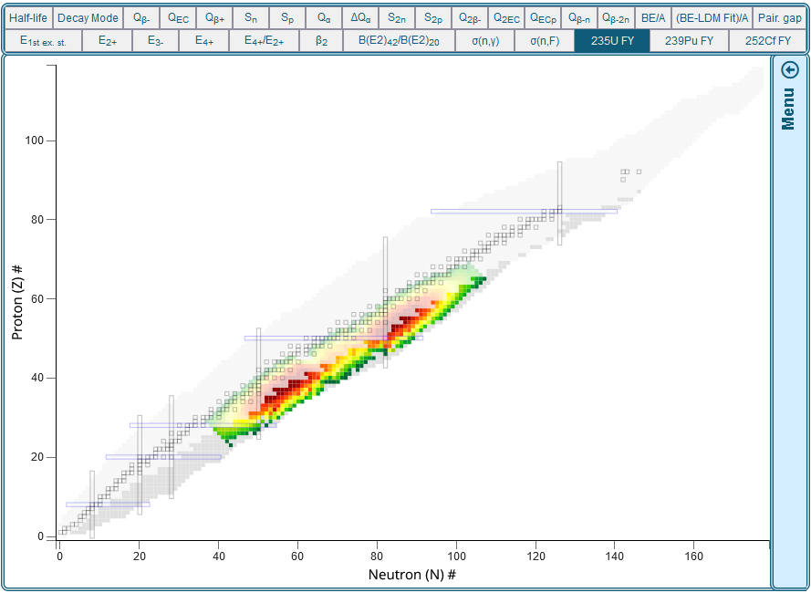
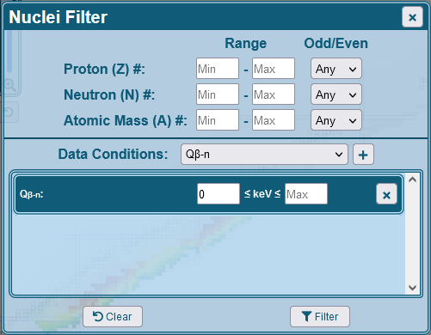
NuDat 3.0
NuDat 3.0 supports exploring nuclear data using responsive visualizations
Features:
Interactive chart of nuclides
1-D neutron and proton plots
Data Filtering
Export Data (CSV, PNG, Link)
Additional Resources

Slide 10
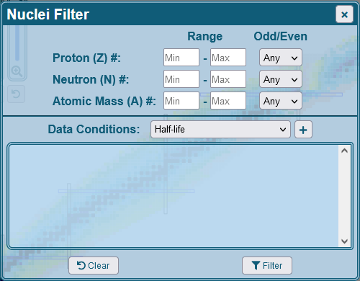
NuDat Data Filter
Customizable filter:
Number of protons
Number of neutrons
Atomic mass
NuDat observables
Half-life
Decay mode
Q-Values
Separation energies
And more

Slide 11
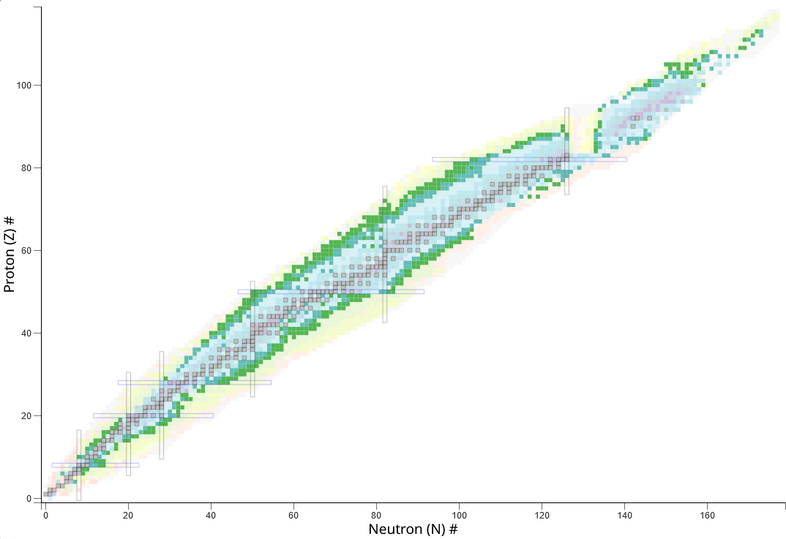
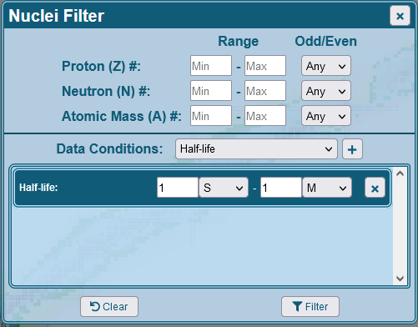
NuDat Data Filter
Half-life
Nuclides with half-life from 1s to 1m

Slide 12
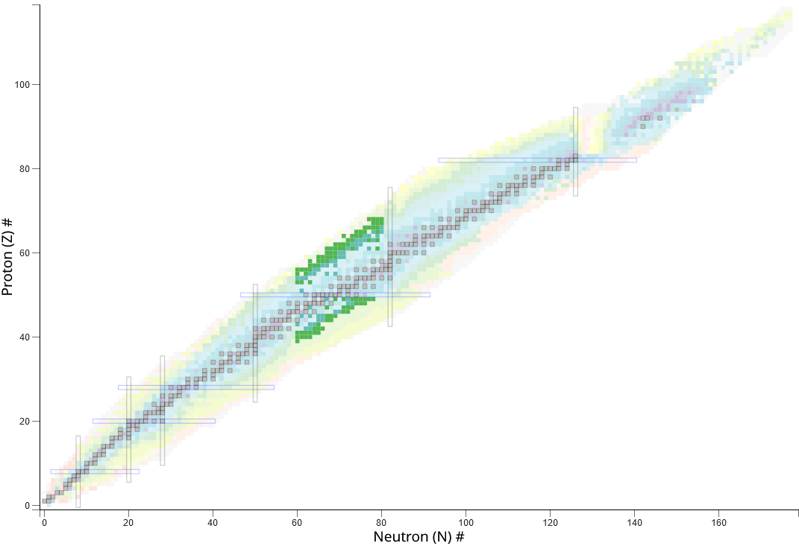
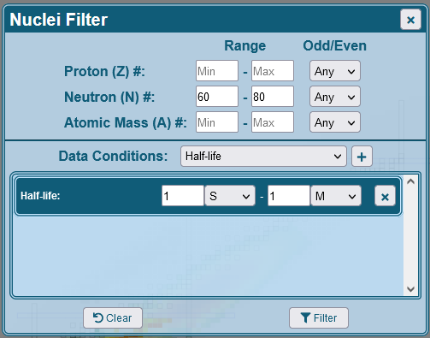
NuDat Data Filter
Half-life
Nuclides with half-life from 1s to 1m
+
# of neutrons 60-80

Slide 13
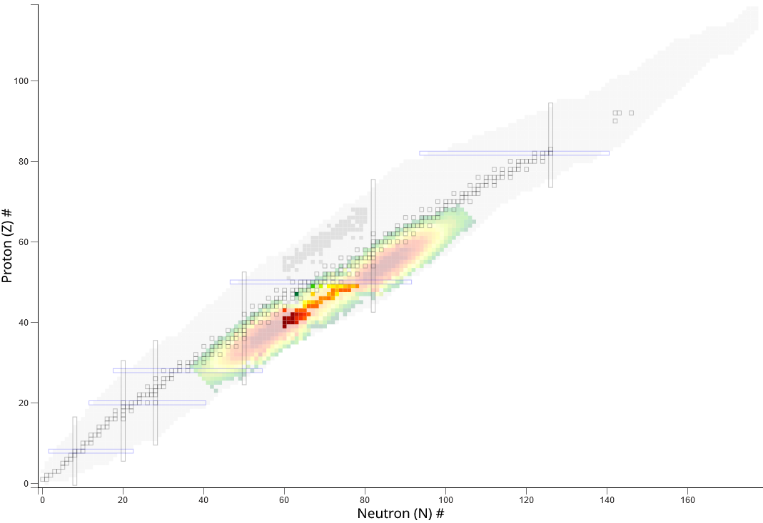
NuDat Data Filter
Thermal Neutron Fission Yields for 235U
Nuclides with half-life from 1s to 1m
+
# of neutrons 60-80

Slide 14
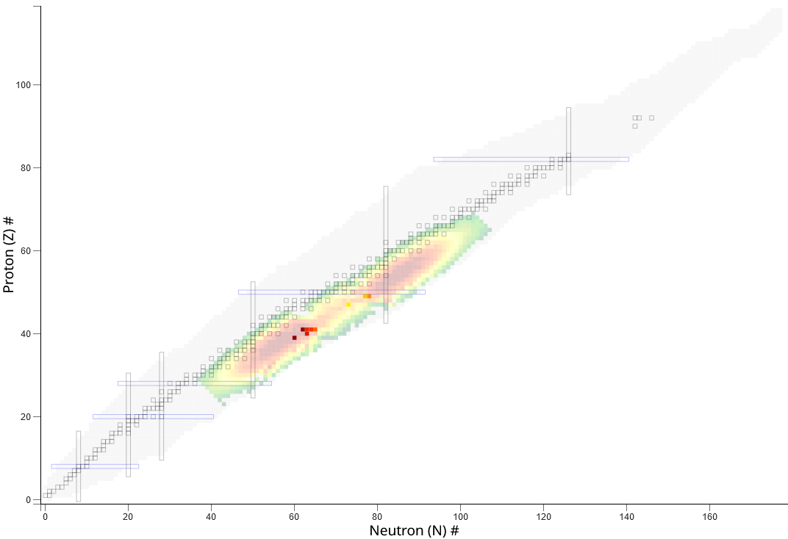
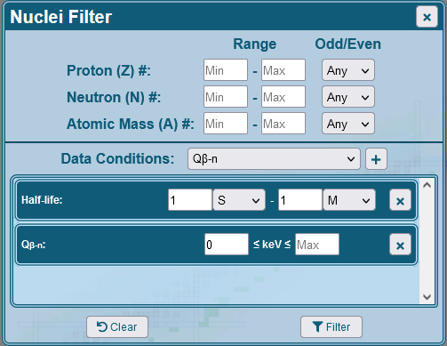
NuDat Data Filter
Thermal Neutron Fission Yields for 235U
Nuclides with half-life from 1s to 1m
+
# of neutrons 60-80
+

Slide 15
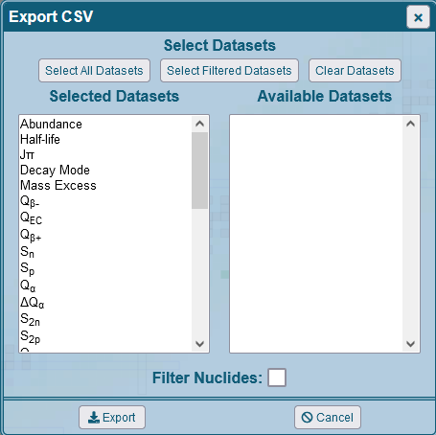
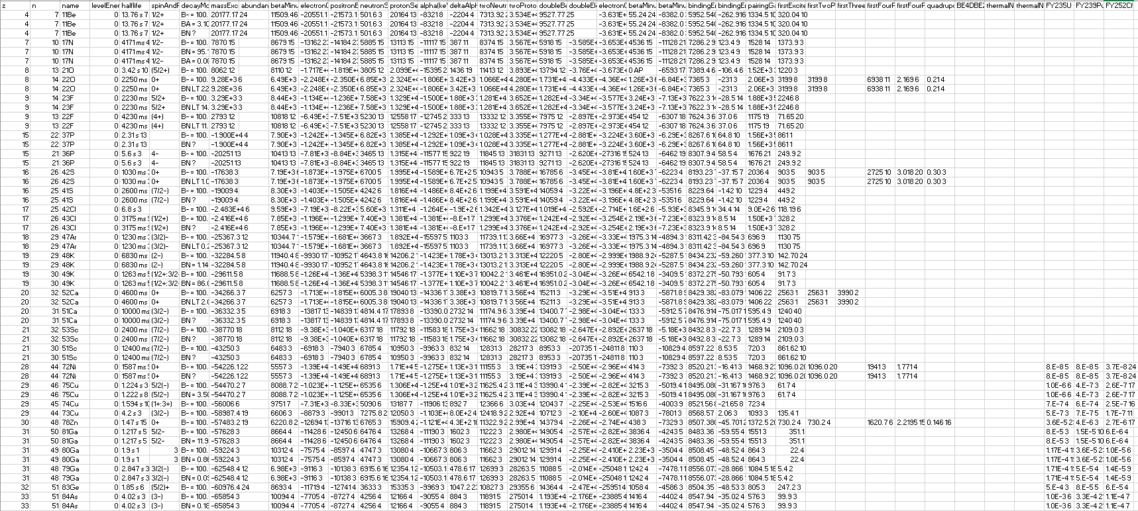
NuDat Data Export
Export all datasets and nuclides
Customizable data export:
JSON/CSV formats
Specify which datasets to export
Export filtered observables
Export filtered nuclides

Slide 16
NuDat Data Export
Thermal Neutron Fission Yields for 235U
Nuclides with half-life from 1s to 1m
+
# of neutrons 60-80
+

Slide 17
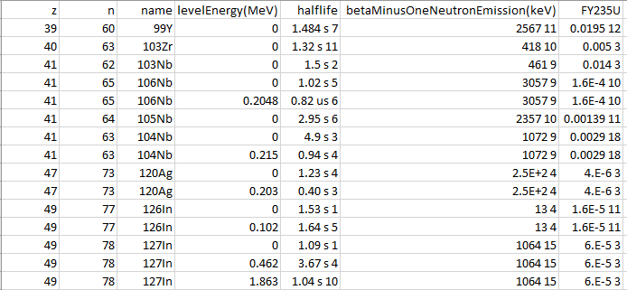
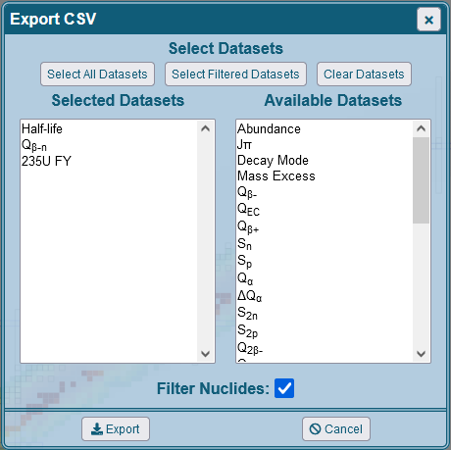
NuDat Data Export
Export filtered datasets and nuclides

Slide 18
NuDat Data Export
Add columns from available datasets

Slide 19
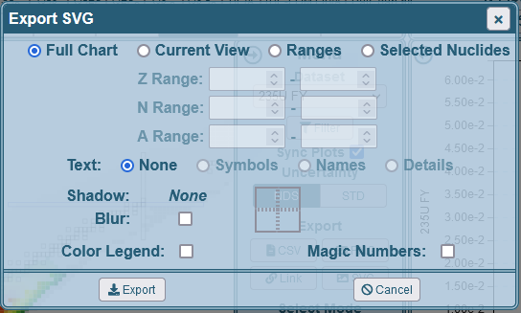
NuDat SVG Export
Customizable SVG export:
Export chart of nuclides
Full chart
Current view
Z/N Ranges
Include text
None
Element symbol
Nuclide name
Dataset details
Shadow (flat or blur)
Color Key
Magic Numbers

Slide 20
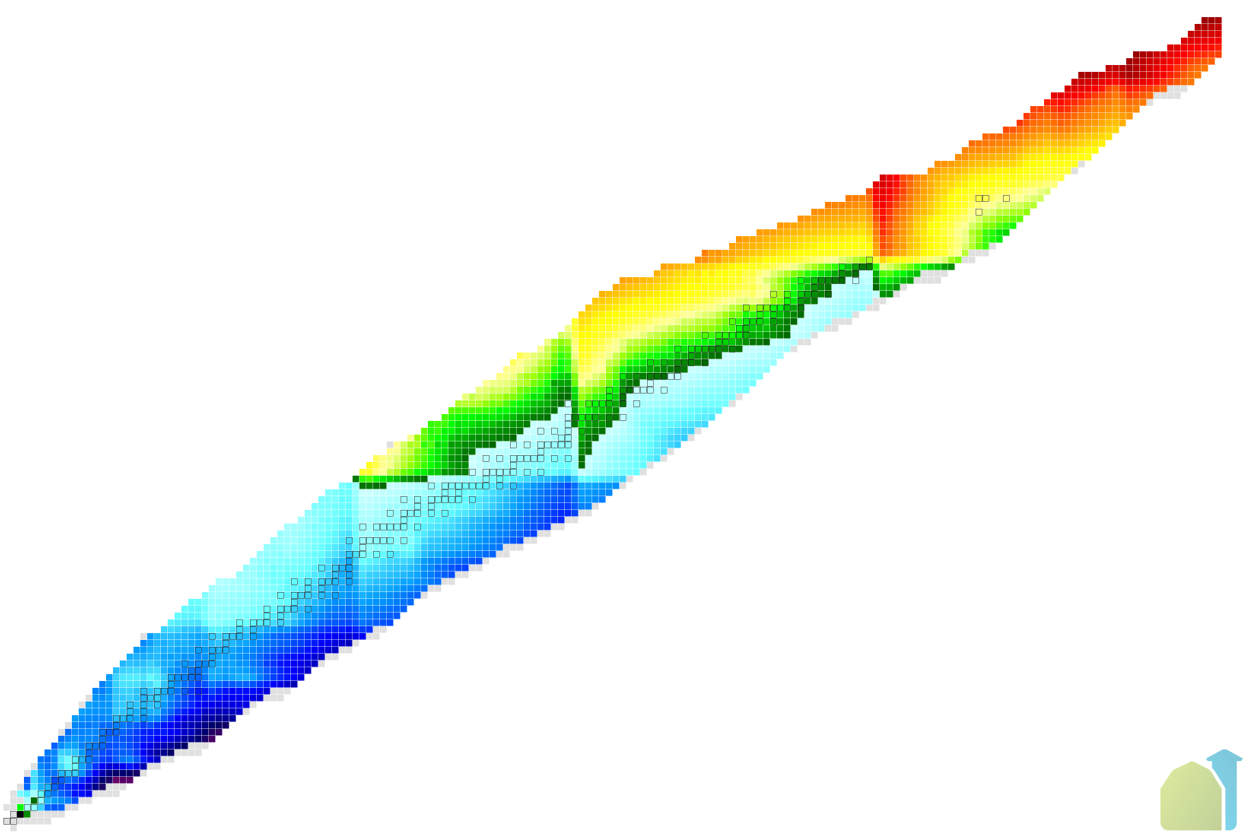
NuDat SVG Export
Q(ɑ) full chart
without text

Slide 21
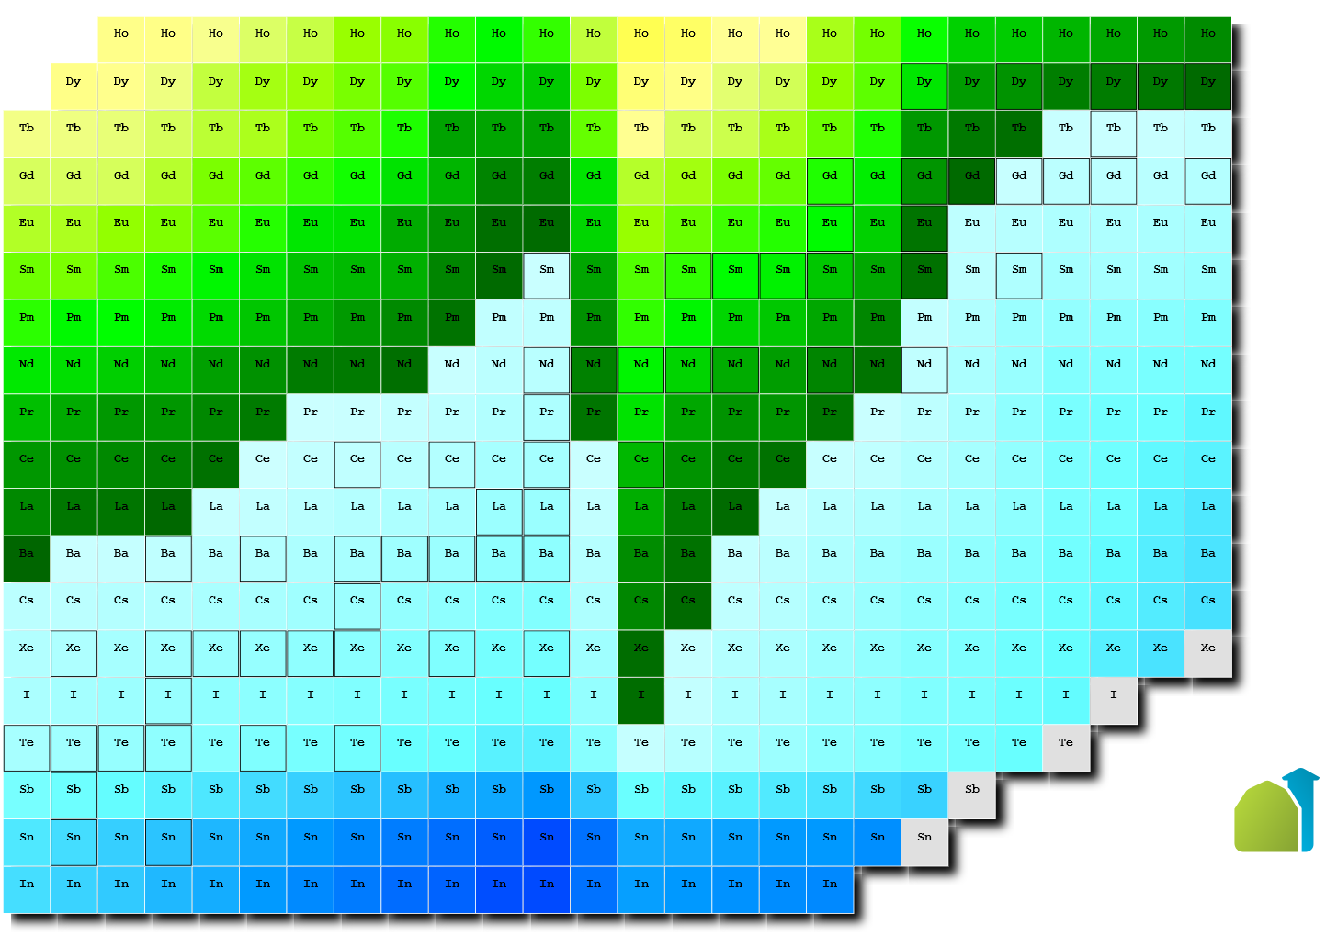
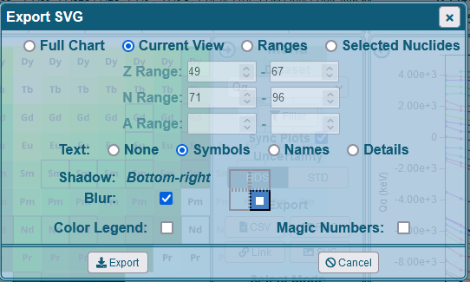
NuDat SVG Export
Q(ɑ) current view
with element symbols
and bottom-right shadow

Slide 22
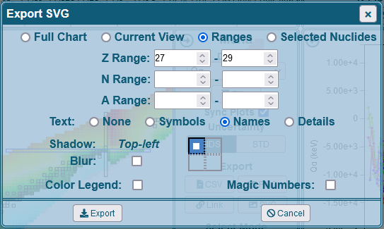
NuDat SVG Export
Q(ɑ) chart z/n range
with element symbols
and top-left shadow

Slide 23
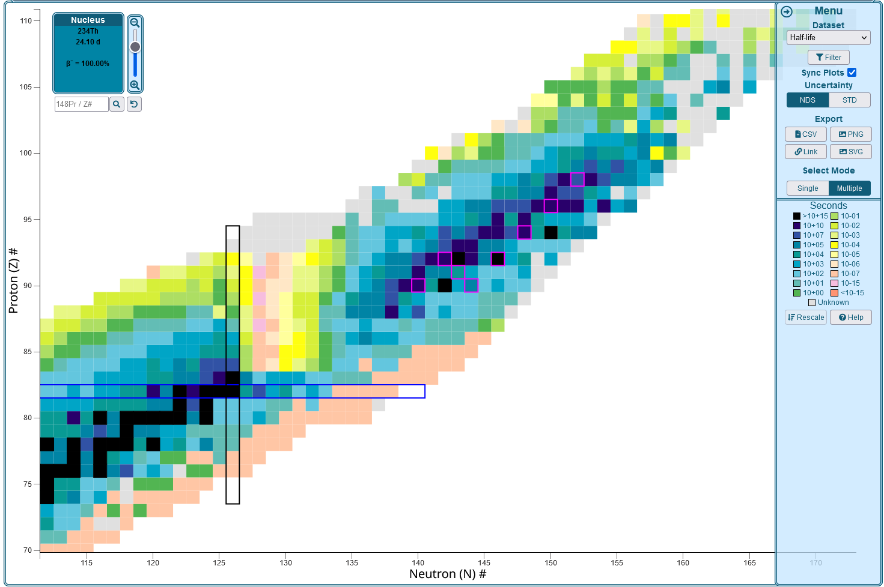
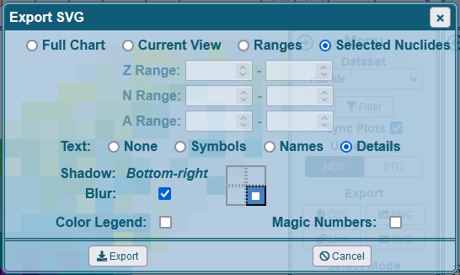
NuDat SVG Export
Select specific nuclides
using the”Multiple” select mode

Slide 24
NuDat SVG Export

Slide 25
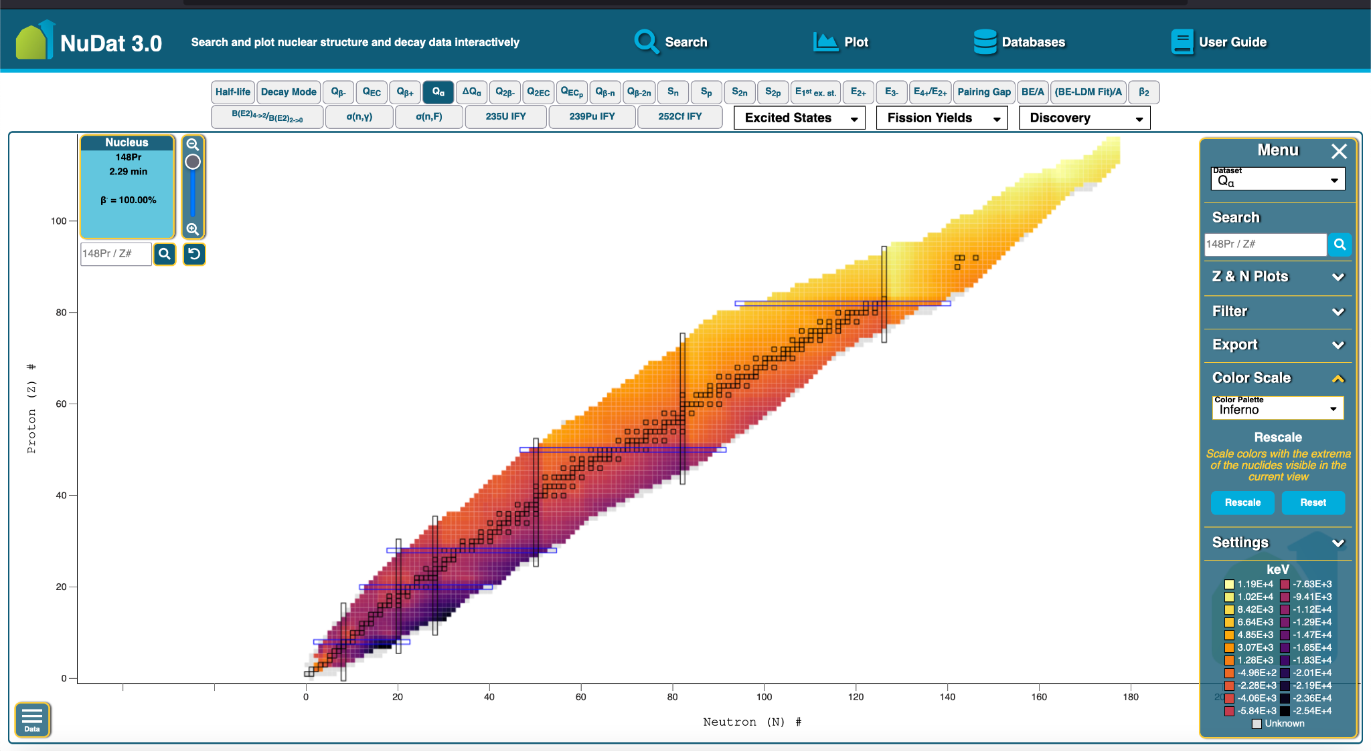
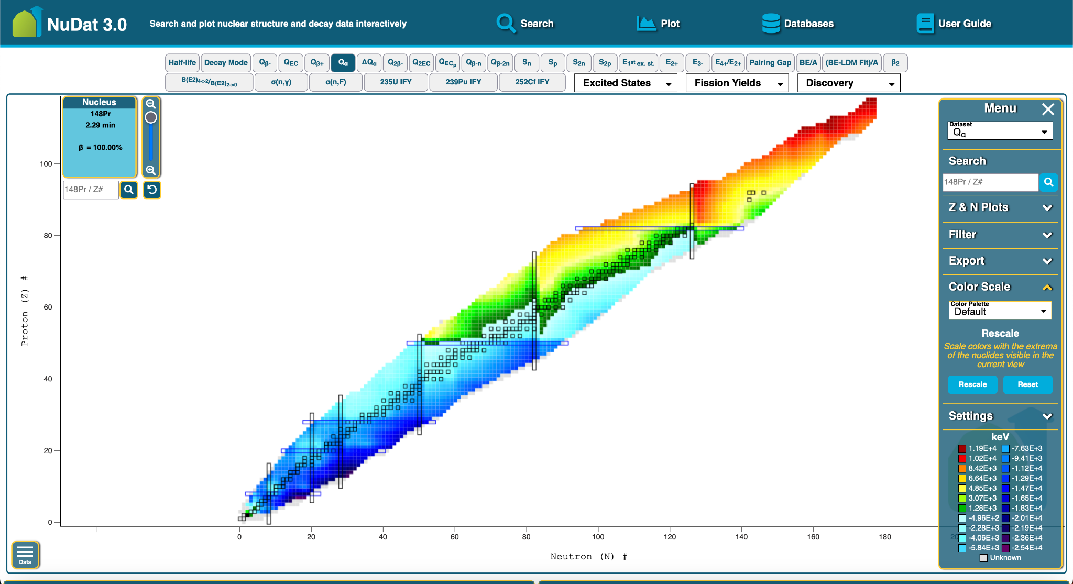
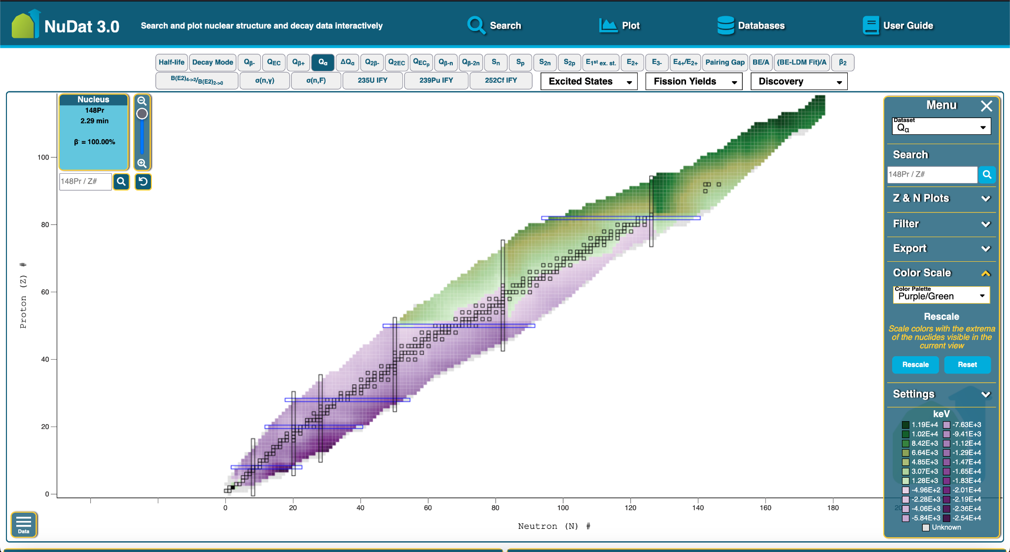
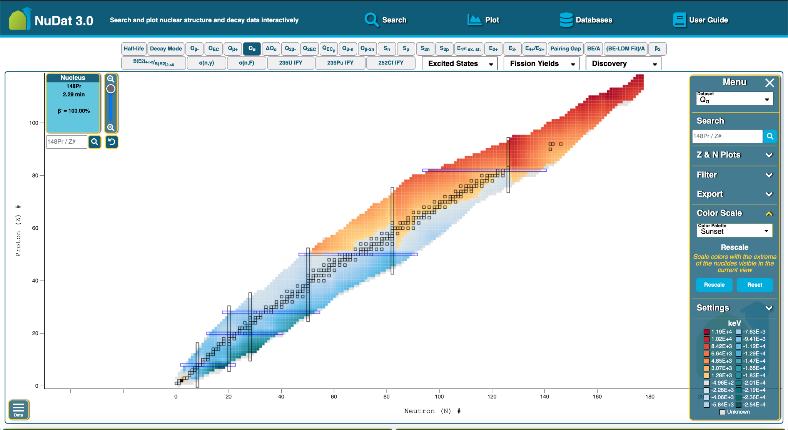
Additional Color Palettes
Accessible

Slide 26
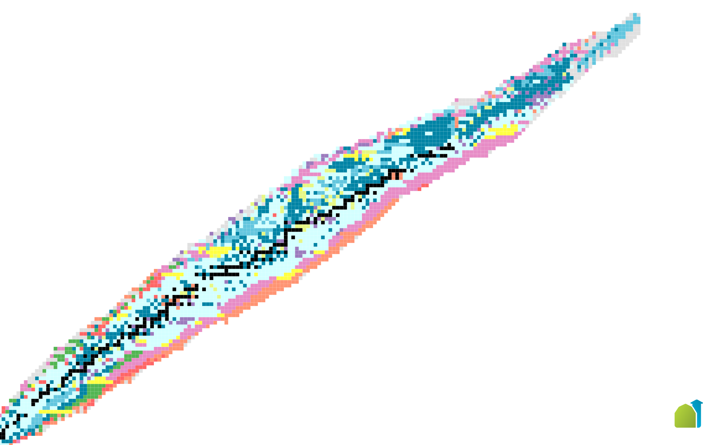
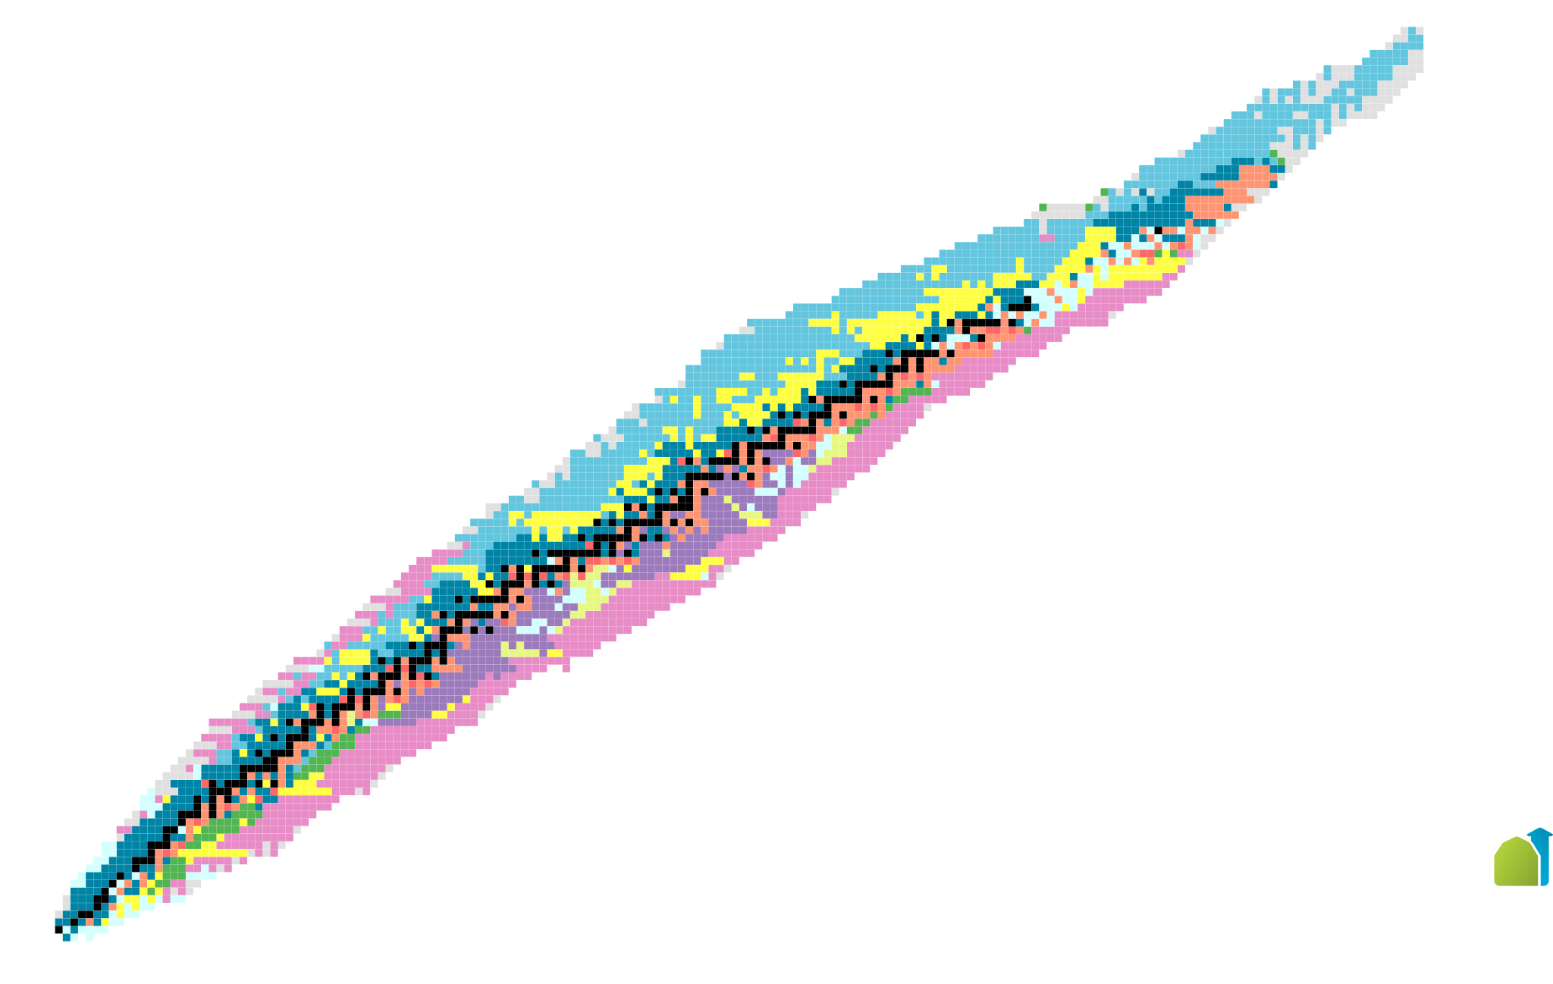
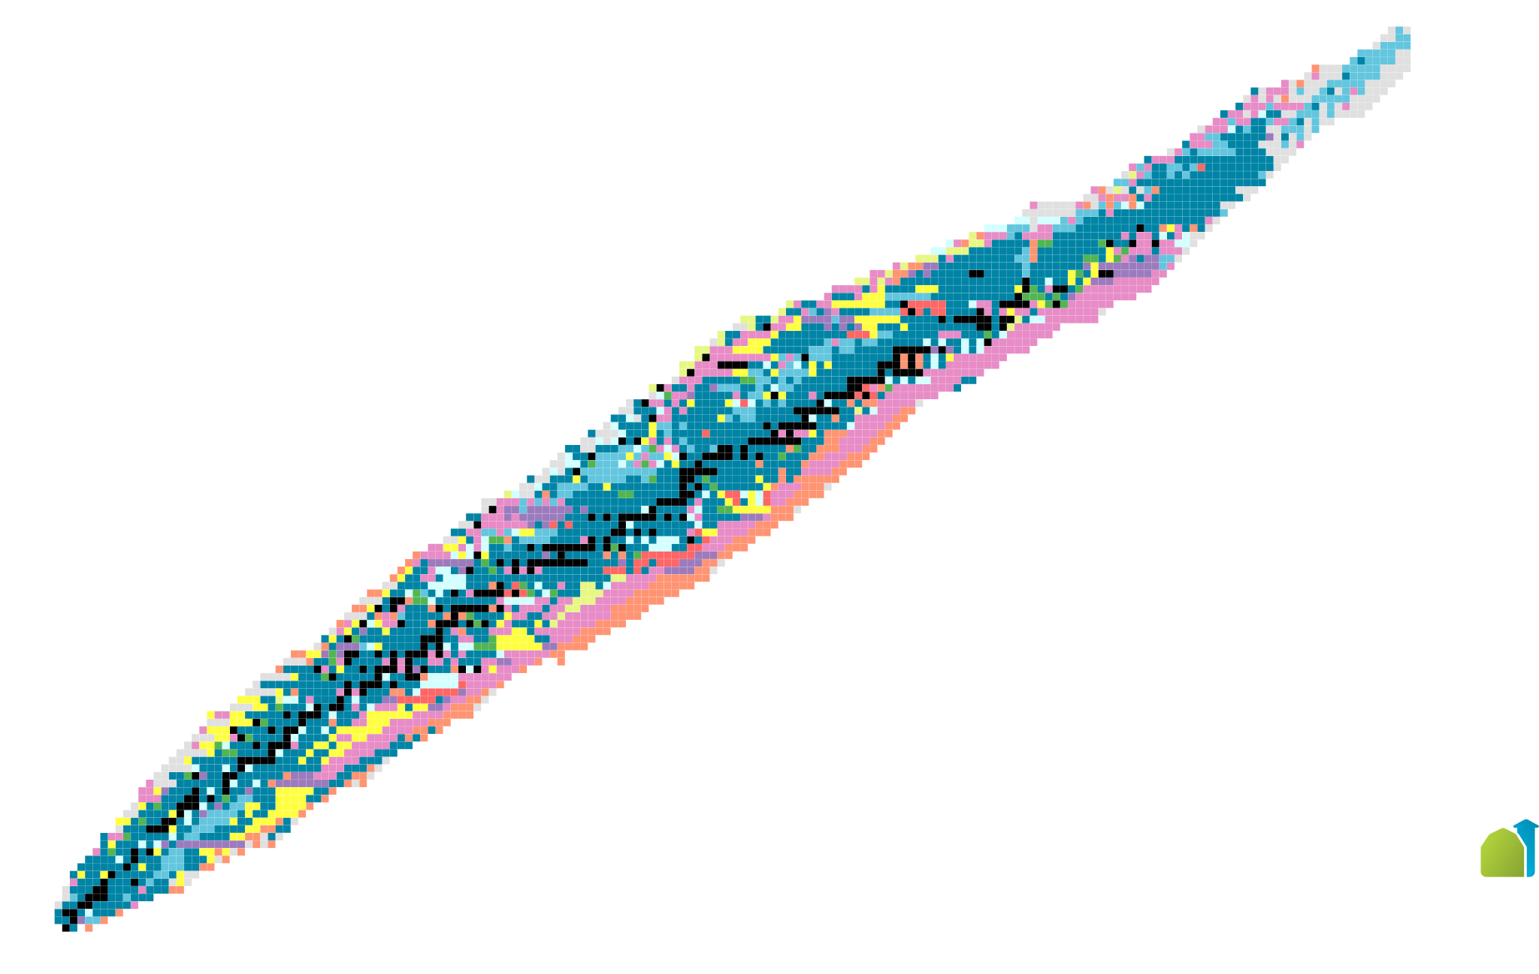
Discovery of Isotopes
Lab
Collaboration with Michael Thoennessen and Jun Chen at MSU / FRIB
Included Discovery Datasets:
Year
Method
Country
Lab
Method
Country

Slide 27
Year of Discovery Timelapse

Slide 28
Searched Nuclides Timelapse

Slide 29
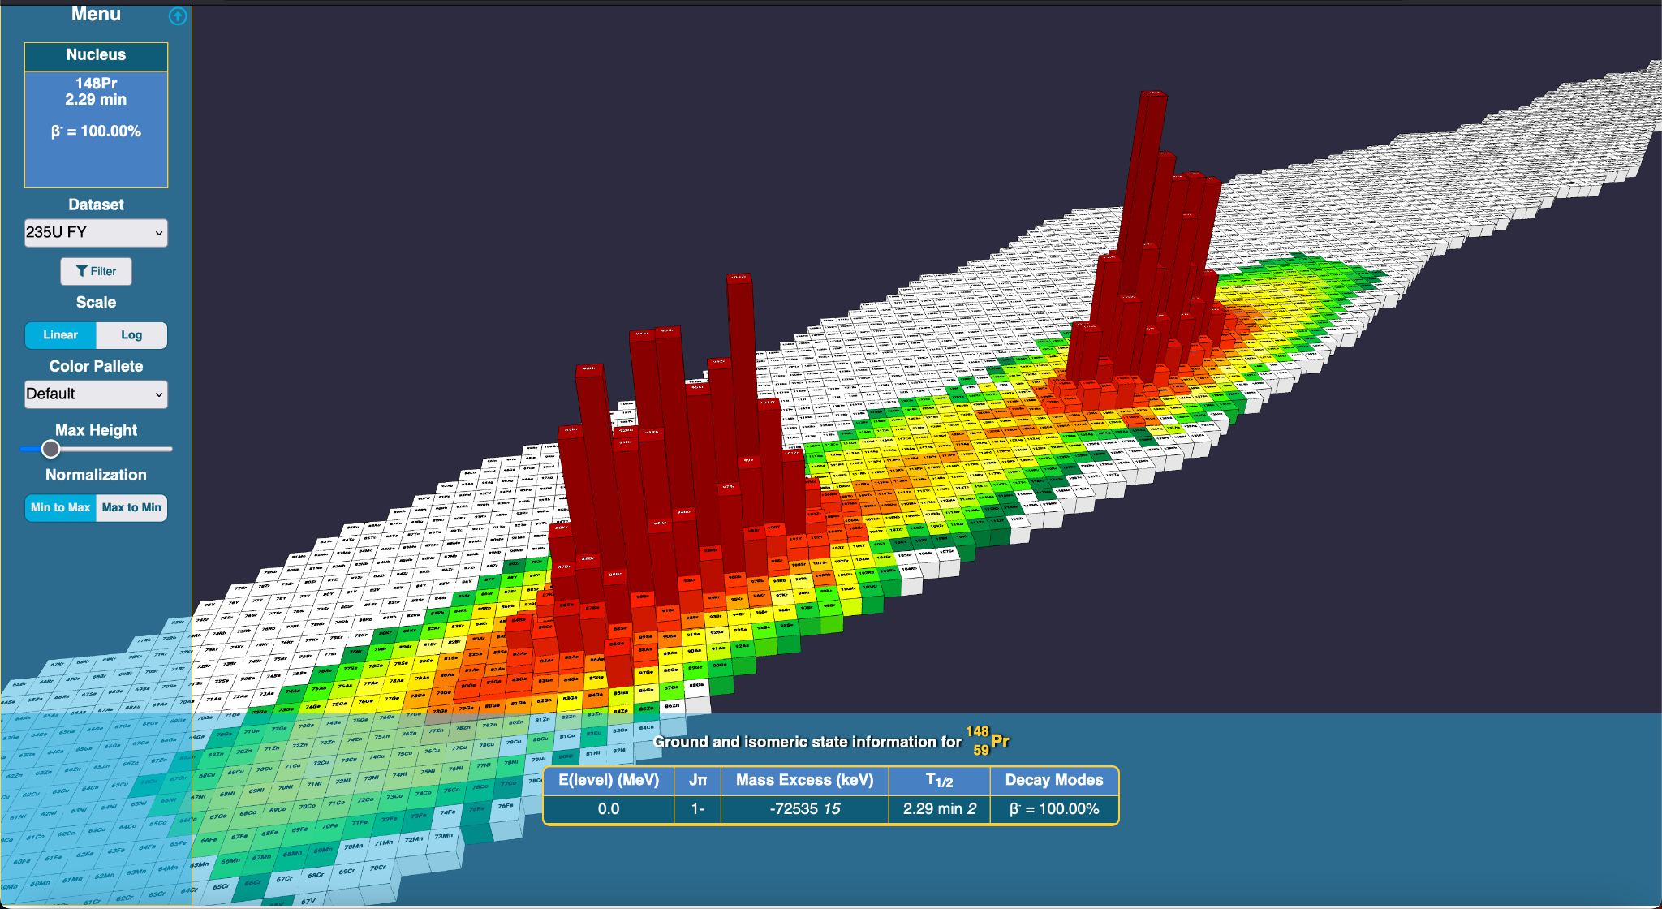
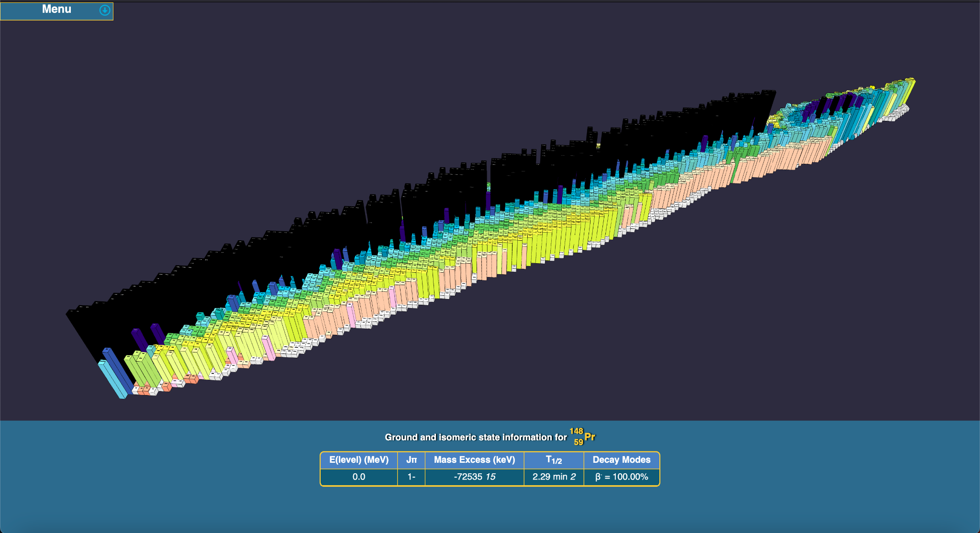
3D Chart of Nuclides (Coming soon)
235U FY
Half-life
Q(ß-)
Q(ß+)
(BE-LDM Fit) / A
Q(α)
ΔQ(α)

Slide 30
235U FY
Half-life
Q(ß-)
Q(ß+)
(BE-LDM Fit) / A
Q(α)
ΔQ(α)

Slide 31
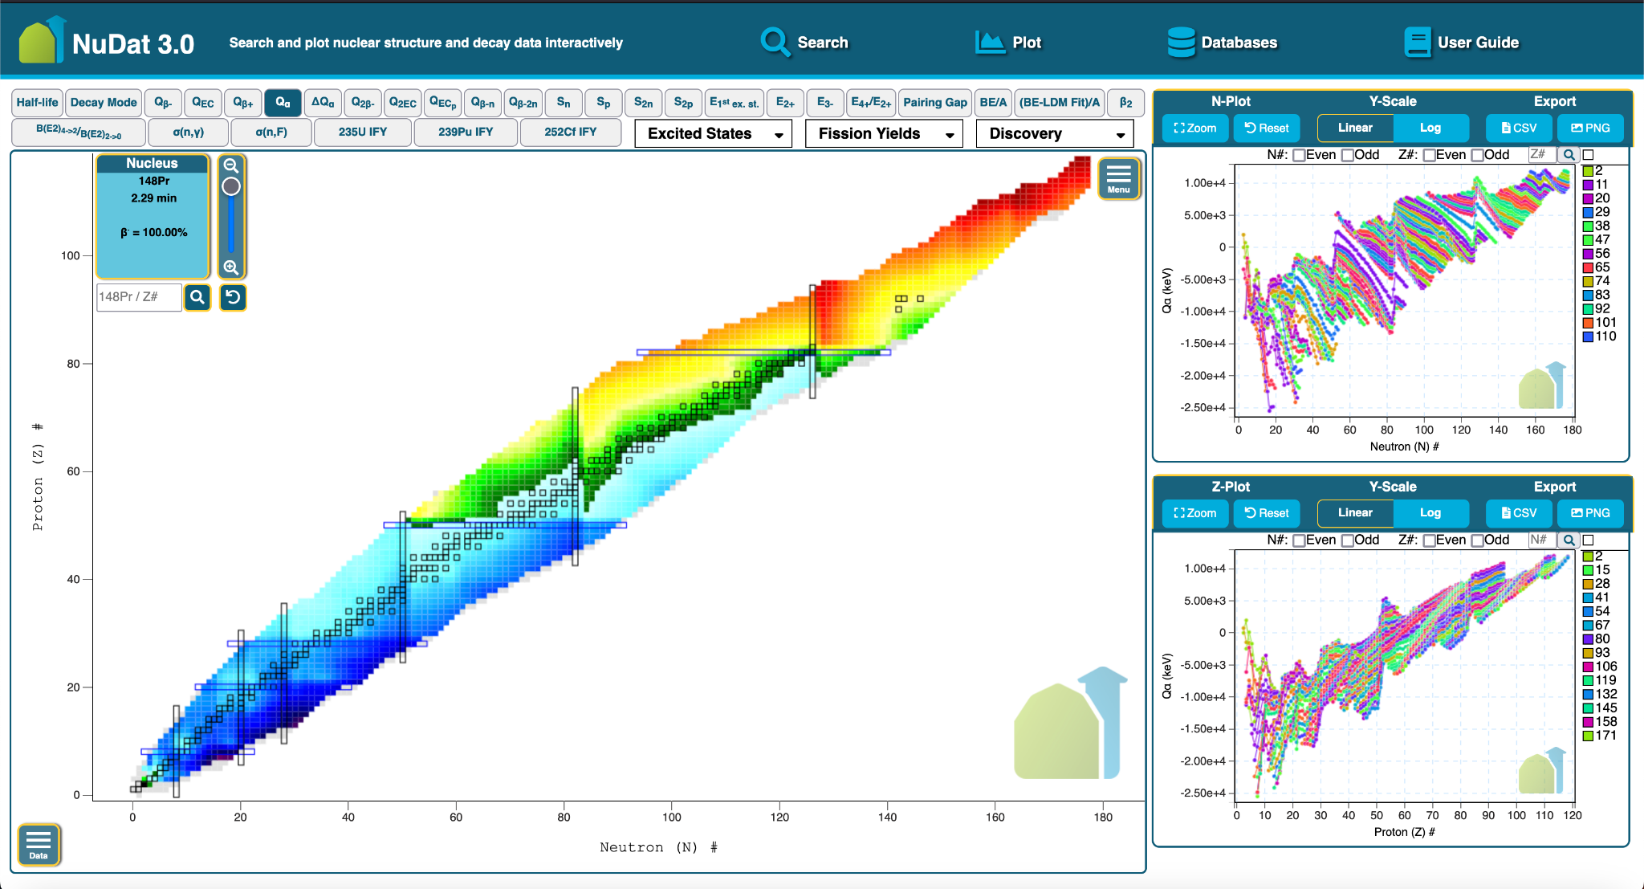
Contact Us
NuDat 3 is available here:
www.nndc.bnl.gov/nudat3/
Improvements based on community feedback
We encourage you to send us your feedback and suggestions
Thank you!
Donnie Mason - dmason@bnl.gov

