Slide 1
Challenges in unifying nuclear data access
Arjan Koning, IAEA
IAEA Technical Meeting on Nuclear Data retrieval, dissemination and data portals, November 11-15 2024, Vienna

Slide 2
Contents
Some points to consider
Some data formats: TALYS, ENDF, EXFOR, GNDS
Attempt to unify, at least, EXFOR, TALYS and ENDF, with a “light” format: YANDF

Slide 3
Some points to consider
General trend: Transition from web-GUI’s to programmatic access (Web-API’s)
3 dominant databases in nuclear data
ENSDF (evaluated nuclear structure)
ENDF (evaluated nuclear reactions)
EXFOR (experimental nuclear reactions)
….all with > 50 year old formats
Parsers and entirely new formats underway, interpretation of the databases is the challenge to allow general use

Slide 4
Some points to consider
IAEA Nuclear Data Section hosts many other basic nuclear databases of which many are in need of
Unified format (if possible)
Richer metadata
Programmatic access
…to allow for more automation and AI/ML applications
Examples:
Nuclear model parameters - Reference Input Parameter Library (RIPL)
Essential experimental/evaluated databases
Thermal cross sections
Full resonance parameter collections
Resonance integrals
30 keV Maxwellian-averaged cross sections
Average radiative widths
Evaluated Gamma-ray Activation file (EGAF)
Evaluated cross sections for medical isotopes
Reference database for beta-delayed neutron emission
Etc.
A new website with emphasis on “Findable” of the FAIR principle.

Slide 5
TEFAL + TALYS
TEFAL processes the output of TALYS, and data from other sources, into an ENDF-6 data library
TAGNDS
Other processing software
Automated plotting
EXFOR outlier detection
Astrophysical databases
Medical isotope data
AI/ML
Replace NDL’s by prob. tables
Input
TALYS
But also:
Output
TALYS input file
‘endf y’
TALYS output files
Input
TEFAL
Output
gam13 y
eswitch 30.
adopt 3 1
11023.0000 22.7920000 0 0 0 01125 3 1
0.0 0.0 0 0 1 16331125 3 1
1633 2 1125 3 1
1.00000E-5 30.01000001.090516E-5 28.88378281.176413E-5 27.93758371125 3 1
1.257105E-5 27.13857751.332237E-5 26.46086031.474673E-5 25.32124481125 3 1
1.591407E-5 24.50371641.684983E-5 23.91068111.835751E-5 23.05234531125 3 1
2.00000E-5 22.23004902.181024E-5 21.4336445 2.35281E-5 20.76452741125 3 1
2.514186E-5 20.19948982.664444E-5 19.72021662.949314E-5 18.91424921125 3 1
3.182781E-5 18.33605613.369931E-5 17.91662593.671479E-5 17.30952461125 3 1
4.00000E-5 16.72787884.362039E-5 16.16458234.705604E-5 15.69129701125 3 1
5.028349E-5 15.29161415.328858E-5 14.95258445.898596E-5 14.38241631125 3 1
6.365529E-5 13.97335646.739828E-5 13.67660147.342935E-5 13.24703021125 3 1
8.00000E-5 12.83542868.724079E-5 12.4367866 9.41123E-5 12.10179941125 3 1
1.005679E-4 11.81885951.065787E-4 11.57883431.179737E-4 11.17514101125 3 1
1.273126E-4 10.88546451.347988E-4 10.67528531.468603E-4 10.37100291125 3 1
1.60000E-4 10.07939391.744821E-4 9.796840691.882251E-4 9.559341041125 3 1
2.011354E-4 9.358695902.131561E-4 9.188433632.359458E-4 8.901941581125 3 1
2.546232E-4 8.696257792.695952E-4 8.546955432.937188E-4 8.330684881125 3 1
3.20000E-4 8.123269843.489633E-4 7.922156003.764486E-4 7.752966031125 3 1
4.022684E-4 7.609911274.263093E-4 7.488420994.718883E-4 7.283756031125 3 1
5.09243E-4 7.13660721 5.39187E-4 7.029664965.874353E-4 6.874528761125 3 1
6.40000E-4 6.725454556.767185E-4 6.631531297.461161E-4 6.472807891125 3 1
8.02796E-4 6.358266288.481141E-4 6.274777049.209316E-4 6.153261151125 3 1
.001000000 6.03600000.0010905086 5.92308619.0011763986 5.828188921125 3 1
.0012570838 5.74802770.0013322101 5.68001327.0014746442 5.565584741125 3 1
.0015913772 5.48345048 .001684952 5.42384184.0018357303 5.337512701125 3 1
.002000000 5.25474099.0021810163 5.17451983.0023527956 5.107057261125 3 1
.0025141652 5.05003618.0026644172 5.00162729.0029492852 4.920115391125 3 1
.0031827511 4.86154670.0033699007 4.81900328.0036714583 4.757324471125 3 1
.004000000 4.69810390.0043620318 4.64061662.0047055896 4.592189681125 3 1
.0050283281 4.55118966.0053288314 4.51632611.0058985672 4.457487391125 3 1
.0063654989 4.41508851 .006739798 4.38421641.0073429143 4.339330731125 3 1
.008000000 4.29606921.0084589708 4.26873941.0091972669 4.228908191125 3 1
.010000000 4.19040000.0109050782 4.15292906.0117639715 4.121243991125 3 1
.0125708168 4.09431934.0133220739 4.07134362.0147464132 4.032373621125 3 1
.0159137422 4.00411715.0168494898 3.98343622.0183572823 3.953185001125 3 1
.020000000 3.92379338.0212105848 3.90409888.0231652286 3.875199481125 3 1
.025300000 3.84700000 .026790941 3.83119247.0296146078 3.804404691125 3 1
.0319259991 3.78500433.0337771793 3.77081994.0367571382 3.750097951125 3 1
.040000000 3.73000000.0436203101 3.71065148.0470558813 3.694226761125 3 1
.0502832602 3.68021721.0532882864 3.66821961 .058985643 3.647767701125 3 1
.0636549587 3.63284665.0673979492 3.62187048.0734291223 3.605720251125 3 1
TEFAL input file
~ 60 keywords (all optional)
ENDF file

Slide 6
Nuclear data pipeline should flow in 2 directions!

Slide 7
Vertical nuclear data evaluation
Improve nuclear data evaluation of a particular projectile - target (- reaction) combination:
Sometimes driven by a sponsor
Sometimes driven by a new measurement
Sometimes driven by feedback from suboptimal integral validation
Hackatons needed
Frankenstein files
We should never throw away data which work well (although we may not remember why), often in the RR
If safe, add missing categories: emission spectra, gamma data, covariances, data above 20 MeV, etc.
Major ‘continental’ NDL’s, ENDF/B-VIII.1, JEFF-3.3, JENDL-5.0, CENDL-3.2, based on this.
Leads to currently the best nuclear data libraries for fission applications
IAEA-INDEN wish list a good example
No evaluators left

Slide 8
Horizontal nuclear data evaluation
Ensure a reproducible nuclear data flow with all experimental, theoretical and evaluated data directly available. Requires:
a parsed and interpreted EXFOR database
evaluated experimental databases with rich metadata:
Thermal cross sections, resonance integrals
Full resonance databases
Maxwellian cross sections (MACS), average radiative widths etc.
Automated non-model evaluation software for low energies
Full control over evaluated nuclear data libraries for optimisation, ML, plotting etc.
Time spent on correct retrieval of all the above should be minimal
Can go (far) beyond ENDF
TALYS code system and TENDL is based on this
Ideal situation: A Horizontal nuclear data approach in which vertical knowledge is inserted

Slide 9
Super code
Data
User
Versus
Code
Code
Code
Data
Data
Data
User
User
User
User

Slide 10
EXFOR parsing
Data mining
Dictio-
naries
Quality
scoresctio-
naries
Nuclear
physicist
No
Man’s
Land
EXFOR
exforparser_py
database
Data mining code
Monitor/Stand.
dards
Correc.factors
dards
XC4/C5
database
EXFOR-
Tables

Slide 11
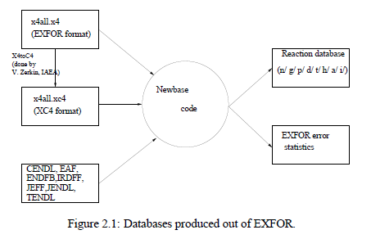
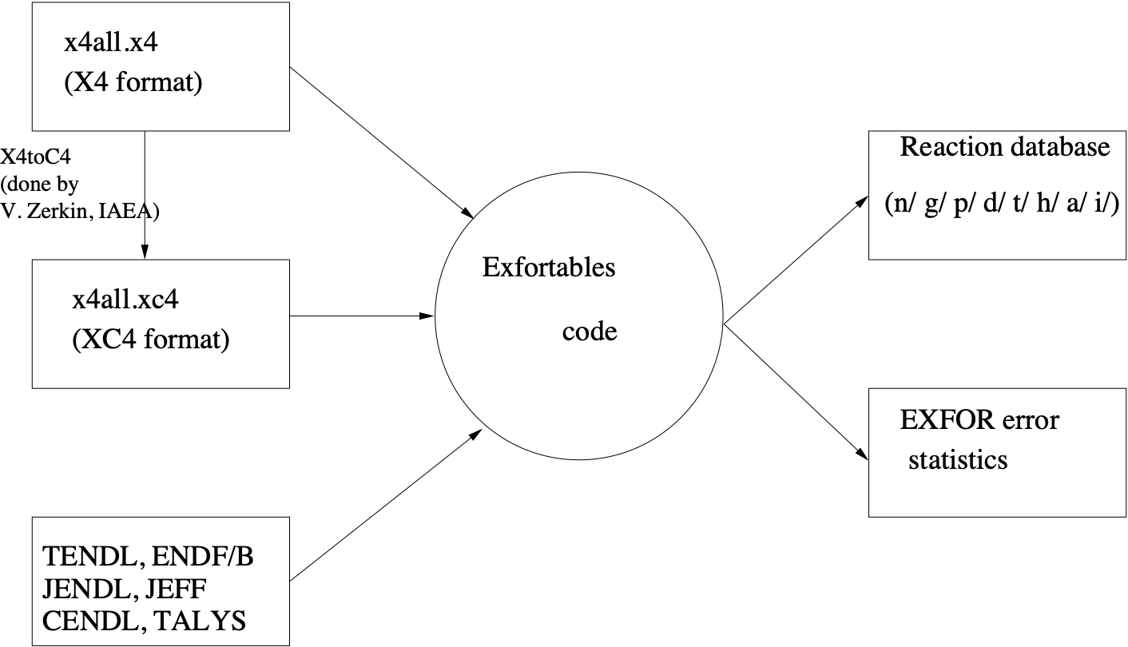
EXFORTABLES code and database
nds.iaea.org/talys
Very complete output of statistics of EXFOR entries: C/E of all data libraries for a large part of EXFOR —> EXFOR quality scoring

Slide 12
ENDFtables
Many output files of
observables:
One x-y (-dy) table
per reaction channel
ENDF file

Slide 14
GNDS
EXFOR
EXFORtables
TALYS-1.97
ENDF

Slide 15
YANDF: Yet Another Nuclear Data Format
Zen of Python: Explicit is better than implicit
Key - value approach: allow ‘easy’ parsing into JSON, YAML, GNDS/XML etc.
Not as non-descriptive as ENDF
Not as ‘heavy’ as GNDS
Not as extensive and abbreviated as EXFOR
More metadata than in previous output files
Human-readable
Same schema for TALYS, EXFOR and ENDF
Data model from the point of view of a nuclear physicist, not from the specialised EXFOR or ENDF formats
Would make ALL nuclear reaction data programmatically available at the same time: good for TENDL, other large data projects, AI/ML

Slide 16
Structure
Inspired by YAML
Multi-level
Using ‘#’ for attributes
A relative small number of main attributes
Use of defaults: if not relevant for particular reaction then metadata is not given
Consistent, clean and parsable (I hope)

Slide 17
TALYS output file: rp039090.L02
‘#’ for direct use in
various software, e.g.
Gnuplot
Without ‘#’: YAMLesque
2 space indentation per
level
Parsing to JSON should
be easy
Only 5 main attributes for
nuclear reactions
TALYS: 2 more main
attributes: ‘parameters’
and ‘observables’
EXFOR: All specific
metadata may follow
after the datablock

Slide 18
TALYS
JENDL5.0
EXFOR
(One file per data set)

Slide 20
TALYS output file: nn0011.000ang.L00

Slide 21
TALYS output file: gam082207L09L03.tot

Slide 22
Uncertainties: Variance, in-channel covariance, cross-channel covariance

Slide 23
Thank you!
Notes:
Thank you!

