Slide 1
Nuclear Data Service System of the China Nuclear Data Center (NDS-C)
JIN Yongli, WU Xiaofei
China Nuclear Data Center
China Institute of Atomic Energy
11 Nov.-15 Nov.，2024, Vienna, Austria

Slide 2

Contents
1 Introduction to NDS-C
2 Examples
3 Works in Progress
4 Summary
2

Slide 3
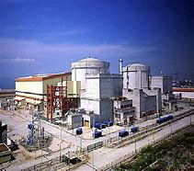



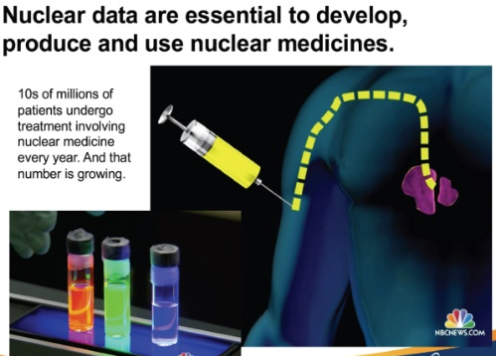
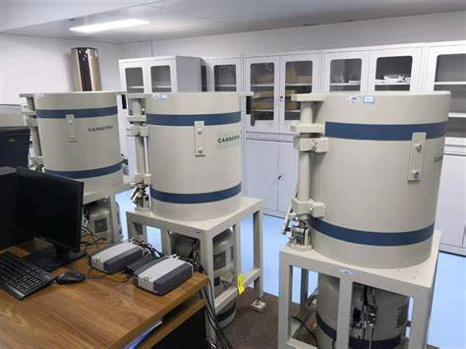
1 Introduction to NDS-C
1.1 Nuclear Data Service in China
Data Services
nuclear reactor
On-line
NDS-C
nuclear fuel
nuclear chemistry
Starting about 2000，Over 20 years
scientific research
experiments
Offline
Evaluation
Processing
Calculation
…
…
evaluations
3

Slide 4







1 Introduction to NDS-C
1.2 The Goal of the NDS-C
CNDC
Evaluators
Nuclear Data Collaboration Network of China
Institutes
Universities
Users
Def. Purposes
utilization
Institutes
Universities
ENDF
Non-evaluators
utilization
Nuclear Power Plants
EXFOR
Nuclear Fuel Factories
Free Format
…
Images
Nuclear Instruments
4

Slide 5

1 Introduction to NDS-C
1.3 API： Provides Uniform Data Processing
Advantages
Easy to maintain
Reduce codes redundancy
Enhance flexibility
Cross-Platform Compatibility
Increase Dev. Efficiency
API
DB
NDS-C
5

Slide 6

1 Introduction to NDS-C
1.4 Software and Tools Based on NDS-C’s API
NDPlot
Nuclear Reaction Data Analysis, Comparison, Visualization
BatchPlot
Batch Plotting,mparison，Visualization
Desktop Applications
Covariance Data
Analysis, Visualization
CovPlot
GDGraph
Image Digitization
FissionYield
Fission Yield Data
Batch Retrieval
Decay
Decay Data
Batch Retrieval
EXFOR-SIG
EXFOR Cross-sections Data
Batch Retrieval, ML Datasets
6

Slide 7





1 Introduction to NDS-C
Calculations
FY APP
Retrieval
Mobile Apps
Decay APP
Web Applications
Visualization
Disadvantages
Less Convenient for users
Platform-dependent
Local File
Dev. For GUI is easier
Why is Desktop
Data Mining
Save work in progress
Batch Task
Powerful
7

Slide 8
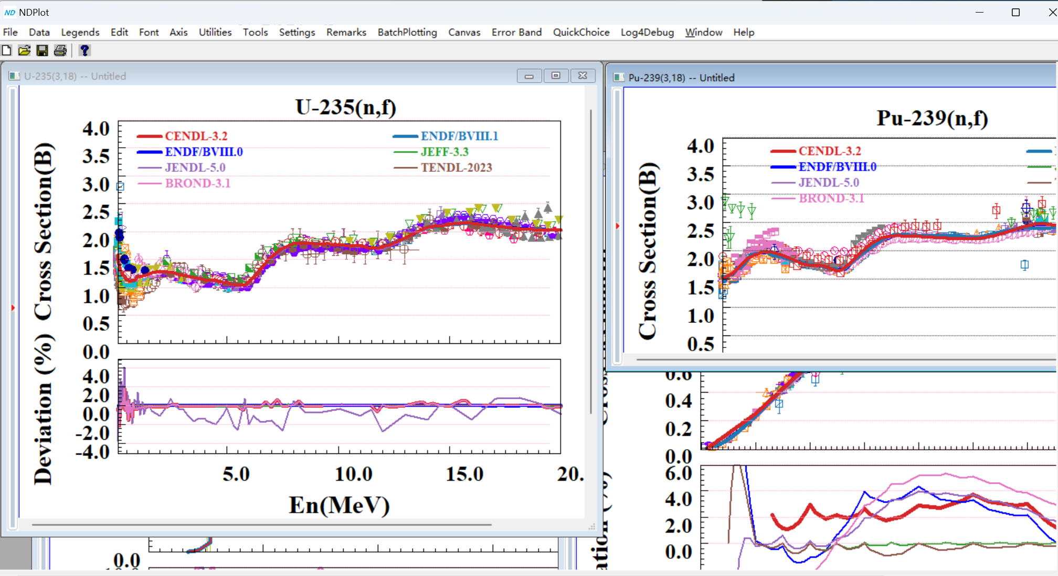

2 Examples
2.1 NDPlot
Features
All-in-one project file： ND 、NDS
ENDF/EXFOR/FREE format
Work with GDGraph, BatchPlot
Template is available
clipboard：data, image
CS, DA, DE, DAE, FY, natural nuclide data processing, photon production CS, Radioactive production CS …
Ratio, summation, emitted particle energy spectrum shape analysis, covariance data analysis, integral, interpolation
http://www.nuclear.csdb.cn/ndplot/
8

Slide 9
2 Examples
Total Emitted Gamma Spectrum Analysis of Fe-0（14.6MeV，90degree）
Emitted Gamma Spectrum Analysis of Fe-56 （14.6MeV，90degree）
http://www.nuclear.csdb.cn/ndplot/
9

Slide 10
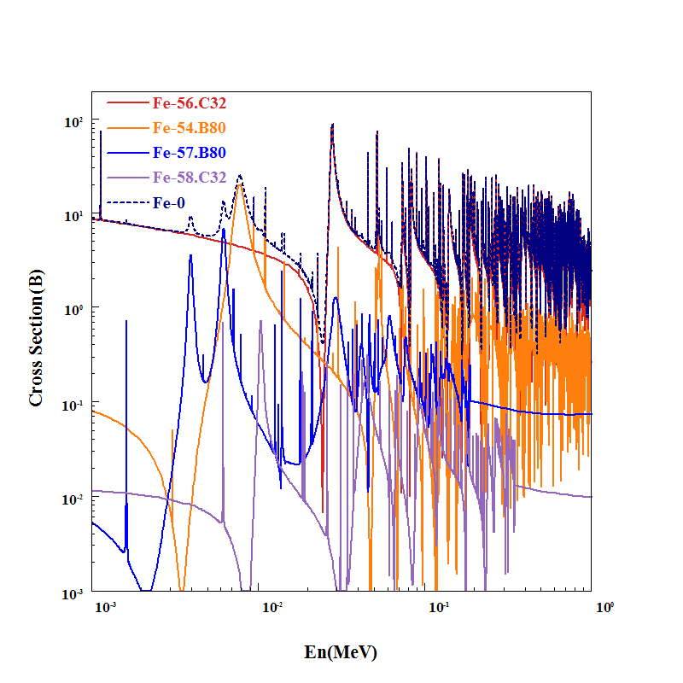
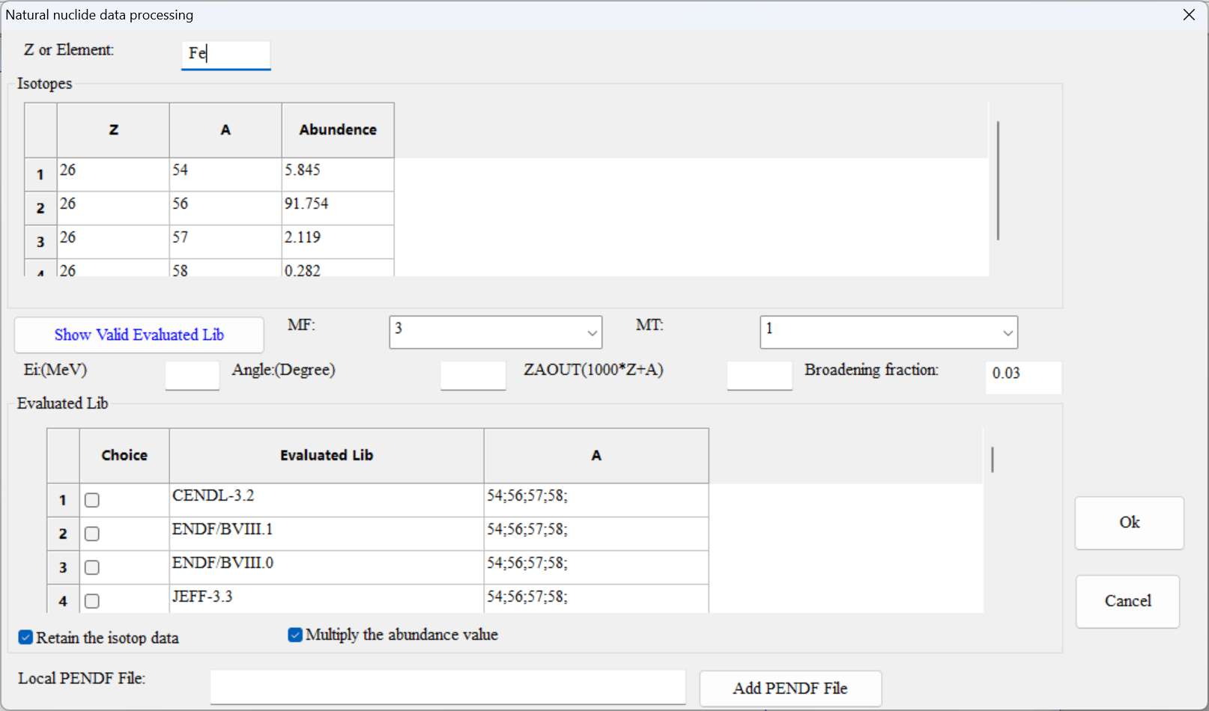
2 Examples
Improve Fe-0 Data for Radiation Shield Design
http://www.nuclear.csdb.cn/ndplot/
10

Slide 11
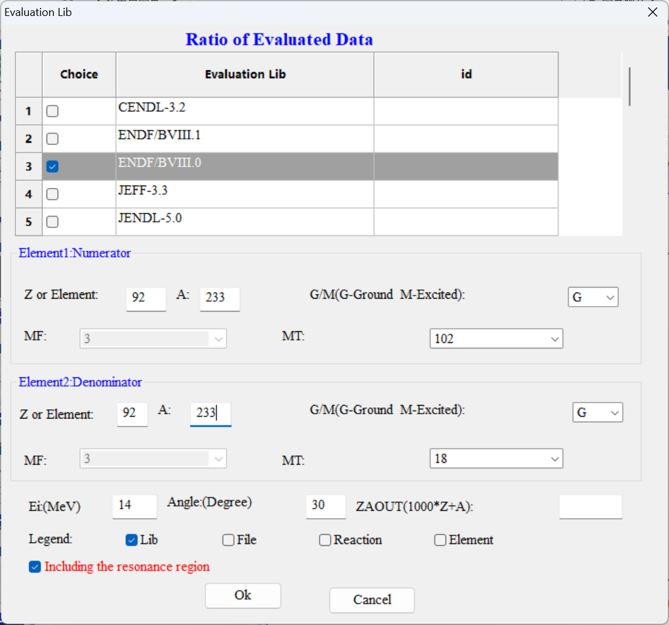
2 Examples
U-233(n, abs),ALF
http://www.nuclear.csdb.cn/ndplot/
11

Slide 12
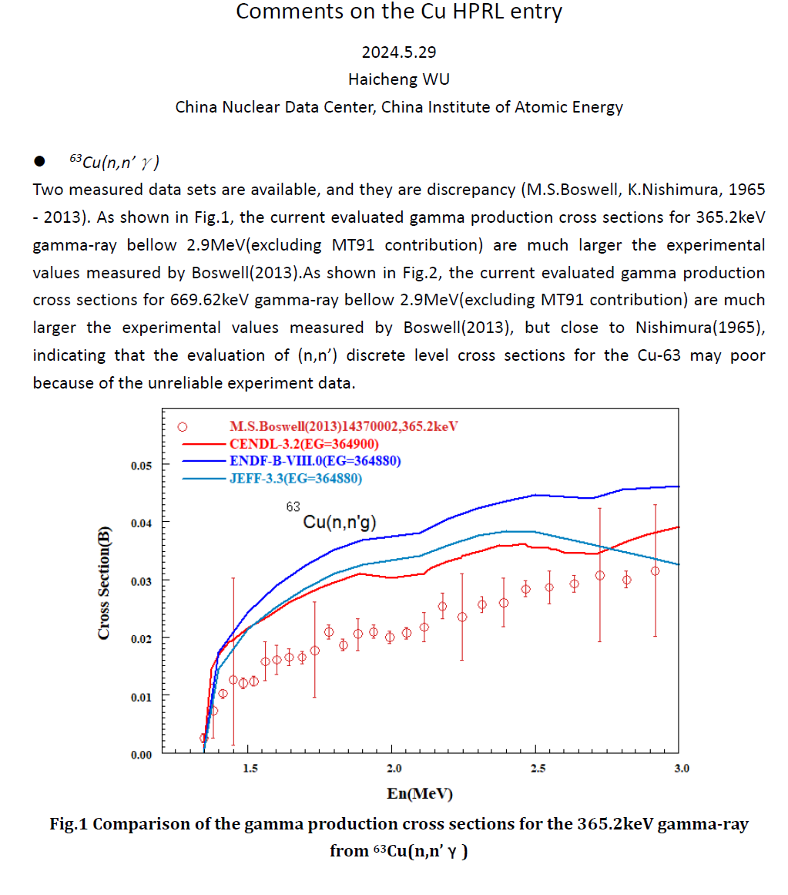
2 Examples
Comparison of the gamma production cross sections Cu-63(n,n’g)
Deviation to ENDF/BVIII.1
Pu-239(n,f)
http://www.nuclear.csdb.cn/ndplot/
12

Slide 13
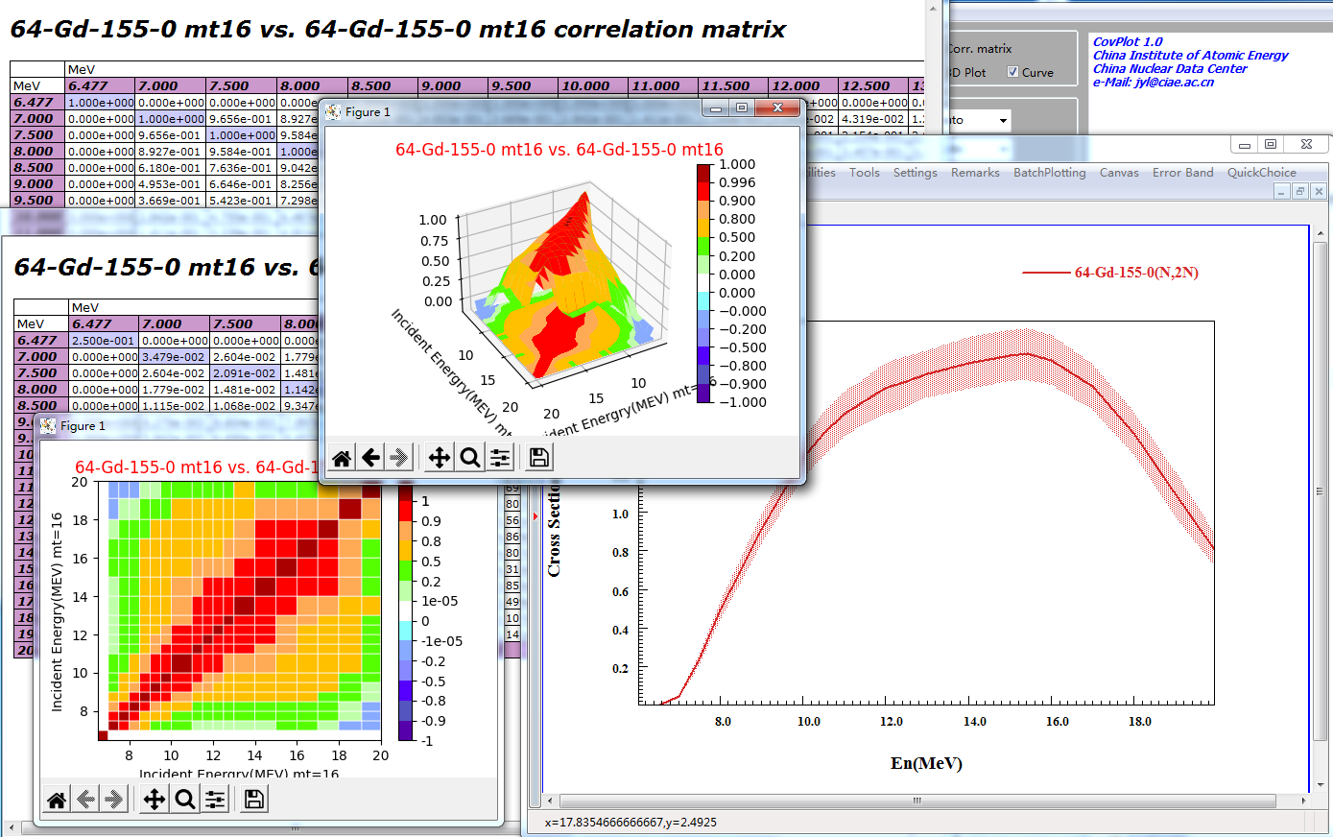
2 Examples
2.2 CovPlot
Correlation coefficient Matrix
2D、3D
covariance matrix
cross-sections with standard deviation
Gd-155(n,2n) vs. Gd-155(n,2n) from ENDF/B-VIII.0
13

Slide 14
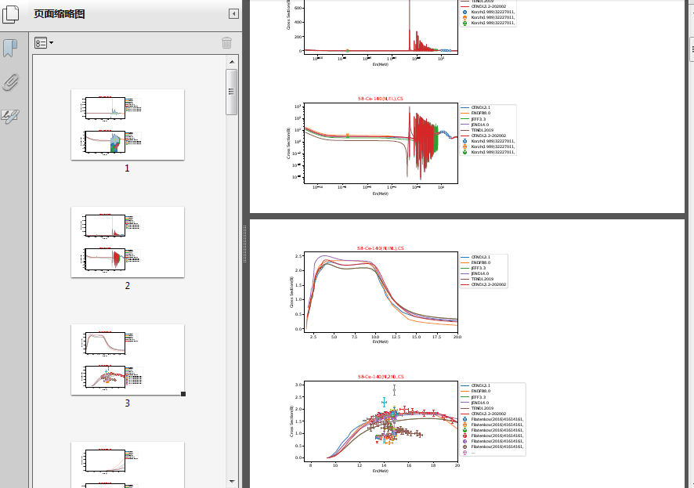
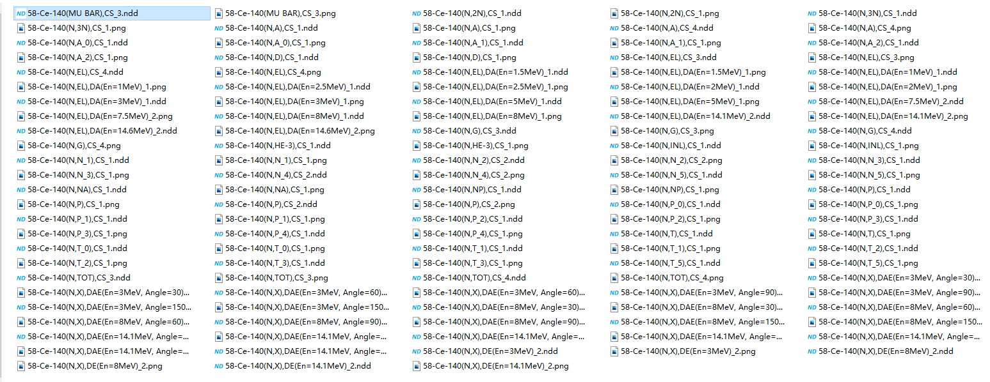

2 Examples
2.3 BatchPlot
NDPlot
Detailed analysis
NDD FILE
Overview browsing
BatchPlot
PDF,PNG
One PDF file per target
CS，DE，DA，DAE（Exp. Eva.)
14

Slide 15

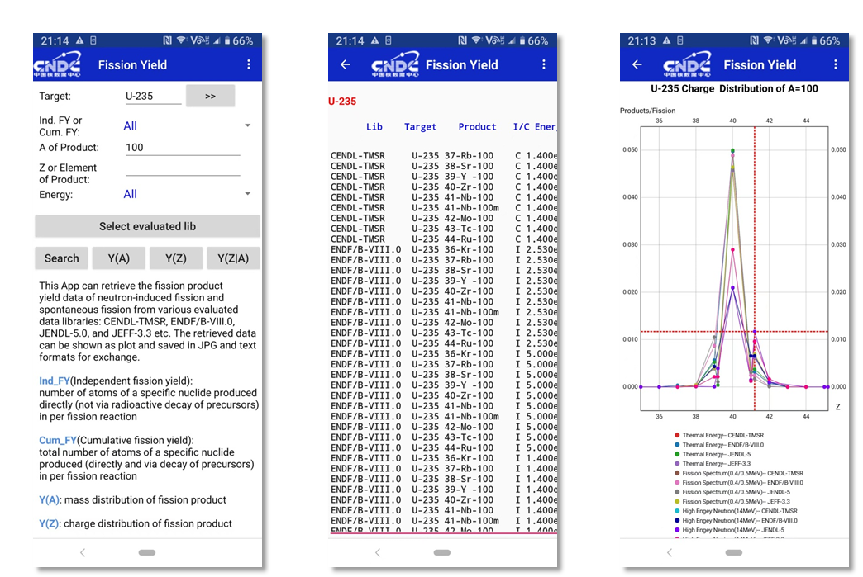
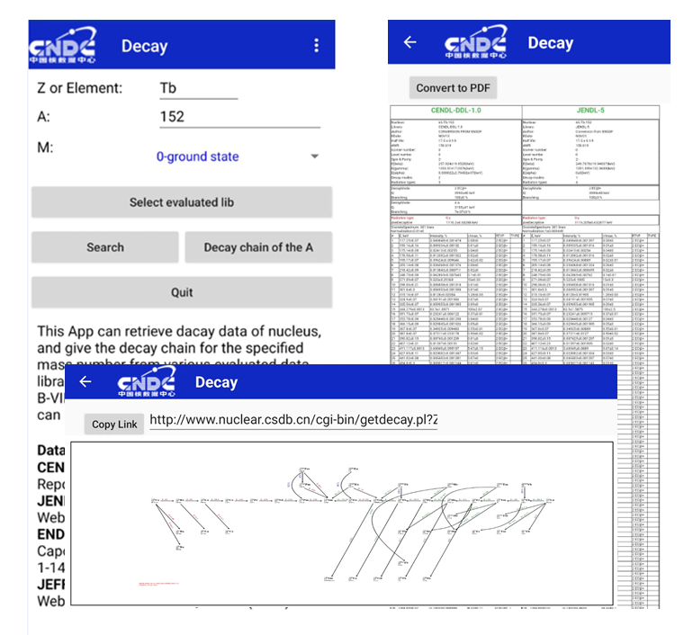
2 Examples
2.4 Mobile App
Fission Yield
Decay
15

Slide 16
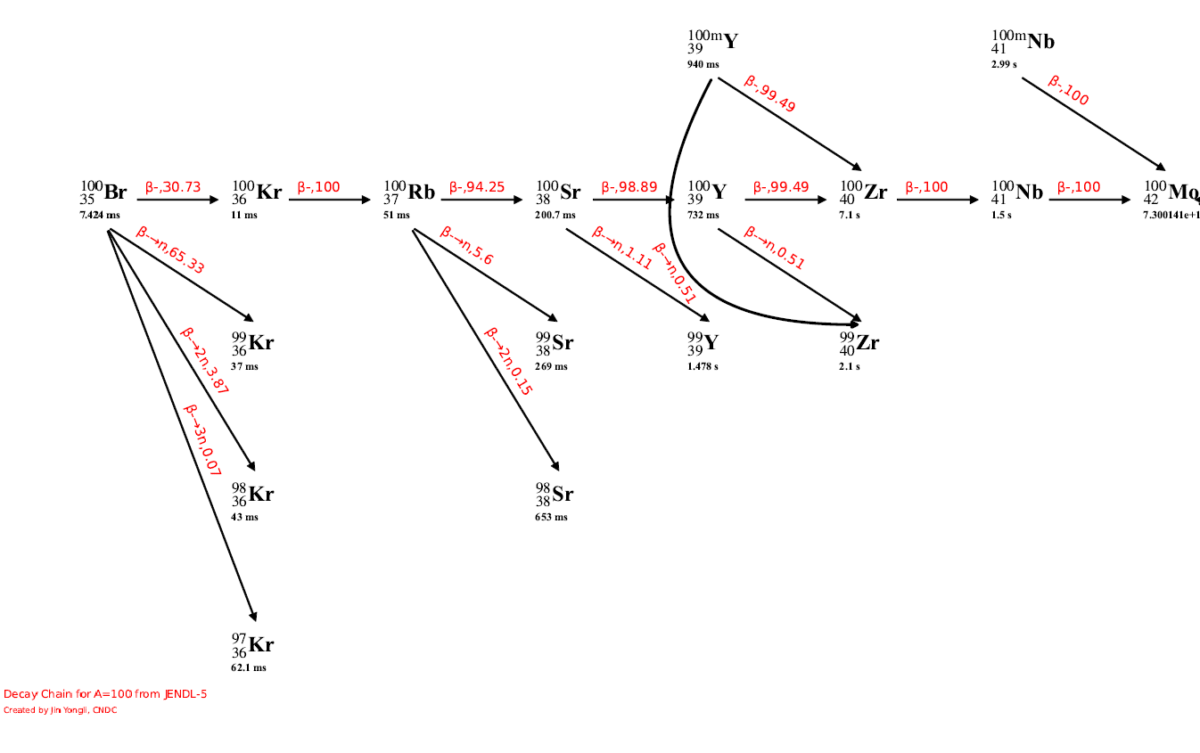
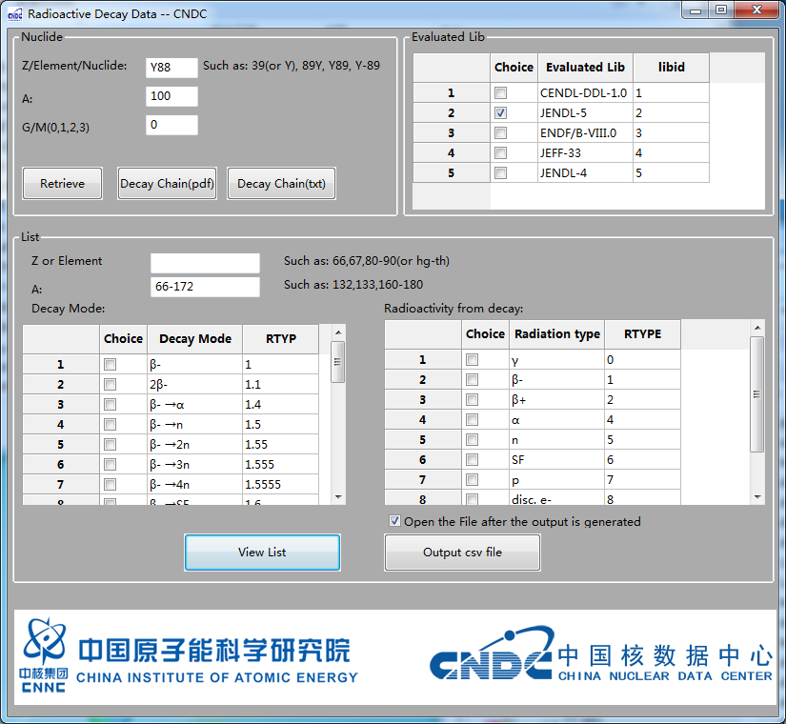
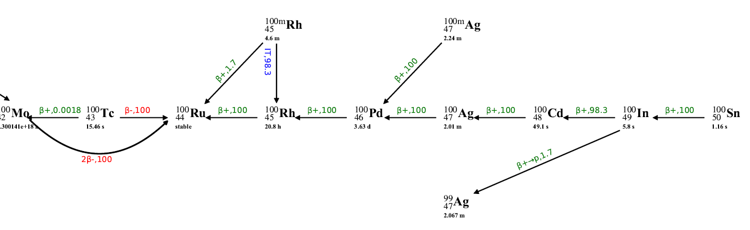
2 Examples
2.5 Decay（desktop）
Decay Chain for A=100
16

Slide 17
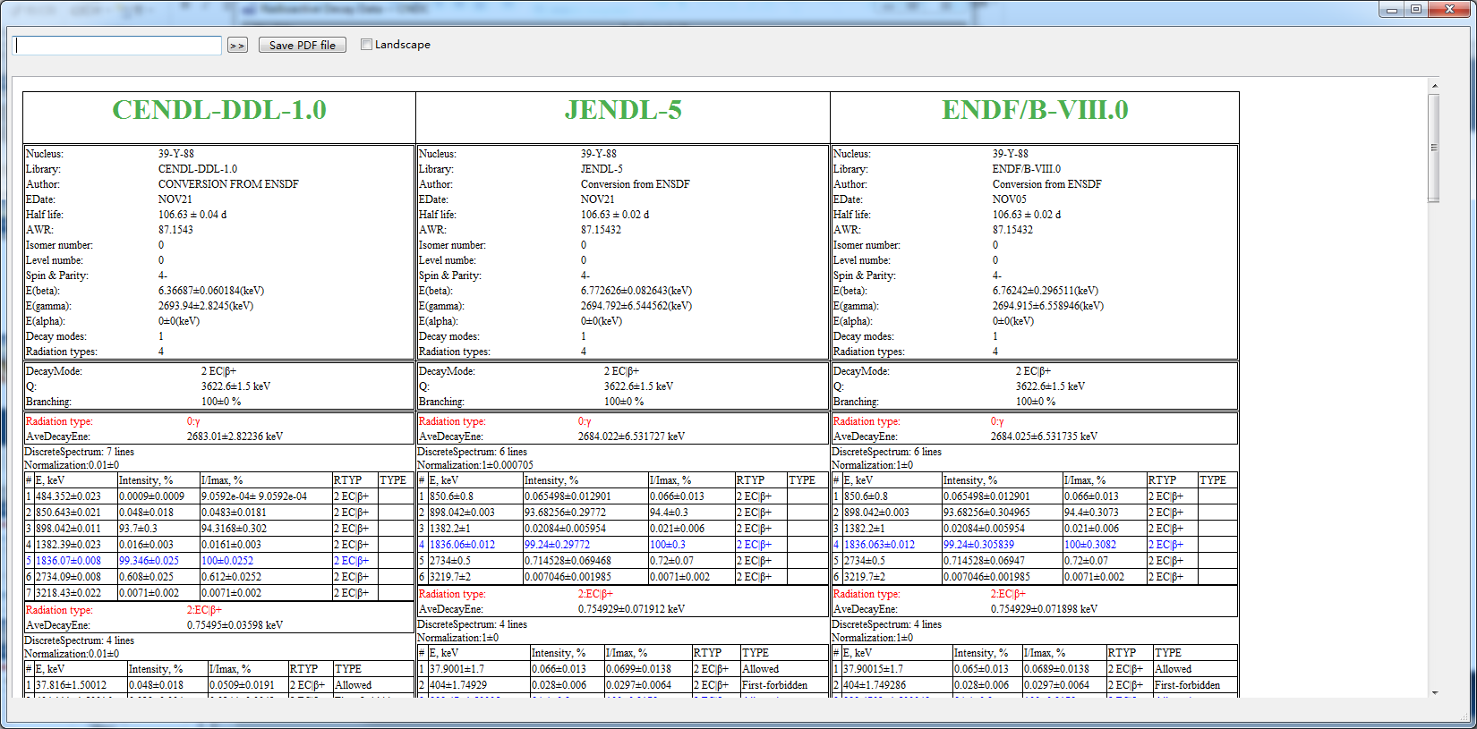
2 Examples
Yttrium-88
decay data for 39-Y-88
17

Slide 18
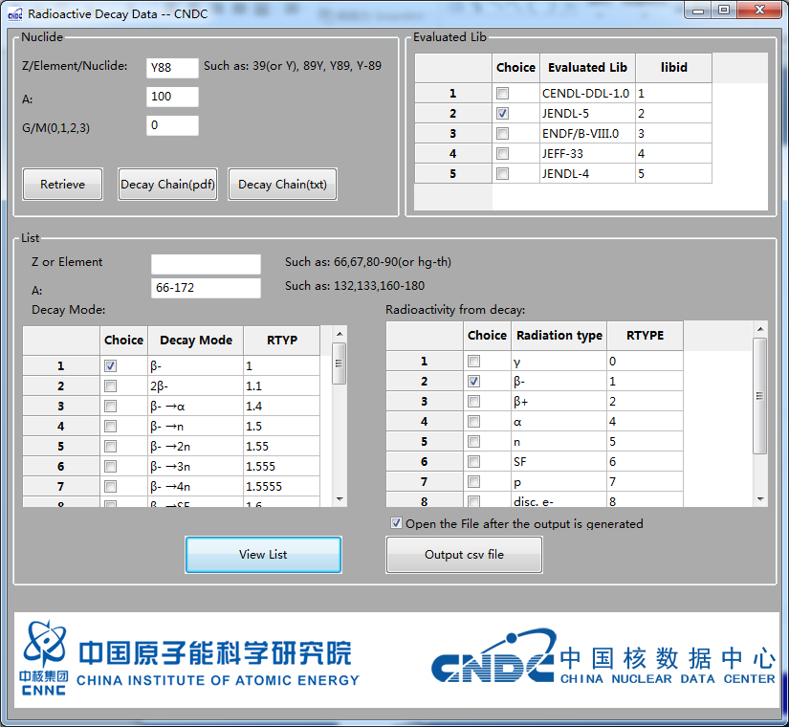
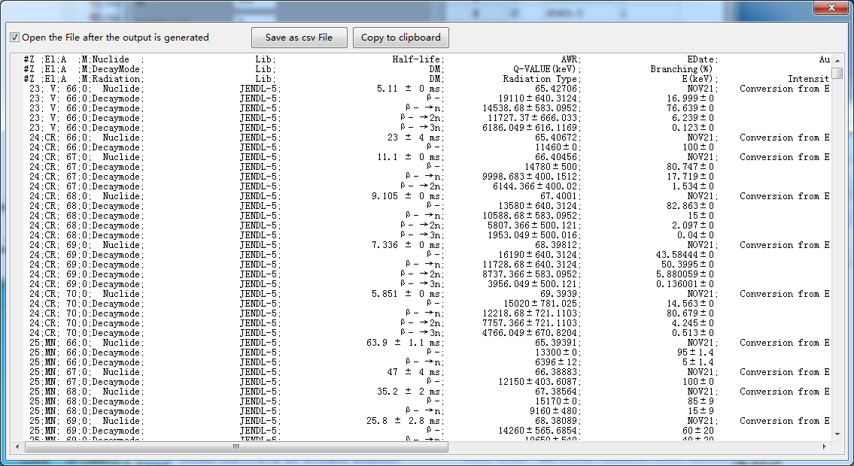
2 Examples
Lists
18

Slide 19
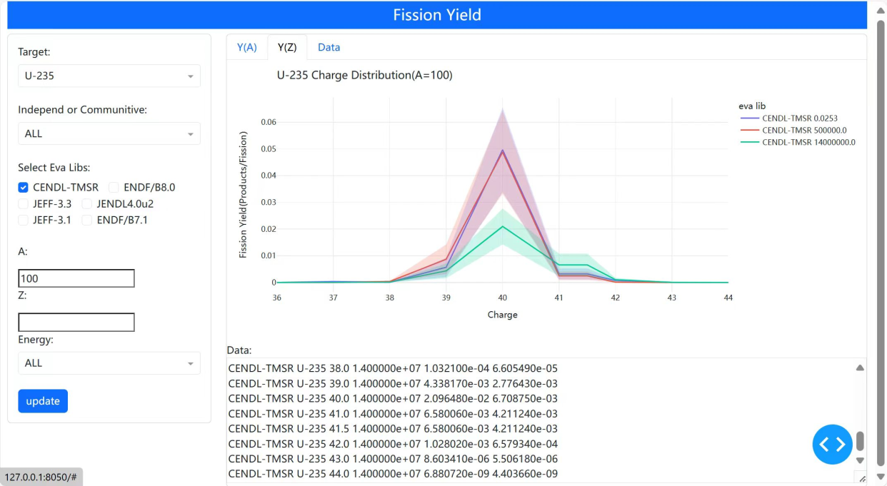
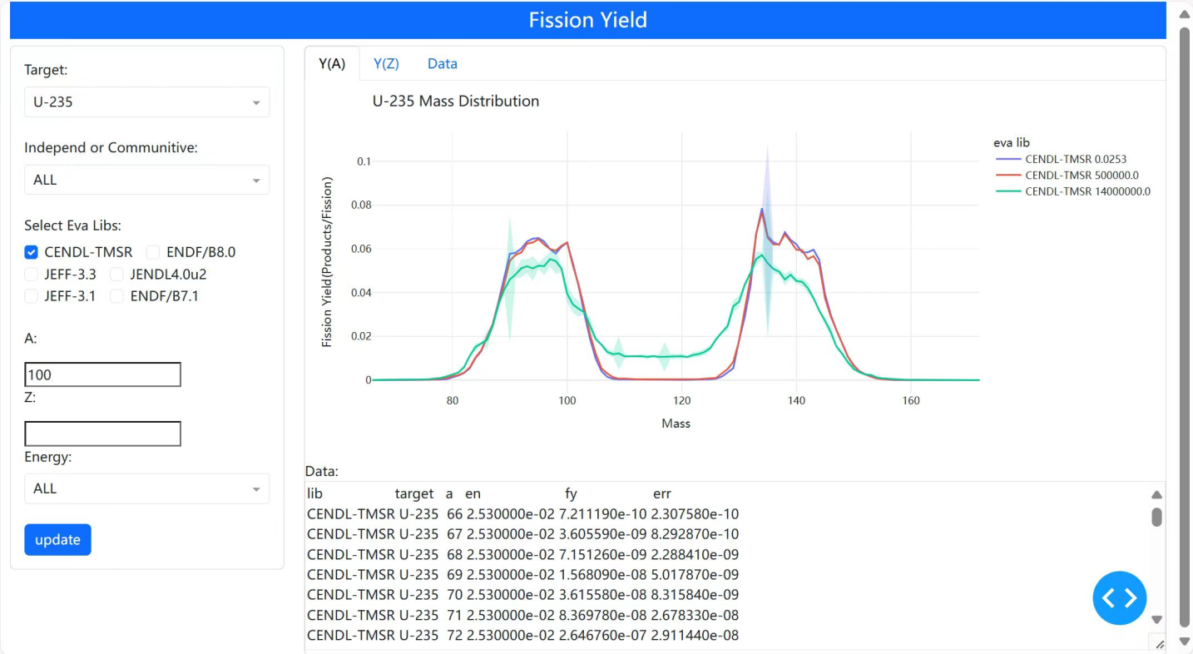
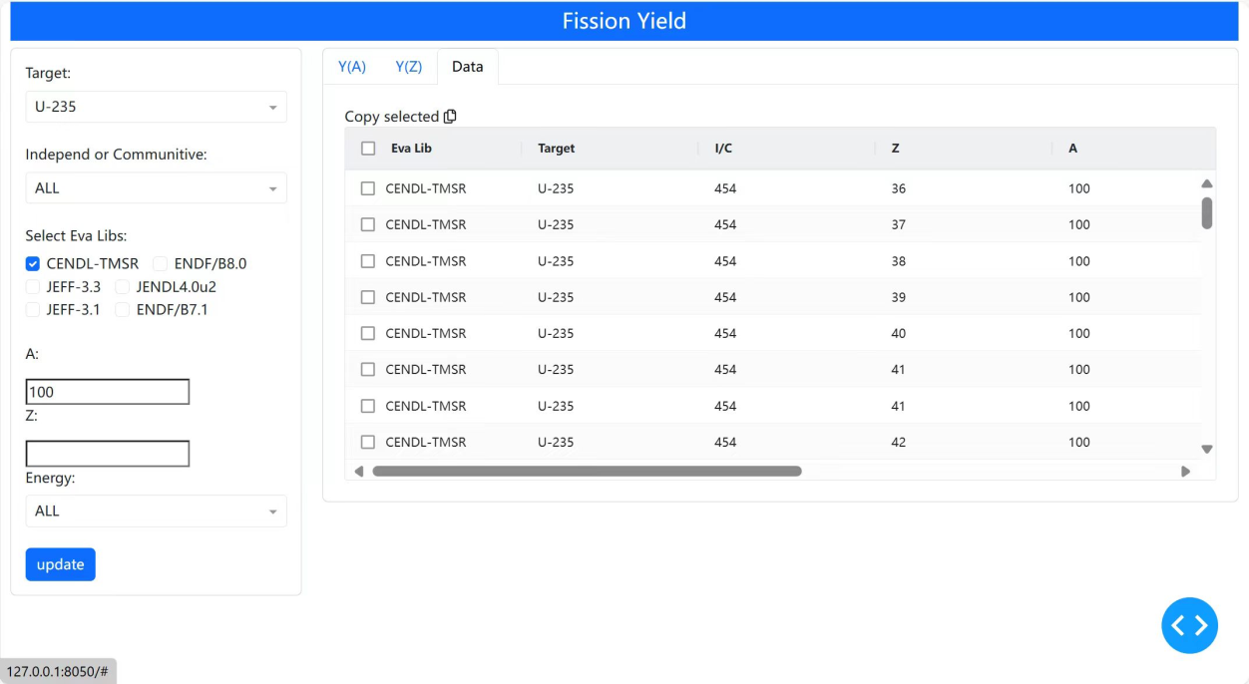
3 Works in Progress
3.1 Modernization of Legacy Code
Perl
Python
Plotly
Dash
19

Slide 20
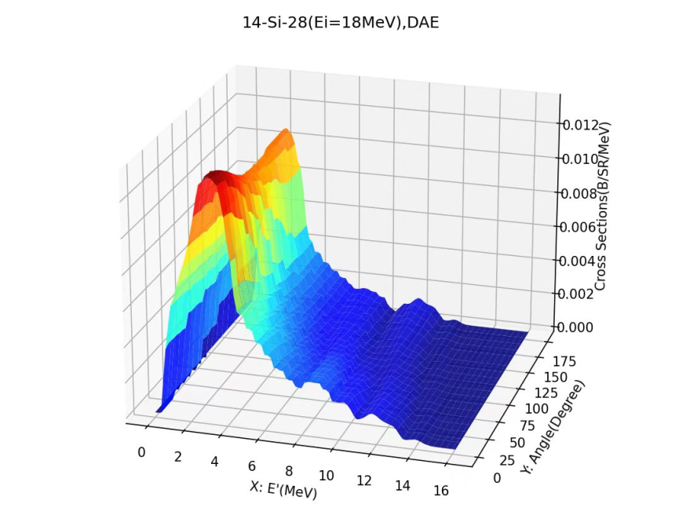
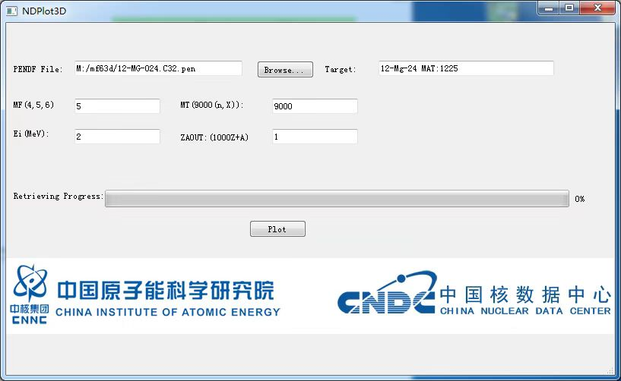
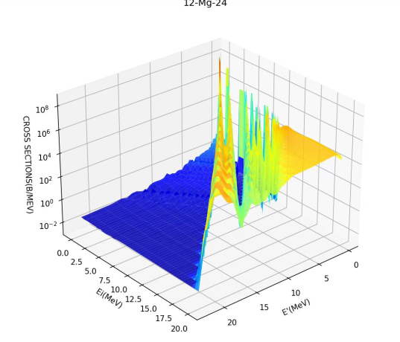
3 Works in Progress
3.2 NDPlot 3D
20

Slide 21
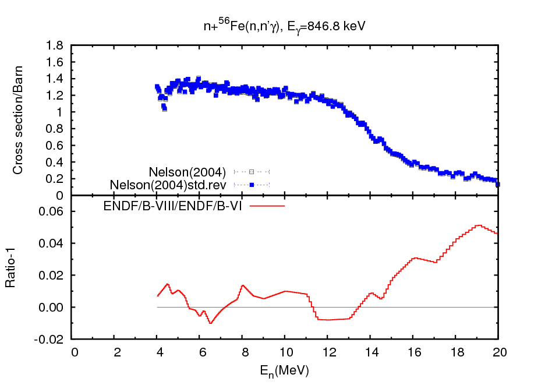
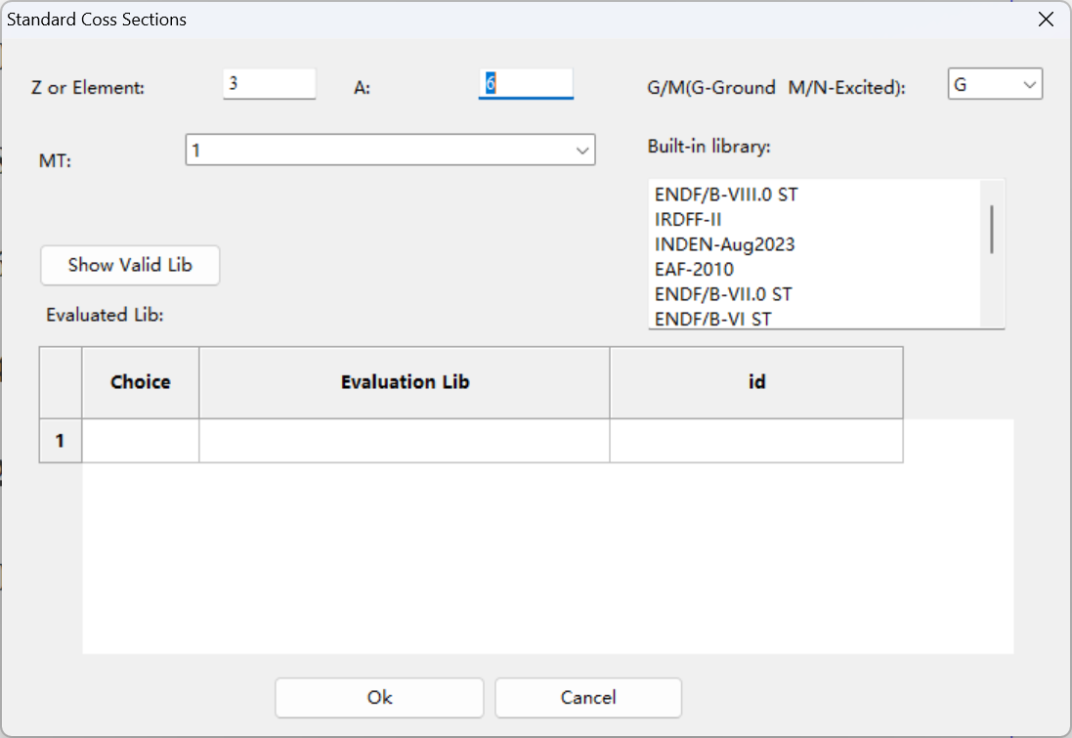
3 Works in Progress
3.3 Revise EXFOR Data with Standard Coss-sections
Reference Cross Section ²³⁵U(n,f), ENDF/B-VI
21

Slide 22
4 Summary
4 Summary
The NDS-C mainly utilizes a client-server architecture(desktop applications）.
It can satisfy some needs of both evaluators and non-evaluators.
Desktop applications are complementary to the web service.
It faces the challenges of modernization, including the upgrading of legacy codes and the adoption of the GNDS format.
The fields it covers are limited to our major works, not as extensive as other systems.
22

Slide 23
Thank you for your attention
23

