Slide 1
General Comments
The quality of the results presented were excellent, clearly articulating advances in understanding of many key issues facing the development of divertor concepts for future fusion devices
Increased participation from the stellarator community is very welcome, with signs of research priorities in common with tokamaks
We need to increase participation from engineering community to improve balance between engineering constraints and plasma physics-based solutions to the plasma exhaust problem
We will prepare a conference report paper summarising the topics discussed, conclusions and recommendations for future research priorities

Slide 2
Divertors for Next-Generation Devices
Substantial progress has been made to quantify the relative benefits of alternative divertor configurations
  Reduced steady-state heat loads
  Reduced sensitivity of detachment front position to actuator actions (e.g. upstream density, divertor radiated power, P_{SOL})
  Improved buffering of “small” transients
  Can test modelling tools in novel regimes (accentuates effects of drifts/cross-field transport, plasma-molecule interactions)
The ITER divertor design is complete but outstanding physics issues remain
  The conditions to access RMP ELM suppression are not fully understood
  The fidelity of the physics model in SOLPS-ITER simulations can significantly affect the predicted neutral pressure required for tolerable power loads. Improved ADAS rates for low ionisation states of Ar are required.

Slide 3
Divertors for Next-Generation Devices
The development of modelling tools continues to support divertor design and operation
  Frameworks to design divertors for complex geometries
  Neural network surrogates of higher fidelity plasma models for model-based control
Divertors should be as simple as possible to meet operational requirements(?)
  Simplicity/complexity depends on anticipated loads, which are highly device and concept dependent
  Operational requirements are uncertain – λ_{q} (q||) a key design driver as well as transient load cases
  What is the relative importance of detachment state controllability vs power and particle handling?
  Physics basis for conventional divertors is most mature, understanding of alternative divertors is improving but need to be tested under more reactor-relevant fluxes to quantify benefits

Slide 4
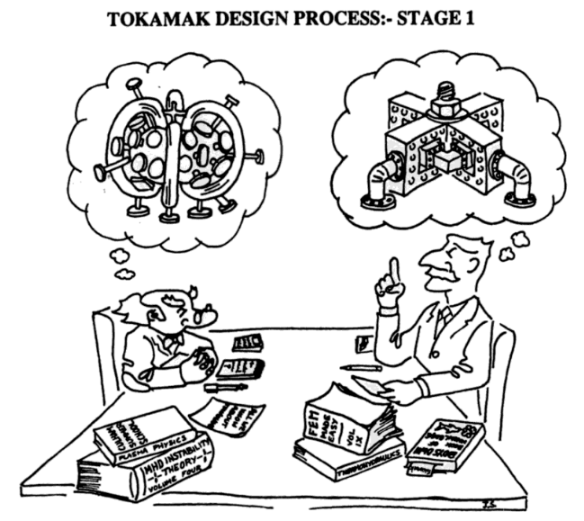
R. O. Dendy et al. “Plasma Physics: An Introductory Course”

Slide 5
X-Point Radiators
X-point radiators have been demonstrated in several experiments (TCV, MAST-U, AUG, DIII-D, EAST, JET) with multiple impurities (N, Ne, Ar, Kr)
  Clear trends of XPR stability/sensitivity observed with different impurities (e.g. Ne vs Ar), non-coronal effects play a role
  Changes in confinement are observed but no clear trends emerge
  Real-time control has been demonstrated with different sensors (bolometry, spectroscopy, interferometry), finding control is easier on larger machines
  But, control is required to avoid H-L transitions
  More work is needed to quantify neutral pressure/compression in CRD
  Need to understand and mitigate high far SOL heat fluxes in CRD
  Role of alternative divertor configurations needs to be quantified, clarifying role of radiators inside/outside LCFS
The pedestal becomes part of the plasma exhaust solution, a joint ITPA DivSOL-PEP meeting to discuss XPR research could be beneficial

Slide 6
X-Point Radiators
Modelling can qualitatively reproduce trends observed in experiments
More work is needed to achieve good quantitative agreement (recombination, timescales, distribution of radiation losses)
Influence of turbulent transport, drifts, neoclassical transport of impurities in the pedestal need to be assessed in multiple devices
Core-edge integrated modelling is needed for extrapolation from current devices
Issues with quality of Ar atomic data for low ionisation states need to be addressed
Development of 2D pedestal models including effects of impurities on transport is needed
Improved models of pedestal transport in regimes with strong poloidal asymmetries is required
Coupling of (normally) 1D core transport models with 2D descriptions of the pedestal
Core-edge integrated modelling is needed for extrapolation from current devices
  Further work is needed to define the characteristics of divertors optimised for the XPR regime
    Do XPRs offer the possibility of simplified divertor designs?

Slide 7
Divertor Engineering & Materials
Consensus that reactor divertor designs should seek simplicity over complexity
  Try to keep HHF areas to the minimum possible and screen as much as possible from direct neutron impact
  Avoid curved target regions and segment targets with non-monoblock technology in areas where heat fluxes are lower (e.g. due only to photons + CX) → different and adapted cooling circuits for each segment
  Do we know enough about neutron irradiation of advanced materials – too much Cu in W-Cu?
Give more thought to optimized monoblock design for HHF areas
  Bonding technology stable, but has been reticence in the community to probe beyond established recipe → study alternatives with wider MB’s, different cooling tube diameters and thicknesses → reduce number of welds, reduce bevel angles to hide leading edges → increase projected area
  MB thickness above cooling channel a compromise between resilience to heat impulses due to transients and stationary + slow transient power fluxes
  Optimise cooling efficiency by more sophisticated cooling channel design → role of additive manufacture?

Slide 8
Divertor Engineering & Materials
Composite materials look promising but care required in case of W-Cu → too high activation?
  Still many unknowns regarding even pure W response under high fluence, real tokamak exposure → latest results from WEST
Make divertor as compact as possible
  Easier to achieve required alignment tolerances on smaller sized components
  Reduce VV area with reduced neutron screening (divertor replaces blanket)
Consensus that reactor divertor cassettes can only be extracted as single units
  Cassette body fills blanket role at divertor location → objective is ensure PFCs and cassette body reach end-of-life (activation) simultaneously requiring exchange of the entire unit
  PFCs and cassette body can be decoupled in experimental reactors with lower fluence (see BEST)
Strong constrains on divertor engineering even if progress in physics:
  Physics : scenario development targets detached divertor regimes / no or mitigated ELM scenario / mitigated disruptions … but still need to design for off normal events (fast transients from unmitigated ELM/disruption or slow transients from re-attachment) : can we design a “inherently detached” solution ?

Slide 9
SOL and Divertor Physics
Significant advances have been made in the stellerator community
  Clearly identified aspects in common with tokamaks, e.g. volumetric losses and others that are distinct, e.g. role of Kelvin-Helmholtz instabilities driving radial transport, distribution of vol. losses
Good progress has been made to develop and apply frameworks such as SepOS to understand and predict operational space and the processes that govern it
  Approach would benefit from being applied to more and different devices to rigorously test underlying assumptions
  How can this approach be applied to stellerators?

Slide 10
SOL and Divertor Physics
Understanding and predicting radial transport is a key issue
  Substantial progress on development and testing of predictive models has been made in recent years and more (de-)validation against experiments is needed
  This is a common issue for tokamaks and stellerators (?)
  Given the importance of this topic, it is recommended that the next IAEA TM has a session dedicated to this
The legacy of wall recycling and impurity trapping in long pulses with impurity seeding is an issue (e.g. EAST, WEST) but is not universal (e.g. AUG)
New devices, including BEST, JT-60SA, DTT, SPARC offer opportunities to test models in new regimes

Slide 11
Towards Integrated Scenarios for Exhaust
ELM-free edge and pedestal regimes offer the possibility of combining acceptable core confinement and power exhaust
  Compatibility with He pumping is an open question and needs further research
  Underlying mechanisms governing pedestal transport in these regimes is not fully understood, hampering extrapolation to future devices
There is emerging evidence that core-divertor decoupling predicted in ITER-scale devices is observed in tightly baffled current experiments
  Eases independent control of density in the confined plasma and divertor detachment

Slide 12

The 6th IAEA Technical Meeting on Divertor Concepts will be hosted by ASIPP Hefei

