Slide 1
Divertor engineering and materials session: discussion (I)
R. A. Pitts, E. Tsitrone
Is impact of neutron irradiation sufficiently well understood?
    Should trying to shield HHF areas from neutron flux be more of a design driver?
    Structures behind main armour → are they determining the limit instead of the W?
    Do we know enough about neutron irradiation of advanced materials – too much Cu in W-Cu?
Is the monoblock design optimized?
    Bonding technology stable, but:
    Width → can relax bevel angle to limit reduction in projected area, fewer welds etc.
    Thickness above cooling channel (1.4 margin to CHF) – physics load spec, trade-off between stationary surface temperature and resilience to transients
    Cooling pipe dimensions (increased diameter, tube thickness)
Are monoblocks even really necessary everywhere?
    Minimize curved PFU designs – unnecessary complexity – MB’s only on straight regions?
    XPR/CRD type solutions may relax the need for extremely high stationary heat flux resilience and we should restrict the HHF areas to the absolute minimum
5th Technical Meeting on Divertor Concepts, IAEA HQ, Vienna, Austria 28 Oct. 2025
IDM UID: EEG3BQ

Slide 2
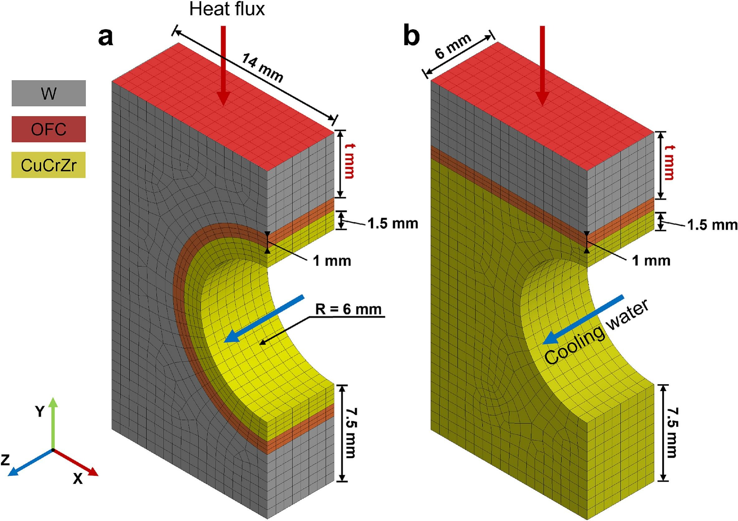
Divertor engineering and materials session: discussion (II)
R. A. Pitts, E. Tsitrone
Can MB’s be replaced by flat tile technology → combined with new advanced materials (e.g. W-K, W-Y₂O₃)?
    What comprehensive test program to be ready for DEMOs
What about completely different designs the for HHF components?
    Or use AM for more complex/optimized cooling channels?
    Need for permeation barrier?
    Liquid metal concepts losing any traction now?
Cassette design?
    Should reactors decouple cassette body from PFC’s → BEST solution, easier for remote maintenance /replacement
    Should any form of embedded diagnostic be simply excluded in reactor designs → makes cassette integration extremely difficult on ITER
    Consider designs optimized for new regimes (XPR)
T. Liu et al., IJRMHM 134 (2026) 107459
5th Technical Meeting on Divertor Concepts, IAEA HQ, Vienna, Austria 28 Oct. 2025
IDM UID: EEG3BQ
J. P. Gunn et al., NME 42 (2025) 101838

