Slide 1
IAEA Divertor Technical Meeting
Session Discussion – X-point Radiator
F. Reimold

Slide 2
Current Status of the X-point radiator scenarios
  X-point radiator observed & controlled
        On all machines along the ITER step-ladder
          TCV, MAST-U, AUG, DIII-D, EAST JET(, C-Mod)
        With multiple impurities (N, Ne, Ar, Kr)
          Sensitivity & stability different (Ne vs Ar)
        In multiple mag. configurations/shapes Triangularity, Snowflake,…
  Modeling show XPR consistently
        Qualitative match (mean field & turbulence)
        Quantitative status less clear
        Extrapolation to ITER & reactors promising
XPR control seems benign
    Easier for larger machines
    Different actuators (fast & slow)
    BUT: Occurrence of H-L transition (MAST-U)
ELM suppression at moderate confinement degradation
    Pedestal stability analysis (AUG, JET)
  Confinement improvement possible
    JET (Ne), AUG (N), DIII-D

Slide 3
Open challenges of the X-point radiator scenario
    Model validation
        Quantitative comparison (recombination,…)
        Timescales
        Detailed radiation distribution
          Radiation distribution (pol. smearing)
          Radiation features away from X-point in exp.
        Impact on turbulence, drifts, neoclassics (transport)
    Validated Core-Edge Integrated Modeling
        Impact on transport in pedestal
          Performance
          Impurity transport
          ELM-suppression
        Particle Exhaust
        Stability & Controllability
          Marfe, HL-transitions
    Particle exhaust (D & He)
        Little analysis on neutral pressure/compression (CRD)
          (far) SOL heatfluxes for compression?
          He enrichment possible?
      Heat transport
    Long-range transport & λ_{q}
          far SOL load (detachment)
          Baffling limits
Scaling to ITER/DEMO
    ELM-suppression
    Pedestal performance (screening/confinement)
    SOL transport

Slide 4
Guiding questions
    Physics base
    Do we understand particle exhaust?
          Sufficient coverage/analysis?
          He-exhaust
      What aspects of heat transport is missing?
          Λ_{q} scaling
          far SOL loads (baffling/MC erosion)
      Fundamental data complete
          Atomic data (Ar)?
    Do we have the tools to understand the impact on pedestal and core edge?
          Impurity transport (flux surface asymmetries)
          Confinement improvement in JET/AUG
    XPR location should matters: Role of ADCs?
          Inside/outside LCFS
      Tungsten transport & redeposition (pedestal & SOL)
What is required to trust scaling to ITER/DEMO?
    Pedestal performance
      Imp. Screening& confinement (improvement)
    ELM-suppression
    SOL transport
    Device size scaling (JET pedestal)
    Modeling for extrapolation
    Validation – current mismatches:
          Timescales, (a)symmetries, recombination, non-coronal effects, drift effects (ExB vortex)
    Predictive Core-Edge Integrated Modeling (incl. validation)
          Validation effort for an ITER-step ladder?
          What parts are missing?

Slide 5
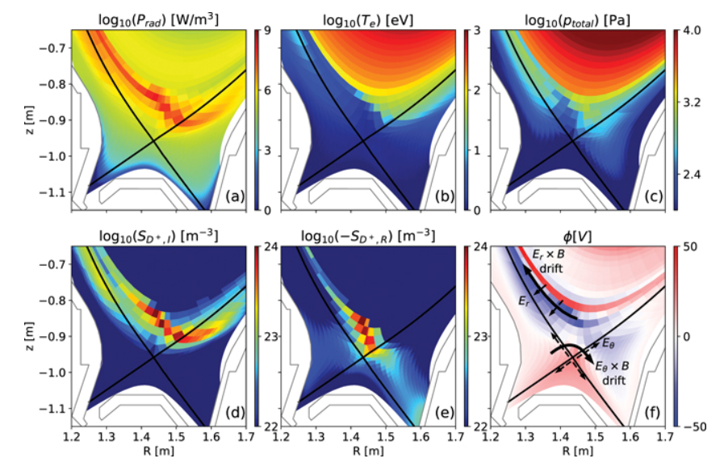
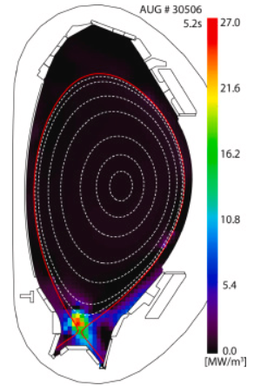
Open challenges of the X-point radiator scenario
O.Pan NF 63 (2022)
M. Bernert NME 43 (2025)

