Slide 1






Progress towards JINTRAC integrated modelling of X-point radiators
S.Q. Korving¹, A. Loarte¹, A. Pshenov¹, F. Köchl¹, M. Bernert², O. Pan², R.A. Pitts¹, R. Futtersack³, S.D. Pinches¹, S. Wiesen⁴, ASDEX Upgrade team, WPTE team.
¹ ITER Organization, ²Max-Planch-institute fur Plasmaphysik, ³CCFE, ⁴DIFFER
Disclaimer: The views and opinions expressed herein do no necessarily reflect those of the ITER Organization, European Union or the European Commission

Slide 2
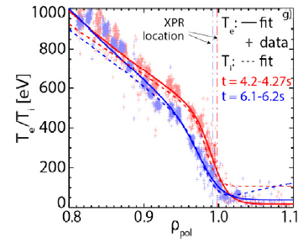
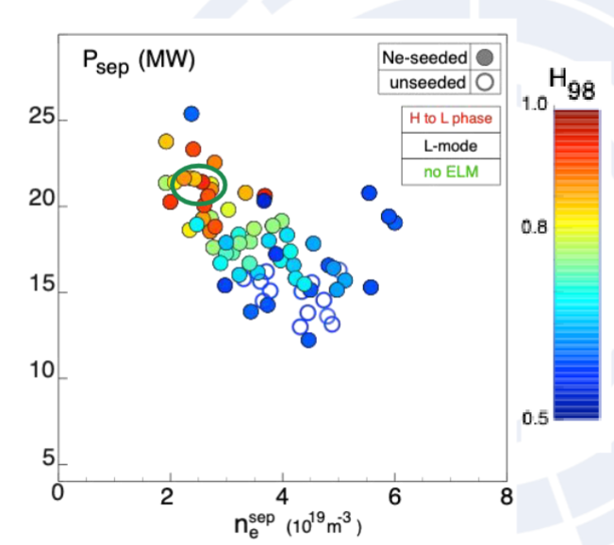
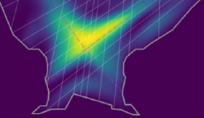
The need for integrated modelling tools
Bernert et al, NME 2025
Modeling work regarding the XPR has been focused on divertor and SOL characteristics
For burning plasmas, a critical question is the core-edge compatibility of these XPR regimes
Such assessments require integrated modelling
Our approach is to deploy and further develop the modelling code suite JINTRAC in IMAS
ELMy
No ELMs
XPR
Giroud et al, NF 2024
Giroud, IAEA FEC 2025

Slide 3
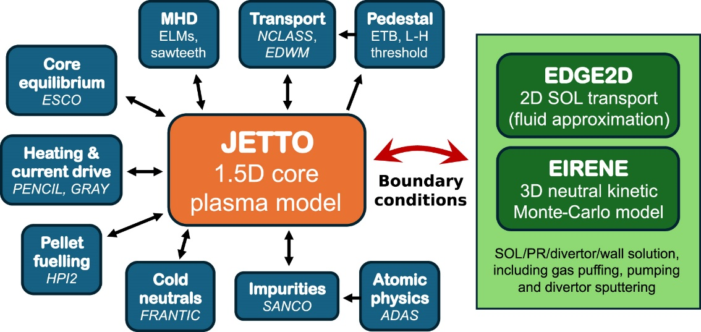
What is the JINTRAC code suite?
Consists of 1.5D core model
And 2D edge/SOL model
Running JETTO + EDGE2D together
“Coconut”
When coupled to DINA, we call it the High-Fidelity Plasma Simulator (HFPS)
Tholerus et al, NF 2025

Slide 4
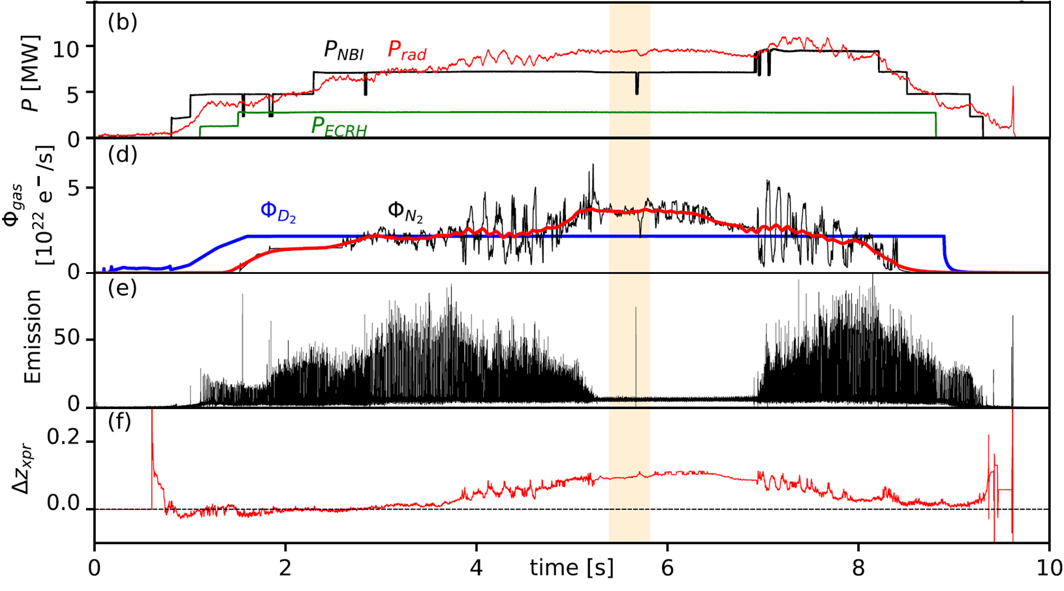
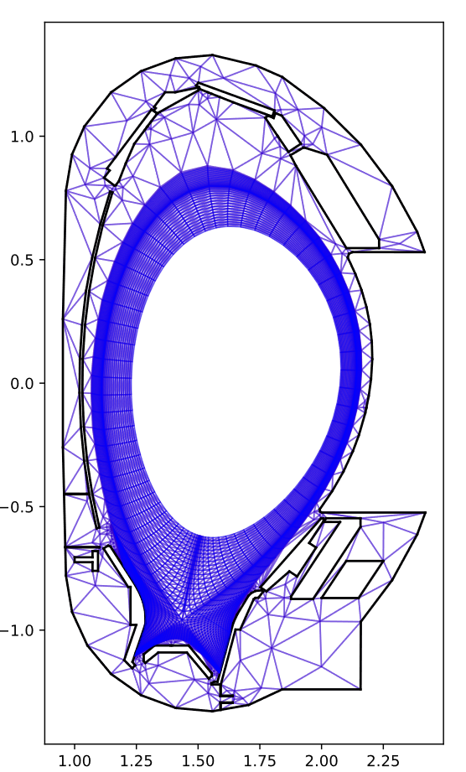
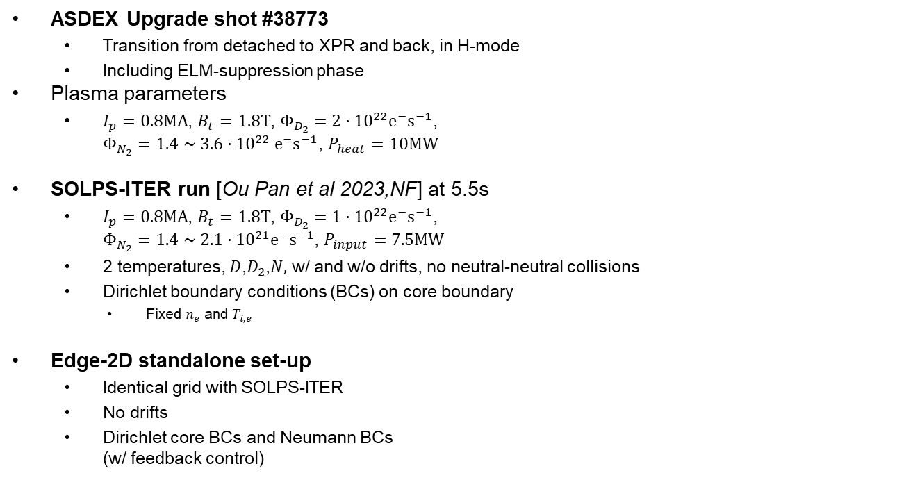
First steps: benchmark EDGE2D-EIRENE
ASDEX Upgrade shot #38773
Transition from detached to XPR and back, in H-mode
Including ELM-suppression phase
Plasma parameters
$I_{p}=0.8MA$, $B_{t}=1.8T$, $Φ_{D_{2}}=2⋅{10}^{22}{e^{−}s}^{−1}$, $Φ_{N_{2}}=1.4∼3.6⋅{10}^{22} {e^{−}s}^{−1}$, $P_{heat}=10MW$
SOLPS-ITER run [Ou Pan et al 2023,NF] at 5.5s
$I_{p}=0.8MA$, $B_{t}=1.8T$, $Φ_{D_{2}}=1⋅{10}^{22}{e^{−}s}^{−1}$, $Φ_{N_{2}}=1.4∼2.1⋅{10}^{21}{e^{−}s}^{−1}$, $P_{input}=7.5MW$
2 temperatures, $D$,$D_{2}$,$N,$ w/ and w/o drifts, no neutral-neutral collisions
Dirichlet boundary conditions (BCs) on core boundary
Fixed $n_{e}$ and $T_{i,e}$
Edge-2D standalone set-up
Identical grid with SOLPS-ITER
No drifts
Dirichlet core BCs and Neumann BCs (w/ feedback control)
Pan et al, NF 2023

Slide 5
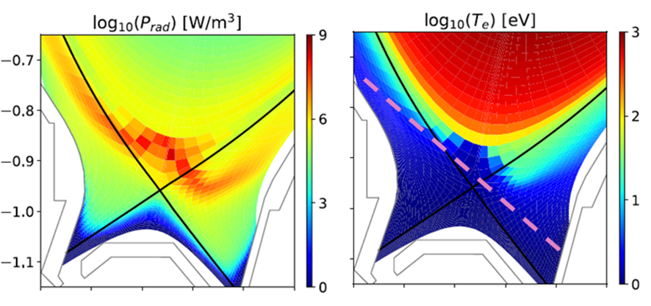
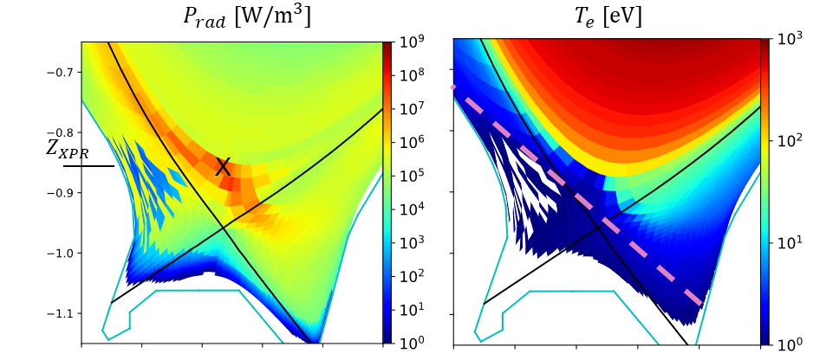
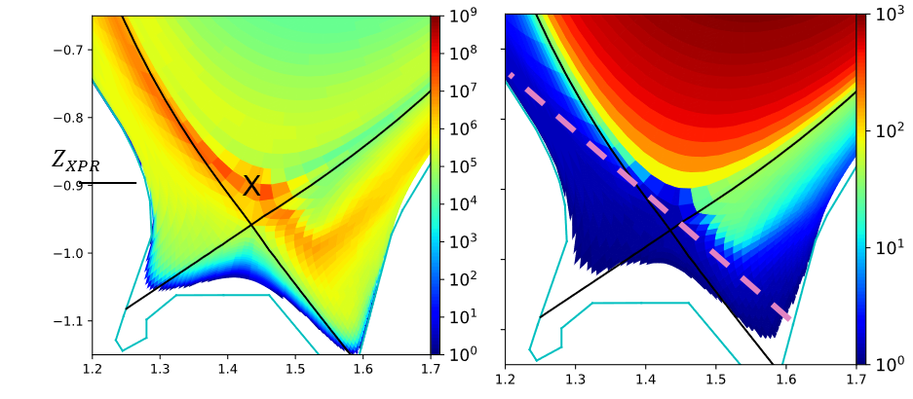
Comparison of ELM suppressing XPR
Pan et al, NF 2023
EDGE2D-Eirene Dirichlet core BC
SOLPS-ITER, Dirichlet core BC
Divertor Thompson scattering
EDGE2D-Eirene, Neumann core BC

Slide 6
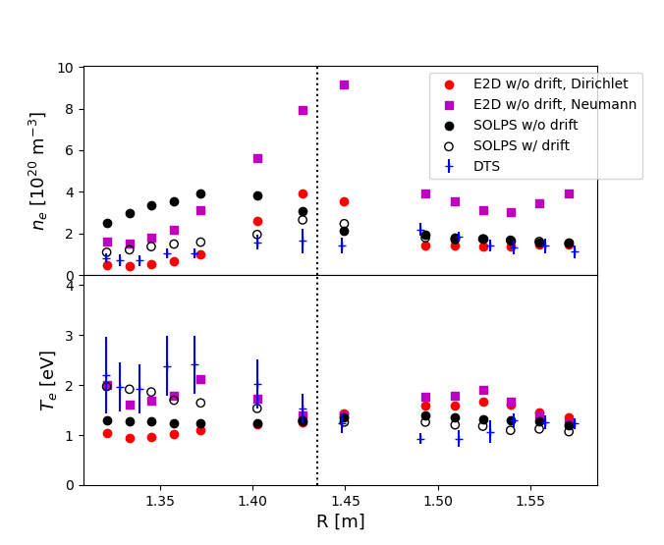
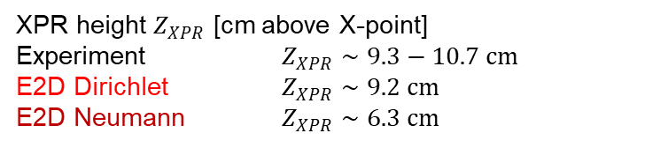
Comparison of ELM suppressing XPR
EDGE2D-Eirene Dirichlet core BC
XPR height $Z_{XPR}$ [cm above X-point]
Experiment $Z_{XPR}∼9.3−10.7 cm$
E2D Dirichlet $Z_{XPR}∼9.2 cm$
E2D Neumann $Z_{XPR}∼6.3 cm$
EDGE2D-Eirene, Neumann core BC

Slide 7
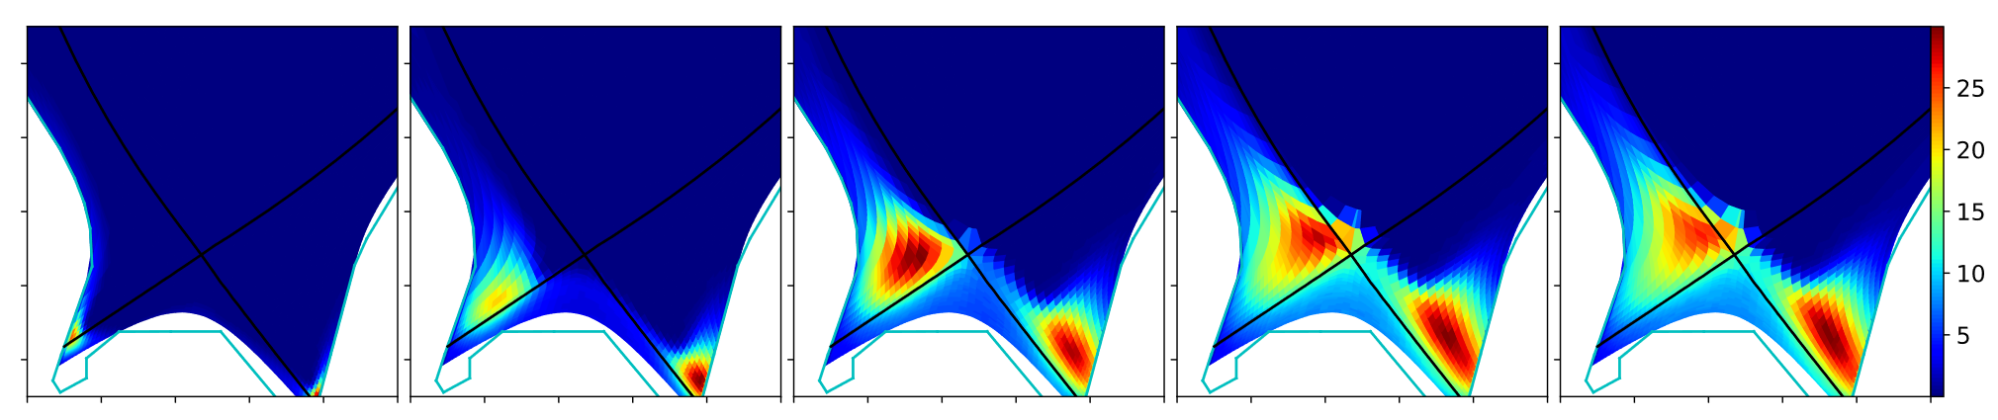
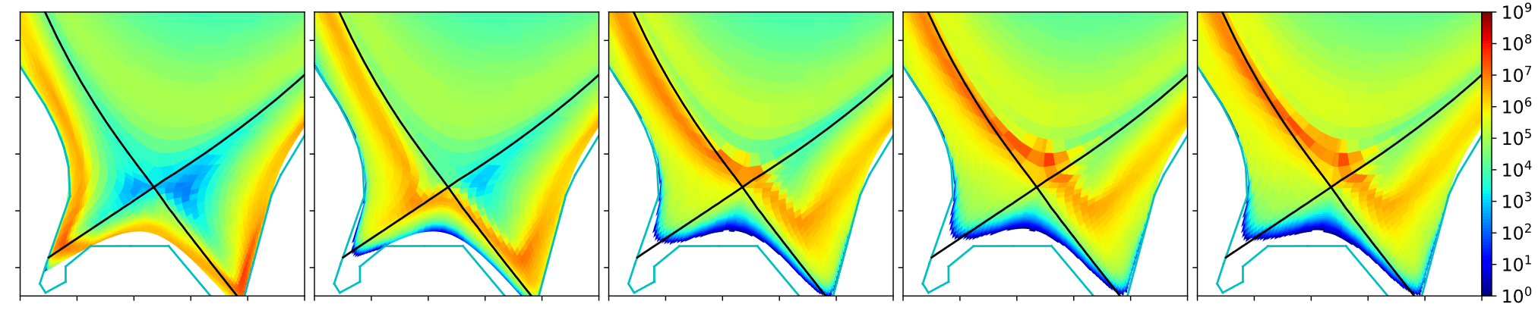
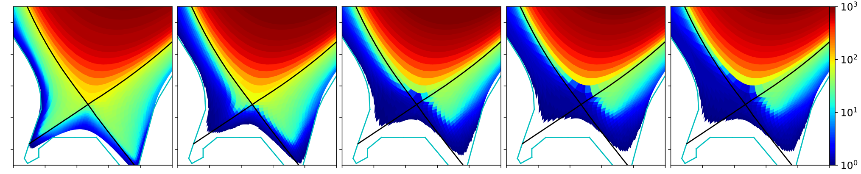




Flux-driven boundary conditions & time dependent runs
Neumann boundary conditions are applied at the core boundary, as it would for core-edge coupling.
Heating power is prescribed.
$$p_{neutrals}^{∗} [Pa]$$
$$P_{rad} [W/m^{3}]$$
$$T_{e} [eV]$$
$$t[ms]=$$
5
20
30
40
55

Slide 8
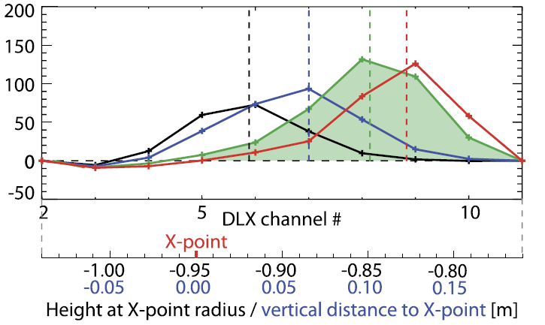
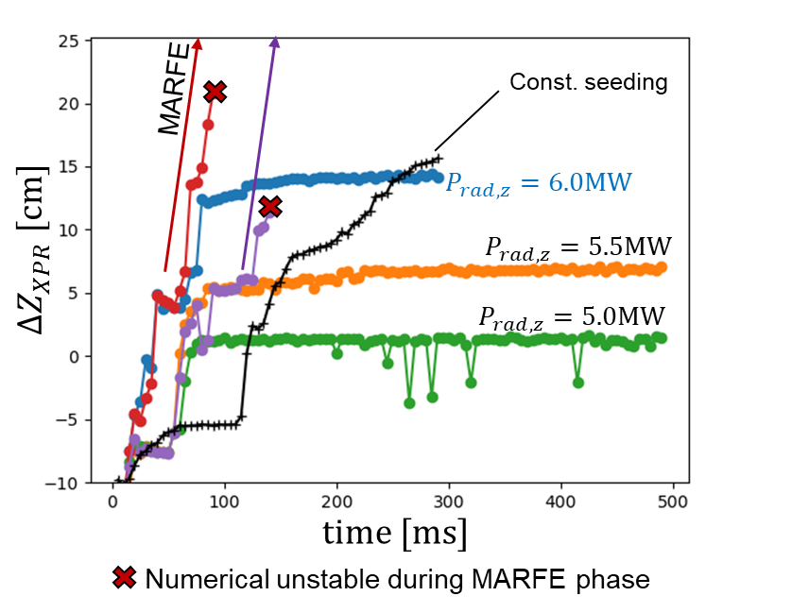
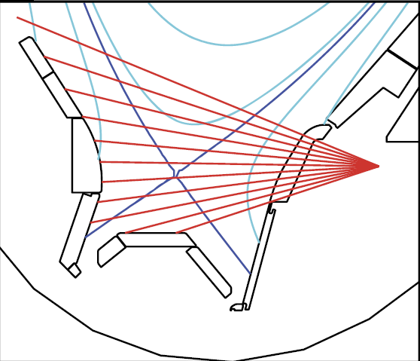


Active feedback control
Control parameter: $P_{rad,imp}$, actuator: seeding rate.
XPR height as diagnostic
Using XPR height as control parameter is being implemented in EDGE2D.
DLX signals
N
$$Δz_{XPR} [cm]$$
N
N
Bernert et al, NF 2021

Slide 9
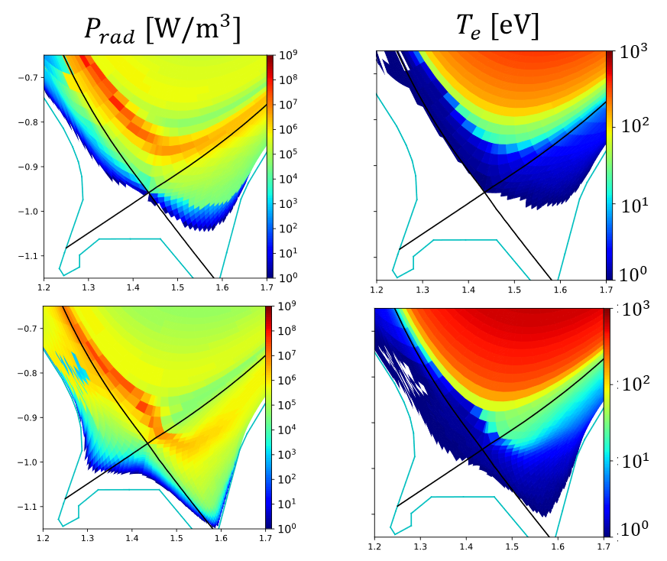
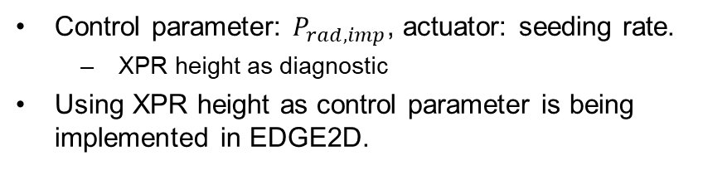

Active feedback control
Control parameter: $P_{rad,imp}$, actuator: seeding rate.
XPR height as diagnostic
Using XPR height as control parameter is being implemented in EDGE2D.
Unstable XPR
(MARFE)
N
$$Δz_{XPR} [cm]$$
N
N
$$P_{rad,N}=6MW$$

Slide 10
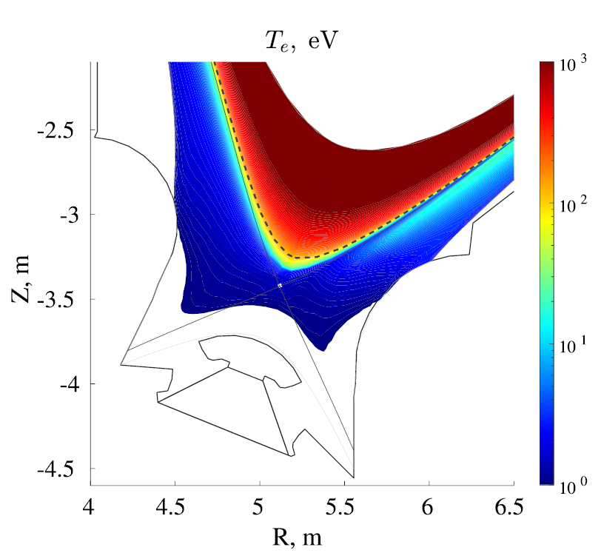
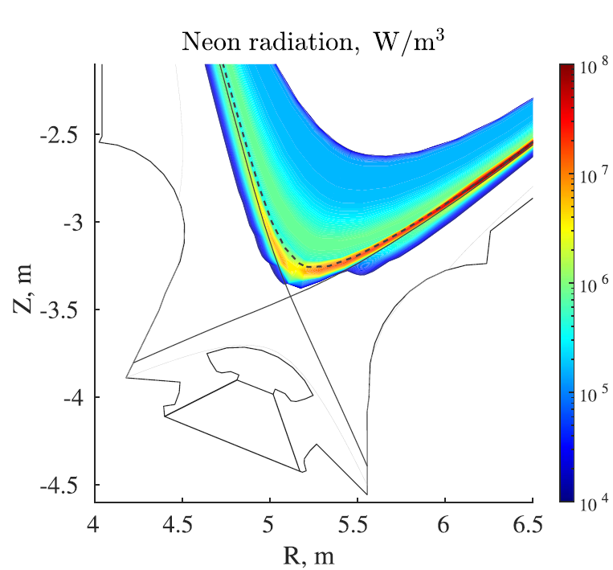
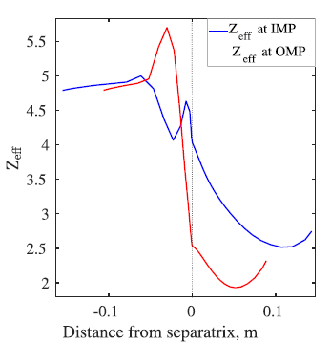









ITER 15MA XPR – SOLPS-ITER w/ drifts
First ITER XPR by Poletaeva et al. NF, 2024
Shows an XPR regime can exists, explores driving mechanisms of XPR location
Deep XPR, Fixed core BCs, high Zeff
Needed 150MW input power to stabilize XPR.
Poletaeva et al. NF, 2024
$${10}^{3}$$
$${10}^{8}$$
$${10}^{7}$$
$${10}^{2}$$
$${10}^{6}$$
$${10}^{1}$$
$${10}^{5}$$
$${10}^{0}$$
$${10}^{4}$$

Slide 11
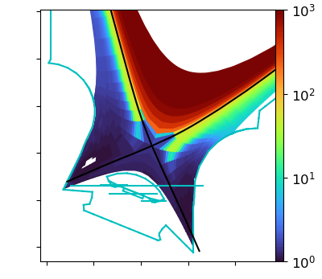
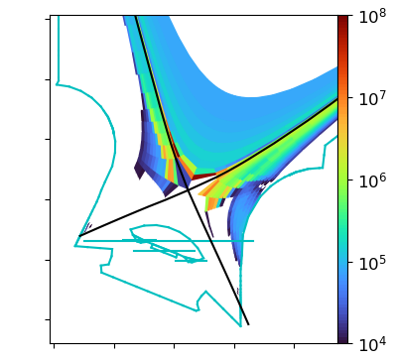
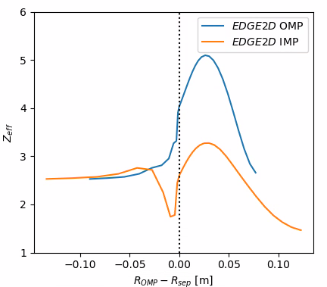
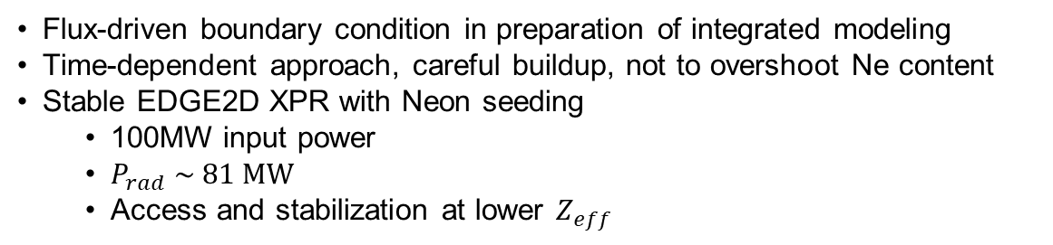



ITER 15MA XPR – EDGE2D w/o drifts
Flux-driven boundary condition in preparation of integrated modeling
Time-dependent approach, careful buildup, not to overshoot Ne content
Stable EDGE2D XPR with Neon seeding
100MW input power
$P_{rad} \sim 81 MW$
Access and stabilization at lower $Z_{eff}$
$$T_{e}[eV]$$
$$P_{rad,Ne}[MWm^{−3}]$$
$Z_{eff}$ on MP

Slide 12
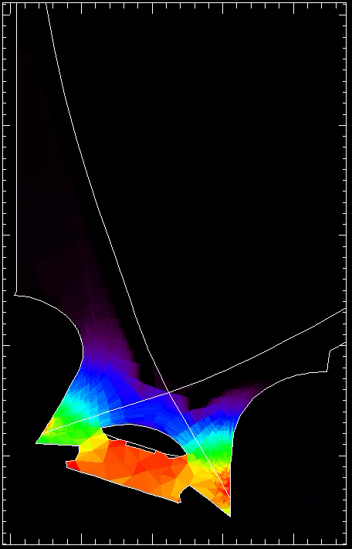
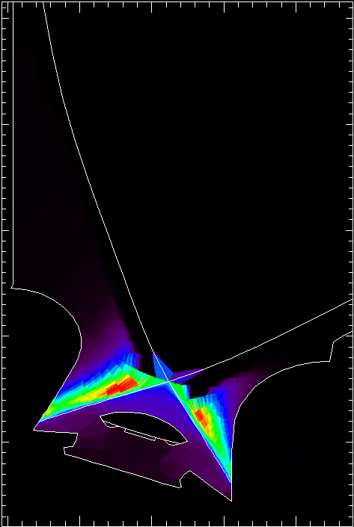
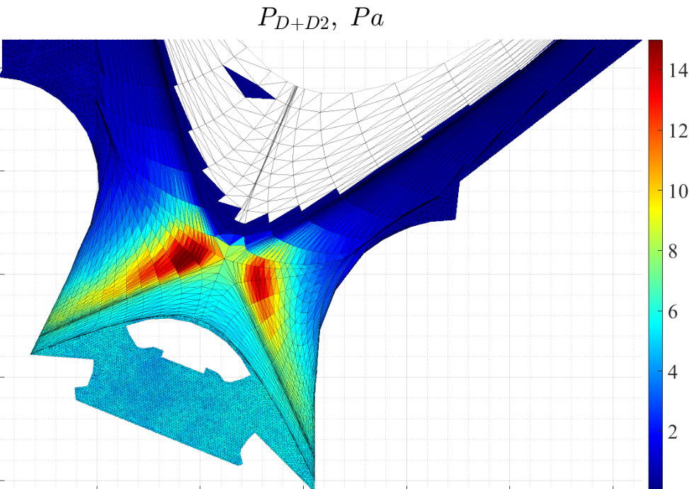




ITER 15MA XPR - EDGE2D w/o drifts
Indication on subdivertor pressure
$D_{2}+D \sim$ 7 Pa
no n-n collision
$$p_{D_{2}}$$
Pa
$$p_{D}$$
4.8
4
96
SOPS-ITER
3.2
64
2.4
1.6
0.8
32
$$\sim 6 Pa$$
Courtesy of A. Poletaeva

Slide 13
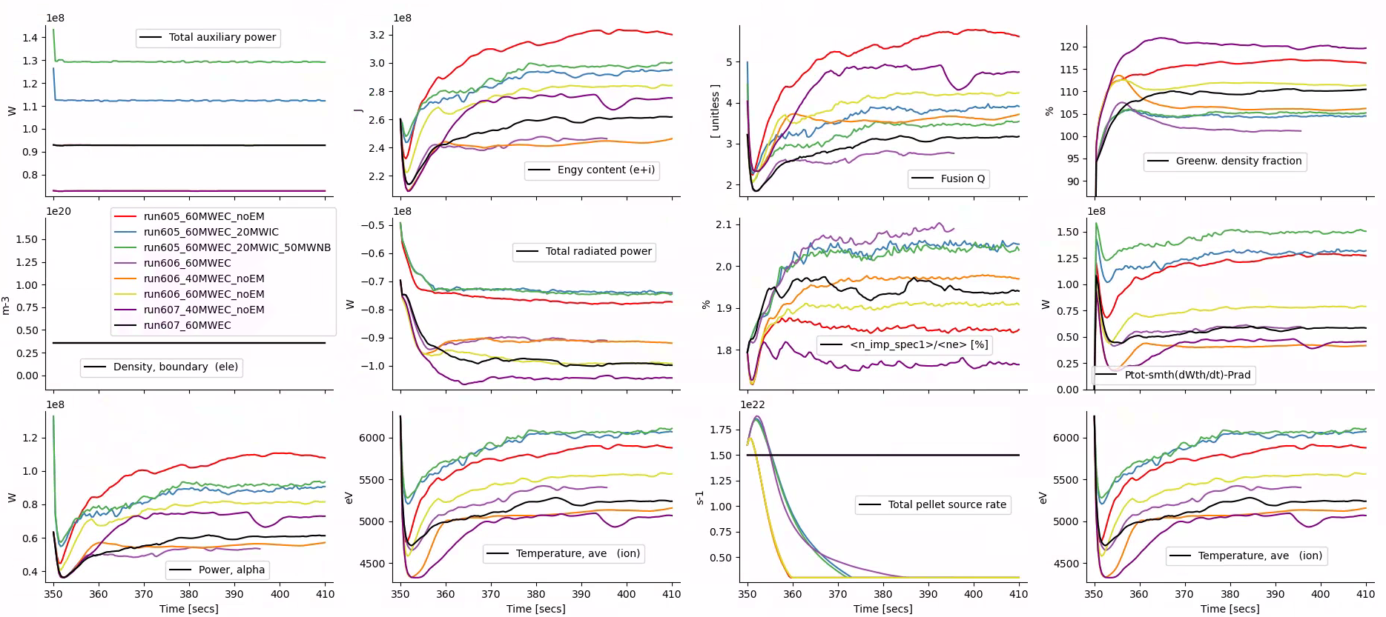
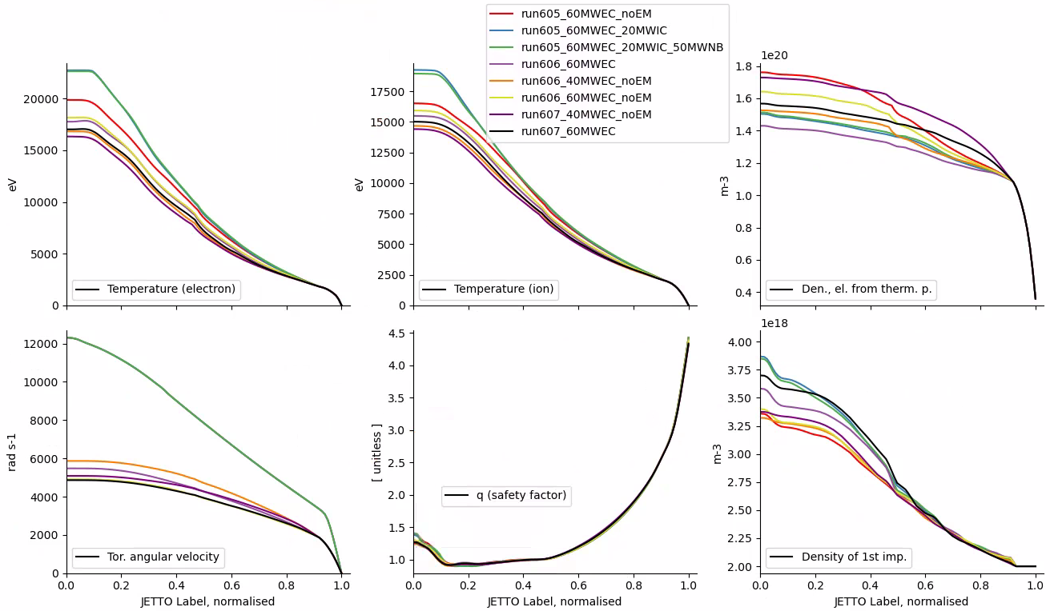





ITER 15MA XPR - JETTO
Simplest implementing modeling approach, use EDGE2D parameters as inputs for JETTO
Then run JETTO standalone
Try several heating schemes and transport models
Could such a scenario be at least stable?
Perhaps an indication on the worst-case scenario
60MW EC, no EM turbulence
60MW EC, 20MW IC
60MW EC, 20MW IC, 50 MW NBI
60MW EC
40MW EC, no EM turbulence
60MW EC, no EM turbulence
40MW EC, no EM turbulence
60MW EC
$$Ne density [{10}^{18}m^{−3}]$$
$$Fusion Q [−]$$
$$\sim 2\% Ne concentration$$
$$ρ [−]$$
$$time [s]$$

Slide 14
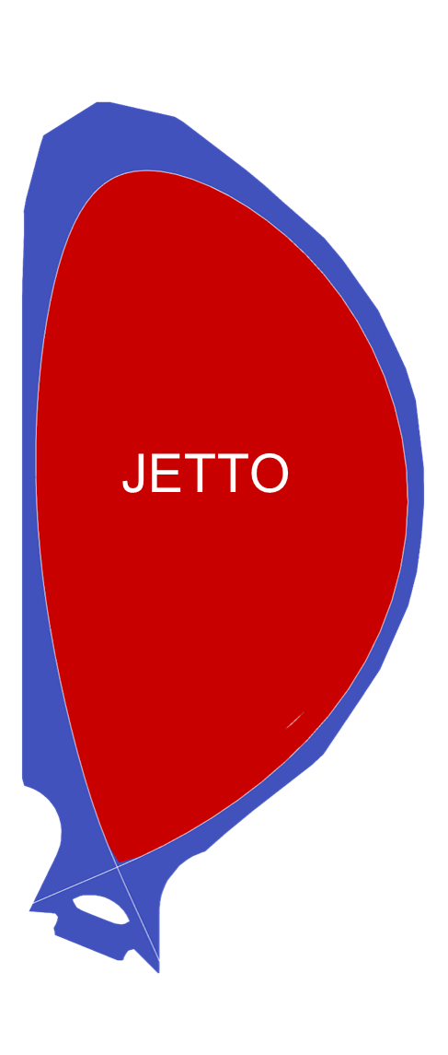
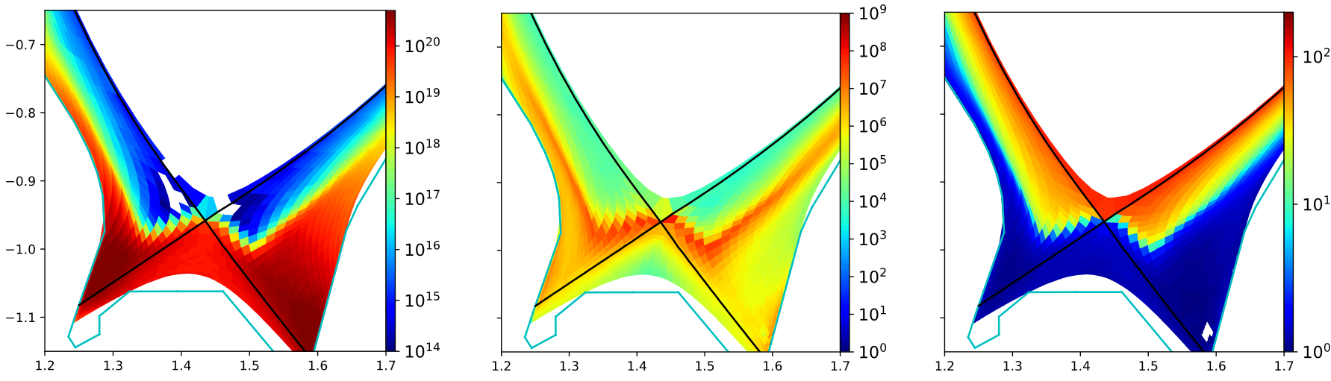



Current state of integrated modeling with JINTRAC
Core-edge coupling at separatrix
JETTO takes flux-surface average
Need for 2D description of pedestal
EDGE2D
Example for ASDEX Upgrade
$$n_{D} [\#/m^{3}]$$
$$P_{rad} [W/m^{3}]$$
$$T_{e} [eV]$$

Slide 15
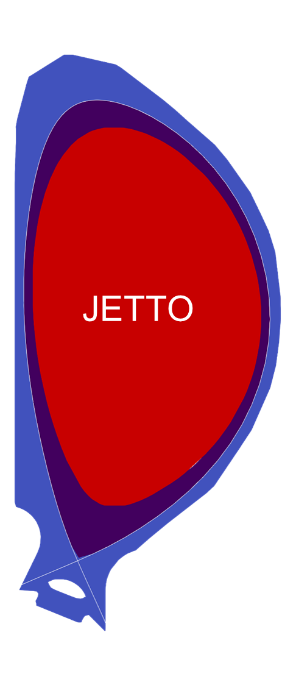
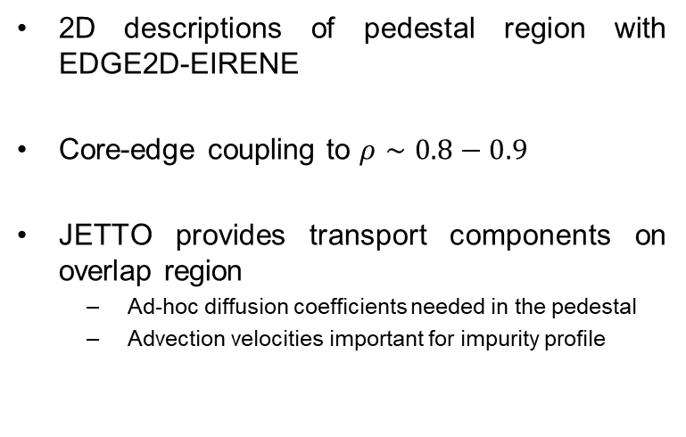
Current development
2D descriptions of pedestal region with EDGE2D-EIRENE
Core-edge coupling to $ρ∼0.8−0.9$
JETTO provides transport components on overlap region
Ad-hoc diffusion coefficients needed in the pedestal
Advection velocities important for impurity profile
EDGE2D
EDGE2D
Overlap

Slide 16
Conclusion
Integrated modeling needed as the feedback of the SOL/edge on the core are important.
core-edge compatibility of XPR regime in ITER
EDGE2D-Eirene can produce stable XPR regime simulations
Ongoing:
Test new core-edge coupling scheme with overlap region
Validation of Integrated model with ASDEX Upgrade scenario

Slide 17
Status of research
1 Multiple models/codes arrive to very similar XPR conditions.
2 Time-dependent XPR modeling with feedback control
3 Core-edge integration with 2D edge is now possible
Open questions
1 Core-edge compatibility for high-performance ITER plasmas
2 ELM-free access to high-performance plasma’s
3 Correct XPR pedestal transport model & validation

Slide 18
Backup slides

Slide 19
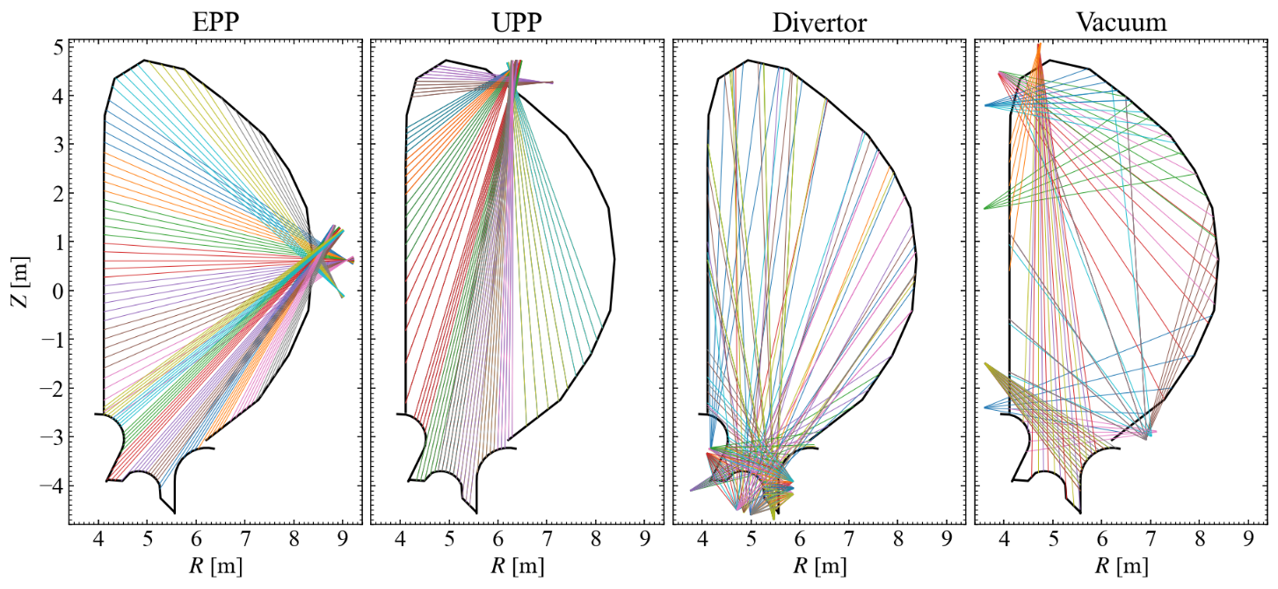
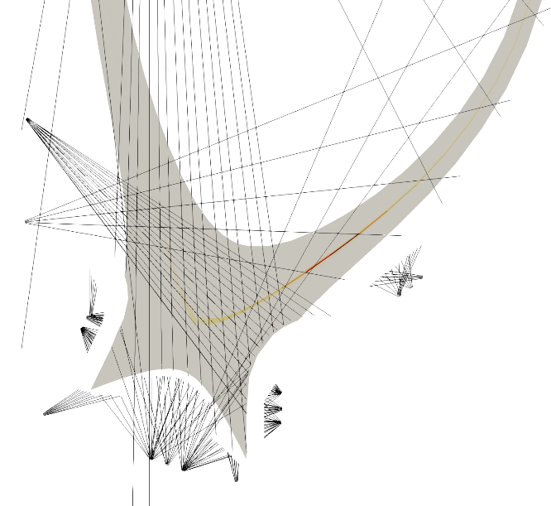
XPR might sit above the divertor
Bolometers do cover sufficient lines of sight to measure the radiation spot.

