Slide 1
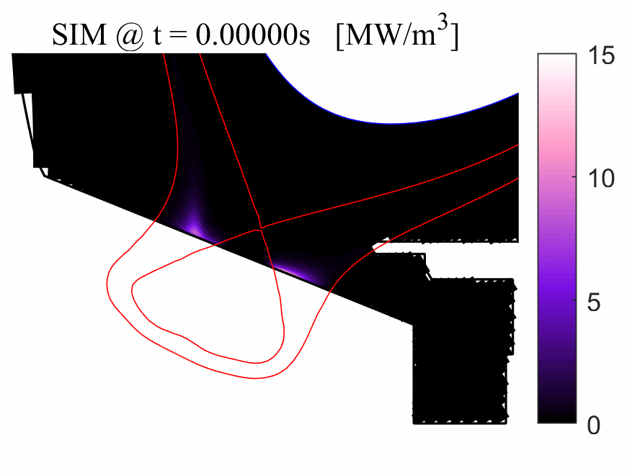
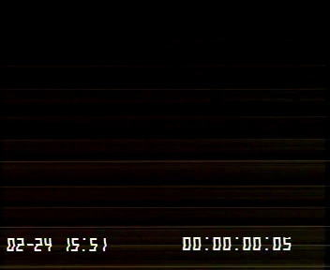



Experimental characterization and numerical investigation of
X-point radiator regime in WEST
WEST EXP :
#57929
SOLEDGE3X-EIRENE SIMU
E. Serre¹, H. Yang¹, Y. Kudashev¹, H. Bufferand², G. Ciraolo², N. Fedorczak², N. Rivals², P. Tamain² & WEST team²
¹Aix Marseille Univ., CNRS, Ecole Centrale Marseille, M2P2 UMR 7340
²IRFM, CEA Cadarache, F-13108 St. Paul-lez-Durance
This work has been carried out within the framework of the EUROfusion Consortium, funded by the European Union via the Euratom Research and Training Programme (Grant Agreement No 101052200 — EUROfusion). Views and opinions expressed are however those of the author(s) only and do not necessarily reflect those of the European Union or the European Commission. Neither the European Union nor the European Commission can be held responsible for them.
Fifth Technical Meeting on Divertor Concepts

Slide 2
CONTEXT AND MOTIVATIONS
Context: XPR regime in WEST
WEST: a tungsten environment tokamak with an actively cooled ITER-grade divertor operated at CEA Cadarache
Bifurcation into X-point radiator regime is obtained in L-mode discharges with 4MW LHCD
Improved L-mode XPR scenario was obtained lasting >20s [Fedorczak et al. ITPA DivSOL 23]
Motivations : the rapid dynamics to XPR
Focus on the rapid dynamics (~ms) observed from attached outer target to XPR [Rivals et al. NME 2024]
Provide new insights on the mechanisms underlying this transition using time-dependent transport simulations
Perform a cross-validation exercice between WEST and SOLEDGE3X-EIRENE [Bufferand et al. NF 2021]
Notes:
ITER successful operation : high performance in the core + controlling heat exhaust [Pitts et al. 2019] Pitts et al. Nucl. Material and Energy 2019

Slide 3
OUTLINE
WEST EXPERIMENT & SOLEDGE3X-EIRENE SET-UP
TRANSITION FROM ATTACHED TO XPR: EXPE VS SIMU
NUMERICAL INSIGHTS ON XPR DEVELOPMENT
CONCLUDING REMARKS AND PERSPECTIVES

Slide 4
OUTLINE
WEST EXPERIMENT & SOLEDGE3X-EIRENE SET-UP
TRANSITION FROM ATTACHED TO XPR: EXPE VS SIMU
NUMERICAL INSIGHTS ON XPR DEVELOPMENT
CONCLUDING REMARKS AND PERSPECTIVES

Slide 5
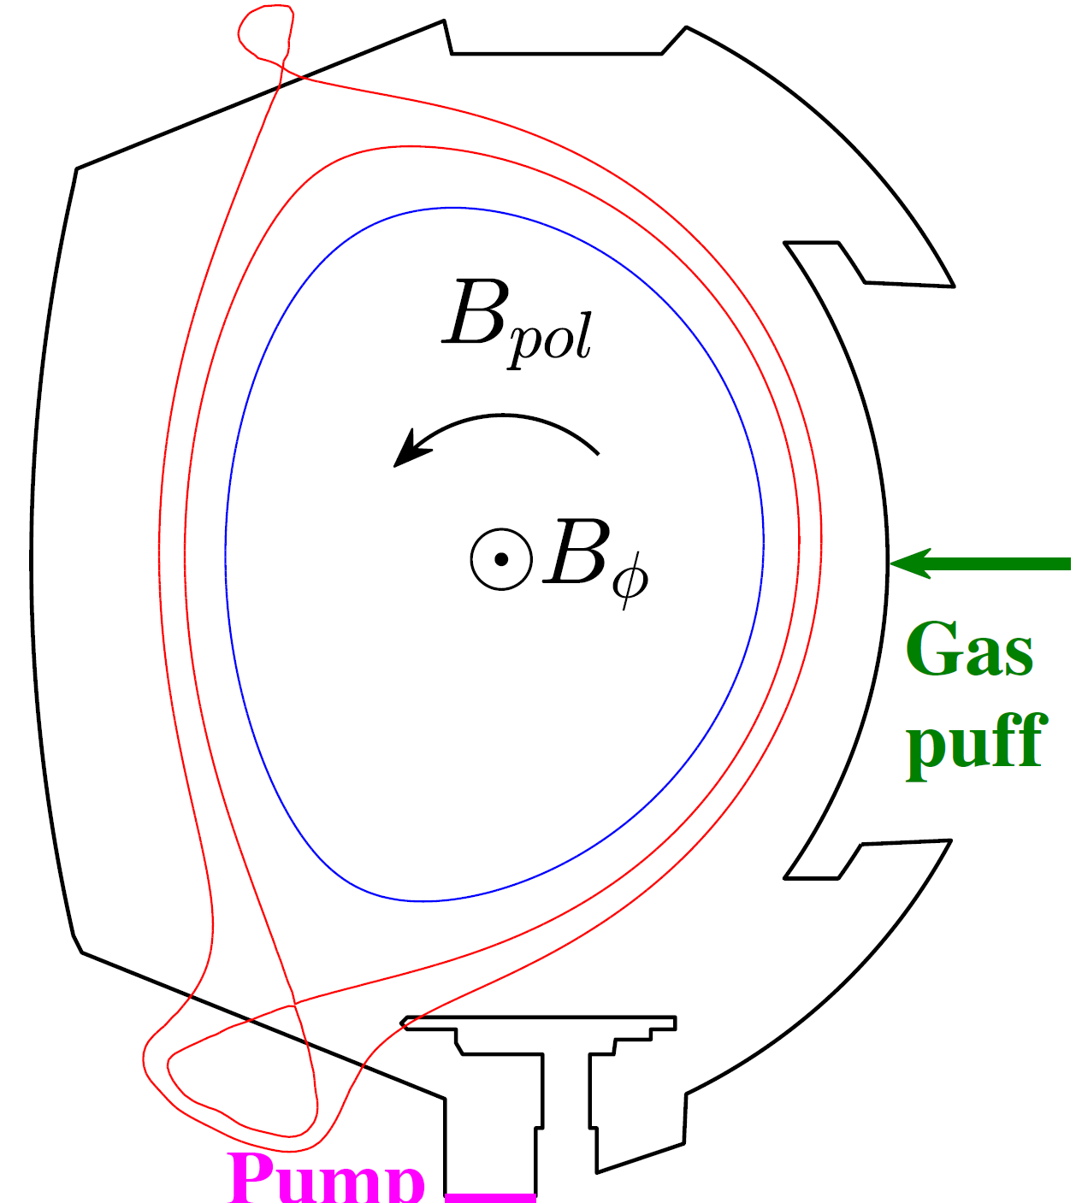
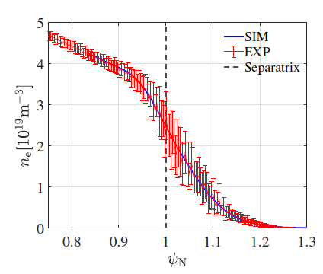
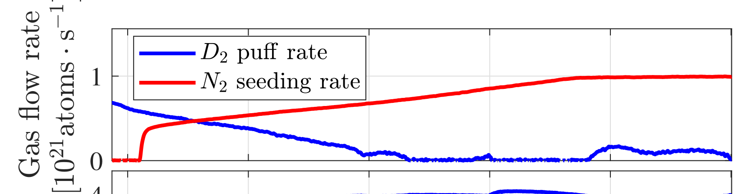
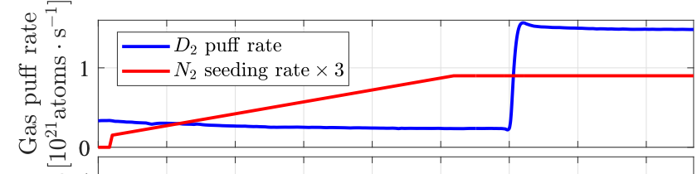
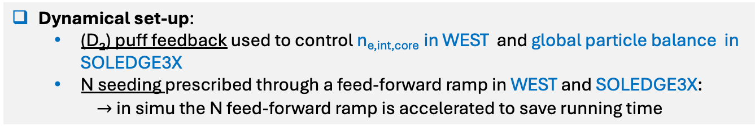
WEST EXPERIMENT & SOLEDGE3X-EIRENE SET-UP
#57929 WEST pulse | SOLEDGE3X-EIRENE
Lower Single Null + 4.2 MW of Lower-hybrid resonance heating power injected Key diagnostic : interferometry with line-integrated density in the core (n_{e,int,core}) and around X-point (n_{e,int,X}) | 2D time-dependent transport mode with full drifts + kinetic neutrals with EIRENE Lower Single Null with 2 MW of injected power across core edge interface Exp. like diffusion profile + ballooning Recycling coefficients R_{wall,N} = 0.9 & R_{wall,D} = 1 Pump speed = 35 m³/s
n_{e,int,core}
D₂ puff
Nitrogen-seeded from the Private Flux Region
n_{e,int,X}
N₂ seeding
Pump
Dynamical set-up:
(D₂) puff feedback used to control n_{e,int,core} in WEST and global particle balance in SOLEDGE3X
N seeding prescribed through a feed-forward ramp in WEST and SOLEDGE3X:
$→$in simu the N feed-forward ramp is accelerated to save running time
Everything is done to match n_{e} profiles at the outer midplane
Expe
Simu
Notes:
In simu N seeding is X3 due to the interplay with the recycling R=0.9 Reduce R will increase the seeding rate
The jump in D feedback is to maintain particle balance because the pumping is X5 larger in simu than in experiment
2MW correspond to 4.2 – 2 supposed to be radiated. Since the core is not simulated it is the power enterinf the SOL

Slide 6
OUTLINE
WEST EXPERIMENT & SOLEDGE3X-EIRENE SET-UP
TRANSITION FROM ATTACHED TO XPR: EXPE VS SIMU
NUMERICAL INSIGHTS ON XPR DEVELOPMENT
CONCLUDING REMARKS AND PERSPECTIVES

Slide 7
TRANSITION FROM ATTACHED TO XPR
A sharp and rapid dynamics : expe vs simu
Evolution of parameters as a function of time in experiment and simulation
Overall agreement between the two dynamics despite a global time scale reduction in simu :
Continuous cooling of the inner target down to 5eV
A sharp and rapid (<10ms) transition [around t∼11s (expe) and t ∼ 0.6 (simu)]
XPR transition markers :
Initial rise of n_{e,int,X} followed by a rapid drop
At outer target : temperature cliff + a sharp increase of particle flux
∼ X 2 divertor radiation (∼ 80% of the input power radiated)
XPR transition markers
Global time scale reduction in simulation due to a faster ramp-up + quicker wall recycling time
Remark: Such quick transition to XPR is only observed when drifts are included
Notes:
in the line integrated density across the X point
Why Gamma_e behaves differently between expe and simu?The reason is that the HFS and LFS in the simulation are very ideally isolated from each other, the neutral particle transport is stopped by the hot plasma between two branches, but in the experiment, there is gaps between the Monoblock, which allow the neutral particle to move between the two branches. This makes the HFS deeper detached in the simulation compared with experiment, as more neutrals and impurities confined in the HFS. Thus we see the difference in particle flux.

Slide 8
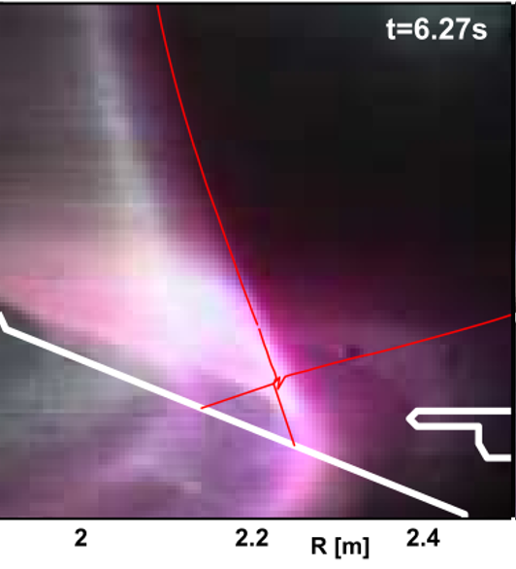
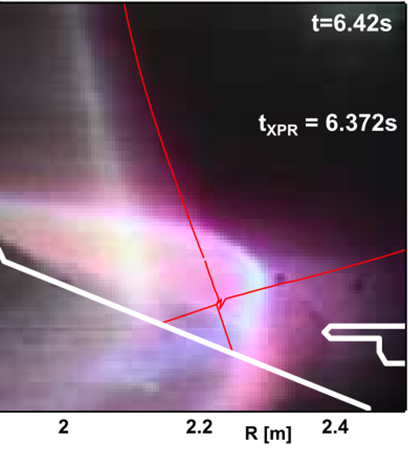
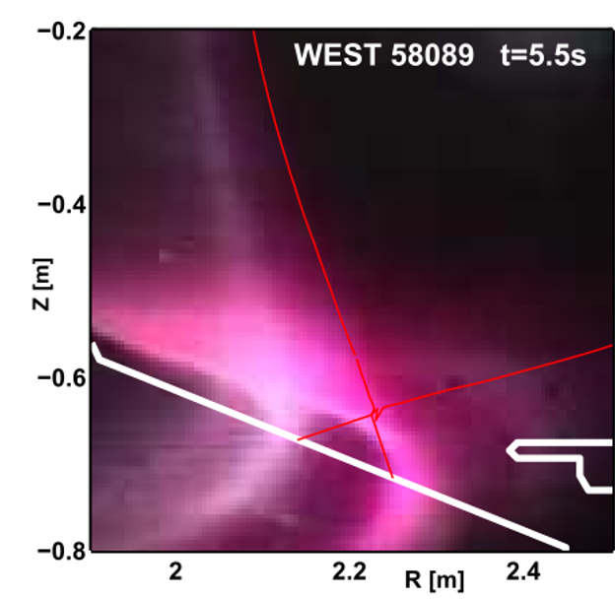
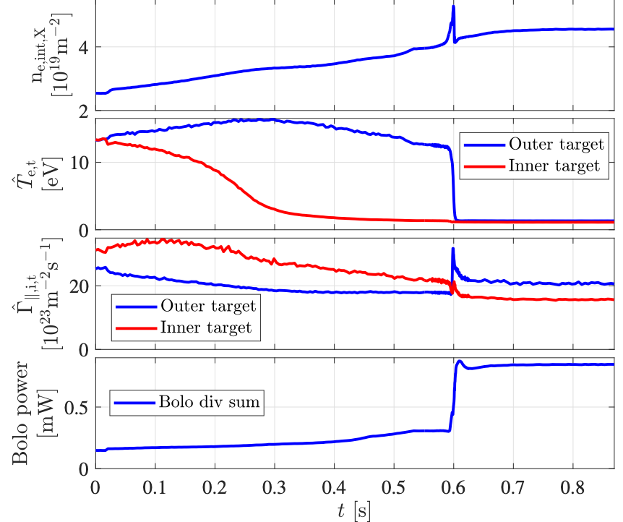
TRANSITION FROM ATTACHED TO XPR
A sharp and rapid dynamics : expe vs simu
2
3
Post-onset XPR Radiation front penetrates into the X-point region
Inner detached first
Radiation “filament” grows on the HFS divertor before bifurcation
Bifurcation (~1ms) : the radiation filament jumps from HFS to LFS region
1
Attached
3
4
2
1
4
Deep XPR Radiation center moves toward the LFS upstream inside the separatrix – consistent with expe
WEST visible synthetic camera model
Simu (t=0.019s)
Simu (t=0.869s)
Time evolution of 2D maps of total power radiation
Notes:
a quick transition to XPR occurs only in the cases with drifts

Slide 9
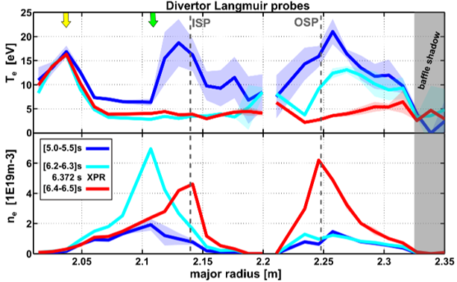


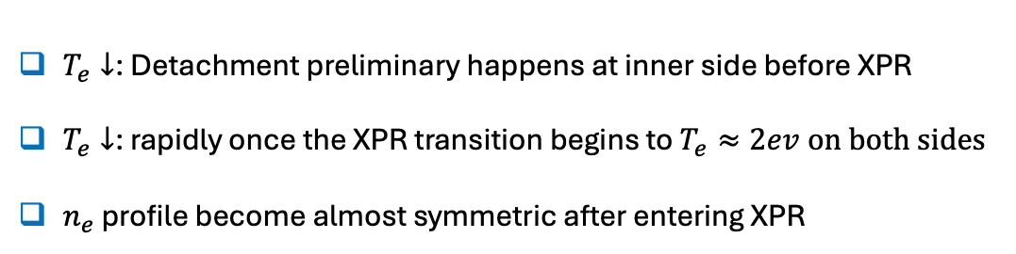

TRANSITION FROM ATTACHED TO XPR
Target profiles: expe vs simu
Inner
Outer
$$T_{e}≈2ev$$
2
3
1
EXP:
# 58089
3
$T_{e}↓$: Detachment preliminary happens at inner side before XPR
$T_{e}↓$: rapidly once the XPR transition begins to $T_{e}≈2ev$ $on both sides$
$n_{e}$ profile become almost symmetric after entering XPR
2
1 $→$ 2
1
2 $→$ 3
- -> After bifurcation both targets are cold (2∽3eV) and dense
Time evolutions
Notes:
Temperature not so far but density much higher in simulation

Slide 10
OUTLINE
WEST EXPERIMENT & SOLEDGE3X-EIRENE SET-UP
TRANSITION FROM ATTACHED TO XPR: EXPE VS SIMU
NUMERICAL INSIGHTS ON XPR DEVELOPMENT
CONCLUDING REMARKS AND PERSPECTIVES

Slide 11
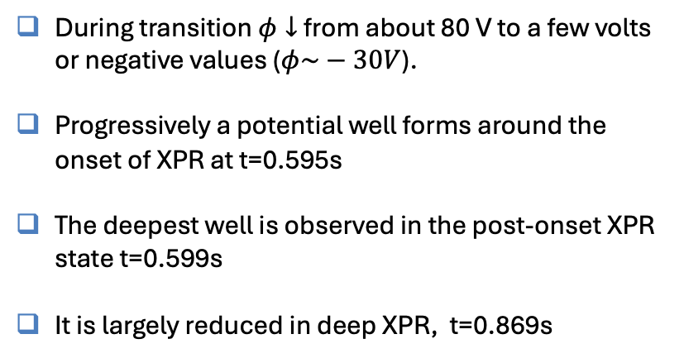
NUMERICAL INSIGHTS ON XPR DEVELOPMENT
Formation of an electric potential well
2D map of the electric potential in the divertor region from the WEST simulation
During transition $φ↓$ from about 80 V to a few volts or negative values ($φ\sim −30V$).
Progressively a potential well forms around the onset of XPR at t=0.595s
The deepest well is observed in the post-onset XPR state t=0.599s
It is largely reduced in deep XPR, t=0.869s
(a) t = 0.019 s, attached
(b) t = 0.551 s, inner divertor
detached
(c) t = 0.599 s, post-onset
of XPR
(d) t = 0.869 s, deep XPR
→ Related to plasma cooling around X-point…
The onset of the XPR data is obtained at t = 0.595 s

Slide 12
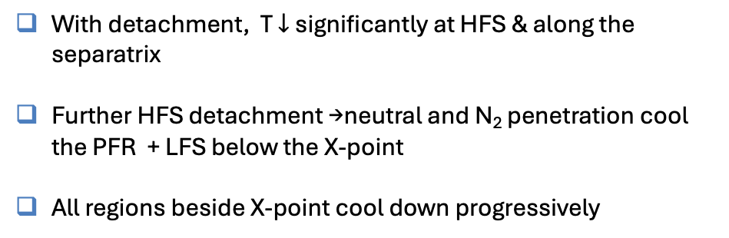
NUMERICAL INSIGHTS ON XPR DEVELOPMENT
Formation of an electric potential well
With detachment, T $↓$ significantly at HFS & along the separatrix
Further HFS detachment →neutral and N₂ penetration cool the PFR + LFS below the X-point
All regions beside X-point cool down progressively
(a) t = 0.019 s, attached
(b) t = 0.551 s, inner divertor
detached
(c) t = 0.599 s, post-onset
of XPR
(d) t = 0.869 s, deep XPR
2D maps of electron temperature in the WEST simulation, showing the transition process to XPR
Notes:
the condition ∇ · ( ∇ ∥ϕ ) > 0 indicates that
ϕ attains a local minimum (“potential well”) along the field line relative to neighboring locations.

Slide 13
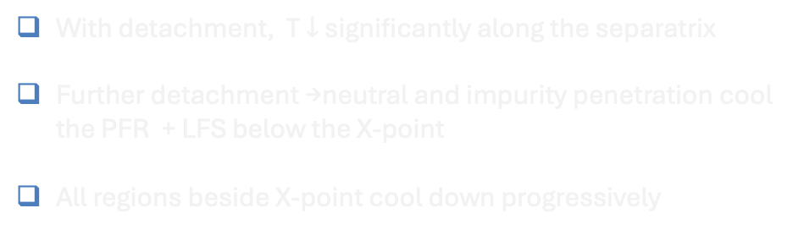

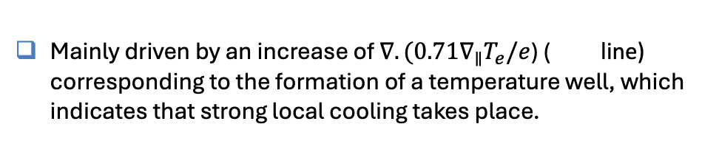
NUMERICAL INSIGHTS ON XPR DEVELOPMENT
Formation of an electric potential well
With detachment, T $↓$ significantly along the separatrix
Further detachment →neutral and impurity penetration cool the PFR + LFS below the X-point
All regions beside X-point cool down progressively
XPR transition
XPR transition
1
2
Occurrence at successive times of potential wells beside X-point characterized by ∇·(∇∥ φ) > 0 lines
XPR transition
XPR transition
Mainly driven by an increase of $∇.(0.71∇_{∥}T_{e}/e$) ( line) corresponding to the formation of a temperature well, which indicates that strong local cooling takes place.
3
4
Time evolution of the terms in Eq. (1) at points beside the X-point.
In the quasi-neutral limit, the overall charge balance leads to
$$\left(1\right) ∇.{(σ}_{∥}∇_{∥}φ)=∇.\left[σ_{∥}\left(\frac{∇_{∥}p_{e}}{en_{e}}+\frac{0.71∇_{∥}T_{e}}{e}\right)+j_{⊥,dia}+j_{⊥,res}\right]$$
Sketch of the X-point region. Potential wells occur successively on time,
from 1 to 4
Notes:
the condition ∇ · ( ∇ ∥ϕ ) > 0 indicates that
ϕ attains a local minimum (“potential well”) along the field line relative to neighboring locations.

Slide 14
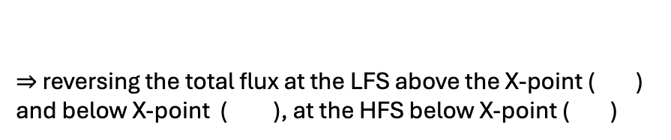


NUMERICAL INSIGHTS ON XPR DEVELOPMENT
Formation of a “X-point vortex”
Reversing the sign of $φ$modifies the E × B flow pattern
Between t₃ = 0.592s and t₆ = 0.595s the E × B fluxes grow up to exceed the opposing diffusive fluxes
Sketch of the fluxes crossing between the LFS sommon SOL and the closed flux region
$⇒$ reversing the total flux at the LFS above the X-point ( ) and below X-point ( ), at the HFS below X-point ( )
Time evolution of integrated radial component of the total and EXB fluxes (sum of all ion fluxes)
Green arrows indicate the flow direction.
$⇒$Together these steps form a closed counterclockwise flow
< t₃
at t₃
between t4 and t7

Slide 15
OUTLINE
WEST EXPERIMENT & SOLEDGE3X-EIRENE SET-UP
TRANSITION FROM ATTACHED TO XPR: EXPE VS SIMU
NUMERICAL INSIGHTS ON XPR DEVELOPMENT
CONCLUDING REMARKS AND PERSPECTIVES

Slide 16
CONCLUDING REMARKS AND PERSPECTIVES
The XPR regime in WEST (L-mode discharges with 4MW LHCD ) sustained by sufficient nitrogen seeding show a very sharp transition within milliseconds
To our knowledge, first time-dependent simulations carried out about XPR transition:
☞ Good overall agreement between SOLEDGE3X and WEST
☞ Highlight of a E×B convective mechanism driven by the temperature collapse around X-point
☞ A « E×B X-point vortex » forms that enhances cross-field transport + impurity accumulation above the X-point
➩ a driving a self-reinforcing cycle that speeds up the transition.
Plasma cooling
Change in $∇_{∥}T$
Change in ∇_∥ 𝑇
Change in $Φ_{}$
Change in Φ_
E X B fluxes modification
Sketch of what could be the self-reinforcing mechanism leading to this rapid transition

Slide 17
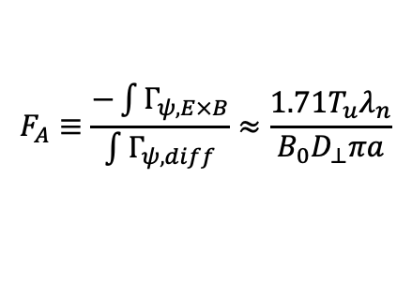

CONCLUDING REMARKS AND PERSPECTIVES
Work in progress : Extend the model proposed by Stroth et al. 22 and based upon a power balance with X_{A} > 1
$X_{A}=\frac{R_{0}q_{s}f_{exp}}{a} \frac{7L_{∥}}{2κ_{0e}} \frac{\left(2{\left\langle σv\right\rangle }_{ion}+{\left\langle σv\right\rangle }_{cx}\right)n_{u}n_{0}}{T_{u}^{5/2}}∆h_{X}$
Mainly considers the change of n_{u} and T_{u} from the upstream midplane, and the increase of n₀ from the penetration process.
- ->The E × B driven flux presented here could provide an additional driving mechanism that modifies the evolution of X_{A} , which has not been considered before.
As in Stroth et al. 22, considering a 1D strongly dissipative plasma volume leads
XPR transition
(∽15ms)
$$F_{A}≡\frac{−\int{Γ_{ψ,E×B}}}{\int{Γ_{ψ,diff}}}≈\frac{1.71T_{u}λ_{n}}{B_{0}D_{⊥}πa}$$
With respect to a fixed configuration:
- when X_{A}>1 et F_{A}>1 at the LFS ⇨ the net plasma flow enters the closed flux region upstream of the X-point
➩ ⤤ n_{u} and ⤥ T_{u},
➩ accelerating the transition towards X_{A}> 1 in the closed flux surface
X_{A} and F_{A} evolutions. n_{u} and T_{u} and n₀ are obtained from simulations

Slide 18
THANK YOU

