Slide 1
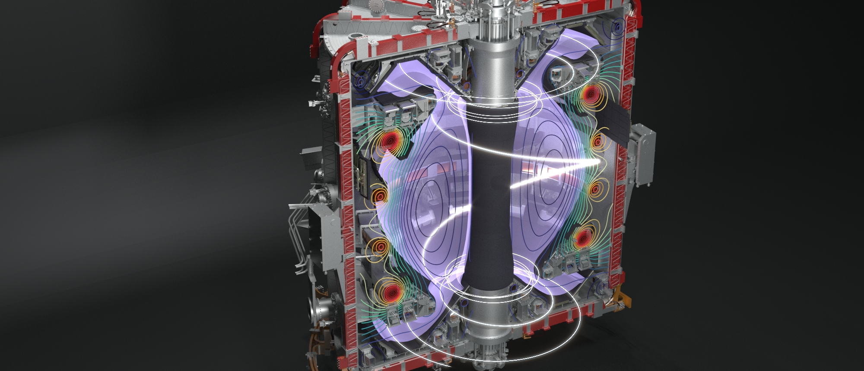
IAEA TM Divertor Concepts
First attempts to establish an X-point radiator regime on MAST-U in N-seeded H-modes
S. Henderson, J. Lovell, F. Federici, D. Morbey, P. Ryan, S. Silburn, S. Elmore, N. Lonigro, S. Menmuir, the MAST-U team, and the EUROfusion Tokamak Exploitation team (RT-05)

Slide 2



Acknowledgements
Thank you to the MAST-U team for executing the shots and for allowing me to inject over a weeks worth of D and N into the machine in one session
Thank you to the committee members for the opportunity to present
This work has been carried out within the framework of the EUROfusion Consortium, funded by the European Union via the Euratom Research and Training Programme (grant agreement no. 101052200 – EUROfusion) and was part funded by the EPSRC Energy Programme [grant number EP/W006839/1] and by the DOE [grant number DE-AC05-00OR22725]
This work has been carried out within the framework of the EUROfusion Consortium, funded by the European Union via the Euratom Research and Training Programme (Grant Agreement No 101052200 — EUROfusion). Views and opinions expressed are however those of the author(s) only and do not necessarily reflect those of the European Union or the European Commission. Neither the European Union nor the European Commission can be held responsible for them.

Slide 3
Aim of talk
Validate existing X-point Radiator (XPR) access models to build confidence in their use for future machines
Assess whether the XPR regime can be achieved on spherical tokamaks, in double-null or single-null
Improve our understanding of the physics governing XPR access and stability
Definition of the XPR regime
following Bernert et al. NME 43 (2025) 101916
Radiation is strongly localised near the X-point, fully within the confined plasma
Actuators can control the vertical position of the radiation region above the X-PT
Typically associated with complete divertor detachment and induced by impurity seeding
ELM suppression
Consequences of an XPR
Moderate confinement drop (~0.1-0.2 H₉₈)

Slide 4
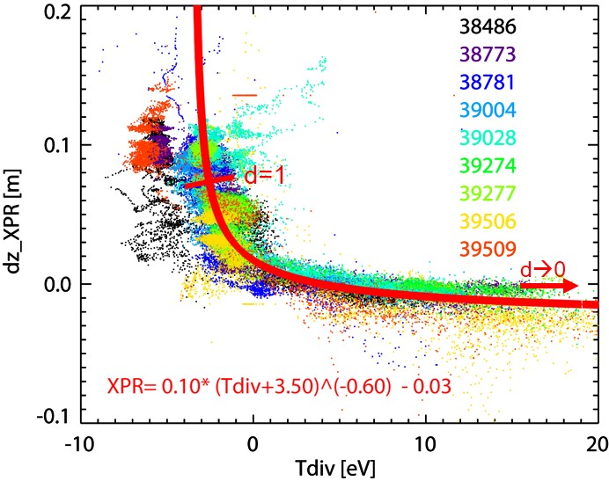
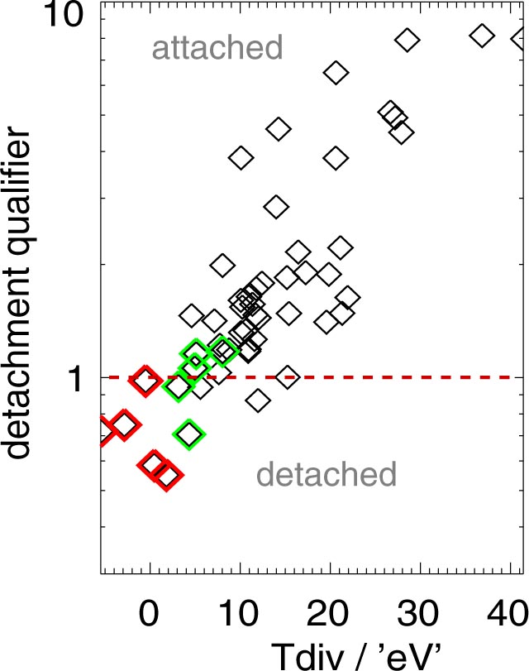
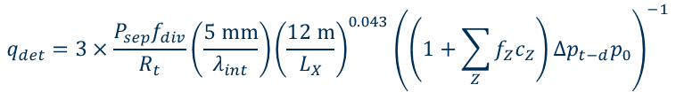
Simple models for XPRs
Typically, XPRs are accessed by achieving pronounced detachment of the inner and outer divertors
If XPR access is purely down to detachment state, then the detachment qualifier can be used to guide access requirements
Stroth model [3] indicates that the neutral density at the X-point is the key parameter for access to an XPR regime
The two models are consistent, assuming that detachment increases neutral densities at the X-PT
XPR height above the X-point
Generalised detachment qualifier [1,2]
Power to divertor
Impurity radiation
$$q_{det}=3×\frac{P_{sep}f_{div}}{R_{t}}\left(\frac{5 \text{mm}}{λ_{int}}\right){\left(\frac{12 \text{m}}{L_{X}}\right)}^{0.043}{\left(\left(1+\sum_{Z}{f_{Z}c_{Z}}\right)Δp_{t−d}p_{0}\right)}^{−1}$$
Exp. normalisation
Connection length cooling
Momentum loss
Kallenbach [1]
Image courtesy of M. Bernert
[1] A. Kallenbach et al 2015 Nucl. Fusion 55 053026
[2] S.S. Henderson et al 2025 Nucl. Fusion 65 016033
[3] U. Stroth et al 2022 Nucl. Fusion 62 076008

Slide 5
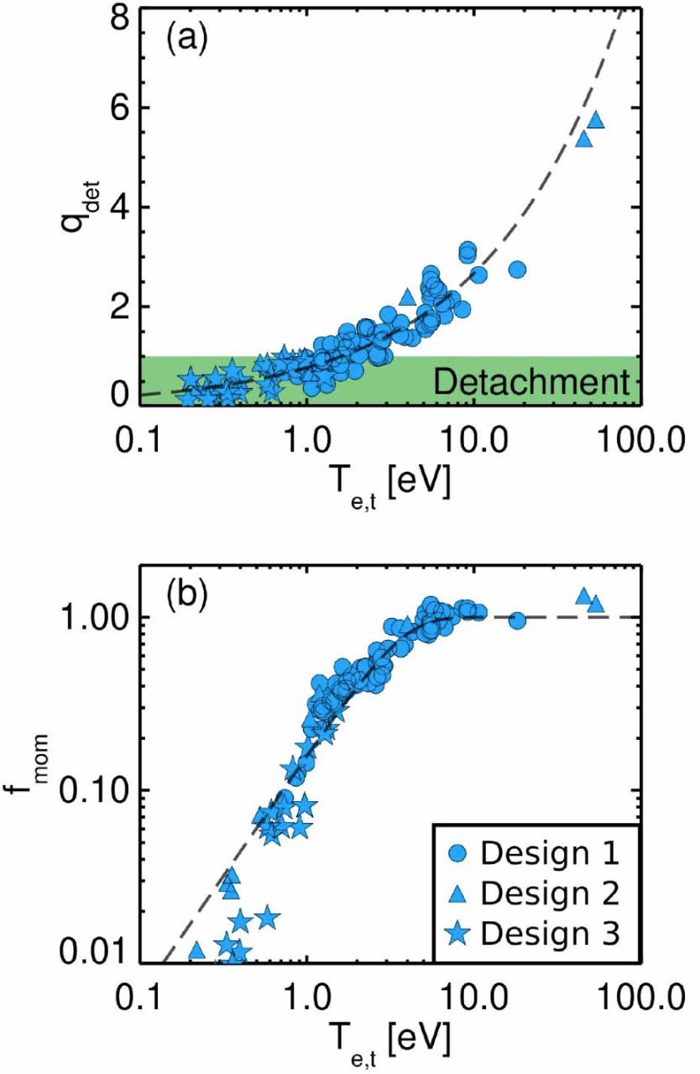
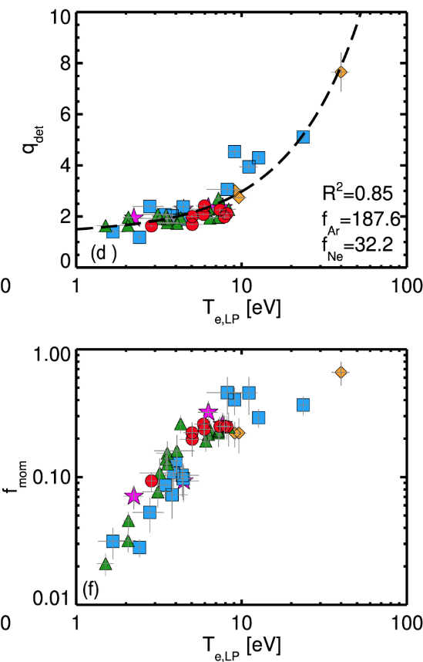
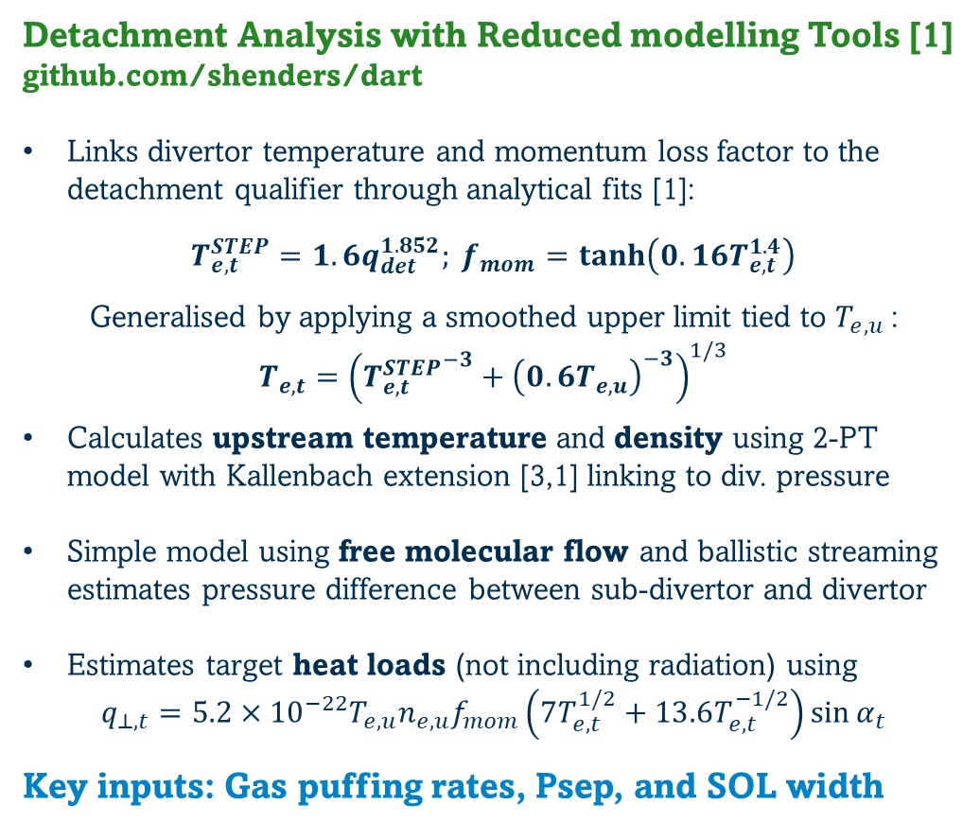
DART
Detachment Analysis with Reduced modelling Tools [1]
github.com/shenders/dart
Links divertor temperature and momentum loss factor to the detachment qualifier through analytical fits [1]:
$$T_{e,t}^{STEP}=1.6q_{det}^{1.852}; f_{mom}=\tanh\left(0.16T_{e,t}^{1.4}\right)$$
Generalised by applying a smoothed upper limit tied to $T_{e,u}$:
$$T_{e,t}={\left({T_{e,t}^{STEP}}^{−3}+{\left(0.6T_{e,u}\right)}^{−3}\right)}^{1/3}$$
Calculates upstream temperature and density using 2-PT model with Kallenbach extension [3,1] linking to div. pressure
Simple model using free molecular flow and ballistic streaming estimates pressure difference between sub-divertor and divertor
Estimates target heat loads (not including radiation) using
$$q_{⊥,t}=5.2×{10}^{−22}T_{e,u}n_{e,u}f_{mom}\left(7T_{e,t}^{1/2}+13.6T_{e,t}^{−1/2}\right)\sin{α_{t}}$$
Key inputs: Gas puffing rates, Psep, and SOL width
Analytical fits for divertor temperature & momentum loss factor
STEP SOLPS-ITER [1]
AUG experiment [2]
[1] S.S. Henderson et al 2025 Nucl. Fusion 65 016033
[2] S.S. Henderson et al 2023 Nucl. Fusion 63 086024
[3] A Kallenbach et al 2018 Plasma Phys. Control. Fusion 60 045006

Slide 6
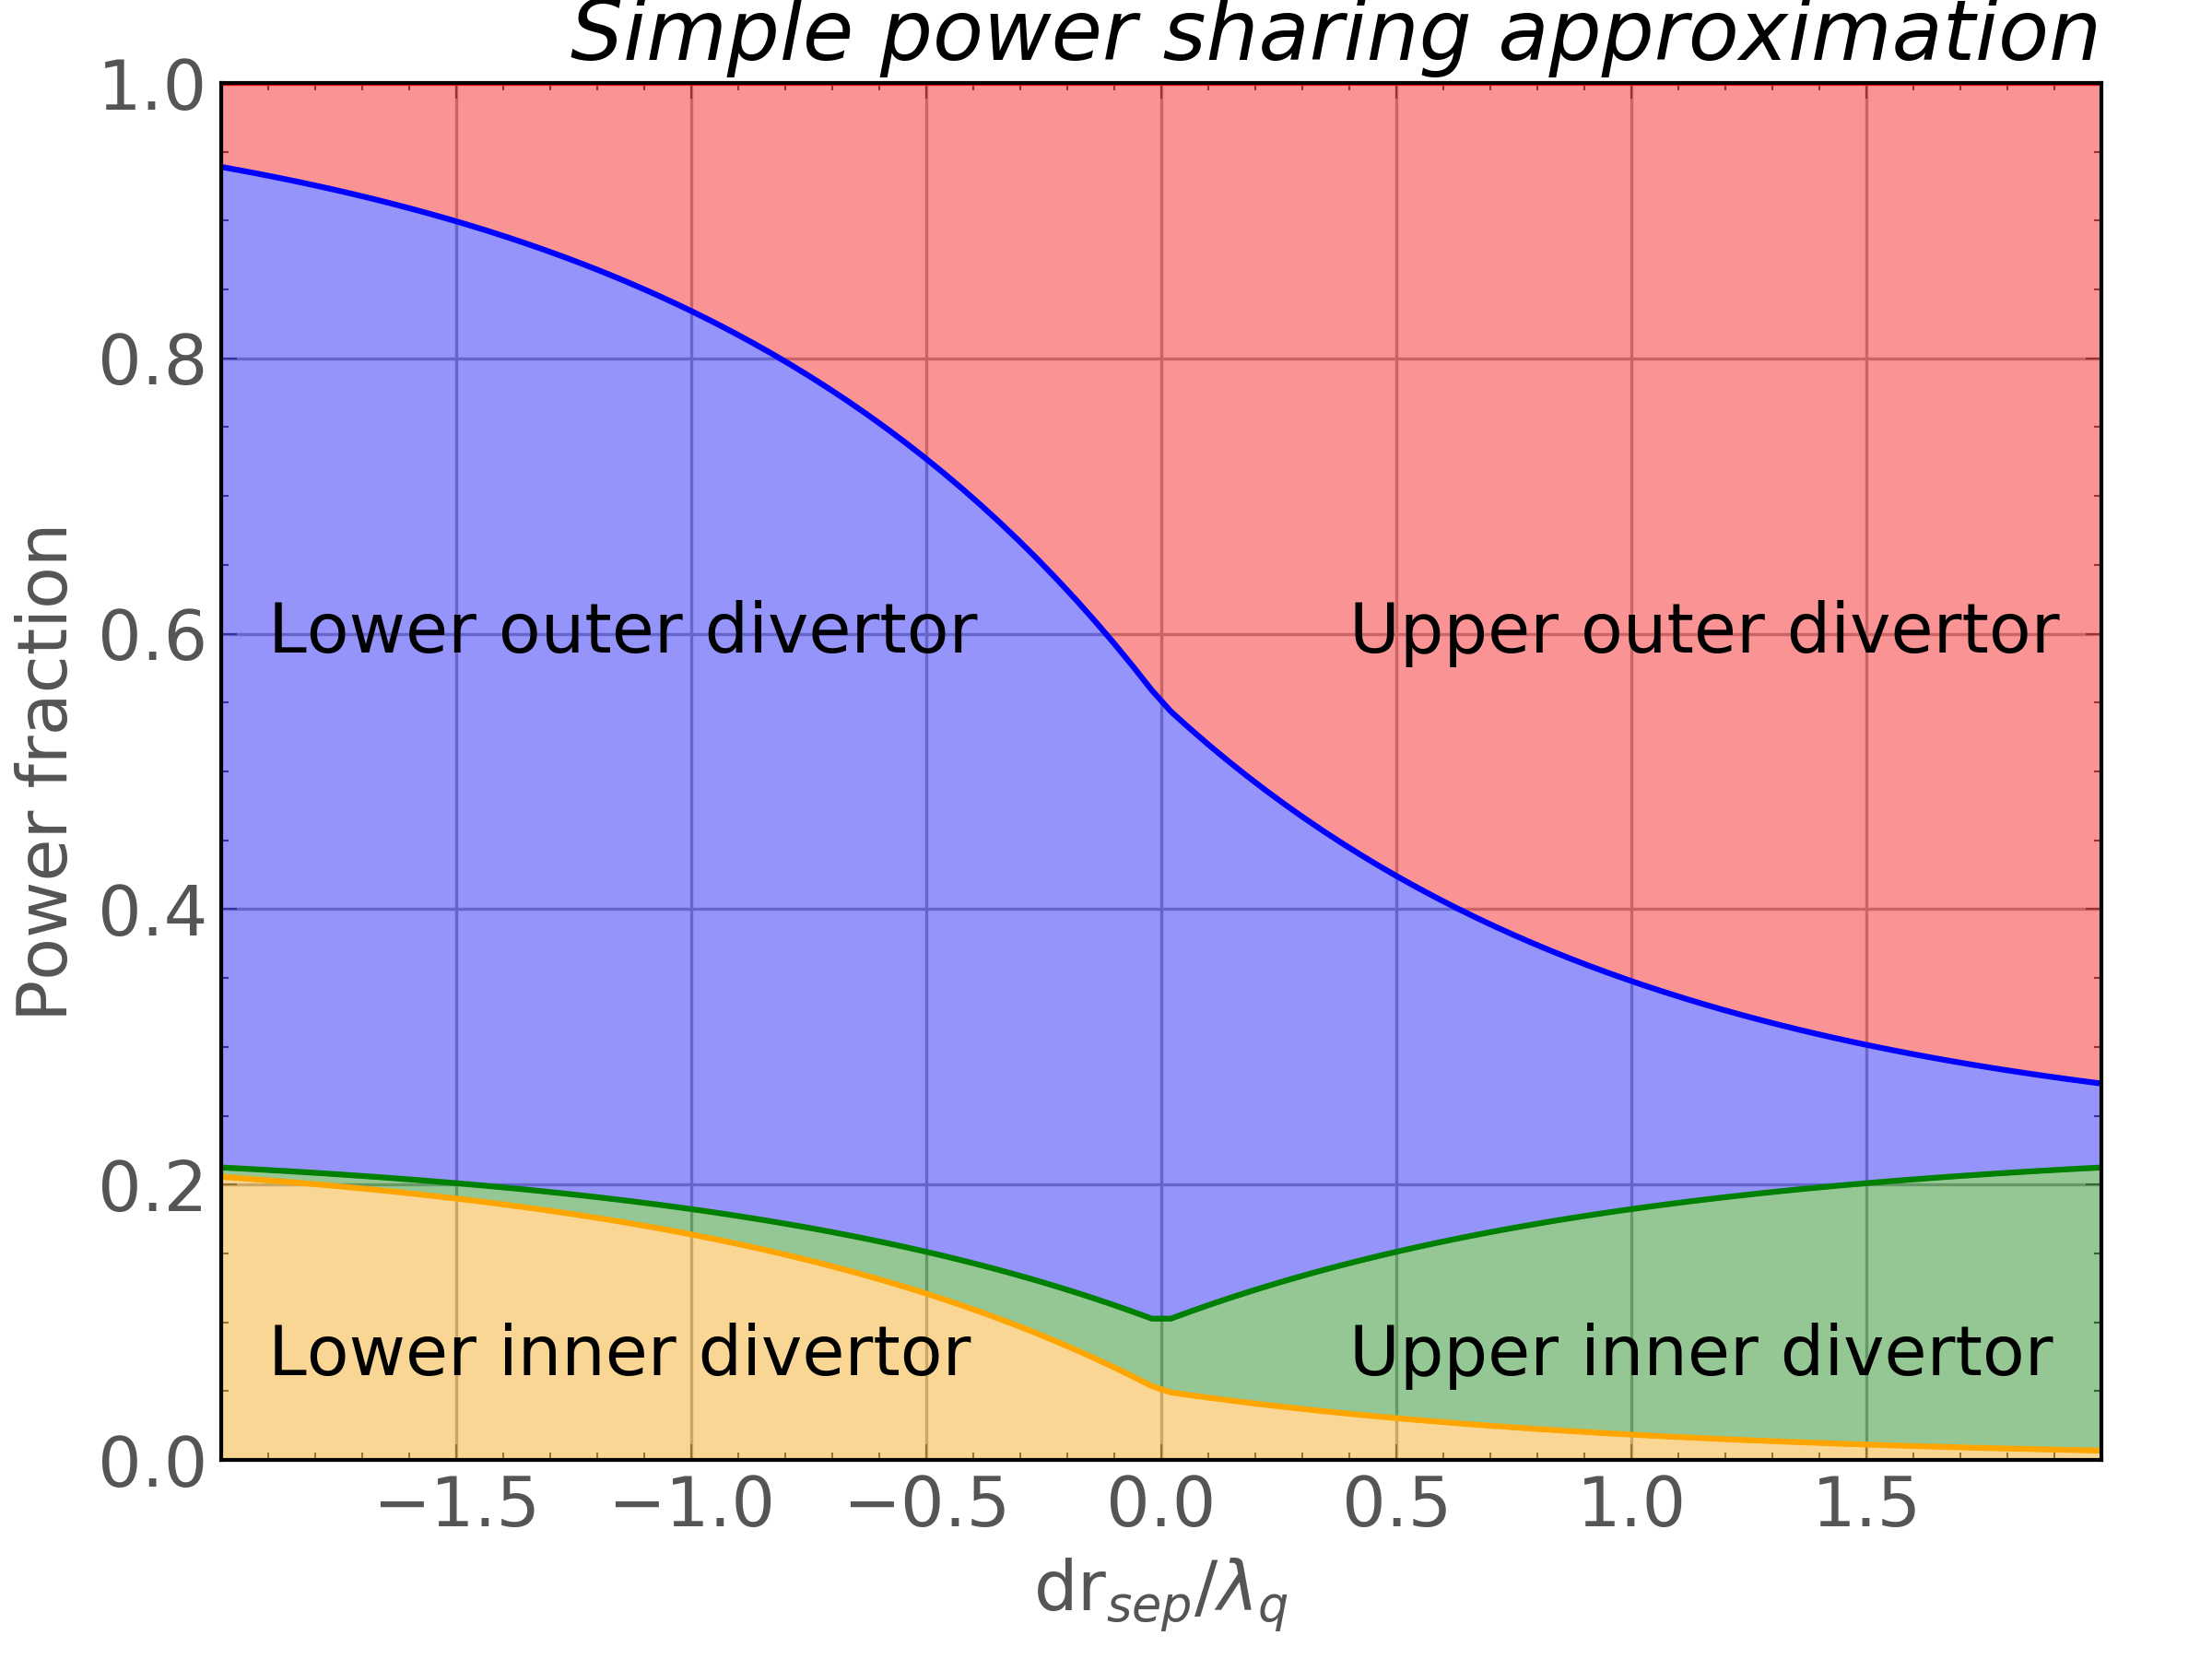
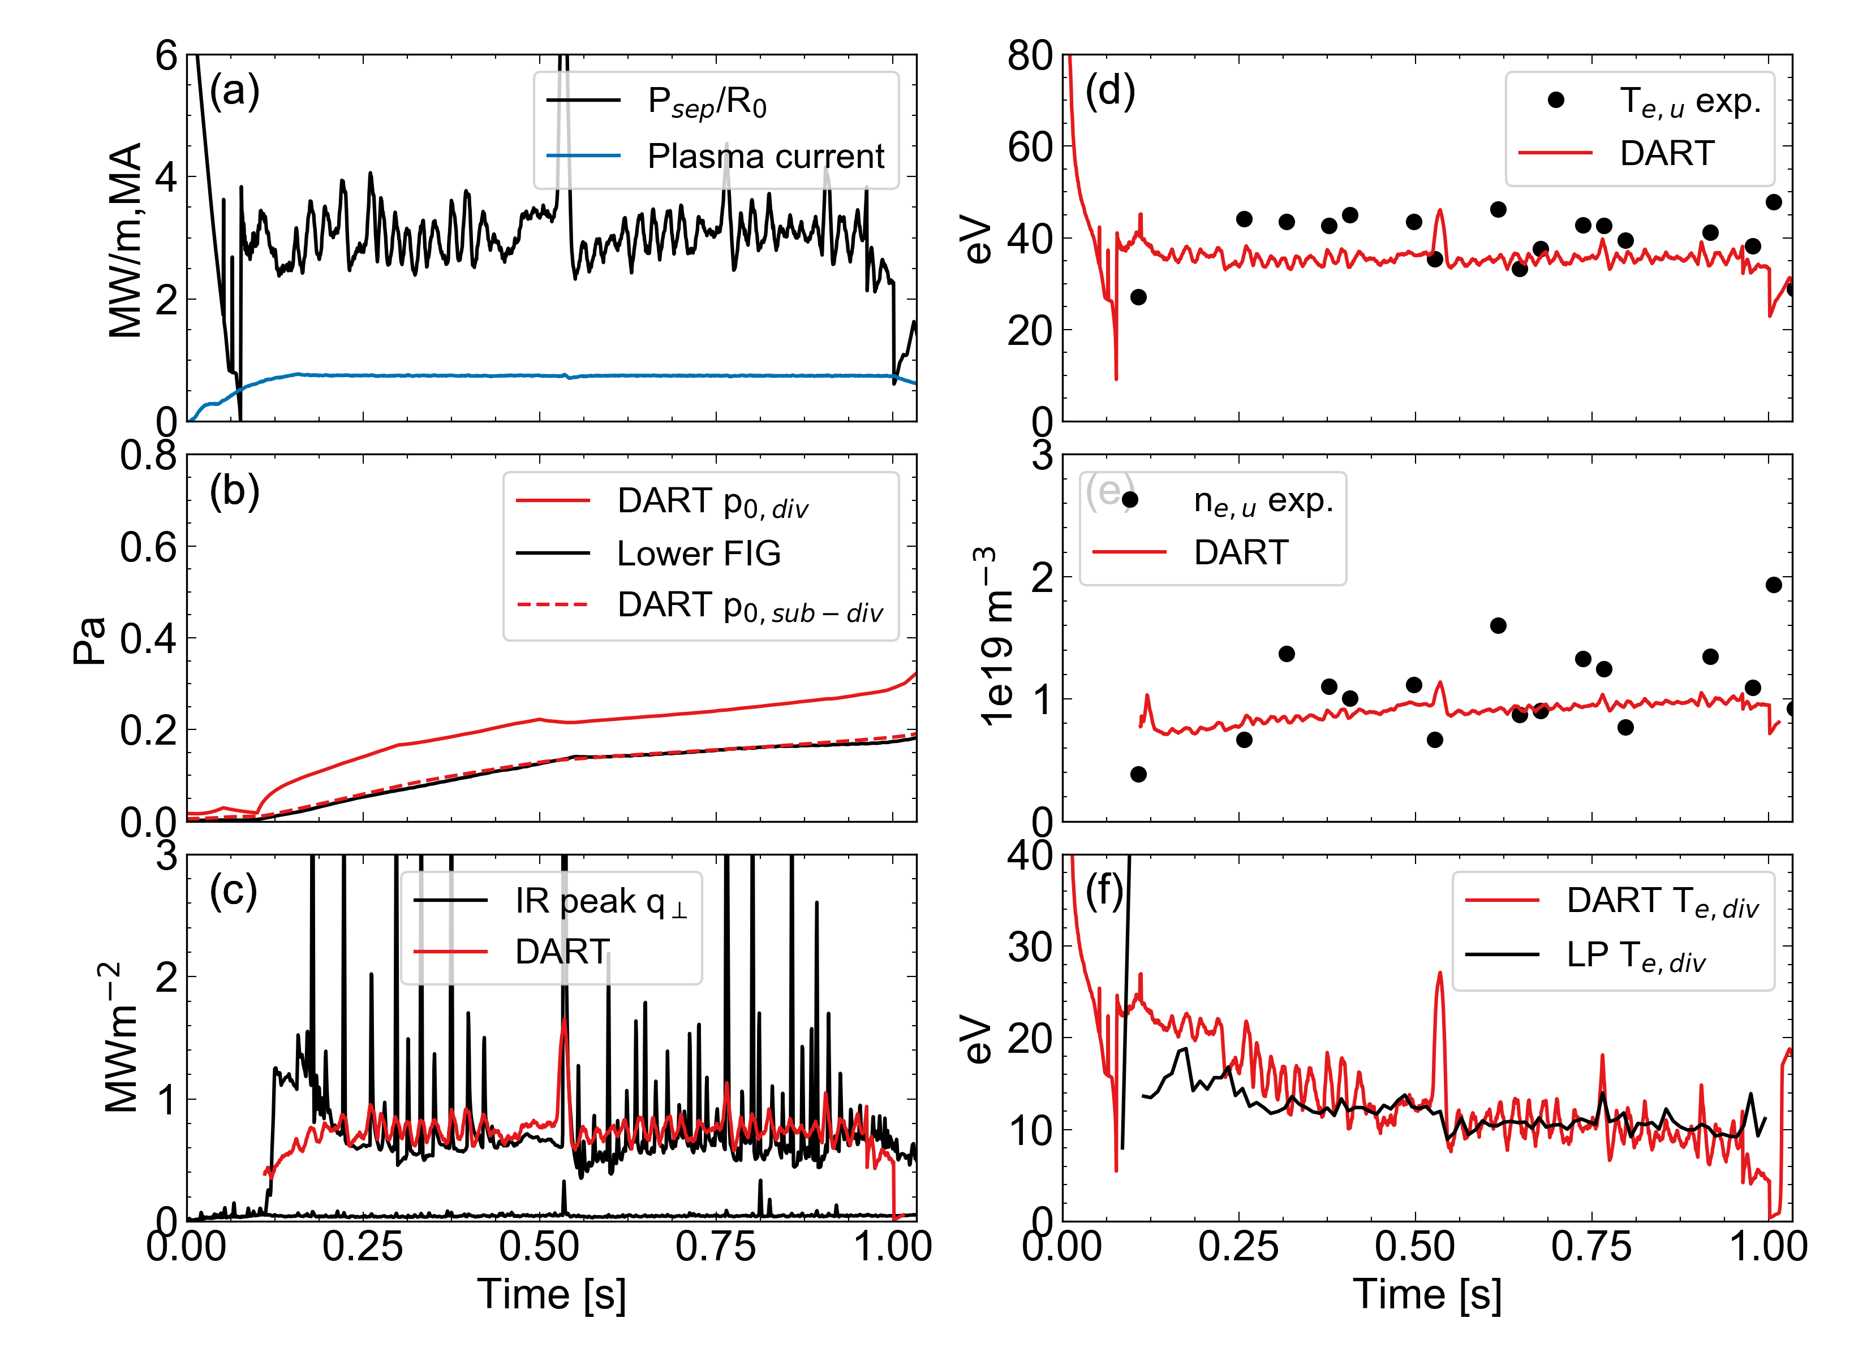
DART benchmark
Overall, reproduces key exhaust quantities in attached conditions during unseeded ELMy H-mode conditions
P_{sep}/R in MAST-U is ~3 MW/m, slightly below JET and ~ half of AUG, but divertor pressures of ~0.2 PA are significantly lower
SOL width determined using Eich scaling and power fraction to each divertor estimated via simple model with fraction lost to wall
DART separatrix temperature and density consistent with measurement determined using 2P model predictions
Predicts attached conditions with good agreement with IR peak heat loads and probe peak divertor temperature
The model will be tested in future with SXD geometry, however that is not covered in this talk
DART predictions for lower outer conventional divertor #50894

Slide 7
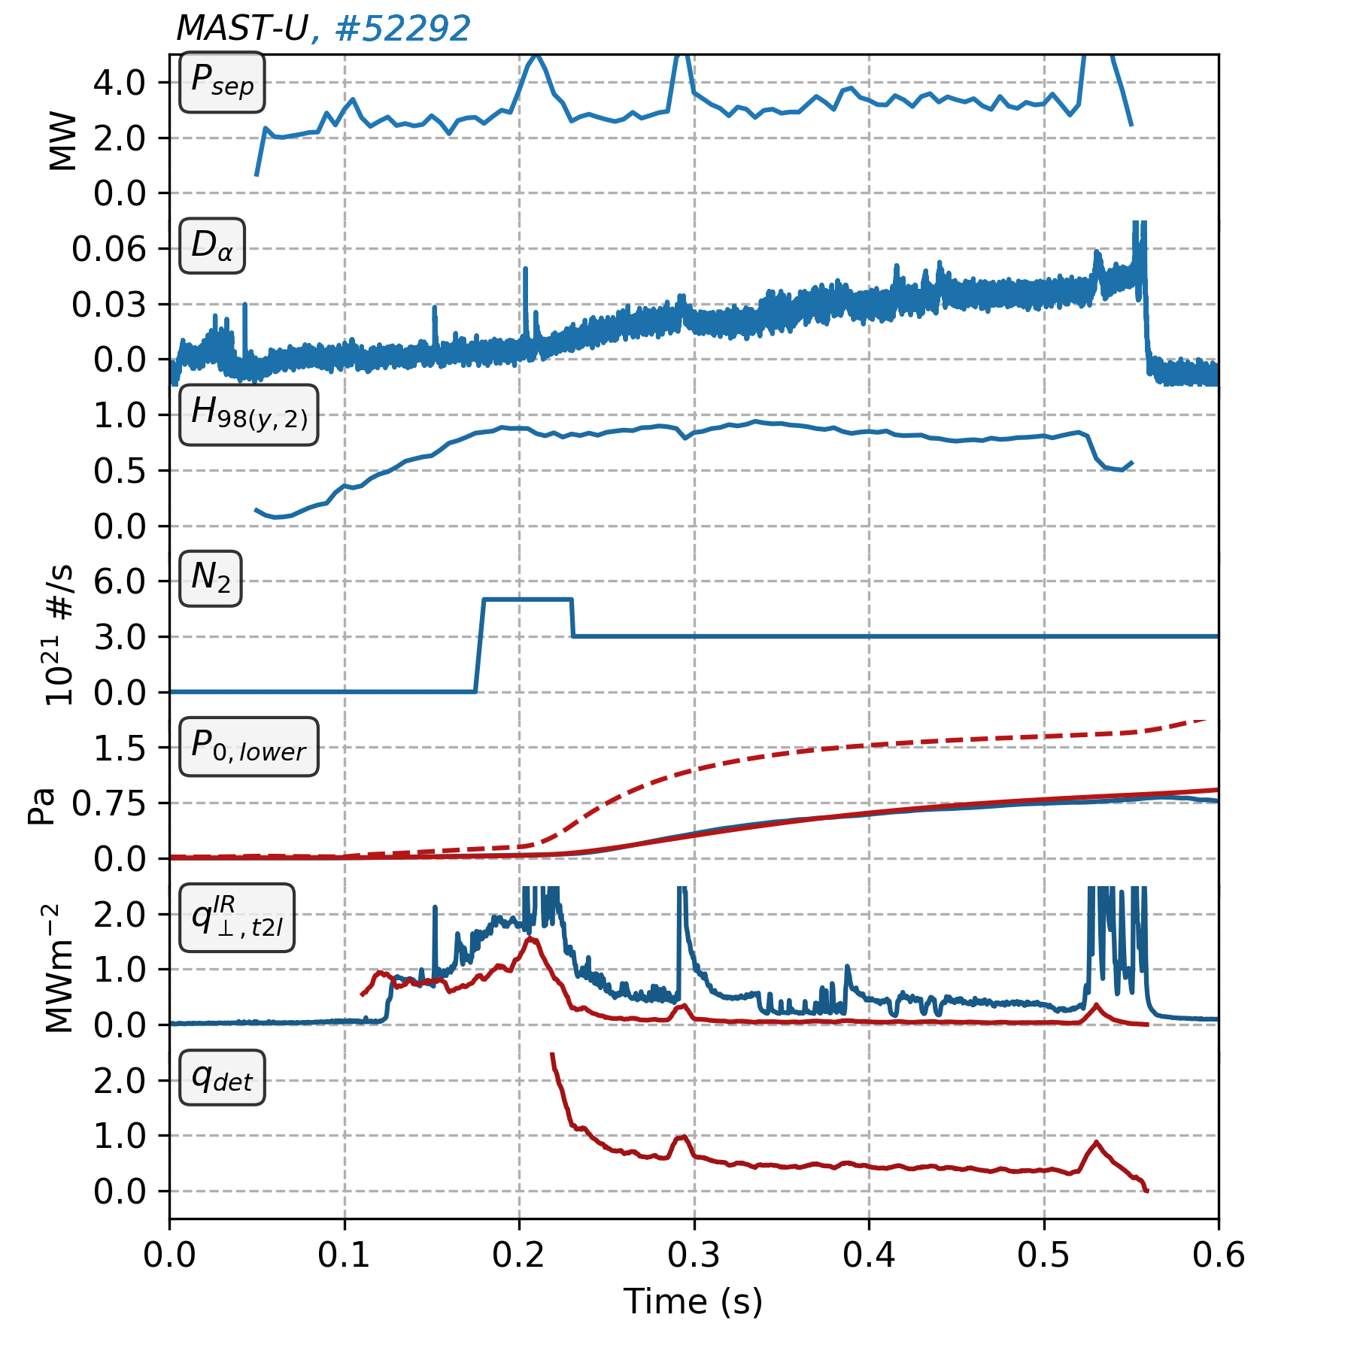
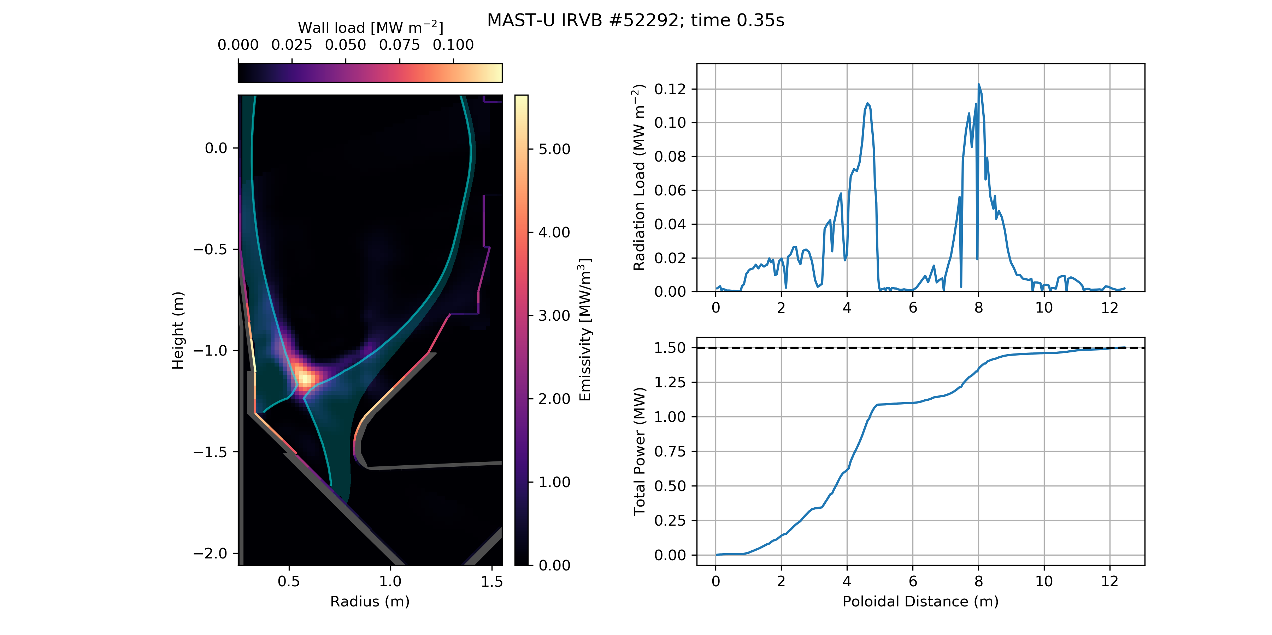
XPR in lower single-null
Strong emission observed within the confined plasma localised at the X-point, indicative of an XPR regime
XPR stable ~50 ms before H-L transition – small decrease in H_{98(y,2)}
Small ELMs observed during H-mode XPR phase
Pronounced detachment predicted by DART at t~0.25 s
Radiation loads [1] up to 0.1 MWm⁻² on side walls, less at the target
XPR in H-mode
DART div. press.
Infra-Red Video Bolometer (IRVB) inversions
F. Federici
D
DART
N
D
[1] Radiation loads calculated using Cherab: https://doi.org/10.5281/zenodo.1206142

Slide 8
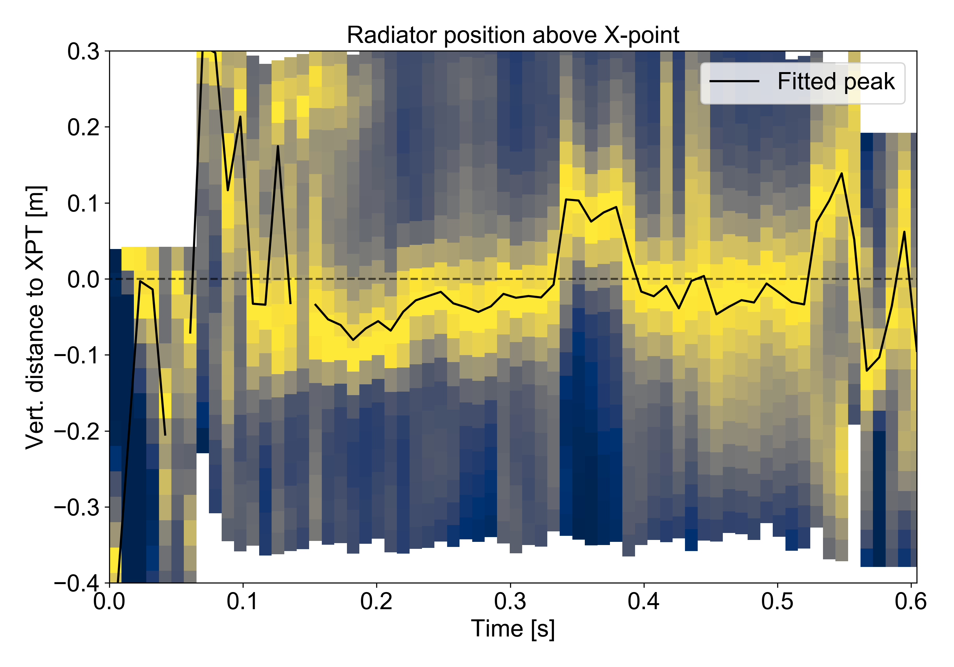
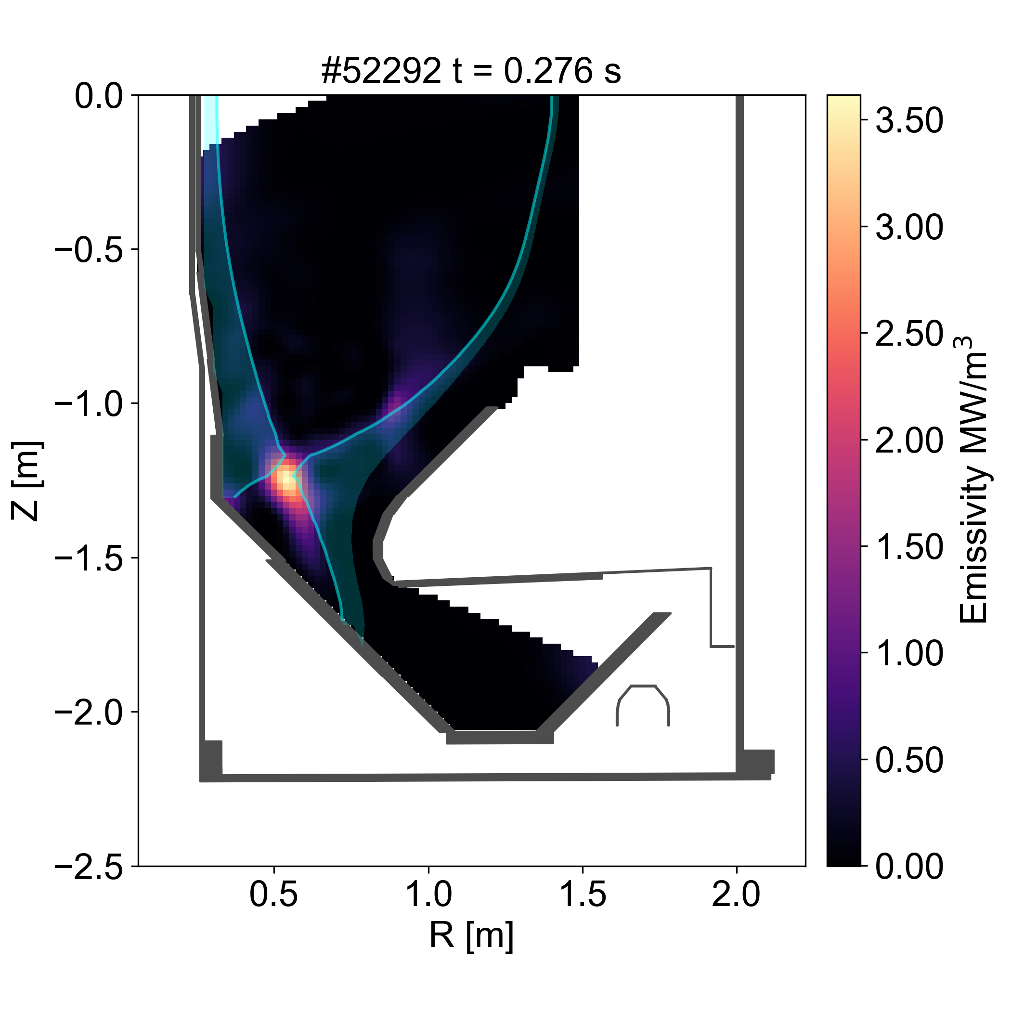

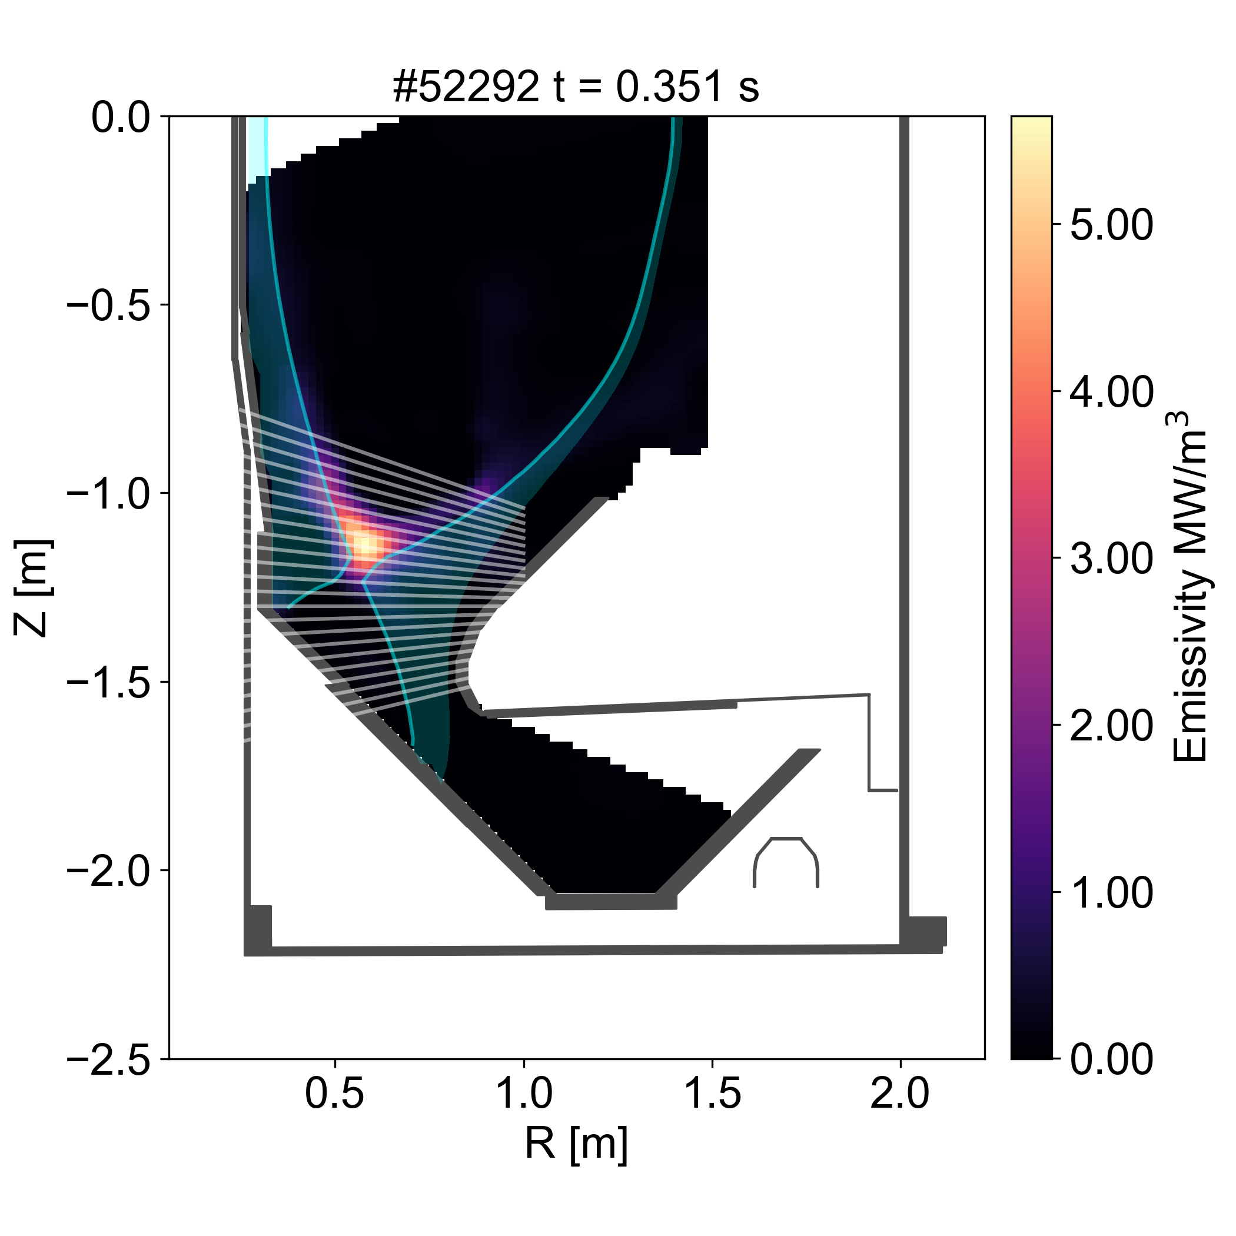
XPR height above X-point
Synthetic LOS arrays are applied to IRVB inversions to mimic typical XPR measurements on other machines
Strong localised radiation first occurs just below the X-PT,
H-L transition shortly after outer leg completely detaches, where the transition causes burn-through of the outer leg
L-H transition then causes an immediate jump of the radiator into the confined plasma, above the X-PT
XPR on MAST-U likely controllable with similar techniques applied on other machines (e.g. JET/AUG)
H-mode
L-mode
H-mode
L-mode
H-mode deep detachment
L-mode front burn-through
H-mode XPR phase
Reduction in radiation near target indicative of deep detachment of both legs, coinciding with q_{det}<1 prediction

Slide 9
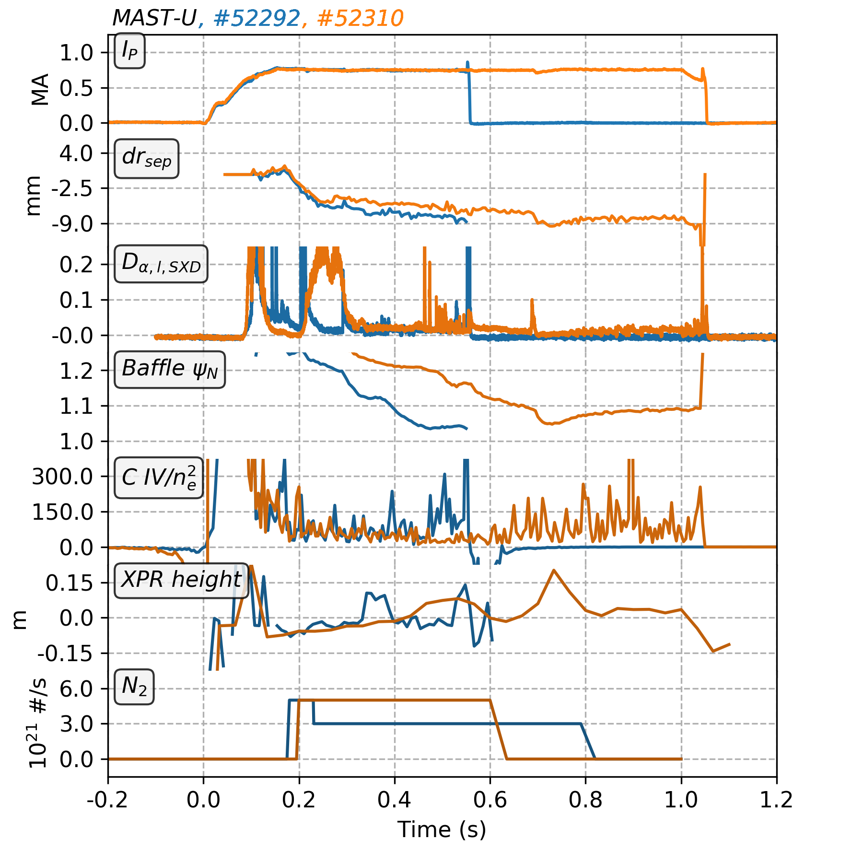
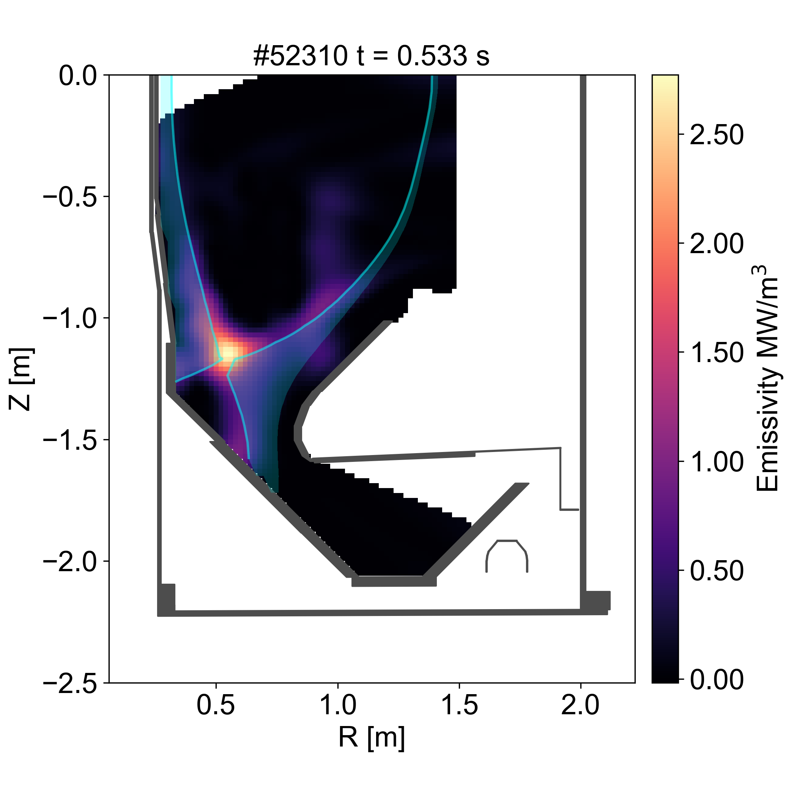

Optimising plasma plugging
Maintaining the plasma shape around the baffle during seeding is difficult due to increasing internal inductance
If the last limiting flux surface on the baffle is ϕ_{N}<1.05, erosion occurs, and C is sputtered into the plasma causing disruption
C moves stable XPR solution to colder temperatures than N, driving more recombination and thus leading to a MARFE [1]
Keeping far SOL further from baffle led to better XPR stability (~100 ms), longer H-mode phase and avoidance of disruptions
C influx
Sufficient baffle clearance
SOL interaction with baffle
[1] U. Stroth et al 2022 Nucl. Fusion 62 076008

Slide 10
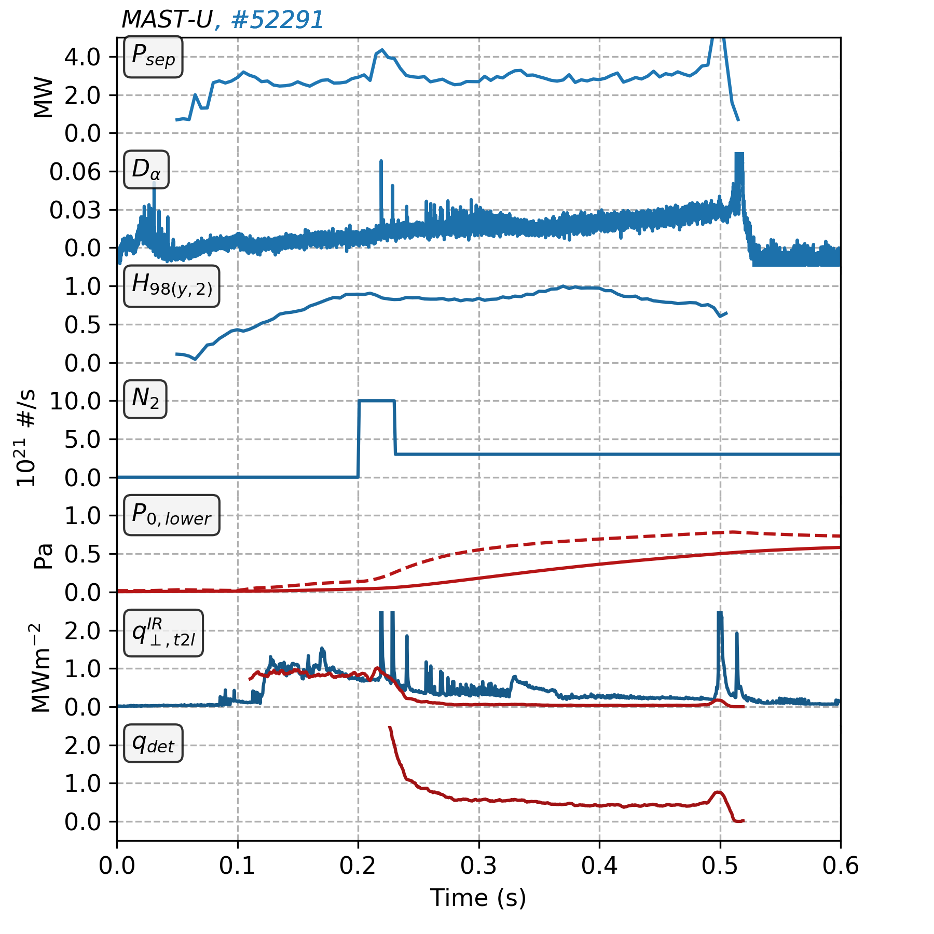
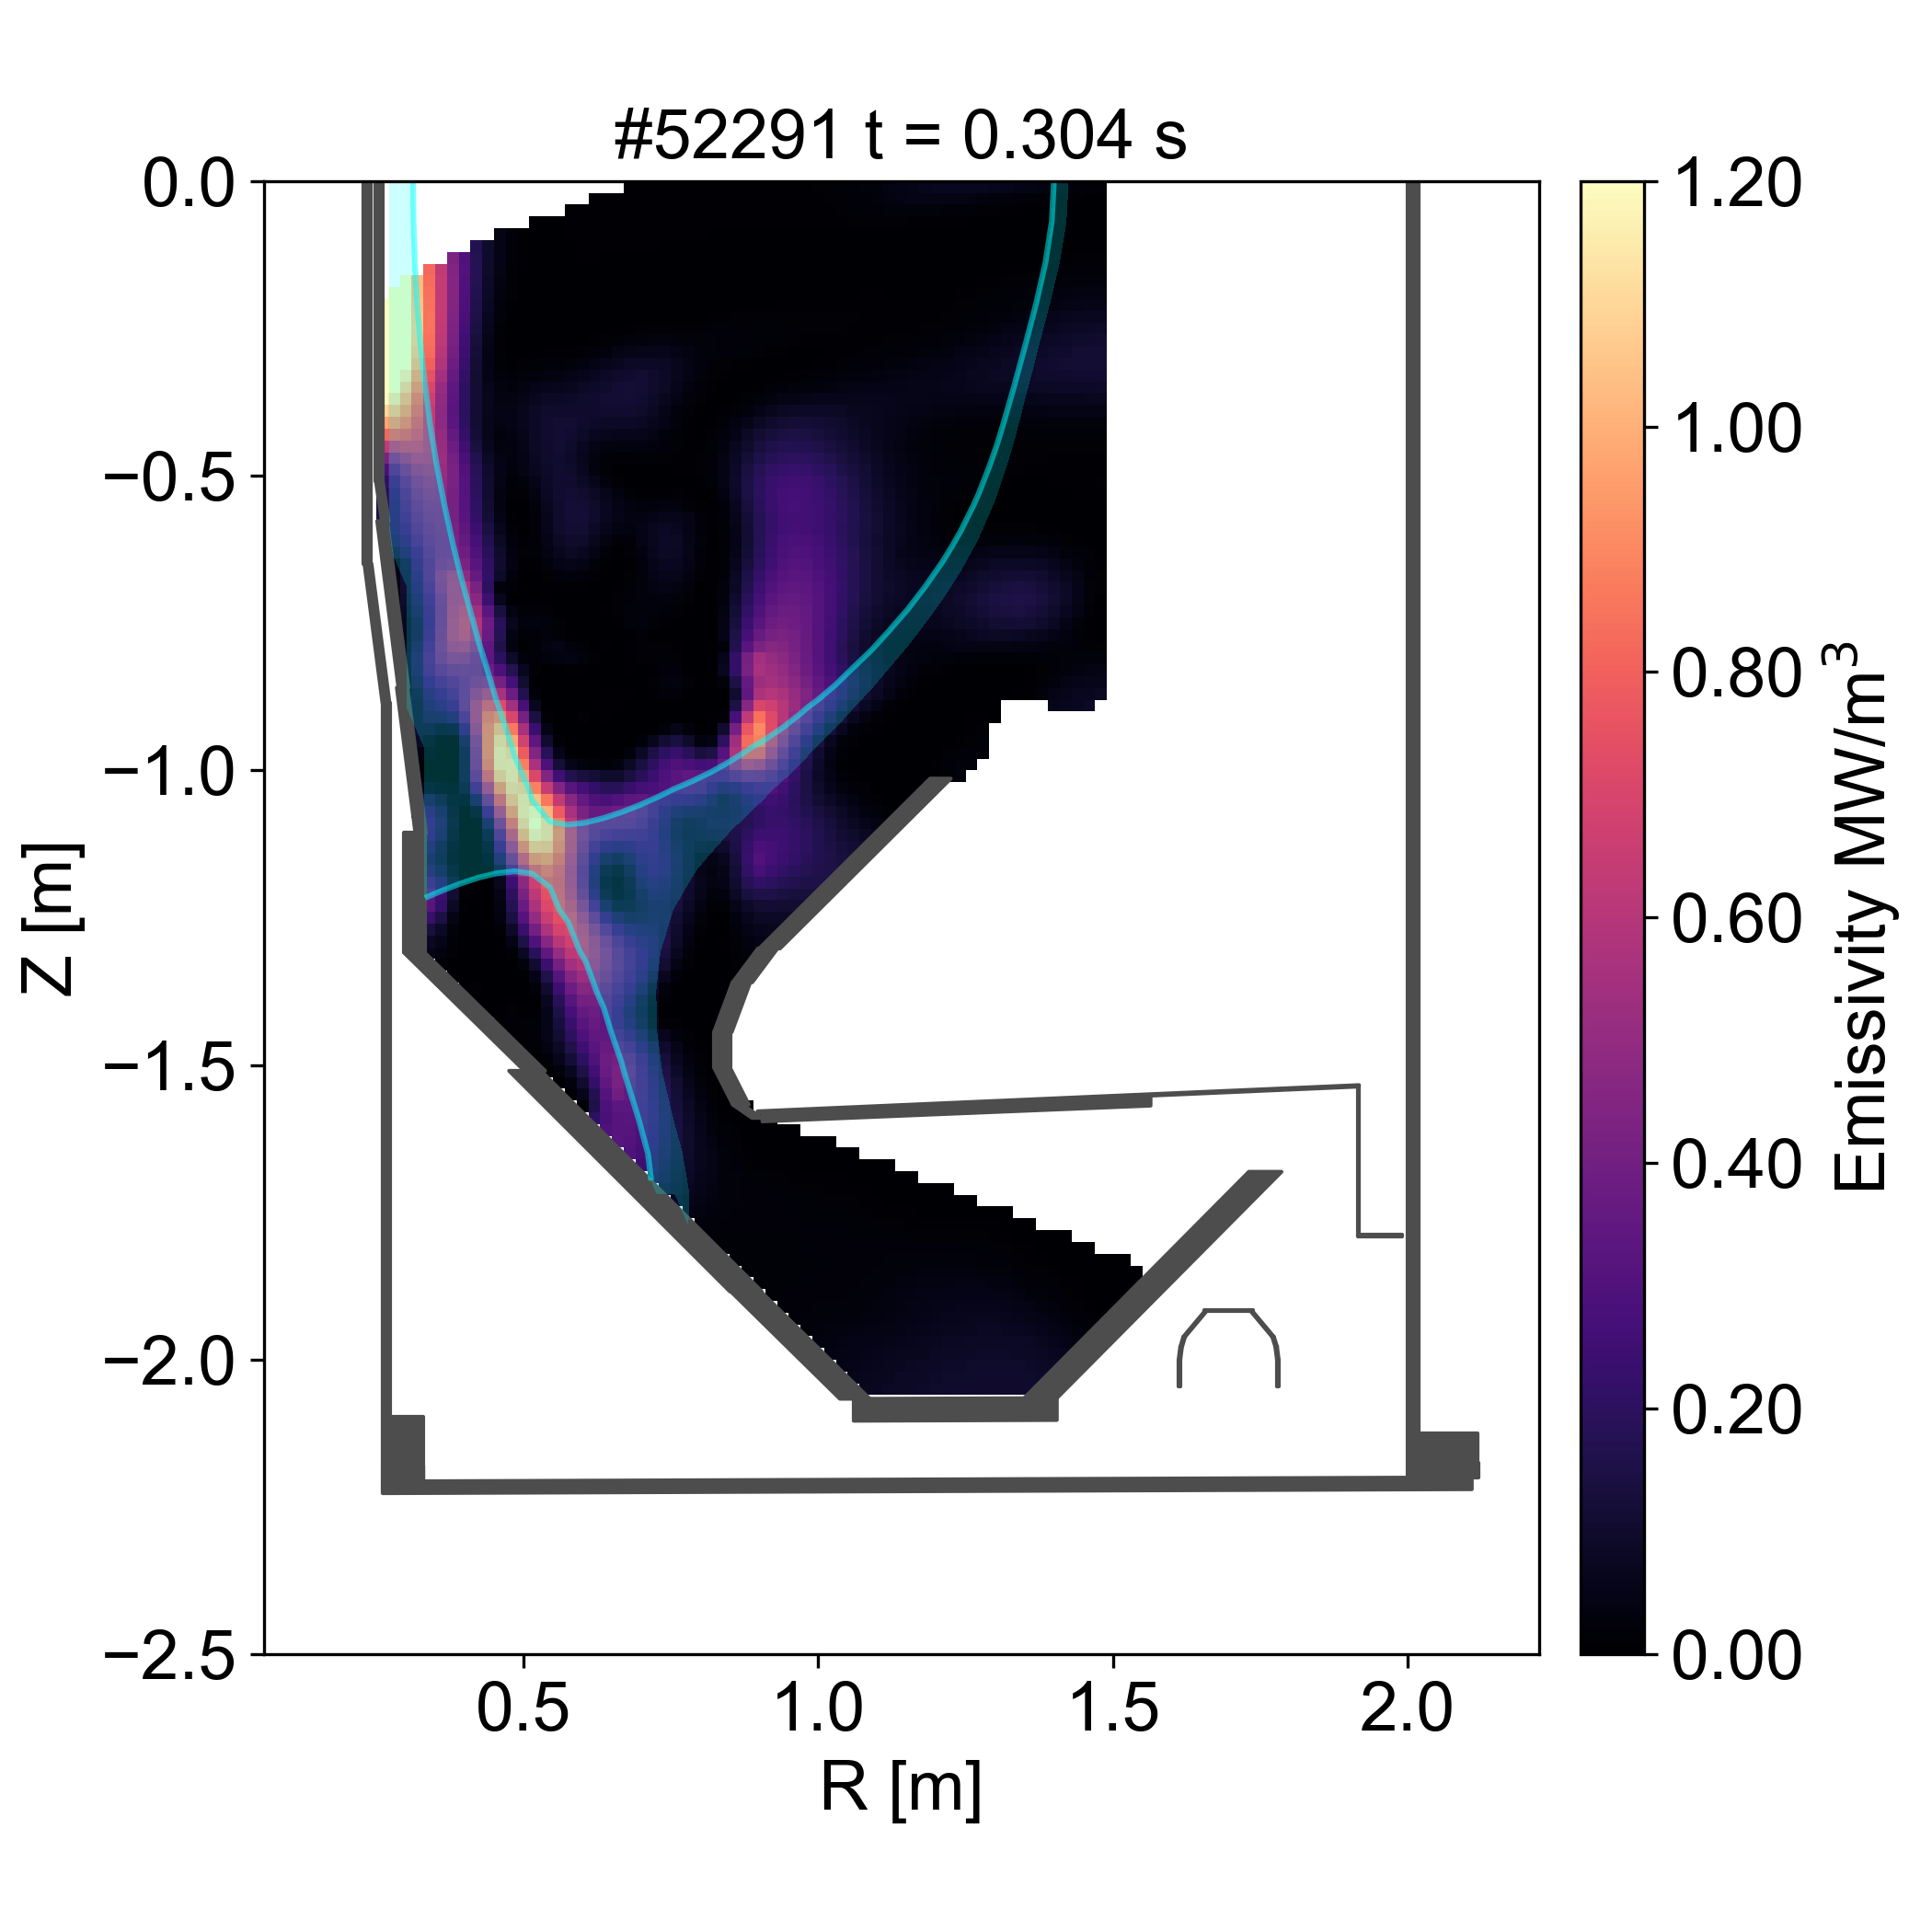
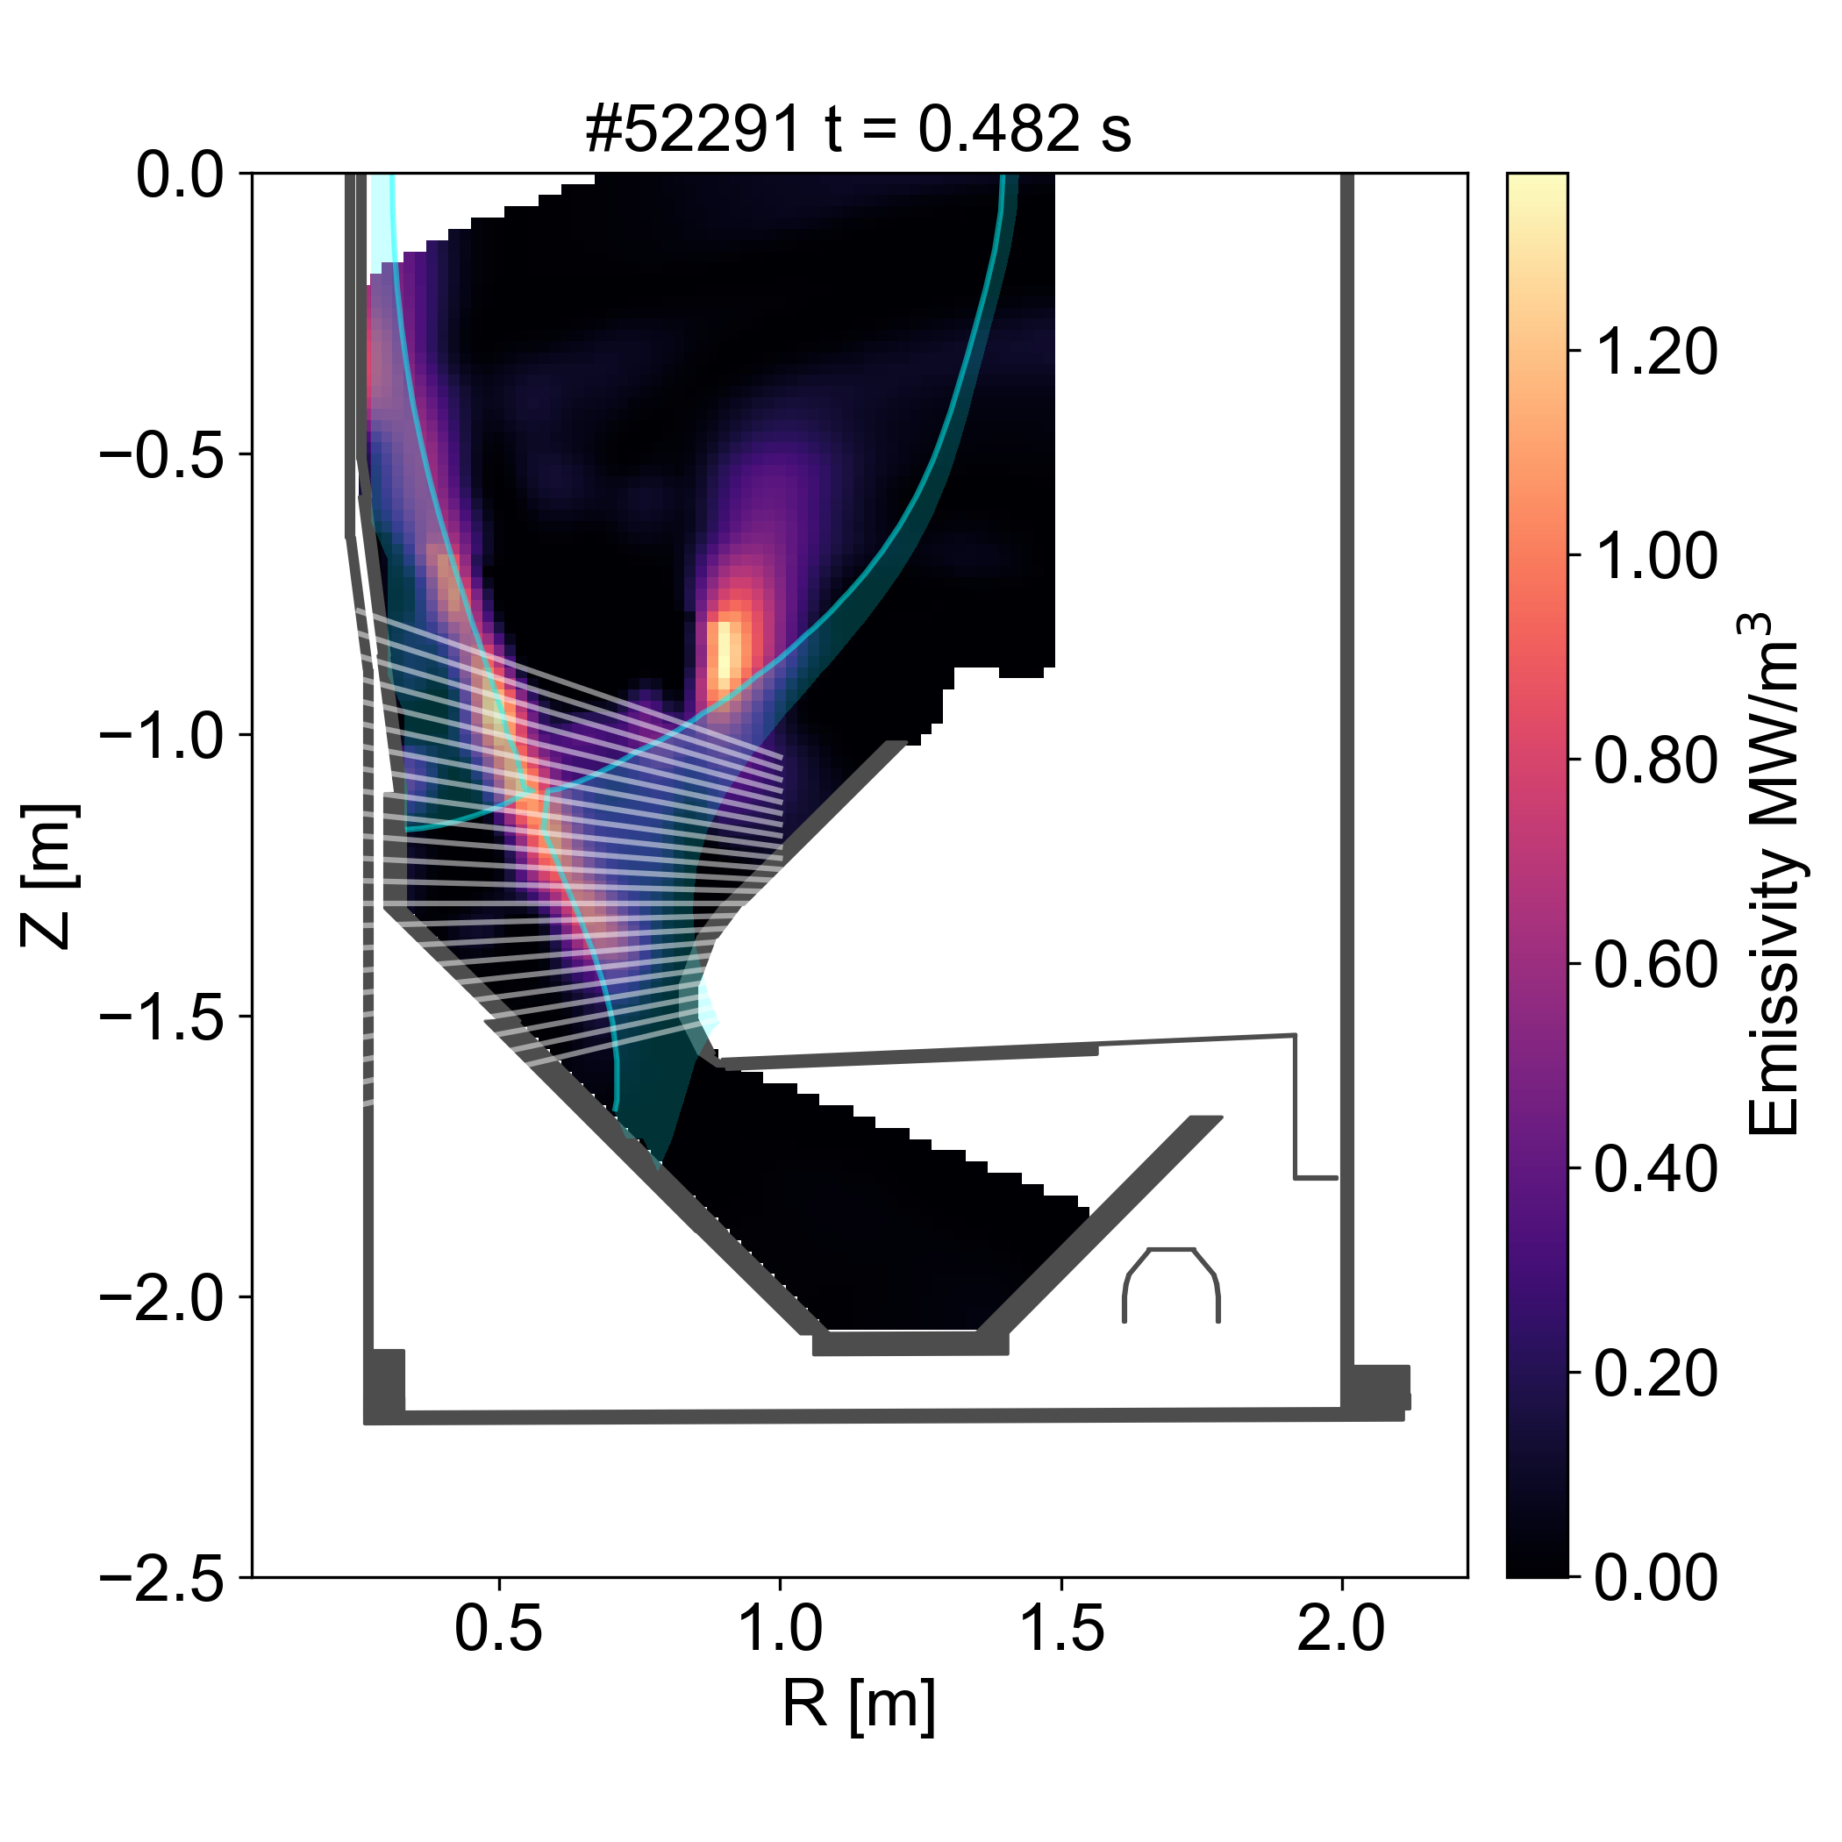
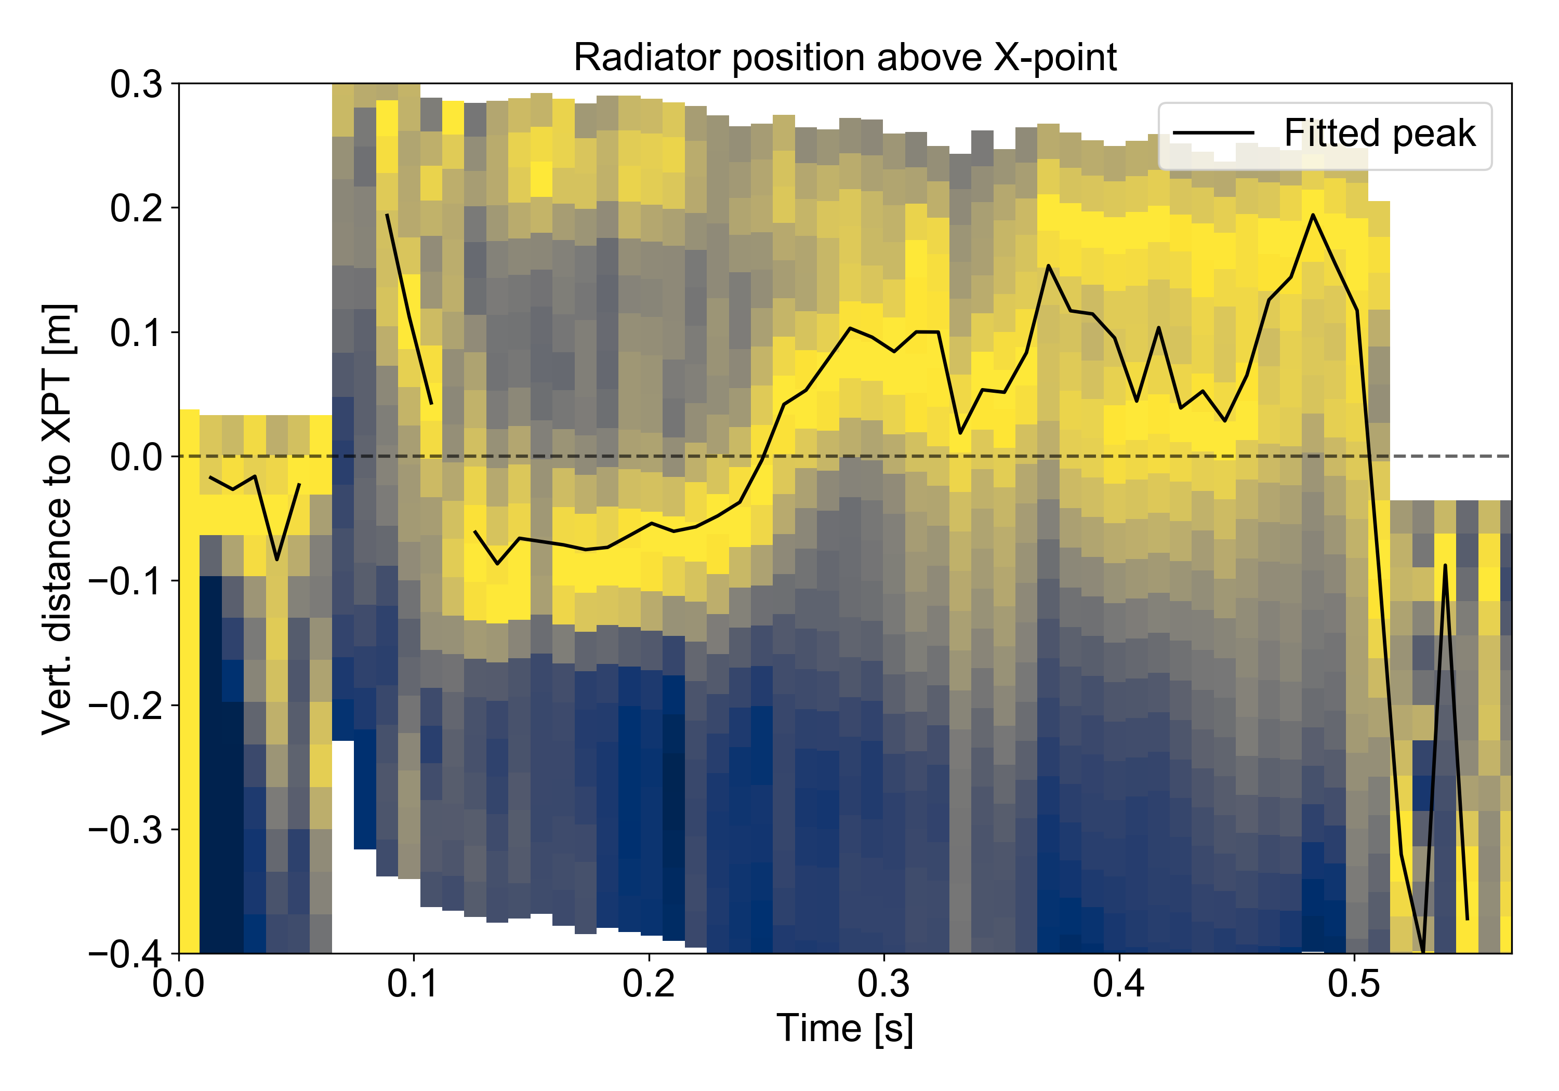
XPR in double-null
The main difference between double null and single null is the x2-3 reduction in power to the inner targets
Pronounced detachment predicted by DART at t~0.25 s
Radiation moves to inner SOL, rather than into confined plasma
Small drop in confinement similar to lower single null scenario
ELMs suppressed in later H-mode phase
Not full XPR regime – more Inner SOL Radiator (ISR) but similar controllability and ELM suppression
ISR in H-mode
DART div. press.
DART

Slide 11
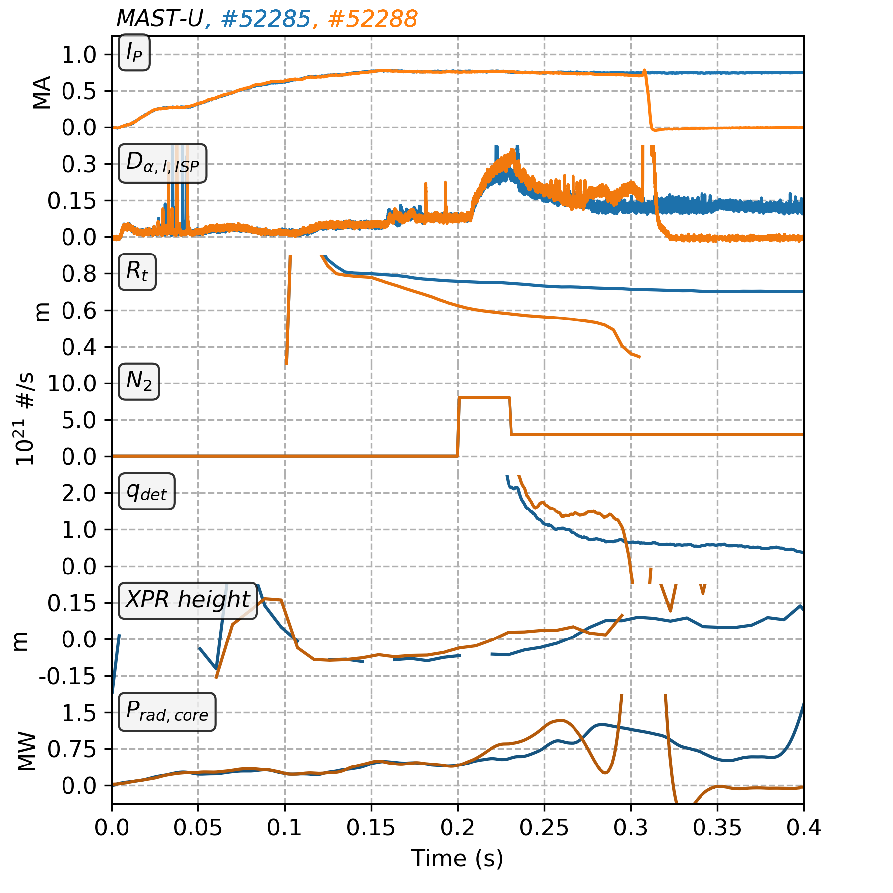
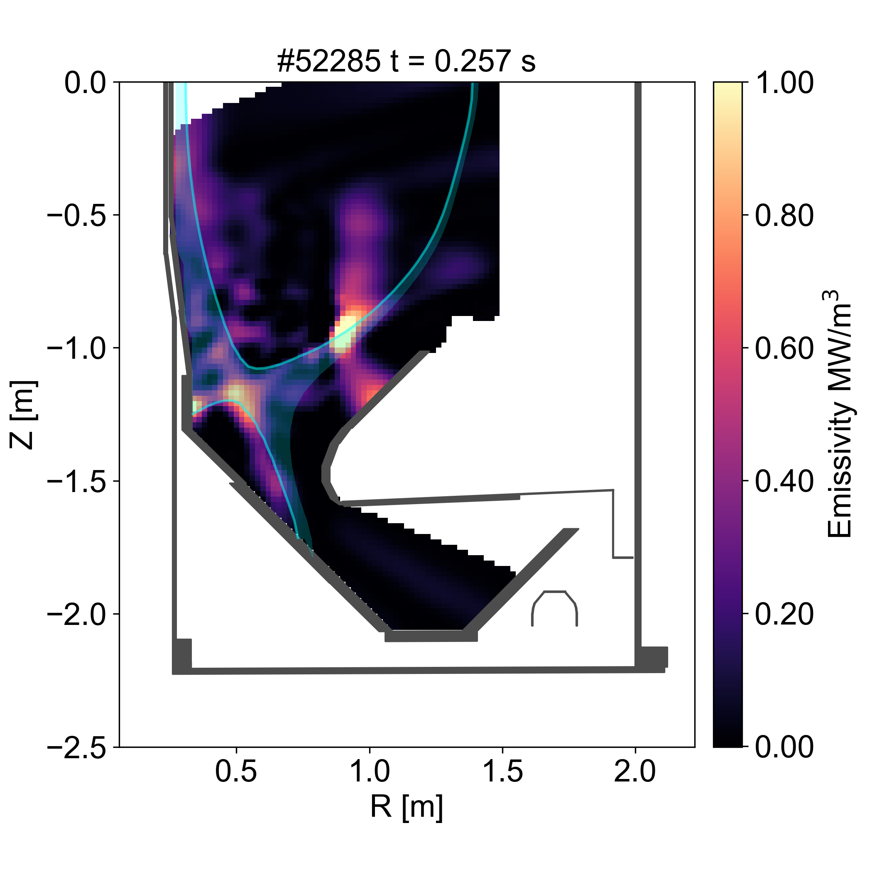
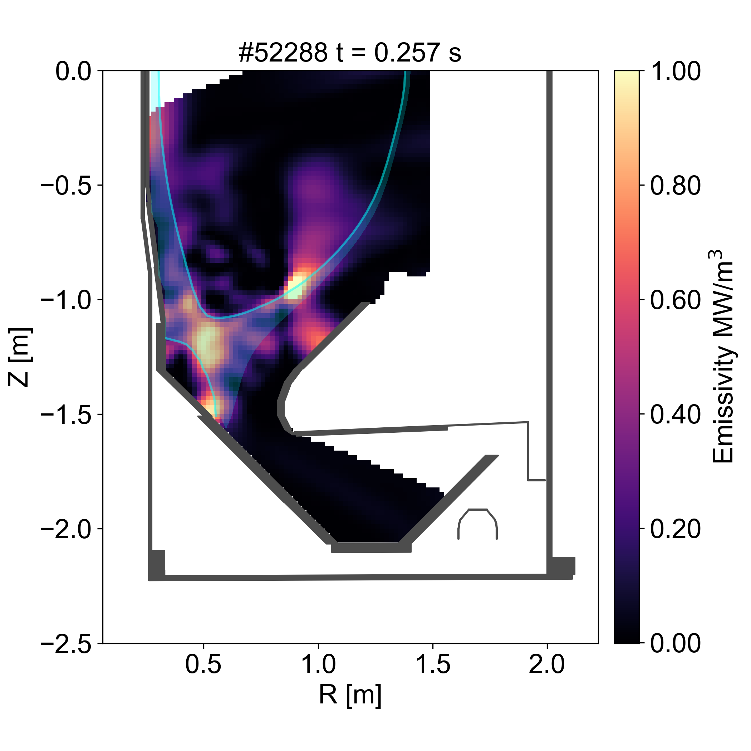
XPR unbaffled (open) divertor
Comparing open and closed geometries in double-null tests interplay between XPR access and detachment
Outer target remains attached with unbaffled geometry due to smaller target radius, with q_{det} remaining above one
Radiation region around X-point is larger with unbaffled geometry, but not yet observed within the confined region
Core radiation increases faster with unbaffled geometry, leading to an earlier H-L transition and disruption
Baffled divertor
Unbaffled divertor

Slide 12

Key messages
The XPR regime is observed in lower single null in MAST-U and behaves like other tokamaks
Strong seeding in double-null geometry leads to radiation moving up the inner SOL, rather than into the confined plasma
Type I ELMs are reduced to small ELMs or suppressed during strong seeding in double-null and single-null
Reducing C flux into plasma key for stability of XPR, consistent with Stroth model and observations from other tokamaks
Unbaffled geometry shows strong radiation underneath X-PT with an attached outer divertor
DART predictions of detachment and XPR access, and target heat loads generally in good agreement with measurements

Slide 13
Next steps
Strong emphasis on XPR physics in WP-TE and MAST-U internal campaign in 2026
Understanding impact of plasma shaping (e.g. triangularity) on confinement during XPR
Testing XPR access to various parameters suggested by Stroth model, e.g. connection length, flux expansion
Improving stability against HL transitions
Quantifying benefits of XPR vs. SXD configurations
Characterise window in which ELM suppression is observed in double-null and single-null
First XPR attempts on MAST-U were successful, plan now to improve understanding with SOLPS-ITER

Slide 14
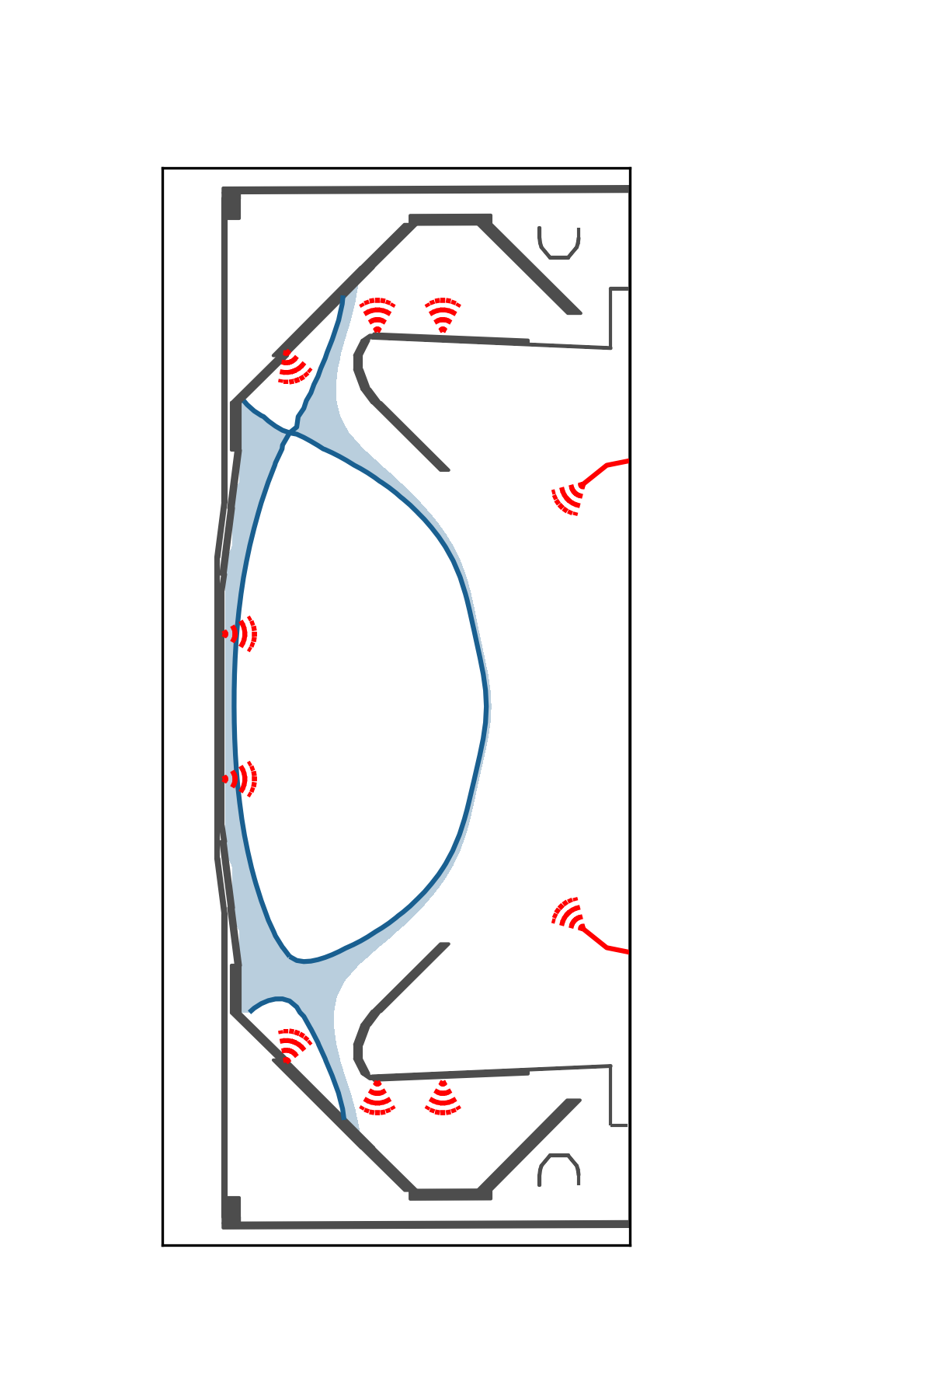
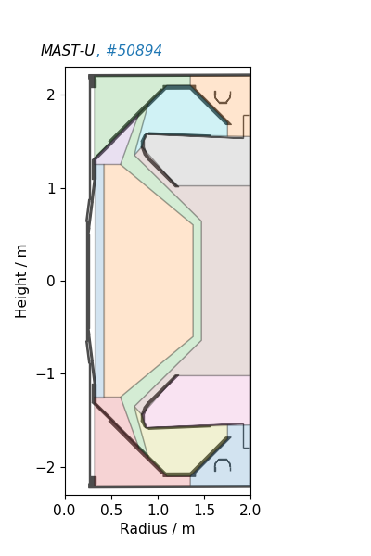
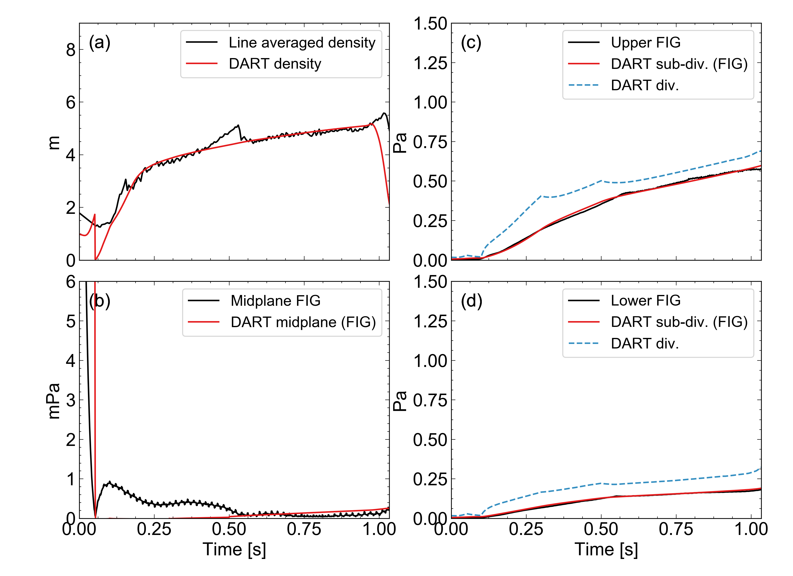
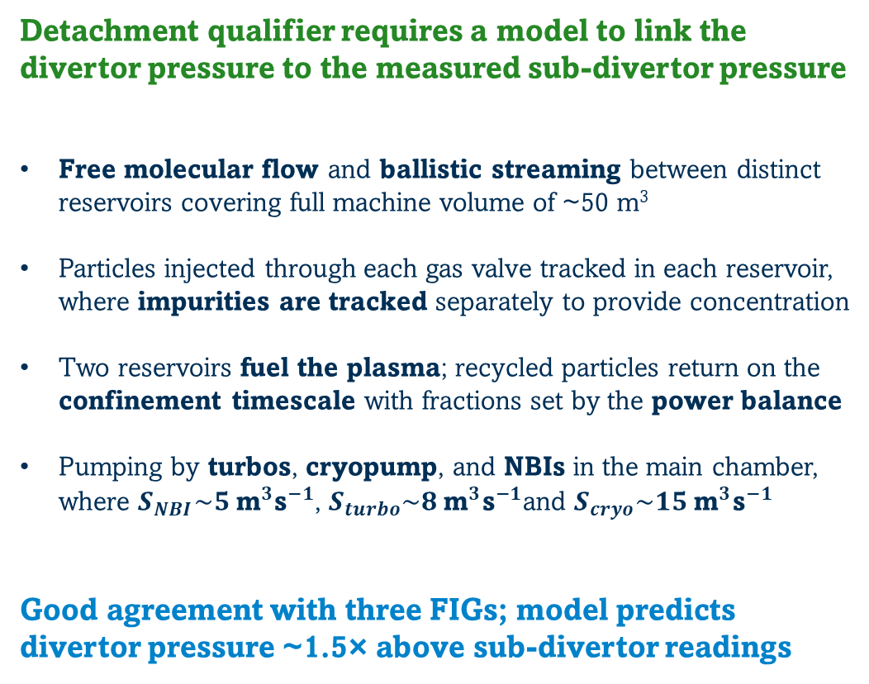
Appendix Neutral reservoir model
Reservoirs
Upper
div. FIG
Detachment qualifier requires a model to link the divertor pressure to the measured sub-divertor pressure
Free molecular flow and ballistic streaming between distinct reservoirs covering full machine volume of ~50 m³
Particles injected through each gas valve tracked in each reservoir, where impurities are tracked separately to provide concentration
Two reservoirs fuel the plasma; recycled particles return on the confinement timescale with fractions set by the power balance
Pumping by turbos, cryopump, and NBIs in the main chamber, where $S_{NBI}\sim 5 {\text{m}}^{3}{\text{s}}^{−1}$, $S_{turbo}\sim 8 {\text{m}}^{3}{\text{s}}^{−1}$and $S_{cryo}\sim 15 {\text{m}}^{3}{\text{s}}^{−1}$
Good agreement with three FIGs; model predicts divertor pressure ~1.5× above sub-divertor readings
Midplane
FIG
Lower
div. FIG
DART reservoir model predictions #50894

