Slide 1
Experimental Investigation of Impurity Enrichment in the W7-X Island Divertor
Frederik Henke, Maciej Krychowiak, Dorothea Gradic, Felix Reimold, Georg Schlisio, Thilo Romba, Victoria Winters, Oliver Ford

Slide 2
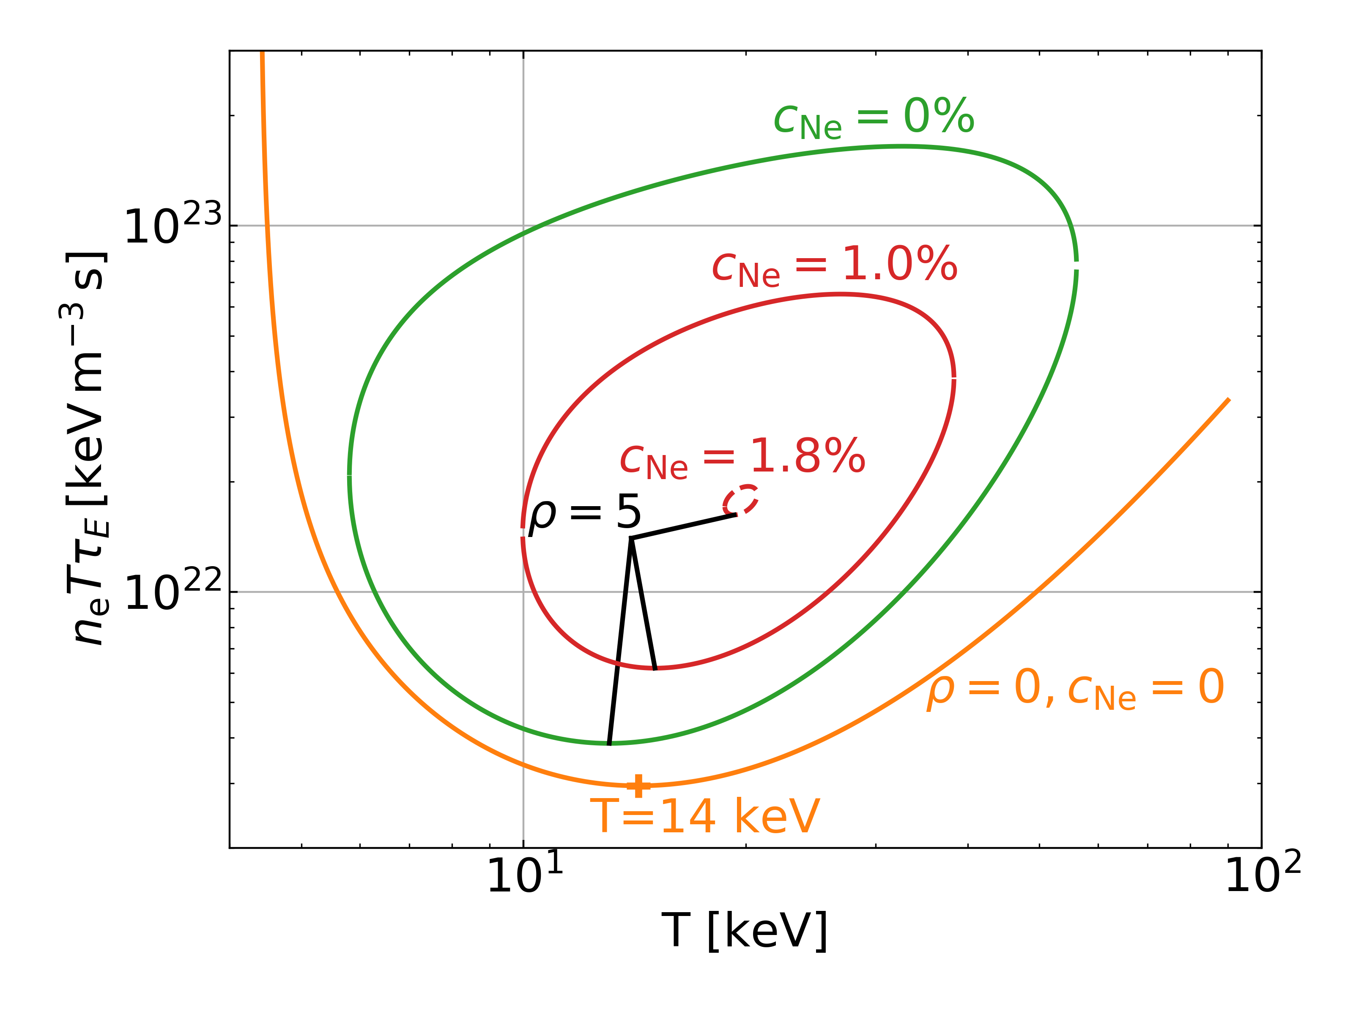

Importance of impurities at W7-X
W7-X is capable of entering a radiative detachment regime
Intrinsic with density ramp (carbon)
Impurity seeding
W7-X high power scenarios need additional seeding
In a future stellarator power plant impurities (seeded and unseeded) will play a large role
This work aims for the experimental measurement of impurity enrichment in attached conditions

Slide 3
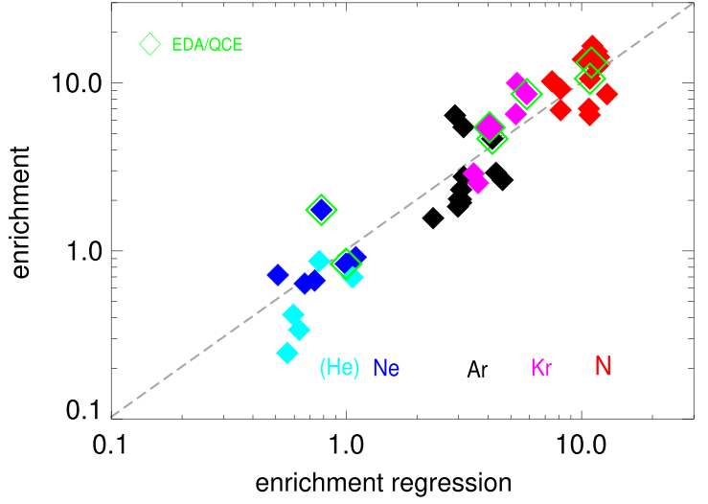

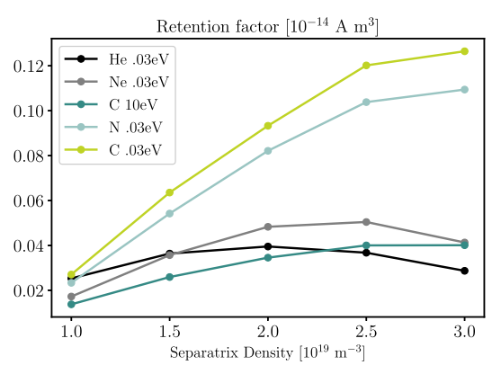
Impurity retention:
In Tokamaks enrichment has been observed to be strongly species dependent
Leakage channel via parallel transport
EMC3-EIRENE simulations show, that in W7-X species dependence is also expected
Leakage mechanism via perpendicular transport
Kallenbach, NF, 2024
Winters, NF, 2024

Slide 4
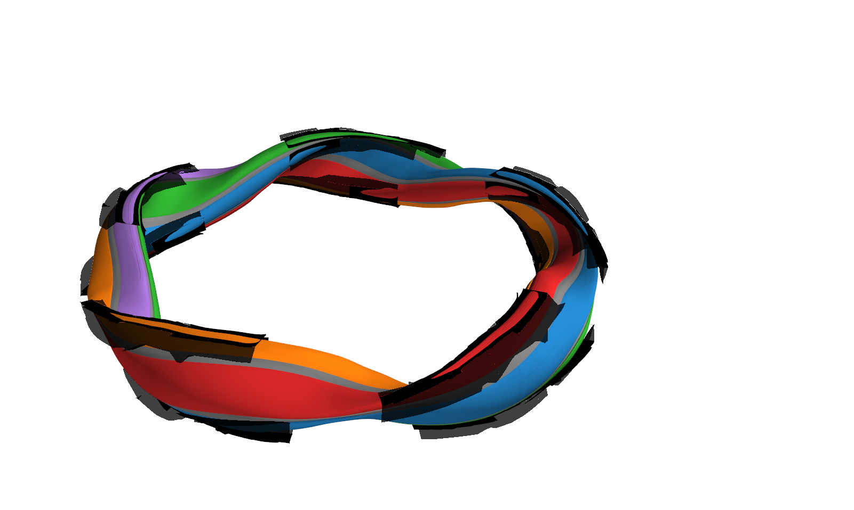
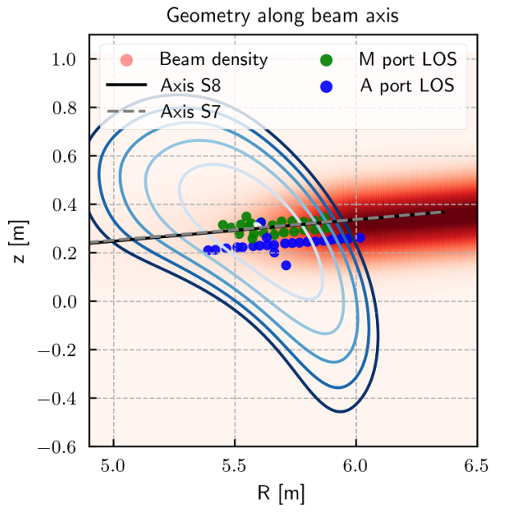
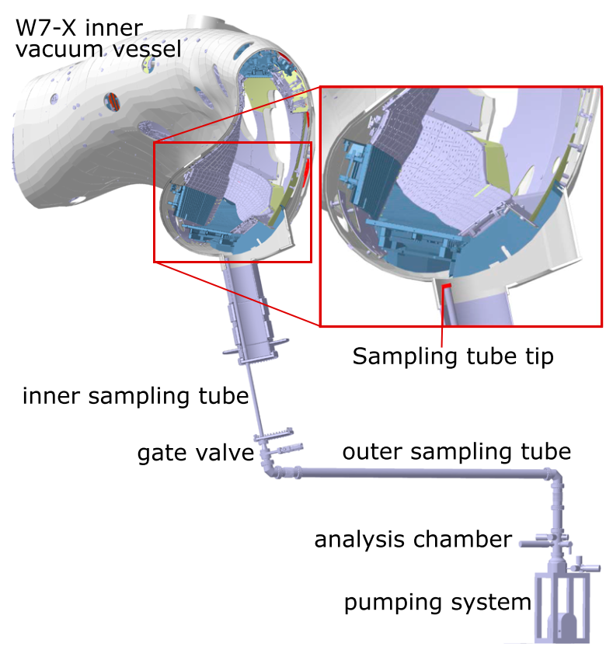
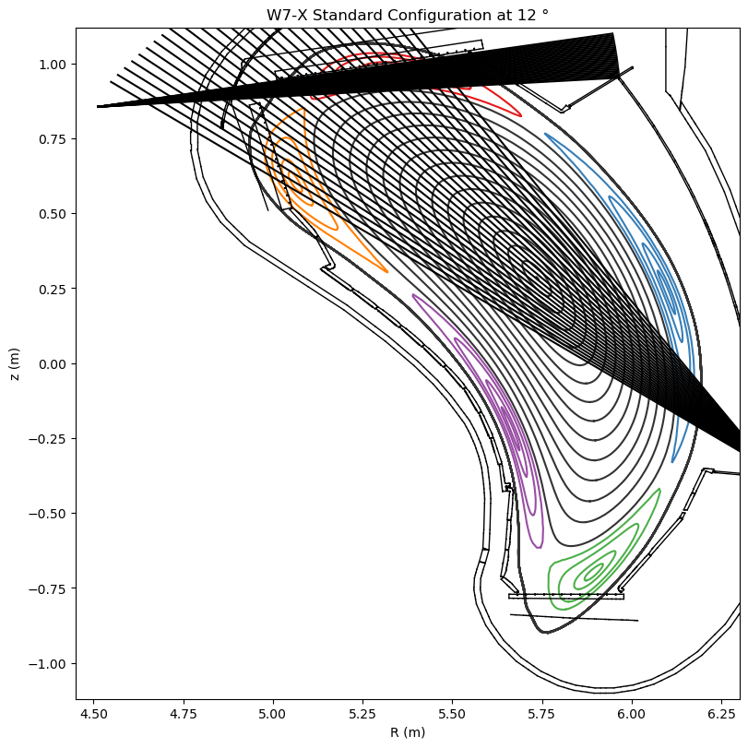
Wendelstein 7-X impurity diagnostics
CXRS
Bannmann, PPCF, 2024
DRGA
Divertor Spectroscopy
Schlisio, RSI, 2019

Slide 5
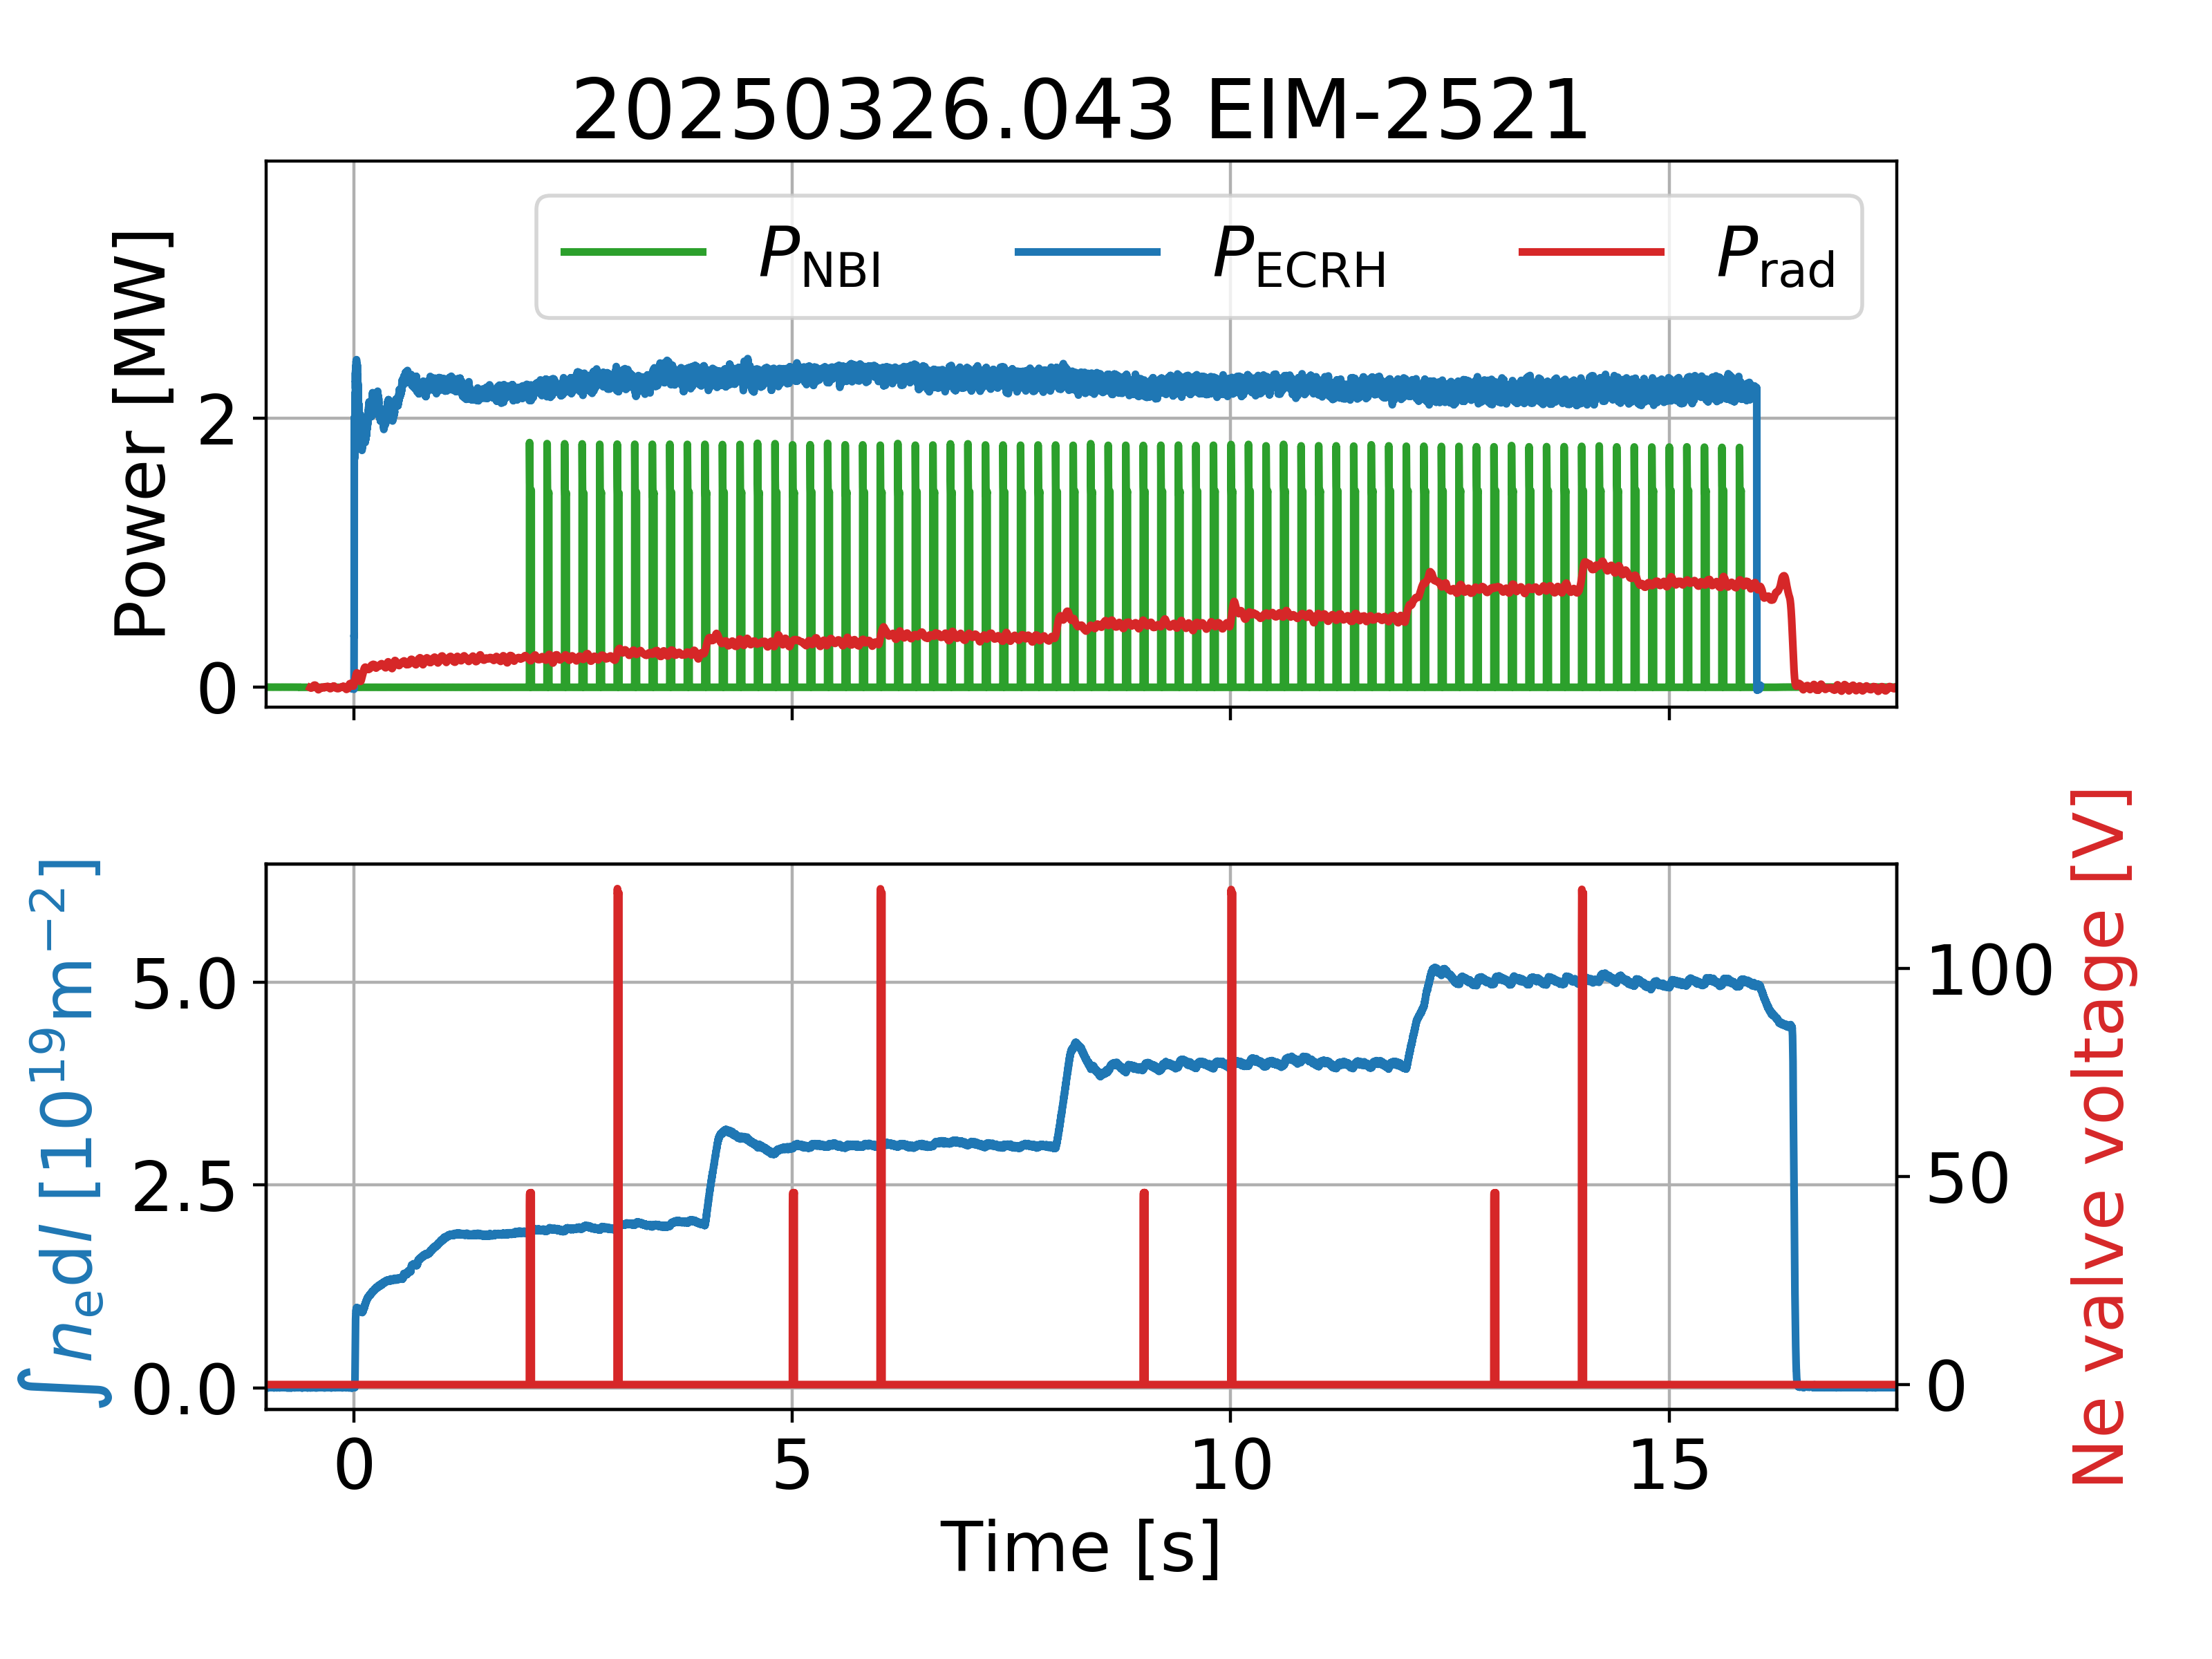
Experiments
Impurity seeding expermiments in attached conditions have been conducted
Purely ECRH heated plasmas (NBI blibs only)
Trace impurity
Density steps
Ne

Slide 6
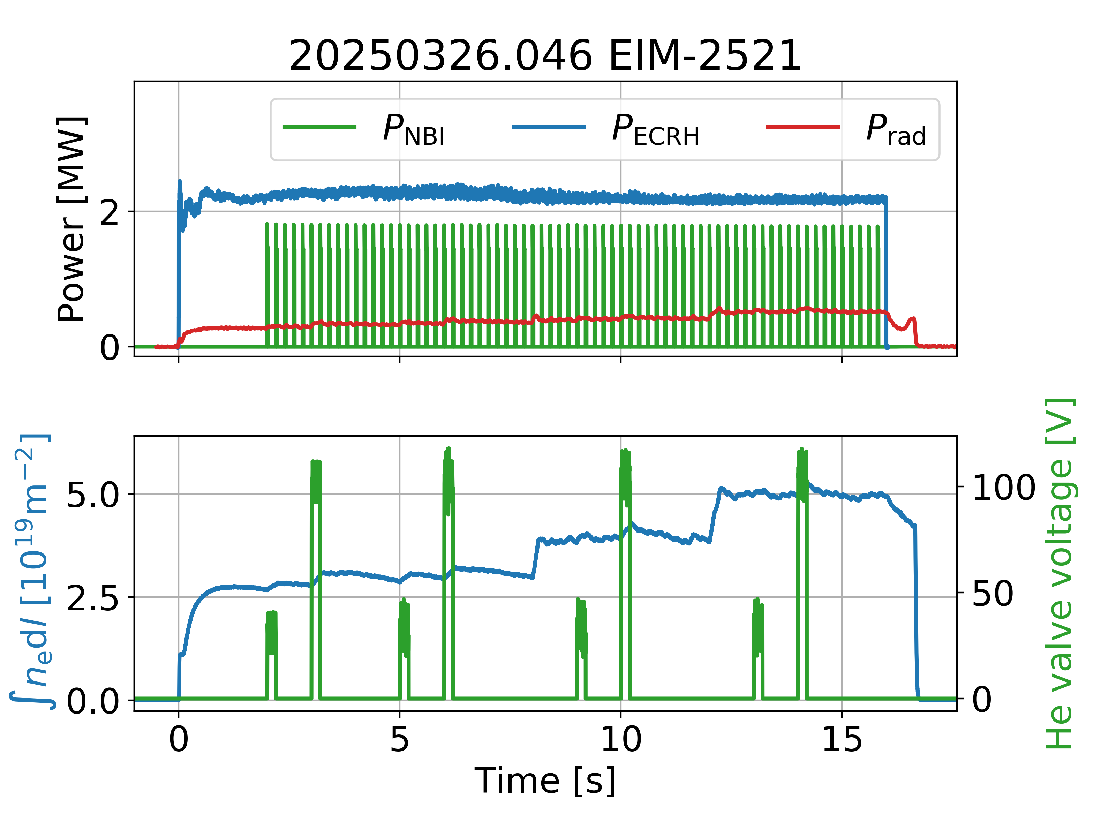
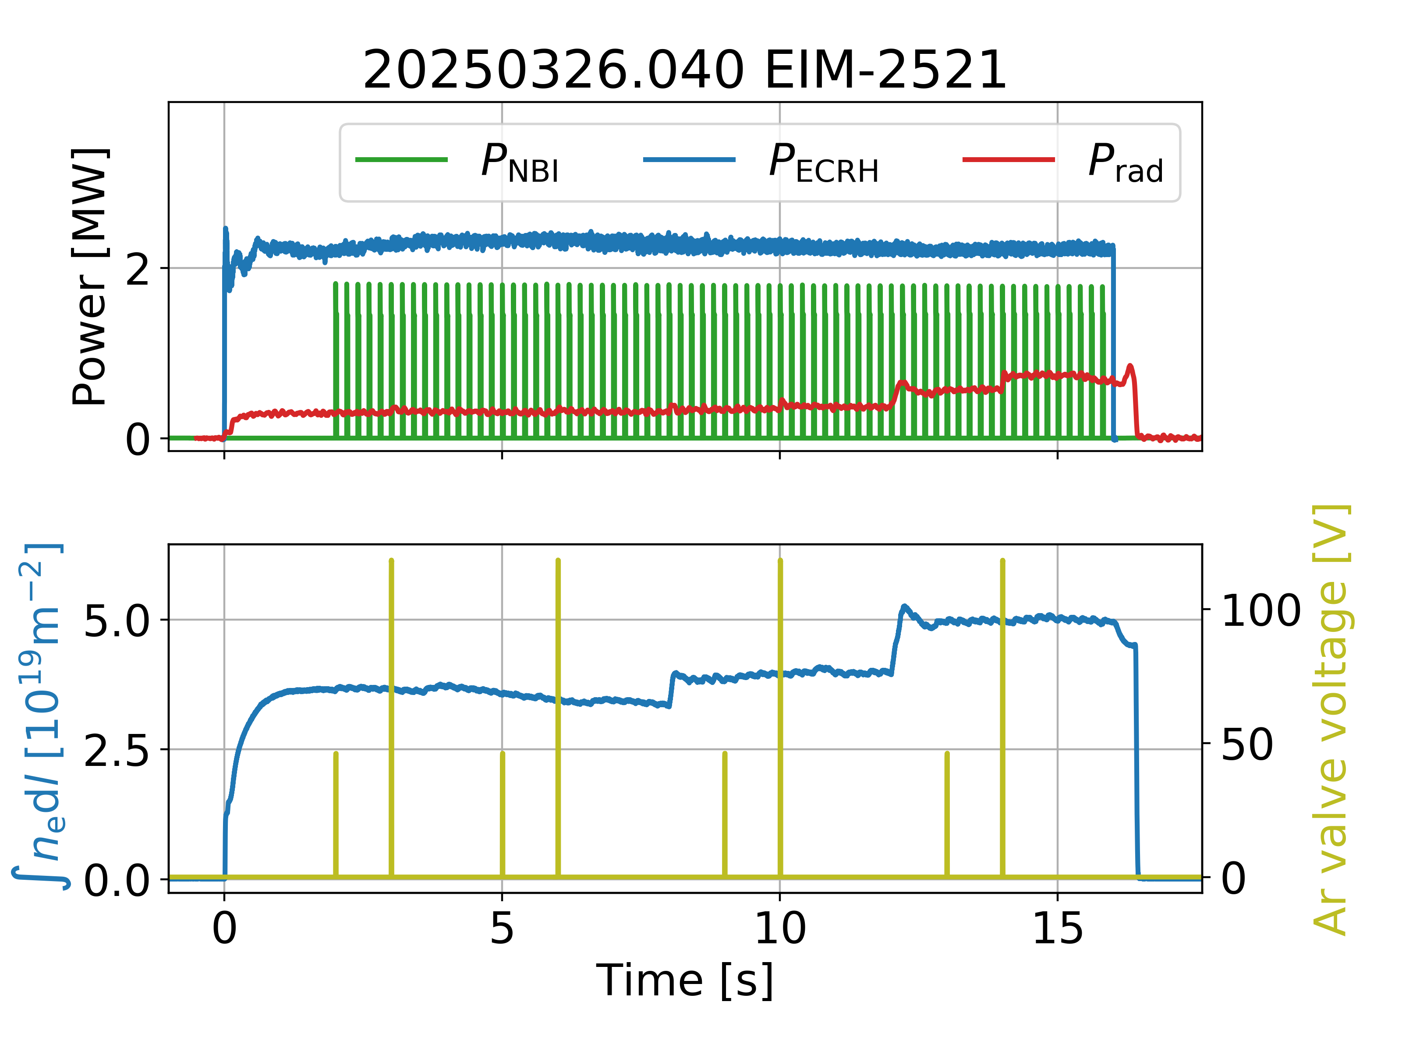
Experiments
Impurity seeding expermiments in attached conditions have been conducted
Purely ECRH heated plasmas (NBI blibs only)
Trace impurity
Density steps
He, Ne and Ar
To be evaluated

Slide 7
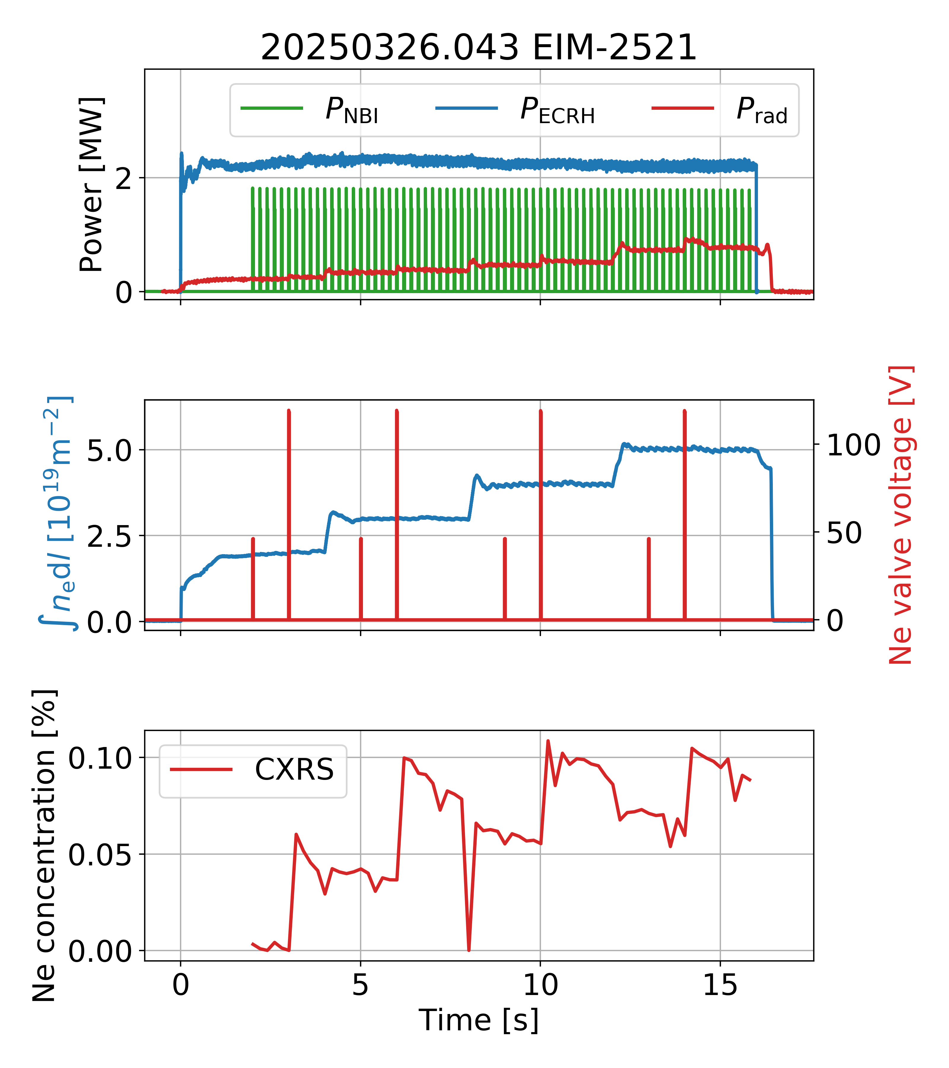
Impurity concentration in the core plasma measured with Charge Exchange Recombination Spectroscopy (CXRS)
In purely ECRH heated plasmas we observe flat impurity density profiles
Core impurity concentration evaluated between 0 < ρ < 0.5
Data provided by CXRS team Romba, PPCF, 2023

Slide 8
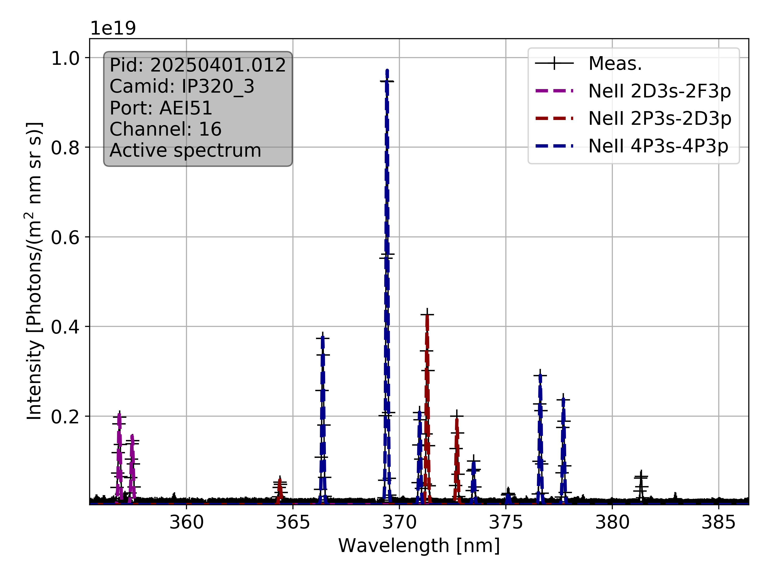
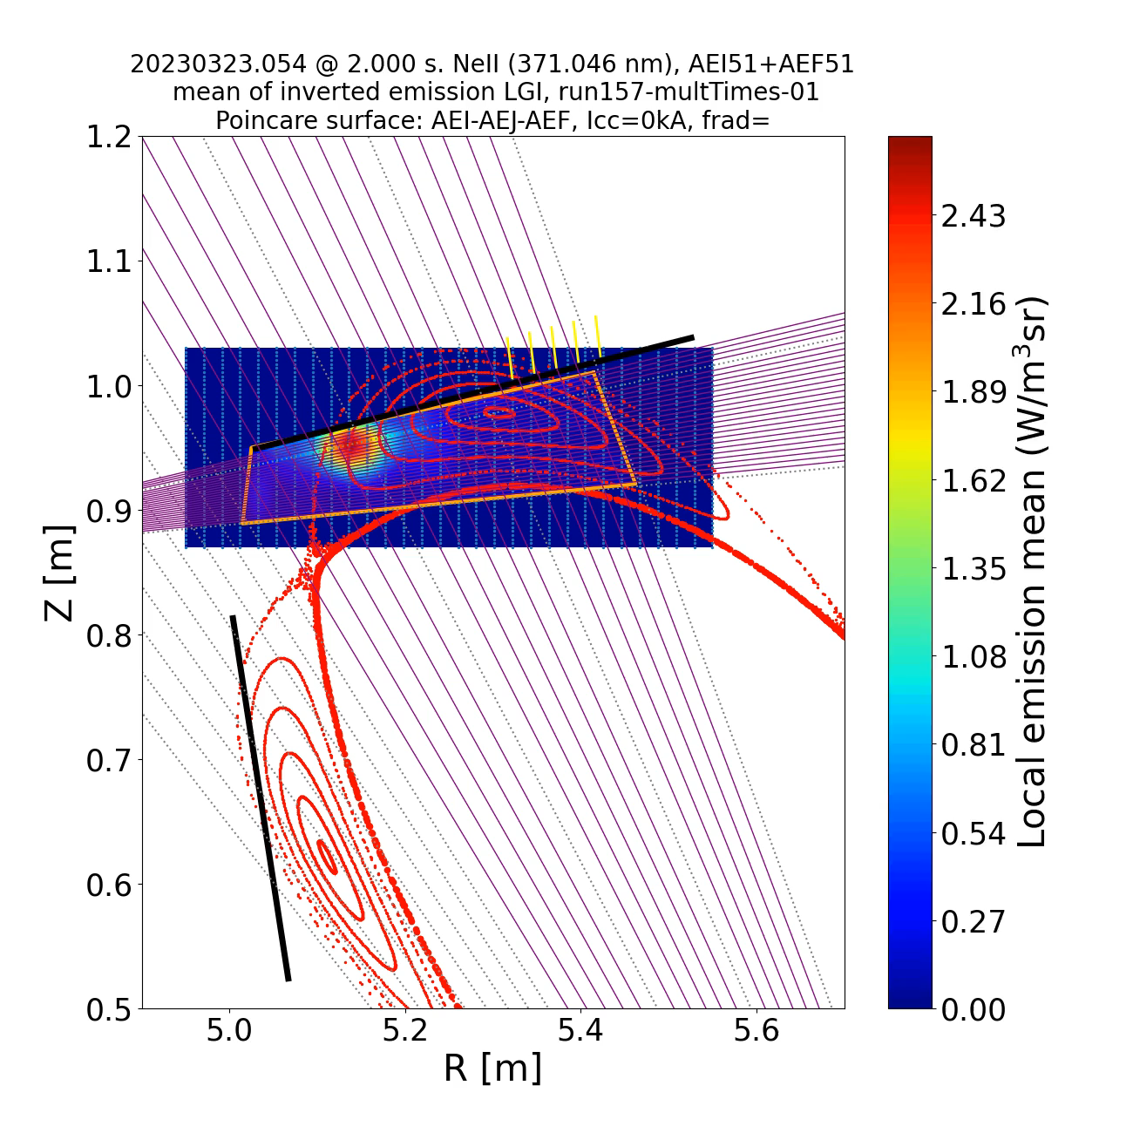
Impurity concentration in the SOL plasma directly measured with divertor spectroscopy
Krychowiak, EPS, 2021

Slide 9
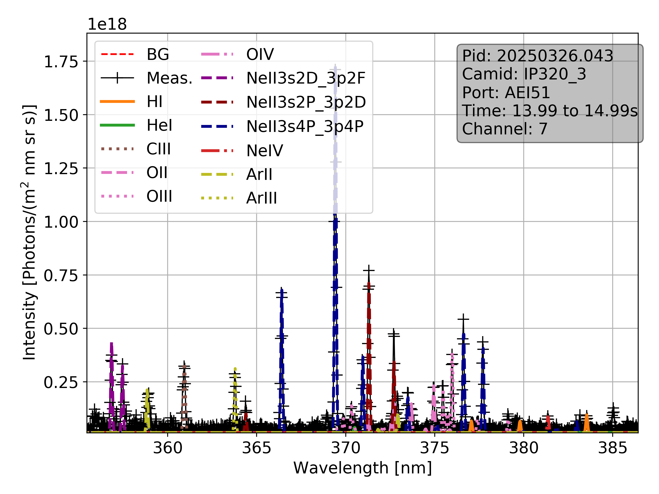
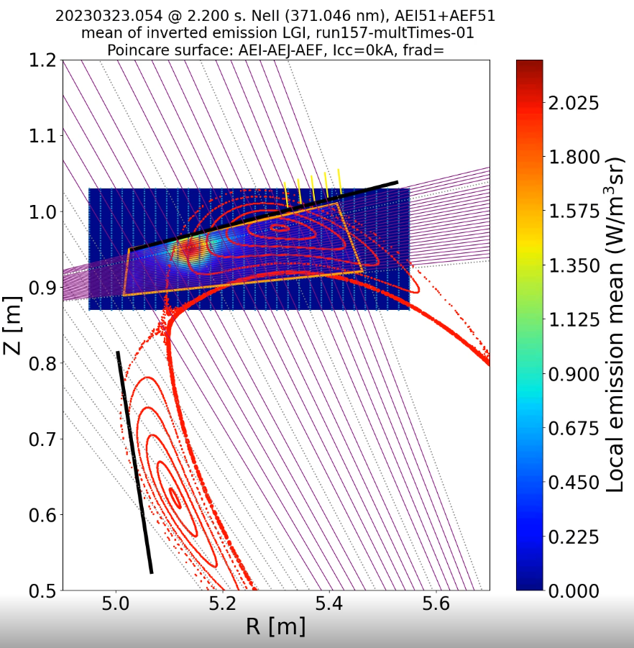
Impurity concentration in the SOL plasma directly measured with divertor spectroscopy
Intensity of three NeII lines is measured

Slide 10
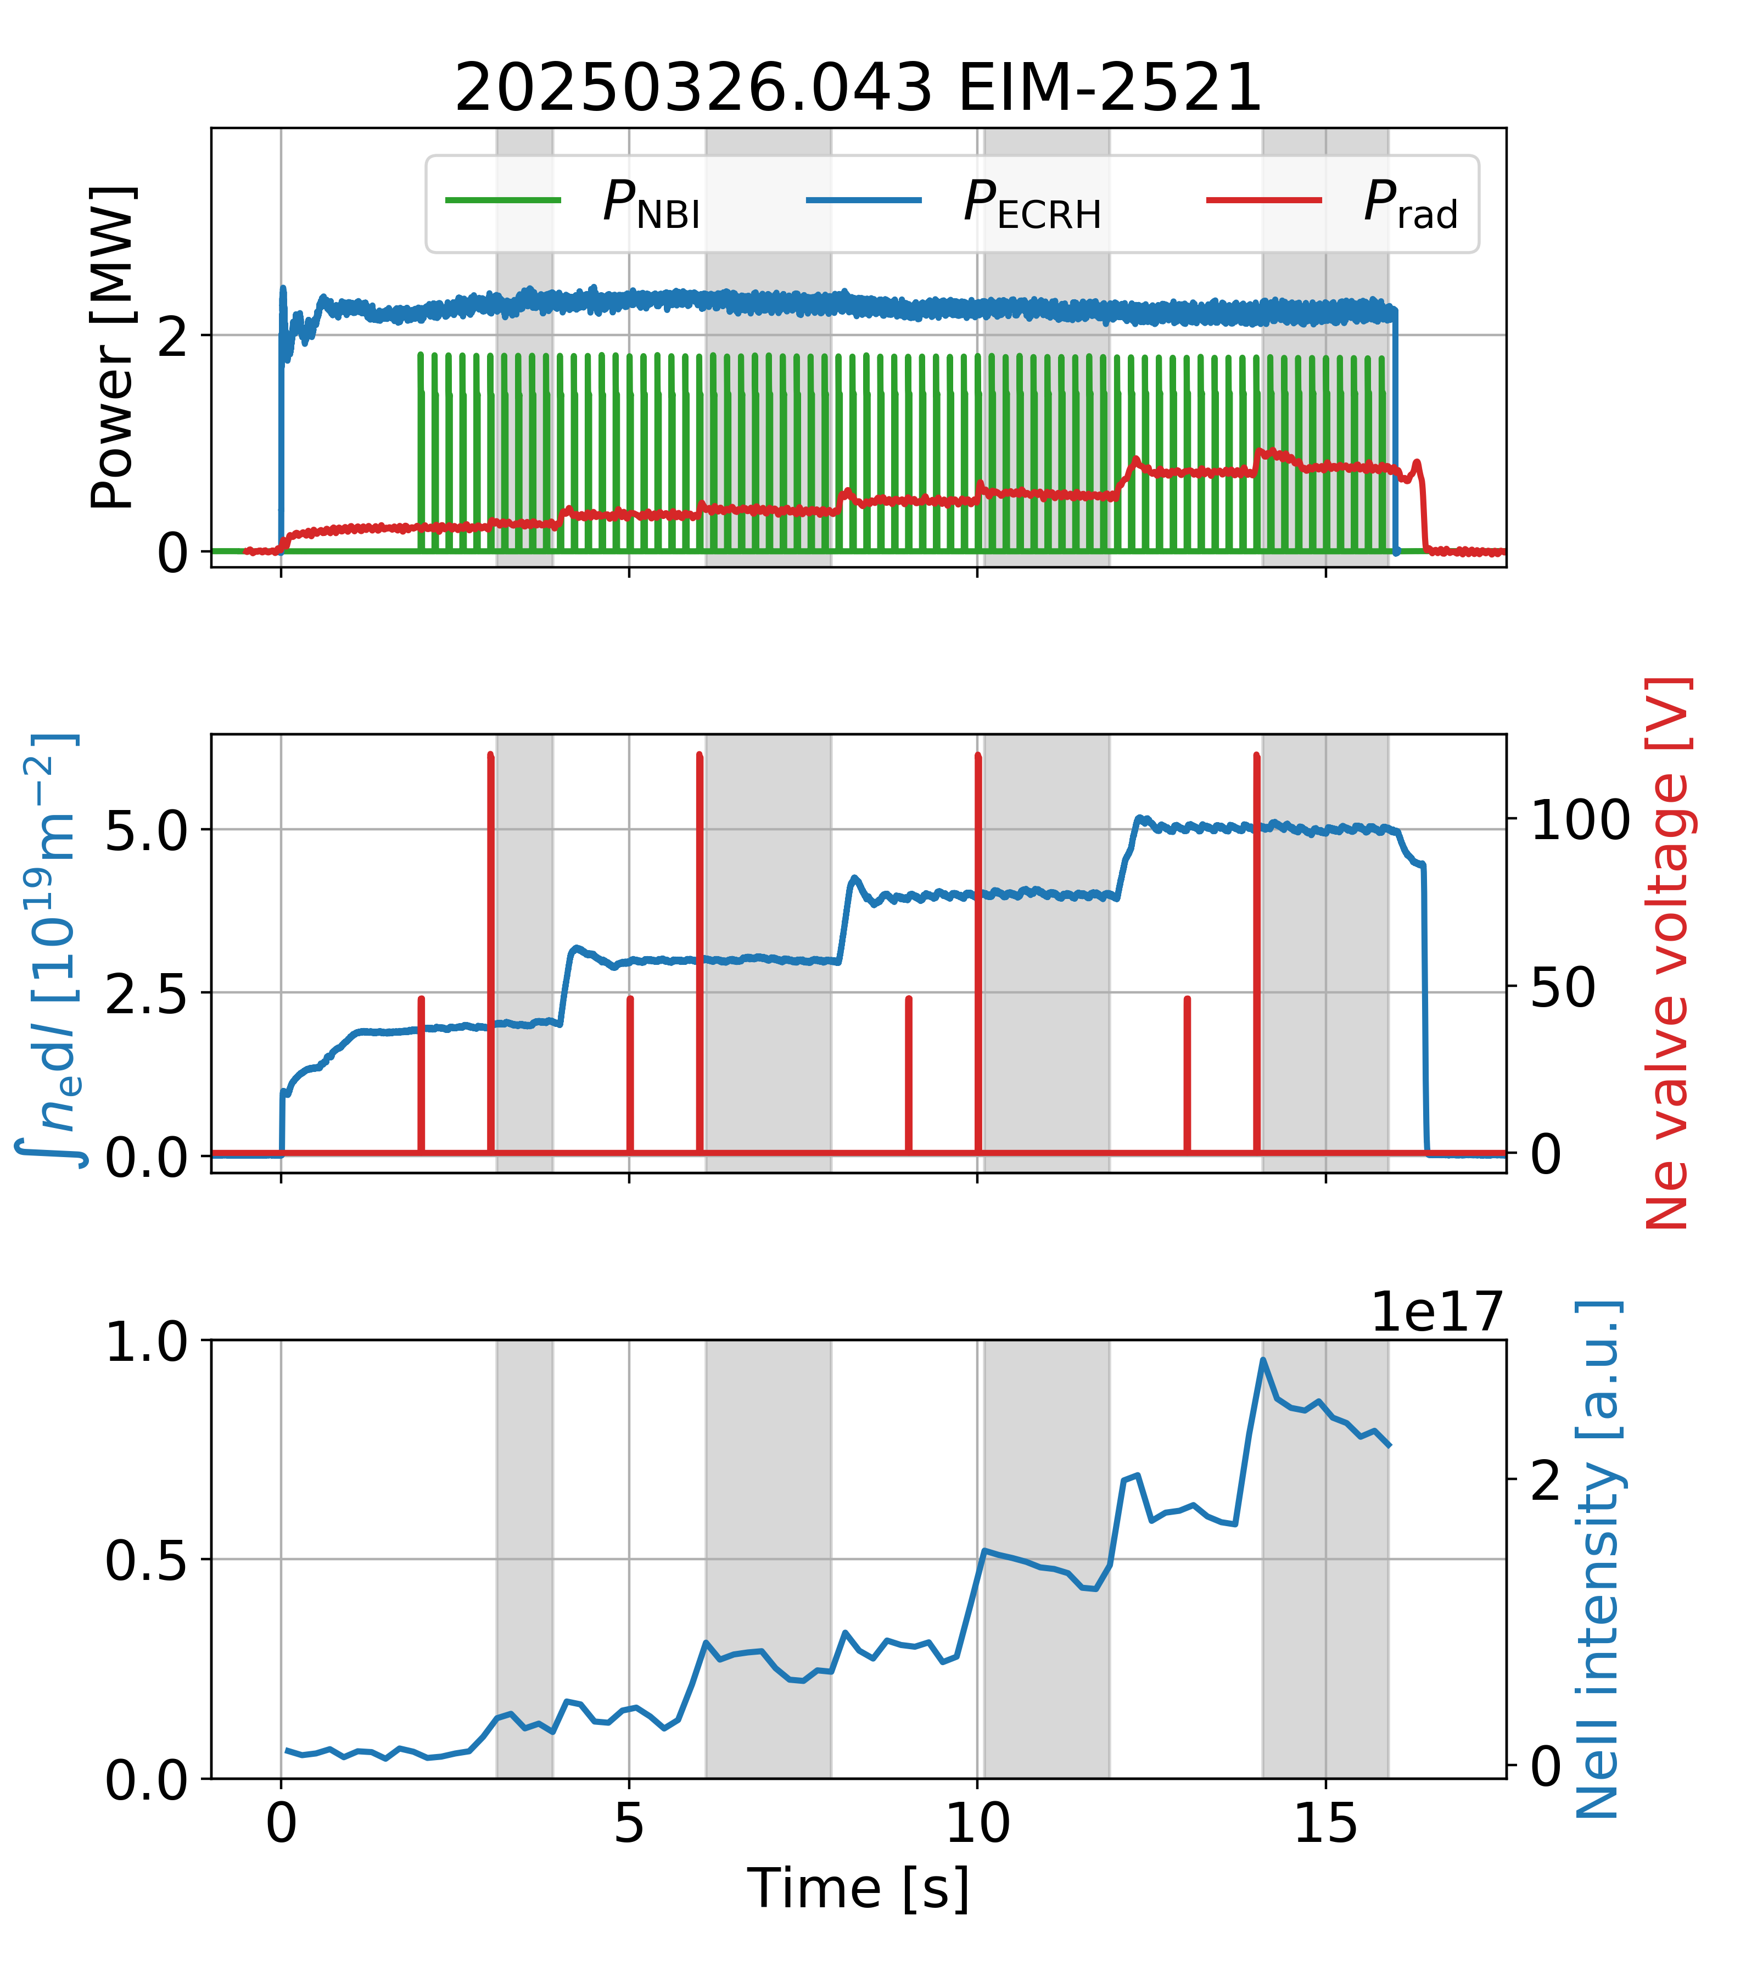
Impurity concentration in the SOL plasma directly measured with divertor spectroscopy
Intensity of three NeII lines is measured

Slide 11
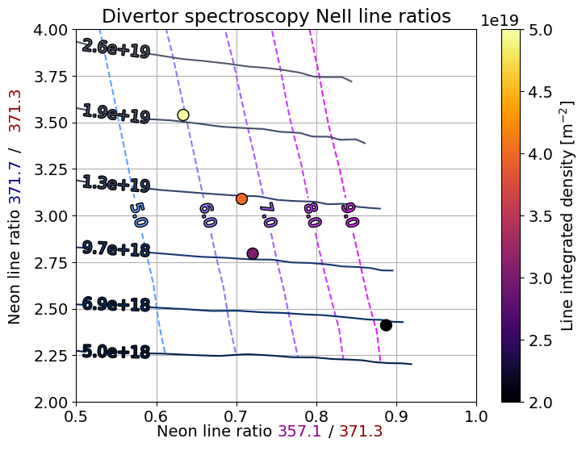
Impurity concentration in the SOL plasma directly measured with divertor spectroscopy
Intensity of three NeII lines is measured
Line ratios are dependent on local plasma parameters n_{e} and T_{e} Henderson, NF, 2017, Henderson, NF, 2023

Slide 12
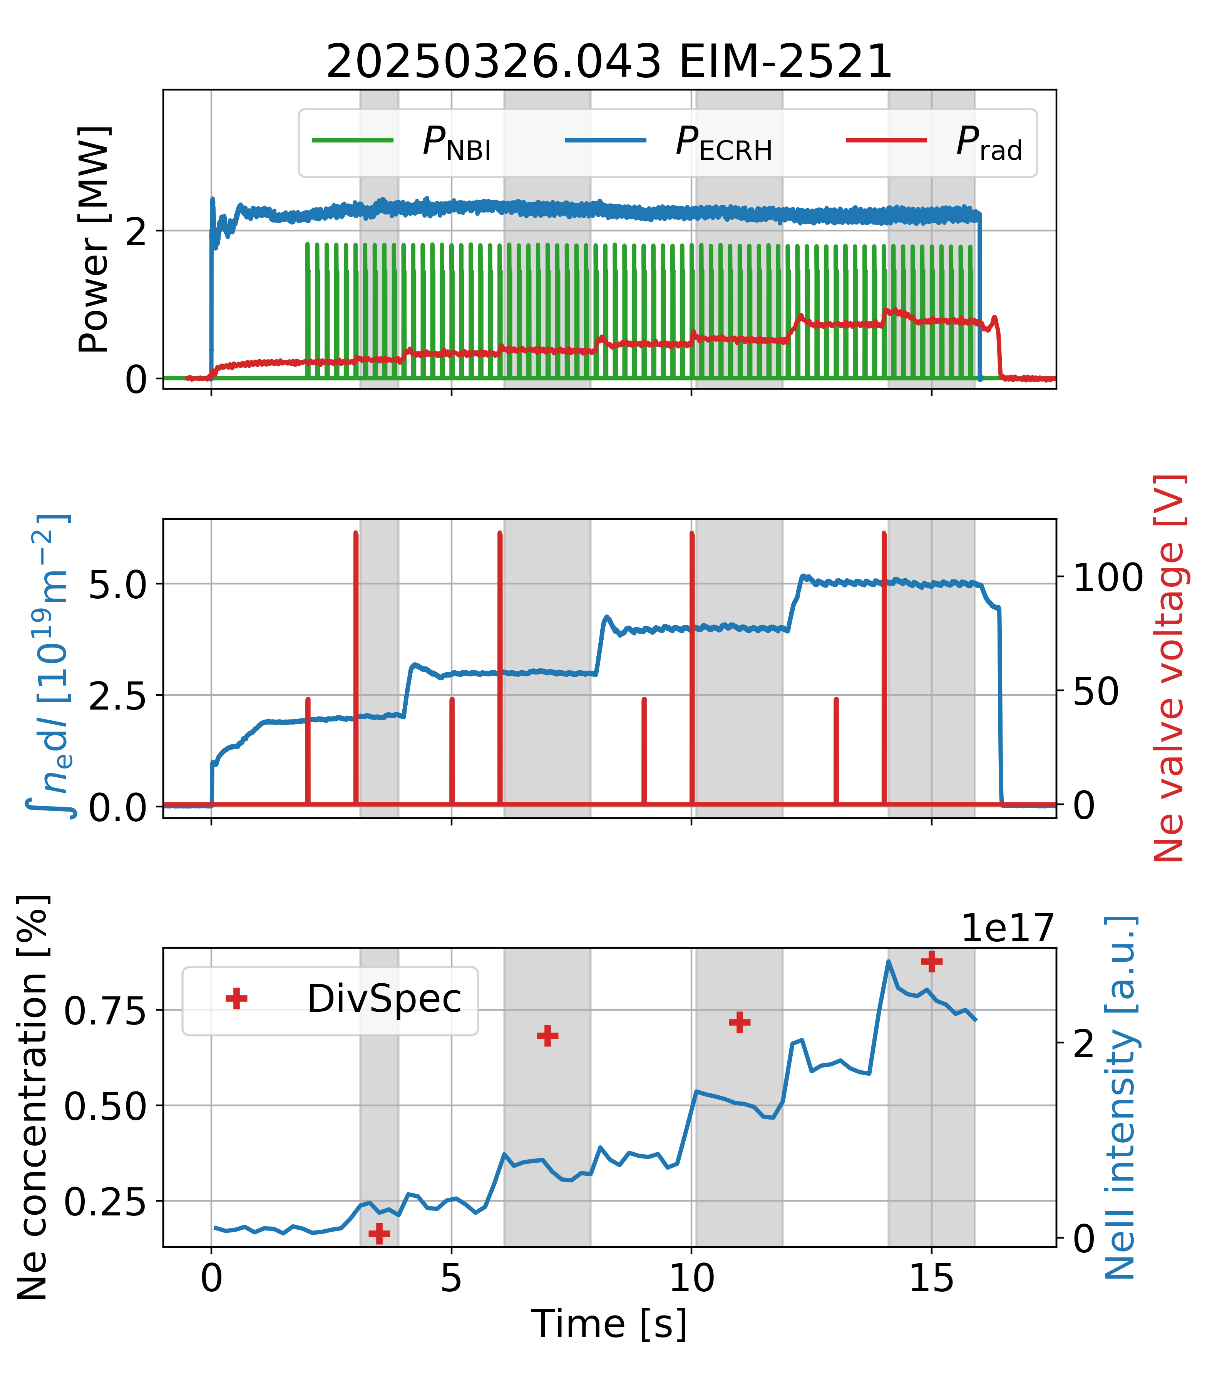

Impurity concentration in the SOL plasma directly measured with divertor spectroscopy
Intensity of three NeII lines is measured
Line ratios are dependent on local plasma parameters n_{e} and T_{e} Henderson, NF, 2017, Henderson, NF, 2023
Divertor spectroscopy analysis overestimates neon concentration

Slide 13
Impurity concentration in the SOL plasma directly measured with divertor spectroscopy
Intensity of three NeII lines is measured
Line ratios are dependent on local plasma parameters n_{e} and T_{e} Henderson, NF, 2017, Henderson, NF, 2023
Divertor spectroscopy analysis overestimates neon concentration
Line ratio spectroscopy has been applied to NeII and NII spectra

Slide 14
Impurity concentration in the residual gas measured with Diagnostic Residual Gas Analyzer (DRGA)
Delayed response due to distance of measurement location to pumping gap

Slide 15
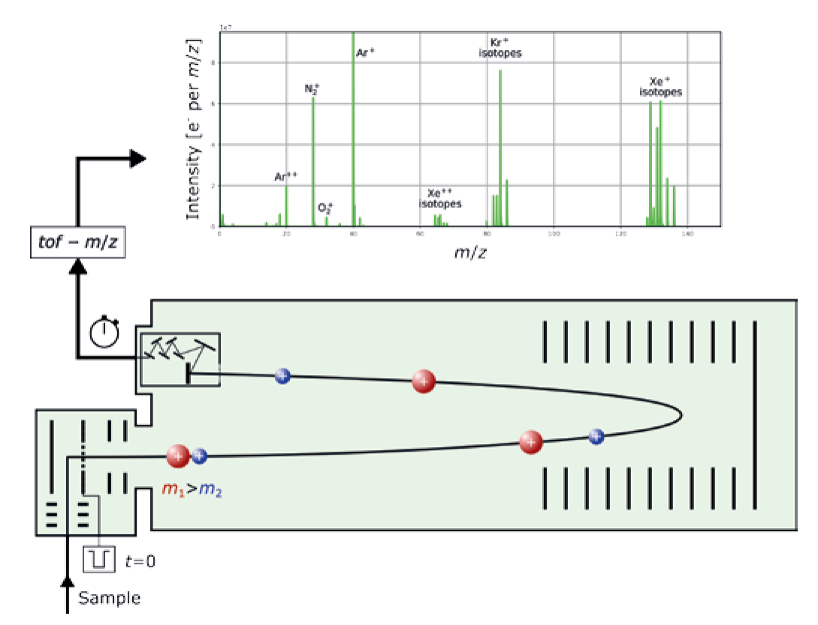
Impurity concentration in the residual gas measured with Diagnostic Residual Gas Analyzer (DRGA)
Delayed response due to distance of measurement location to pumping gap
New Time-of-Flight mass spectrometer has good time and m/z resolution Schlisio 2025 in preparation; Gasc, Chimia, 2022

Slide 16
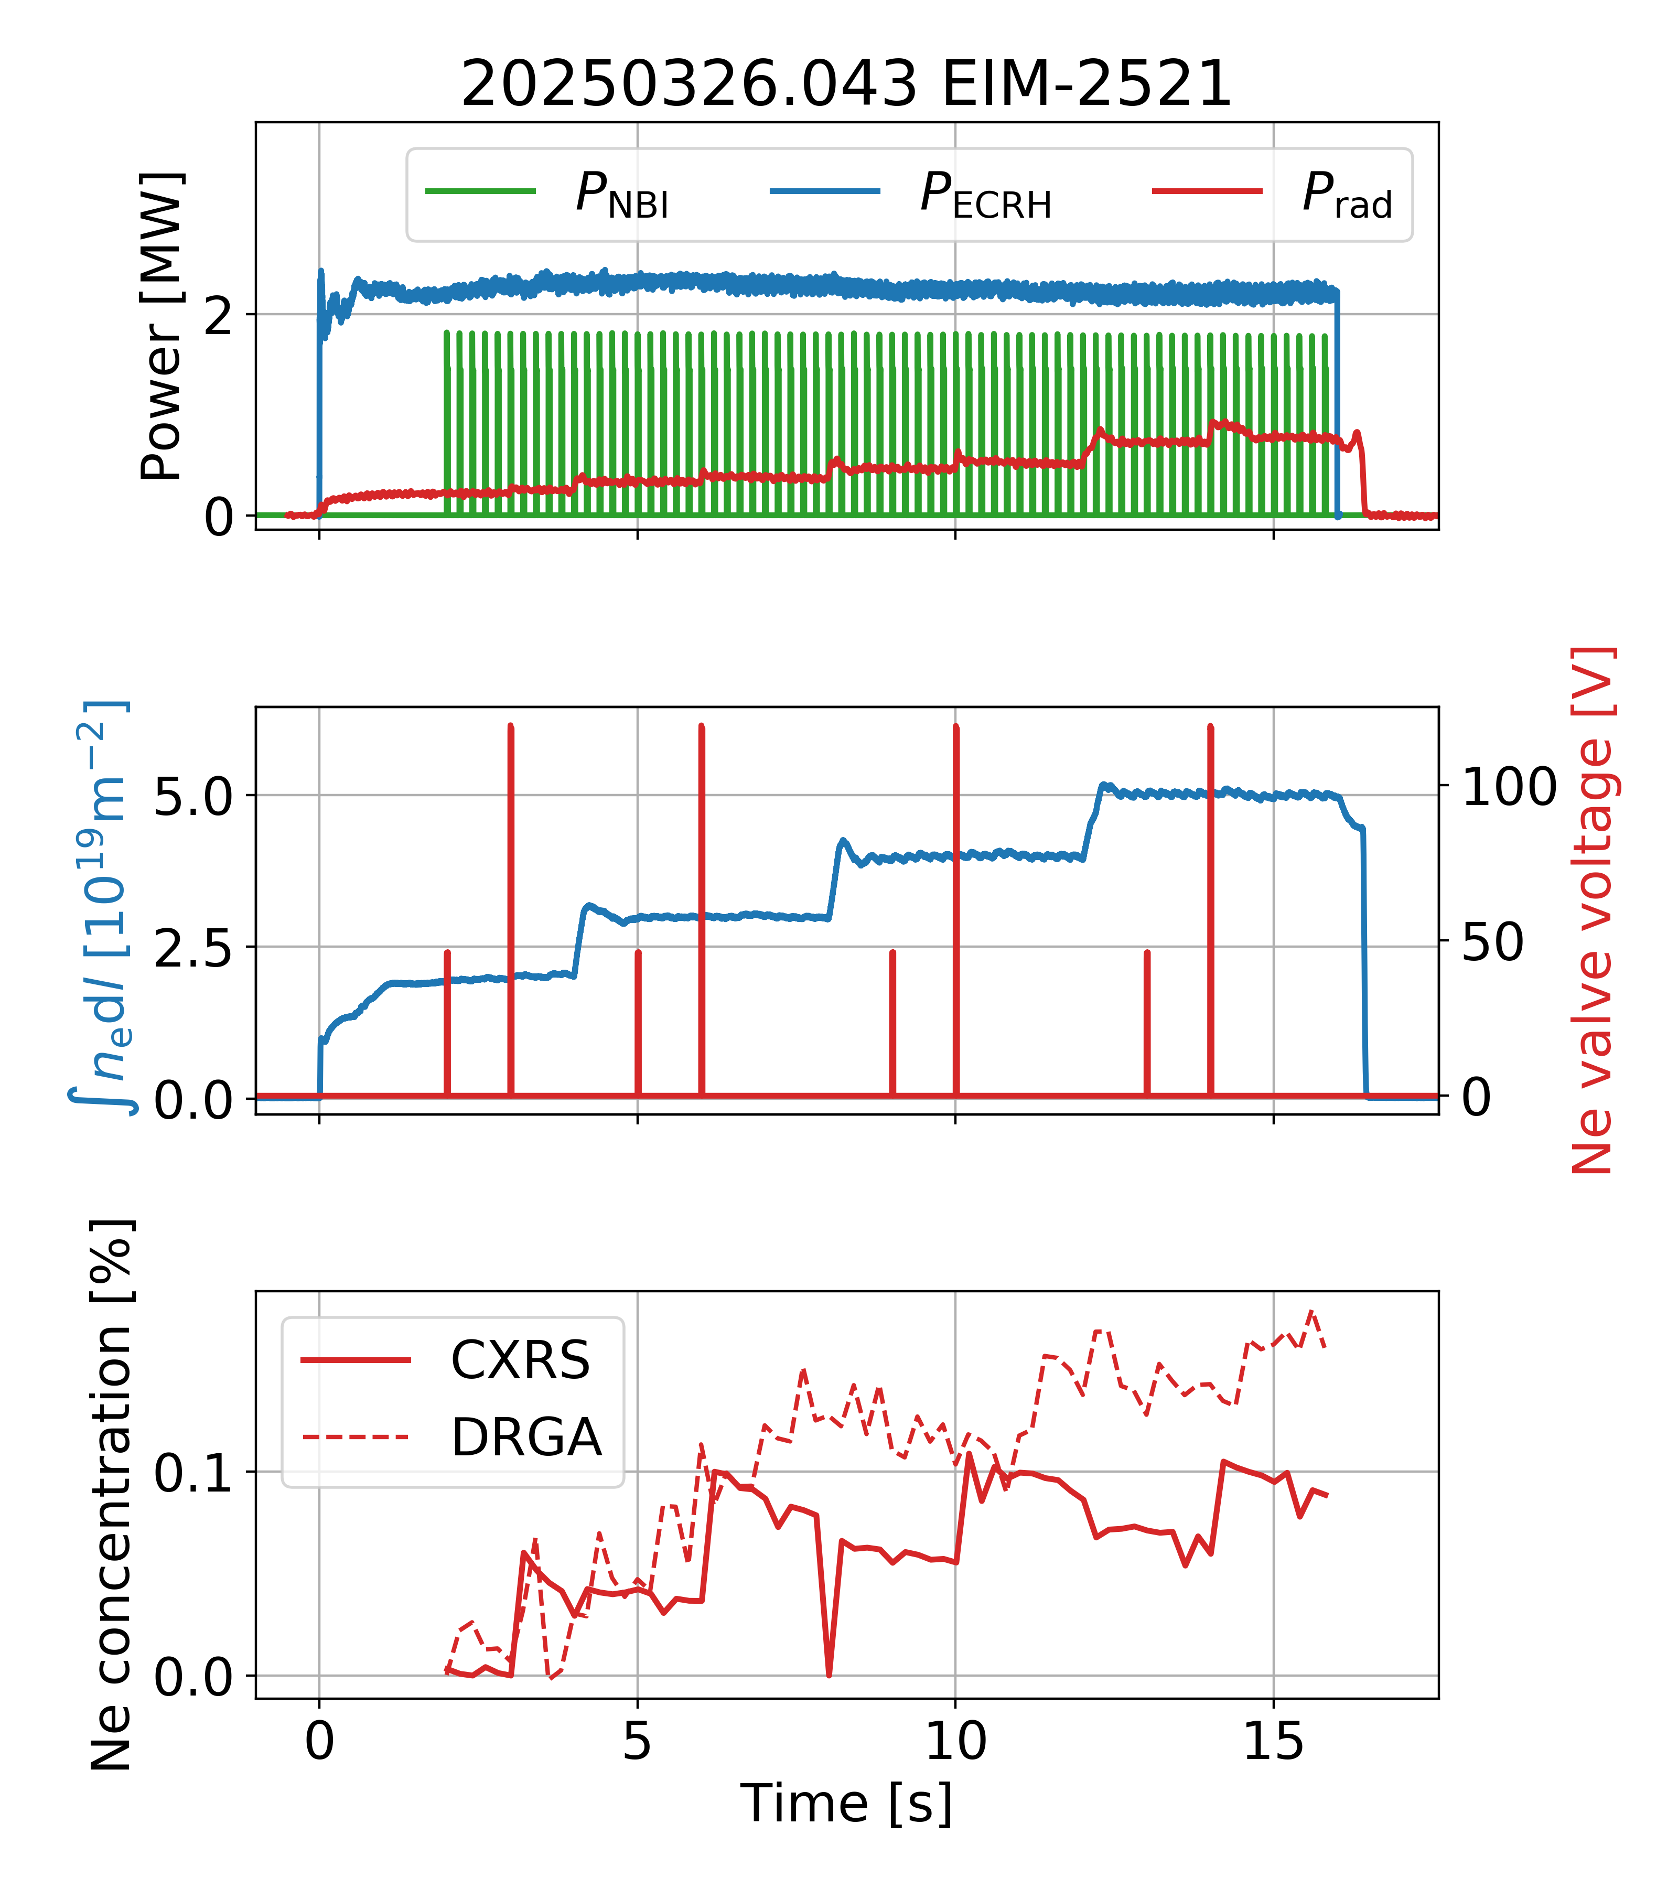

Impurity concentration in the residual gas measured with Diagnostic Residual Gas Analyzer (DRGA)
Delayed response due to distance of measurement location to pumping gap
New Time-of-Flight mass spectrometer has good time and m/z resolution Schlisio 2025 in preparation; Gasc, Chimia, 2022
Intensities are converted to densities by using the ionization cross sections

Slide 17
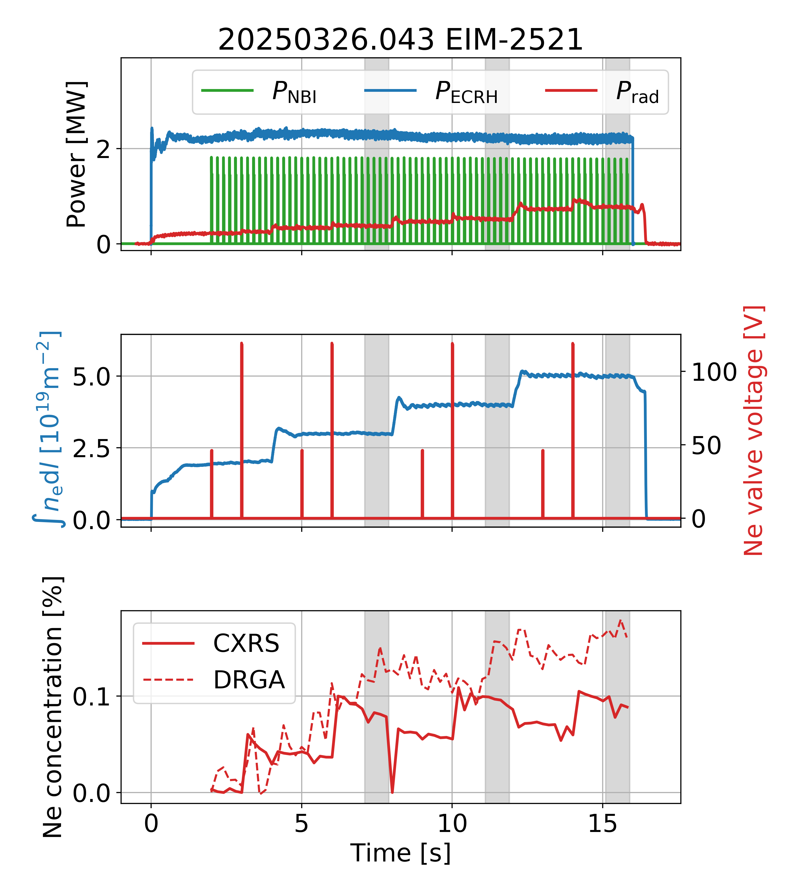
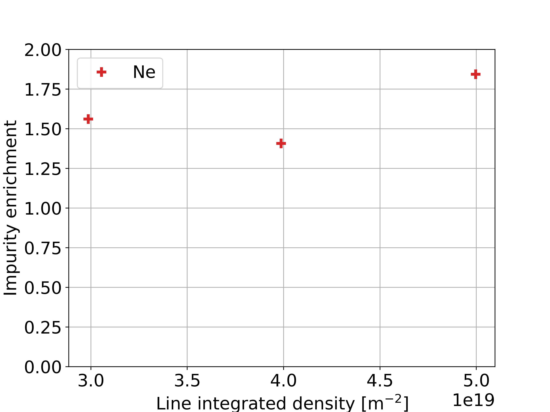
Impurity Enrichment in W7-X Island Divertor
Enrichment does not significantly vary with density steps

Slide 18
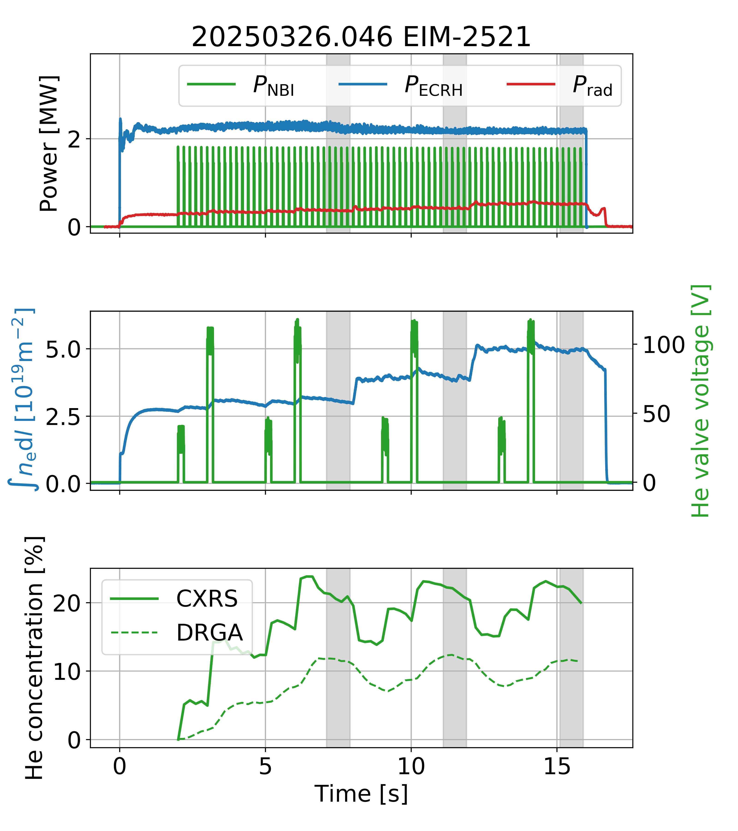
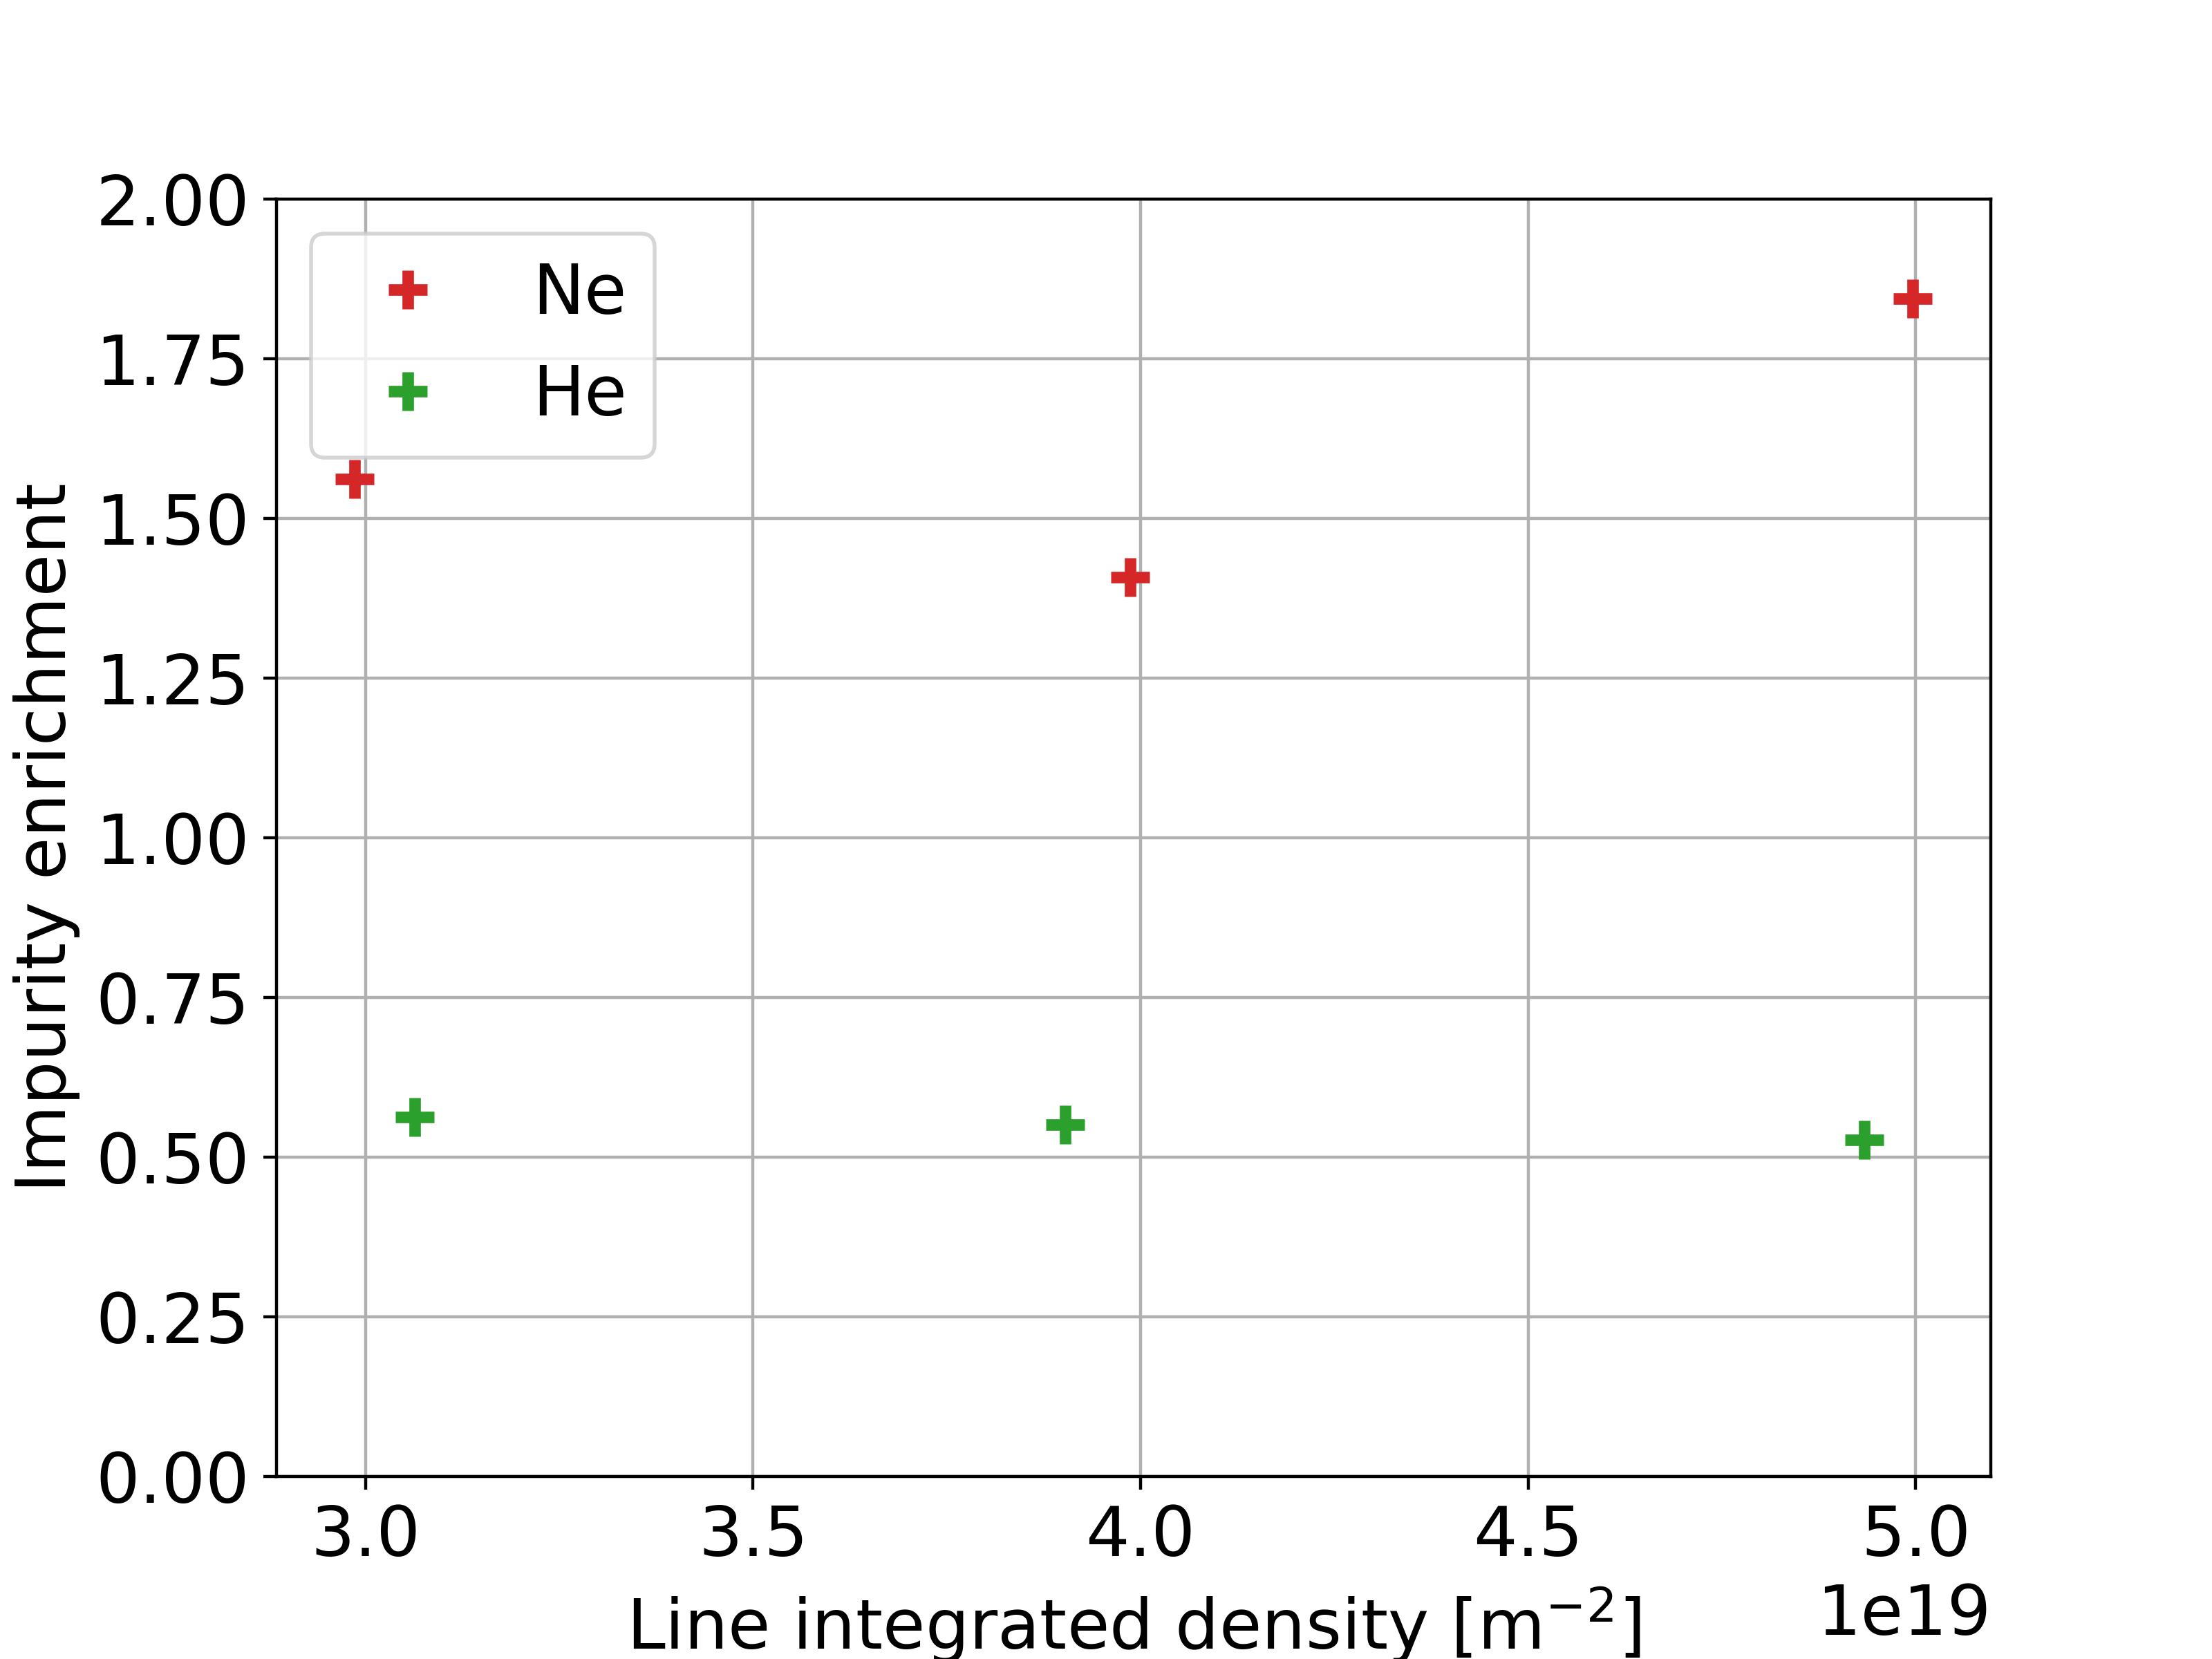
Impurity Enrichment in W7-X Island Divertor
Enrichment does not significantly vary with density steps
Neon is better retained in the divertor than helium

Slide 19
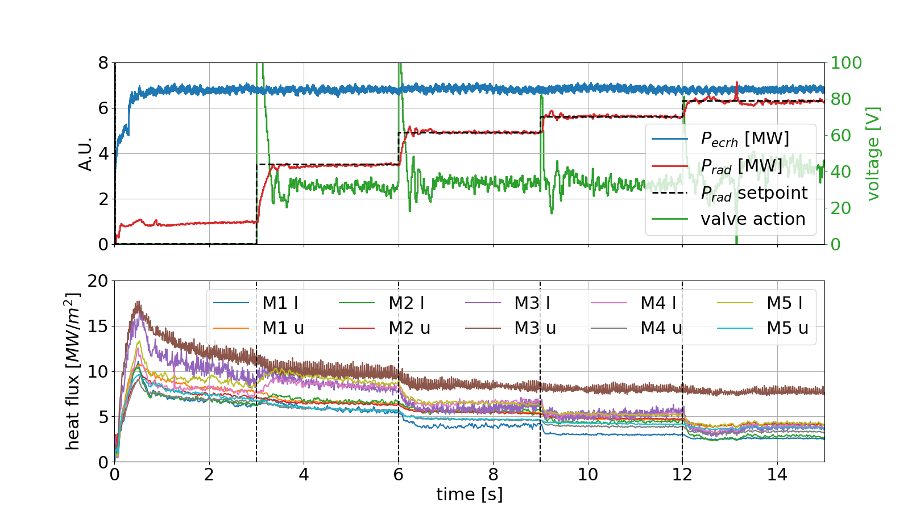
Conclusion
First measurements of helium and heon enrichment in attached plasmas have been conducted
Neon has higher enrichment than helium
No significant variation of enrichment is seen with changing density in limited amount of dicharges
Outlook:
Detached plasmas will be investigated in the next campaign with new radiation feedback capabilities (Anastasios Poster)
Scans of: f_{rad}, n_{e}, power, etc. possible

Slide 20
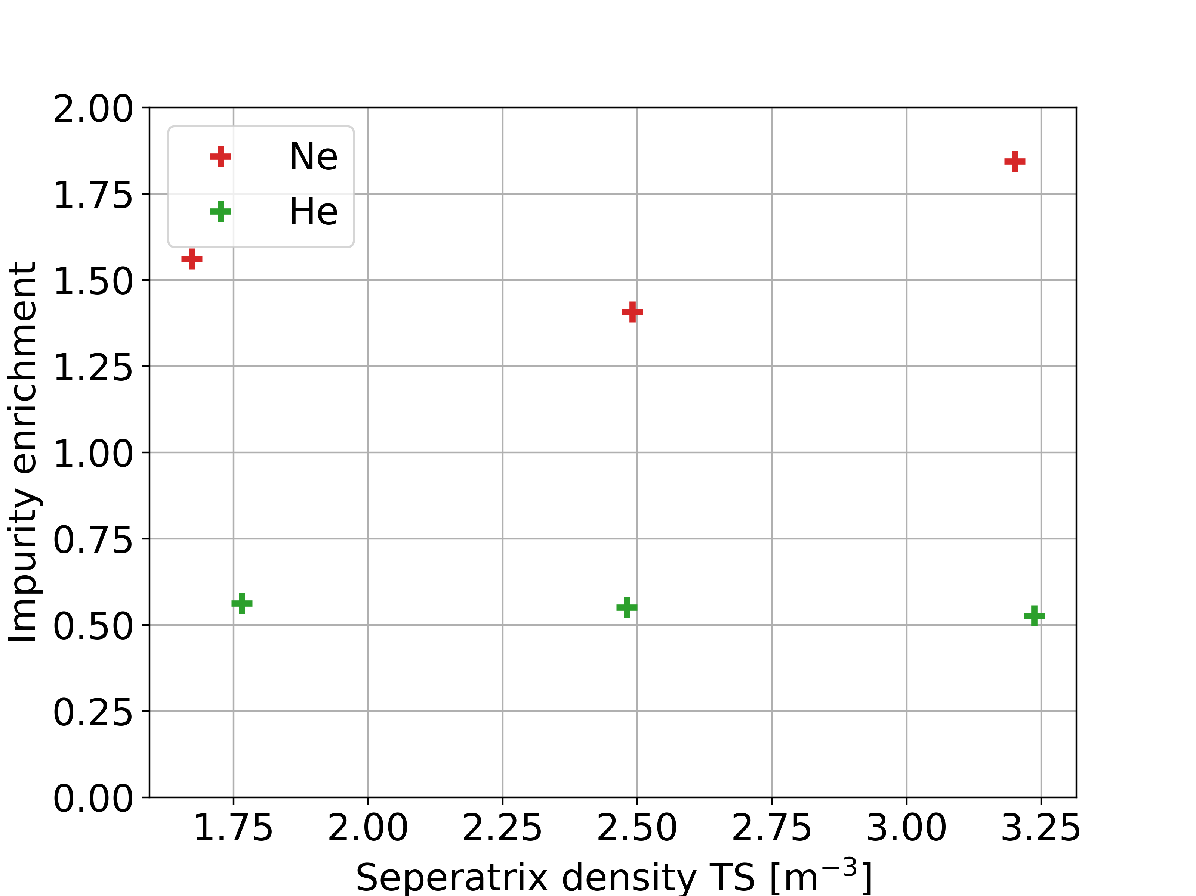
Comparison of Simulation and Experiment

Slide 21
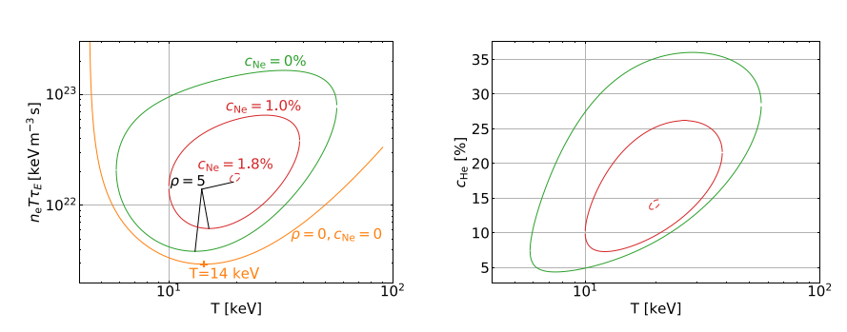
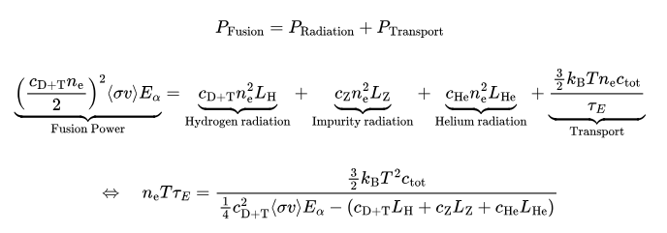
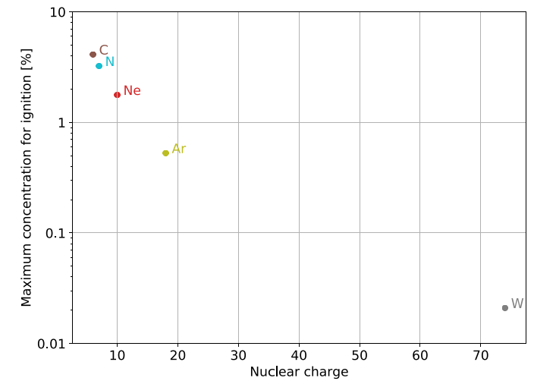
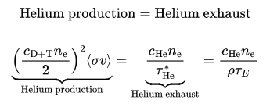
Motivation: Why is impurity enrichment important for reactor?
Power balance
Particle balance
IAEA Divertor Concepts Meeting 2025 Vienna | Frederik Henke
21
Impurity Enrichment in W7-X

Slide 22
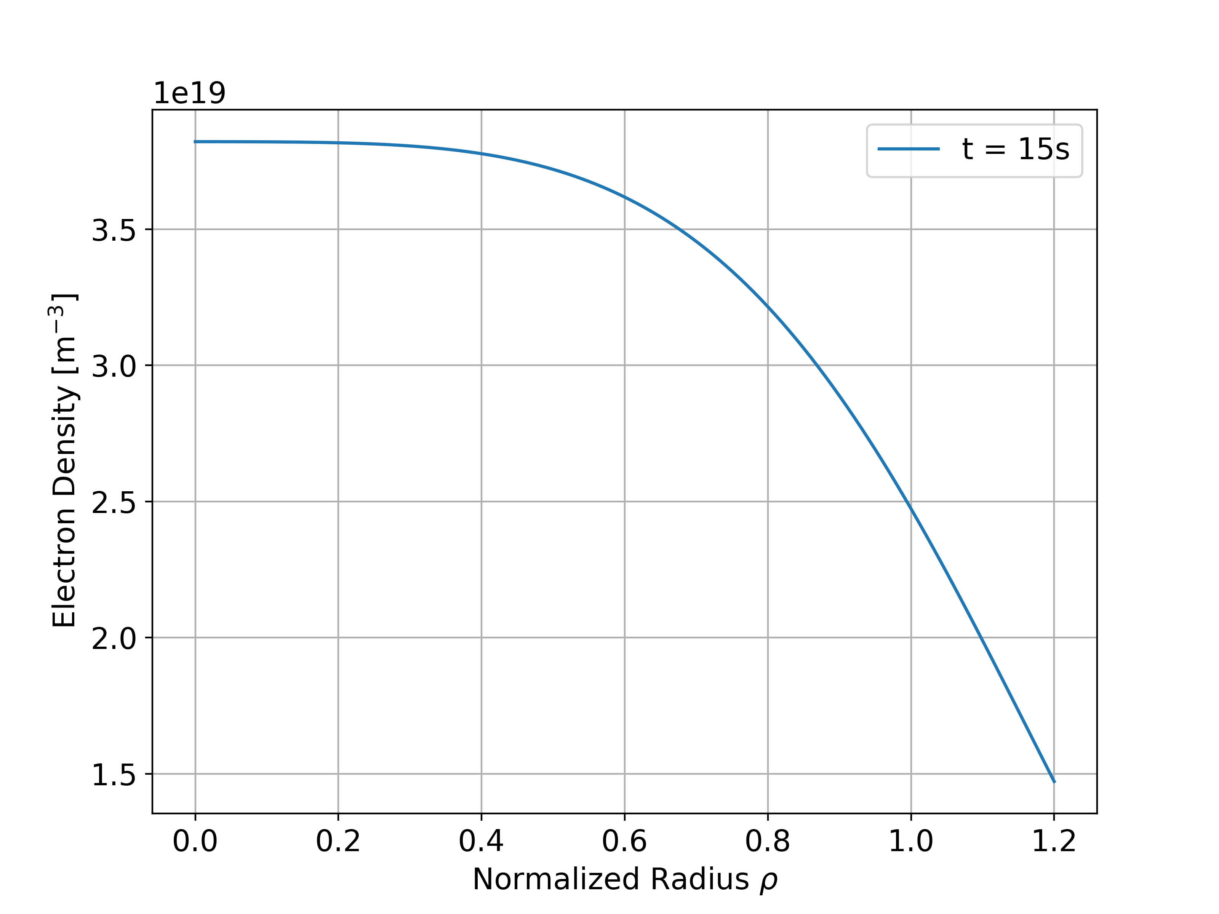
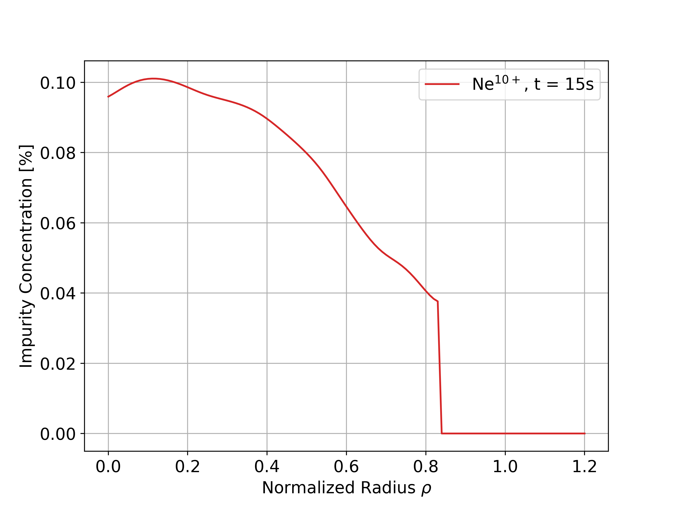
Impurity concentration in the core plasma measured with Charge Exchange Recombination Spectroscopy (CXRS)
In purely ECRH heated plasmas we observe flat impurity density profiles

Slide 23
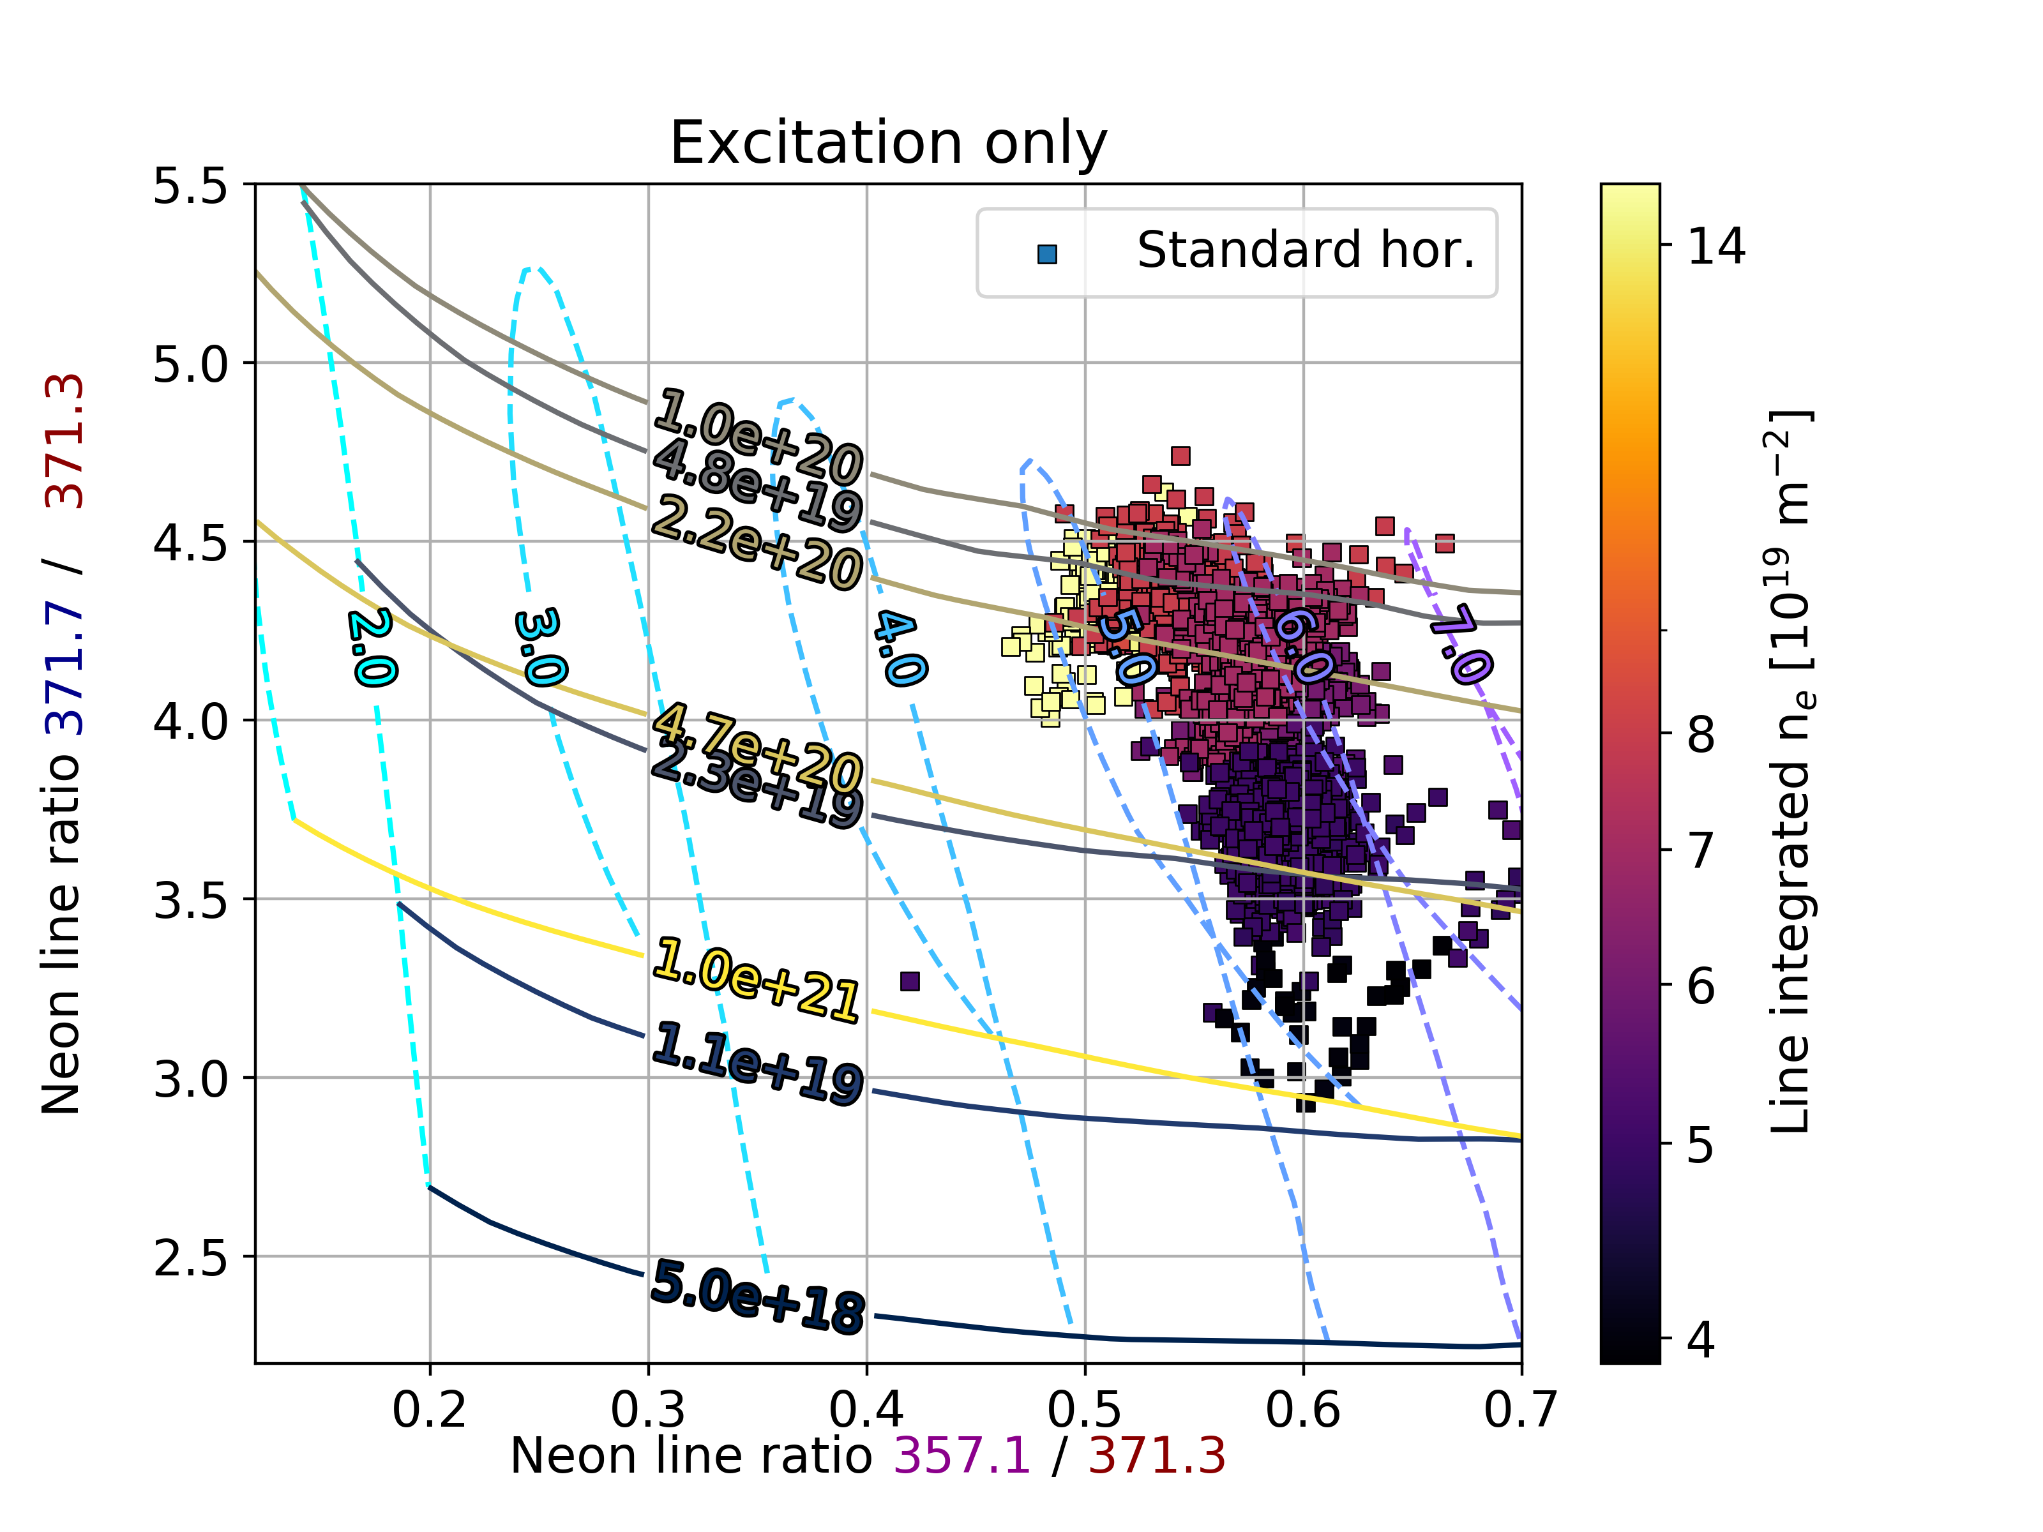
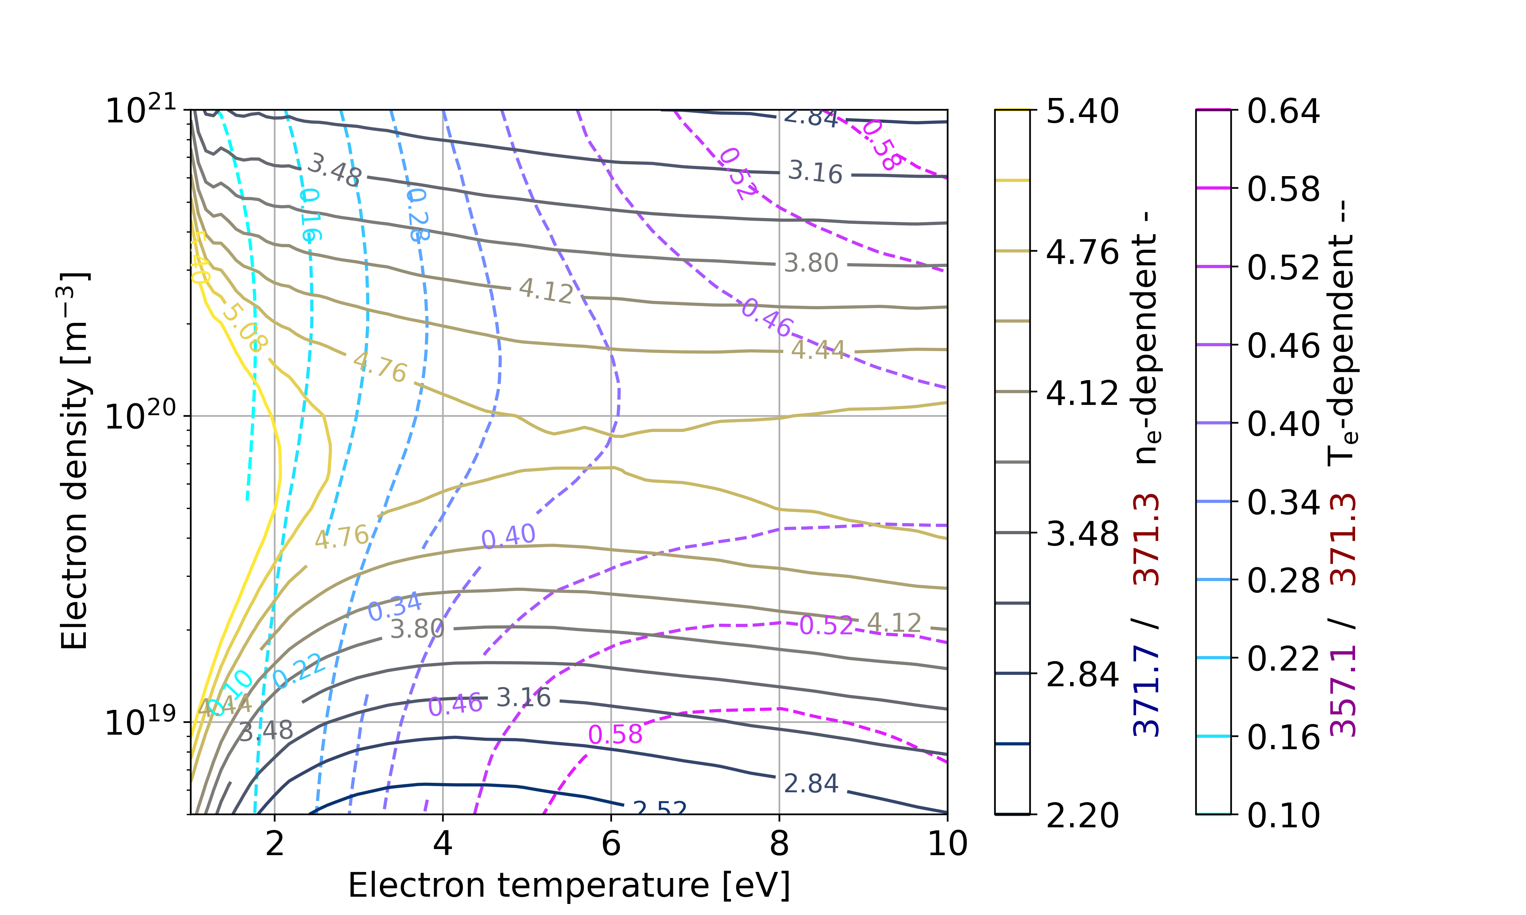
NeII line ratios

Slide 24
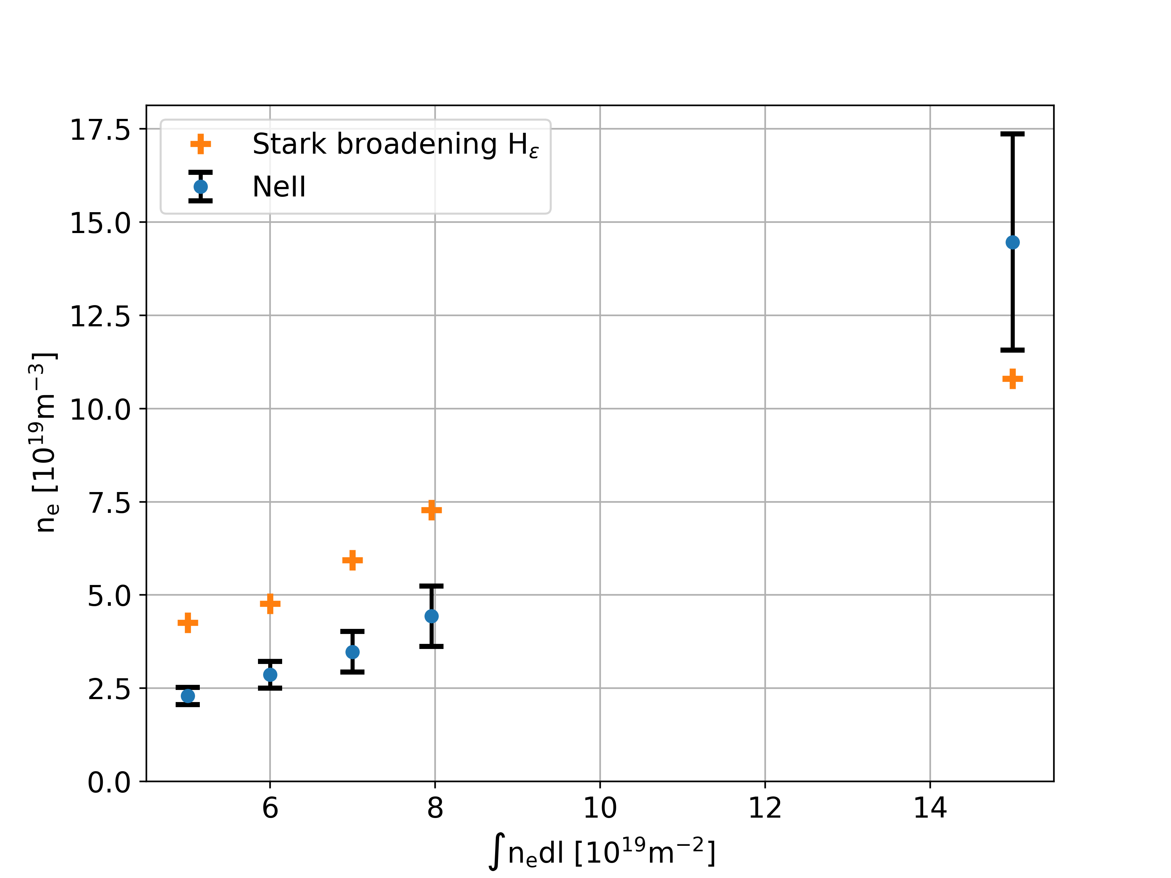
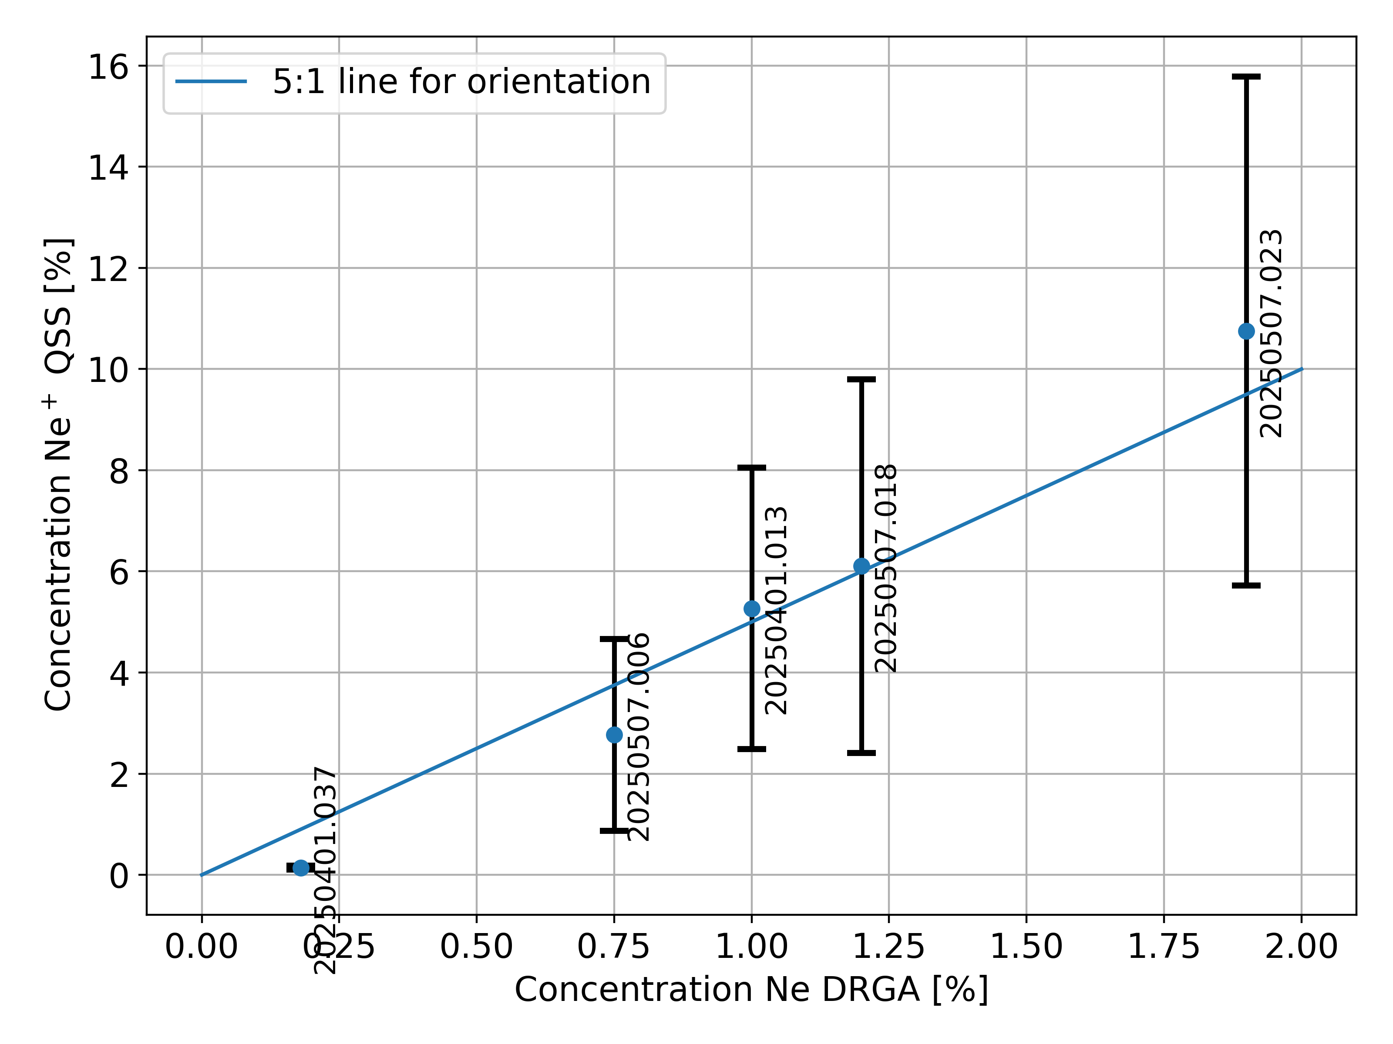
Comparison NeII line ratio spectroscopy with other diagnostics

Slide 25
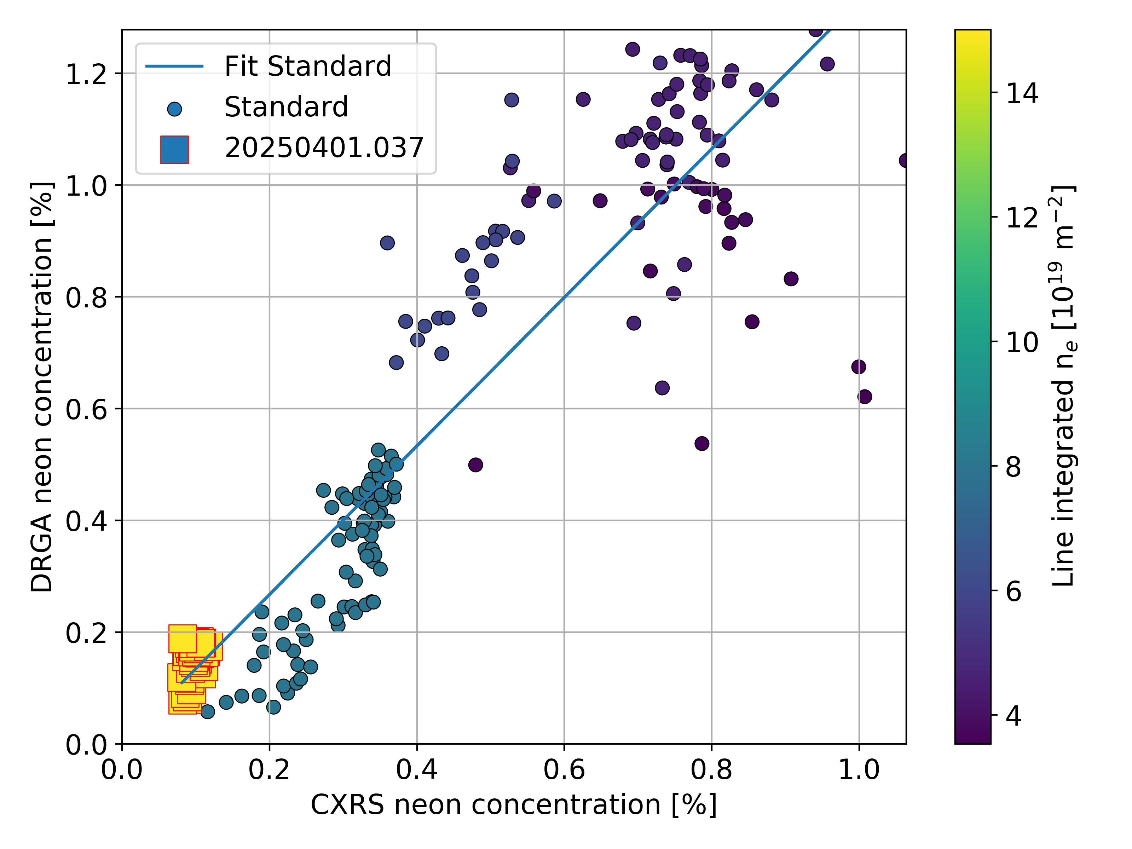
Enrichment Neon detached plasmas:

