Slide 1
Heat Transport Widths and their Scaling in the W7-X Island Divertor
Amit. Kharwandikar*, F. Reimold, R. Schneider, D. Naujoks, Y. Feng, Y. Gao and the W7-X Team

Slide 2
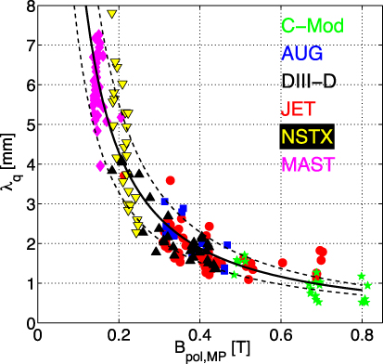
Motivation and Scope
Framework for Heat Flux Scaling in Stellarators
Island divertor: leading plasma exhaust concept
Power exhaust, Particle exhaust, Impurity screening
Divertor heat loads
SOL heat flux width an important metric
Practical prediction approach
SOL widths by fitting divertor heat loads
Well-established approach in Tokamaks [Eich 2011]
Framework for estimating and scaling heat flux widths is missing in Stellarators!
Notes:
Thanks Victoria for the nice overview, and for the convincing arguments to say that island divertor is the leading….
Today, I am gonna focus on power exhaust aspect
As we all know, challenge to ensure divertor heat loads below 10 MW/m2, sol width key determining metric
Also, studying its scaling offers practical tool for extrapolation
Tokamaks have well established approach, successful scaling studies
Missing in stellarators, and my talk is about how we have tried to address this gap!

Slide 3
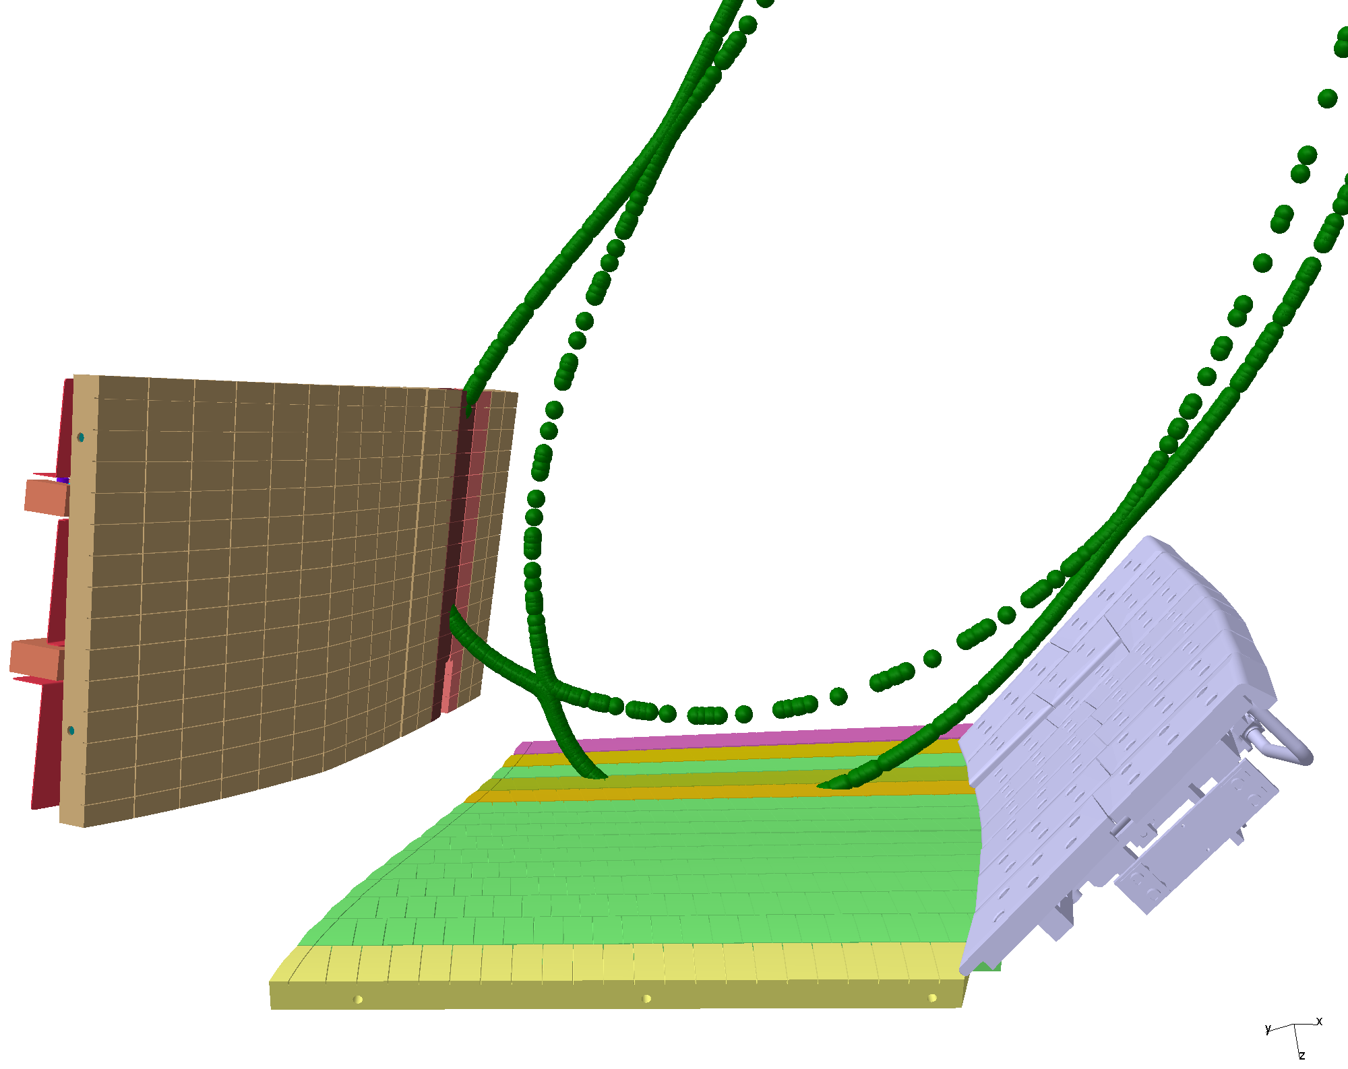
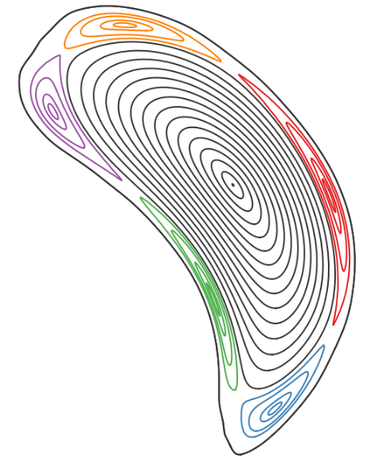
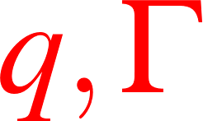
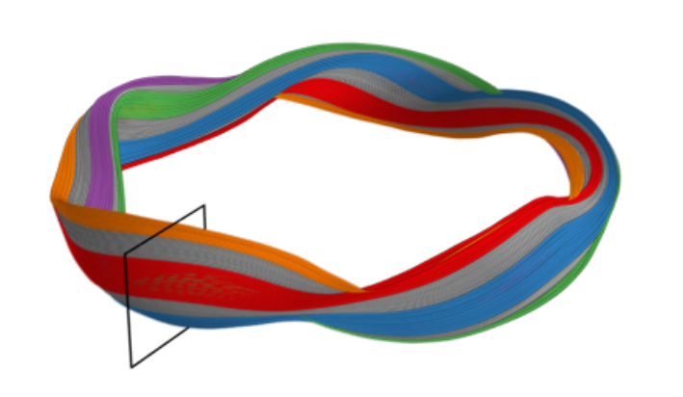

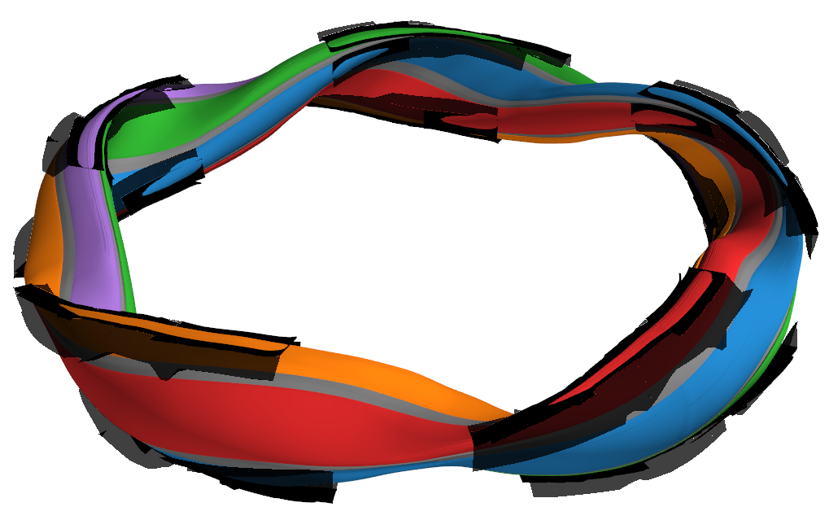
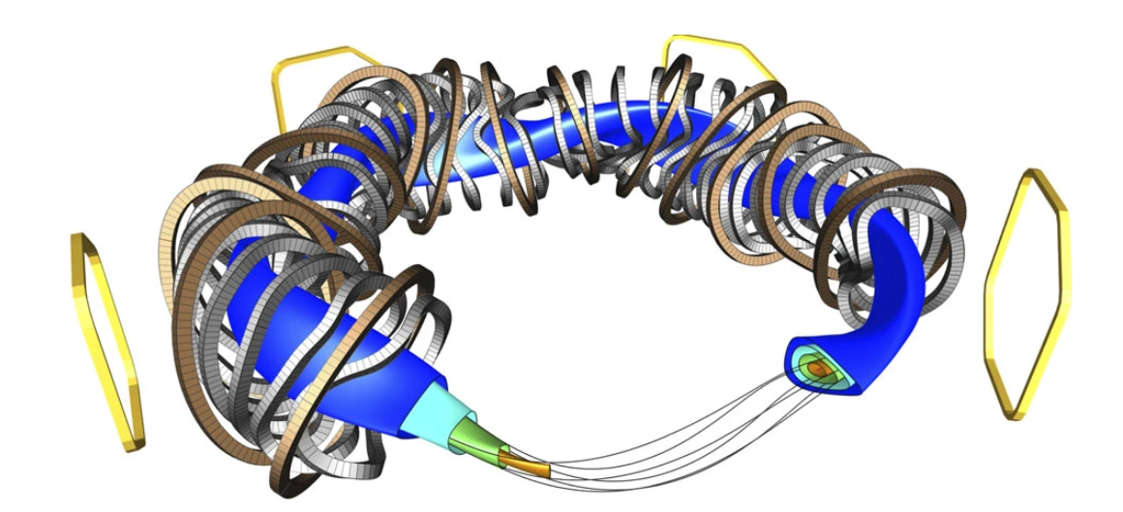
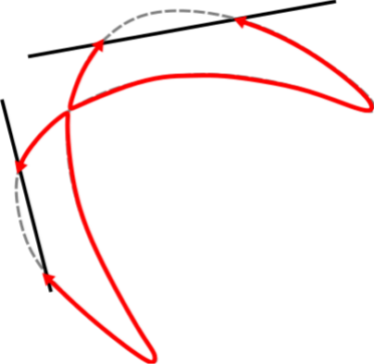
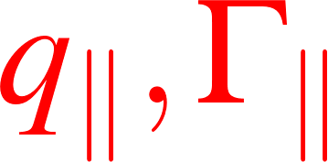

Introduction
Heat Flux Deposition in Island Divertor
Inherent magnetic islands in the boundary
Intersected with 10 identical divertor targets
Complex 3D SOL $→$ Non-trivial strike lines
Strike line
Notes:
- Let’s start with a brief refresher of how island divertor works
Field- coils- islands – intersected – open field lines, carries heat and particles
3D sol, deposition in stripes called strike lines

Slide 4
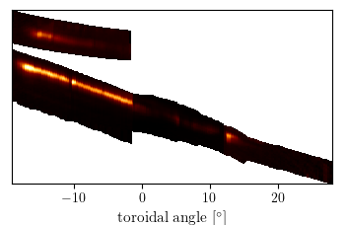
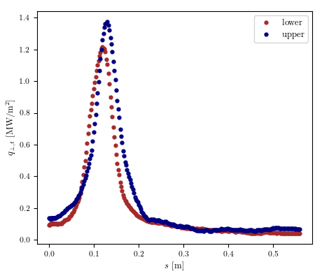
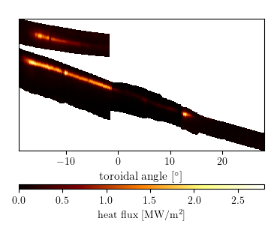

Heat Flux Patterns in W7-X
Infrared (IR) Thermography
Averaged Upper Divertor Pattern
IR cameras measure heat flux [MW/${\text{m}}^{2}$]
Strong up-down asymmetry [Gao 2019]
Governing aspects: Topology and Transport
Averaged Lower Divertor Pattern
Notes:
W7-X has IR cameras to measure divertor heat flux
For physics analysis, average upper and lower, strong asymmetry, seen from this poloidal slice
For understanding the patterns, I would like to talk a bit about the governing aspects- topology and transport

Slide 5
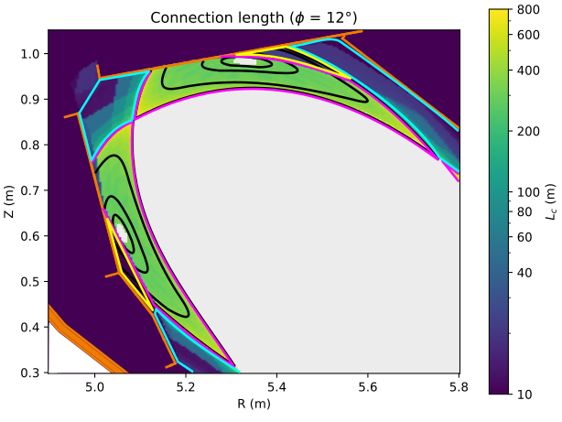
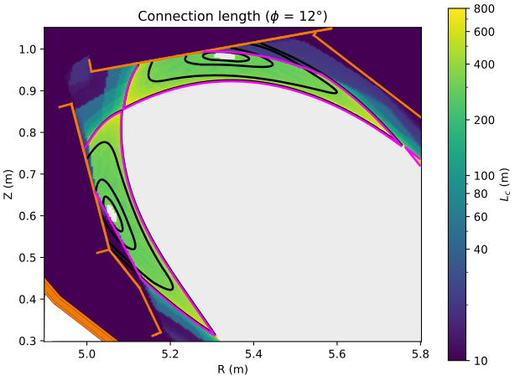


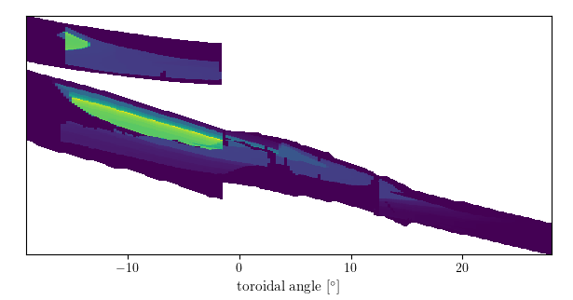
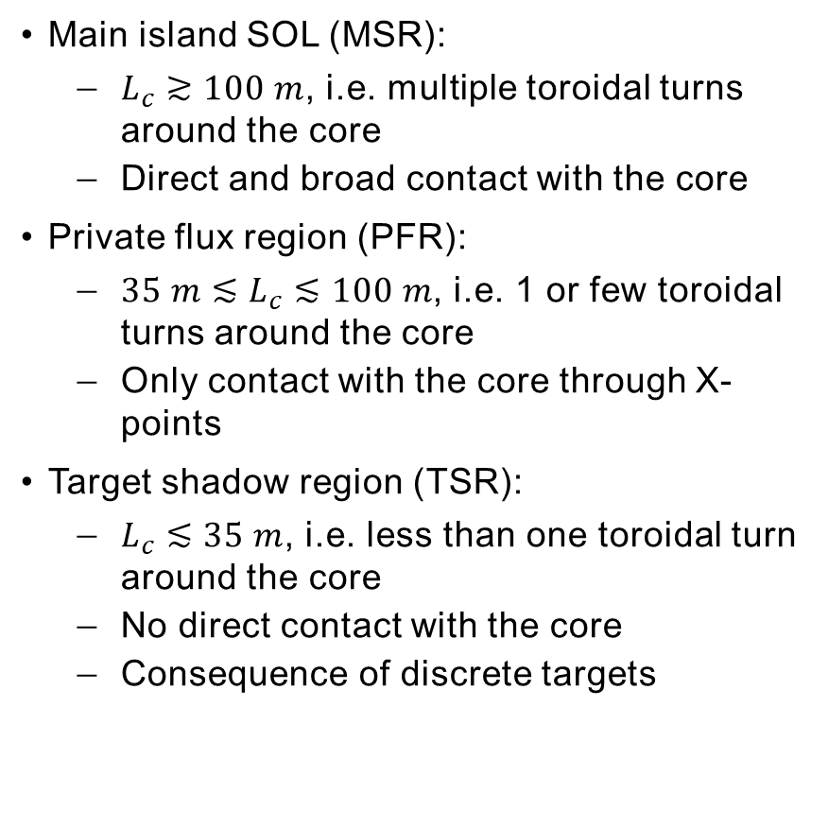
Simplifying the Island SOL
Topology
      Main island SOL (MSR):
          $L_{c}≳100 m$, i.e. multiple toroidal turns around the core
          Direct and broad contact with the core
      Private flux region (PFR):
          $35 m≲L_{c}≲100 m$, i.e. 1 or few toroidal turns around the core
          Only contact with the core through X-points
      Target shadow region (TSR):
          $L_{c}≲35 m$, i.e. less than one toroidal turn around the core
          No direct contact with the core
          Consequence of discrete targets
Connection length
footprint
Notes:
3D interaction- SOL partitioned –
Main SOL
PFR
TSR- victoria explained well, short lc and only accessible via the prev 2 regions
We can also find the footprints of these regions, which looks quite complex but gives us an idea in the 0th order how the upstream is connected to the downstream

Slide 6
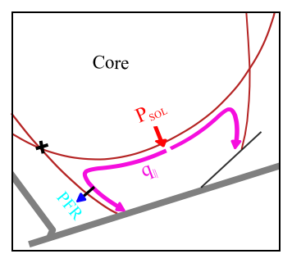
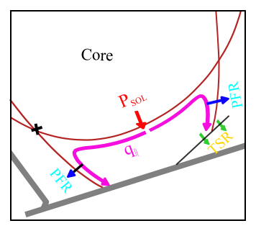
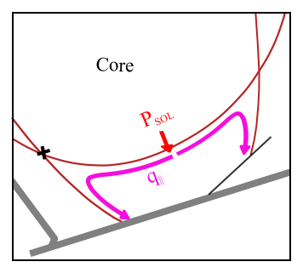
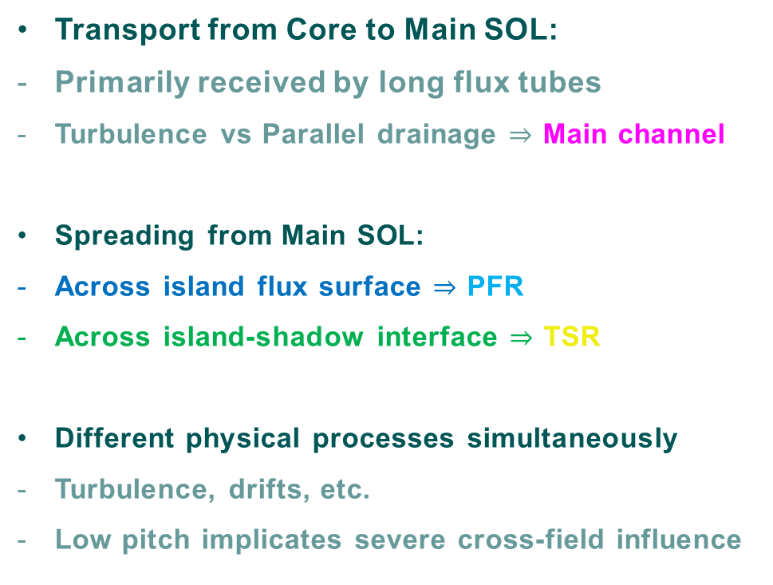
Simplifying the Island SOL
Main Transport Channel and Spreading
Transport from Core to Main SOL:
Primarily received by long flux tubes
Turbulence vs Parallel drainage $⇒$ Main channel
Spreading from Main SOL:
Across island flux surface $⇒$ PFR
Across island-shadow interface $⇒$ TSR
Different physical processes simultaneously
Turbulence, drifts, etc.
Low pitch implicates severe cross-field influence
Notes:
Next, lets look at the phenomenology of transport processes upstream
I like to break this down into two steps
First core to Main SOL – main channel set
Next, spreading from main channel in 2 characteristic directions
First across flux surfaces into pFR
Next, across the island-shadow interface, but both regions populate the TSR
Different cross-field mechanisms
What makes things more complicated is that low pitch as explained by Victoria, makes perpendicular transport strongly influential for the net transport

Slide 7
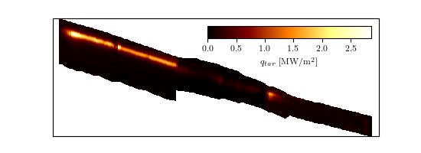
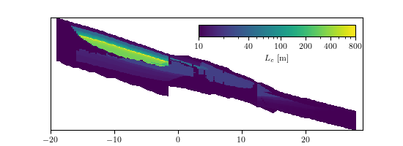

Simple Model for Loads in Island Divertor (SMoLID)
Heuristic Approach
Topology as a lens to interpret 2D heat flux patterns [Kharwandikar PhD Thesis 2025]
Effective $∥vs⊥$ dynamics sets dowstream width $⇒$ Fit features and infer upstream widths
Notes:
Having said that, let’s come back to the question of interpretation of heat flux patterns, specifically the horizontal target of upper divertor
If we juxtapose with lc footprints, immediately recognise that different parts of strike line corresponds to different regions
Now, downstream width is set by effective dynamics, so if we fit the features individually, can get an idea of upstream width, thanks to the heuristic understanding of main channel and spreading
These are the main principles of SMOLID
I am going to explain this better by applying it on this heat flux pattern

Slide 8

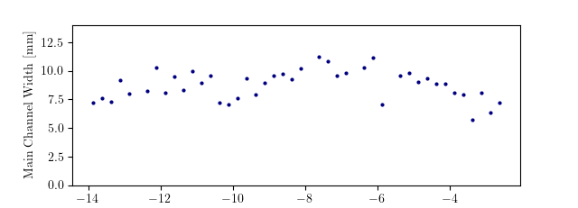
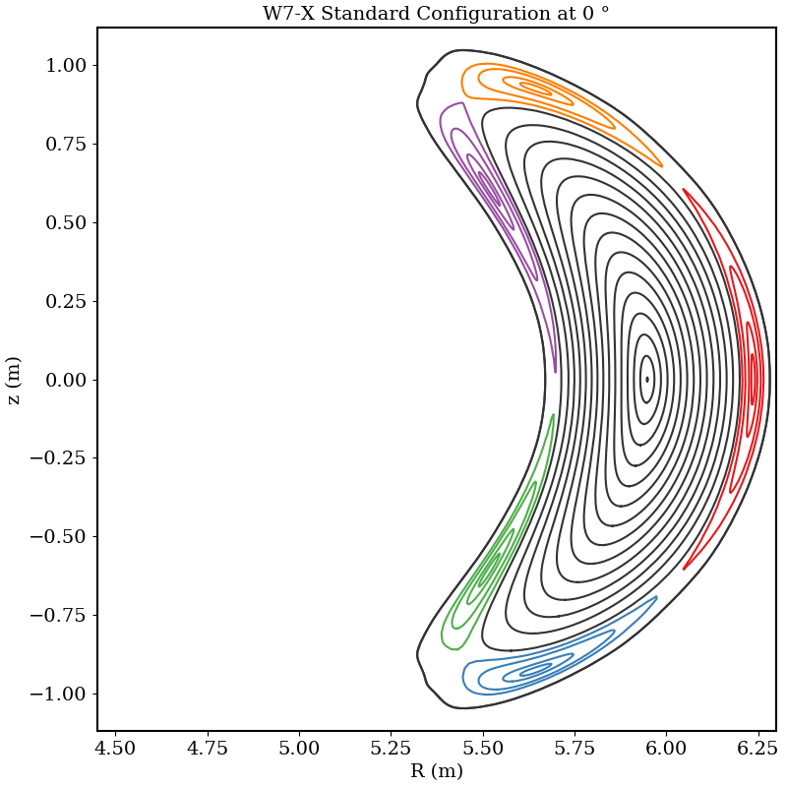
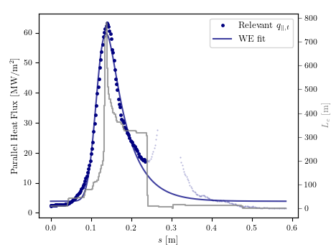
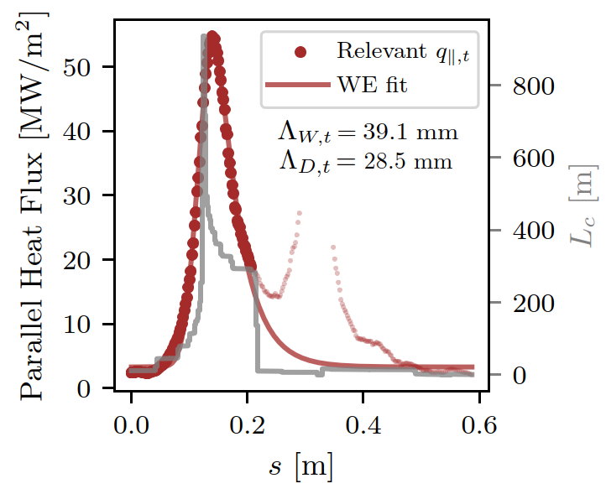



Characterizing MSR and PFR transport
Adapting Eich Parametrization
Wagner-Eich (WE) Ansatz:
$Λ_{W}$ = 8.75 $±$ 1.27 mm
$$Λ_{W}$$
Upstream
$$mapping$$
Local Fitting + Flux space mapping
Average width of main channel $Λ_{W}$ ~ Tokamak ‘$λ_{q}$’
PFR diffusion width $Λ_{D}$ ~ Tokamak ‘S’
Notes:
First, MSR and PFR low hanging fruit, use adaptation of eich parameterization
So consider a poloidal slice in ROI
Parallel heat flux profile, fit only MSR and PFR
Target MSR width is and PFR width is
This is at target, but need to decouple target geometry effects
Upstream chosen as outboard midplane at bean shaped cross-section
Equivalent width found by mapping in flux space
Repeated for all slices in ROI
As u can see, tend to cluster around a certain value. In this case, the average main channel width is 8.75 mm
Analogue of tokamak

Slide 9
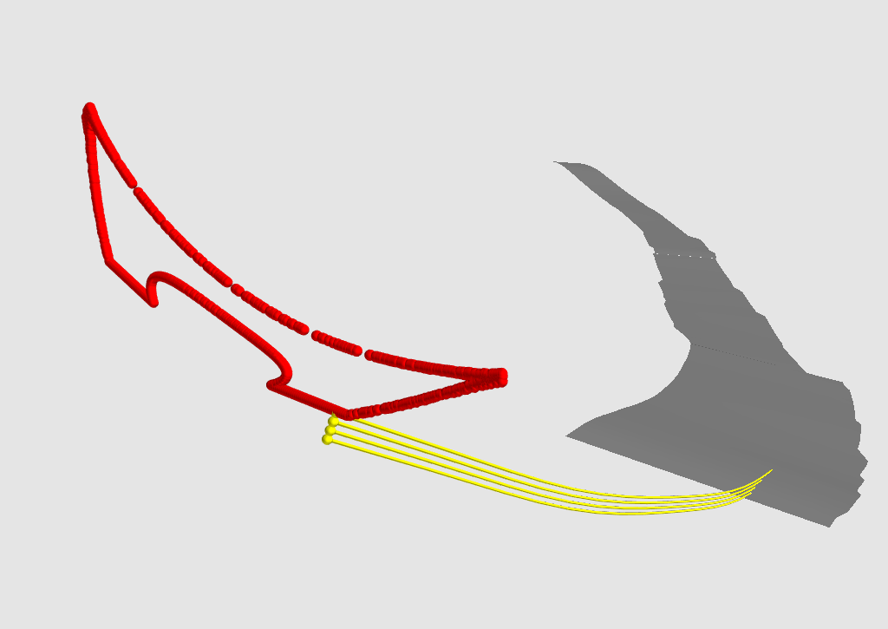
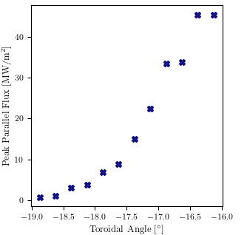
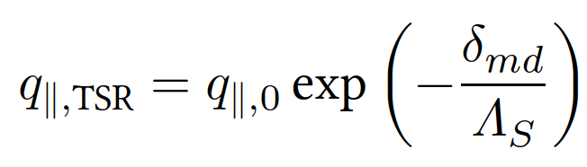

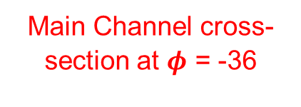

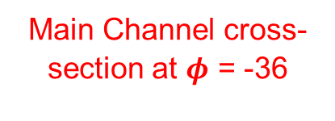
Characterizing TSR transport
Exponential Ansatz
Toroidal decay of peak heat flux
Heat Flux penetration “into” Target Shadow
Upstream filling: Arbitrary plane
Main Channel cross-section at $φ$ = -36
Main Channel cross-section at $φ$ = -36
$Λ_{S}$ = 7.5 mm
$$δ_{md}$$
Notes:
Next the tsr
Need to look at 3d figure
Topologically, direction across interface maps toroidally on target
With this in mind, find toroidal profile of peak heat flux – reflection of extent of penetration of heat flux into shadow
We map this to an arbitrarily chosen plane and find the decay width Lambda_S

Slide 10
Empirical Scaling of Heat Flux Widths
Notes:
We applied this framework to conduct scaling studies for w7-x experiments

Slide 11
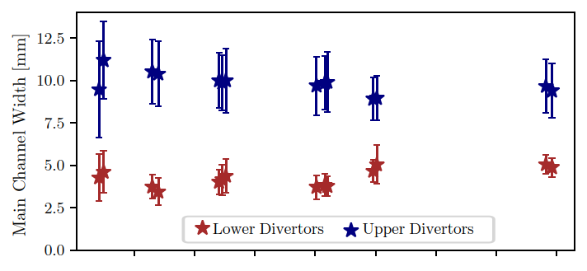
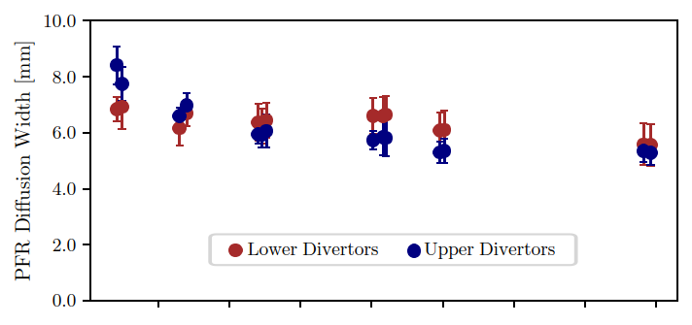
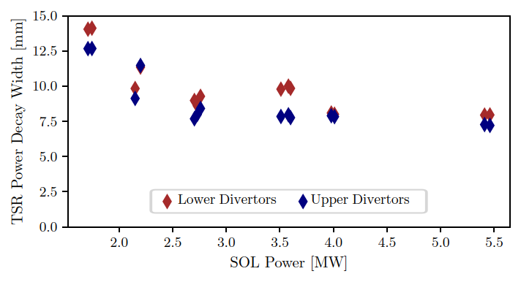
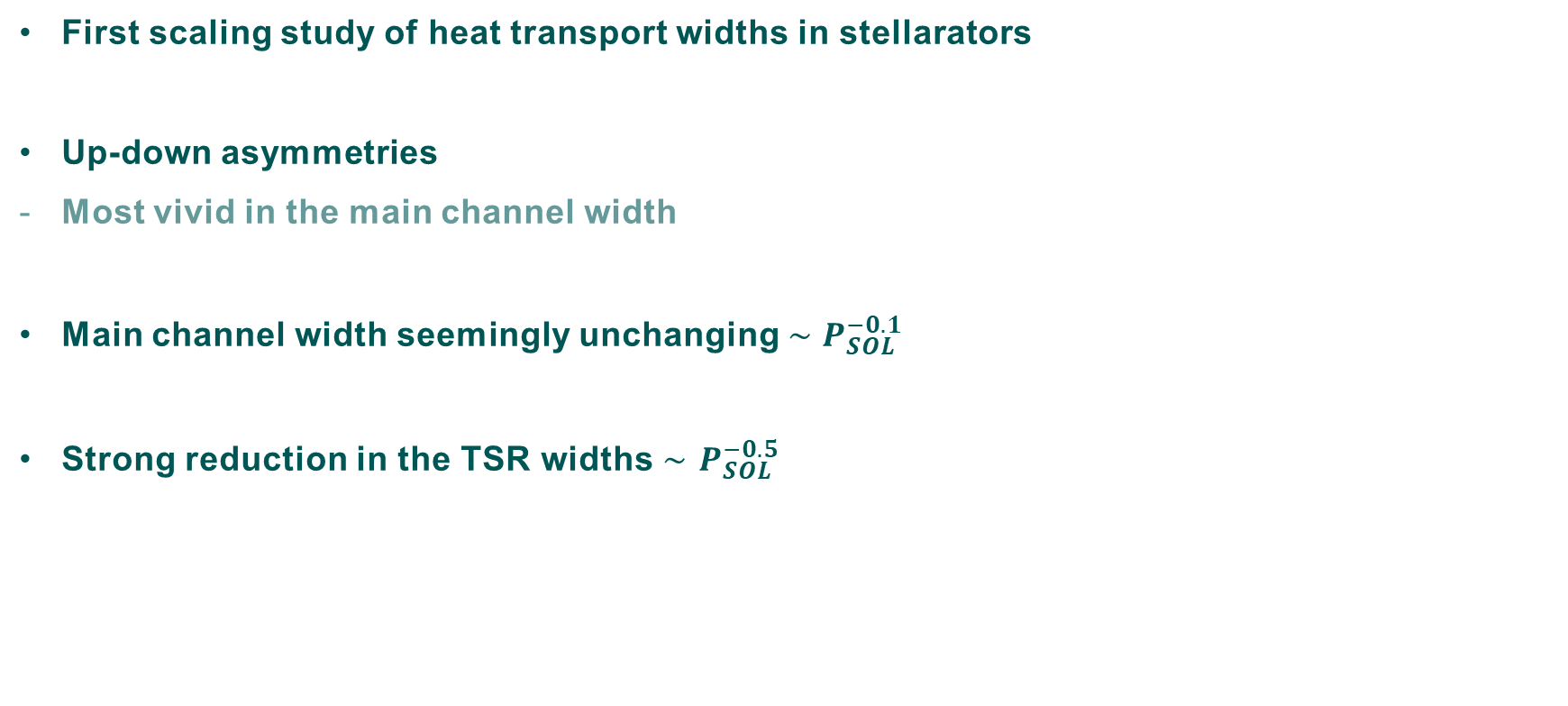
Empirical Scaling
SOL Power
First scaling study of heat transport widths in stellarators
Up-down asymmetries
Most vivid in the main channel width
Main channel width seemingly unchanging $∼P_{SOL}^{−0.1}$
Strong reduction in the TSR widths $∼$ $P_{SOL}^{−0.5}$
Notes:
- I want to show here the variation of these wiudths as a function of Psol
Other parameters were ensured to be same
The main takeaways are as follows:
Vivid asymmetry –akin to in-out asymmetry
Scaling behaviour, lambda_w insensitive to Psol
Strangely similar to h-mode eich scaling outcome
Another observation, tsr decay width strongly reduces

Slide 12
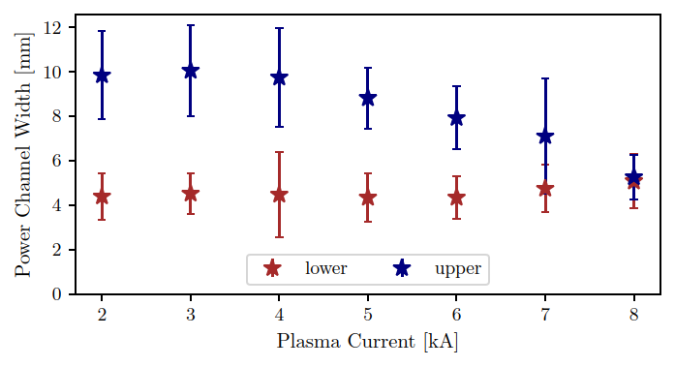
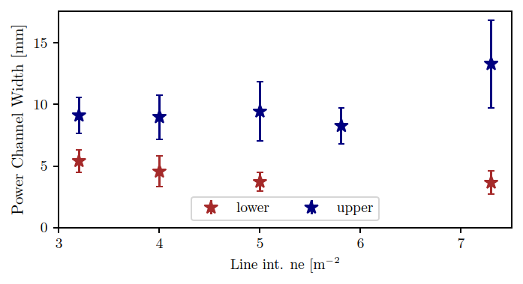
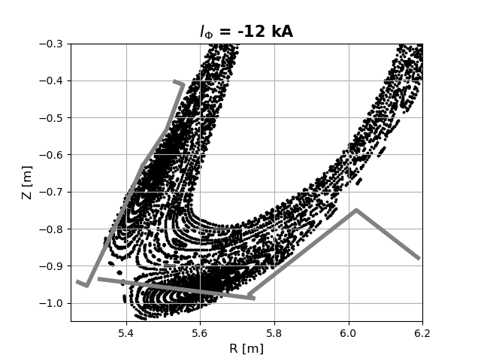
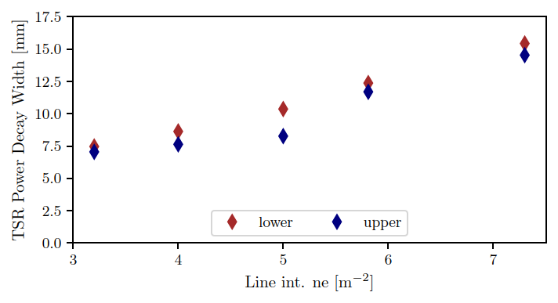

Empirical Scaling – Indicative trends of $Λ_{W}$
Plasma Current and Density
*Different role than
in tokamak SOL
[See Valeria’s talk]
Notes:
- I also have some scaling results of lambda_w with a very sparse database, but I though would be interesting to share here
- Plasma current – different role than in tokamaks
- Reduction after a value
- On the other hand, posirtive scaling with density, albeit after a certain threshold value
- As a teaser, strictly increasing behaviour of tsr decay width, more in valeria’s talk

Slide 13
Summary and Conclusions
Heuristic model - SMoLID
3 characteristic widths of heat transport inferred from 2D heat flux pattern
Application: Heat load prediction, divertor design, etc.
Scaling studies to understand influence of different parameters
Identify favourable and unfavourable parameters (and underlying reasons)
Need to considerably expand the database (Upcoming: Wdia, Field strength, ….)
Lack multi-machine possibilities!!!
Eager to learn from the tokamak community ☺
Ideas, criticisms, words of wisdom,..
Notes:
To summarize:
Framewrok to extract
But not just that
Of course, scaling studies
Goes without saying, need to expand database
Lack multi-machine possibilities still then
Lastly, I am keen to get some feedback from tokamak community, any words of wisdom are gladly welcome!
Thanks

Slide 14
THANK YOU FOR YOUR TIME AND ATTENTION!

