Slide 1
XPR access and stability for different impurities in AUG, JET and DEMO
U. Stroth, M. Bernert, G. Birkenmeier,
R. Dux, T. Lunt, O. Pan, V. Rohde, B. Sieglin,
and the ASDEX Upgrade Team

Slide 2
Outline & Objectives
Recap of the reduced XPR model and its extension
Effect of different impurities on XPR height in AUG, JET and DEMO
A word on the stability of XPRs
XPR operation and L-H Power threshold

Slide 3
Recap of the reduced XPR model and its extension

Slide 4
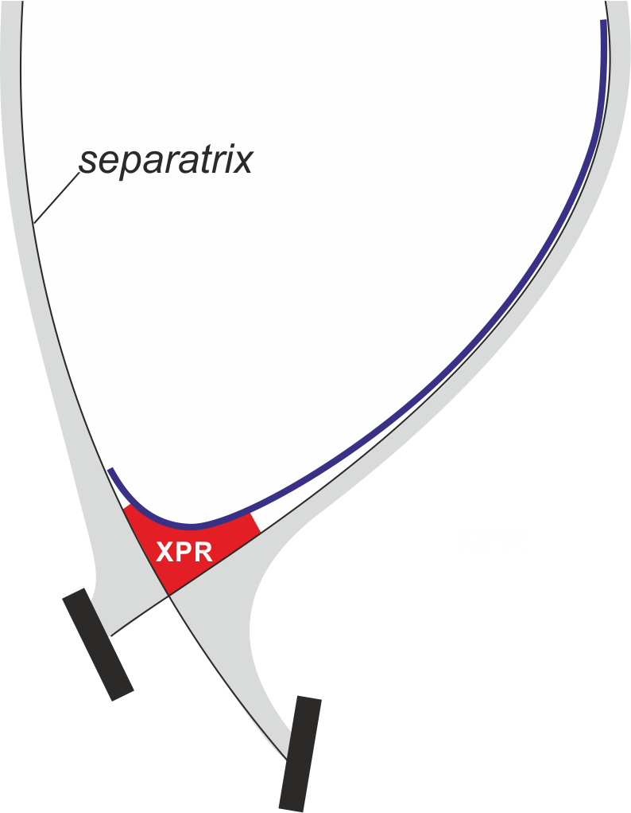
Power balance analysis in the XPR volume
AUG cross-section
XPR power source
    heat conduction
XPR power losses
    impurity line radiation
    neutral deuterium ionization
    charge exchange
Realistic geometry
    flux expansion f_{exp}
    connection length L_{c}
High flux
expansion
[U. Stroth et al., NF 2022]

Slide 5
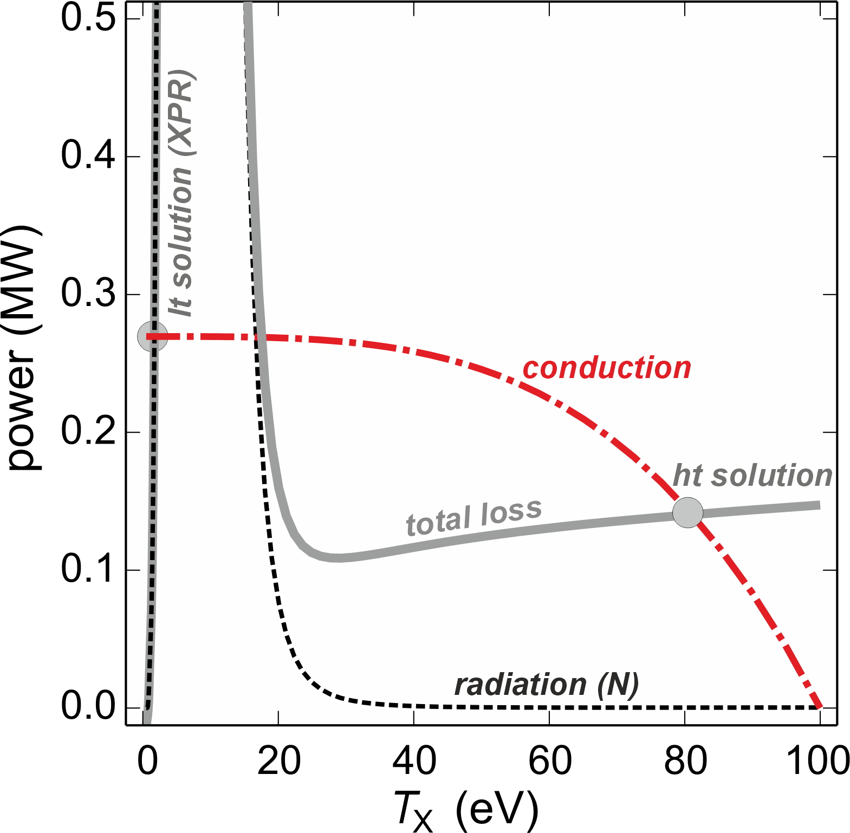
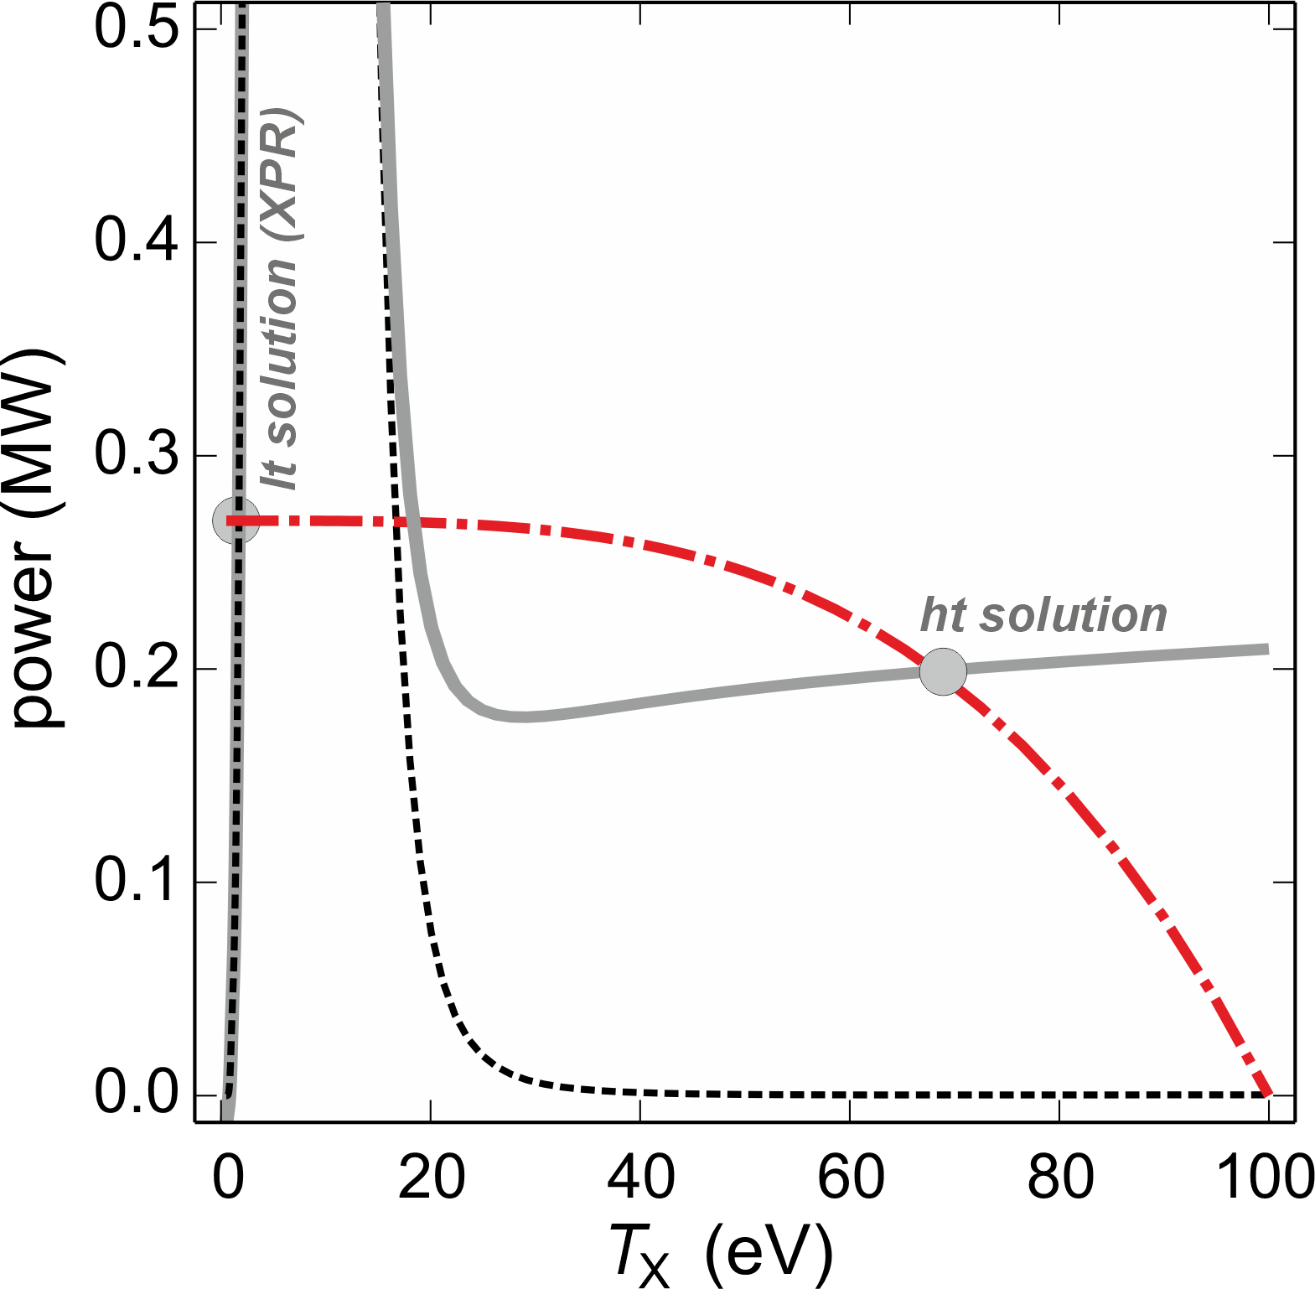
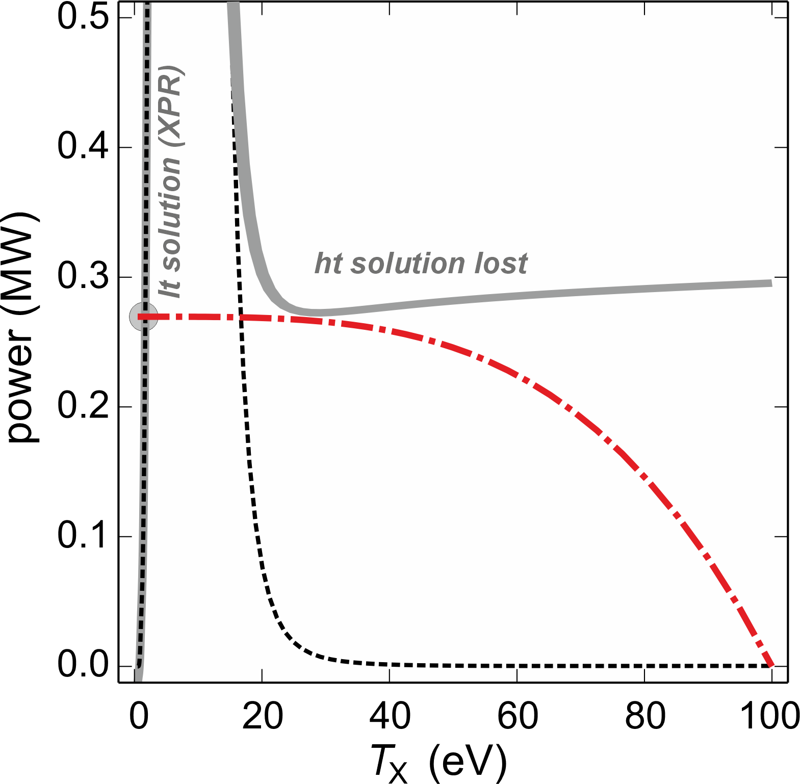
XPR power balance and access condition
An increase in neutral density cools the plasma until a radiative collapse occurs
XPR access parameter
n₀
Deuterium fueling
Geometry:
flux expansion
connection length
Heating power
[U. Stroth et al., NF 2022]

Slide 6
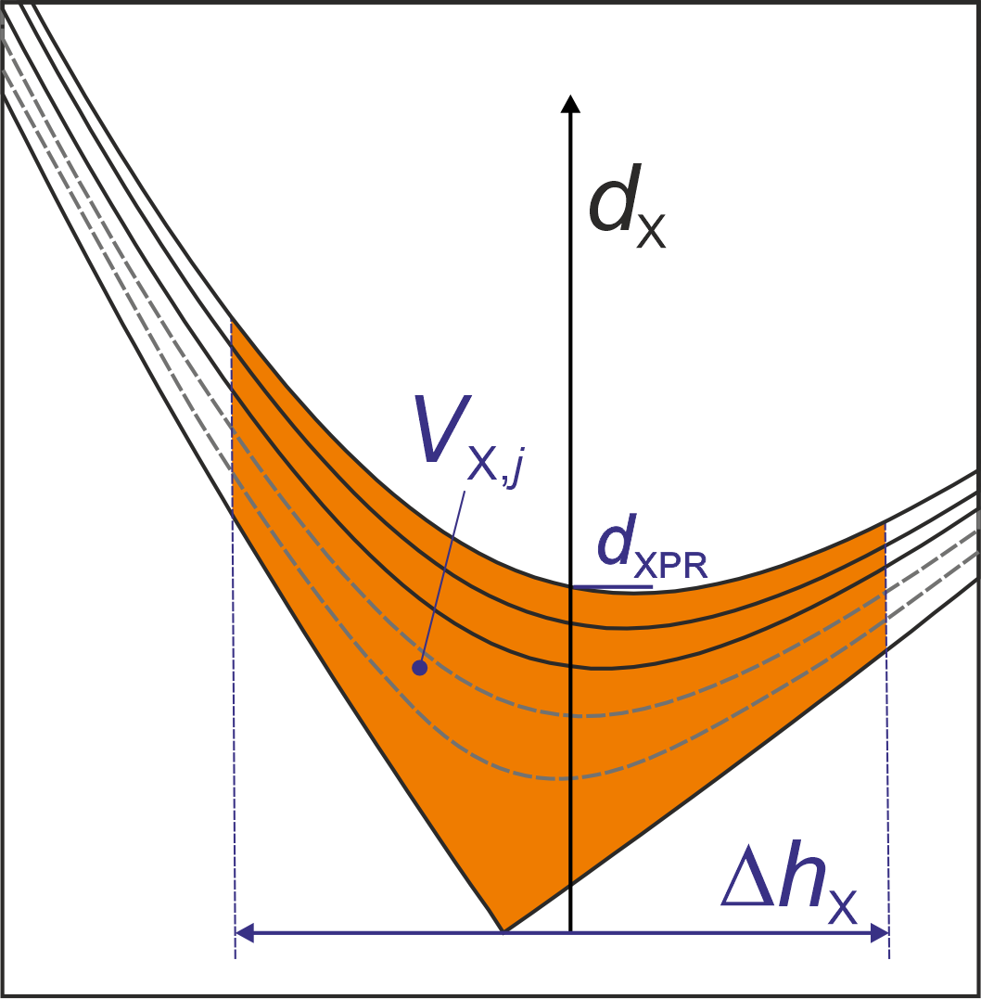
Model extension to estimate XPR height and XPR-edge coupling
      Apply the model to more inner volumes
      XPR grows until the local X_{A} value becomes too small
      Upstream T_{e} and T_{i} profiles are continuously recalculated, taking into account losses in the XPR
Parameters
n₀
[U. Stroth et al., PPCF 2025]

Slide 7
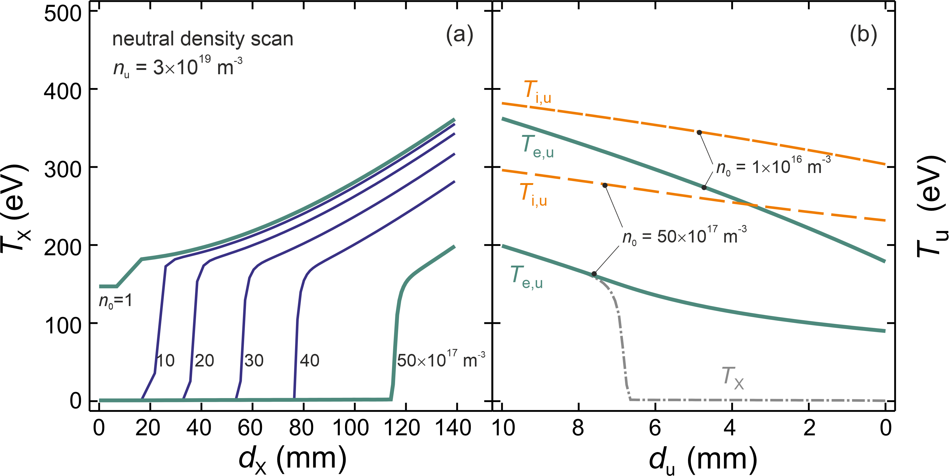
Evolution of XPR and edge temperature profiles
AUG, 10 MW heating power, split 70/30 to electrons/ions
XPR profiles Upstream profiles
      XPR reaches a height of 12 cm and dissipates up to 70 % of the heating power

Slide 8
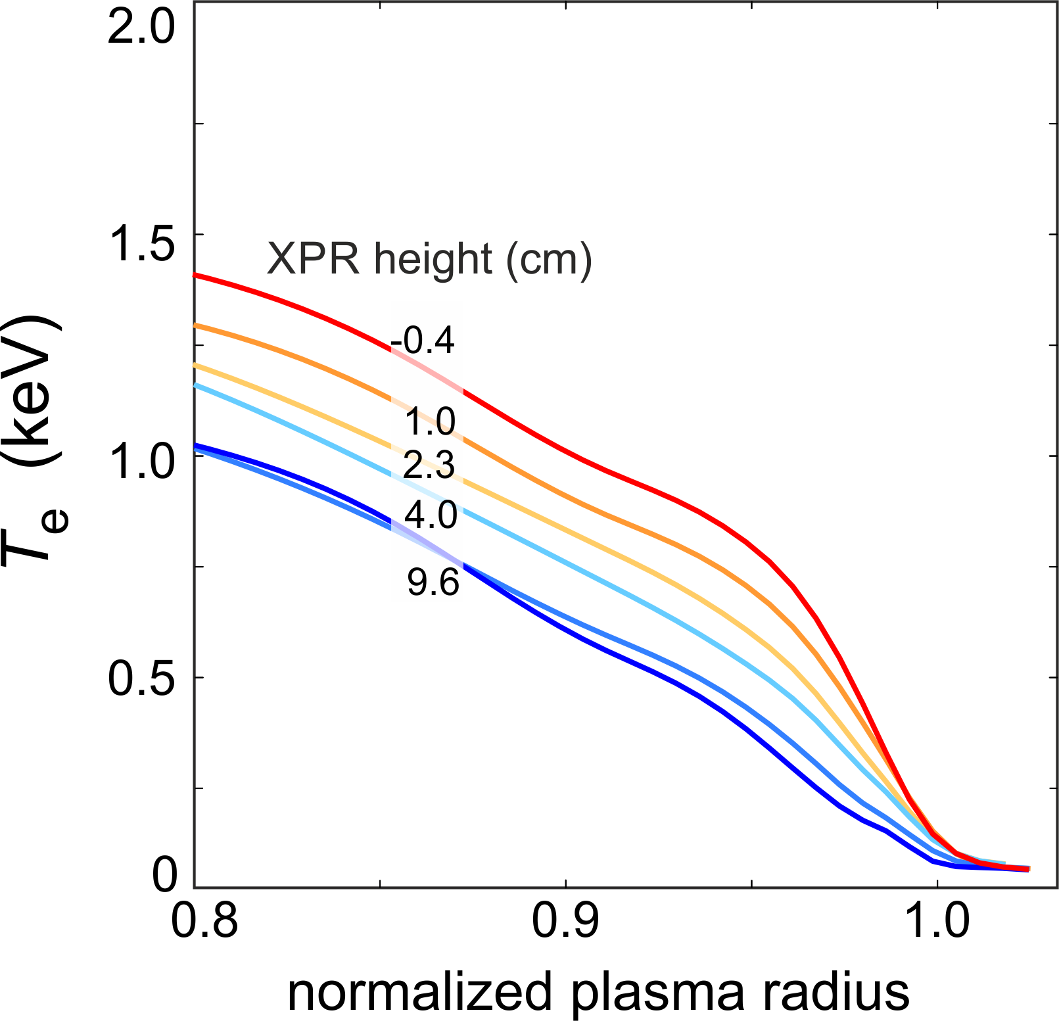
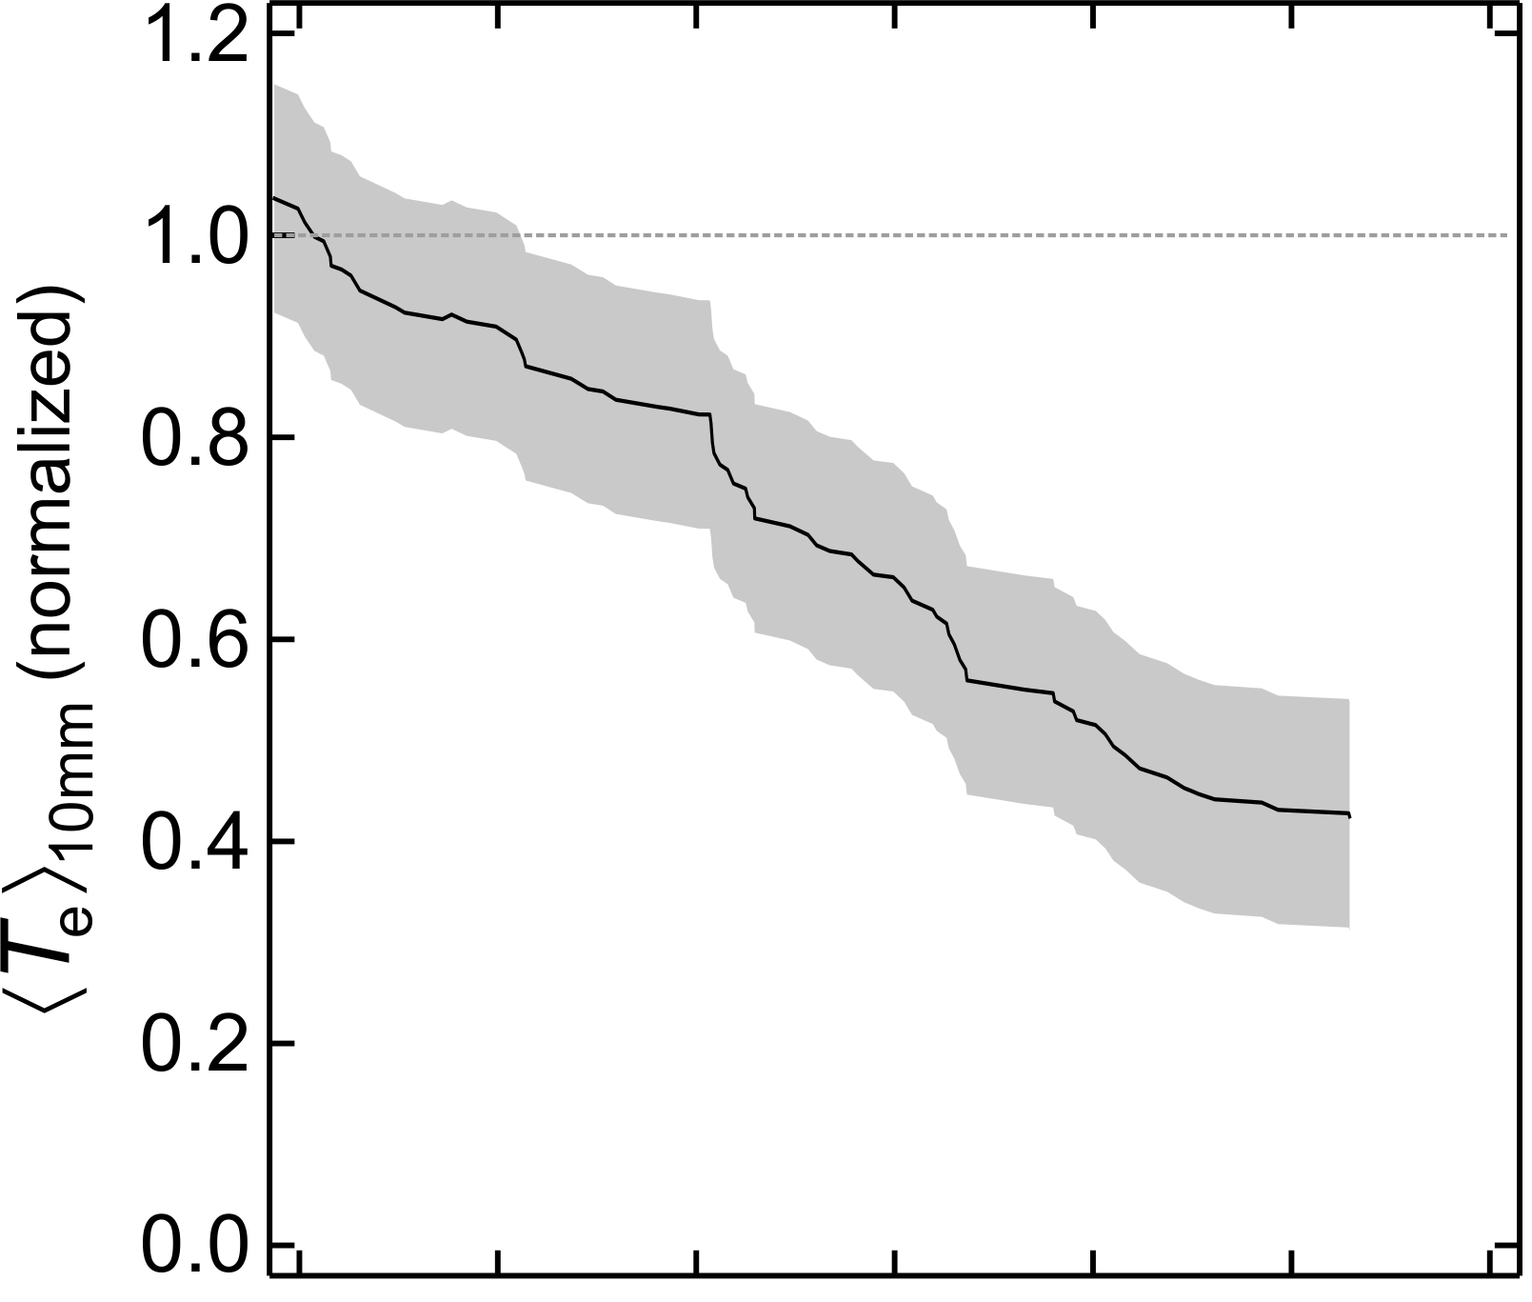
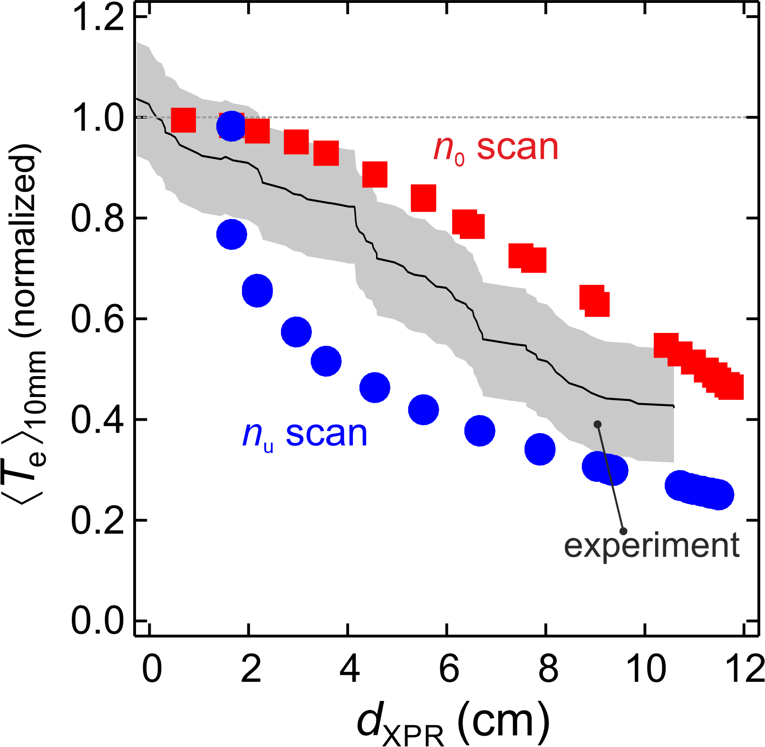
Comparison with an AUG experiment with 10 MW heating power
Experimental upstream T_{e} profiles
      Model reproduced edge temperature drop
[L. Hofstadler, Master thesis, TU Wien; E. Wolfrum et al. EPS 2025]
The pressure gradient drop near the separatrix may lead to ELM suppression

Slide 9
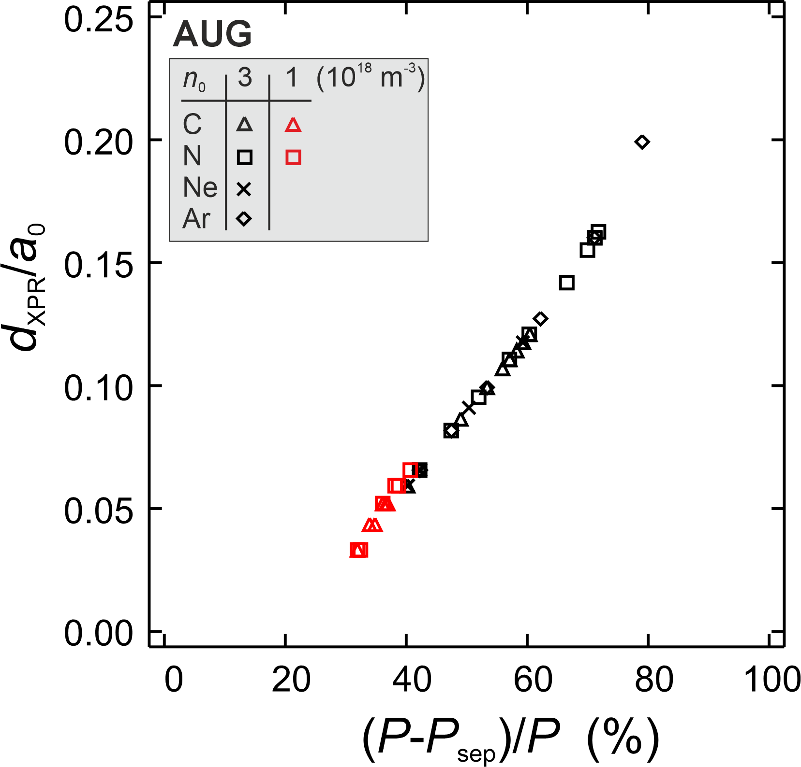
The XPR height is directly related to the dissipated power, regardless of impurity species and neutral density

Slide 10
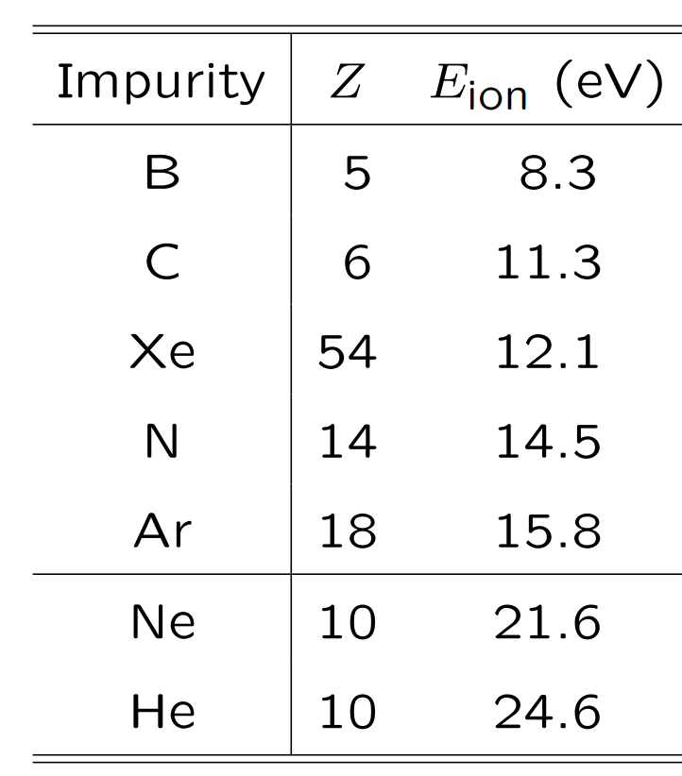
Study effect of different impurities on XPR height in AUG, JET and
EU-DEMO
sputtering
Reduced divertor
compression

Slide 11
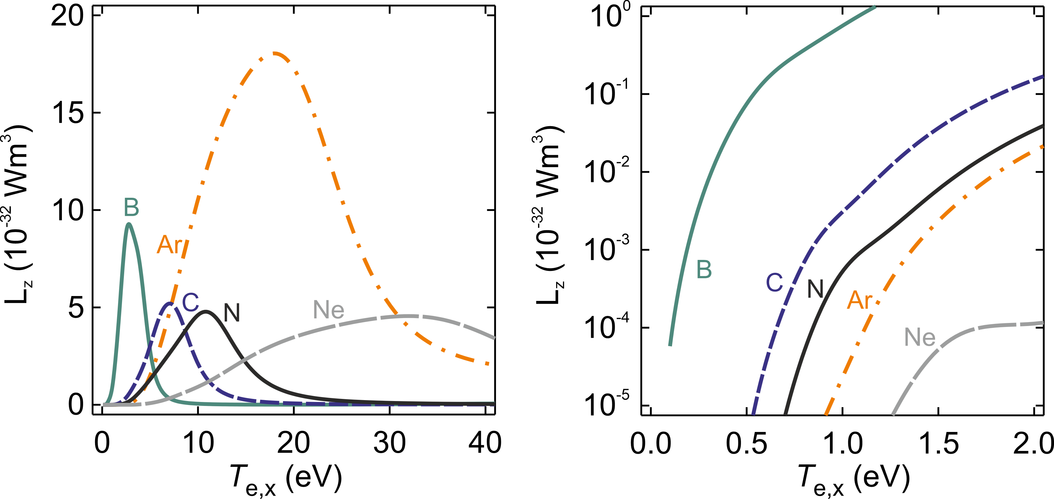
Loss curves for the main impurities
      Ar radiates most strongly
      Ne radiates at high temperature
      B radiates at lowest temperature

Slide 12
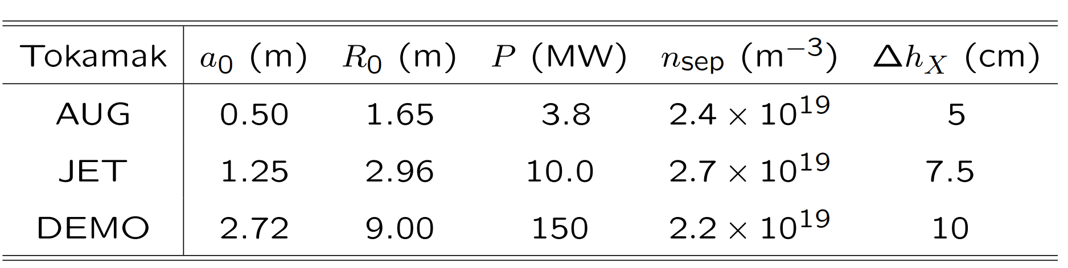
Parameters of tokamaks investigated
Reference values taken from SOLPS-ITER runs (Ou Pan). P refers to power crossing the pedestal (in AUG, 1 cm from separatrix). AUG geometry scaled up ∼ a₀
Conclusions refer to these parameters

Slide 13
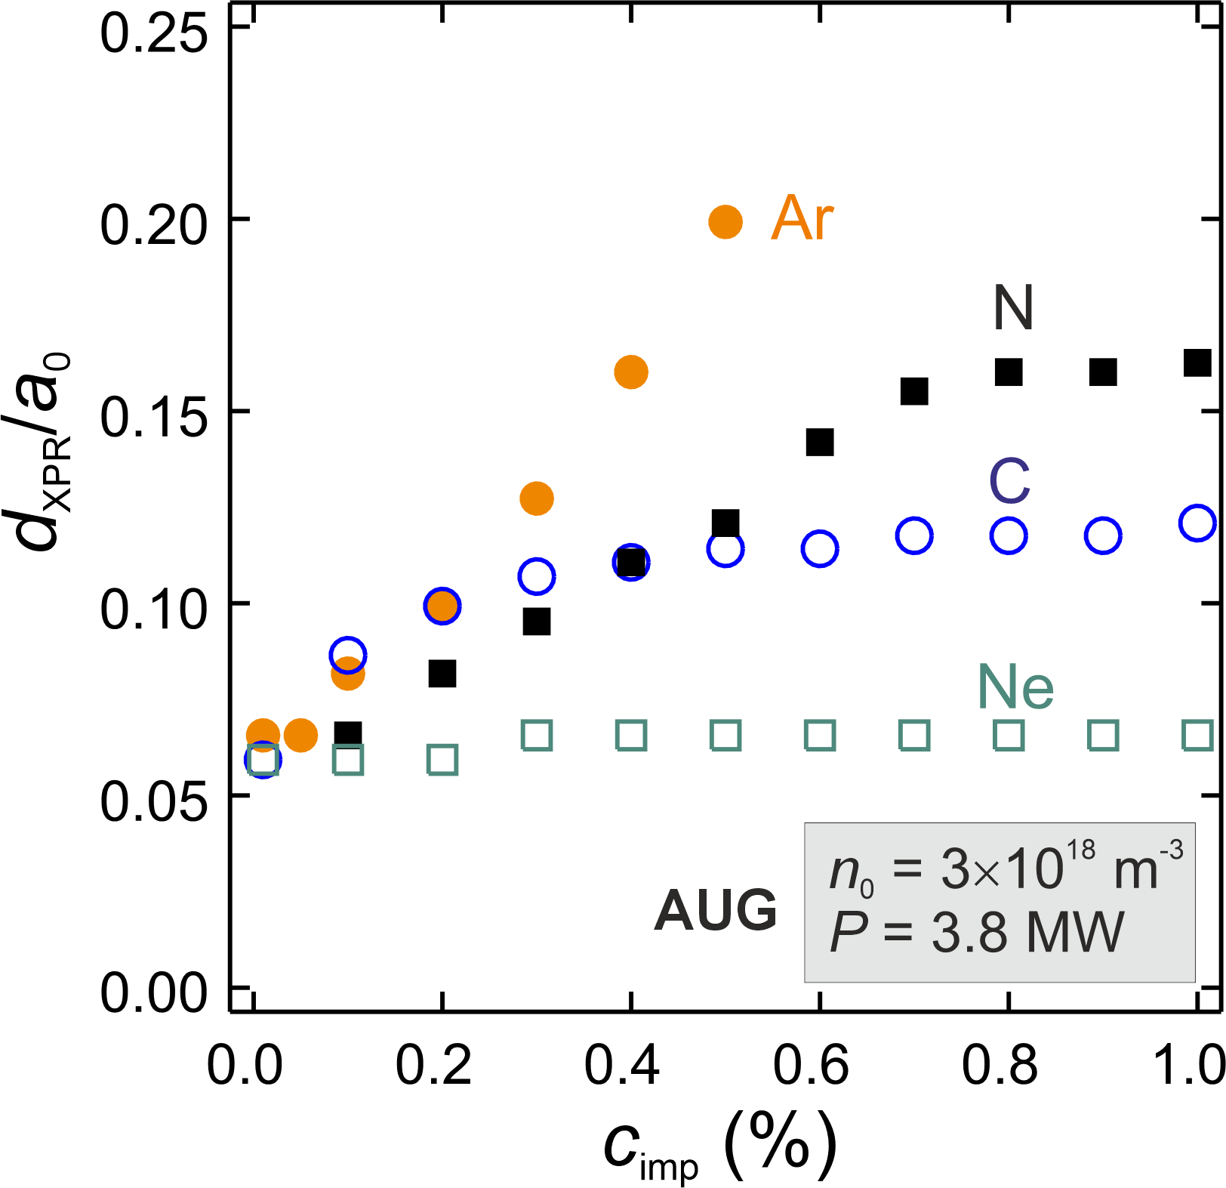
XPR development for various impurities in AUG
      With Ar or N, heights of 8−10 cm are reached
      Ne produces only small XPRs
      Both observations are consistent with experiment
[M. Bernert et al., NME 2025]

Slide 14
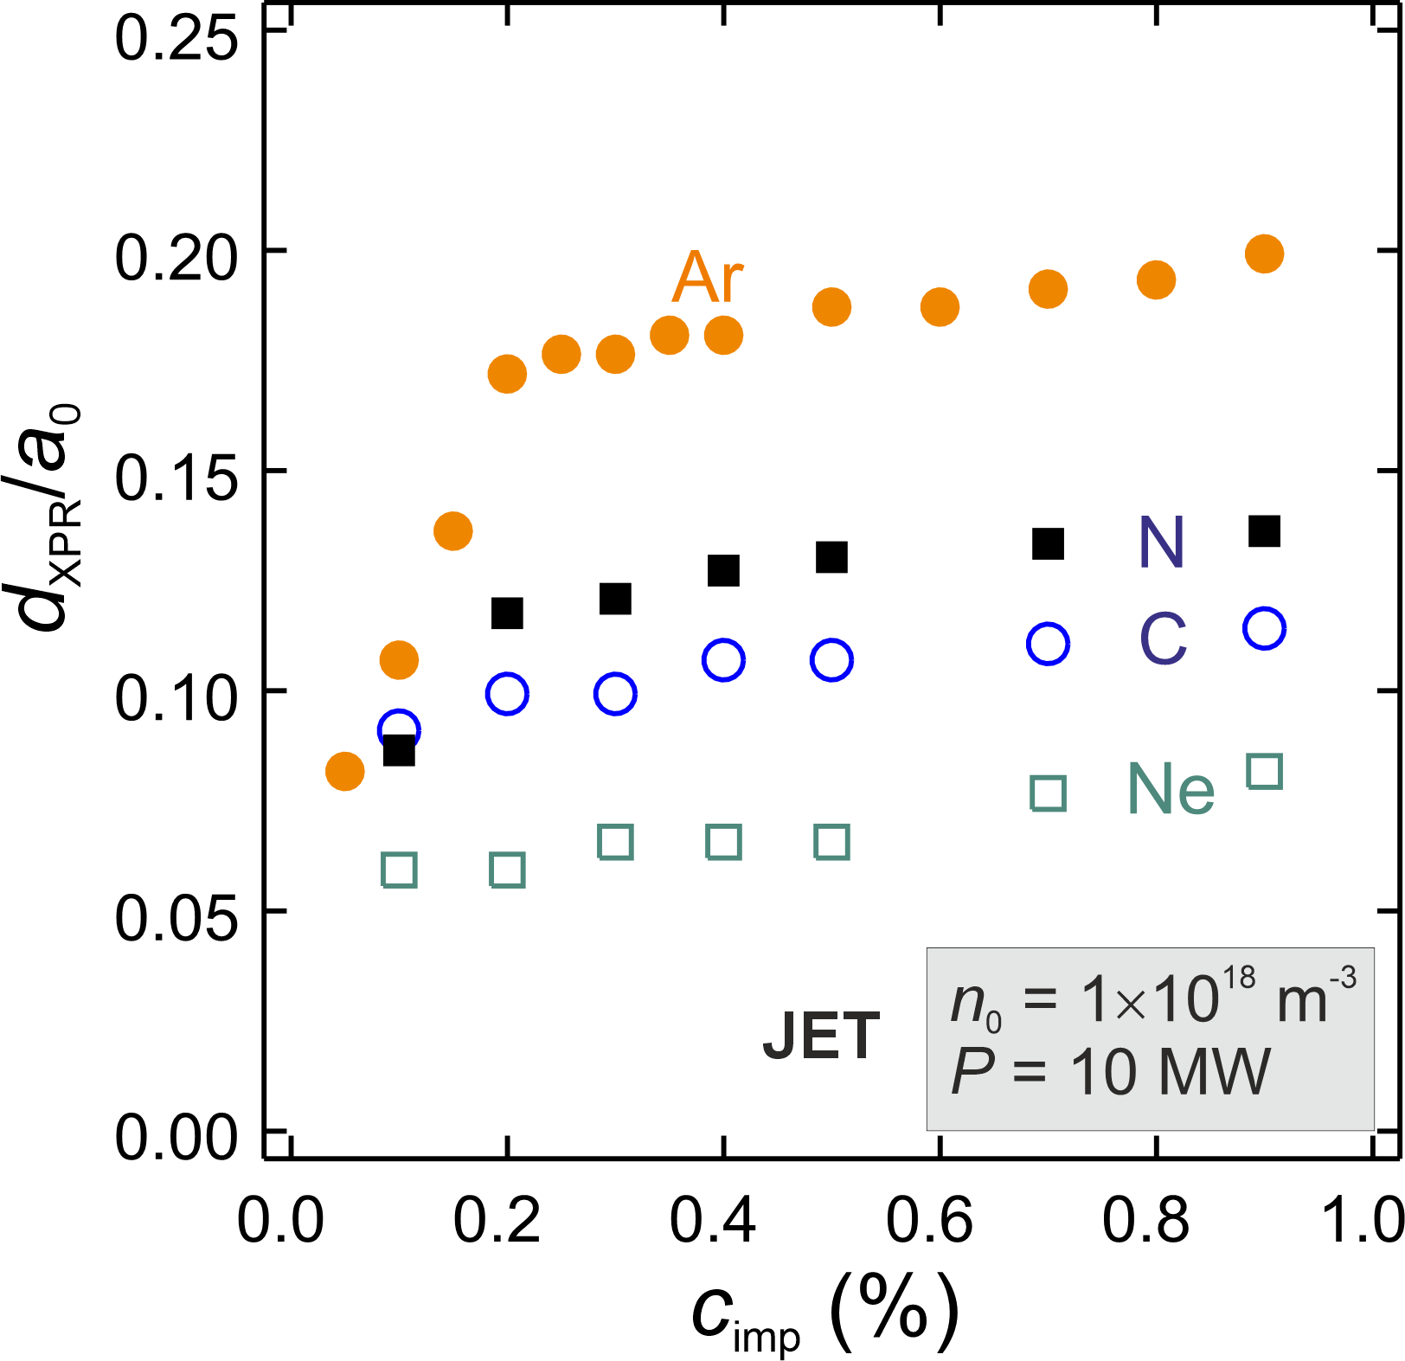
XPR development for various impurities in JET
Similar observations as in AUG
        XPR achieved at lower n₀, due to low power
        Ar produces XPRs up to a height of 20−25 cm at low c_{Ar} before the height saturates
        Ne doesn’t produce large XPRs
        This is consistent with JET experiments, where XPR control is only possible with Ar and not with Ne
[T. Bosman et al., NF 2025]

Slide 15
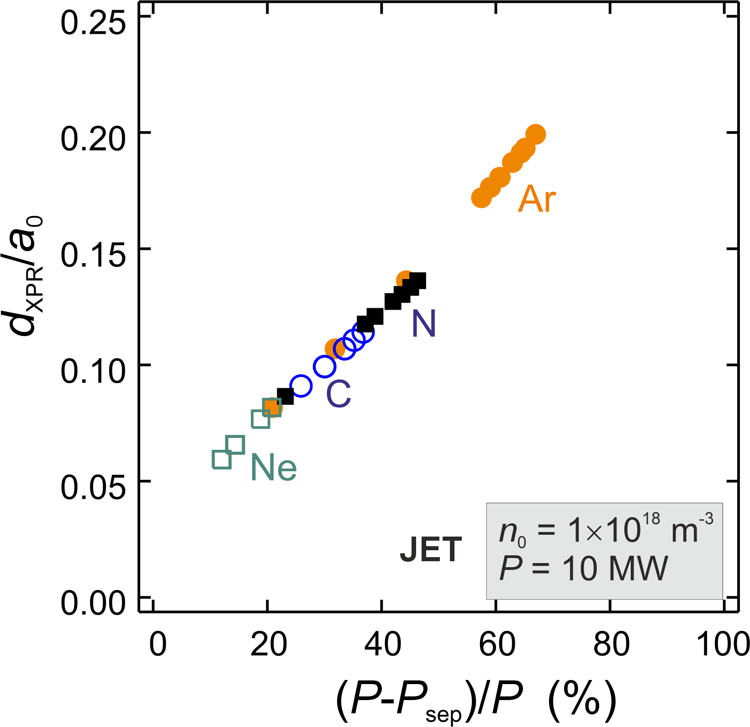
XPR development for various impurities in JET
      With c_{Ar} = 0.3 %, up to 70 % of the power entering the pedestal can be dissipated

Slide 16
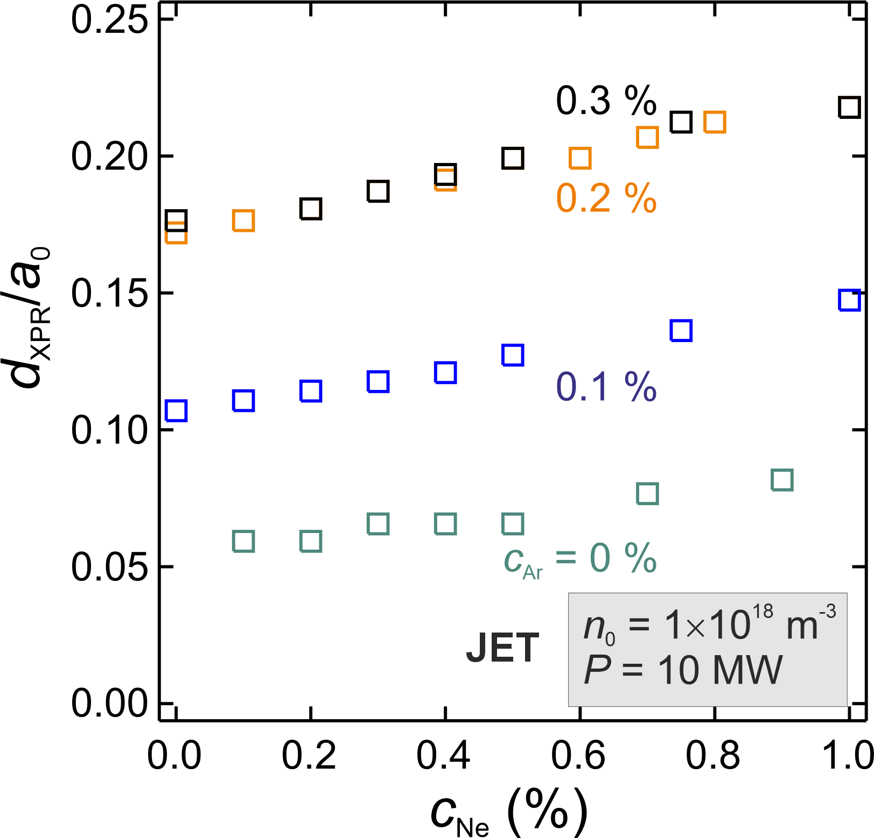
Mixed impurities in JET varying the Ne concentration on a fixed Ar background
The XPR height is mainly determined by the Ar concentration
Adding Ne has only little influence on the XPR height
Core and edge radiation losses are not considered here
  → See also the next presentation by Ou Pan

Slide 17
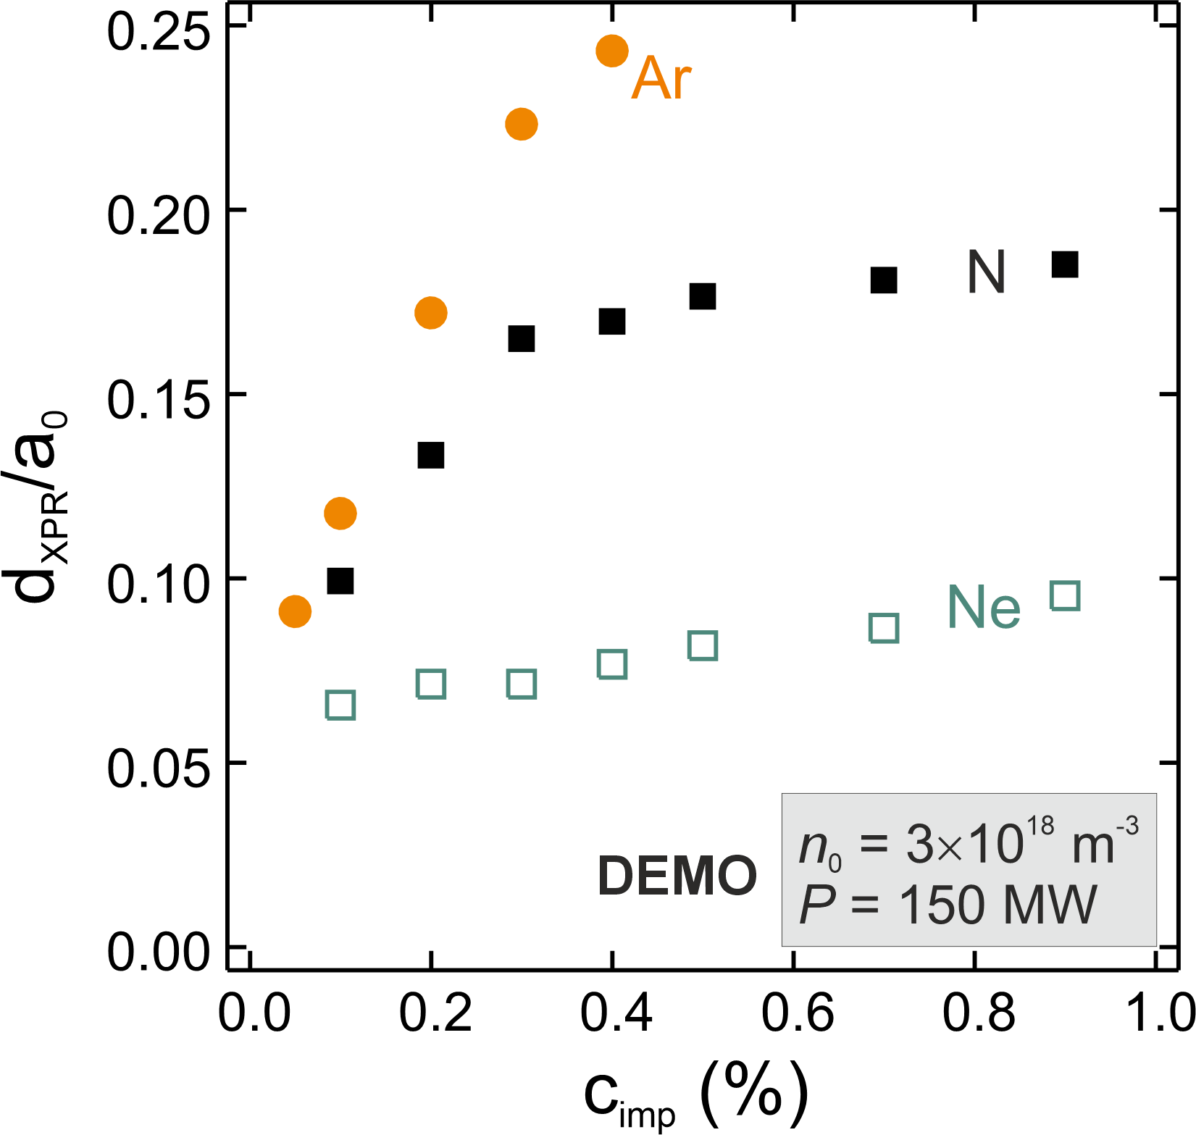
XPR development for various impurities on DEMO
      Due to the higher edge temperature, large XPRs demand high neutral densities
      Small changes in c_{Ar} have a strong effect on XPR height
      With N or Ar, up to 80 % of the pedestal power can be dissipated
      With Ne, the XPR remains small in DEMO either

Slide 18
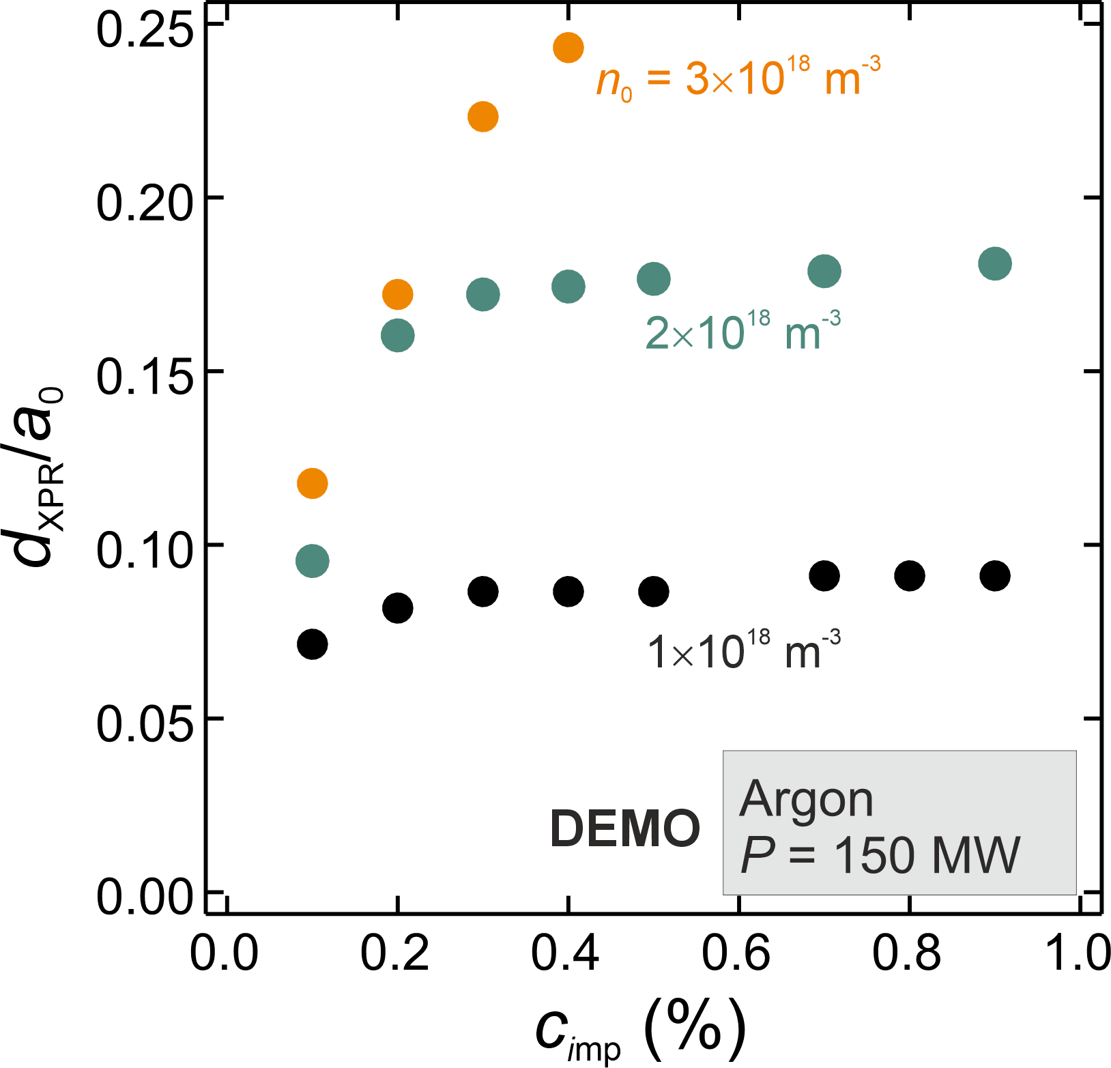
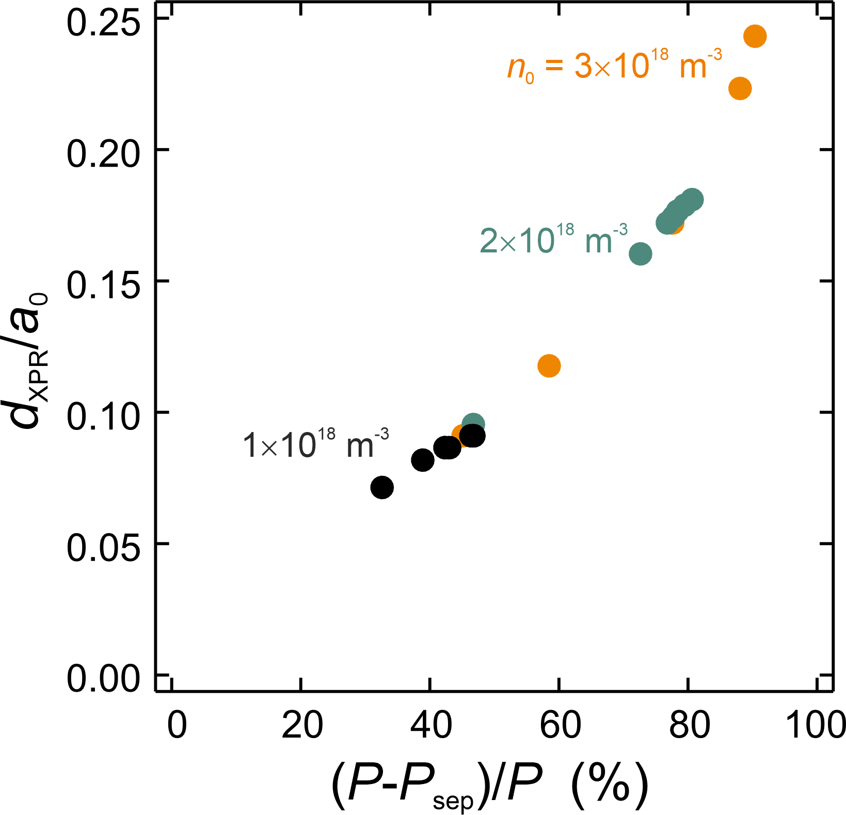
Neutral density effect on the XPR for DEMO with Ar
In DEMO, Ar at low concentration can be used to create a strongly dissipative XPR

Slide 19
A word on XPR stability
→ see also presentation by Filippo Scotti on DIIID

Slide 20
XPR instability stability at low XPR temperatures
      Particle balance in the XPR volume
  At T_{X} < T_{M} a pressure hole develops and
  a MARFE may be triggered
          Radiation curves at low temperature
[U. Stroth et al., NF 2022]

Slide 21
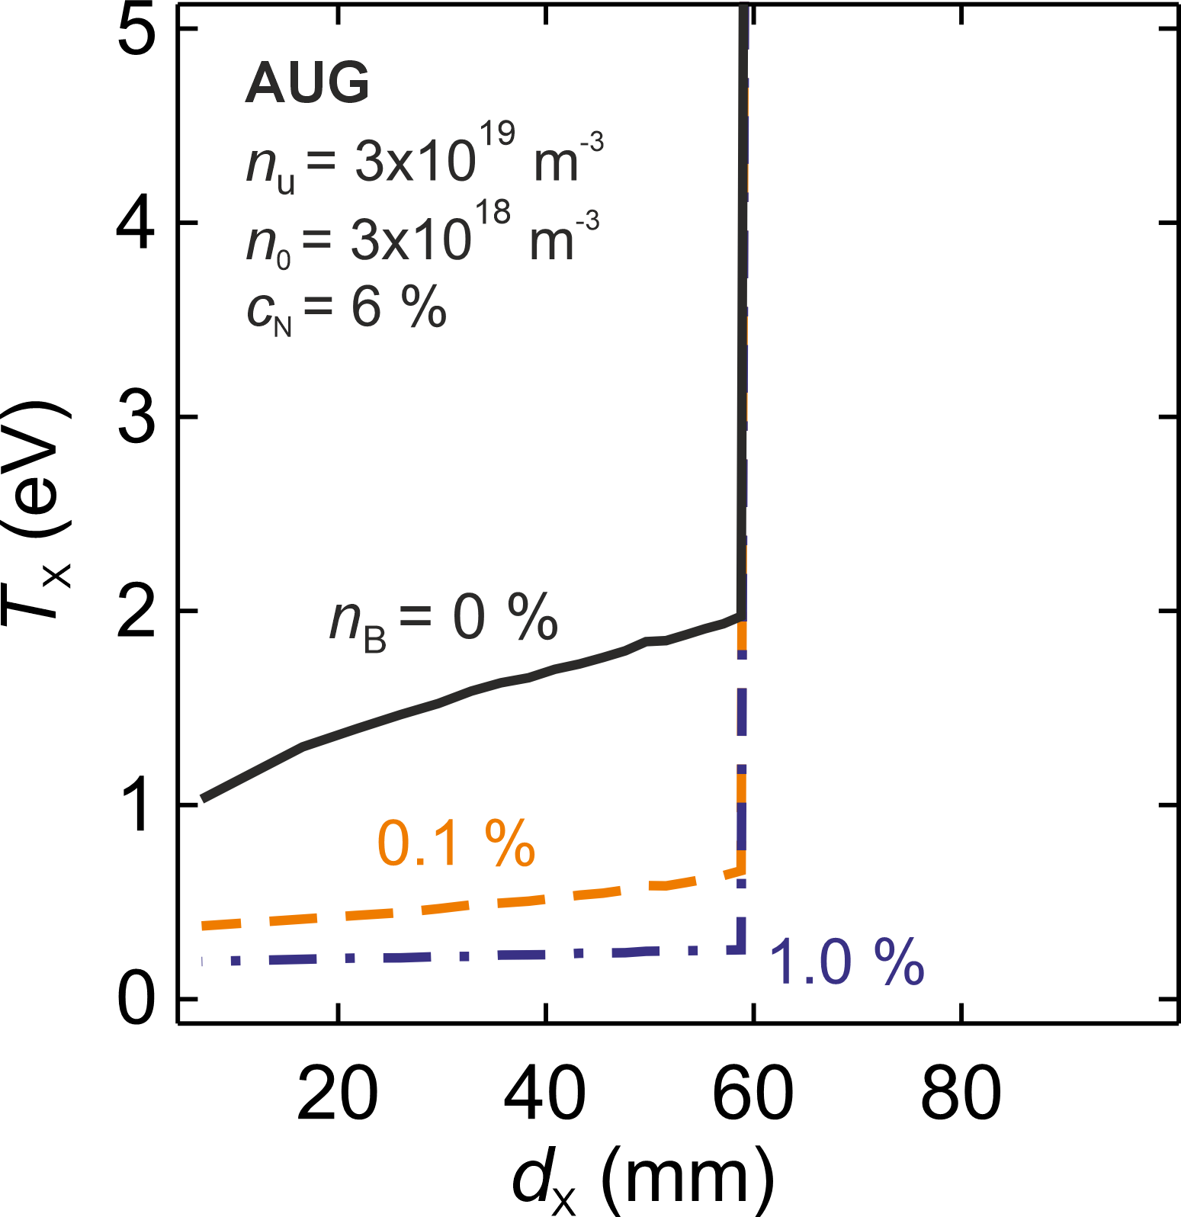
Effect of boron on an XPR controlled by nitrogen seeding
      A small admixture of B significantly
      reduces T_{X}; this may affect the XPR stability
      Initial AUG experiments where B was added to an XPR discharge were not conclusive

Slide 22
On a possible link between XPR physics and the LH power threshold

Slide 23
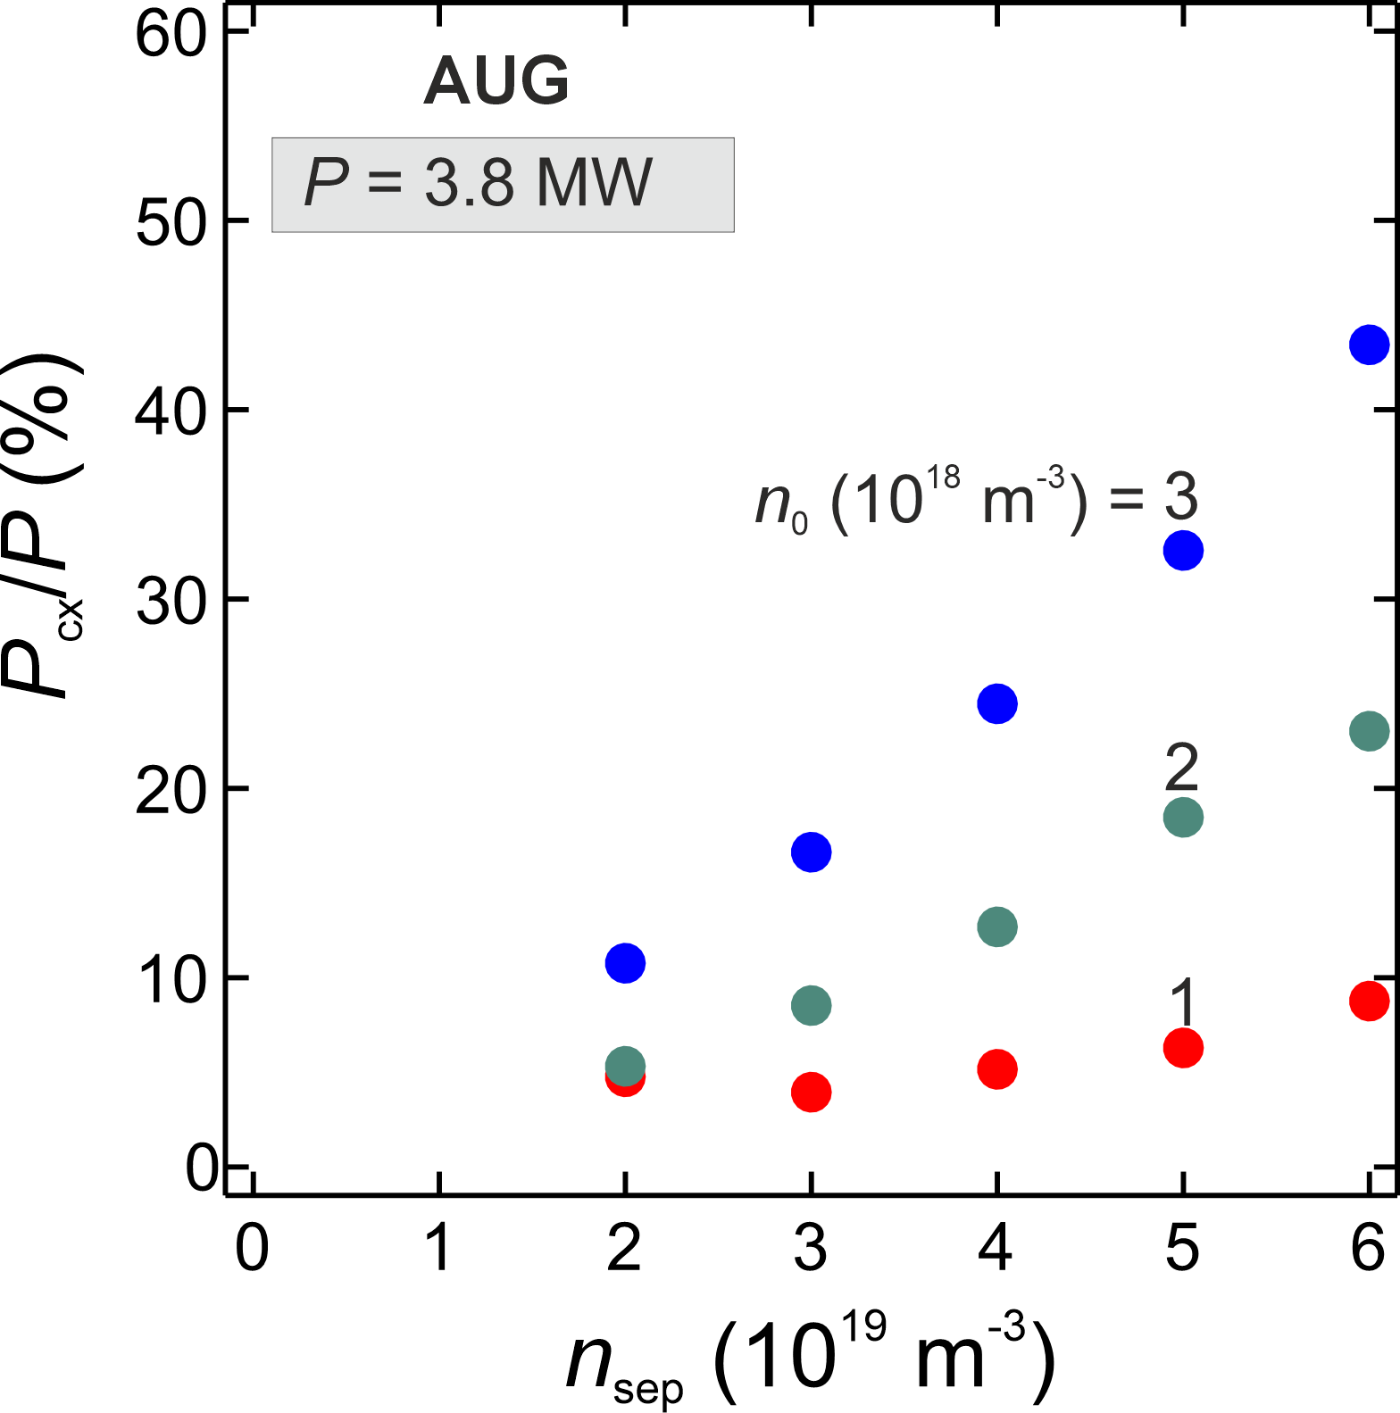
CX-losses in X-point region may affect the L-H power threshold density scan without impurities in AUG
      At high neutral pressure, CX losses can reach up to 40 % of the heating power
      This can cause a density dependence of the
      L-H power threshold as found in scalings
      ⇒ P_{LH} = P_{sep,crit} + P_{cx}
      …and could introduce a dependence of P_{LH} on divertor closeness, as observed on JET
[H. Meyer et al., Report EFDA–JET–CP(14)03/20]

Slide 24
L-H power threshold in JET depends on divertor configuration
[H. Meyer et al., EPS Berlin, 2014]
    The effect of power losses in the XPR region on the L-H transition my be important

Slide 25
Summary & Conclusion
The extended XPR model qualitatively reproduces experimental findings on XPR height and dissipated power
It indicates that neon cannot produce large XPRs in AUG, JET and DEMO
For DEMO, it is indicated that high neutral compression is required for high power dissipation rates at low Argon concentrations
CX losses in the X-point region may influence the L-H power threshold
XPR stability needs to be further investigated (experiments, MHD and turbulence codes)

