Slide 1
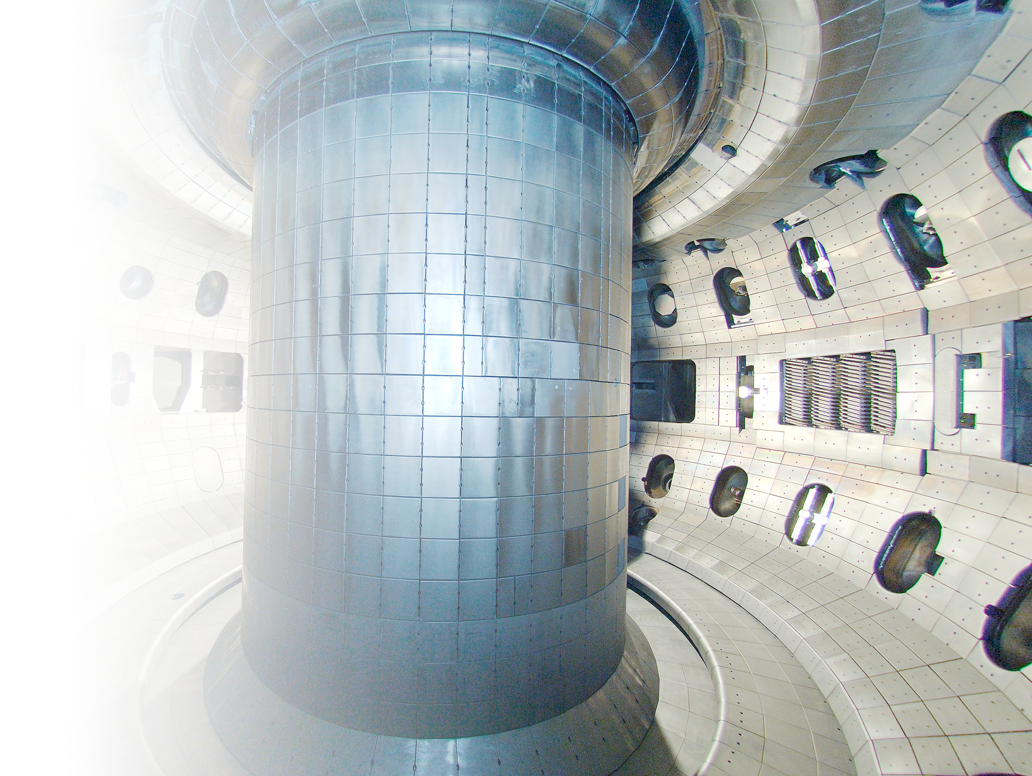
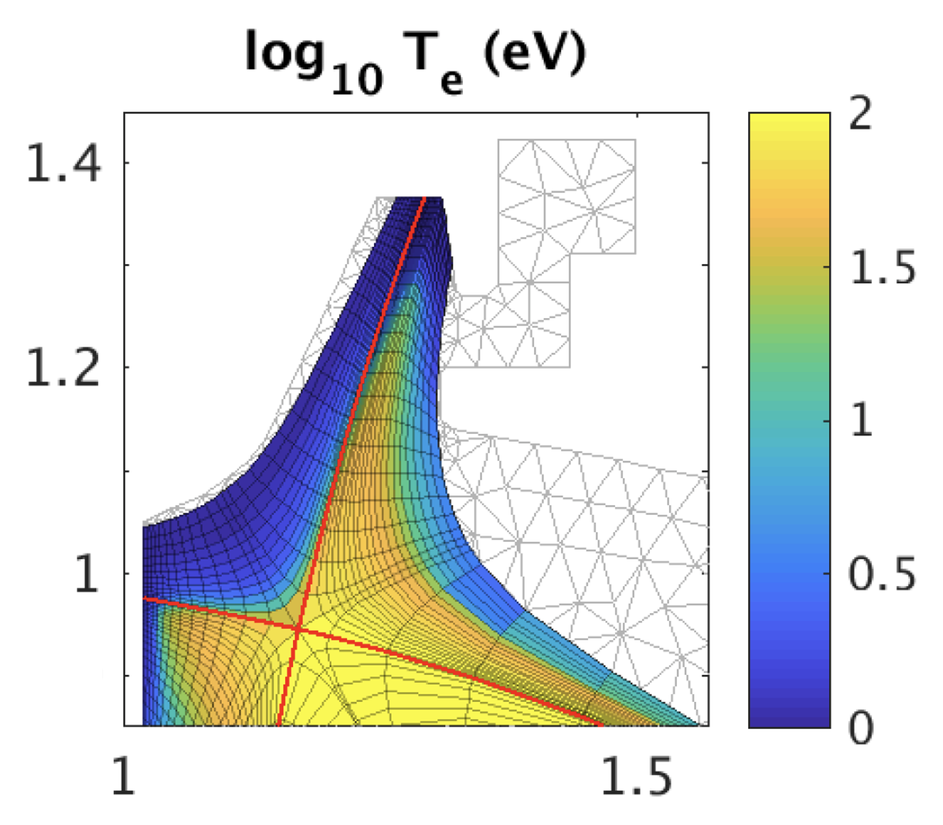

The “Chimney” divertor: A closed divertor with mid-leg pumping for core-edge integration in DIII-D
Presented by
Bob Wilcox^{1*}
with
J.H. Yu², A. Holm³, M.W. Shafer¹, T. Elsey², S.L. Allen³, W. Choi², M.E. Fenstermacher³, F. Glass², M. Groth⁴, J. Hicok², C.T. Holcomb³, R. Hood⁵, C.J. Lasnier³, A.W. Leonard², J.D. Lore¹, R. Maurizio², A.G. McLean³, W. Meyer³, A. Moser², C. Murphy², J. Ren⁶, T. Rognlien³, G. Ronchi¹, F. Scotti³, C. Tsui⁵
¹Oak Ridge National Laboratory
²General Atomics
³Lawrence Livermore National Laboratory
⁴Aalto University
⁵Sandia National Laboratories
⁶University of Tennessee – Knoxville
*contact: wilcoxrs@ornl.gov
IAEA Divertor Concepts Meeting
October 30, 2025
100
10
1

Slide 2
A novel divertor design has been developed with the goal of improving both access to detachment and detachment control via mid-leg pumping
100
Simulated T_{e} (eV)
Pumping part way along the baffled divertor leg keeps neutral gas particles localized where they are useful for power dissipation
SOLPS and UEDGE simulations find that this design robustly maintains a detached target (T_{e,targ} < ~1 eV) with a hot fusion core (T_{e,Xpt} > ~60 eV)
T_{e,targ} and q⟂ are predicted to be reduced for a given n_{e,sep}
A “chimney” divertor has been designed to test this concept of mid-leg pumping in DIII-D
Experiments will test simulation predictions, establish parametric dependencies
Planning now to add reactor-relevant material(s)
10
1

Slide 3
Outline: DIII-D Chimney Divertor
Neutral particle control as a tool for detachment access and stabilization
Chimney divertor design and experimental goals

Slide 4
Outline: DIII-D Chimney Divertor
Neutral particle control as a tool for detachment access and stabilization
Chimney divertor design and experimental goals

Slide 5
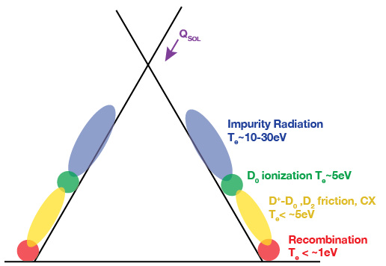
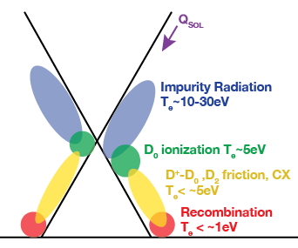
T_{e}-dependent dissipation processes require volume (L∥) for the target plasma to be detached without core confinement degradation
Hot core
1D cartoon
Colder, denser core, can be unstable
Goal

Slide 6
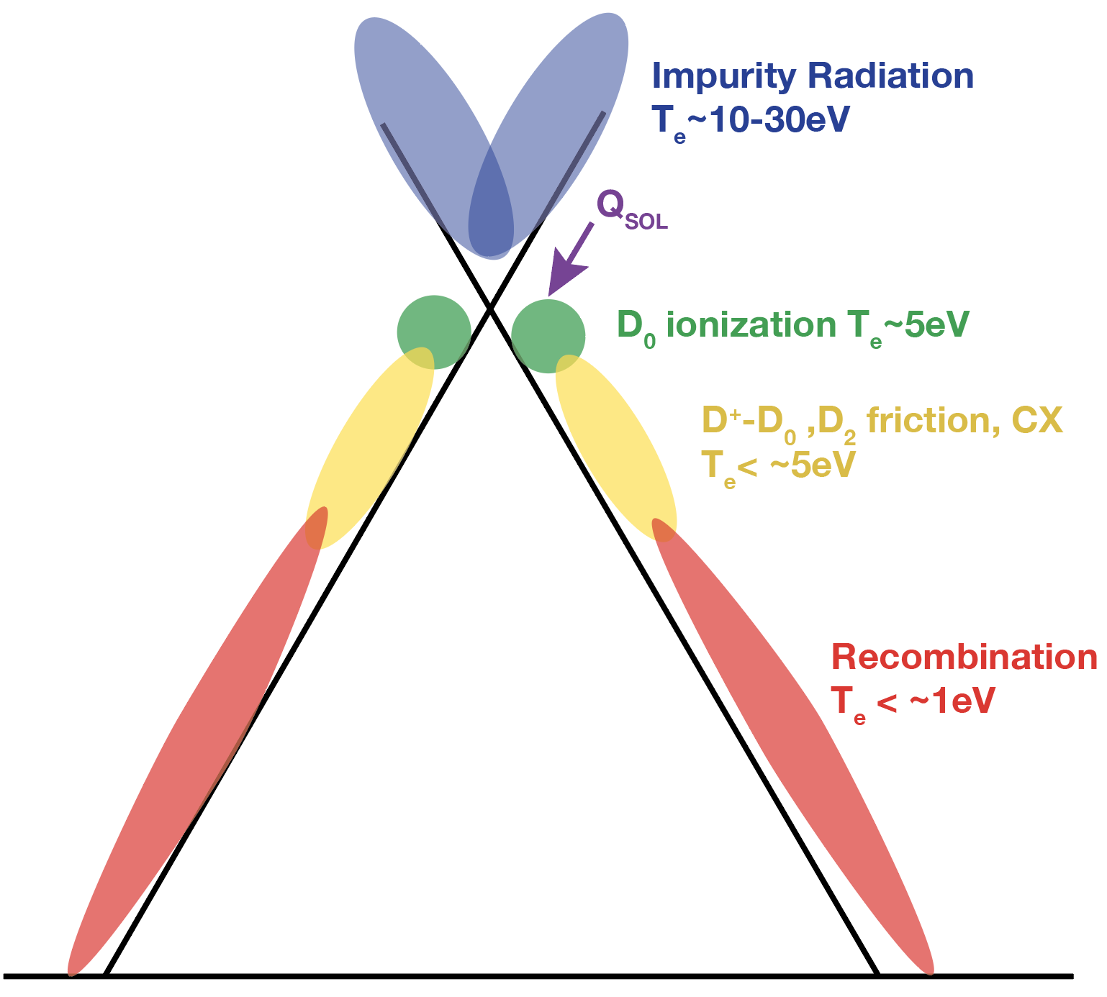
Without careful control, detachment front often migrates to the X-point, negating benefit of the longer divertor leg
Hot core
1D cartoon

Slide 7
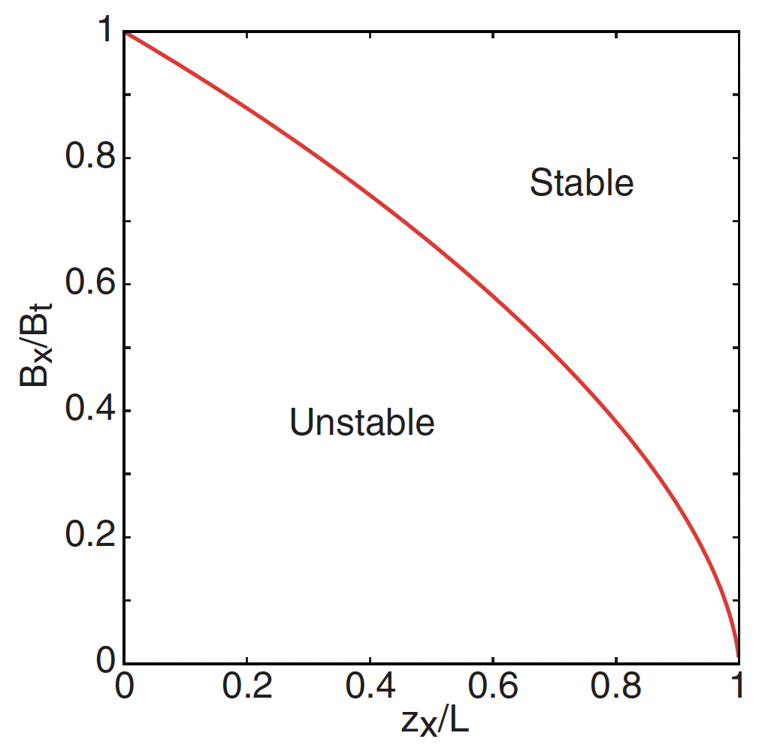
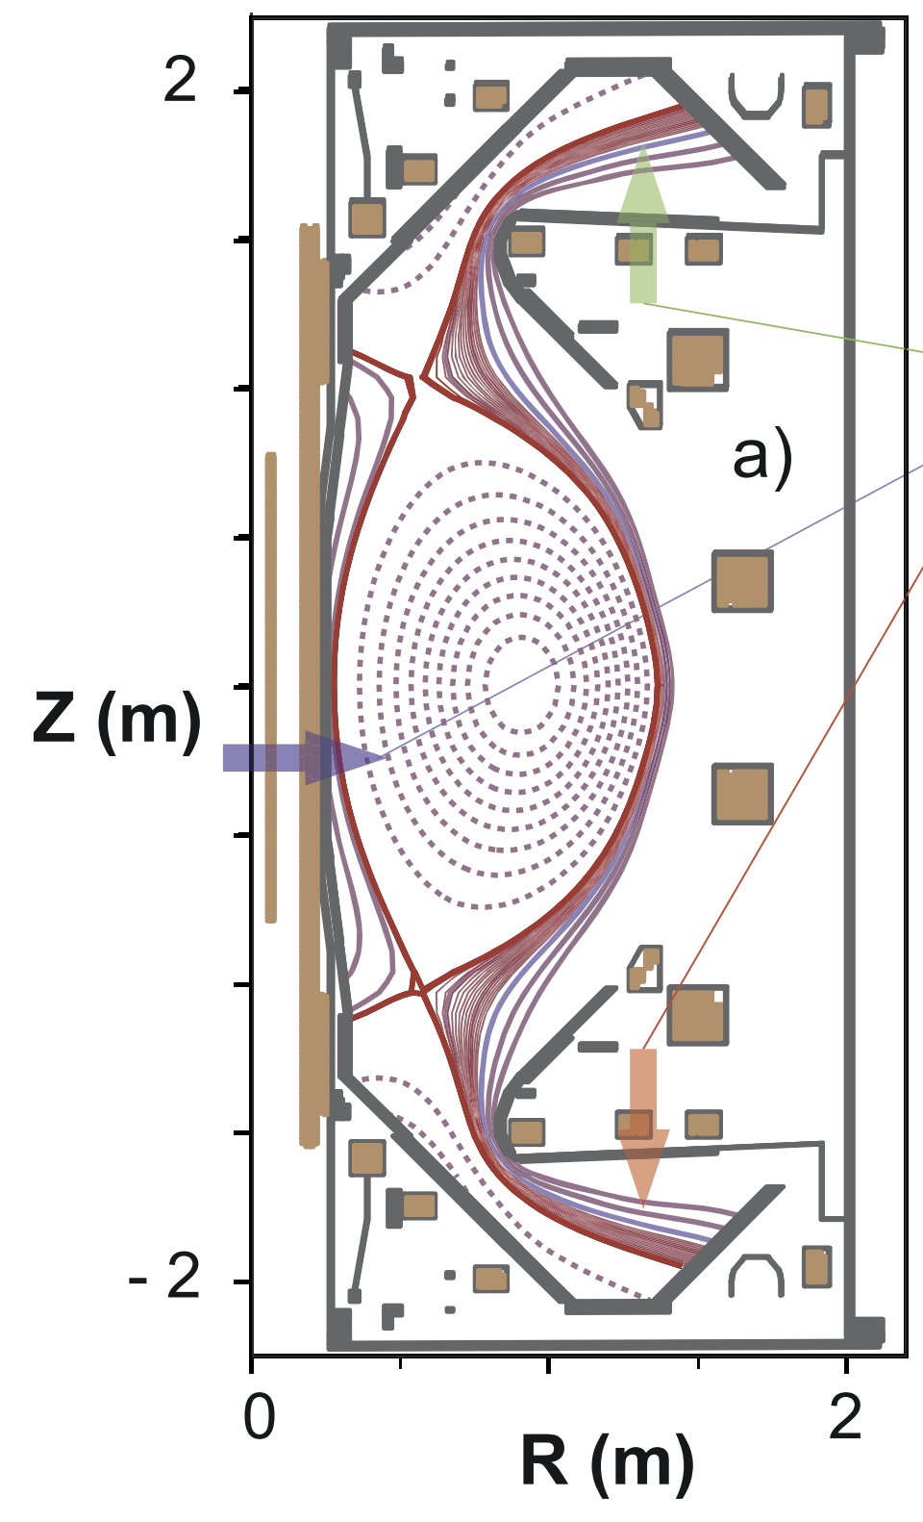
Magnetic geometry can improve access and stability of detachment, but this can be constraining for reactor design
Decreasing field strength, long divertor legs are found to be stabilizing for detachment
MAST-U is a good example of a magnetic geometry with stable detachment front
Unstable example: short, vertical leg
High triangularity is desirable for pedestal stability
Modifications to basic DLS model find L∥, flux expansion more important
C. Cowley et al., Nucl. Fusion 62 (2022) 086046
K. Verhaegh et al., Nucl. Fusion 63 (2023) 016014
(Fraction of the exhaust flux tube in the divertor)
B. Lipschultz et al., Nucl. Fusion 56 (2016) 056007

Slide 8
Magnetic geometry can improve access and stability of detachment, but this can be constraining for reactor design
Decreasing field strength, long divertor legs are found to be stabilizing for detachment
MAST-U is a good example of a magnetic geometry with stable detachment front
Unstable example: short, vertical leg
High triangularity is desirable for pedestal stability
Modifications to basic DLS model find L∥, flux expansion more important
C. Cowley et al., Nucl. Fusion 62 (2022) 086046
K. Verhaegh et al., Nucl. Fusion 63 (2023) 016014
Internal PF coils can be an engineering challenge and experience high neutron flux, so it would be helpful to have other tools
(Fraction of the exhaust flux tube in the divertor)
B. Lipschultz et al., Nucl. Fusion 56 (2016) 056007

Slide 9
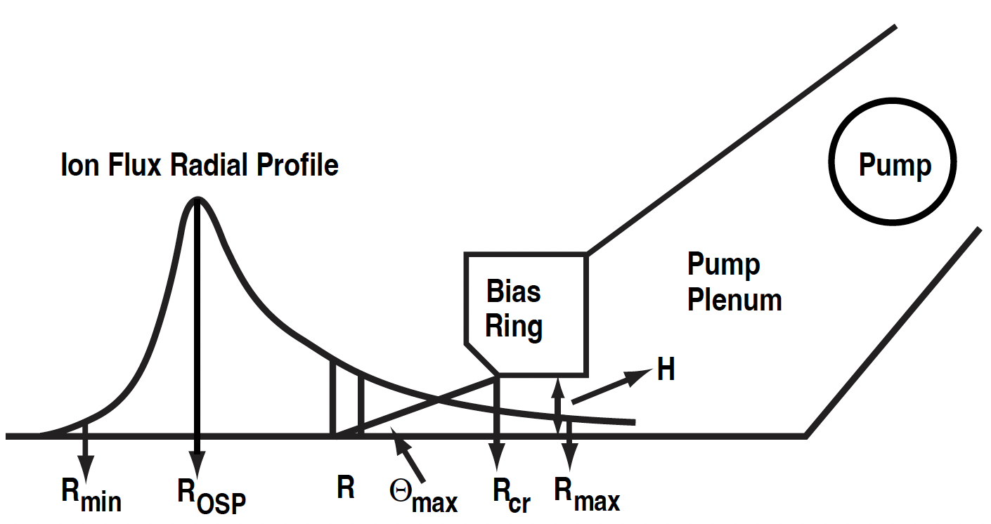
Pumping particles from a reactor divertor is necessary for He ash removal and core density control, but deprives neutral dissipation processes
Historically, positioning pump near the strike point provides efficient particle removal
Capture neutral particles sourced by recombination at the divertor target
Core density can be minimized
Efficient pumping for density control has been a primary goal of most experimental divertors
Pump
Pump duct
Modified from R. Maingi et al., Nucl. Fusion 39 (1999) 1187

Slide 10
Pumping particles from a reactor divertor is necessary for He ash removal and core density control, but deprives neutral dissipation processes
Historically, positioning pump near the strike point provides efficient particle removal
Capture neutral particles sourced by recombination at the divertor target
Core density can be minimized
Efficient pumping for density control has been a primary goal of most experimental divertors
Pump
Pump duct
But absolute minimization of particle inventory is not necessarily the primary goal of a divertor in a reactor
Particles are a key element required for thermal dissipation in the divertor
Modified from R. Maingi et al., Nucl. Fusion 39 (1999) 1187

Slide 11
Can pumping part way up a “closed” divertor leg stabilize the detachment front before it migrates to the X-point and degrades the core?
Neutrals can be undesirable in the main chamber
1D cartoon
ions
D₀ ionization ∝ n_{D0}
Neutrals are desirable in the divertor
Neutral friction and CX ∝ n_{n}
neutrals

Slide 12
Can pumping part way up a “closed” divertor leg stabilize the detachment front before it migrates to the X-point and degrades the core?
Neutrals can be undesirable in the main chamber
1D cartoon
ions
Ideally remove neutrals here
D₀ ionization ∝ n_{D0}
Neutrals are desirable in the divertor
Neutral friction and CX ∝ n_{n}
neutrals

Slide 13
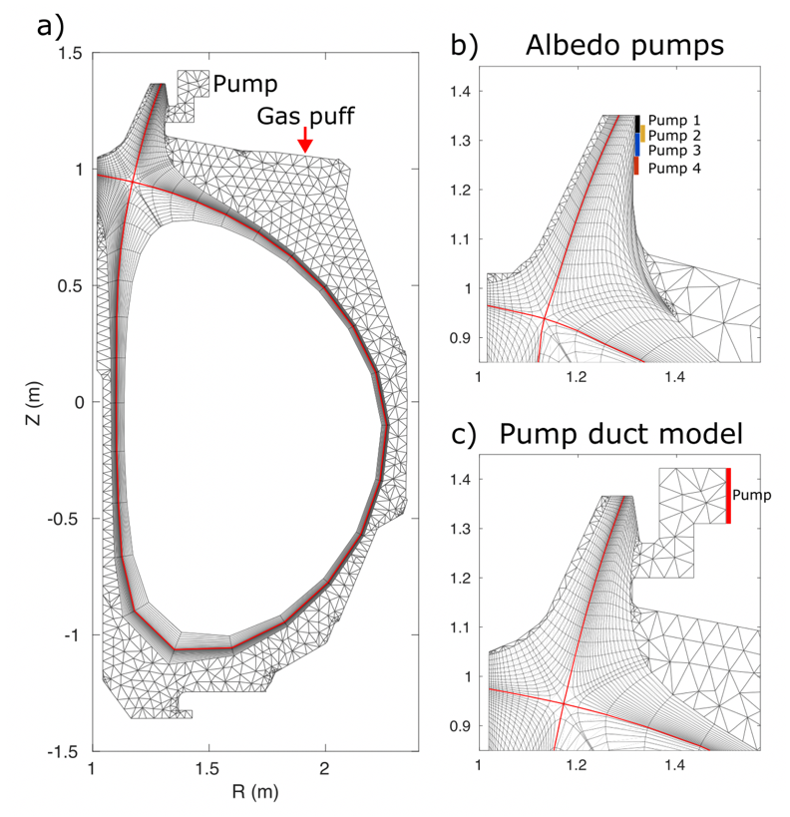
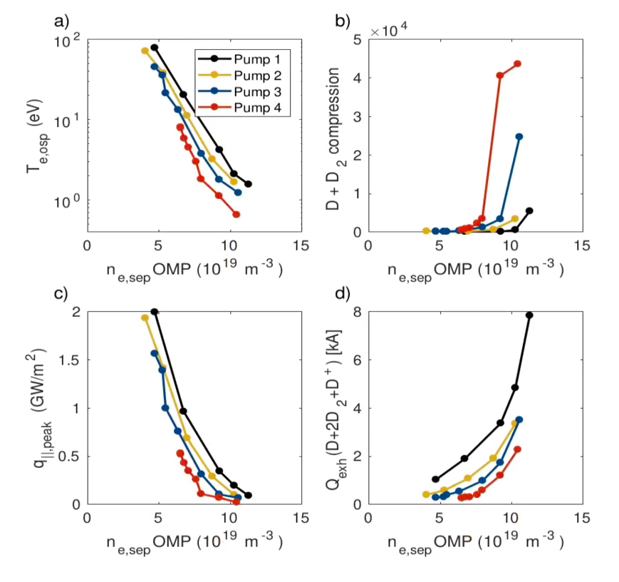
Coupled fluid-kinetic boundary modeling with SOLPS-ITER finds that pumping upstream from the divertor target increases neutral density and lowers T_{e} at target
Upstream pumping in simulations:
Higher neutral density at divertor target relative to main chamber
Pumping locations
SOLPS-ITER
Previous related work: C. Sang et al., Nucl. Fusion 61 (2021) 016022
J. Yu et al., Nucl. Mat. Energy 41 (2024) 101826

Slide 14
Coupled fluid-kinetic boundary modeling with SOLPS-ITER finds that pumping upstream from the divertor target increases neutral density and lowers T_{e} at target
Upstream pumping in simulations:
Higher neutral density at divertor target relative to main chamber
Lower T_{e} and peak heat flux at the outer divertor target for a given core density
Pumping locations
SOLPS-ITER
Previous related work: C. Sang et al., Nucl. Fusion 61 (2021) 016022
J. Yu et al., Nucl. Mat. Energy 41 (2024) 101826

Slide 15
Coupled fluid-kinetic boundary modeling with SOLPS-ITER finds that pumping upstream from the divertor target increases neutral density and lowers T_{e} at target
Upstream pumping in simulations:
Higher neutral density at divertor target relative to main chamber
Lower T_{e} and peak heat flux at the outer divertor target for a given core density
Pumping locations
SOLPS-ITER
Previous related work: C. Sang et al., Nucl. Fusion 61 (2021) 016022
J. Yu et al., Nucl. Mat. Energy 41 (2024) 101826

Slide 16
Coupled fluid-kinetic boundary modeling with SOLPS-ITER finds that pumping upstream from the divertor target increases neutral density and lowers T_{e} at target
Upstream pumping in simulations:
Higher neutral density at divertor target relative to main chamber
Lower T_{e} and peak heat flux at the outer divertor target for a given core density
Minimum achievable core density is higher for given particle injection and pumping rate
Likely acceptable as long as core density remains below stability limits for operational particle throughput
Pumping locations
SOLPS-ITER
Previous related work: C. Sang et al., Nucl. Fusion 61 (2021) 016022
J. Yu et al., Nucl. Mat. Energy 41 (2024) 101826

Slide 17
Outline: DIII-D Chimney Divertor
Neutral particle control as a tool for detachment access and stabilization
Chimney divertor design and experimental goals

Slide 18
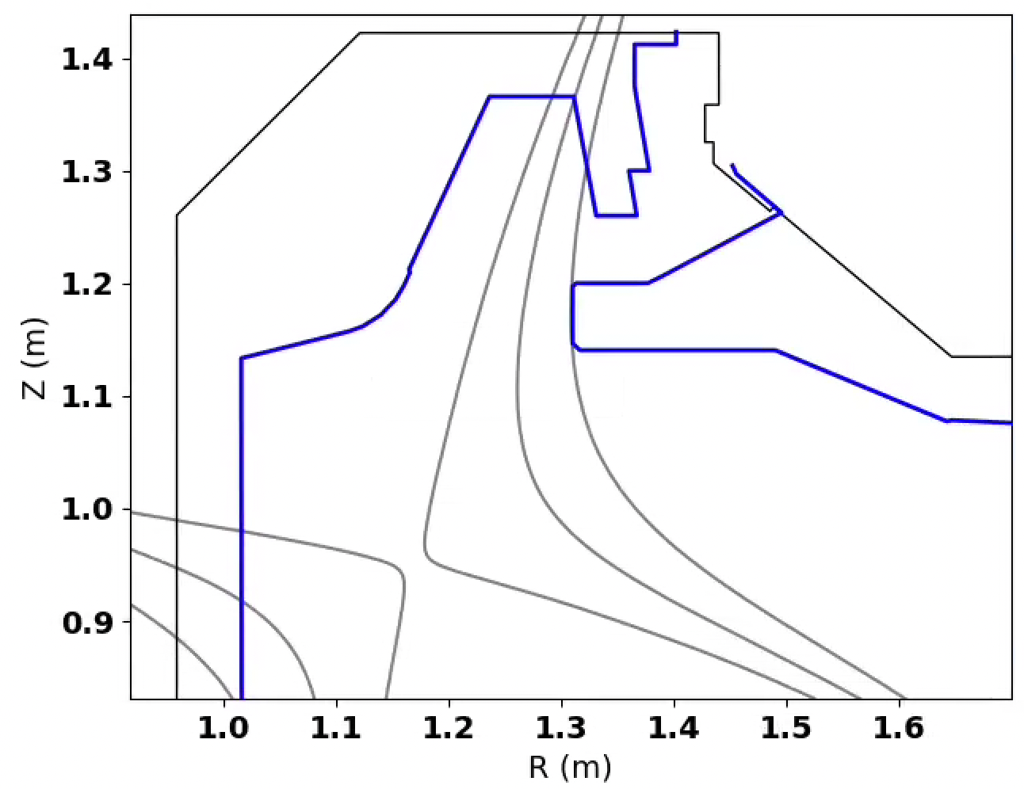
“Chimney” divertor is designed to pump part way up the divertor leg in attempt to stabilize the detachment front, reduce T_{e,targ} and q⟂ for a given core plasma
Maintain high neutral density near the divertor target surfaces
I_{P} = 1.8 MA
B_{T} = 2.1 T
q₉₅ = 3.3
𝛌_{q,Eich} = ~1.6 mm @ OMP
44 cm
16.8 cm
4 𝜆_{q}
9 𝜆_{q}

Slide 19
“Chimney” divertor is designed to pump part way up the divertor leg in attempt to stabilize the detachment front, reduce T_{e,targ} and q⟂ for a given core plasma
Maintain high neutral density near the divertor target surfaces
Minimize neutral particles escaping to the main chamber
Plasma exhaust influx helps to “plug” the slot by ionizing outgoing neutrals
Minimize charge exchange fluxes to main chamber surfaces
I_{P} = 1.8 MA
B_{T} = 2.1 T
q₉₅ = 3.3
𝛌_{q,Eich} = ~1.6 mm @ OMP
4 𝜆_{q}
9 𝜆_{q}

Slide 20
“Chimney” divertor is designed to pump part way up the divertor leg in attempt to stabilize the detachment front, reduce T_{e,targ} and q⟂ for a given core plasma
Maintain high neutral density near the divertor target surfaces
Minimize neutral particles escaping to the main chamber
Plasma exhaust influx helps to “plug” the slot by ionizing outgoing neutrals
Minimize charge exchange fluxes to main chamber surfaces
Experimental flexibility enables variation of X-point position
Scan outer leg length, flux acceptance into slot
I_{P} = 1.8 MA
B_{T} = 2.1 T
q₉₅ = 3.3
𝛌_{q,Eich} = ~1.6 mm @ OMP
X-point scans
4 𝜆_{q}
9 𝜆_{q}

Slide 21
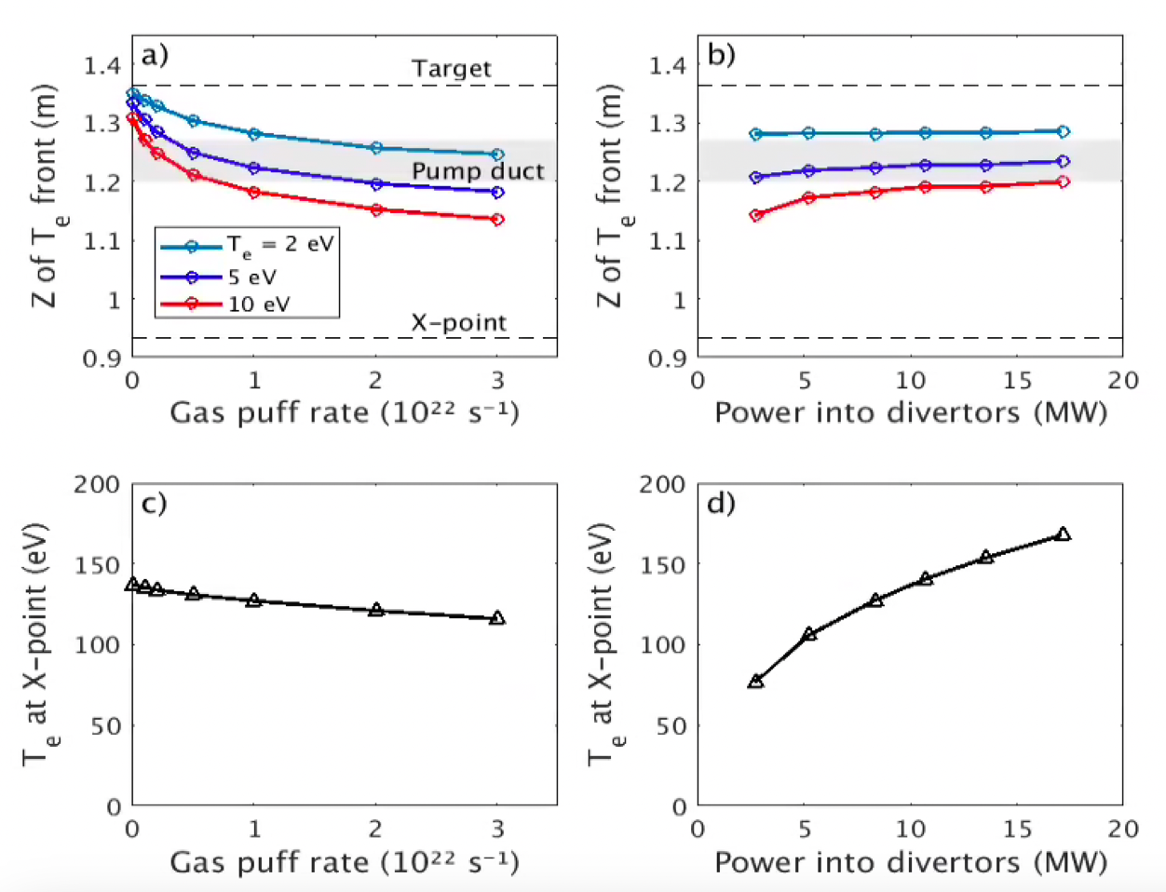
Despite strongly vertical leg, both UEDGE and SOLPS-ITER simulations predict a stable detachment front across wide range of power and particle injection
SOLPS-ITER
100
T_{e}
10
1
J. Yu et al., Nucl. Mat. Energy 41 (2024) 101826
UEDGE: A. Holm et al., Nucl. Mat. Energy 41 (2024) 101782

Slide 22
Despite strongly vertical leg, both UEDGE and SOLPS-ITER simulations predict a stable detachment front across wide range of power and particle injection
SOLPS-ITER
100
T_{e}
10
1
J. Yu et al., Nucl. Mat. Energy 41 (2024) 101826
UEDGE: A. Holm et al., Nucl. Mat. Energy 41 (2024) 101782

Slide 23
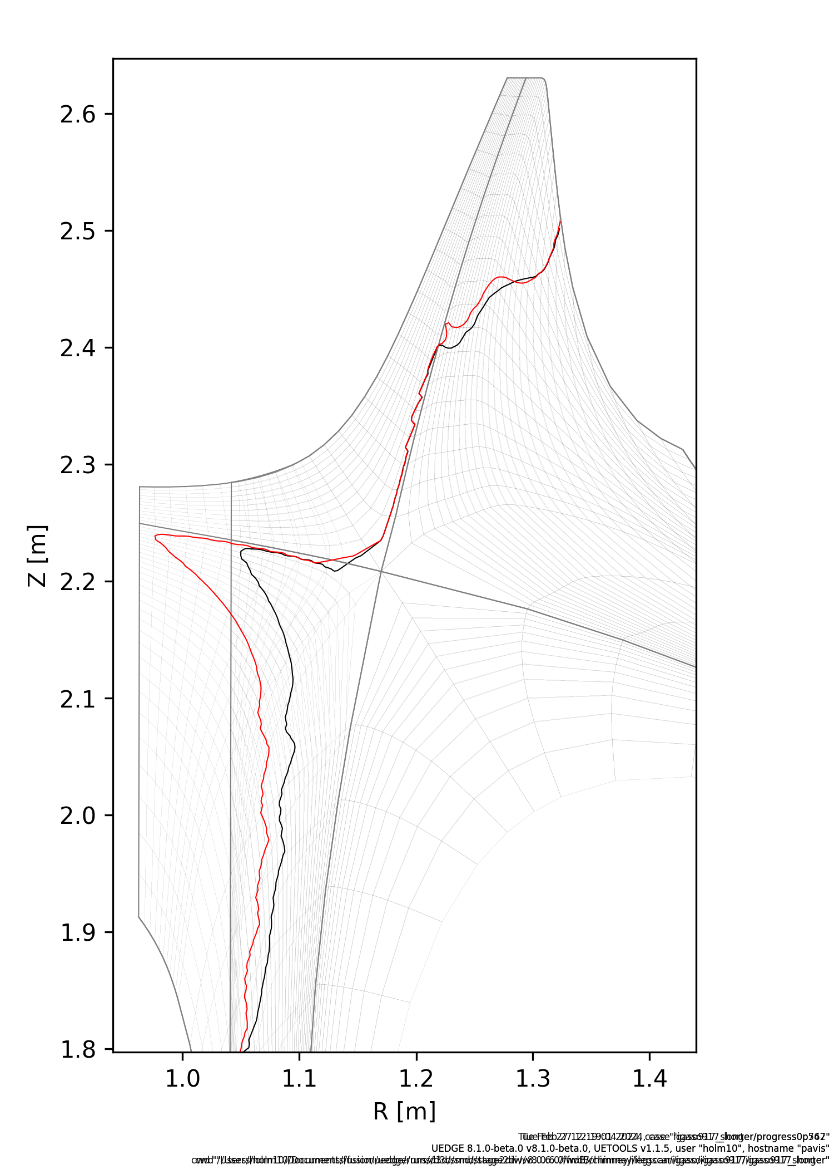
Modeling finds inner leg detachment front does not reach X-point for any experimental inputs using the range of inner leg lengths explored (> ~14.5 cm)
UEDGE
How long should inner leg be to minimize interference with study of outer leg detachment?
We don’t expect inner leg detachment front to reach the X-point for any inner leg length studied (> 14.5 cm)
10 eV contours
Inner leg = 22 cm
Inner leg = 15 cm

Slide 24
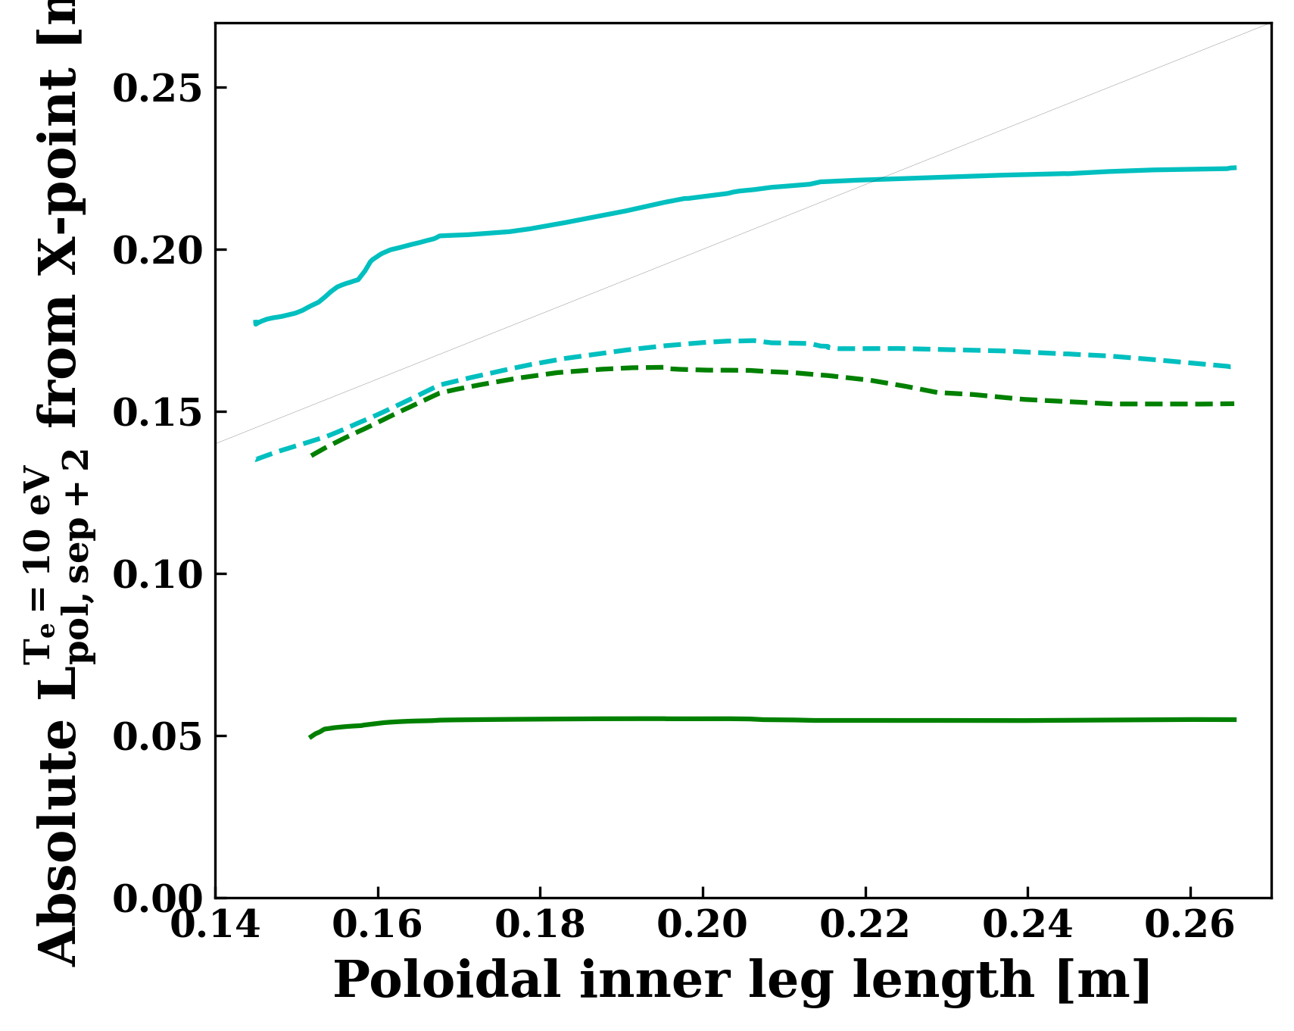
Modeling finds inner leg detachment front does not reach X-point for any experimental inputs using the range of inner leg lengths explored (> ~14.5 cm)
Outer Target
UEDGE
How long should inner leg be to minimize interference with study of outer leg detachment?
We don’t expect inner leg detachment front to reach the X-point for any inner leg length studied (> 14.5 cm)
Inner leg length has some small impact on outer leg detachment front position when it is <~17 cm, depending on particle throughput
L_{IL} = 16.8 cm design point should be ok
Particle throughput supersedes importance of inner leg length
Pumping x6
Pumping x0.1
–– LFS Leg
- - HFS Leg
X-point

Slide 25
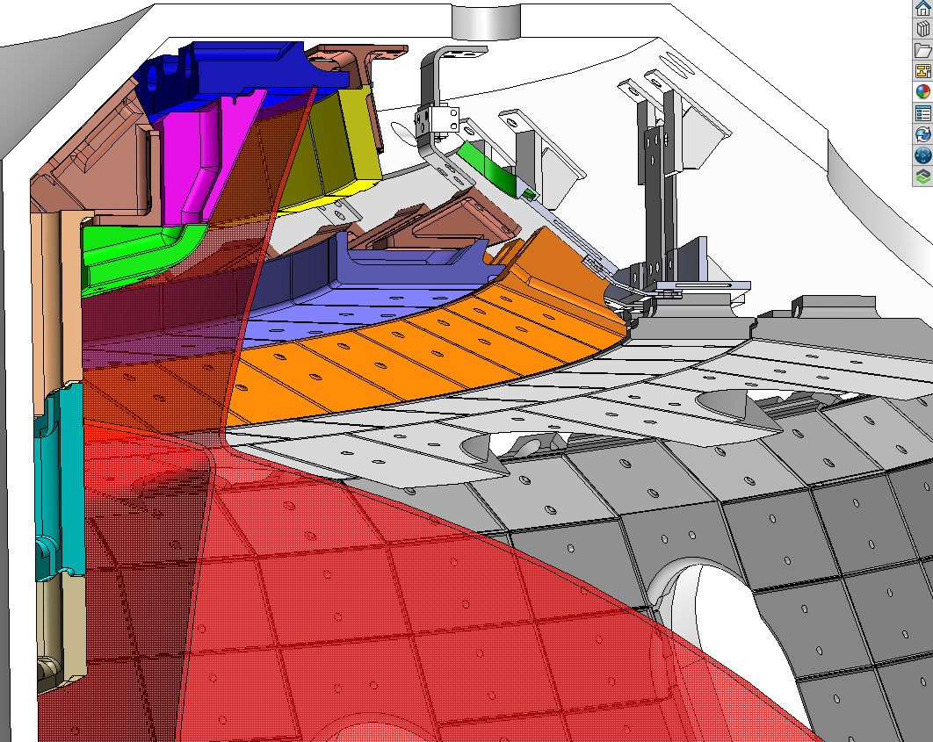
Relatively rapid, inexpensive iteration of divertor designs is made possible by custom-designed copper pedestals, mica baffling

Slide 26
Relatively rapid, inexpensive iteration of divertor designs is made possible by custom-designed copper pedestals, mica baffling
Tiles designed to maintain neutral gas pressure in key volumes

Slide 27
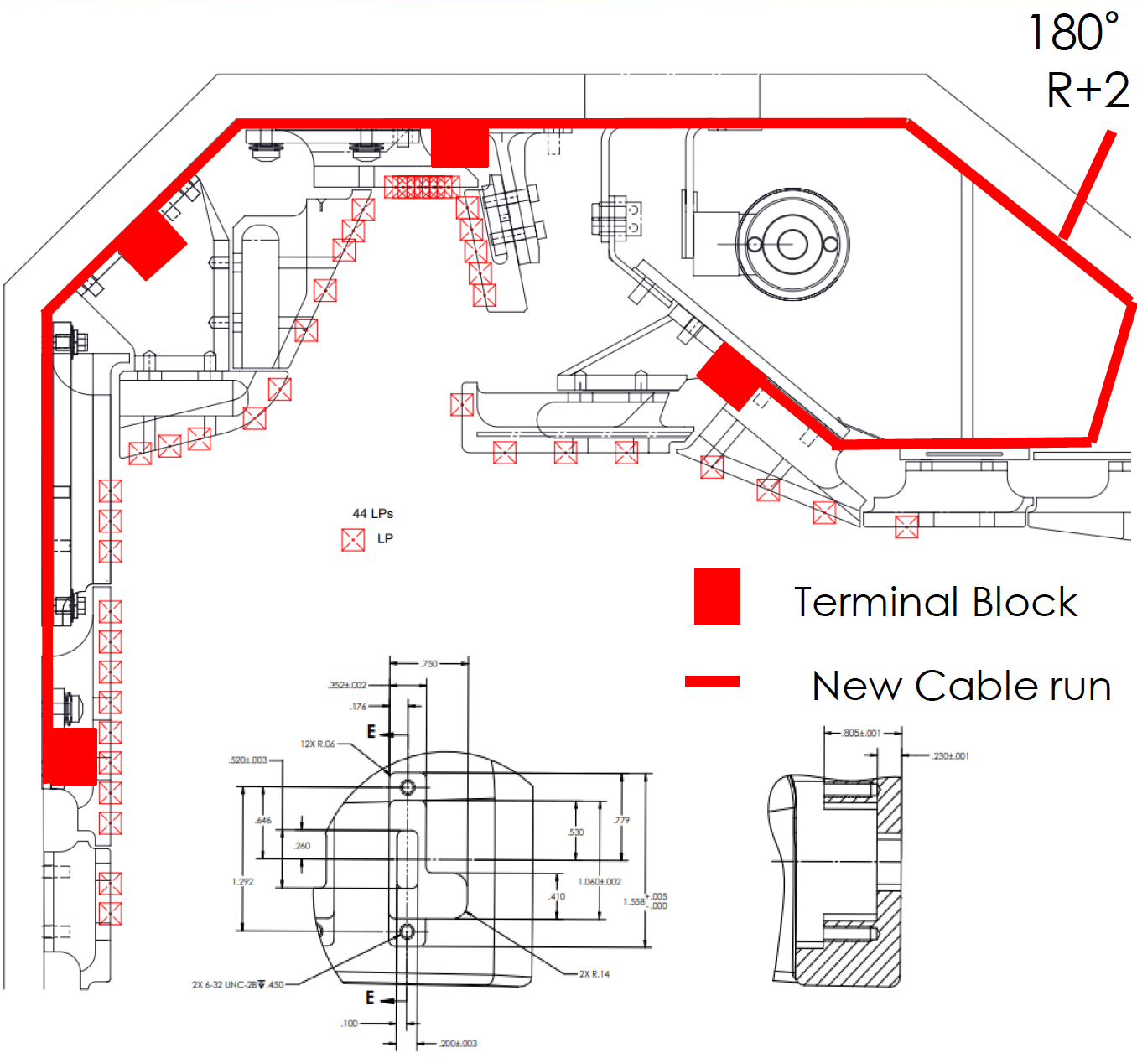
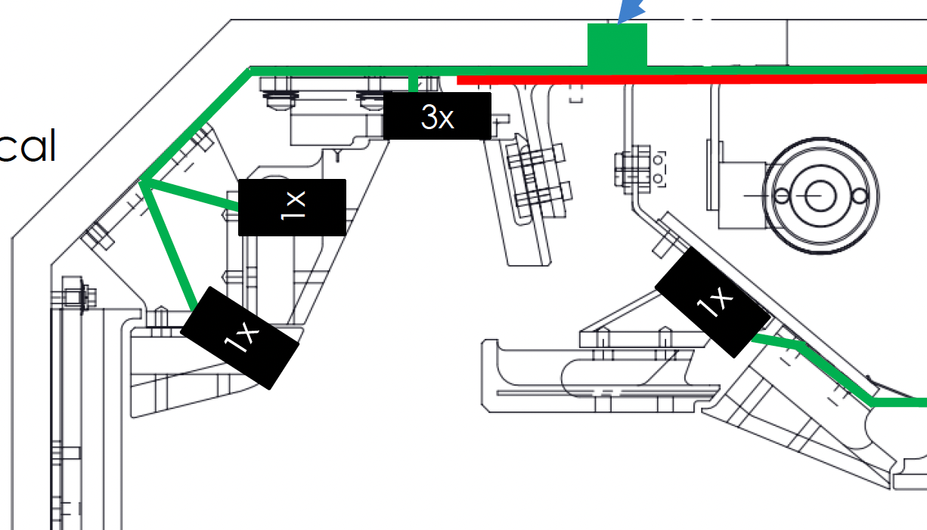
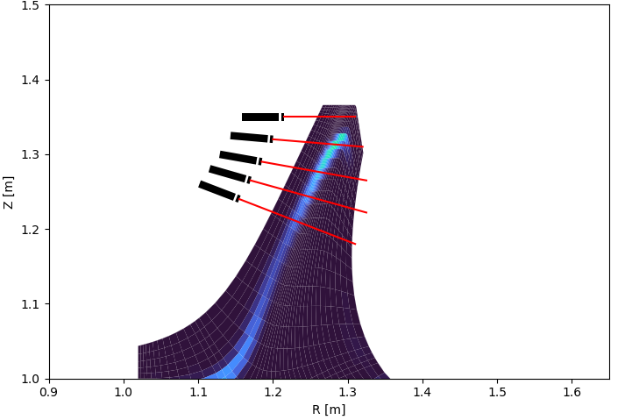
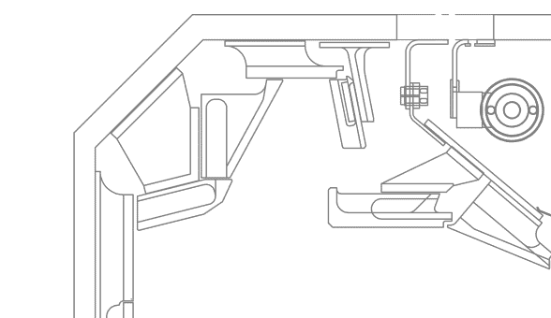
Extensive planned diagnostic suite would enable research to extrapolate physics to next-step devices
Thomson Scattering (T_{e}, n_{e})
Langmuir probes, surface eroding thermocouples
Neutral gas pressure gauges
In-tile spectroscopy (impurity radiation)

Slide 28
Summary and future work
A novel divertor design has been developed for DIII-D with the goal of achieving a robustly detached divertor target while maintaining a hot plasma core
Extensive boundary modeling informs the divertor design, suggests detachment access at lower n_{e,sep} and stability across a broad range of experimental inputs
Pumping part way up the divertor leg could be applied to a range of plasma shapes, potentially reducing the required volume allocated to the divertor
Model validation is critical for projecting results to future divertor designs
Installation scheduled for summer & fall 2026 for experiments in 2027
Experiments would measure divertor conditions and core confinement as magnetic geometry, power and particle inputs are all scanned
Planning now for future installation of reactor-relevant divertor material(s)
Likely (but not necessarily) W-coated graphite

Slide 29
Backup slides

Slide 30
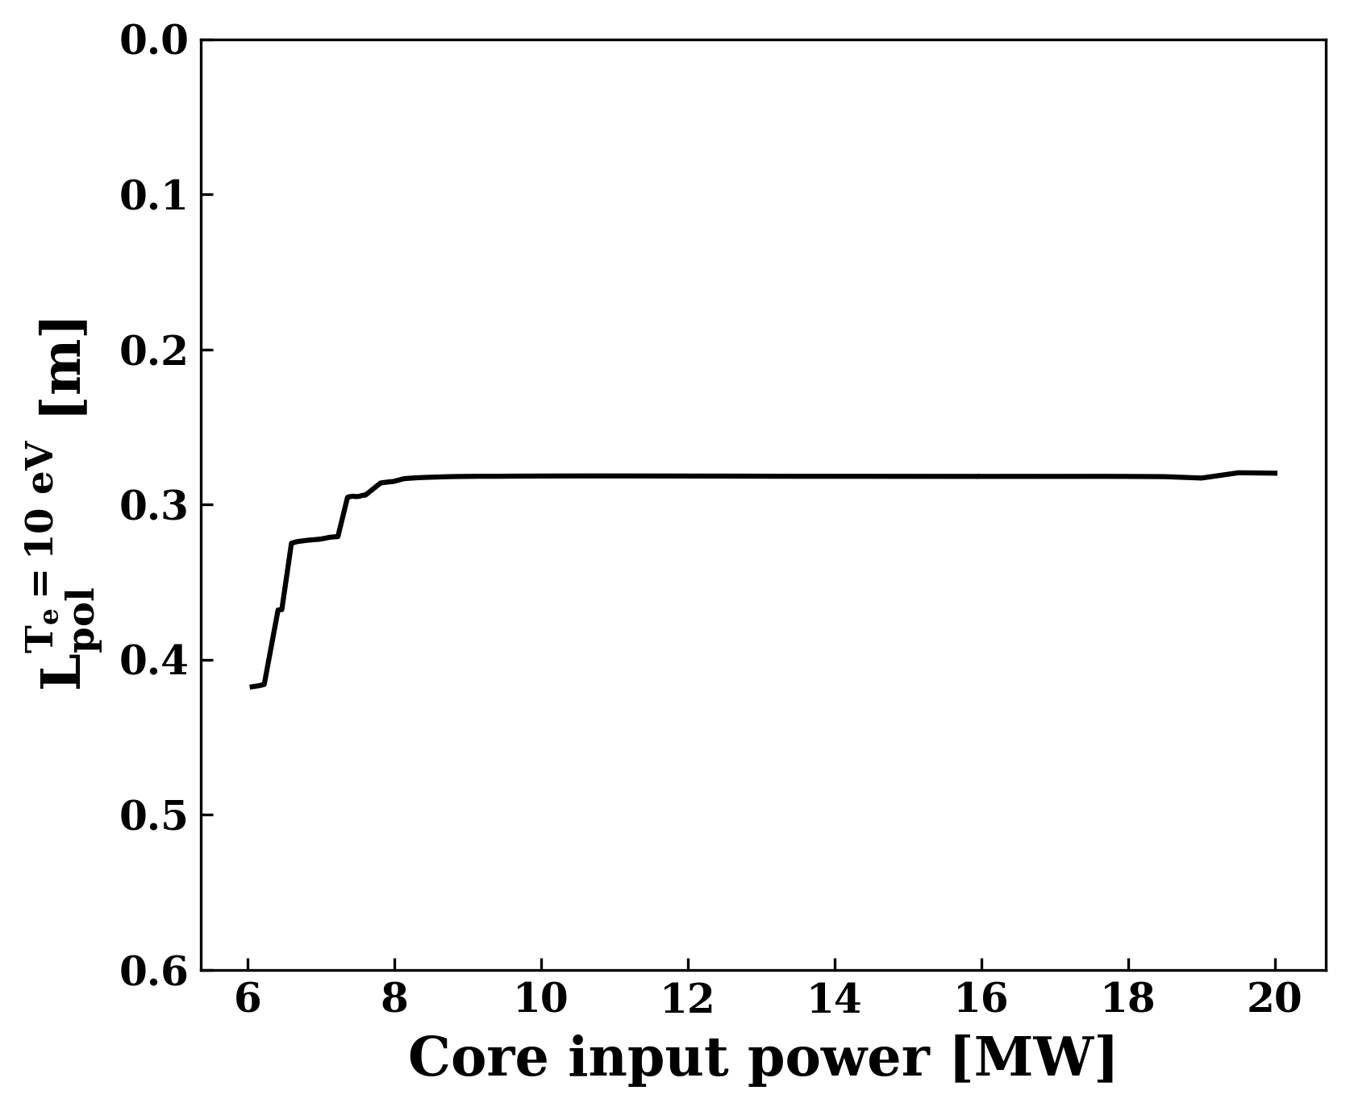
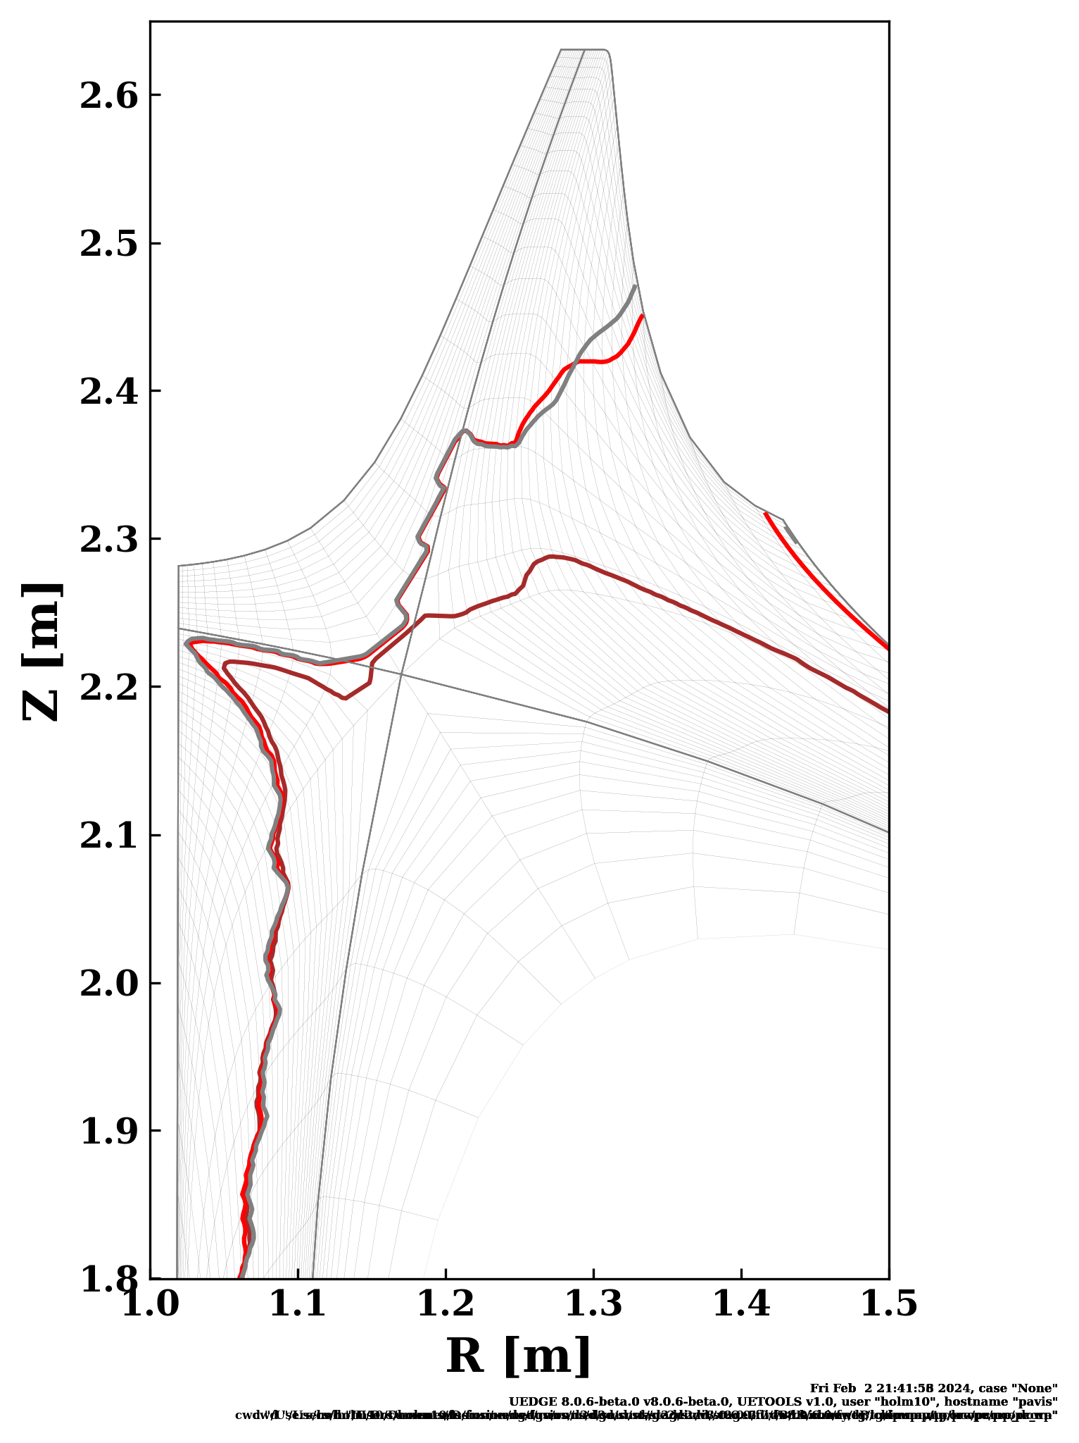




Fluid boundary plasma and neutral modeling with UEDGE finds a stable detachment front without active control using upstream pumping
Outer Target
UEDGE
$T_{e}=10 eV$
contours
$$18.5 MW$$
$$12.5 MW$$
$$6.2 MW$$
X-point
A. Holm et al., Nucl. Mat. Energy 41 (2024) 101782
A. Holm (PSI 2024)

Slide 31
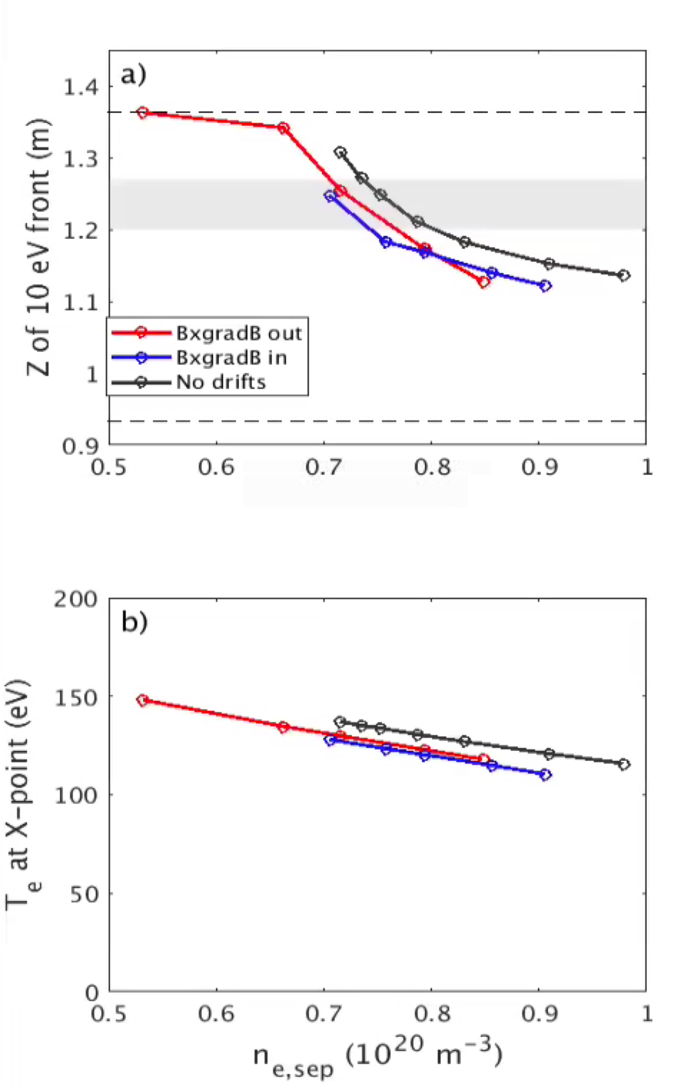
Adding cross-field drift effects to a subset of SOLPS simulations did not significantly modify the qualitative relationships
SOLPS-ITER

Slide 32
Tiles designed to minimize line-of-sight between targets and copper, eliminate leading edges from bolt holes near strike points
Shiplapping tiles minimizes line-of-sight between plasma and copper, particularly near targets
Energetic neutrals can sputter copper, contaminate plasma
Bolt holes avoided near priority strike point positions
Leading edges from large incident field line angles cause hot spots, excessive material erosion
No bolt holes near strike points

Slide 33
Tile design incorporates thin, pliable mica sheets to maintain gas pressure and prevent undesirable leakage in key areas
Maintaining high neutral pressure in the slot is critical to the design
Budget and time constraints preclude new steel structures
Mica sheets will be inserted between tiles to minimize gas pressure loss
Tile-to-tile gaps are calculated to result in unacceptable leakage rates
Vacuum “caulk” would be ideal, but pliable ceramic sheets should sufficiently reduce leakage at each tile interface
Mica (red)
Minimize gas pressure loss between tiles in divertor slot

Slide 34
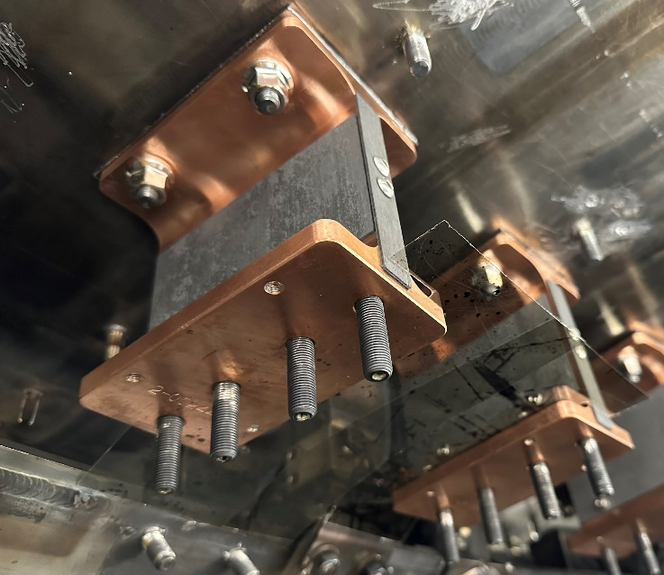
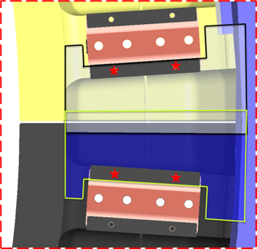
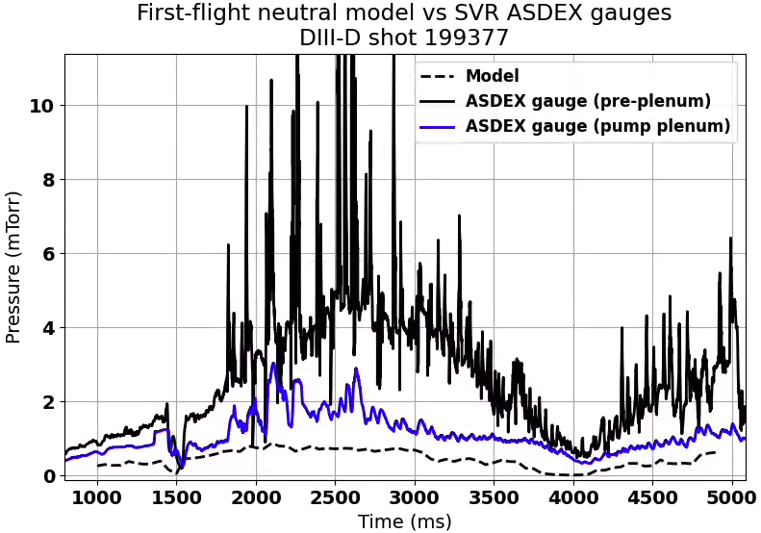
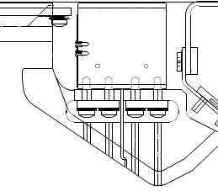
Mica baffling has been demonstrated to be sufficient to hold gas pressure in presently-installed DIII-D SVR divertor
Nose Tile
Mica Gas Baffle
CFC

Slide 35
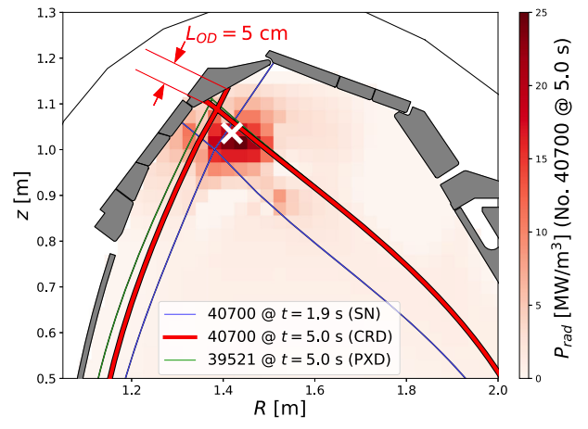
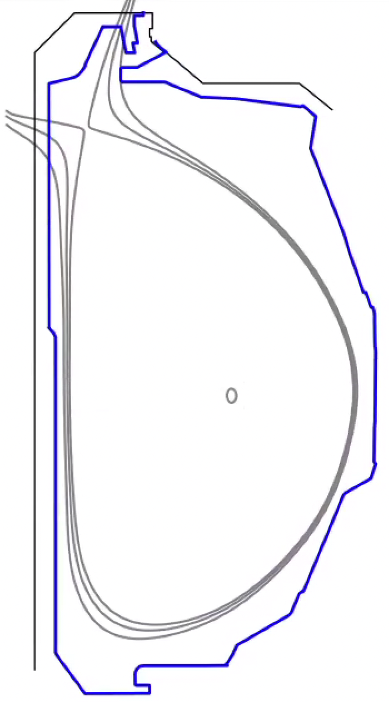
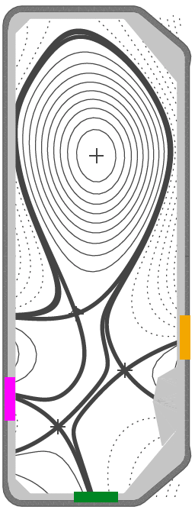
This long-legged, conventional divertor would complement other approaches to detachment in the international tokamak community
Can we achieve a stable detachment front between the target and the X-point using a conventional magnetic geometry?
Ideally fully detached (T_{e} < ~1 eV at the wall) with a “hot” core (T_{e,sep} >= ~60 eV)
“Conventional”: no secondary X-points and no poloidal field coils inside the blanket envelope
Mid-leg pumping geometry would be a unique capability
TCV
(Switzerland)
MAST-U
(UK)
DIII-D Chimney
AUG CRD/XPR
(Germany)
T. Lunt et al., Phys. Rev. Lett. 130 (2023) 145102
K. Verhaegh et al., Nucl. Fusion 63 (2023) 016014
S. Gorno et al., Phys. Plasmas 31 (2024) 072504

Slide 36
Divertor is designed for experimental flexibility to perform strike point sweeps and X-point height scans up to I_{P}=1.8 MA with DIII-D coil set (𝛌_{q} = ~1.6 mm)
I_{P} = 1.8 MA
B_{T} = 2.1 T
q₉₅ = 3.3
𝛌_{q} = ~1.6 mm at OMP
Shape flexibility
44 cm
16.8 cm
4 𝜆_{q}
9 𝜆_{q}

Slide 37
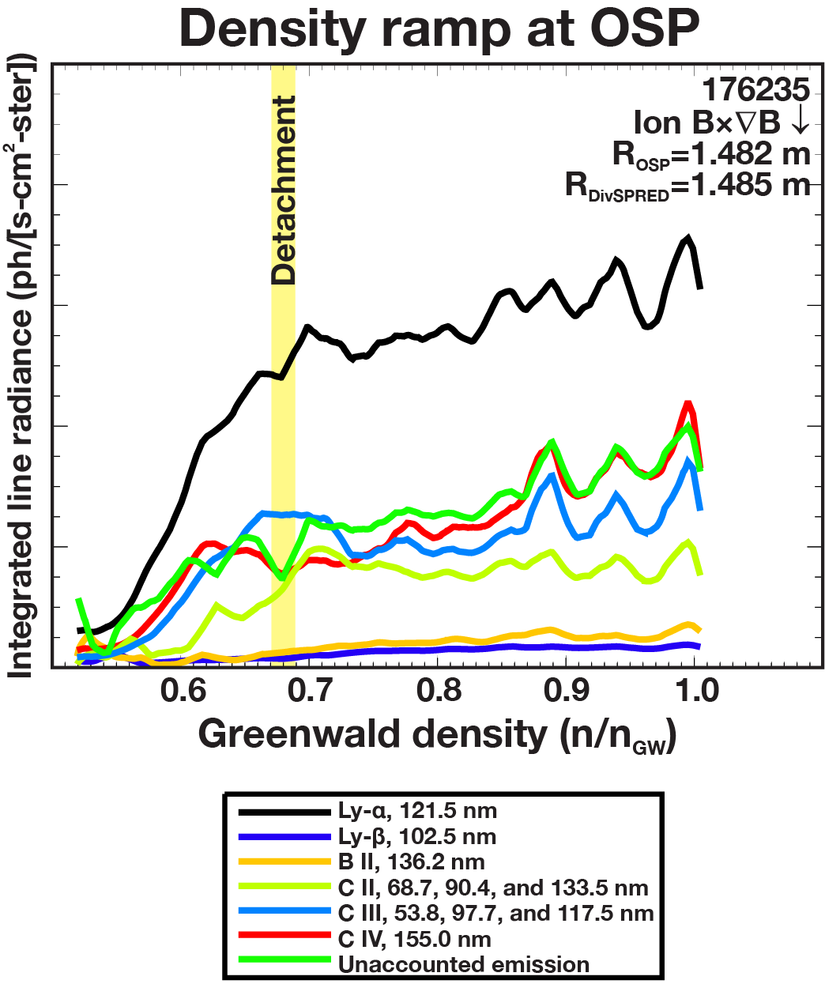
Changing the target material from graphite may modify integrated divertor physics in critical ways
DIII-D first wall is all made of graphite, including proposed divertor tiles
Carbon retains D fuel particles, modifies recycling dynamics
Carbon self-regulates by eroding at high T_{e}, cooling the plasma to prevent further erosion
Control of detachment front with metal target may be less stable without self-regulating C
Should be less important if target is consistently detached
Carbon radiation increases
up to detachment, then saturates
Ly-⍺
CIV
CIII
CII
Normalized density
A.G. McLean PSI 2021

Slide 38
Next step: Incorporate reactor-relevant materials
What material(s) should we test? Where?
Baseline concept is W-coated graphite at the outer target, but we want more ideas
If experiments confirm predictions from modeling, this divertor geometry could ease material requirements
Reduced material sputtering, peak heat flux for a given plasma core
Easier detachment control
Goal: demonstrate good core confinement with a reactor-relevant plasma-facing material
???

Slide 39
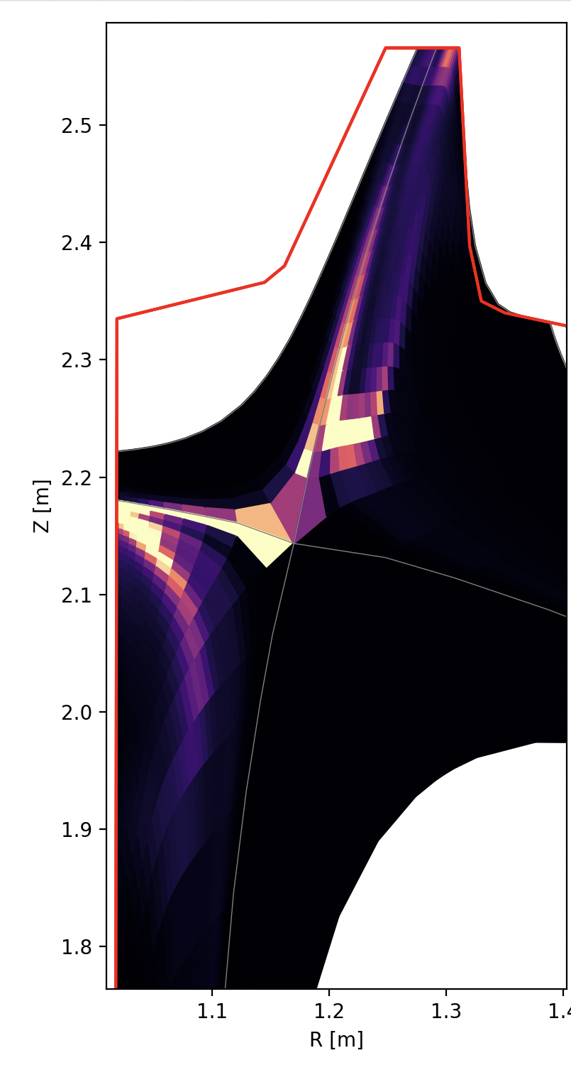
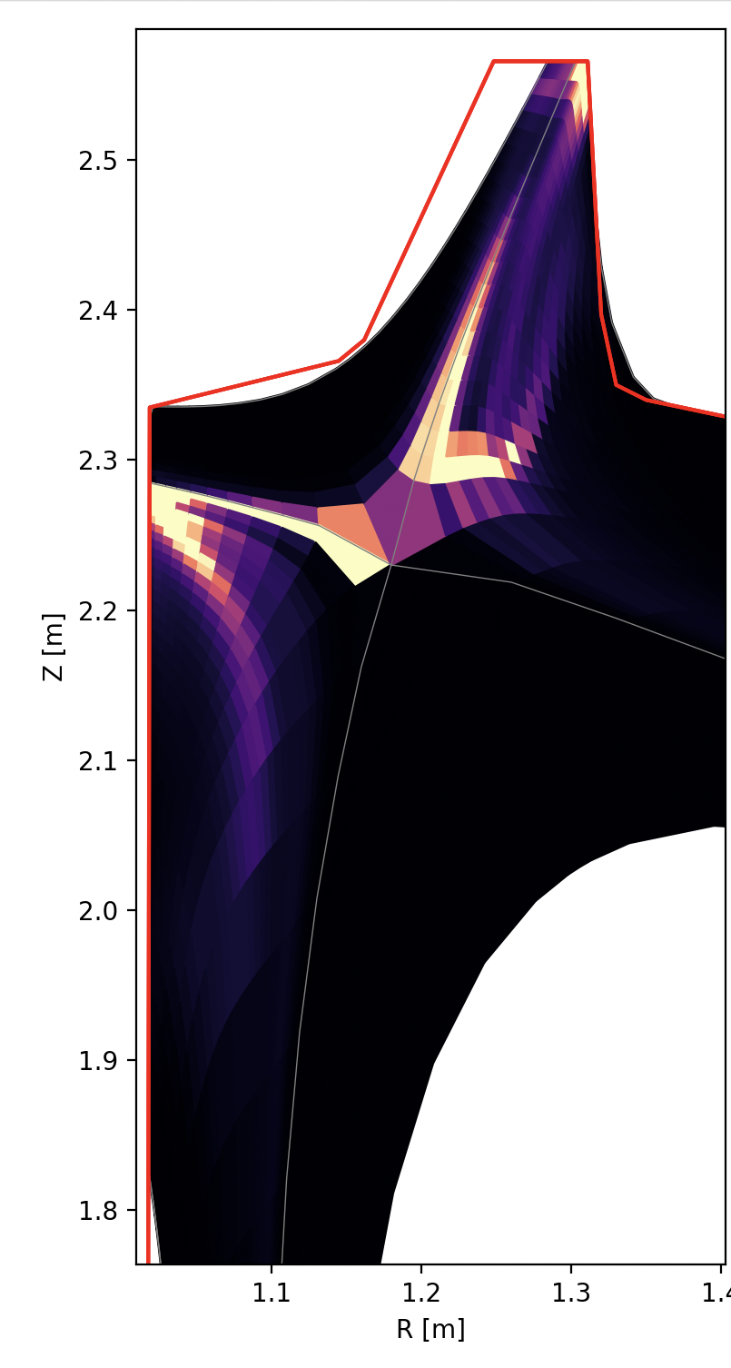
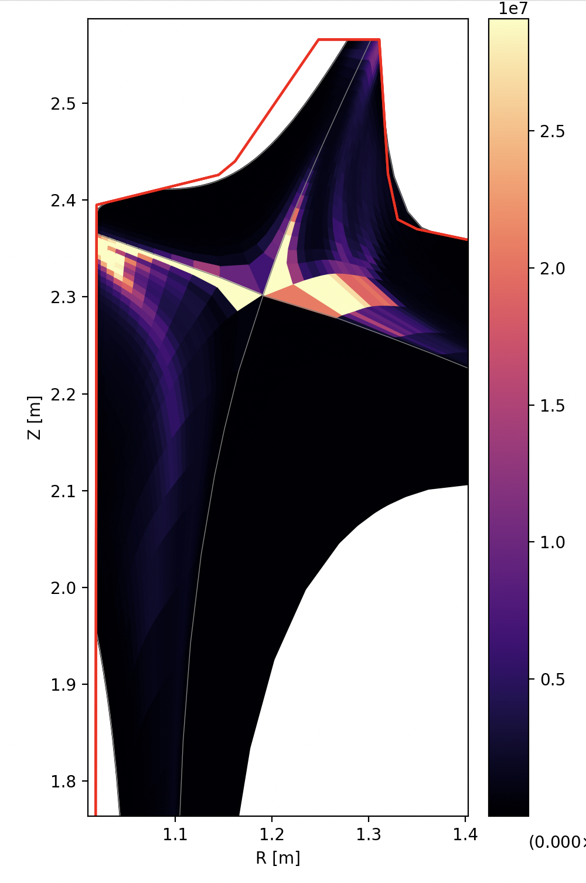
UEDGE X-point height scan shows position of radiation front on outer leg is tied to physical structures and pump more than X-point
Total radiated power (D+C, W/m³)

Slide 40
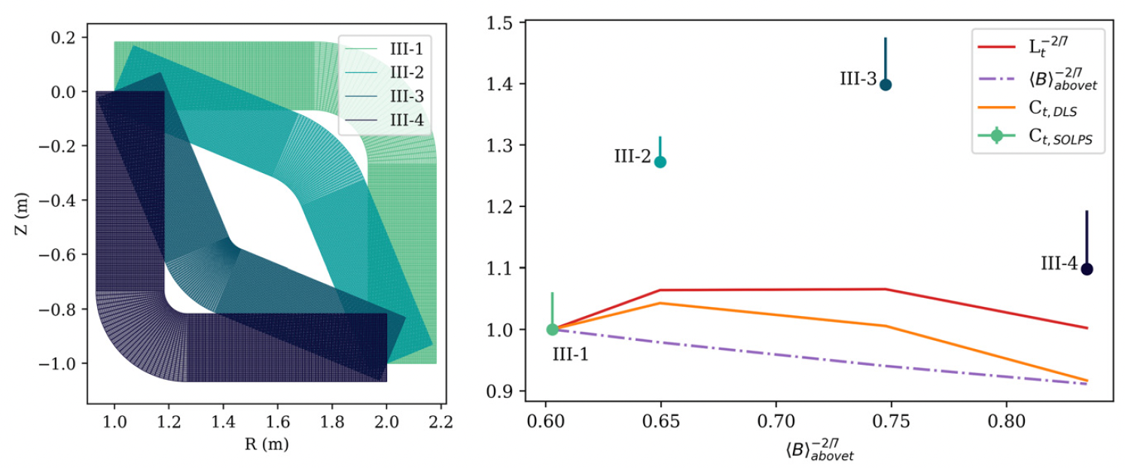
Magnetic geometry can improve access and stability of detachment, but this can be constraining for reactor design
Normalized Detachment Threshold
(Fraction of the exhaust flux tube in the divertor)
C. Cowley et al., Nucl. Fusion 62 (2022) 086046
B. Lipschultz et al., Nucl. Fusion 56 (2016) 056007

Slide 41
Installation will test whether some core-edge integration challenges for a reactor can be addressed with advanced divertor design
Can pumping part way up the divertor leg prevent the cold detachment front from migrating to the core plasma?
Are q⟂ and T_{e,targ} reduced for a given plasma core?
Does this enable a divertor design that requires less volume / fewer coils in a reactor?
Does it reduce the quantity of radiating impurities that need to be injected to prevent damage or high-Z impurity influx from divertor materials?
How does chimney divertor performance change with geometric parameters?
How long does the divertor leg need to be (scan Z_{Xpt})?
How wide does the slot need to be to keep neutrals contained (scan R_{Xpt})?
Where do computational models need improvement?
Many details that may become important in dissipative conditions
Lyman opacity, atomic physics, time-dependent dynamics, cross-field transport, …

Slide 42
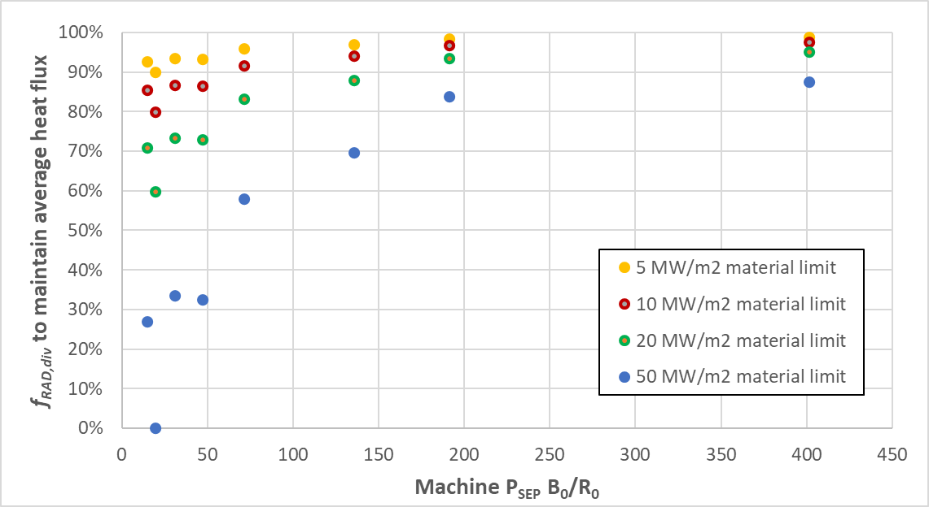
Even for very resilient materials, for stationary pulses, a large fraction of plasma exhaust energy must be radiated away to prevent damage
~ARC³
~SPARC²
ITER¹
Present assumptions
¹K. Krieger et al., Nucl. Fusion 65 (2025) 043001
²A.J. Creely et al., J. Plasma Phys. 86 (2020) 865860502
³B.N. Sorbom et al., Fusion Eng. & Design 100 (2015) 378
courtesy of A.G. McLean

Slide 43
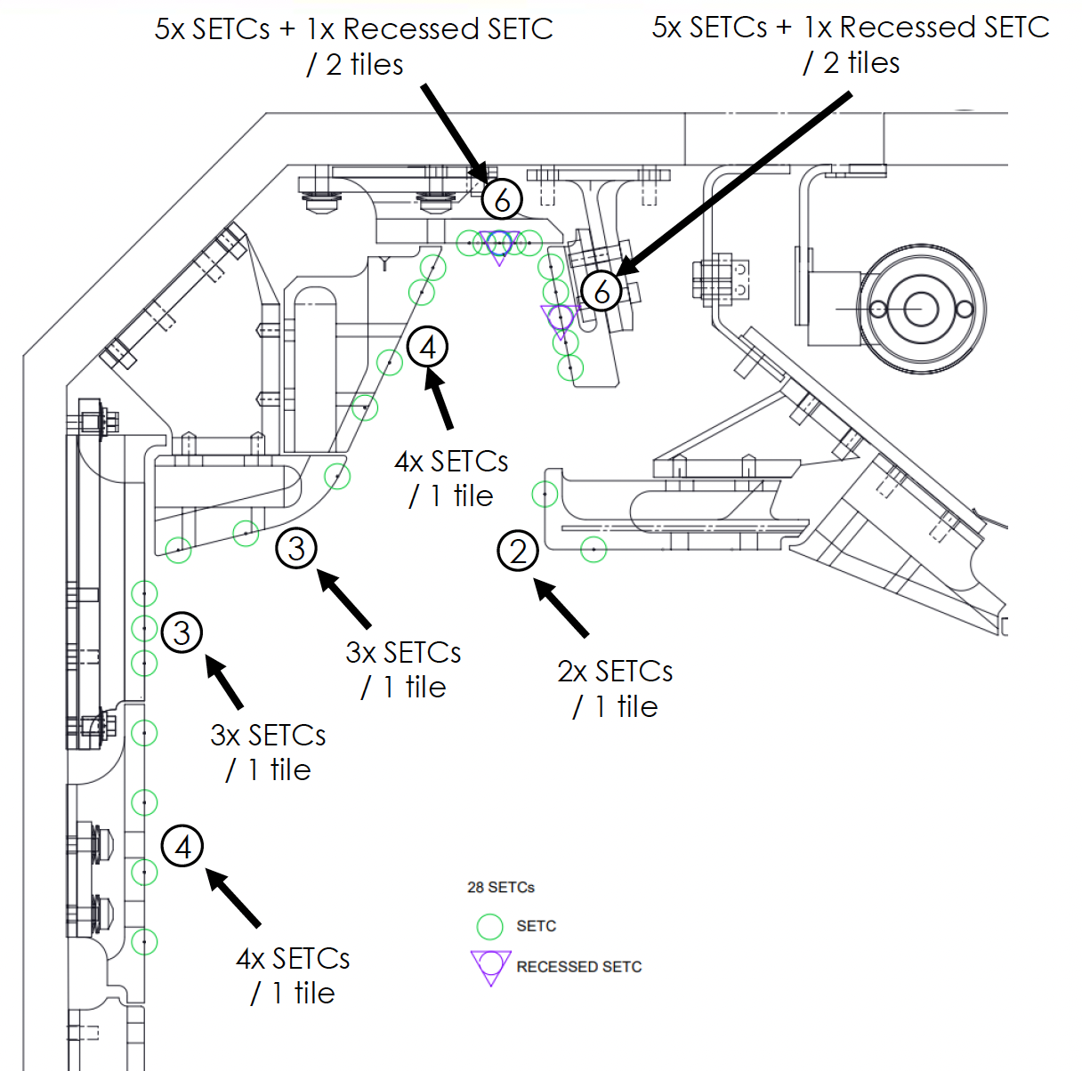
Comprehensive set of Langmuir probes and SETCs are planned

Slide 44
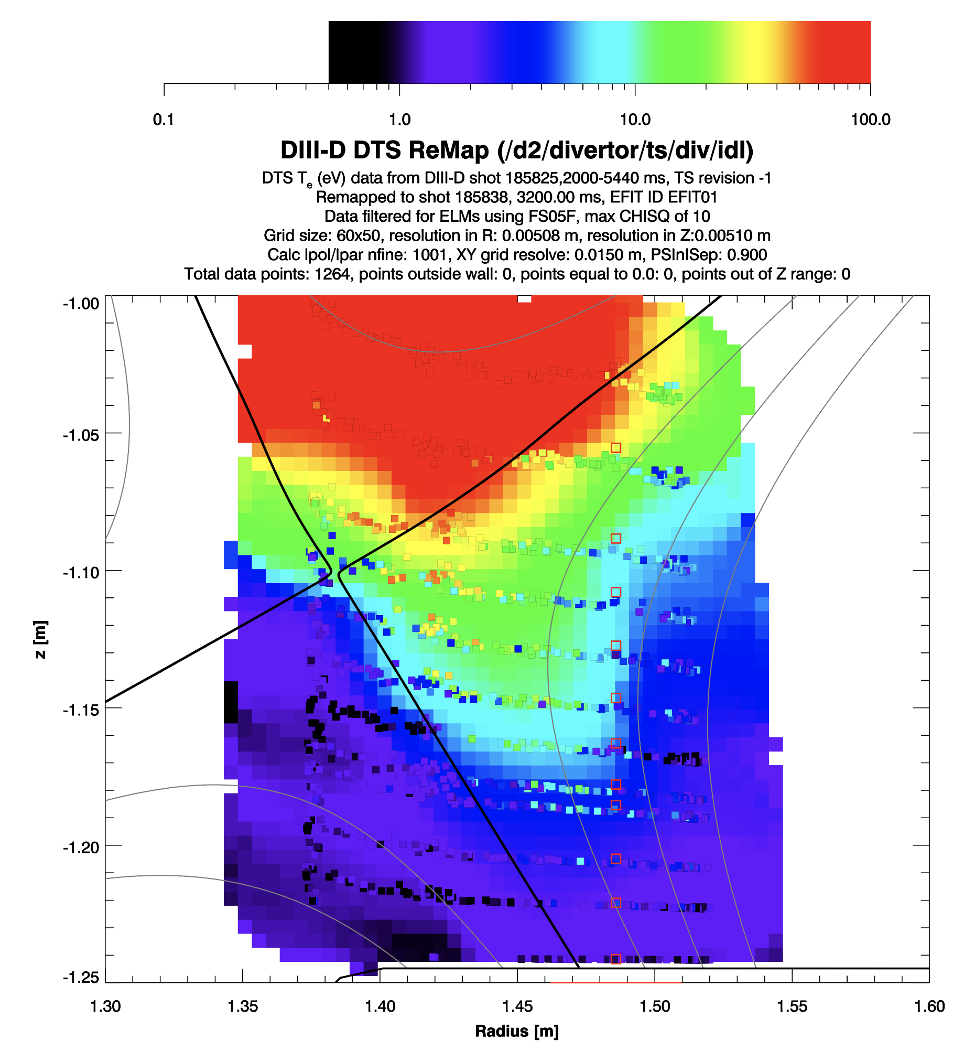
Necessary outer leg length (40-50 cm) determined based on poloidal T_{e} gradient measured with divertor Thomson scattering in open divertor configuration
Stable detachment front for 9 MW plasma with N seeding
This is a challenge to keep stable
∇_{pol}(T_{e}) ≈ 200 eV / m
If we want ~1 eV at the target and ~80-100 eV at the separatrix
→ ~40-50 cm divertor leg
Measurement was with an open, unbaffled divertor
Might expect neutral baffling to be able to increase this gradient, but we want to make sure the long leg is achievable
[A.G. McLean]

Slide 45
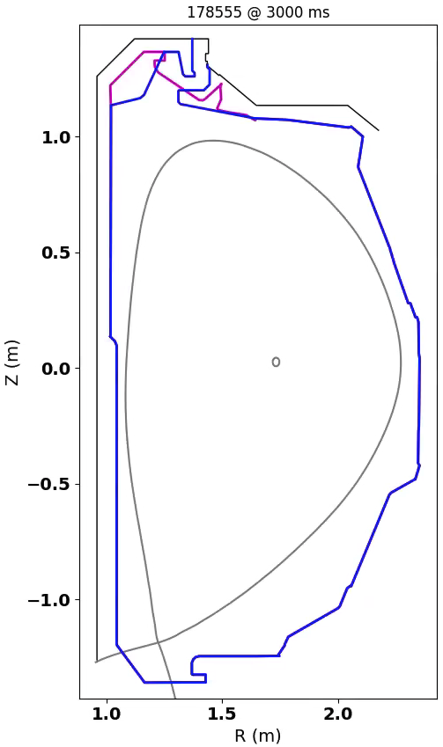
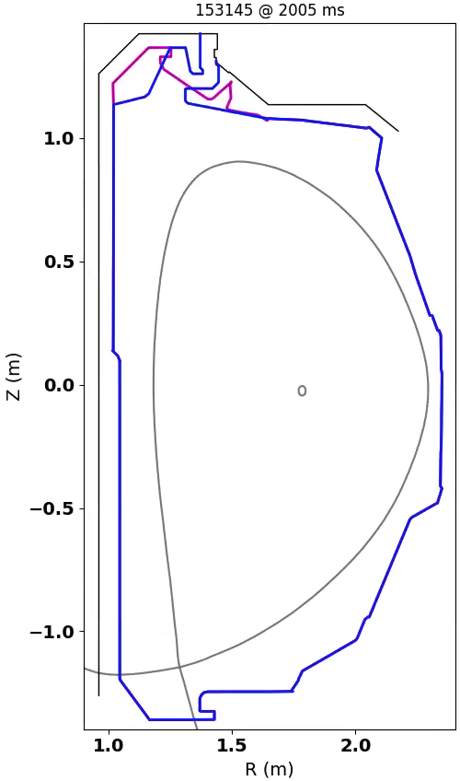
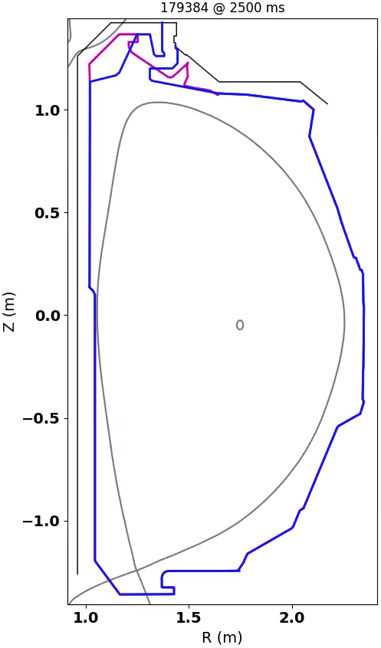
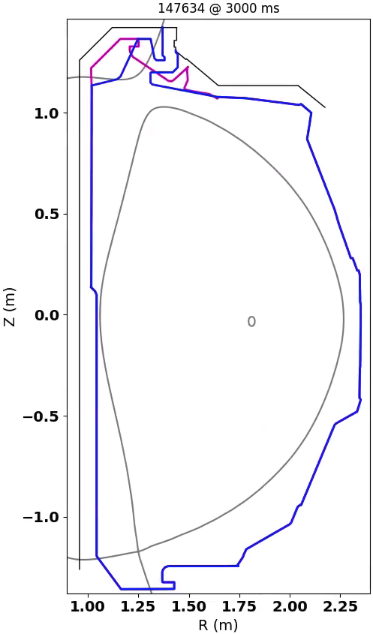
New upper divertor structures should not be a significant constraint on standard LSN plasma shapes, even those approaching DN
ISS
IBS
Super-H
AT

Slide 46
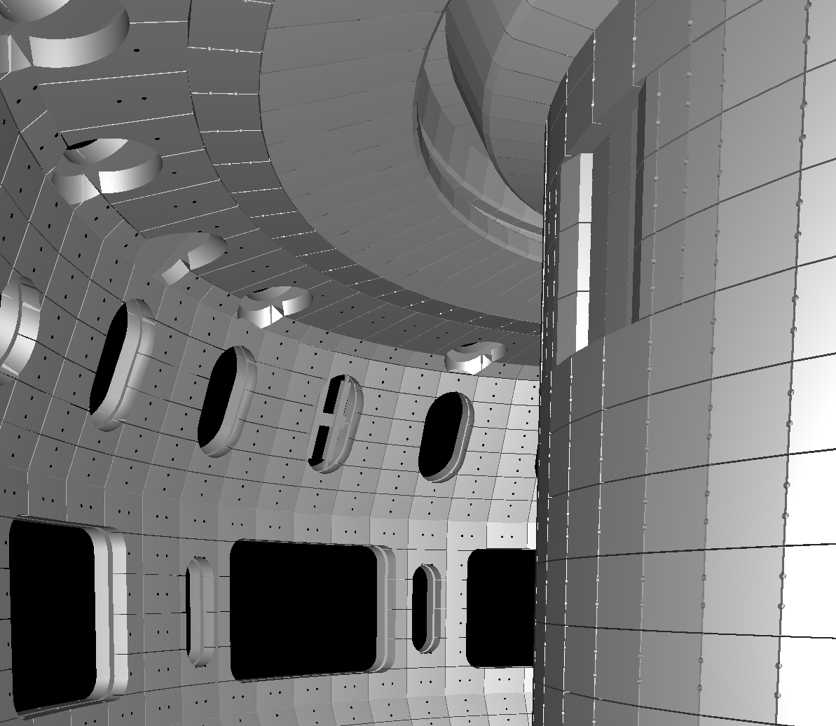
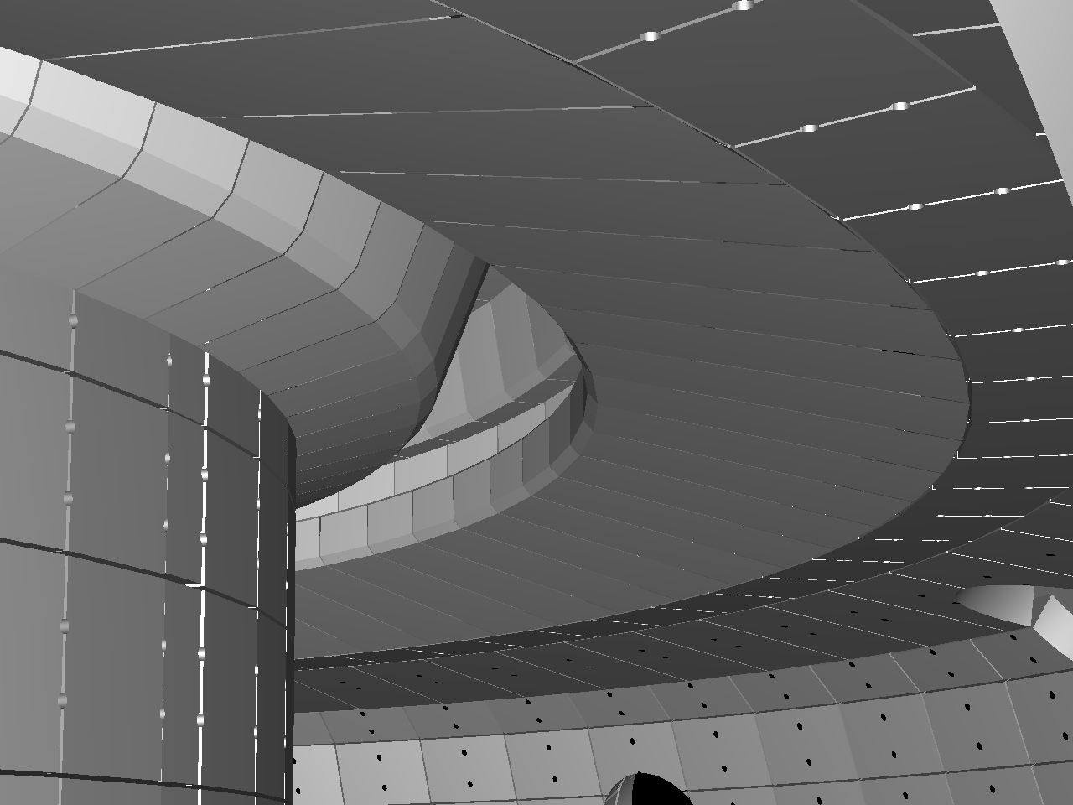
Tangential cameras have view access to most of the divertor volume for monitoring heat flux and impurity line radiation
TangTV (R+1)
Impurity radiation
IR Periscope (R0)
Heat flux
Diagnostic camera views with proposed divertor tile structures
Bill Meyer, LLNL

Slide 47
Divertor diagnostic needs are based on 2D evaluation of radiative dissipation
Essential
Langmuir probes
Single TS laser path with multiple vertical positions
SETCs
ASDEX gauges^
Magnetics ^
2D Bolometry
Infrared*
TanTV*
CIS/flows*
In-tile spectroscopy
MDS, FS, broadband UV/VIS/NIR
Gas lines^
Important
In-slot views of the single TS laser path
Penning gauges
In-tile thermocouples
Volumetric neutral density
Additional gas lines
Desired
Ion temperature
EUV/VUV spectroscopy
* = Acceptable as-is
^ = Move existing
The rest require significant development
Focus on particle AND radiative fluxes
In 2D for spatial identification of radiation

Slide 48
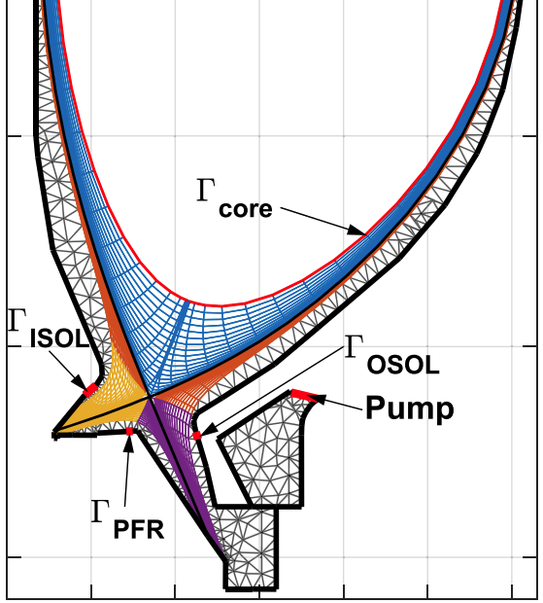
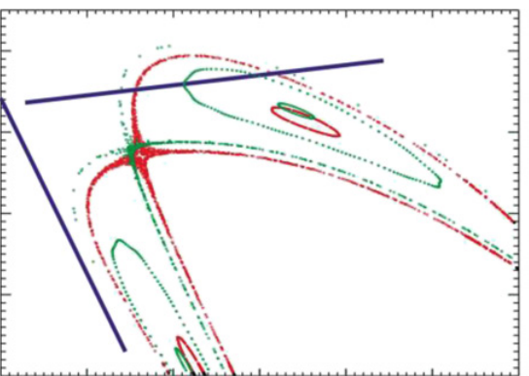
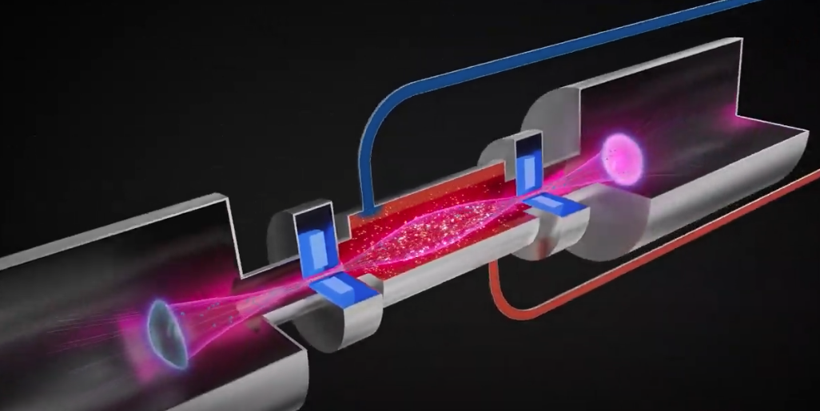
If model predictions are validated experimentally, “upstream pumping” concept could be beneficial to other magnetic confinement designs
SPARC (CFS)
W7-X
?
A. Kuang et al., J. Plasma Phys. 86 (2020) 865860505
Y. Feng et al., Nucl. Fusion 61 (2021) 086012
J.D. Lore et al., Nucl. Fusion 64 (2024) 126054
Mirror (Realta)
Add baffling to maximize neutral density near target?
?
Realta Fusion YouTube channel

Slide 49
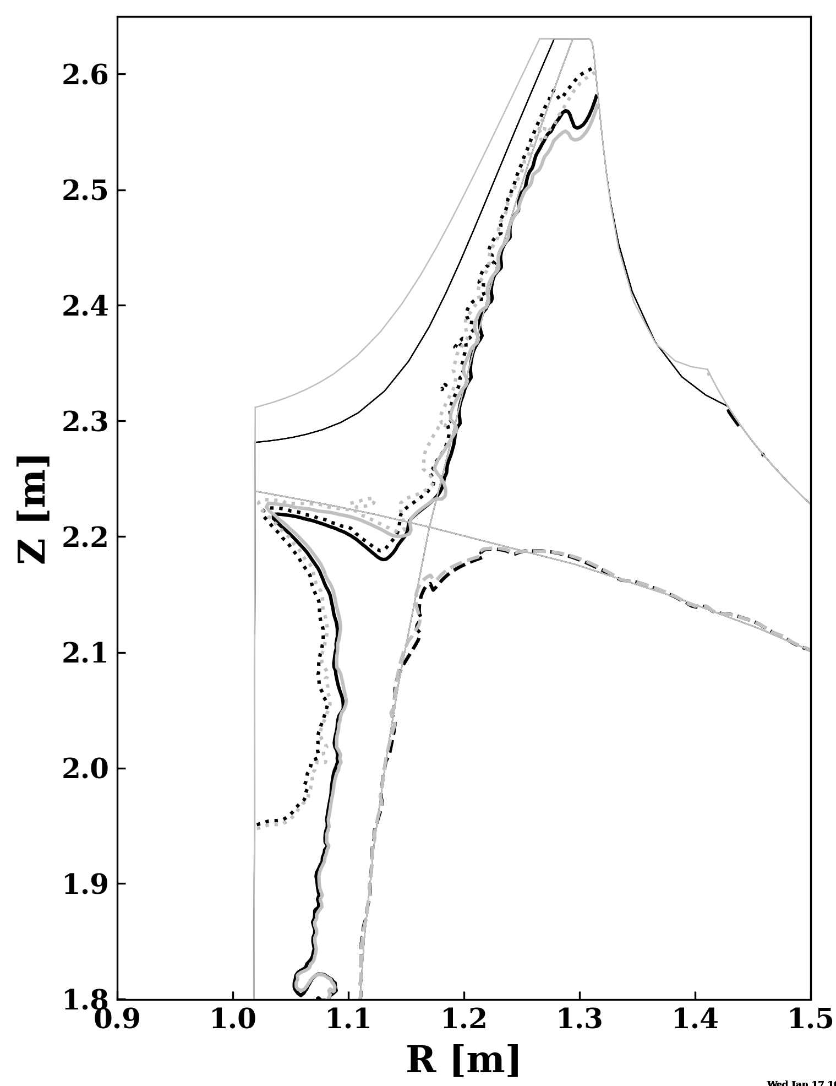
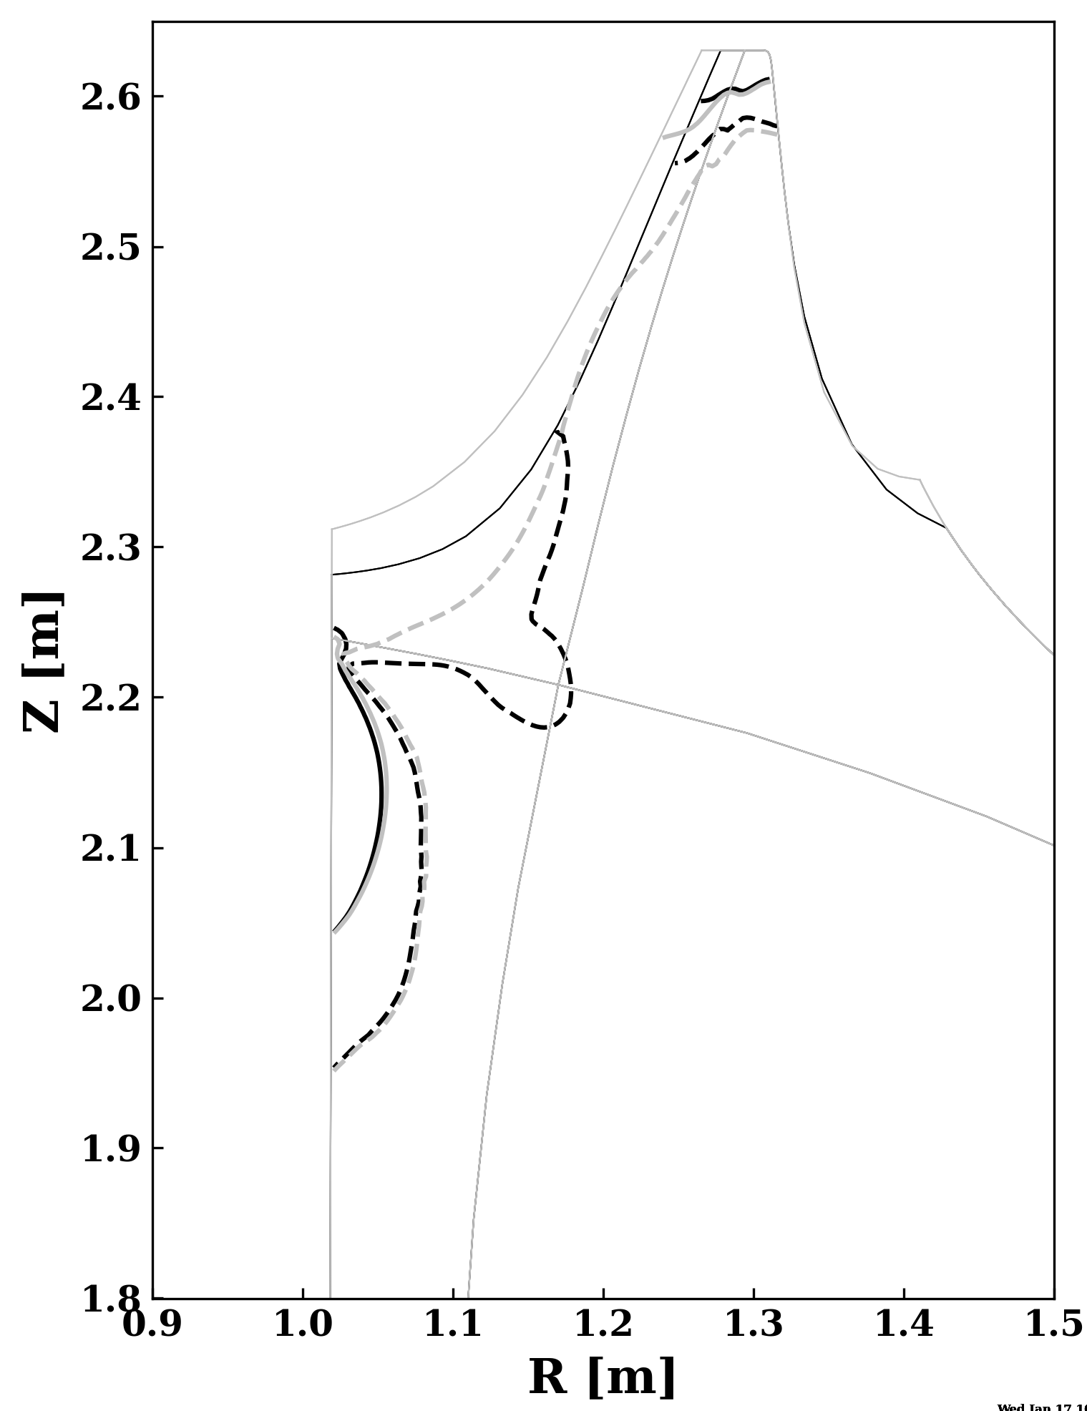

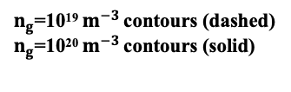
Having PFR baffling too close to the inner leg can allow neutrals to go through the plasma to get to the pump
Reducing inner wall baffling provides a more-direct path for particles to flow from inner target to the pump without going through the core
$T_{e}$=3 $eV$ contours (dashed)
$T_{e}$=10 $eV$ contours (solid)
$n_{g}$=10¹⁹ $m^{−3}$ contours (dashed)
$n_{g}$=10²⁰ $m^{−3}$ contours (solid)
UEDGE
B⨯∇B

Slide 50

Sufficient clearance of upstream plasma to walls ensures that most recombination and plasma-wall interaction will happen in the divertor
[R. Perillo et al., NF 2023]
To minimize ELM particle fluxes that intercepted upstream, request clearance for ~2.5 cm of outboard midplane flux
Good to have some outer gap to accommodate fast particle orbits as well
Somewhat conservatively accounts for worst case scenario
[W. Choi (Toksys)]

Slide 51

12.5 MW, Dpuff = 1.0 E22 s⁻¹, Cpuff = 0.15 E22 s⁻¹
SOLPS-ITER

Slide 52

12.5 MW, Dpuff = 2.0 E22 s⁻¹, Cpuff = 0
SOLPS-ITER

Slide 53

20 MW, Dpuff = 1.0 E22 s⁻¹, Cpuff = 0
SOLPS-ITER

Slide 54

20 MW, Dpuff = 1.0 E22 s⁻¹, Cpuff = 0.15 E22 s⁻¹
SOLPS-ITER

Slide 55

20 MW, Dpuff = 2.0 E22 s⁻¹, Cpuff = 0
SOLPS-ITER

