Slide 1





Comparative Overview of Divertor Cassette Design and Integration in EU-DEMO, VNS and DTT
Fifth Technical Meeting on Divertor Concepts
IAEA Headquarters Vienna, 28-31 October 2025
D. Marzullo, C. Bachmann, J. Boscary, D. Caprini, A. Clagnan, C. Gliss, V. Imbriani, N. Massanova, G. Mazzone, I. Moscato, R. Neu, A. Quartararo, S. Roccella, D. Valente, P. Vinoni, J.H. You
CREATE Consortium – University of Trieste

Slide 2
Table of Content
Overview
Divertor design drivers
Main design features of:
Fixation systems
Conclusions
DEMO Divertor
VNS Divertor
DTT Divertor
October 29th, 2025

Slide 3
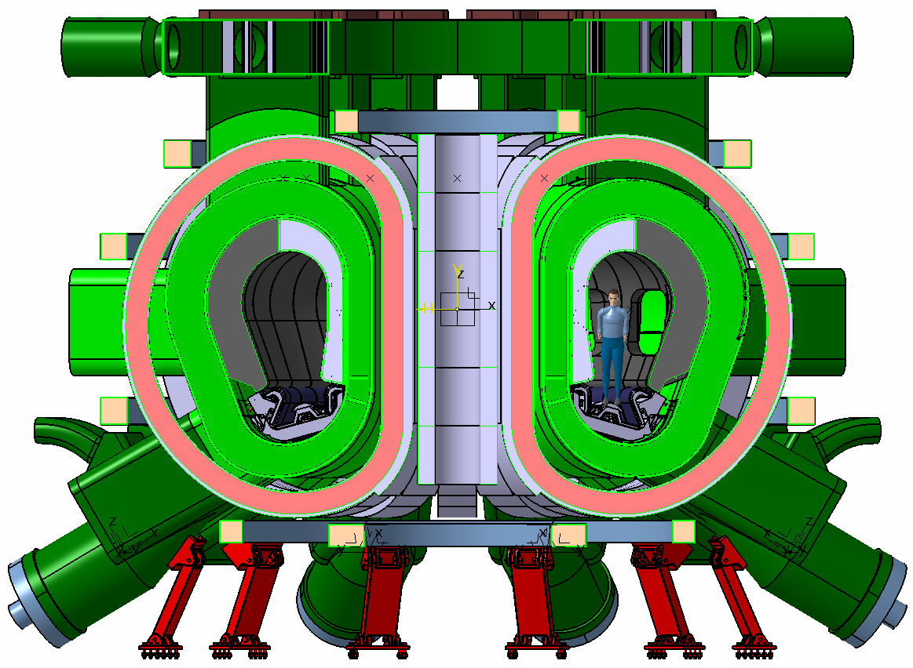
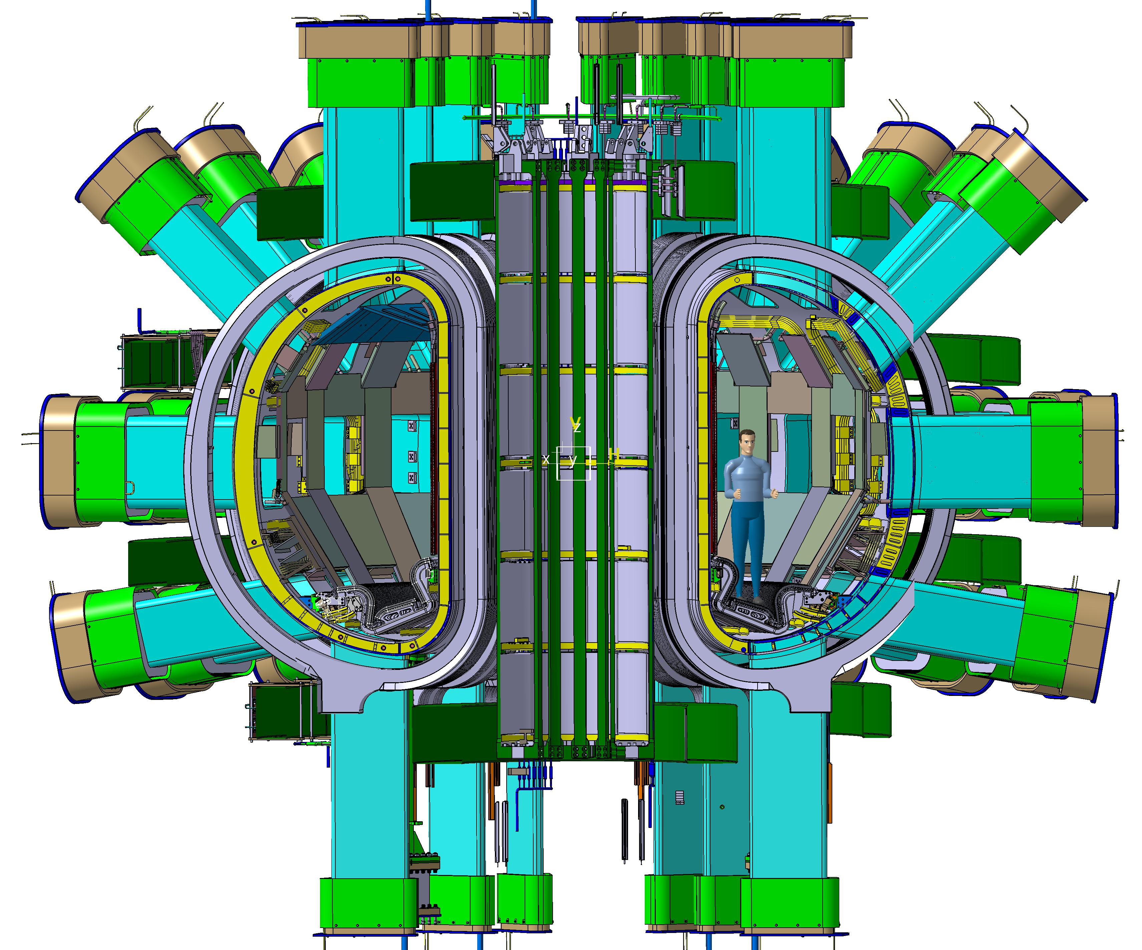
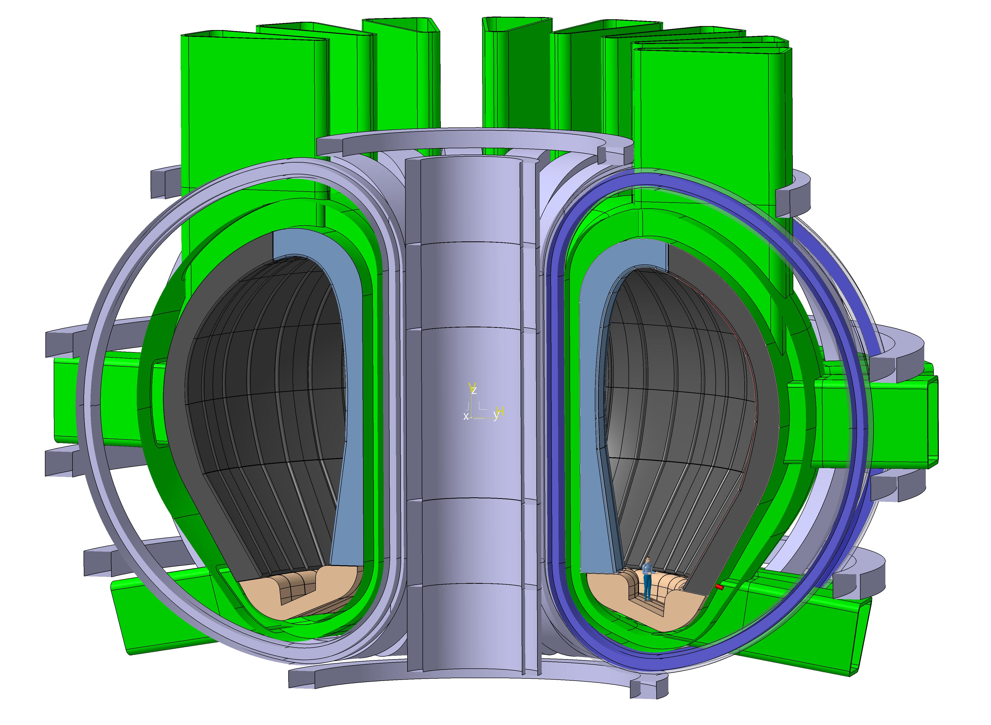
Overview
VNS
DTT
DEMO LAR
Generate a high neutron flux for testing of nuclear fusion components (BB)
Explore alternative divertor solutions to exhausts/withstand thermal loads
Parameter | EU DEMO LAR | VNS | DTT
Major radius (R) | 8.6 m | 2.67 m | 2.19 m
Minor radius (a) | 3.1 m | 0.64 m | 0.70 m
Aspect ratio (A = R/a) | 2.8 | 4.25 | 3.13
V_{p} | 2805.2 m³ | 31 m³ | 28 m³
Toroidal magnetic field (Bₜ) | 4.39 T | 5.6 T | 5.85 T
Plasma current (Iₚ) | ~18.8 MA | 2.55 MA | 5.5 MA
P_{sep} | 108 MW | 55 MW | 33 MW
P_{sep}/R | ~13 | ~20 | ~15
October 29th, 2025

Slide 4
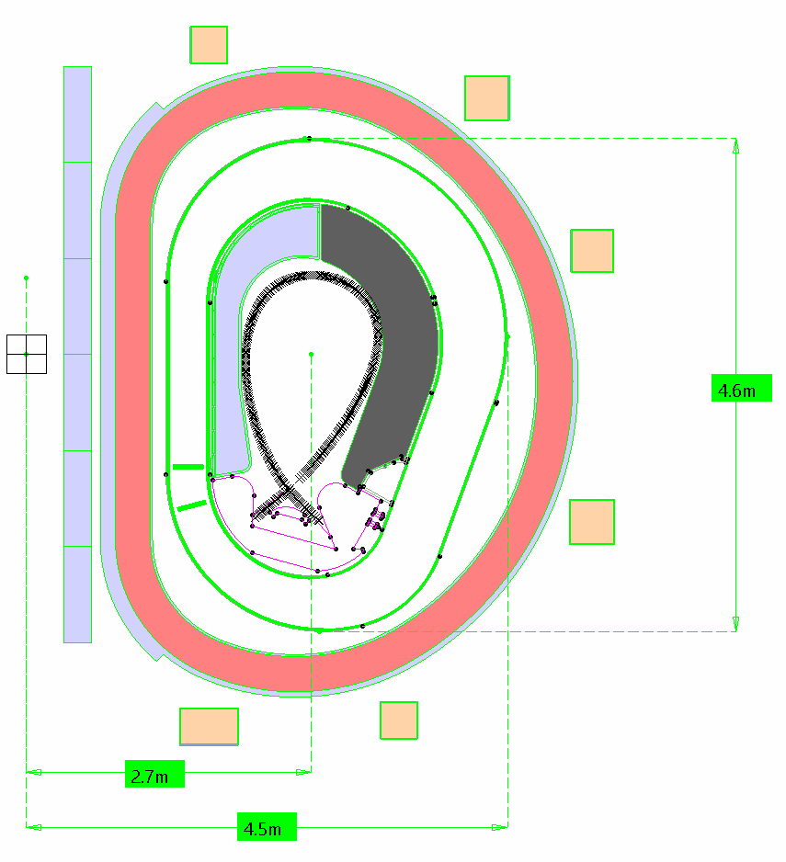
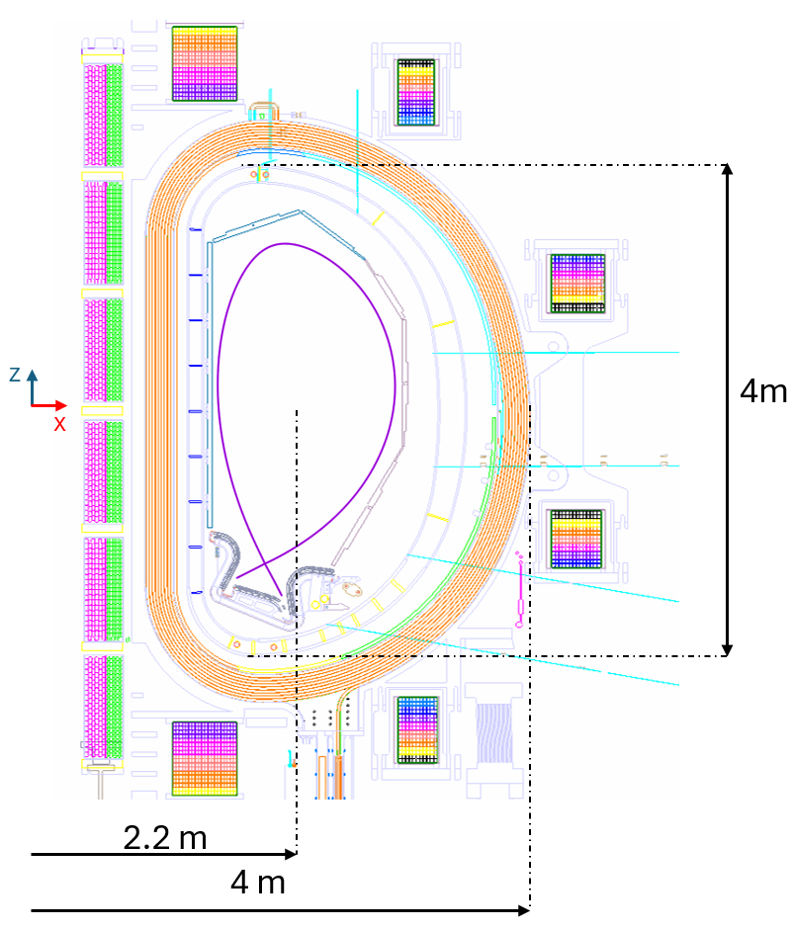
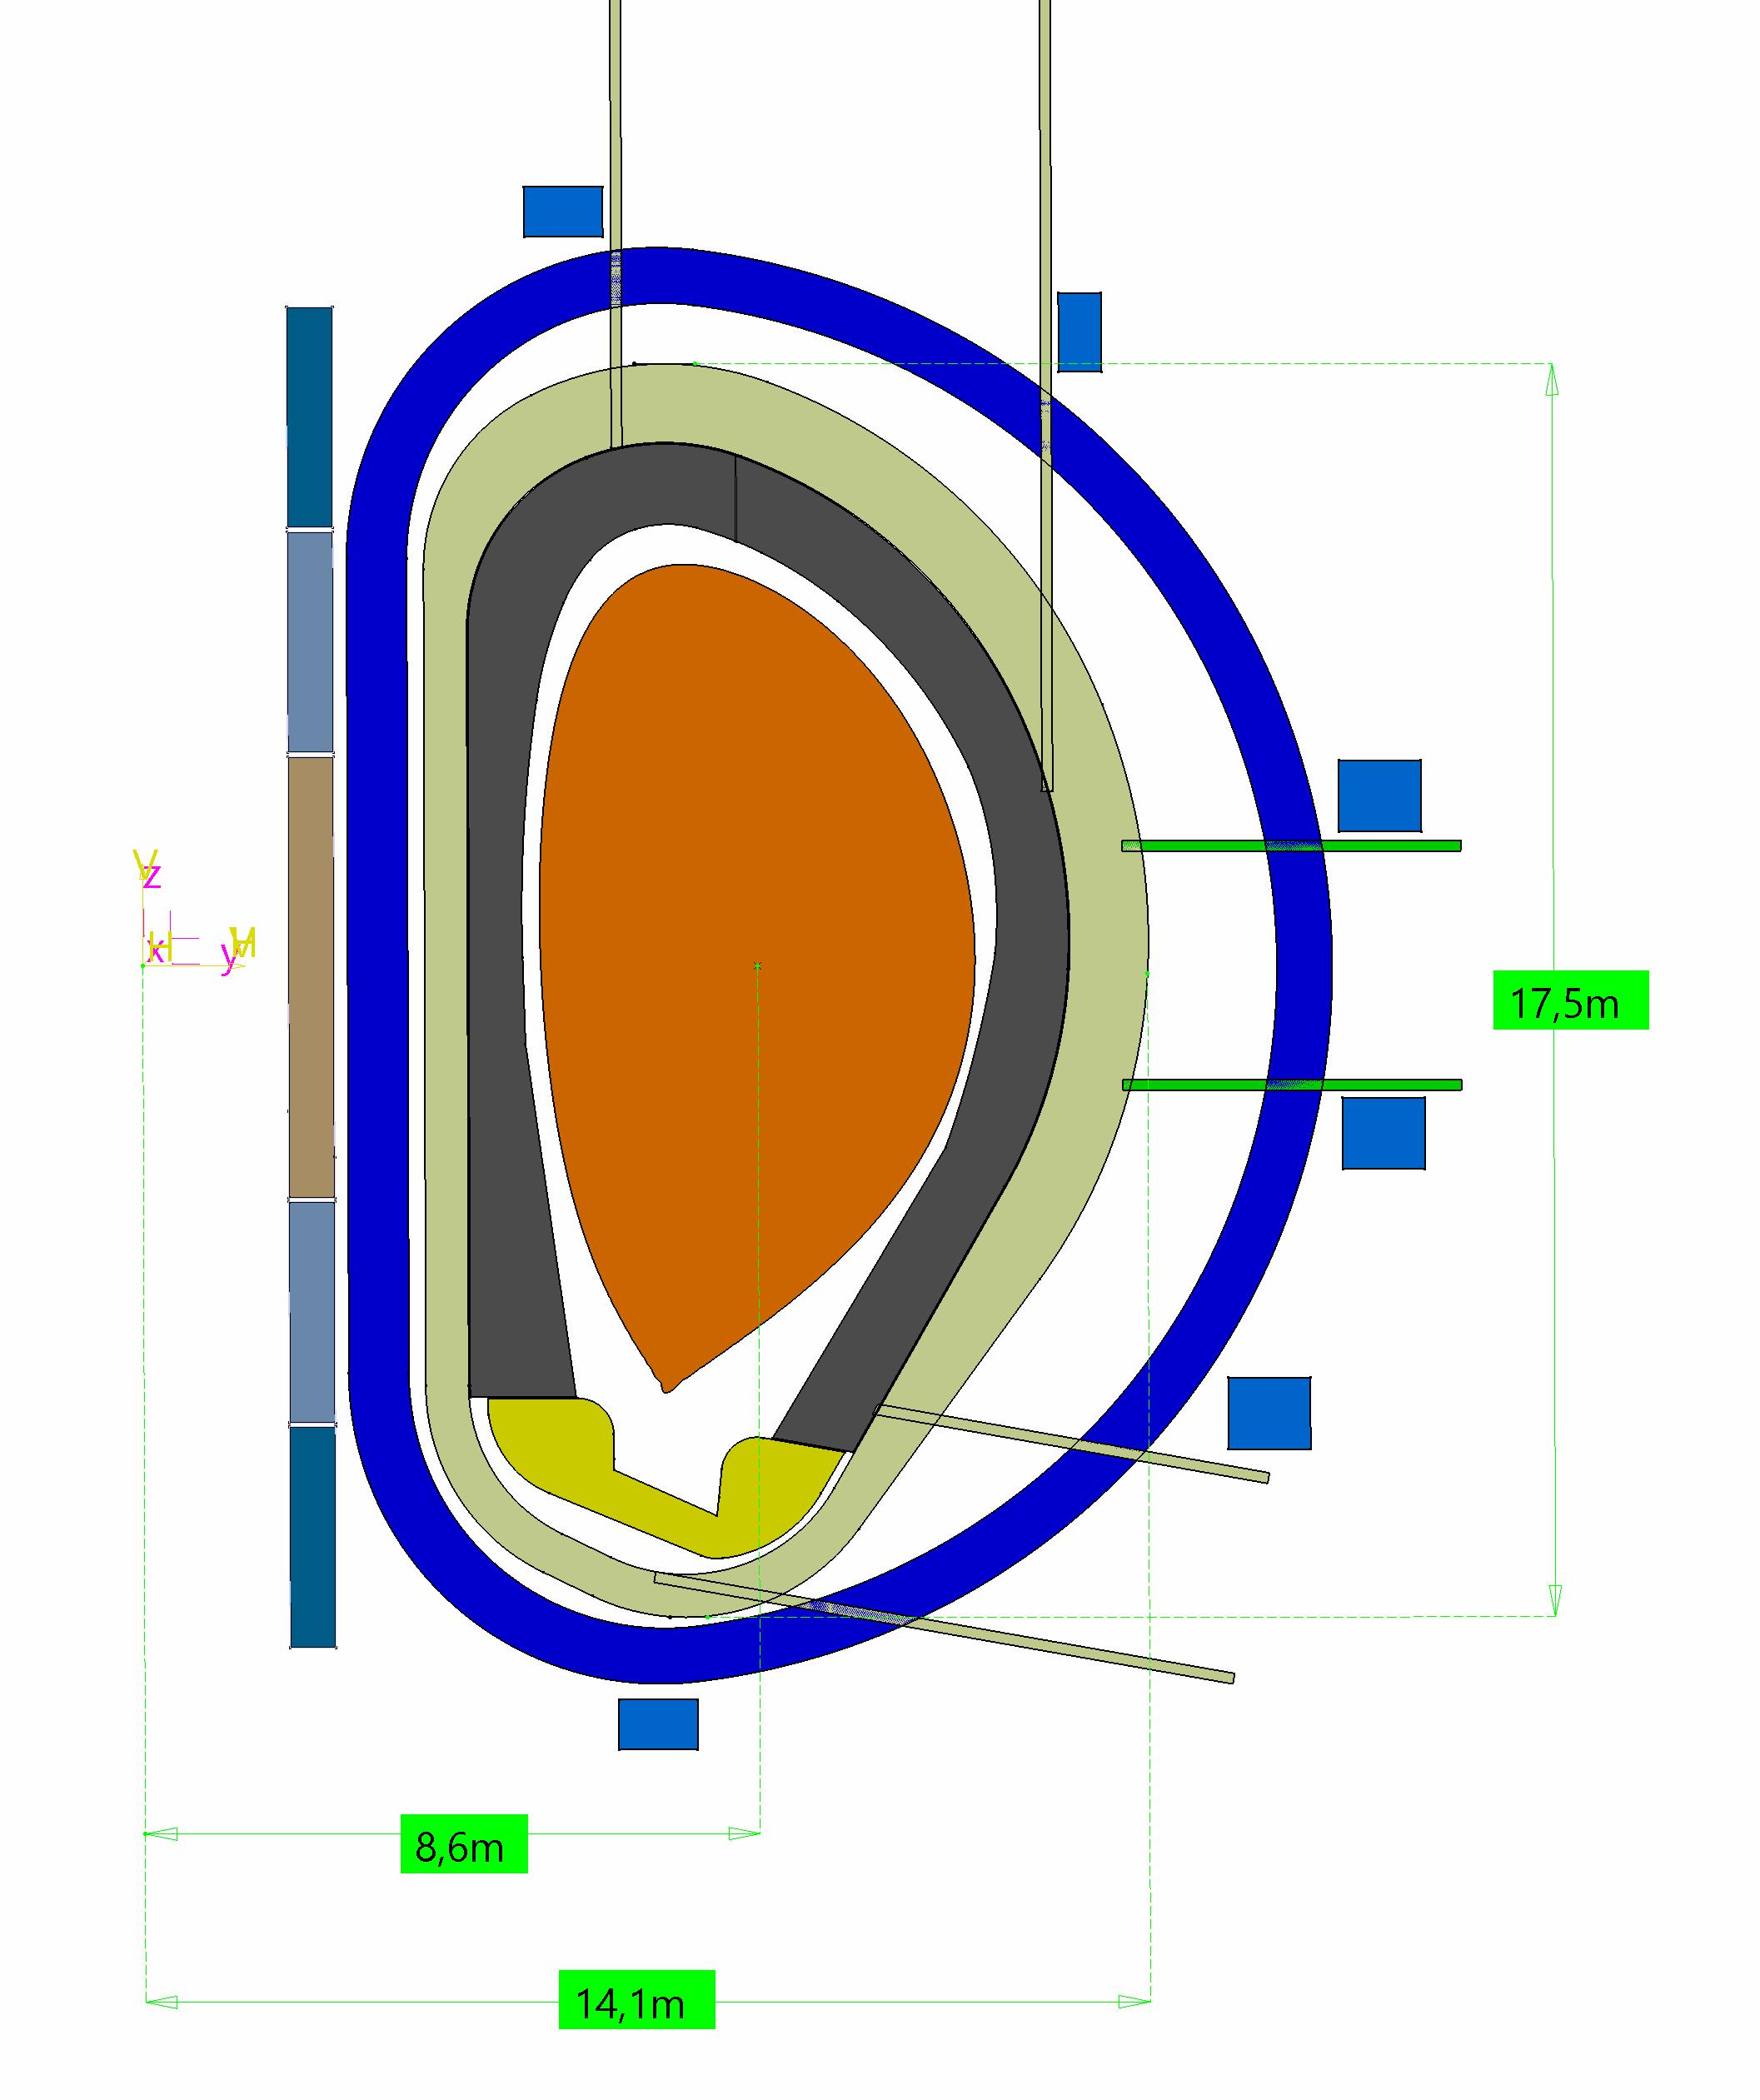
Overview
VNS
DTT
DEMO
Z
Z
X
X
Z
 | EU DEMO LAR | VNS | DTT
DIV design status | Conceptual Design (LAR configuration from 2024) | Feasibility Assessment | Manufacturing
Peak heat flux density (NOC) | 10 MW/m² | 10 MW/m² | 10 MW/m²
X [mm] | 4985 | 1538 | 1211
Z [mm] | 2245 | 890 | 793
X
October 29th, 2025

Slide 5
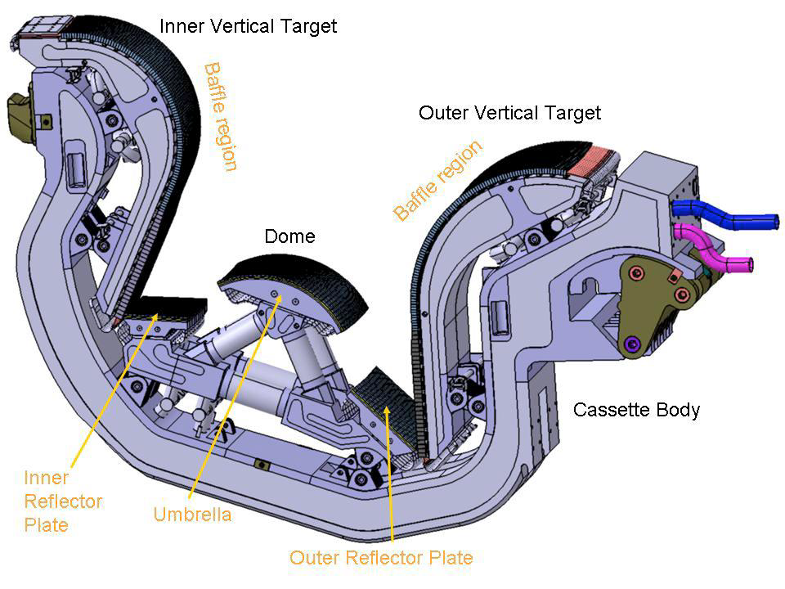
Divertor functions
The main functions of the divertor are to :
Extract heat from intercepted high-energy particles;
Exhaust particles including unburnt fusion fuel and fusion products;
Reduce plasma impurities;
Allow efficient pumping of the exhausted particles;
Provide plasma boundary control;
Protect surrounding walls from thermal and neutronic loads
B. Riccardi, A. Cardella and G. Janeschitz, Section on Divertor to appear in ITER Engineering Basis Handbook, Volume 2, Chapter 6, 2026
October 29th, 2025

Slide 6
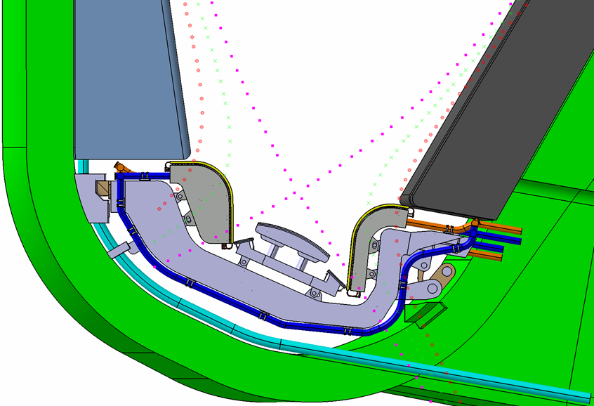
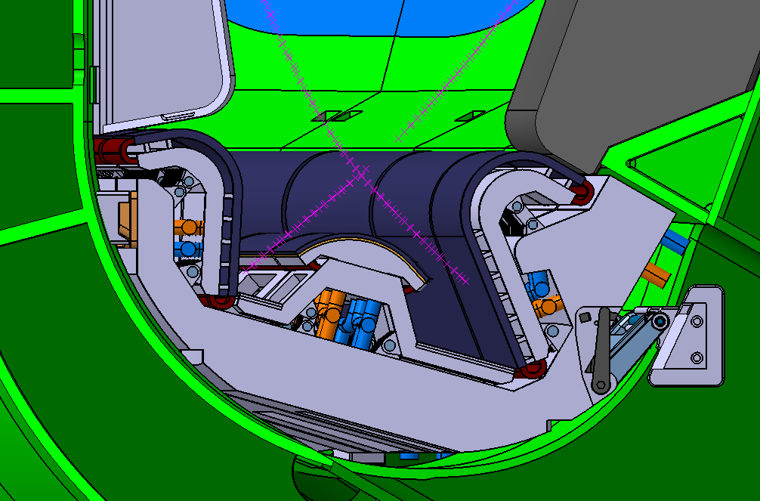
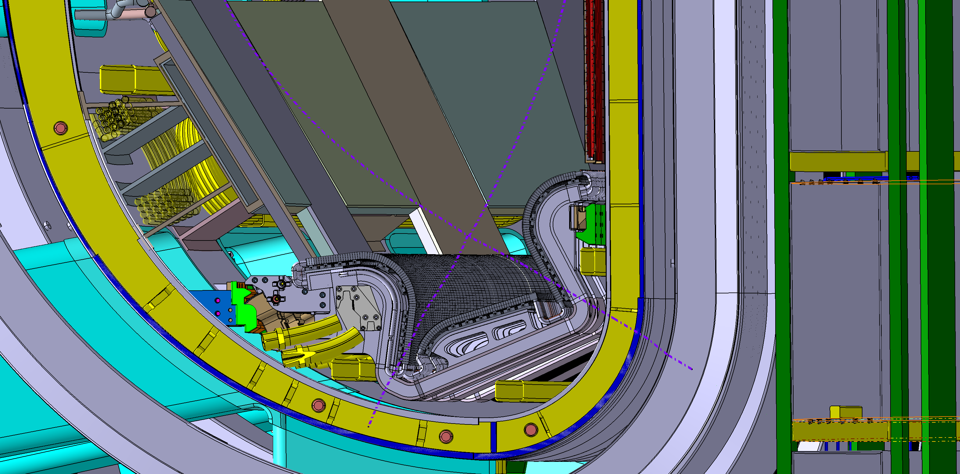
Divertors’ design drivers
DEMO LAR
VNS
DTT
Design Drivers | DEMO | VNS | DTT
Heat fluxes (detachment/reattachment)
Shielding of VV and TFC
Neutron irradiation and He production
Pumping efficiency
Loads (TH, CP, EM, …)
Plant Availability
Remote Handling compatibility
Radwaste
Flexibility for different magnetic configurations | N.A. | N.A.
Absolutely relevant
Relevant
Slightly Relevant
October 29th, 2025

Slide 7
EU DEMO Divertor
October 29th, 2025

Slide 8
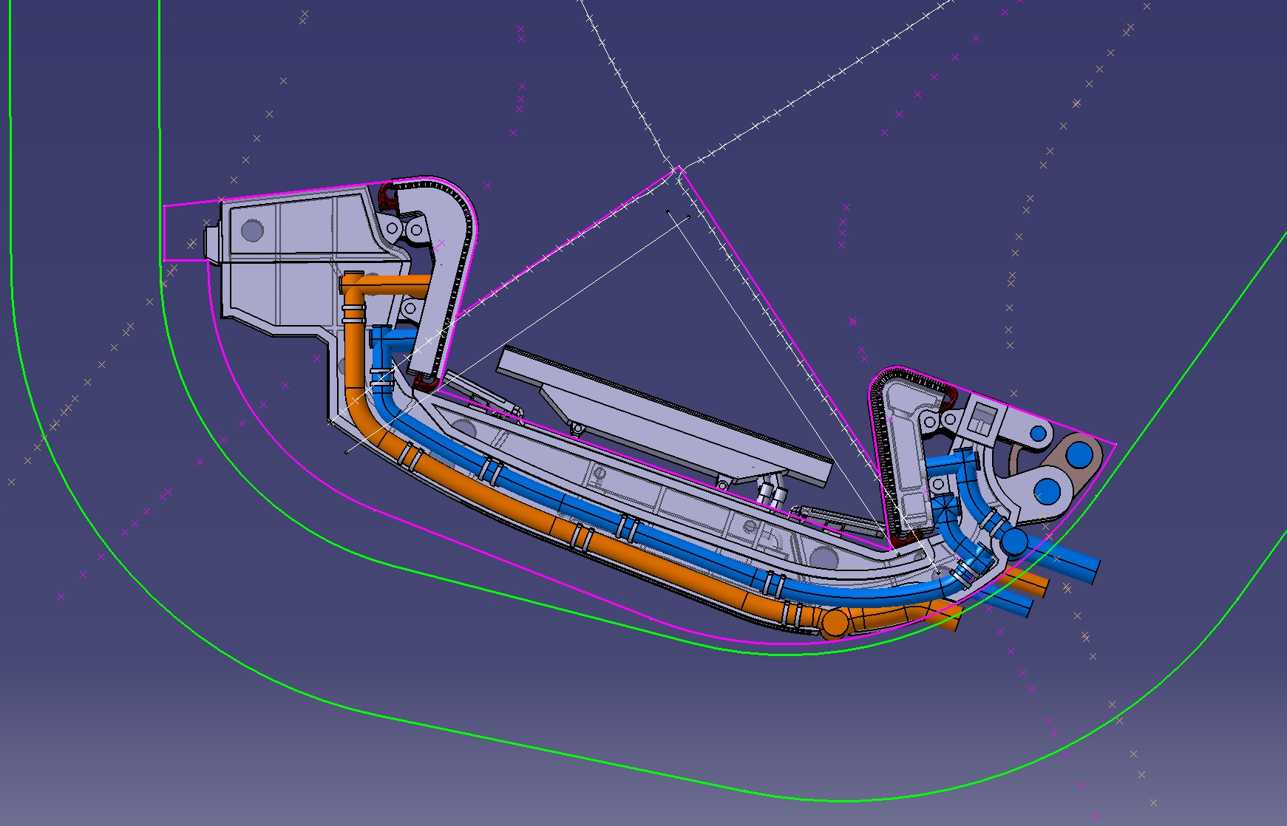
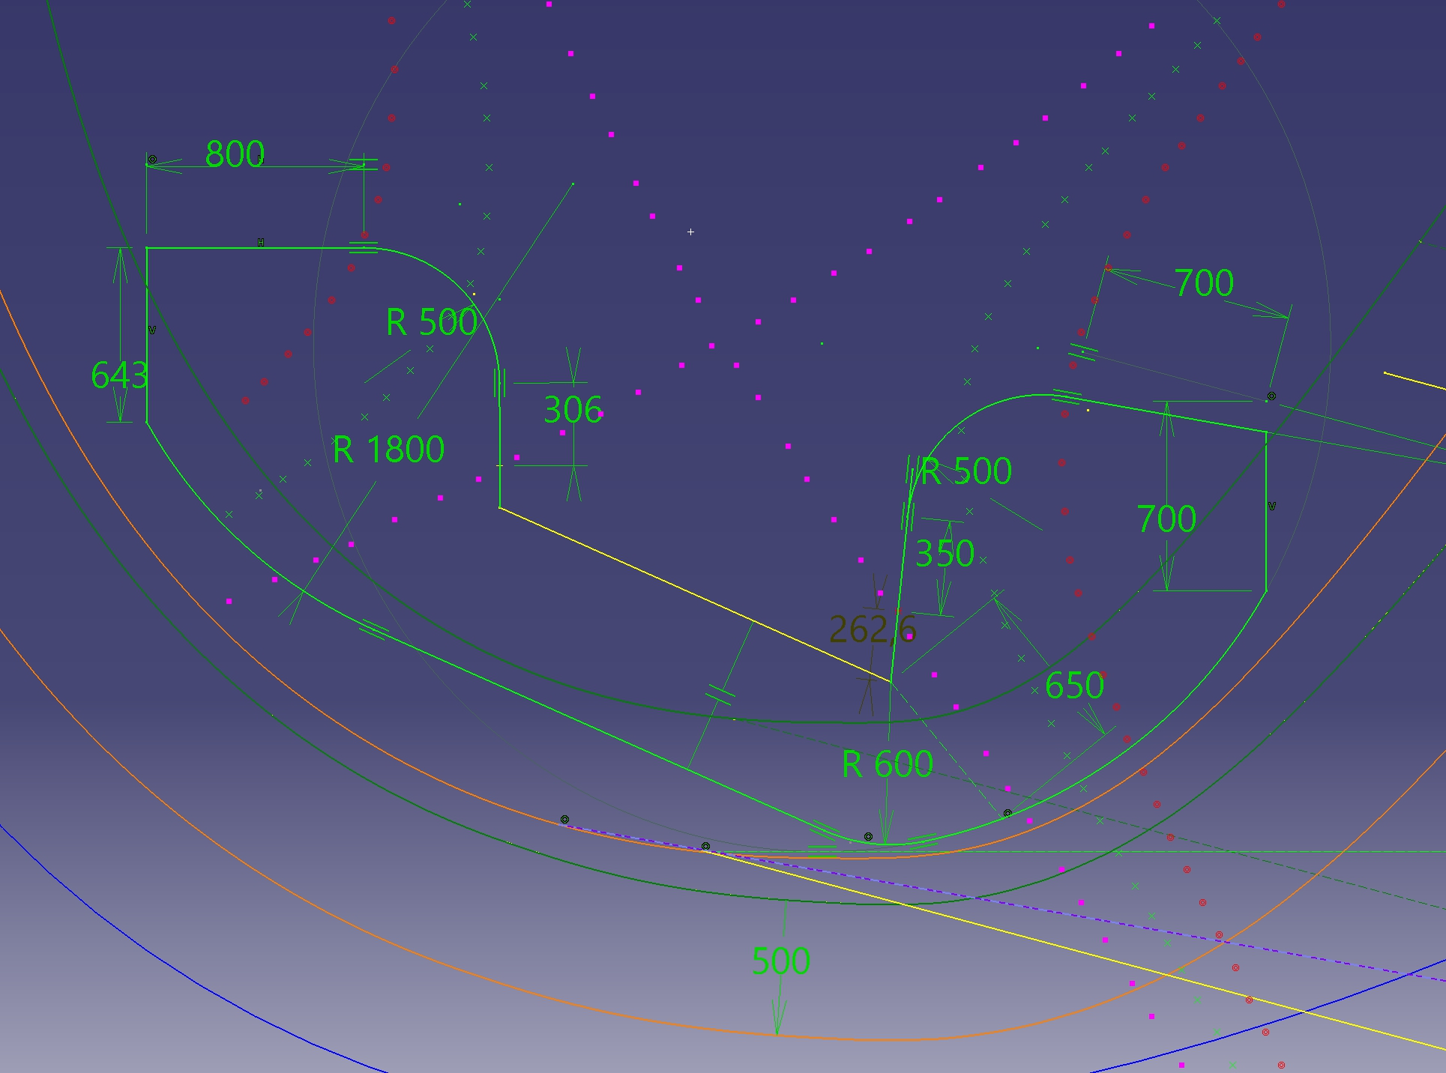
DEMO Divertor – from previous baseline to LAR configuration
DEMO Baseline 2019
DEMO LAR
Main considerations
Plasma Facing profiles determined with simplified physics model and considering constraints on grazing angle
Power load to the divertor in case of reattachment decrease from ≈ 82 MW/m² down to ≈44 MW/m² (-46.5 %)
In the DIV poloidal profile, space is reserved in the outboard area to integrate all the sub-systems (overcoming a main issues experienced in G1 baseline)
Baffle curvature radius compatible with current technological limits
Interface with blanket and VV Lower port determined to improve RH compatibility
October 29th, 2025

Slide 9
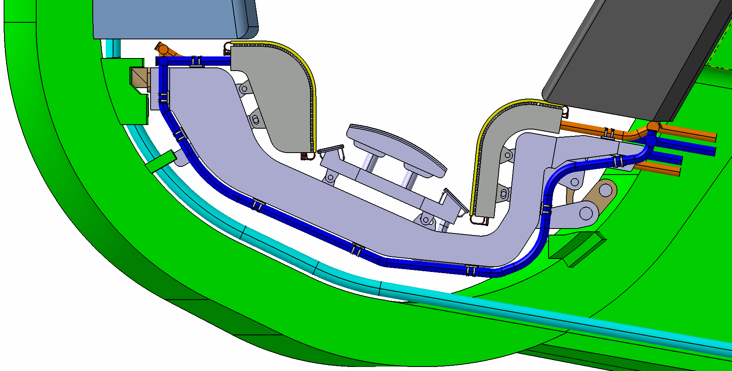
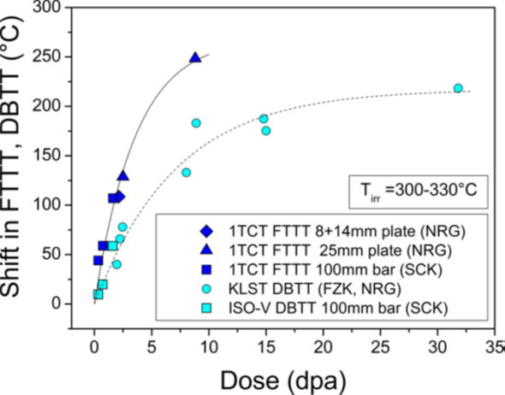
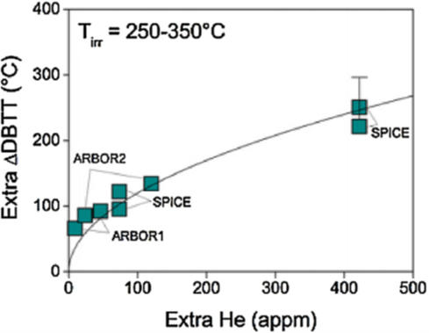
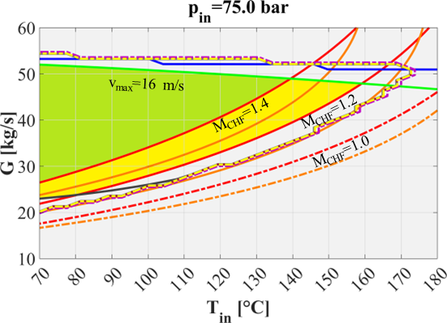
DEMO Divertor – operating parameters
Vertical targets
Separate Cassette and VTs cooling circuits to:
Replace target units (1.5/2 FPY)
Preserve Eurofer97 ductility under irradiation to re-use cassette body after annealing
Eurofer97 structures (CB/SL/RPs):
Targets
PWR conditions are assumed
ITER-like technology
Inlet T= 130°C
Inlet P=7.5 MPa
T_{inlet}=285-295°C P_{inlet} = 15.5 MPa
Marzullo, D., et al. "Selection of EU-DEMO divertor operating conditions: water cooling thermal-hydraulic parameters and power exhaust capabilities." Fusion Engineering and Design 203 (2024
October 29th, 2025

Slide 10
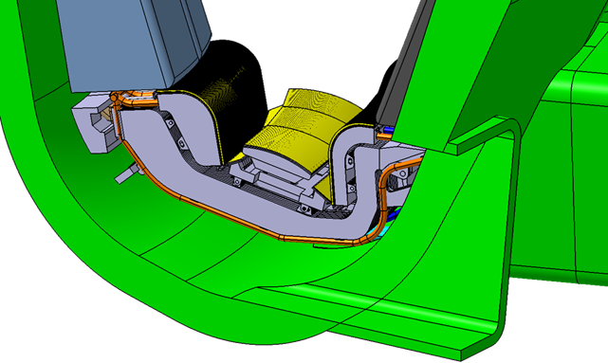
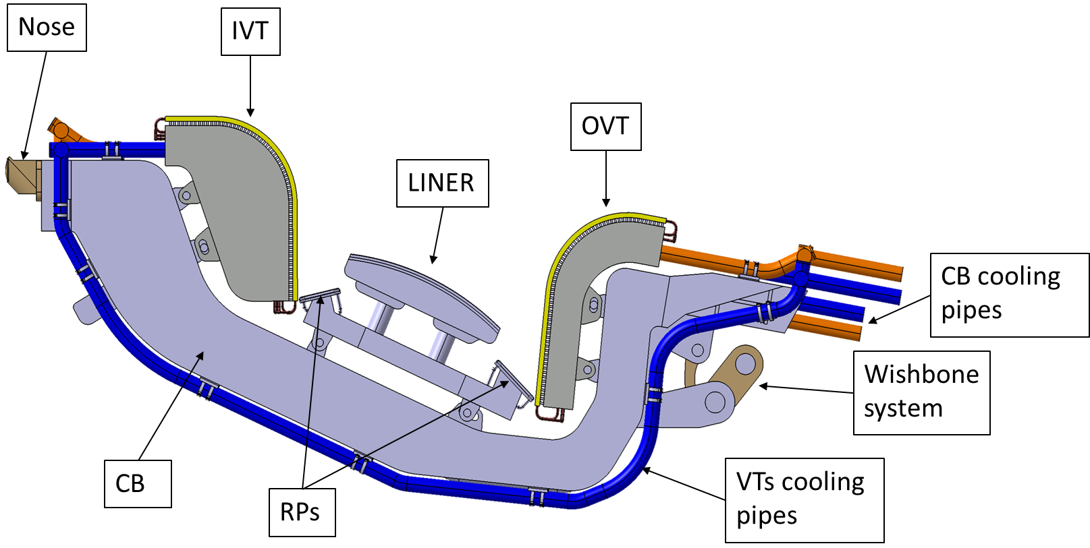
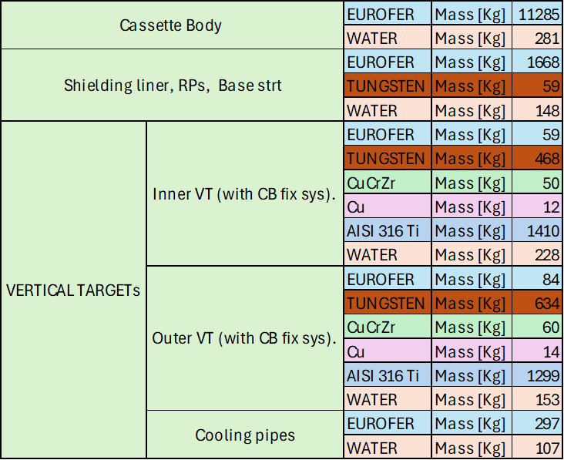
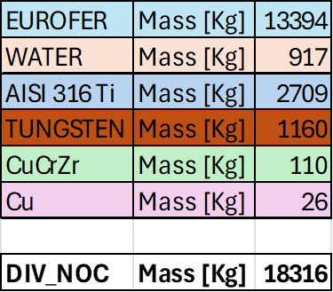
DEMO Divertor system
Three cassettes per sector – 54 modules
RH through lower port (10° inclination)
G. Mazzone, Revised Divertor Design for the new European 'DEMO LAR' reactor, session “Divertors for Next-Generation Devices” - Tuesday 28 October
October 29th, 2025

Slide 11
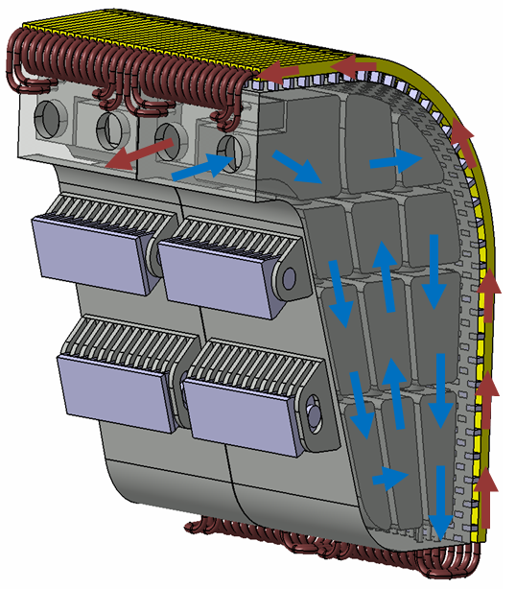
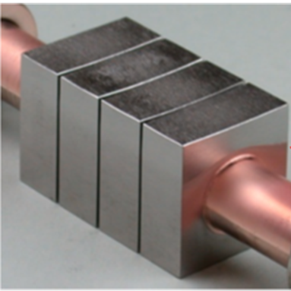
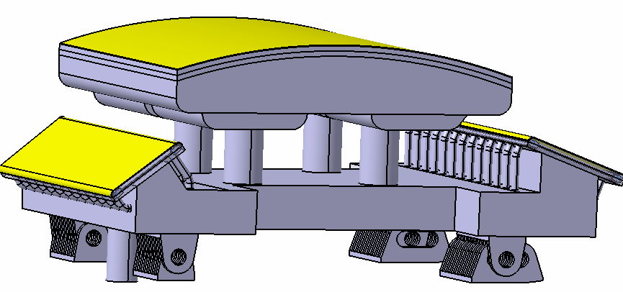
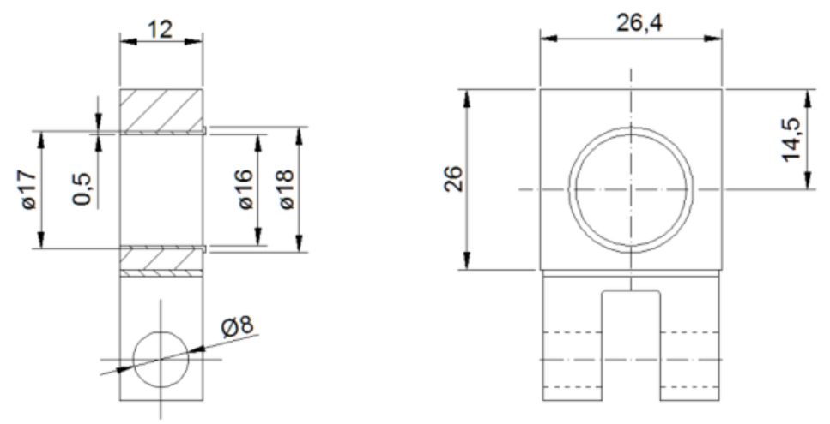
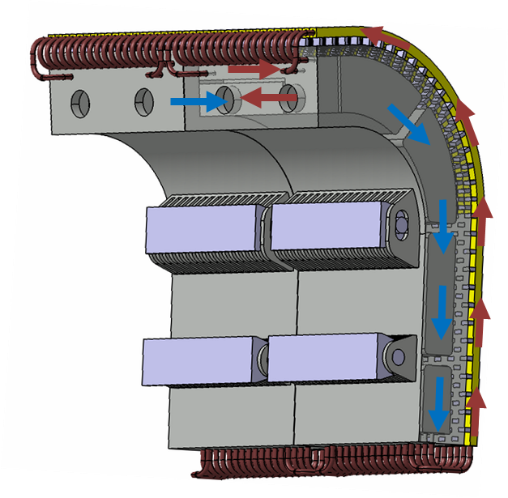
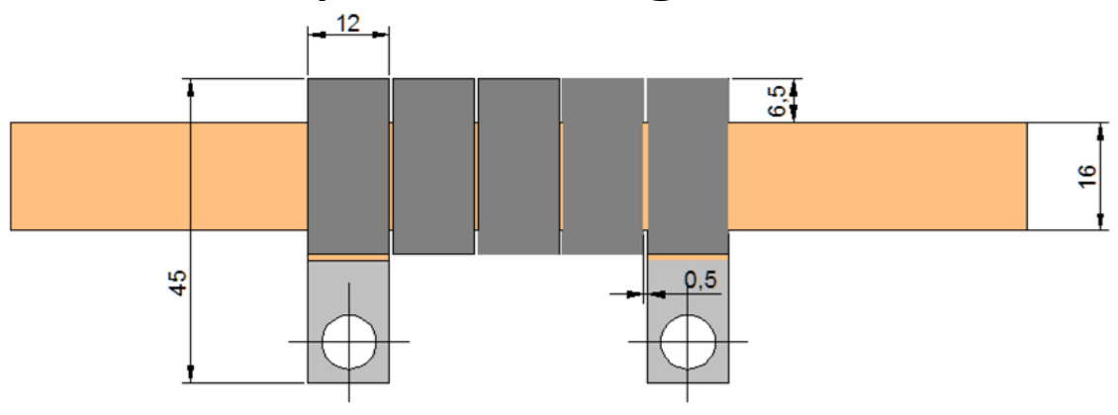
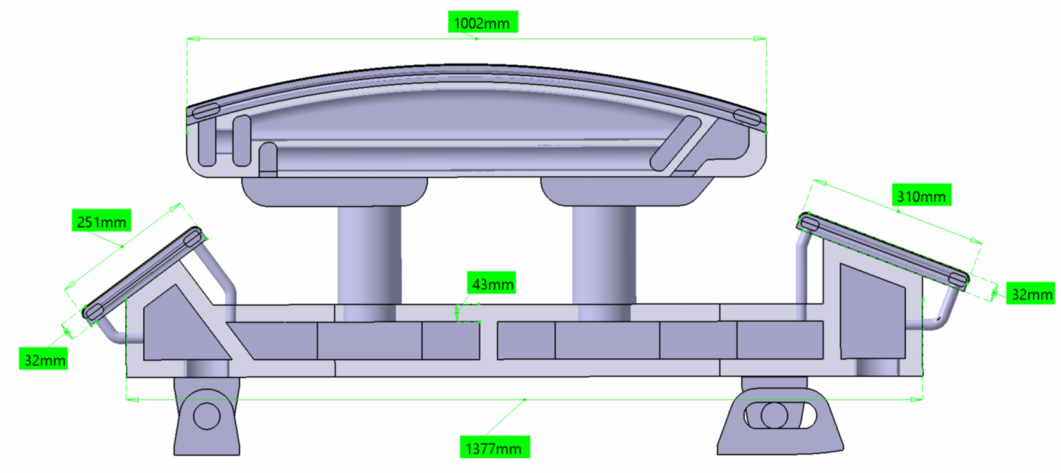
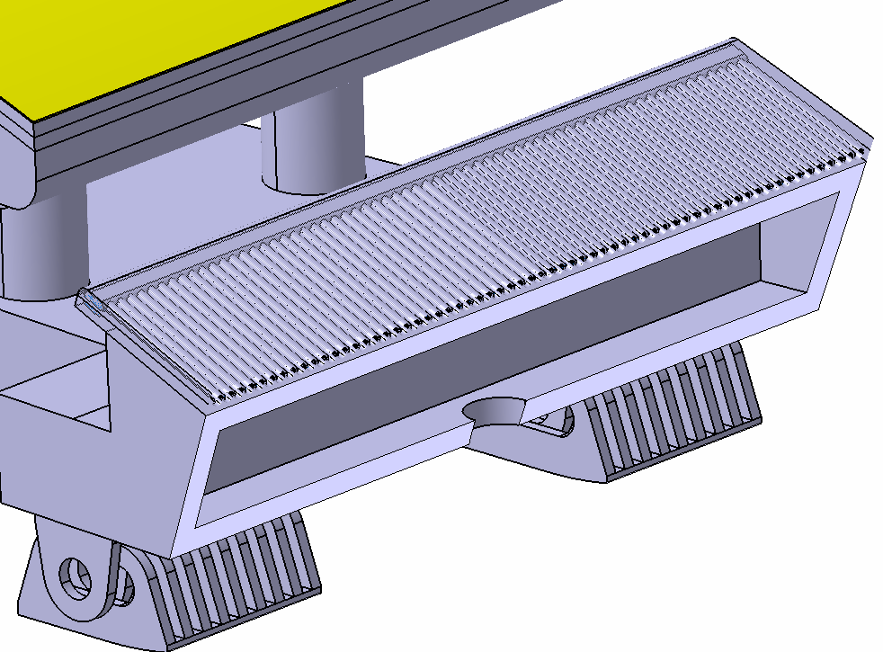
DEMO Divertor – main subsystems
Vertical Targets
Shielding liner and RPs
Targets shall maintain shape and functionalities under Normal Events
W layer – 2mm
ITER-like technology
Eurofer
Cooling channels
NOC: 6600 pulses, 2h, 10 MW/m²
Short plasma transient (<1s) to higher heat flux density (5000 pulses at 40 MW/m²)
HF <1MW/m²
October 29th, 2025

Slide 12
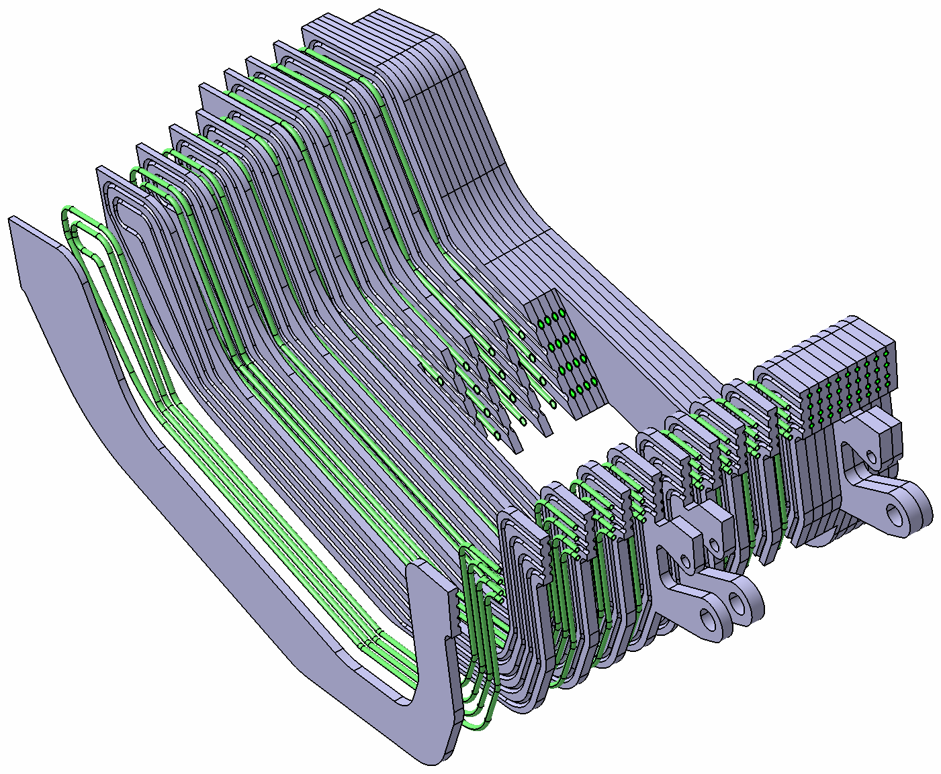
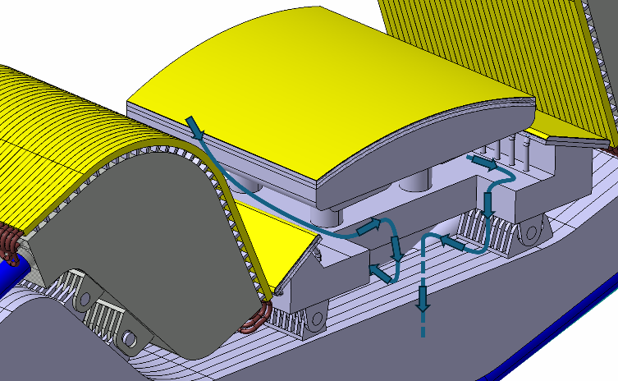
DEMO Divertor – main subsystems
Cassette Body
Internal pipes. ID = 12 mm
OD = 15 mm
Plates machined and joined by HIP (against “welded box” structure) to withstand high pressure
Dog-Leg solution for vacuum pumping duct
Eurofer97 plates
Poster session - C. Tantos, DIVGAS: A Robust and Reliable Workflow for Modelling Divertor Neutral Gas Flow and Optimizing Divertors in Next-Generation Fusion Reactors – Applications to DTT and EU-DEMO Divertors
October 29th, 2025

Slide 13
VNS Divertor
October 29th, 2025

Slide 14
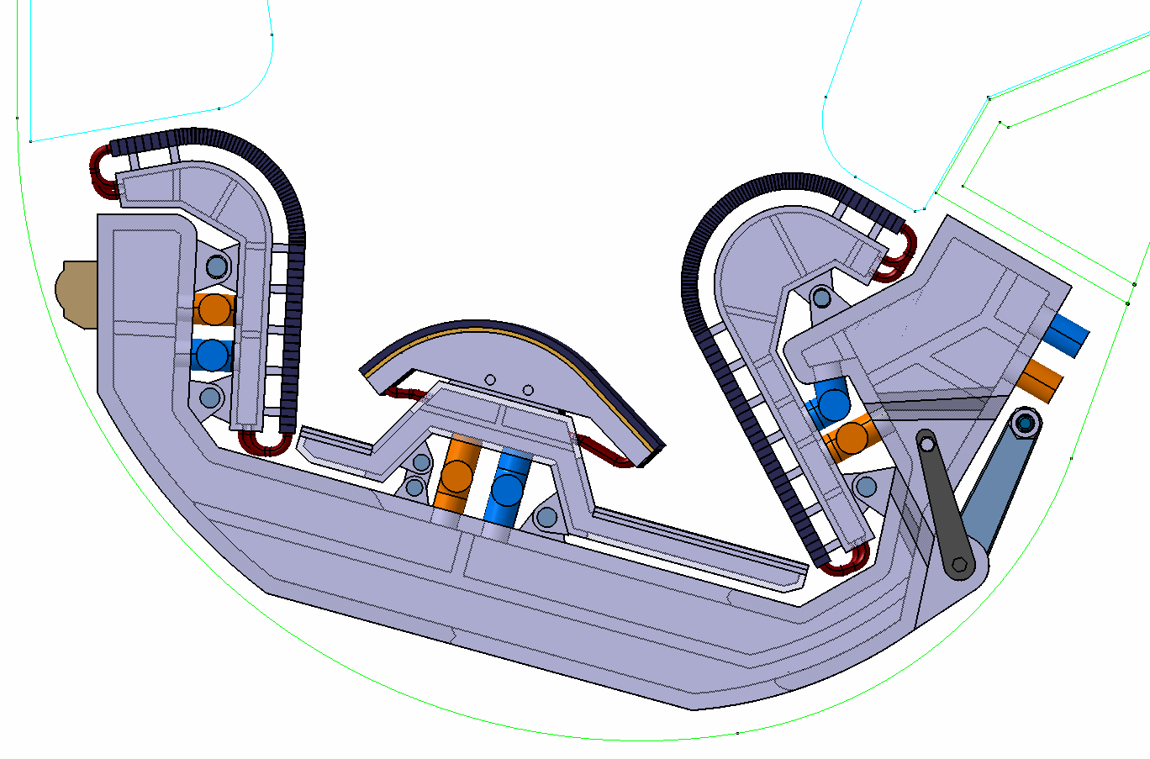
VNS Divertor System
Heat fluxes (detachment/reattachment)
Neutron irradiation and He production
Shielding of VV and TFC
Plant Availability
Absolutely relevant
Radwaste
Relevant
Slightly Relevant
Three cassette per sector (36 modules)
VTs - > ITER-like technologies
Single cooling for VTs, CB and DOME:
T_{in}=50 °C
P_{in}=3.5 MPa
Cassette body – all welded box structure made of AISI 316Ti
Challenge: adapt ITER and DEMO studies to compact dimensions
October 29th, 2025

Slide 15
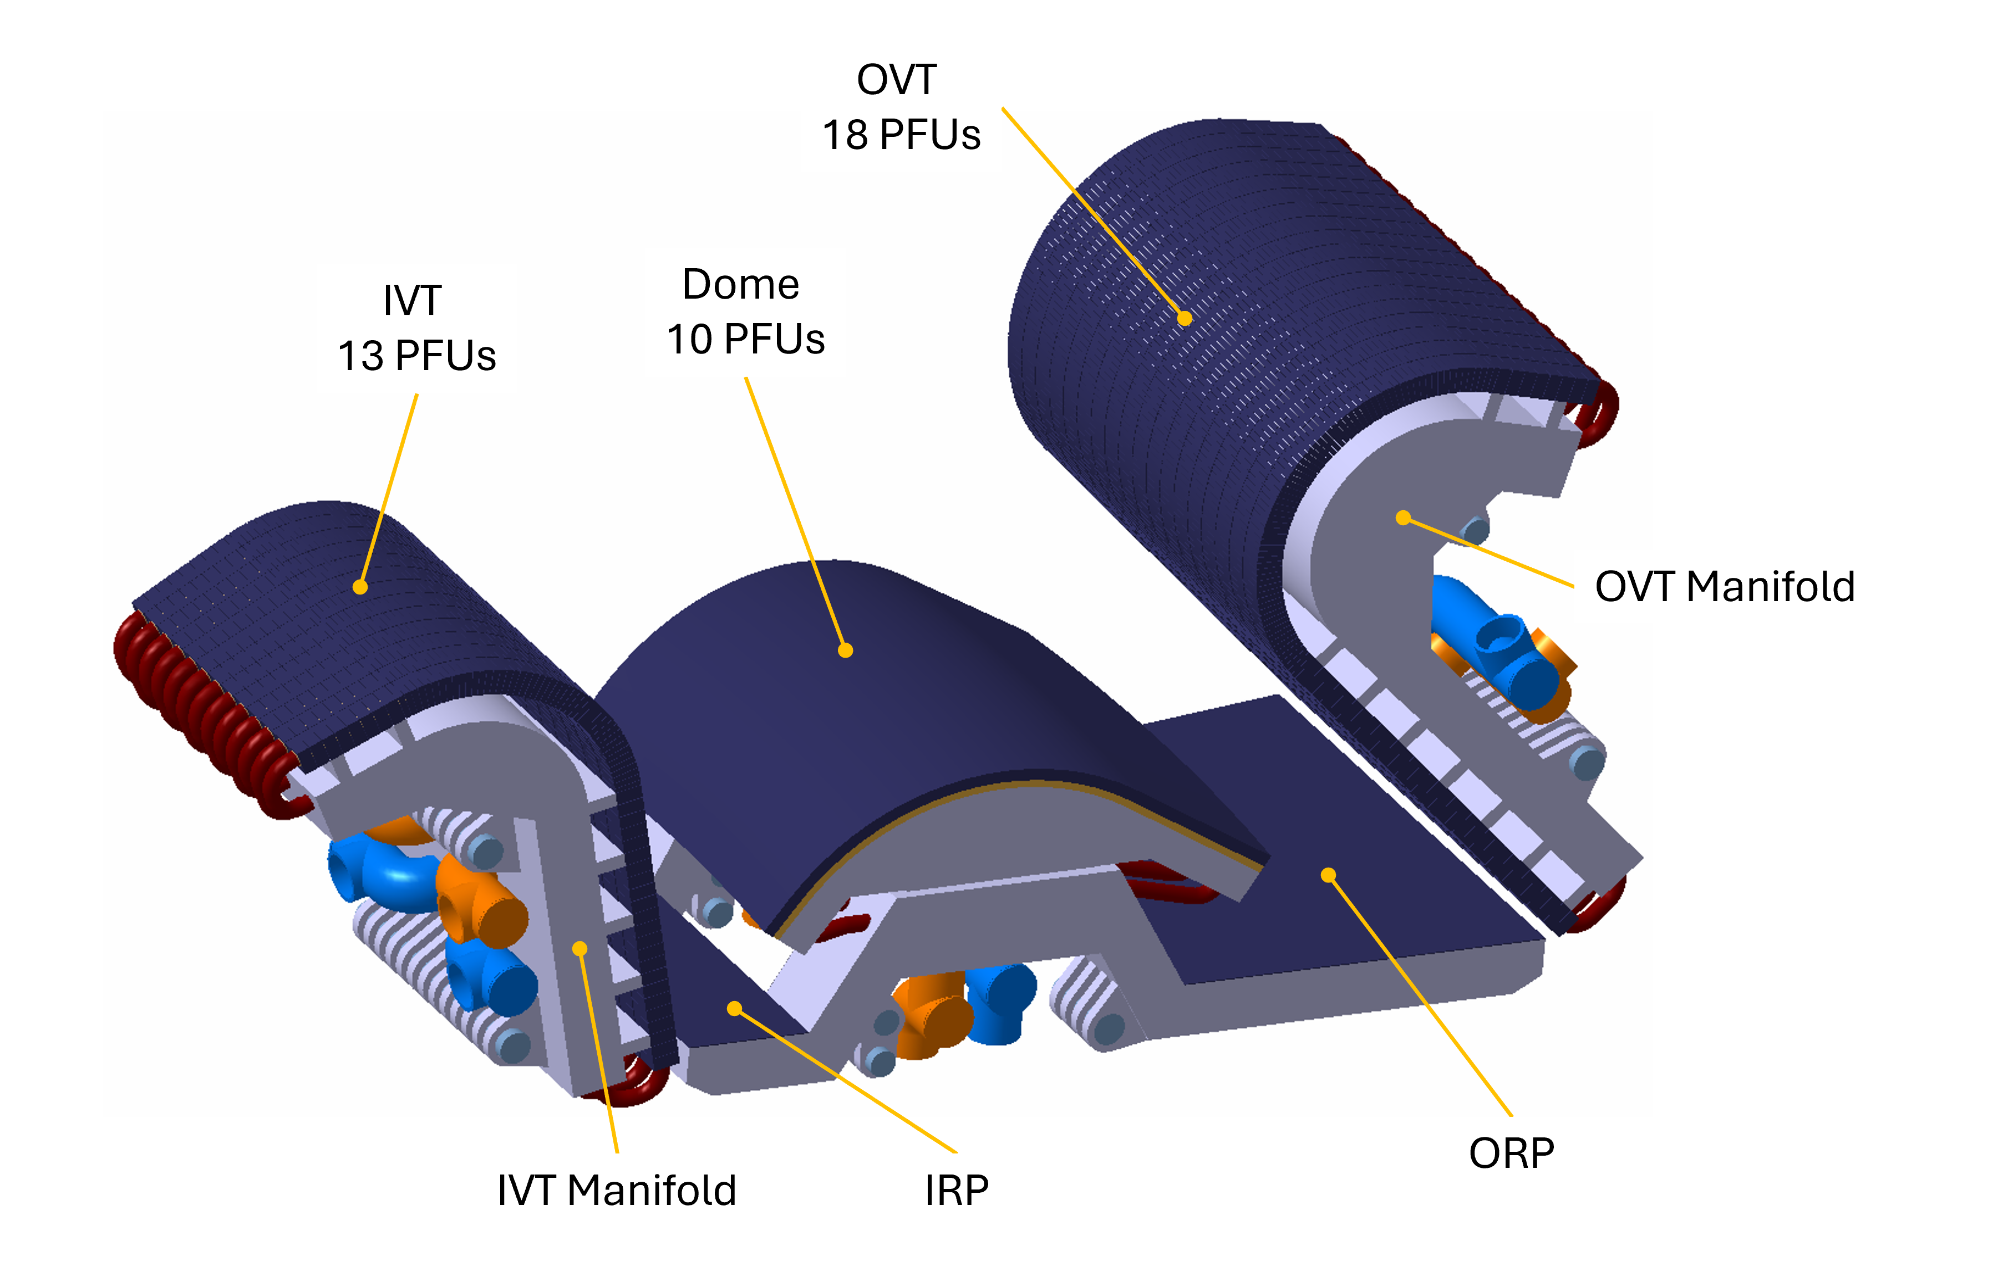
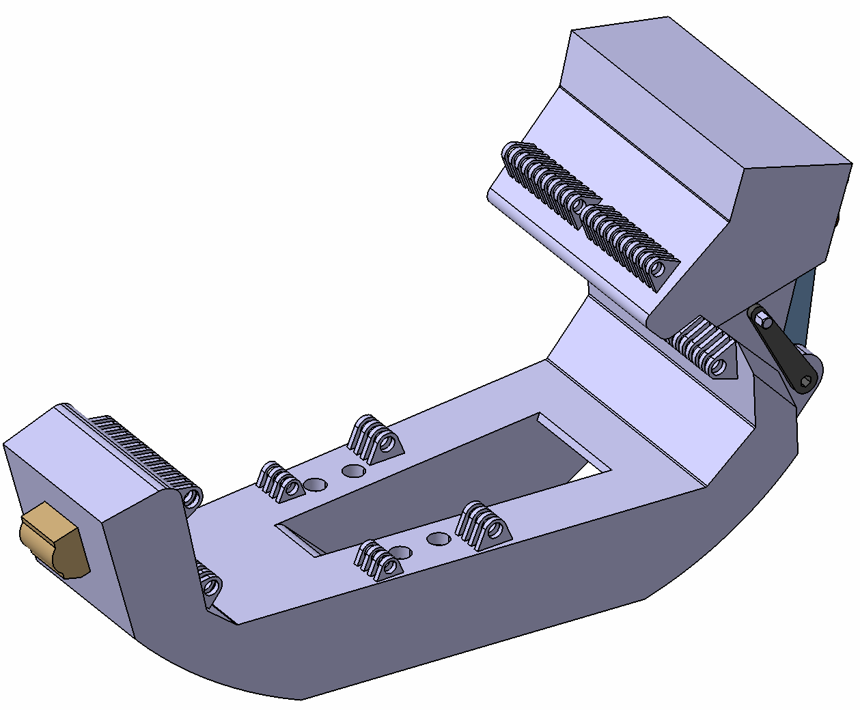
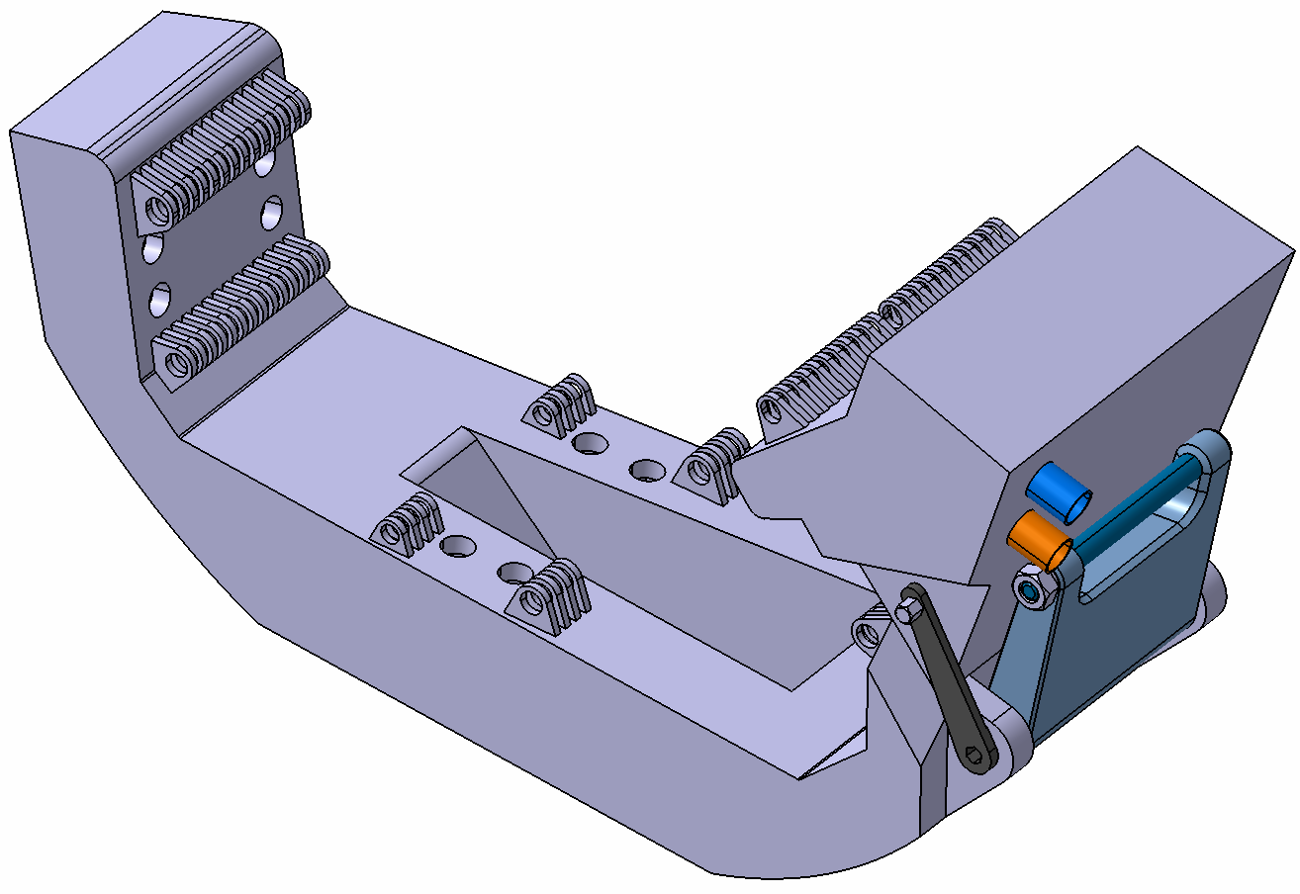
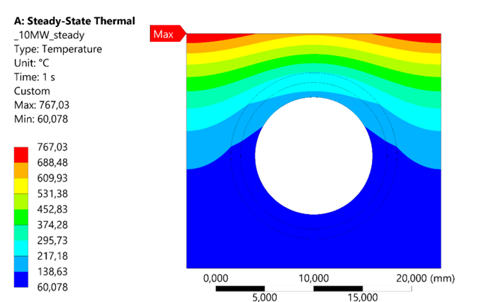
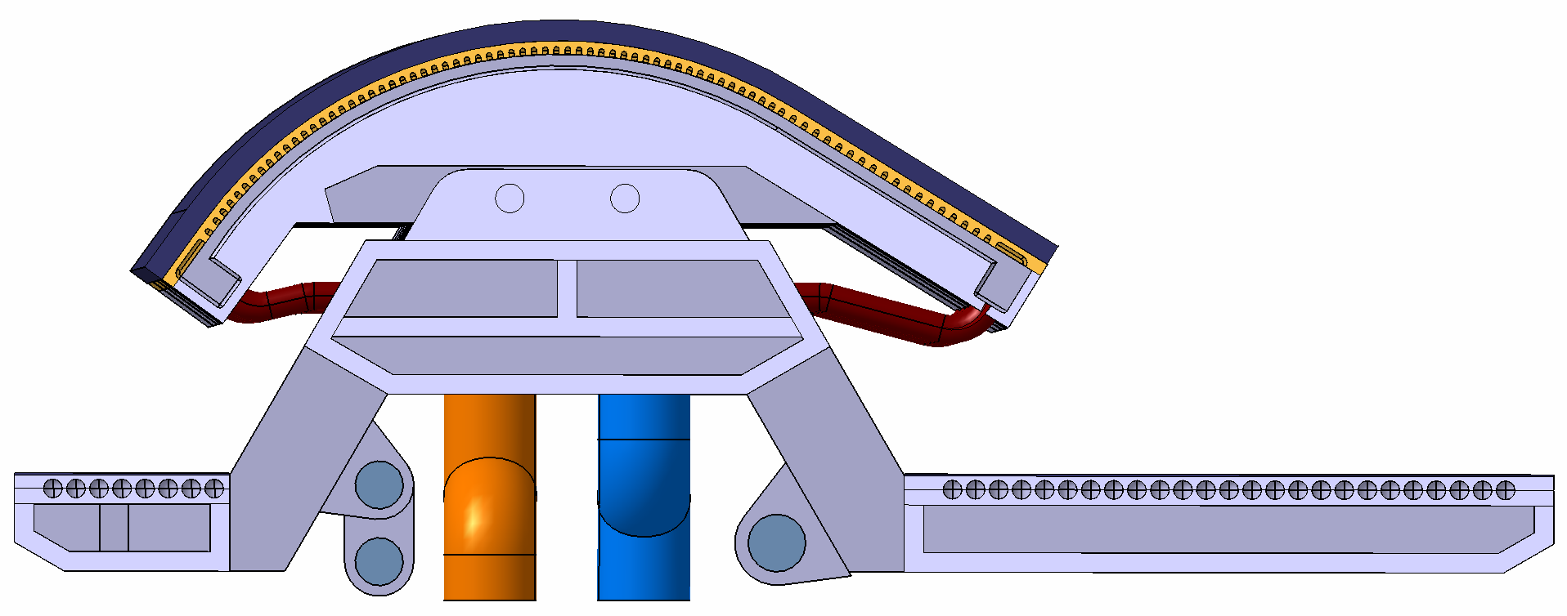
VNS Divertor – main subsystems
IVT connection
OVT connection
Dome connection
VV connection
1 MW/m²
W tiles
Turbulence promoters
W coating
ITER like-technology
4 mm Armour thickness - 26 mm of Toroidal Width
Boscary, J., et al. "Divertor conceptual design of the European Volumetric Neutron Source." Fusion Engineering and Design 212 (2025): 114861.
October 29th, 2025

Slide 16
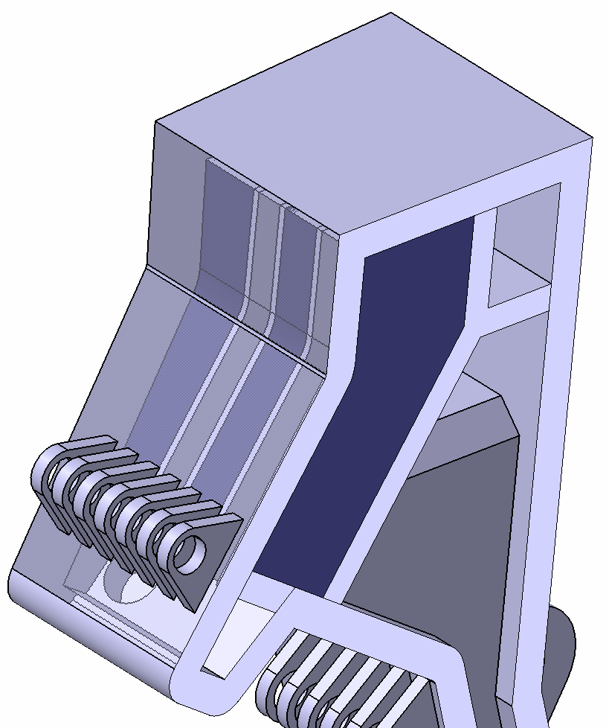
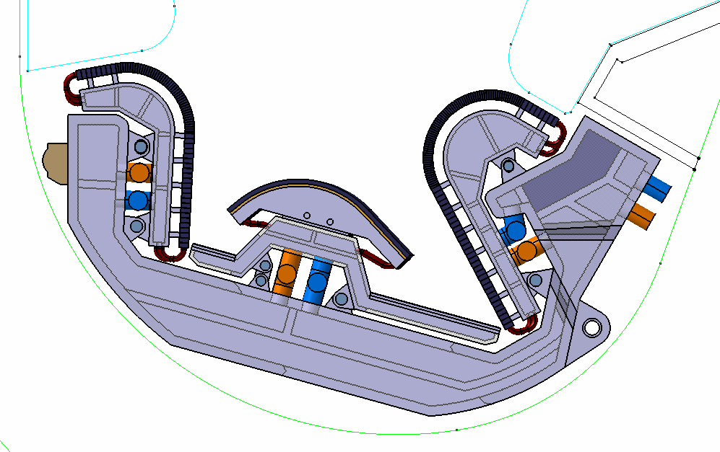
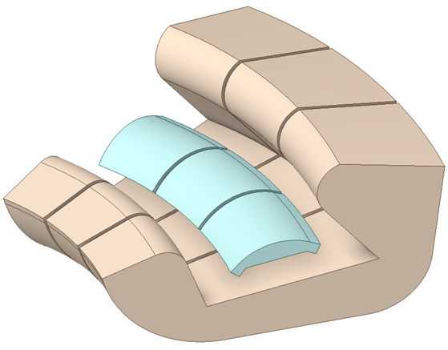
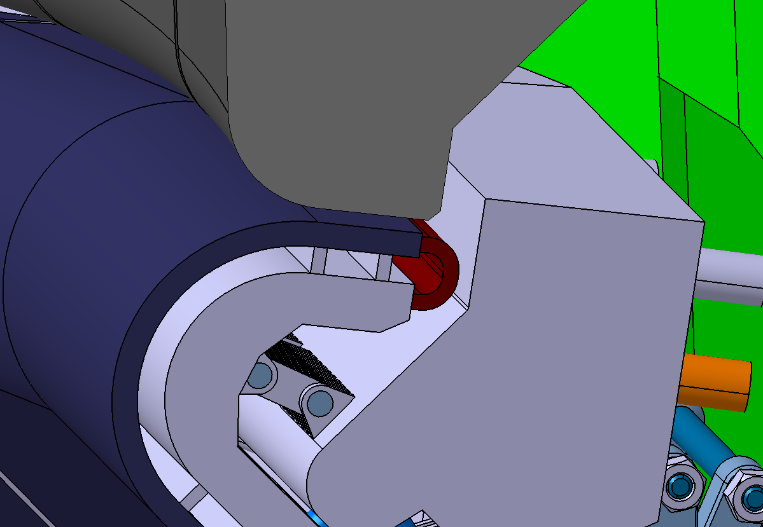
VNS Divertor – shielding function
Tungsten Shielding to reduce He production on the pipes
Gaps between adjacent modules to be minimized
w
BB
vv
Dogleg with Shielding Blanket to reduce dpa on VV
Dogleg
October 29th, 2025

Slide 17
DTT Divertor
October 29th, 2025

Slide 18
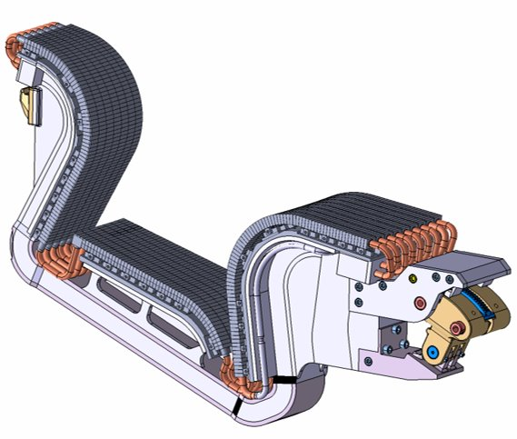
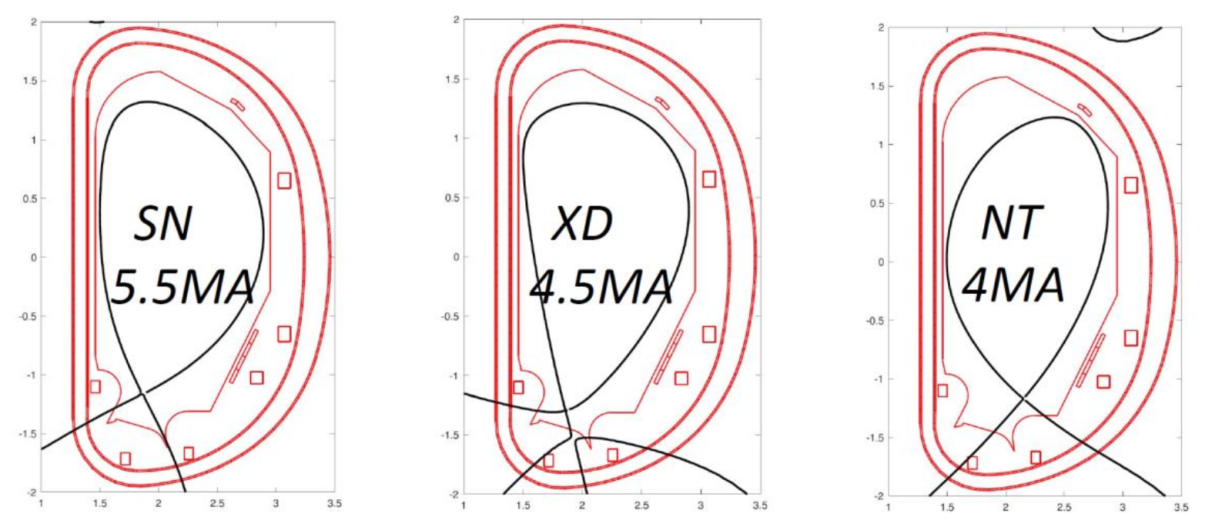
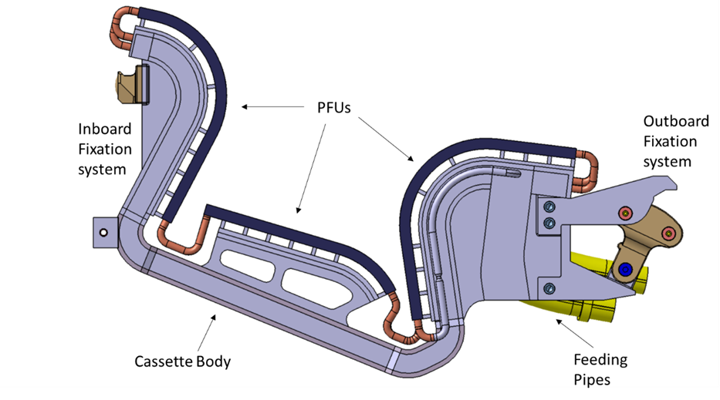
Divertor Tokamak Test
54 standard modules​
3 per 20° sector; 4 test modules in RH sectors
Single cooling for VTs and CB
T_{in}=[60-130] °C
P_{in}=5 MPa
Heat fluxes (detachment/reattachment)
Neutron irradiation and He production
Shielding of VV and TFC
Plant Availability
Radwaste
Absolutely relevant
Flexibility for different magnetic configurations
Relevant
Slightly Relevant
October 29th, 2025

Slide 19
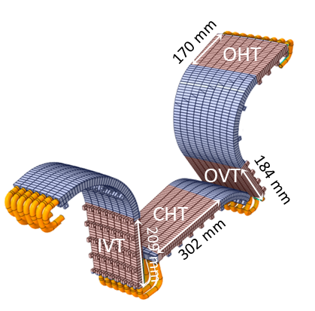
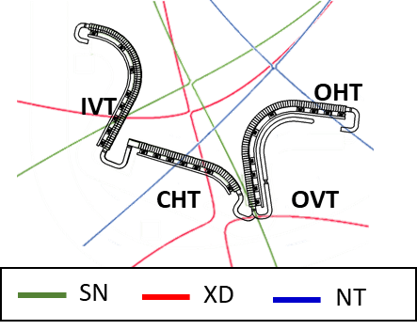
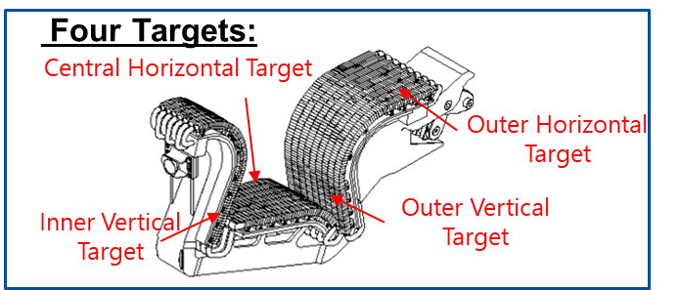
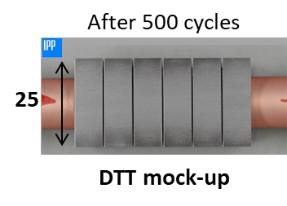

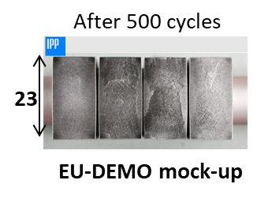
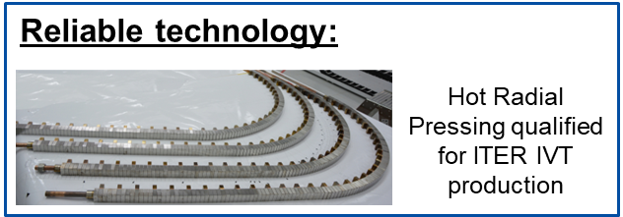
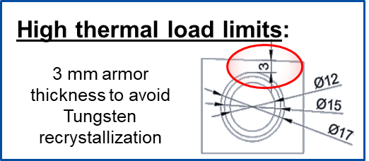
Divertor Tokamak Test
PFCs
500 cycles, 10s, hot water (130 °C)
S. Roccella, Design and qualification activity of the first divertor of the DIVERTOR TOKAMAK TEST FACILITY, poster Session, Tuesday 28th October
October 29th, 2025

Slide 20



DTT Divertor – main subsystems
AISI 316L
Cassette body
Pumping slots realized between adjacent cassette
XM-19
Cassette body146 |  | AISI 316 LN | Mass [kg] | 116
 |  | XM-19 | Mass [kg] | 16
Targets | IVT | Tungsten | Mass [kg] | 25
 |  | CuCrZr | Mass [kg] | 2
 |  | AISI 316 LN | Mass [kg] | 8
 | OVT | Tungsten | Mass [kg] | 55
 |  | CuCrZr | Mass [kg] | 3
 |  | 316 | Mass [kg] | 13
 | CT | Tungsten | Mass [kg] | 29
 |  | CuCrZr | Mass [kg] | 1
 |  | AISI 316 LN | Mass [kg] | 10
TOT |  |  | Mass [kg] | 278
AISI 316 LN | Mass [kg] | 147
XM-19 | Mass [kg] | 16
TUNGSTEN | Mass [kg] | 109
CuCrZr | Mass [kg] | 6
RH interface
October 29th, 2025

Slide 21




Fixation systems
All Divertor cassette-to-VV fixation system are developed based on the ITER concept
Nose
Lower stop
Nose
Wishbone
Nose
Wishbone
Lower stop
Knuckle
October 29th, 2025

Slide 22




Fixation systems - DTT
Nose-Inboard rail interaction
Knuckle-Outboard rail interaction
At the end of this phase, the hemispherical nose surface matches the inboard rail hemispherical slot. The mounting pins are not yet aligned with the respective holes in the knuckle case.
CB-Lower stop interaction
October 29th, 2025

Slide 23




Fixation systems - DTT
Nose-Inboard rail interaction
Knuckle-Outboard rail interaction
The preloading phase ends when the knuckle pins are aligned with the relative mounting holes. Consequently, the pin are extracted from the knuckle by actuating the driving rods. Therefore, the divertor reaches its mounted configuration.
CB-Lower stop interaction
October 29th, 2025

Slide 24



Fixation systems - DTT
Wedge solution
Test rig for DTT divertor fixation system
Knuckle solution
October 29th, 2025

Slide 25



Fixation systems – DTT
October 29th, 2025

Slide 26





Fixation system - DTT
1)
2)
3)
Baseline
Mechanical jack
20 kN
50 mm
Geared knuckle 1) | Pros | Cons
 | Easier to machine – Less components needed, no gear train of | Retrograde motion ( to be blocked through the addition of other components )
 | Higher torque for actuation | Higher actuation torque
 | Tougher design in terms of robustness of the single tooth | Asynchronies in the left and right gear rotation could eventually lead to the failure of the whole system ( an accurate phasing between the gears is needed)
Geared knuckle 2) | No retrograde motion (if the lead angle is properly dimensioned in relation to the friction coefficient) – Back driving possible
 | Lower actuation torque
 | Higher number of teeth engaged | Asynchronies in the left and right gear rotation could eventually lead to the failure of the whole system ( an accurate phasing between the gears is needed)
Geared knuckle 3) | Lower probability of failure due to asynchronies ( the worm gear is coupled with just one conic gear)
 | Lower actuation torque
 | Higher number of teeth engaged
 | No retrograde motion (if the lead angle is properly dimensioned in relation to the friction coefficient) – Back driving possible
1000 Nm
October 29th, 2025

Slide 27






Fixation systems VNS
Same facility used to test VNS fixation system
October 29th, 2025

Slide 28
Conclusions
Divertor cassettes developed under EUROfusion shares common design drivers, characterized by specific parameters for each project
Design of EU-DEMO Divertor cassette is mostly driven by the material choices for shielding and activation. High coolant pressure and mechanical loads are the main challenges for the design. The heavy load and the dimensions pose challenging requirements for RH systems
VNS divertor design, at feasibility assessment stage, is affected by relevant neutron fluxes and shielding requirements, to be addressed in compact space
DTT divertor, at manufacturing stage, can contribute with manufacturing and design experience to the development of next divertors, in particular for PFC
Shared tests on fixation systems between DTT and VNS can provide relevant information, to be generalized for the design on next machines.
October 29th, 2025

Slide 29
Thank you
October 29th, 2025

