Slide 1
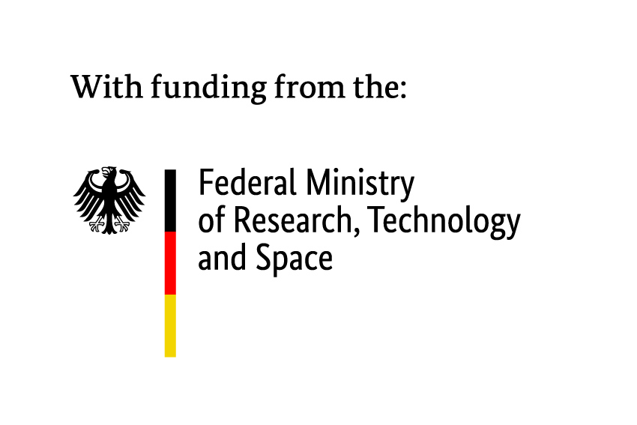

Status of Divertor Operation in Stellarators
V. R. Winters^{1,2}, F. Reimold², D. Boeyaert³, R. Davies², Y. Feng², K. Garcia^{1,2,3}, A. Kharwandikar², D.M. Kriete⁴,N. Maaziz², V. Perseo², T. Tork², D.Zhang² and the W7-X Team
¹Universität Greifswald, Institut für Physik, 17489 Greifswald, DE
²Max-Planck-Institut für Plasma Physik, 17491 Greifswald, DE
³University of Wisconsin – Madison, Madison, WI USA
⁴Auburn University, Auburn, AL USA

Slide 2
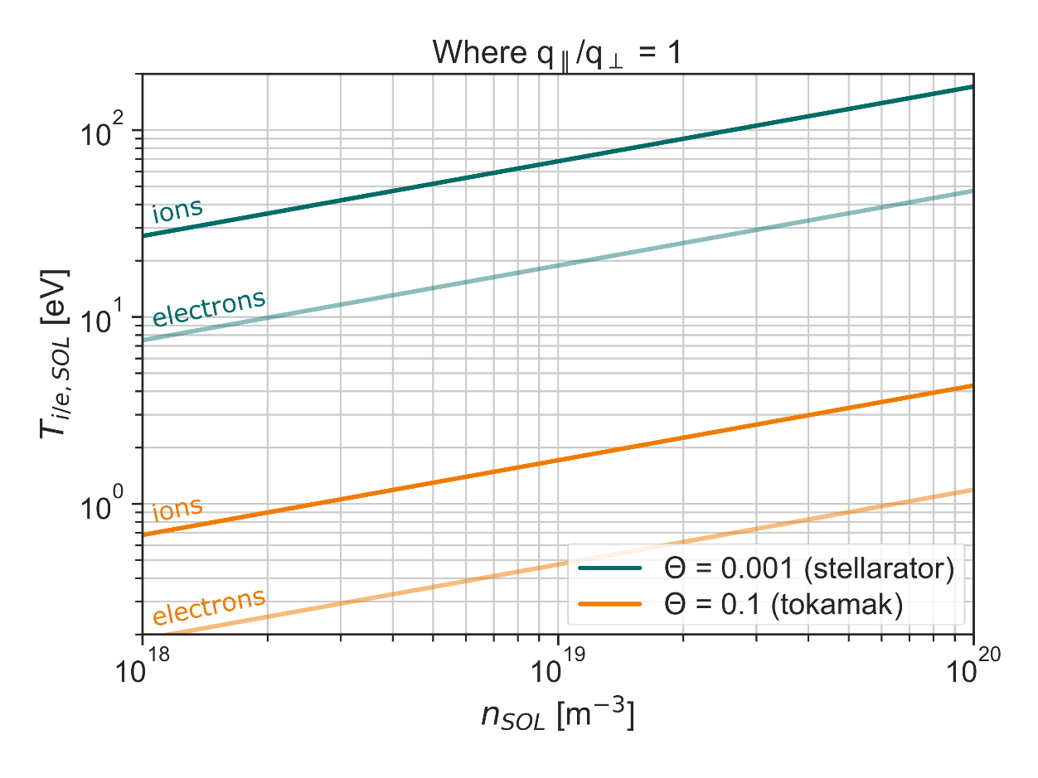
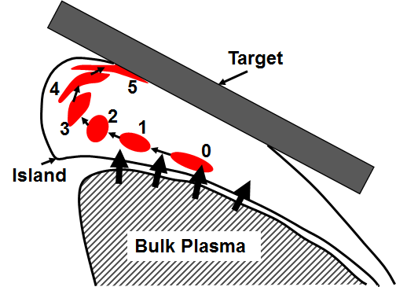
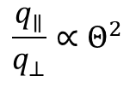

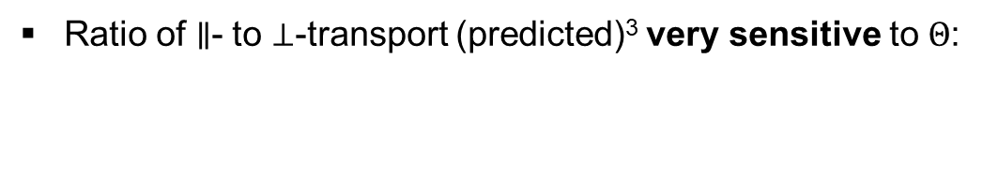
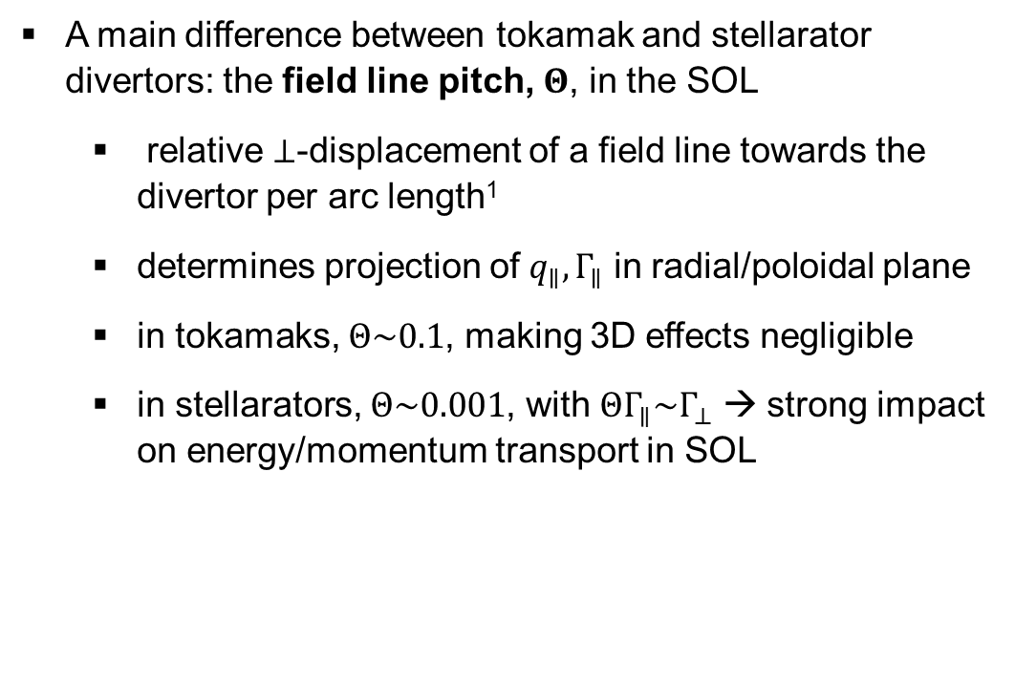
Geometry as a basis for understanding differences in stellarator performance
A main difference between tokamak and stellarator divertors: the field line pitch, $Θ$, in the SOL
relative $⊥$-displacement of a field line towards the divertor per arc length¹
determines projection of $q_{∥}, Γ_{∥}$ in radial/poloidal plane
in tokamaks, $Θ\sim 0.1$, making 3D effects negligible
in stellarators, $Θ\sim 0.001$, with $ΘΓ_{∥}\sim Γ_{⊥}$ → strong impact on energy/momentum transport in SOL
Adapted from [3]
[2]
$⊥$-transport much more important in stellarators than tokamaks!
Ratio of $∥$- to $⊥$-transport (predicted)³ very sensitive to $Θ$:
$$\frac{q_{∥}}{q_{⊥}}∝Θ^{2}$$
¹Y. Feng et al, Plasma Phys. Control. Fusion 64 (2022) 125012
²R. König et al, Plasma Phys. Control. Fusion 44 (2002) 2365-2422
³Y. Feng et al, Plasma Phys. Control. Fusion 53 (2011) 024009

Slide 3
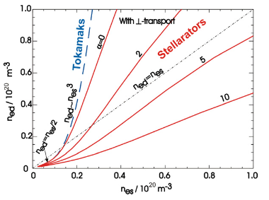
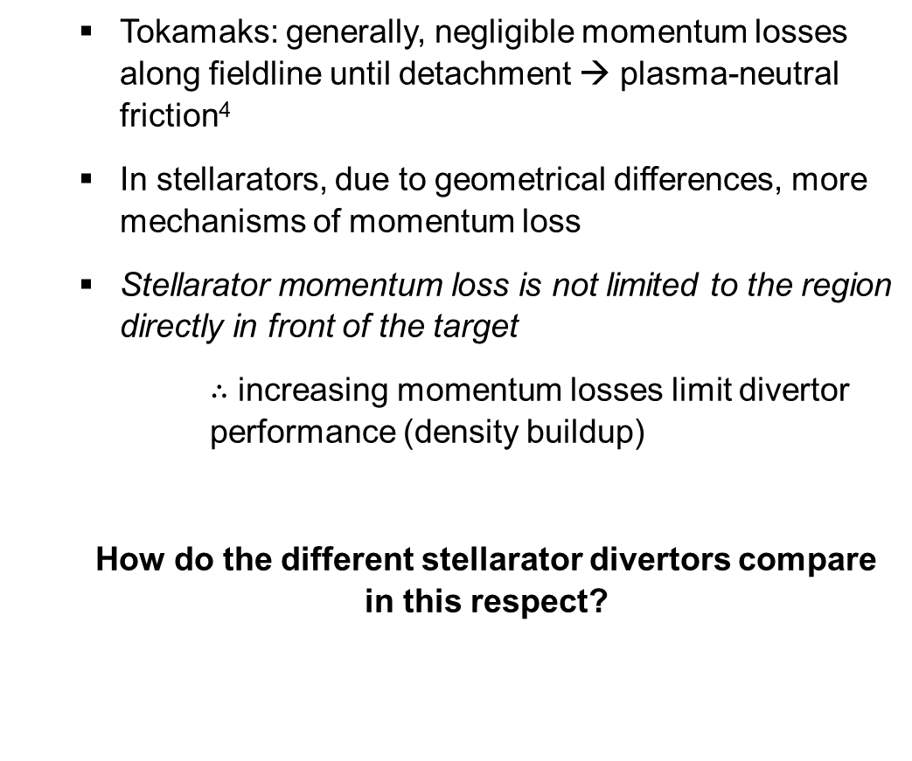
Momentum losses in stellarator SOLS: Not just plasma-neutral friction
Tokamaks: generally, negligible momentum losses along fieldline until detachment → plasma-neutral friction⁴
In stellarators, due to geometrical differences, more mechanisms of momentum loss
Stellarator momentum loss is not limited to the region directly in front of the target
$∴$ increasing momentum losses limit divertor performance (density buildup)
How do the different stellarator divertors compare in this respect?
[3]
increasing mom losses
⁴P. C. Stangeby, Plasma Phys. Control. Fusion 60 (2018) 044022
³Y. Feng et al, Plasma Phys. Control. Fusion 53 (2011) 024009

Slide 4
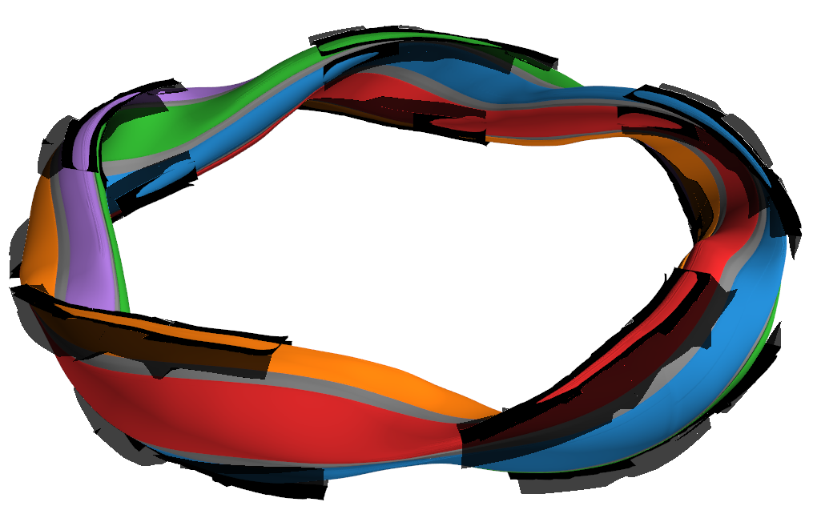
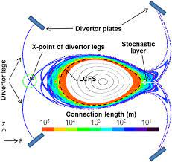
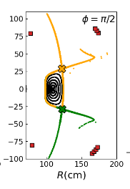
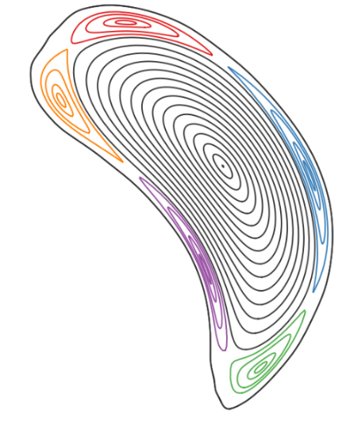
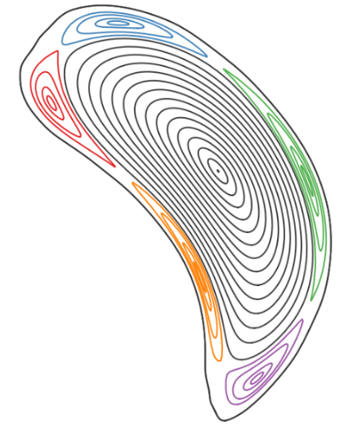



Three Types of Stellarator Divertors
[V. Perseo]
Island Divertor
Helical Divertor
Nonresonant Divertor
$$φ=18°$$
2
1
1
2
Machine Examples
W7-AS, W7-X
Machine Examples
LHD
Machine Examples
HSX, CTH

Slide 5
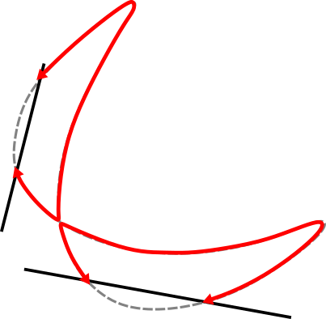
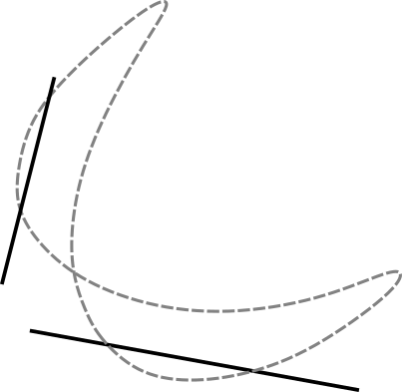

Three main types of stellarator divertors
[V. Perseo]
Island Divertor
large island chain designed at the plasma edge, intersected by divertor target plates
islands precess poloidally around the LCFS as they move toroidally
2
Shadowed by other targets
1
1
2
$$Γ_{∥}, q_{∥}$$
island
separatrix
Machine Examples
W7-AS, W7-X

Slide 6
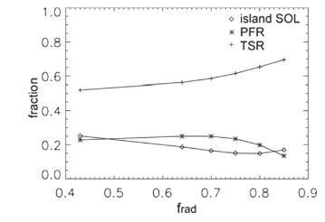




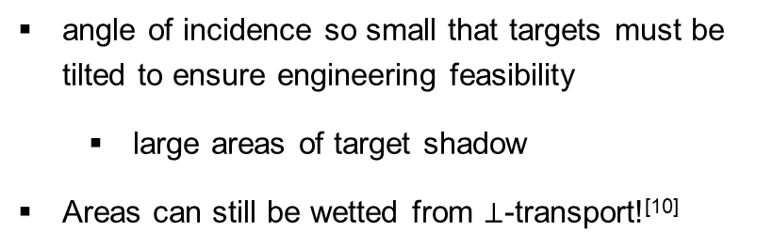

The Target Shadow Region
Tokamak
Island Divertor
$$\overset{⃑}{B}$$
Baffle plates in target shadow were modified in W7-X after heatflux overload observed in first divertor experimental phase!⁵
indicates importance of understanding heatflux decay length into this region*
*More details in talk by A. Kharwandikar
$$3.2°$$
$$\overset{⃑}{B}$$
„wetted area“
0.46$°$
„target shadow“
$$⊥$$
⁶Y. Feng et al, Nucl. Fusion 61 (2021) 086012
„wetted area“
Simulations show significant momentum deposition inTSR in W7-X⁶
„target shadow“
full toroidal extent!
0
2π
„target shadow“ corresponds to extremely small areas (constructed to avoid leading edges)
angle of incidence so small that targets must be tilted to ensure engineering feasibility
large areas of target shadow
Areas can still be wetted from $⊥$-transport!^{[10]}
⁹R. Pitts et al, Nuclear Materials and Energy 12 (2017) 60-74
¹Y. Feng et al, Plasma Phys. Control Fusion 64 (2022) 125012
⁵Y. Gao et al, Nucl. Fusion 60 (2020) 096012

Slide 7
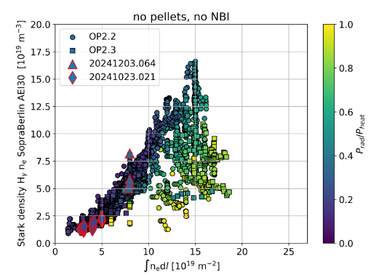
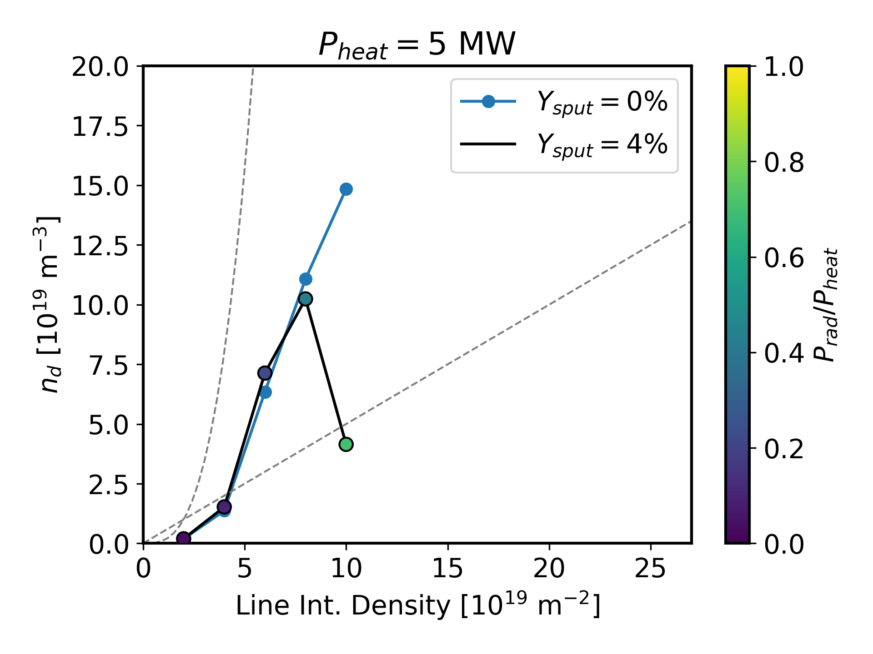
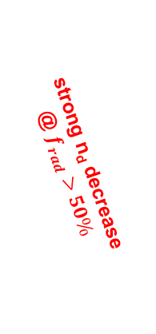
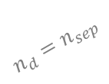

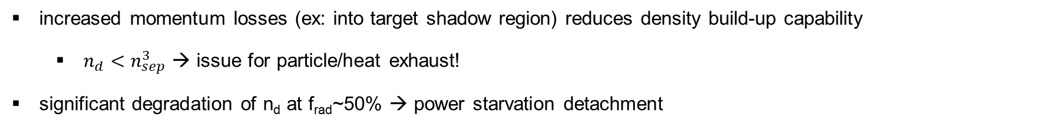
Momentum losses to TSR → Suspected (as part) of density build-up difficulties in W7-X island divertor
Difficulties in density build-up → poor particle exhaust⁷ in W7-X island divertor
Not yet clear if a „closed“ divertor is the full solution, though there are promising results⁸
$$n_{d}=n_{sep}^{3}$$
strong n_{d} decrease
@ $f_{rad}>50\%$
$$n_{d}=n_{sep}$$
moderate increase until f_{rad}~50%
n_{d} (Stark Broadening) [10¹⁹ m⁻³]
[F. Henke PhD Thesis]
EMC3-Eirene
Line Int. Density [10¹⁹ m⁻²]
(approx)
increased momentum losses (ex: into target shadow region) reduces density build-up capability
$n_{d}<n_{sep}^{3}$ → issue for particle/heat exhaust!
significant degradation of n_{d} at f_{rad}~50% → power starvation detachment
*More Details in F. Henke‘s talk
⁷T. Kremeyer et al, Nucl. Fusion 62 (2022) 036023
⁸N. Maaziz et al, Nuclear Materials and Energy (2025) 42 101886

Slide 8
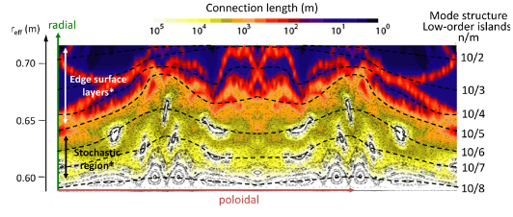

Three main types of stellarator divertors
Helical Divertor
utilizes inherent helical geometry of magnetic coils^{9,10}
X-points follow helical pattern → looks a bit familiar to tokamak geometry
higher shear near the plasma edge leads to „edge stochastic layer“¹⁰
$$φ=18°$$
[9]
[3]
Machine Examples
LHD
⁹N. Ohyabu et al, Nucl. Fusion 34 (1994) 387
¹⁰M. Kobayashi et al, Nuclear Materials and Energy 12 (2017) 1043-1048
³Y. Feng et al, Plasma Phys. Control. Fusion 53 (2011) 024009

Slide 9
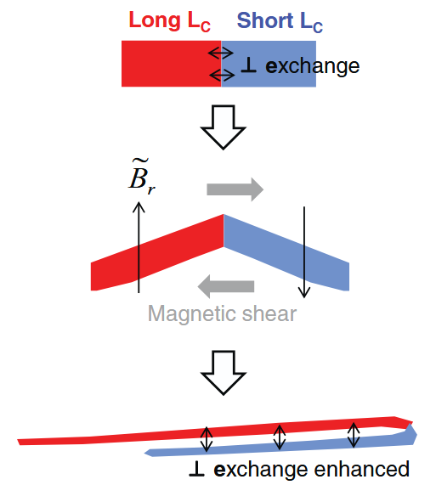
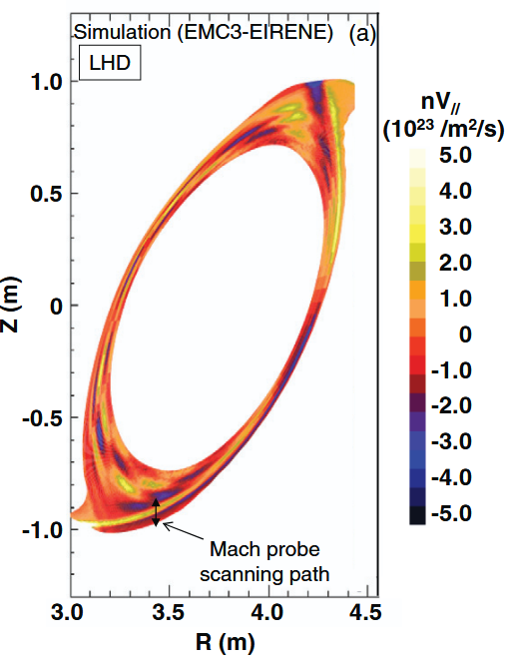
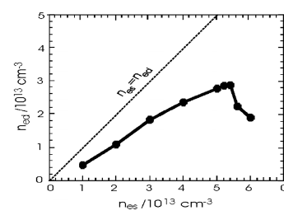
Density Build-up in LHD
[11]
Historically, no high recycling regime observed in LHD¹¹
Hypothesis¹¹:
momentum losses between counter-streaming flows
Enhanced momentum losses from viscous losses between high and low L_{c} regions (chaos)
Recently: Record neutral pressures observed for a stellarator in LHD¹²→ see talk G. Motojima (Fri)
Physics mechanism not exactly clear yet?
[11]
¹¹M. Kobayashi et al, Nucl. Fusion 55 (2015) 104021
¹²U. Wenzel et al, Nucl. Fusion 64 (2024) 034002

Slide 10
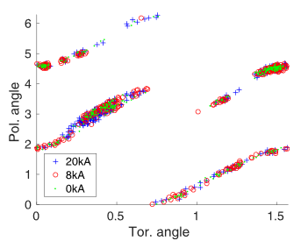
Three main types of stellarator divertors
Nonresonant Divertor
Utilizes the fact that heat and particles preferentially leave LCFS near regions of high curvature
In a practical sense: „resilient“ divertors whose strikelines are unaffected by changes in the edge rotational transform¹⁴
Necessary for stellarators that exhibit large bootstrap currents
Example: HSX
[13]
strikelines remain localized to same locations with 20kA current evolution¹⁵
Machine Examples
HSX, CTH
¹³R. Davies et al, Nucl. Fusion 65 (2025) 076018
¹⁴K. Garcia et al, Plasma Phys. Control. Fusion 67 (2025) 035011
¹⁵A. Bader et al, Phys. Plasmas 24 (2017) 032506

Slide 11
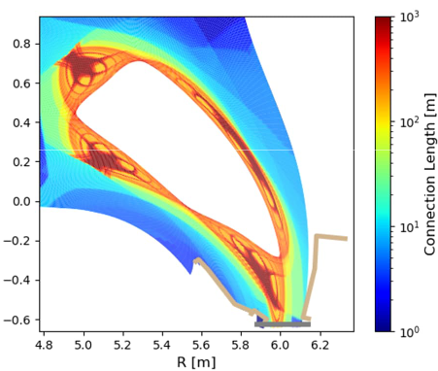
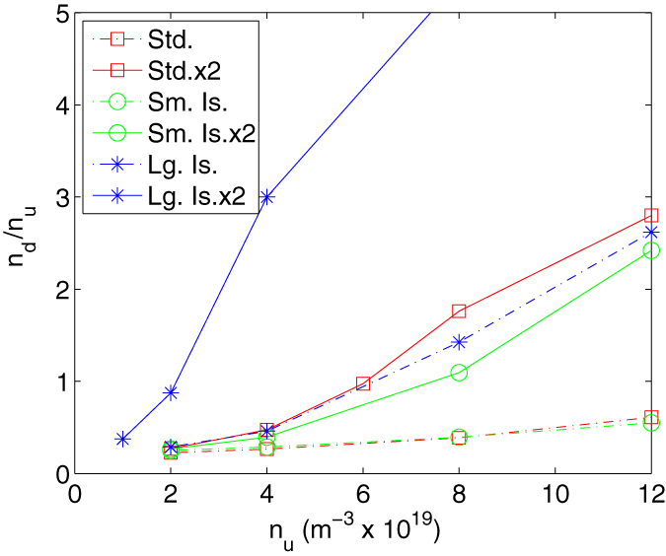
Three main types of stellarator divertors
Nonresonant Divertor
Utilizes the fact that heat and particles preferentially leave LCFS near regions of high curvature
In a practical sense: „resilient“ divertors whose strikelines are unaffected by changes in the edge rotational transform¹²
Necessary for stellarators that exhibit large bootstrap currents
Relatively unexplored concept, but
simulation results show poor density build-up¹⁶
Both counter-streaming flows and perpendicular mixing of flux tubes likely responsible
Test show that NRD configurations can be tested on W7-X
strike lines away from most edge diagnostic locations
HSX, doubled HSX
large island
exhibit resiliency
Example: HSX
std island
small island
[13]
strikelines remain localized to same locations with 20kA current evolution¹⁵
2 x HSX
HSX
Machine Examples
HSX, CTH
¹³R. Davies et al, Nucl. Fusion 65 (2025) 076018
¹⁴K. Garcia et al, Plasma Phys. Control. Fusion 67 (2025) 035011
¹⁵A. Bader et al, Phys. Plasmas 24 (2017) 032506
¹⁶A´. Bader et al, Nucl. Fusion 53 (2013) 113036

Slide 12
Three types of stellarator divertors
[V. Perseo]
Island Divertor
Helical Divertor
Nonresonant Divertor
$$φ=18°$$
2
Thus far, the island divertor has shown the most promising results in density build-up at the target.
Large islands like W7-X minimize momentum losses, but more work needs to be done to improve
Our goal: To advance its maturity such that we have reactor-required performance in heat/particle exhaust
1
1
2
[3]
[5]
Machine Examples
W7-AS, W7-X
Machine Examples
LHD
Machine Examples
HSX, CTH

Slide 13
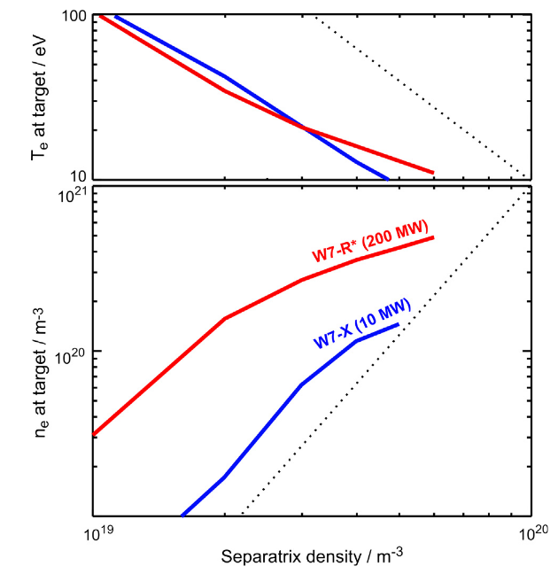
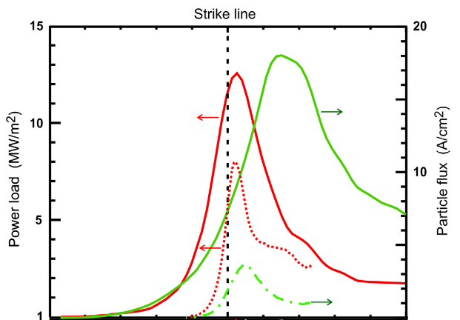
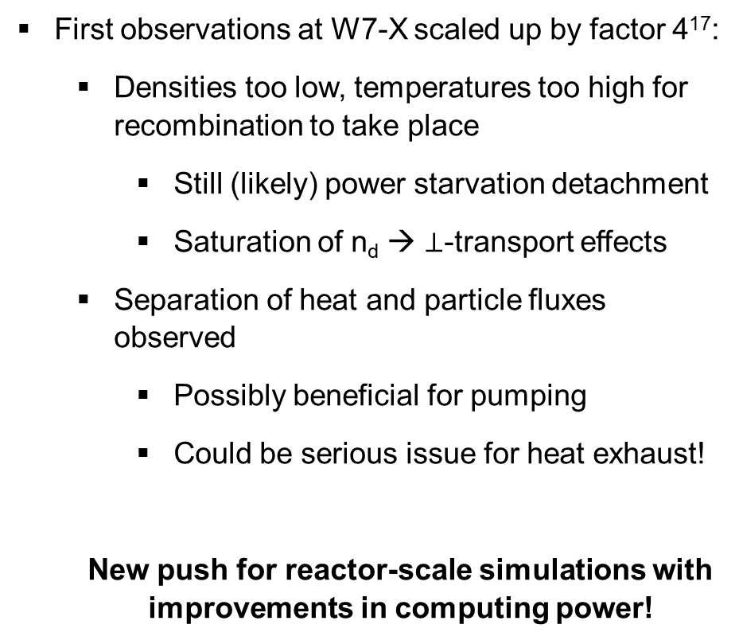
Preview at the scale of the work ahead of us: First simulation results of reactor-size W7-X¹⁷
First observations at W7-X scaled up by factor 4¹⁷:
Densities too low, temperatures too high for recombination to take place
Still (likely) power starvation detachment
Saturation of n_{d} → $⊥$-transport effects
Separation of heat and particle fluxes observed
Possibly beneficial for pumping
Could be serious issue for heat exhaust!
New push for reactor-scale simulations with improvements in computing power!
¹⁷Y. Feng et al, J. Nuc. Mat. 438(2013) S497-S500

Slide 14
Outlook and Conclusions: Stellarator Divertor Operation
Open Questions:
How can we improve density build-up (particle exhaust)/detachment in stellarator divertors?
Transport
→How to further minimize momentum losses in stellarator devices?
Access to improved detachment regimes (not just power starvation)
Hardware
→Is better baffling or target shaping enough to overcome the particle exhaust challenge?
Completely untreated thus far:
Drift effects/SOL current effects on heat/particle transport (some experimental observations, deep physical understanding missing)
→upcoming code suites → e.g. BOUT++
Understanding edge turbulence in stellarator devices
→upcoming code suites → e.g. BOUT++, GRILLIX, GBS
How to extrapolate to reactor scale (higher power, larger scale size)? → Talk by V. Perseo
Not presented here but ongoing work: radiation stability, impurity retention →Talk by F. Henke

Slide 15
Back-up Slides

Slide 16
density buildup
$$n_{d}=n_{sep}^{3}$$
$$n_{d}=n_{sep}$$
moderate increase until f_{rad}~50%
strong n_{d} collapse to detachment
n_{d} (Stark Broadening) [10¹⁹ m⁻³]
[F. Henke PhD Thesis]
EMC3-Eirene
Line Int. Density [10¹⁹ m⁻²]
(approx)
increased momentum losses (ex: into target shadow region) reduces density build-up capability
$n_{d}<n_{sep}^{3}$ → issue for particle/heat exhaust!
significant degradation of n_{d} at f_{rad}~50% → power starvation detachment
*More Details in F. Henke‘s talk

Slide 17
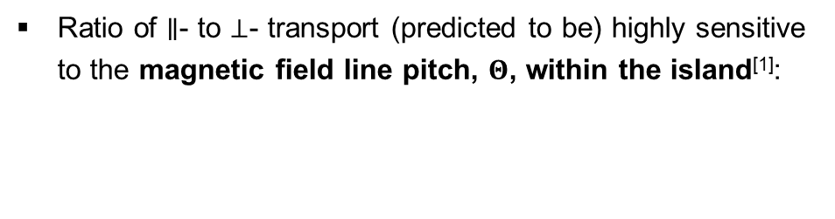
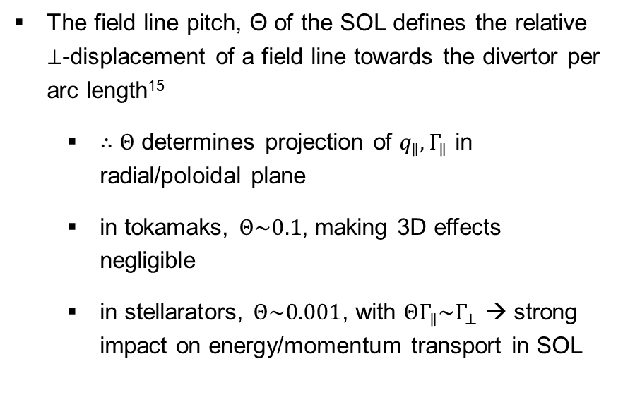

Geometrical properties of the stellarator divertor compared to tokamaks
The field line pitch, Θ of the SOL defines the relative $⊥$-displacement of a field line towards the divertor per arc length¹⁵
$∴Θ$ determines projection of $q_{∥}, Γ_{∥}$ in radial/poloidal plane
in tokamaks, $Θ\sim 0.1$, making 3D effects negligible
in stellarators, $Θ\sim 0.001$, with $ΘΓ_{∥}\sim Γ_{⊥}$ → strong impact on energy/momentum transport in SOL
Adapted from [4]
$⊥$-transport much more important in stellarators than tokamaks!
Ratio of $∥$- to $⊥$- transport (predicted to be) highly sensitive to the magnetic field line pitch, $Θ$, within the island^{[1]}:
$$\frac{q_{∥}}{q_{⊥}}∝Θ^{2}$$
²R. König et al, Plasma Phys. Control. Fusion 44 (2002) 2365-2422
⁴Y. Feng et al, Plasma Phys. Control. Fusion 53 (2011) 024009
⁸Y. Feng et al, Plasma Phys. Control. Fusion 64 (2022) 125012

Slide 18
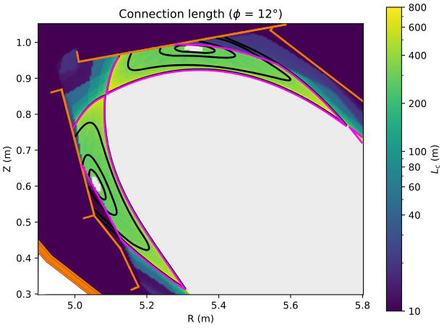
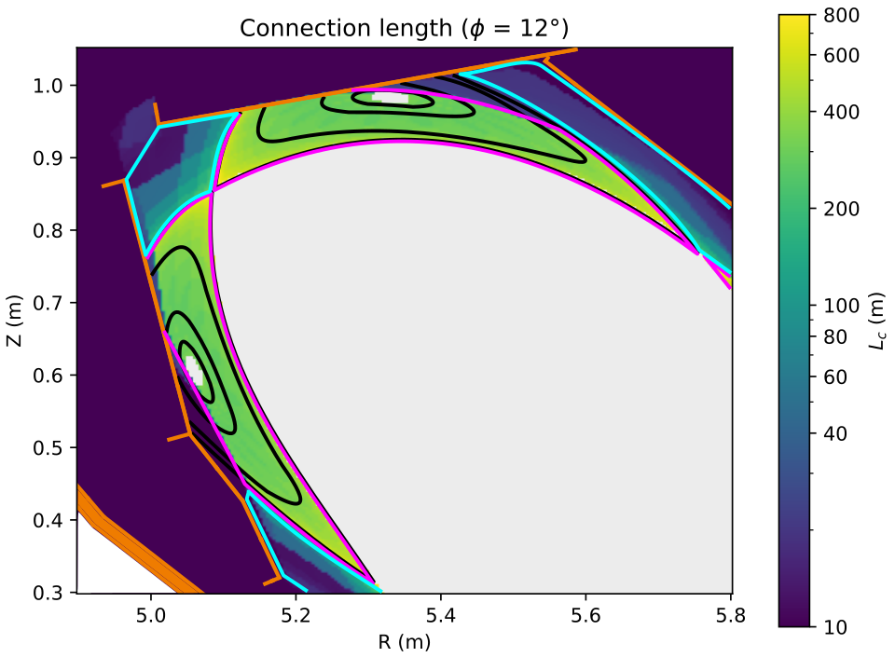


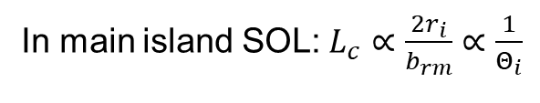
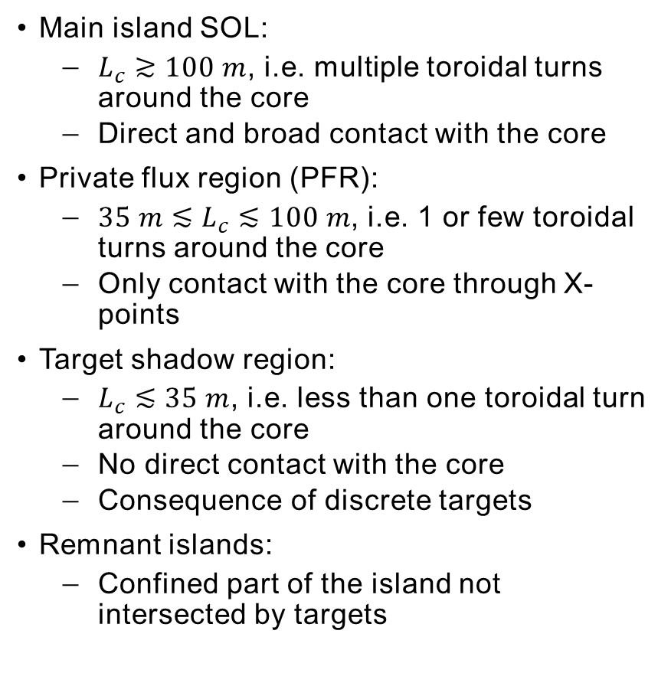
Different areas of the SOL with similar geometric properties
Main island SOL:
$L_{c}≳100 m$, i.e. multiple toroidal turns around the core
Direct and broad contact with the core
Private flux region (PFR):
$35 m≲L_{c}≲100 m$, i.e. 1 or few toroidal turns around the core
Only contact with the core through X-points
Target shadow region:
$L_{c}≲35 m$, i.e. less than one toroidal turn around the core
No direct contact with the core
Consequence of discrete targets
Remnant islands:
Confined part of the island not intersected by targets
In main island SOL:$L_{c}∝\frac{{2r}_{i}}{b_{rm}}∝\frac{1}{Θ_{i}}$
Notes:
Note: Lc integrated quantity (defined as integral over a flux surface) while $Θ_{i}$ local quantity! (the proportionality is not direct)

Slide 19
The Target Shadow Region
Tokamak
Island Divertor
Baffle plates in target shadow were modified after heatflux overload observed in first divertor experimental phase!
indicates importance of understanding heatflux decay length into this region*
*More details in talk by A. Kharwandikar
$$\overset{⃑}{B}$$
$$3.2°$$
$$\overset{⃑}{B}$$
„wetted area“
0.46$°$
„target shadow“
$$⊥$$
¹¹Y. Feng et al, Nucl. Fusion 61 (2021) 086012
„wetted area“
in simulations, most momentum flux deposited on target shadow region!¹¹
„target shadow“
full toroidal extent!
0
2π
„target shadow“ corresponds to extremely small areas (constructed to avoid leading edges)
angle of incidence so small that targets must be tilted to ensure engineering feasibility
large areas of target shadow
Areas can still be wetted from $⊥$-transport!^{[10]}
⁹R. Pitts et al, Nuclear Materials and Energy 12 (2017) 60-74
⁸Y. Feng et al, Plasma Phys. Control Fusion 64 (2022) 125012
¹⁰Y. Gao et al, Nucl. Fusion 60 (2020) 096012

Slide 20
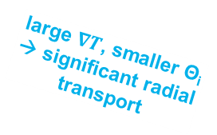
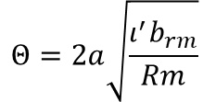
Geometrical properties of the stellarator divertor compared to tokamaks
The field line pitch, Θ of the SOL defines the relative $⊥$-displacement of a field line towards the divertor per arc length¹⁵
$∴Θ$ determines projection of $q_{∥}, Γ_{∥}$ in radial/poloidal plane
in tokamaks, $Θ\sim 0.1$, making 3D effects negligible
in stellarators, $Θ\sim 0.001$, with $ΘΓ_{∥}\sim Γ_{⊥}$ → strong impact on energy/momentum transport in SOL
[2]
large $∇T$, smaller Θ_{i} → significant radial transport
T_{i,e} , Θ_{i} large enough to poloidally bring heat to X-point
Ratio of $∥$- to $⊥$- transport (predicted to be) highly sensitive to the magnetic field line pitch, $Θ$, within the island^{[1]}:
shear at resonant surface
radial resonant field component
$$\frac{q_{∥}}{q_{⊥}}∝Θ^{2}$$
$$Θ=2a\sqrt{\frac{ι^{′}b_{rm}}{Rm}}$$
poloidal mode number of islands
²R. König et al, Plasma Phys. Control. Fusion 44 (2002) 2365-2422
⁴Y. Feng et al, Plasma Phys. Control. Fusion 53 (2011) 024009
⁸Y. Feng et al, Plasma Phys. Control. Fusion 64 (2022) 125012

Slide 21
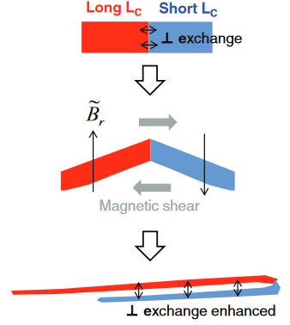
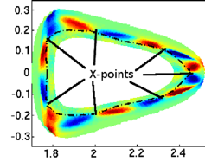
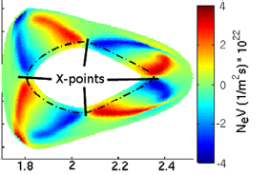

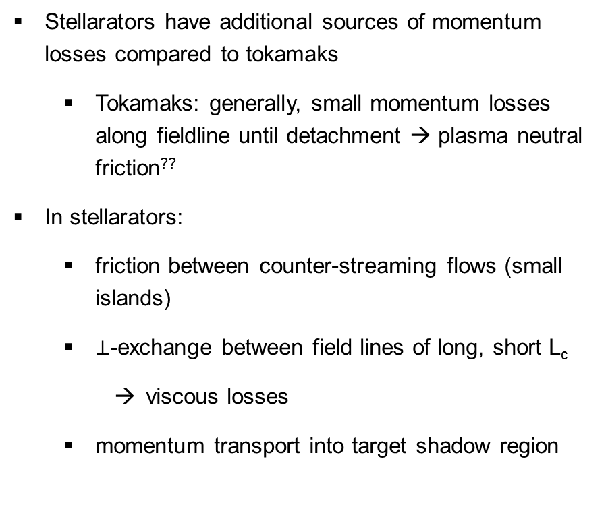
Momentum losses in stellarator SOLS: Not just plasma-neutral friction
Stellarators have additional sources of momentum losses compared to tokamaks
Tokamaks: generally, small momentum losses along fieldline until detachment → plasma neutral friction??
In stellarators:
friction between counter-streaming flows (small islands)
$⊥$-exchange between field lines of long, short L_{c}
viscous losses
momentum transport into target shadow region
[15]
The island divertor likely has the lowest momentum losses compared to other stellarator divertor concepts → best performance
Counterstreaming flows well-separated
low-shear (required for large islands) means enhanced viscous losses from distorted flux tubes are minimal
Still, transport in the island divertor differs significantly from the tokamak
ex: significant $⊥$-transport into target shadow region
„small“ island
large island
[14]
increasing mom losses
well-separated flow bundles reduce momentum exchange
*Particularly prevalent in SOLs with significant chaos → helical/NRD divertors!
??P. C. Stangeby, Plasma Phys. Control. Fusion 60 (2018) 044022

