Slide 1

First high power experiments of Alternative Divertor Experiments in ASDEX Upgrade
Overview ADC and XPR experiments and gaps in extrapolating to future devices
Overview ADC and XPR experiments and gaps in extrapolating to future devices
T.Lunt¹ on behalf of the ASDEX Upgrade and EUROfusion teams
¹Max Planck Institute for Plasma Physics, Boltzmannstr. 2, 85748 Garching, Germany
Outline:
- Introduction
- New upper divertor of ASDEX Upgrade
- Overview experimental campaign 2025
- First experimental observations
- Gaps in extrapolating to future devices
- Summary

Slide 2
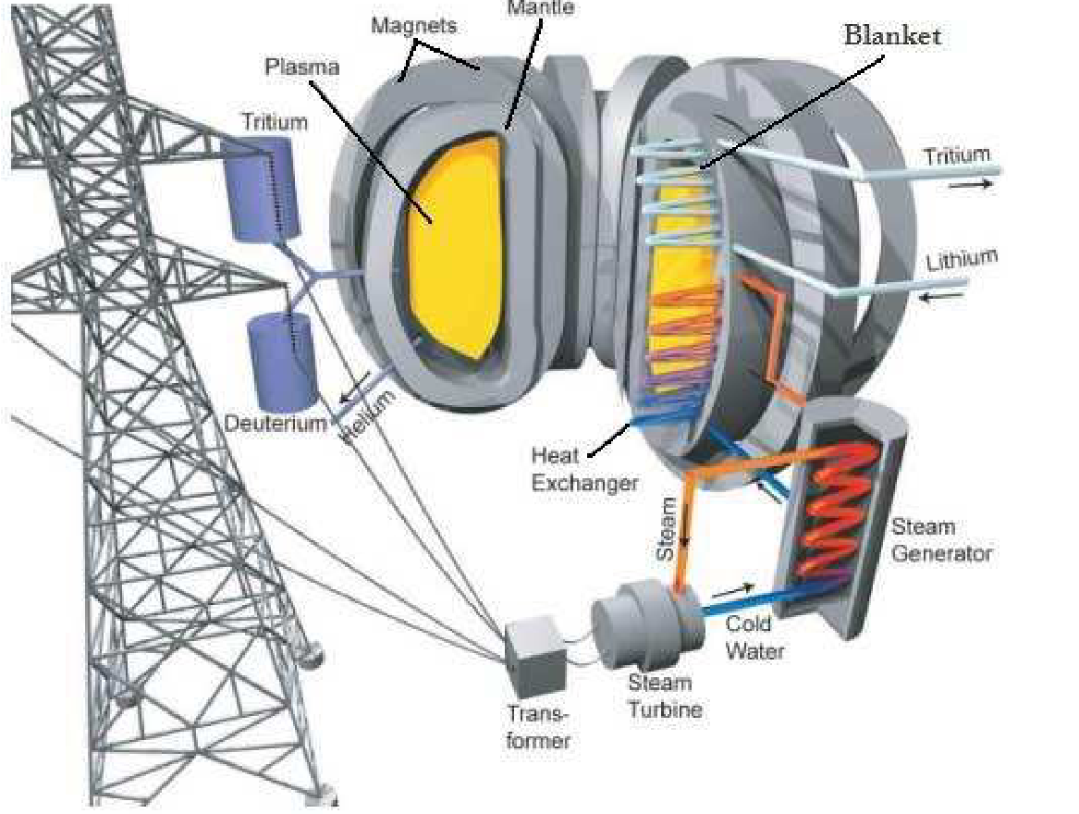
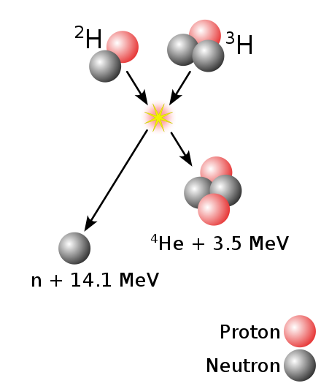
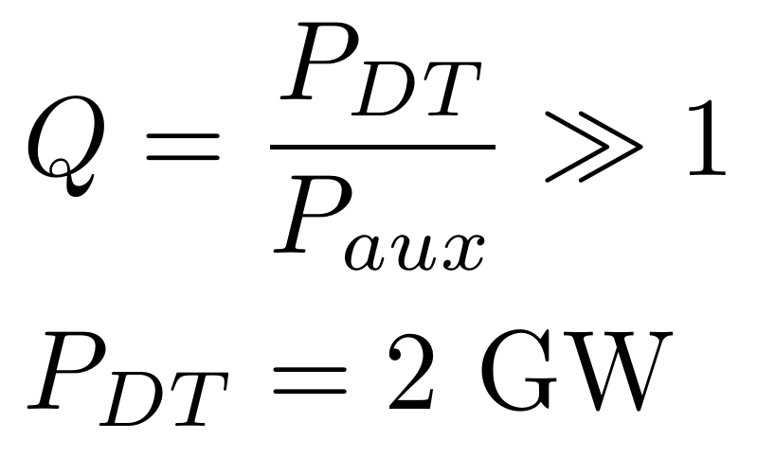
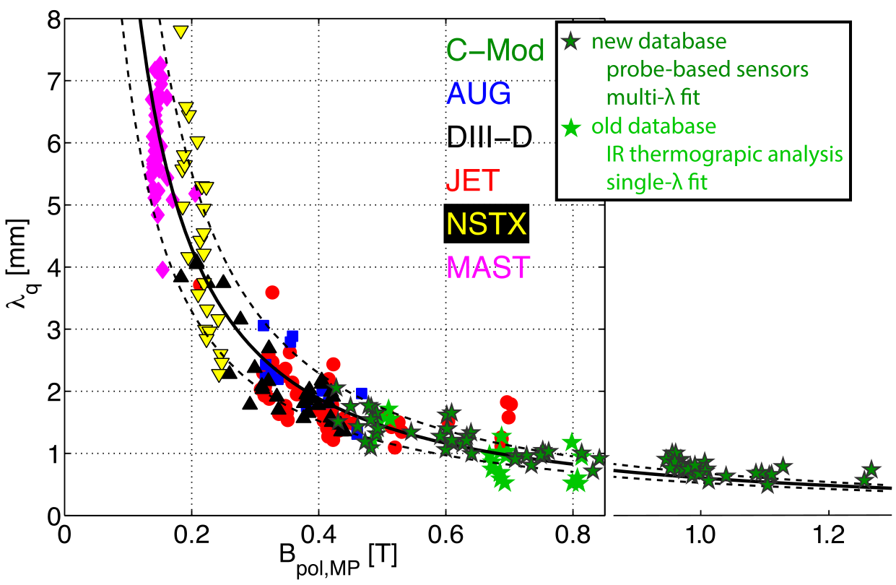
Introduction: Power and He exhaust challenge
P_{α}=400 MW
Φ_{He}= 7x10²⁰ 1/s
+P_{aux}
[Eich PRL 2011]
[Brunner NF 2018]
Φ_{He} = S_{pump} n_{He,pump}
High neutral He densities (pressures) in subdivertor volume mandatory for reactor to remove He ‚ash‘
A_{wet}=2 π R f_{x} λ_{q}
T.Lunt, 5th TM on divertor concepts 2025, IAEA Headquarters, Vienna, Austria
2

Slide 3
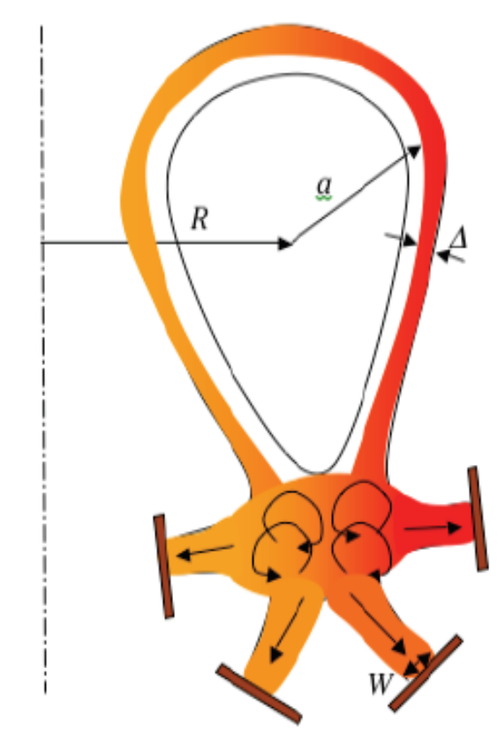
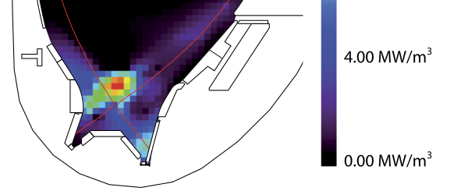
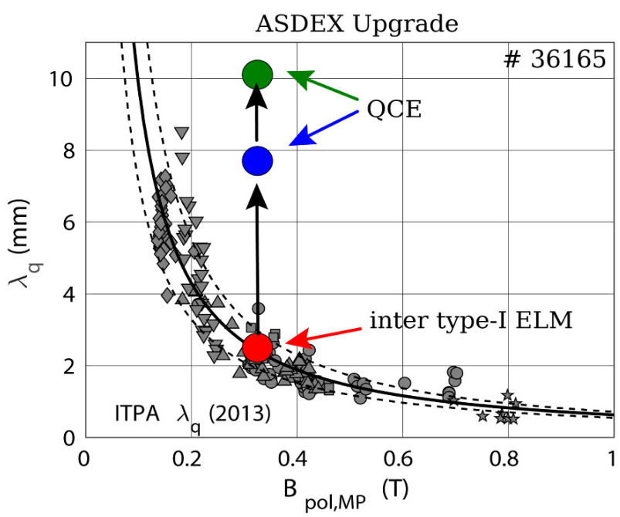
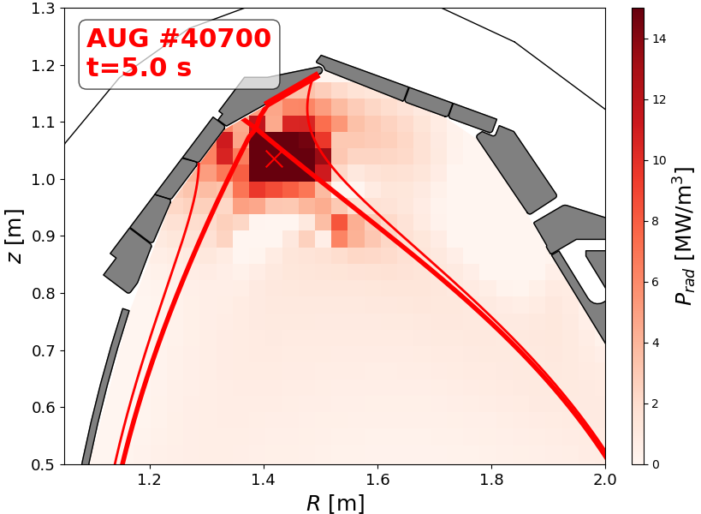
Introduction: Power and He exhaust challenge
Alternative Divertor
Configurations
Radiative scenarios
Small-ELM / QCE / EDA
[Bernert NF 2021]
[Faitsch NME 2021]
[Ryutov IAEA-FEC 2012]
[Lunt/Bernert PRL 2023]
T.Lunt, 5th TM on divertor concepts 2025, IAEA Headquarters, Vienna, Austria
3

Slide 4
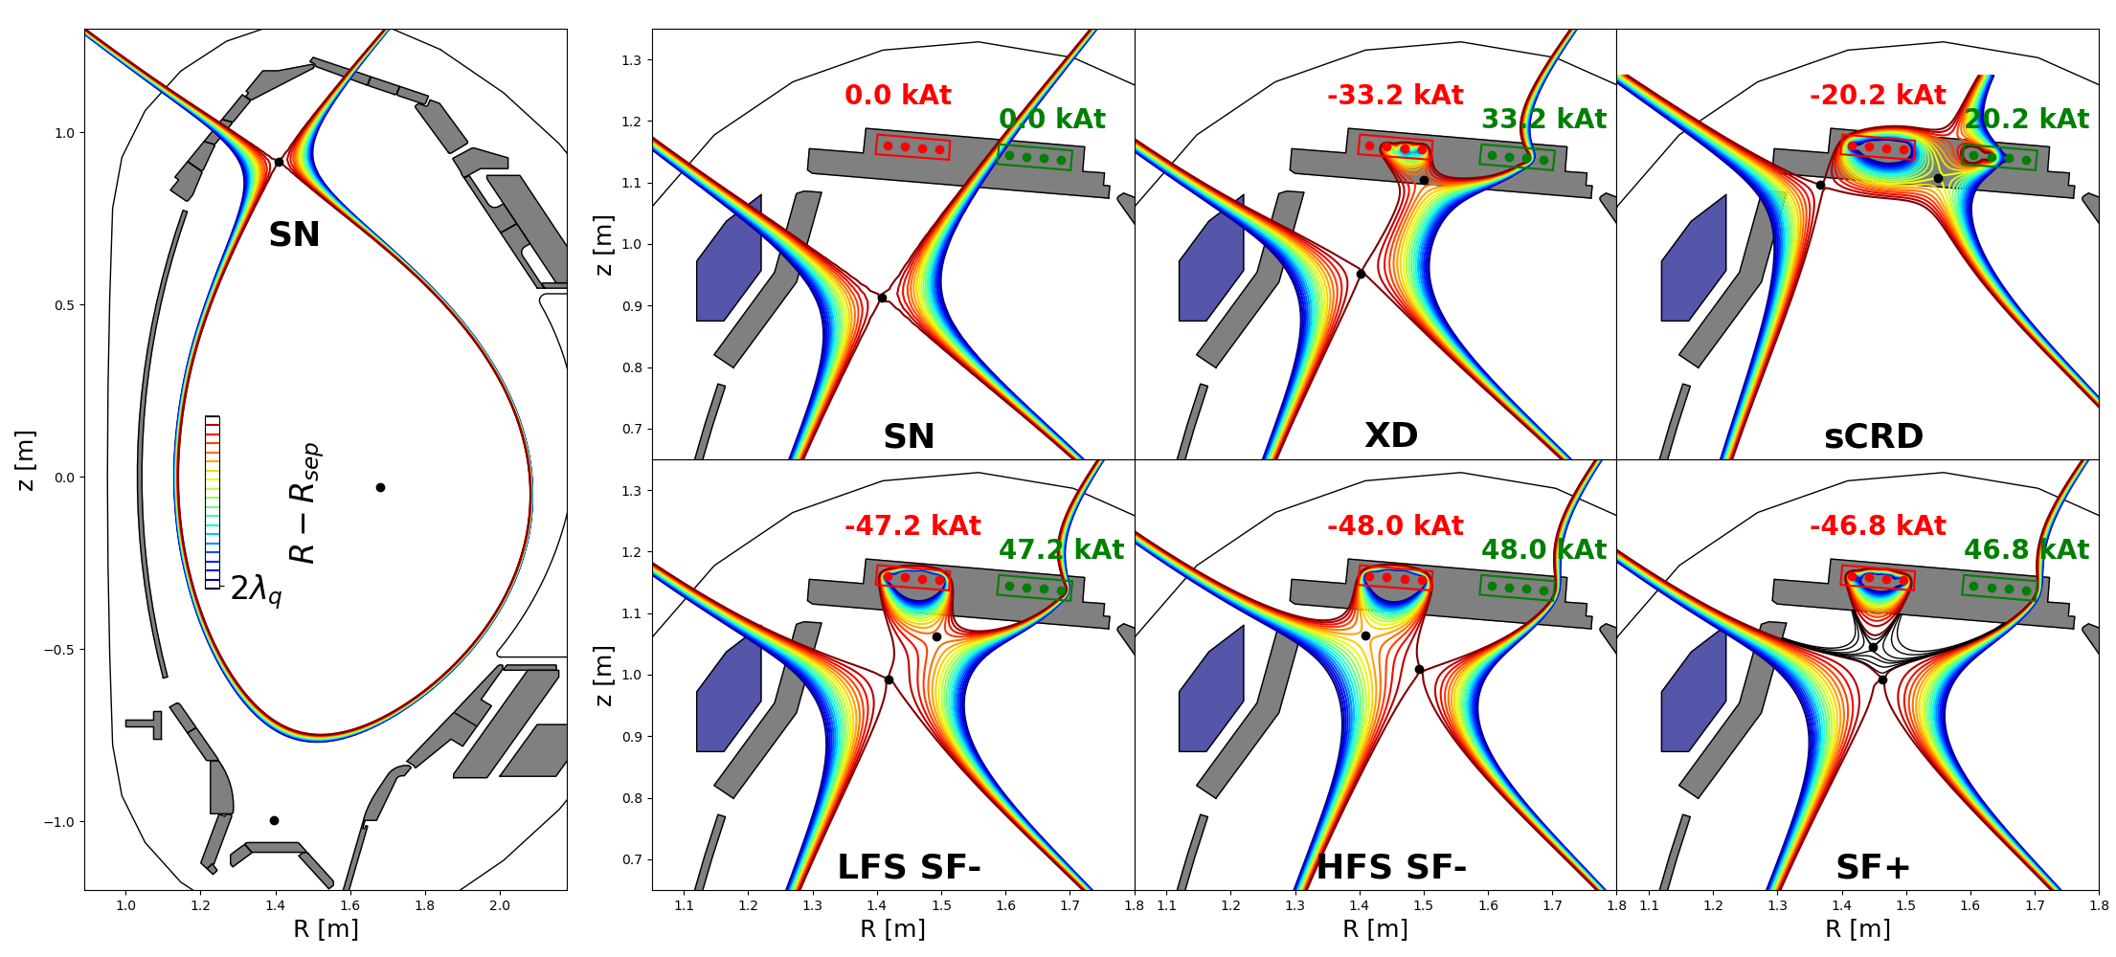
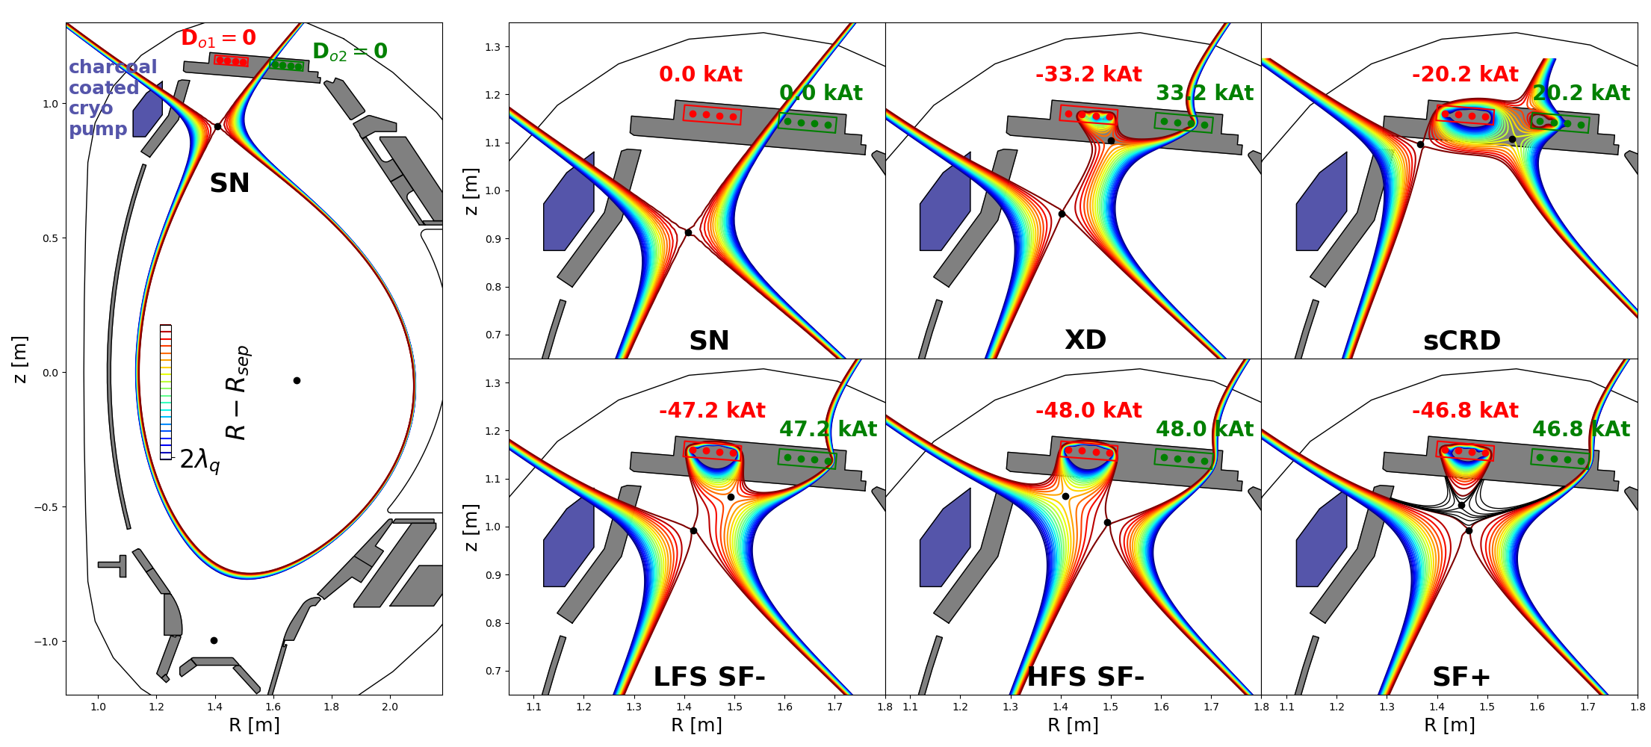
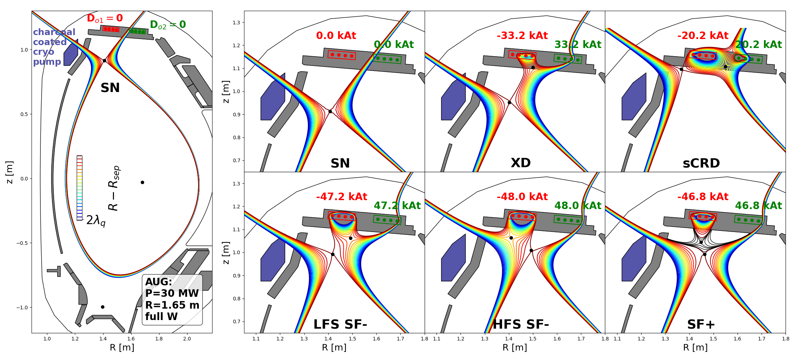
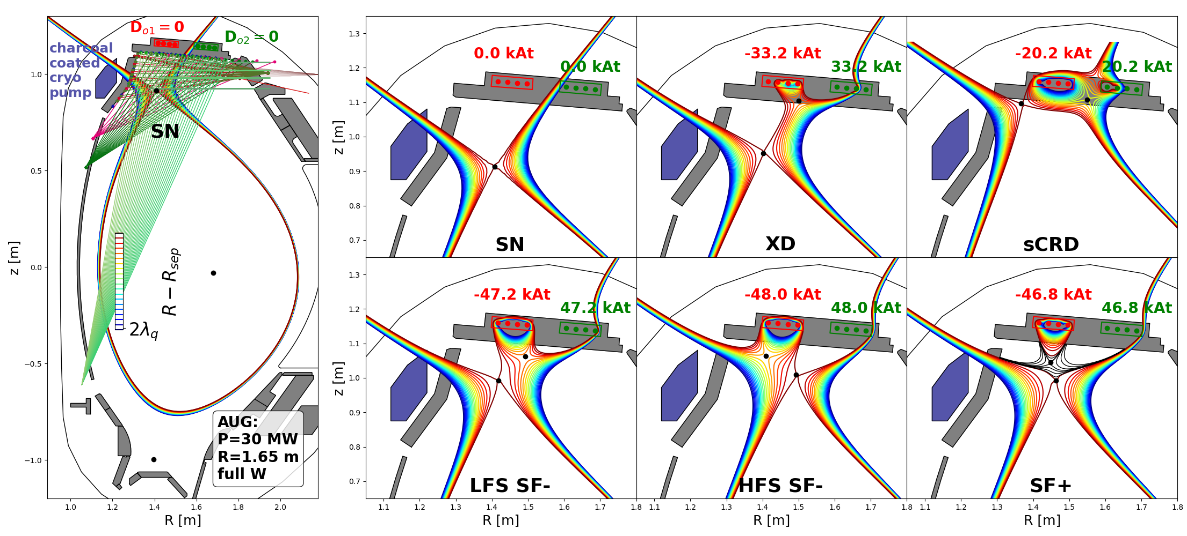
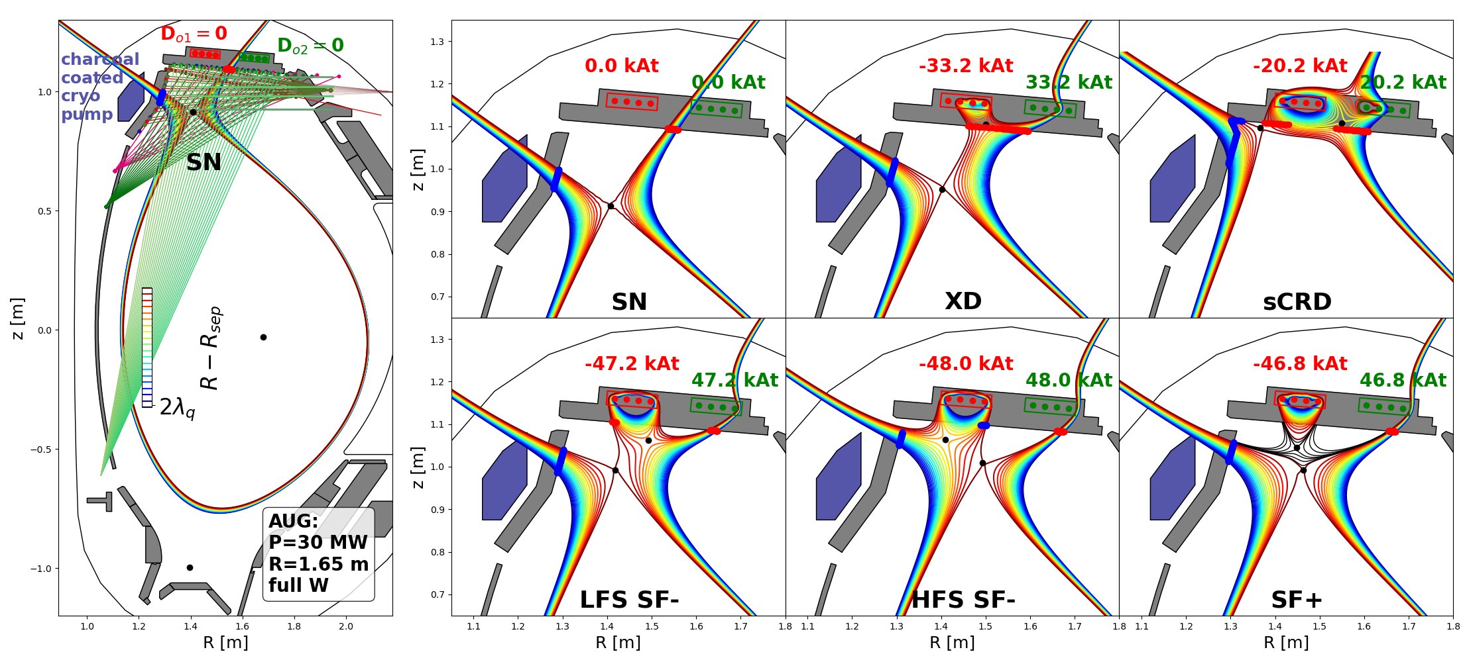

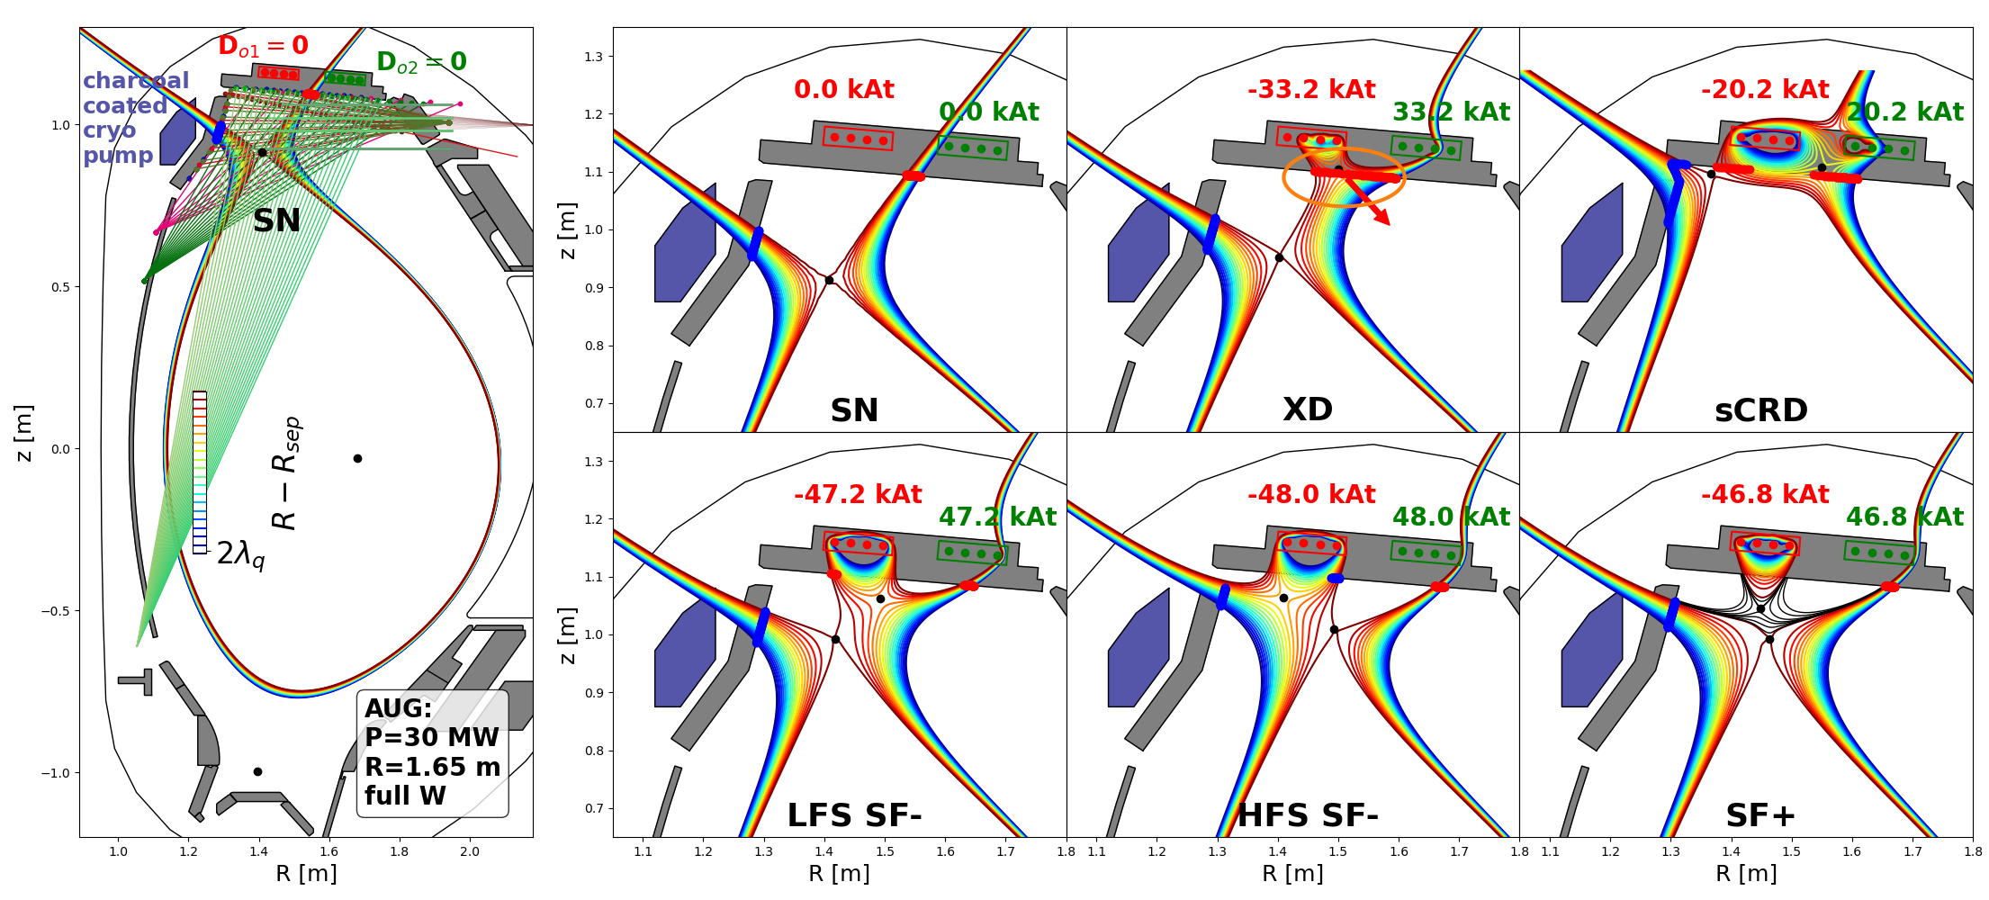

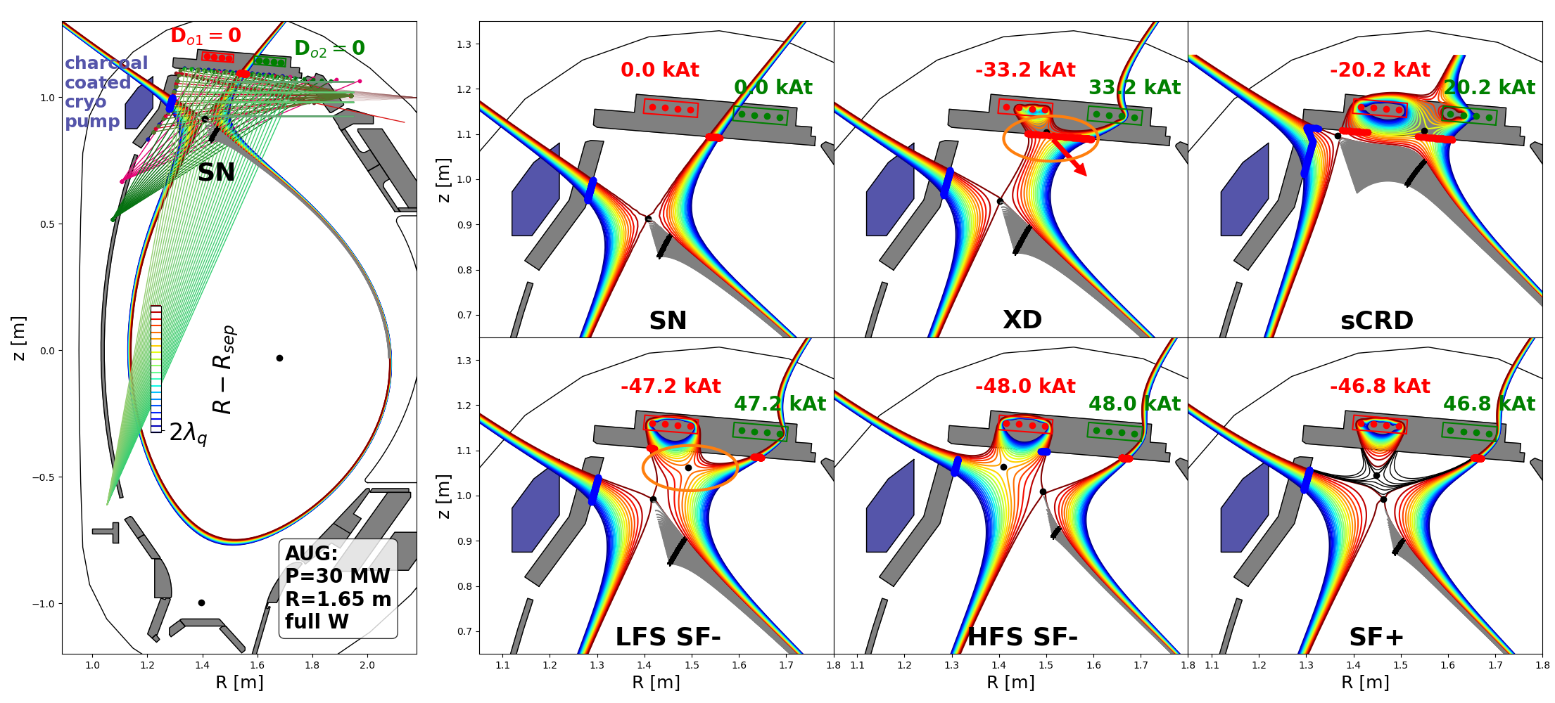
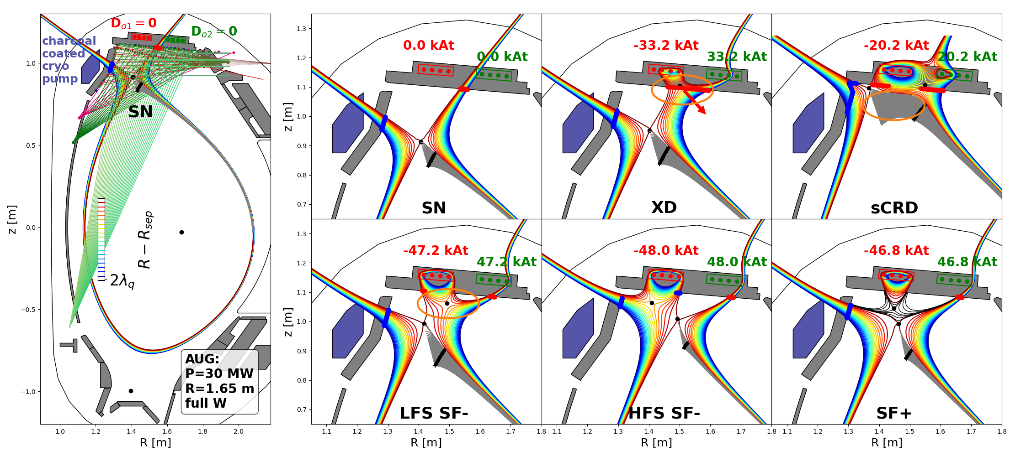

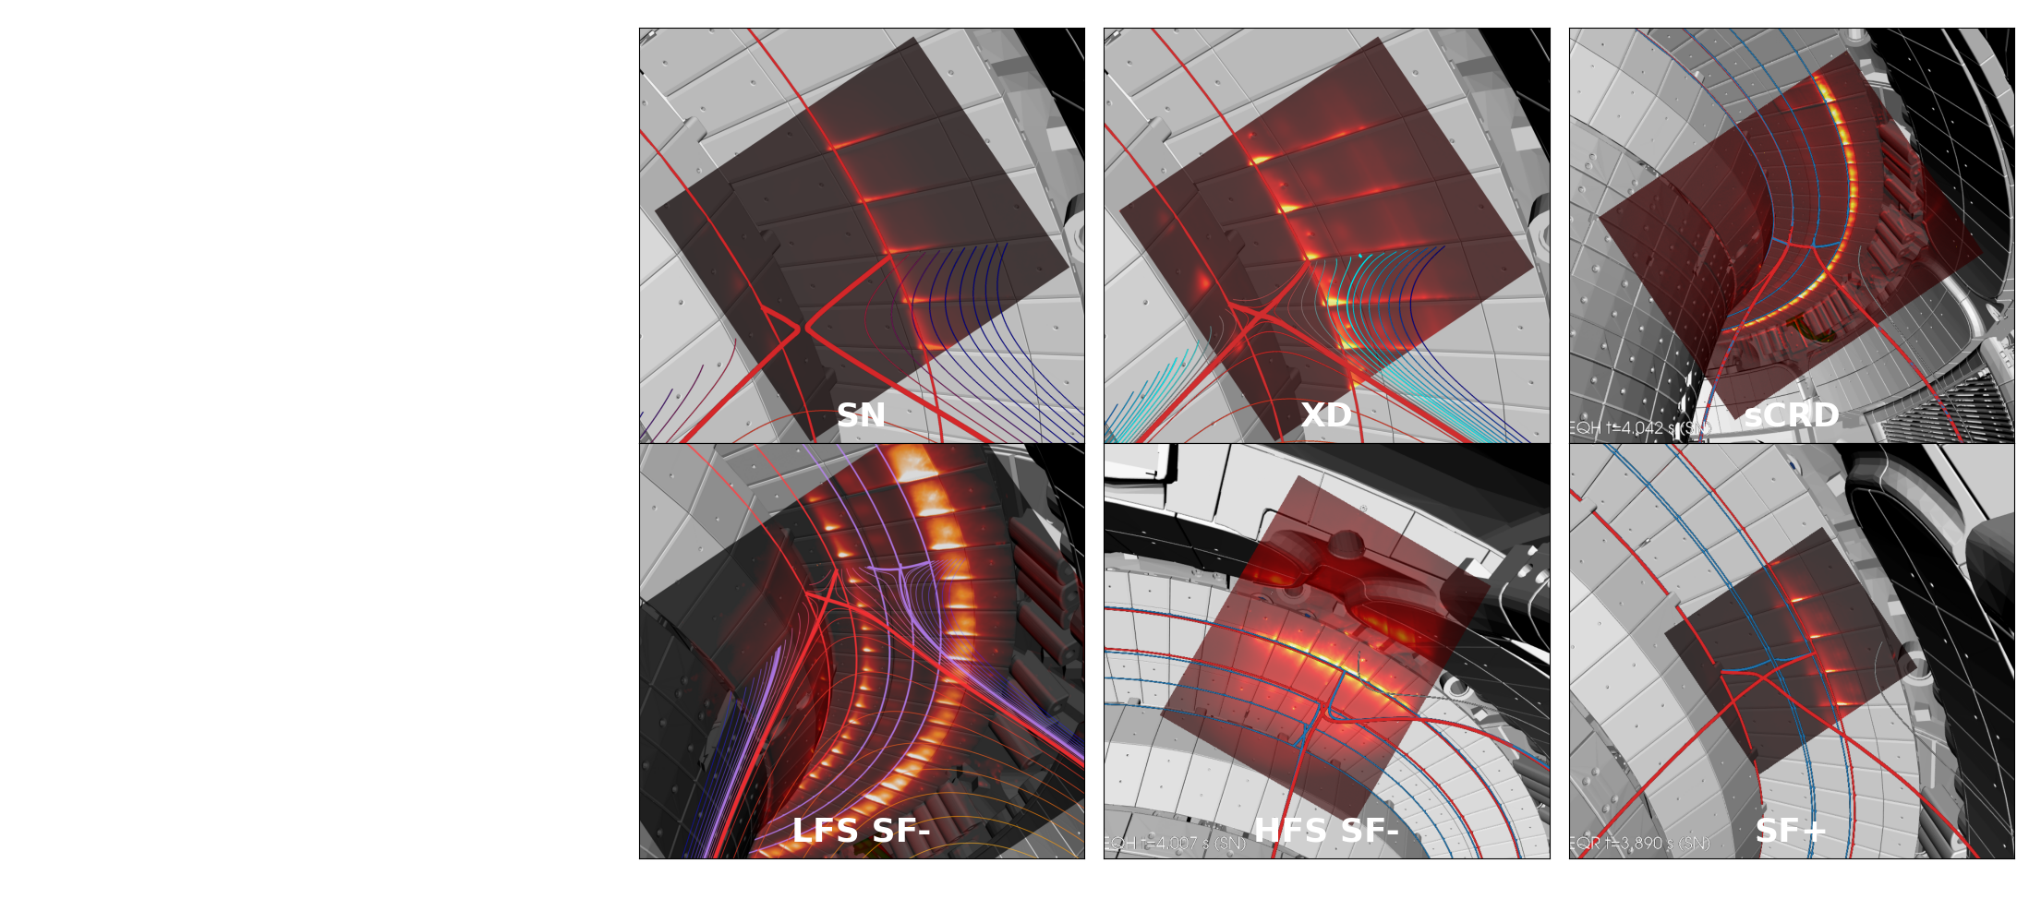
New Upper Divertor of ASDEX Upgrade: Configurations
[Lunt et al. PRL 2023]
T.Lunt, 5th TM on divertor concepts 2025, IAEA Headquarters, Vienna, Austria
4

Slide 5
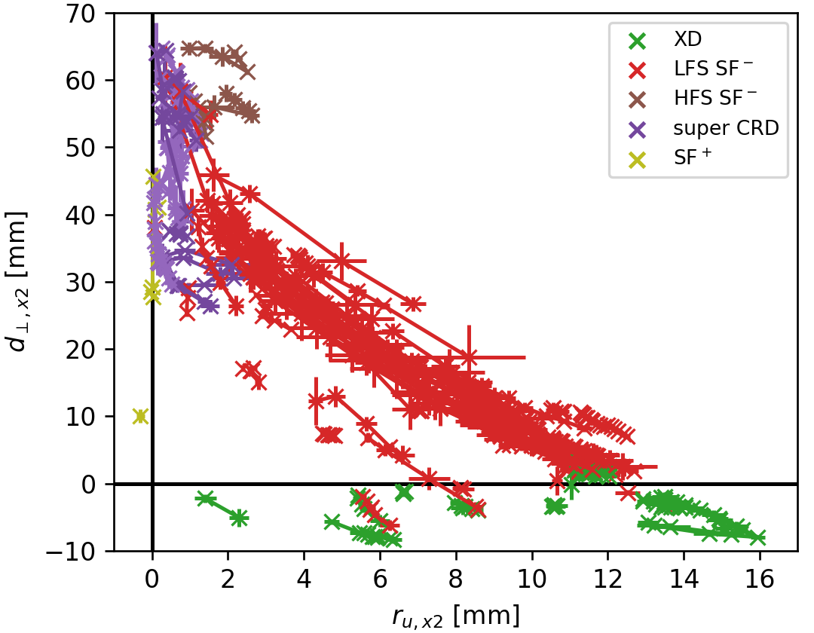
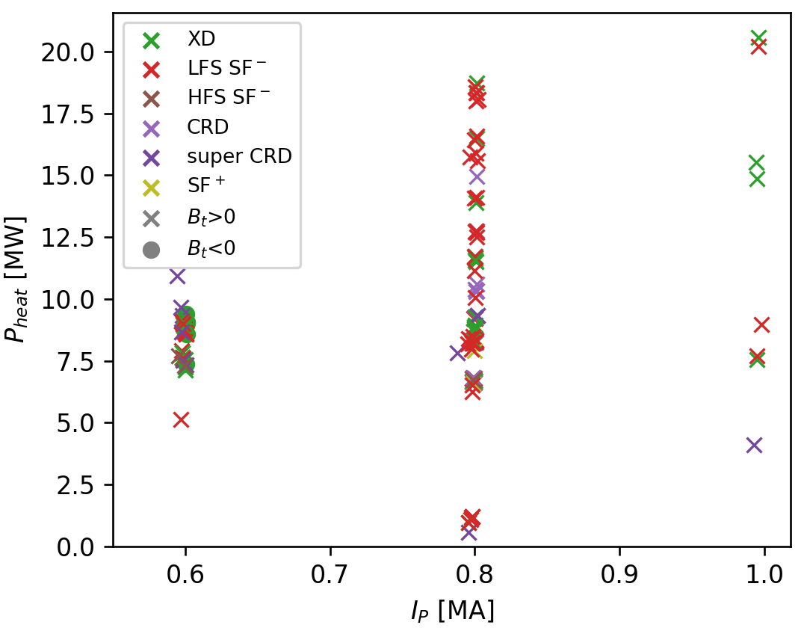
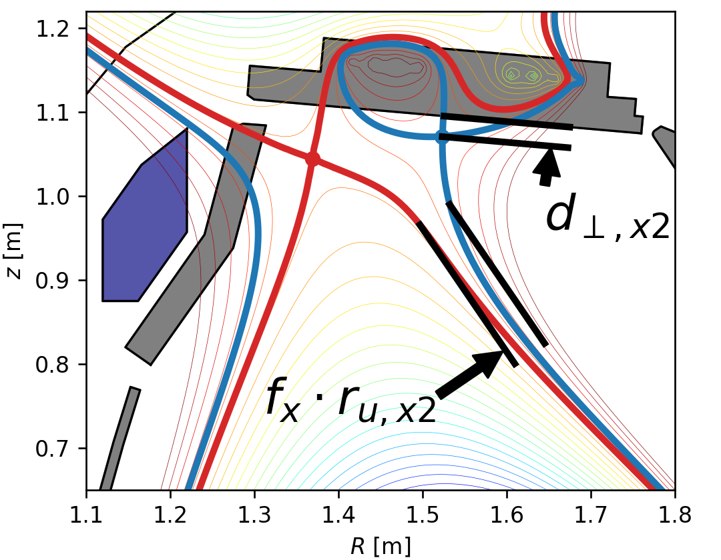
Overview experimental campaign 2025
Database of >100 discharges in stable ADC
increasing
decreasing
λ_{q}
Position of the 2nd X-point
Operational space
Hardware installation completed
New upper divertor of AUG operational, but cryo-pump not yet at full performance
All alternative divertor configurations (ADC) successfully established, stable for seconds and during ELMs (except SF+)
Heating power up to 20 MW and plasma current up to 1 MA in ADC
f_{x}=flux expansion
T.Lunt, 5th TM on divertor concepts 2025, IAEA Headquarters, Vienna, Austria
5

Slide 6
First experimental observations
T.Lunt, 5th TM on divertor concepts 2025, IAEA Headquarters, Vienna, Austria
6

Slide 7
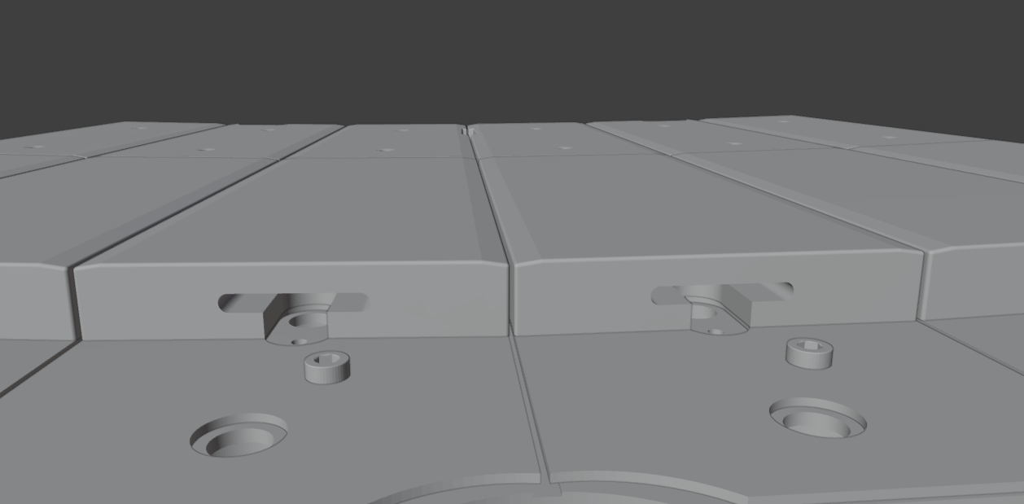
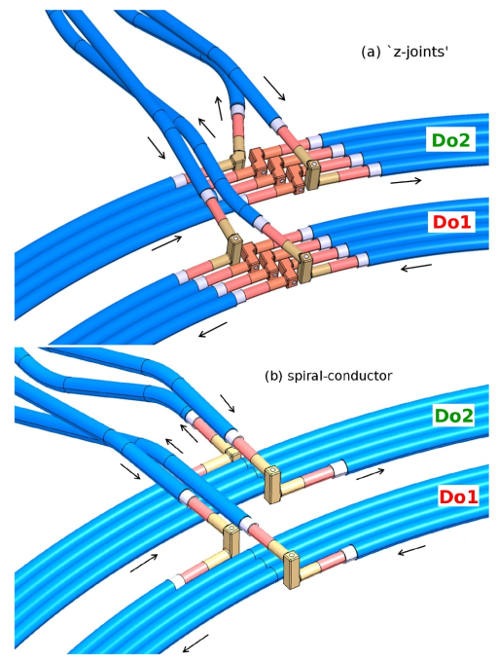
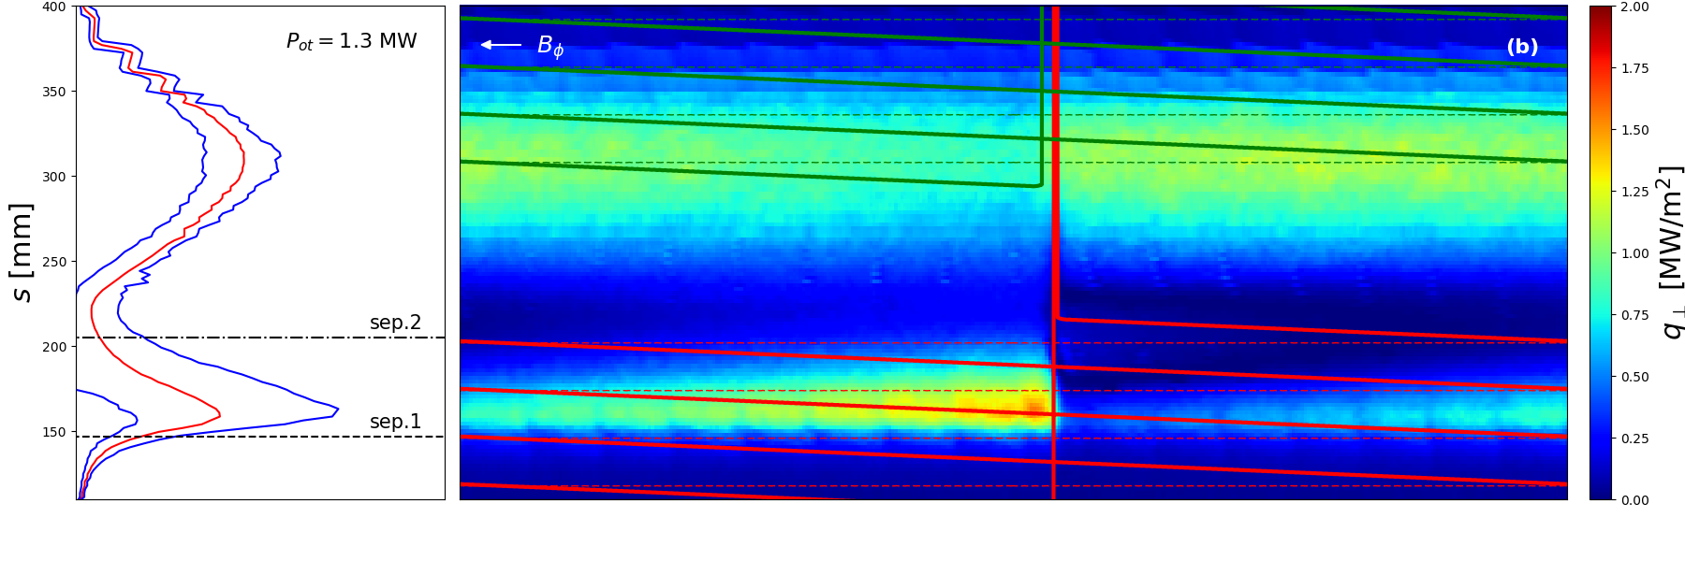
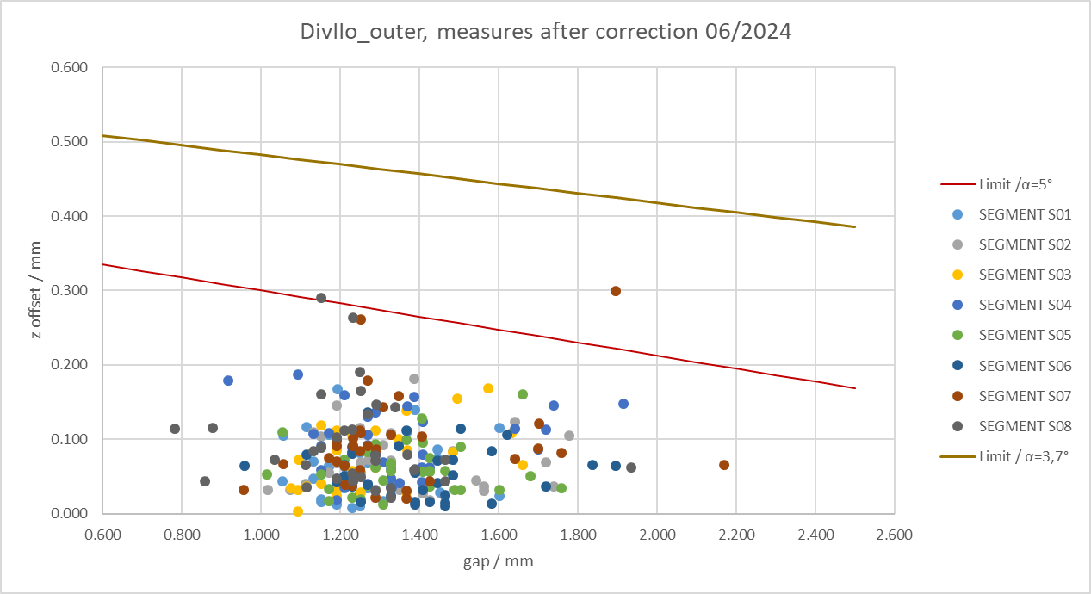
Small field line incidence angles θ⊥<2º can be handled
Alignment tolerance <300µm
[Lunt NME 2019]
T.Lunt, 5th TM on divertor concepts 2025, IAEA Headquarters, Vienna, Austria
7

Slide 8
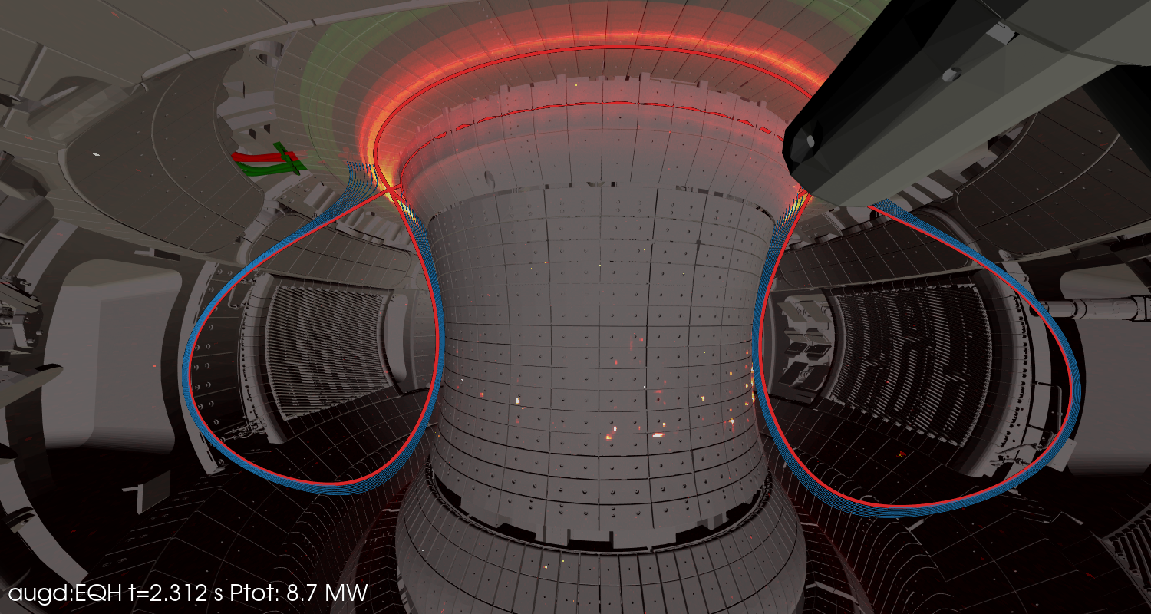
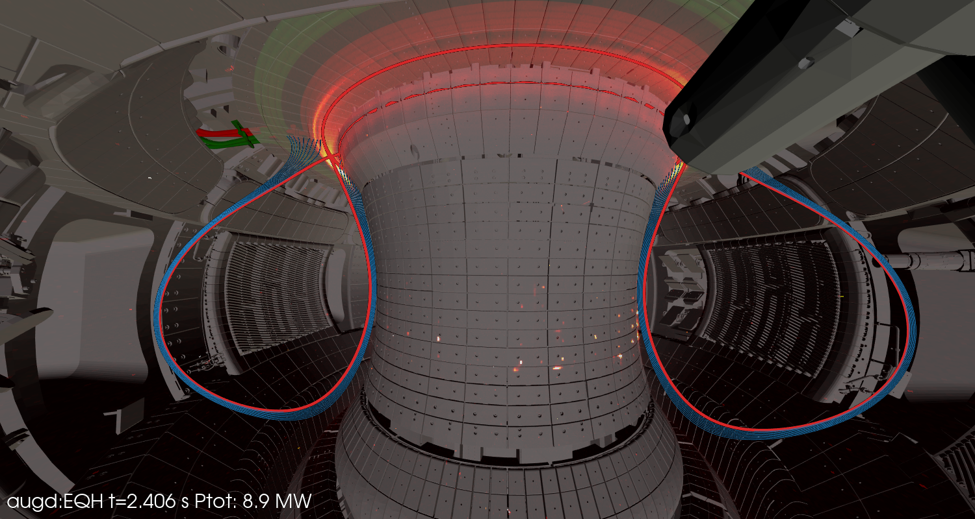
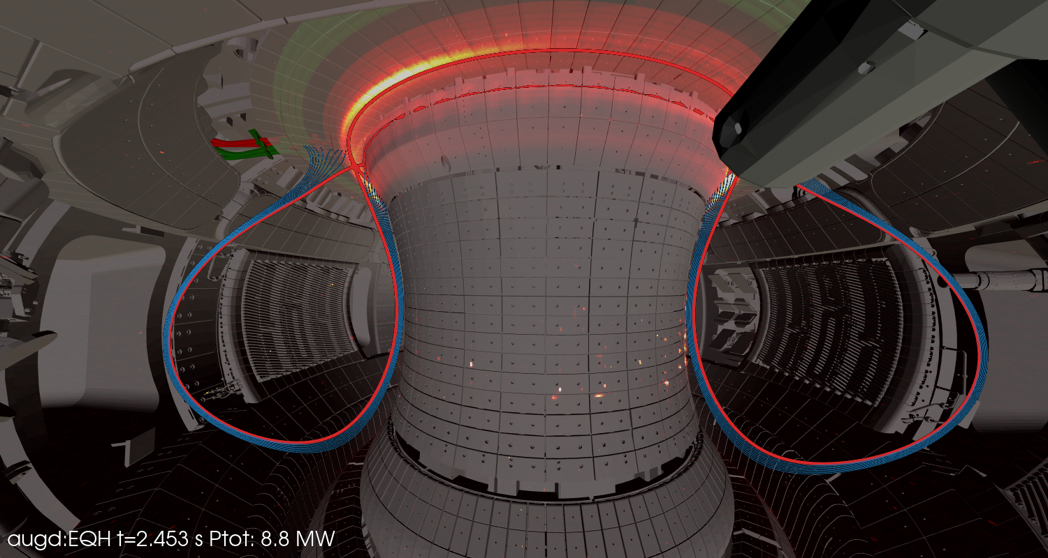


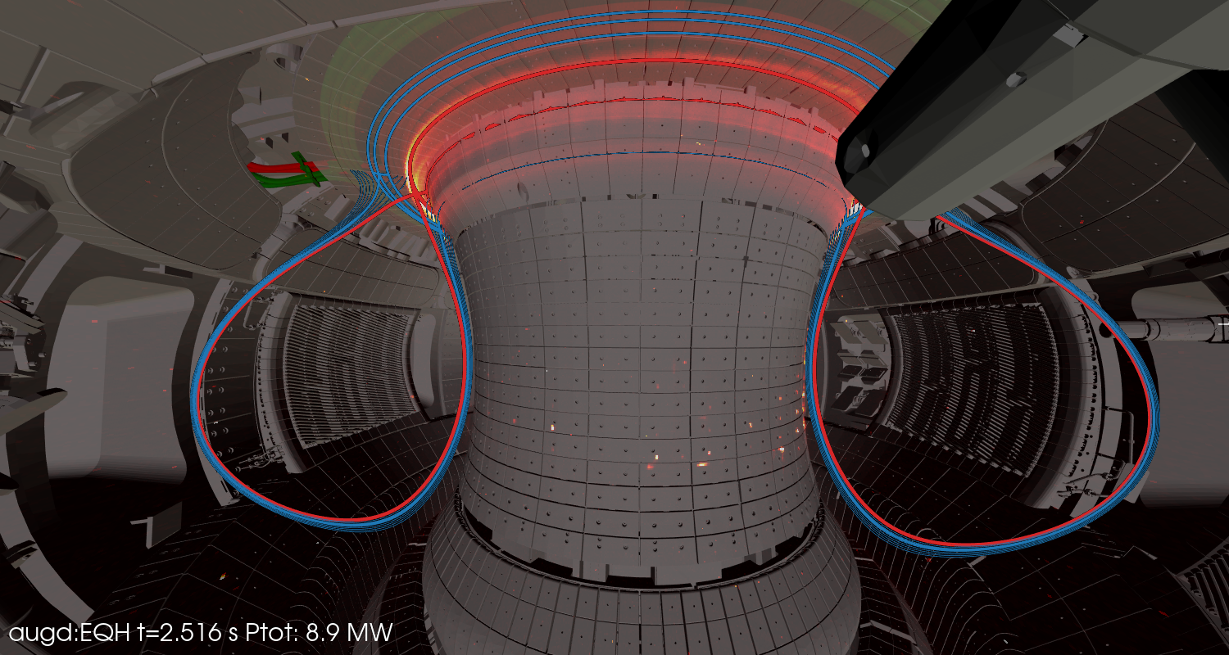

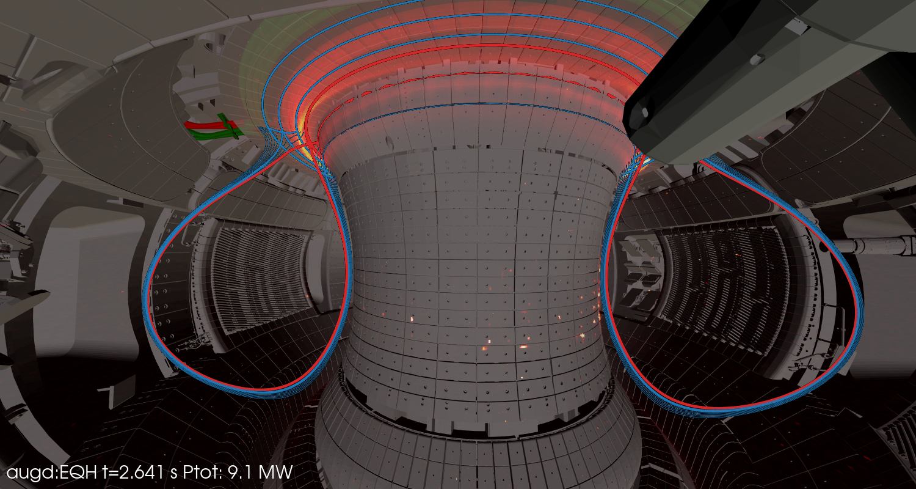
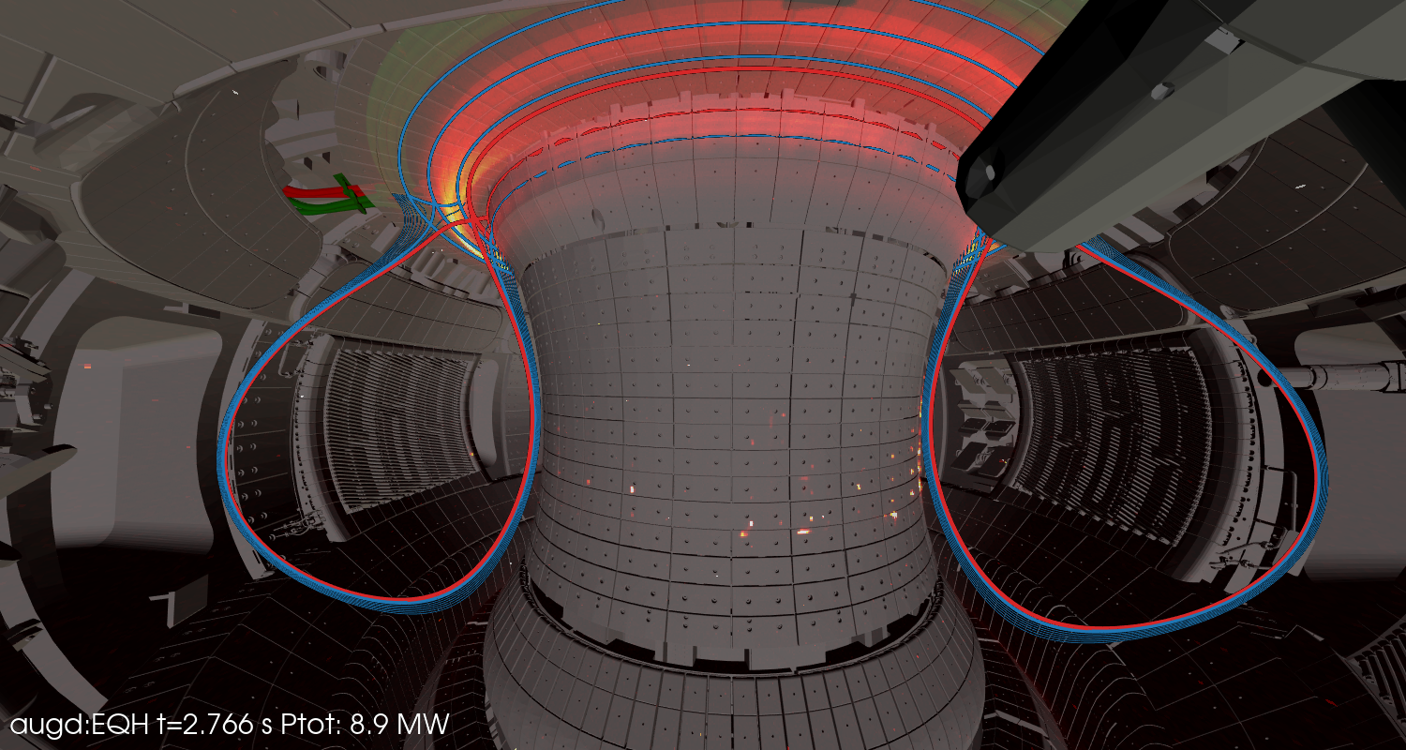
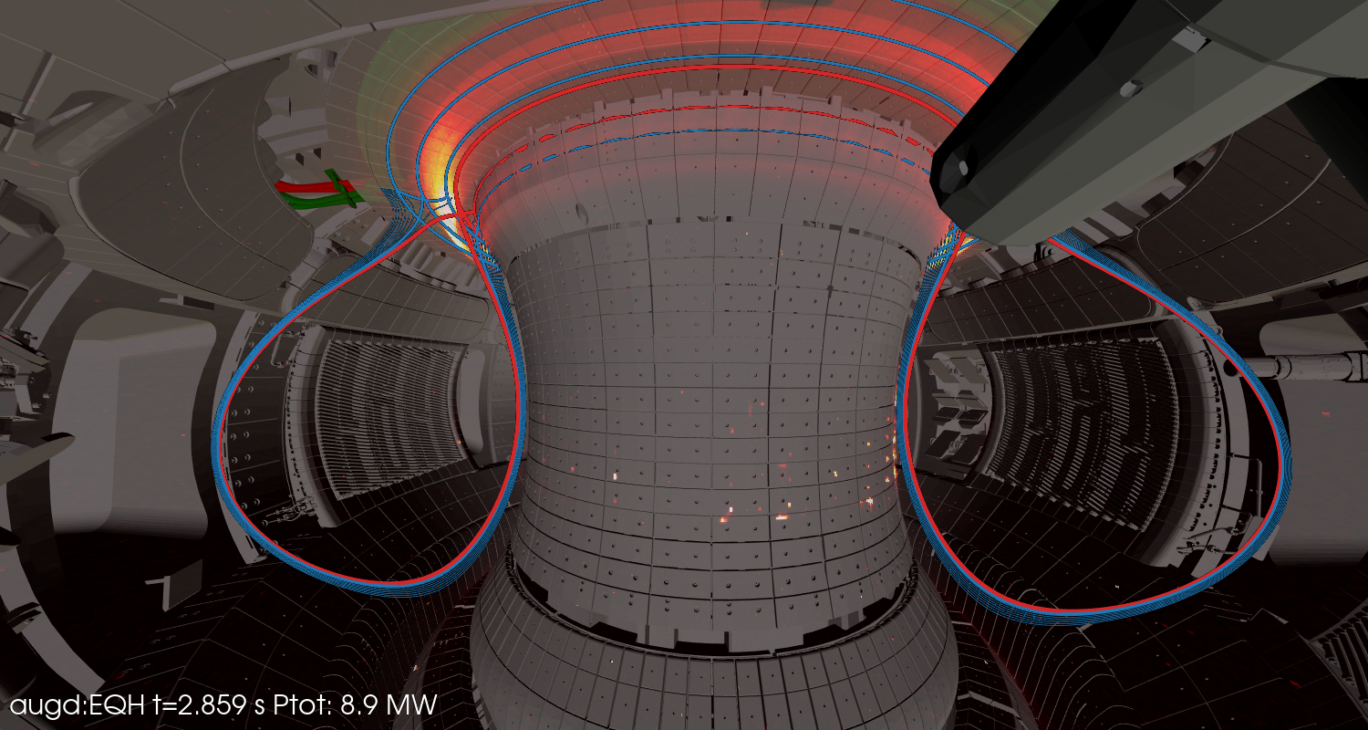

Small field line incidence angles θ⊥<2º can be handled
Observation 1:
Small field line incidence angles θ⊥<2º can be handled ..
with a tile aligment accuracy better than 300 µm
and optimized error fields of the current feeds
AUG 43638 NIR camera
T.Lunt, 5th TM on divertor concepts 2025, IAEA Headquarters, Vienna, Austria
8

Slide 9
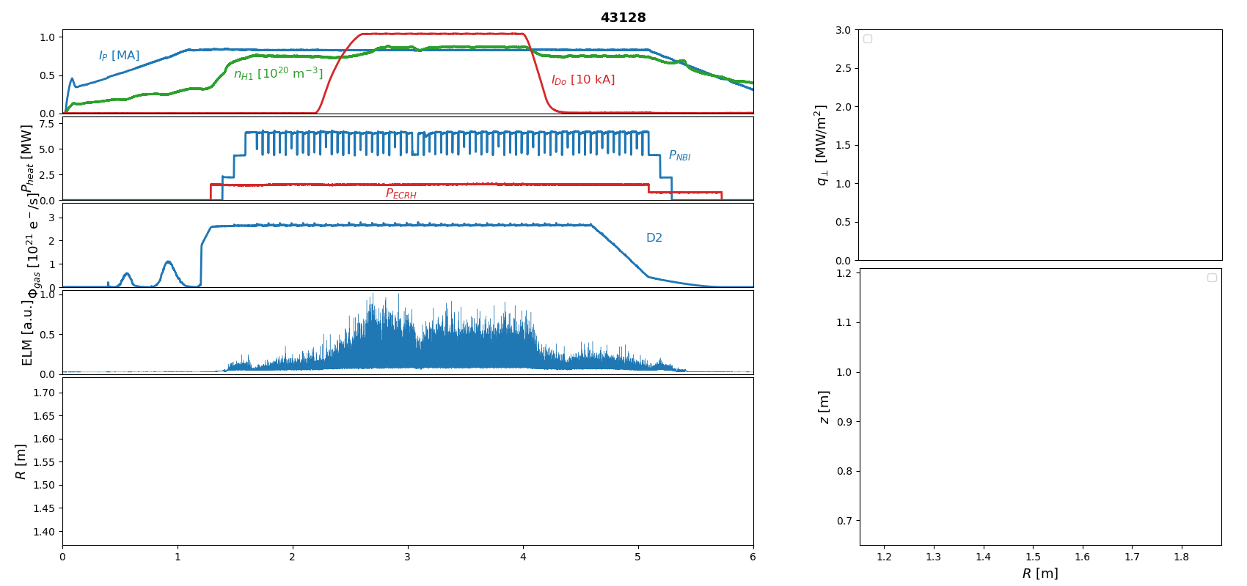
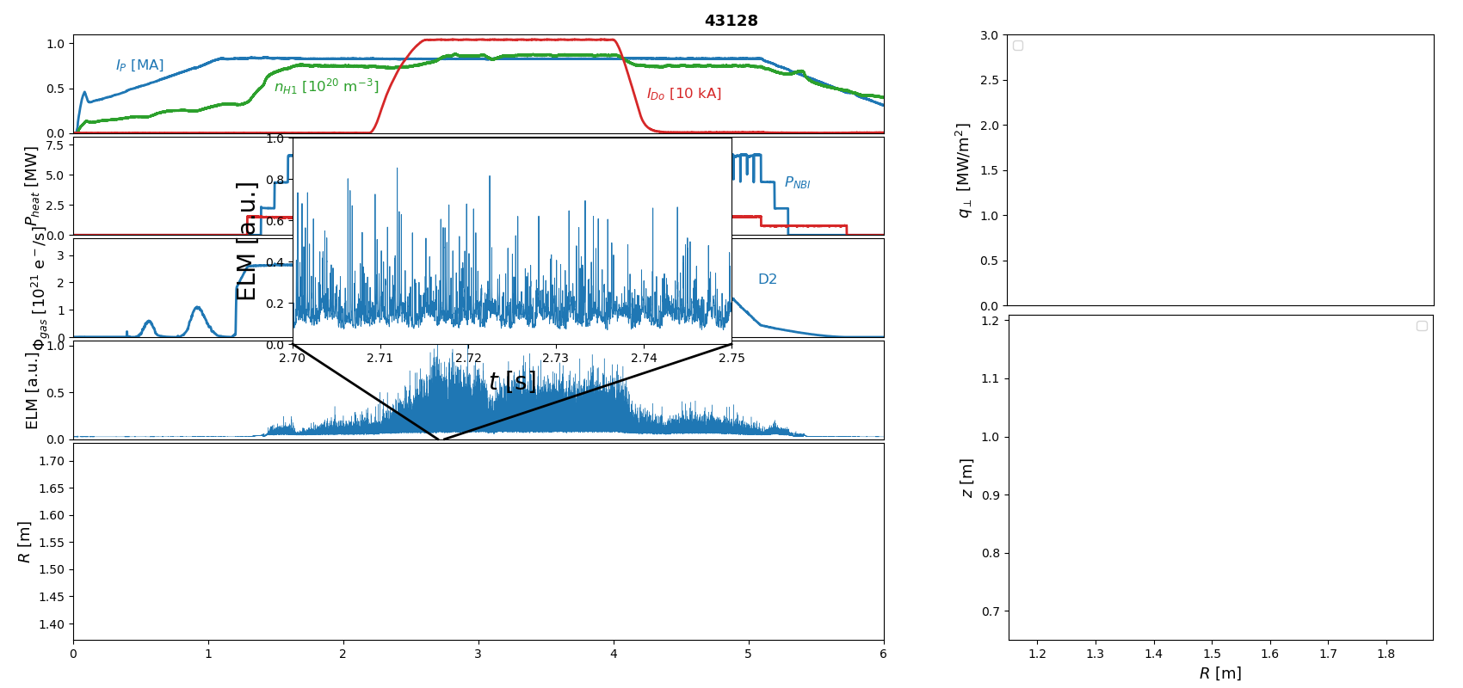
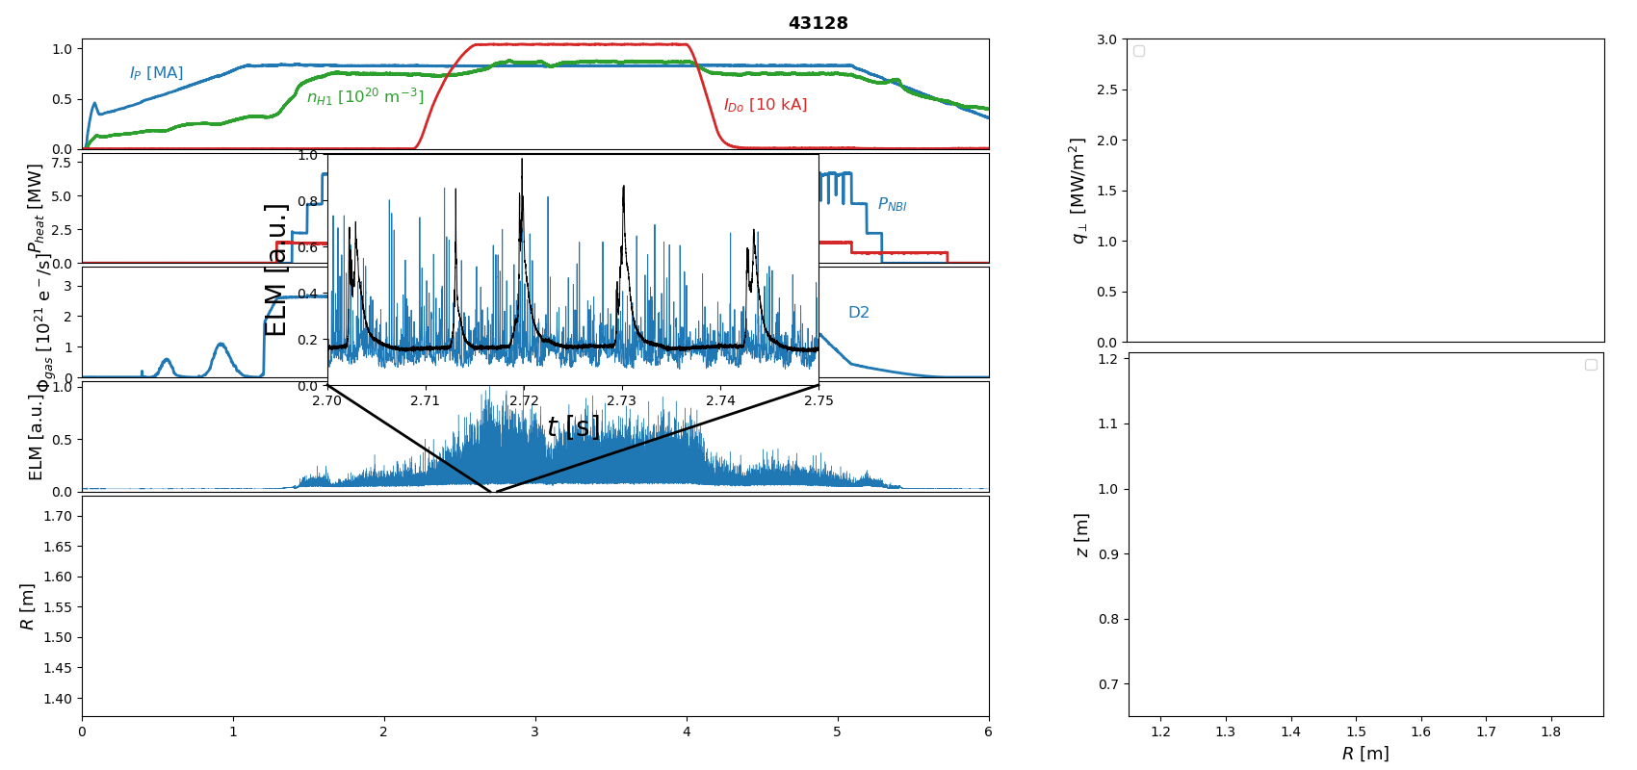
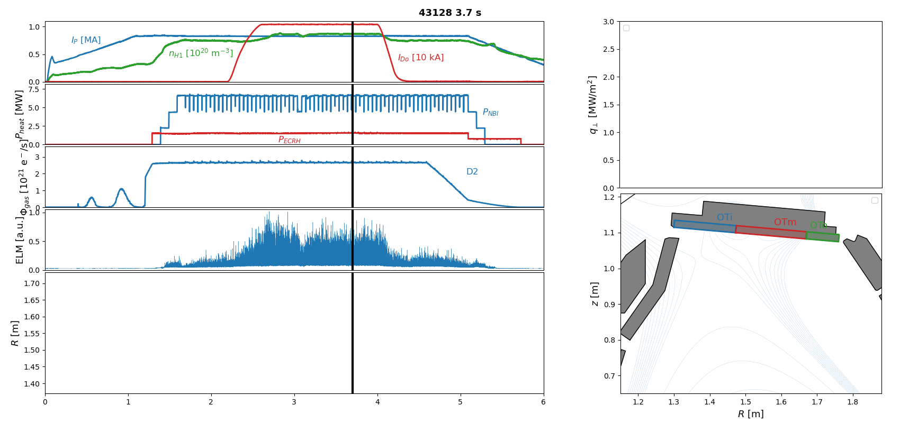
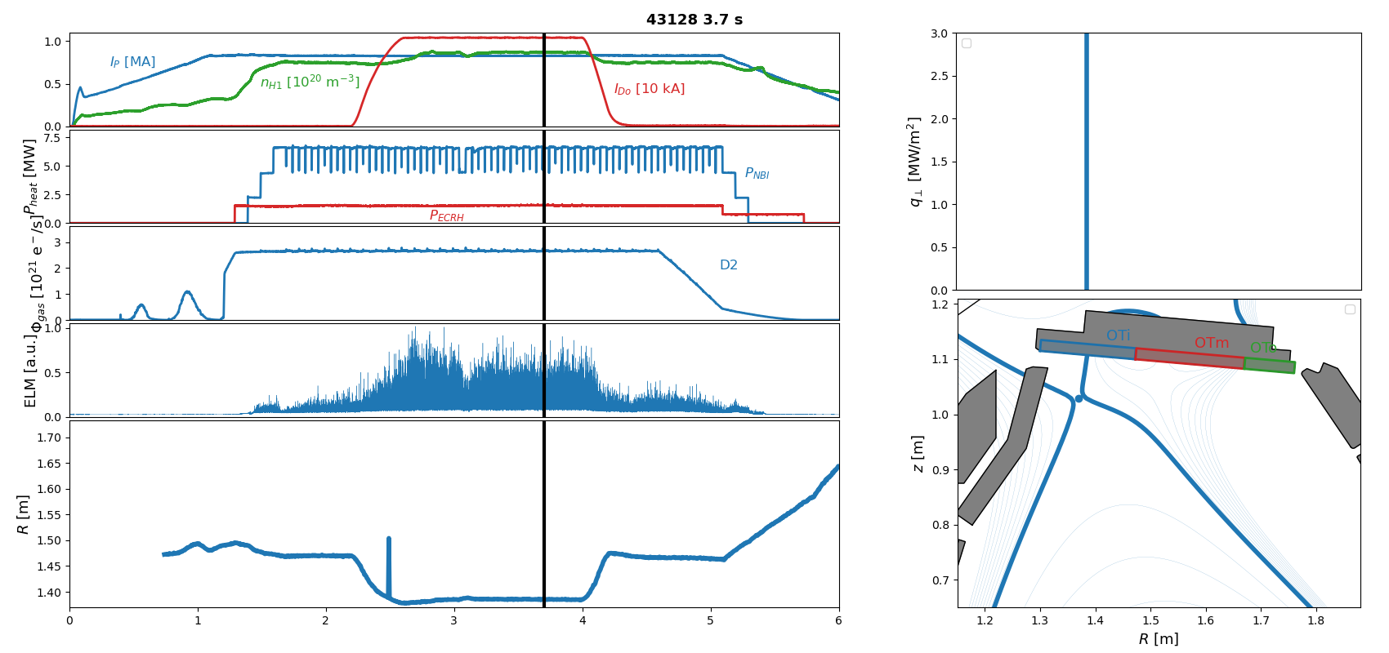
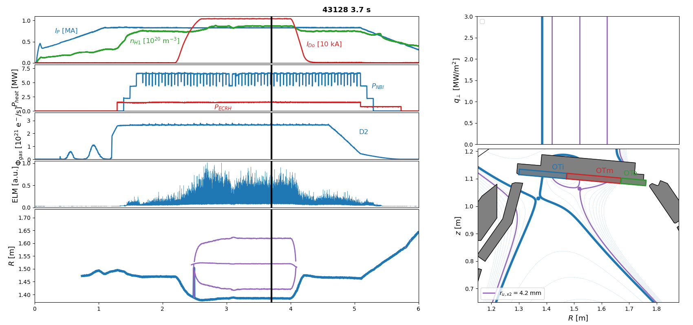
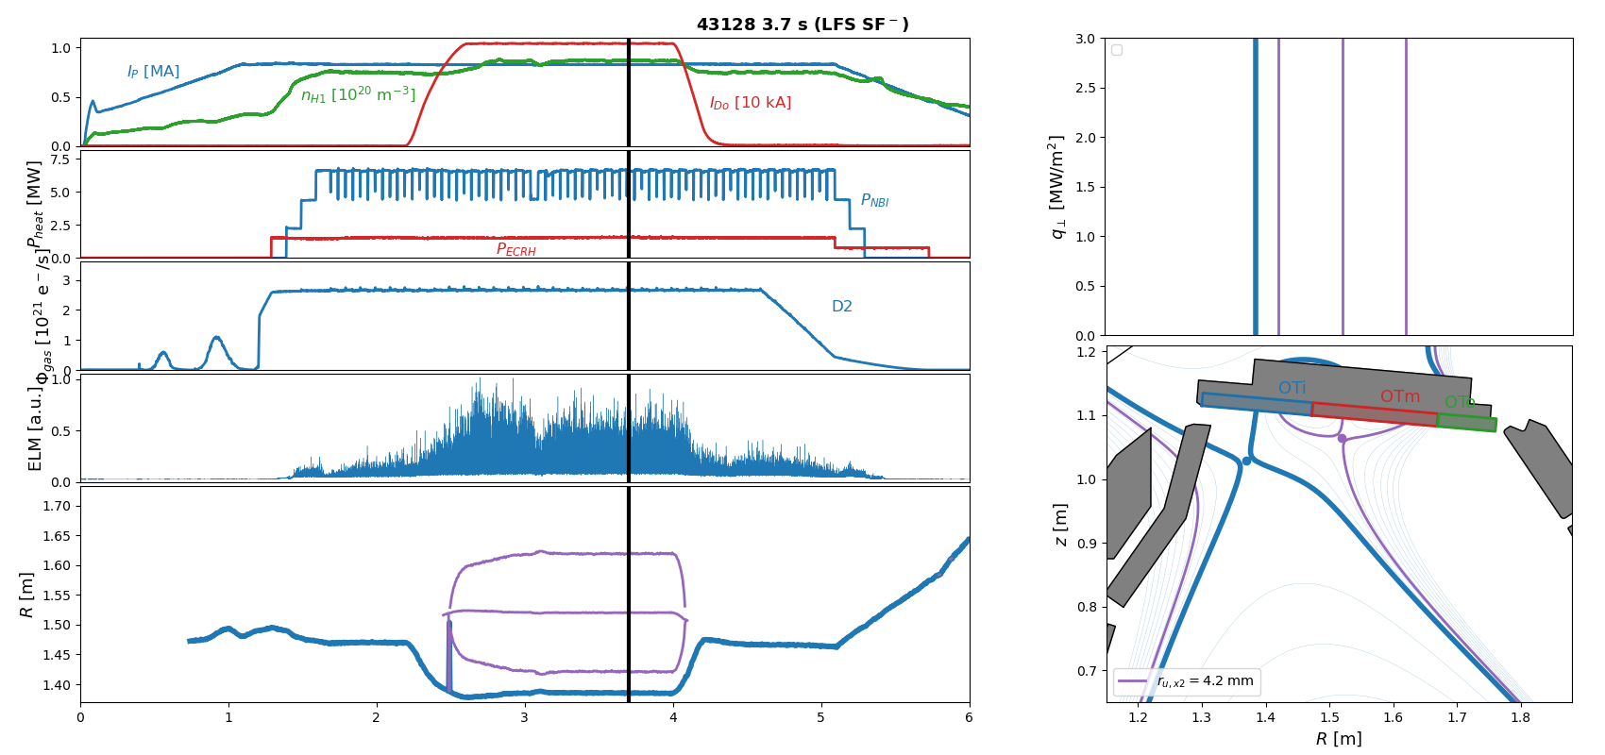
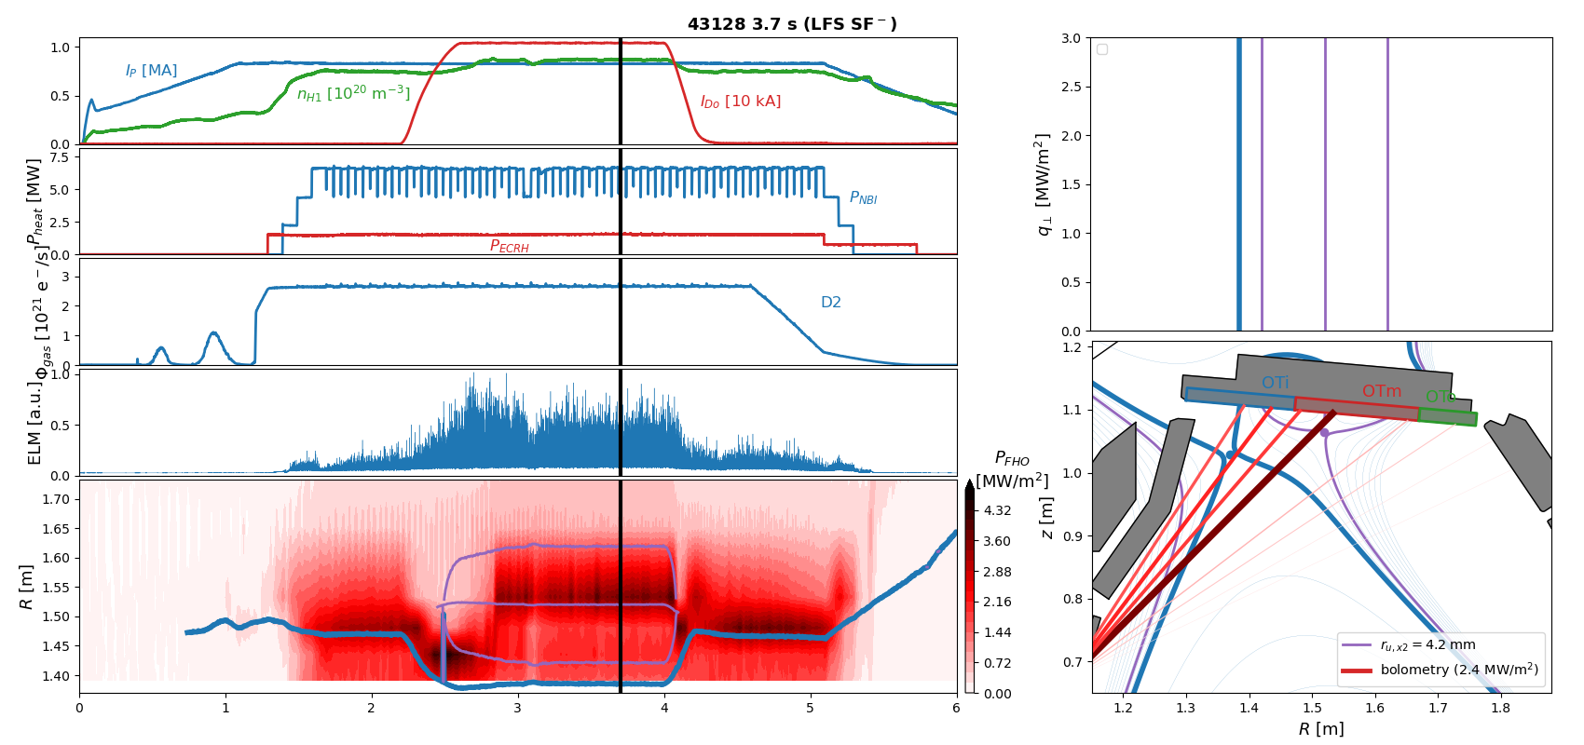
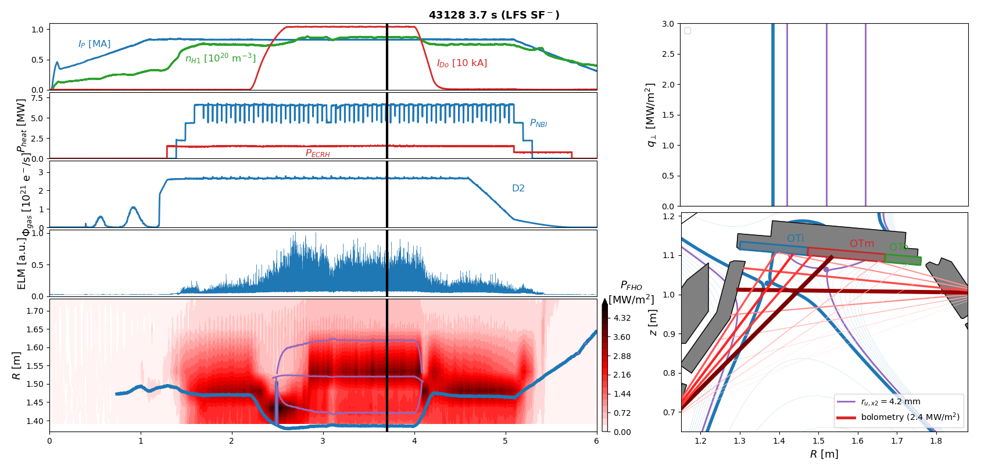
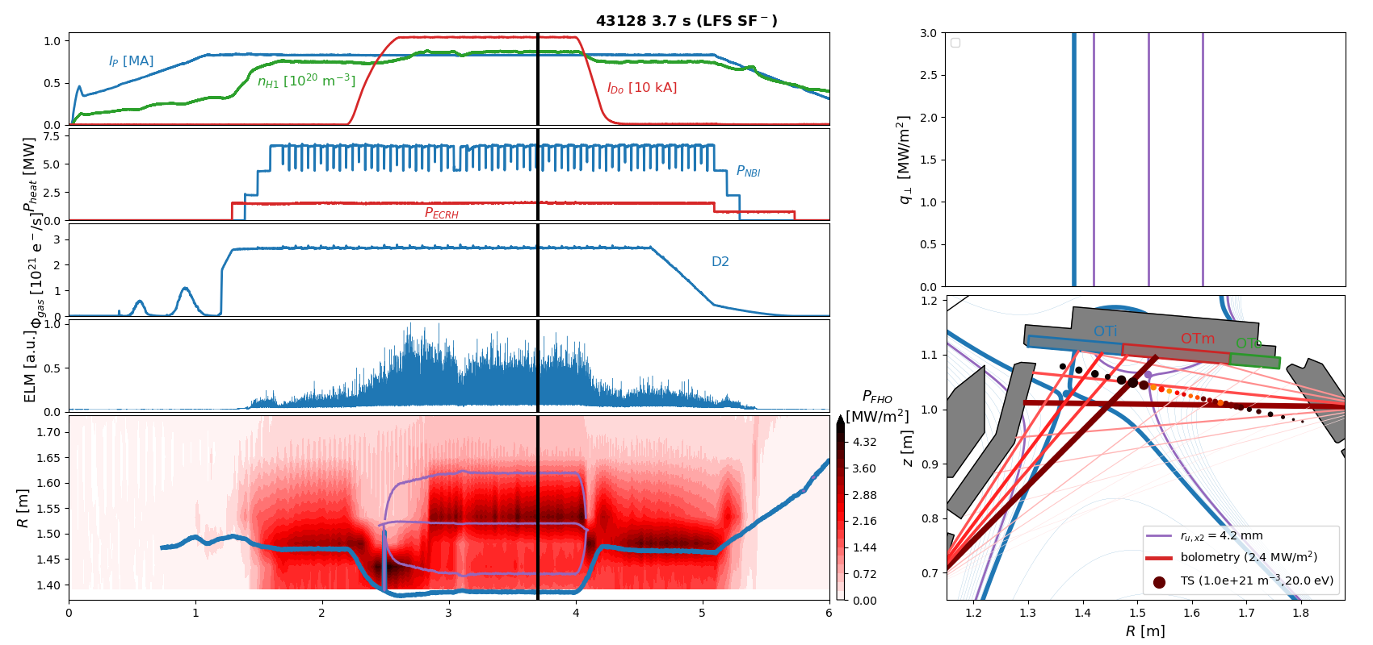



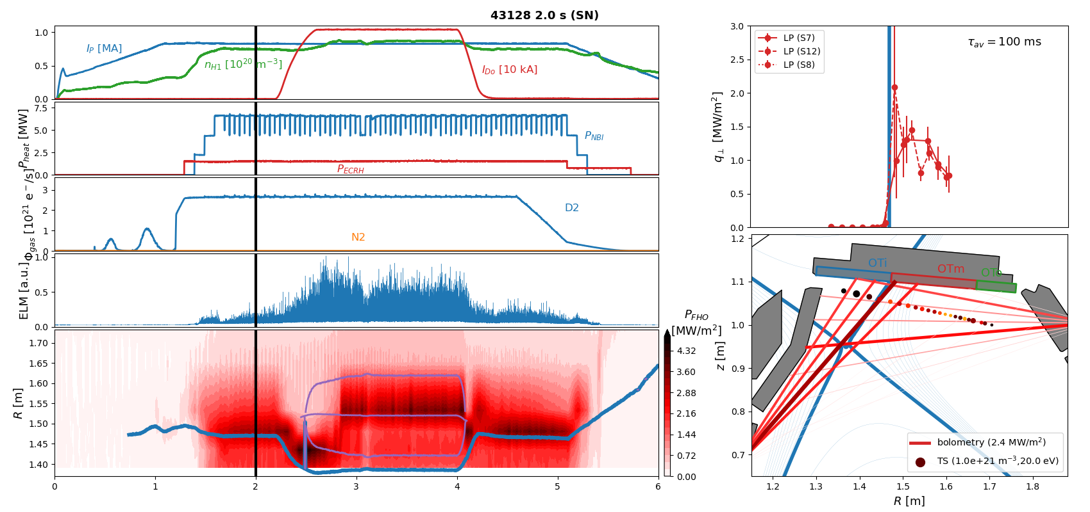
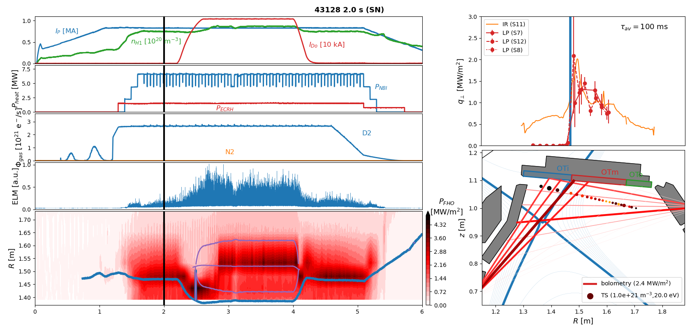

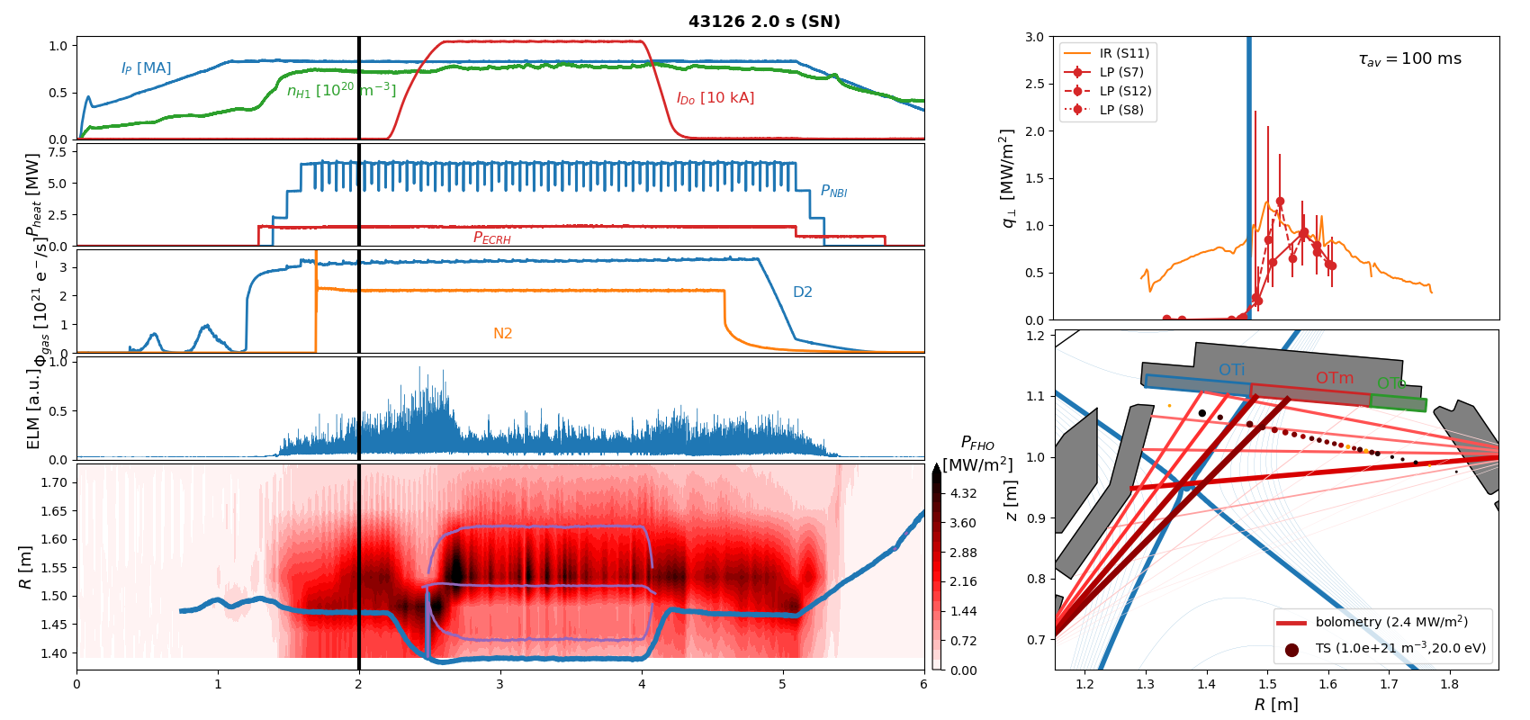
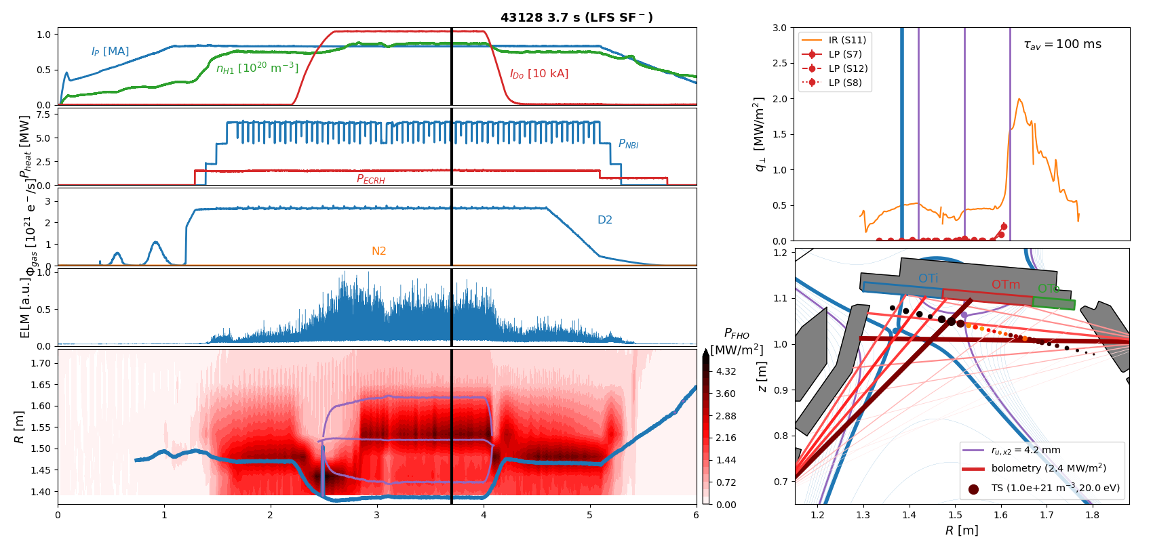

X-point radiator w/o impurity seeding in 800kA H-mode
Observation 2:
Even without impurity seeding an X-point radiator can be established in a LFS SF- configuration …
accompanied by detachment of the primary strike line,
but far-SOL heat-fluxes beyond secondary strike line remain high
t [s]
[Bernert NF 2021], [Stroth NF 2022]
T.Lunt, 5th TM on divertor concepts 2025, IAEA Headquarters, Vienna, Austria
9

Slide 10
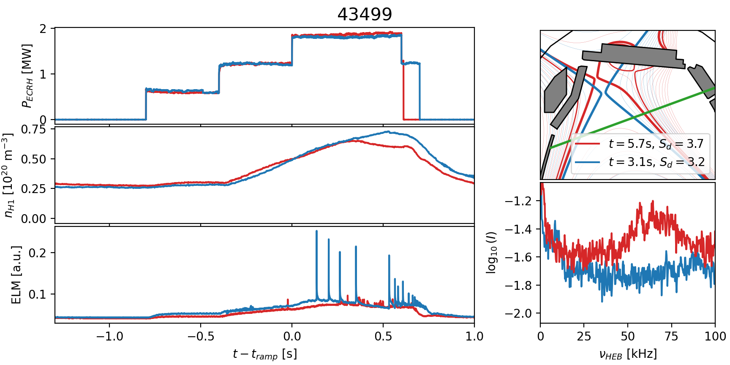
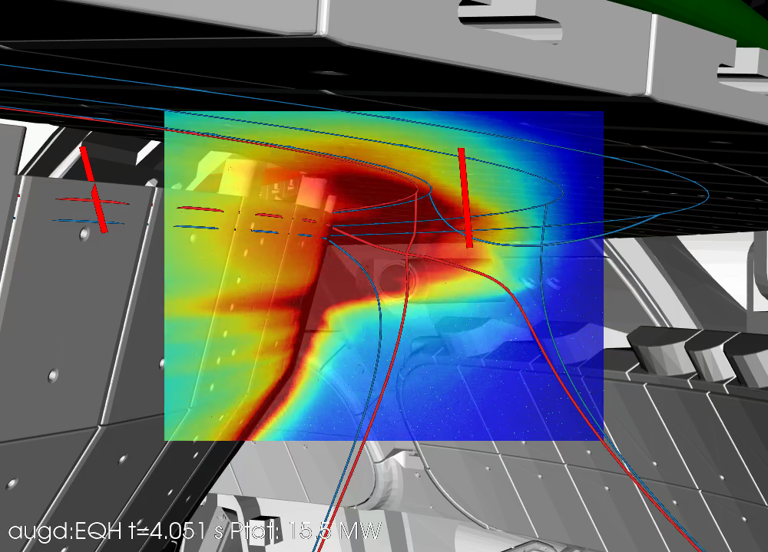

Small-ELM regime (QCE?)
[Faitsch NME 2021]
Observation 3:
Most (all?) of the ADC discharges are in a small-ELM (QCE?) regime
The different shape …
…or the high main chamber neutral density might be the reason
[shots by G. Birkenmeier]
Φ_{mc,USN}/Φ_{mc,LSN} ~ 7
[Dunne NF 2024]
T.Lunt, 5th TM on divertor concepts 2025, IAEA Headquarters, Vienna, Austria
10

Slide 11
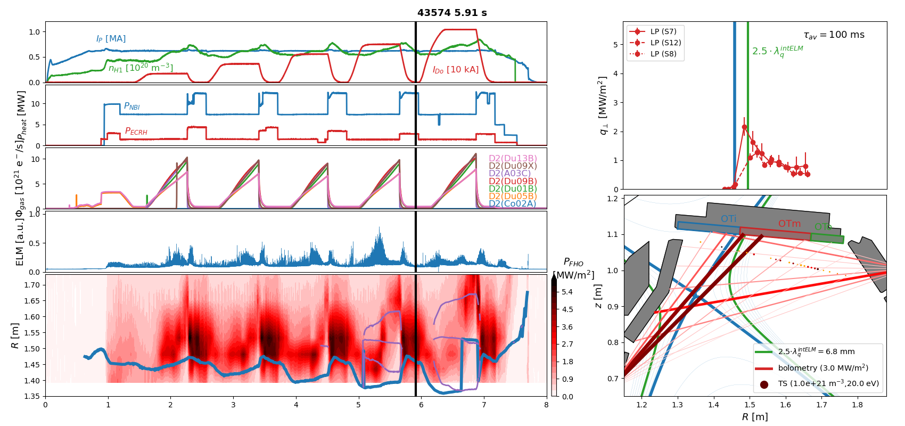
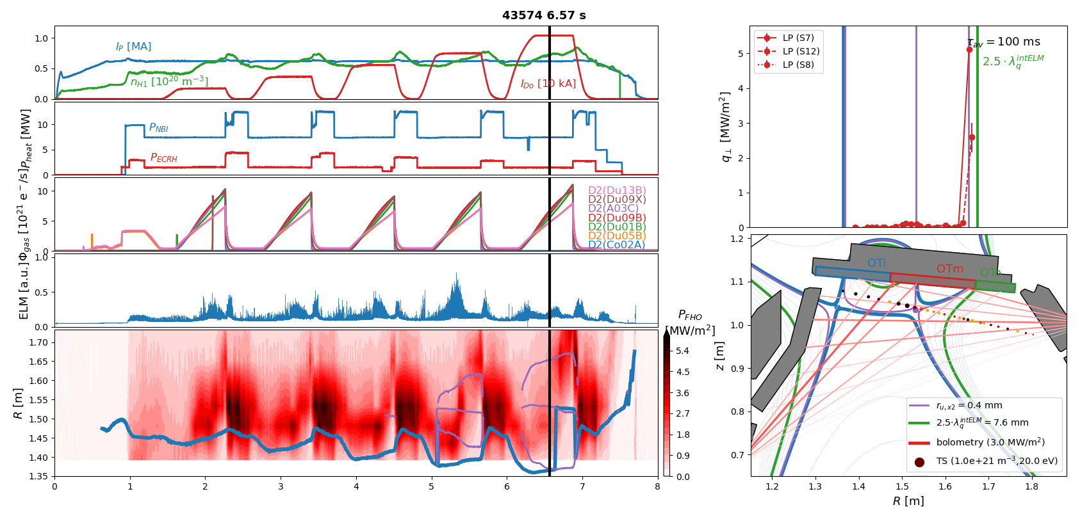
X-point radiator in sCRD configuration 600 kA H-mode
[shots by B.Sieglin]
t [s]
T.Lunt, 5th TM on divertor concepts 2025, IAEA Headquarters, Vienna, Austria
11

Slide 12
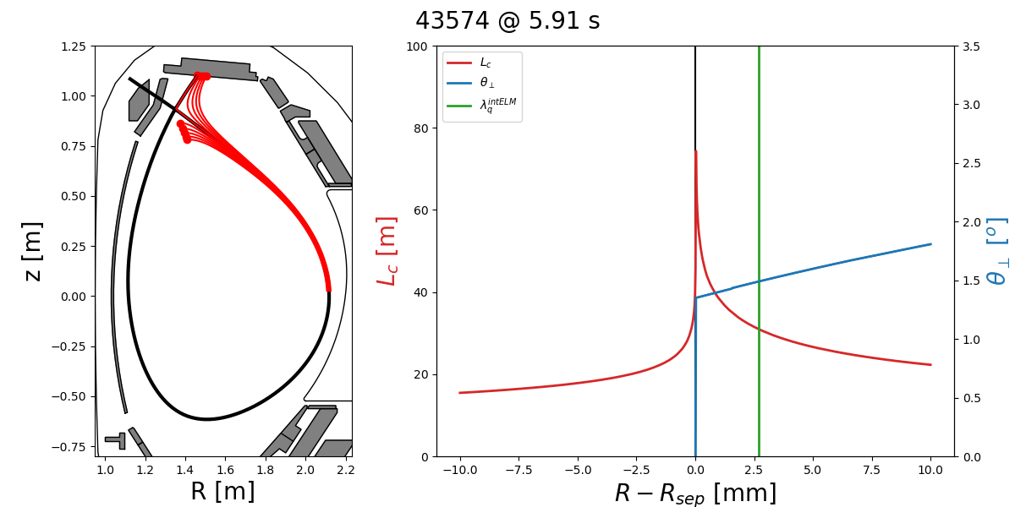

X-point radiator in sCRD configuration 600 kA H-mode
Observation 4:
Despite the very large volume of large f_{x} and L_{c} an XPR is not established/excited if λ_{q}>> Δr_{XPR}
T.Lunt, 5th TM on divertor concepts 2025, IAEA Headquarters, Vienna, Austria
12

Slide 13


X-point radiator in sCRD configuration at 800 kA
Observation 5:
A stable XPR is observed in sCRD configuration with N2 seeding
ELM size and far-SOL heat fluxes strongly reduced
t [s]
T.Lunt, 5th TM on divertor concepts 2025, IAEA Headquarters, Vienna, Austria
13

Slide 14



Strike point splitting in 1MA H-mode
Observation 6:
A splitting of the strike point is observed ..
accompanied by a reduction of a factor of 2 in the heat flux measured by Langmuir probes
t [s]
[Lunt NME 2017], [Pan PPCF 2018]
T.Lunt, 5th TM on divertor concepts 2025, IAEA Headquarters, Vienna, Austria
14

Slide 15
Gaps in extrapolating to future devices
T.Lunt, 5th TM on divertor concepts 2025, IAEA Headquarters, Vienna, Austria
15

Slide 16








Gaps: stability of XPR at short λ_{q}
DEMO (9m/1.65m=5.45 times larger)
Δr_{u,XPR}
[Eich, PRL 2011]
[Brunner NF 2018]
XPR
[Lunt, Bernert et al.
PRL 2023]
Radial extension Δr_{u,xpr} of XPR increases compared to λ_{q} in ITER & DEMO
Is it stable?
T.Lunt, 5th TM on divertor concepts 2025, IAEA Headquarters, Vienna, Austria
CRD experiments at AUG and their consequences for a reactor
16

Slide 17

Gaps: Near/Far-SOL fall-off length
[Lunt PPCF 2020]
Near-SOL power fall-off length scaling
[Eich PRL 2011] / [Brunner NF 2018]
Far-SOL power fall-off length scaling ?
Access to QCE ?
[Dunne NF 2024]
T.Lunt, 5th TM on divertor concepts 2025, IAEA Headquarters, Vienna, Austria
17

Slide 18
Summary
Hardware installation of a pair of in-vessel coils, a charcoal coated cryo-pump and new divertor targets completed
All alternative divertor configurations (ADC) successfully established, stable for seconds and during ELMs (except SF+)
Heating power up to 20 MW and plasma current up to 1 MA in ADC
Observations:
Even at high heating powers field line incidence angles can be made arbitrarily small – or even negative – due to outstanding target alignment accuracy and small magnetic error fields
X-point radiator forms in a LFS SF- configuration even without impurity seeding, where the primary strike point is fully detached, but far-SOL heat fluxes still high
Most (all?) of the ADC discharges are in a small-ELM (QCE?) regime
Large XPR volume no guarantee for XPR formation
Stable XPR observed in sCRD configuration
Splitting of the outer strike point observed, accompanied by reduction of the peak heat flux of a factor of ~2 in 1 MA LFS SF⁻ discharges measured by Langmuir probes
T.Lunt, 5th TM on divertor concepts 2025, IAEA Headquarters, Vienna, Austria
18

Slide 19

Outlook
Upcoming campaign
Install protection plates on cryo-pump
Carry out 1 MA discharges in (s)CRD configuration
Try other seeding gases to reduce far-SOL heat fluxes
Long term
Install baffles
T.Lunt, 5th TM on divertor concepts 2025, IAEA Headquarters, Vienna, Austria
19

Slide 20
Backup slides
T.Lunt, IAEA-FEC 2025 Chengdu, China
20

Slide 21



Extrapolation to (EU-)DEMO – SOLPS-ITER modelling
Modeling of AUG geometry scaled to DEMO
divertor neutral pressures up to 15 Pa (beneficial for He pumping)
impurity concentration far below tolerable limits
heat flux <=2 MW/m² dominated by radiation
[Pan et al]
MAX-PLANCK-INSTITUT FÜR PLASMAPHYSIK | Tilmann Lunt | 49th EPS Conference on Plasma Physics, Bordeaux July 3-7th 2023
CRD experiments at AUG and their consequences for a reactor
21

