Slide 1

First high power experiments of Alternative Divertor Experiments in ASDEX Upgrade
Overview ADC and XPR experiments and gaps in extrapolating to future devices
Overview ADC and XPR experiments and gaps in extrapolating to future devices
T.Lunt¹ on behalf of the ASDEX Upgrade and EUROfusion teams
¹Max Planck Institute for Plasma Physics, Boltzmannstr. 2, 85748 Garching, Germany
Outline:
- Introduction
- New upper divertor of ASDEX Upgrade
- Overview experimental campaign 2025
- First experimental observations
- Gaps in extrapolating to future devices
- Summary

Slide 2
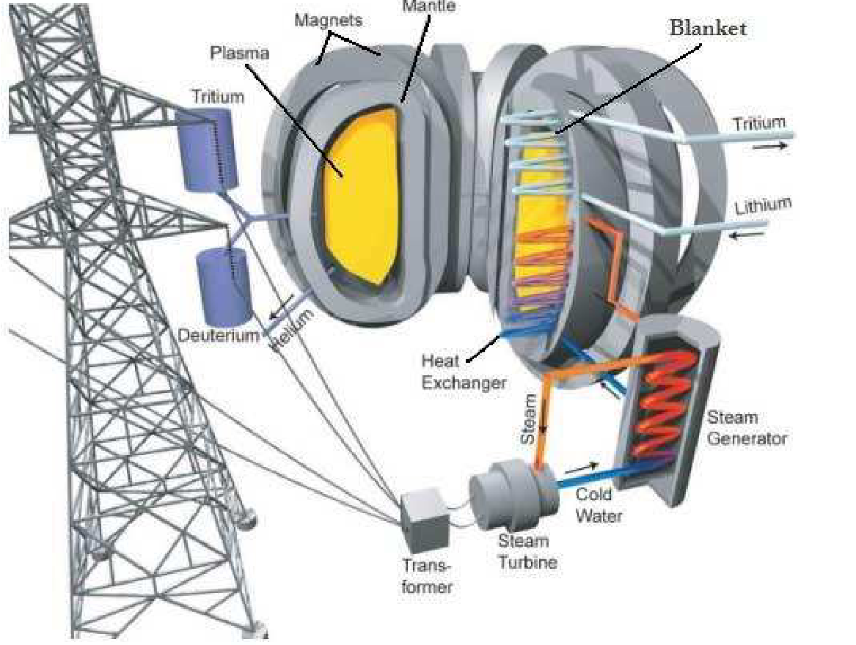
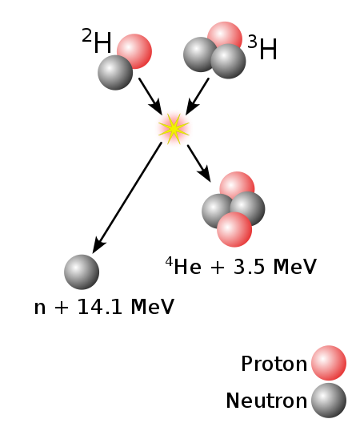
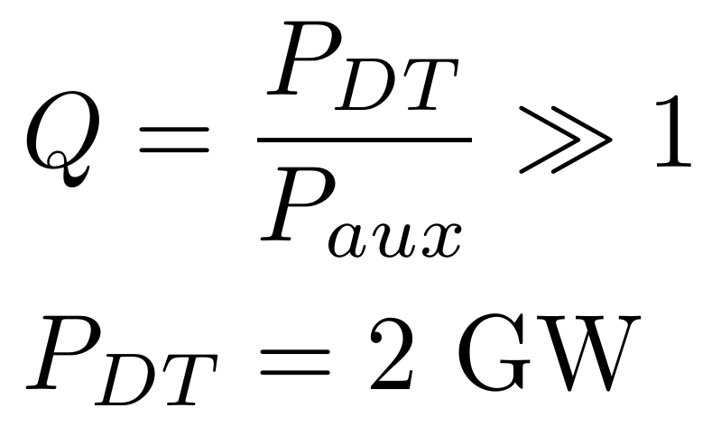
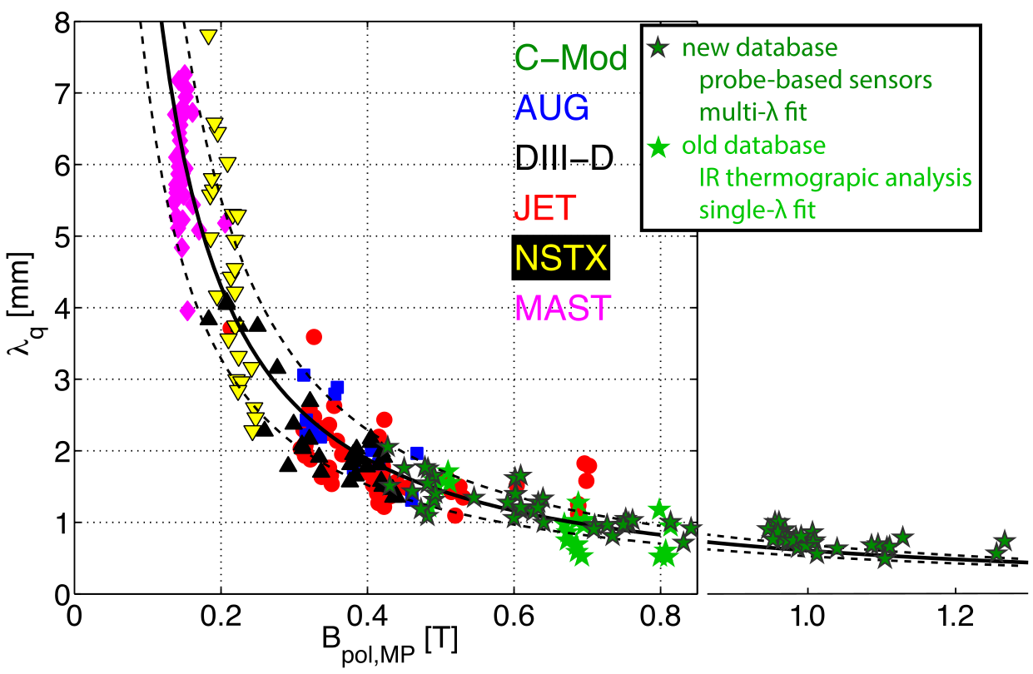
Introduction: Power and He exhaust challenge
P_{α}=400 MW
Φ_{He}= 7x10²⁰ 1/s
+P_{aux}
[Eich PRL 2011]
[Brunner NF 2018]
Φ_{He} = S_{pump} n_{He,pump}
High neutral He densities (pressures) in subdivertor volume mandatory for reactor to remove He ‚ash‘
A_{wet}=2 π R f_{x} λ_{q}
T.Lunt, 5th TM on divertor concepts 2025, IAEA Headquarters, Vienna, Austria
2

Slide 3
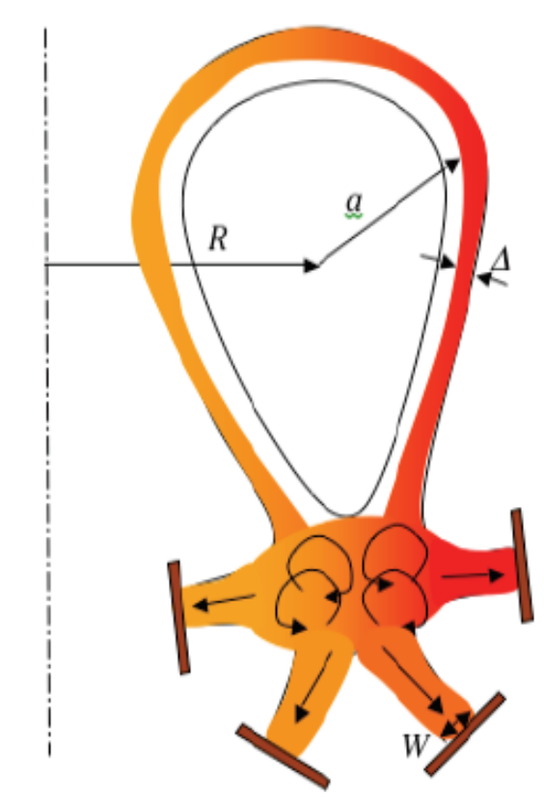
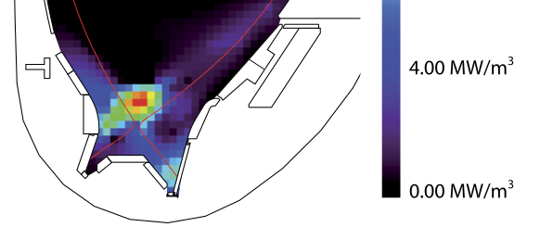
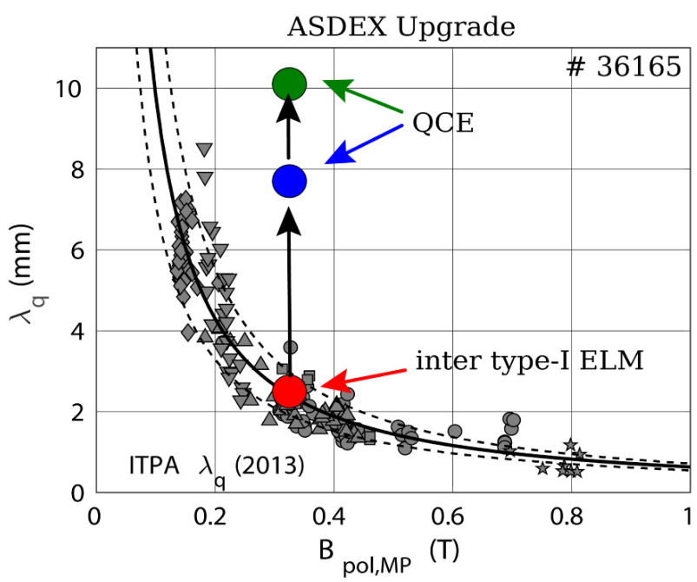
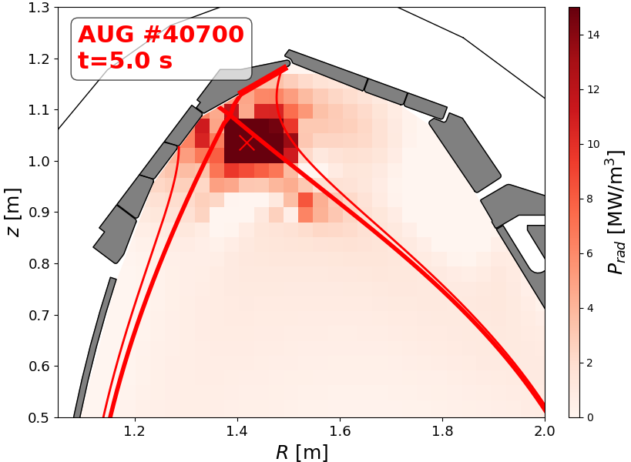
Introduction: Power and He exhaust challenge
Alternative Divertor
Configurations
Radiative scenarios
Small-ELM / QCE / EDA
[Bernert NF 2021]
[Faitsch NME 2021]
[Ryutov IAEA-FEC 2012]
[Lunt/Bernert PRL 2023]
T.Lunt, 5th TM on divertor concepts 2025, IAEA Headquarters, Vienna, Austria
3

Slide 4
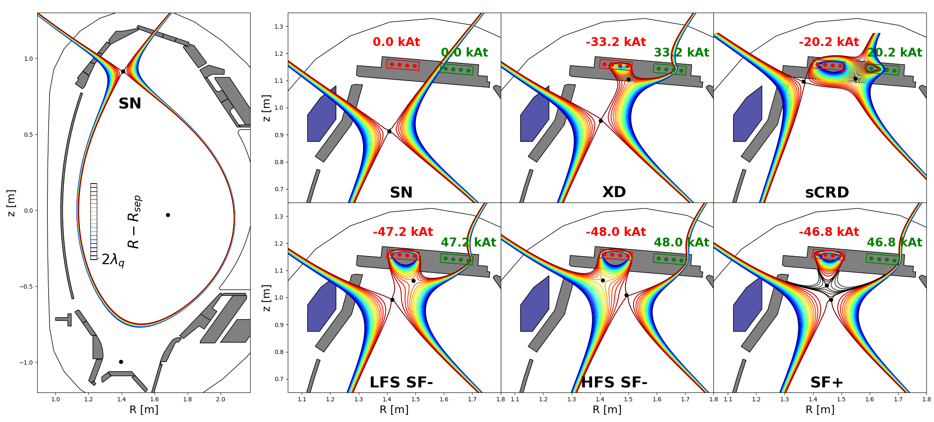
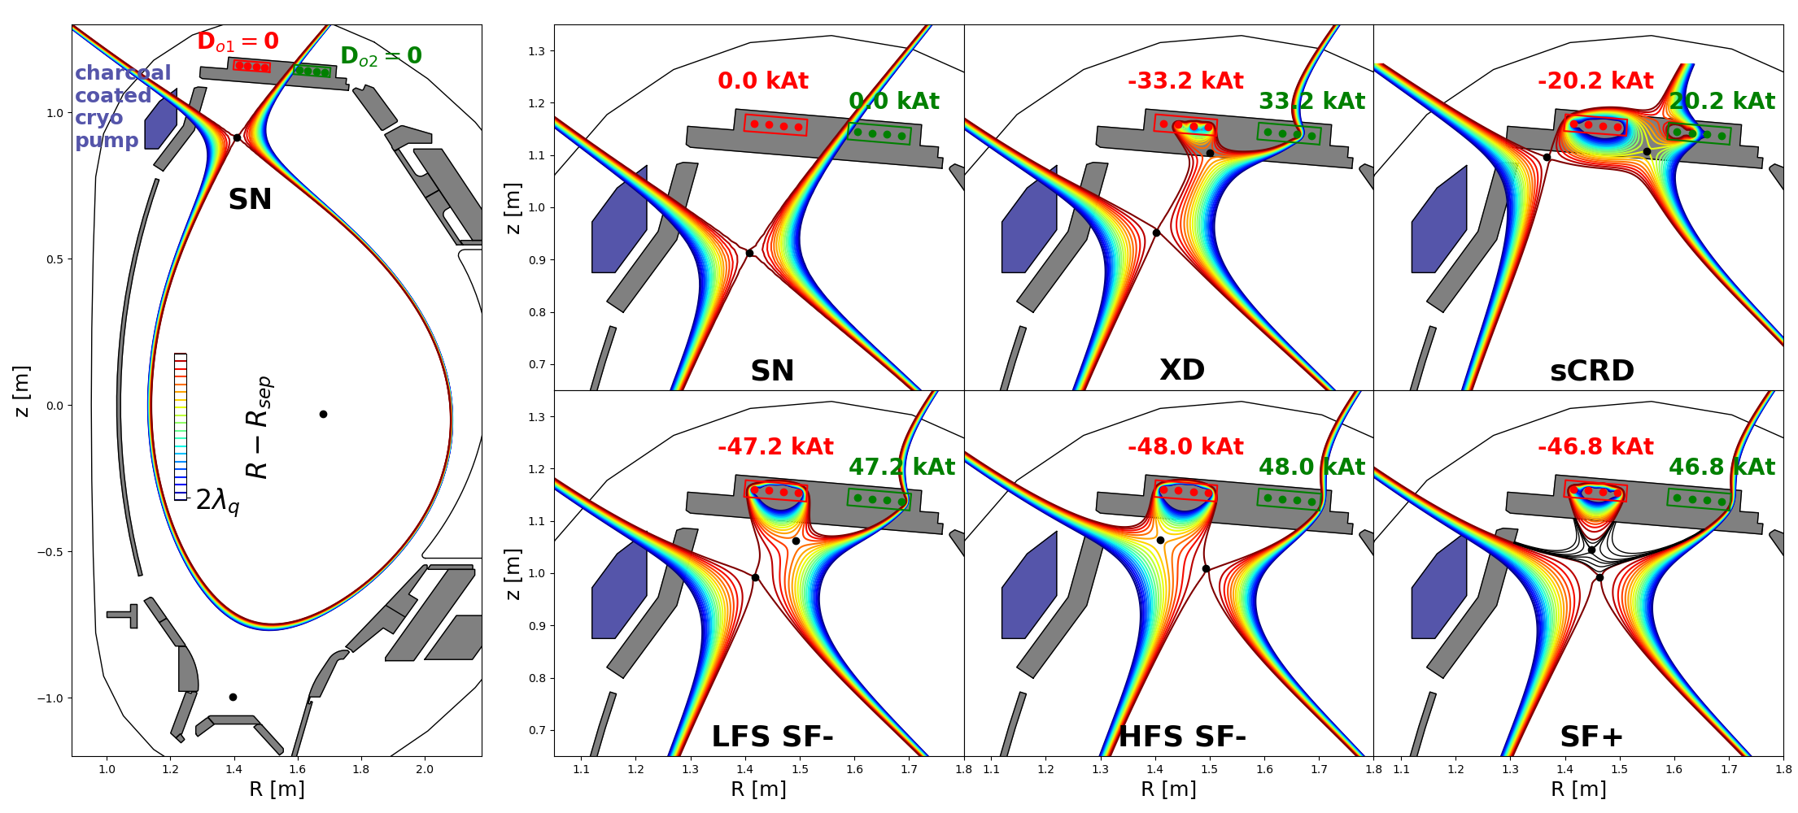
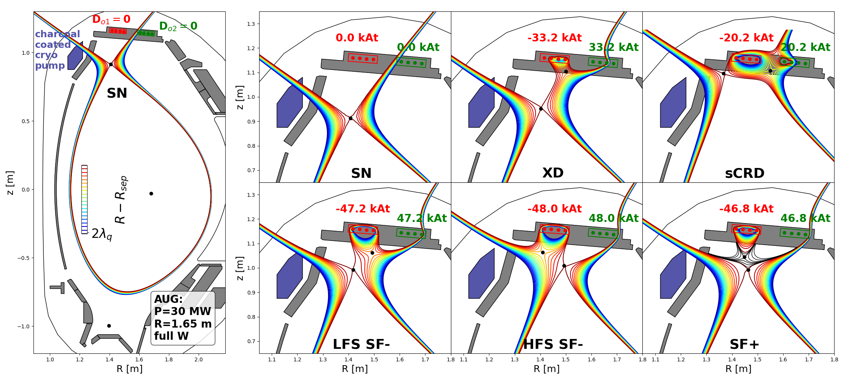
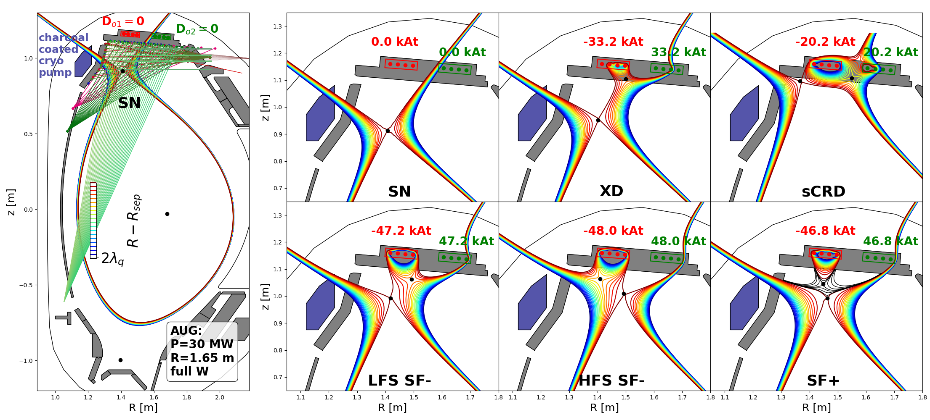
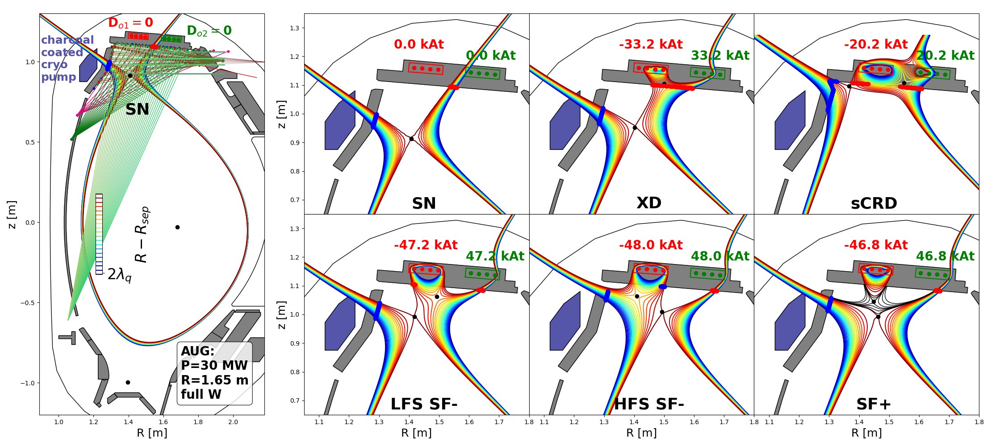

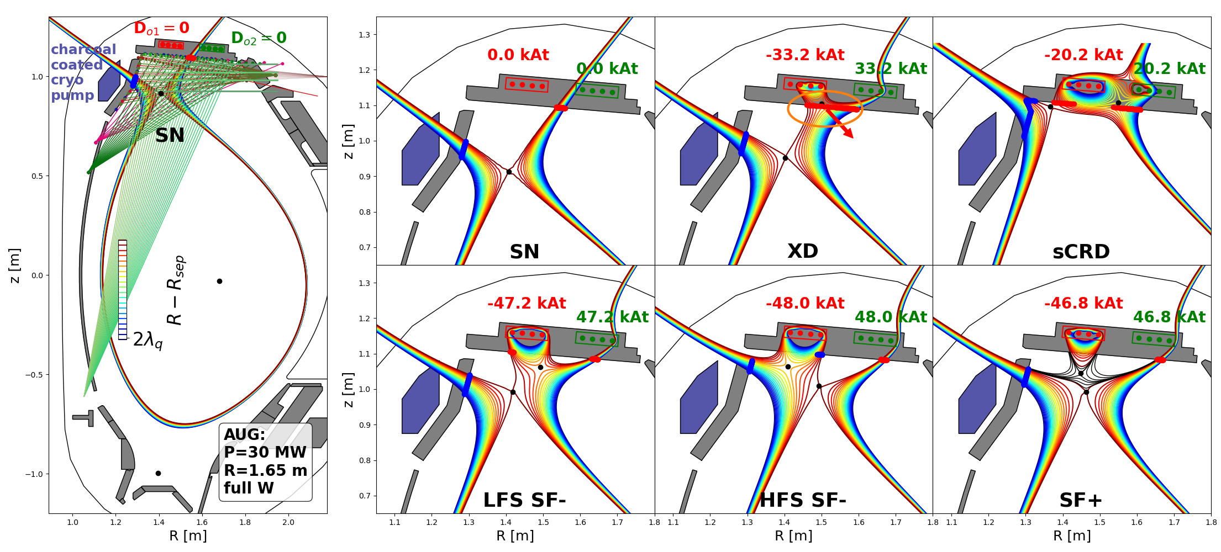

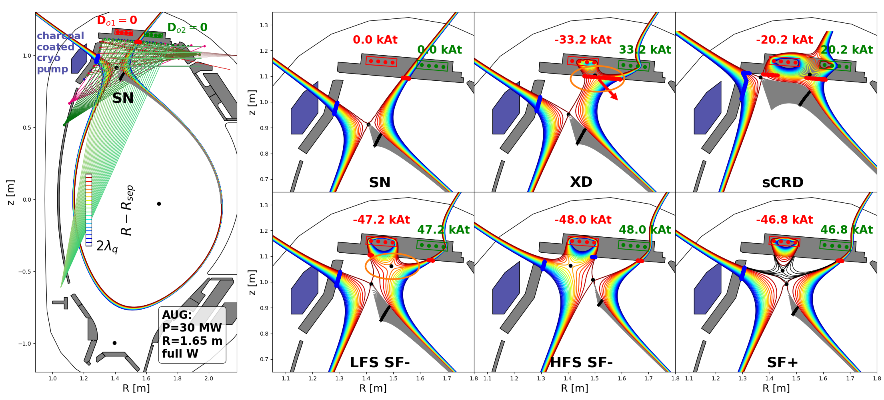
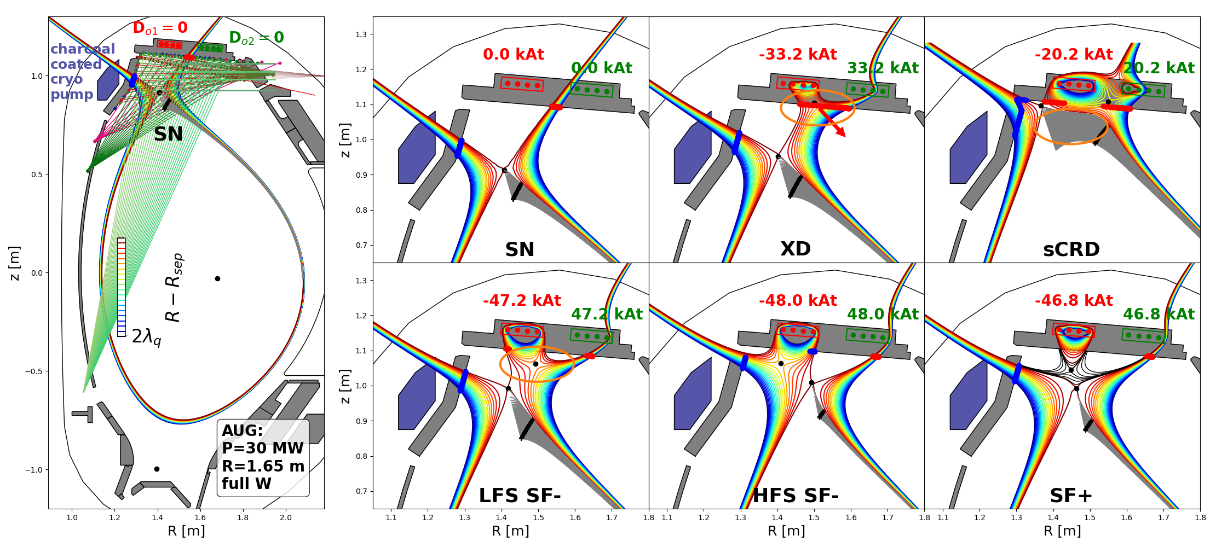

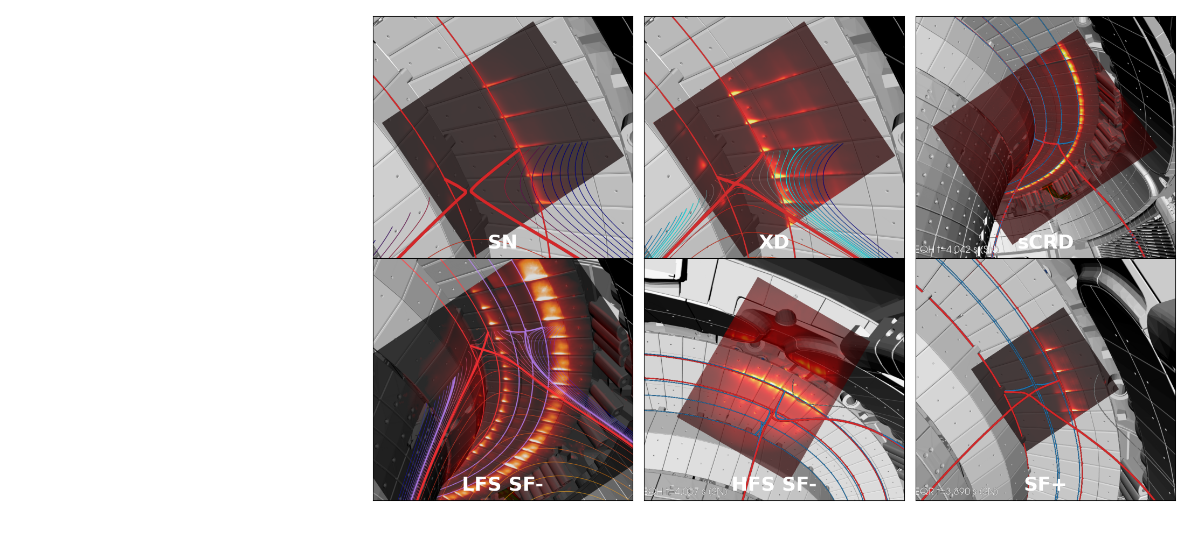
New Upper Divertor of ASDEX Upgrade: Configurations
[Lunt et al. PRL 2023]
T.Lunt, 5th TM on divertor concepts 2025, IAEA Headquarters, Vienna, Austria
4

Slide 5
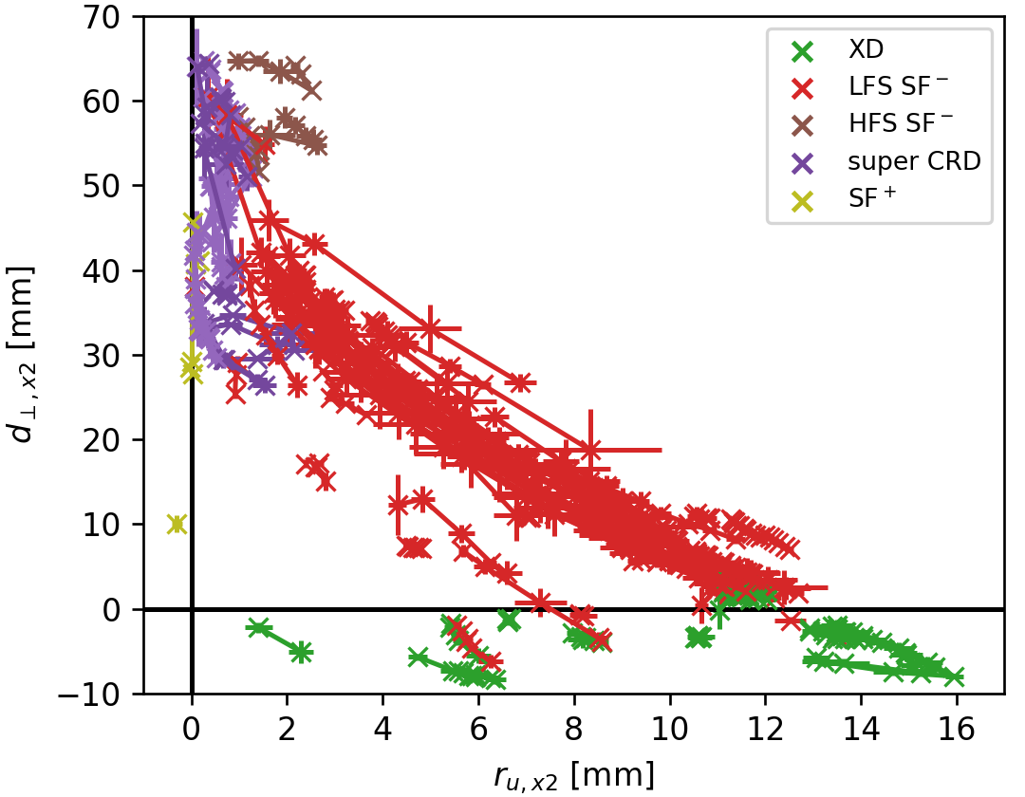
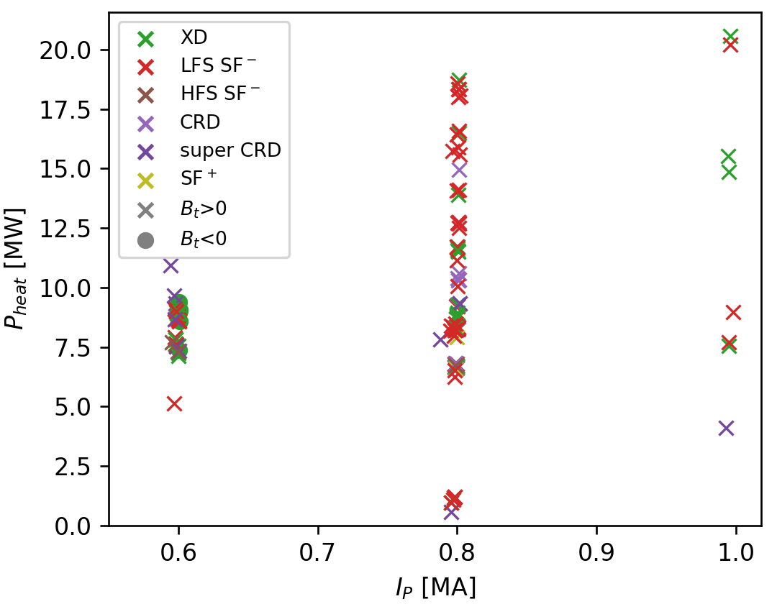
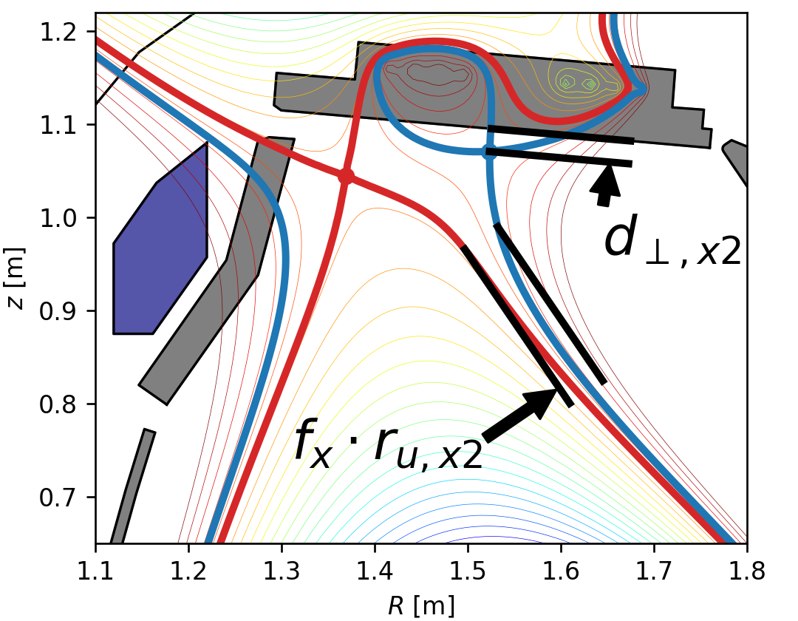
Overview experimental campaign 2025
Database of >100 discharges in stable ADC
increasing
decreasing
λ_{q}
Position of the 2nd X-point
Operational space
Hardware installation completed
New upper divertor of AUG operational, but cryo-pump not yet at full performance
All alternative divertor configurations (ADC) successfully established, stable for seconds and during ELMs (except SF+)
Heating power up to 20 MW and plasma current up to 1 MA in ADC
f_{x}=flux expansion
T.Lunt, 5th TM on divertor concepts 2025, IAEA Headquarters, Vienna, Austria
5

Slide 6
First experimental observations
T.Lunt, 5th TM on divertor concepts 2025, IAEA Headquarters, Vienna, Austria
6

Slide 7
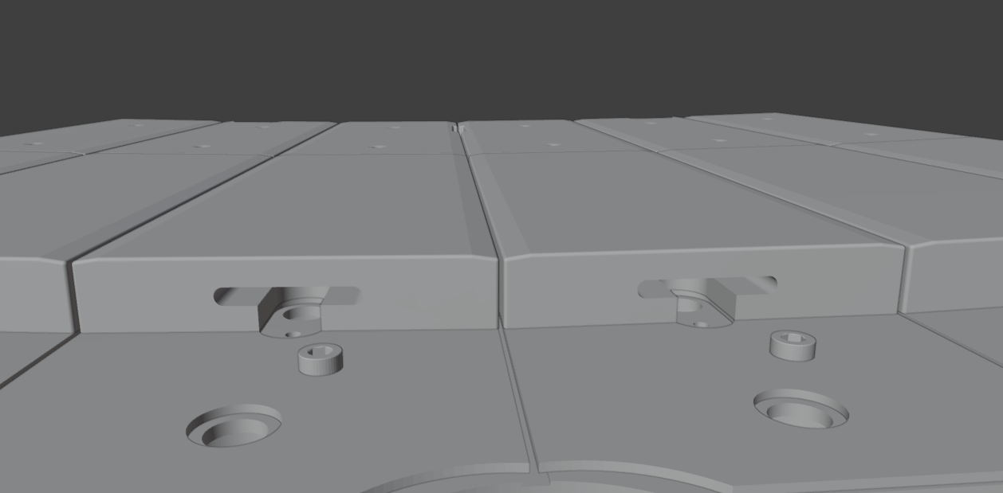
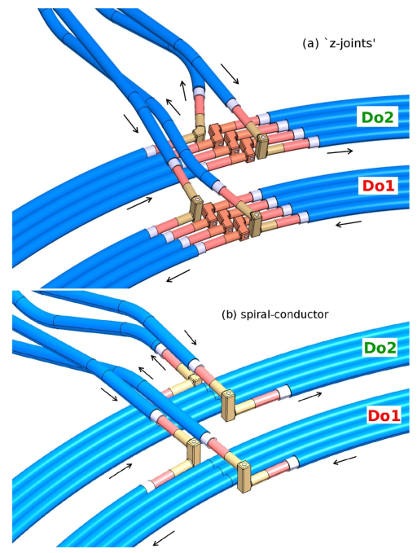
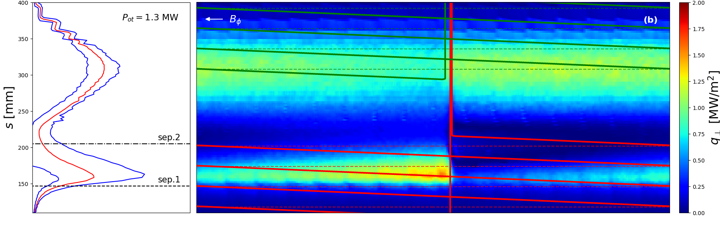
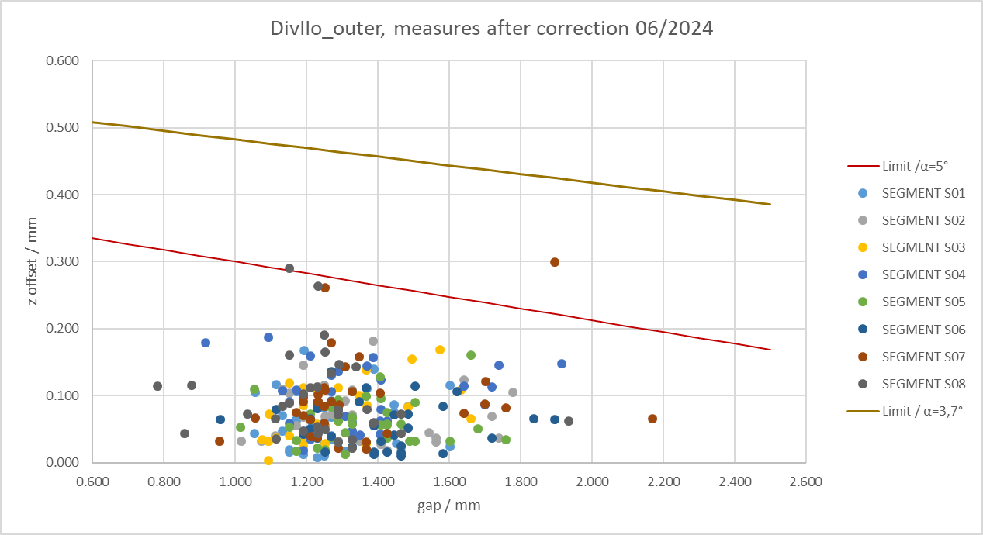
Small field line incidence angles θ⊥<2º can be handled
Alignment tolerance <300µm
[Lunt NME 2019]
T.Lunt, 5th TM on divertor concepts 2025, IAEA Headquarters, Vienna, Austria
7

Slide 8
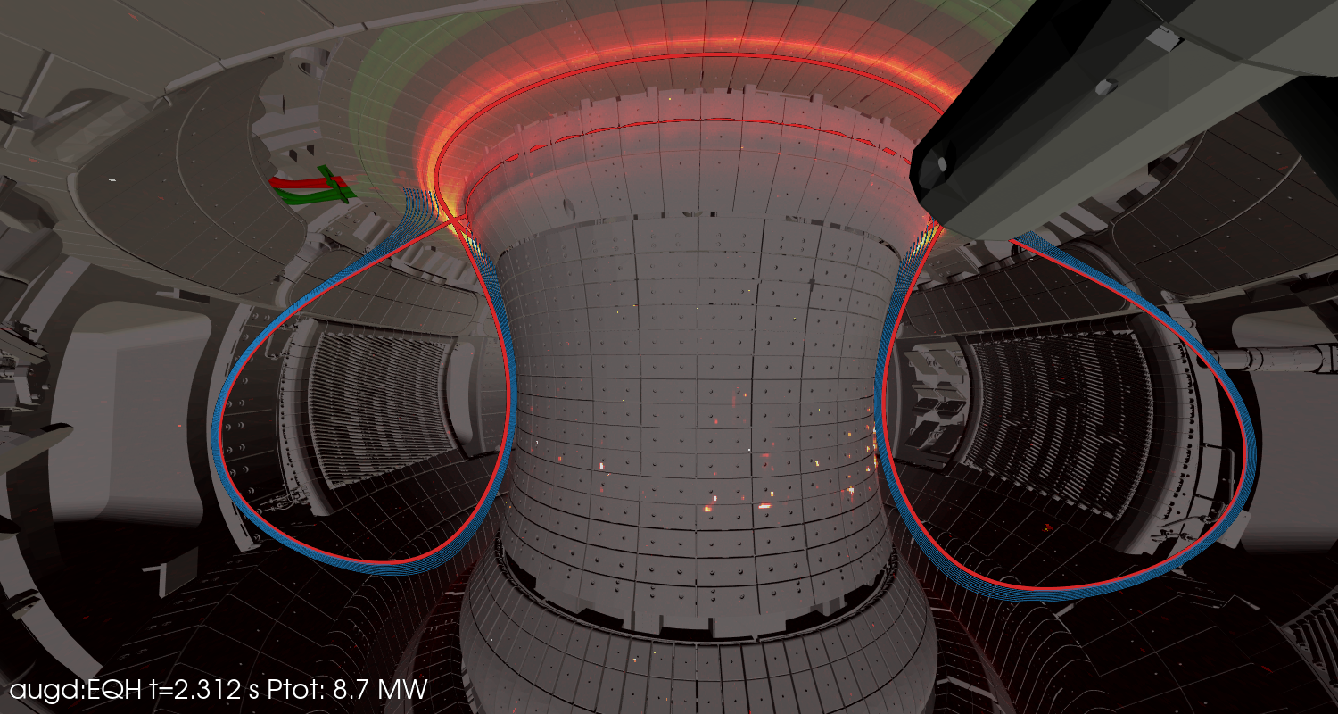
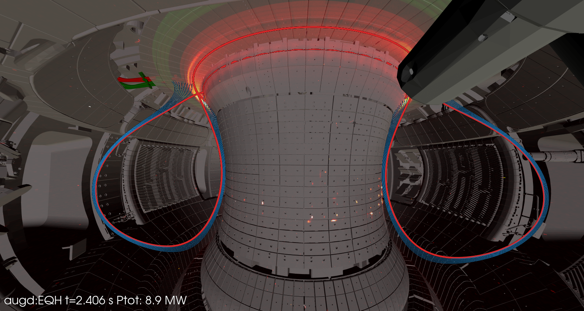
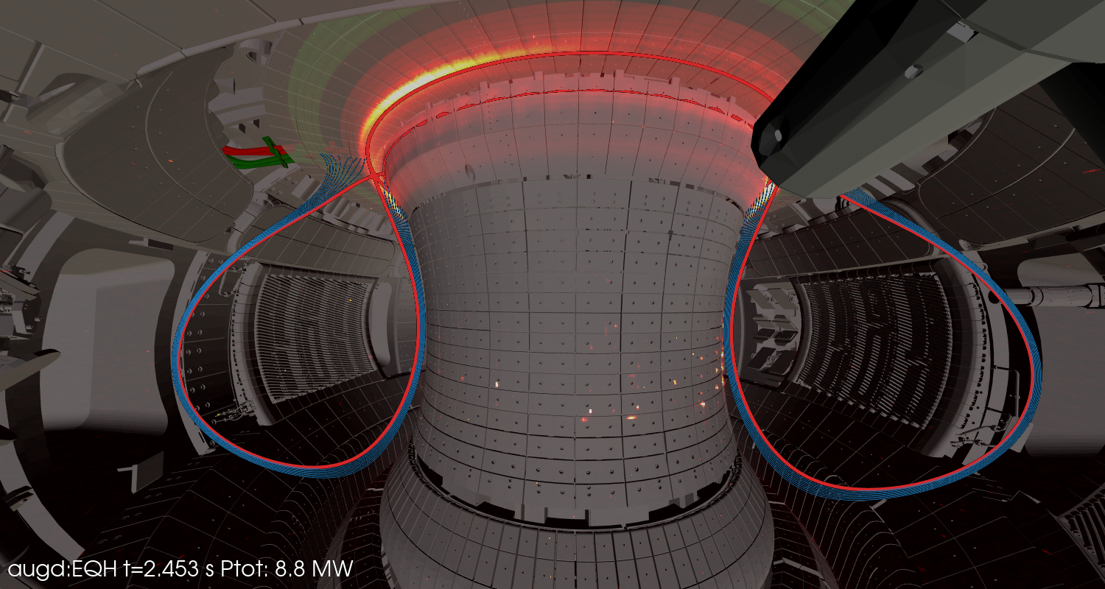


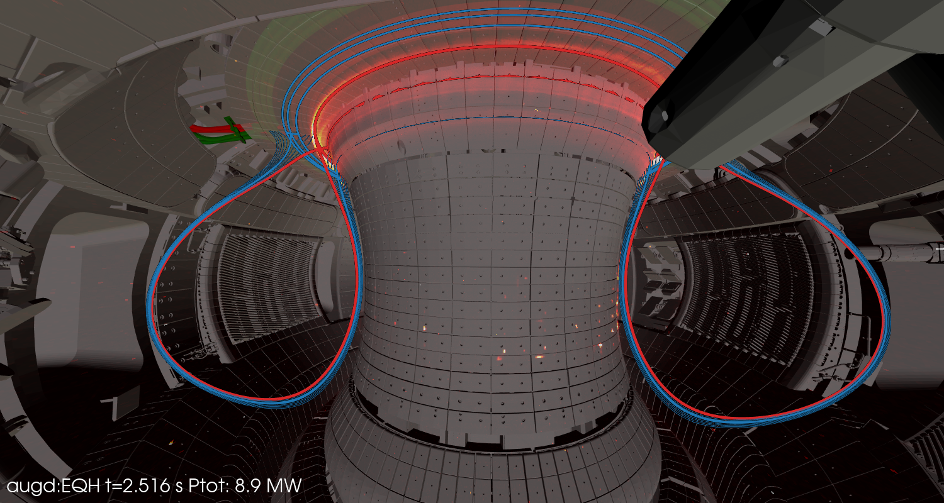

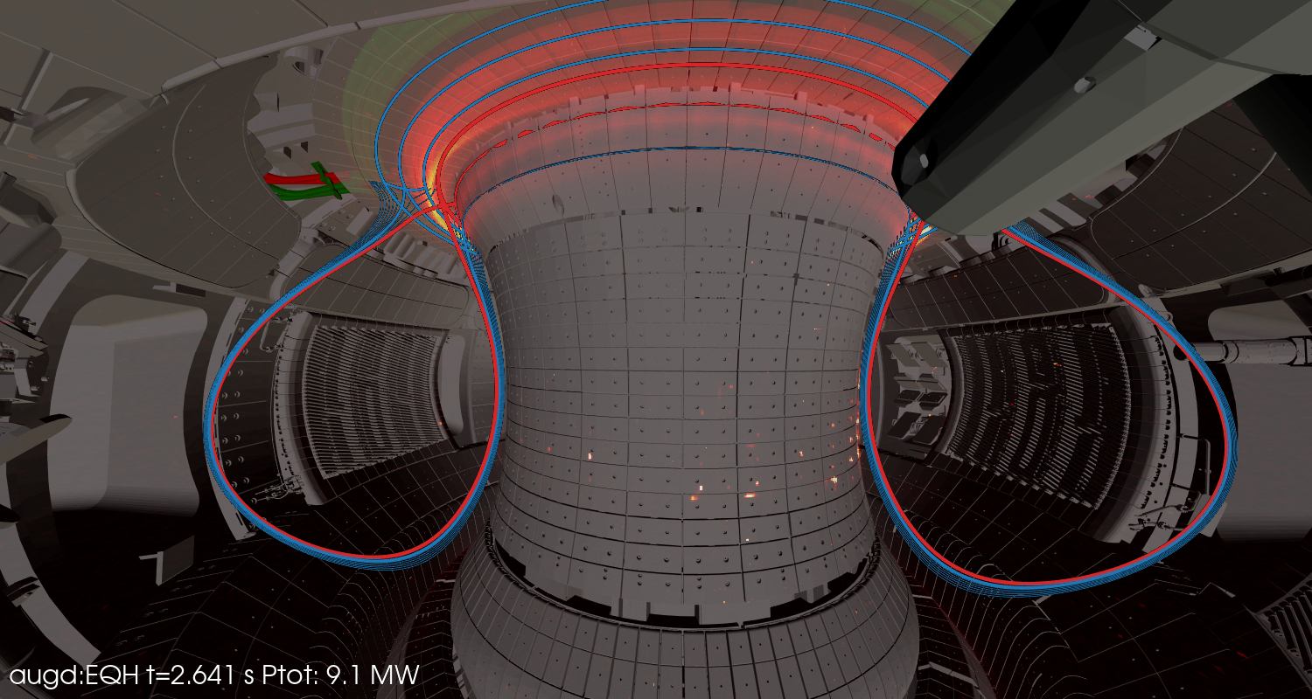
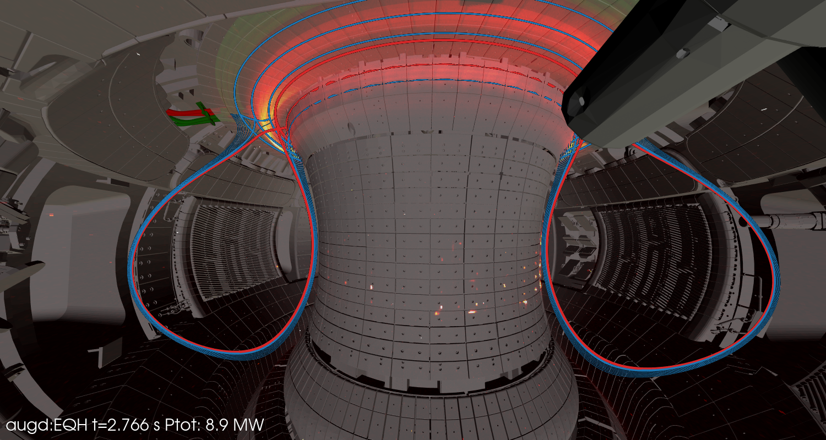
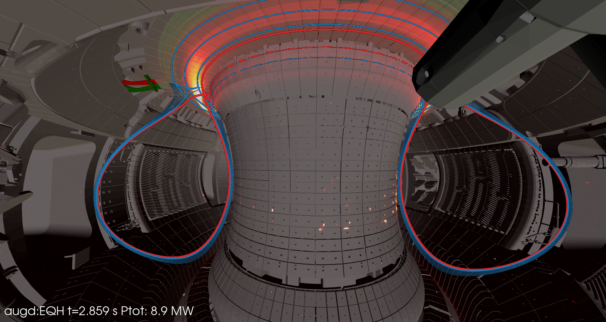

Small field line incidence angles θ⊥<2º can be handled
Observation 1:
Small field line incidence angles θ⊥<2º can be handled ..
with a tile aligment accuracy better than 300 µm
and optimized error fields of the current feeds
AUG 43638 NIR camera
T.Lunt, 5th TM on divertor concepts 2025, IAEA Headquarters, Vienna, Austria
8

Slide 9
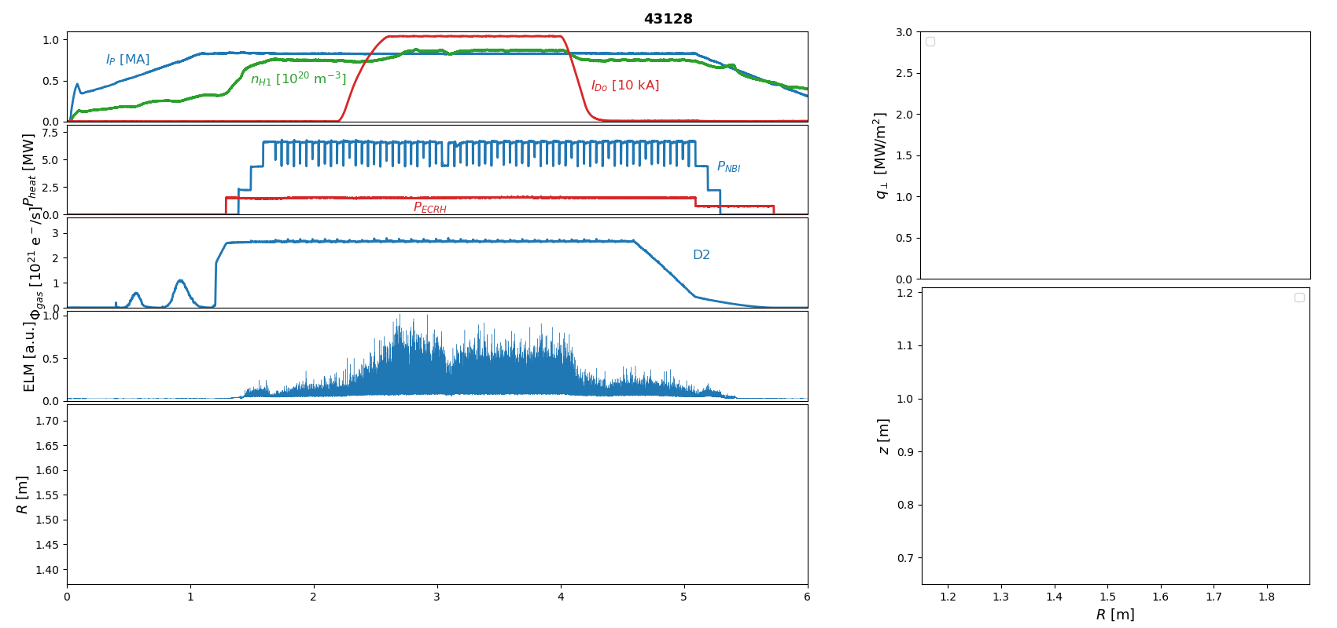
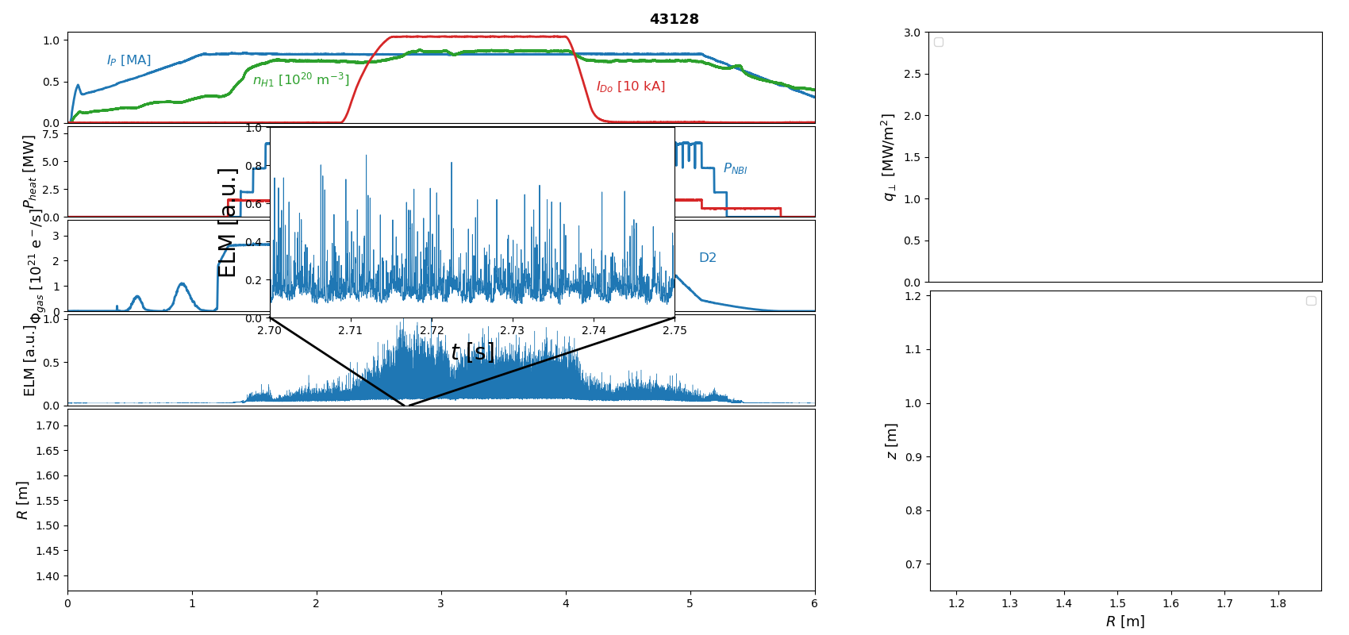
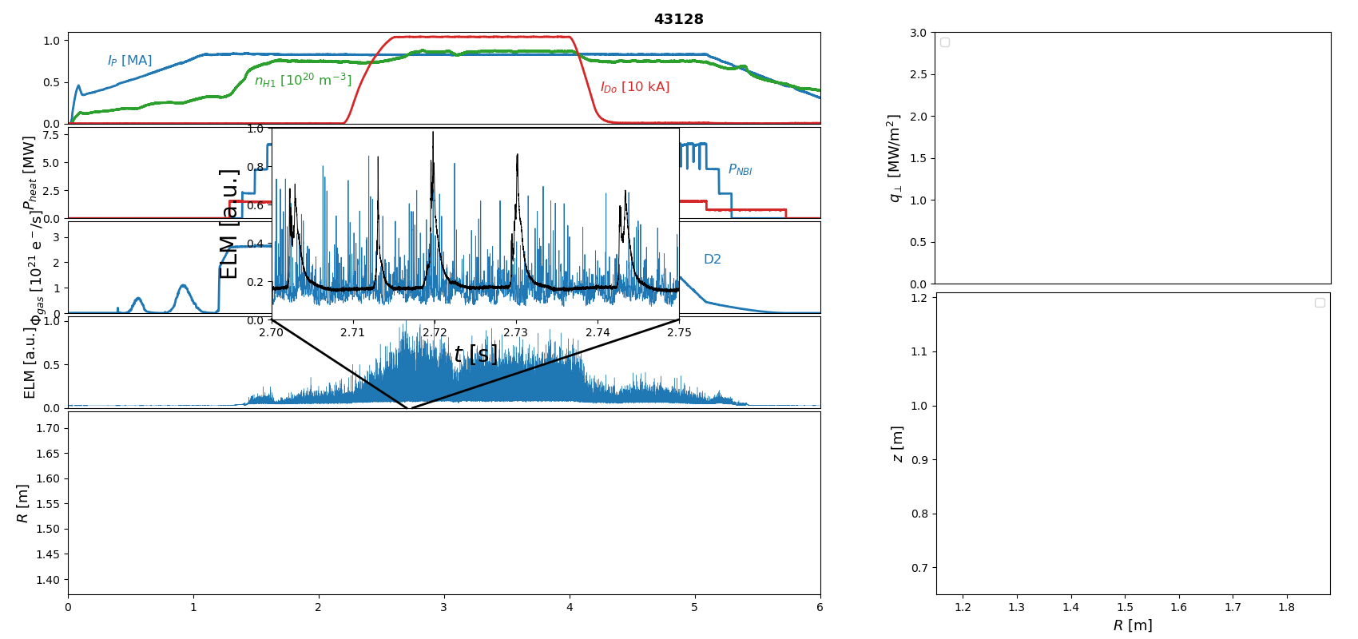
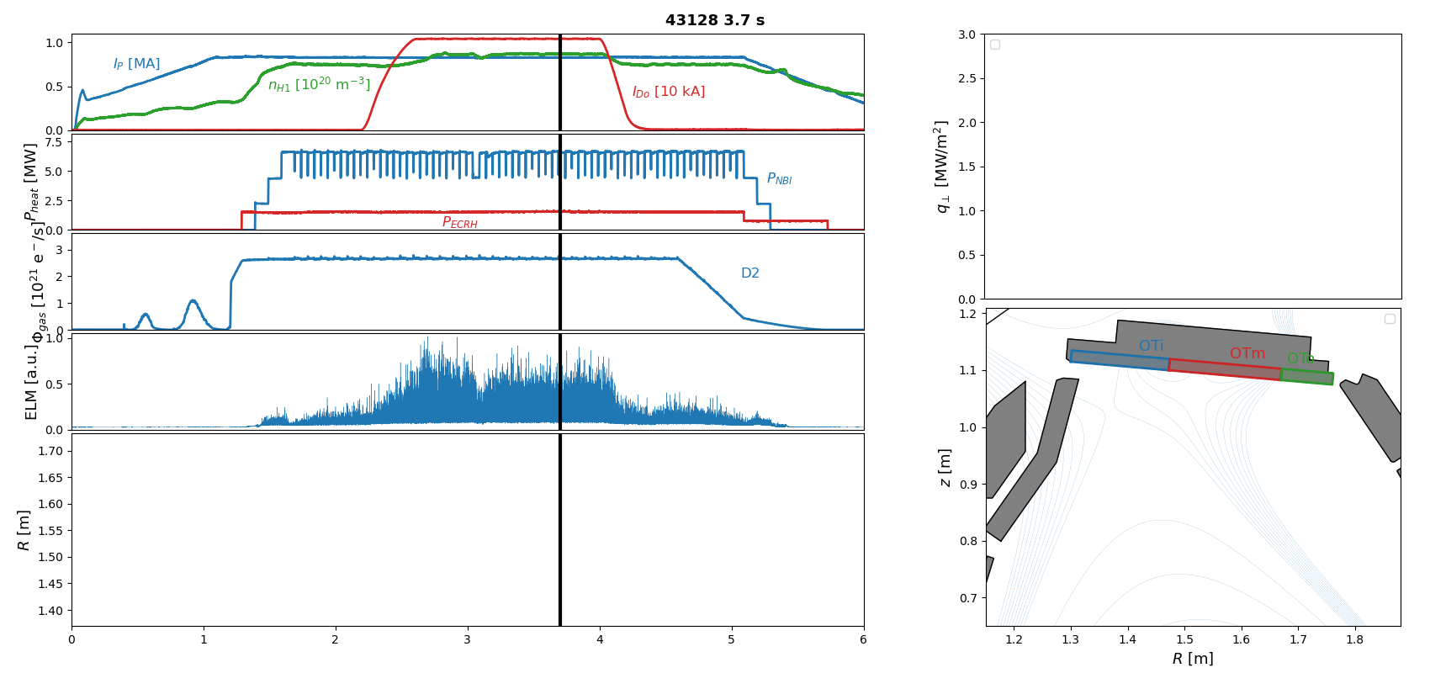
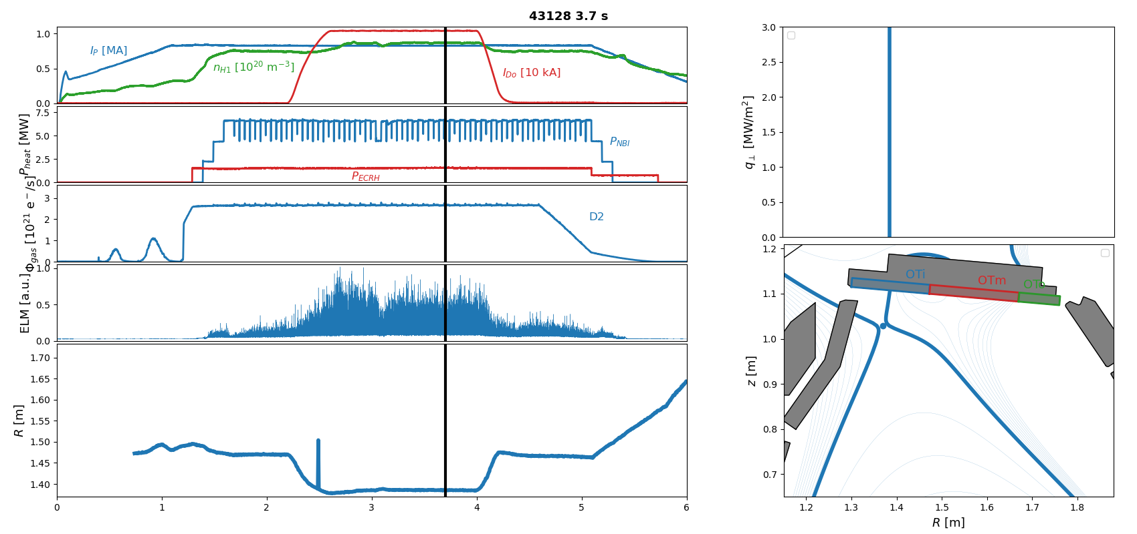
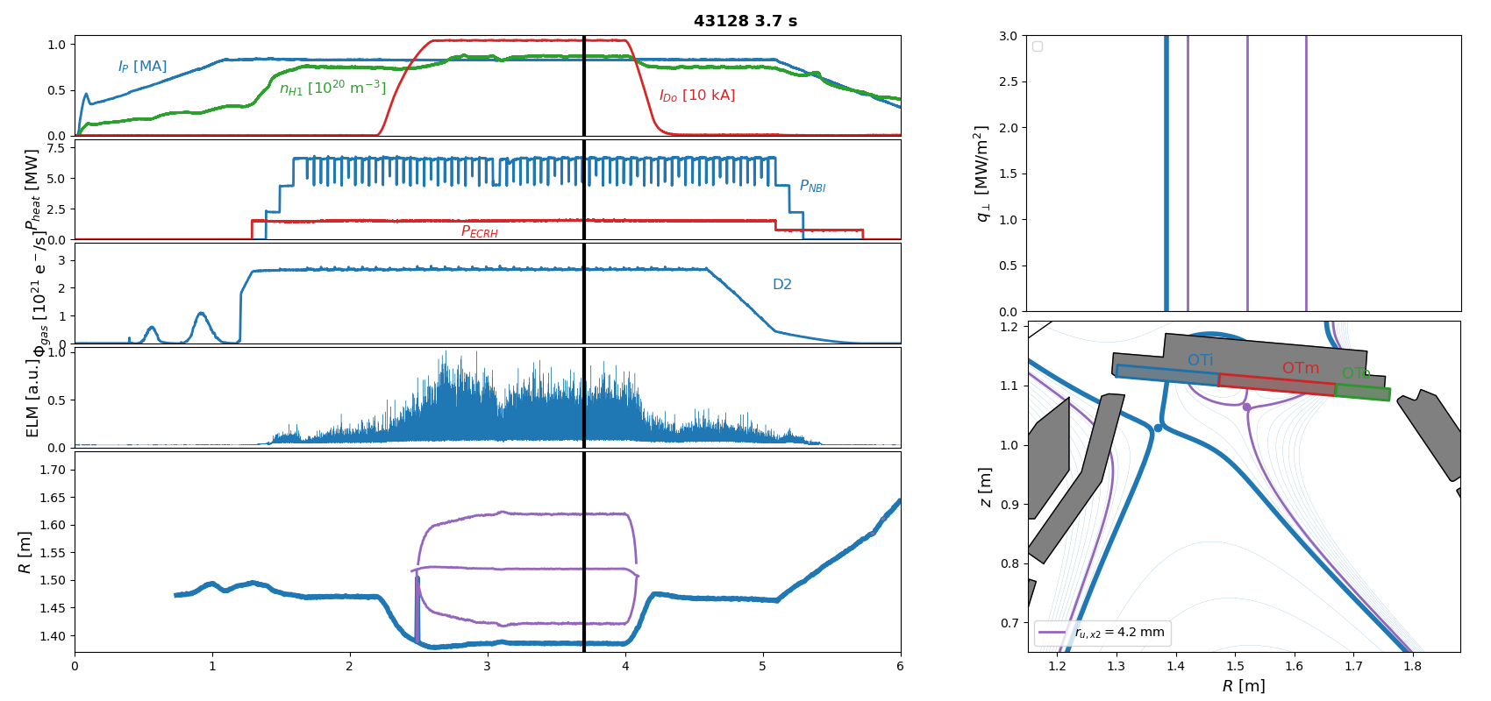
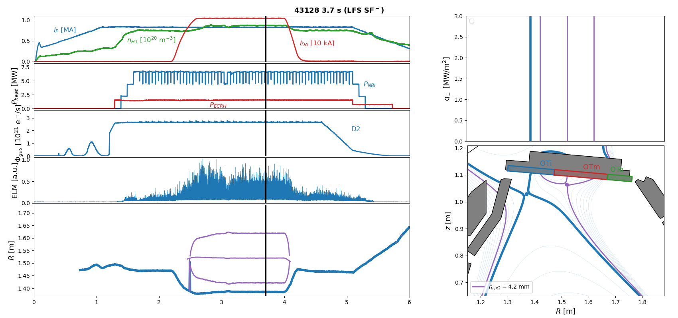
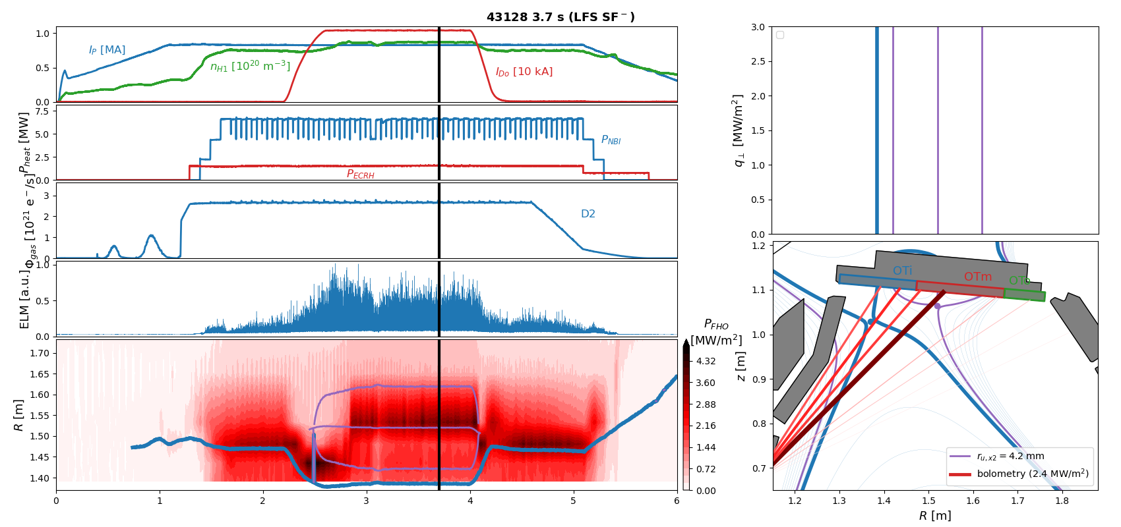
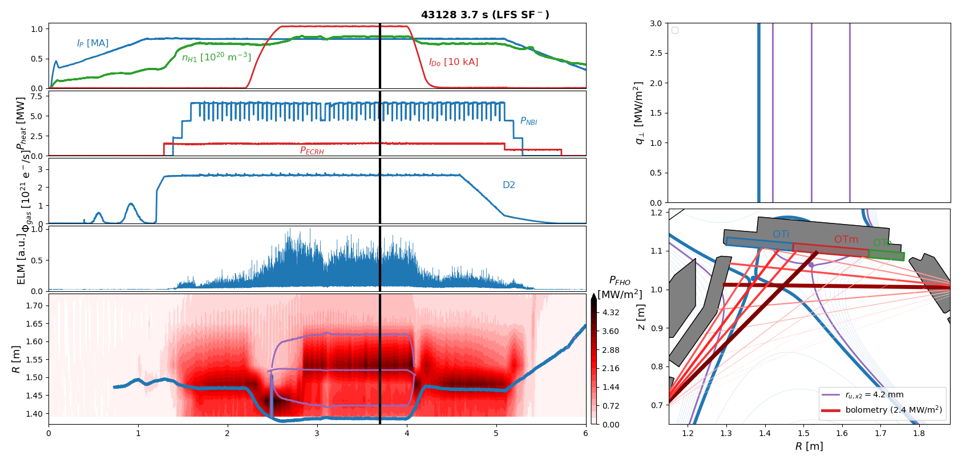
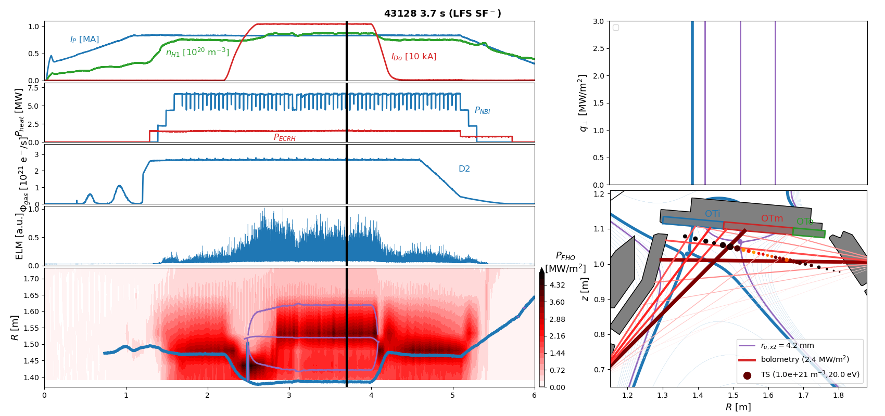



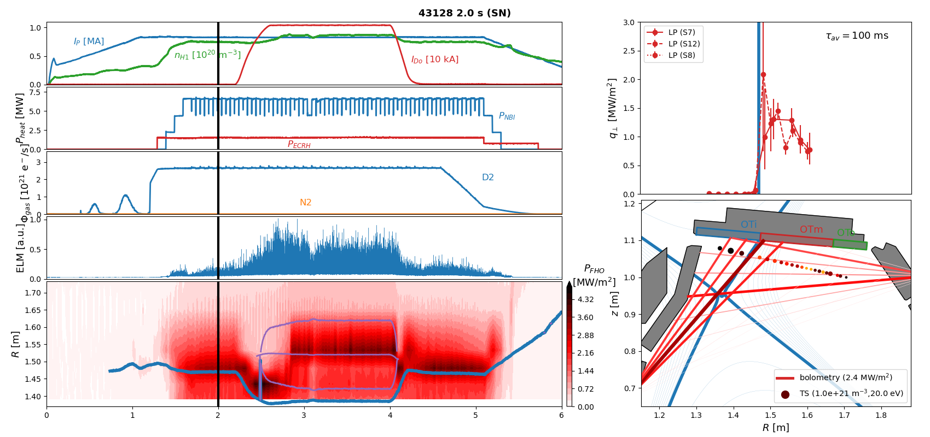
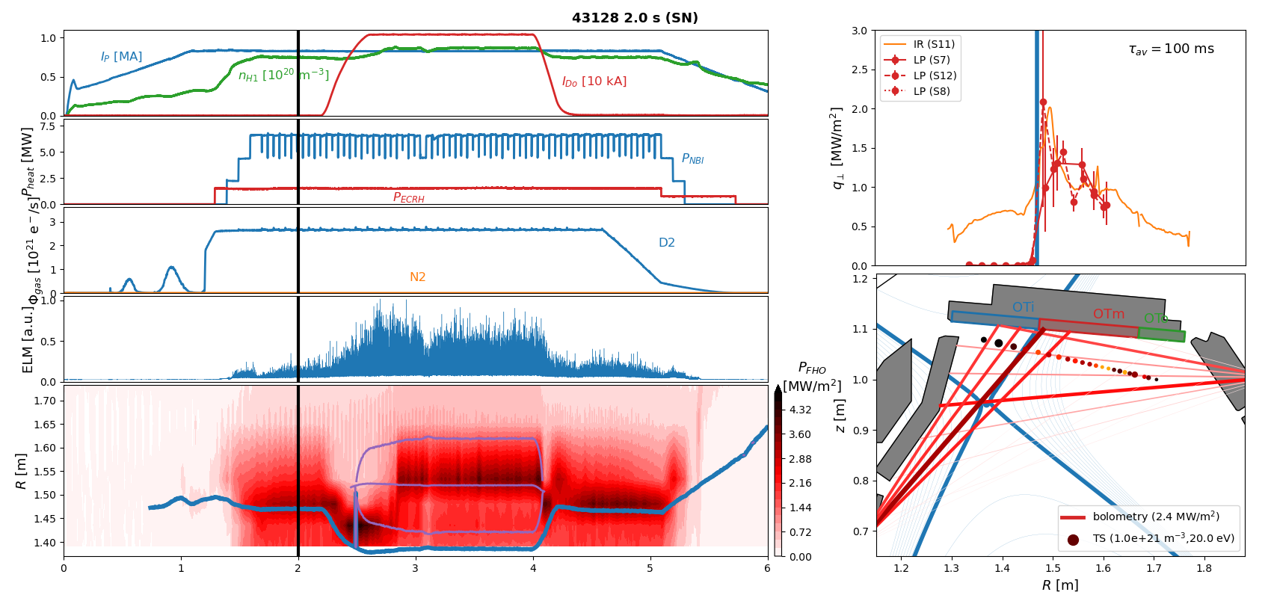

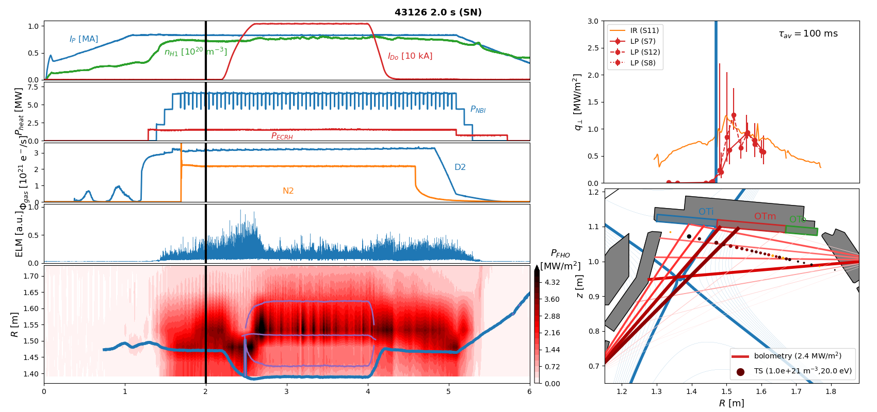
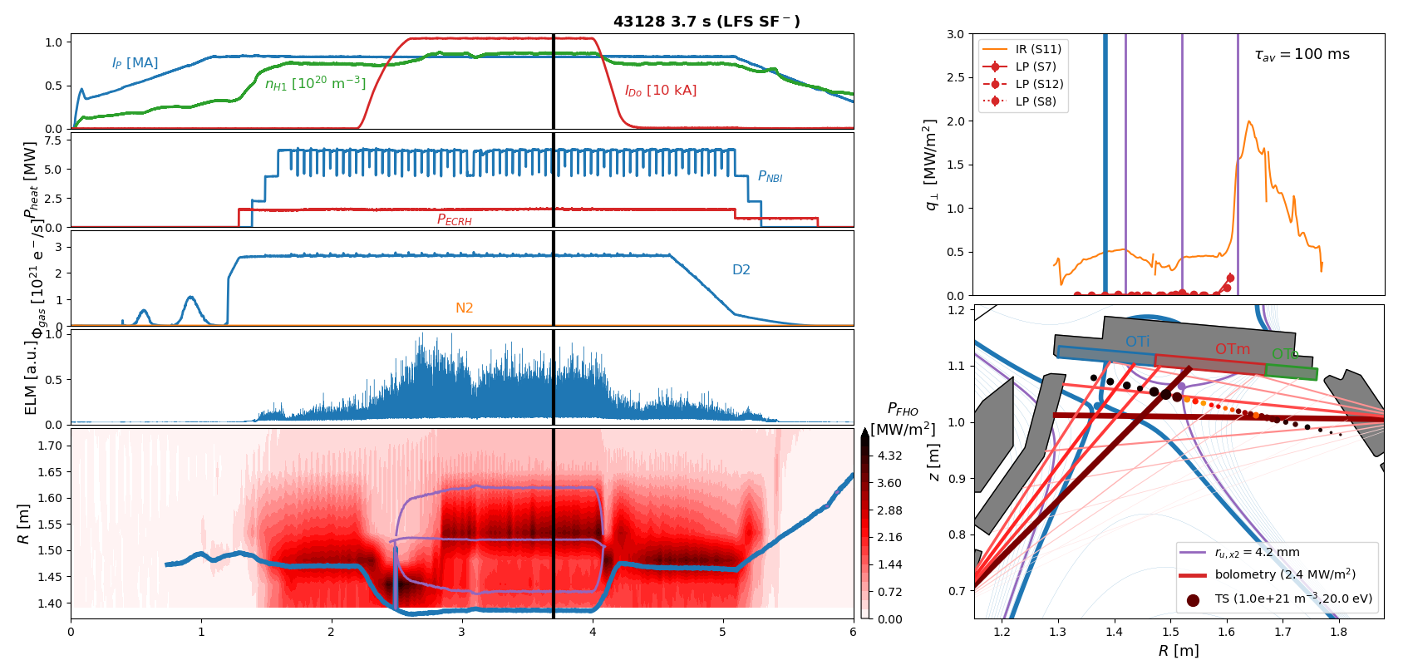

X-point radiator w/o impurity seeding in 800kA H-mode
Observation 2:
Even without impurity seeding an X-point radiator can be established in a LFS SF- configuration …
accompanied by detachment of the primary strike line,
but far-SOL heat-fluxes beyond secondary strike line remain high
t [s]
[Bernert NF 2021], [Stroth NF 2022]
T.Lunt, 5th TM on divertor concepts 2025, IAEA Headquarters, Vienna, Austria
9

Slide 10
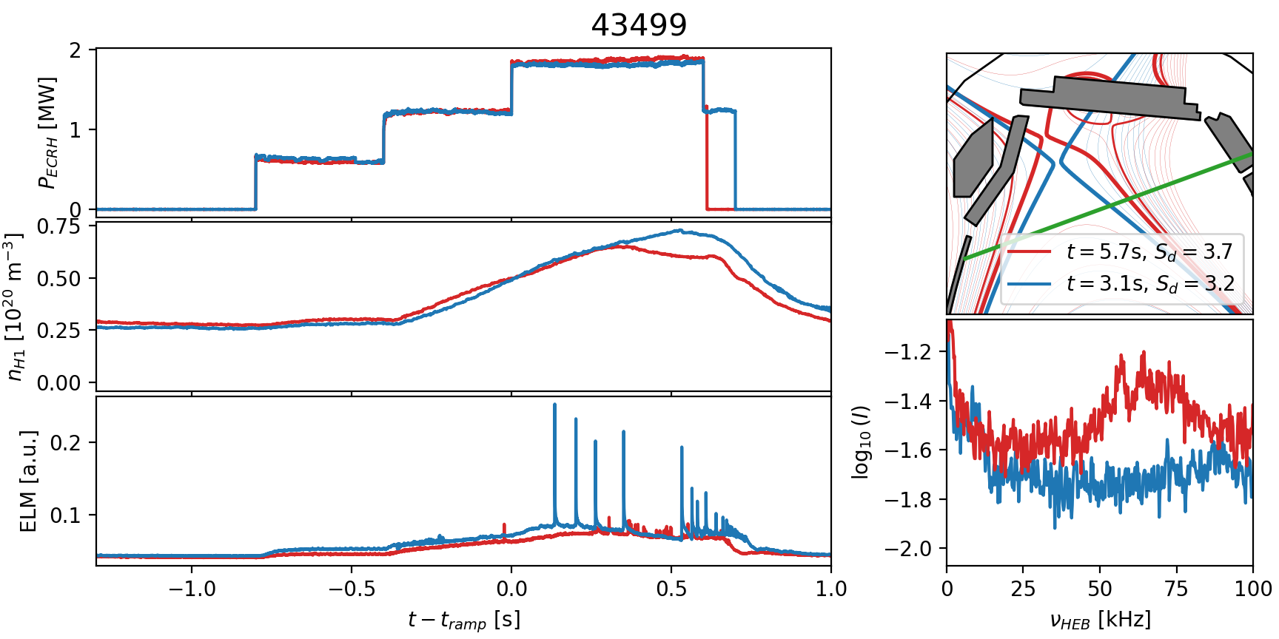
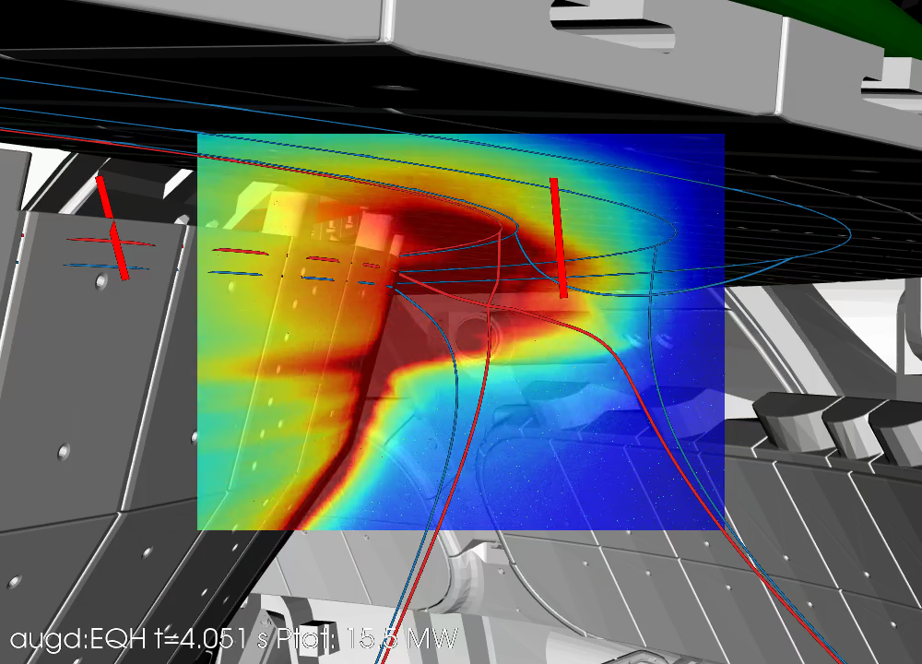

Small-ELM regime (QCE?)
[Faitsch NME 2021]
Observation 3:
Most (all?) of the ADC discharges are in a small-ELM (QCE?) regime
The different shape …
…or the high main chamber neutral density might be the reason
[shots by G. Birkenmeier]
Φ_{mc,USN}/Φ_{mc,LSN} ~ 7
[Dunne NF 2024]
T.Lunt, 5th TM on divertor concepts 2025, IAEA Headquarters, Vienna, Austria
10

Slide 11
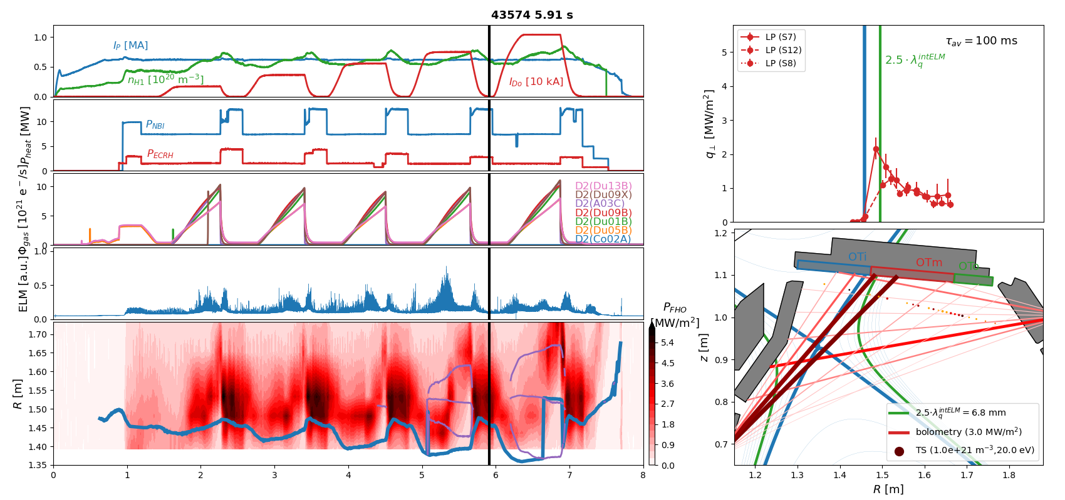
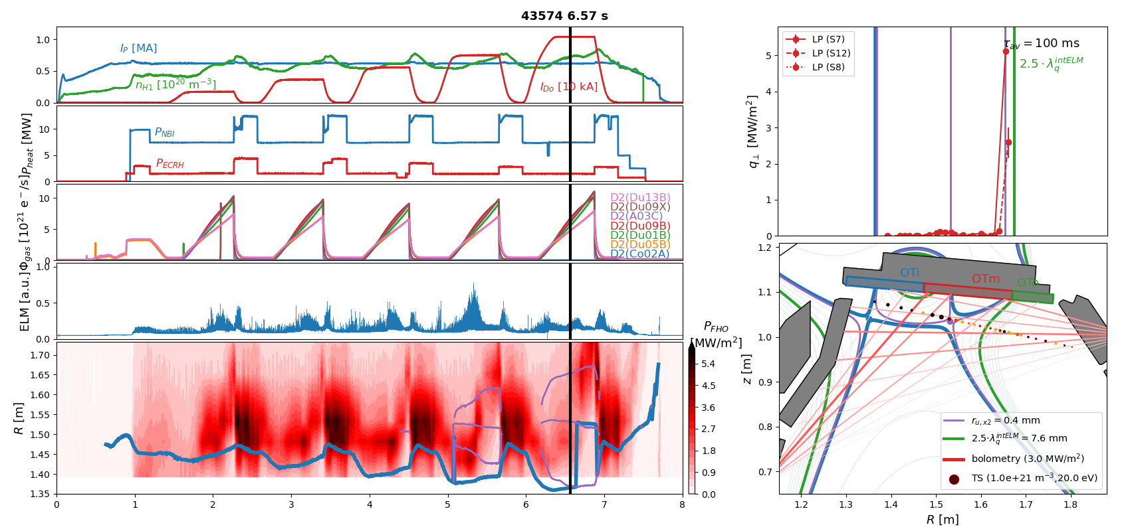
X-point radiator in sCRD configuration 600 kA H-mode
[shots by B.Sieglin]
t [s]
T.Lunt, 5th TM on divertor concepts 2025, IAEA Headquarters, Vienna, Austria
11

Slide 12
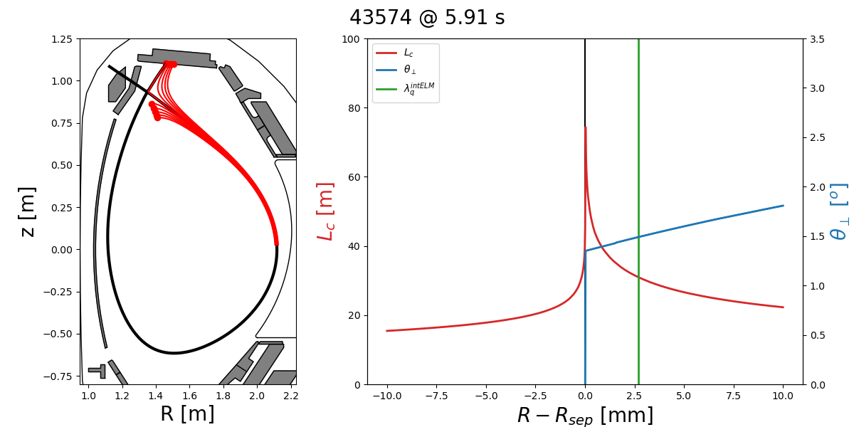

X-point radiator in sCRD configuration 600 kA H-mode
Observation 4:
Despite the very large volume of large f_{x} and L_{c} an XPR is not established/excited if λ_{q}>> Δr_{XPR}
T.Lunt, 5th TM on divertor concepts 2025, IAEA Headquarters, Vienna, Austria
12

Slide 13


X-point radiator in sCRD configuration at 800 kA
Observation 5:
A stable XPR is observed in sCRD configuration with N2 seeding
ELM size and far-SOL heat fluxes strongly reduced
t [s]
T.Lunt, 5th TM on divertor concepts 2025, IAEA Headquarters, Vienna, Austria
13

Slide 14



Strike point splitting in 1MA H-mode
Observation 6:
A splitting of the strike point is observed ..
accompanied by a reduction of a factor of 2 in the heat flux measured by Langmuir probes
t [s]
[Lunt NME 2017], [Pan PPCF 2018]
T.Lunt, 5th TM on divertor concepts 2025, IAEA Headquarters, Vienna, Austria
14

Slide 15
Gaps in extrapolating to future devices
T.Lunt, 5th TM on divertor concepts 2025, IAEA Headquarters, Vienna, Austria
15

Slide 16








Gaps: stability of XPR at short λ_{q}
DEMO (9m/1.65m=5.45 times larger)
Δr_{u,XPR}
[Eich, PRL 2011]
[Brunner NF 2018]
XPR
[Lunt, Bernert et al.
PRL 2023]
Radial extension Δr_{u,xpr} of XPR increases compared to λ_{q} in ITER & DEMO
Is it stable?
T.Lunt, 5th TM on divertor concepts 2025, IAEA Headquarters, Vienna, Austria
CRD experiments at AUG and their consequences for a reactor
16

Slide 17

Gaps: Near/Far-SOL fall-off length
[Lunt PPCF 2020]
Near-SOL power fall-off length scaling
[Eich PRL 2011] / [Brunner NF 2018]
Far-SOL power fall-off length scaling ?
Access to QCE ?
[Dunne NF 2024]
T.Lunt, 5th TM on divertor concepts 2025, IAEA Headquarters, Vienna, Austria
17

Slide 18
Summary
Hardware installation of a pair of in-vessel coils, a charcoal coated cryo-pump and new divertor targets completed
All alternative divertor configurations (ADC) successfully established, stable for seconds and during ELMs (except SF+)
Heating power up to 20 MW and plasma current up to 1 MA in ADC
Observations:
Even at high heating powers field line incidence angles can be made arbitrarily small – or even negative – due to outstanding target alignment accuracy and small magnetic error fields
X-point radiator forms in a LFS SF- configuration even without impurity seeding, where the primary strike point is fully detached, but far-SOL heat fluxes still high
Most (all?) of the ADC discharges are in a small-ELM (QCE?) regime
Large XPR volume no guarantee for XPR formation
Stable XPR observed in sCRD configuration
Splitting of the outer strike point observed, accompanied by reduction of the peak heat flux of a factor of ~2 in 1 MA LFS SF⁻ discharges measured by Langmuir probes
T.Lunt, 5th TM on divertor concepts 2025, IAEA Headquarters, Vienna, Austria
18

Slide 19

Outlook
Upcoming campaign
Install protection plates on cryo-pump
Carry out 1 MA discharges in (s)CRD configuration
Try other seeding gases to reduce far-SOL heat fluxes
Long term
Install baffles
T.Lunt, 5th TM on divertor concepts 2025, IAEA Headquarters, Vienna, Austria
19

Slide 20
Backup slides
T.Lunt, IAEA-FEC 2025 Chengdu, China
20

Slide 21

Access to QCE
[Dunne et al., NF 2024]
T.Lunt, 5th TM on divertor concepts 2025, IAEA Headquarters, Vienna, Austria
21

Slide 22

Filamentary transport
[Krasheninnikov, Phys.Rev. A]
T.Lunt, 5th TM on divertor concepts 2025, IAEA Headquarters, Vienna, Austria
22

Slide 23








Experiments – discharges
CRD successfully established, even
without feed-back control
15 MW total heating
with X-point exactly on target
MAX-PLANCK-INSTITUT FÜR PLASMAPHYSIK | Tilmann Lunt | 49th EPS Conference on Plasma Physics, Bordeaux July 3-7th 2023
CRD experiments at AUG and their consequences for a reactor
23

Slide 24






Experiments – IR thermography
1.5xλ_{q,Eich}
separatrix
IR camera images superimposed to 3D-CAD drawings
ΔT_{surf}=T_{surf}-T_{surf,0}, T_{surf,0}=373 ± 30 K
Large toroidal coverage: Δφ=70°
[Lunt, Bernert et al. PRL 2023]
No hotspots observed in CRD & PXD
MAX-PLANCK-INSTITUT FÜR PLASMAPHYSIK | Tilmann Lunt | 49th EPS Conference on Plasma Physics, Bordeaux July 3-7th 2023
CRD experiments at AUG and their consequences for a reactor
24

Slide 25








Experiments – heat fluxes
< >
[Lunt, Bernert et al. PRL 2023]
strong reduction of heat flux of charged particles in CRD compared to SN
heatflux dominated by radiation in CRD
MAX-PLANCK-INSTITUT FÜR PLASMAPHYSIK | Tilmann Lunt | 49th EPS Conference on Plasma Physics, Bordeaux July 3-7th 2023
CRD experiments at AUG and their consequences for a reactor
25

Slide 26

Experiments – Interpretation with EMC3-EIRENE
modeling of CRD successful with EMC3-EIRENE
state of deep detachment
large flux expansion at target seems to be favorable for neutral particle trapping
MAX-PLANCK-INSTITUT FÜR PLASMAPHYSIK | Tilmann Lunt | 49th EPS Conference on Plasma Physics, Bordeaux July 3-7th 2023
CRD experiments at AUG and their consequences for a reactor
26

Slide 27




Experiments – target tile alignment accuracy
S15
S16
q⊥=0.2°
S15
S16
S1
S14
Leading edge as large as
1.7 mm!
Tile state since 2003 (!)
Visible true color camera 16Boc
superimposed to 3D CAD drawings
substantial (1.7 mm) tile misalignment
compatible with CRD operation
MAX-PLANCK-INSTITUT FÜR PLASMAPHYSIK | Tilmann Lunt | 49th EPS Conference on Plasma Physics, Bordeaux July 3-7th 2023
CRD experiments at AUG and their consequences for a reactor
27

Slide 28


Core impurity pollution & dilution
c_{N,max}=3.5%
Spectroscopy 40700:
c_{N}<~2.5%
c_{W}=2x10⁻⁵
c_{W,max}=2x10⁻⁴
individual impurity concentrations below limit
what about all impuritites together?
how does this scale to a reactor?
[Pütterich et al. NF 2019]
MAX-PLANCK-INSTITUT FÜR PLASMAPHYSIK | Tilmann Lunt | 49th EPS Conference on Plasma Physics, Bordeaux July 3-7th 2023
CRD experiments at AUG and their consequences for a reactor
28

Slide 29



Extrapolation to (EU-)DEMO – SOLPS-ITER modelling
Modeling of AUG geometry scaled to DEMO
divertor neutral pressures up to 15 Pa (beneficial for He pumping)
impurity concentration far below tolerable limits
heat flux <=2 MW/m² dominated by radiation
[Pan et al, upcoming IAEA 2023]
MAX-PLANCK-INSTITUT FÜR PLASMAPHYSIK | Tilmann Lunt | 49th EPS Conference on Plasma Physics, Bordeaux July 3-7th 2023
CRD experiments at AUG and their consequences for a reactor
29

Slide 30

SOL splitting
[Lunt NME 2017]
30
T.Lunt, 5th TM on divertor concepts 2025, IAEA Headquarters, Vienna, Austria

Slide 31

SOL splitting
[Pan PPCF 2018]
31
T.Lunt, 5th TM on divertor concepts 2025, IAEA Headquarters, Vienna, Austria

Slide 32
Small field line incidence angles θ⊥<2º can be handled
Alignment tolerance <300µm
Result 2:
Small field line incidence angles θ⊥<2º can be handled ..
with a tile aligment accuracy better than 300 µm
and optimized error fields of the current feeds
AUG 43638 NIR camera
[Lunt NME 2019]
T.Lunt, 5th TM on divertor concepts 2025, IAEA Headquarters, Vienna, Austria
32

Slide 33


Energy Balance
T.Lunt, 5th TM on divertor concepts 2025, IAEA Headquarters, Vienna, Austria

Slide 34


Effect on Lc
T.Lunt, 5th TM on divertor concepts 2025, IAEA Headquarters, Vienna, Austria
34

Slide 35




Gaps: importance of the XPR volume in large device
DEMO (9m/1.65m=5.45 times larger)
T.Lunt, 5th TM on divertor concepts 2025, IAEA Headquarters, Vienna, Austria
35

Slide 36


New upper divertor hardware
T.Lunt, 5th TM on divertor concepts 2025, IAEA Headquarters, Vienna, Austria
36

Slide 37

New upper divertor hardware
[Zammuto IEEE 2024]
T.Lunt, 5th TM on divertor concepts 2025, IAEA Headquarters, Vienna, Austria
37

Slide 38


AUG mechanical twin
[Zammuto IEEE 2024]
T.Lunt, 5th TM on divertor concepts 2025, IAEA Headquarters, Vienna, Austria
38

Slide 39




New upper divertor hardware
[Zammuto IEEE 2024]
T.Lunt, 5th TM on divertor concepts 2025, IAEA Headquarters, Vienna, Austria
39

Slide 40


New upper divertor hardware
AUG VV
Bending
machine
Unspooler and straightening machine
T.Lunt, 5th TM on divertor concepts 2025, IAEA Headquarters, Vienna, Austria
40

Slide 41


New upper divertor hardware
Tungsten coated
graphite tile
Papyex pad
Eccentric bolt
T.Lunt, 5th TM on divertor concepts 2025, IAEA Headquarters, Vienna, Austria
41

Slide 42


New upper divertor hardware
Cryo-pump installed in AUG
(coconut) charcoal coated cryo-pump for He-removal
cryo-pump installation finished
charcoal coating allows He-pumping
challenges for 3D in-vessel conductor bending and installation solved
completion of installation expected after summer 2024
T.Lunt, 5th TM on divertor concepts 2025, IAEA Headquarters, Vienna, Austria
42

Slide 43

New upper divertor hardware
New charcoal coated cryo pump
T.Lunt, 5th TM on divertor concepts 2025, IAEA Headquarters, Vienna, Austria
43

Slide 44


New upper divertor hardware
T.Lunt, 5th TM on divertor concepts 2025, IAEA Headquarters, Vienna, Austria
44

Slide 45

New upper divertor hardware
T.Lunt, 5th TM on divertor concepts 2025, IAEA Headquarters, Vienna, Austria
45

Slide 46

Cryopanel Temperature on stainless steel surface
T.Lunt, 5th TM on divertor concepts 2025, IAEA Headquarters, Vienna, Austria
46

Slide 47




Backup: 3D asymmetries (detachment?)
47

Slide 48

Near/Far-SOL fall-off length
[Brunner NF 2018]
[Lunt PPCF 2020]
T.Lunt, 5th TM on divertor concepts 2025, IAEA Headquarters, Vienna, Austria
48

Slide 49


1 MA H-mode
λ_{q,Eich/Brunner}=1.9 mm
Δr_{u,x2}=10.8 mm
T.Lunt, 5th TM on divertor concepts 2025, IAEA Headquarters, Vienna, Austria
49

Slide 50


800 kA H-mode strong gas puff
λ_{q,Eich/Brunner}=2.1 mm
Δr_{u,x2}=11.8 mm
Δr_{u,x2}=1.2 mm
T.Lunt, 5th TM on divertor concepts 2025, IAEA Headquarters, Vienna, Austria
50

