Slide 1
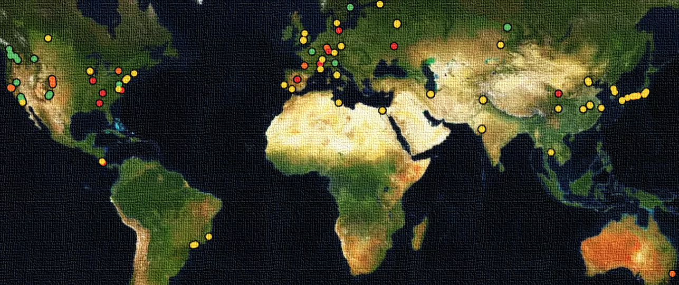

Development of the IMAS Data Model
Towards an Open Standard for Fusion Data
IAEA Technical Meeting on Fusion Data Processing, Validation and Analysis, 12 September 2025​, Shanghai
O. Hoenen¹, S. Mcintosh¹, M. Sebregts², D. van Vugt², S. Pinches¹
and many other IMAS contributors
¹ ITER Organization, ² Ignition Computing
@ IAEA FusDIS

Slide 2

Outline
Introduction
  IMAS overview
  Lessons learned on IMAS data model
Ongoing developments
  Opening IMAS Data Dictionary and tools
  Mapping the existing data
  Improving the data model with Standard Names
  Data storage and performance tests
Conclusion

Slide 3
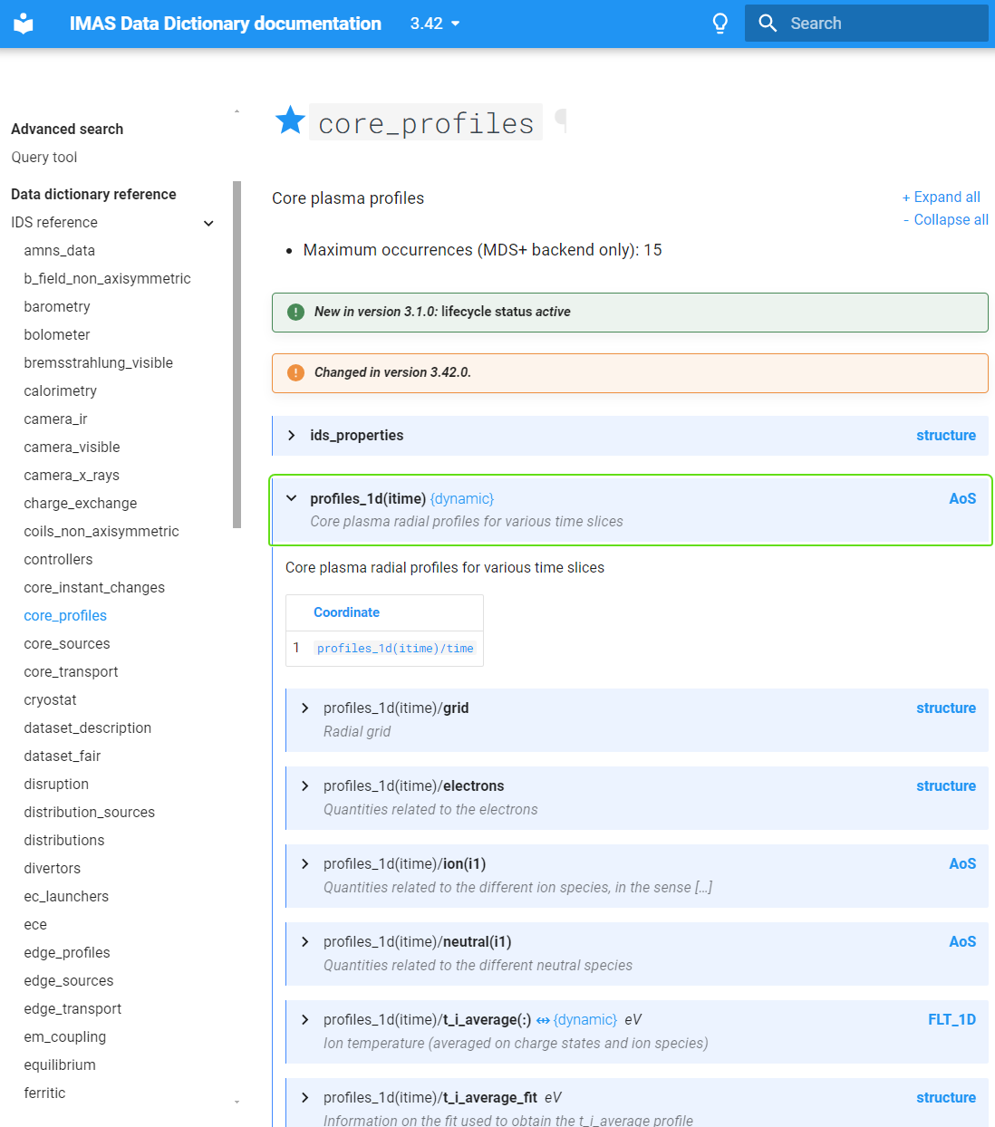
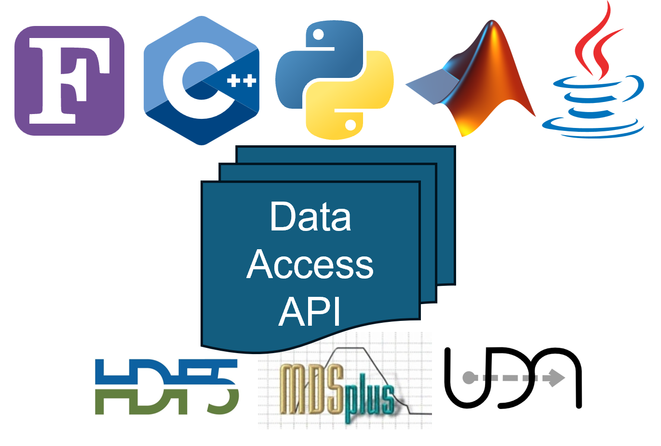
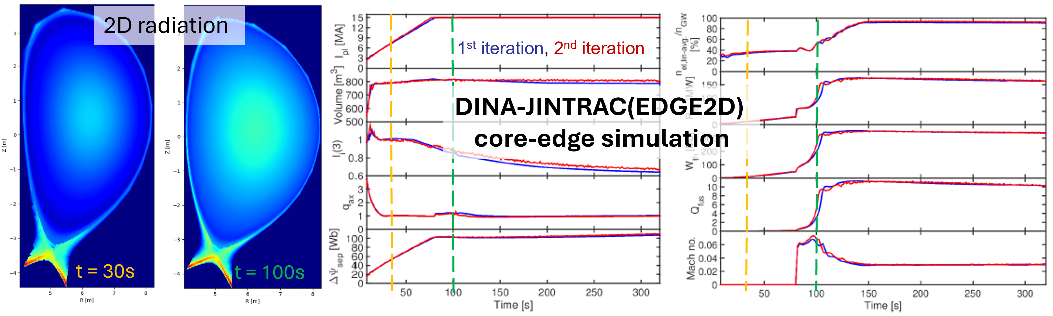
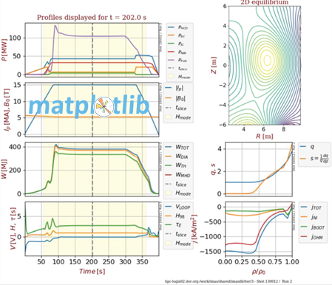
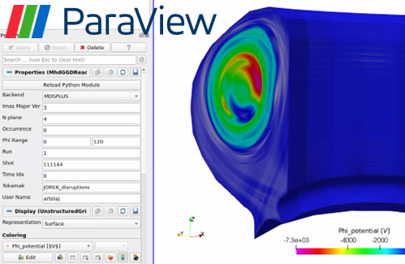
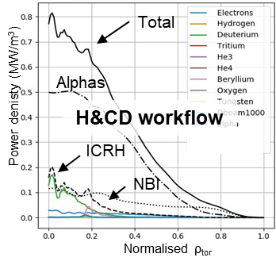
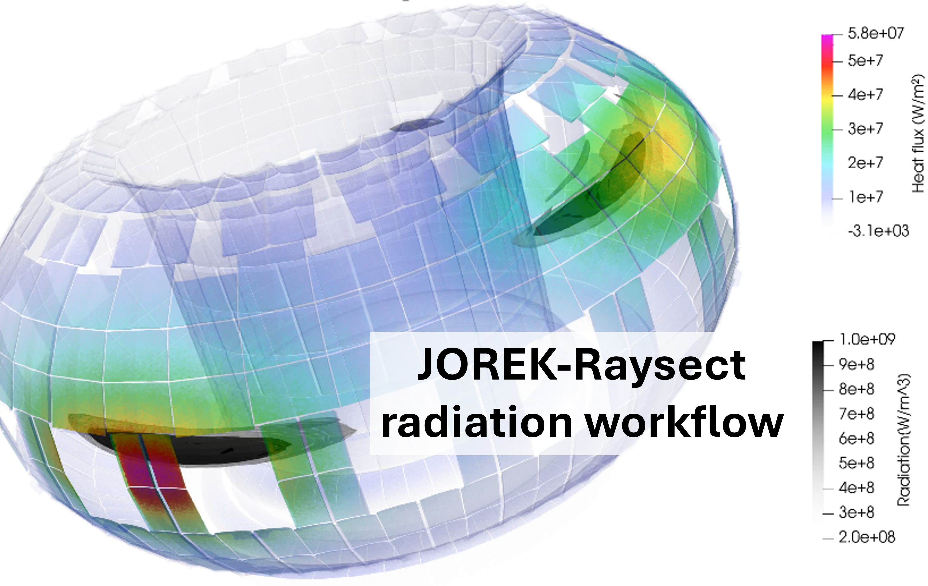
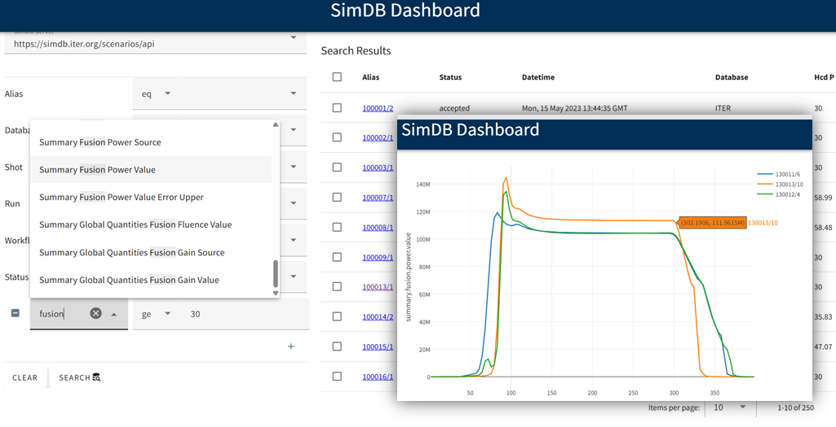

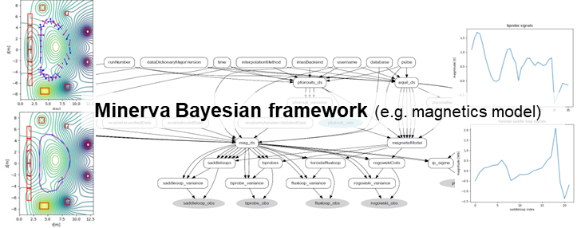
IMAS Overview
Integrated Modelling & Analysis Suite is the collection of physics software that will be used to support ITER operations and research as defined in the Integrated Modelling Programme
Data model
Generic tools
Applications

Slide 4
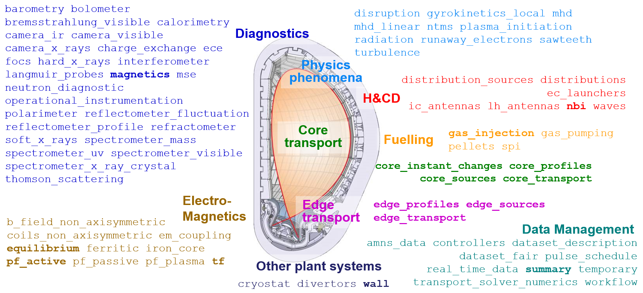
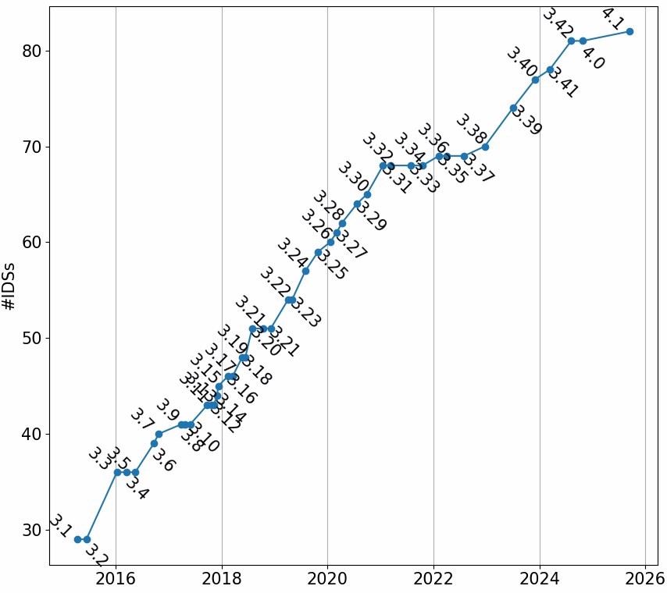
IMAS Data Model (DM)… so far
Cover experimental and simulation data → Integrated Modelling
  Set of Interface Data Structure (IDS), described in XML by the Data Dictionary (DD)
  Made device agnostic to allow validation of ITER application on existing experiments
Rules for versioning
IDS lifecycle (alpha vs active, last change)
Track non-backward compatible change

Slide 5
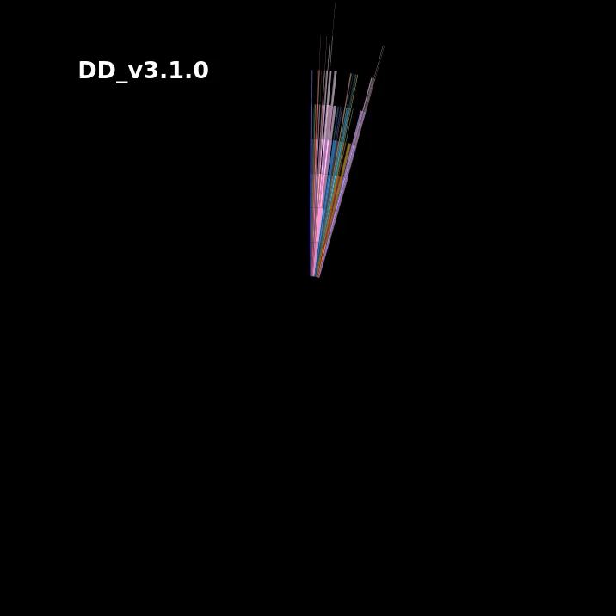
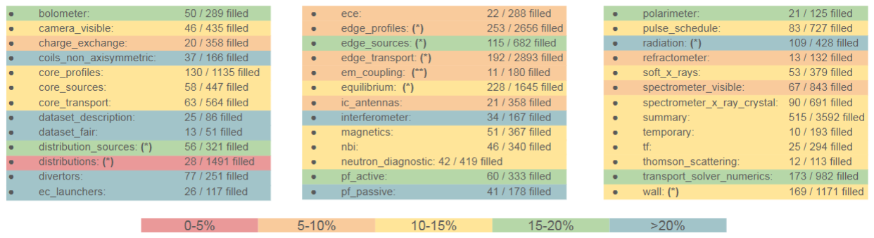

Lessons Learned
Evolution of the number of IDS, fields and nesting
A (too?) broad scope → complex structures
  Data providers vs consumers
  Coupling codes vs data archiving
  “plasma state” vs separate “interfaces”
  Premature compatibility constraints on alpha versions vs releasing active IDS
0-5%
5-10%
10-15%
15-20%
>20%
Can’t store data outside of an IDS → require adding edge cases in IDS

Slide 6
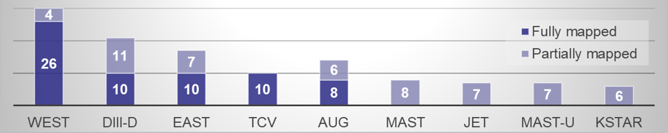
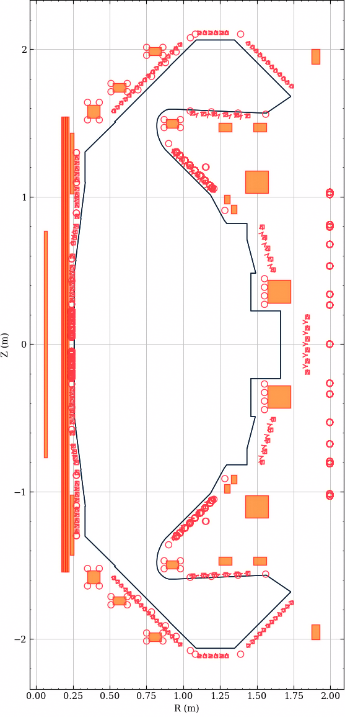
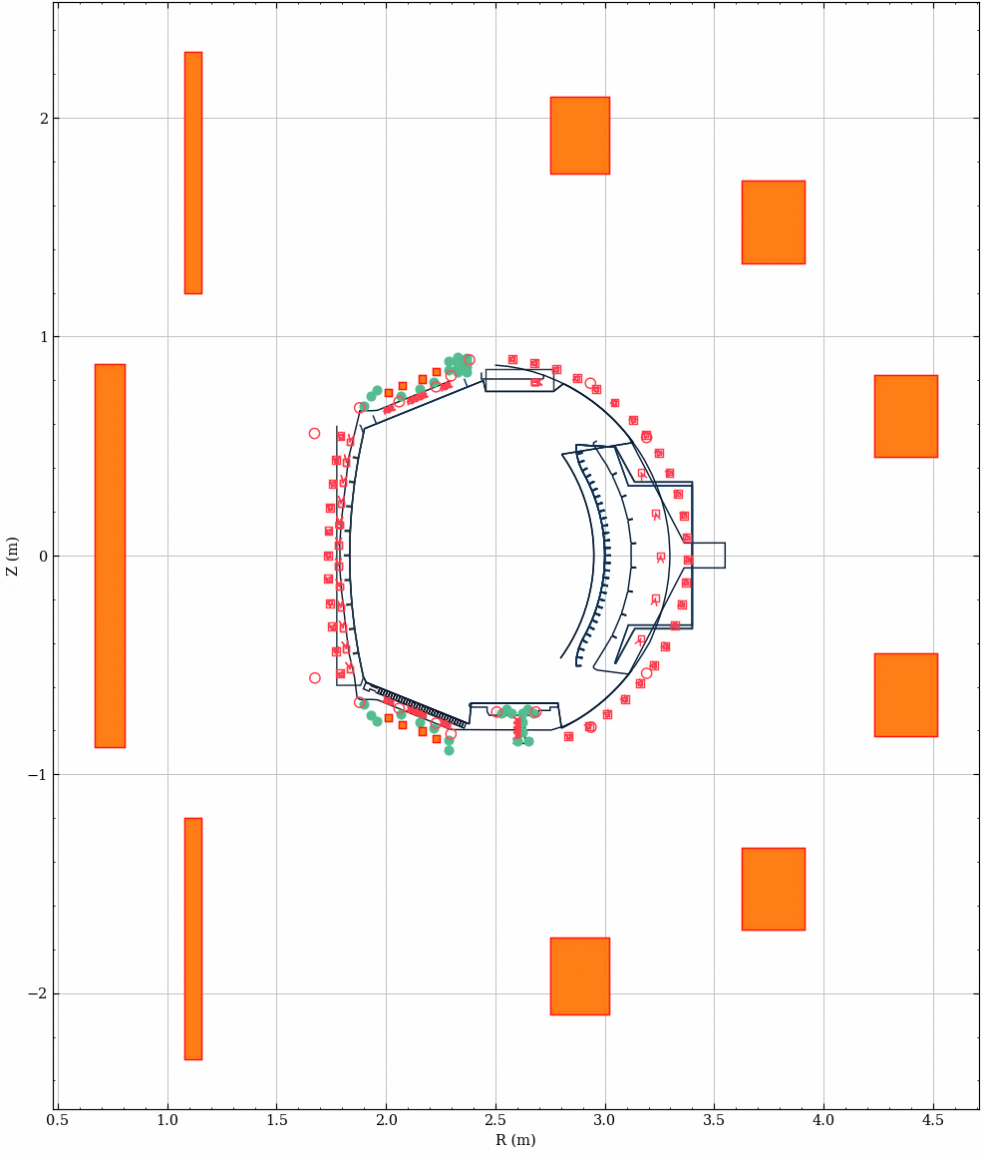
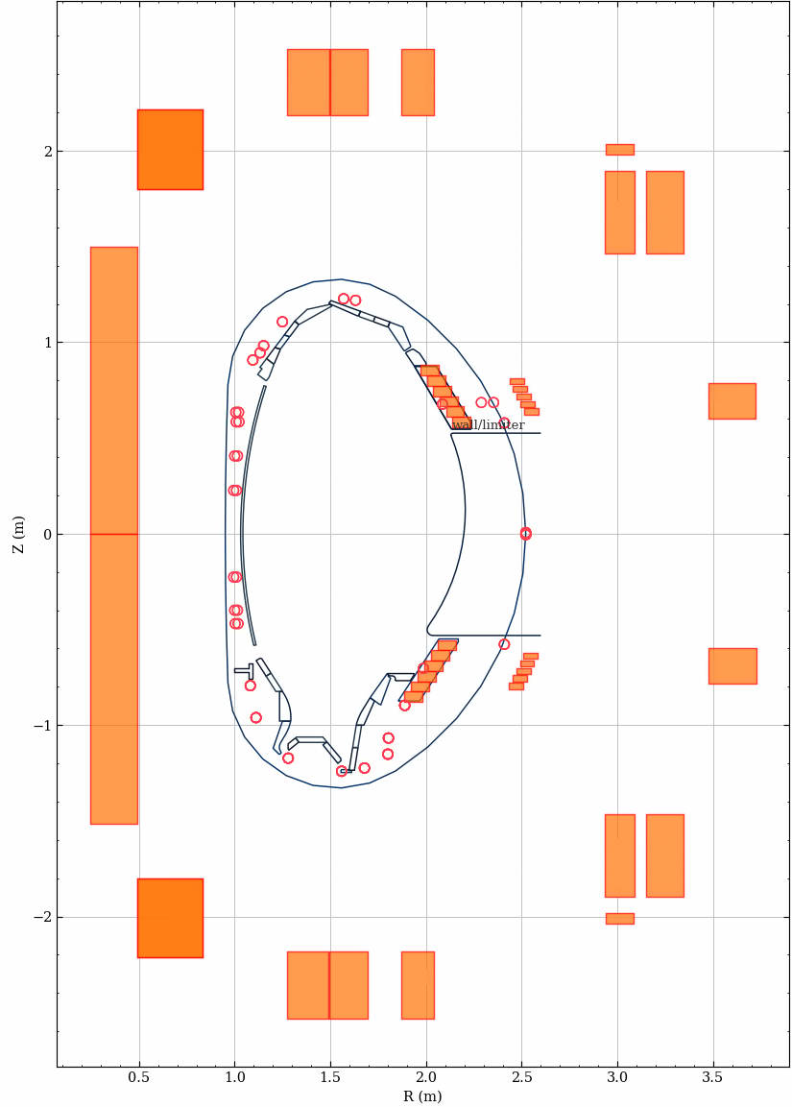
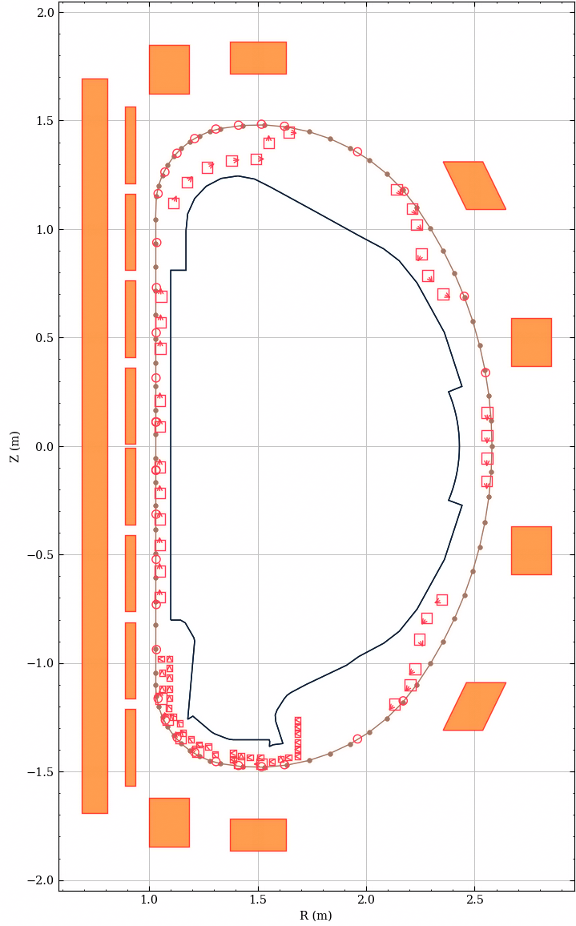
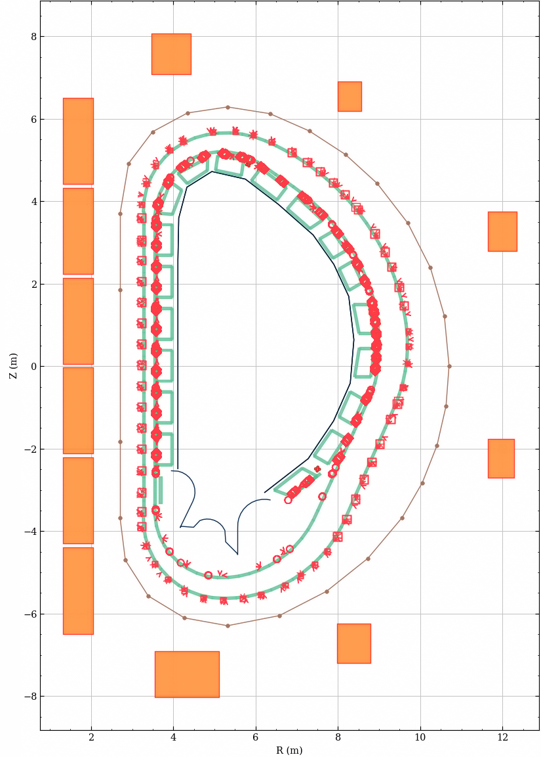
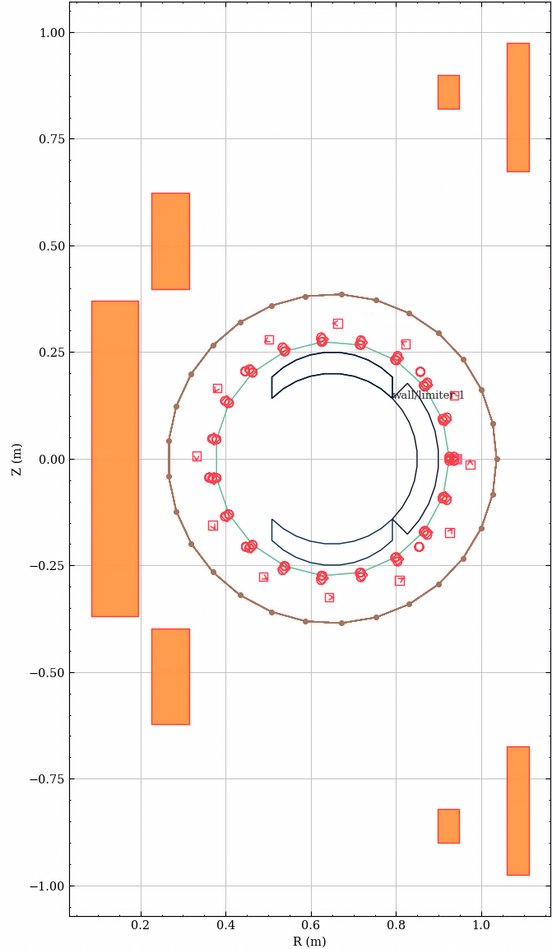
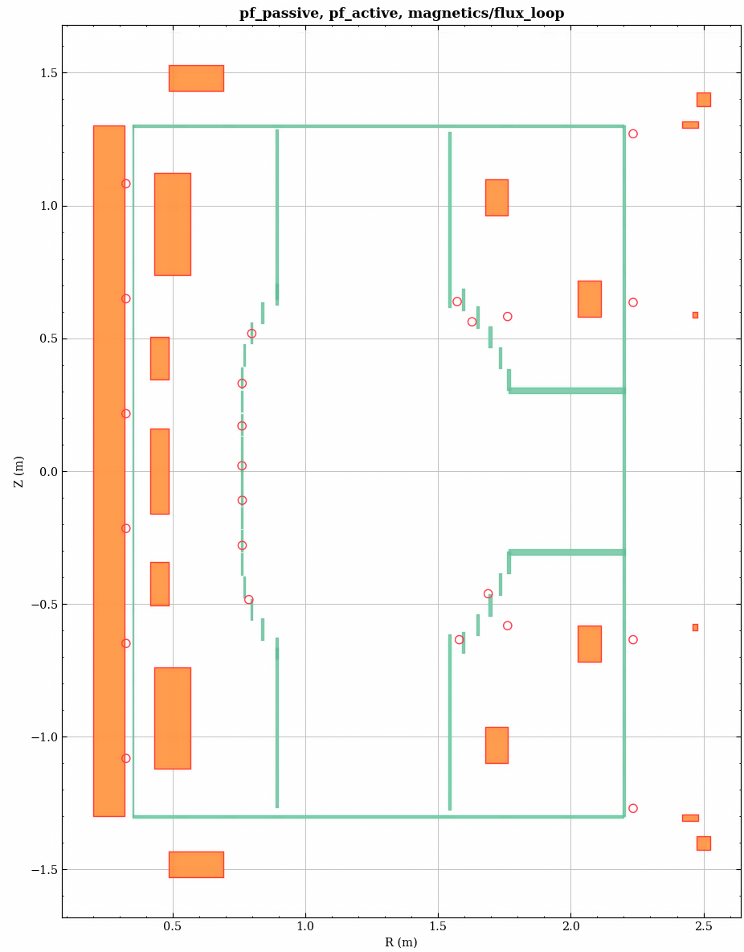
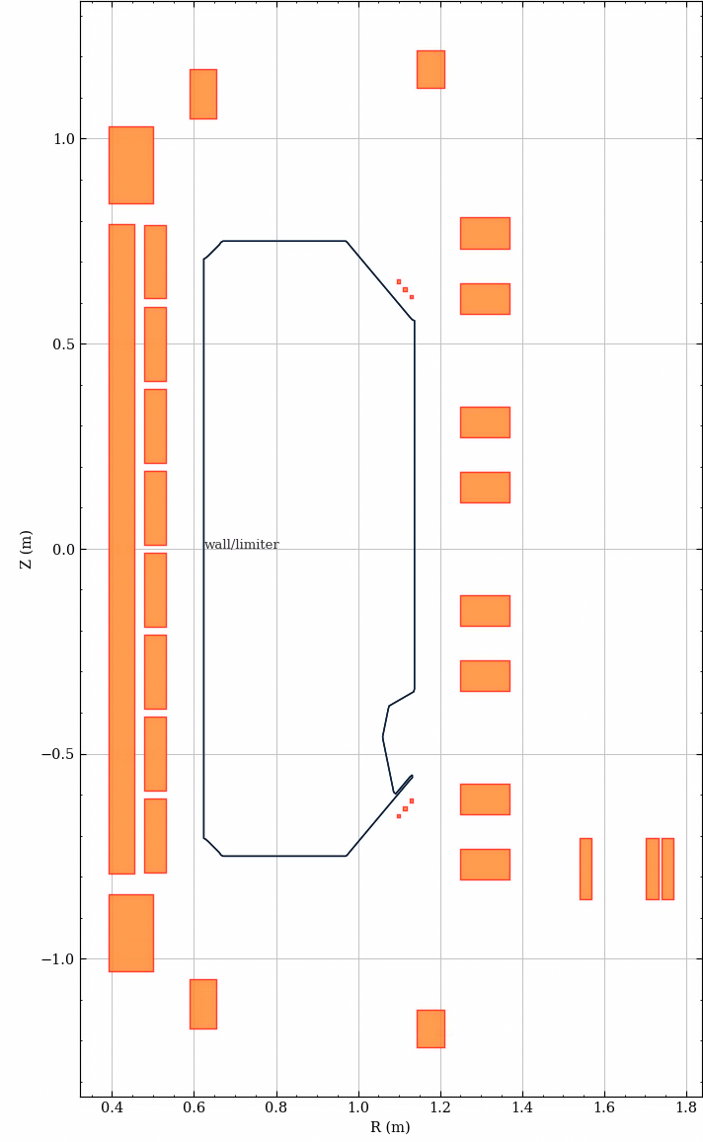
Lessons Learned (cont.)
Mapped data is the ultimate justification for IMAS design (but is WIP)
  https://www.fair4fusion.eu/ → pulse cataloguing via the summary IDS
  Experimental data
  (survey 2023)
  Databases
    ITPA H-mode confinement, 45% in 2021 (tool and mapping in IDStools)
    GKDB and MGKDB → both efforts follow the gyrokinetics_local IDS
  Machine description
→ Mapping needs local experts and a joint effort

Slide 7
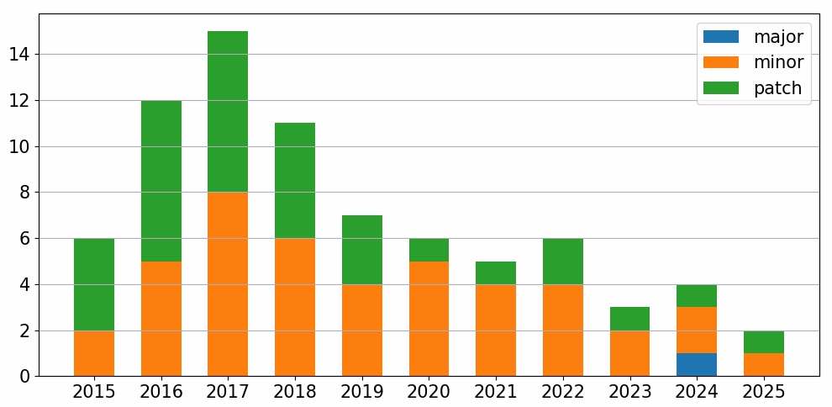

Lessons Learned (cont.)
Burden of compatibility with legacy software, Access-Layer (AL)
  DD+AL forked in 2011 from ITM-CPO (dev started in 2003)
  Hidden major change (2018): DD 3.21.0 (AL3) → 3.21.1 (AL4)
  Complicated software stack → slow adoption
    Code generation (for each DD update)
    Interfaces: F90, C++, Py, Java, Matlab
    Backends: MDSplus, HDF5, UDA, ASCII
  Fast pace of changes in the DD
Access to information + code
2023-24
AL5, split repo,
Cmake
AL mono-repo,
Installer
Apply FAIR principles, go open-source

Slide 8


Towards an open Community Standard
IMAS is gaining momentum
  Through continued effort from early adopters!
  No emerging alternate candidate for fusion* data
The IMAS-Data-Dictionary is open access on GitHub!
  Doc at https://imas-data-dictionary.readthedocs.io/en/latest/
  Package (CLI) on PyPI: imas-data-dictionary
  All-versions package (XML only): imas-data-dictionaries
Contributions in all forms are welcome
  Questions, discussions, issues, additions in existing IDS, new IDS, …
  Pull-requests reviewed by contact-persons for each ITER member
* very few attempts
on stellarators

Slide 9
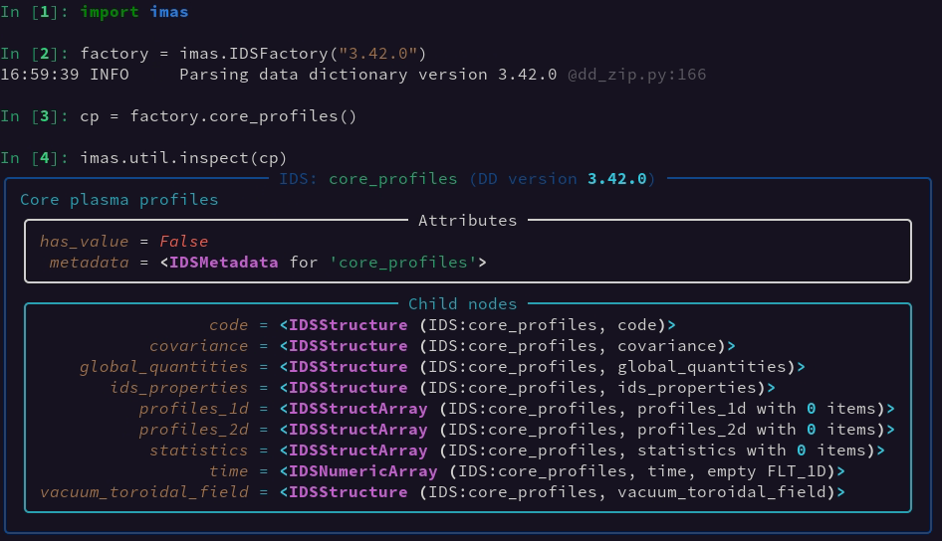
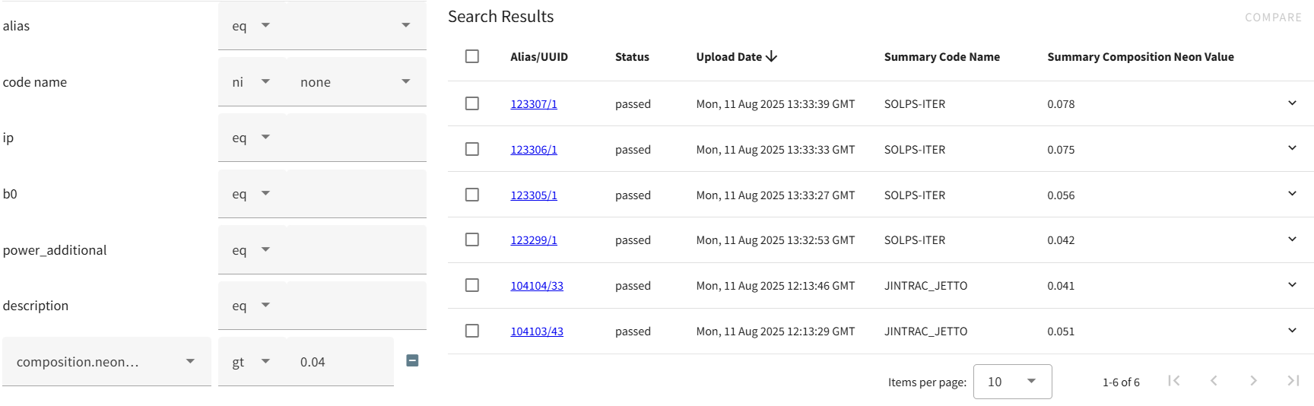

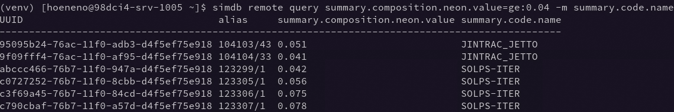

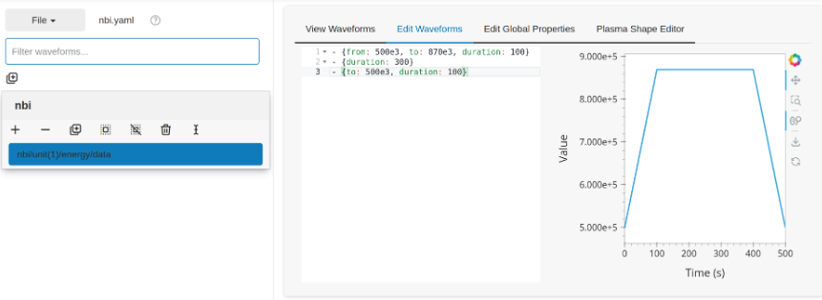
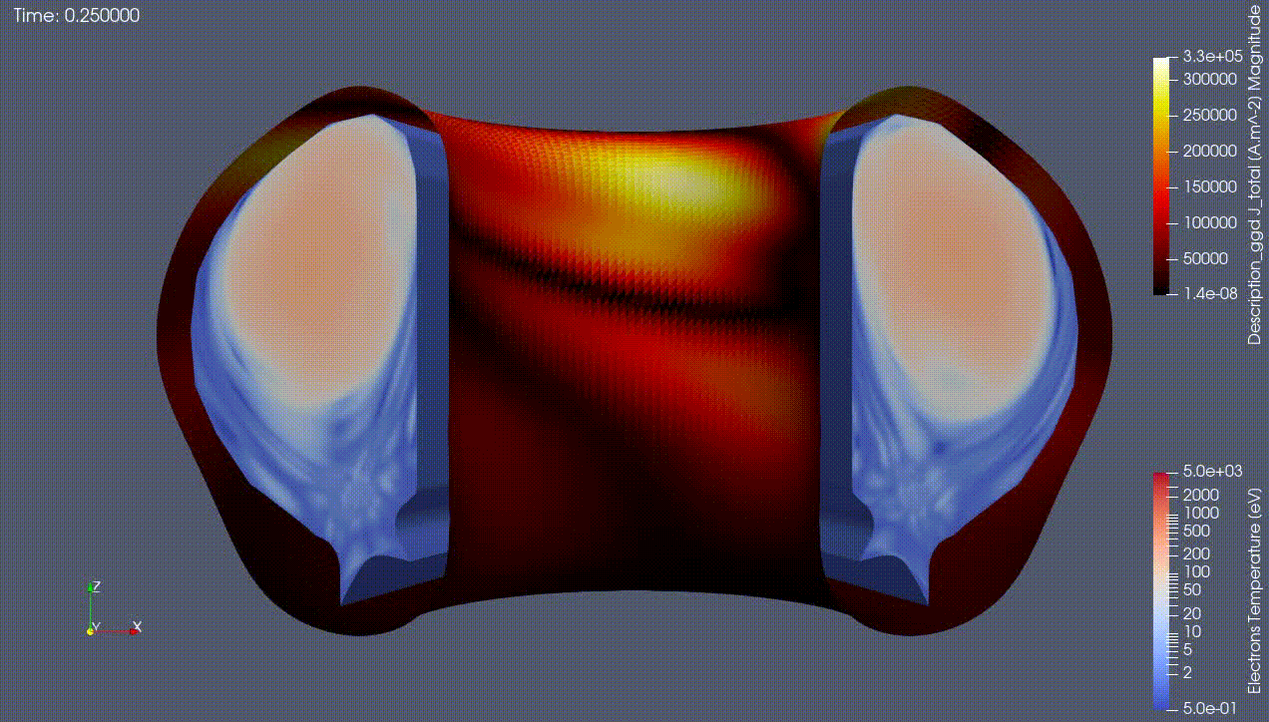


A Growing List of IDS Open-Source Software
IMAS-Python
SimDB-Dashboard
SimDB
IMAS-ParaView
Waveform-Editor
… and more by the community (e.g. tofu, omas, duqtools): search for #imas #fusion

Slide 10
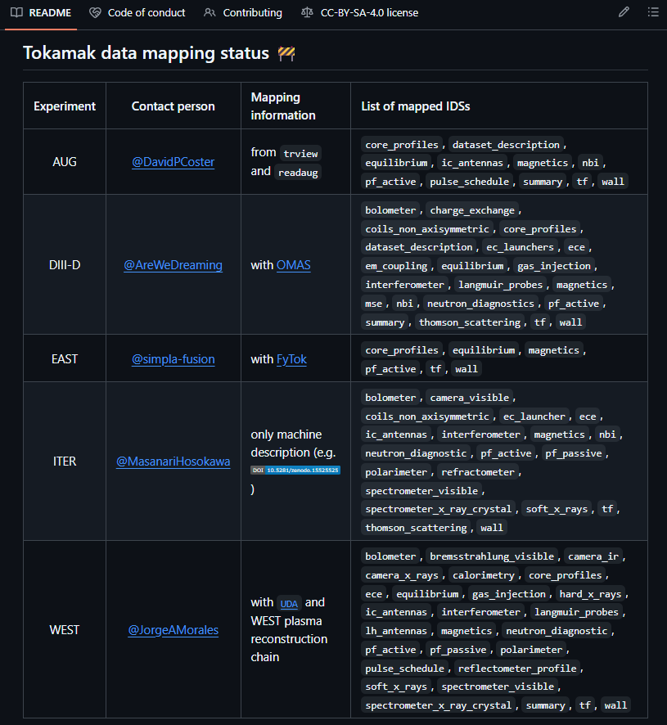


Engage in Data Mapping
Open platform to centralize knowledge
  Update status, list of IDS, tools, …
  Monthly online meetings
  Promote open mapping, data samples
  Collect feedback, data needs
  Dedicated workshop will be organized at ITER (26-29 Jan 2026)
  Support application validation effort
  Prepare ITER CODAC→IMAS mapping
Aim at a unified syntax for data mapping
https://indico.iter.org/e/imas-data-mapping-2026
IMAS-Data-Mapping

Slide 11
Disentangle Data Model and Interfaces
Reflect ideas from other domains (CF-Conventions, NeXus) + lessons learned
Fusion Conventions
Defines the metadata vocabulary
to describe what the data represents
the spatial/temporal properties of the data
relations with ancillary and modifiers
IDS have metadata
Same IDS for code coupling and acquisition
Interfaces
Standard Names
Identify physical quantities
name + aliases
units, description
Smaller/stricter IDS
(especially for code coupling)
MDSplus
HDF5
netCDF
(self-described)
File has data+metadata to describe it
variable name, dimensions
units and coordinates
allow use of standard access libraries

Slide 12
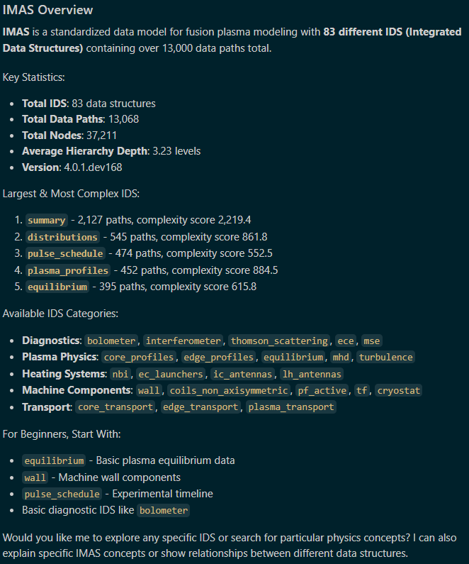




Defining Standard Names (SN)
Large community-driven effort
  CF (30 years!) = 4990 names (595 aliases)
Does not start from scratch for fusion
  Years of knowledge in IMAS DD
  Modern supporting tools (LLMs)
    DD-aware via Model Context Protocol (MCP)
    Via a prompt: generate SN + submit PR
    Extend with more knowledge (e.g. JIRA?)
  Open IMAS Standard Names repository
    Curate and review proposed SN
    Host official SN list
pypi:imas-mcp

Slide 13
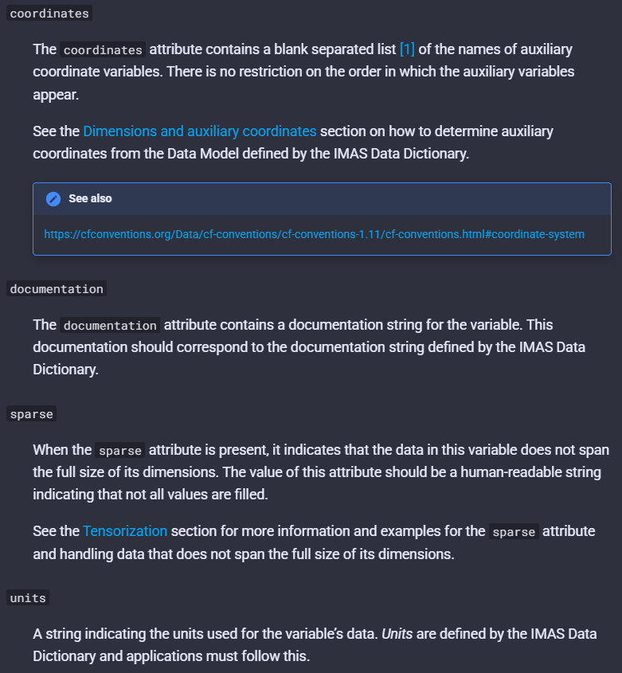


Self-Describing Storage Format
Available in IMAS-Python with netCDF-4
  Store various attributes (DD metadata)
  Data is tensorized (padded if irregular)
  Support get*/put but not slicing
  File readable by tools other libs (Xarray)
More ND Array prototypes
  Fortran data access
  Remote data access (Zarr)
  Serialized IDS for streaming
imas-python
* with lazy loading and DD version conversion
Shall serve as a basis for the Fusion Conventions

Slide 14
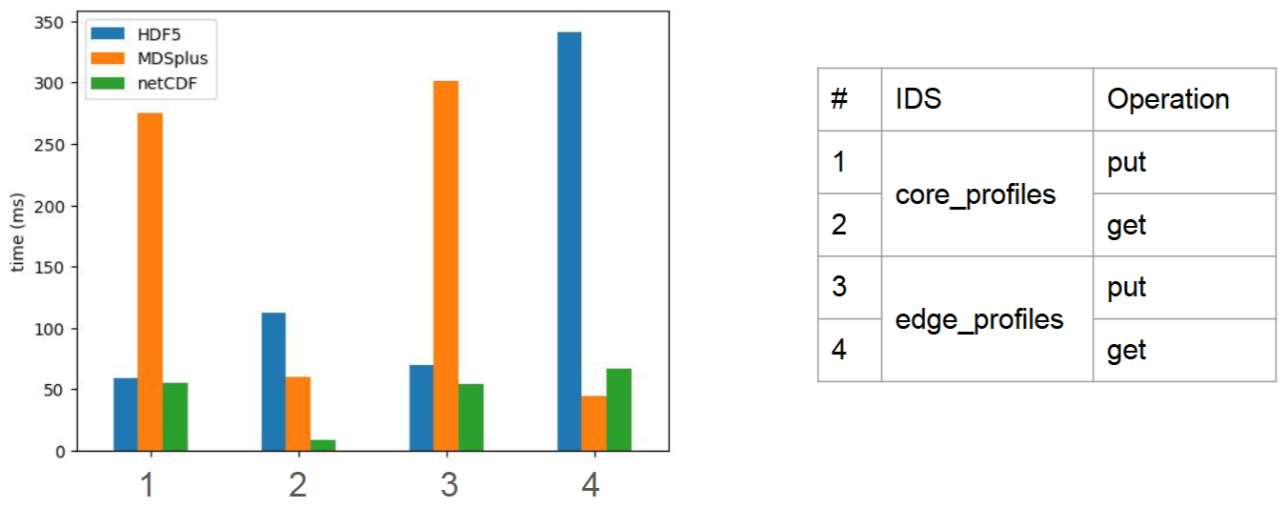
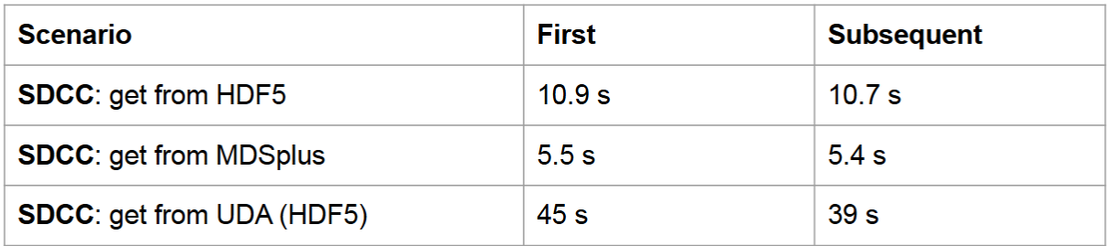
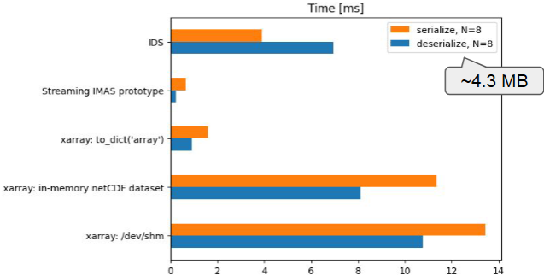
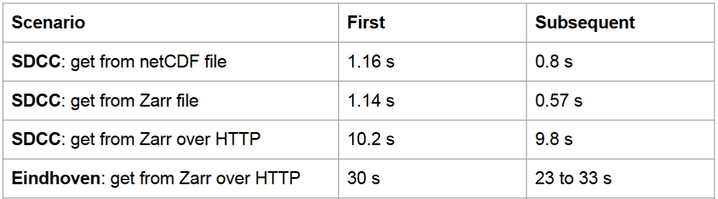
Early Performance POC
Compare with existing software stack before pushing major changes
IMAS-Python asv benchmark
netCDF compared to IMAS-Core backends
Faster than HDF5 (also tensorized, but AL logic overhead)
Faster than MDSplus for homogeneous data
MDSplus faster when reading inhomogeneous data (GGD)
Serialized IDS for streaming (workflow)
Local vs remote access and UDA vs Zarr
FlexBuffers
Test dataset with core_profiles and equilibrium IDS imas://uda.iter.org/uda?path=/work/imas/shared/imasdb/ITER_SCENARIOS/3/135013/2

Slide 15
Conclusion
Vision of common, robust, data processing pipelines portable across multiple devices
  Validation of pipelines for ITER on current machines/data
  Building consistent multi-machines databases (datasets for AI)
IMAS DM aims at providing a much-needed data standard
  Now openly accessible and welcoming contributions on GitHub
  Various improvements explored on the data model and storage
Needs mapping of existing data into IMAS format
  Building an open community to engage more in this effort
Olivier.Hoenen@iter.org

