Slide 1




Bayesian integrated estimation of tungsten impurity concentration distributions at WEST
using soft X-ray and bolometer diagnostics
H. Wu^{1,2}, A. Jardin³, T. Wang⁴, D. Mazon⁵, G. Verdoolaege¹
and the WEST Team
¹ Department of Applied Physics, Ghent University, Belgium
² Southwestern Institute of Physics, China
³ Institute of Nuclear Physics Polish Academy of Sciences (IFJ PAN), Poland
⁴ ITER Organization, France
⁵ CEA Cadarache, France
6th IAEA Technical Meeting on Fusion Data Processing, Validation and Analysis
September 2025
Shanghai, China

Slide 2
Outline
1. Background: plasma radiation
2. Bayesian SXR tomography with Gaussian process priors
3. Integrated data analysis of tungsten concentration profiles
4. MCMC sampling with reparameterization
5. Summary
Notes:
Here is the outline of my talk.
First, I will briefly introduce the relation between plasma radiation and impurity densities.
Then, I will show the application of Bayesian inference to tomographic reconstruction and the estimation of tungsten concentration profiles.
In this work, the efficiency of MCMC sampling is improved by using reparameterization.
Finally I will give the summary.

Slide 3
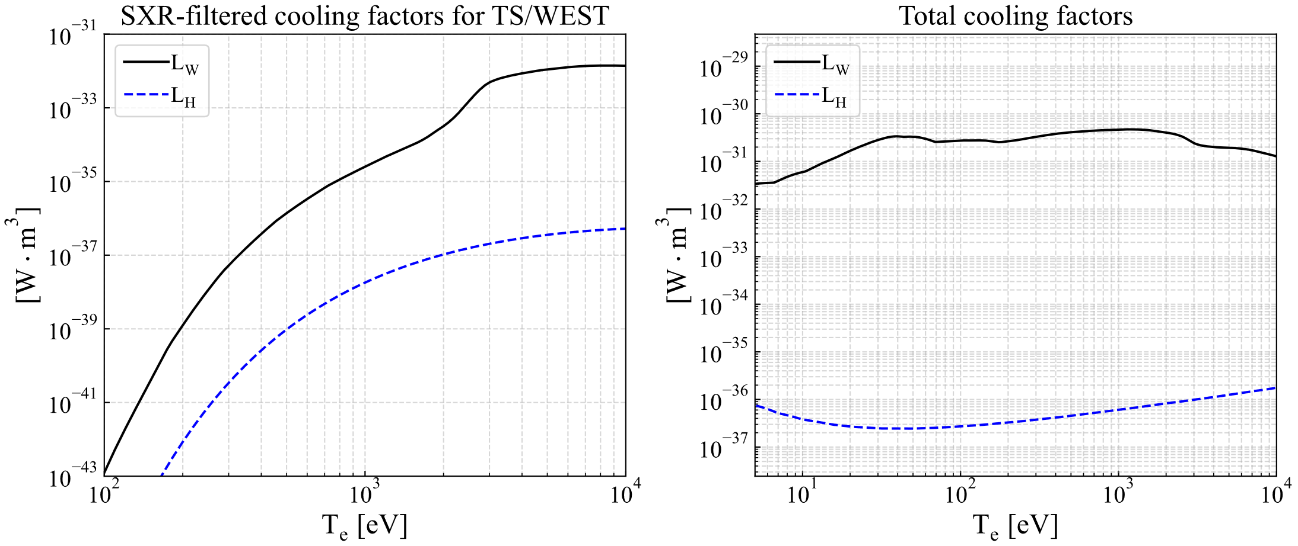
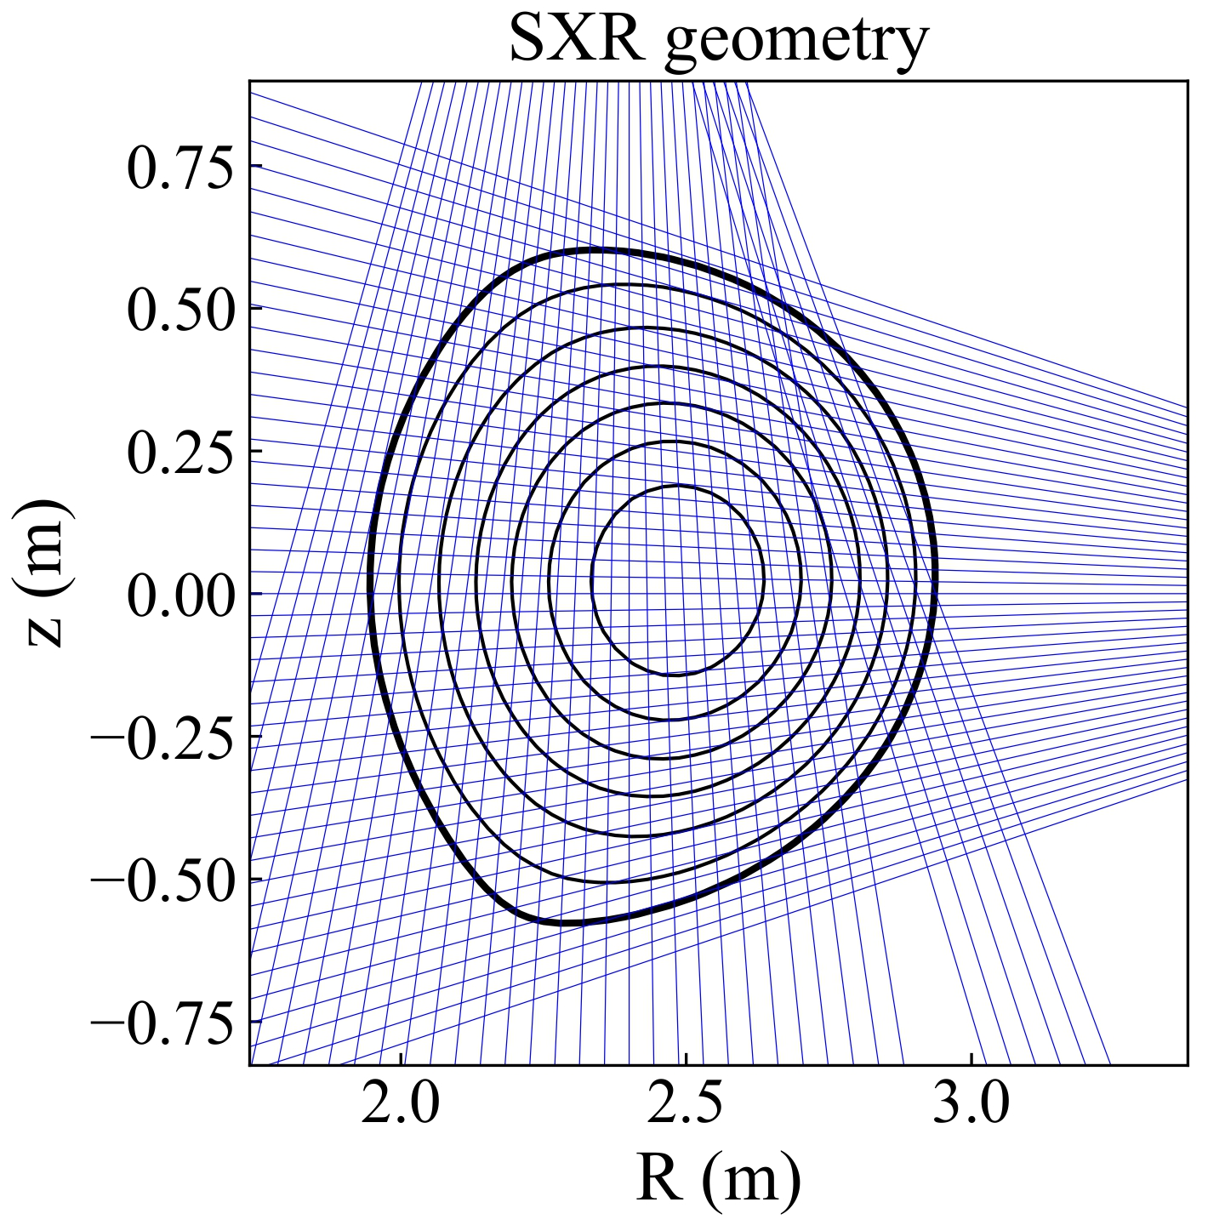
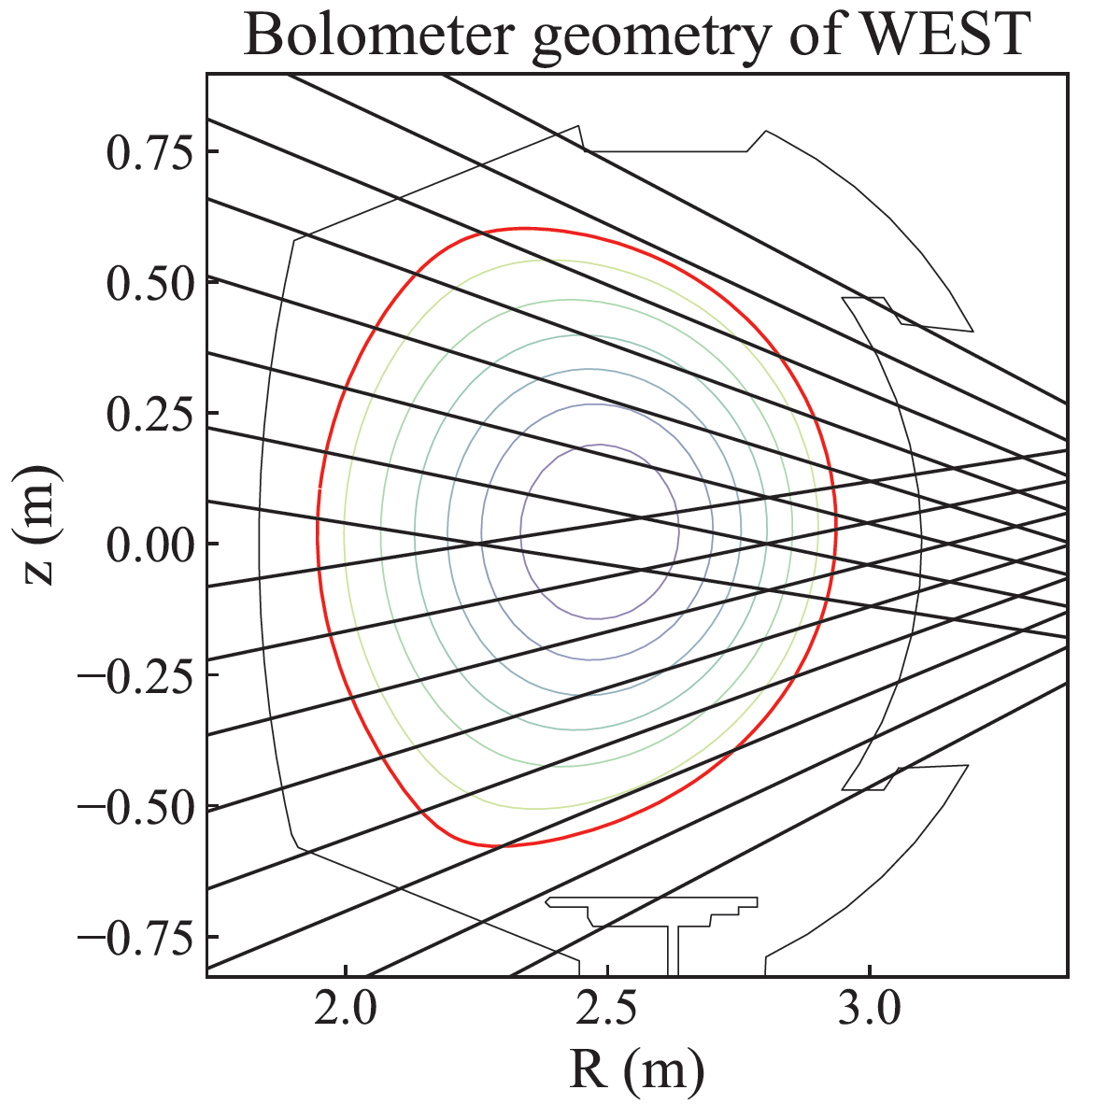
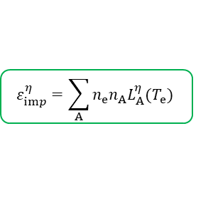

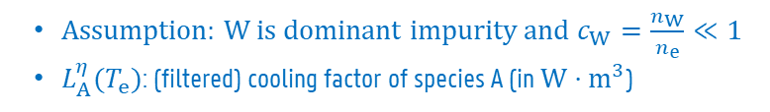

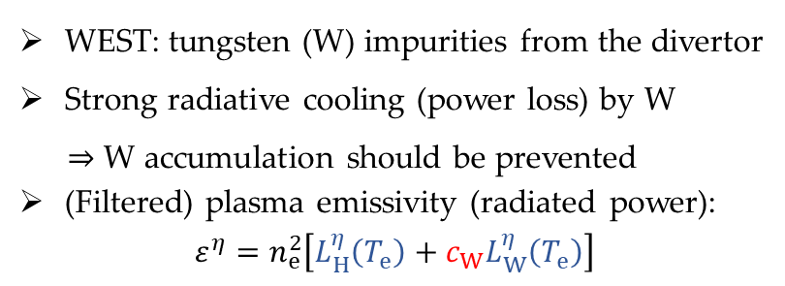
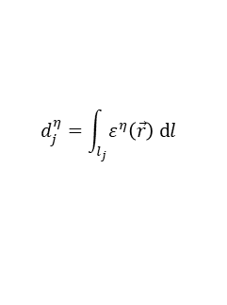

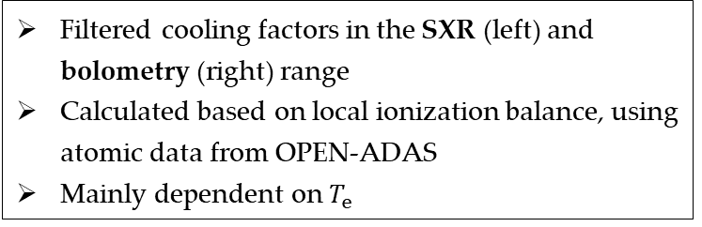

Background: plasma radiation
WEST: tungsten (W) impurities from the divertor
Strong radiative cooling (power loss) by W
$⇒$ W accumulation should be prevented
(Filtered) plasma emissivity (radiated power):
$$ε^{η}=n_{e}^{2}\left[L_{H}^{η}\left(T_{e}\right)+c_{W}L_{W}^{η}\left(T_{e}\right)\right]$$
H isotopes
Impurities
For each species, consider all ionization stages
$$ε_{H}^{η}=n_{e}n_{H}L_{H}^{η}(T_{e})$$
$$ε_{imp}^{η}=\sum_{A}{n_{e}n_{A}L_{A}^{η}(T_{e})}$$
$η=η(hν)$:
spectral response of the detector
Plasma emissivity $ε^{η}$
Assumption: W is dominant impurity and $c_{W}=\frac{n_{W}}{n_{e}}≪1$
$L_{A}^{η}(T_{e})$: (filtered) cooling factor of species A (in $W⋅m^{3}$)
SXR
Bolometry
EUV
…
$$d_{j}^{η}=\int_{l_{j}}{ε^{η}\left(\vec{r}\right) dl}$$
Low $T_{e}$ $→$ low $L_{W}^{SXR}$
Filtered cooling factors in the SXR (left) and bolometry (right) range
Calculated based on local ionization balance, using atomic data from OPEN-ADAS
Mainly dependent on $T_{e}$
Notes:
The WEST tokamak has tungsten divertor, which makes tungsten an importance source of impurities in the plasma. The radiation from W impurities may significantly increase the radiative power loss and affect the energy confinement. Therefore, it is important to avoid W accumulation.
On the other hand, this radiation also allows us to estimate the W density or concentration. We know that the plasma radiation comes from both H isotopes and impurities. Depending on the concerned spectral range, the radiation can be recorded by various diagnostics, such as … . Most of them provide line-integrated measurements of the emissivity. Here we show the geometries of two diagnostics as an example, which are the SXR and bolometry.
Spectrally integrated measurements (radiated power) -> cannot discriminate contributions from different species.
If we assume tungsten is the dominant impurity, the emissivity of plasma radiation can be modeled using the cooling factors of H and W.
The cooling factors presented here are filtered in the SXR and bolometry range, calculated based on local ionization balance, using atomic data from OPEN-ADAS. They mainly depend on the temperature. Obviously, the SXR-filtered cooling factors is low for low temperatures. This implies the SXR emission mainly comes from the core.

Slide 4
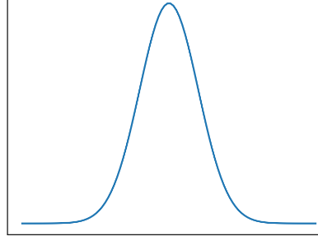

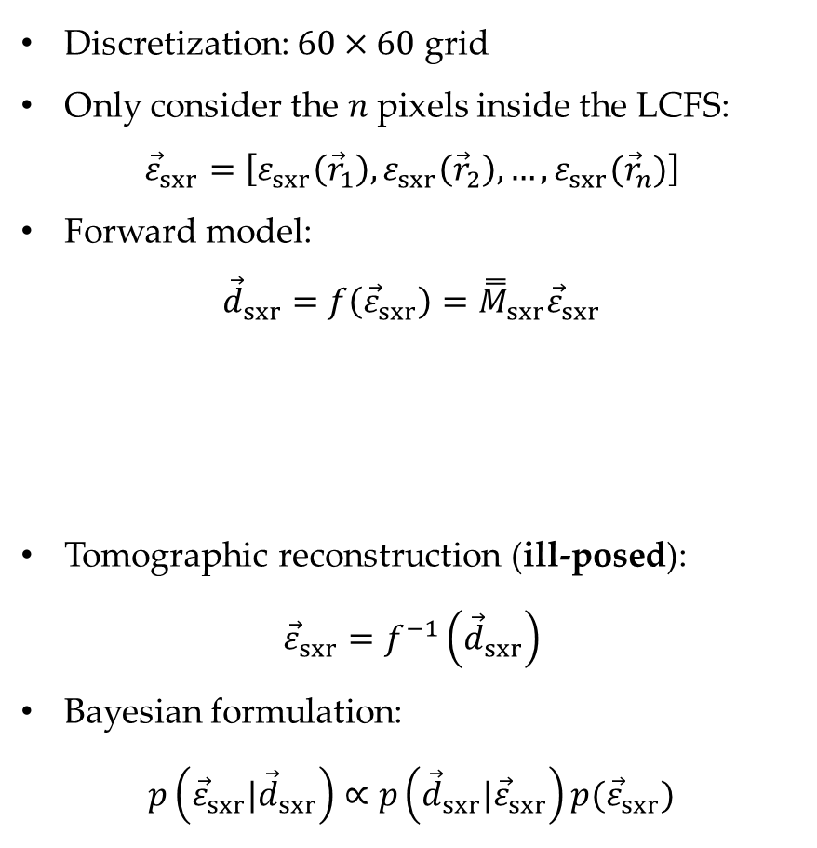


Bayesian SXR tomography
Discretization: $60×60$ grid
Only consider the $n$ pixels inside the LCFS:
$${\vec{ε}}_{sxr}=\left[ε_{sxr}\left({\vec{r}}_{1}\right),ε_{sxr}\left({\vec{r}}_{2}\right),…,ε_{sxr}({\vec{r}}_{n})\right]$$
Forward model:
$${\vec{d}}_{sxr}=f\left({\vec{ε}}_{sxr}\right)={\overset{̿}{M}}_{sxr}{\vec{ε}}_{sxr}$$
Tomographic reconstruction (ill-posed):
$${\vec{ε}}_{sxr}=f^{−1}\left({\vec{d}}_{sxr}\right)$$
Bayesian formulation:
$$p\left({{\vec{ε}}_{sxr}|\vec{d}}_{sxr}\right)∝p\left({{\vec{d}}_{sxr}|\vec{ε}}_{sxr}\right)p({\vec{ε}}_{sxr})$$
Line-integrated emissivity
Response matrix
(number of pixels: $n>1000$)
$$p\left(ε_{sxr}\left({\vec{r}}_{i}\right) | {\vec{d}}_{sxr}\right)$$
Uncertainty
posterior
likelihood
prior
$$ε_{sxr}\left({\vec{r}}_{i}\right)$$
Notes:
Now we first look at the tomographic reconstruction of the SXR emissivity distribution in a poloidal cross-section.
We use a 60 by 60 grid and only consider the n pixels inside the LCFS. Our forward model that calculates the line-integrated emissivity from a given emissivity profile is linear. The tomographic reconstruction of the emissivity distribution from line-integrated measurements is an ill-posed problem. Because the number of pixels is much larger than the number of channels. Prior constraints are therefore necessary for a valid reconstruction.
In this work, we use a Bayesian probabilistic approach. Our goal is to obtain the posterior distribution of the emissivity profile. According to the Bayes’ theorem, it is proportional to the prior distribution and the likelihood. The prior represents a priori assumptions and constraints, while the likelihood carries the information from the measurements. The advantage of this probabilistic approach is to provide a natural uncertainty quantification from the probability distribution, and the width of the marginal distribution is an estimate of the error bar.

Slide 5
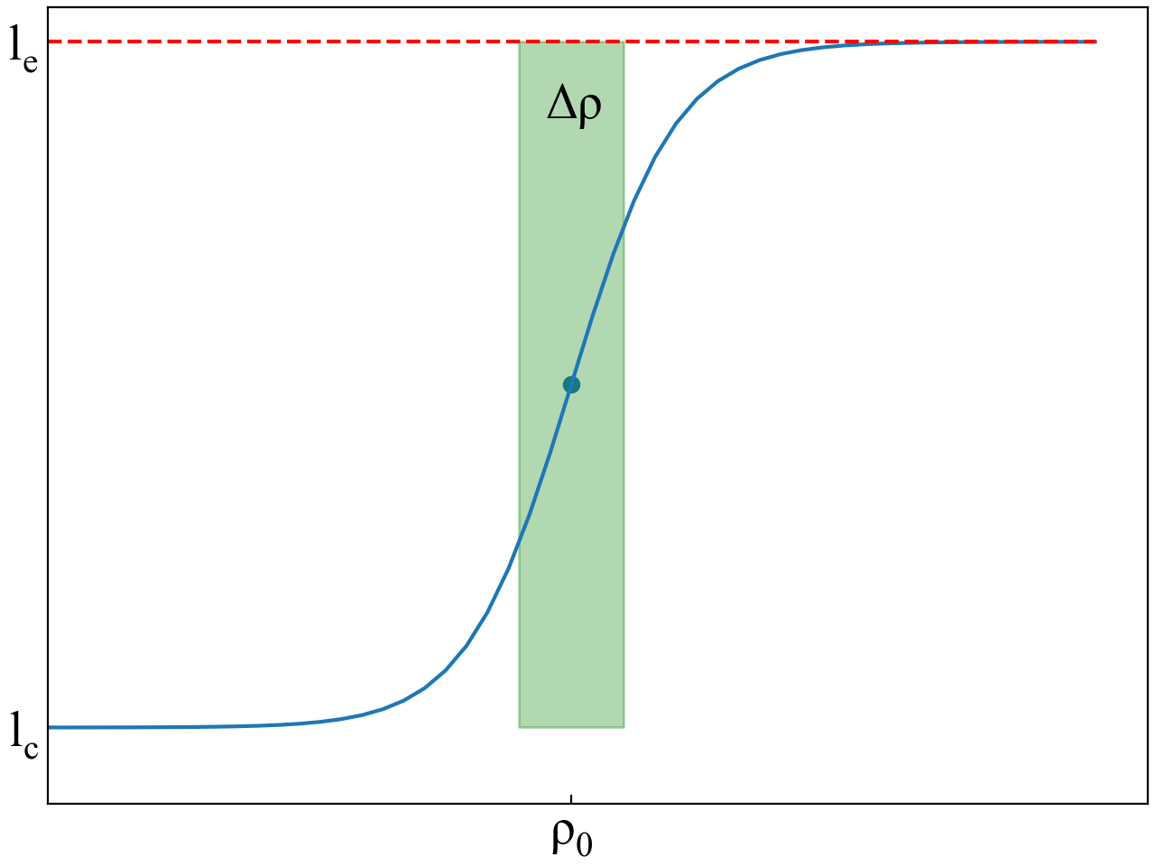

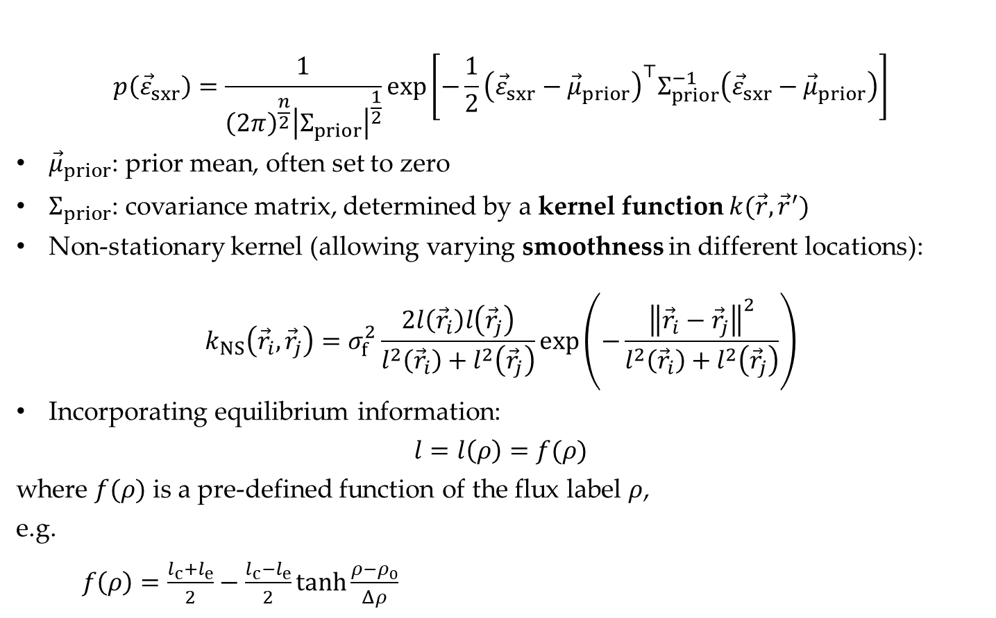


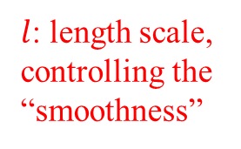

Gaussian process (GP) prior
$$p\left({\vec{ε}}_{sxr}\right)=\frac{1}{{\left(2π\right)}^{\frac{n}{2}}{\left|Σ_{prior}\right|}^{\frac{1}{2}}}exp\left[−\frac{1}{2}{\left({\vec{ε}}_{sxr}−{\vec{μ}}_{prior}\right)}^{⊤}Σ_{prior}^{−1}\left({\vec{ε}}_{sxr}−{\vec{μ}}_{prior}\right)\right]$$
${\vec{μ}}_{prior}$: prior mean, often set to zero
$Σ_{prior}$: covariance matrix, determined by a kernel function $k(\vec{r},{\vec{r}}^{′})$
Non-stationary kernel (allowing varying smoothness in different locations):
$$k_{NS}\left({\vec{r}}_{i},{\vec{r}}_{j}\right)=σ_{f}^{2}\frac{2l\left({\vec{r}}_{i}\right)l\left({\vec{r}}_{j}\right)}{l^{2}\left({\vec{r}}_{i}\right)+l^{2}\left({\vec{r}}_{j}\right)}exp\left(−\frac{{\left\|{\vec{r}}_{i}−{\vec{r}}_{j}\right\|}^{2}}{l^{2}\left({\vec{r}}_{i}\right)+l^{2}\left({\vec{r}}_{j}\right)}\right)$$
Incorporating equilibrium information:
$$l=l\left(ρ\right)=f(ρ)$$
where $f(ρ)$ is a pre-defined function of the flux label $ρ$,
e.g.
$f\left(ρ\right)=\frac{l_{c}+l_{e}}{2}−\frac{l_{c}−l_{e}}{2}tanh\frac{ρ−ρ_{0}}{Δρ}$
$l$: length scale, controlling the “smoothness”
$l↑$ $⇒$ correlation $↑$ $⇒$ smoothness $↑$
Edge: larger $l$, smoother
Different smoothness in the core and edge region (marked by $ρ$)!
M.A. Chilenski et al, Nucl. Fusion 55 023012 (2015)
$$ρ=0$$
$$ρ=1$$
Notes:
…
…
Non-stationary kernel … A large length scale means strong correlation and high smoothness.
We can also incorporate equilibrium information by assuming the length scale is a flux function. For example, we can use this hyperbolic tangent function to model the length scale, so that the emissivity profile at the edge can be smoother. In this way, we only impose a weak constraints on the emissivity without forcing it to be constant on the flux surface.

Slide 6
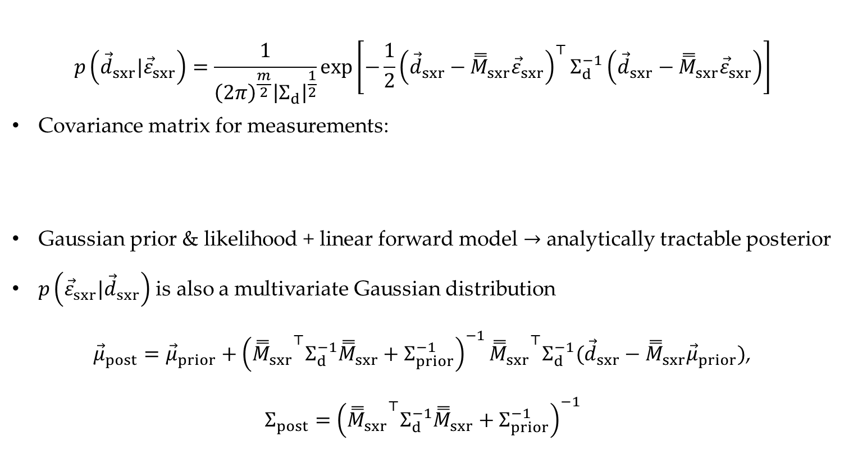


Gaussian likelihood and analytical posterior
$$p\left({\vec{d}}_{sxr}|{\vec{ε}}_{sxr}\right)=\frac{1}{{\left(2π\right)}^{\frac{m}{2}}{\left|Σ_{d}\right|}^{\frac{1}{2}}}exp\left[−\frac{1}{2}{\left({\vec{d}}_{sxr}−{\overset{̿}{M}}_{sxr}{\vec{ε}}_{sxr}\right)}^{⊤}Σ_{d}^{−1}\left({\vec{d}}_{sxr}−{\overset{̿}{M}}_{sxr}{\vec{ε}}_{sxr}\right)\right]$$
Covariance matrix for measurements:
Gaussian prior & likelihood + linear forward model $→$ analytically tractable posterior
$p\left({\vec{ε}}_{sxr}|{\vec{d}}_{sxr}\right)$ is also a multivariate Gaussian distribution
${\vec{μ}}_{post}={\vec{μ}}_{prior}+{\left({{\overset{̿}{M}}_{sxr}}^{⊤}Σ_{d}^{−1}{\overset{̿}{M}}_{sxr}+Σ_{prior}^{−1}\right)}^{−1}{{\overset{̿}{M}}_{sxr}}^{⊤}Σ_{d}^{−1}({\vec{d}}_{sxr}−{\overset{̿}{M}}_{sxr}{\vec{μ}}_{prior})$,
$$Σ_{post}={\left({{\overset{̿}{M}}_{sxr}}^{⊤}Σ_{d}^{−1}{\overset{̿}{M}}_{sxr}+Σ_{prior}^{−1}\right)}^{−1}$$
background noise
$$Σ_{d}=\left[\begin{matrix}σ_{1}^{2} & & \\ & ⋱ & \\ & & σ_{m}^{2}\end{matrix}\right]$$
$$σ_{i}^{2}=σ_{bg,i}^{2}+{\left(α⋅d_{sxr,i}\right)}^{2}$$
estimate
uncertainty
Diagonal elements: posterior variances
Notes:
Background noise $σ_{bg,i}^{2}$ is estimated by the variance of the signal without plasma

Slide 7
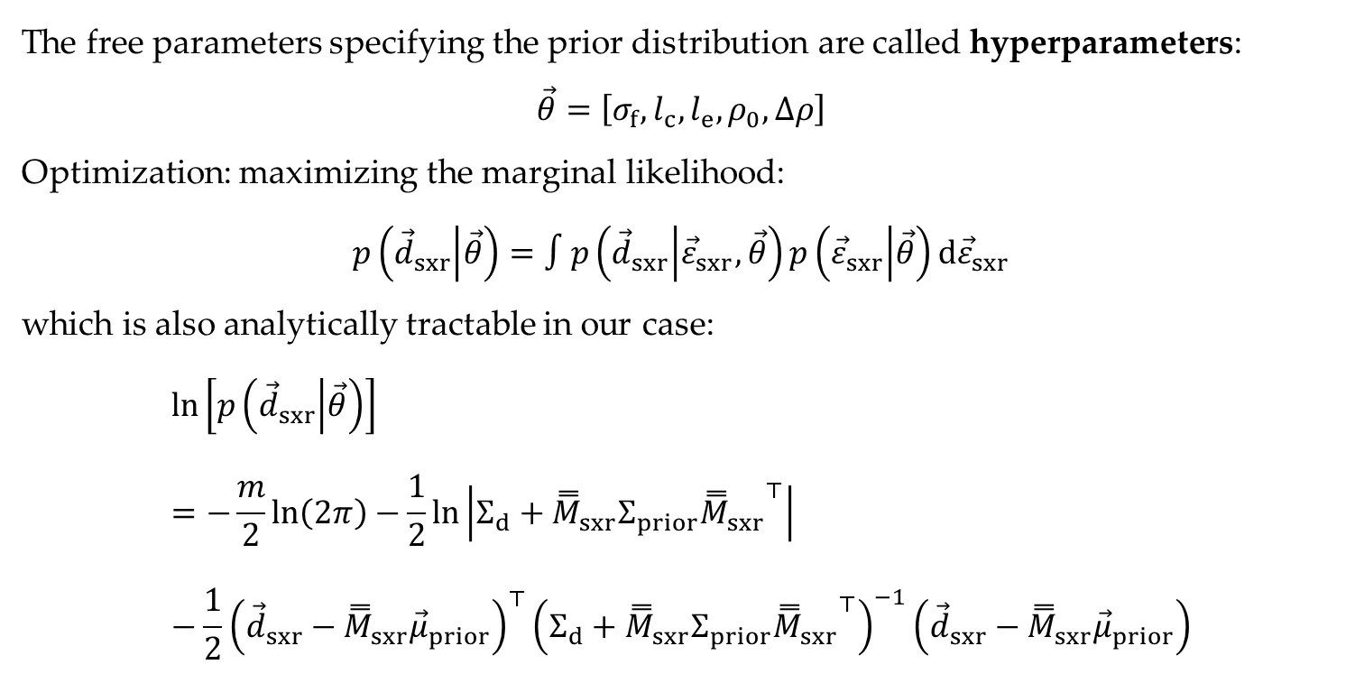
Hyperparameter optimization
The free parameters specifying the prior distribution are called hyperparameters:
$$\vec{θ}=\left[σ_{f},l_{c},l_{e},ρ_{0},Δρ\right]$$
Optimization: maximizing the marginal likelihood:
$$p\left({\vec{d}}_{sxr} | \vec{θ}\right)=∫p\left({\vec{d}}_{sxr} | {\vec{ε}}_{sxr},\vec{θ}\right)p\left({\vec{ε}}_{sxr} | \vec{θ}\right)d{\vec{ε}}_{sxr}$$
which is also analytically tractable in our case:
$$ln\left[p\left({\vec{d}}_{sxr} | \vec{θ}\right)\right]=−\frac{m}{2}ln\left(2π\right)−\frac{1}{2}ln\left|Σ_{d}+{\overset{̿}{M}}_{sxr}Σ_{prior}{{\overset{̿}{M}}_{sxr}}^{⊤}\right|−\frac{1}{2}{\left({\vec{d}}_{sxr}−{\overset{̿}{M}}_{sxr}{\vec{μ}}_{prior}\right)}^{⊤}{\left(Σ_{d}+{\overset{̿}{M}}_{sxr}Σ_{prior}{{\overset{̿}{M}}_{sxr}}^{⊤}\right)}^{−1}\left({\vec{d}}_{sxr}−{\overset{̿}{M}}_{sxr}{\vec{μ}}_{prior}\right)$$

Slide 8
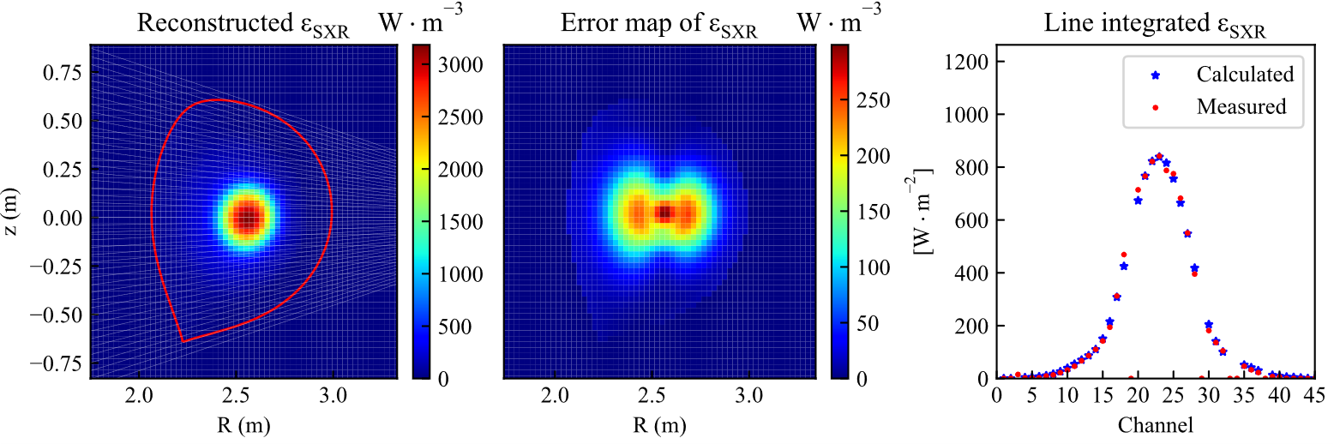


Tomography with WEST experimental data
WEST pulse #58089, t = 1.4 s (high $n_{e}$ and $T_{e}$, flat-top phase)
$$≤66.6 W⋅m^{−3}$$
$$≤25.0 W⋅m^{−3}$$
Reconstruction (posterior mean)
Posterior standard deviation
Line-integrated emissivity
(only 45 horizontal lines-of-sight)
Notes:
On WEST, due to the installation of the upper divertor, currently the SXR only have 45 horizontal lines-of-sight.
With a flux-dependent length scale in a non-stational covariance function, the Bayesian tomography method with a GP prior can give a reasonable tomographic reconstruction, even with only

Slide 9
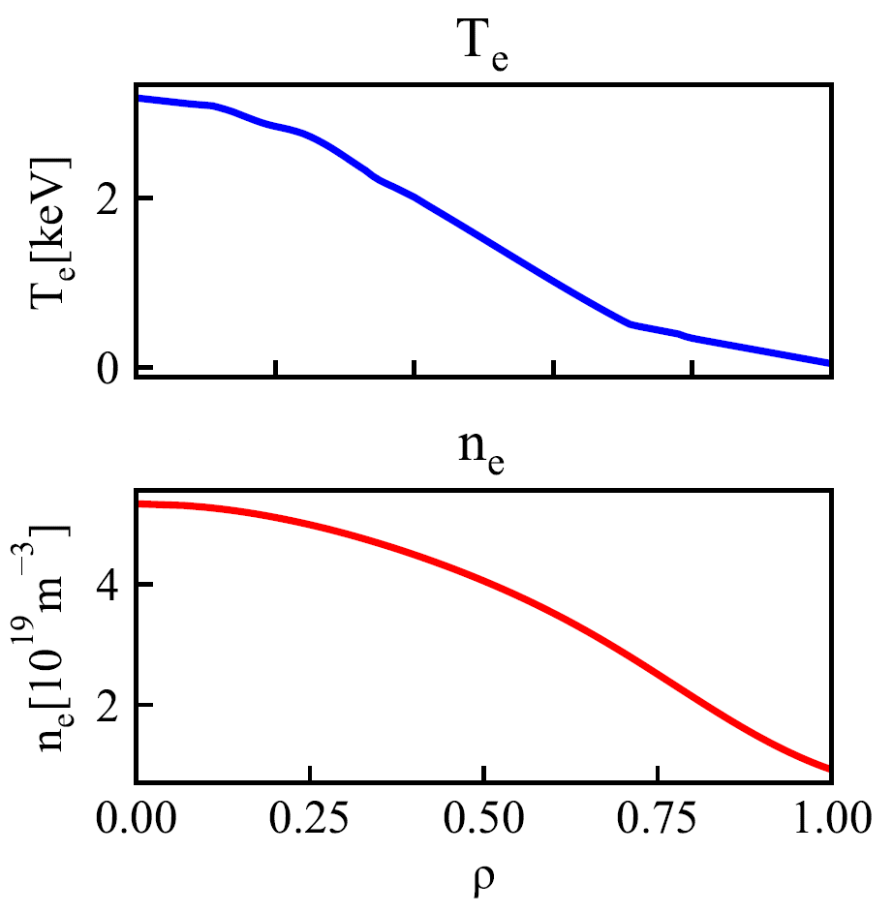
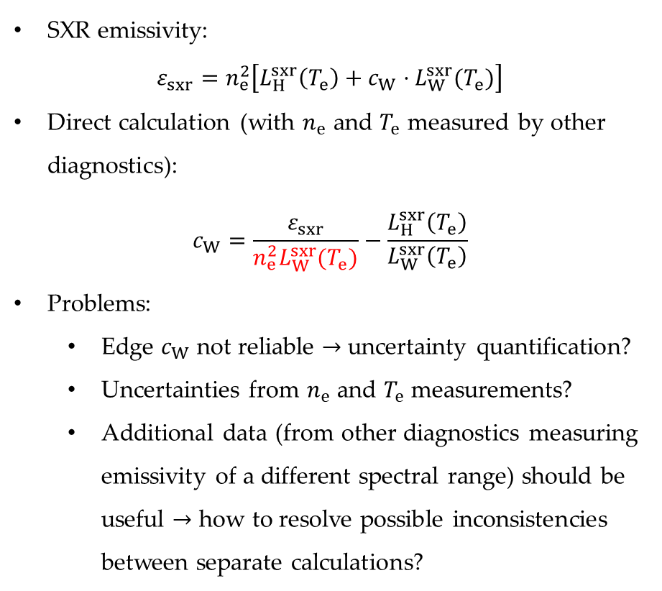
$c_{W}$: (1) Direct calculation from SXR?
SXR emissivity:
$$ε_{sxr}=n_{e}^{2}\left[L_{H}^{sxr}\left(T_{e}\right)+c_{W}⋅L_{W}^{sxr}(T_{e})\right]$$
Direct calculation (with $n_{e}$ and $T_{e}$ measured by other diagnostics):
$$c_{W}=\frac{ε_{sxr}}{n_{e}^{2}L_{W}^{sxr}(T_{e})}−\frac{L_{H}^{sxr}\left(T_{e}\right)}{L_{W}^{sxr}\left(T_{e}\right)}$$
Problems:
  Edge $c_{W}$ not reliable $→$ uncertainty quantification?
  Uncertainties from $n_{e}$ and $T_{e}$ measurements?
  Additional data (from other diagnostics measuring emissivity of a different spectral range) should be useful $→$ how to resolve possible inconsistencies between separate calculations?
weak SXR signals at the edge
(low signal-to-noise ratio)
Notes:
Recall that our goal is to infer the tungsten concentration or density profiles. The first approach is to use a direct calculation. Once we have the reconstructed SXR emissivity, the cw can be calculated using ne and Te measured by other diagnostics.
However, there are several problems in this calculation. As we mentioned earlier, in the edge, we have low electron temperatures and thus also low SXR-filtered cooling factors. The low densities and low cooling factors make the inferred edge cw not reliable. The uncertainties from ne and Te measurements also have effect on cw? Including additional data from other diagnostics measuring emissivity of a different spectral range may improve the edge inference, but independent results based on different diagnostics may not align with each other. How to solve the possible inconsistencies?

Slide 10












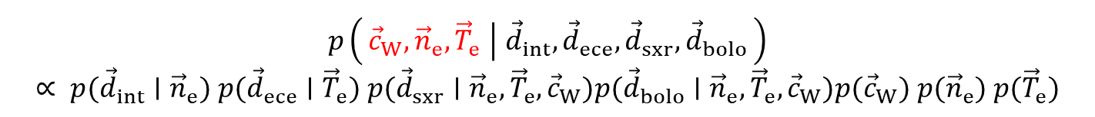


$c_{W}$: (2) Integrated data analysis (IDA) approach
Posterior distribution (hyperparameters omitted):
$$p\left({\vec{c}}_{W}, {\vec{n}}_{e}, {\vec{T}}_{e} ∣ {\vec{d}}_{int}, {\vec{d}}_{ece}, {\vec{d}}_{sxr},{\vec{d}}_{bolo}\right)$$
$$∝ p({\vec{d}}_{int}∣{\vec{n}}_{e}) p({\vec{d}}_{ece}∣{\vec{T}}_{e}) p({\vec{d}}_{sxr}∣{\vec{n}}_{e}, {\vec{T}}_{e}, {\vec{c}}_{W})p({\vec{d}}_{bolo}∣{\vec{n}}_{e}, {\vec{T}}_{e}, {\vec{c}}_{W})p({\vec{c}}_{W}) p({\vec{n}}_{e}) p({\vec{T}}_{e})$$
Hyperparameters
One-step analysis with pooled data
(data fusion)
$$NICE$$
$$n_{e}(ρ)$$
$$T_{e}(ρ)$$
$$c_{W}(\vec{r})$$
Increased reliability
Consistency
Error propagation
$ψ_{N}$ and $ρ$
$$n_{e}(\vec{r})$$
$$T_{e}(\vec{r})$$
$$L_{A}(T_{e})$$
$$ε_{bolo}(\vec{r})$$
$$d_{bolo}$$
Bolometer
$$ε_{sxr}(\vec{r})$$
$$d_{sxr}$$
SXR
$$d_{int}$$
$$d_{ece}$$
R. Fischer et al, Fusion Sci. Technol. 58:2, 675-684 (2010)
Interferometer
ECE
Notes:
Due to these limitations, in this work we use a different approach, the IDA based on Bayesian probability theory. We consider the joint posterior distribution of tungsten concentration, electron density and electron temperature profiles. This approach enables a one-step analysis with pooled data. The advantages are: … . This is a schematic diagram of our model.

Slide 11
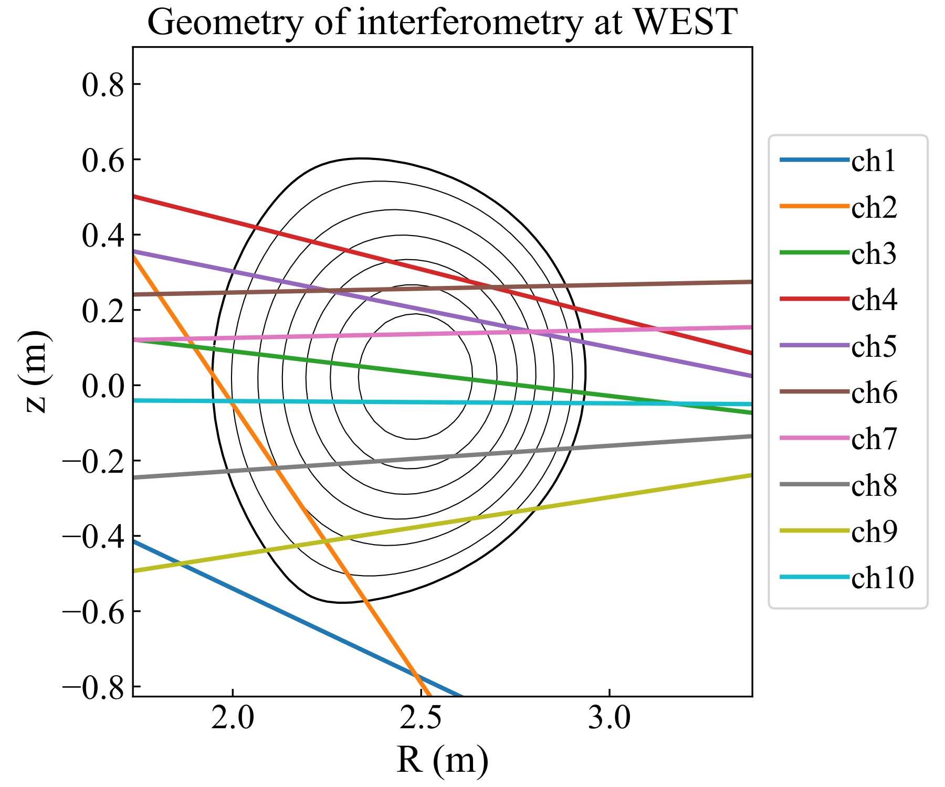

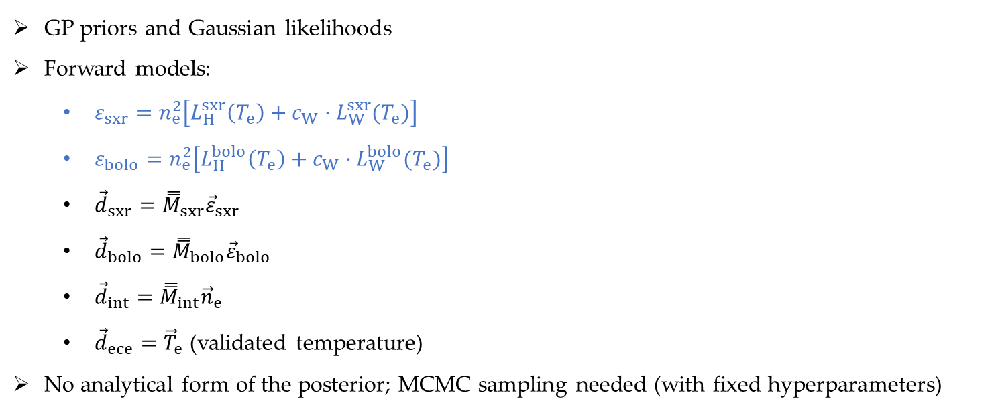
IDA: implementation
GP priors and Gaussian likelihoods
Forward models:
  $ε_{sxr}=n_{e}^{2}\left[L_{H}^{sxr}\left(T_{e}\right)+c_{W}⋅L_{W}^{sxr}(T_{e})\right]$
  $ε_{bolo}=n_{e}^{2}\left[L_{H}^{bolo}\left(T_{e}\right)+c_{W}⋅L_{W}^{bolo}(T_{e})\right]$
  ${\vec{d}}_{sxr}={\overset{̿}{M}}_{sxr}{\vec{ε}}_{sxr}$
  ${\vec{d}}_{bolo}={\overset{̿}{M}}_{bolo}{\vec{ε}}_{bolo}$
  ${\vec{d}}_{int}={\overset{̿}{M}}_{int}{\vec{n}}_{e}$
  ${\vec{d}}_{ece}={\vec{T}}_{e}$ (validated temperature)
No analytical form of the posterior; MCMC sampling needed (with fixed hyperparameters)
$$p\left({\vec{c}}_{W}, {\vec{n}}_{e}, {\vec{T}}_{e} ∣ {\vec{d}}_{int}, {\vec{d}}_{ece}, {\vec{d}}_{sxr},{\vec{d}}_{bolo}\right)$$
Notes:
Again, we use GP priors for all three profiles and Gaussian likelihoods for all diagnostics. The forward models for the diagnostics are all linear. However, due to the non-linear dependence of the emissivity on electron density and temperature, the complete forward model is not linear and the joint posterior distribution has no analytical solution. We need MCMC sampling for the exploration of the posterior distribution.

Slide 12
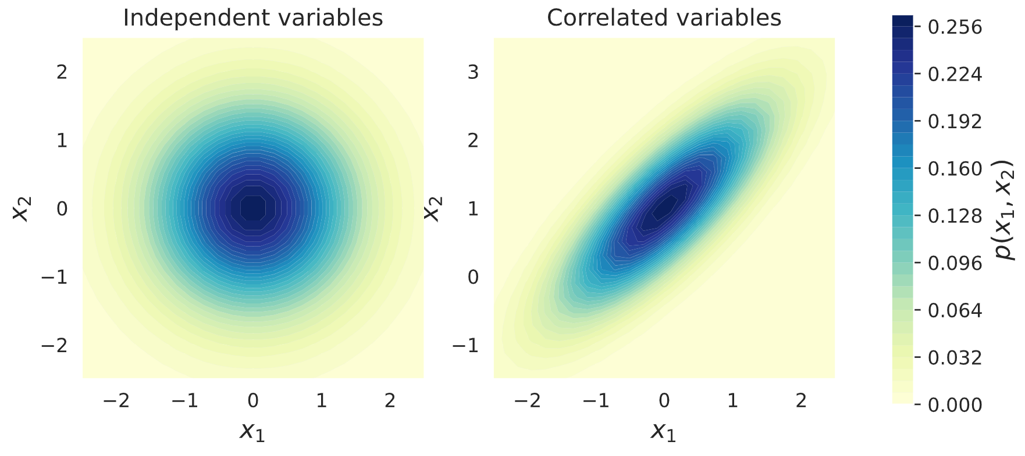
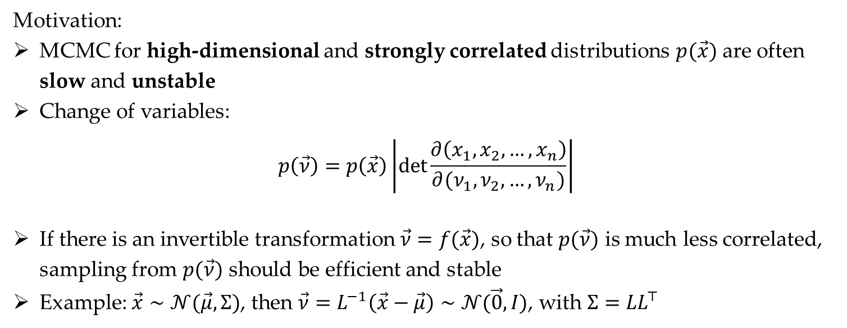

Reparameterization in MCMC
Motivation:
MCMC for high-dimensional and strongly correlated distributions $p(\vec{x})$ are often slow and unstable
Change of variables:
$$p\left(\vec{ν}\right)=p\left(\vec{x}\right)\left|det\frac{∂\left(x_{1},x_{2},…,x_{n}\right)}{∂(ν_{1},ν_{2},…,ν_{n})}\right|$$
If there is an invertible transformation $\vec{ν}=f(\vec{x})$, so that $p(\vec{ν})$ is much less correlated, sampling from $p(\vec{ν})$ should be efficient and stable
Example: $\vec{x}∼𝒩(\vec{μ},Σ)$, then $\vec{ν}=L^{−1}\left(\vec{x}−\vec{μ}\right)∼𝒩(\vec{0},I)$, with $Σ={LL}^{⊤}$
(Jacobian determinant)
Joint distribution $p(x_{1},x_{2})$
Notes:
To improve the efficiency and stability of the MCMC sampling scheme (see figure). We have adopted a reparameterization trick. The motivation is that MCMC for high-dimensional and strongly correlated distributions $p(\vec{x})$ are often slow and unstable.
Therefore, we may want to sample from some auxiliary variables that are less correlated. According to the rule for change of variables, the distribution of the auxiliary variable can be obtained using the Jacobian of the transformation.

Slide 13
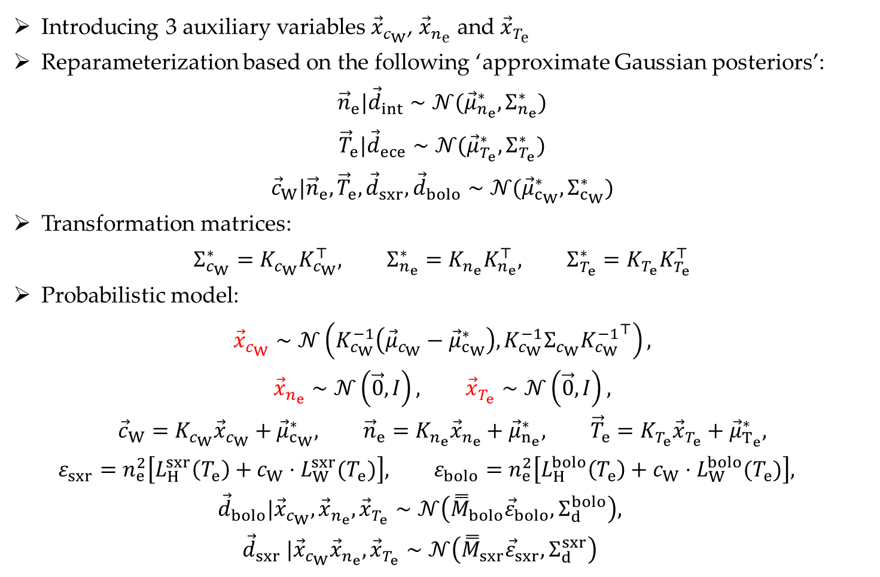
Improved sampling scheme after reparameterization
Introducing 3 auxiliary variables ${\vec{x}}_{c_{W}}$, ${\vec{x}}_{n_{e}}$ and ${\vec{x}}_{T_{e}}$
Reparameterization based on the following ‘approximate Gaussian posteriors’:
$${\vec{n}}_{e}|{\vec{d}}_{int}∼𝒩({\vec{μ}}_{n_{e}}^{∗},Σ_{n_{e}}^{∗})$$
$${\vec{T}}_{e}|{\vec{d}}_{ece}∼𝒩({\vec{μ}}_{T_{e}}^{∗},Σ_{T_{e}}^{∗})$$
$${\vec{c}}_{W}|{\vec{n}}_{e}, {\vec{T}}_{e},{\vec{d}}_{sxr},{\vec{d}}_{bolo}∼𝒩({\vec{μ}}_{c_{W}}^{∗},Σ_{c_{W}}^{∗})$$
Transformation matrices:
$$Σ_{c_{W}}^{∗}=K_{c_{W}}K_{c_{W}}^{⊤}, Σ_{n_{e}}^{∗}={K_{n_{e}}K}_{n_{e}}^{⊤}, Σ_{T_{e}}^{∗}={K_{T_{e}}K}_{T_{e}}^{⊤}$$
Probabilistic model:
$${\vec{x}}_{c_{W}}∼𝒩\left(K_{c_{W}}^{−1}\left({\vec{μ}}_{c_{W}}−{\vec{μ}}_{c_{W}}^{∗}\right),K_{c_{W}}^{−1}Σ_{c_{W}}{K_{c_{W}}^{−1}}^{⊤}\right),$$
$${\vec{x}}_{n_{e}}∼𝒩\left(\vec{0},I\right), {\vec{x}}_{T_{e}}∼𝒩\left(\vec{0},I\right),$$
$${\vec{c}}_{W}=K_{c_{W}}{\vec{x}}_{c_{W}}+{\vec{μ}}_{c_{W}}^{∗}, {\vec{n}}_{e}=K_{n_{e}}{\vec{x}}_{n_{e}}+{\vec{μ}}_{n_{e}}^{∗}, {\vec{T}}_{e}=K_{T_{e}}{\vec{x}}_{T_{e}}+{\vec{μ}}_{T_{e}}^{∗},$$
  $$ε_{sxr}=n_{e}^{2}\left[L_{H}^{sxr}\left(T_{e}\right)+c_{W}⋅L_{W}^{sxr}(T_{e})\right], ε_{bolo}=n_{e}^{2}\left[L_{H}^{bolo}\left(T_{e}\right)+c_{W}⋅L_{W}^{bolo}(T_{e})\right],$$
  $${\vec{d}}_{bolo}|{\vec{x}}_{c_{W}},{\vec{x}}_{n_{e}},{\vec{x}}_{T_{e}}∼𝒩\left({\overset{̿}{M}}_{bolo}{\vec{ε}}_{bolo},Σ_{d}^{bolo}\right),$$
  $${\vec{d}}_{sxr} |{\vec{x}}_{c_{W}}{\vec{x}}_{n_{e}},{\vec{x}}_{T_{e}}∼𝒩\left({\overset{̿}{M}}_{sxr}{\vec{ε}}_{sxr},Σ_{d}^{sxr}\right)$$
(Analytically tractable)
(Cholesky decomposition)

Slide 14
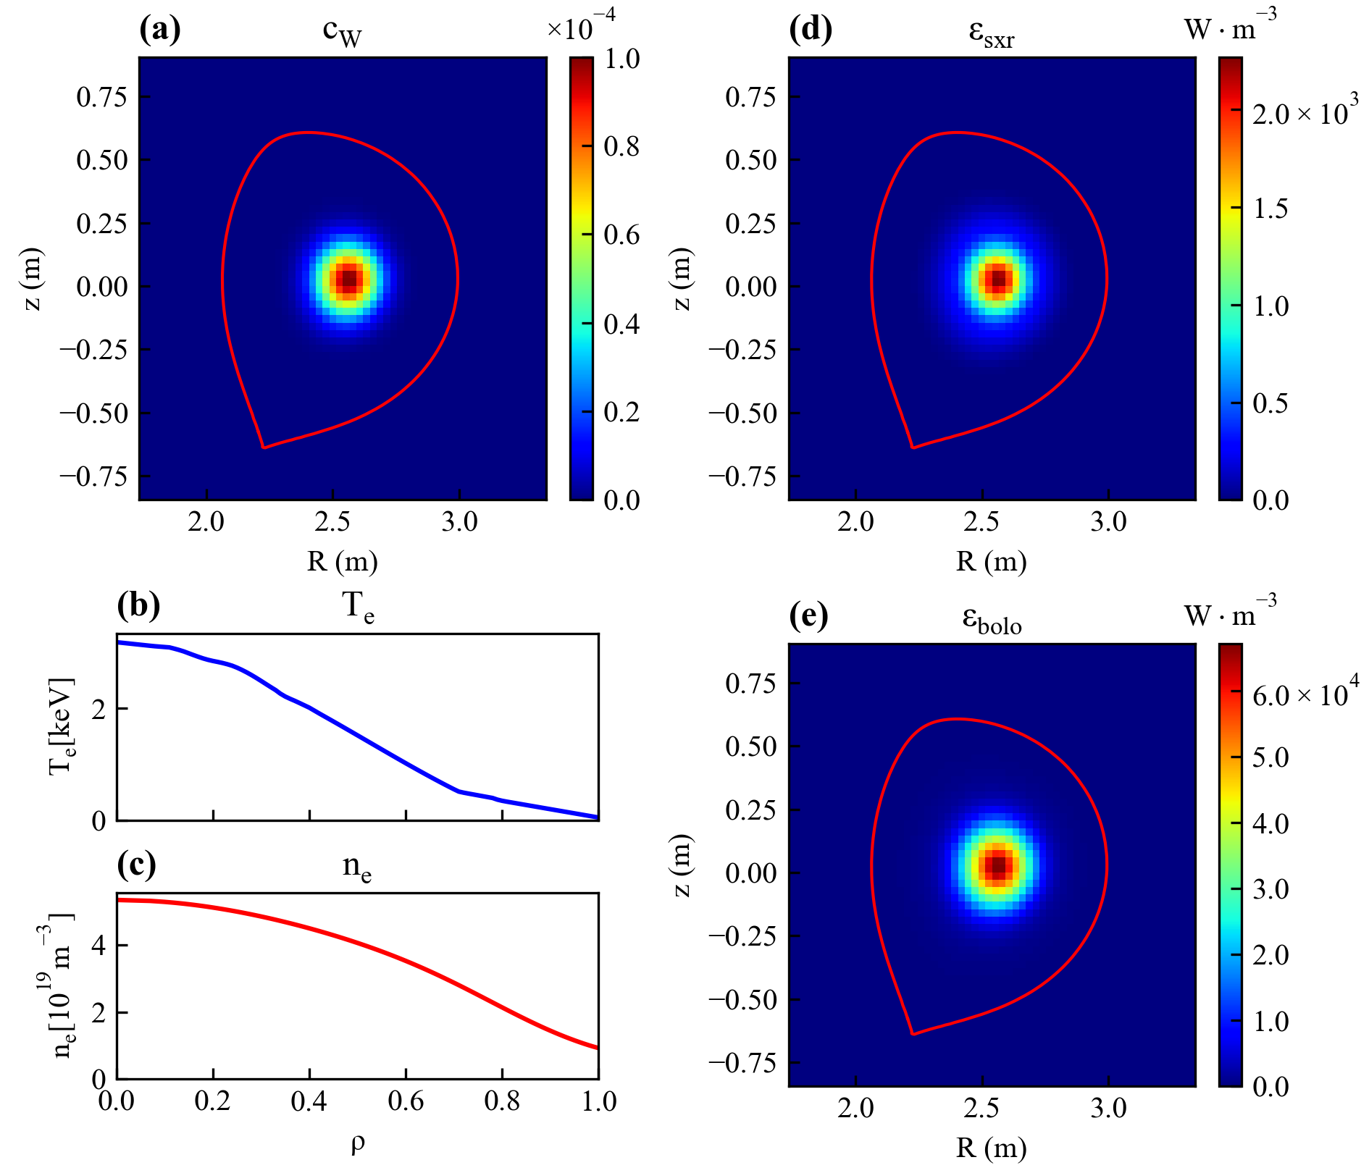

IDA validation on synthetic data: data generation
Synthetic data:
Synthetic $c_{W}$, $n_{e}$, $T_{e}$ profiles
Emissivity profiles
(Noisy) ECE data
(Noisy) Interferometry data
(Noisy) SXR data
(Noisy) bolometry data

Slide 15
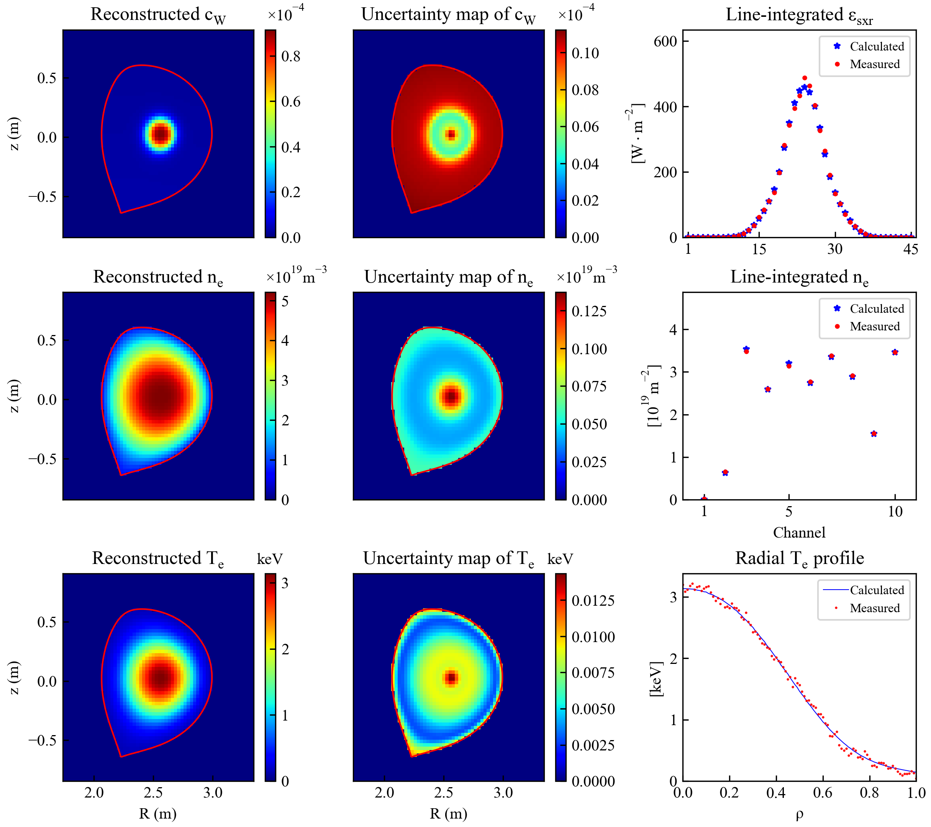
IDA validation on synthetic data: SXR only
Reconstruction:
High uncertainty!
H. Wu et al, PPCF 67 085001 (2025)

Slide 16
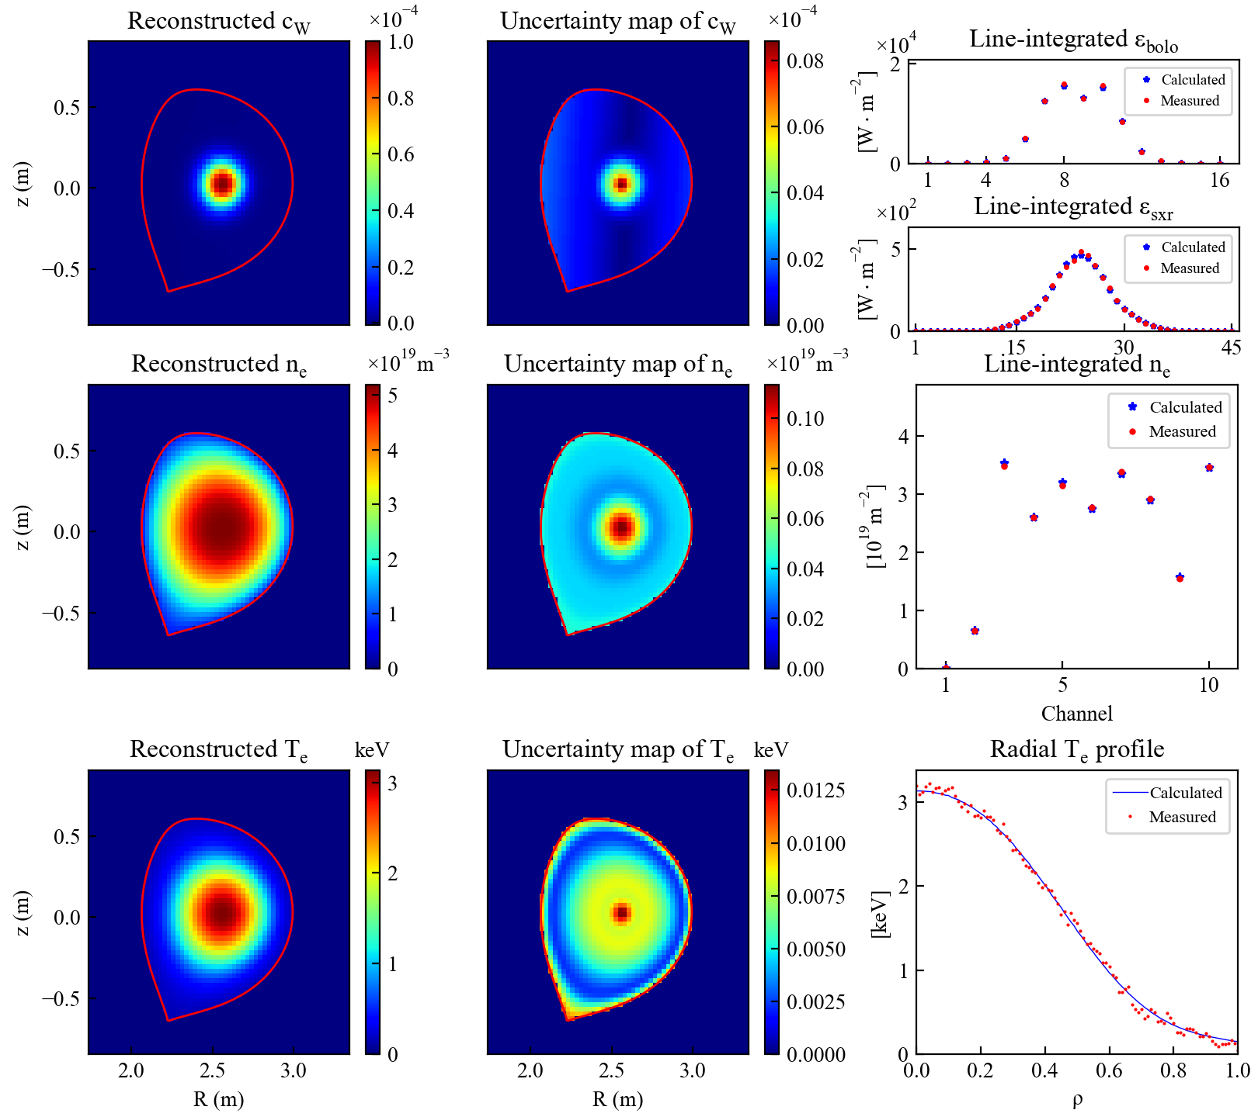
IDA validation on synthetic data: SXR+bolometry
Reconstruction:
H. Wu et al, PPCF 67 085001 (2025)

Slide 17
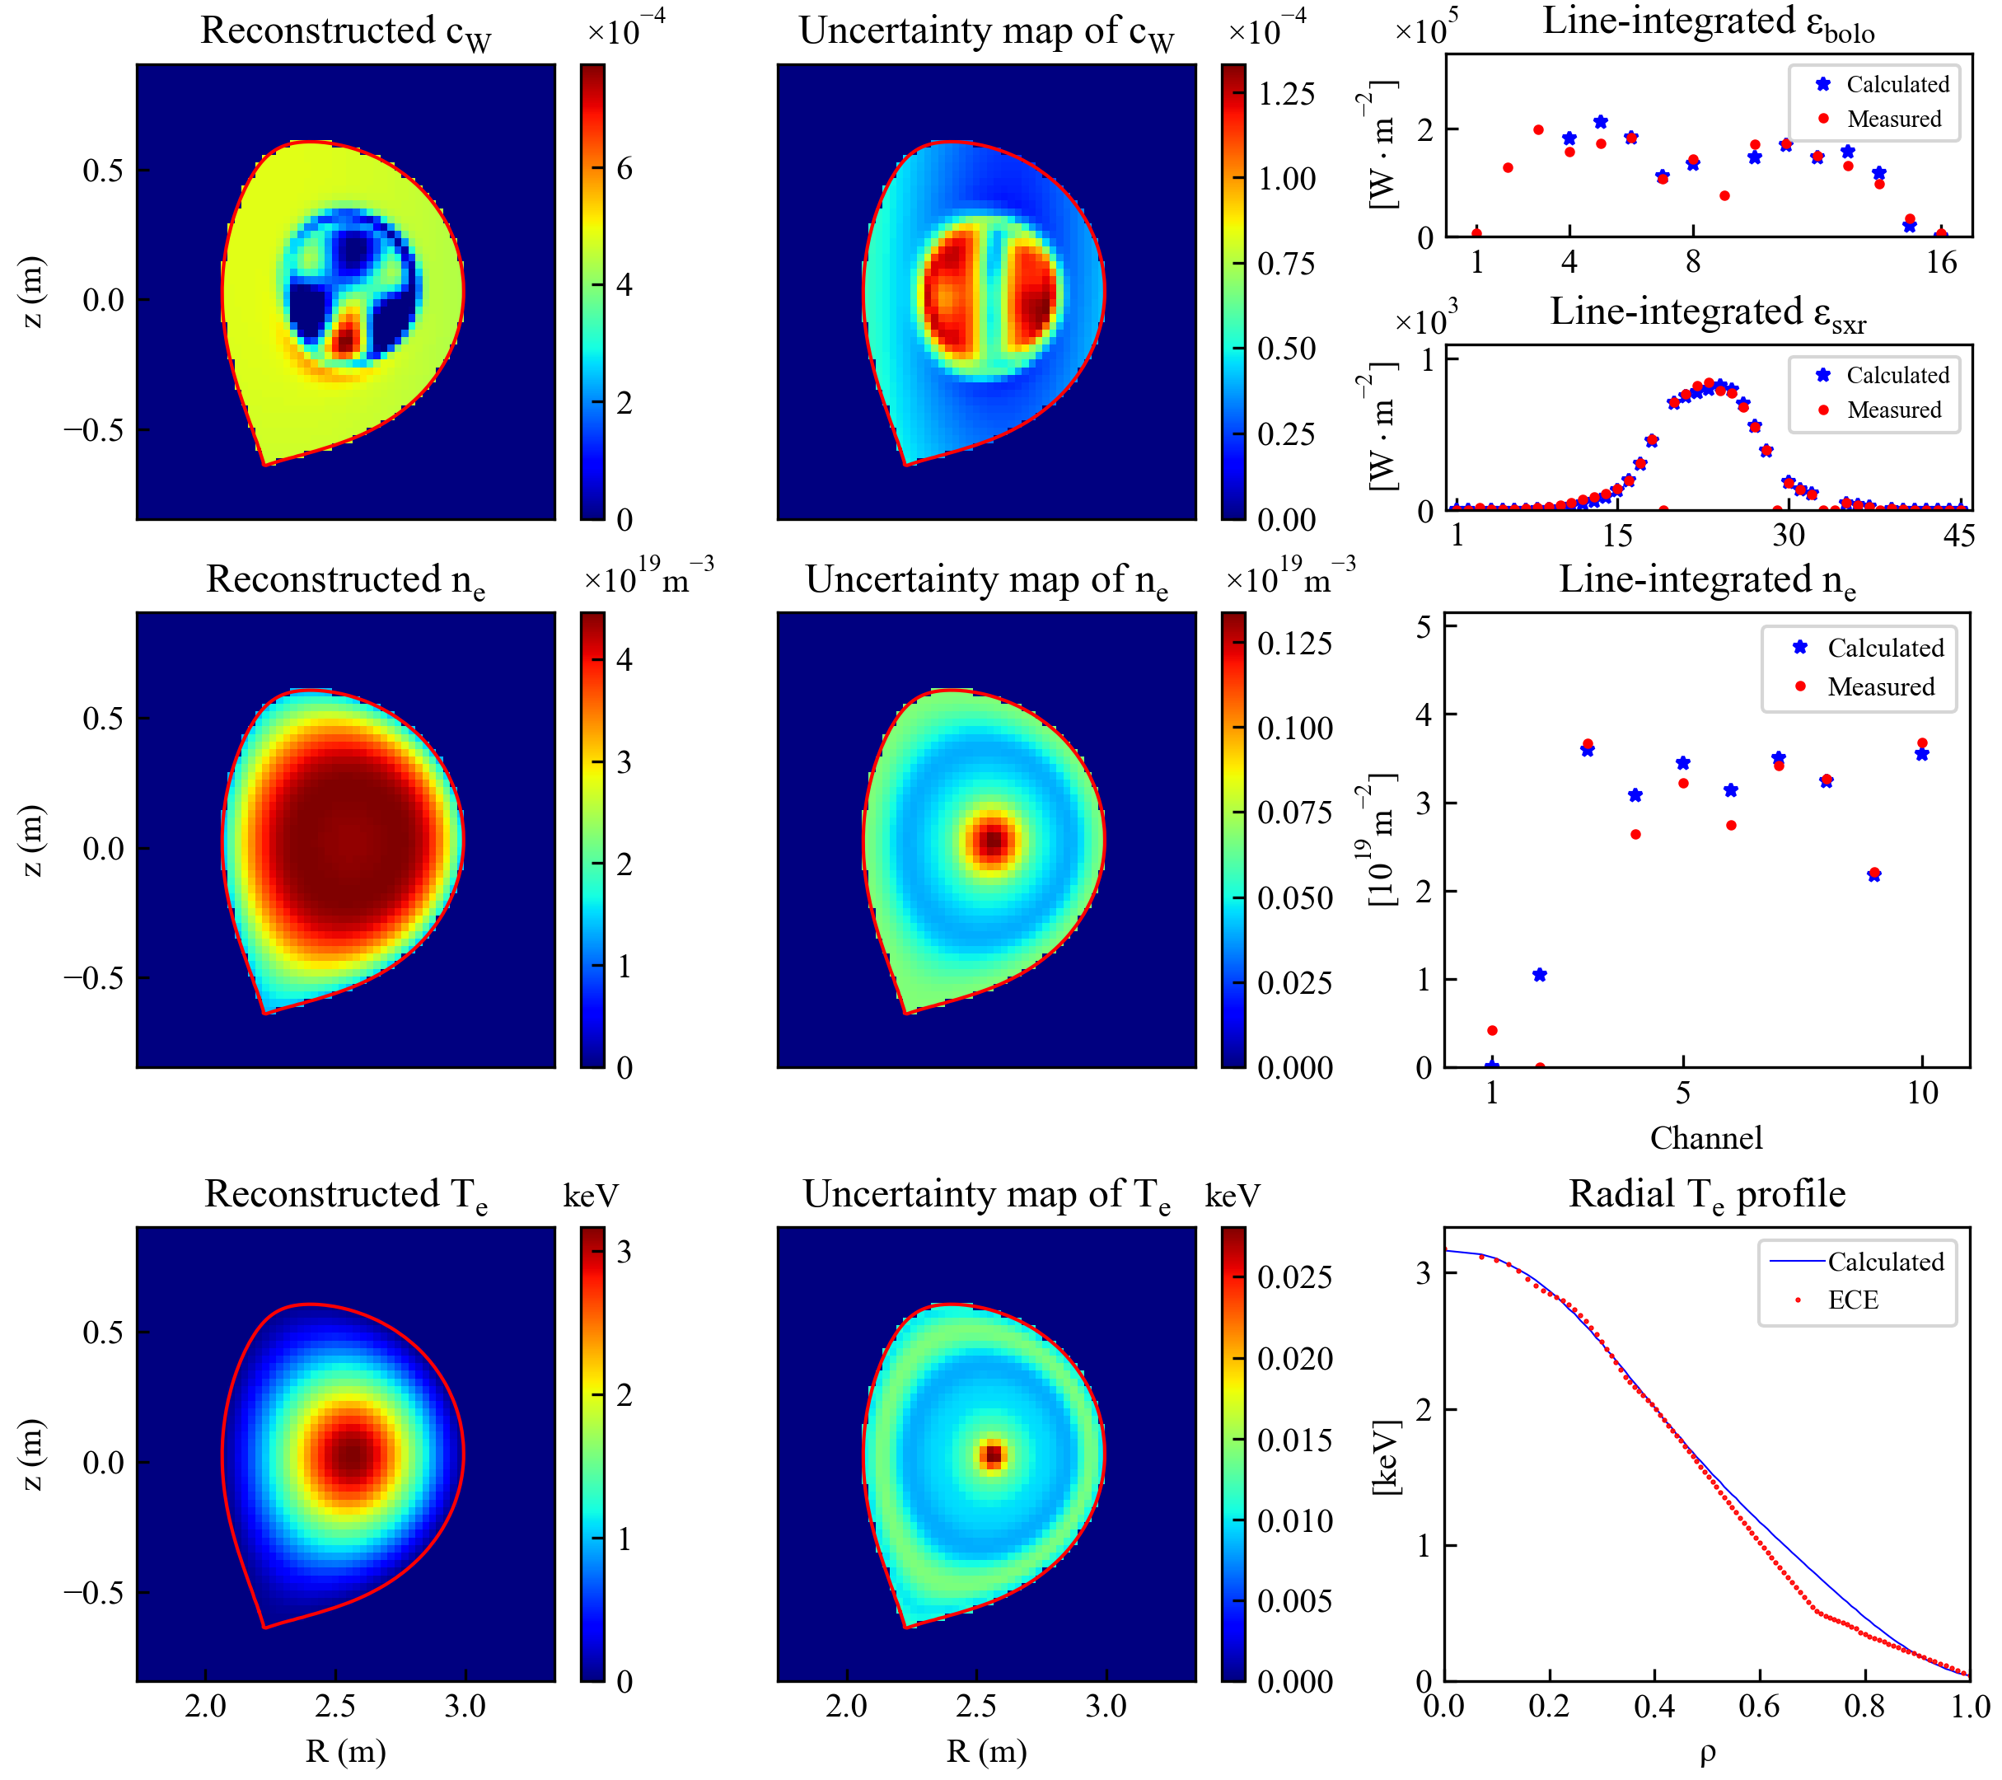
Test on WEST experimental data
WEST pulse #58089, t = 5.0 s (only SXR data)
possibly an artifact
Limitations:
- No positive constraints
- Absence of horizontal views
- Bolometer channels crossing the divertor region were excluded
H. Wu et al, PPCF 67 085001 (2025)

Slide 18
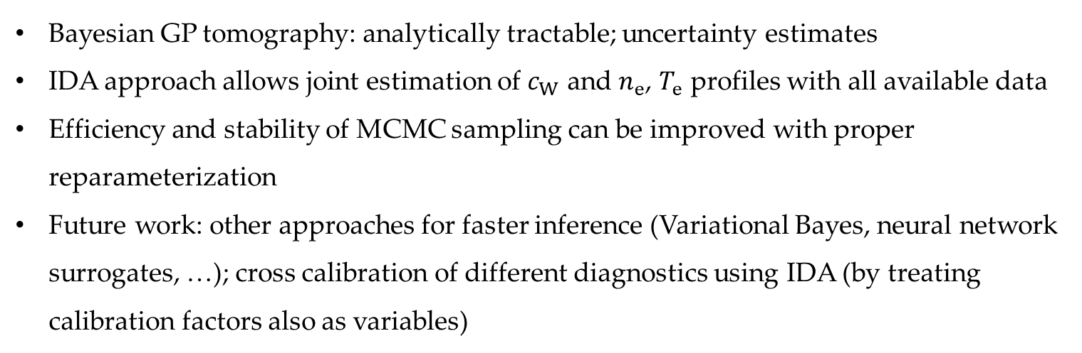
Summary
Bayesian GP tomography: analytically tractable; uncertainty estimates
IDA approach allows joint estimation of $c_{W}$ and $n_{e}$, $T_{e}$ profiles with all available data
Efficiency and stability of MCMC sampling can be improved with proper reparameterization
Future work: other approaches for faster inference (Variational Bayes, neural network surrogates, …); cross calibration of different diagnostics using IDA (by treating calibration factors also as variables)

