Slide 1
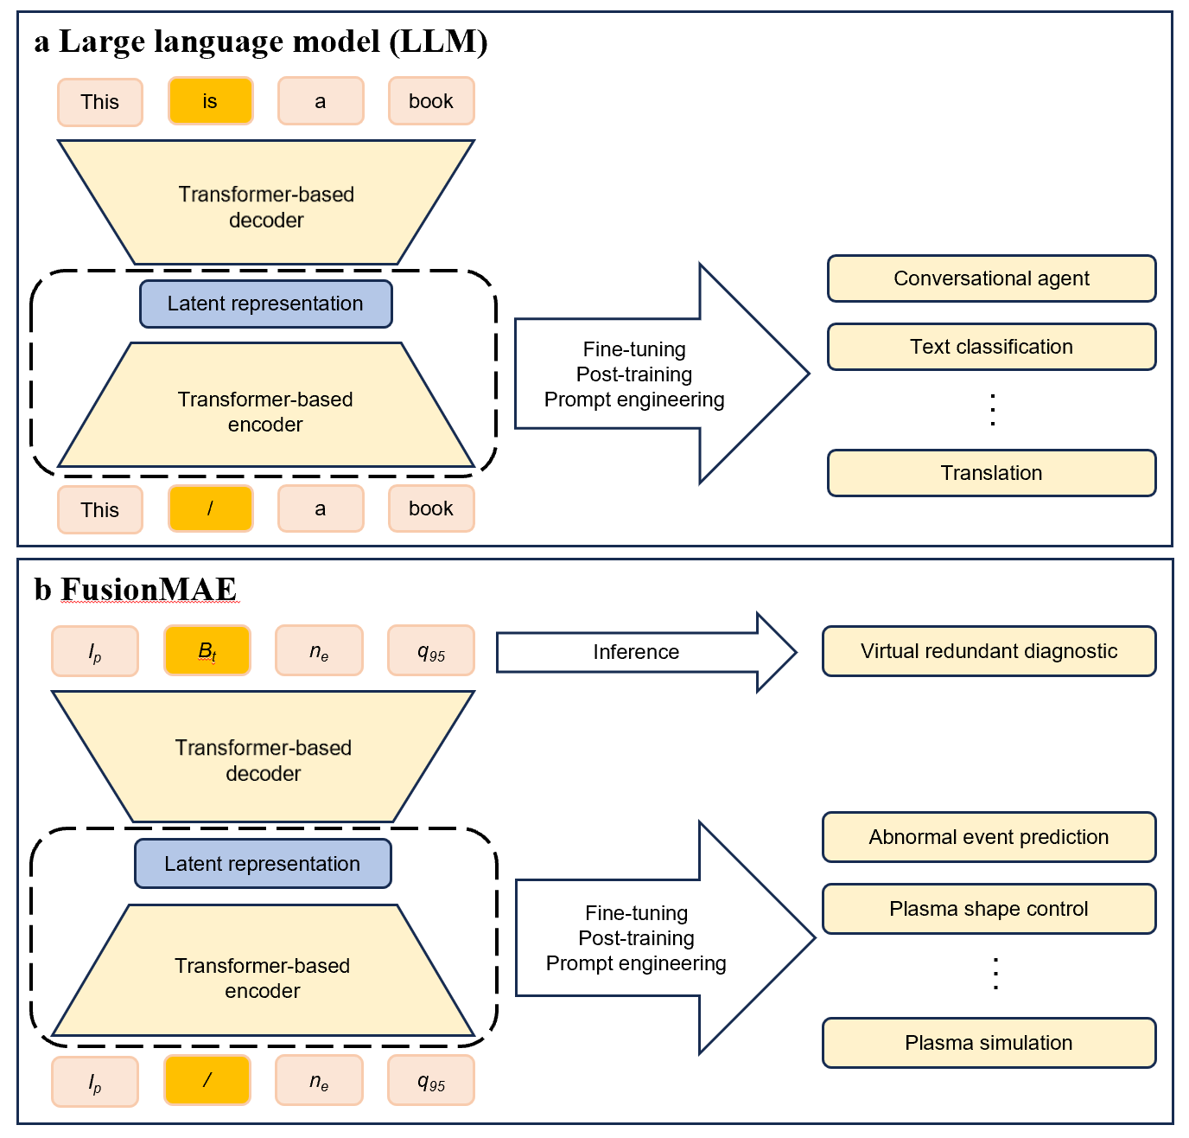
FusionMAE vs LLM
Large language model（LLM）
  Learn general knowledge and basic grammar by generative pre-training
  BERT is pretrained by filling masked words
  GPT is pretrained by predicting the next word
  LLM can be used in language downstream tasks and promote their performance
Fusion masked auto-encoder(FusionMAE)
  Learn basic plasma physics by filling missing diagnostic data
  FusionMAE itself can serve as virtual redundant diagnostic in future reactors
  FusionMAE can be used in fusion downstream tasks and promote their performance
1

Slide 2
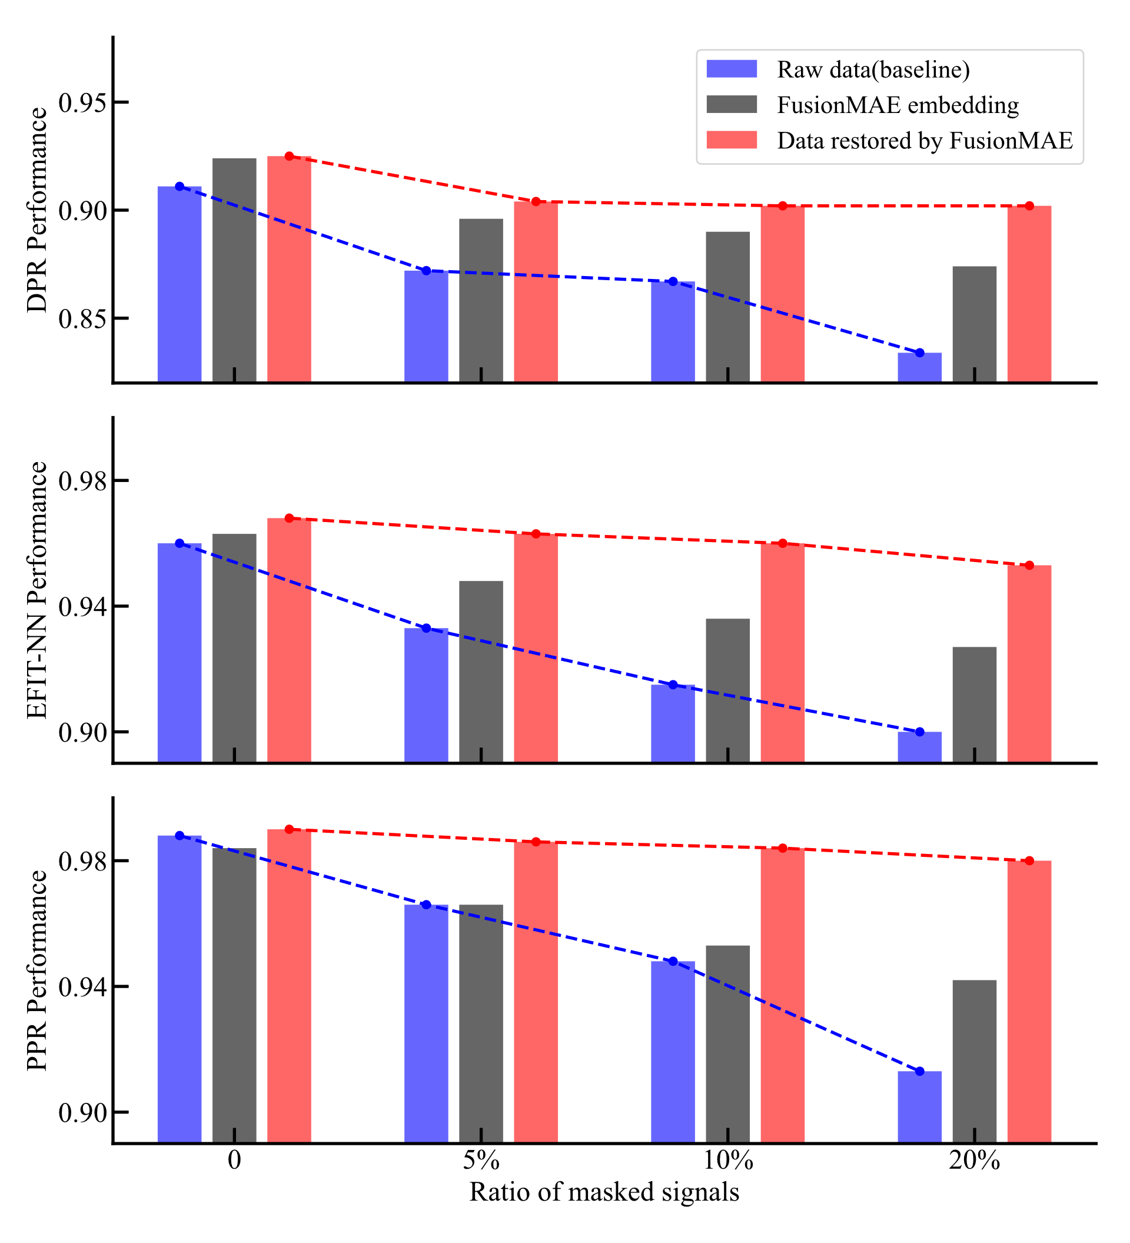
FusionMAE performance
Fullfill all the missing data under randomly missing situations, unless the ratio of missing is too high
Model performance：AE similarity = 98.4%，MAE similarity = 96.7%
Exhibits emergent abilities akin to foundation models in HL-3:
  Automated secondary data analysis
  Serving as a foundation model for diverse downstream control tasks
  Holistic performance improvements across all supported task
2

