Slide 1



Bayesian Experimental Design on Pick-up Coil System for WEST Tokamak
Y. Zhang, J. De Rycke, D. Mazon, P. Moreau, J. Morales, G. Verdoolaege and the WEST team

Slide 2
Outline
Background: Thermal Nuclear Fusion, Tokamaks and Equilibrium
Bayesian Experimental Design: The Principle
Bayesian Formula Set Up on Pick-up Coils of WEST Tokamak
Result I: Single Coil Drop per Time
Result II: Cumulative Drops
Result III: Toroidal Harmonic Reconstruction
Summary and Conclusion

Slide 3
Outline
Background: Thermal Nuclear Fusion, Tokamaks and Equilibrium…
Bayesian Experimental Design: The Principle
Bayesian Formula Set Up on Pick-up Coils of WEST Tokamak
Result I: Single Coil Drop per Time
Result II: Cumulative Drops
Result III: Toroidal Harmonic Reconstruction
Summary and Conclusion

Slide 4
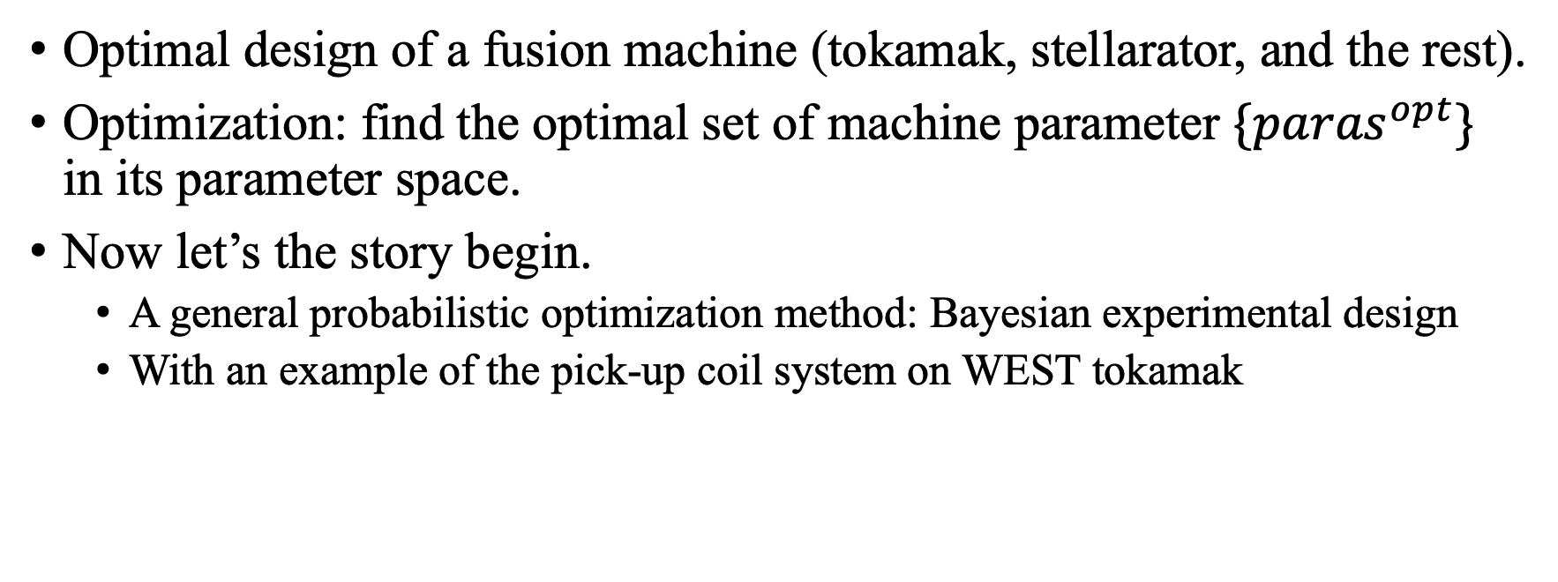
What are we seeking for?
Optimal design of a fusion machine (tokamak, stellarator, and the rest).
Optimization: find the optimal set of machine parameter $\{{paras}^{opt}\}$ in its parameter space.
Now let’s the story begin.
  A general probabilistic optimization method: Bayesian experimental design
  With an example of the pick-up coil system on WEST tokamak

Slide 5
Outline
Thermal Nuclear Fusion, Tokamaks and Equilibrium
Bayesian Experimental Design: The Principle
Bayesian Formula Set Up on Pick-up Coils of WEST Tokamak
Result I: Single Coil Drop per Time
Result II: Cumulative Drops
Result III: Toroidal Harmonic Reconstruction
Summary and Conclusion

Slide 6
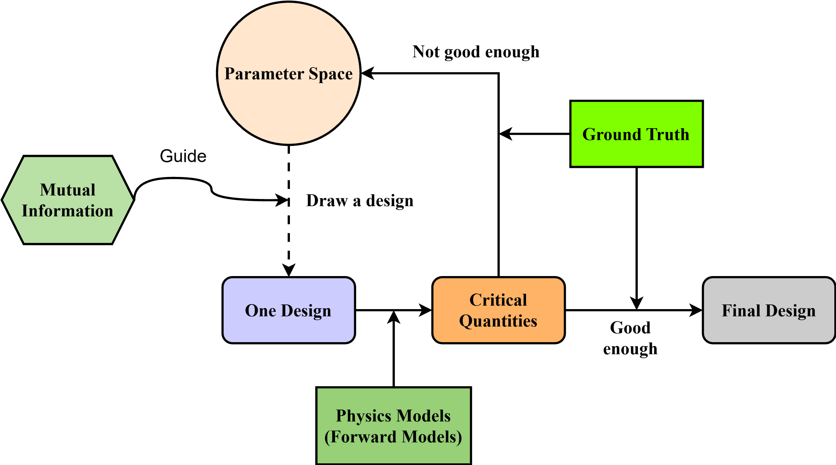
Experimental Design
Goal:
  Find an optimal design of a system: accuracy, cost, etc.
How:
  Altering (with certain guide/principle) the system, compare with the “ground truth” until “convergence”.
  Preferably altering the design in the most efficient direction, which is provided by mutual information.
Parameter space (pick-up coils):
  Location, angle, quantity.
  In discrete space.
Loss Function

Slide 7
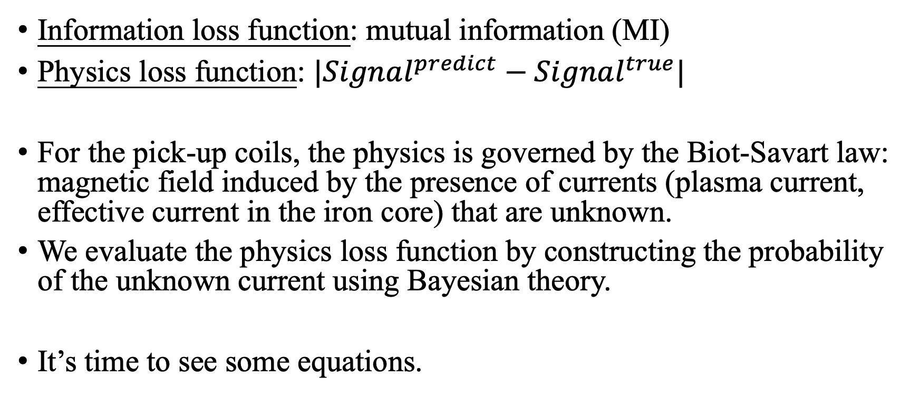
Two metrics
Information loss function: mutual information (MI)
Physics loss function: $|Signal^{predict}−Signal^{true}|$
For the pick-up coils, the physics is governed by the Biot-Savart law: magnetic field induced by the presence of currents (plasma current, effective current in the iron core) that are unknown.
We evaluate the physics loss function by constructing the probability of the unknown current using Bayesian theory.
It’s time to see some equations.

Slide 8
Outline
Thermal Nuclear Fusion, Tokamaks and Equilibrium
Bayesian Experimental Design: The Principle
Bayesian Formula Set Up on Pick-up Coils of WEST Tokamak
Result I: Single Coil Drop per Time
Result II: Cumulative Drops
Result III: Toroidal Harmonic Reconstruction
Summary and Conclusion

Slide 9
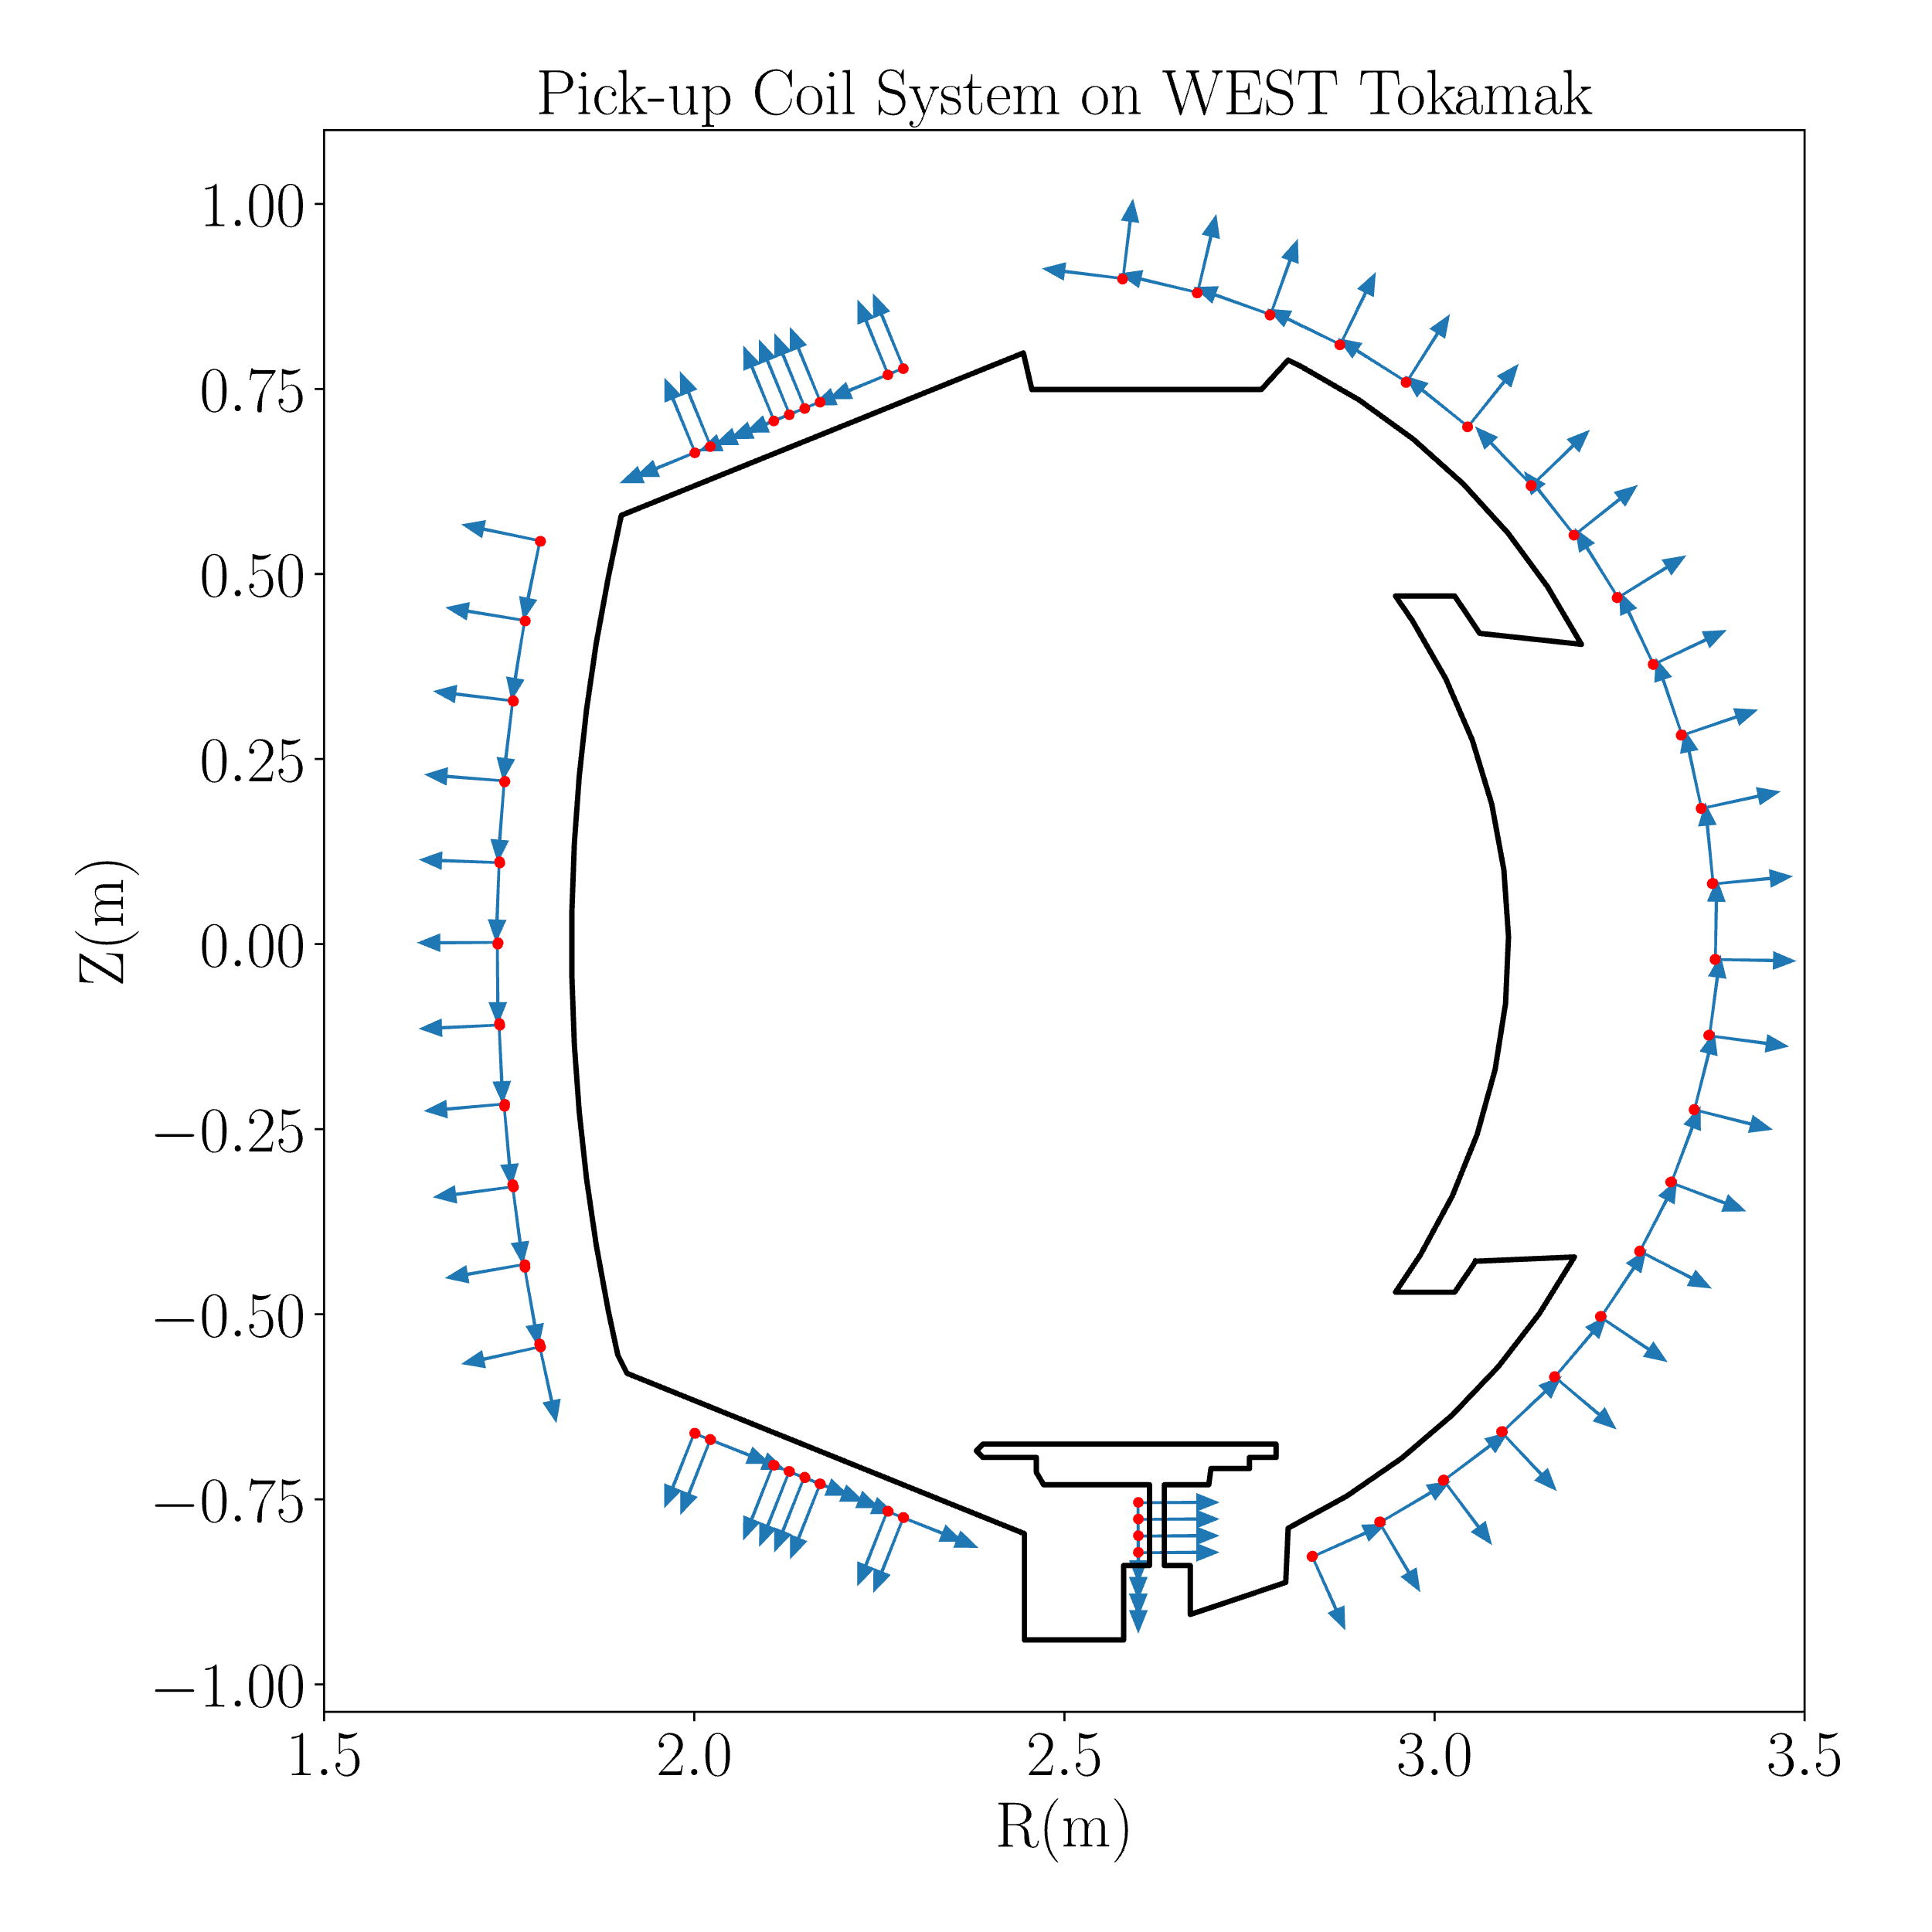
Pick-Up Coil System on WEST Tokamak
WEST: R=2.5m, a=0.5m.
Iron Core on WEST: nonlinear effect.
There are 110 pick-up coils on WEST:
  55 normal coils,
  55 tangential coils.
Normal: the normal direction of a coils is (nearly) perpendicular to the contour.

Slide 10
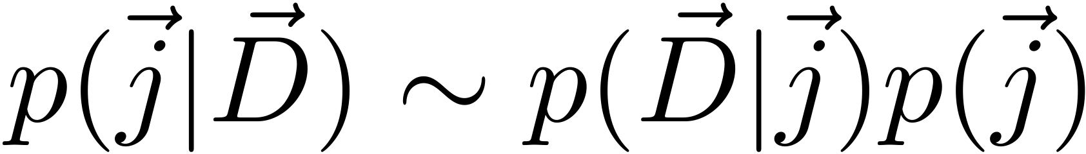
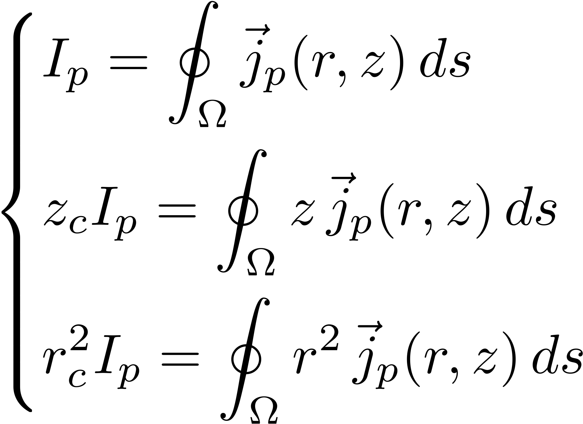
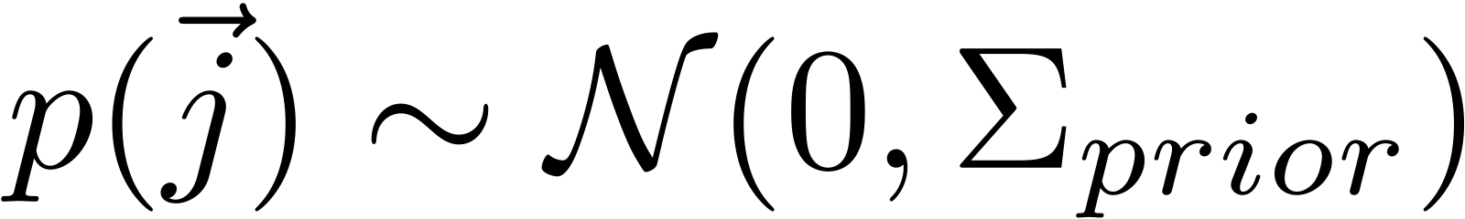
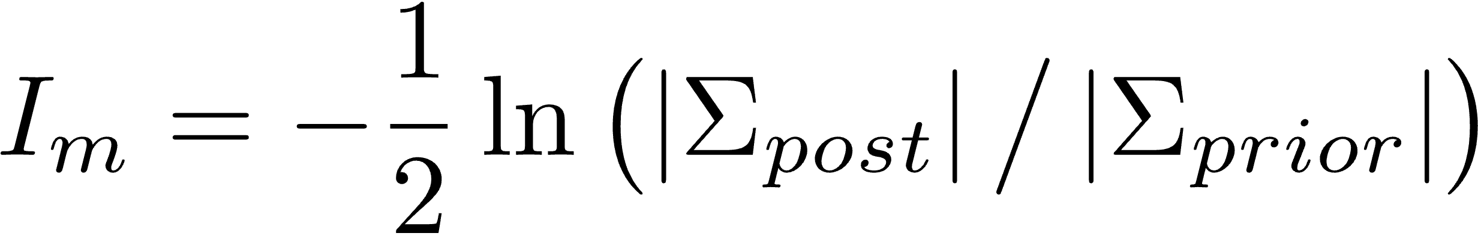


Bayesian Experimental Design on Pick-up Coils for WEST Tokamak
  Parameter space: Coil quantity (limited by the data $\vec{D}$).
  Ground truth: Not available, use equilibrium (EQ) info.
  Quantities of interest:
    Unknown: Plasma current density ( ${\vec{\text{j}}}_{\text{p}}$), Iron core current ( ${\vec{\text{j}}}_{\text{ic}}$).
    Total plasma current (Ip),
    Plasma centroid (Rc, Zc),
    X-point position.
  Physics model: Biot-Savart law
    Current sources: plasma current, PF current and the iron core.
Beyesian theory set up:
To construct the probability of unknown current tomogram, given the data measured.
Bayesian Formula
$$\vec{\text{j}}\text{=} {\vec{\text{j}}}_{\text{p}}\text{+} {\vec{\text{j}}}_{\text{ic}}$$
Posterior:
Prior:
Mutual Information

Slide 11
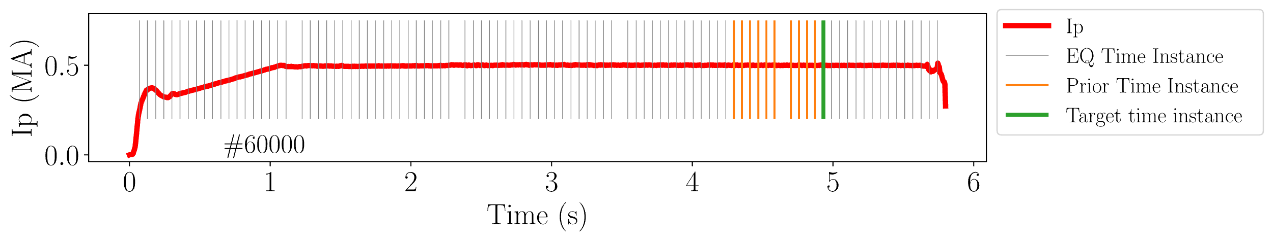
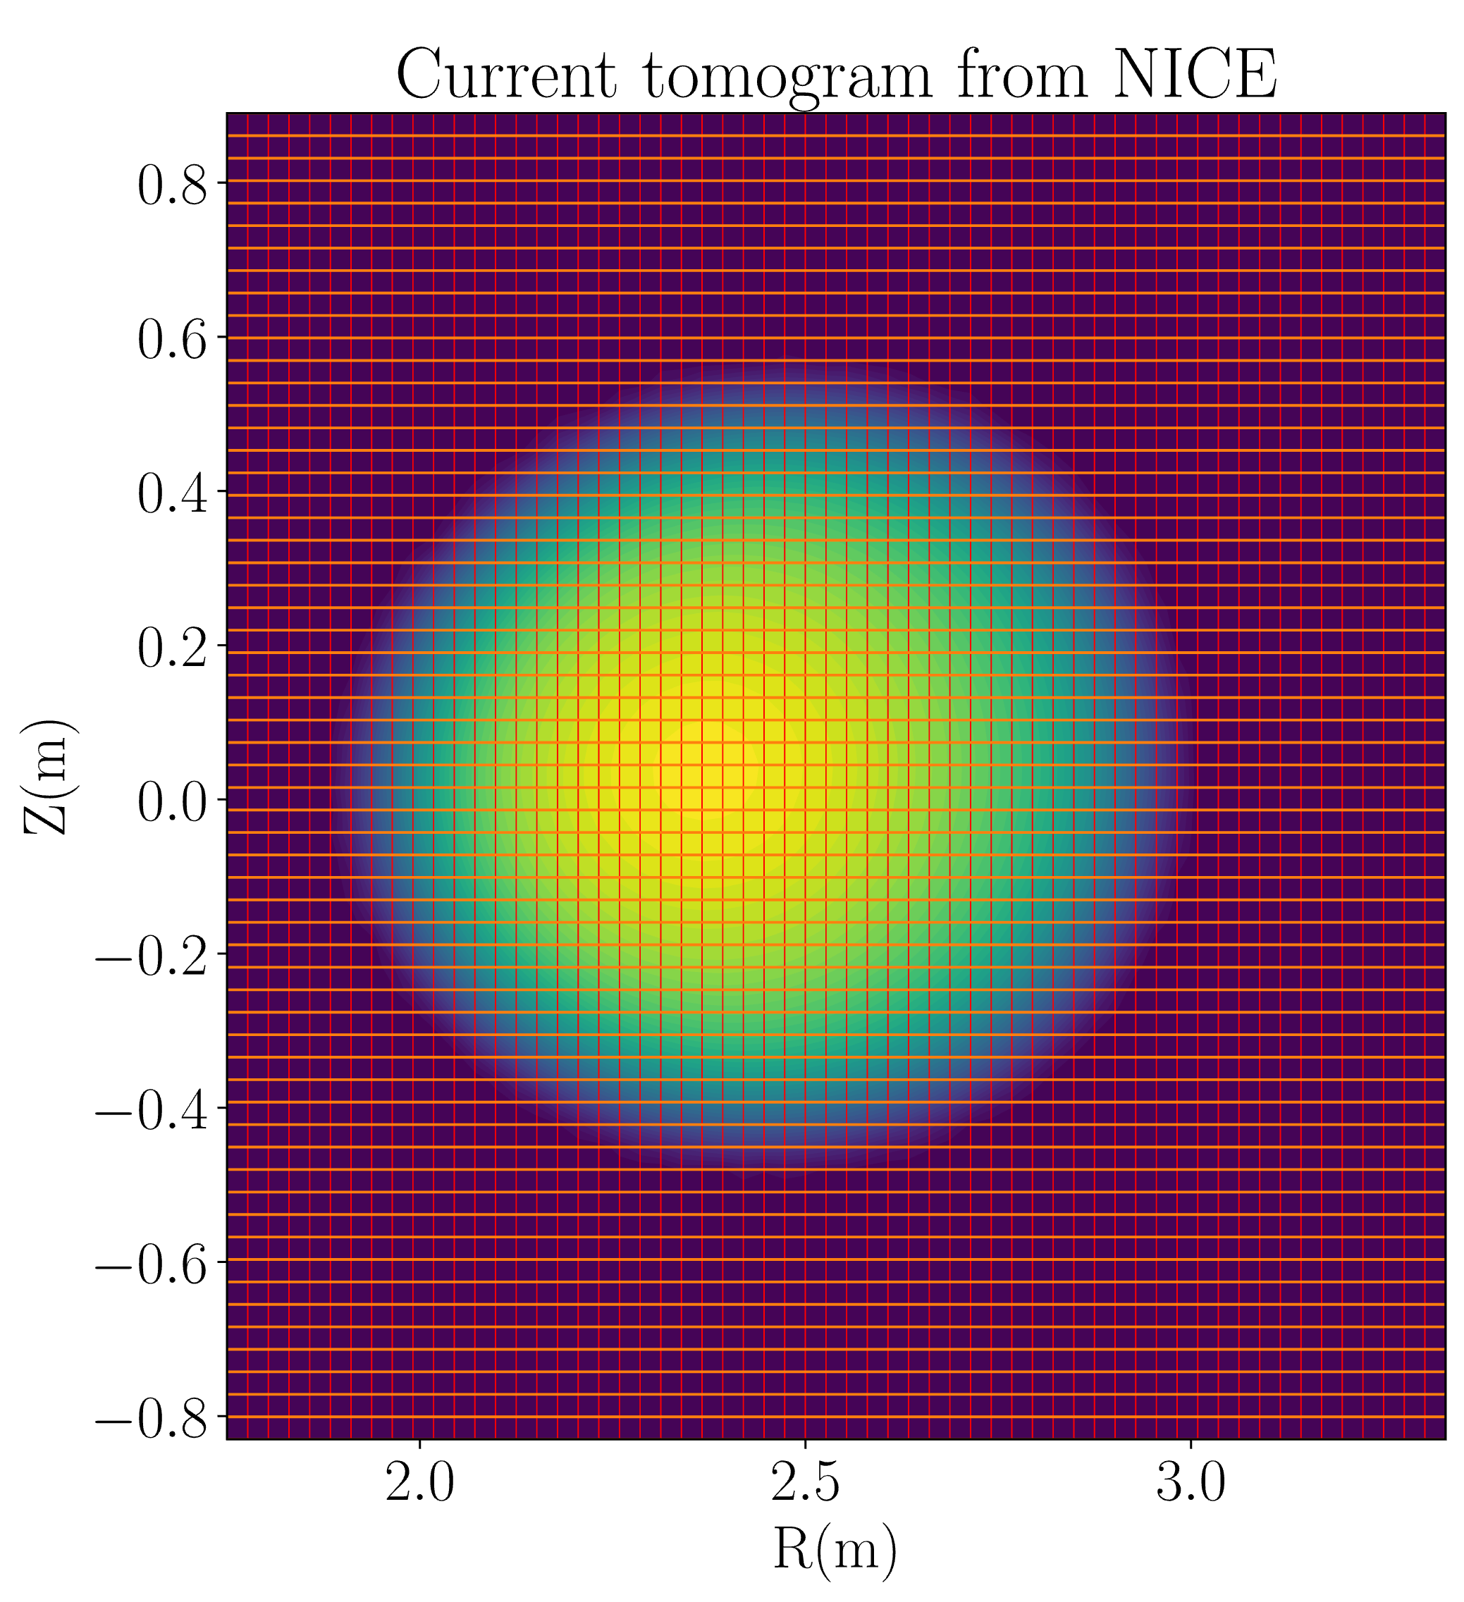
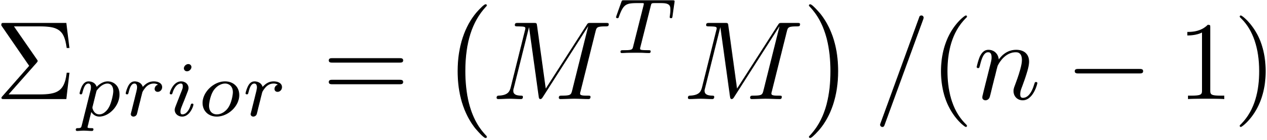
Prior Covariance Matrix: M
10 used EQ: n=10.
Each EQ has current tomogram with 60*60 resolution.
M: 10 x 3600.
The covariance matrix is (raw second moment):
The points outside the limiter will be removed afterwards.
Iron core: Gaussian process with stationary kernel.

Slide 12
Outline
Thermal Nuclear Fusion, Tokamaks and Equilibrium
Bayesian Experimental Design: The Principle
Bayesian Formula Set Up on Pick-up Coils of WEST Tokamak
Result I: Single Coil Drop per Time
Result II: Cumulative Drops
Result III: Toroidal Harmonic Reconstruction
Summary and Conclusion

Slide 13
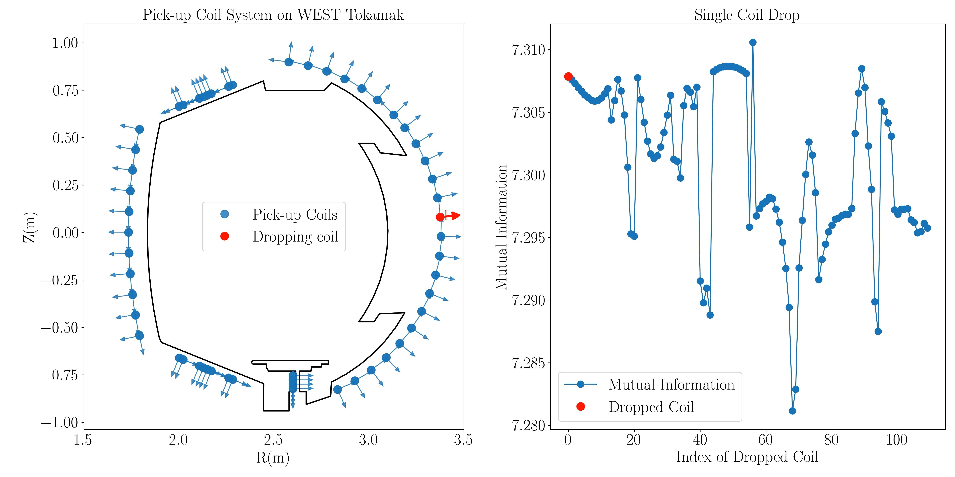
Single Coil Drop Process:
Lower MI value indicates higher information loose when dropping this coil, i.e., important
The lower,
The more important

Slide 14
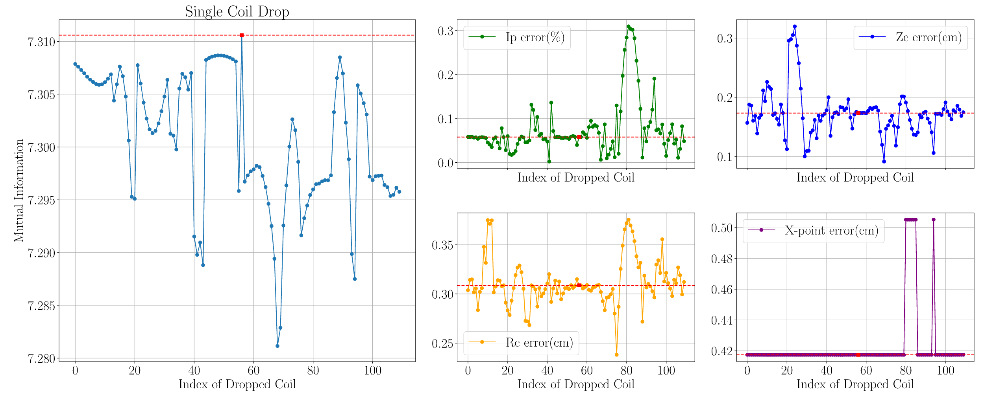
Single Coil Drop: Errors Remains Low
Single coil drop doesn’t show statistical trend.
The change remains at low level: the system is supposed to be resilience to small change.
Notice in the presentation, the values of Ip, Rc, Zc are corrected values. X-point is uncorrected.

Slide 15
Outline
Thermal Nuclear Fusion, Tokamaks and Equilibrium
Bayesian Experimental Design: The Principle
Bayesian Formula Set Up on Pick-up Coils of WEST Tokamak
Result I: Single Coil Drop per Time
Result II: Cumulative Drops
Result III: Toroidal Harmonic Reconstruction
Summary and Conclusion

Slide 16
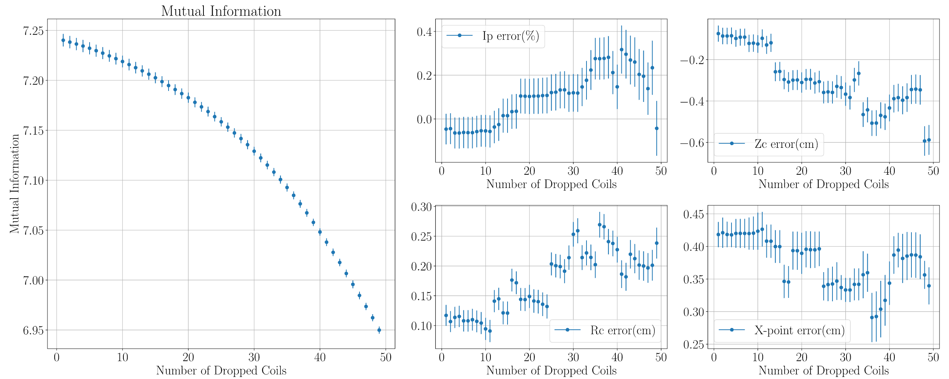
Cumulative Drops: n Dropped Coils at n step
Error of Ip, Zc, Rc and X-point shows increase/constant trend as expected.

Slide 17
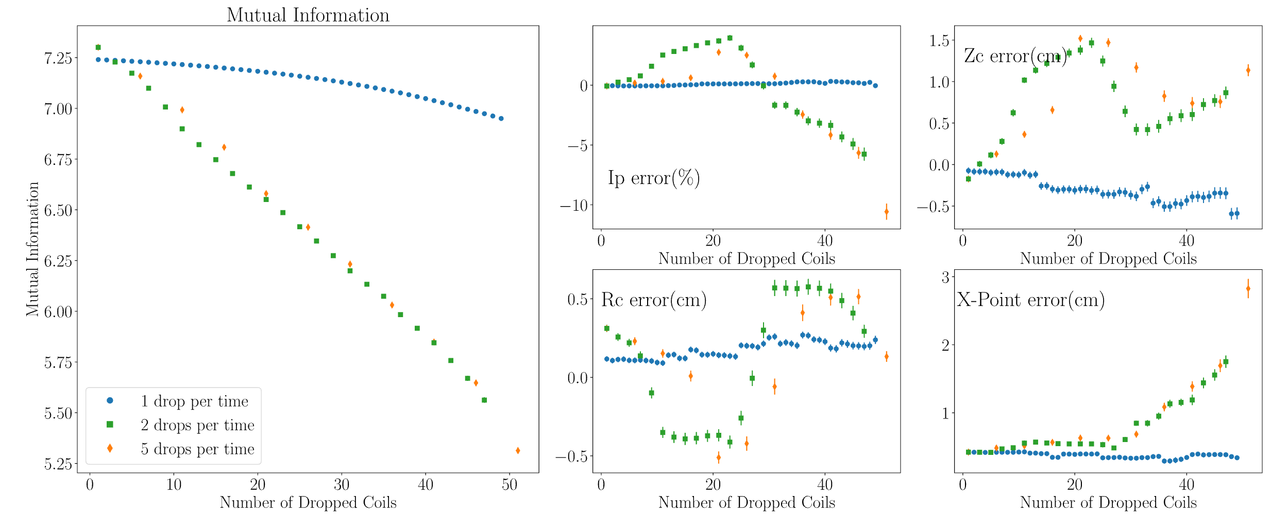
Cumulative Drops: n Dropped Coils at n step
Mutual Information is sensitive to the change of a system.
Error behaves better for single drop per time than multiple cases.
One should sample from the parameter space with minimum step.

Slide 18
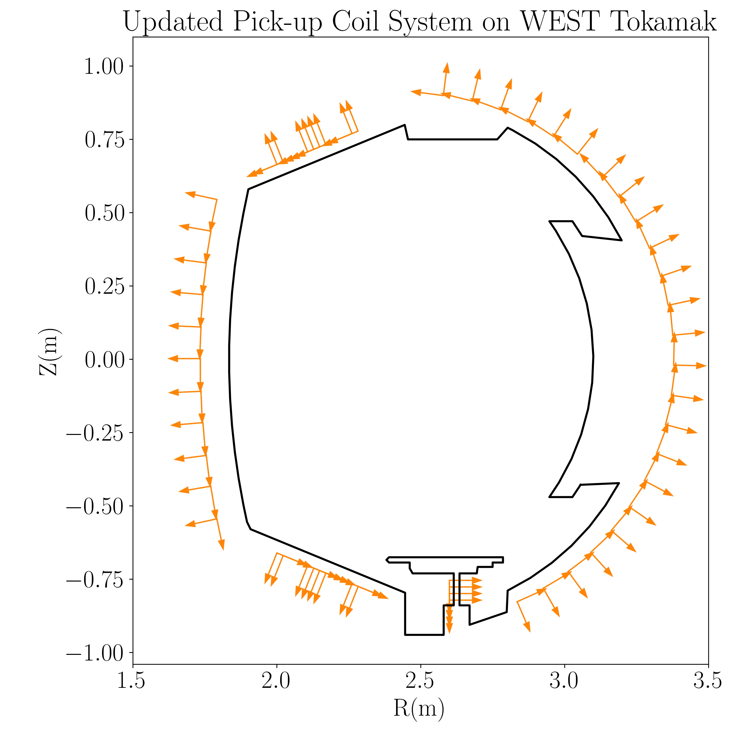
Final Result:
Single EQ Instance
The main removed coils are normal coils.
Only one divertor coils is removed.
When to stop: should be discussed with experts of machine design.
This is only for information reconstruction of the last closed surface, not for other purpose like MHD activities.

Slide 19
Outline
Thermal Nuclear Fusion, Tokamaks and Equilibrium
Bayesian Experimental Design: The Principle
Bayesian Formula Set Up on Pick-up Coils of WEST Tokamak
Result I: Single Coil Drop per Time
Result II: Cumulative Drops
Result III: Toroidal Harmonic Reconstruction
Summary and Conclusion

Slide 20
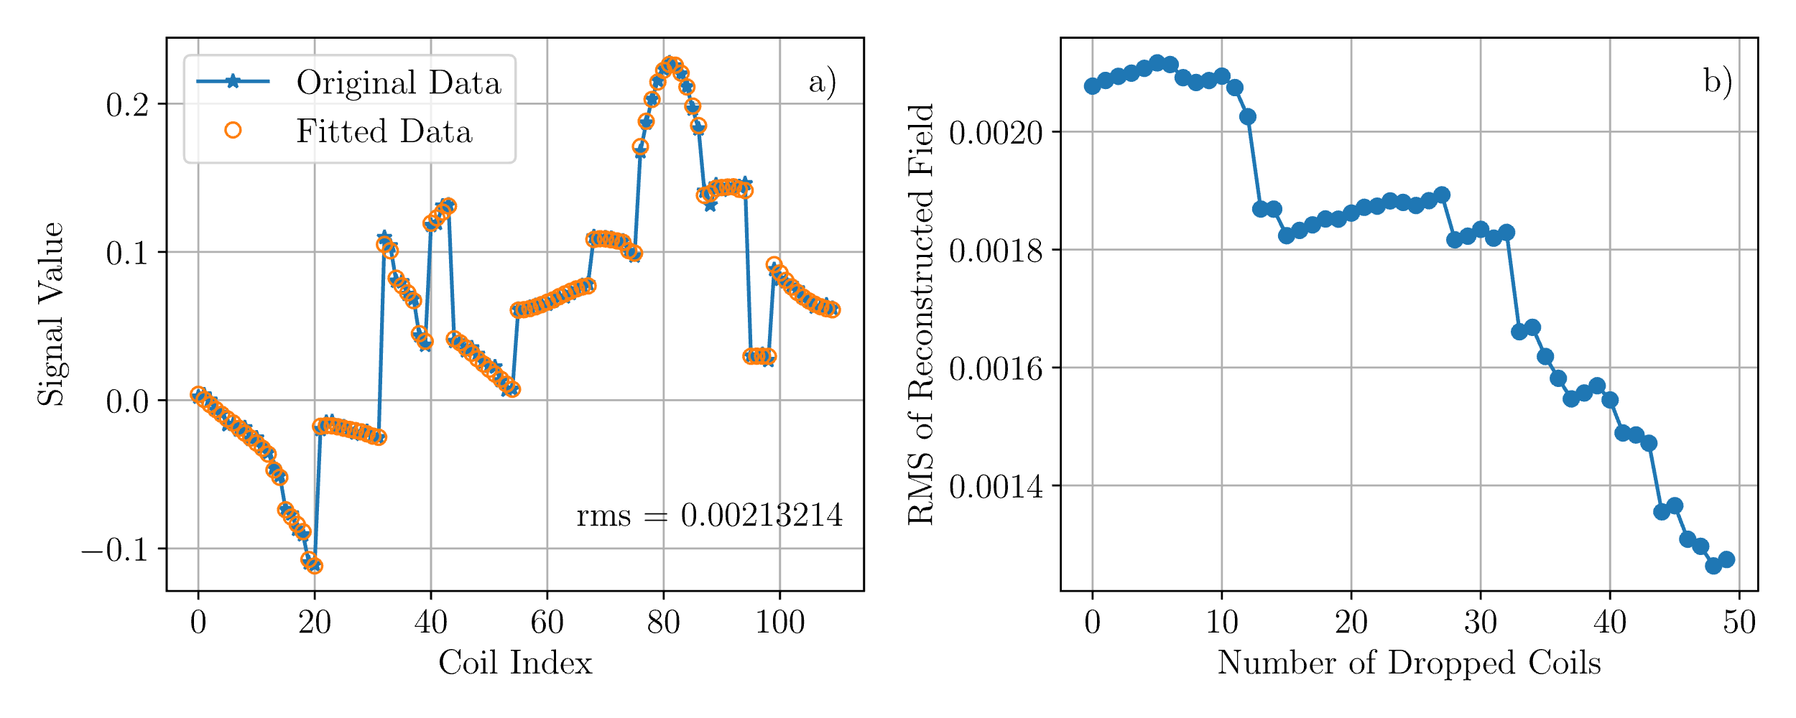
One More Thing: Toroidal Harmonics
The same code as VacTH (used on WEST) has been developed.
The rms (root mean square) is calculated using toroidal harmonics.
The decreasing trend: by removing certain coils, the redundancy and/or collinearity among the coils could be eased.

Slide 21
Outline
Thermal Nuclear Fusion, Tokamaks and Equilibrium
Bayesian Experimental Design: The Principle
Bayesian Formula Set Up on Pick-up Coils of WEST Tokamak
Result I: Single Coil Drop per Time
Result II: Cumulative Drops
Result III: Toroidal Harmonic Reconstruction
*Result IV: Marginalization: Over 20 EQs
Summary and Conclusion

Slide 22
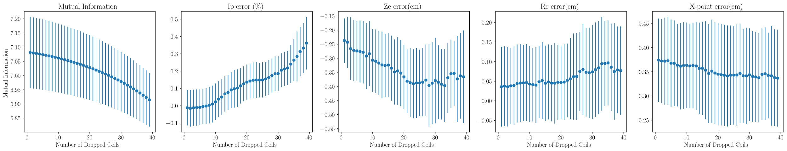
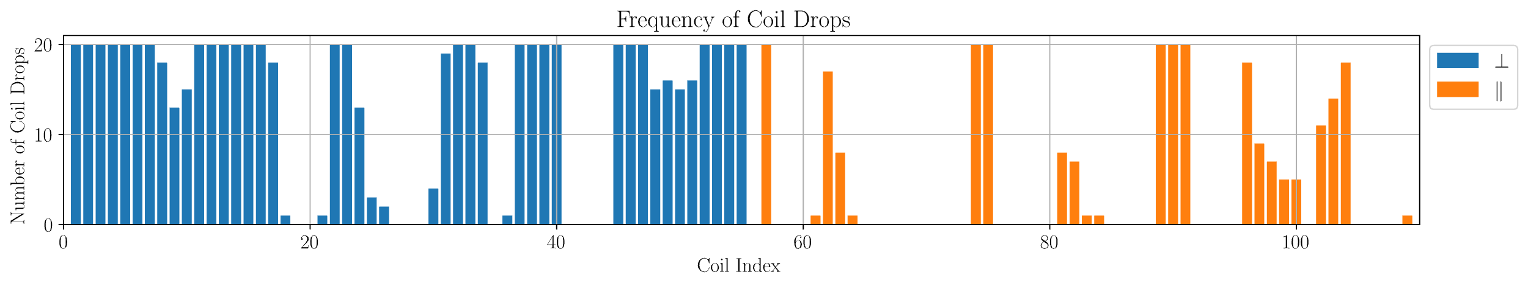
Marginalization over 20 EQs

Slide 23
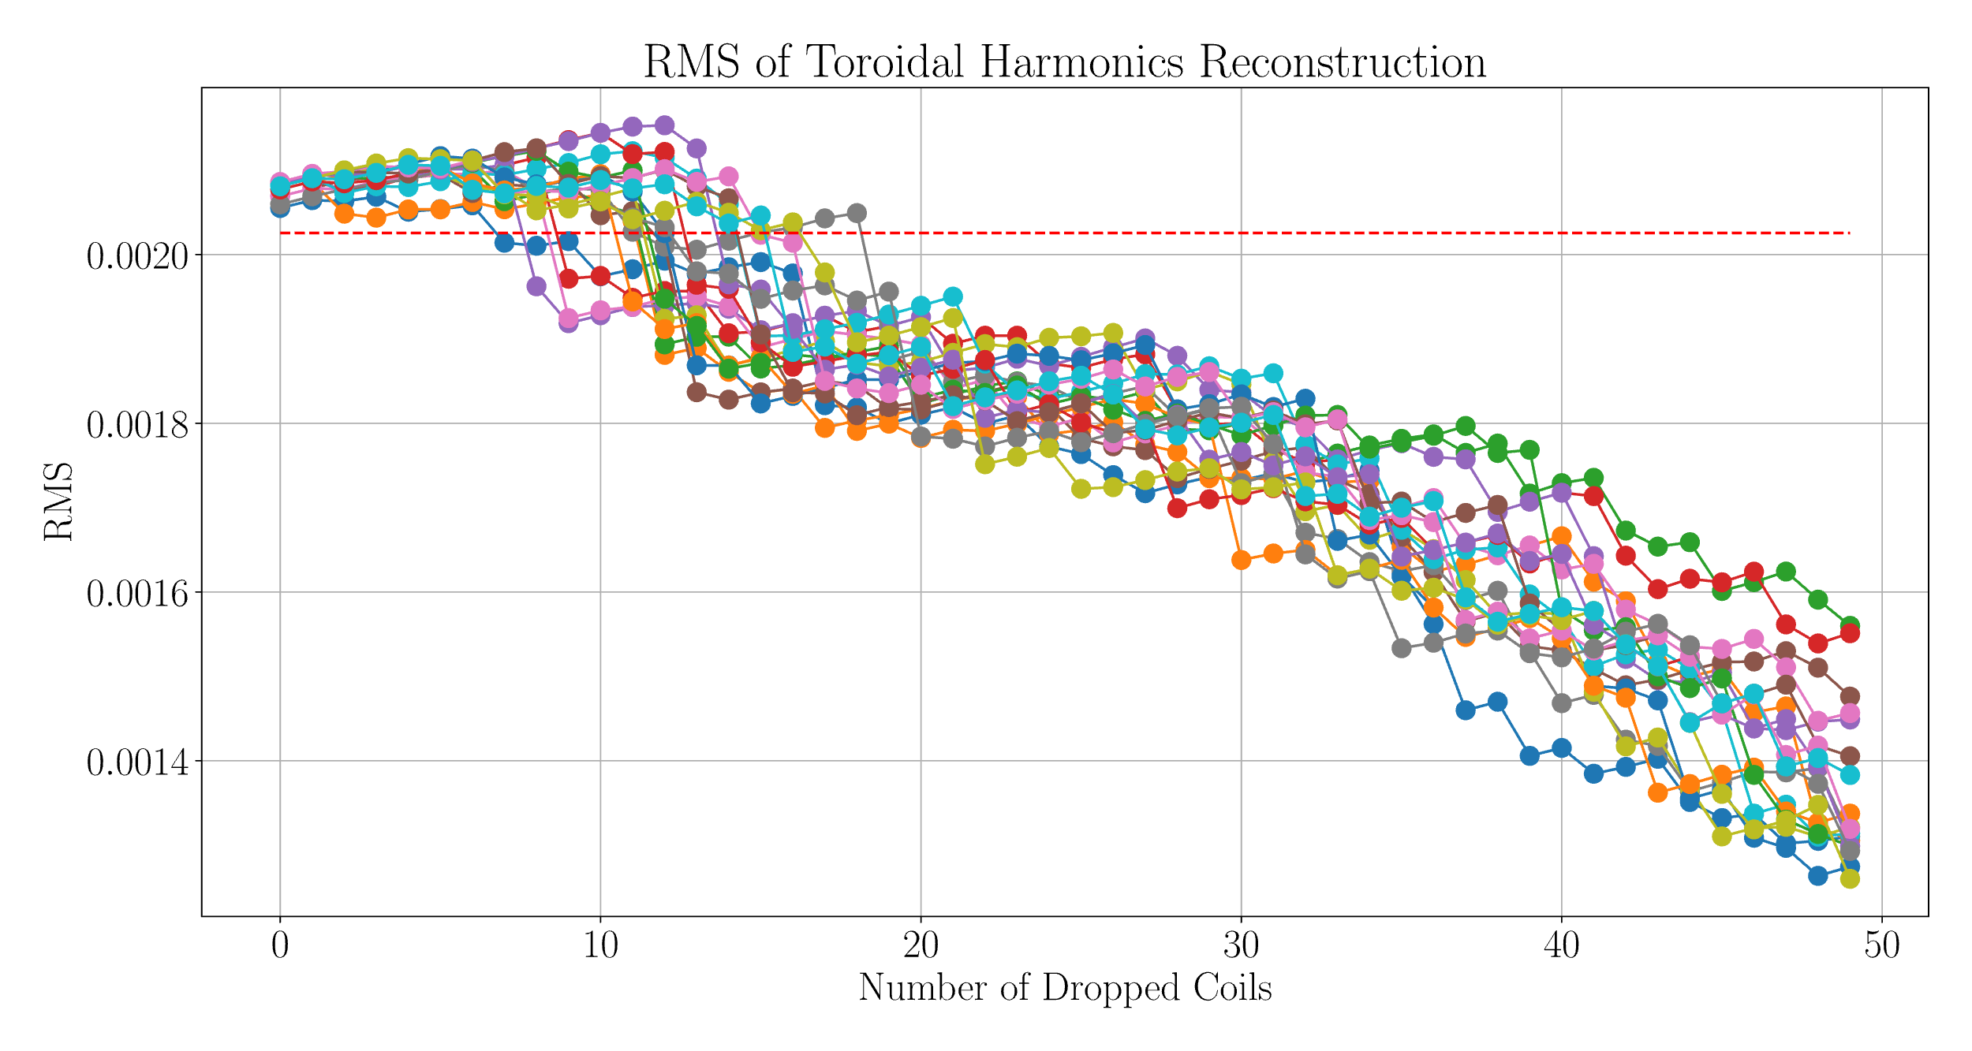
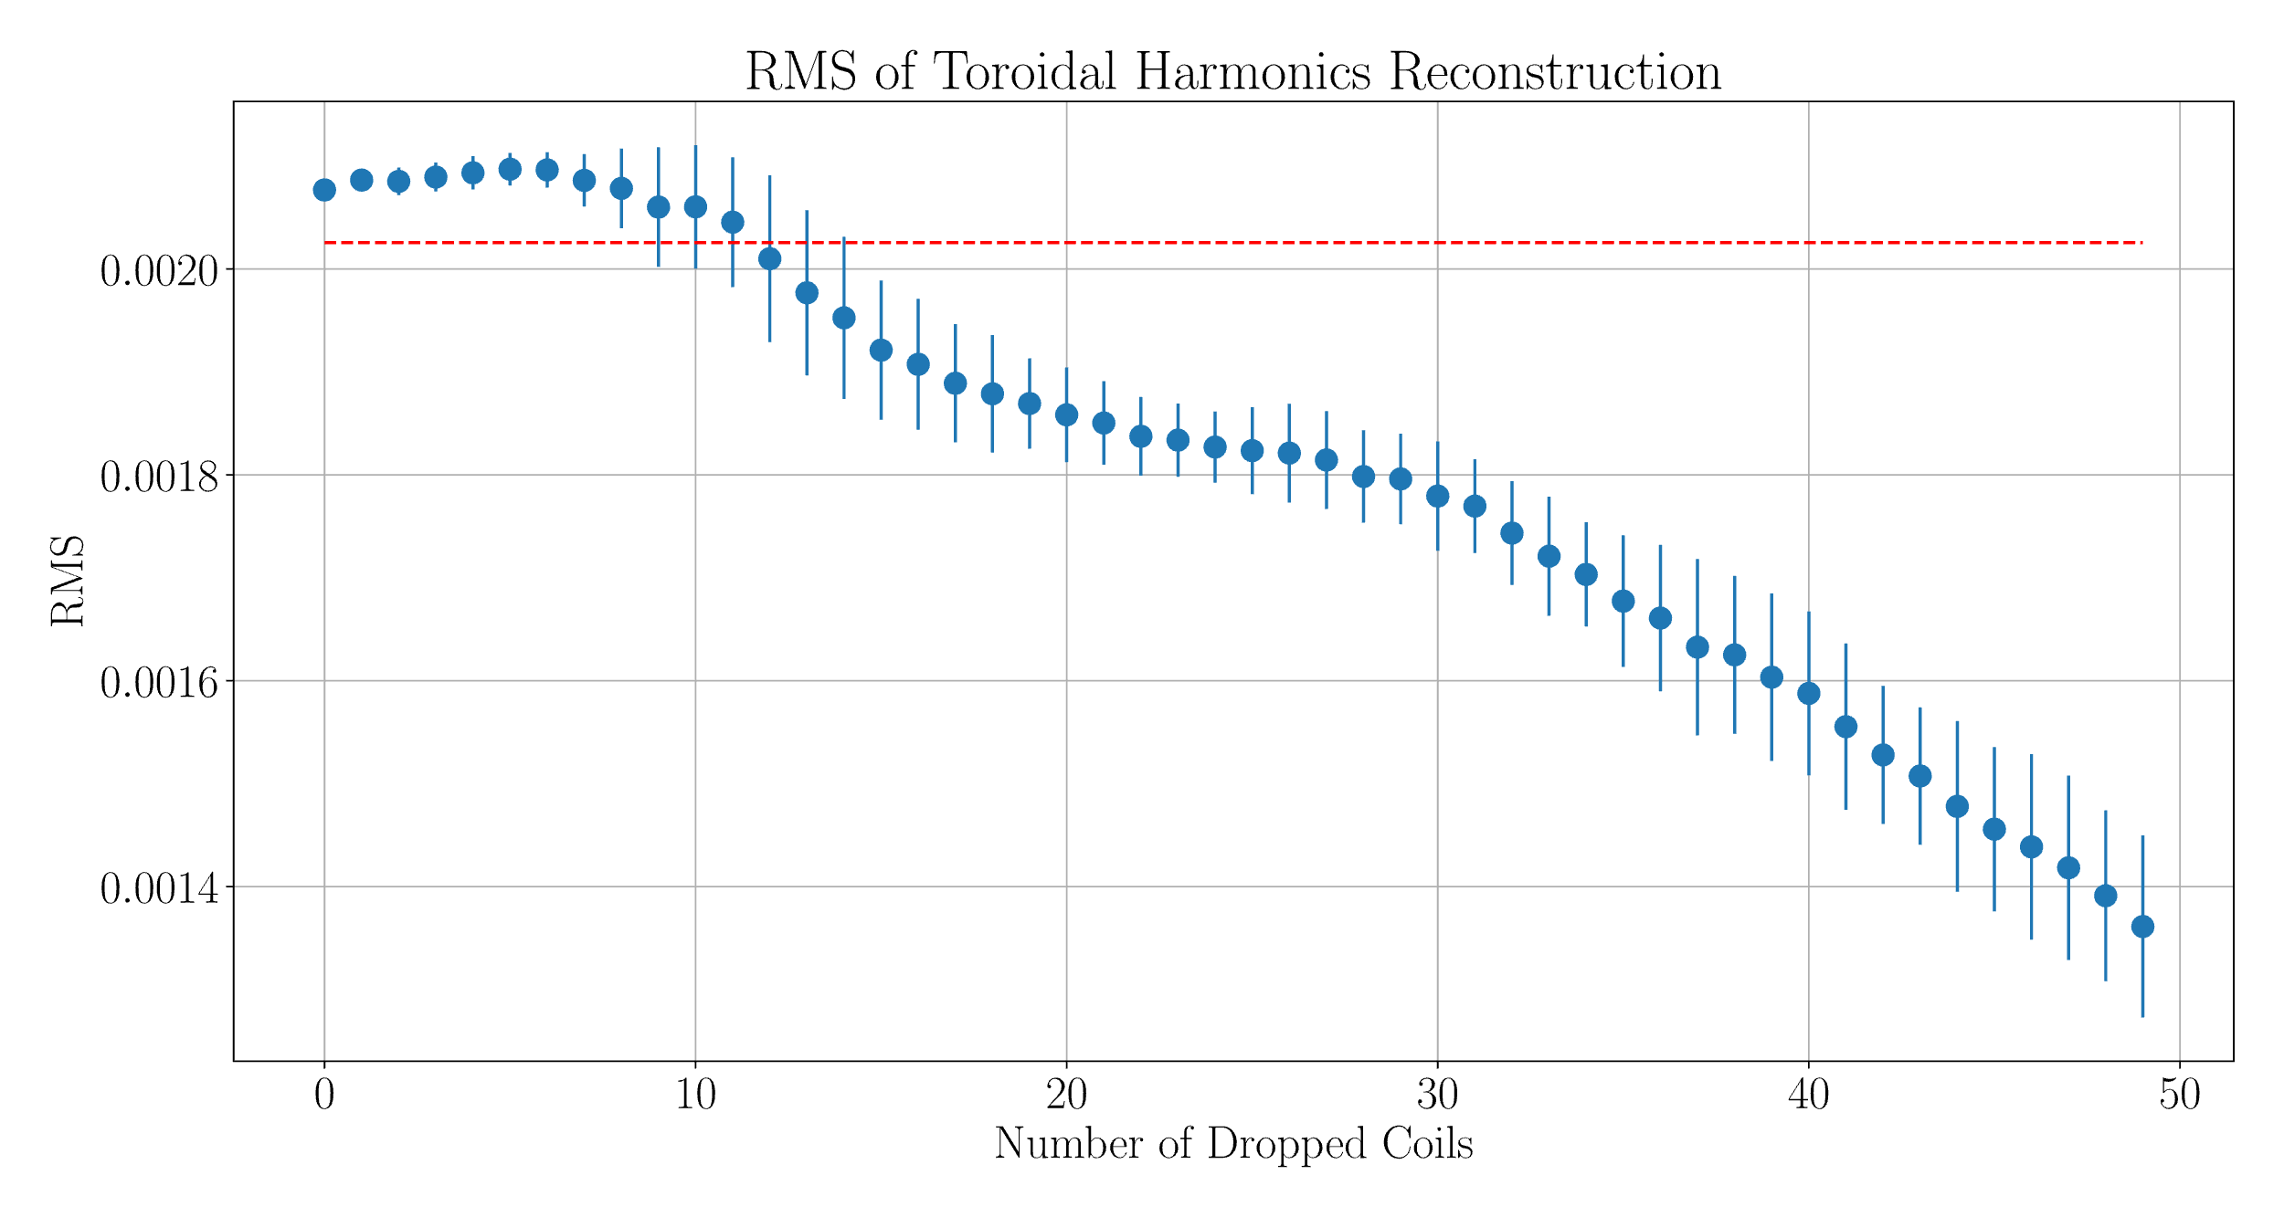
RMS of Toroidal Harmonics Reconstruction over 20 EQs
The decreasing trend remains.
This trend is likely due to redundance reduction (and/or multicollinearity).
The normal coils is likely to have low signal-to-noise ratio (SNR) for the purpose of poloidal field measurements.
Notice the decreasing trend doesn’t necessarily mean the fitting is better.

Slide 24
Outline
Thermal Nuclear Fusion, Tokamaks and Equilibrium
Bayesian Experimental Design: The Principle
Bayesian Formula Set Up on Pick-up Coils of WEST Tokamak
Result I: Single Coil Drop per Time
Result II: Cumulative Drops
Result III: Toroidal Harmonic Reconstruction
Summary and Conclusion

Slide 25
Summary and Conclusion
Bayesian experimental design is a general and powerful tool for system optimization and design. It falls into the general framework of a digital twin system that is growing fast.
Significant amount of pick-up coils are removed while the accuracy remains at low level; the decreasing trend of rms from THs also indicate possible redundance that could be addressed by machine experts.
Notice this is not equilibrium reconstruction which is the next step work: a semi-free boundary, 3D equilibrium solver that is under the framework of Bayesian probability theory.

Slide 27
Back Up Slides

Slide 28
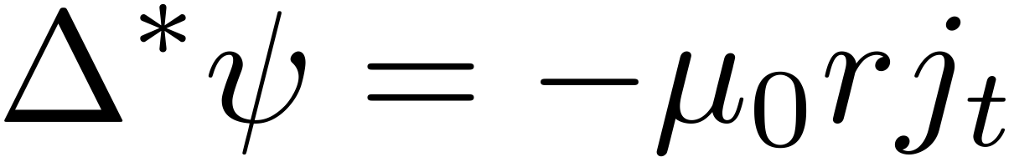
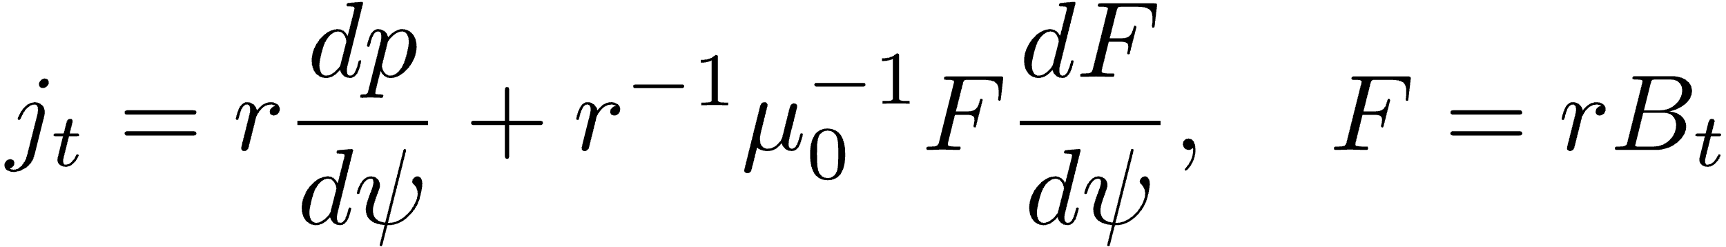
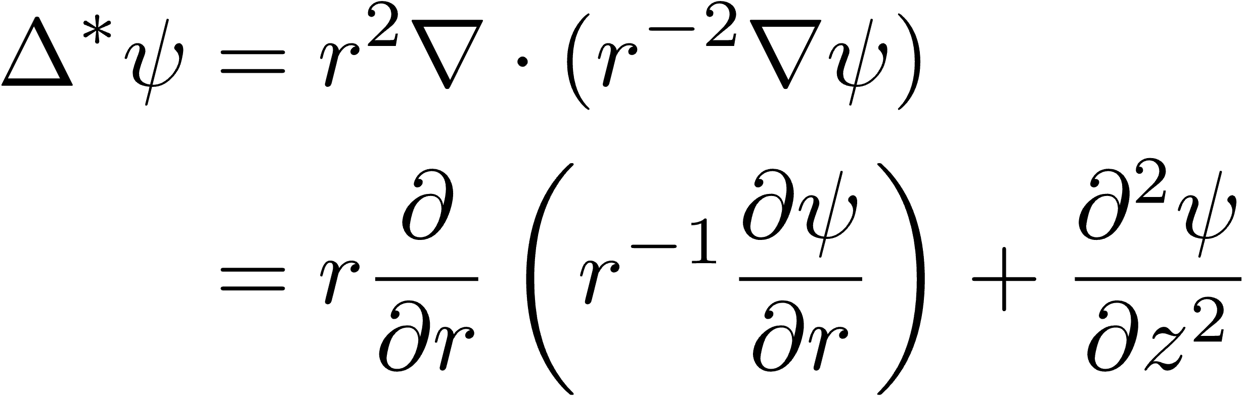
Grad-Shafranov Equation

Slide 29
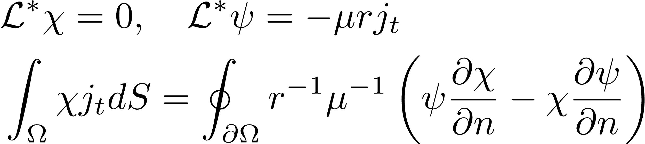
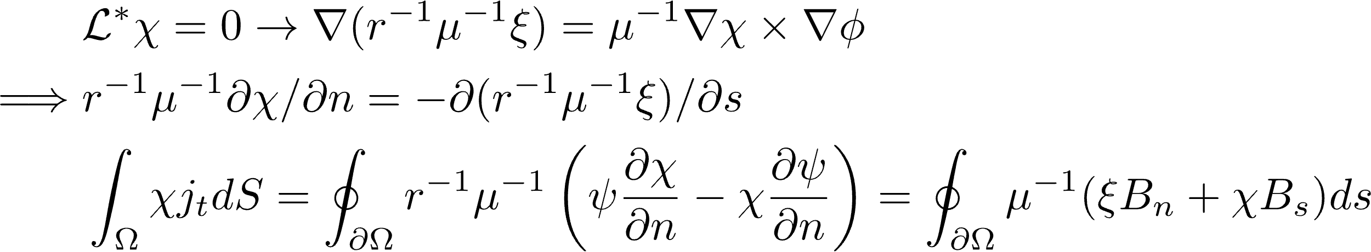
For arbitrary function $\text{χ}$, its conjugate function $\text{ξ}$ , one can evaluate the moment of the toroidal current by measuring the magnetic field B = (B_{n} ,B_{s}) along the boundary of the plasma:

Slide 30
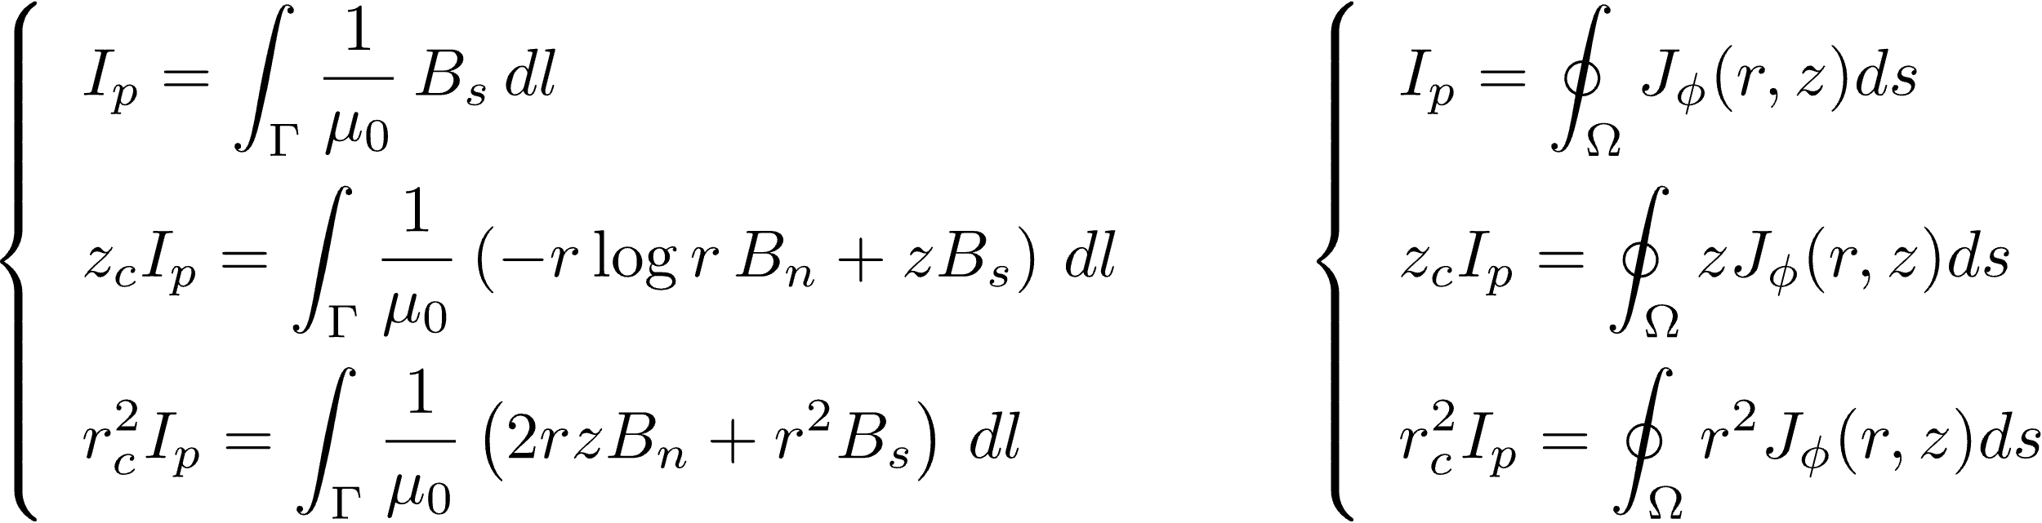
Important quantities: Ip, Rc, Zc, X-point
For the quantities of interest, the original definition (below, right) is used to check the accuracy.
Using coil information
Green’s second identity
Original definition

Slide 31
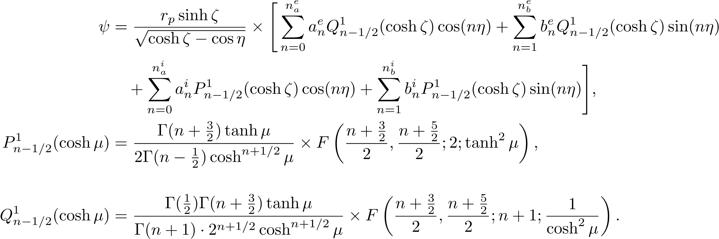
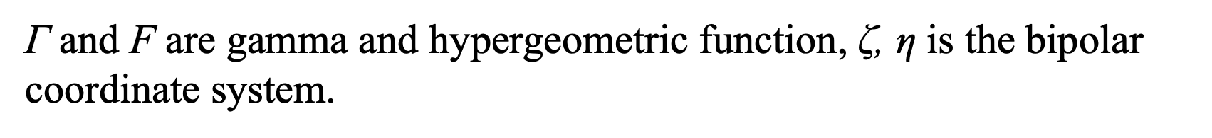
Poloidal Flux in Vacuum Expressed with Toroidal Harmonics with Toroidal Symmetry:
Analytical Solution of the Laplace Equation in Vacuum
$\text{Γ}$ and $\text{F}$ are gamma and hypergeometric function, $\text{ζ}\text{, }\text{η}$ is the bipolar coordinate system.

Slide 32
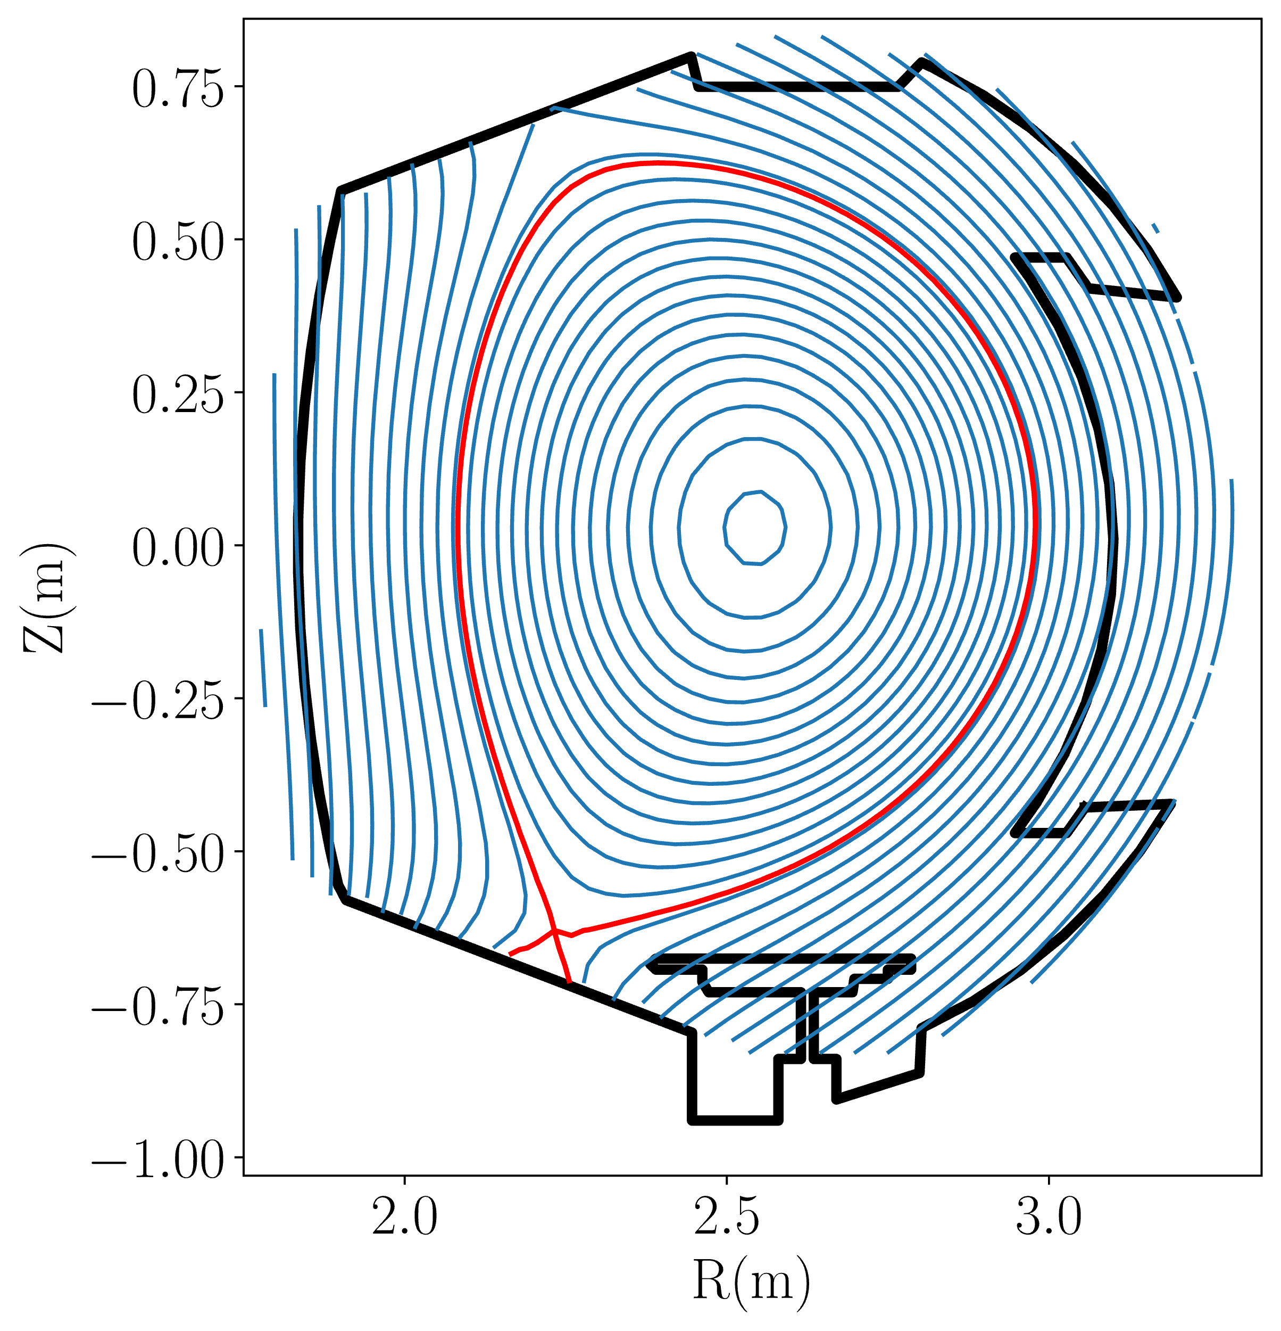
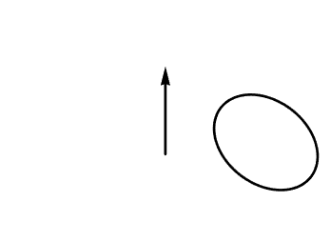
Nuclear Fusion, Tokamaks and Equilibrium
Tokamak is the leading configuration in magnetically confined nuclear fusion design, followed by stellarators (2ed), and the rest.
Axisymmetry and ideal MHD: nested flux surfaces, leading to good radial confinement.
Steady-state operation: plasma in equilibrium state and extreme conditions, which requires multiple measurements (diagnostic).
a
R

Slide 33
What are we doing here?
We are pursuing nuclear fusion energy, clean, safe, reliable, sustainable energy.
We, besides inertial people, are fan of magnetically confined approach.
Tokamaks (leading candidate), stellarators (2^{ed} candidate) and the rest (the large amount of 3rd candidates)
So we want to build a machine(product) that could fulfill our expectations.
The design is crucial for fusion community, simply because it’s too expensive.
So we want to find the optimal solution of a machine for high fidelity, reliable operation and low cost.

Slide 34
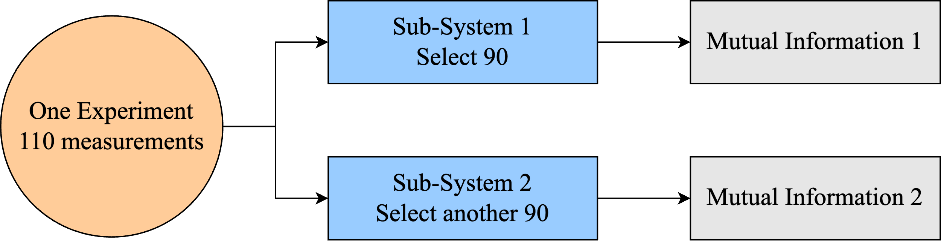
Mutual Information (MI)
MI1>MI2: sub-system 1 is better, for the Selected 90 coils
Mutual Information: quantifies the information of a system given the prior and data.
Altering the system leads to the change of the MI.
MI compare: for the same prior and two sub-set of data: the higher, the better.

