Slide 1
Initial Development of Web Interface and User Access Control of IMAS Databases
Xiang LIU (刘祥)^{1,*}, Yang ZHANG¹, Haiqing LIU¹
¹ Institute of plasma physics, Chinese Academy of Sciences, Hefei 230031 * E-mail: xliu@ipp.ac.cn
Sixth Technical Meeting on Fusion Data Processing, Validation and Analysis, Shanghai, 9.9-9.12, 2025

Slide 2
Outlines
01 Introductions
02 Architecture and implementations
03 Performance test
04 Future development
05 Summaries

Slide 3
Introduction to the Integrated Modelling & Analysis Suite (IMAS)
Why develop IMAS?
  Provide a unified framework to support ITER plasma operation and research.
What is IMAS?
  Protocol Layer: Data Dictionary (DD), including >80 engineering, physical and diagnostic Interface Data Structure (IDS).
  Low-level Layer: MDSplus, HDF5, ASCII, and Memory as database backends.
  Access Layer (AL): Python, C++, Fortran, Java, MATLAB.
How IMAS works?
Code A
(Fortran)
Code A
(Fortran)
Code B
(C++)
IMAS
Code D
(Python)
IMAS
Code A
(Fortran)
IMAS
Code B
(C++)
IMAS
Code C
(Python)
Code C
(Java)
Code B
(C++)
Code C
(Java)

Slide 4
Motivation
Synthetic Diagnostic Platform (SDP)
  Mission: diagnostic design, physical quantities measurements, data analysis and visualization.
  Key resources: diagnostic data -> plasma physical quantities.
  Roles: developers (data contributors), users (data consumers), administrators.
  Architecture: High-performance computers -> developing environments -> data processing codes & applications.
  IMAS is selected as the core infrastructure
SDP Requirements
   A unified interface to couple codes with different programming language (Server)
   Flexible tools to manage database (Server)
   Web interface to share data (Clients)
   Access control to secure data

Slide 5
Architecture
Web server
  Flask web framework
    Backend: Jinja2, Flask-SQLAlchemy
    Frontend: Bootstrap5
    MVC design pattern
  Account
    Flask-Security
    Account registration
  User access control
    Data request (user/dev)
    Data review/nominate (dev)
  IMAS web interface
    Serialization: orjson
    RESTful API
Client
  Client API
Client
Web
Apps
SDP
Apps
Review
Client
API
Deserialization
Request
RESTful API
IMAS
UAC
IMAS
Web
Nominate
Serialization
Review
Account
IMAS AL
Register
Flask
Data
Server

Slide 6
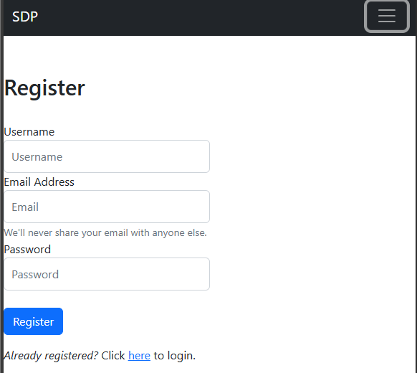
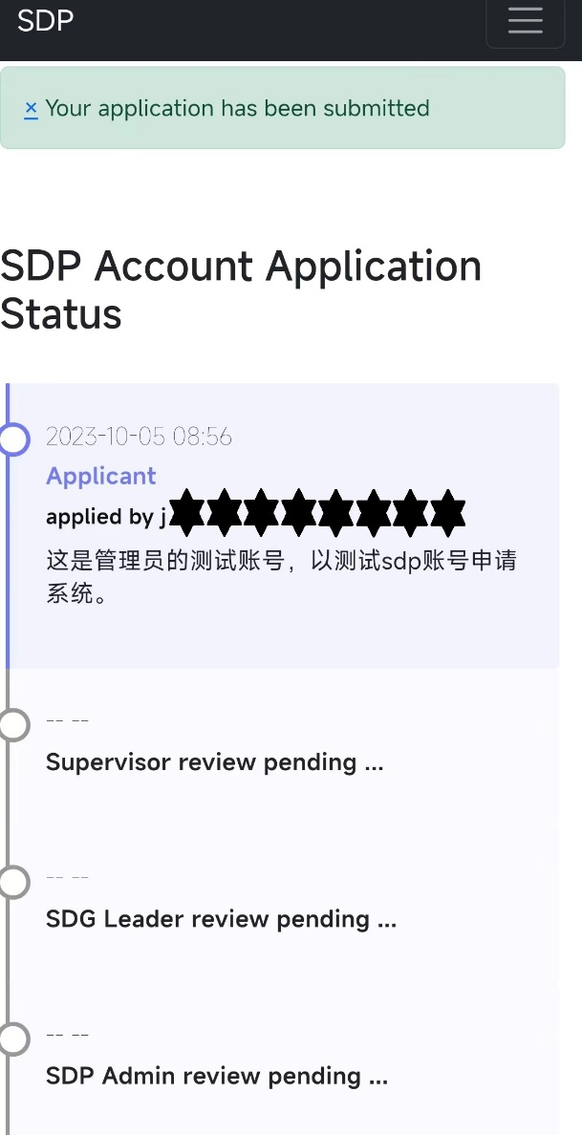
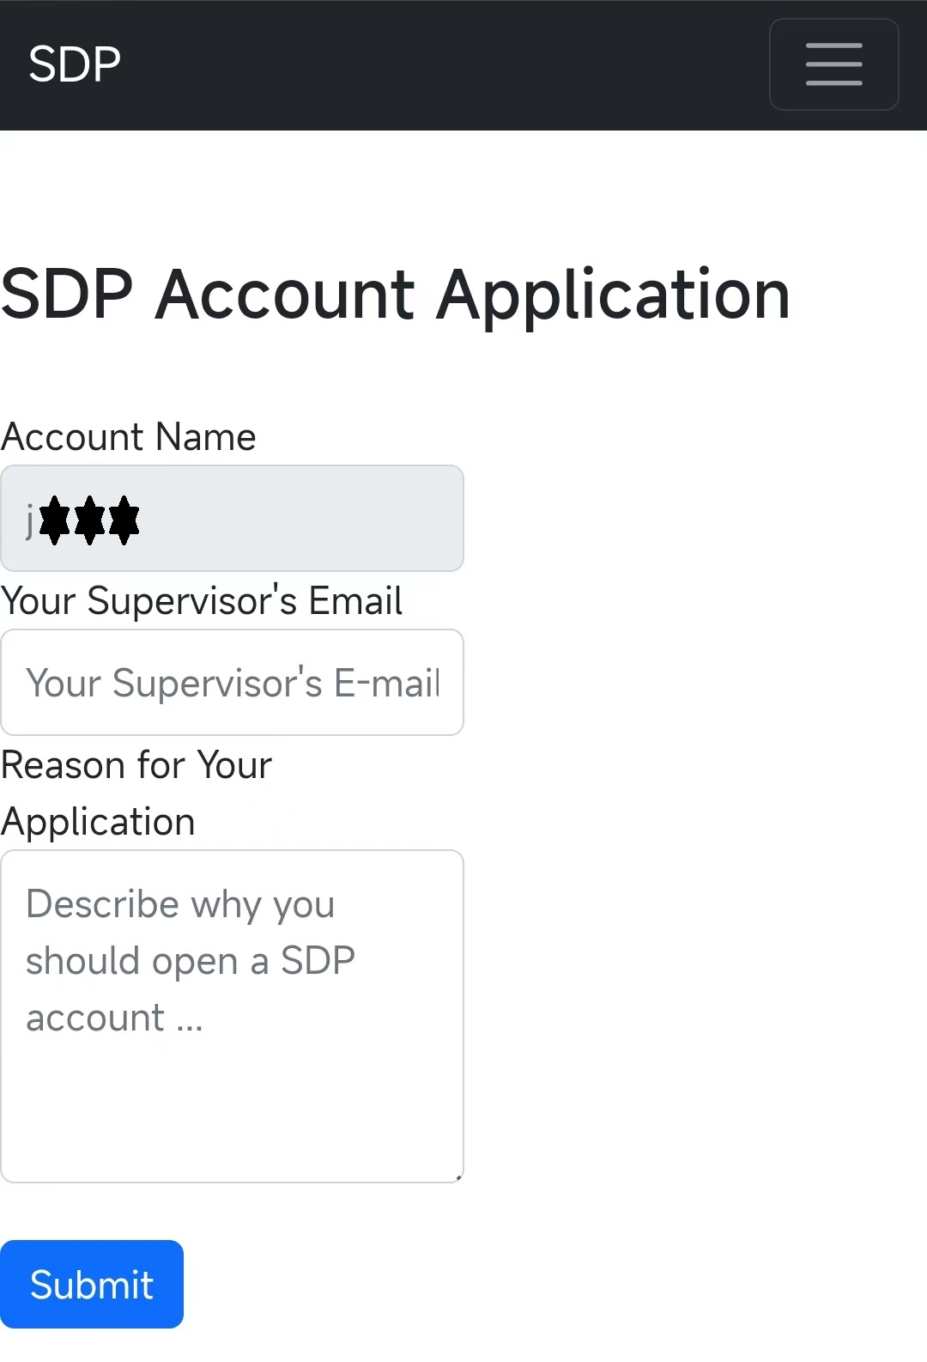
Implementation: account module
SDP Website Account
  Using Flask-Security
  Registration
  Multiple login methods
  Role-based permission control
SDP Account
  Submit application
    One can claim to be developer
  Reviewed by group and department leaders
  Creation (confirmed by admin)
    Linux username same as website account
    Website role ←→ Linux Group

Slide 7
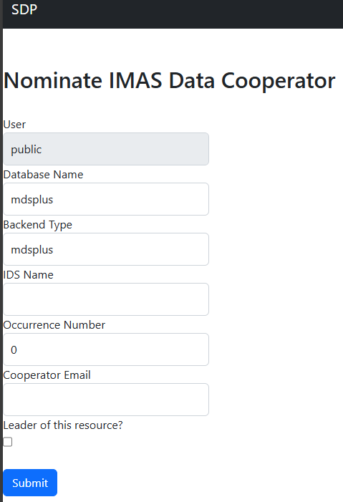
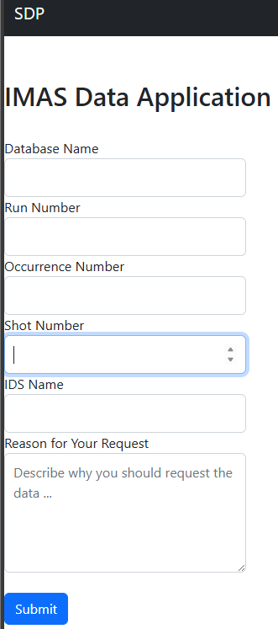
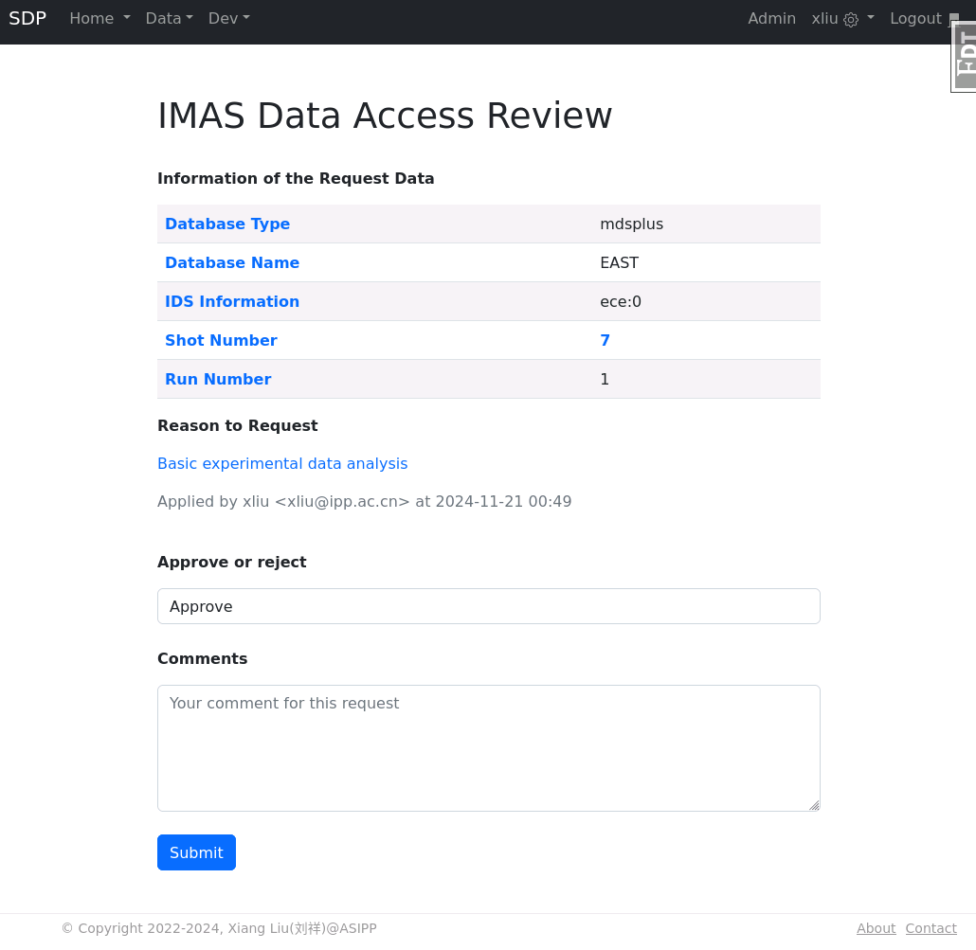
Implementation: user access control
Protected data
  Asset: database + idsname + occurrence
  Resource: asset + shotno + runno
Roles (different access permission)
  Admin
    Nominate a dev as asset owner
  Dev
    Nominate a dev/user as asset co-reviewer
    Review user’s data access application
  User
    Request resource before accessing
Models (SQL Table)
  IMASOwner (Nominate)
  IMASAccess (Request & Review)

Slide 8
Implementation: web interface
IMAS DD
IMASDB class
  Wrapper of IMAS python AL
IMASSchema class
  IMAS DD (IDSDef.xml) parsing
  Marshmallow Schema generation
IMASResponse class
  IMAS Resource validation
  Access permission check
  Resource data loading (call IMASDB)
  Data serialization (call generated schema)
  Resource access counting
IMASData Class (Flask-RESTful)
  GET: CSRF Token generation
  POST: respond request (call IMASResponse)
IMAS AL
IMASSchema
Close
Get Node
IDS Name Check
Open
Get Element
Get
Partial Get
Gen Schema
Is Node
IMASDB
Data availability check
Read Data
IMASResponse
Access Check
Serialization
Resource validation
Access Count
IMASData
Resource Parsing
Respond
GET
CSRF
POST (CSRF, Resource JSON)
Data (JSON)
Web Request (with auth token)

Slide 9
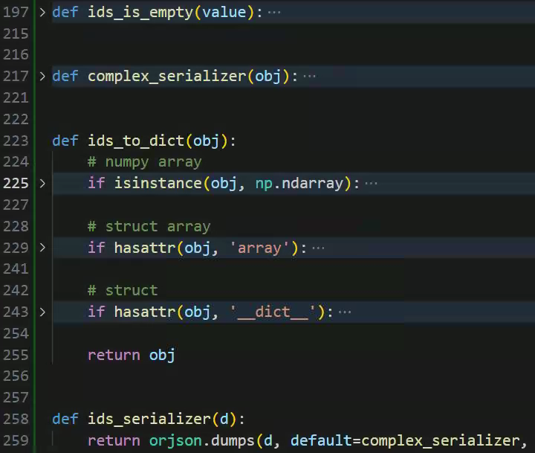
Implementation: serialization
IDS object —> Python Dict
  ids_to_dict
    Recursively change oject to dictionary
  ids_is_empty
    Remove empty value and struct
Python Dict —> JSON
  ids_serializer
    Call orjson.dumps
  complex_serializer
    Convert complex type to list
Marshmallow (deprecated)
  Generate schemas by IMAS DD
Marshmallow Orjson

Slide 10
Implementation: client API
SDPAPI class
  dump: convert IDS to python Dict
  read: call IMASDB to read IDS
WebAPI class
  fetch_csrf_token: update CSRF token in session header for next request
  login: call Flask-security RESTful API to update authentication token in session header
  deserialize: convert retrieved JSON data to python Dict
  read: call RESTful API to read IMAS data
IMASWeb class
  wrapper of SDPAPI and WebAPI
IMASWeb.read
Start
On SDP?
NO
WebAPI.fetch_csrf_token
WebAPI.login
YES
SDPAPI.read
WebAPI.read
WebAPI.fetch_csrf_token
Failed?
WebAPI.deserialize
YES
NO
SDPAPI.dump
End

Slide 11
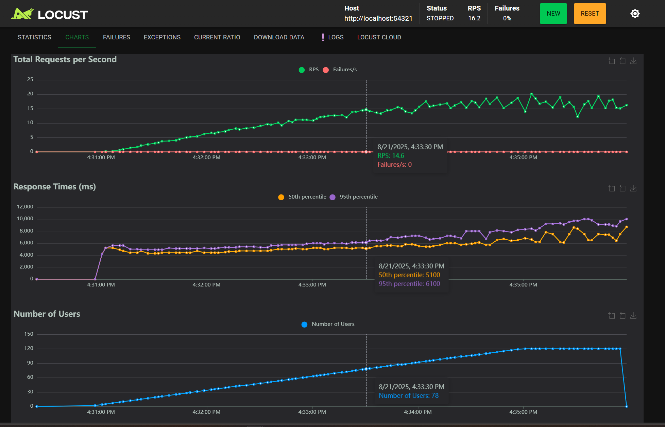
Performance test
Test server
  Almalinux 8.10
  Intel 4210R*2 (20 Cores)
  Memory: 22 GB free
HTTP server
  8 Gunicorn workers
Load test
  LOCUST
  one channel ECE channel signal (16 MB)
  120 users in total
2200 homepage

Slide 12
Future development
Optimize performance
  Caching: JSON
  Caching: memory backend
Simplify usage
  Client API: MATLAB support
  Using aliases instead of long idspath
  Data visualization, data downloading and database status
  Data processing triggering
User feedback
  Data comments
  Data access statistics
General data visualization
Database status
Data downloading and conversion
Data Comments
Access Statistics
UAC Lifetime
RESTful API
Data Processing Triggering
Web
Apps
SDP
Apps
Client
API
IMAS
UAC
IMAS
Web
MATLAB Ver
Aliases
Account
IMAS AL
Flask
Data
Caching
Writing

Slide 13
Summaries
IMAS web interface is developed for easier data access and user access control is used to secure the platform data.
Built on Flask framework, including account, IMAS UAC, IMAS web, and client API components.
Performance test results
  Response time is about 6 seconds for 16MB data.
  8 Gunicorn workers support 78 users.
Future Goals
  Enhance performance via caching
  Add MATLAB client support
  Develop data visualization and download tools.

