Slide 1

First campaign with Alternative Divertor Configurations in ASDEX Upgrade
T.Lunt¹ on behalf of the ASDEX Upgrade and EUROfusion teams
¹Max Planck Institute for Plasma Physics, Boltzmannstr. 2, 85748 Garching, Germany
Outline:
- Introduction
- New upper divertor of ASDEX Upgrade
- Overview experimental campaign 2025
- First results
- Summary

Slide 2
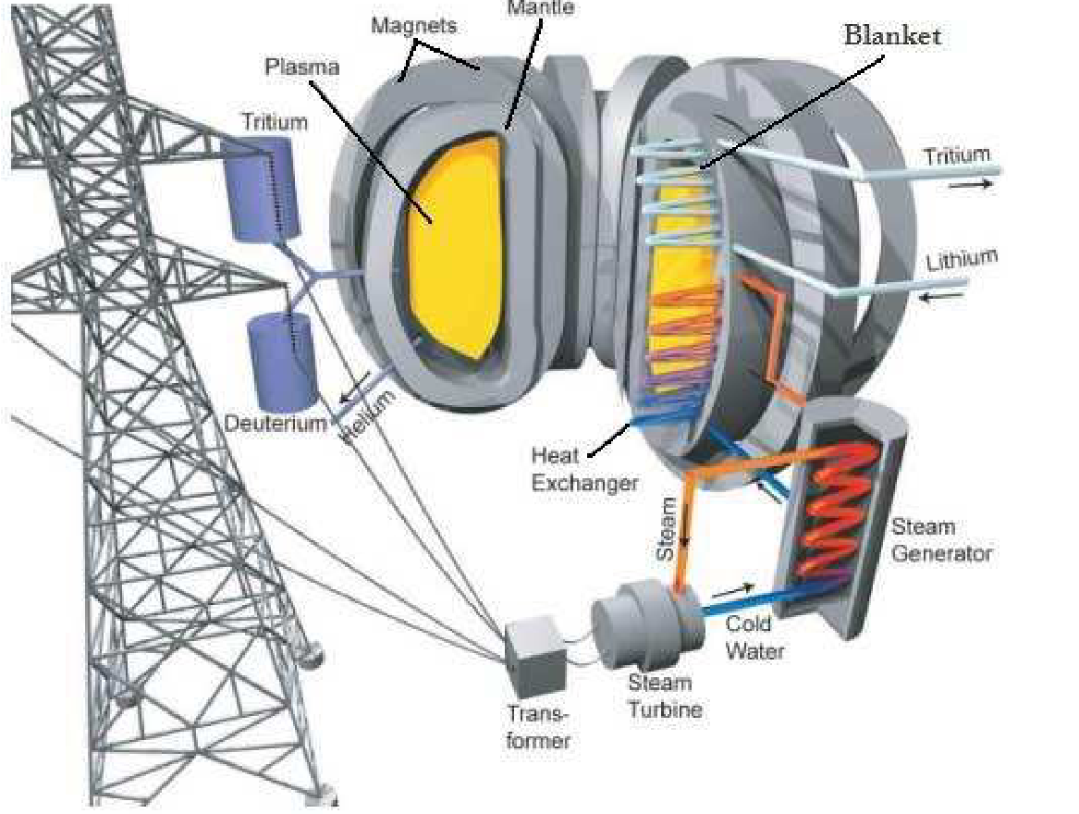
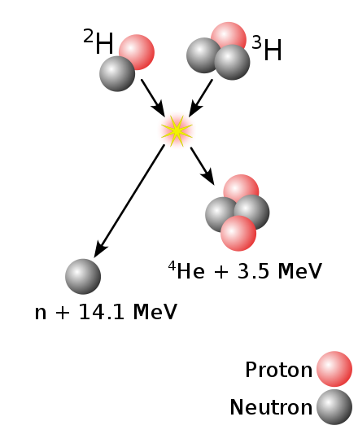
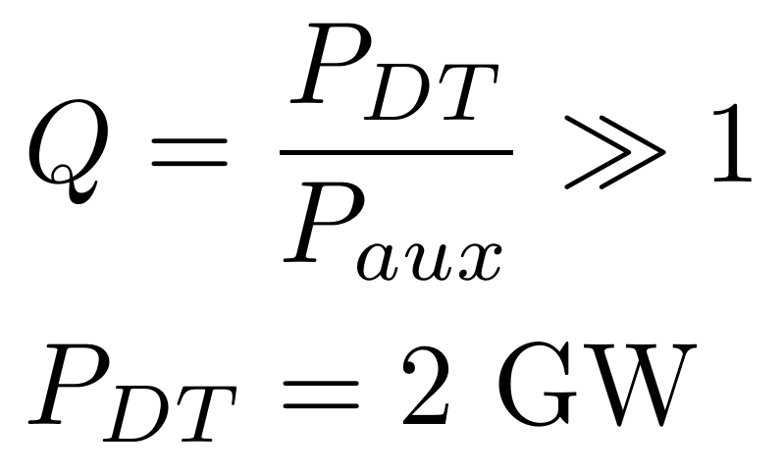
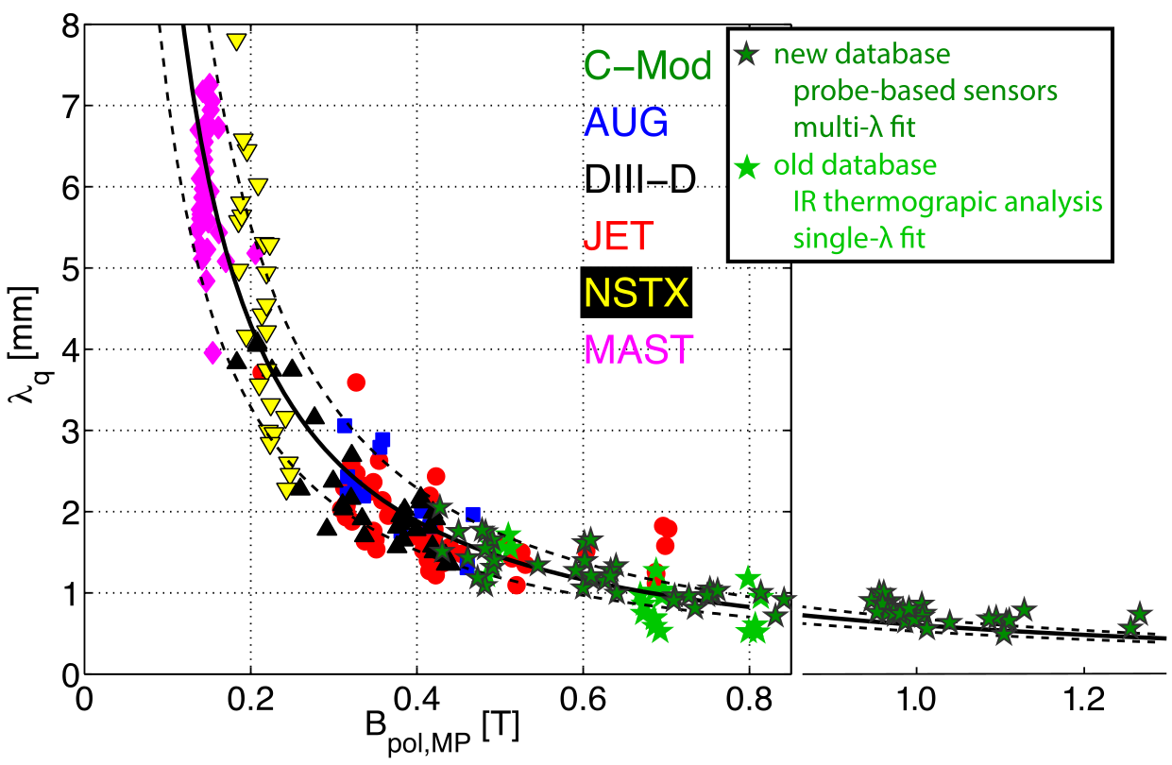
Introduction: Power and He exhaust challenge
P_{α}=400 MW
Φ_{He}= 7x10²⁰ 1/s
+P_{aux}
[Eich PRL 2011]
[Brunner NF 2018]
Φ_{He} = S_{pump} n_{He,pump}
High neutral He densities (pressures) in subdivertor volume mandatory for reactor to remove He ‚ash‘
A_{wet}=2 π R f_{x} λ_{q}
T.Lunt, IAEA-FEC 2025 Chengdu, China
2

Slide 3
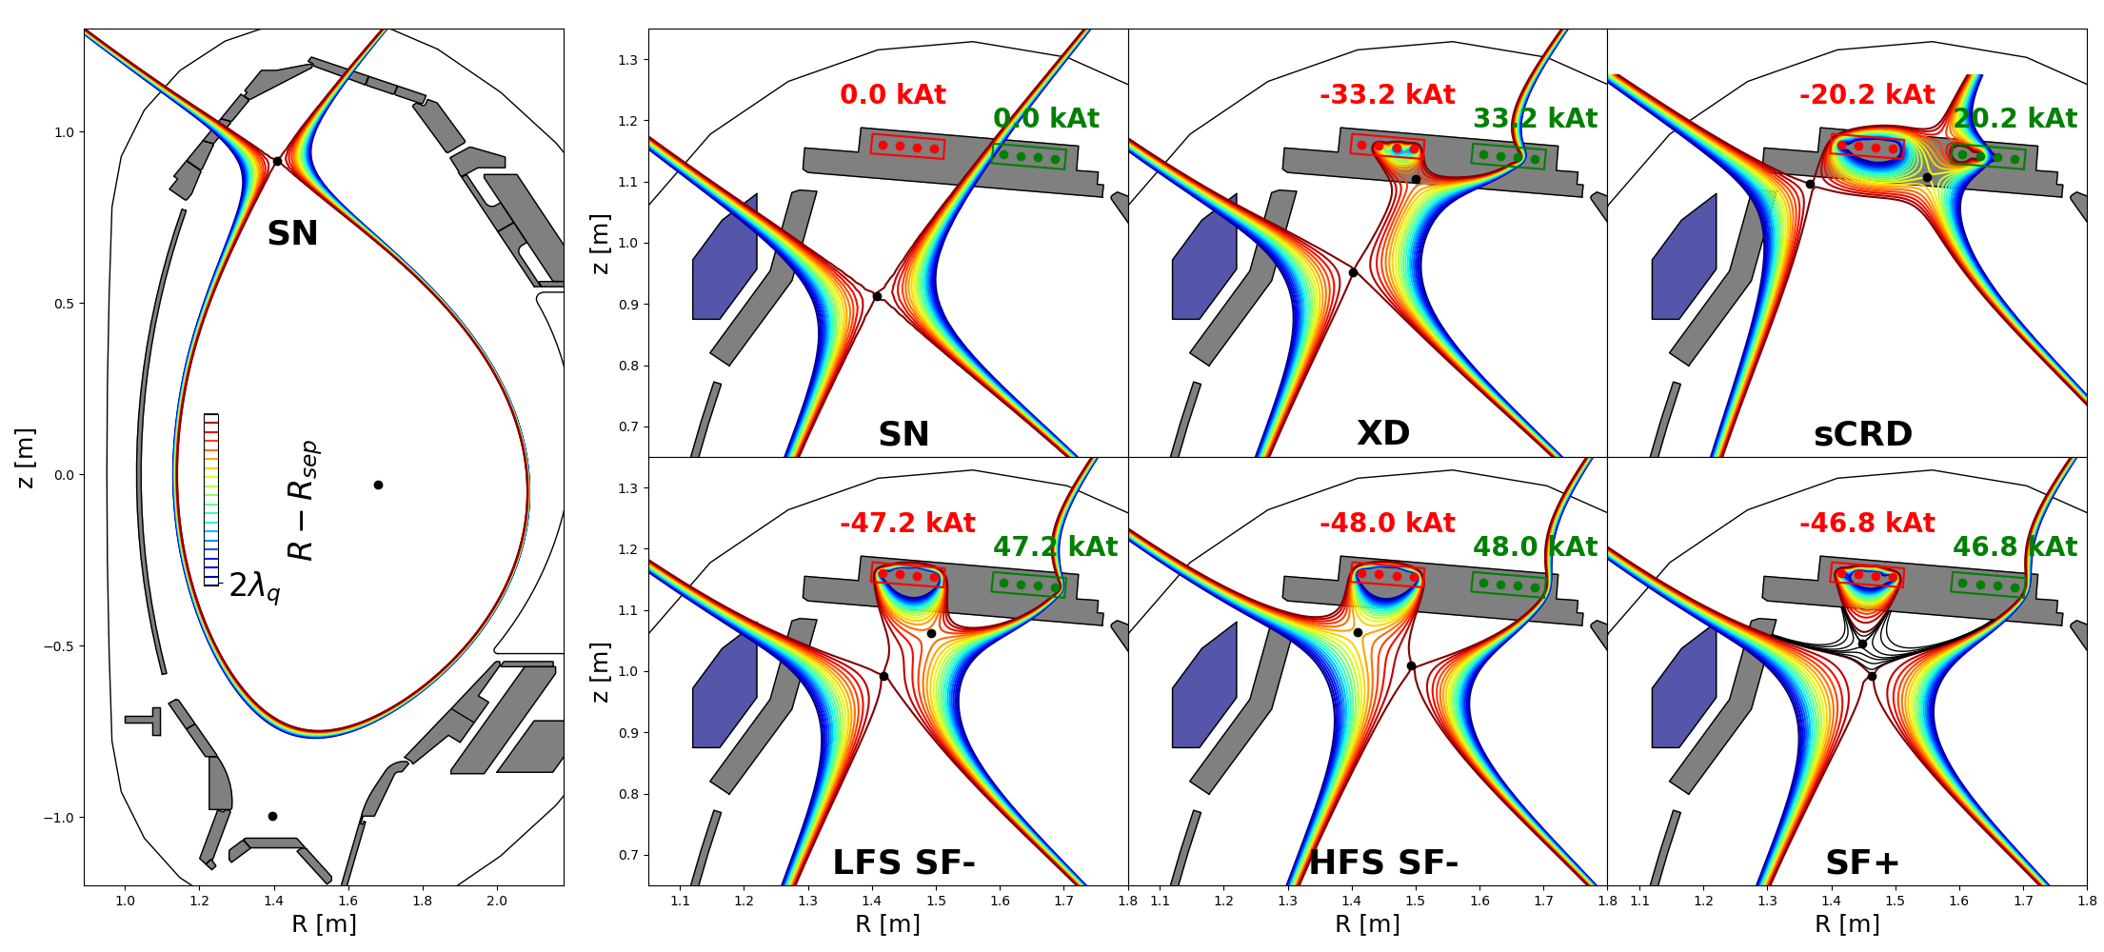
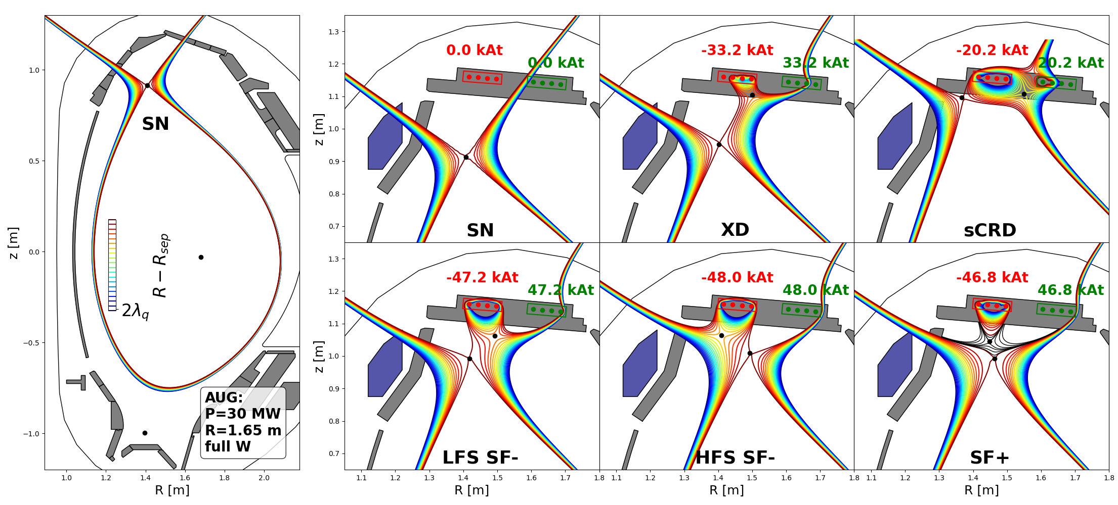
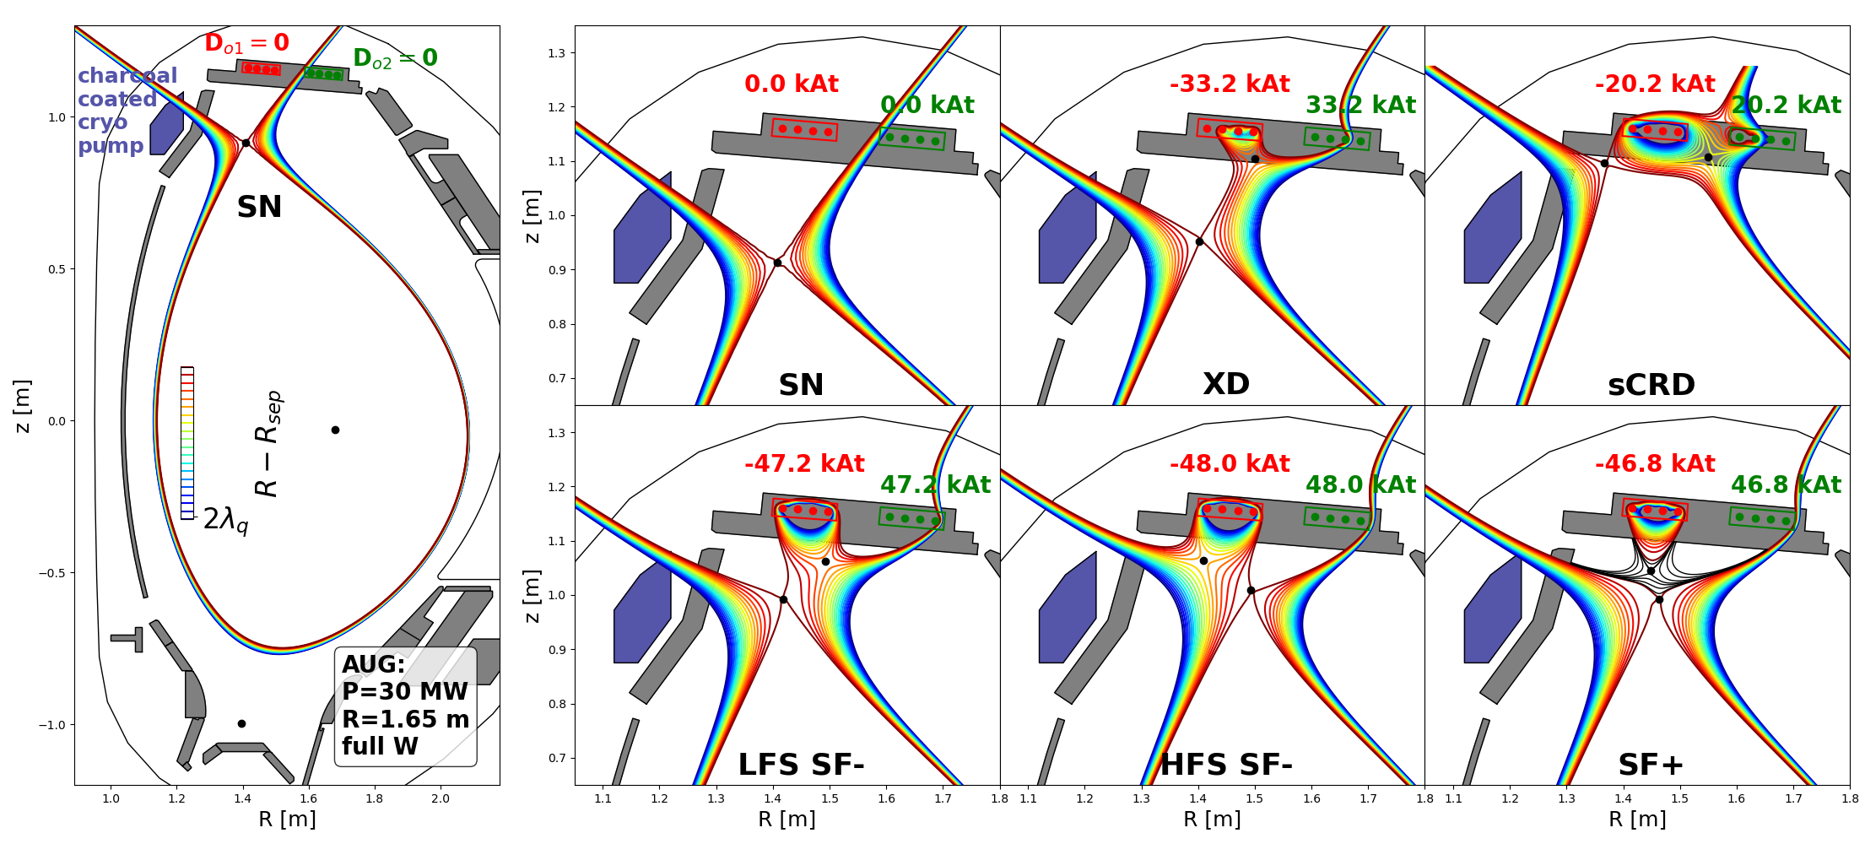
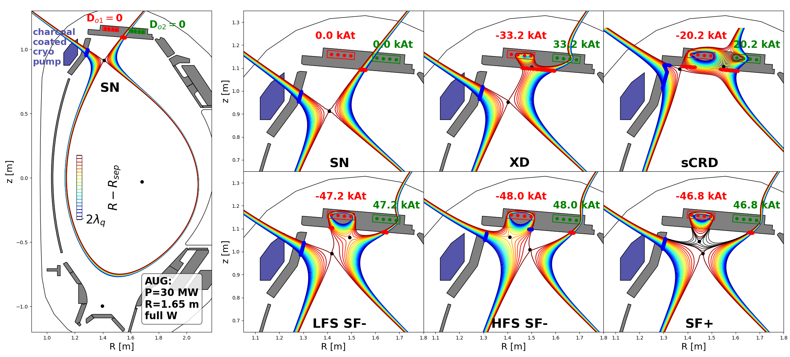
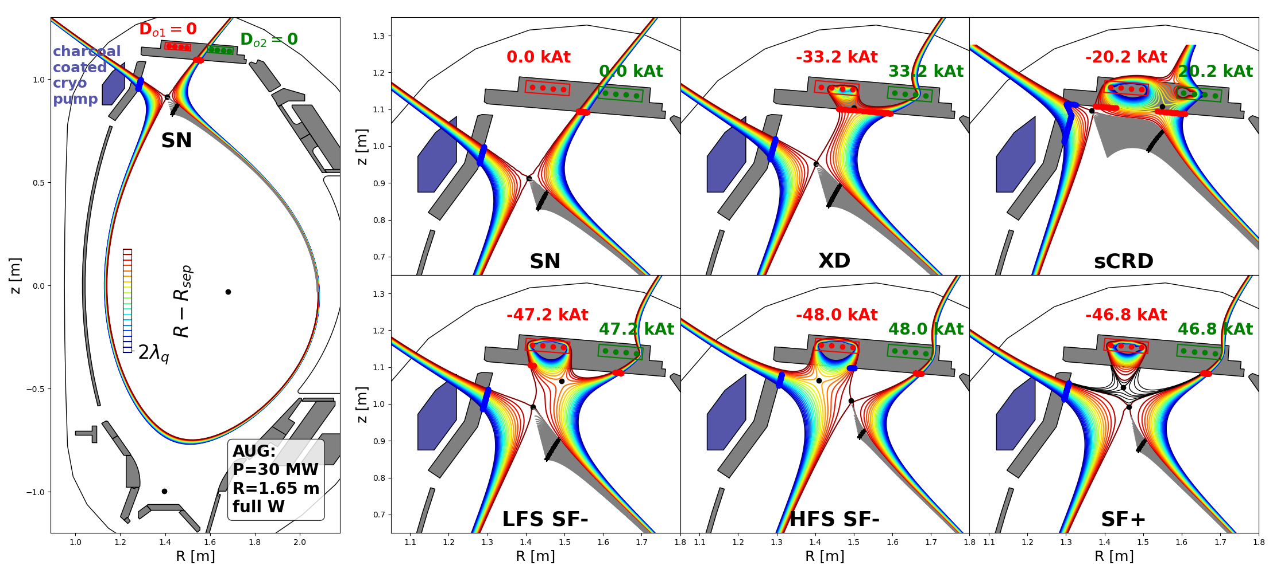
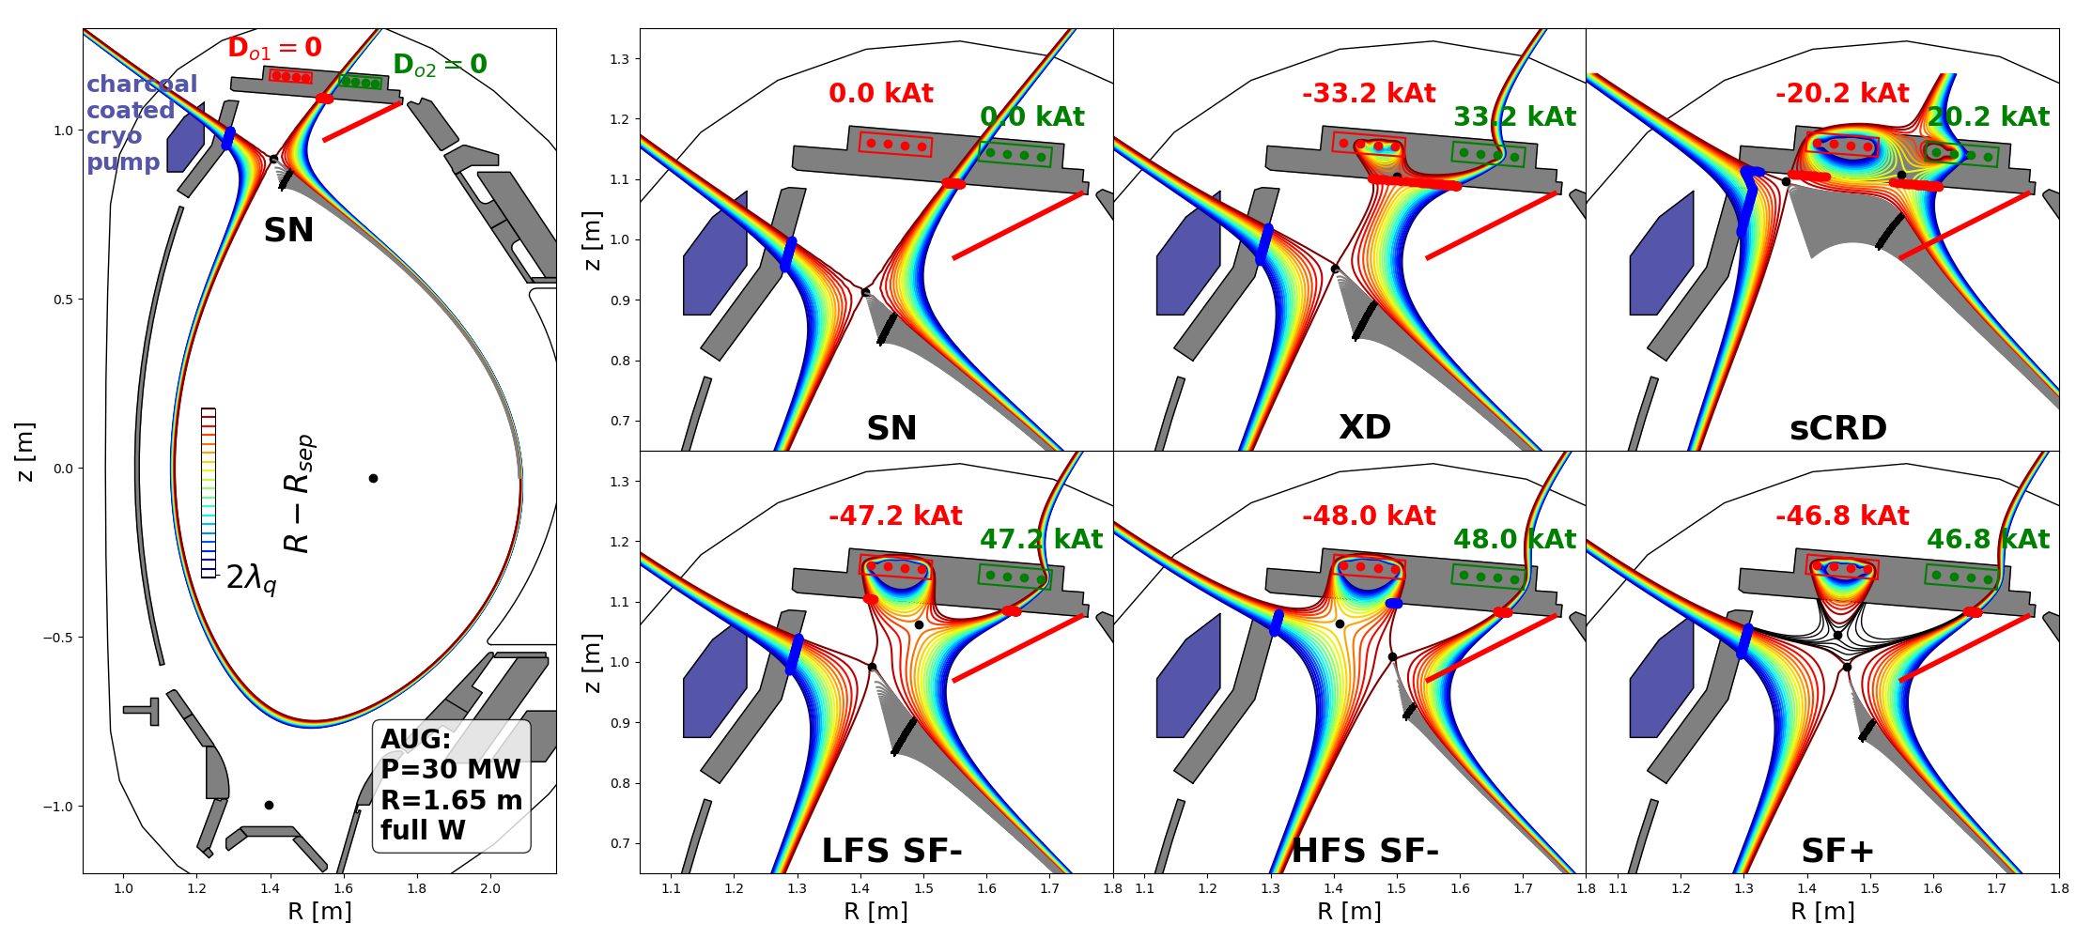
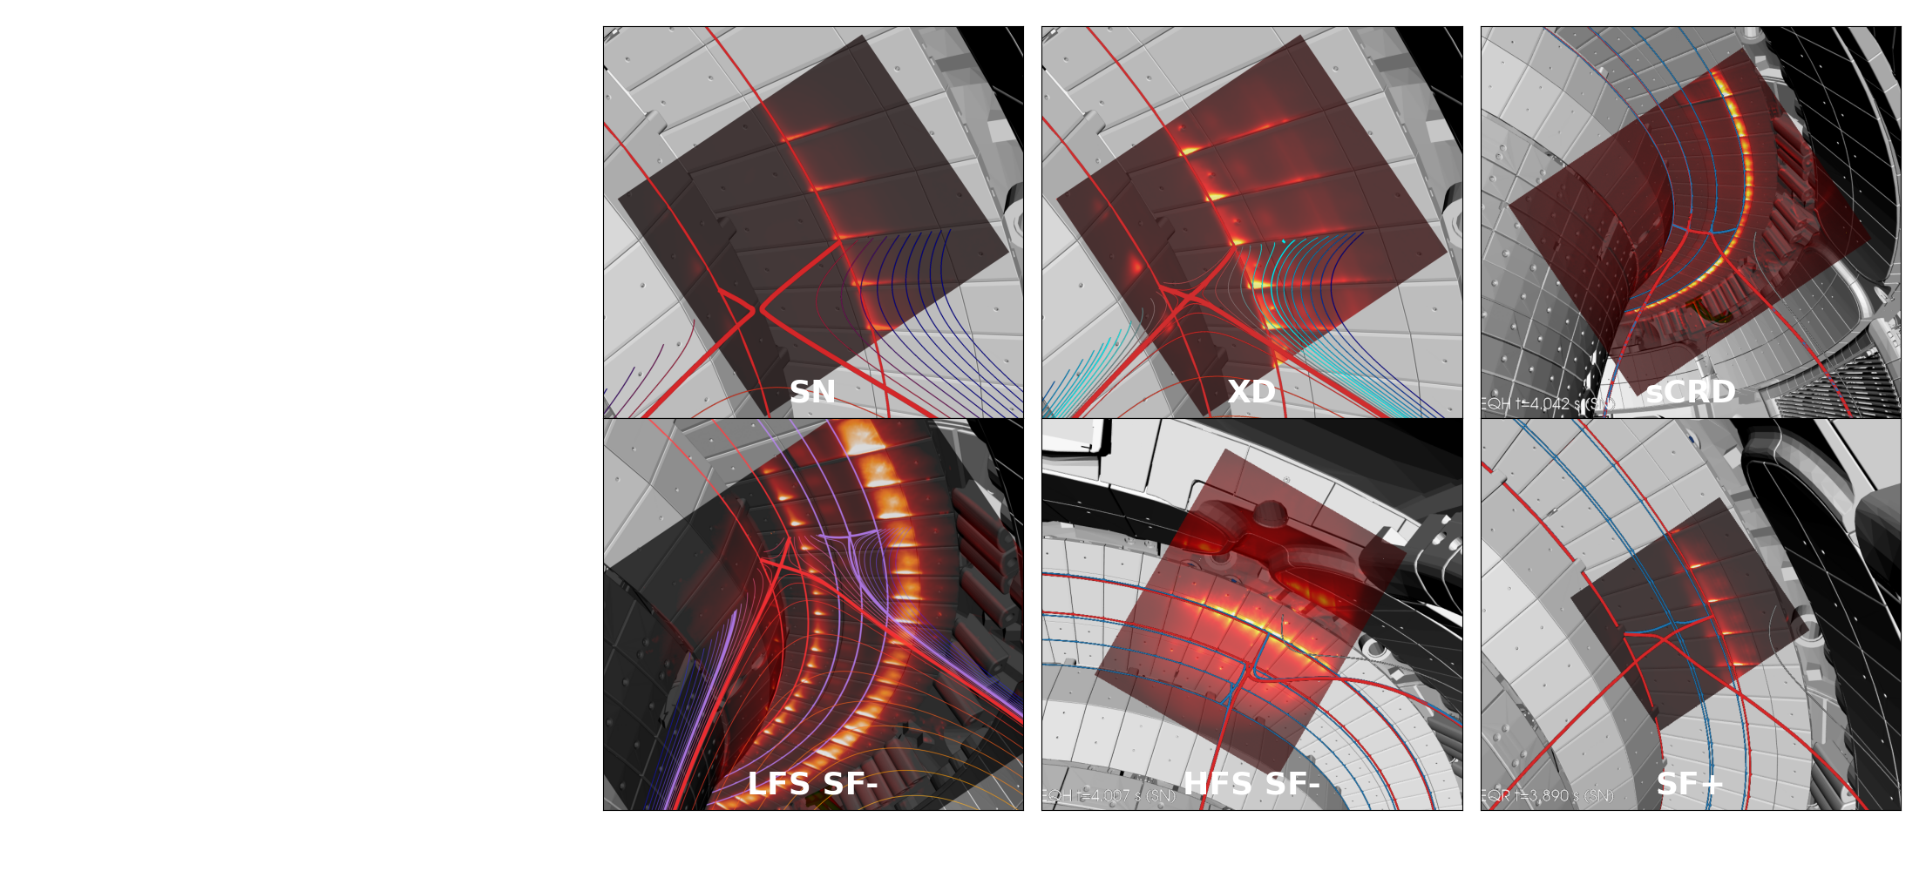
New Upper Divertor of ASDEX Upgrade: Configurations
Overview alternative divertor configurations
[Lunt et al. PRL 2023]
T.Lunt, IAEA-FEC 2025 Chengdu, China
3

Slide 4
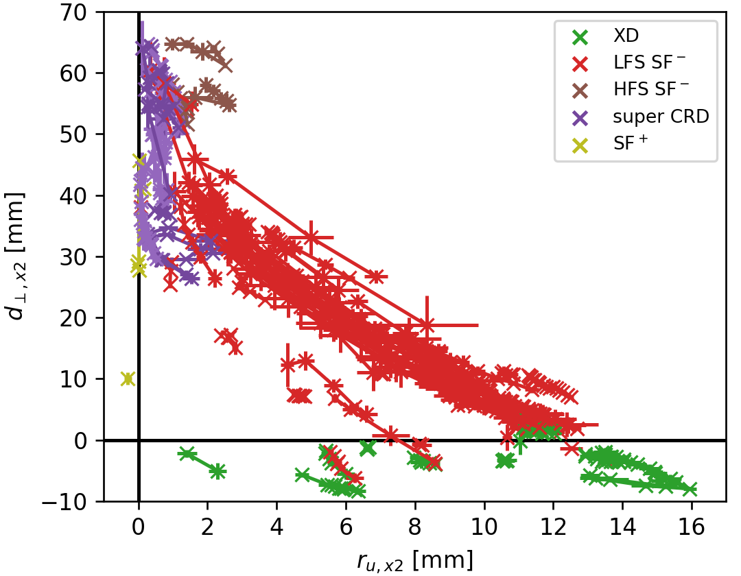
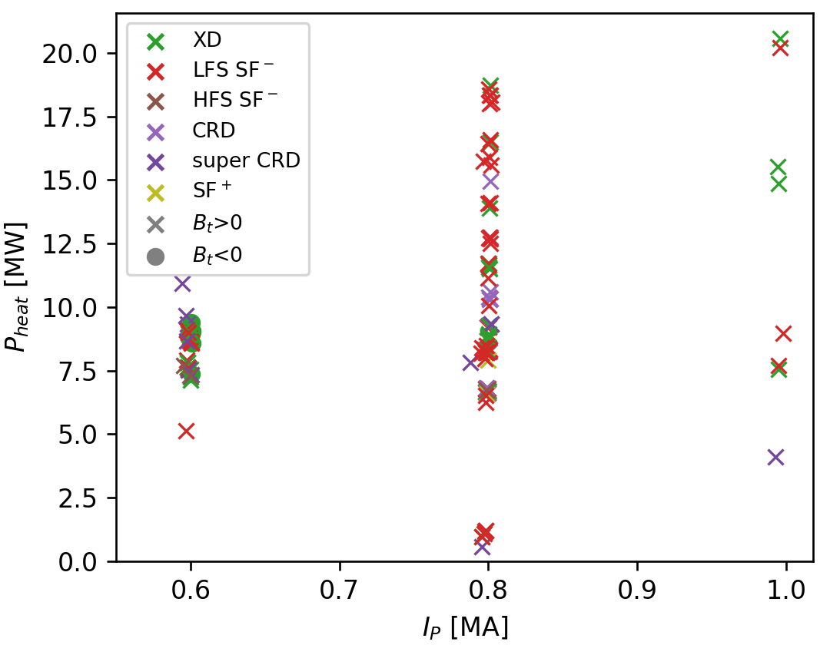
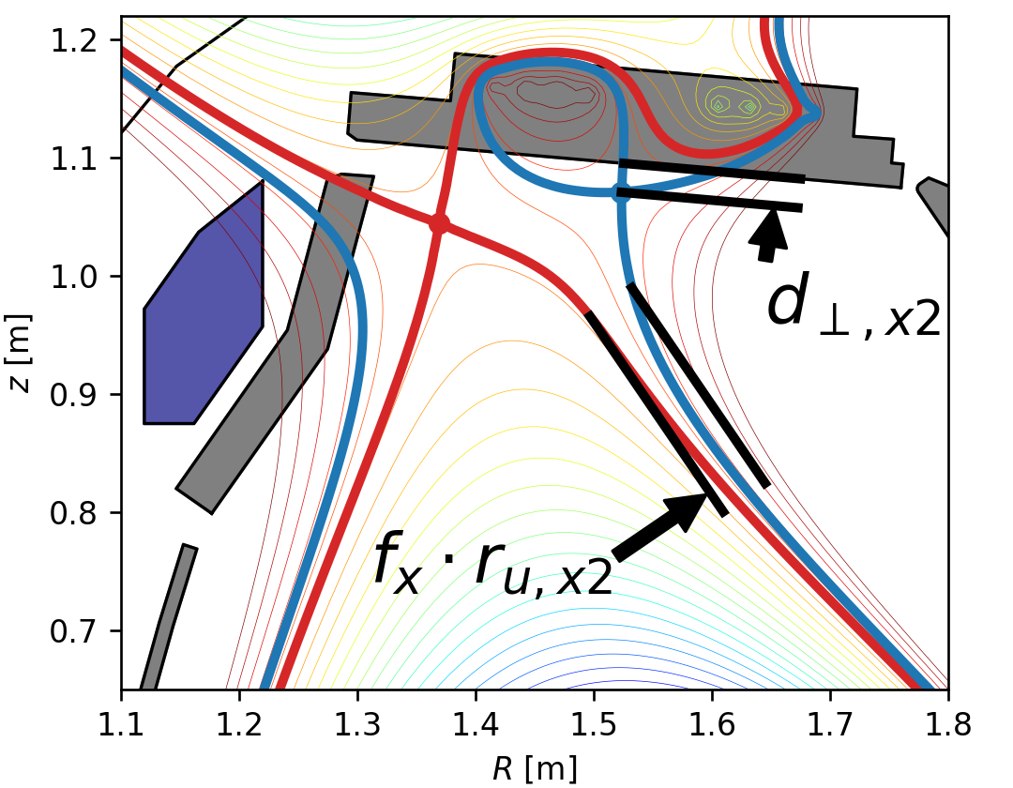
Overview experimental campaign 2025
increasing
decreasing
λ_{q}
Position of the 2nd X-point
Operational space
Result 1:
Hardware installation completed
New upper divertor of AUG operational, but cryo-pump not yet at full performance
All alternative divertor configurations (ADC) successfully established, stable for seconds and during ELMs (except SF+)
Heating power up to 20 MW and plasma current up to 1 MA in ADC
Database of >100 discharges in stable ADC
f_{x}=flux expansion
T.Lunt, IAEA-FEC 2025 Chengdu, China
4

Slide 5
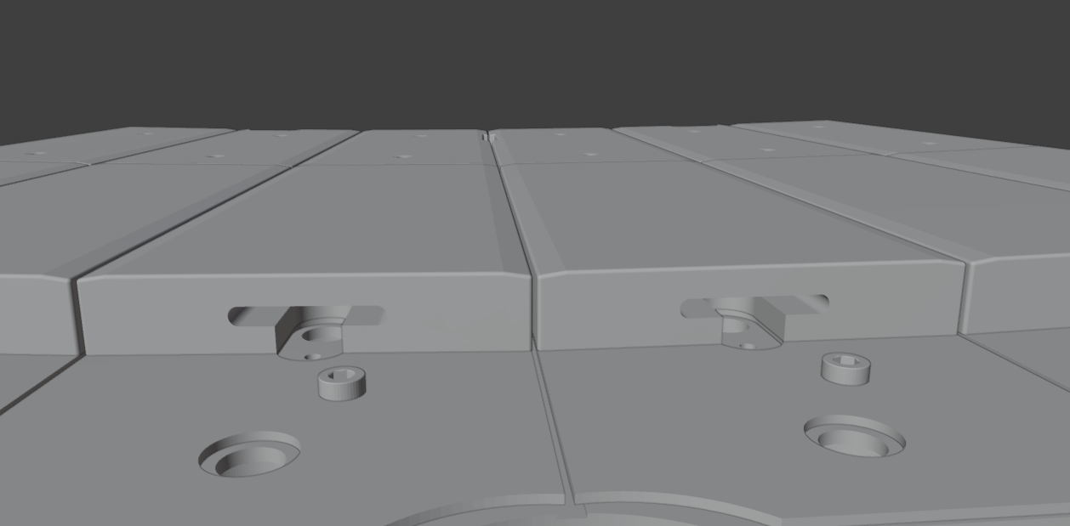
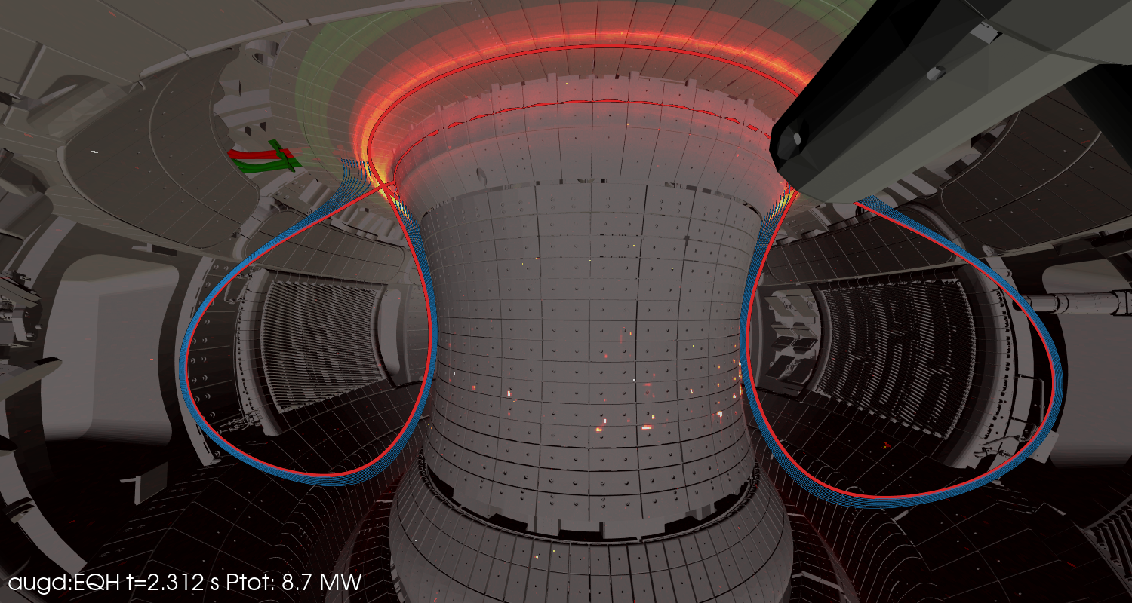
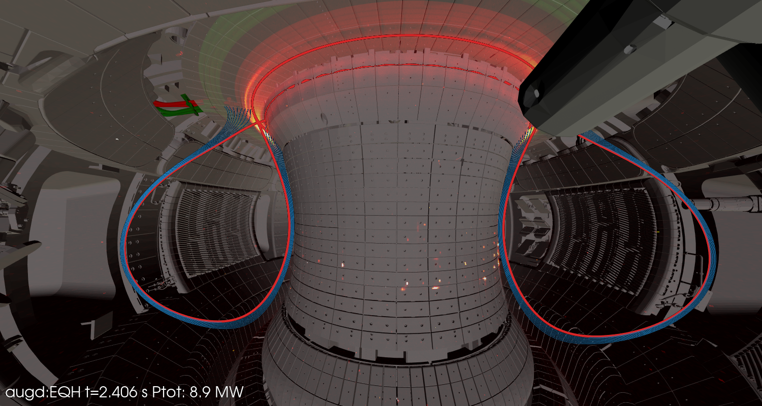
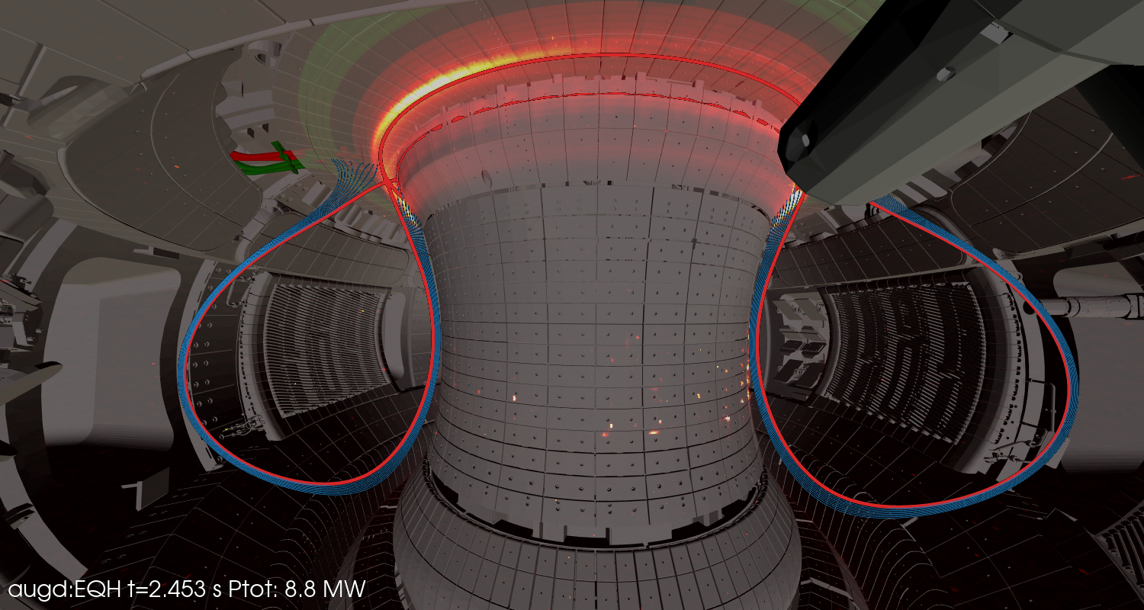


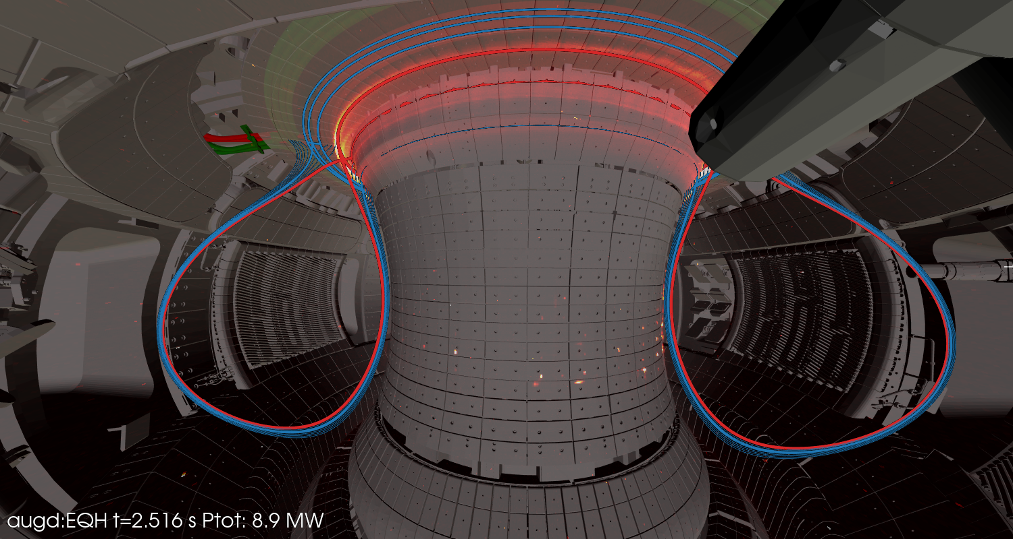

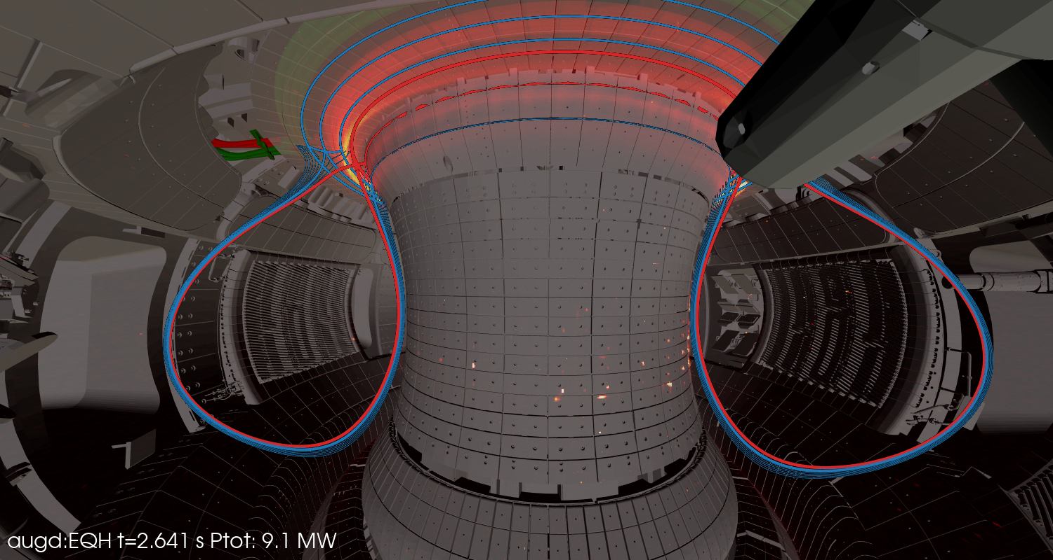
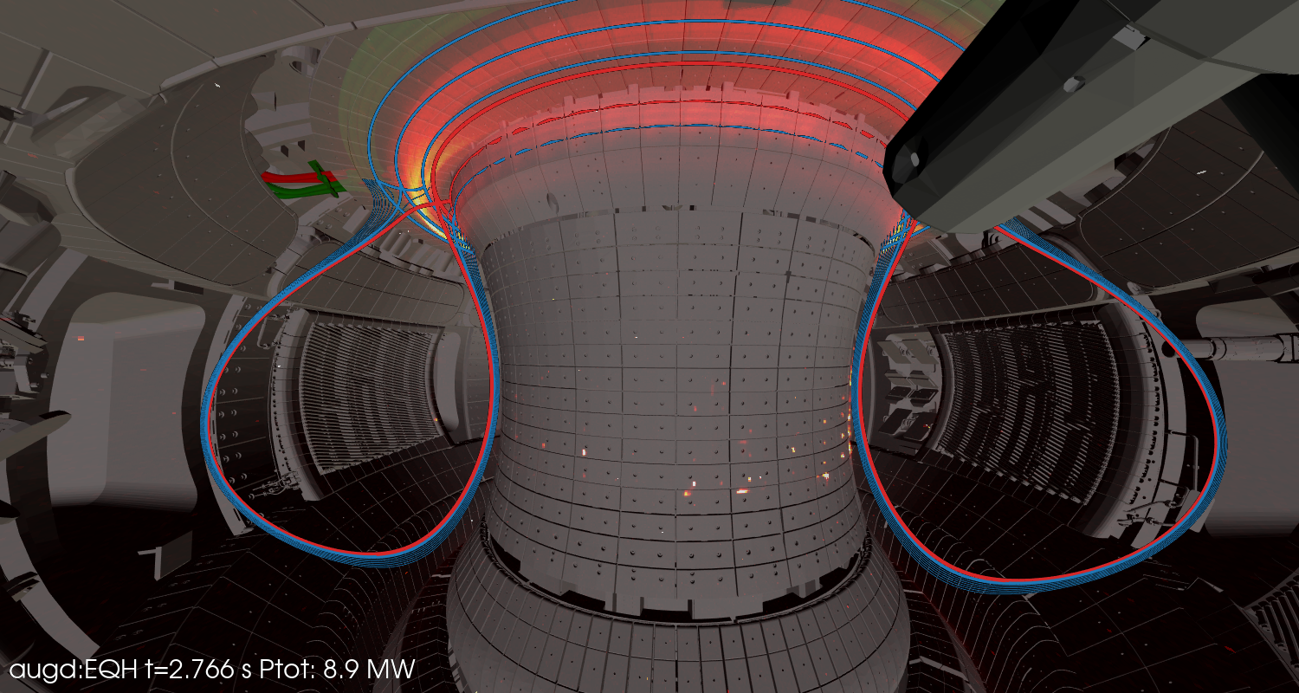
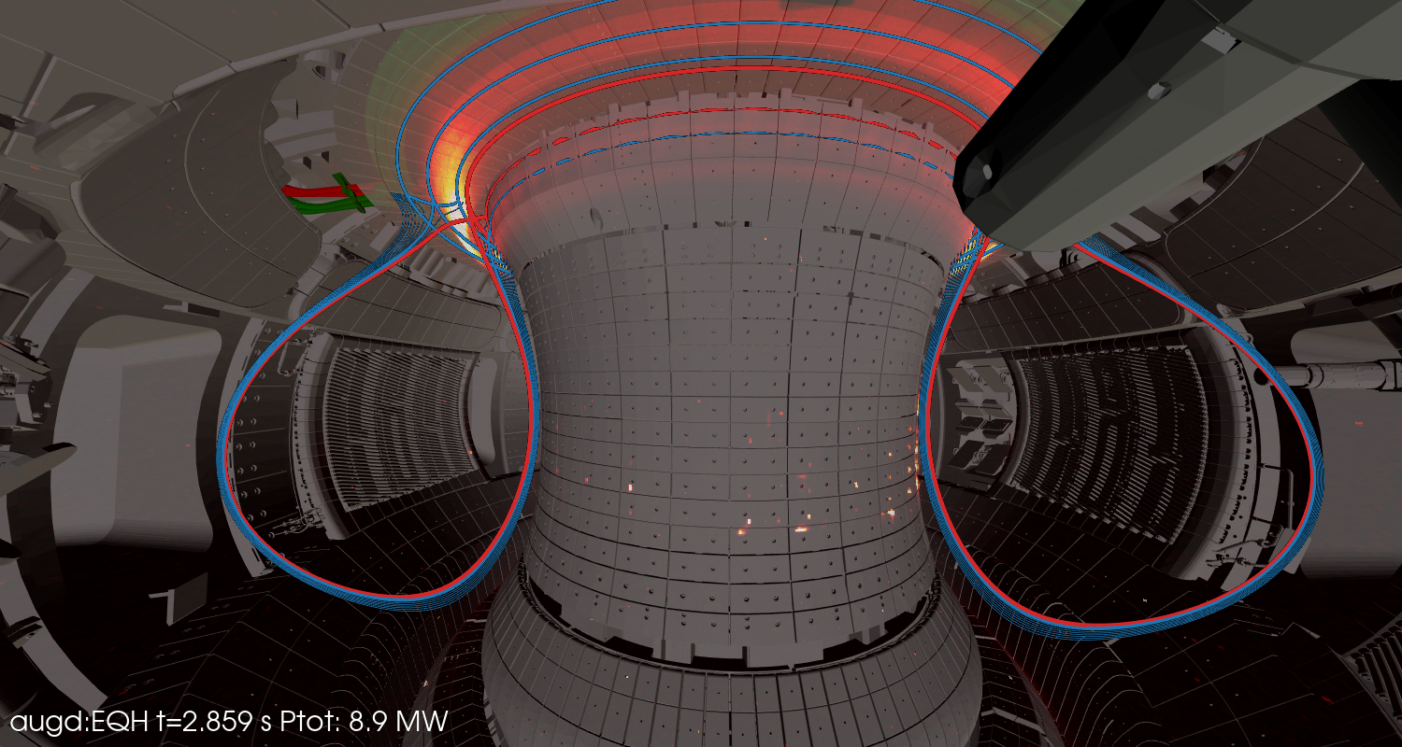

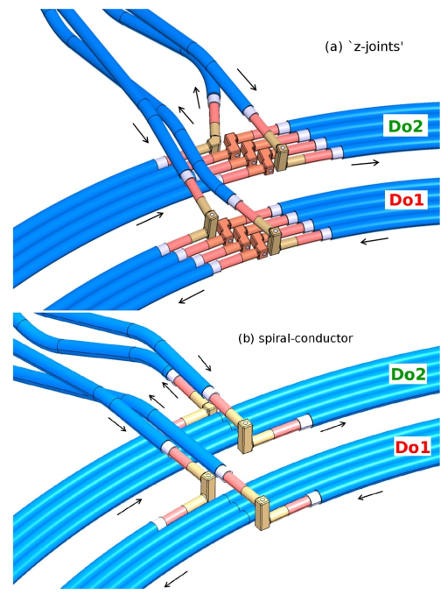
Small field line incidence angles θ⊥<2º can be handled
Alignment tolerance <300µm
Result 2:
Small field line incidence angles θ⊥<2º can be handled ..
with a tile aligment accuracy better than 300 µm
and optimized error fields of the current feeds
AUG 43638 NIR camera
[Lunt NME 2019]
T.Lunt, IAEA-FEC 2025 Chengdu, China
5

Slide 6
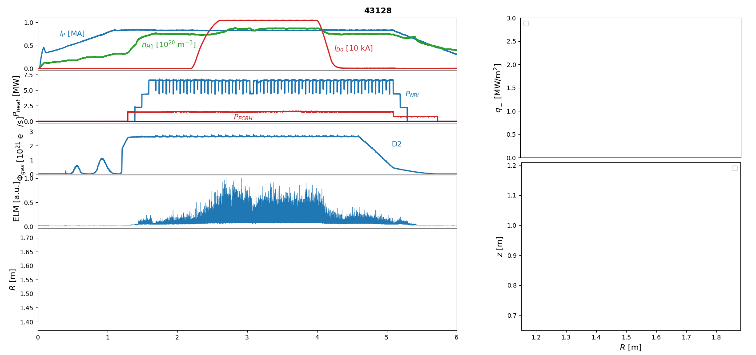
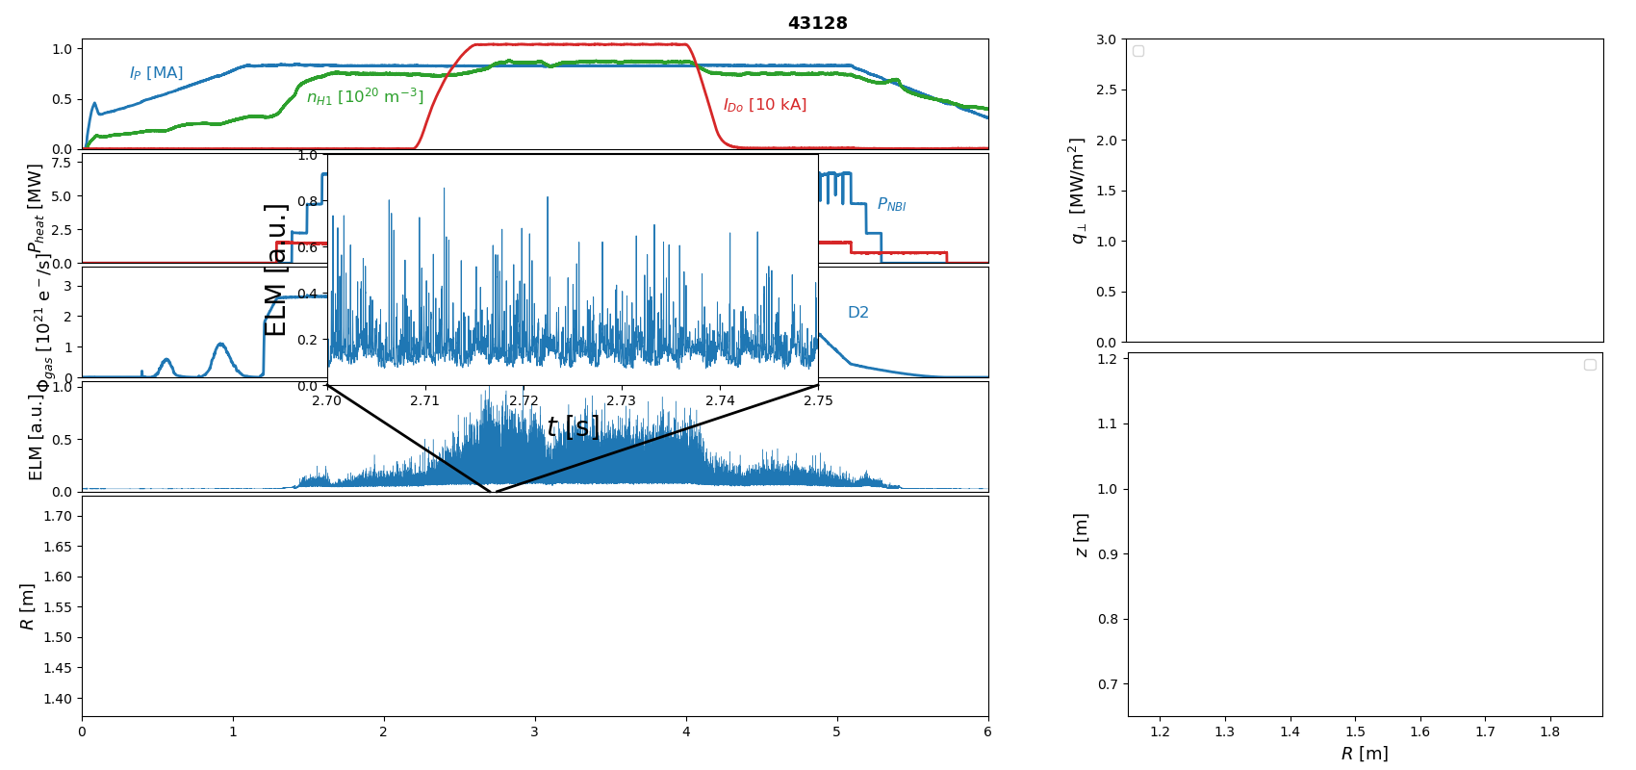
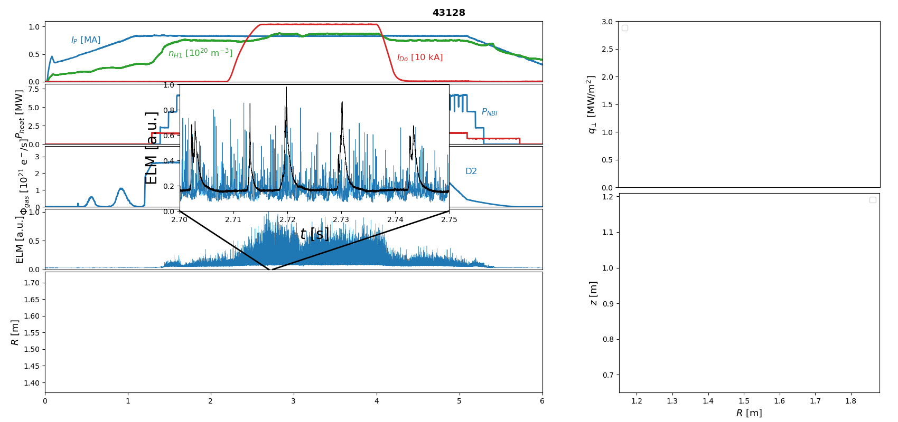
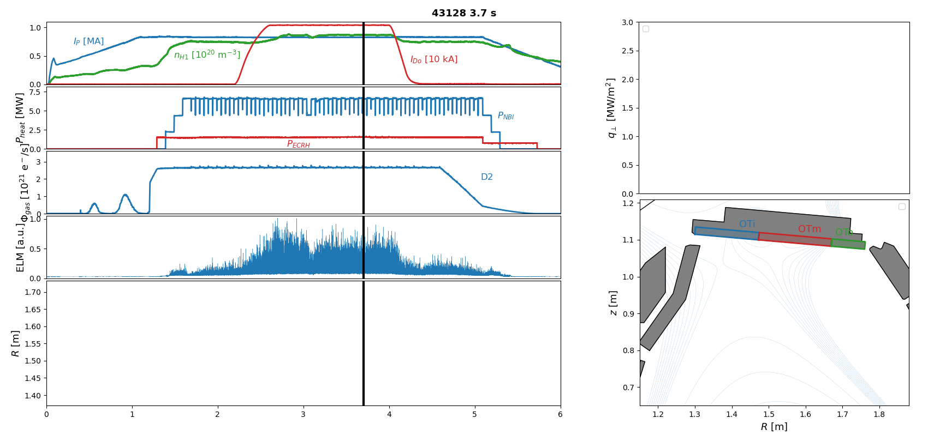
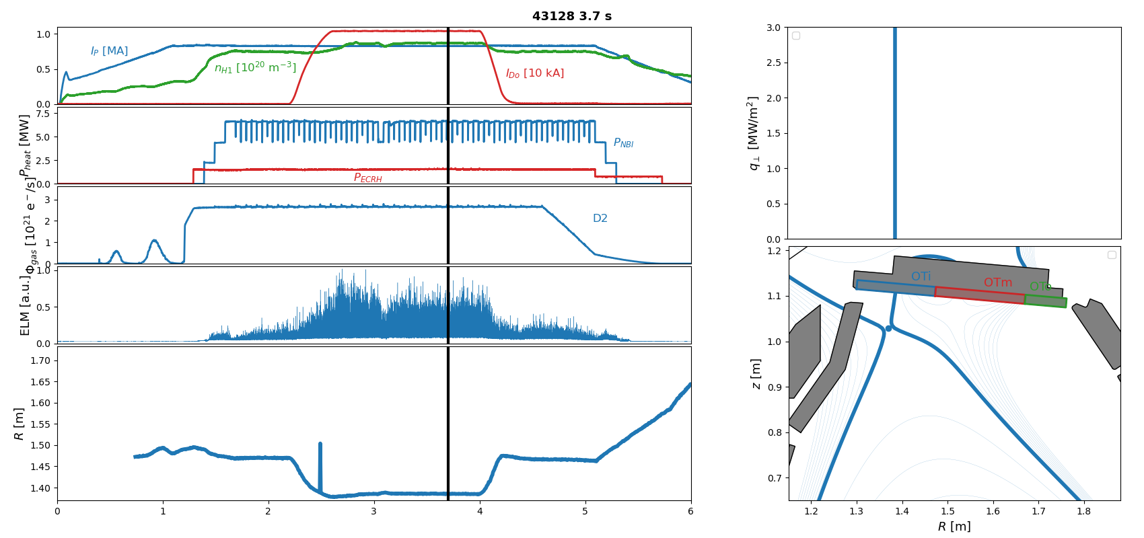
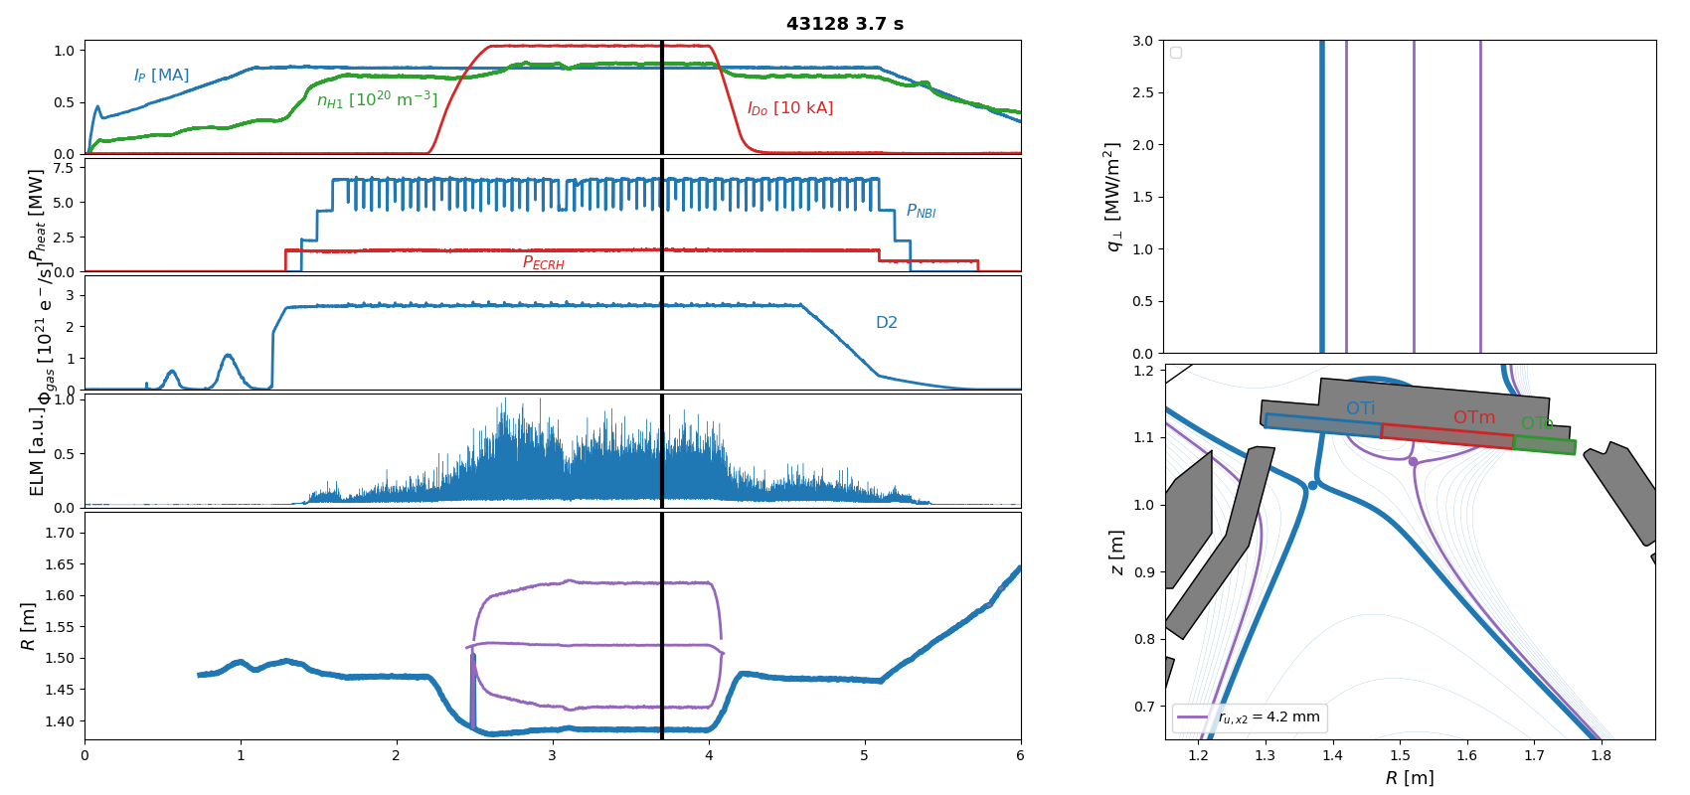
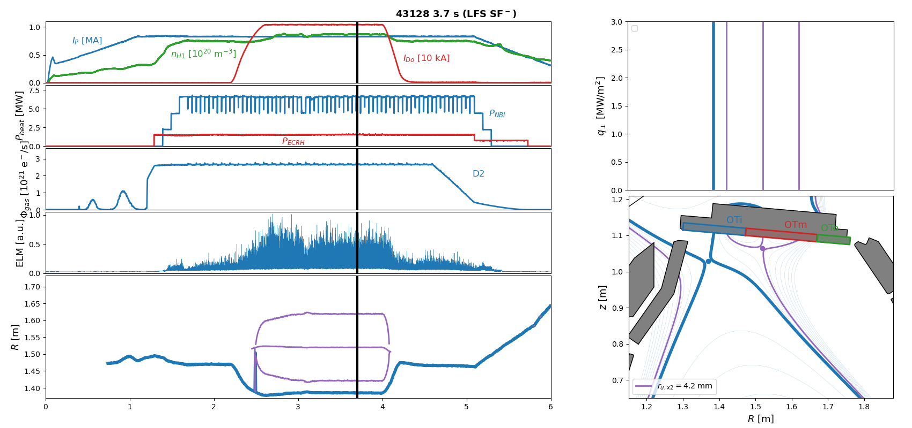
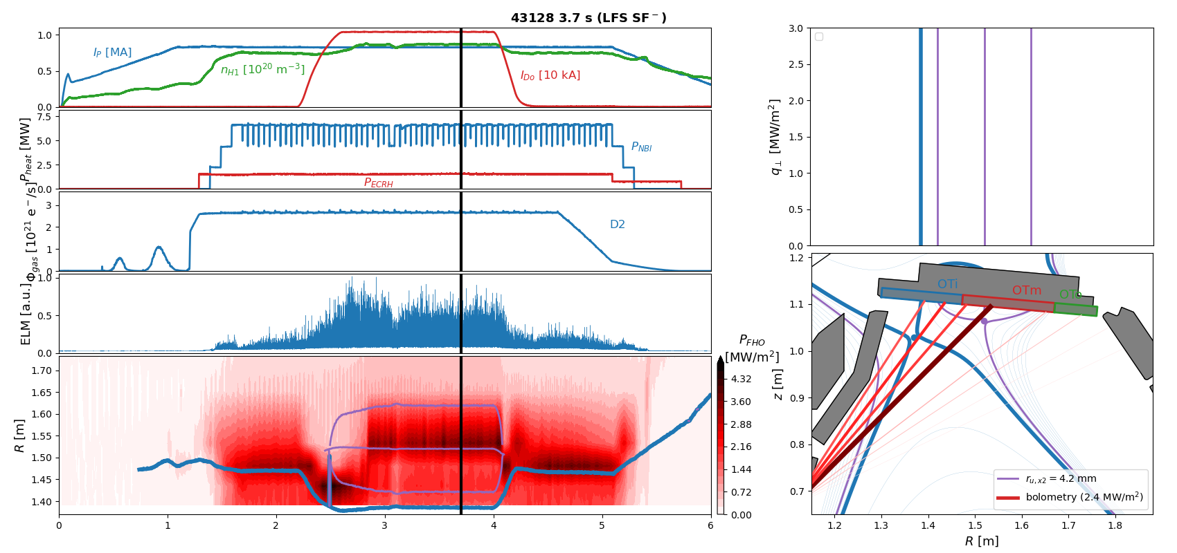
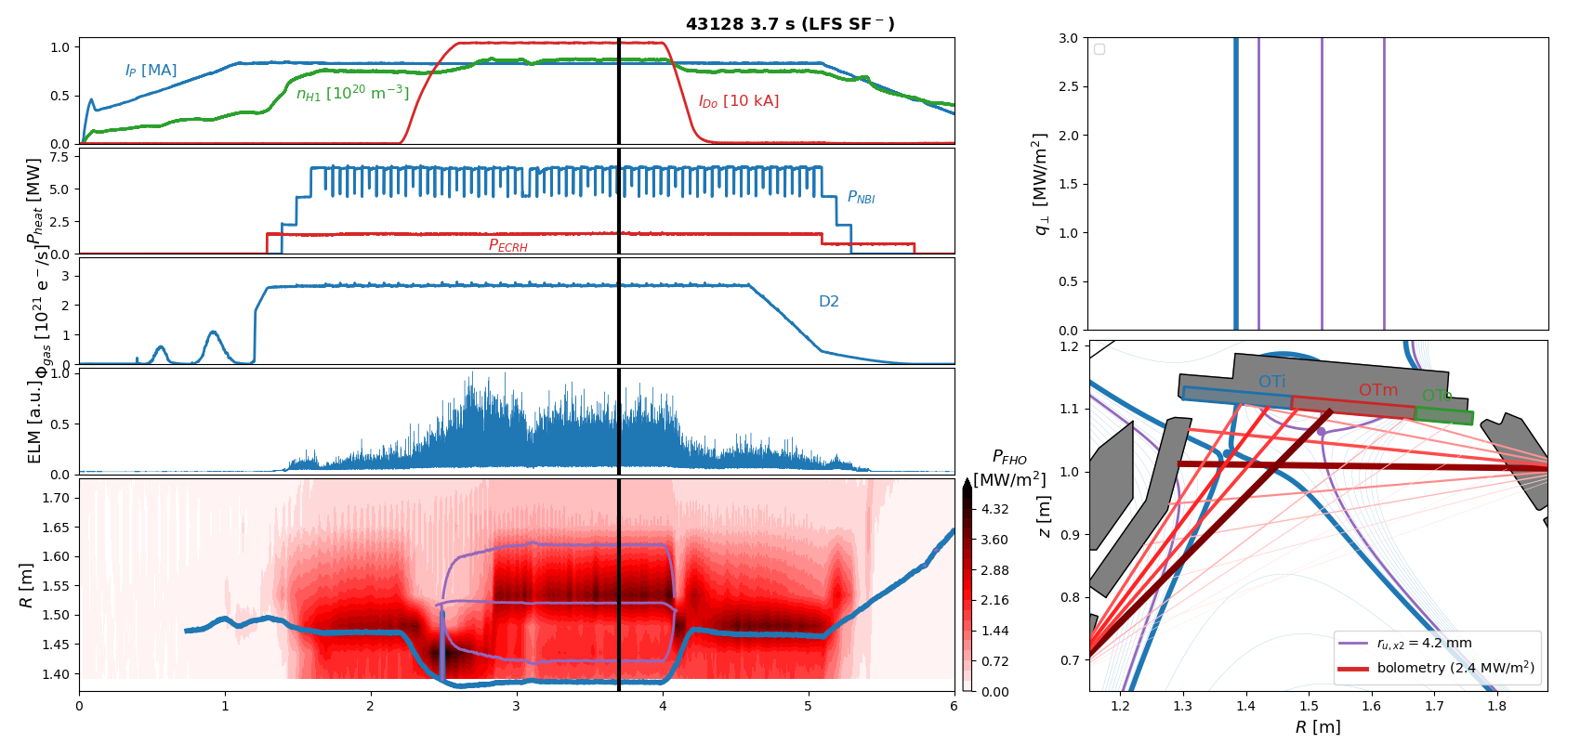
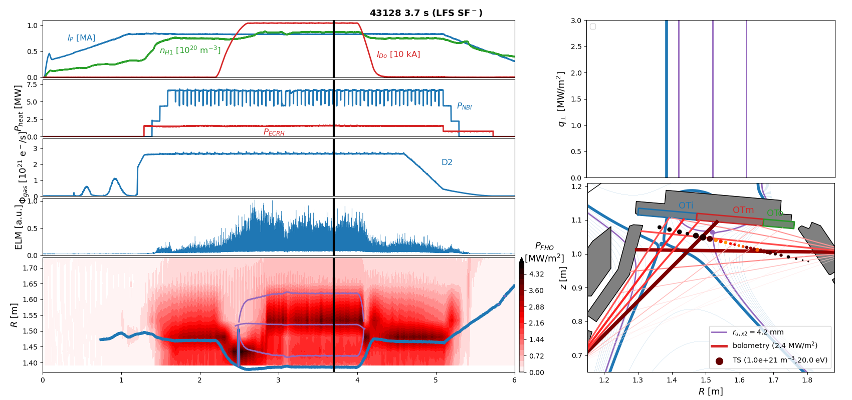



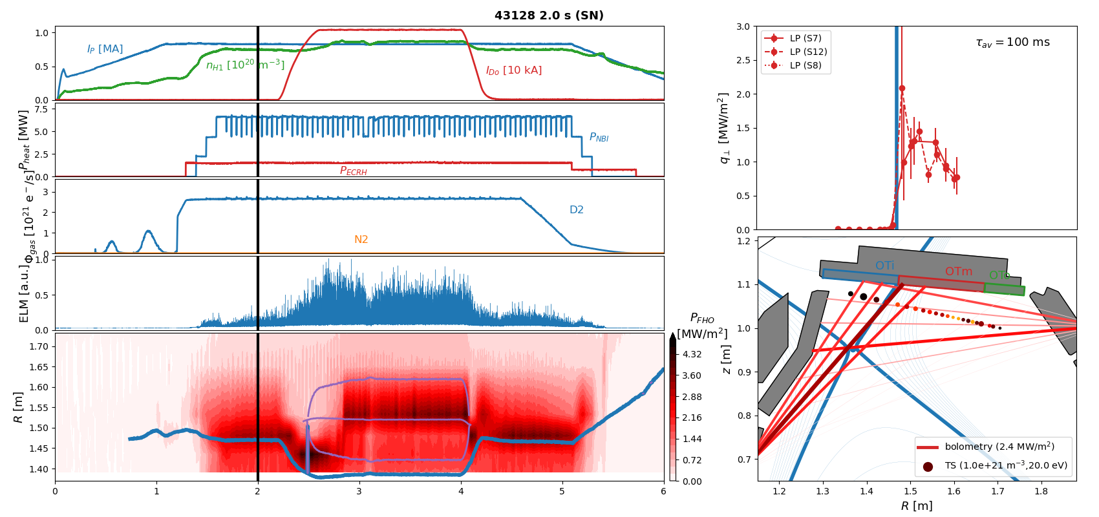
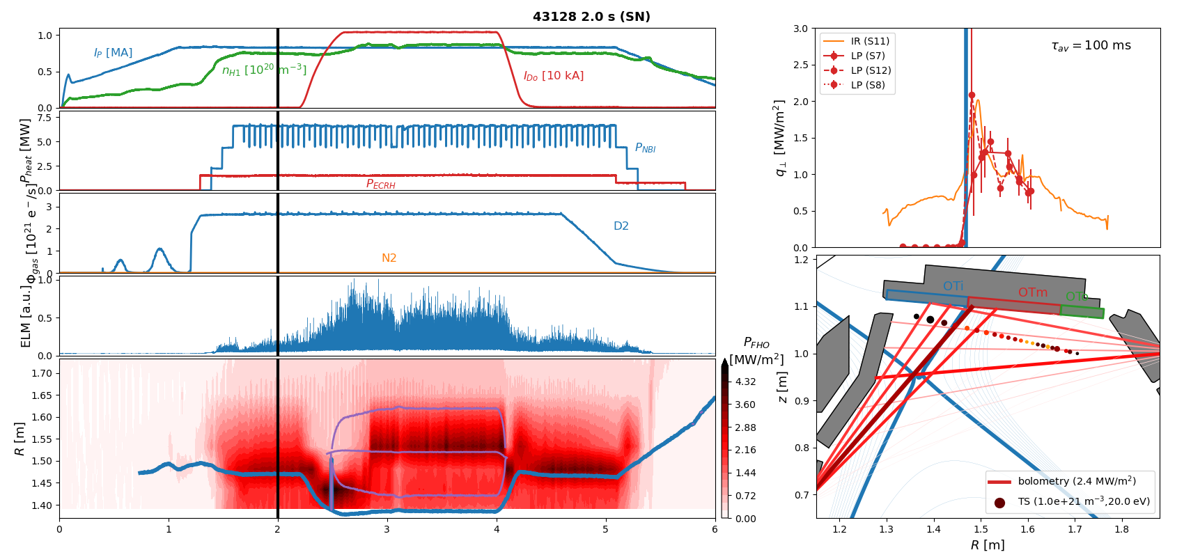

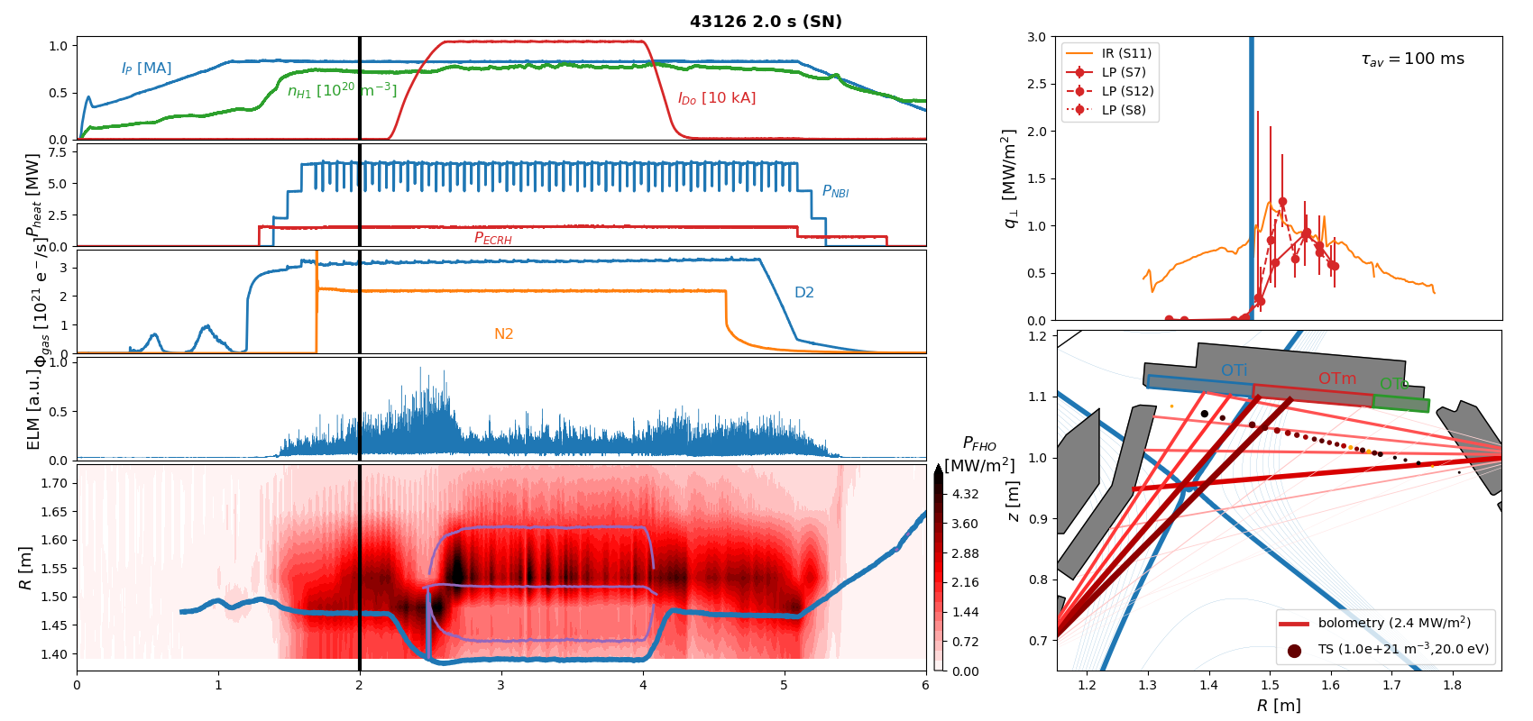
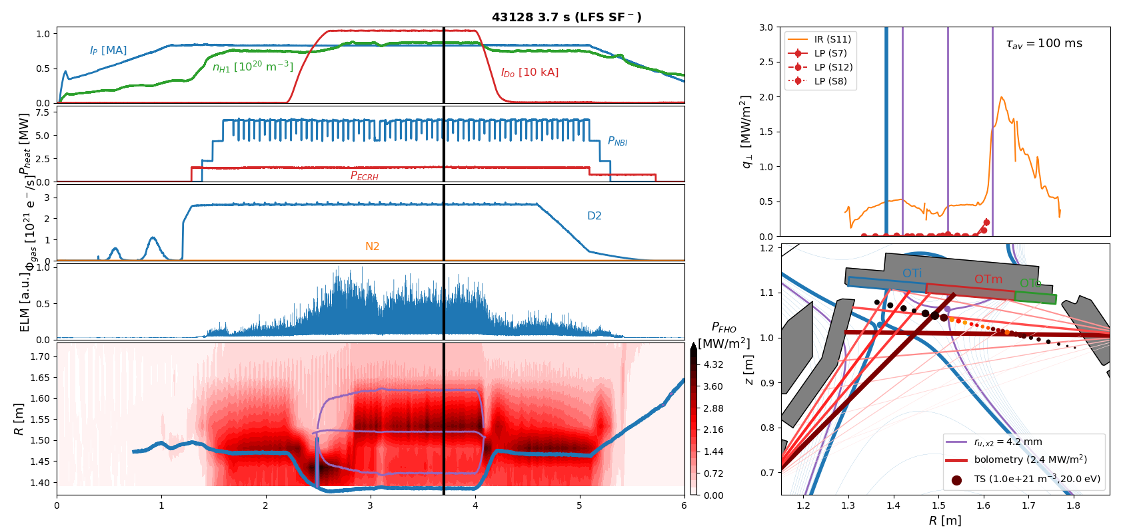

X-point radiator w/o impurity seeding in 800kA H-mode
Result 3:
Even without impurity seeding an X-point radiator can be established in a LFS SF- configuration …
accompanied by detachment of the primary strike line,
but far-SOL heat-fluxes beyond secondary strike line remain high
[Bernert NF 2021], [Stroth NF 2022]
T.Lunt, IAEA-FEC 2025 Chengdu, China
6

Slide 7
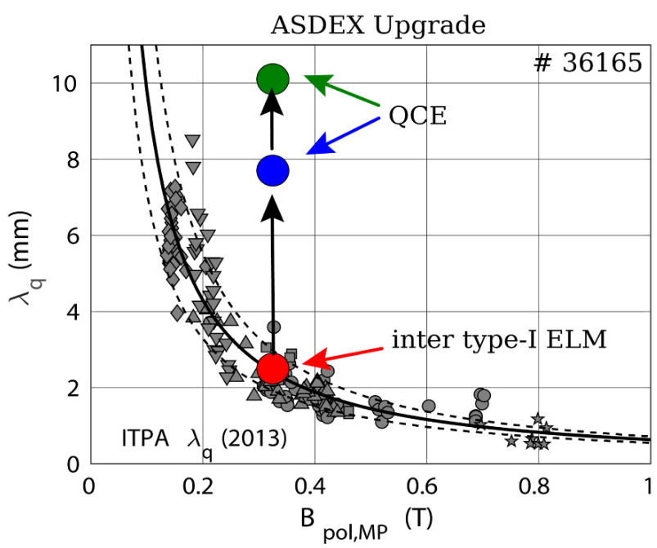
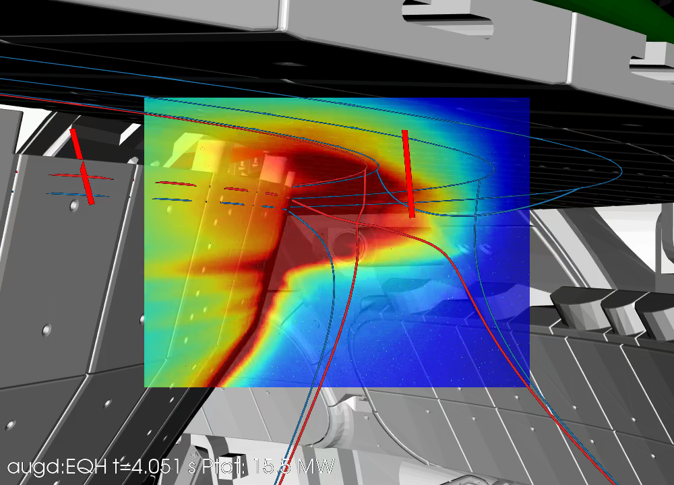
Small-ELM regime (QCE?)
[Brunner NF 2018]
[Faitsch NME 2021]
Φ_{mc,USN}/Φ_{mc,LSN} ~ 7
T.Lunt, IAEA-FEC 2025 Chengdu, China
7

Slide 8
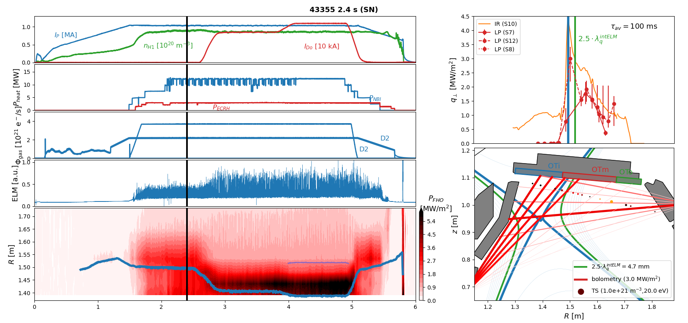
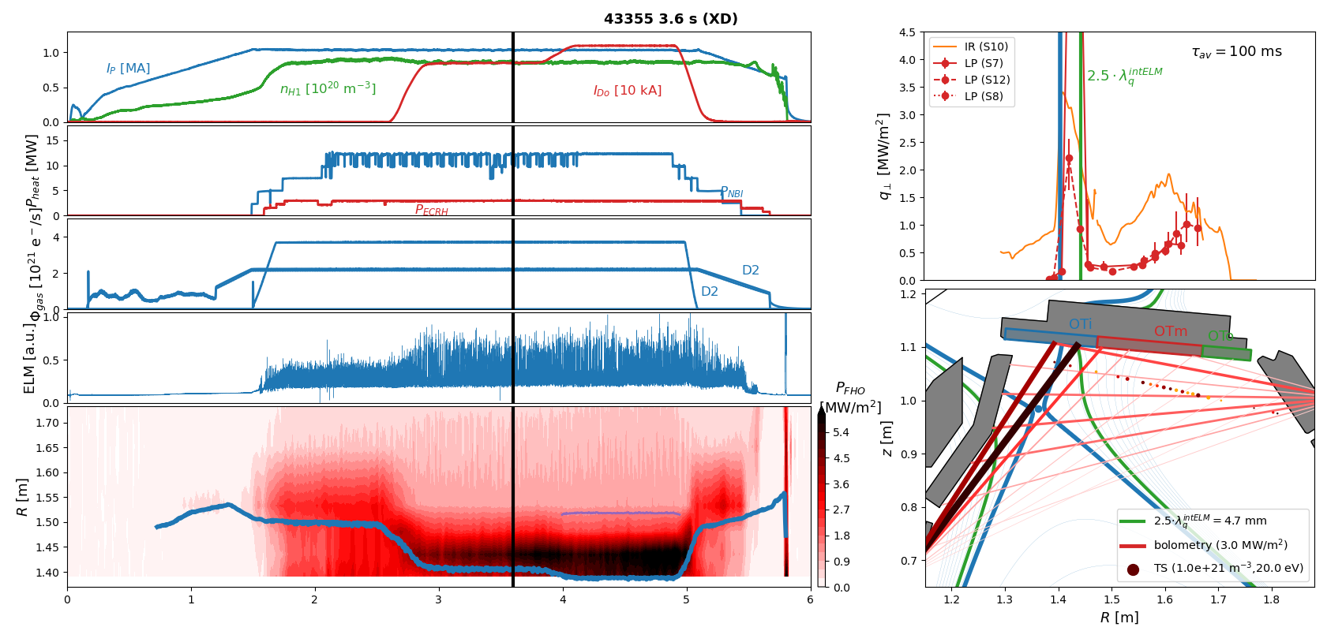
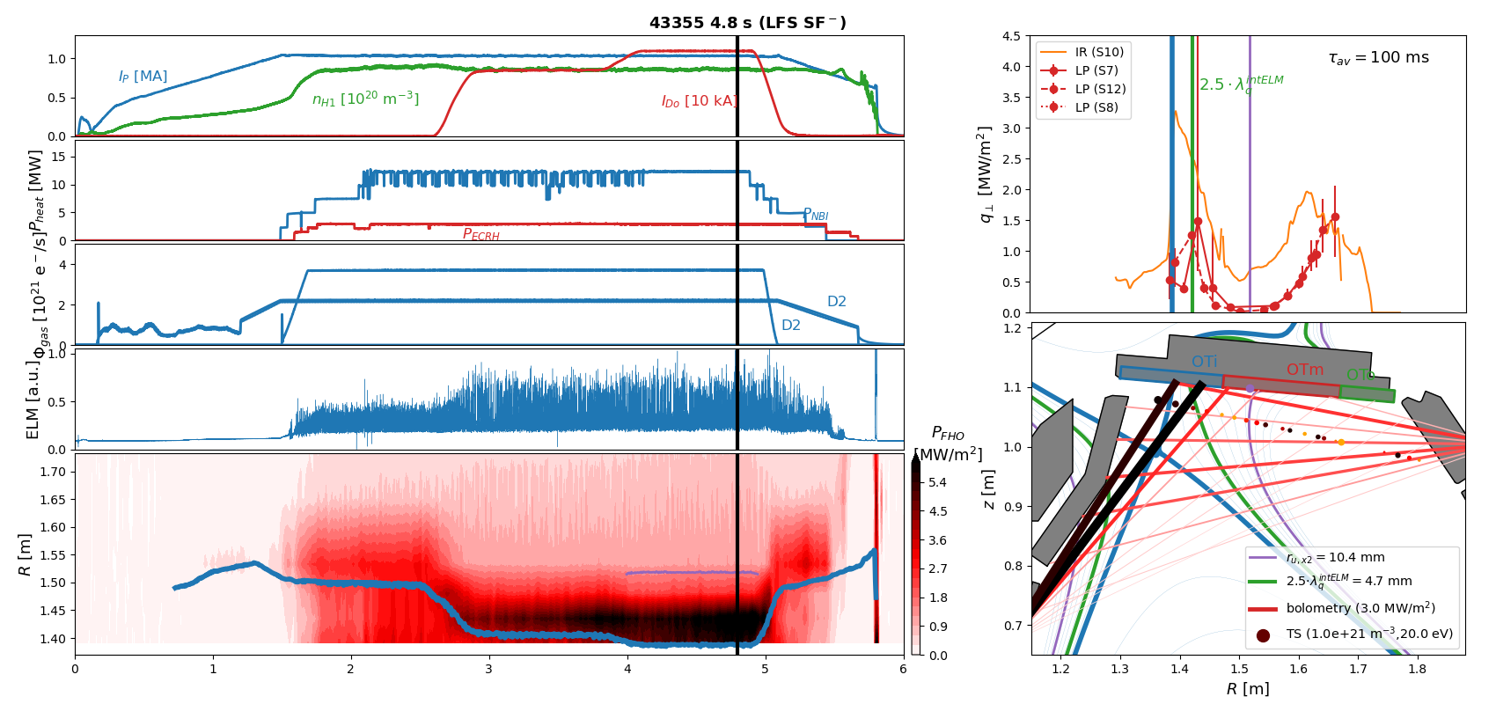
Strike point splitting in 1MA H-mode
Result 4:
A splitting of the strike point is observed ..
accompanied by a reduction of a factor of 2 in the heat flux measured by Langmuir probes
[Lunt NME 2017], [Pan PPCF 2018]
T.Lunt, IAEA-FEC 2025 Chengdu, China
8

Slide 9
Summary
First results:
Hardware installation of a pair of in-vessel coils, a charcoal coated cryo-pump and new divertor targets completed
All alternative divertor configurations (ADC) successfully established, stable for seconds and during ELMs (except SF+)
Heating power up to 20 MW and plasma current up to 1 MA in ADC
Even at high heating powers field line incidence angles can be made arbitrarily small – or even negative – due to outstanding target alignment accuracy and small magnetic error fields
X-point radiator forms in a LFS SF- configuration even without impurity seeding, where the primary strike point is fully detached, but far-SOL heat fluxes still high → far-SOL fluxes irrelevant at a reactor-like power fall-off lengths λ_{q}?
Splitting of the outer strike point observed, accompanied by reduction of the peak heat flux of a factor of ~2 in 1 MA LFS SF⁻ discharges measured by Langmuir probes
T.Lunt, IAEA-FEC 2025 Chengdu, China
9

Slide 10
Backup slides
T.Lunt, IAEA-FEC 2025 Chengdu, China
10

Slide 11
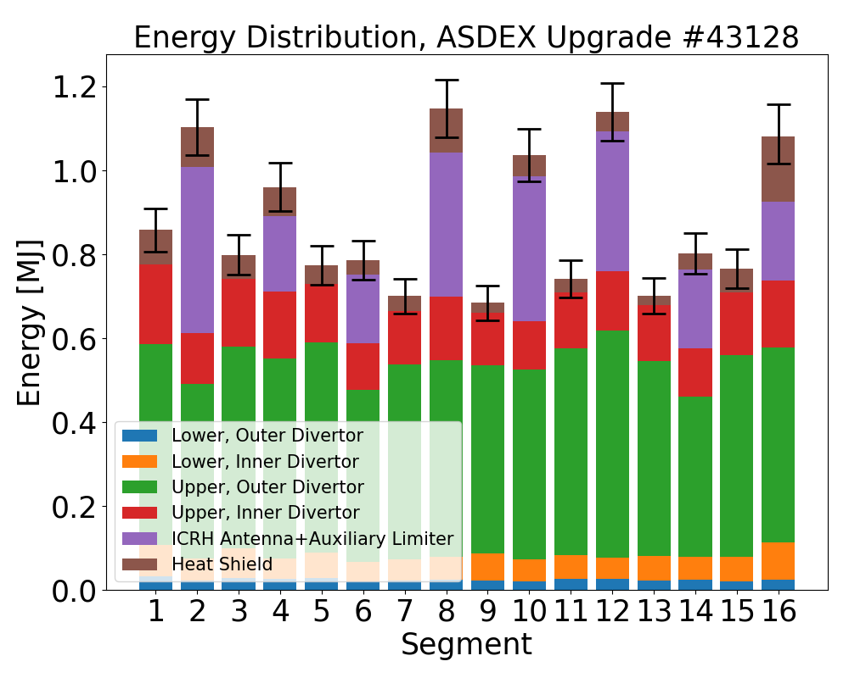
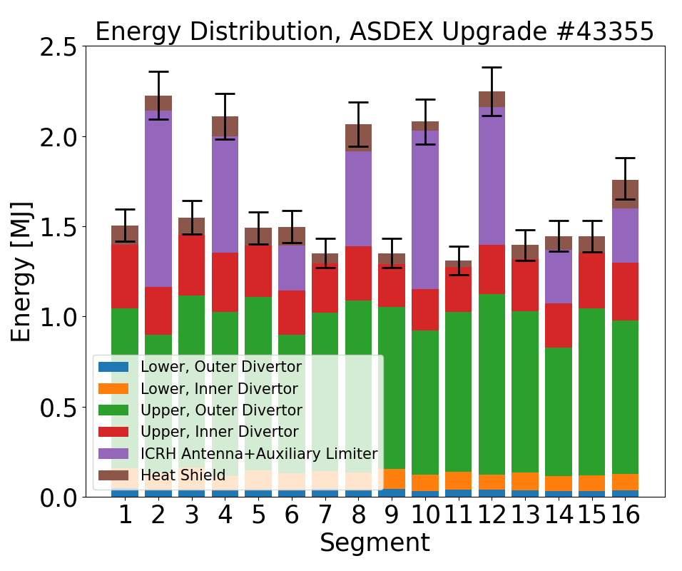
Energy Balance

