Slide 1

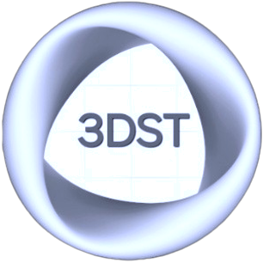
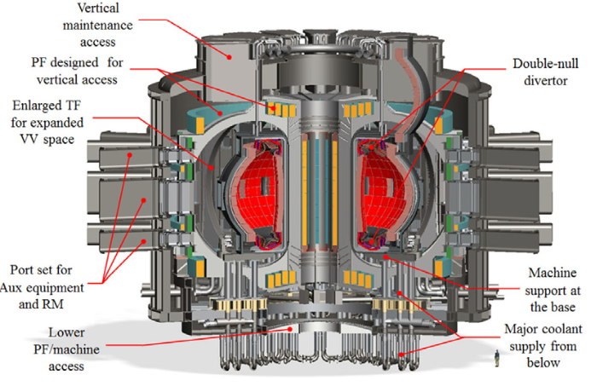
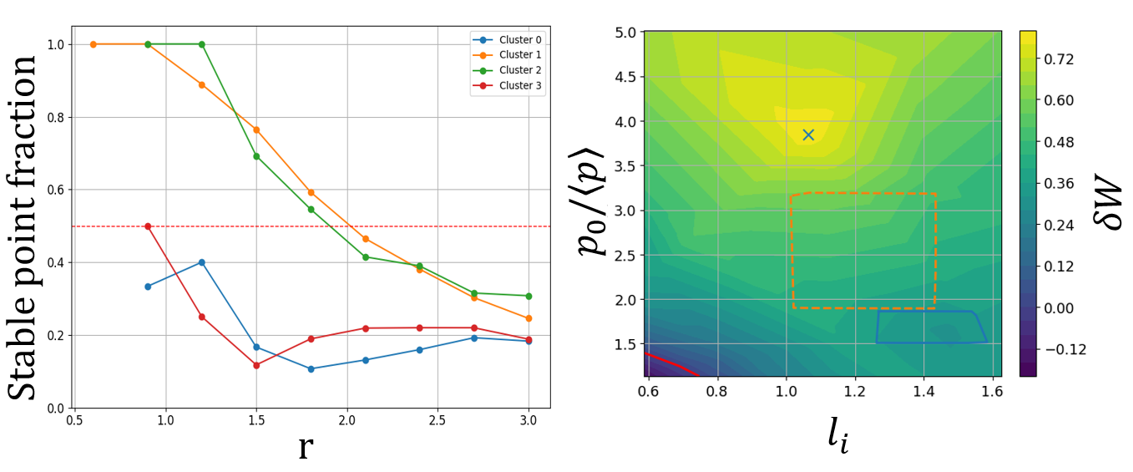
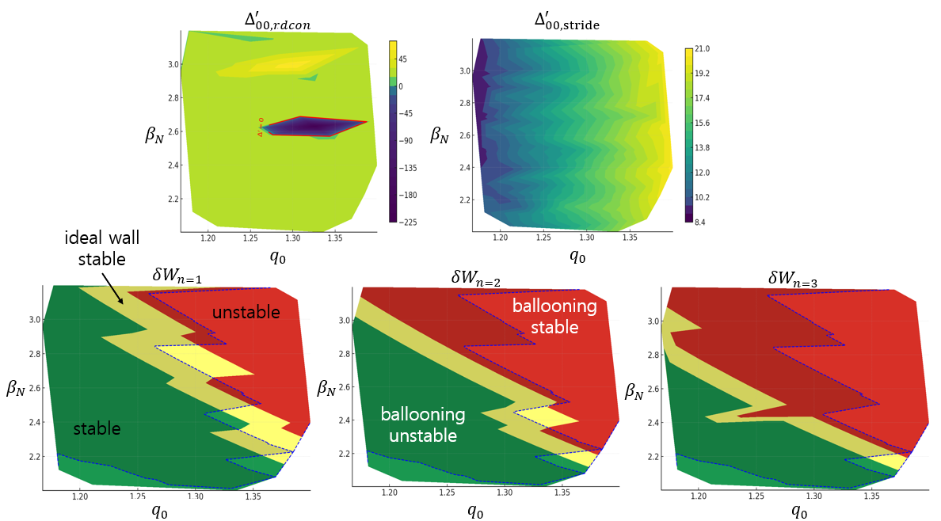
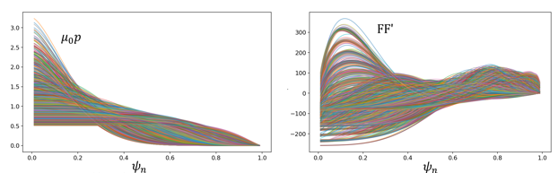
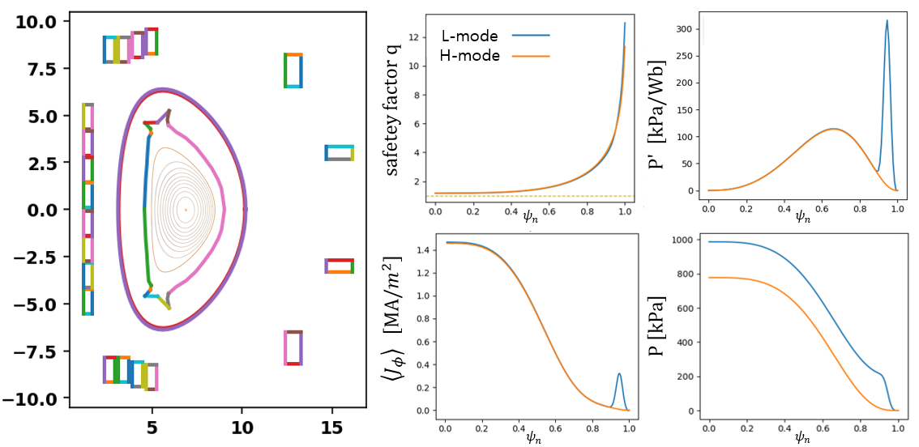
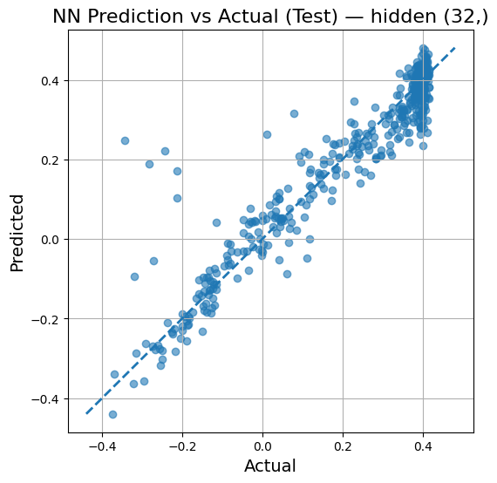
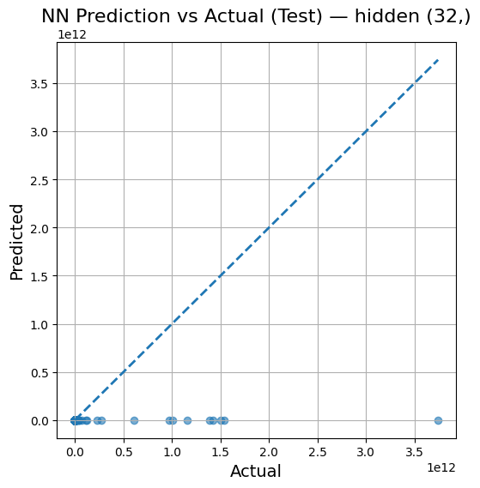
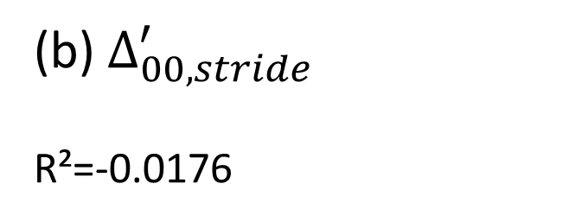


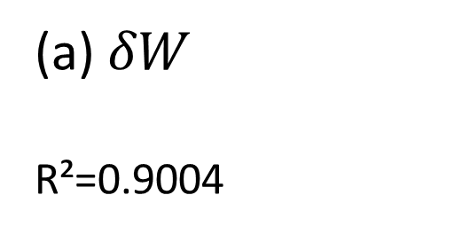
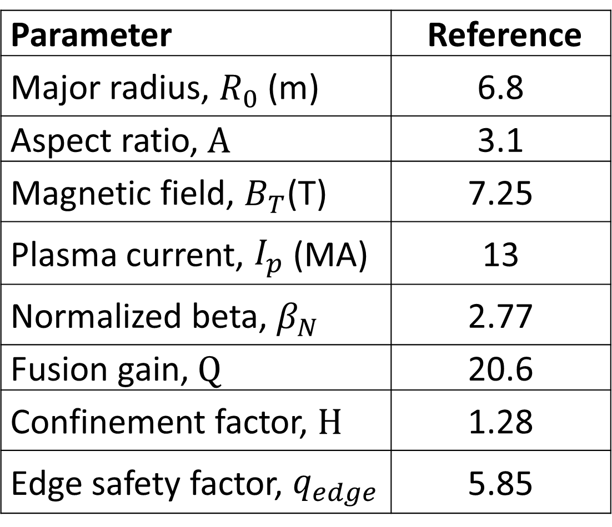
ACCESSING STABLE OPERATIONAL WINDOWS IN K-DEMO:
A STABILITY ASSESSMENT WORKFLOW FOR CONCEPTUAL PILOT PLANT DESIGN
J.M. LEE, J.B. CHO, M.S. CHA, S.J. HAHN¹, C. HANSEN²
Seoul National Univesity, Korea¹, Columbia University, USA.²
jmlmir@snu.ac.kr
1. ABSTRACT
4. KEY RESULTS
Developed an integrated workflow for K-DEMO operational-window exploration.
Optimized coil design and MHD stability using 5 analysis codes (TOKAMAKER, CHEASE, DCON^{[3]}, RDCON^{[4]}, STRIDE^{[5]} etc.).
Successfully pinpointed a numerically consistent region that is the least unstable and most predictable, despite residual instabilities.
Coil Design and VDE Stability
A VDE-stable coil set ($γτ_{E}<8$)^{[9]} is designed using TOKAMAKER (Fig.6).
  Ideal/Resistive MHD-Optimized H-mode Profile
  A final H-mode candidate profile is identified from robust L-mode clusters via a pedestal scan (Fig. 4).
  Target $β_{N}=3,I_{p}=13MA$ is achieved by relaxing the tearing criterion to $Δ^{′}<15$, as no profile was strictly stable to all modes.
Parameter | Reference
Major radius, $R_{0}$ (m) | 6.8
Aspect ratio, $A$ | 3.1
Magnetic field, $B_{T}$(T) | 7.25
Plasma current, $I_{p}$ (MA) | 13
Normalized beta, $β_{N}$ | 2.77
Fusion gain, $Q$ | 20.6
Confinement factor, $H$ | 1.28
Edge safety factor, $q_{edge}$ | 5.85
Fig.1 K-DEMO device design features.^{[8]}
Table 1. System parameters of
K-DEMO design points.^{[6]}
Fig.4 Results of the robust stable region search
2. BACKGROUND & CHALLENGES
Established workflow for 0D system scan(Table 1)^{[6]} and ideal MHD^{[7]}, but did not yet include systematic tearing mode analysis.
Inherent sensitivity of Δ′ calculation, failing NN model training (Fig. 3) while a model for 𝛿W succeeded.
3. CHALLENGES / METHODS
METHODS
Coil design (TOKAMAKER) and fixed boundary scan (CHEASE) based on prior 0D design are executed (Fig. 2).
Identified robust candidates via clustering analysis on a stable data set (δW>0, ballooning stable, Δ′<offset).
  clusters with stable/total point ratio > 0.5 over a broad radius are selected (Fig. 5).
final operating point ($I_{p}=13MA,β_{N}=3$) via subsequent pedestal scan is pinpointed.
Fig.5 Pedestal scan result of H-mode scenario
Fig.2 Profile distribution of the initial L-mode database
Fig.6 Designed L-mode, H-mode scenario and coil
5. CONCLUSION
RESULTS
Successfully developed an integrated workflow to identify robust operating regions by overcoming Δ′ sensitivity through a comprehensive MHD stability assessment.
FUTURE WORK / IMPROVEMENTS
Find profiles strictly stable to both ballooning and tearing modes.
Integrate the workflow with transport simulations for a fully self-consistent analysis.
(a) $δW$
R²=0.9004
$$\backslash delta W$$
(b) $Δ_{00,stride}^{′}$
R²=-0.0176
REFERENCES
Fig.3 Prediction results of stability indices using a neural network
[1] C. Hansen et al., Comput. Phys. Commun. 298, 109111 (2024). [2] H. Lütjens et al., Comput. Phys. Commun. 97, 219 (1996).
[3] A. H. Glasser, Phys. Plasmas 23, 072505 (2016). [4] A. H. Glasser et al., Phys. Plasmas 23, 112506 (2016).
[5] A. S. Glasser et al., Phys. Plasmas 25, 082502 (2018). [6] J.S. Kang et al., Fusion Eng. Des. 211, 114741 (2025).
[7] J.S. Kang et al., Nucl. Fusion 57, 126034 (2017). [8] K. Kim et al., Nucl. Fusion 55, 053027 (2015).
[9] J. P. Freidberg et al., J. Plasma Phys. 83, 905830107 (2017).

