Slide 1
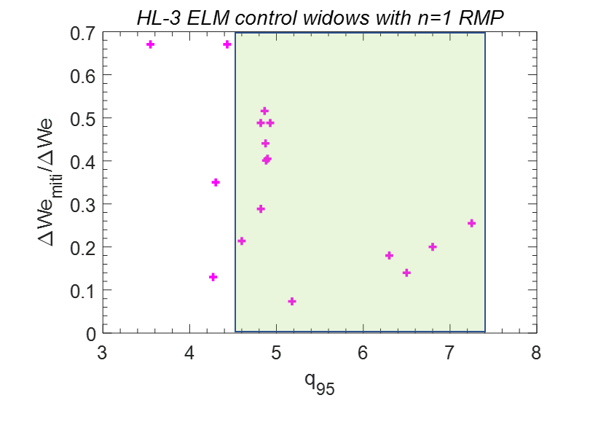
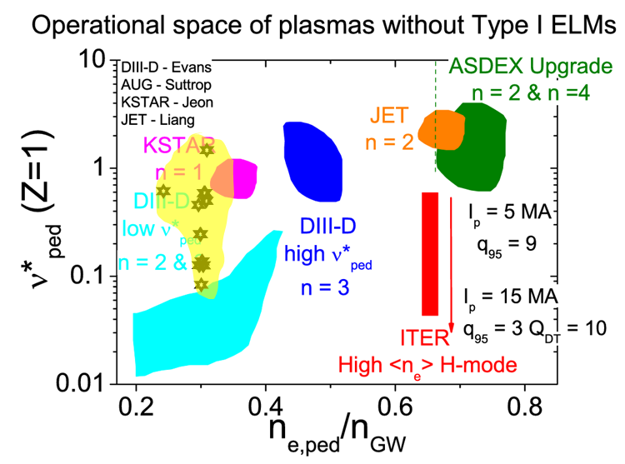
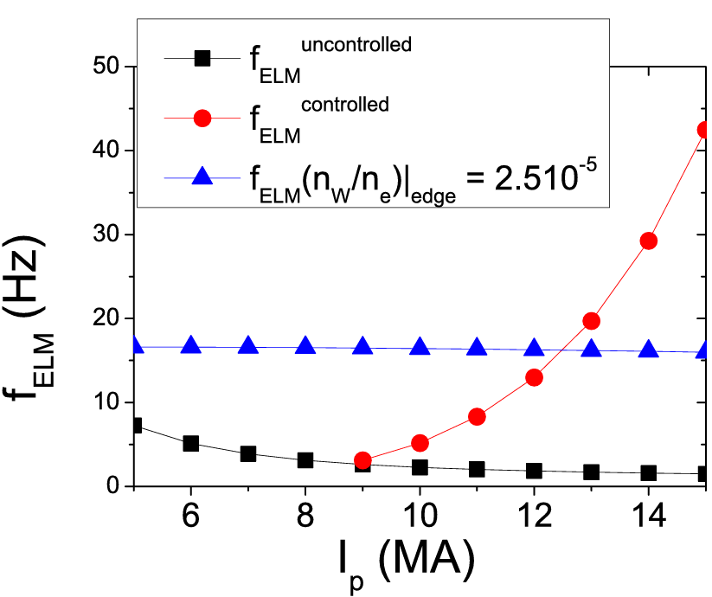
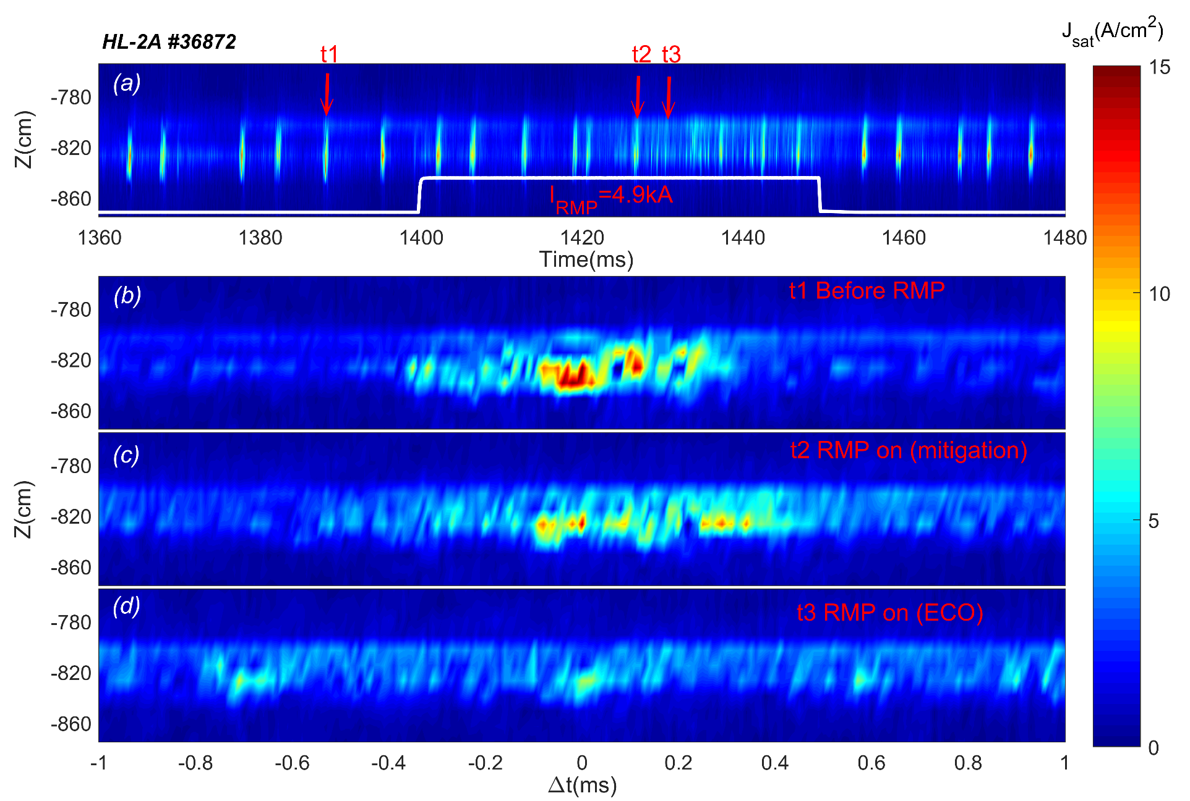
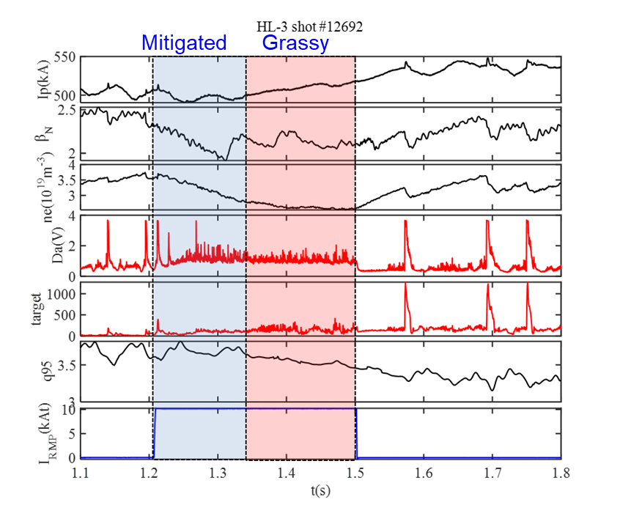
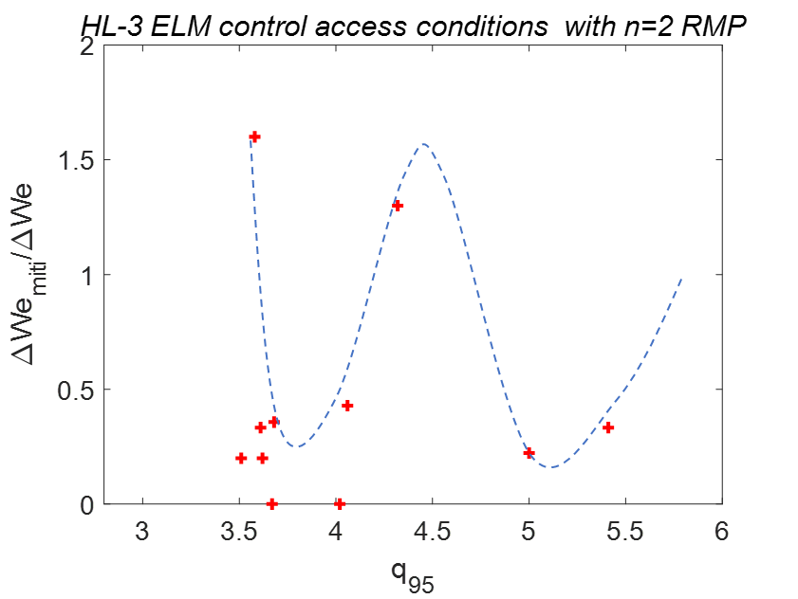
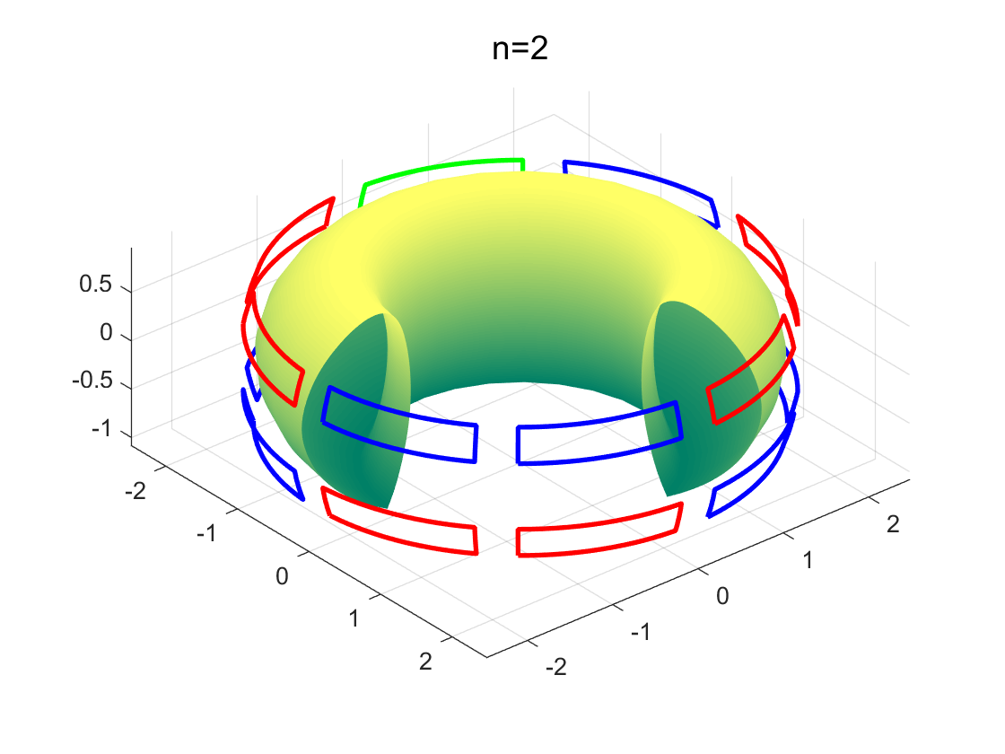
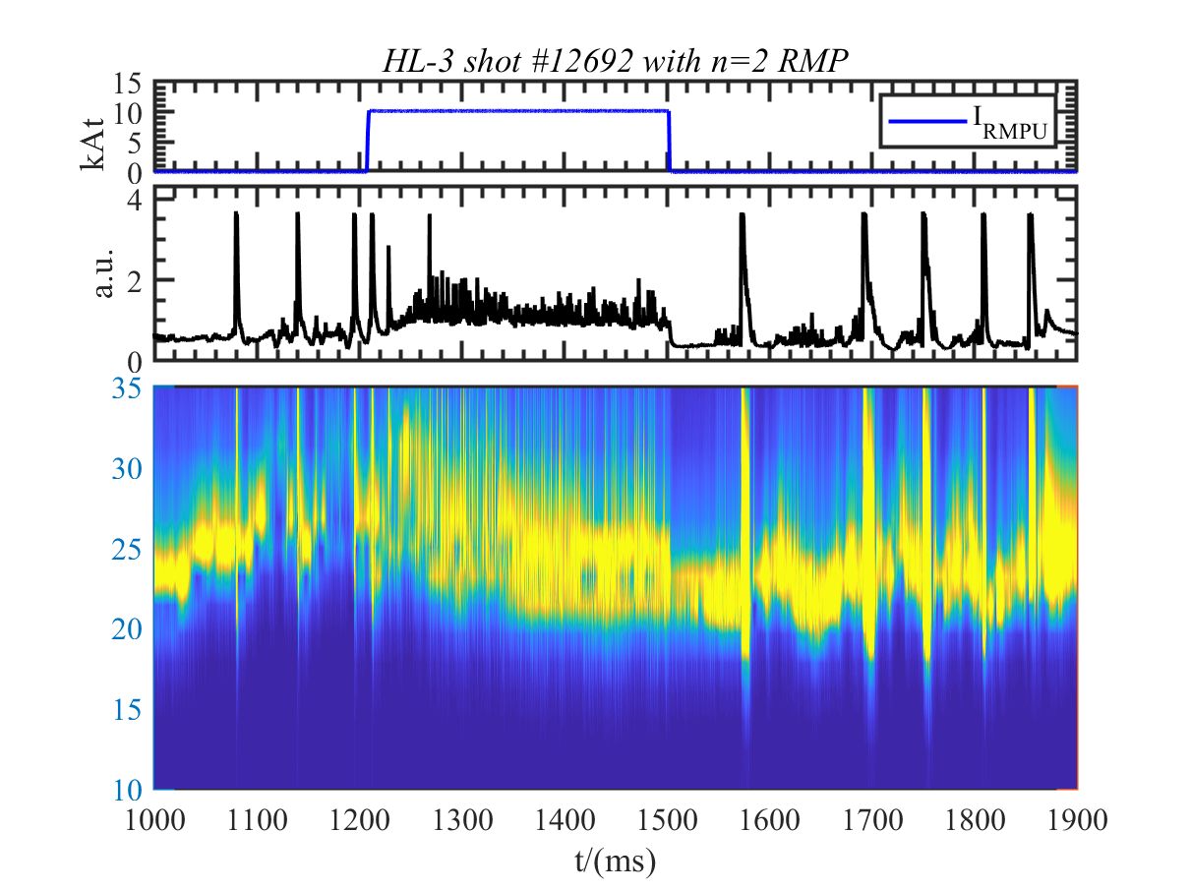
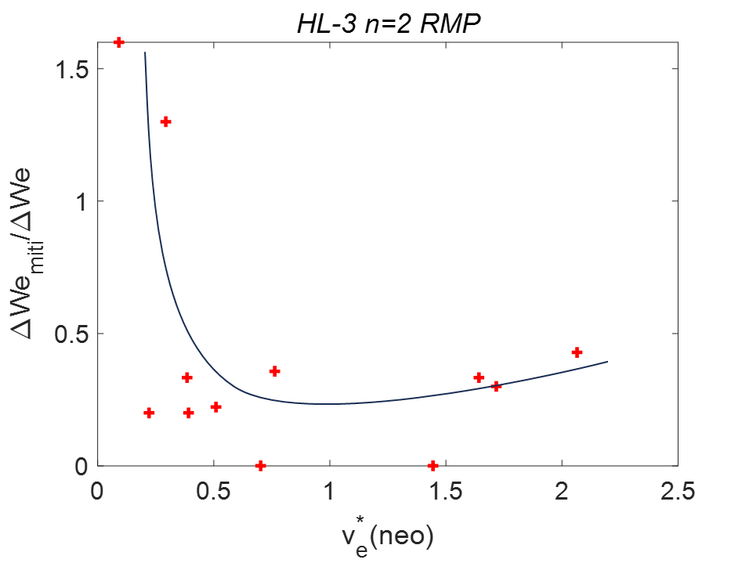
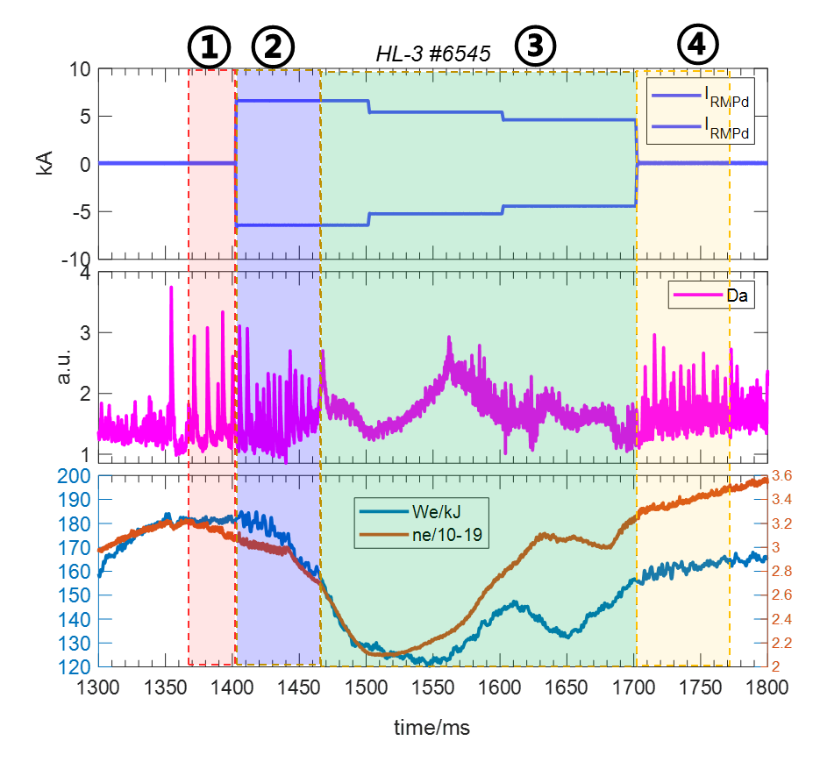

PERTURBATED MAGNETIC FIELD THRESHOLD OF EDGE COHERENT OSCILLATION
DURING ELM MITIGATION BY RMP
¹T. F. SUN, ¹YI LIU, ¹X. Q. JI, ^{1,2}B. T. CUI, ¹G. Z. HAO, ¹R. KE, ¹J.M. GAO, ¹N. WU, ¹S. WANG, ¹J. Q. XU, ¹A. WANG, ¹M. Y. HE and ¹Y. X. FENG
¹Southwestern Institute of Physics, Chengdu 610041 China
²Department of Engineering Physics, Tsinghua University, Beijing 100084 China
suntf@swip.ac.cn
ID: 3286
Progress of ELM Control Experiments with RMP HL-3 Tokamak
BACKGROUND
The access condition mitigation with n=1 RMP
Experimentally determined access condition in terms of pedestal collisionality (ν∗_{e}) versus pedestal density as a fraction of the Greenwald density (n_{e}/n_{GW}) for mitigation of type I ELMs.
The collisional region of type-I ELM mitigation with the n=1 RMP : ν∗_{e}= 0.1-1, and relatively wide range on HL-3.
The access condition mitigation of type I ELMs with n=1 RMP on HL-3 is near the KSTAR n=1.
The reference scenario for ITER is H-mode, the divertor energy flux density below 0.5MJ/m²[2]; The ELM frequency scales as f_{ELM} ∝ I_{P}^{−1.8} in the ITER baseline Q ∼ 10 scenario, plasma current I_{P} - 15MA. Without control, natural f_{ELM} ∼1Hz with each ELM having W_{ELM} ∼ 20MJ must vary from f_{ELM} ∼ 7Hz for I_{P} = 5MA[3].
RMP decreases the ELM amplitude and keep high current discharge has shown the different region of collisionalities on different devices[5].
It was found that the ECO is excited by three-wave interaction of turbulence enhanced by the RMP field through the change of electron density gradient in the pedestal region because of pump-out effect. The oscillation providing a channel for a nearly continuous extra particle transport across the pedestal during the ELM mitigation by RMP[].
But the threshold makes the RMP mitigate ELMs successfully with different types of phenomenon, including ELMs with higher frequency, grassy ELMs, and mitigated ELMs with ECOs.
HL-3 n=1
ELM mitigation with n=2 RMP
RMP control ELM with 2 stage：
ELM mitigation with ne pomp-out.
Enhance the Da radiation but still maintain the H-mode.
Change Type-I ELM to small (grassy) ELM.
Small ELMs help the transport of energy.
The access condition of collisional region with n=2 is similar with n=1.
There are two q₉₅ widows of ELM control 3.7 and 5.2 from we loss.
The mitigation effect decreases when the collisionality becomes lower.
.
Setup of RMP Coil on HL-3
n=1 and 2 RMP arrays
n=1 RMP is produced by 2×4 coil array.
n=2 RMP is produced by approximate 2×8 coil array
With the 180° phase and poloidal angle between up and down coil is about 73°.
n=1 and 2 RMP are all odd connection and n=1 toroidal connection which configured as ’++--’ and n=2 is configured as ’++--++--’ .
CONCLUSION
The collisionality (ν_{e}*) versus (n_{e} / n_{GW}) region of type-I ELM mitigation with the n = 1 RMP shows relatively wide range on HL-3 and the access condition is near the K-STAR access condition with n = 1；
The n = 2 RMP can control the ELM and change them to small(grassy) ELM with the increasing ne accompanying long live mode. The control effect decrease when the collisionality become lower；
The current (Magnetic field) statistic window of ELM mitigation with ECO is found;
ELM mitigation with n=1 RMP
RMP control ELM with 3 stage
ELM mitigation;
exit the H mode with ne pumpout ;
ne increases when I_{RMP} decrease and access H mode again after RMP;
B_{t} ~ 1.52–1.53 T; I_{p} ~ 497–500 kA;
n_{e} ~ 1.9 ×10⁻¹⁹/ m³ ;
q₉₅ = 4.65;P_{NBI}=2MW；
REFERENCES
Loarte A et al 2013 Plan for ELM mitigation on ITER ITER Technical Report No 1. C
A. Kirk, PPCF 55 (2013) 124003 (11pp)
A. Loarte , Nucl. Fusion 54 (2014) 033007
T. F. Sun et al. (2021) Nucl. Fusion 61 036020 (8pp)

