Slide 1
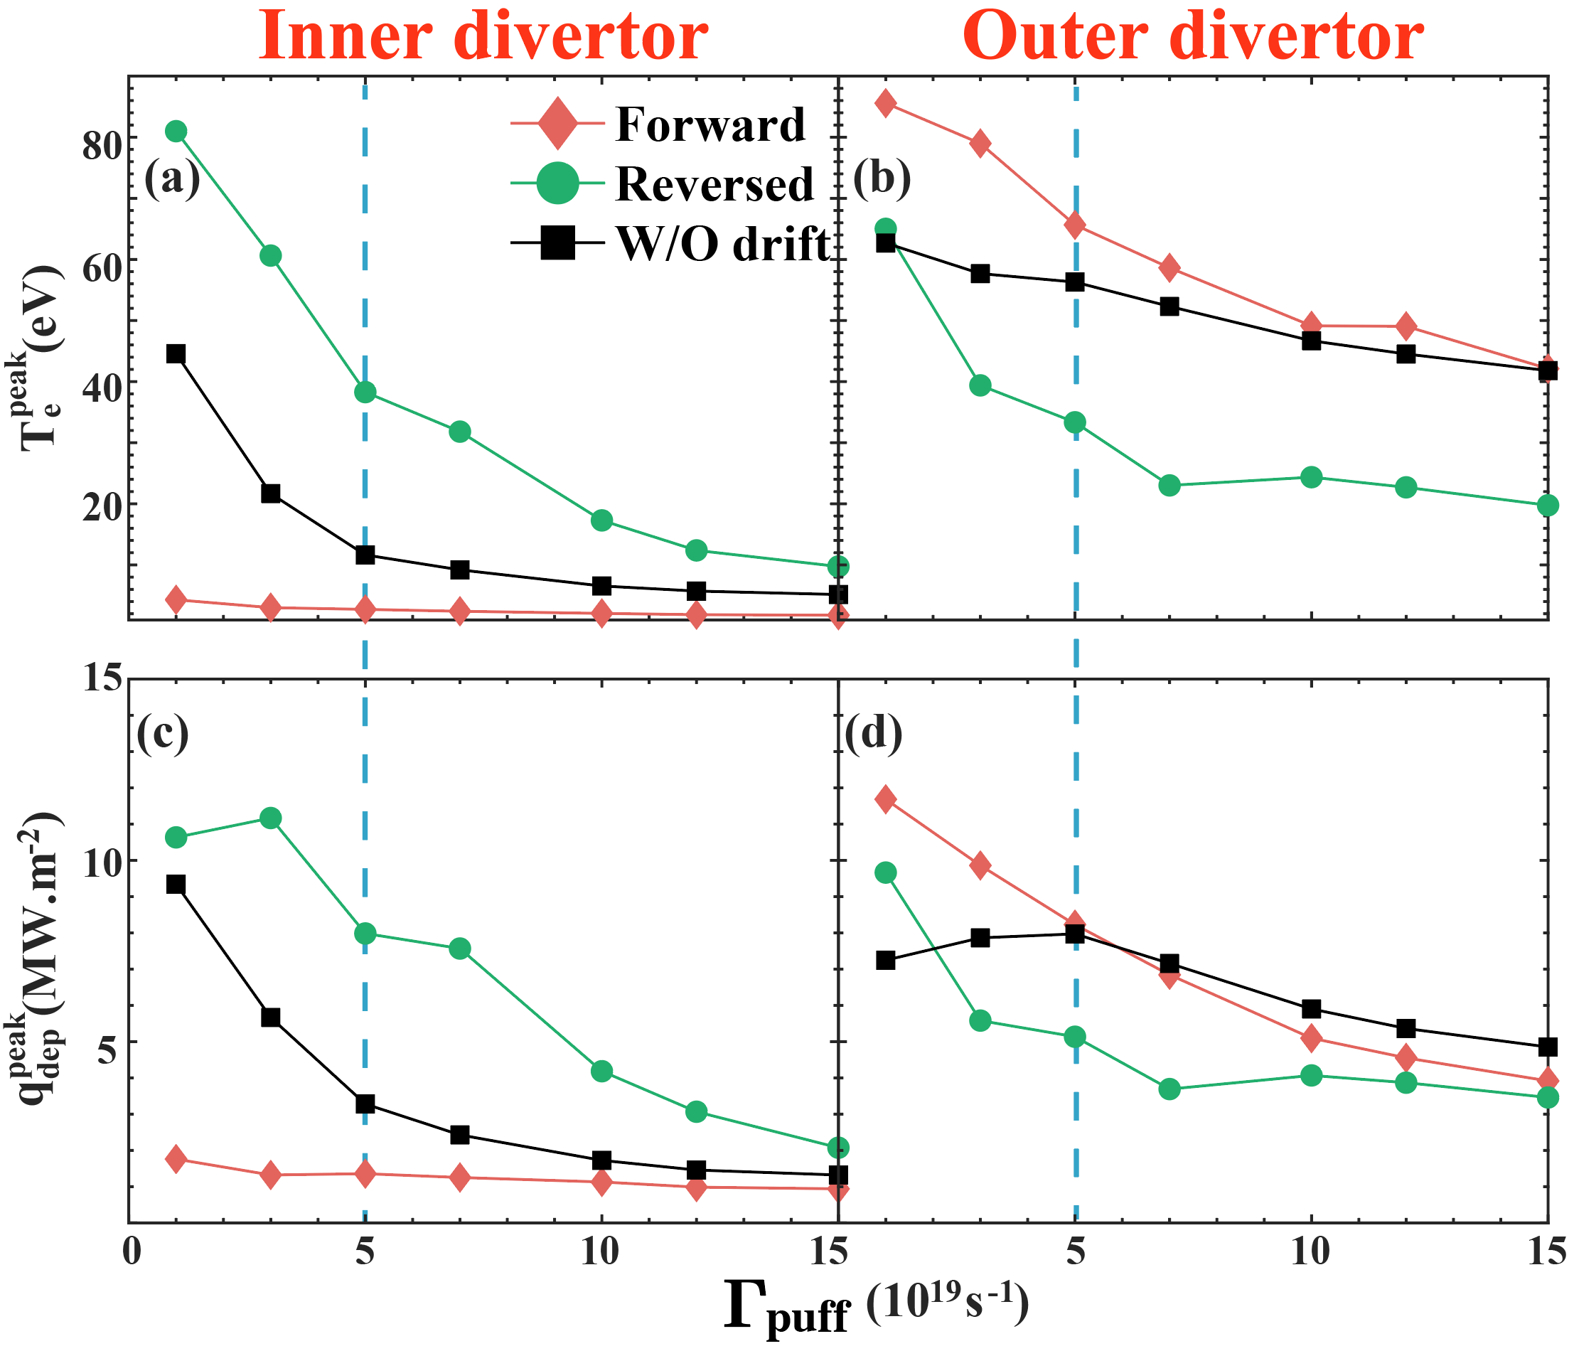
The radiative divertor and in/out asymmetry in HL-3 by impurity seeding with full drifts
Yanjie Zhang¹, Chaofeng Sang², Ilya Y Senichenkov³, Jiaxian Li⁴, Guoyao Zheng⁴, Vladimir A Rozhansky³, Xuele Zhao², Chen Zhang², Yilin Wang² and Dezhen Wang²
¹School of Physical and Mathematical Sciences, Nanyang Technological University, 637371 Singapore
²Key Laboratory of Materials Modification by Laser, Ion and Electron Beams (Ministry of Education), School of Physics, Dalian University of Technology, Dalian 116024, People’s Republic of China
³Peter the Great St. Petersburg Polytechnic University, 195251, Polytechnicheskaya ul., 29, Saint Petersburg, Russia Federation
⁴Southwestern Institute of Physics, Chengdu, 610041, People’s Republic of China
^{Yanjie.zhang@ntu.edu.sg}
ID: P5-3288
ABSTRACT
OUTCOME
Goal: Mitigate extreme heat loads on divertor components in the HL-3 tokamak using Neon (Ne) and Argon (Ar) gas seeding to manage heat distribution (in/out asymmetry).
Unfavorable Magnetic Field: Benefit: Successfully reduces the in/out asymmetry of the divertor heat load; Trade-off: Causes a significant increase of Neon (Ne) impurity in the main plasma core.
Divertor Geometry: A smaller, "shrunken" dome geometry was found to hinder fuel pumping efficiency. This directly impacts impurity distribution and the effectiveness of asymmetry control.
Argon vs. Neon Seeding: Argon (Ar) is a more effective impurity screener than Neon (Ne). However, Ar results in higher energy loss from the core plasma due to its higher radiation efficiency.
Primary Takeaway for Discussion: Controlling divertor heat load asymmetry involves a series of critical trade-offs. The choice of magnetic field, divertor design, fueling location, and impurity gas type must be carefully balanced to reduce divertor heat loads without compromising the core plasma's purity and performance.
Divertor Asymmetry
Forward Drifts: Intensify the in/out divertor asymmetry, leading to easy detachment at the inner target while leaving the outer target hot.
Reversed Drifts: Significantly reduce the asymmetry by increasing the inner target heat load, resulting in a more symmetric and balanced power distribution.
Detachment Limitation: Despite improved symmetry, even high Neon seeding with reversed drifts was insufficient to achieve simultaneous full detachment at both inner and outer divertor targets.
BACKGROUND
A critical challenge for future fusion devices like ITER is managing the immense heat flux that will strike the divertor targets. The necessary shift from carbon to more resilient tungsten components has created a new problem: tungsten's low intrinsic radiation is insufficient to safely dissipate the incoming power, risking material damage.
The leading solution is the "radiative divertor," a concept that involves seeding impurities (e.g., Neon, Argon) into the plasma edge to radiate energy away. However, inherent plasma drifts create a significant in/out asymmetry, which unbalances the heat load on the divertor targets and must be actively controlled.
This work utilizes the HL-3 tokamak, whose highly flexible divertor is ideal for this research, to systematically investigate key control knobs. We explore the combined effects of magnetic field direction, divertor geometry, upstream fueling, and the choice of impurity species to develop a comprehensive control strategy.
By developing a robust understanding of these control methods, this research directly contributes to designing a viable power exhaust solution, a crucial step toward making fusion energy a safe and sustainable reality.
FIG. 2 The peak of electron temperature (𝑇_𝑒^𝑝𝑒𝑎𝑘) and deposited heat flux (𝑞_𝑑𝑒𝑝^𝑝𝑒𝑎𝑘) in the inner divertor target (a,c) and the outer divertor target (b,d) of SD, as functions of the Ne seeding rate. The upstream D2 fueling rates is set to 1×1022 particles/s. The blue dash line indicates Ne seeding rate used for detailed analysis.
FIG. 3 The 2D contours of Te (a-c), Prad,total (d-f) and total Ne density nNe,ions (g-i) of forward drifts (upper), no drifts and reversed drifts (lower) cases. The Ne seeding rate is 5×1019 Ne atoms/s
Key Findings: Effect of Dome Geometry
Improved Performance: Reducing the size of the divertor dome progressively lowers the divertor plasma temperature, with the "no dome" case showing the largest reduction.
Full Detachment Achieved: The "no dome" configuration is the most effective, successfully achieving simultaneous and complete detachment at both the inner and outer divertor targets.
Mechanism: A smaller dome reduces pumping efficiency, which traps more Neon ions in the divertor region, thereby enhancing radiation and facilitating detachment.
METHODS
Superior Cooling: Argon (Ar) is a more efficient radiator than Neon (Ne), resulting in lower divertor plasma temperatures and more extended high-radiation regions for the same seeding rate.
Better Impurity Screening: Ar provides significantly better impurity screening. Consequently, core plasma contamination with Ar is less than half that of Ne under the same conditions.
Computational Model: The simulations were performed using the SOLPS-ITER code package (v3.0.8). This code couples the B2.5 multi-fluid plasma code with the EIRENE kinetic code for neutral particle transport.
Physical Configuration: The model is based on the HL-3 tokamak in a Lower Single Null (LSN) magnetic configuration, assuming Tungsten (W) as the plasma-facing material. Both forward and reversed toroidal magnetic field (B_{t}) directions were simulated to study the effect of plasma drifts.
Gas & Impurity Injection:Deuterium (D₂) fuel is injected at the Outer Mid-Plane (OMP). Impurities—either Neon (Ne) or Argon (Ar)—are seeded near the Outer Strike Point (OSP) to induce radiative divertor conditions.
FIG. 5 The 2D contours of Te (a-c), Prad,total (d-f) and total Ne density nNe,ions (g-i) of forward drifts (upper), no drifts and reversed drifts (lower) cases. The Ne seeding rate is 5×1019 Ne atoms/s
FIG. 6 Comparison of 𝑇_𝑒^𝑝𝑒𝑎𝑘 (a) and 𝑞_𝑑𝑒𝑝^𝑝𝑒𝑎𝑘 (b) between inner and outer divertor for forward (red) and reversed (green) drifts with Ne (diamond marker) and Ar (circle marker) seeding.
CONCLUSION
Requiring a balance between divertor protection and core plasma performance due to critical trade-offs.
Reversed magnetic drifts are highly effective at mitigating asymmetry, but this benefit comes at the cost of increased impurity accumulation in the core.
Argon (Ar) seeding provides superior impurity screening compared to Neon (Ne); however, its high radiation efficiency leads to greater power losses from the core plasma.
Upstream D₂ fueling is a confirmed tool for improving impurity screening, providing a positive control mechanism for influencing divertor conditions.
FIG. 1 (a) Sketch of the SOLPS simulation domain and wall structure. The regions of the core, SOL, PFR and the divertor entrance are indicated by different colors (the divertor entrance is taken at the X-point). (b) ﻿The imposed radial profiles of particle diffusivity D⊥ and electron/ion thermal diffusivity χe,i at outer mid-plane (OMP).
ACKNOWLEDGEMENTS
This work was supported by the National Natural Science Foundation of China under Grant No. 12235002, National MCF energy R&D Program No. 2024YFE03160000.

