Slide 1
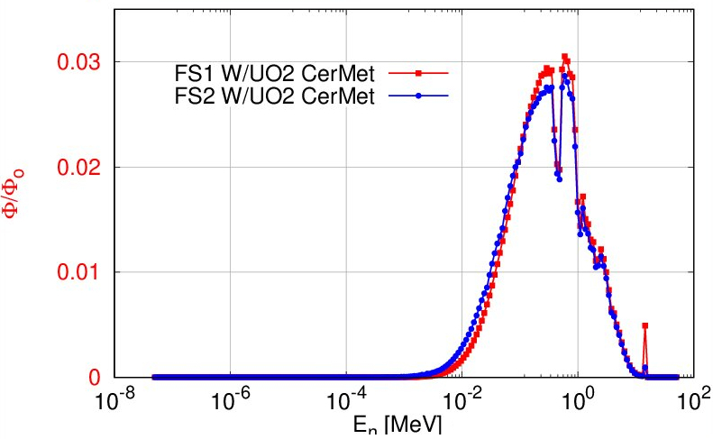
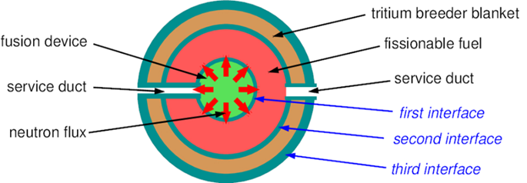
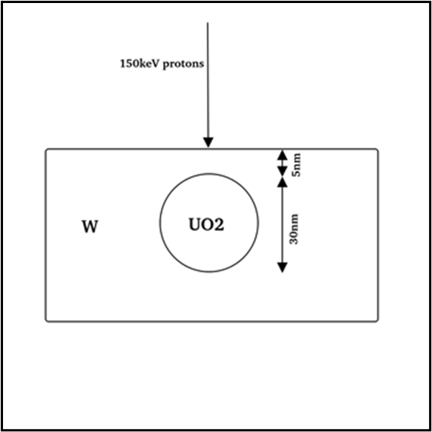
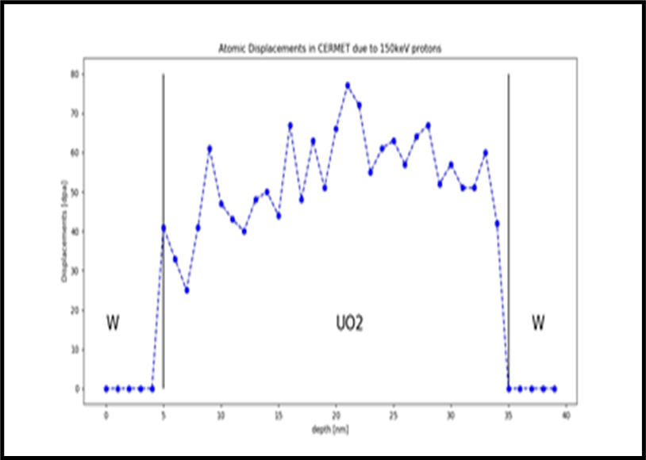
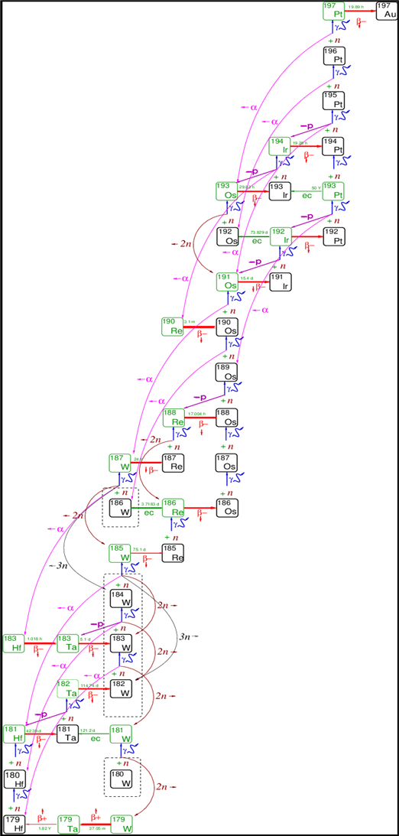
Ion Interactions in Tungsten-Rich CERMET Materials
M. Petaccia
J. A. Garcia Gallardo
J. L. Gervasoni
CNEA, Argentina
Juana.gervasoni@gmail.com
ID: xxx
ABSTRACT
OUTCOME
Tungsten (W) is a prime candidate for plasma-facing and nuclear structural materials due to:
Highest melting point of any metal
Low tritium retention and erosion resistance
Stability under neutron irradiation
CERMETs with high W concentration aim to combine mechanical strength and radiation resistance.
CERMET MATERIALS
Metallic fuels such as U-Pu-Zr have limitations in temperature (up to about 1000 K) that can be exceeded using CerMets (Ceramic+Metal) that allow reaching close to3000 K. These materials were developed to build reactors for air and space propulsion like , as is described in [3].
CERMET Samples consist of uranium dioxide (UO2) fuel particles in a tungsten metal matrix, which has been shown in previous international programs to improve the yield and retention of fission products.
We use uranium dioxide in the two shells.
ION ENERGY LOSS MECHANISMS
Dominant process: Electronic stopping (electron excitations & plasmons)
Secondary process: Nuclear stopping (phonon generation & atomic displacements)
At ~100 keV for hydrogen isotopes (H, D, T): Electron excitation: ~100× larger than phonon excitation. Defect production (phonons): peaks near the ion range, linked to lattice damage Depth. High-Z tungsten increases electron availability → higher energy loss to electronic stopping.
ODS TUNGSTEN & NANOPARTICLES
Oxide dispersion strengthened (ODS) W alloys embed Y₂O₃ nanoparticles to trap defects.
Under α-particle irradiation (~150 keV): Nanoparticle size matters:
Small (~10 nm) particles at ~150 nm depth → bulk-like displacement profile. - Larger or shallower particles → modify cascades by lowering atomic density locally. - Interfaces act as sinks for radiation-induced defects, mitigating swelling and long-range damage.
BACKGROUND: HYBRID REACTORS
Global Interest in Hybrid fusion–fission systems (FFHS) are gaining attention worldwide, with diverse design approaches: SEE FIGURE 1
Core Components of FFHS Fusion device as neutron source. Fissionable fuel system. Tritium breeding blanket (TBB). Neutron reflector for flux optimization. Three-Layer Configuration Components are arranged concentrically to maximize neutron utilization.
This model: Two concentric shells of 8% enriched uranium as metallic fuel. Lithium silicate as tritium breeding blanket (TBB)
Multiplier Cascades Solution Proposed design uses concentric fissile shells separated by large voids to enhance neutron multiplication.
Multiplying capacity depends on shell geometry, fuel type, and spacing between layers.
Figure 3: Neutron Spectra for different shells [4]
Figure 1: Scheme of a FFHS reactor [1]
SPENT NUCLEAR FUEL CHALLENGES & FFHR MODELING
Spent nuclear fuel emits radiation over extended periods due to the presence of radioactive isotopes formed during irradiation.
Minor Actinides Formation These isotopes, including minor actinides, result from neutron capture by uranium or plutonium in the fuel.
Transmutation Potential Radionuclides can be converted into stable or fissile isotopes through further irradiation with fast or thermal neutrons. Figure 2 shows that the spectra of W is Free from minor actinides!:
System simulated with IMPC5, where a sphere of UO2 is embedded into a Tungsten matrix [5]
CONCLUSION
Implications for CERMET Materials:
Large tungsten content ensures strong electronic stopping and radiation shielding.
Ceramic/oxide phases can localize or redistribute cascades, reducing damage propagation.
By microstructural design (nanoparticle size, depth, distribution):Radiation damage can be controlled
Material performance in fusion/fission environments can be optimized.
However, corrosion mechanisms at these energies require further investigation. Future research should also focus on the temperature distribution surrounding the fuel sphere, with special attention to the temperature-dependent properties of tungsten.
REFERENCES
[1] CLAUSSE A., SOTO L., FRIEDLI C., ALTAMIRANO L., Annals of Nuclear Energy 78 (2015) 10-14.
[2] GARCIA-GALLARDO, J.A., GIMENEZ, M.A.N., GERVASONI, J.L., Annals of Nuclear Energy 147 (2020) 107739.
[3] SONG, J., AN, W., WU, Y., TIAN, W., Front. Energy Res., 6 (2018).
[4] GARCÍA GALLARDO, J.A., New Energy Exploitation and Application, Vol. 04, Issue 01, (2025), 175-186.
[5] PETACCIA, M., GALLARDO, J.A., GERVASONI, J:L, Tech. Meeting on Compatibility Between Coolants and Materials for Fusion Facilities and Advanced Fission Reactors; International Atomic Energy Agency (IAEA), (2023).
Figure 2: W transmutation cycle under 14 MeV neutron irradiation.
Dashed lines enclose initial isotopes present in natural W.
Stable isotopes are in bold boxes. Arrows : reactions and decays [2].

