Slide 1

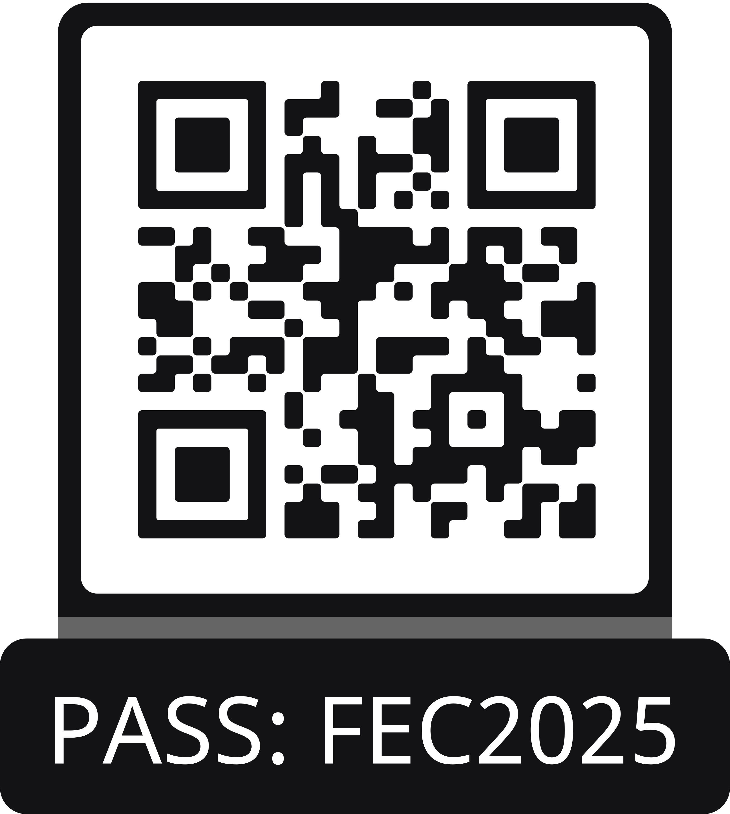
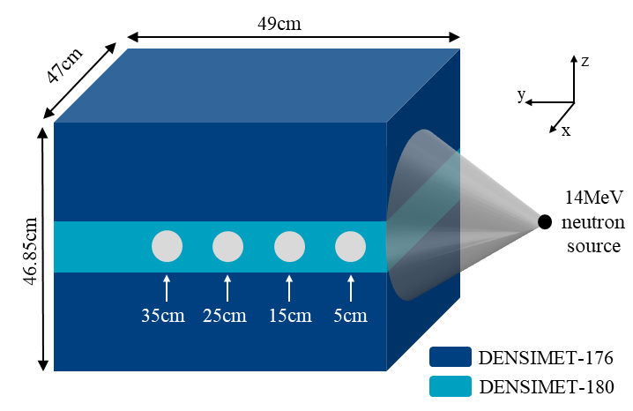



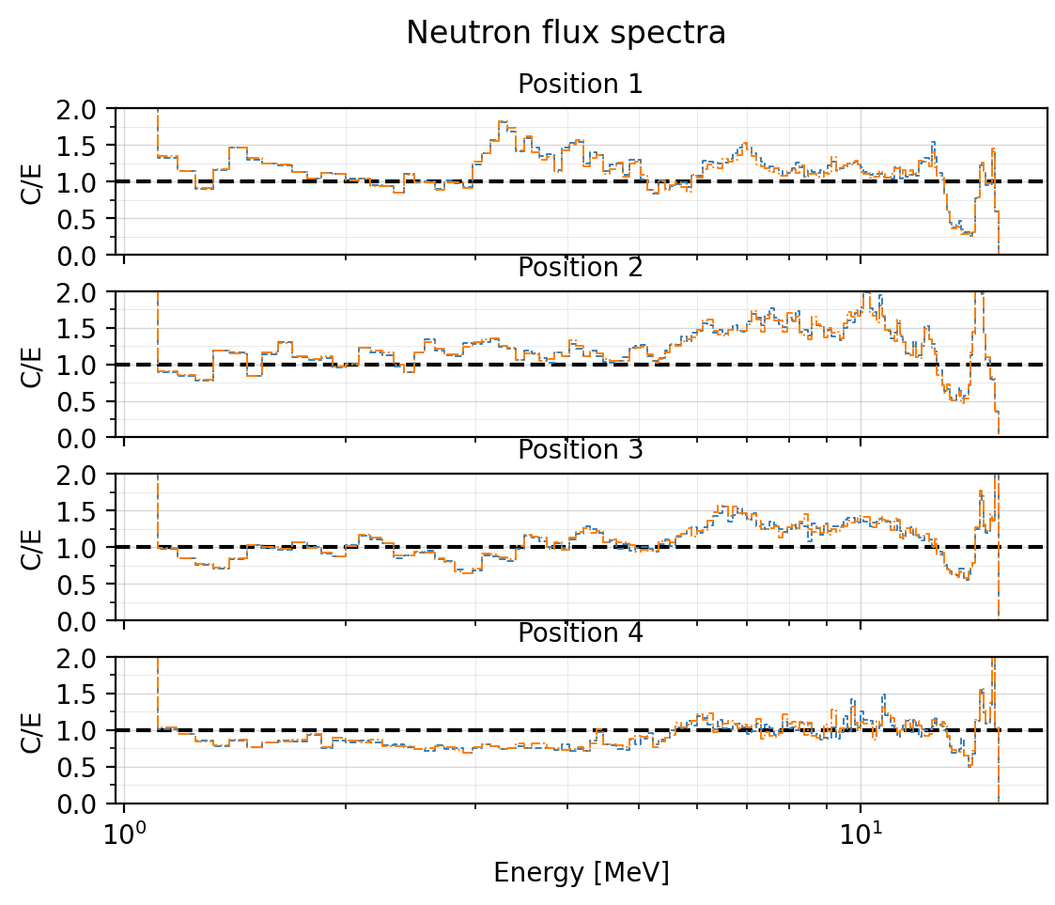
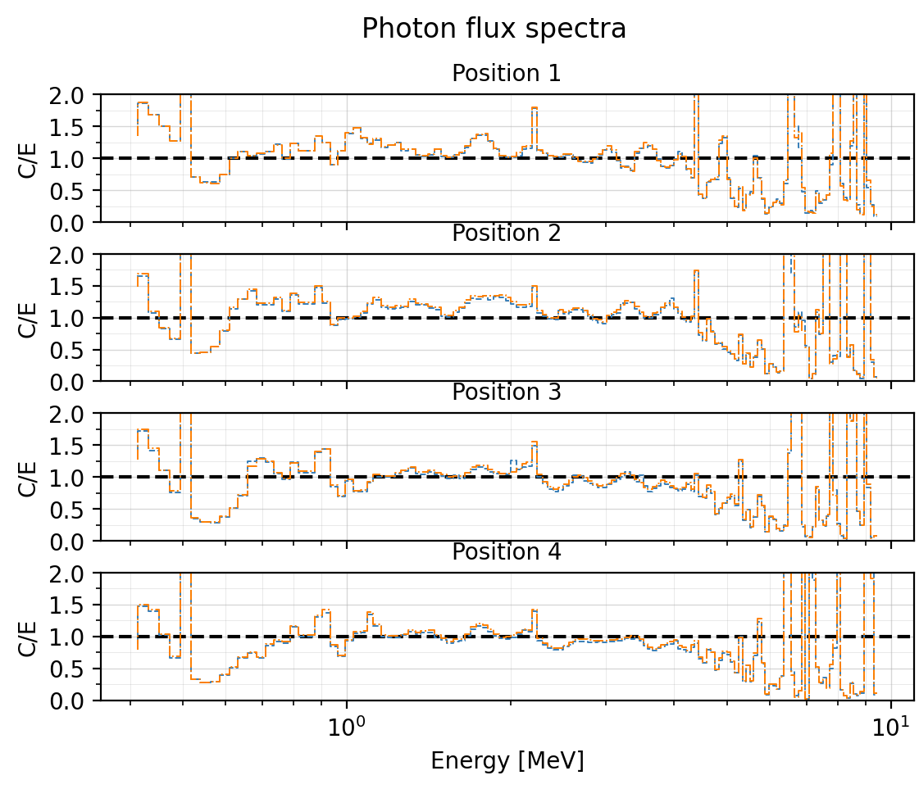
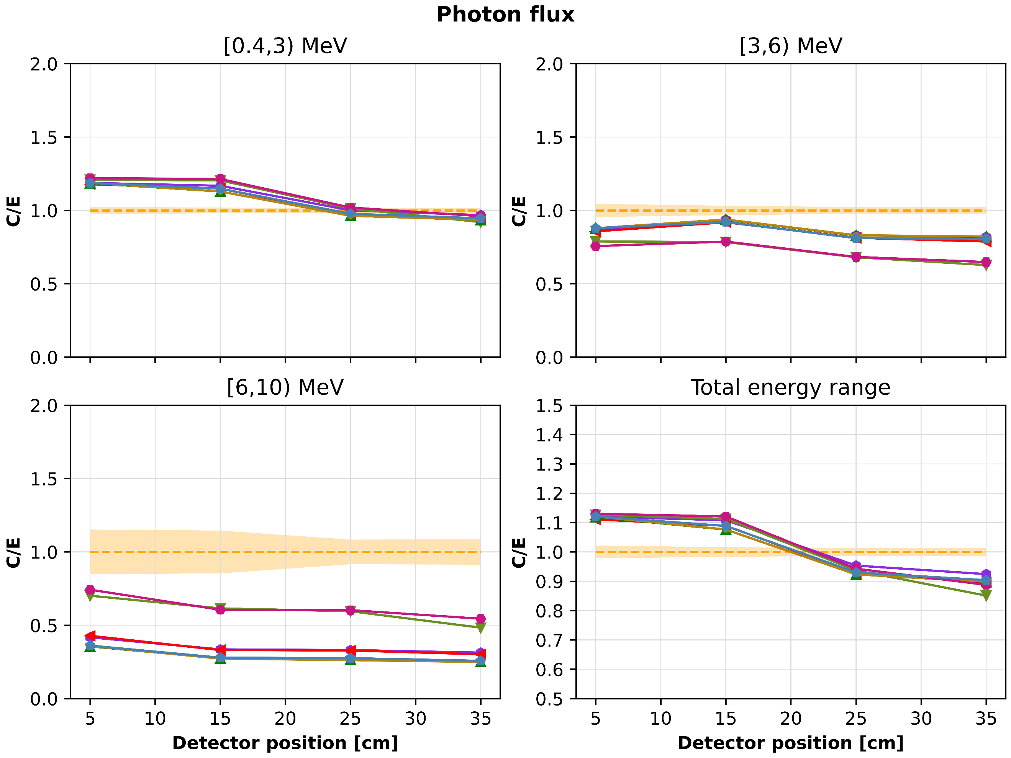
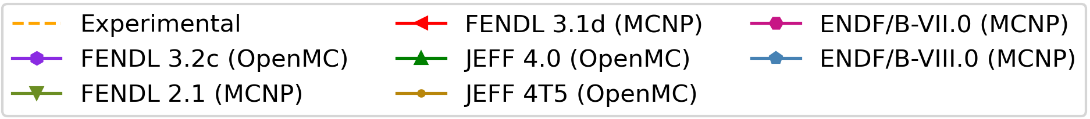
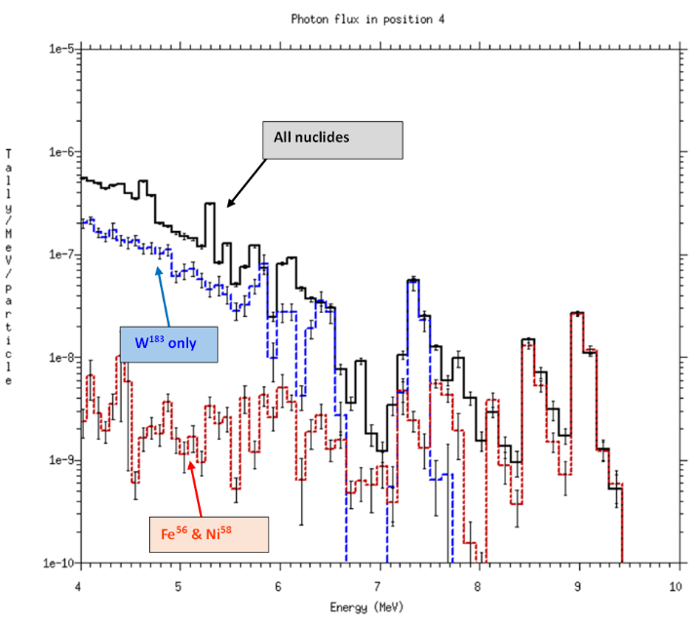
APPLICATION OF THE TUD-W BENCHMARK FOR NUCLEAR DATA AND CODE ASSESSMENT
M. Fabbri*, F4E, M. Campos, ATG, L. Petrizzi, Retiree – former EU commission,
A. Kolsek, F4E, D. Laghi, F4E.
Executive resume
The study evaluates tungsten nuclear data using the TUD-W SINBAD benchmark across two Monte Carlo transport codes: MCNP6.2 and OpenMC v0.15.0, providing to the latest indications for the further development of the code. Simulations were performed to calculate neutron and photon flux spectra at different depths of within a thick tungsten alloy (DENSIMET-176/180) exposed to a 14 MeV neutron source. Experimental measurements from an NE 213 scintillation spectrometer served as reference.
The contribution shows:
The successful conversion of the MCNP model to OpenMC and confirms model equivalence.
The comparison of results using various nuclear data libraries, finding general agreement but notable discrepancies (computational underestimation) in photon spectra above 6 MeV. These were traced to (n,γ) reactions in 183W and 58Ni, with differences among libraries like FENDL 2.1 and ENDF/B-VII.0 attributed to variations in tungsten isotope data.
Pre-print
MCNP to OpenMC conversion
Geometry and material: csg2csg repository employed.
Tally: reimplemented from scratch.
Source: quite challenging, which required a thorough understanding of source definition for both transport codes and a detailed manual translation process.
Weight window: the MCNP based on cells cannot be translated as this features is absent in OpenMC, thus regenerated by the MAGIC approach.
MCNP vs OpenMC C/E results
FENDL3.2c employed for both software.
A very good agreement can be observed for both neutron and photon computational spectra in all positions.
The mean of the discrepancy between OpenMC and MCNP being 3.43% for neutrons and 4.23% for photons.
Validation of the developed OpenMC model and the confirmation of the proper operation of OpenMC as a transport code in the context of the TUD-W benchmark.
The benchmark added to the JADE V&V code.
Comparison across the different nuclear data libraries
The C/E discrepancy observed results for high-energy photons was investigated by the PKMT card in MCNP.
This card was employed to selectively disable the secondary gamma production for different isotopes.
This revealed that one of the first photon lines responsible for a substantial deviation, corresponding to an energy of 7 MeV, originated from 183W(n,γ) reactions.
The higher-energy peaks related to the discrepancies were found to originate predominantly from radiative capture, (n,γ), in 58Ni, one of the main impurities present in DENSIMET.
Highlighted critical role of impurities, not only in activation studies, but also in prompt radiation transport → necessity for thorough material characterization and certification to ensure accurate response predictions.
DISCLAIMER. The views and opinions here in do not necessarily reflect those of the F4E or ATG.
F4E and ATG Europe cannot be held responsible for any use which may be made of the information contained herein.

