Slide 1
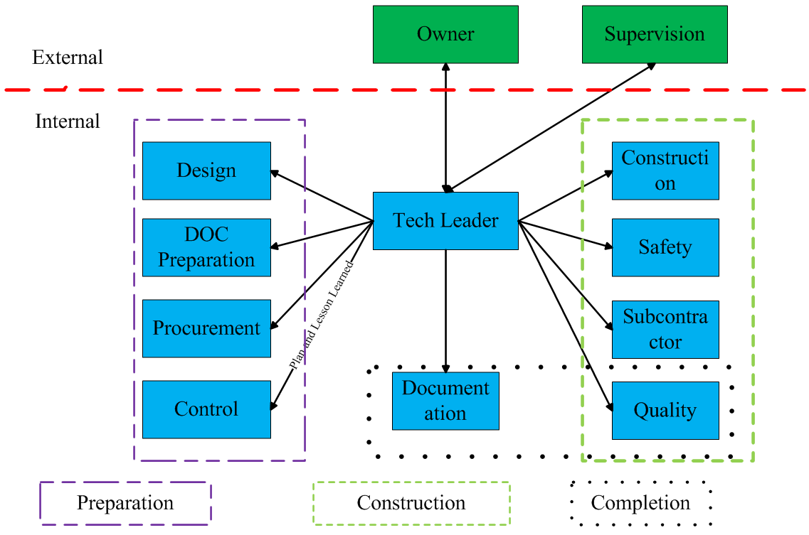
Towards Practical Fusion Energy - Engineering Challenges and Development Strategies by the Perspective of CNPE
Wen Jingwu¹, Peng Shangkun¹, He Xuxia¹, Fan Li², Li Haitao², Lu Peng¹, Guo Zhipeng² , Song Zhilin²
1. Fusion Engineering Technology Center (FETEC), 2. Beijing Institute of Nuclear Engineering (BINE)
China Nuclear Power Engineering Co., Ltd. (CNPE), Beijing 100840, China
wenjw@eu.cnpe.cc
ID: 3016
ABSTRACT
BACKGROUND
There are five critical dimensions in fusion reactor engineering:
①safety regulatory systems; ②design and engineering management;
③project implementation practices; ④industrial supply chain cultivation; ⑤standardization framework.
Development strategies: leveraging organizational strengths to advance fusion energy development, formulating fusion regulatory policies that balance safety and development, fostering public-private collaboration to cultivate the fusion industry chain, and establishing a top-down design approach for building the fusion standardization system.
Breakthroughs in nuclear fusion technology poised to revolutionize energy production and generate substantial economic benefits, emerging as a key medium-to-long-term development focus in global science, technology, and energy domain.
The current research on controlled nuclear fusion is transitioning from scientific experiments to engineering practice.
The main forces of China's fusion industry include 2 research institutes (SWIP and ASIPP), 3 leading nuclear power EPC companies (CNNC, CGN, and SPIC), as well as a series of universities and innovative enterprises.
The engineering connotations of different development stages of fusion reactors
Dimension of Engineering | Experimental Facility | Experimental Reactor | Demonstration Reactor | Commercial Reactor
Organizational Model | Led by Research Institutes | Led by Research Institutes with Enterprise Participation | Led by Enterprises with Research Institute Participation | Led by Commercial Operation Companies
Safety Regulatory Systems | Establish Basic Safety Standards | Introduce a Hierarchical Regulatory Framework | Establish a Regulatory and Legal System for Fusion Reactors | Optimize and Iterate the Fusion Reactor Regulatory System
Design and Engineering | —— | Full-System Integrated Design | Economic Optimization Design | Factory Standardized Design
Project Implementation | —— | Model-Based Systems Engineering (MBSE) | Full-Lifecycle Project Management | Mature Fusion Reactor Project Management System
Industrial Supply Chain | —— | Industrial Chain Cultivation | Industrial Chain Cultivation with Diversified Applications | Enhancement of Full-Industrial-Chain Independence
Standardization Framework | —— | —— | —— | Systematization and Independence of Standards
CHALLENGES / METHODS / IMPLEMENTATION
ITER Project Assembly Management with Technology at its Core
1. Fusion reactor engineering organizations face the dilemma of a disconnect between research institute and enterprise delivery, coupled with talent and engineer mismatch.
2. Nuclear safety regulatory principles urgently need to be clarified.
3. Engineering design capabilities for fusion reactors need to be enhanced.
4. The understanding of fusion reactor project management and its difficulty needs to be deepened.
5. There is a contradiction between the development of the fusion reactor supply chain industry and its actual demands.
6. Existing standard system is incompatible with fusion reactor engineering.
OUTCOME
1. Leverage Organizational Advantages to Promote Fusion Energy Development
- Implement proactive policy guidance.
- Utilize enterprises' strengths in innovation and industrial transformation.
2. Formulate Nuclear Fusion Regulatory Policies Balancing Safety and Development
- Clarify the principles of fusion nuclear safety regulation.
- Expand the scope of nuclear material application and research.
- Adhere to the bottom line of nuclear safety culture.
3. Public-Private Cooperation to Cultivate the Fusion Industry Chain
- Give play to the development guiding role of management departments.
- Attach importance to the promotion role of industrial alliances.
- Highlight the facilitation role of iterative industrial incubation.
4. Establish a Nuclear Fusion Standard Framework based on the Top-Level Design
- Implement top-level planning for standards.
- Promote the institutionalized operation of standard formulation.
CONCLUSION
Research and Establishment of Design Management System for Fusion Reactor Engineering. This system is built and improved based on the existing systems and platforms of the nuclear industry.
Fusion Reactor Engineering and Construction System led by professional enterprises.
- Project organization system centered on plant EPC;
- Project management system with technical management as core;
- Project control system centered on agile management;
-Construction management system supported by IT and Digitalization.
ACKNOWLEDGEMENTS / REFERENCES
Research on the Development of Engineering Applications of Fusion Reactors in China [J]. Strategic Study of Chinese Academy of Engineering

