Slide 1
COPYRIGHT NOTICE
This original Work was created by Howard Wilson, Director Science and Technology, on 9 October, 2025.
Copyright © UK Industrial Fusion Solutions Ltd. 2025. All rights reserved.
No part of this publication may be reproduced, stored in a retrieval system of any nature, or transmitted, in any form or by any means including photocopying and recording, without the prior written permission of the copyright owner.
Licences issued by the Copyright Licensing Agency or any other reproduction rights organisation do not apply. If any unauthorised acts are carried out in relation to this copyright work, a civil claim for damages may be made and/or a criminal prosecution may result.

Slide 2
STEP: Driving a pathway to accelerated fusion delivery
Howard Wilson for the STEP Team
30th IAEA Fusion energy conference
13-18 October, 2025

Slide 3
STEP: Accelerating fusion delivery
Climate change and energy security drive urgency in the delivery of a sustainable, reliable, independent means to power our industry and society
Raises a key and fundamentally important question:

Slide 4
STEP: Accelerating fusion delivery
Climate change and energy security drive urgency in the delivery of sustainable, reliable, independent means to power our industry and society
Raises a key and fundamentally important question:
Can we accelerate the delivery of fusion energy?
The STEP programme is designed to provide an answer

Slide 5
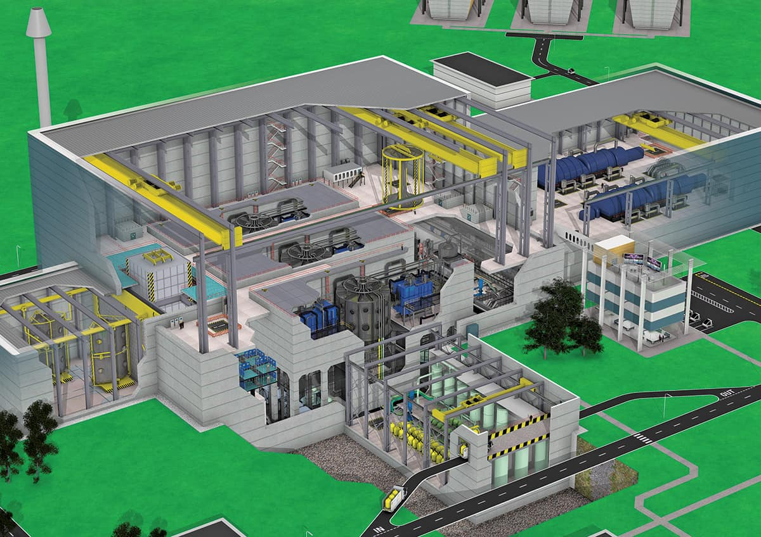
Commercially viable pathway to fusion delivery contains three key elements
Commercial Fusion Power
Near term benefits for stakeholders and investors
National skills and industrial capability to deliver fusion
Requirements
Demonstration of technical and commercial viability

Slide 6
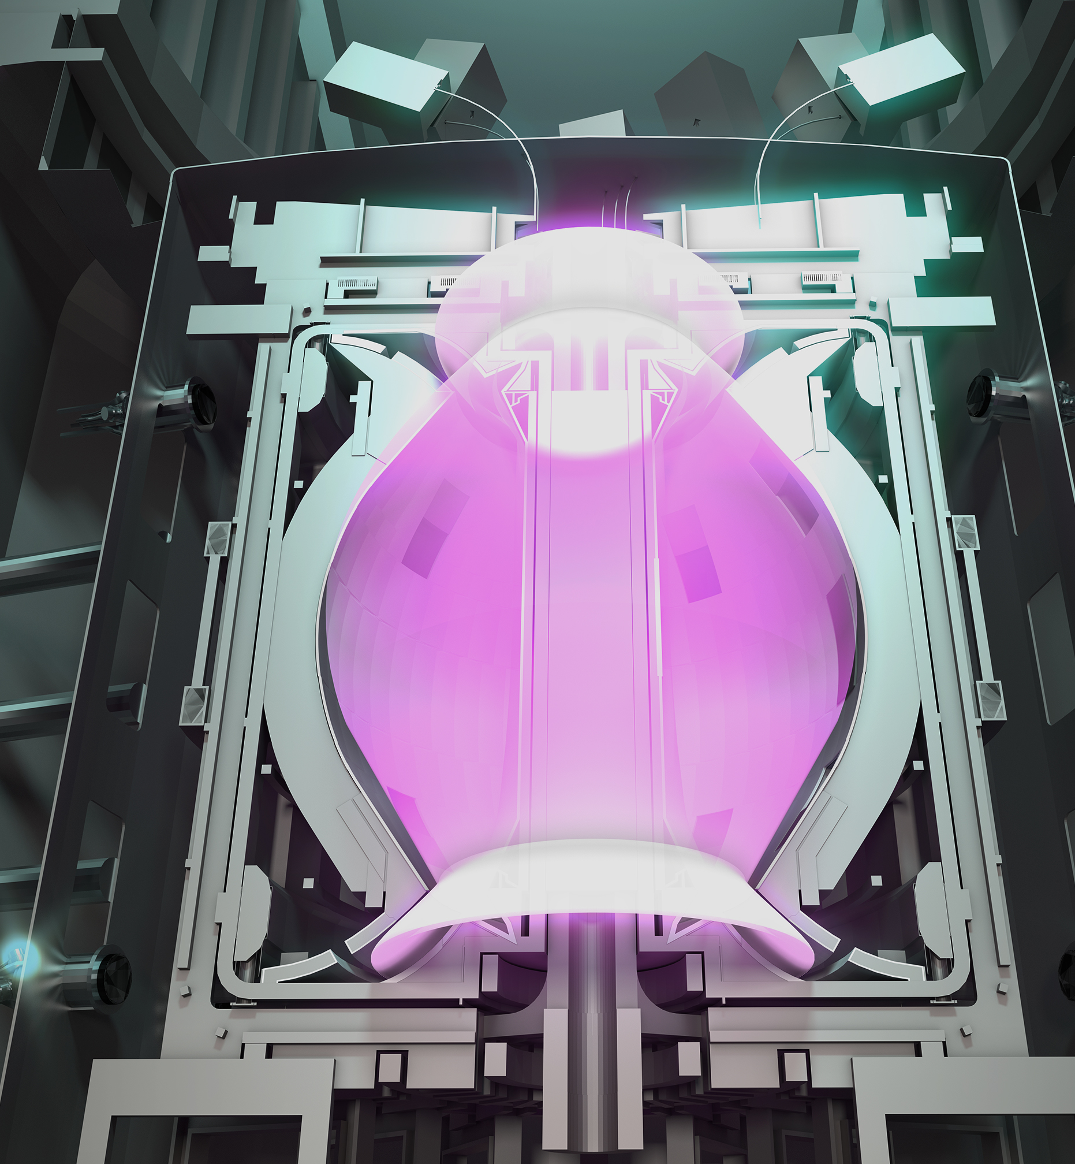
STEP: An Integrated Multi-pronged pathway to commercial fusion delivery
Commercial Fusion Power
Drive near term economic and societal benefits
STEP
Grow a skilled and capable fusion industry
Demonstrate commercial viability through prototype
STEP: Spherical Tokamak for Energy Production
STEP Prototype Plant (SPP) is the key vehicle to drive delivery
Net electrical power to the grid at the 100MW level
Demonstrate fuel self-sufficiency
Targeting operation in the 2040’s

Slide 7
STEP: more than just a pilot plant

Slide 8
STEP Prototype Plant (SPP) Timeline
2020
2025
2030
2035
2040
Concept
Concept/reference design
Site Selection
Operating model

Slide 9
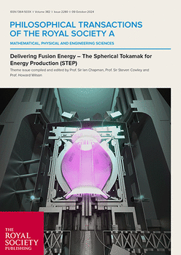
STEP Prototype Plant (SPP) Timeline
2020
2025
2030
2035
2040
Concept
Concept/reference design
Site Selection
Operating model

Slide 10
STEP Prototype Plant (SPP) Timeline
2020
2025
2030
2035
2040
Concept
Concept/reference design
Site Selection
Operating model
Detailed Design and Mobilisation
Build partnerships
Engineering design
Test rigs
Early manufacture
Site Development
Main Constructuction
Full plant manufacture & assembly
Full site development
System testing
Commission and operate
Commissioning
Prototype operations
Commercial plant design

Slide 11
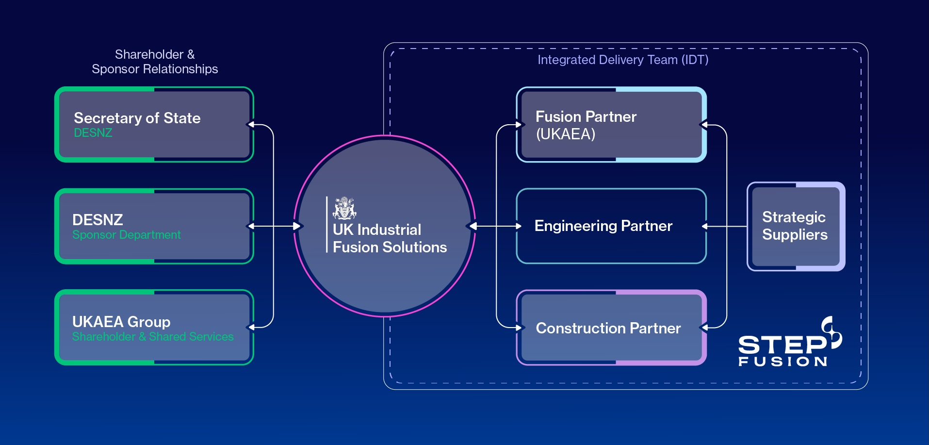
STEP operating model: Achieves its objectives through partnerships

Slide 12
STEP Prototype Plant: Why a spherical tokamak?
Compact radial build
High current-carrying capacity
Pathway to steady state operation
Novel, simplified maintenance options
No requirement for inboard breeding

Slide 13
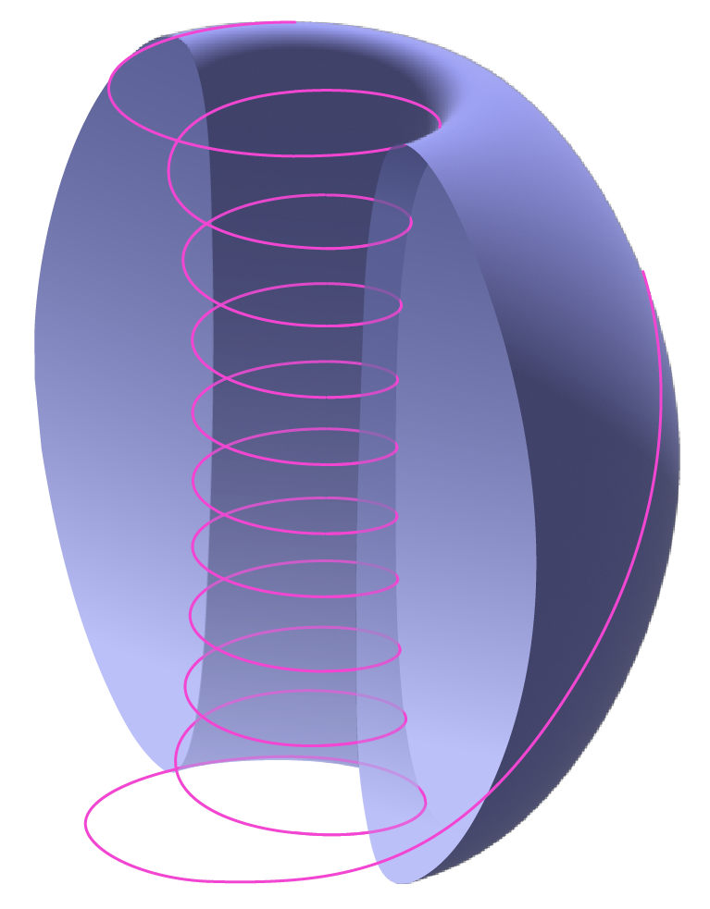
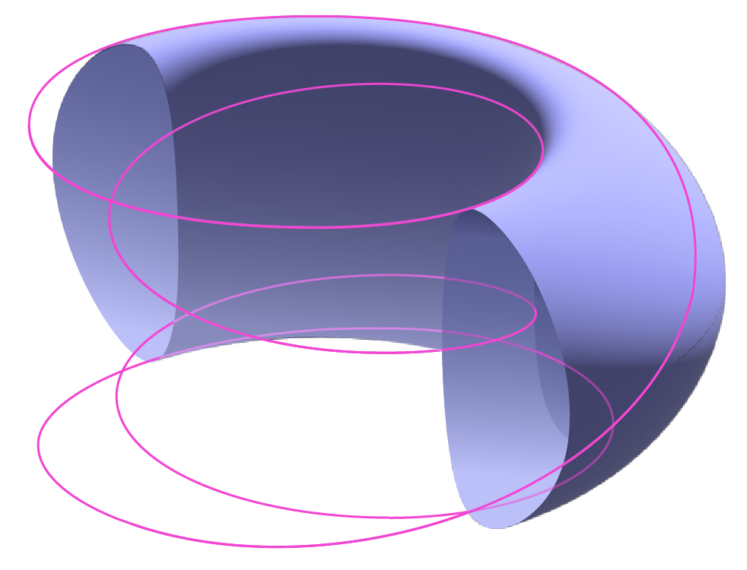
Spherical tokamak offers advantages: 1) Compact radial build
Conventional Tokamak
Spherical Tokamak

Slide 14
Spherical tokamak offers advantages: 1) Compact radial build
Radial build of SPP is below that of ITER
High SPP elongation means plasma volumes are similar
SPP has ~3 times the fusion power of ITER

Slide 15
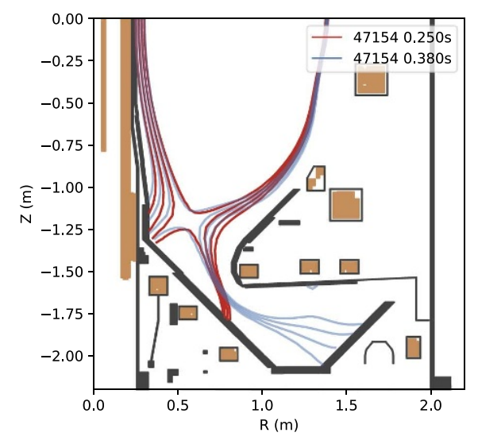
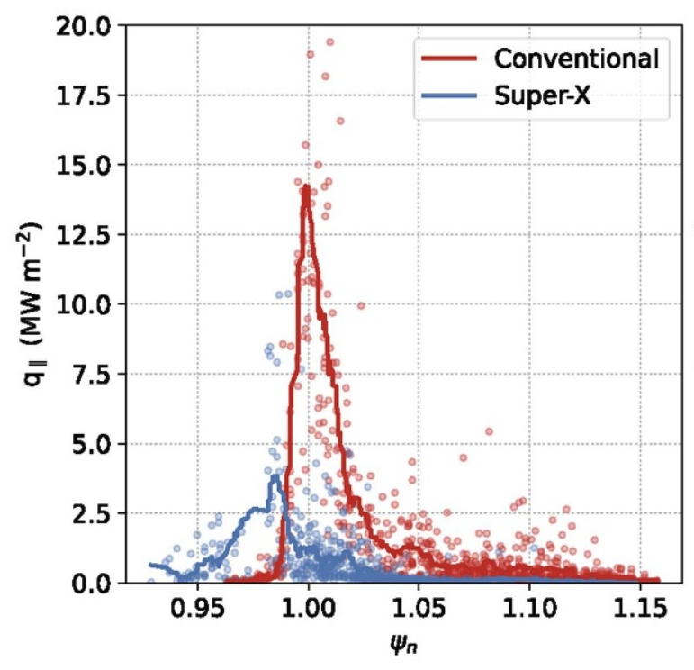
Spherical tokamak offers advantages: 1) Compact radial build
Managing the exhaust in compact geometry requires a novel approach
MAST-U has demonstrated beneficial properties of Super-X, which SPP exploits
Acceptable power loads predicted for SPP with:
Double null; balanced X-points
Super-X outboard leg
Extended inner leg
Ar divertor gas seeding to drive detachment
~70% core radiation through Xe pellets
Further modelling/optimisation seeks to:
Reduce core radiation requirement to access lower P_{fus} solutions
Manage transients
Quantify/reduce uncertainty in SOL width
MAST-U
Harrison et al, PPCF 66 (2024) 065019
(H. Meyer, TH/6-2 ; J. Harrison OV/4-5; S Wang Poster 2813;
E. Tholerus, Poster 2899; D. Moulton Poster 3044; M.J. Kryjak)

Slide 16
Spherical tokamak offers advantages: 2) High normalised current
ST geometry has high q for given I_{N}=I_{p}/aB
Provides access to high plasma current, I_{p}
High normalised current gives:
High confinement time
High β<β_{N}I_{N}
Puts STEP plasma in new regimes
Turbulence and transport, for example
(D. Kennedy, TH/6-3; L. Zanesi, Poster 2936)
High ratio of toroidal to poloidal magnetic field on inboard side creates high q

Slide 17
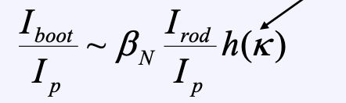
Spherical tokamak offers advantages: 3) Steady state with ~90% bootstrap
∝ κ→κ²
High q₀
Second ballooning stability, and aids kink and neoclassical tearing mode stability
High β_{N}
Monotonic q(r)
Enabled by high edge magnetic shear
Total
Bootstrap
High Bootstrap
hollow current profile
EBW
ECCD
00
Low internal inductance
Large edge current density can be accommodated, keeping q(r) monotonic
Remaining current can be provided by microwaves
Enabled by low A, and low l_{i}
High elongation
(E. Pennington, Poster 3068)

Slide 18
Spherical tokamak offers advantages: 3) Steady state with ~90% bootstrap
Two significant challenges with non-inductive
Microwaves planned for remaining 10% current is inefficient
Over 100MW required, driving up recirculating power
Electron Bernstein wave (EBW) predicted to be more efficient: validation on MAST-U planned
Drives R&D into higher efficiency gyrotrons
Improved efficiency will reduce recirculating power, opening pathways to lower P_{fus}
Non-inductive ramp-up is feasible, but uncertain:
Compact radial build leaves little room for solenoid
Seeking innovative ways to maximise solenoid flux swing available for initiating plasma
(H.T Kim, Poster 2754; P. Jacquet Poster 2867)

Slide 19
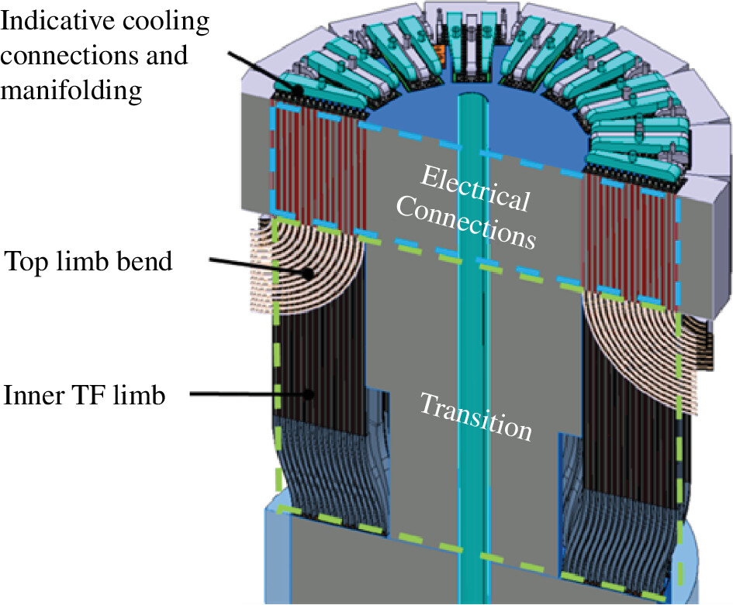
Spherical tokamak offers advantages: 4) Novel simplified maintenance options
Removable centre stack opens up novel vertical maintenance options
A challenge is remountable HTS joints
We have an encouraging solution in an advanced state of testing
(R. Skilton, TEC/5-1; S. Kirk, Poster 2928)

Slide 20
Managing Uncertainty: Science and technology advances inform design & operations
2020’s
2030’s
2040’s

Slide 21
Managing Uncertainty: Science and technology advances inform design & operations

Slide 22
Managing Uncertainty: Science and technology advances inform design & operations

Slide 23
Managing Uncertainty: Science and technology advances inform design & operations
(R. Lawless, OV/5-1)

Slide 24
Conclusions
STEP adopts an holistic approach to fusion delivery
Delivering early benefits for stakeholders
Building a skilled fusion industry capability
Addressing technical challenges for fusion commercialisation
The STEP Prototype Plant is the key vehicle to deliver all three
Exploits the advantages of the spherical tokamak
Will deliver 100MW net electrical power and demonstrate fuel self-sufficiency
Meeting the 2040 timeline requires close integration between science & technology and design, engineering & testing to reduce technical risk

Slide 25
DELIVER A UK PROTOTYPE FUSION ENERGY PLANT,
TARGETING 2040, AND A PATH TO
COMMERCIAL VIABILITY OF FUSION.
STEP MISSION

