Slide 1
Overview of Recent Results in Research Tackling Remote Maintenance Challenges of Future Fusion Energy Devices
Robert Skilton et al.
UKAEA Fellow
Head of Robotics Research and Technology

Slide 2
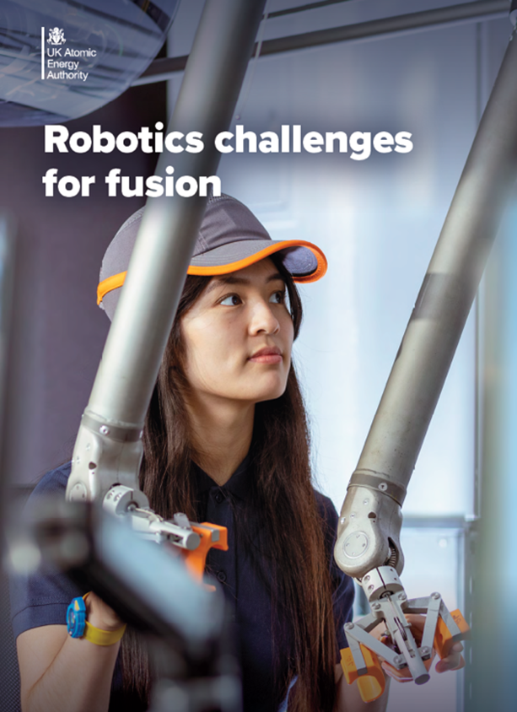
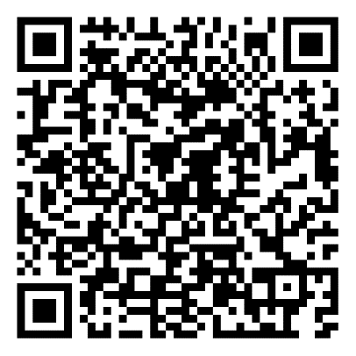
Robotics challenges for fusion energy
1
Architecture optimisation including design for remote maintenance
Assurance, trust and regulation
6
2
Service joining including pipes, bolts, connectors and NDE
Rapid response including inspection and in-situ repair
7
3
Slender mechanisms and operations in confined, cramped spaces
8
Maintenance productivity
4
Handling of challenging components
9
Waste Management
10
5
Environmental compatibility including radiation, vacuum, magnetic fields
Through-life cost reduction for long-lived facilities
https://race.ukaea.uk/programmes/collaborative-research-programme/

Slide 3
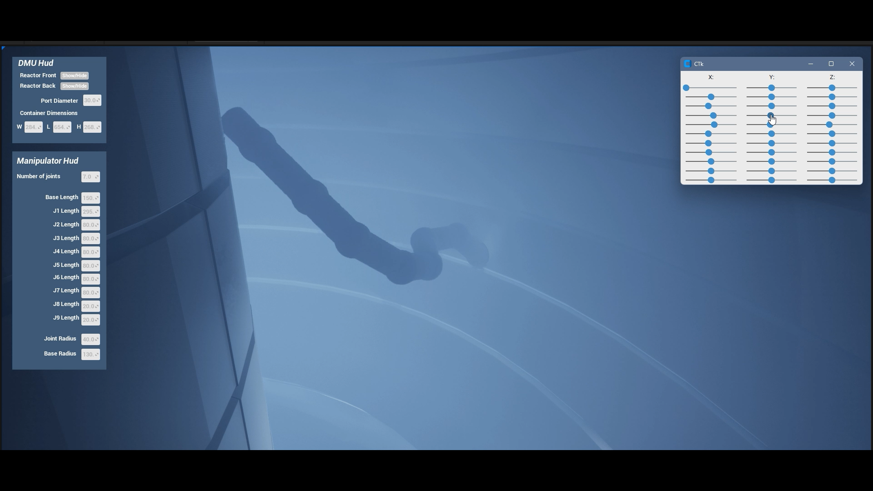
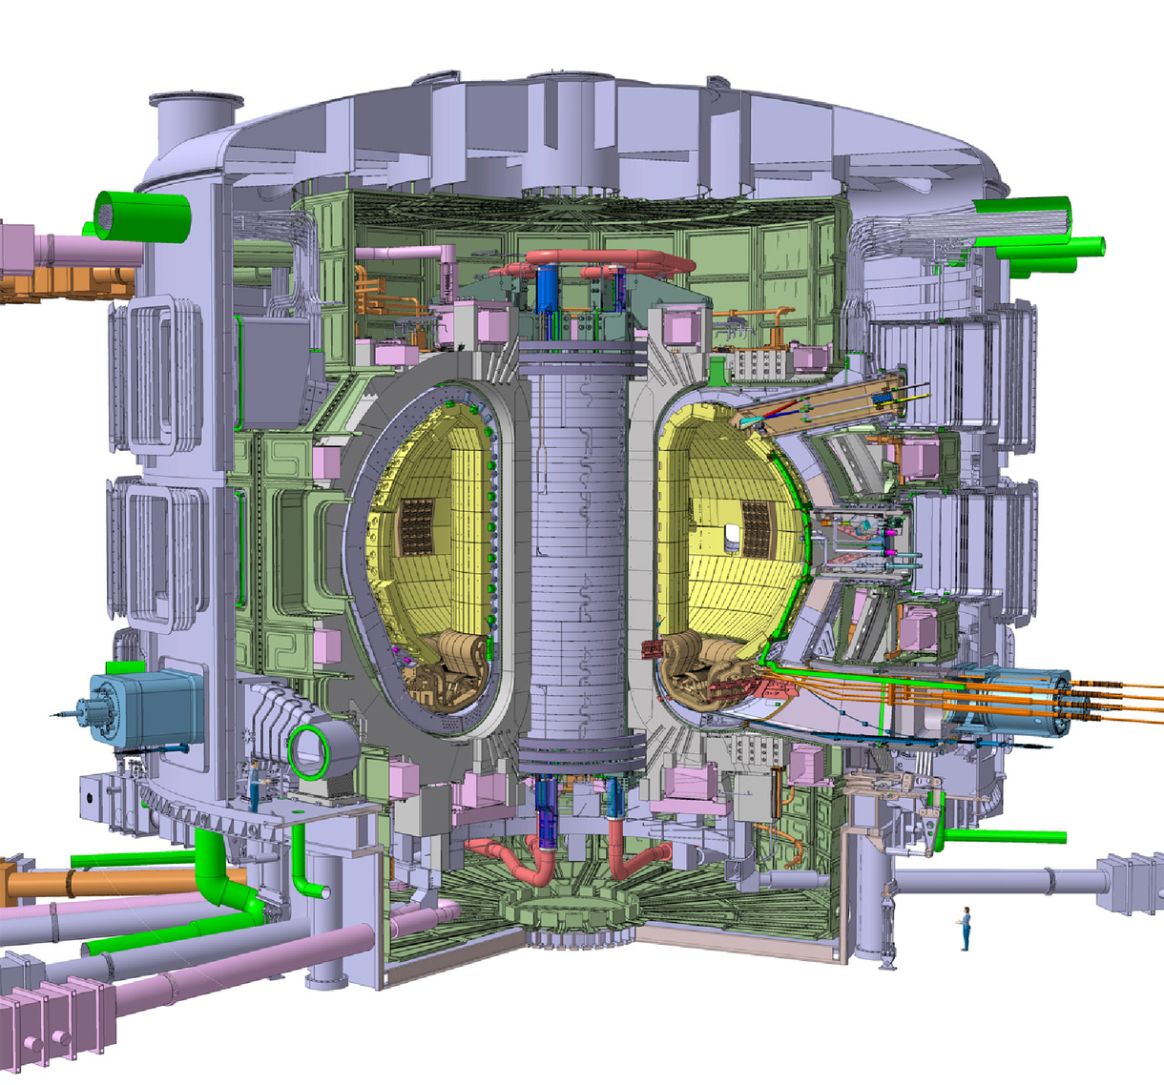
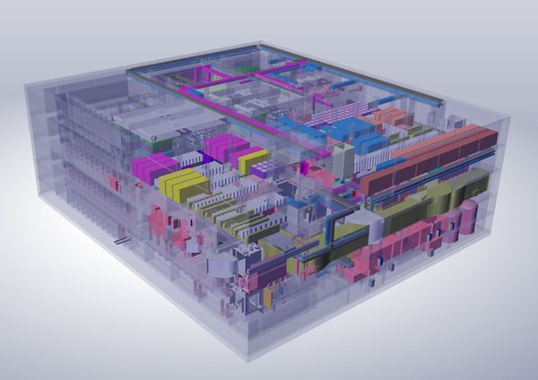
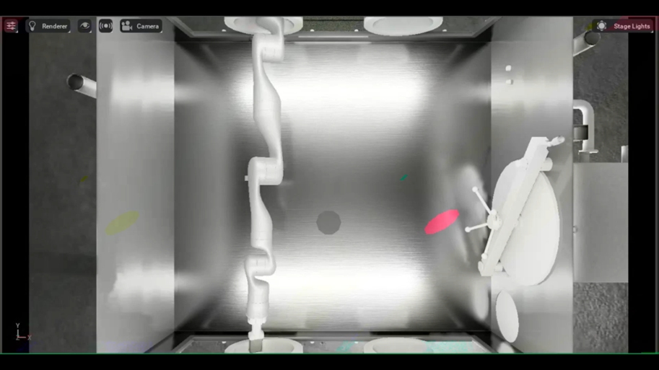
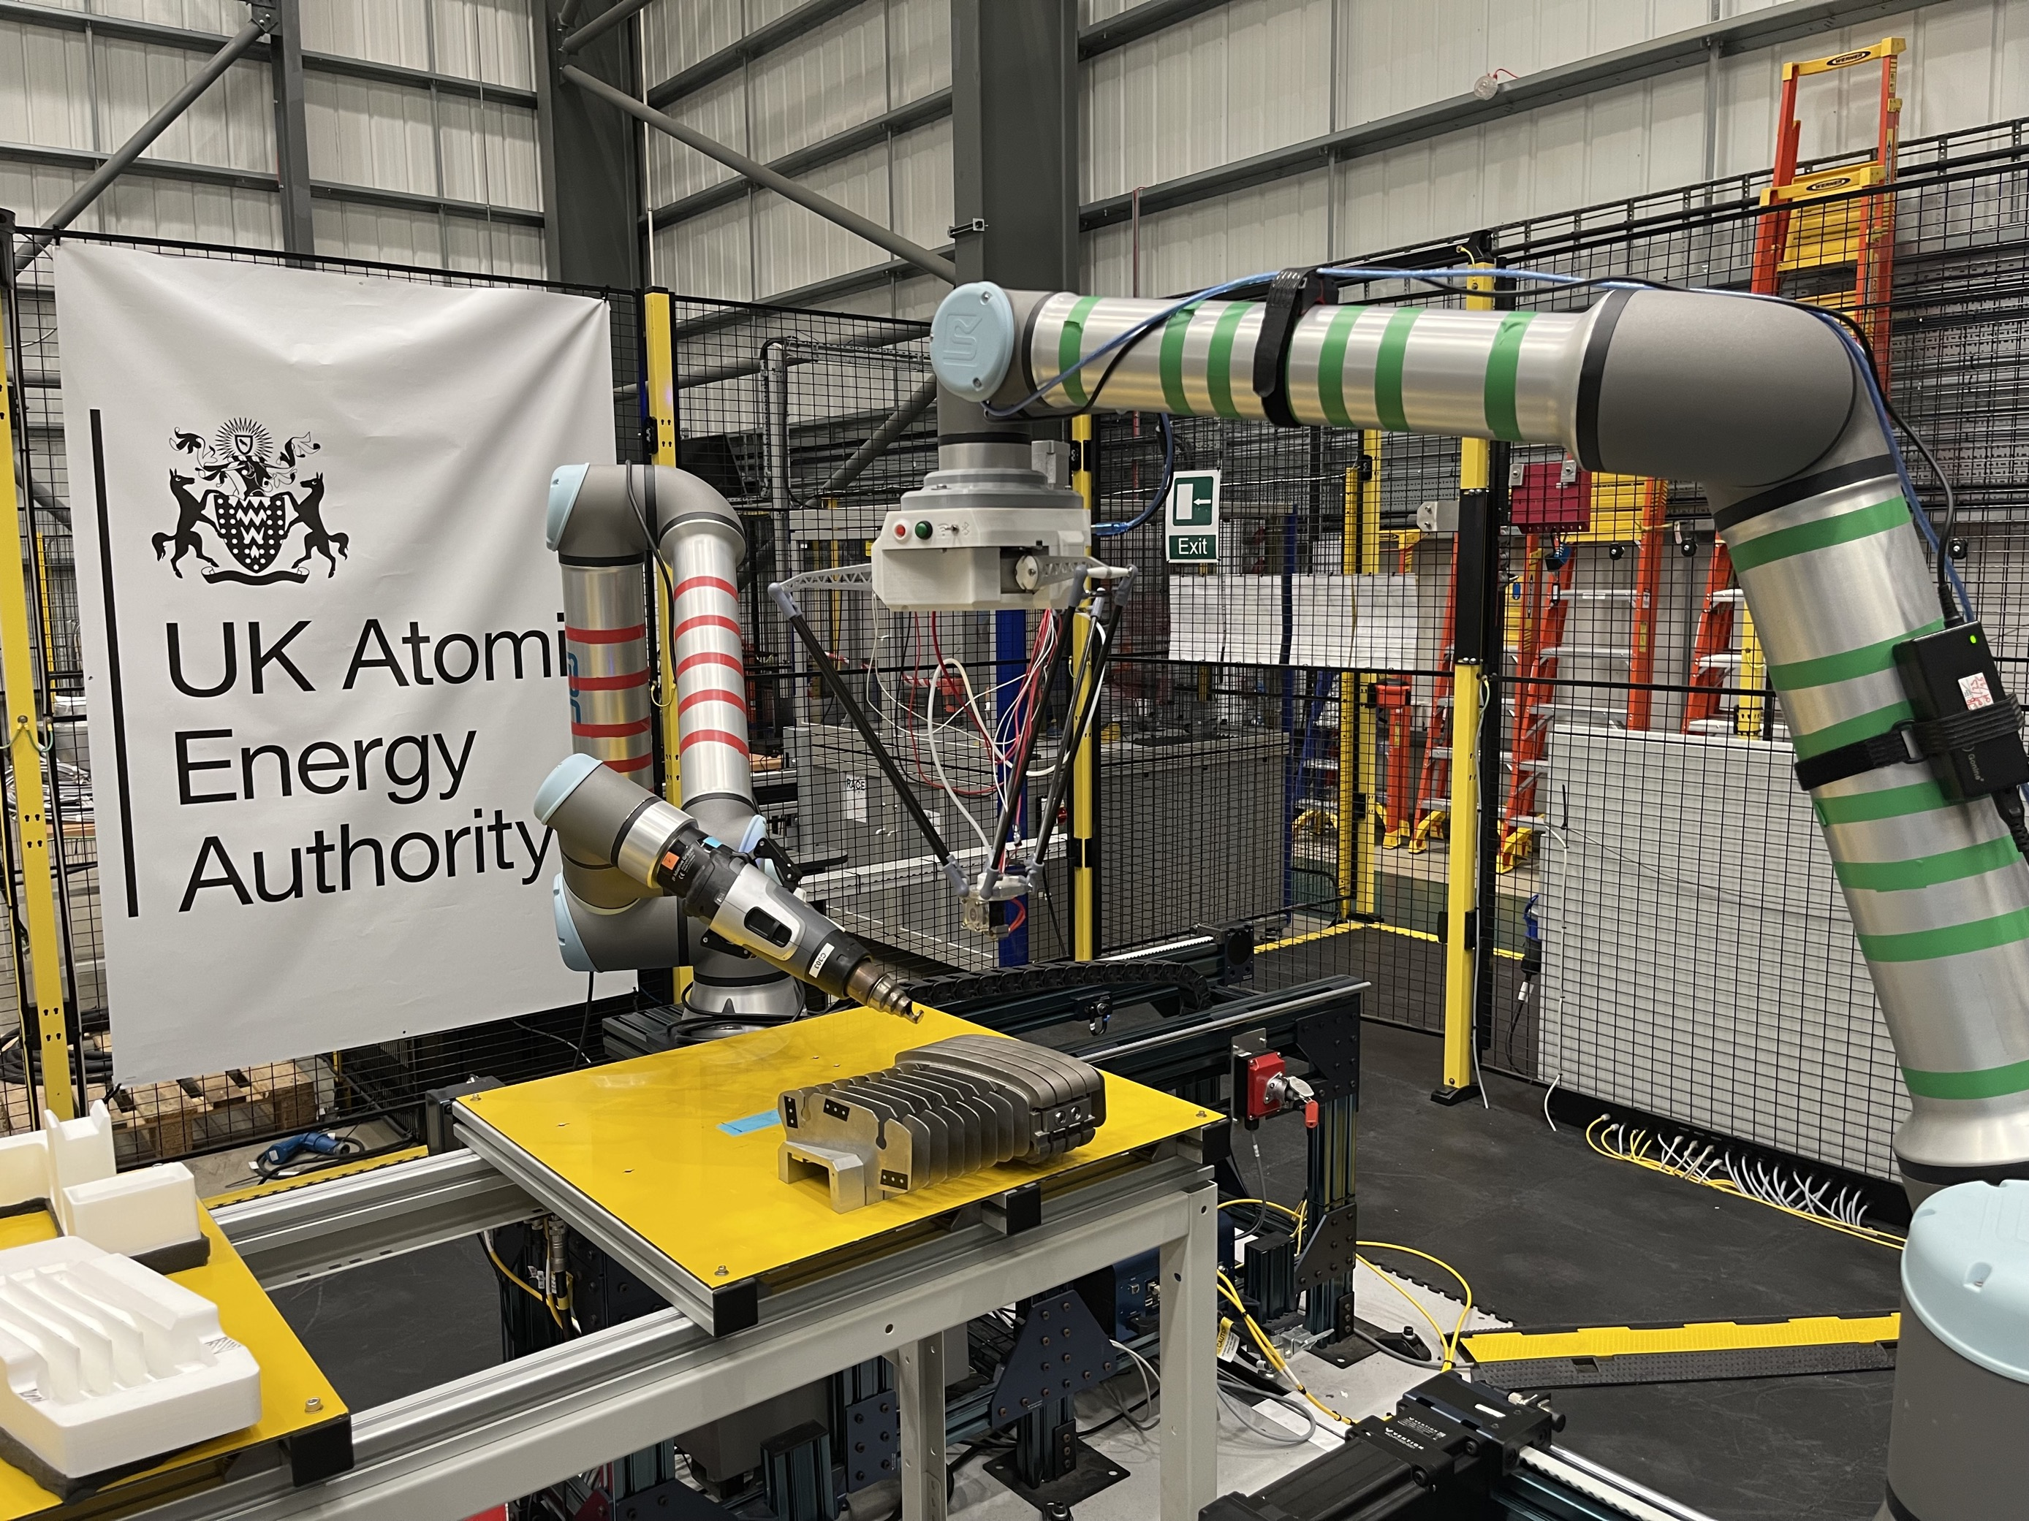
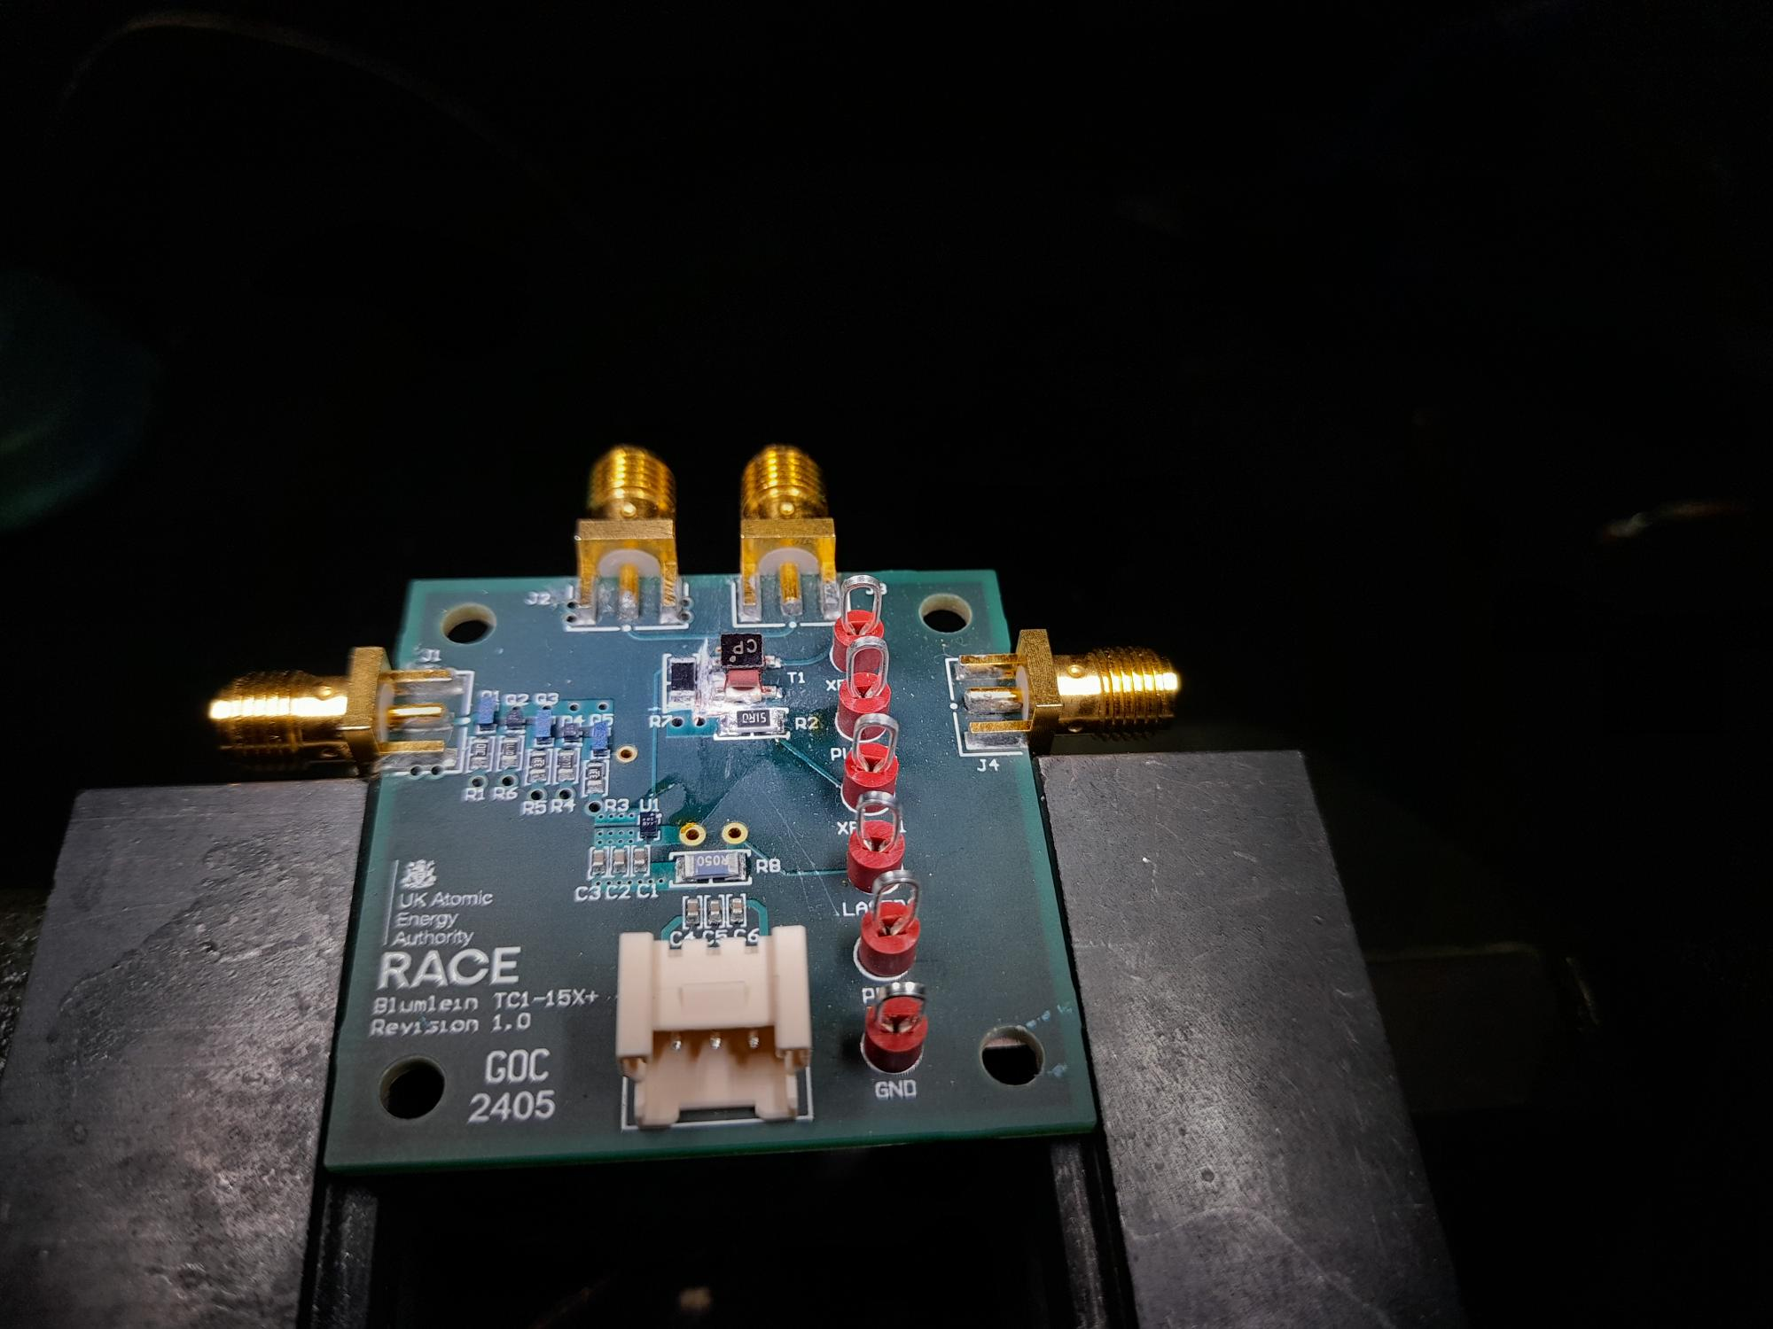
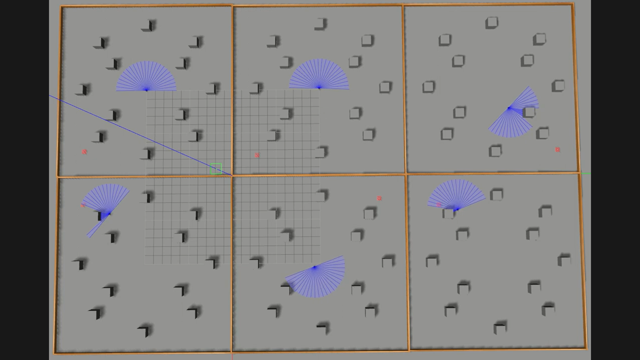
Robotics Research Themes
1. Deployment and payloads
5. Maintenance automation
Reactor
Hot cell
2. In-situ maintenance
3. Fusion environment compatible systems
4. Learning for robotic maintenance

Slide 4
Architecture design
System design for maintenance
(Challenge 1)

Slide 5

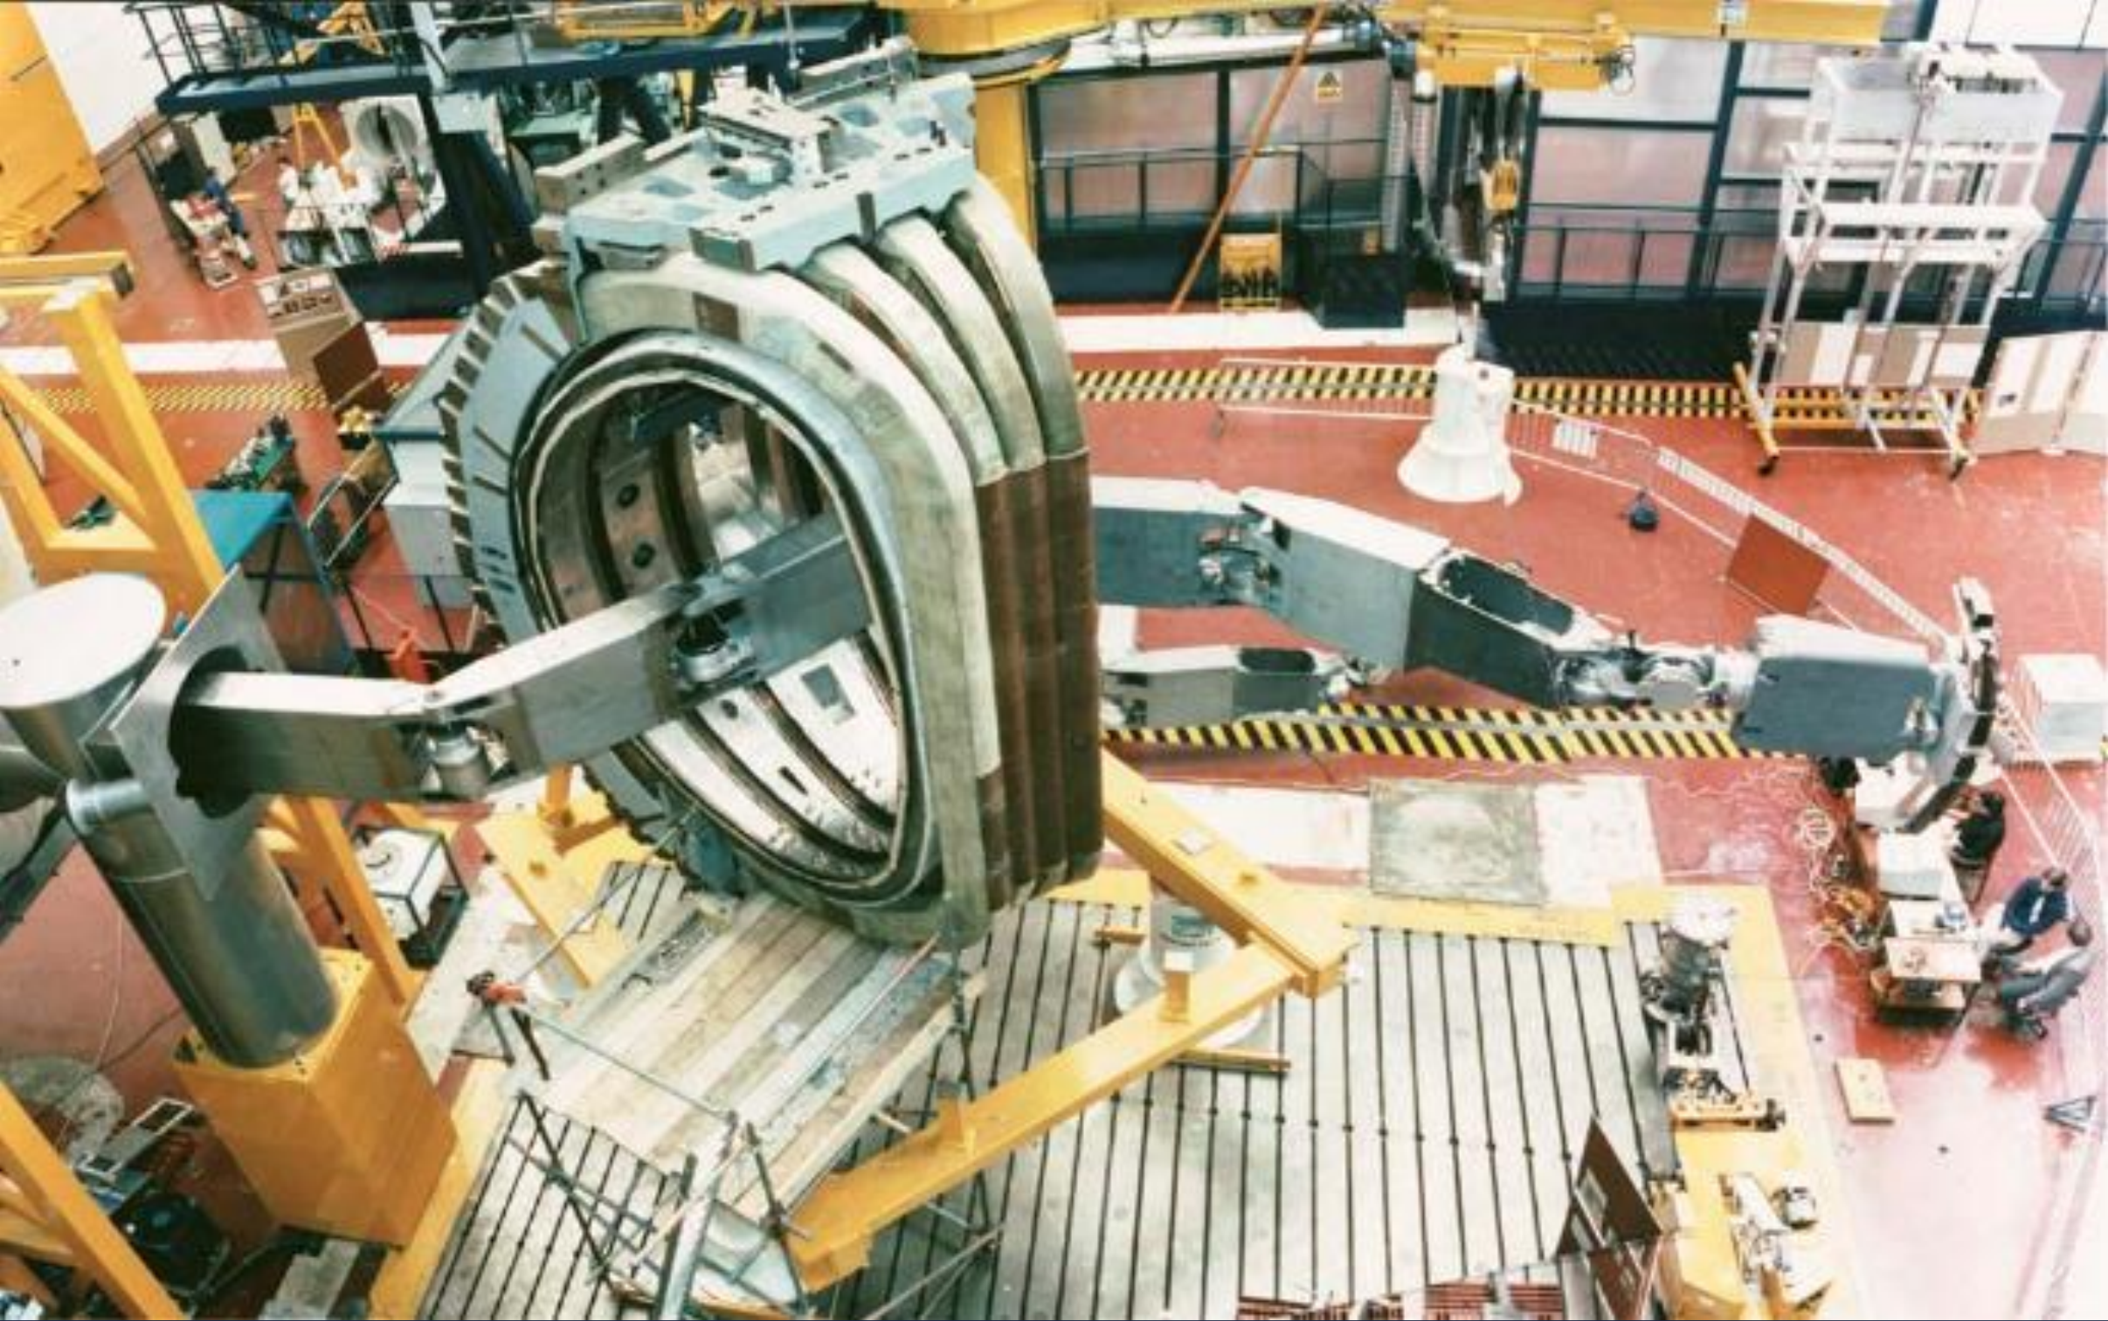
Rapid design optimisation of remote maintenance solutions for fusion
Problem:
Accessing cluttered spaces, typically through narrow ports
Slender robotics with limited reach and payload
How to rapidly optimise the robot design?
  Minimal joints?
  Shorter links?
  Less mass?

Slide 6
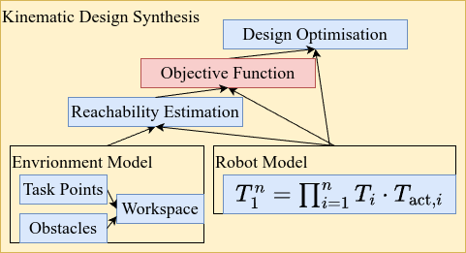

Framework for Kinematic Design
Synthesis
Framework to optimise link dimensions and kinematic topology of serial manipulators operating in a constrained task environment using a generalised parametric model
Genetic Algorithm used a hierarchical objective prioritising:
Full reachability utilising Rapidly-exploring Random Trees (RRT)
Structural efficiency
Design synthesis framework

Slide 7
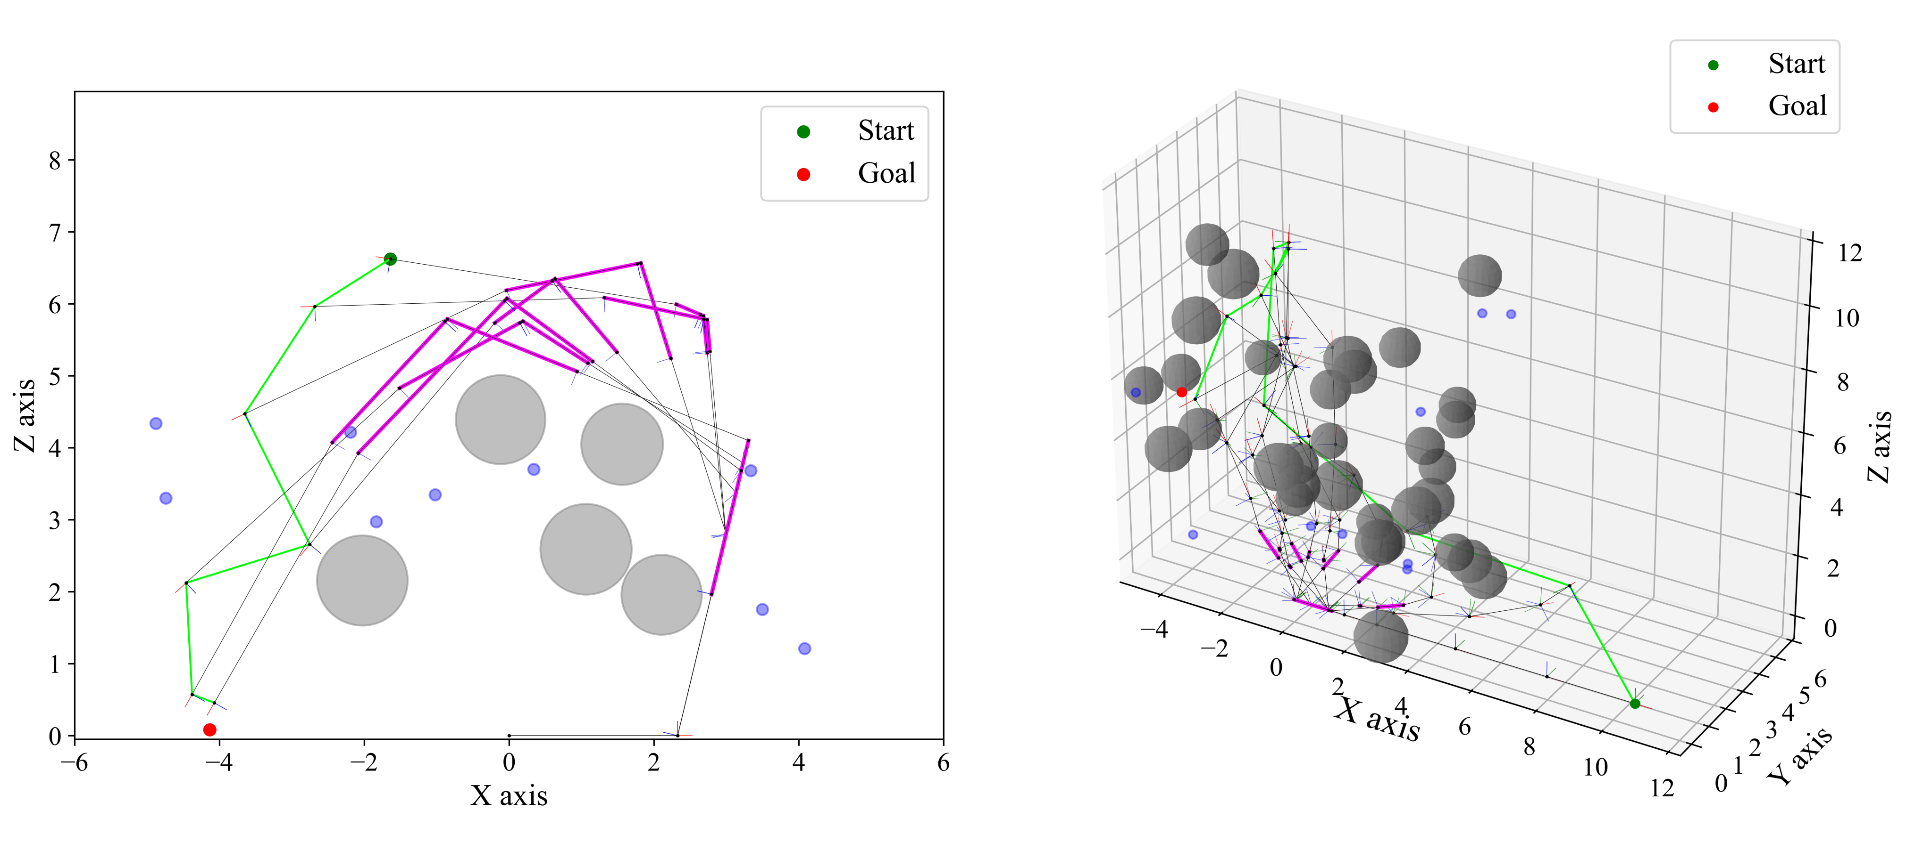
Results
Framework evaluated in task spaces:
  2D (planar) and
  3D (volumetric)
The GA converged rapidly
Systematically shortening links and pruning unnecessary axes.
Designs consistently maximised reachability
2D Task
3D Task

Slide 8
Rapid In-Vessel Inspection
(Challenge 7)

Slide 10
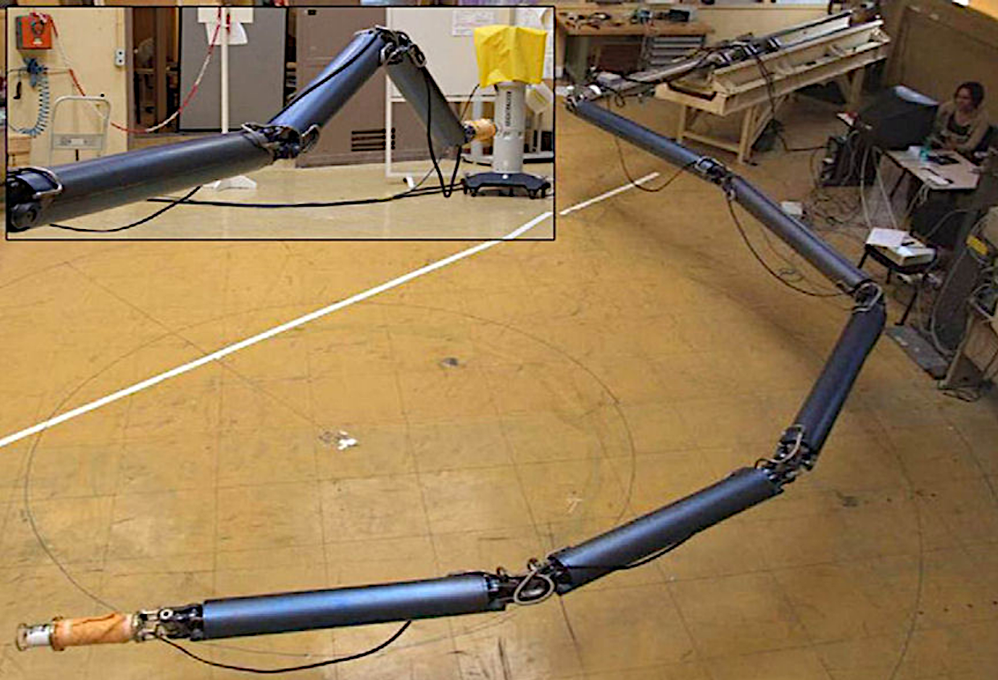
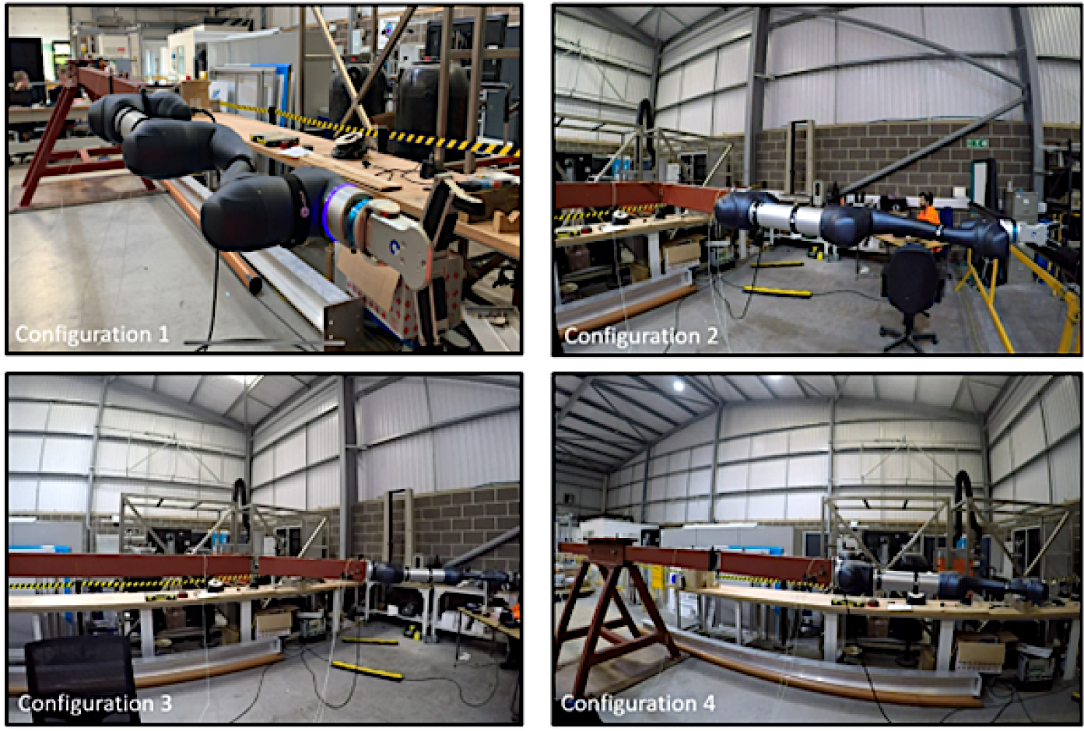
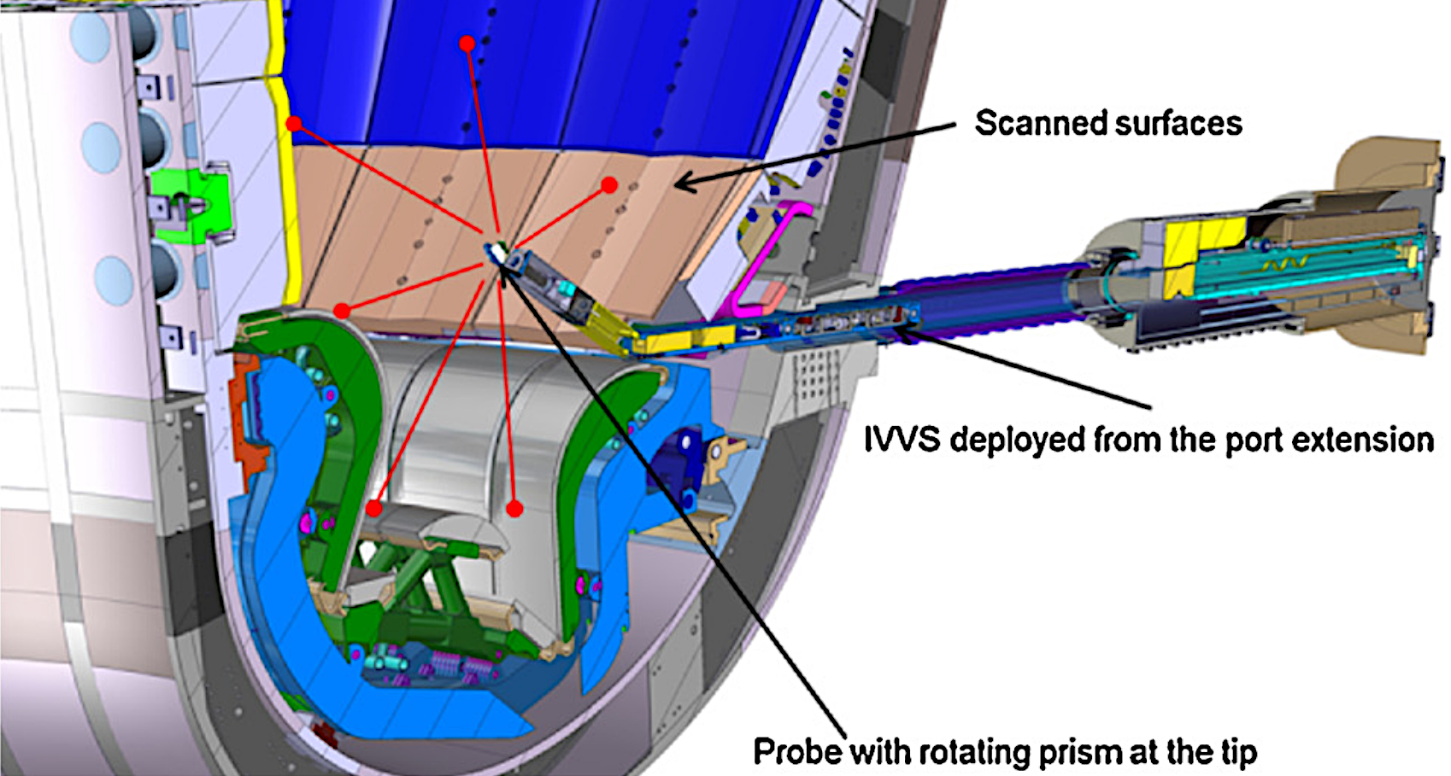
Long-reach slender manipulators for rapid inspection
AIA robot assembled, CEA-LIST Laboratory
ITER In-Vessel Viewing and Metrology System (IVVS)
Through wall manipulation (TWD) system

Slide 11

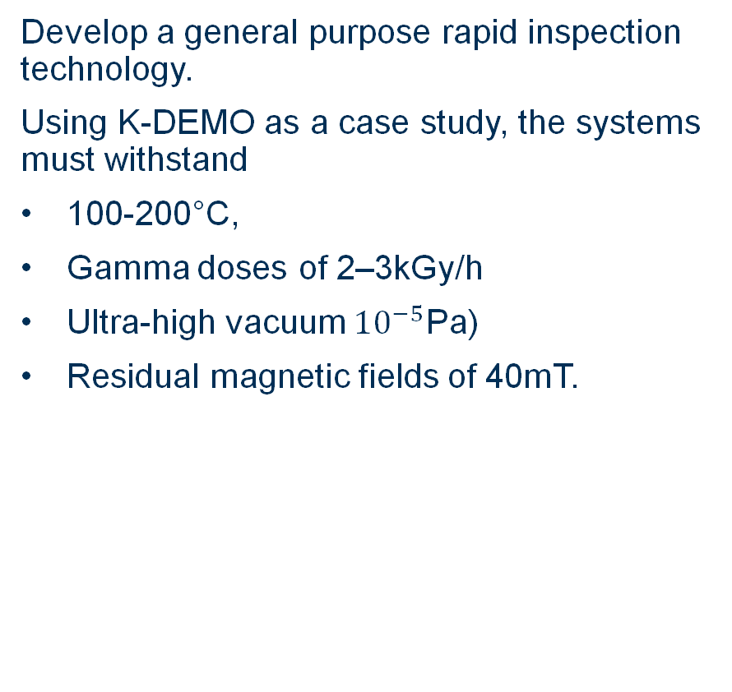
In-Vessel Rapid Inspection System
Develop a general purpose rapid inspection technology.
Using K-DEMO as a case study, the systems must withstand
100-200°C,
Gamma doses of 2–3kGy/h
Ultra-high vacuum ${10}^{−5}$Pa)
Residual magnetic fields of 40mT.
Phase 1
Manipulator kinematics developed via a multi-objective optimisation
Reachability of representative inspection targets was ensured using a novel surface clustering approach
A prototype with a reduced number of DoF was then built to explore
Tendon actuation
Decoupling of DoF
Gravity compensation
Detachable actuation

Slide 12
Service joining
NDT for quality assurance
(Challenge 2)

Slide 13

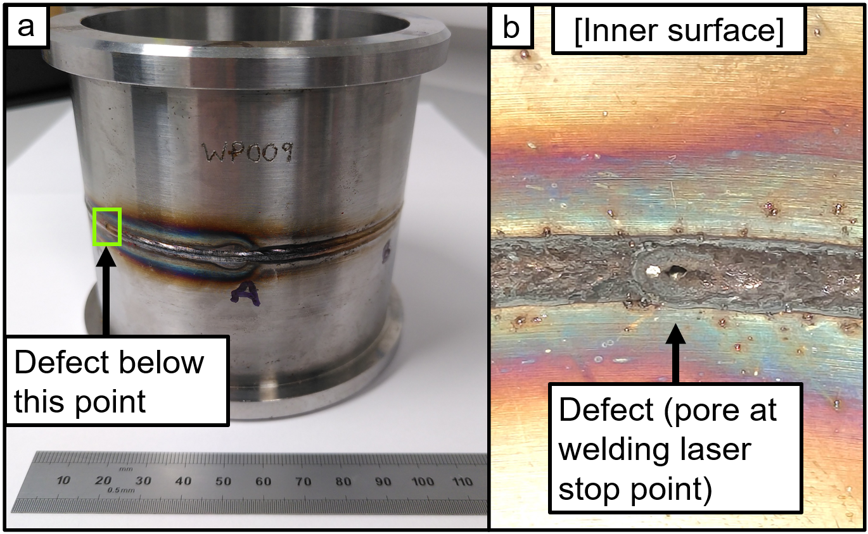
Evaluating laser ultrasound for
NDE challenges in fusion power plants
What is Laser UT (Ultrasonic Testing)
Generation and detection of ultrasonic elastic waves in a target via laser beams
Why Laser UT?
Radiation-tolerance
Vacuum-compatibility
Ease of robotic deployment
No need for couplant fluid
Welding defect sample

Slide 14
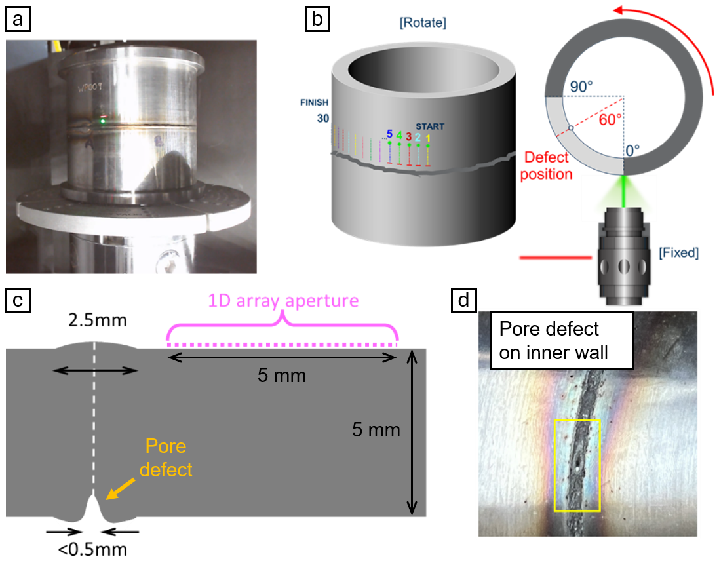
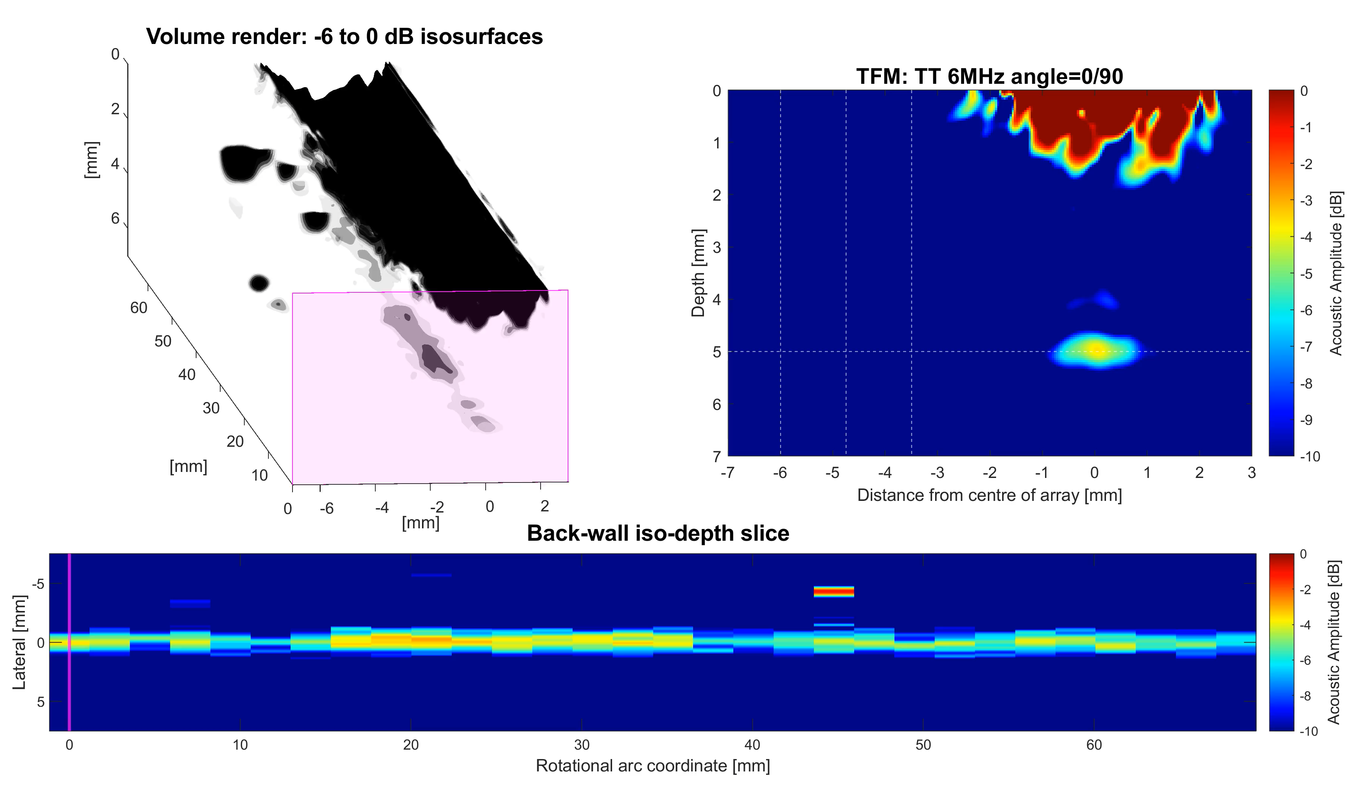
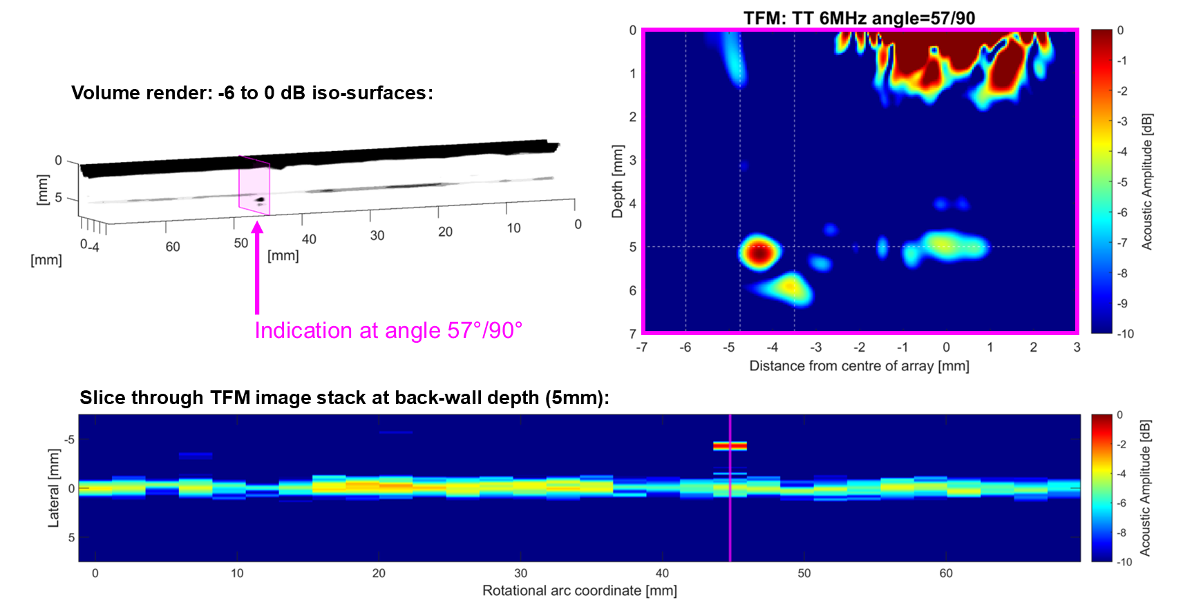
Pipe weld results
A <0.5 mm diameter weld stop pore, on the inner surface of the pipe weld, was targeted as a known defect for the LU NDE inspection.
A single, pronounced indication at the expected depth and lateral offset (beneath the weld) can be seen at 57° into the 90° scan, within 3°of the 60°target (which was positioned by-eye).

Slide 15
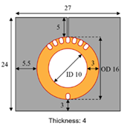
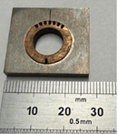
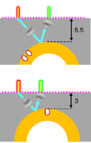
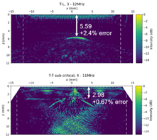
EU DEMO Divertor Monoblock trials
Establish compatibility with:
  Small sample dimensions,
  Tungsten material
Ability to detect the tungsten/copper dissimilar metal interface
The curved tungsten/copper interface was detected at the expected depth, and thickness measurements with errors of less than 2.5% relative to the design dimensions.
Laser UT for a fusion component

Slide 16
Mobile inspection
(Challenge 8)

Slide 17

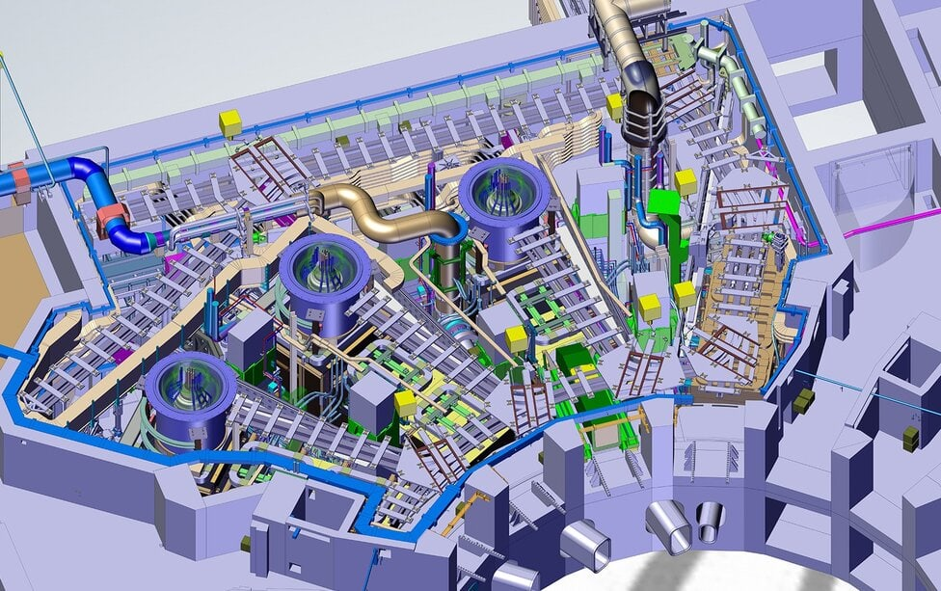
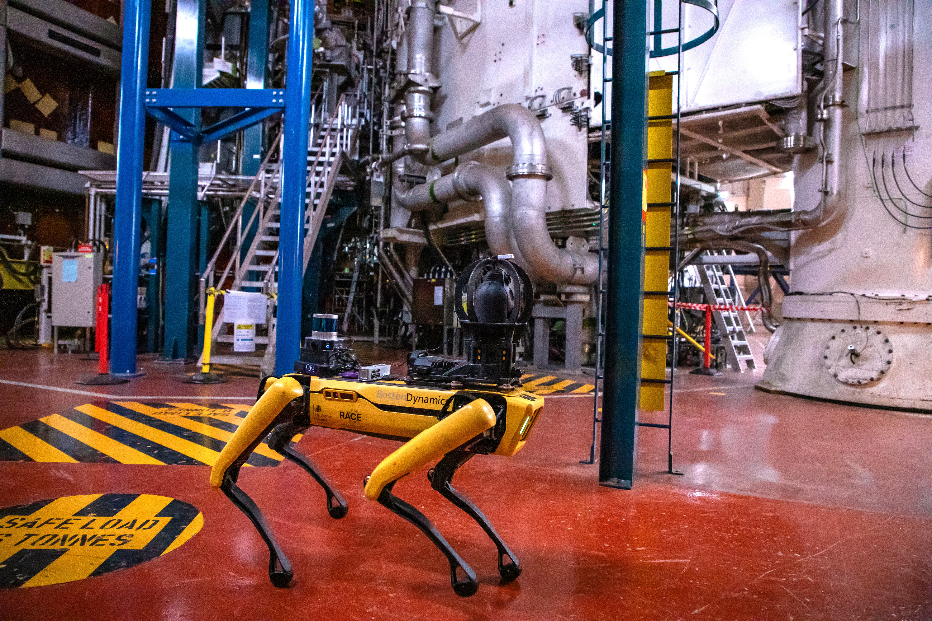
Establishment of long-term, robust autonomy for routine inspection of plant
ITER Neutral Beam Hall
Trials in JET Torus Hall

Slide 18
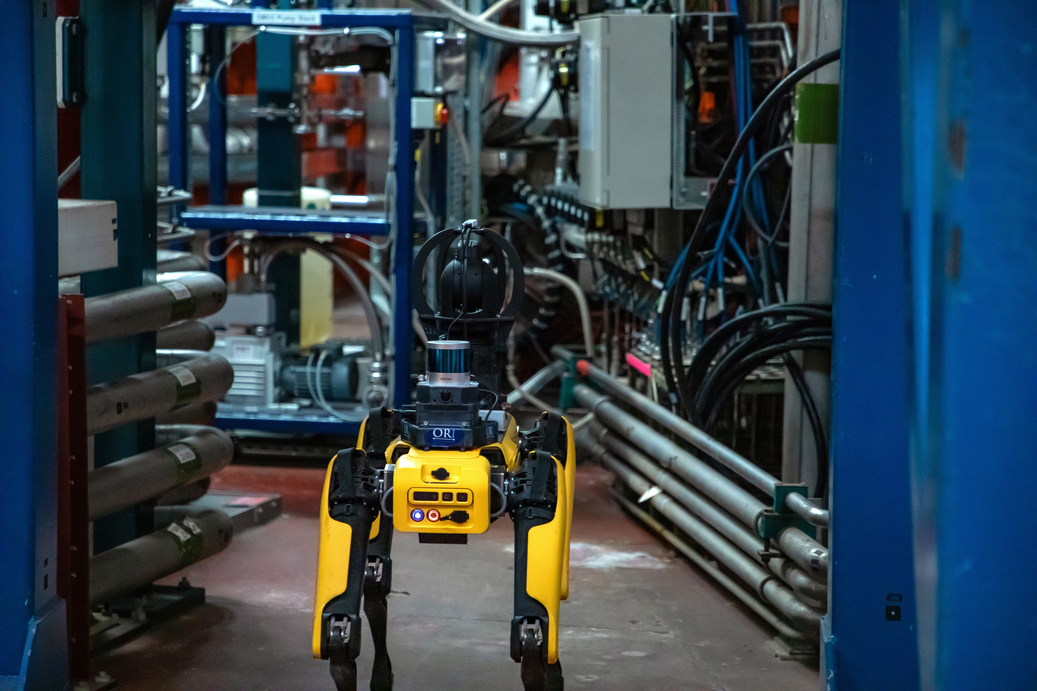
JET inspection and monitoring trials
35 consecutive days, 2 patrols per day
7 inspection points
Visual images
IR Thermal Images
Gamma radiation spectrum
Temperature and humidity measurements
Geometric pointcloud mapping every run
Mission duration average 20 minutes
81 Missions executed
571 of 653 inspection actions succeeded
Walked approximately 15 km over the 19.5 hrs, in which it was performing missions.
Trials in JET Torus Hall

Slide 19
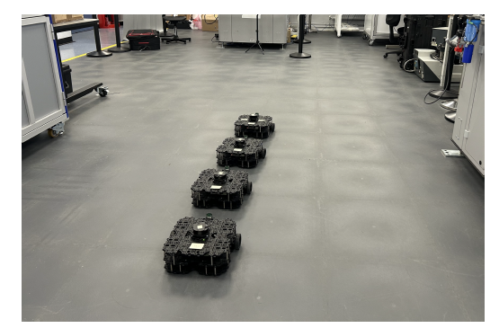
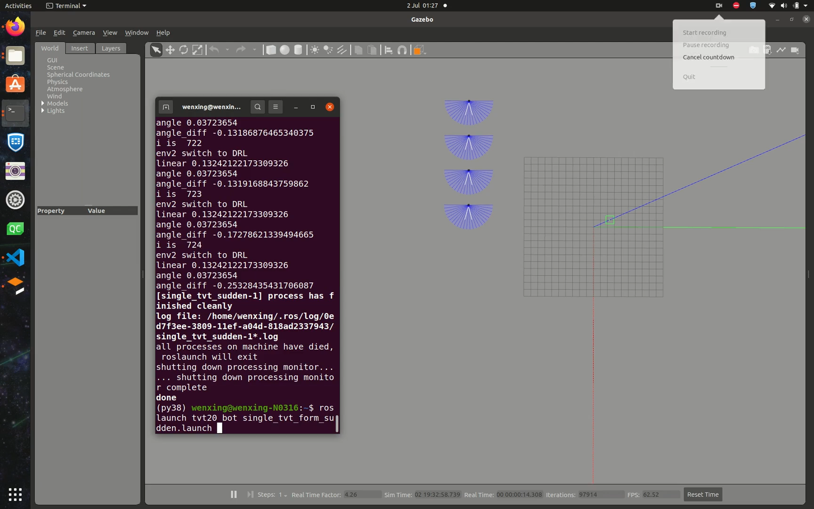
Extending to multi-robot inspections
Challenges of parallelising autonomous robotic inspections
Safe deployment of Deep Reinforcement Learning (DRL) algorithms
Tolerance to faults and failures of individual robots
Simulation and experimental validation

Slide 20
Discussion and Future work plans
Robotics Challenges for Fusion Energy
  10 Key Challenges
UKAEA Collaborative Research Programme
4 Areas of advancements:
  Automated design optimisation
  Tendon-driven long-reach rapid inspection arm
  LaserUT for in-situ volumetric NDE
  Autonomous robotic inspection in industrial facilities
Future work

Slide 21
Thank you
Robert Skilton
Hanlin Niu
Luca Raimondi
Yao Ren
Matthew Riding
Theodosia Stratoudaki
Emre Uzunoglu
Kaiqiang Zhang

