Slide 1







Jorek simulation of injection assimilation and radiation asymmetry during ITER H-mode dual Shattered Pellet Injections
FEC2025，2025/10/16
D. Hu,
F. J. Artola, E. Nardon, K Munechika, M. Kong, D. Bonfiglio, M. Hoelzl, W. Tang, G.T.A. Huijsmans, Y. Yuan, L. Cheng, Y. Li, and JOREK Team

Slide 2
Contents
Introduction
Simulation setup
Injection assimilation and penetration
Radiation asymmetry and energy impact
Conclusion & Discussion

Slide 3
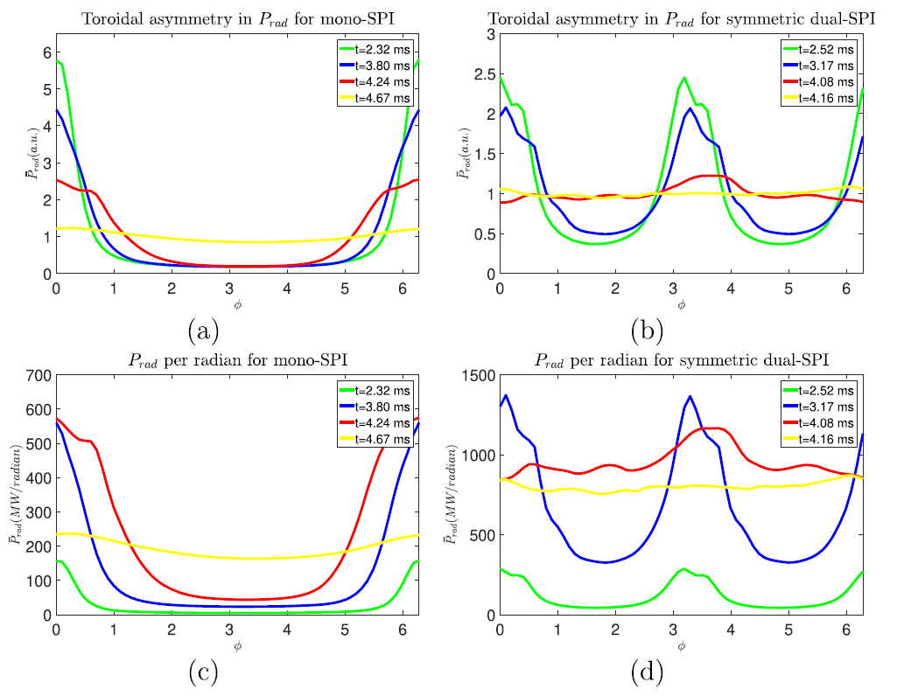
Introduction
Radiative depletion of thermal energy during disruption is desirable.
The radiation asymmetry during the TQ mitigation is of concern.
Already substantial investigation into the asymmetry within the plasma.
The ultimate criterion is the temperature rise on the first wall characterized by the so-called energy impact.
The total injection assimilation as well as the core density rise is also of interest.
D. Hu et al 2021 Nucl. Fusion 61 026015

Slide 4
Modelling structure
Integrated Modelling & Analysis Suite (IMAS)
RaySect/
CHERAB
First wall temperature rise
Ignore opacity
Physical interest
The 3D nonlinear reduced MHD version of JOREK is used.
Radiation power density to first wall radiation heat flux via RaySect/CHERAB incorporated in IMAS.
Energy impact estimated via 1D semi-infinite passively cooled heat conduction model.
Melting evaluated via energy impact distribution.
JOREK
M. Hoelzl et al 2021 Nucl. Fusion 61 065001; M. Hoelzl et al 2024 Nucl. Fusion 64 112016;

Slide 5
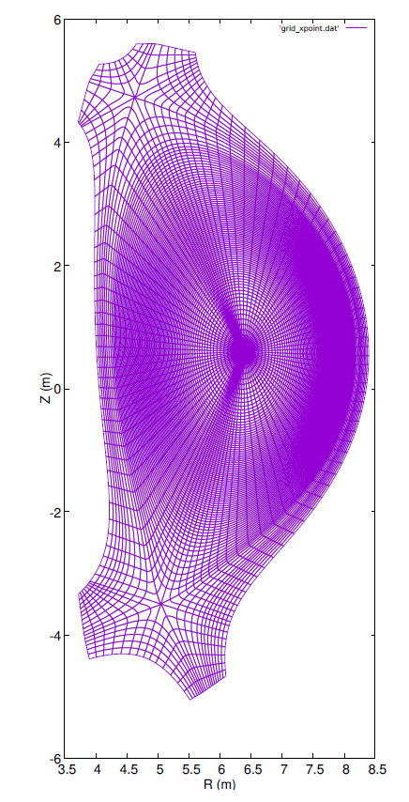
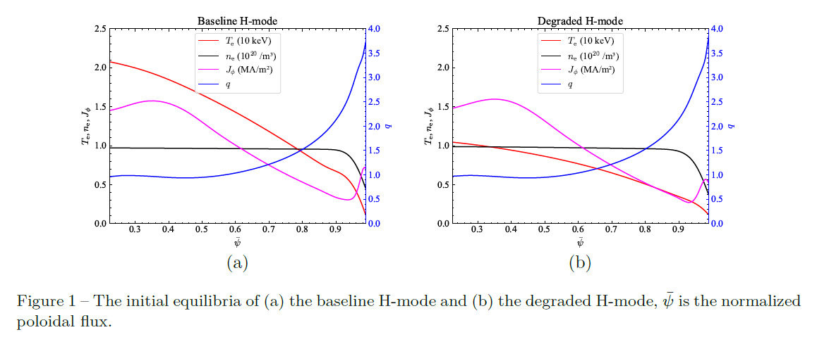
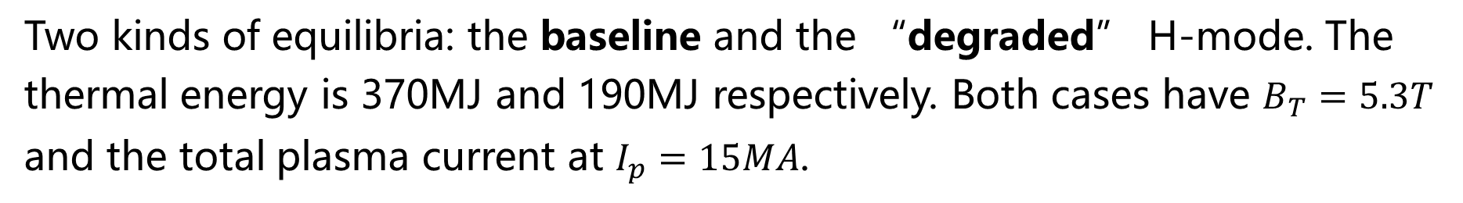
Simulation setup: equilibria
Two kinds of equilibria: the baseline and the “degraded” H-mode. The thermal energy is 370MJ and 190MJ respectively. Both cases have $B_{T}=5.3T$ and the total plasma current at $I_{p}=15MA$.
D. Hu et al Nucl. Fusion 64 (2024) 086005

Slide 6
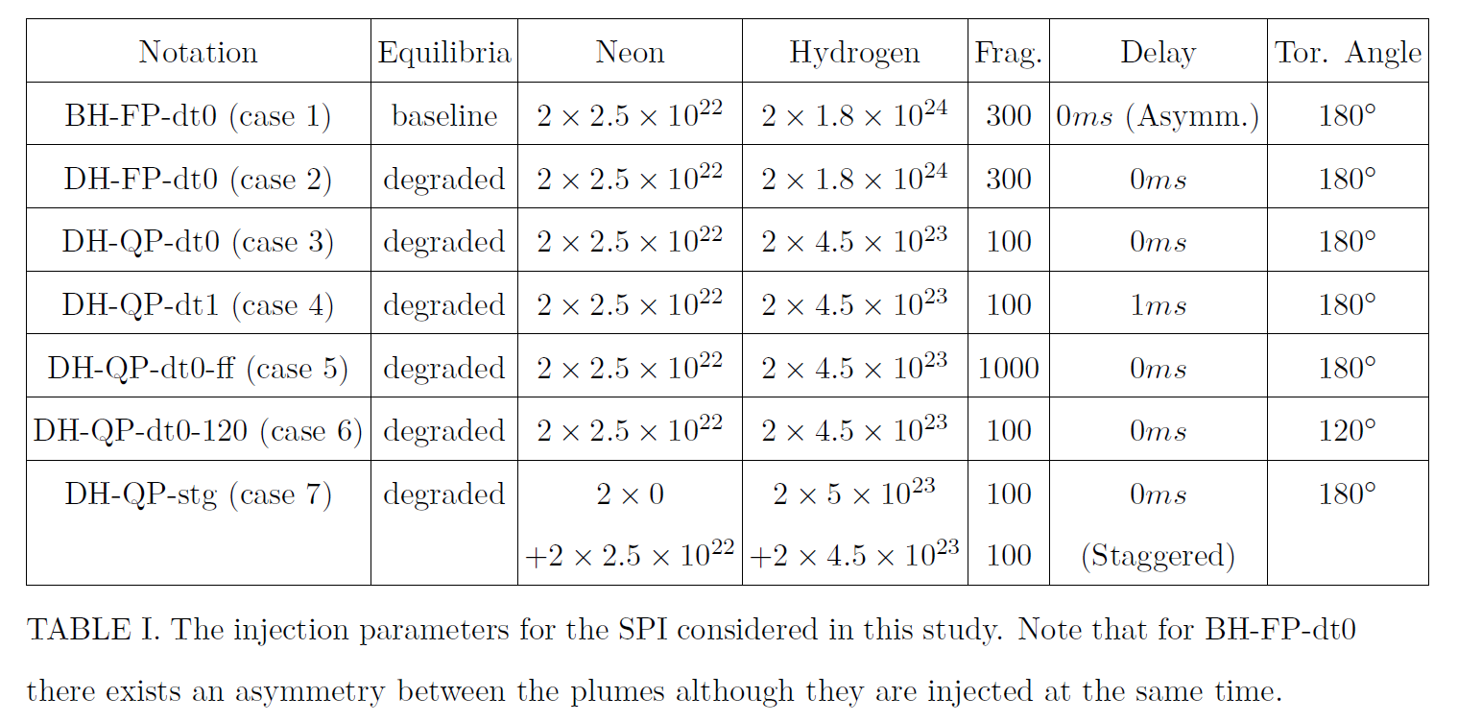
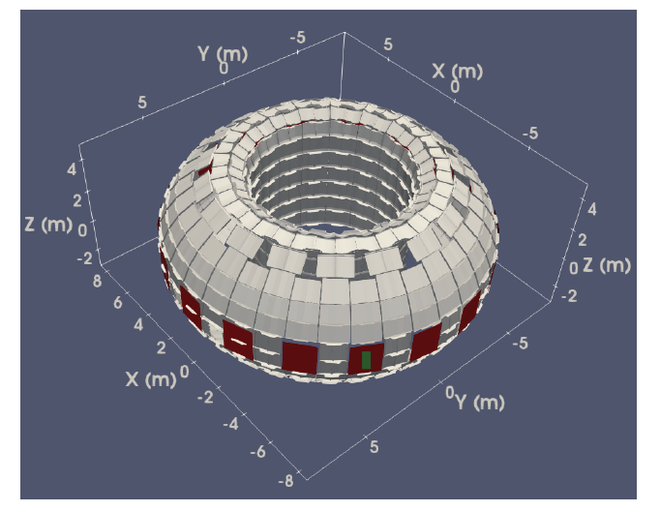
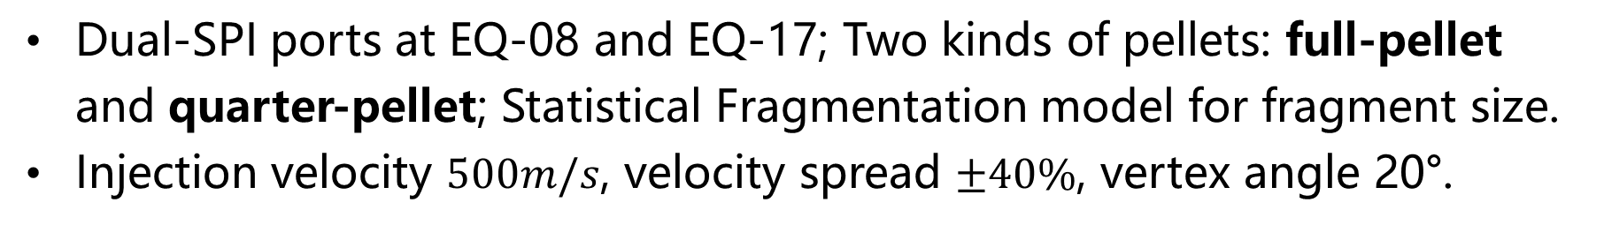
Simulation setup: SPI parameters
Dual-SPI ports at EQ-08 and EQ-17; Two kinds of pellets: full-pellet and quarter-pellet; Statistical Fragmentation model for fragment size.
Injection velocity $500m/s$, velocity spread $±40\%$, vertex angle 20°.
D. Hu et al Nucl. Fusion 64 (2024) 086005

Slide 7
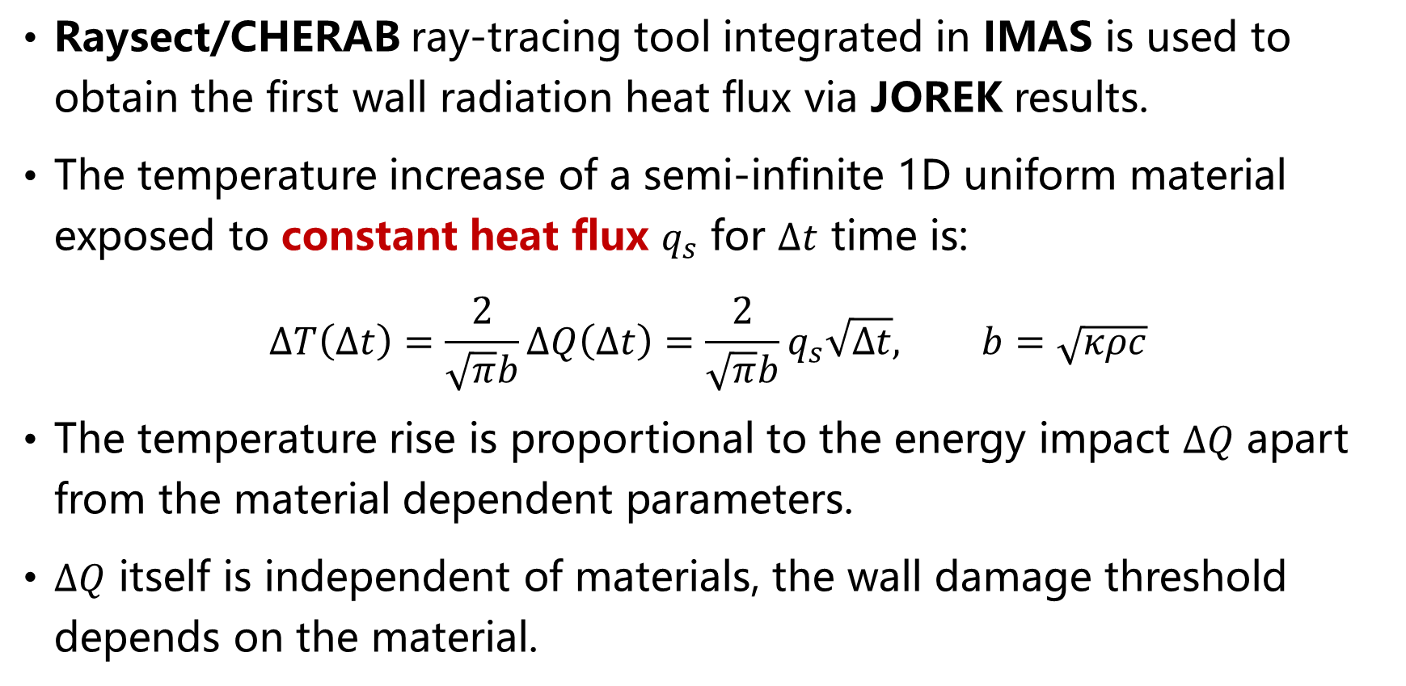
Energy impact calculation
Raysect/CHERAB ray-tracing tool integrated in IMAS is used to obtain the first wall radiation heat flux via JOREK results.
The temperature increase of a semi-infinite 1D uniform material exposed to constant heat flux $q_{s}$ for $∆t$ time is:
$$∆T\left(∆t\right)=\frac{2}{\sqrt{π}b}∆Q\left(∆t\right)=\frac{2}{\sqrt{π}b}q_{s}\sqrt{∆t}, b=\sqrt{κρc}$$
The temperature rise is proportional to the energy impact $∆Q$ apart from the material dependent parameters.
$∆Q$ itself is independent of materials, the wall damage threshold depends on the material.
A Herrmann, Plasma Phys. Control. Fusion 44 (2002) 883–903;

Slide 8
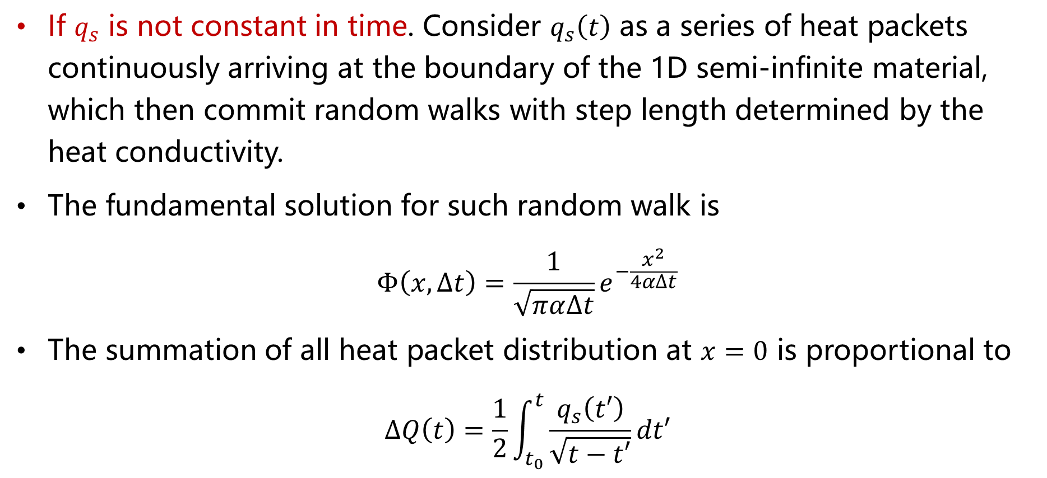
Energy impact calculation
If $q_{s}$ is not constant in time. Consider $q_{s}\left(t\right)$ as a series of heat packets continuously arriving at the boundary of the 1D semi-infinite material, which then commit random walks with step length determined by the heat conductivity.
The fundamental solution for such random walk is
$$Φ\left(x,∆t\right)=\frac{1}{\sqrt{πα∆t}}e^{−\frac{x^{2}}{4α∆t}}$$
The summation of all heat packet distribution at $x=0$ is proportional to
$$∆Q\left(t\right)=\frac{1}{2}\int_{t_{0}}^{t}{\frac{q_{s}\left(t′\right)}{\sqrt{t−t′}}dt′}$$
D. Hu et al Nucl. Fusion 64 (2024) 086005

Slide 9
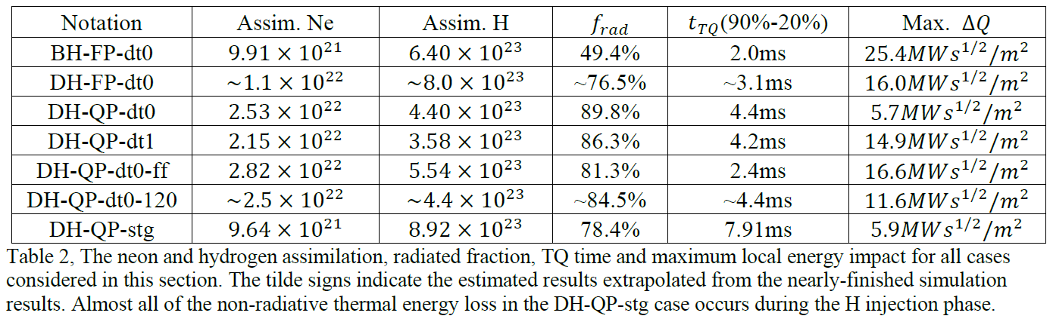
Quick summary of the results
Fragments entering the baseline H-mode pedestal result in significant plasmoid drift and accompanied MHD, undermining the mitigation efficiency.
Reasonably good mitigation for degraded cases, the tungsten tiles would not melt under any circumstances, and the SS plate melting is acceptable.
The rocket effect has not been considered in those studies.

Slide 10
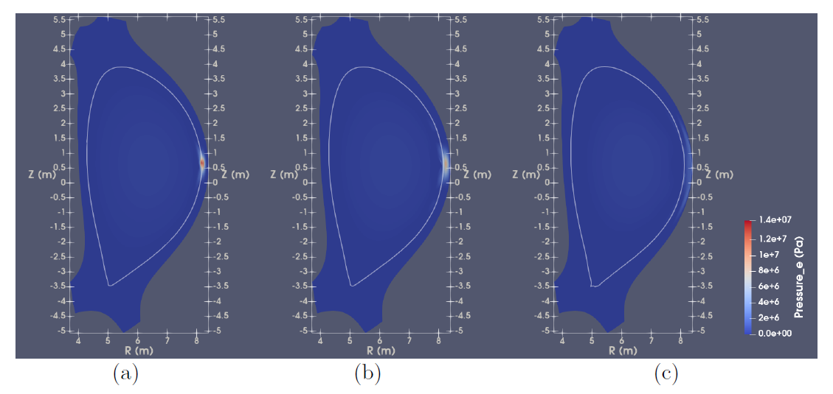
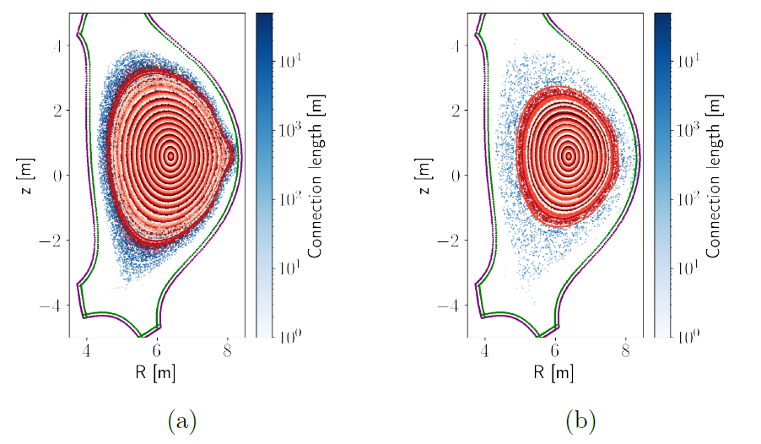
Plasmoid drift & MHD
Local over-pressure close to the fragment plume drives polarization and plasmoid drift along major radius for the baseline H-mode case.
The drift motion is accompanied by edge stochasticity and heat flux.
Direct SPIs into “healthy” H-mode might be challenging。
D. Hu et al Nucl. Fusion 64 (2024) 086005

Slide 11
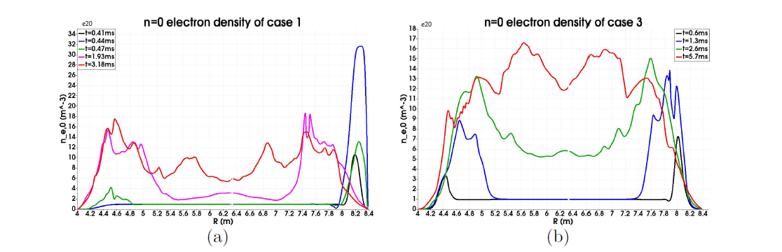
Injection assimilation
Such drift motion could be significantly mitigated by injecting into the degraded H-mode, or by using higher neon mixture ratio.
Significantly improve the assimilation and penetration.
LCFS
LCFS
D. Hu et al Nucl. Fusion 64 (2024) 086005

Slide 12
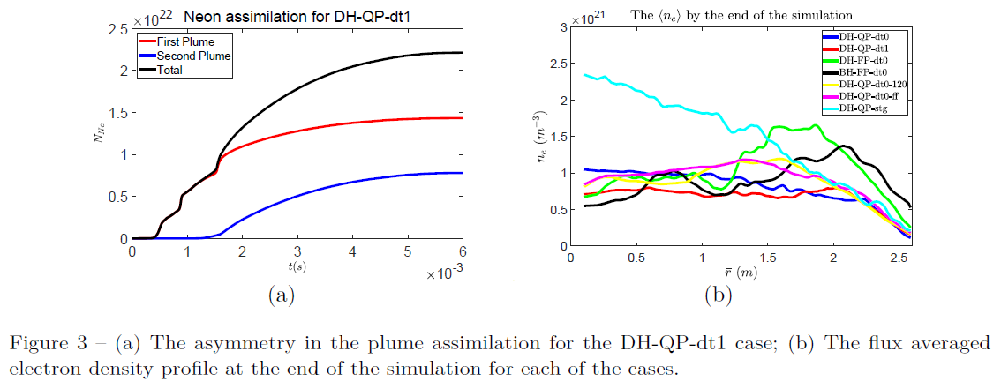
Injection assimilation
Delay between injectors negatively impact the assimilation, but not very drastically for delay on the order of 1ms.
Staggered injection shows significantly better core density rise.
D. Hu et al Nucl. Fusion 64 (2024) 086005

Slide 13
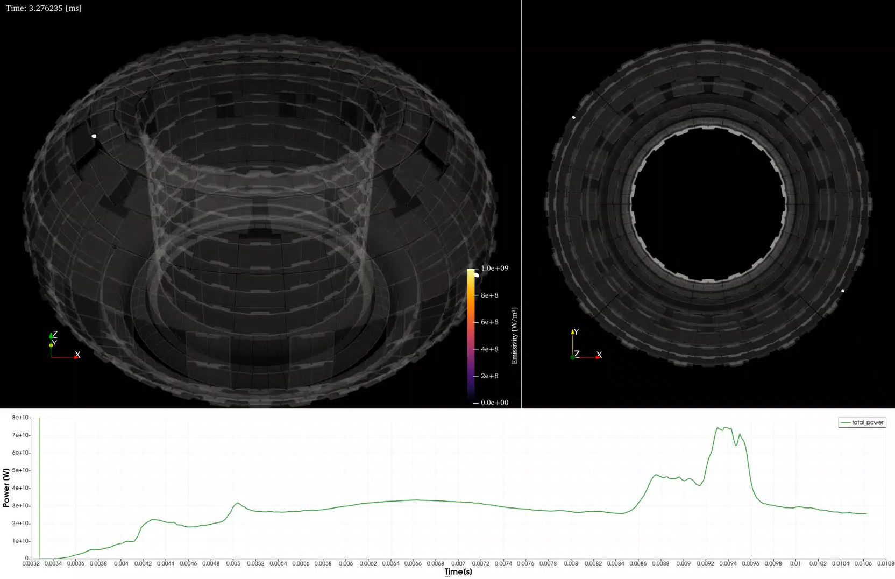
The radiation asymmetry
Helical radiative bands occur first around the plume.
Radiation is more localized despite lower total power in the early TQ.
The radiation power density is more uniform during late TQ.
DH-QP-dt0
K. Munechika, et al., “Synthetic framework for ITER bolometer performance assessment”, o26, 6th European Conference on Plasma Diagnostics, Prague, Czechia, 2025

Slide 14
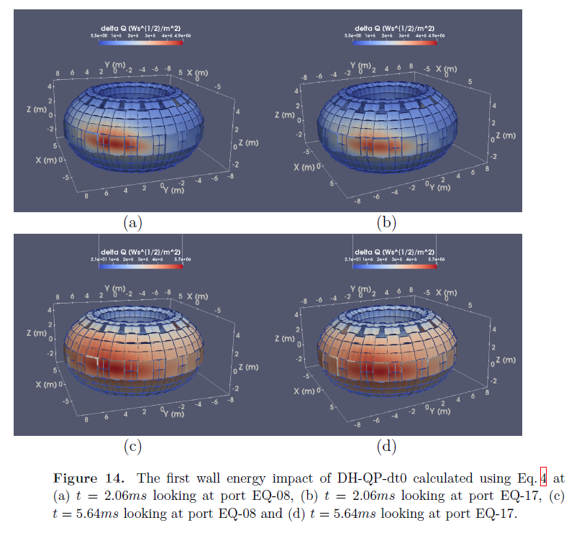
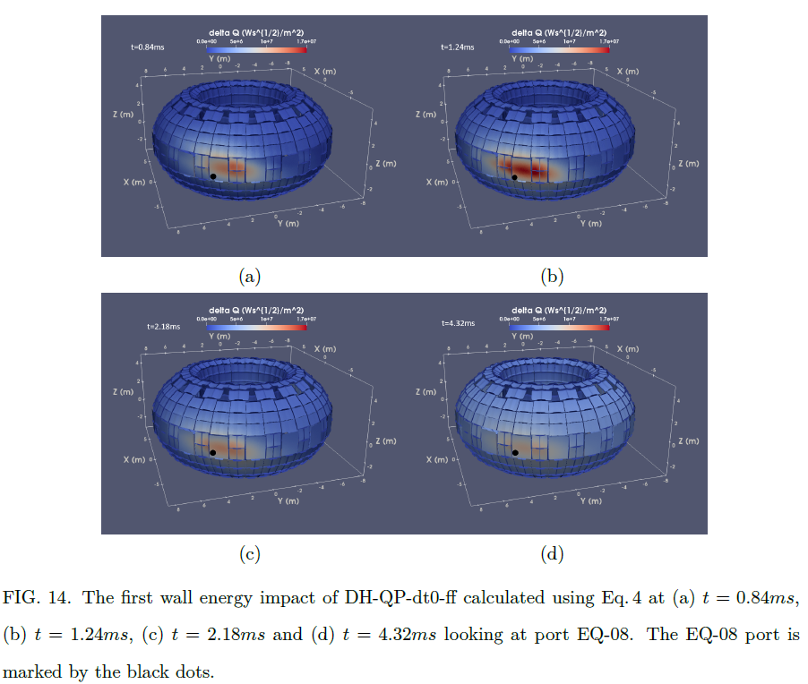
First wall energy impact

Slide 15
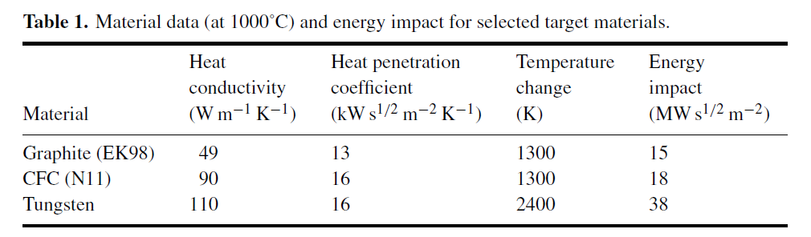
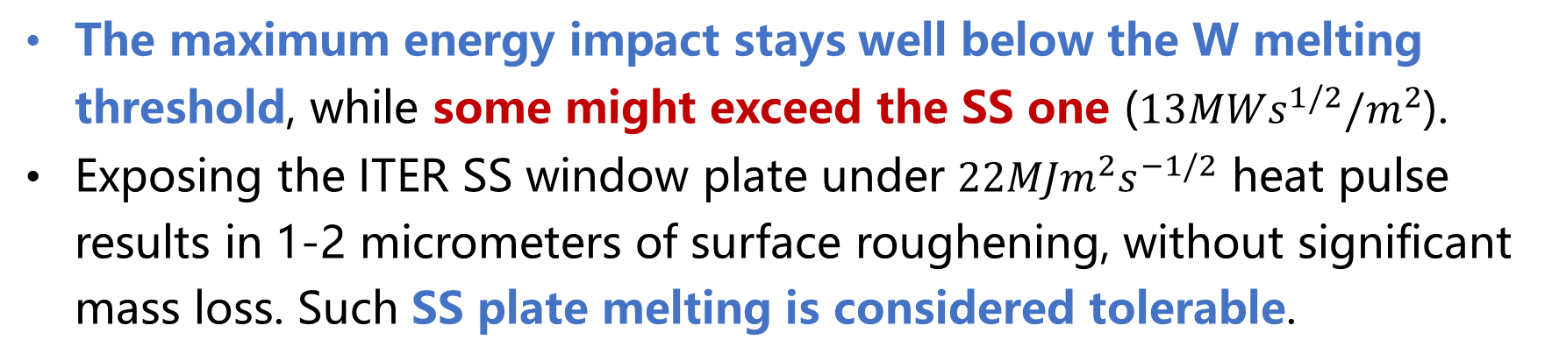
The energy impact threshold
The maximum energy impact stays well below the W melting threshold, while some might exceed the SS one ($13MWs^{1/2}/m^{2}$).
Exposing the ITER SS window plate under $22MJm^{2}s^{−1/2}$ heat pulse results in 1-2 micrometers of surface roughening, without significant mass loss. Such SS plate melting is considered tolerable.
A Herrmann, Plasma Phys. Control. Fusion 44 (2002) 883–903; R.A. Pitts et al. J. Nucl. Mater. 463 (2015) 748–752

Slide 16
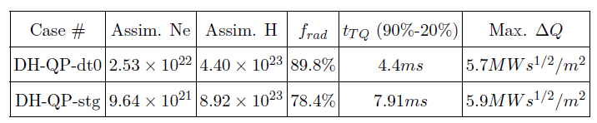
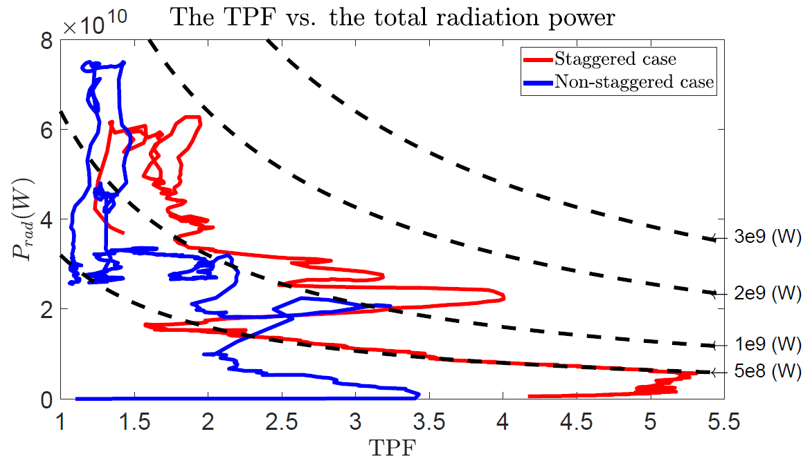
TPF in the plasma and on the wall
The radiation power density within the plasma does not necessarily translate into the asymmetry on the wall.
As an example, comparing DH-QP-dt0 and DH-QP-stg, the staggered case shows stronger radiation asymmetry within the plasma, but not so much difference on the wall.
Could be attributed to deeper impurity deposition for DH-QP-stg

Slide 17
Conclusion & Discussion
JOREK coupled with Raysect/CHERAB is used to investigate the MHD and the radiation characteristics during dual-SPIs into ITER H-modes.
Strong plasmoid drift and accompanied MHD for the baseline H-mode case. Detrimental to the TQ mitigation efficacy. Could be avoided by considering the neon mixture and precursor confinement loss.
Delay between injectors on the order of 1ms reduces assimilation, but not drastically.
Significantly better core penetration for the staggered scheme.
Radiation asymmetry could arise from SPI configuration or inherent MHD. The asymmetry is stronger in the early phase.
The energy impact would not exceed the W limit. Although it could exceed the SS limit, it won’t result in significant mass loss.
Future: More realistic fragment distribution & toroidal elongation? Repeated exposure? Rocket effect and its assimilation impact?

