Slide 1
EX-P #3117
Advancing Fueling for Future D-T Fusion: Innovations in SMBI Technology and Physics-Based Fueling Strategies for Tritium
G.L. Xiao¹, Y.R. Zhu¹, Y.Q. Shen¹, C.Y. Wang¹, K. Xu¹, J. Yin¹, Y. Zhou¹, A.S. Liang¹,D.M. Fan¹, H.L. Du¹,
G.Q. Xue¹, C.Y. Chen¹, X.L. Zou², W.L. Zhong¹
Email: xiaogl@swip.ac.cn
1 Southwestern institute of physics, Chengdu, China
2 CEA, IRFM, St Paul-lez-Durance, France

Slide 2
Outline
Background
Improvements of SMBI techniques
Strategy for fueling via SMBI
Heat load control with SMBI
Summary

Slide 3
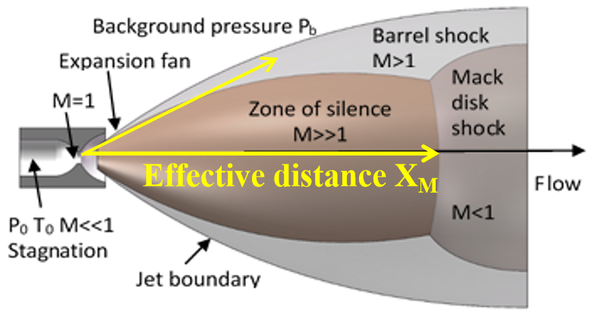
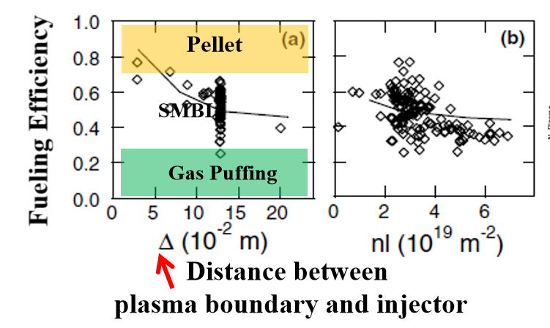
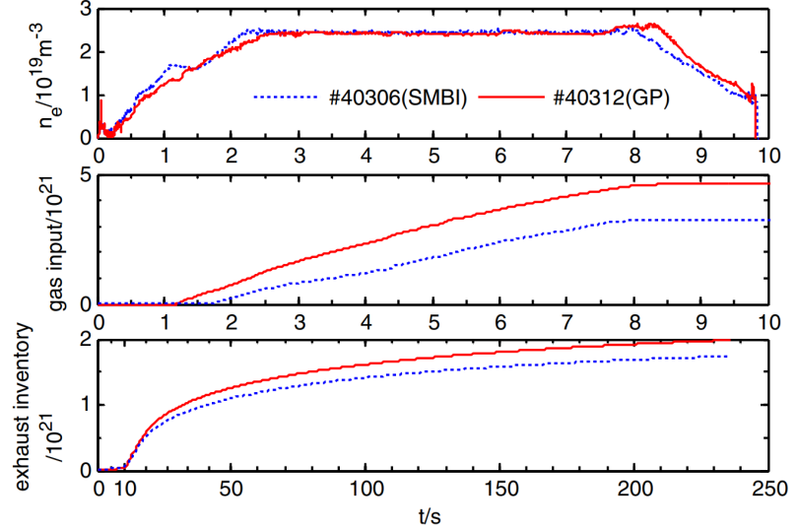
Background
SMBI stands as the leading candidate for T₂ fueling at present
Supersonic molecular beam injection (SMBI) was first introduced into the fusion field as a fueling technology on HL-1 and has been applied in more than a dozen fusion devices [G.L.Xiao RMPP 2023]
SMBI | Gas puffing
higher speed, higher fueling efficiency | slower speed, lower fueling efficiency
directivity | low directivity
lower recycling, supports long-pulse operation | higher recycling
Pégourié JNM 2003
[Zheng PPCF 2013]
……

Slide 4
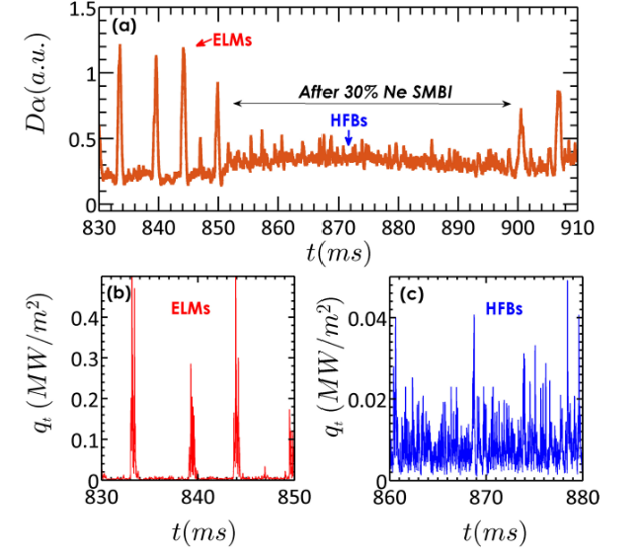
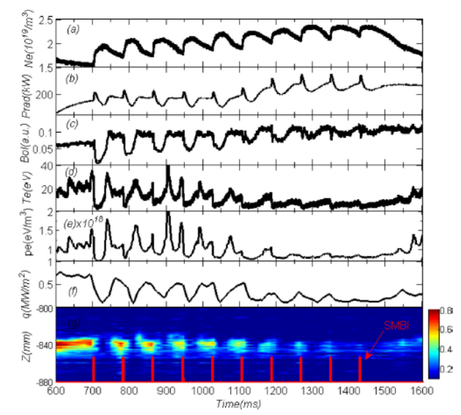
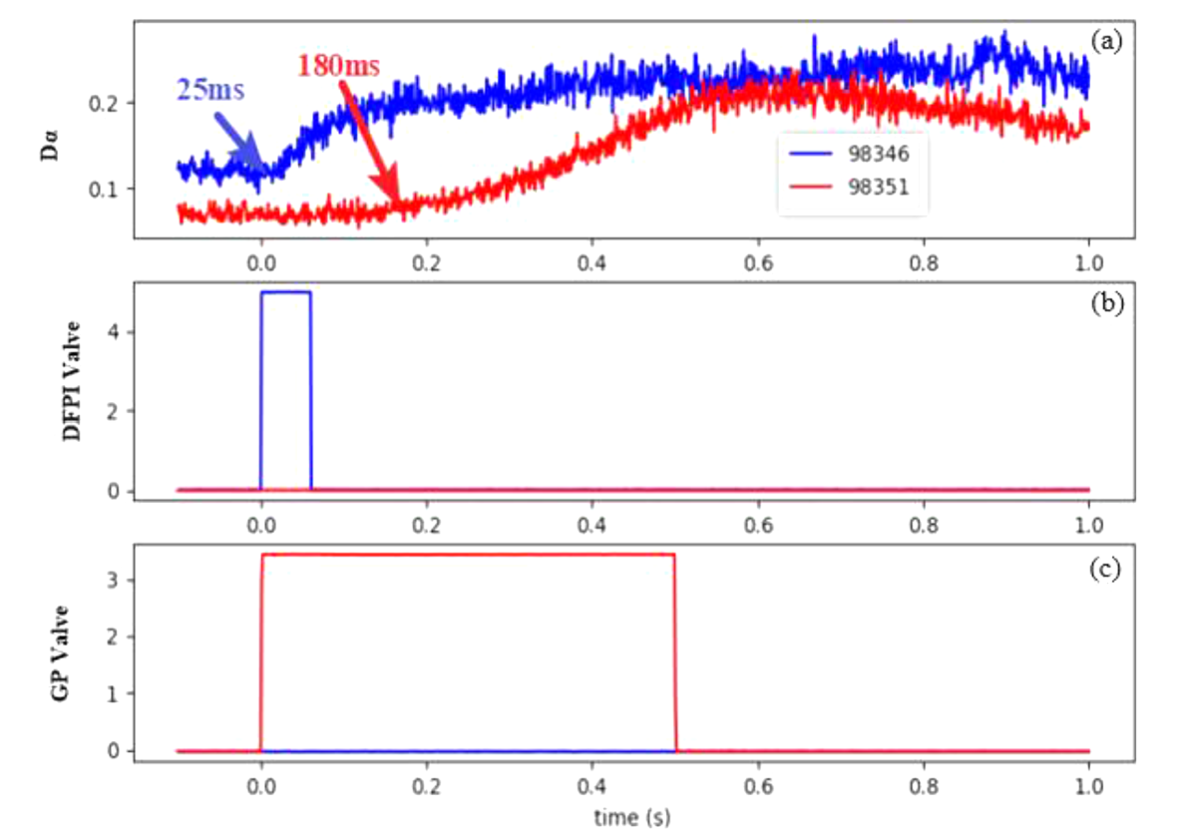
Background
SMBI offers a significant benefit for heat load control
ELM control with SMBI
ELM mitigation by fueling SMBI first demonstrated in HL-2 [Xiao NF 2012], then applied in EAST and KSTAR[Zou IAEA 2012, Xiao NF 2014, Lee PoP 2015]
ELM suppression with impurity (or mixture) SMBI on HL-2/3 [Zhong NF 2019] and EAST [Cao PST 2025]
Divertor detachment with SMBI
Similar to GP, SMBI at midplane is applied to reduce the divertor heat on HL-2[Yan NF 2010, Gao JNM 2017] and detachment experiment on EAST [Yuan FED 2020].
SMBI directly installed in divertor can has good capacity, implemented on HL-2/3 and EAST [Xiao, AAPPS-DPP 2021, Cao FED 2022]

Slide 5
Challenges and solutions
Fuel supply
SMBI system design
Nozzle and injector
SMB characteristics
Plasma interaction
Challenges
Solutions
?
low pressure for T₂ fueling
SMB distribution control
convergent fuel
targeted plasma fueling
fueling efficiency
high heat load control
time response
enhanced capacity
techique improvements
AI based distribution prediction
injector optimization
Multi-phase SMBI
Vector SMBI
experimental fueling strategy
divertor SMBI for heat control

SMBI
application
?


Slide 6
Outline
Background
Improvements of SMBI techniques
Strategy for fueling via SMBI
Heat load control with SMBI
Summary

Slide 7
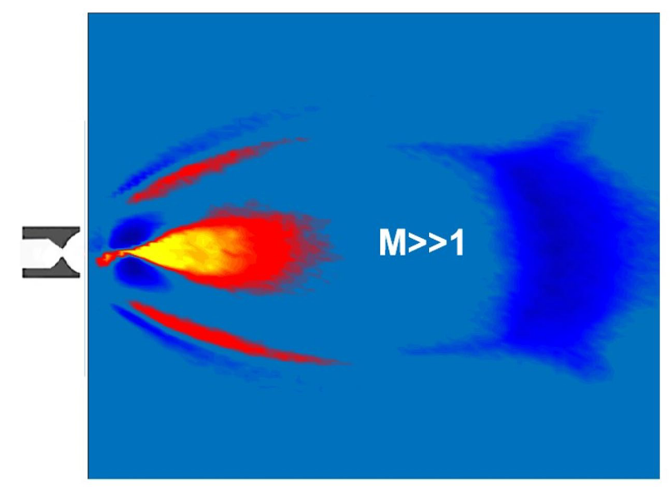
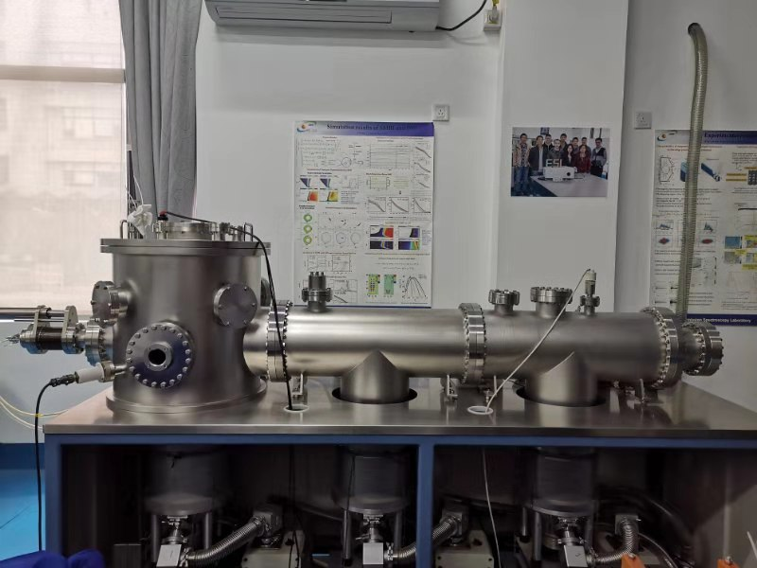
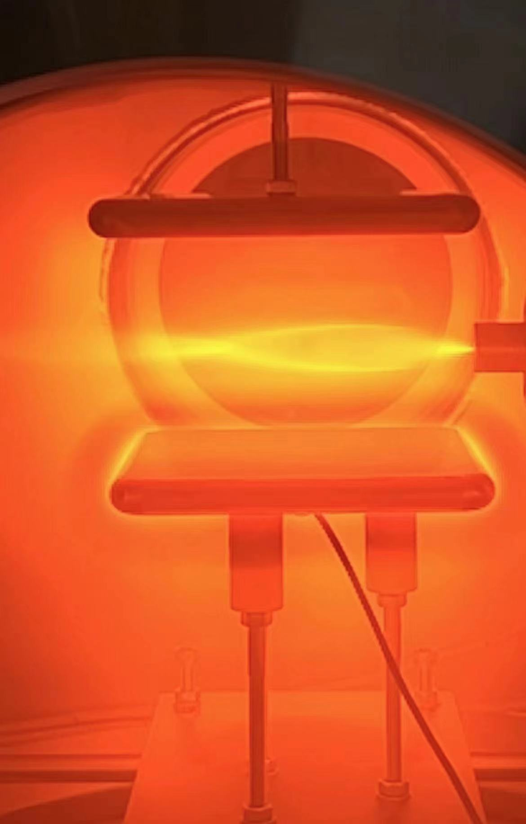
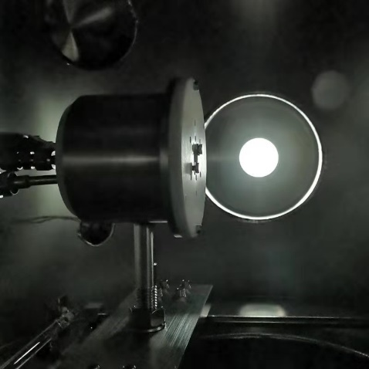
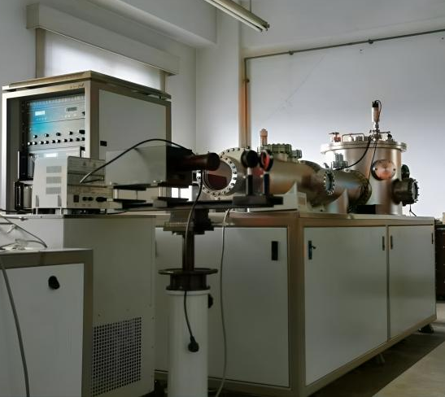
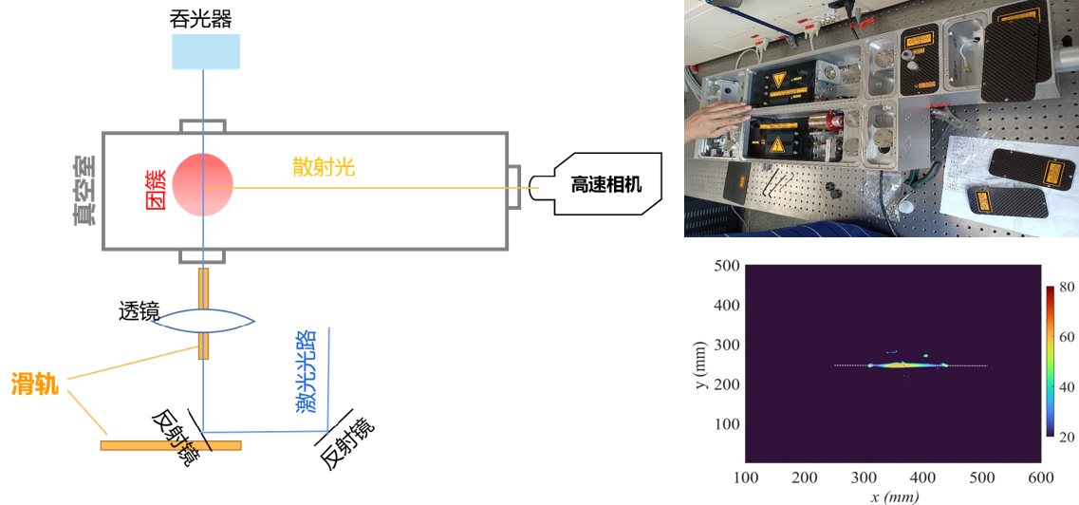
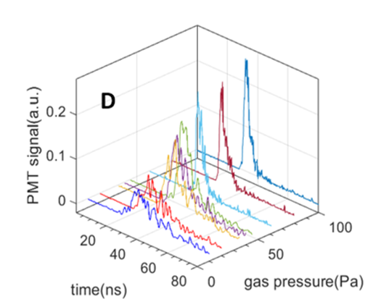
SMBI testing platform and diagnostic systems
A offline SMBI testing platform with comprehensive diagnostic systems was estabished
Offline SMBI testing platform
>5×10⁻⁵ Pa, d_{max} = 0.5 m, L =2.2 m
Diagnostics | Parameters | Measurements
Schlieren system | Beam structure, density
Glow discharge scanning LPs | Beam structure, velocity
Laser Rayleigh scattering | Scale of cluster
Laser induced fluorescence | Atom density, velocity

Slide 8
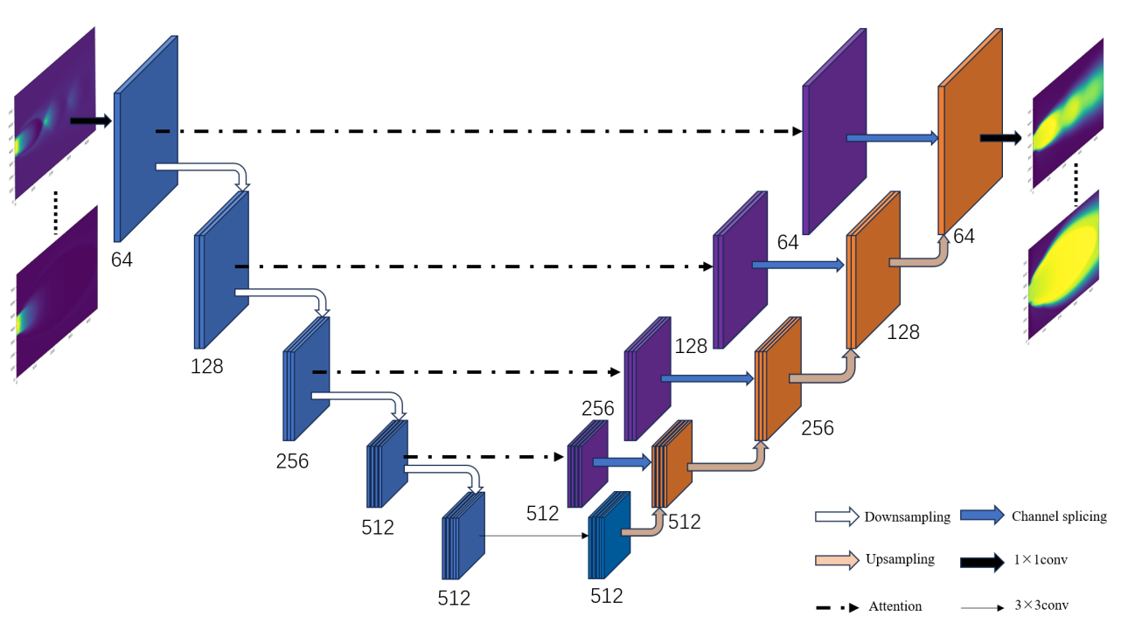
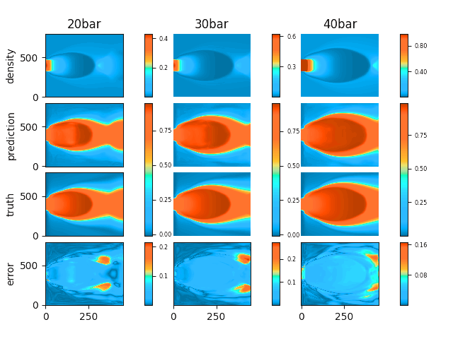
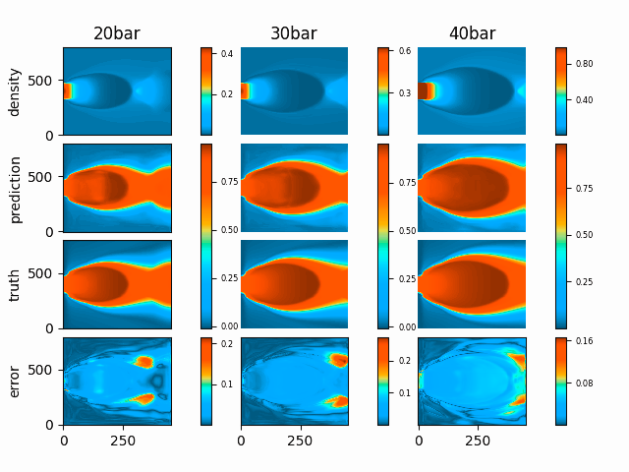
AI-based SMBI velocity distribution
Obtain velocity distribution from density [ρ(x,y) → v(x,y)] via U-net deep learning model
Simulation data: ρ(x,y) & v(x,y) ;
Experimental testing data: ρ(x,y) (schlieren system) & v(x,y) (GD & langmiur probes)
U-net model
[Xu K. et al, China Sci: Tech. sci, 2025]
High Generalization Capability ✔： Accurately predicts unseen data.
Optimal Architecture ✅ ：U-net + attention @ boundary → superior beam analysis

Slide 9
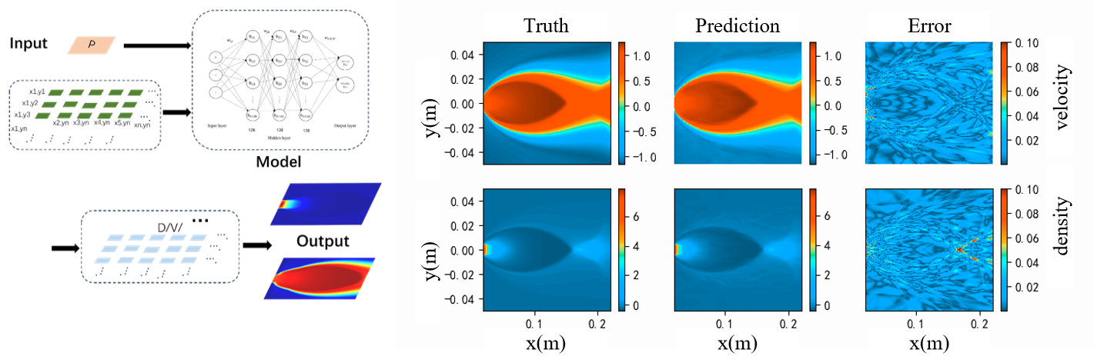
AI-based SMBI distribution prediction
Realized > 1000× faster prediction of SMB distribution aiming for real-time control of plasma profiles
Key Assumption: Beam distribution is governed only by gas source pressure P_{SMBI}
Fixed: Injector geometry (d, L, θ) & background pressure. Sole variable: P_{SMBI} or P₀
Baseline: Surpasses traditional fluid simulation and beam image measurement
Speed: Millisecond-level beam distribution prediction for real-time control

Slide 10
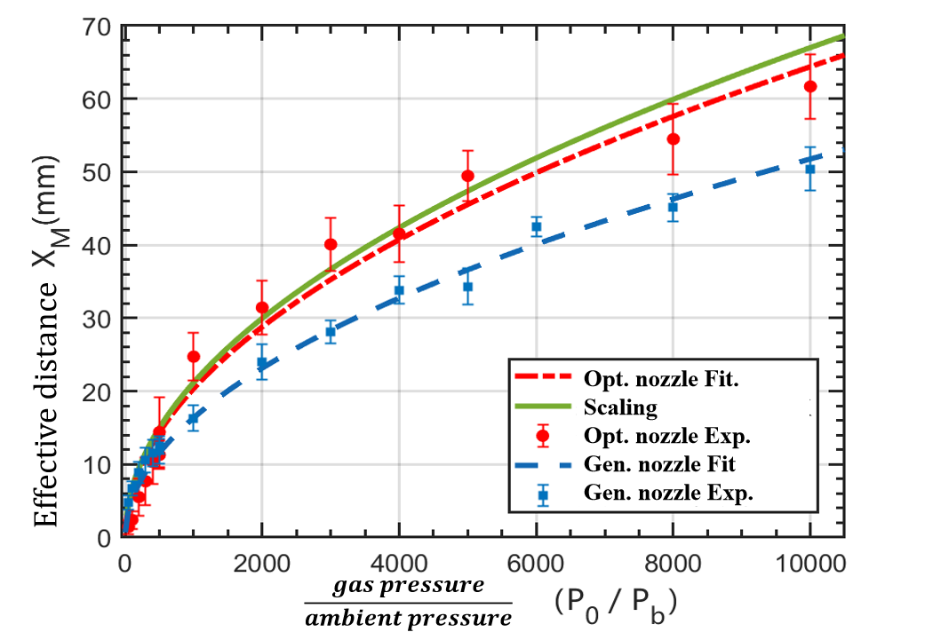
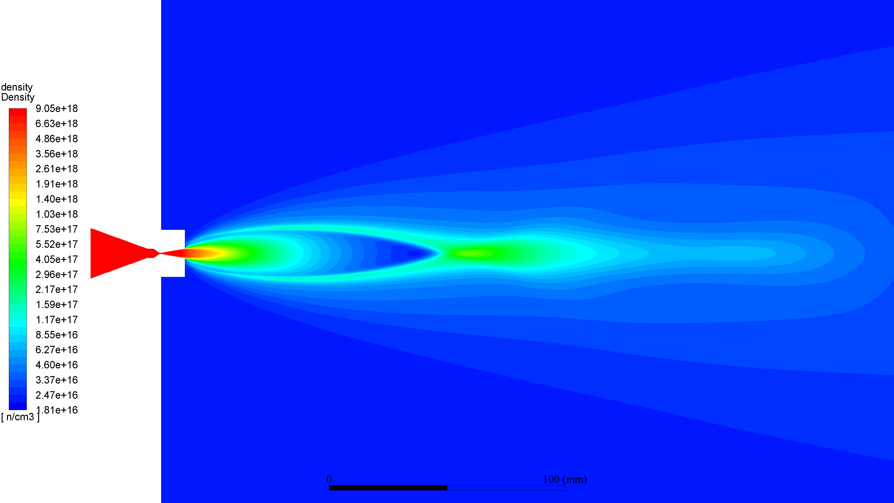
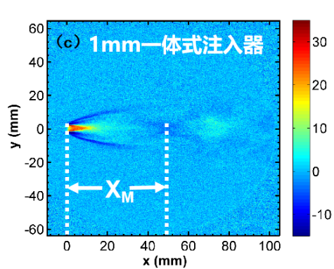
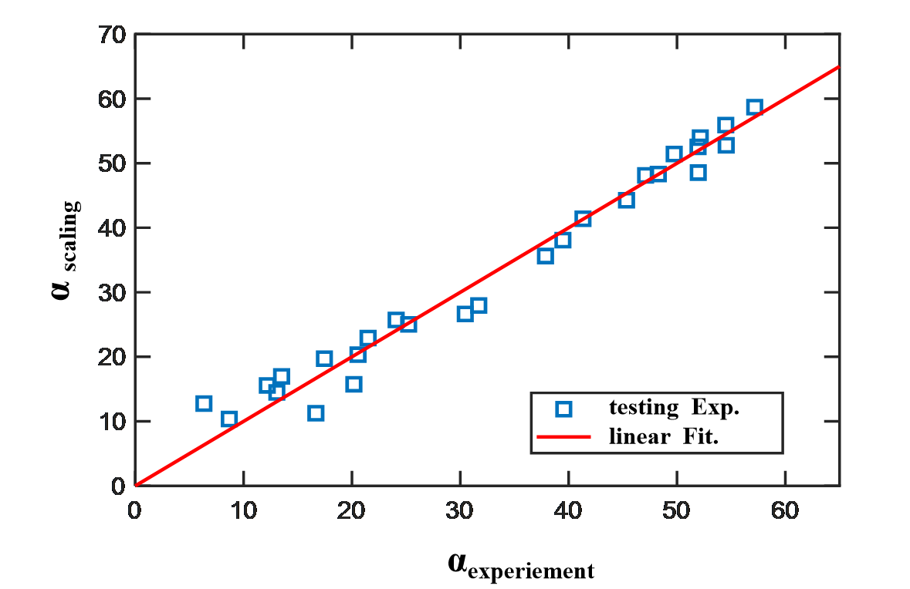
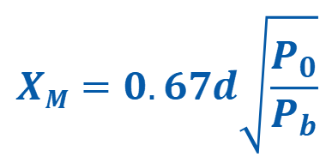
SMB parameter dependance
Parametric dependance of SMB characteristics on injector and working condition
Simulation
Injector structure design
L: Length of the expansion section
θ: cone angle
d: diameter of nozzle
P₀: source pressure of SMBI
P_{b}: pressure of the background at oulet
$$XM=0.67d\sqrt{\frac{P_{0}}{P_{b}}}$$
offline experiment
α : divergence angle
X M : effective distance
α
Beam characteristic parameters:
X_{M}: Length of silent zone; effective distance
α: Half of the divergence angle
α _{scaling} ∝ d ^{0.15}×L^{-0.82}×θ ^{-0.83}×P₀ ^{0.21}×P_{b} ^{-0.12}
Optimized injectors obtained for effective fueling

Slide 11
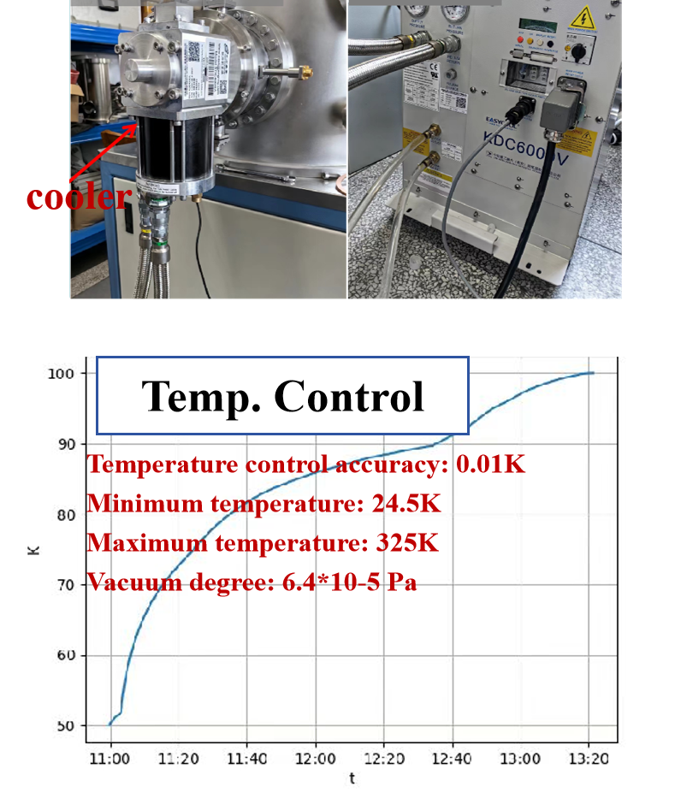
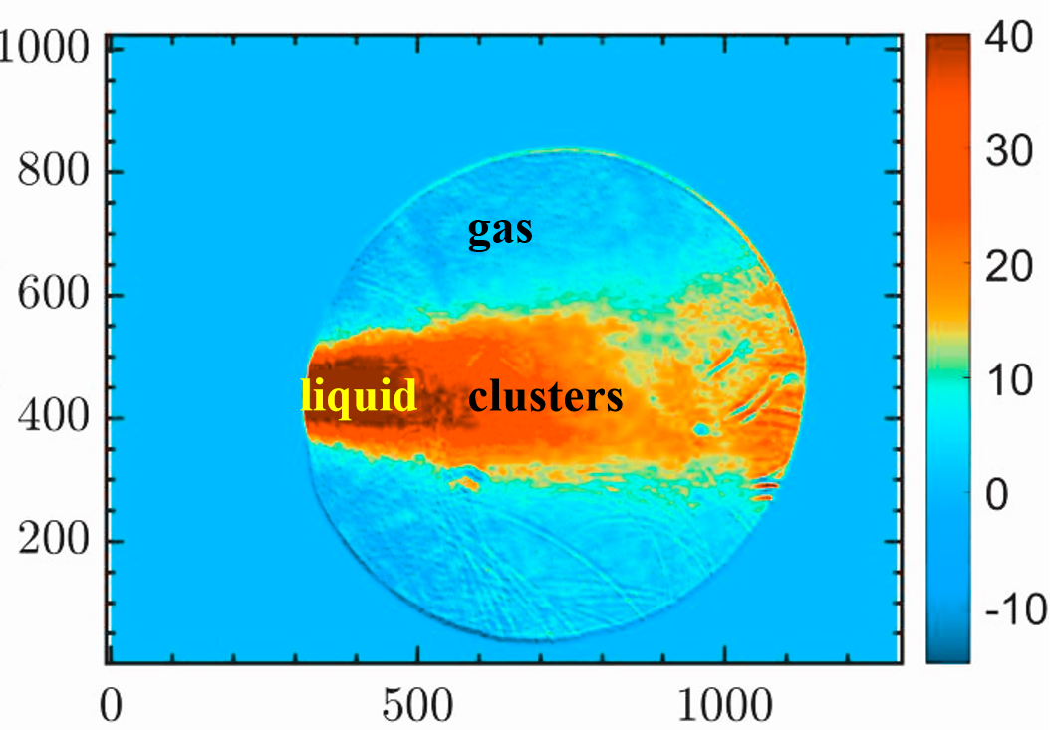
Multi-phase SMB injection technology
Precise control of injected components via gas source temperature
Approches: Adjusting gas source temperature (also the pressure)
Regulates component injection from gas, cluster, to liquid phases and their mixing.
An illustrative measurement of the beam composition by the Schlieren system

Slide 12
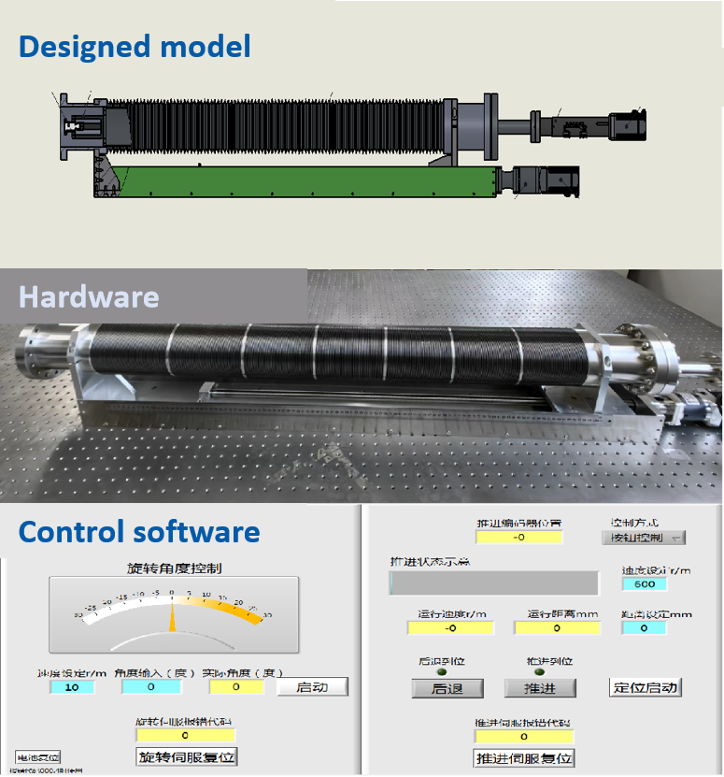
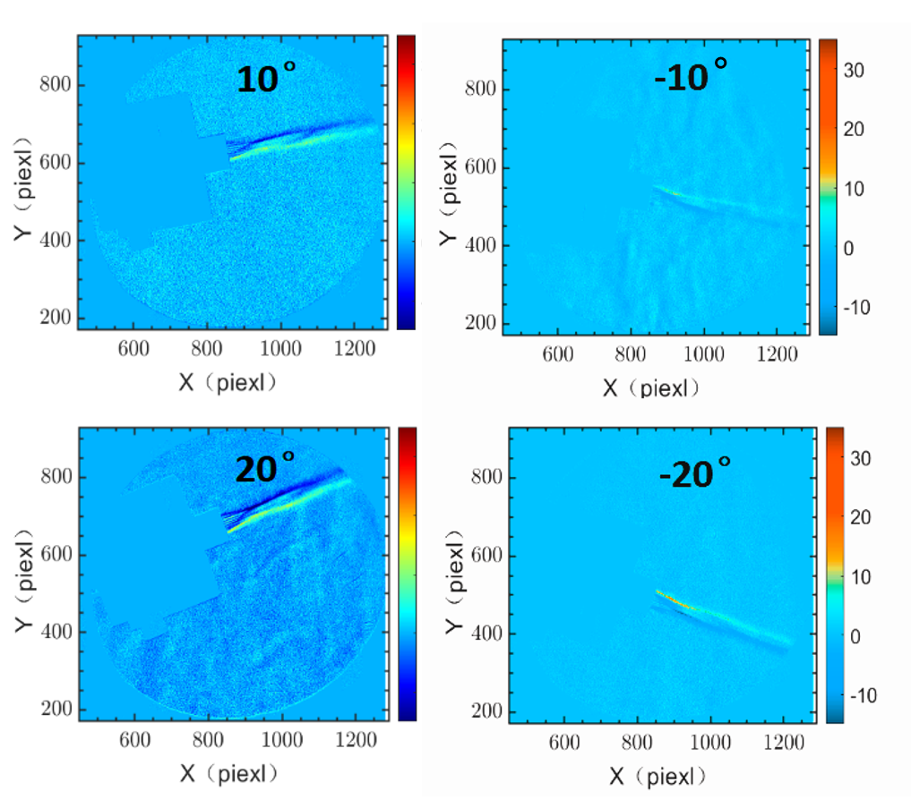
Vector injection technology
Vector injection SMB system: flexible beam steering before reaching plasma edge
Capabilities: precise control of injection position and angle
Adjustment Ranges:
Radial Position:
0 - 0.66 m
Poloidal/Toroidal Angle: ±20°

Slide 13
Outline
Background
Improvements of SMBI techniques
Strategy for fueling via SMBI
Heat load control with SMBI
Summary

Slide 14
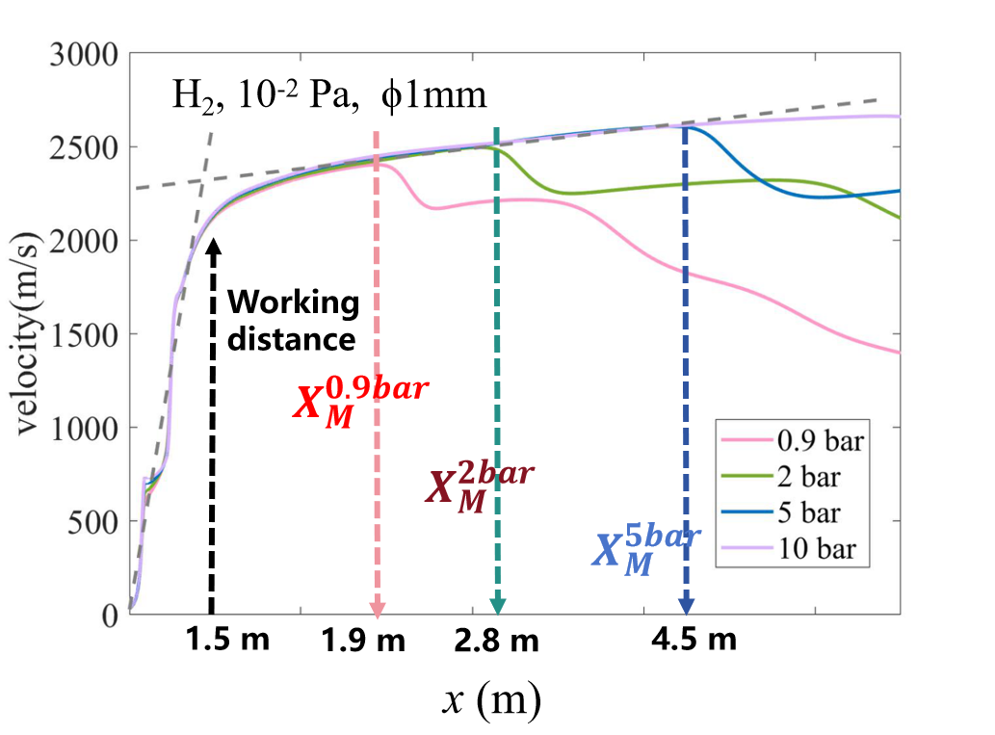
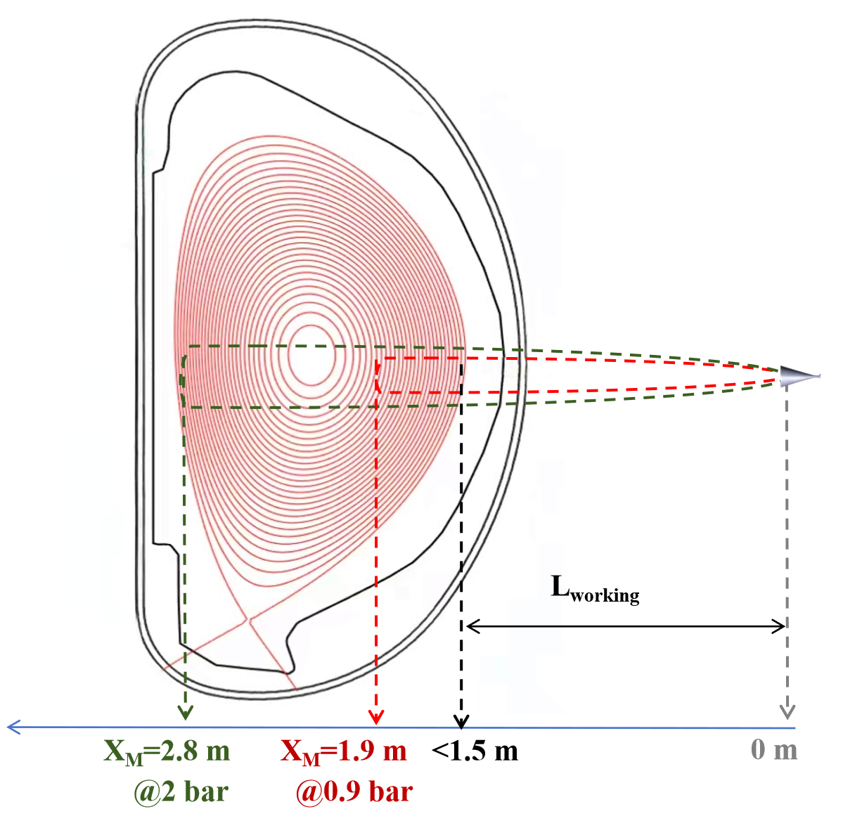
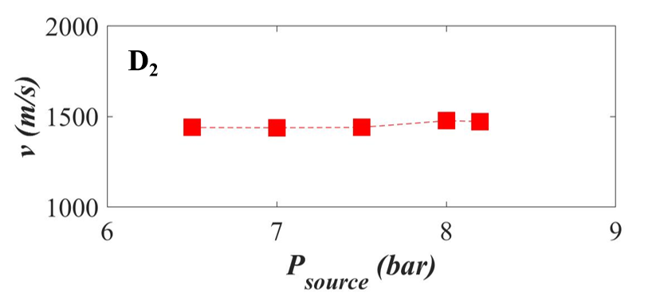
Maximized SMB velocity
Simulation and experiments: the beam velocity is independent of pressure, which primarily affects density
Ideal design SMB nozzle allows adiabatic expansion → v_{max}∝$\sqrt{T0​ }$ (γ, M constant)
In fluent simulation:
X_{eff} (0.9 bar) > L_{working}
when: L_{working} = 1.5 m
⇒ v_{H2} = 2100 m/s
⇒ v_{D2} = 1500 m/s
In tokamak expriements:
L_{working} = d(plasma, injector)
Δt = t_{Dα,onset} - t_{SMBI,start}
⇒ v = slope (L_{working}, Δt)
Fueling analysis prioritize how SMB density distribution shapes edge plasma profiles

Slide 15
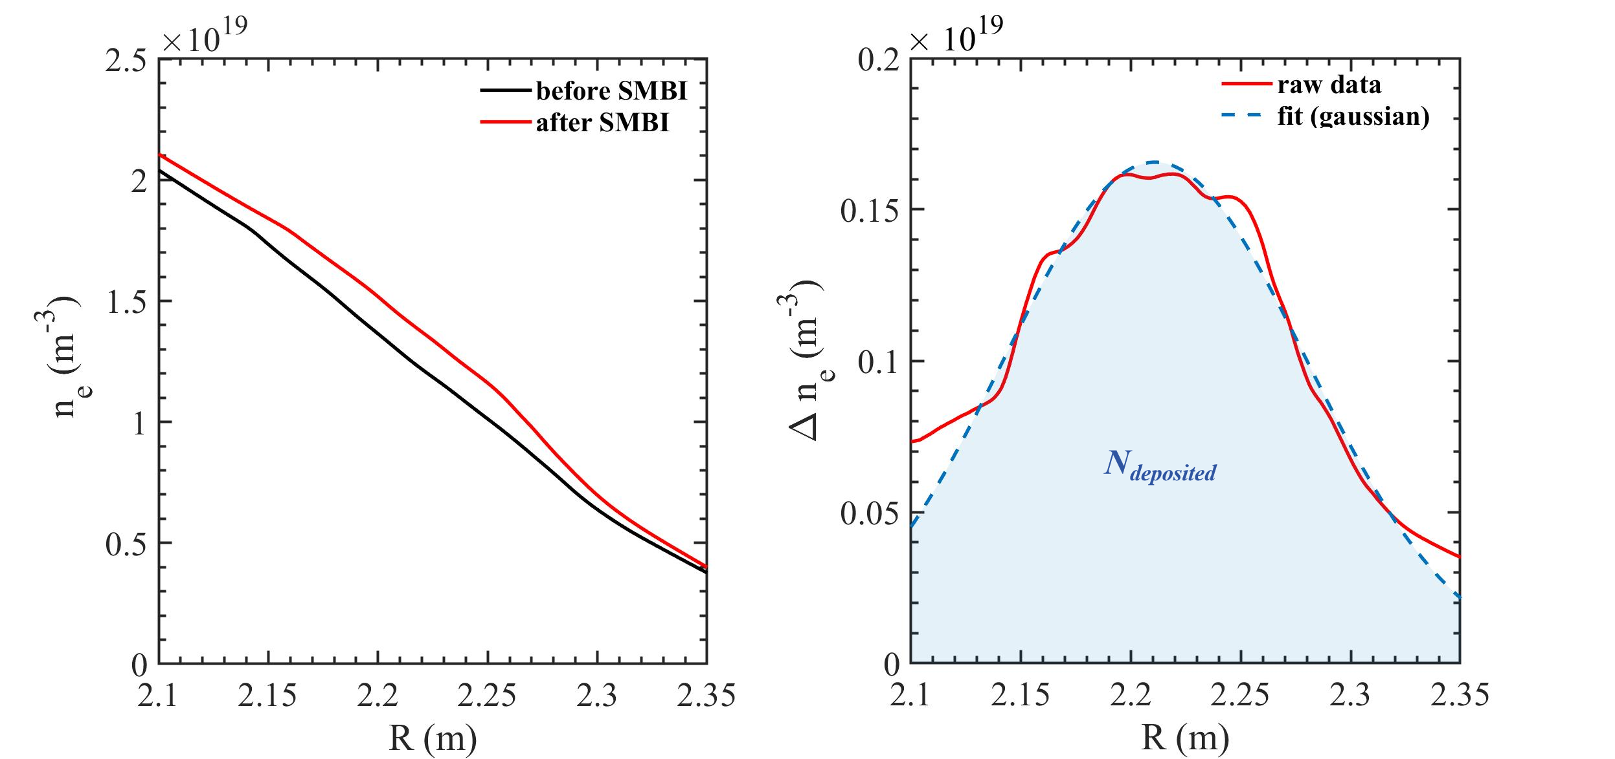
Fueling efficiency analysis method
Localized analysis of short-time density distributions from microwave reflectometers
MR: Δn_{e} = n_{e,after}(r) - n_{e,before}(r)
Local Deposition (Transport Neglected)
Δn_{e} → Gaussian Fit → N_{deposited}
N_{injected}(P_{SMBI}, t_{SMBI}) : offline calibrated, linear relation for SMBI valve)
Fueling efficiency:
$$η=N_{deposited} / N_{injected}$$

Slide 16
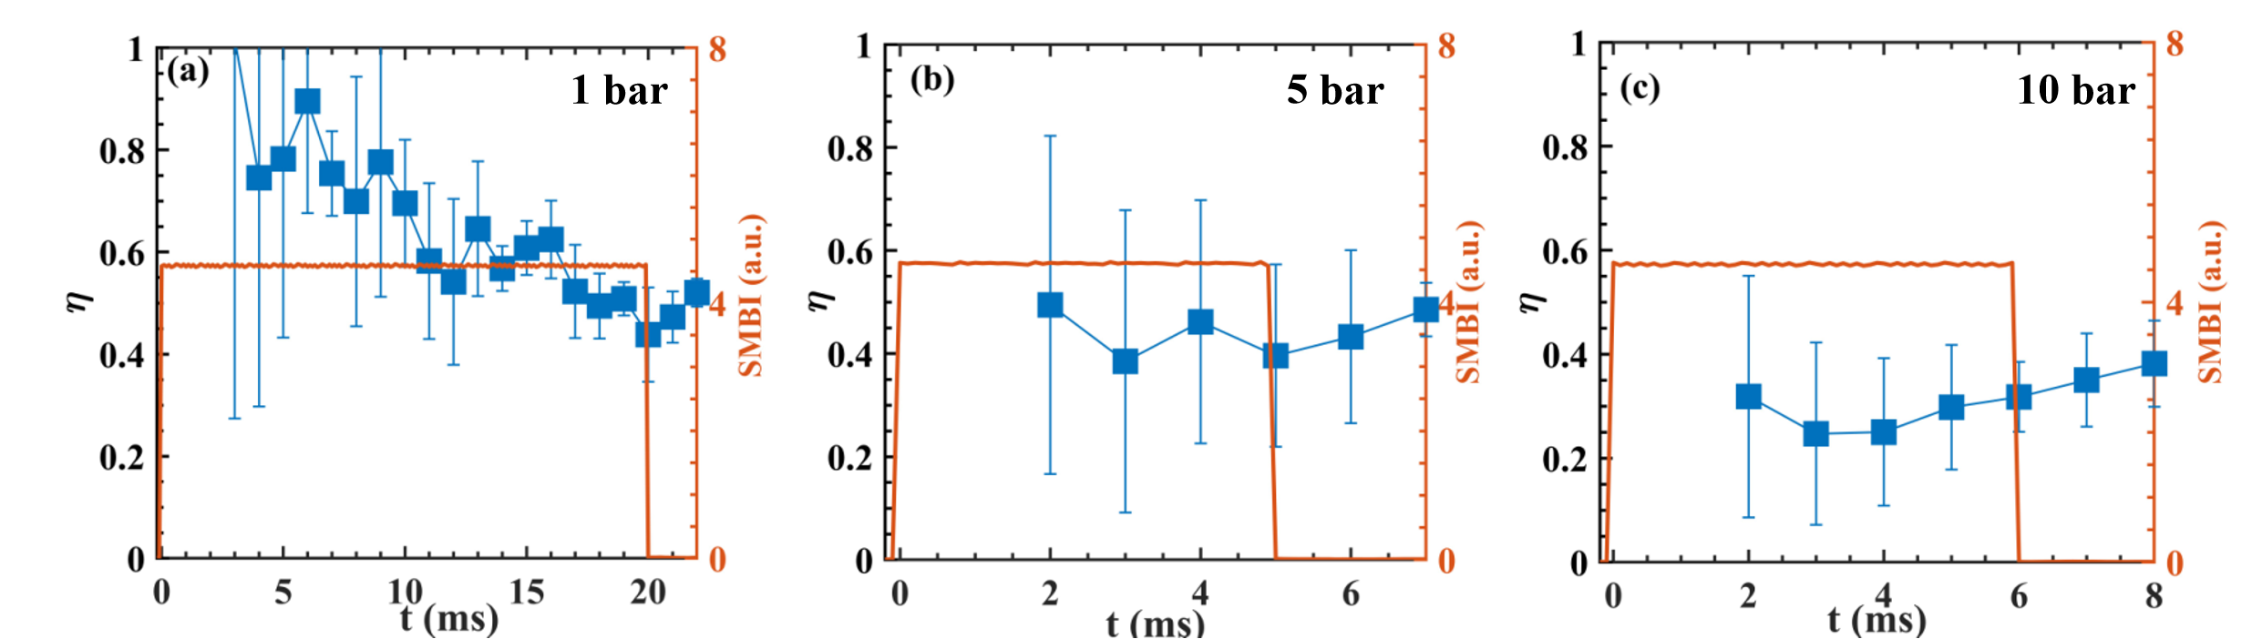
Effect of gas pressure on fueling efficiency
Fueling efficiency η decreases with increasing pulse pressure:
Fueling experiments with SMBI pressure scan at fixed parameters:
n_{e} = 2.4×10¹⁹ m⁻³, b_{t} = 1.65 T , I_{p} = 0.5 MA, P_{SMBI} ~ (1 - 10bar)
η: ~53% @ 1 bar → ~ 47% @ 5 bar → ~35% @ 10 bar
The use of low-pressure SMB is recommended, as it enables higher fueling efficiency while complying with tritium safety protocols.

Slide 17
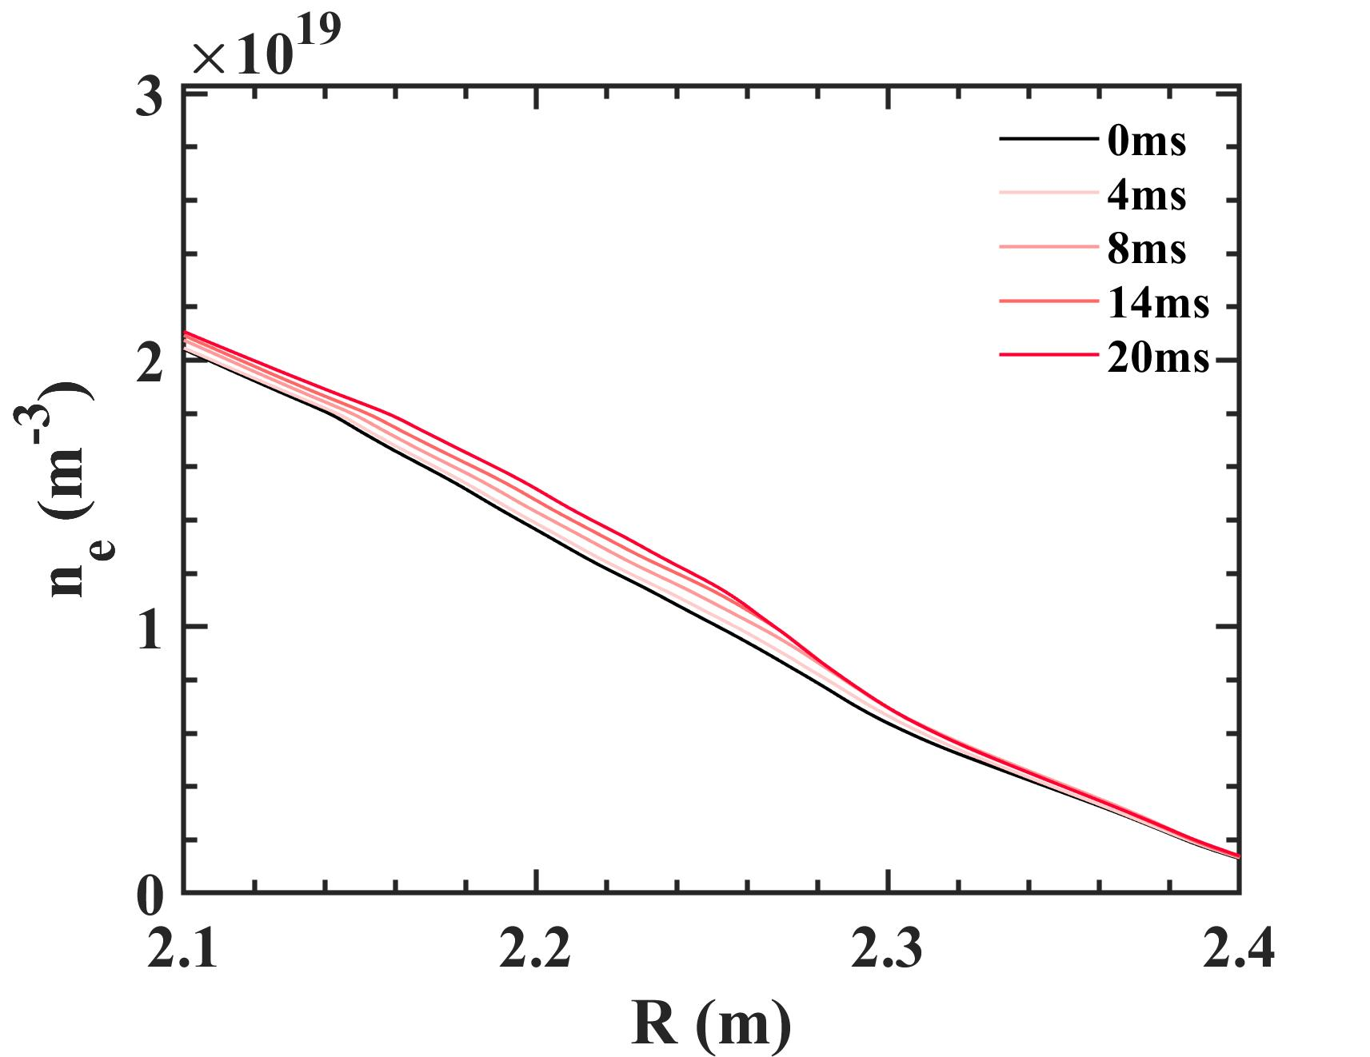
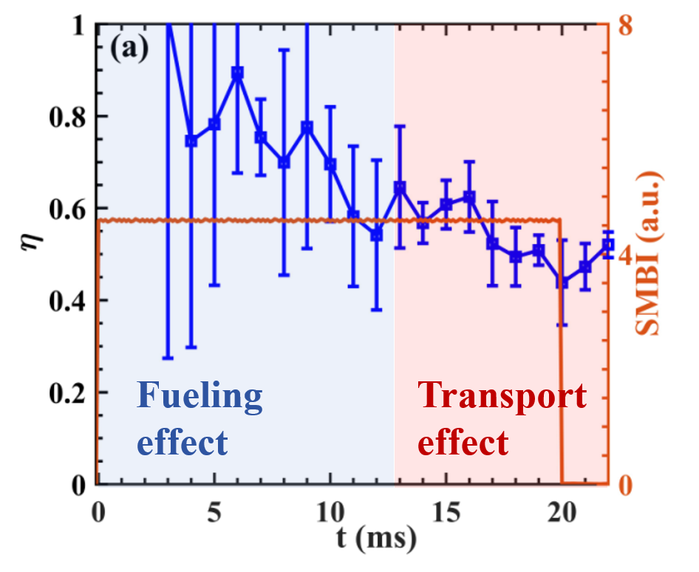
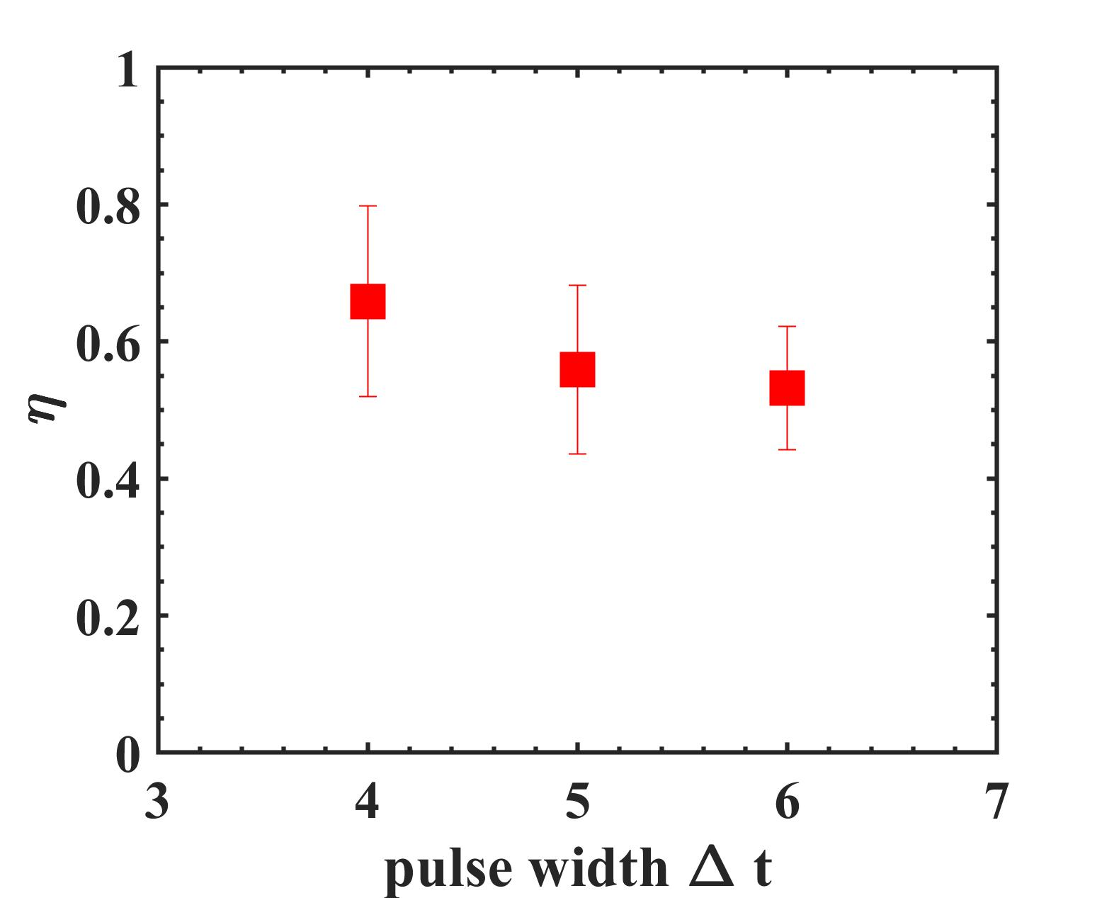
Effect of pulse width on fueling efficiency
Fueling efficiency η decreases with increasing pulse width
Analysis via single-pulse temporal evolution and multi-pulse width comparison
1 bar
5bar
The use of short-pulsed, high-frequency SMBI is advised over long-pulsed SMBI for higher fueling efficiency.

Slide 18
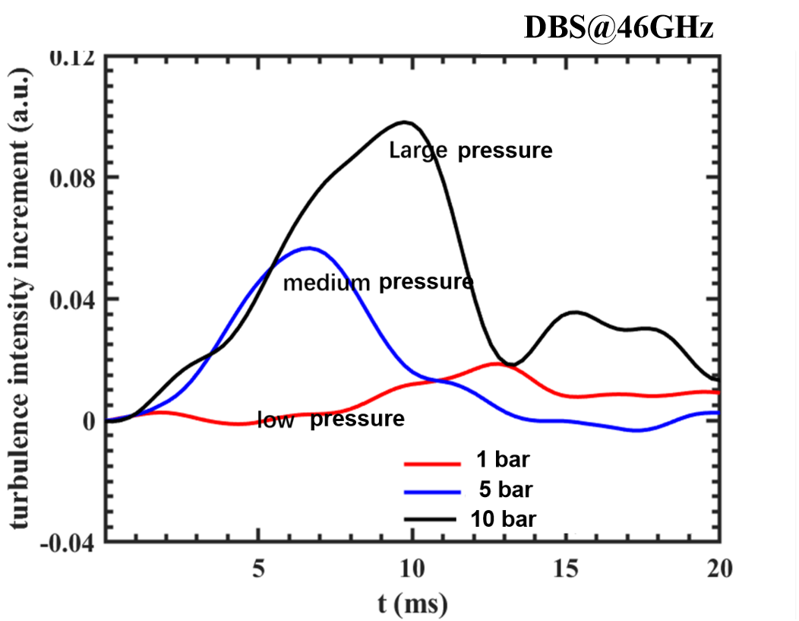
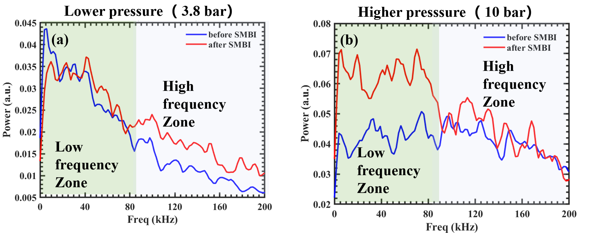
Turbulence behavior
Higher turbulence intensity and scale for larger SMBI gas pressure
turbulence intensity
turbulence spectrum
Correlation: P_{SMBI} ↑ ⇒ ΔI_{turb} ↑ (confirmed at fixed channel)
Spectral Analysis: P_{SMBI} ↑ ⇒ f_{dominant} : High frequency zone → Low frequency zone (large scale)

Slide 19
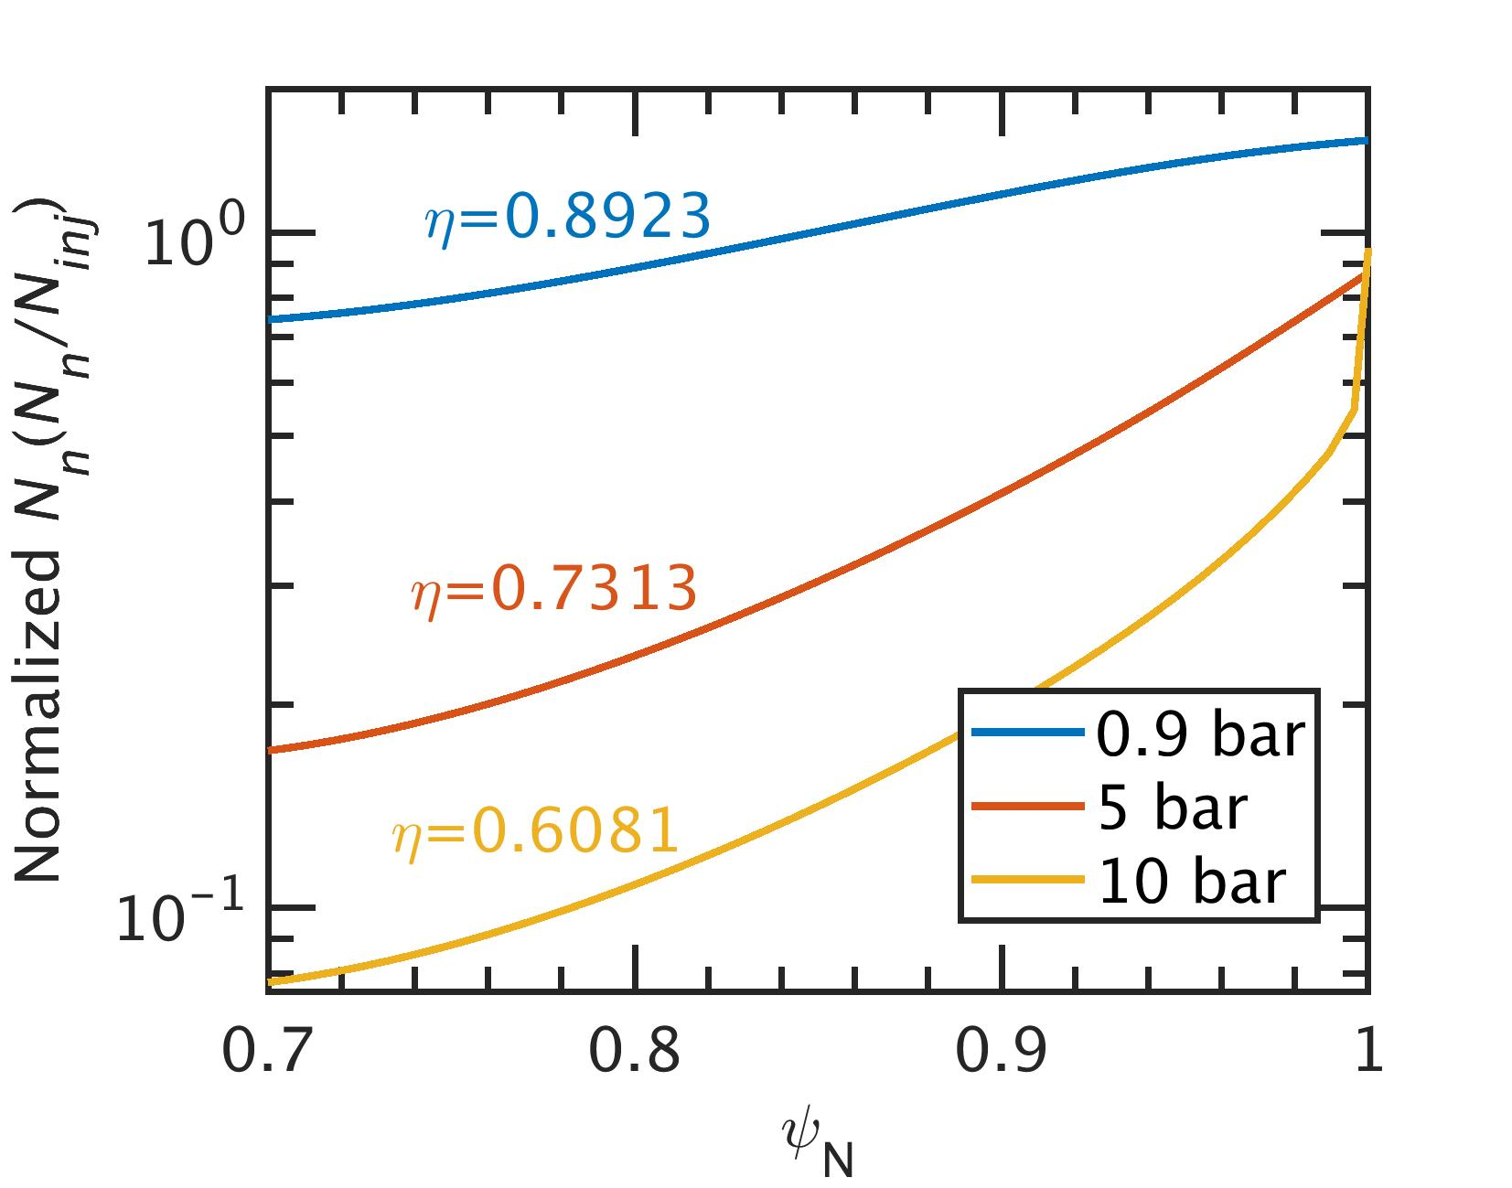
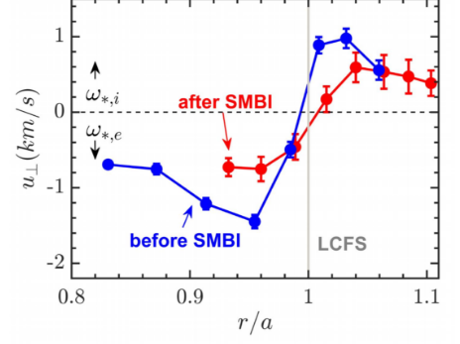
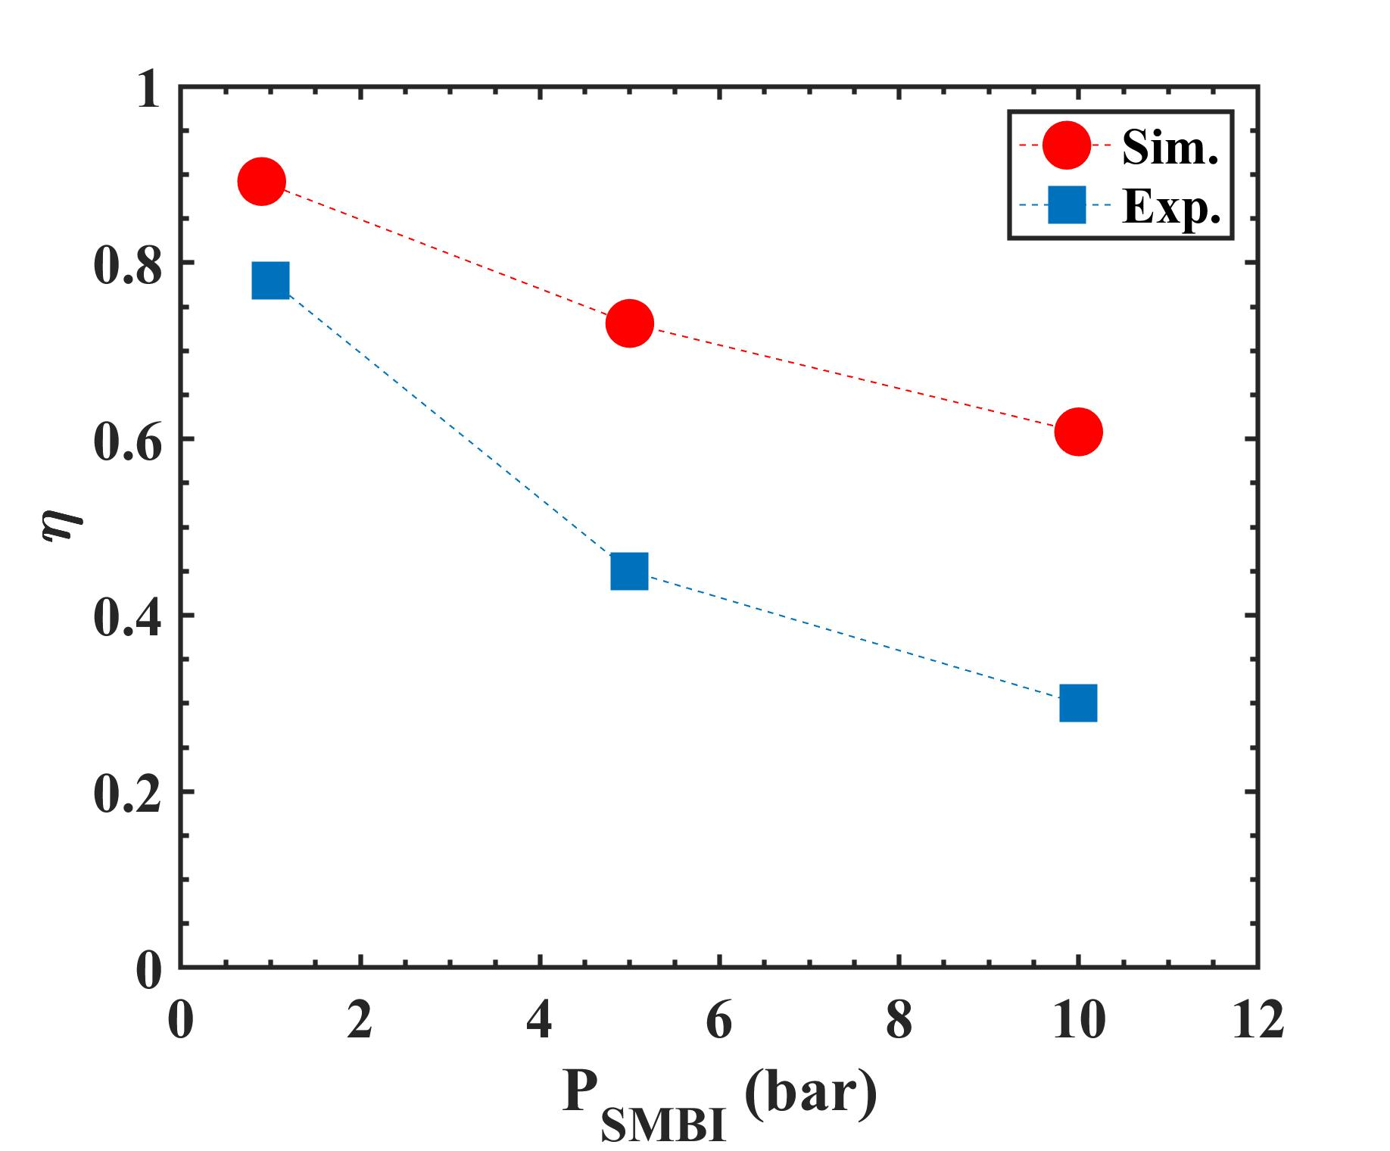
Plausible physical process
BOUT++ simulation:
Key Assumptions:
Constant beam velocity across all P_{SMBI} cases
All deposited neutral particles are retained in the plasma
Low P_{SMBI} → high P_{SMBI}: local ∇n_{e} steep ↑ ⇒ Γ_{conv} ↑ ⇒ η ↓
η: 89.2% @ 0.9 bar → 73.1% @ 5 bar → 60.8% @10 bar
Plausible physical process: P_{SMBI} ↑ ⇒ n_{SMB} ↑ (t_{SMBI}) →
→ ∇n_{e} (edge) ↑ → ${ ∂E_{r}}/{∂r}$↓ → turbulence↑ → Γ_{transport} ↑ → η_{fuel} ↓

Slide 20
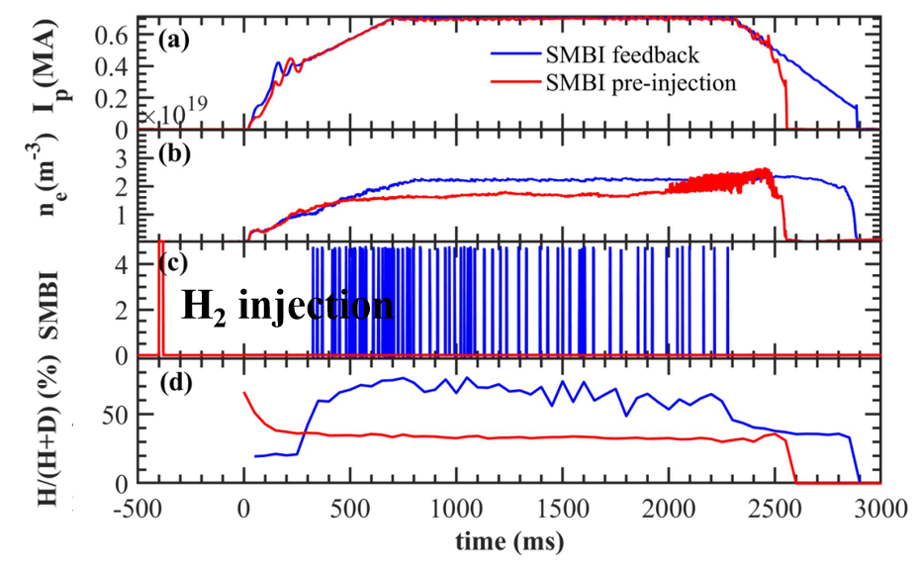
Timing for HD ratio control
SMBI enables efficient H-D ratio control, with pre-injection providing further enhancement.
For injection timing
Feedback SMBI:
Higher H₂ consumption
Pre-injection SMBI:
Requires only 25% of the H₂
The pre-injection of T₂ is recommended, with the option to follow with a combined D/T feedback

Slide 21
Outline
Background
Improvements of SMBI techniques
Strategy for fueling via SMBI
Heat load control with SMBI
Summary

Slide 22
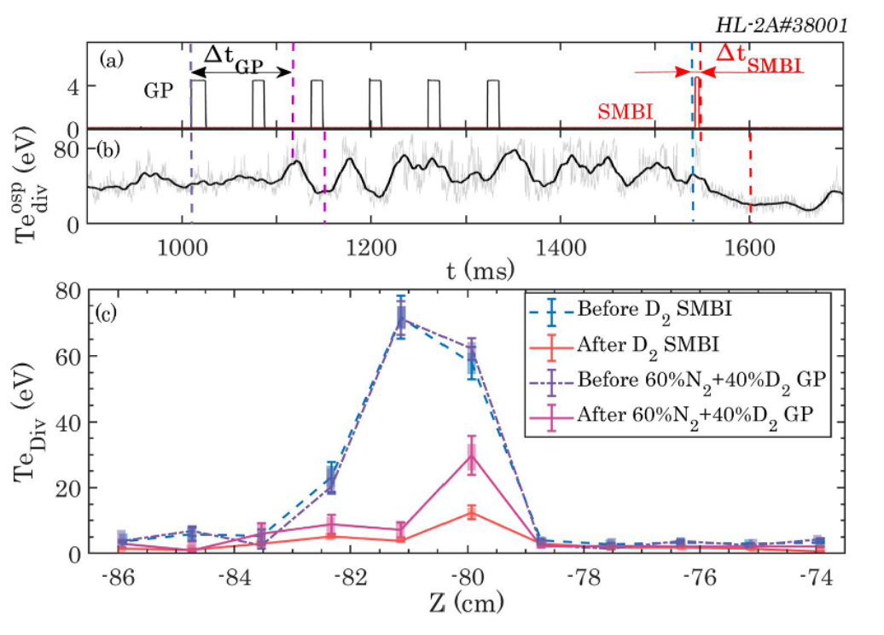
Comparison of heat load control with SMB and GP
Divertor SMBI is more effective than GP: faster time response, stronger heat mitigation effects
Offline testing experiments show SMBI particles reach the divertor plasma in 2.7ms — 20 times faster than GP (50ms) over a 3-meter distance.
 | SMBI | GP
Gas types | D₂ | 60% N₂+ 40% D₂
injection ratio | 2e22 /s | 4e21 /s
response time （ velocity ） | 9 ms | 112 ms
Te ^{OST} | 9 eV | 25eV
Plasma experiments indicate particle injection rate and velocity as critical factors for heat load control

Slide 23
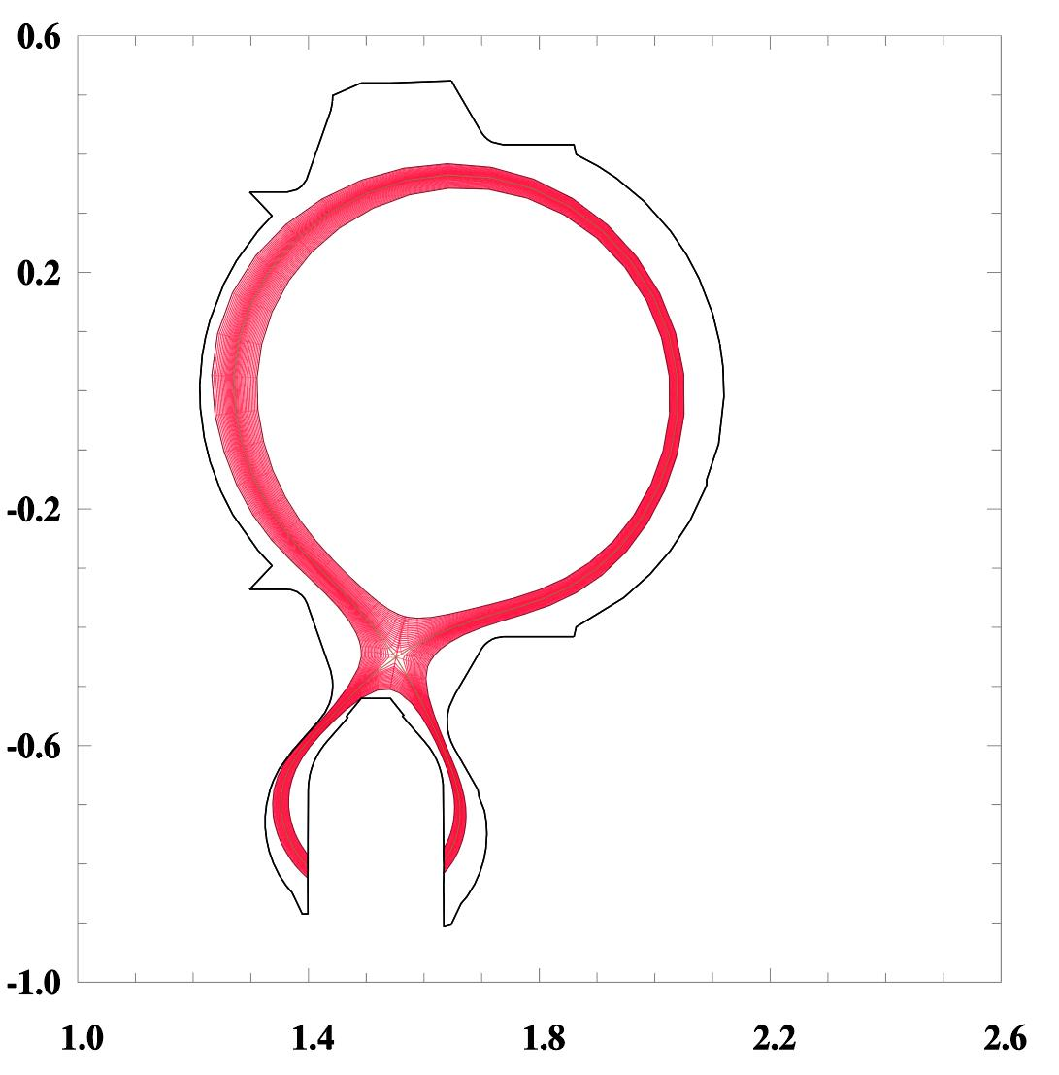
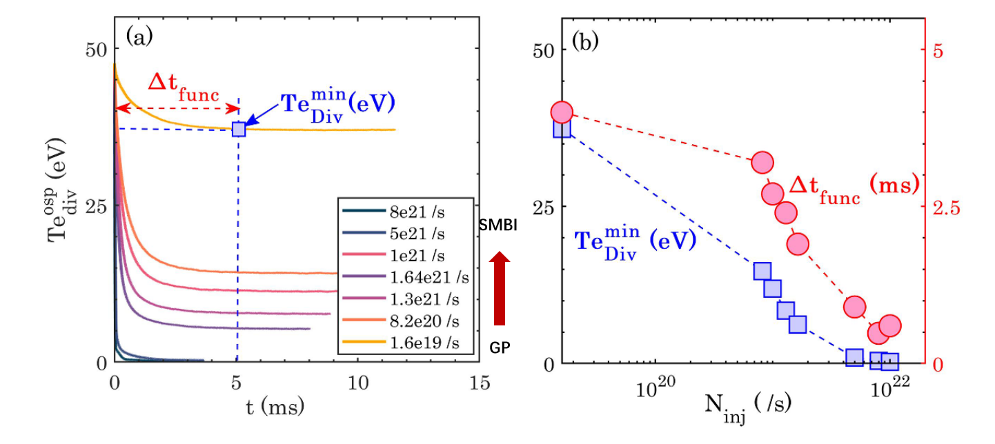
Particle injection rate effect simulation
SOLPS results: a higher injection rate significantly enhances and accelerates heat load mitigation
Simulation results indicate that with increasing injection rate:
strong target plate temperature drops.
control effect decay time shortens.
Both trends are in agreement with experimental data.
gas injection
HL-2A SOLPS grid
Sufficient instantaneous particle flux control is adviced for enhanced, rapid heat load control

Slide 24
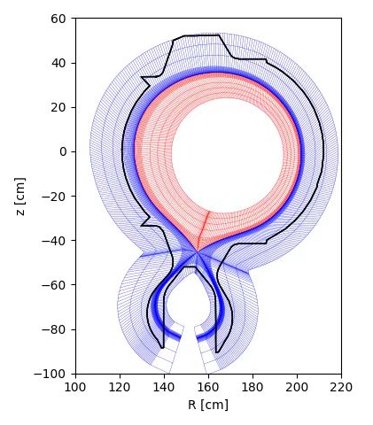
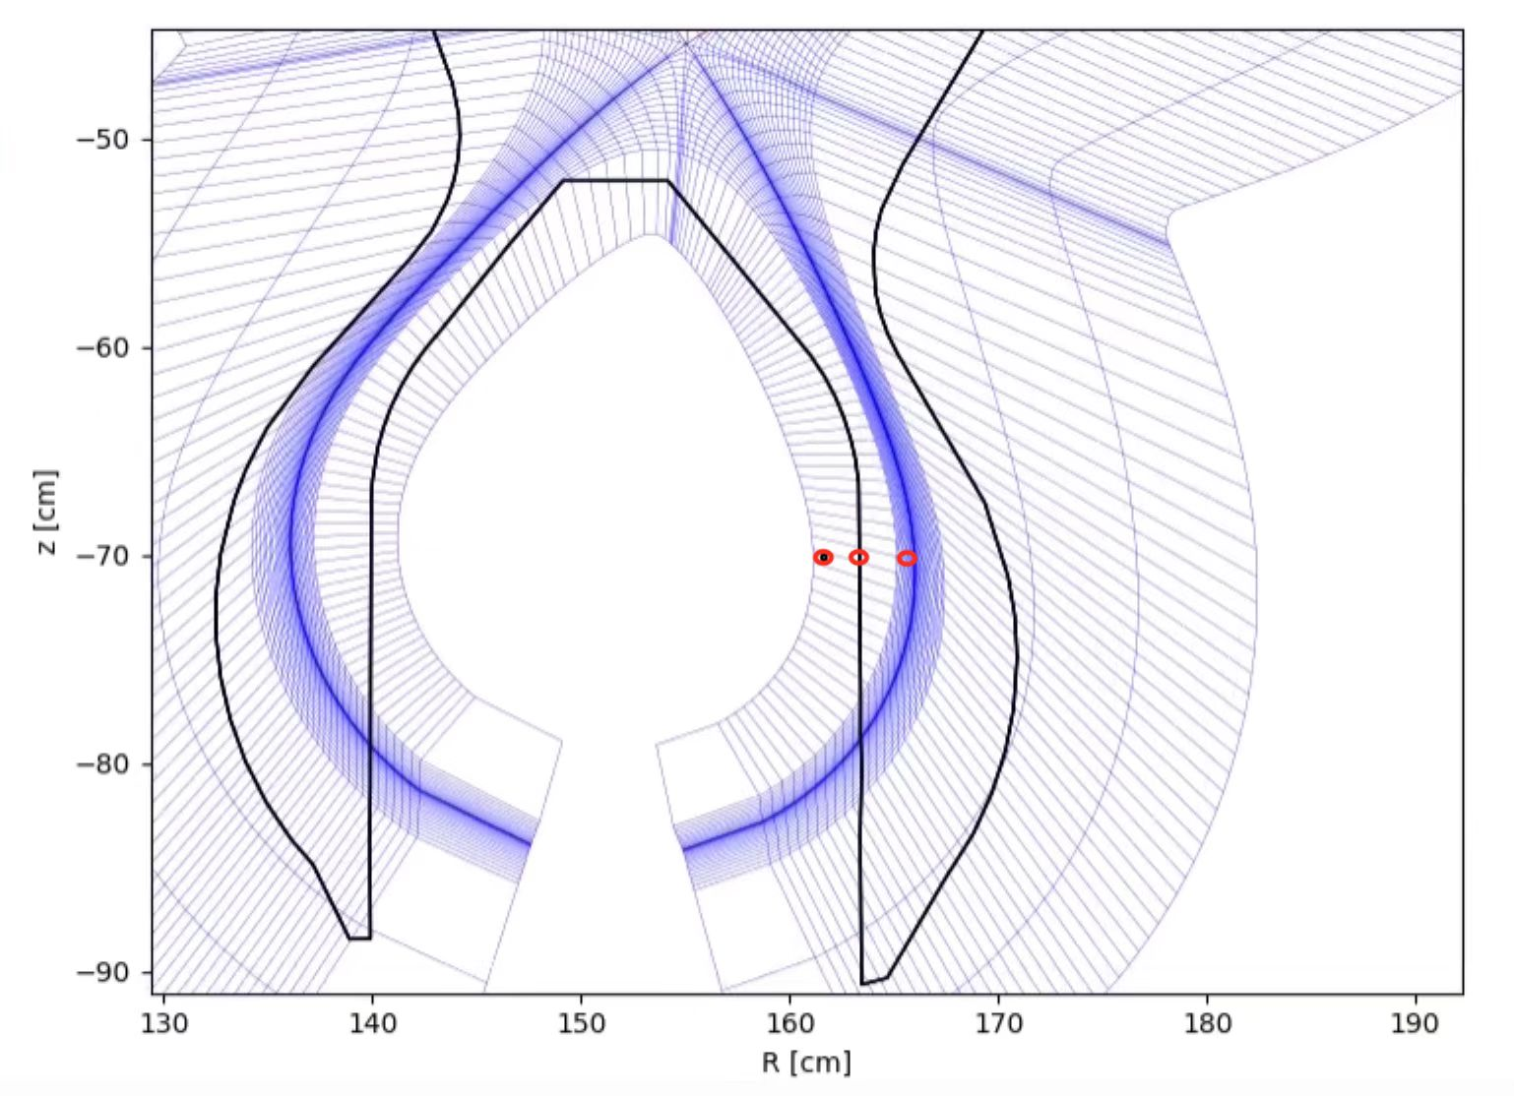
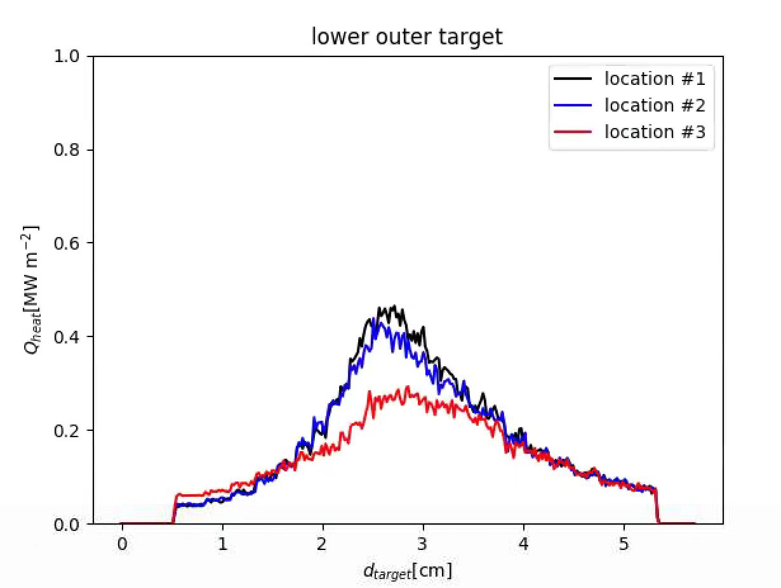
Particle velocity (deposit location) effect
The different neutral particle deposition depths caused by different particle velocity in EMC3-EIRENE based on experimental data
Mid-plane results suggests: Higher velocity → Deeper deposition
Gas source location
#3 (SMBI)
#1 (GP)
z [cm]
#2
Superior SMBI divertor heat load control via deeper, velocity-driven penetration

Slide 25
Outline
Background
Improvements of SMBI techniques
Strategy for fueling via SMBI
Heat load control with SMBI
Summary

Slide 26
Summary
Technology Development
Integrated Test Platform: Established a comprehensive SMBI test platform, integrating diagnostics including Schlieren, glow discharge, scanning probe, and laser Rayleigh scattering/induced fluorescence systems.
AI-Powered Analysis: AI models enable integrated analysis of SMBI velocity distribution and rapid prediction of SMBI beam distribution including density and velocity.
Advanced Injection Systems: The vector and multiphase molecular beam injection systems provide enhanced support for improving supersonic beam directivity.
Strategy for experiments
Fueling Strategy: Experimental and simulation results confirm that low-pressure, short-pulse SMBI is advantageous for higher fueling efficiency, and pre-injection is better for DT ratio control.
Superior Heat Load Control: The higher injection rate and particle velocity of SMB offers better heat load control compared to conventional gas puffing, presenting a new approach for optimizing radiative divertor performance.

