Slide 1
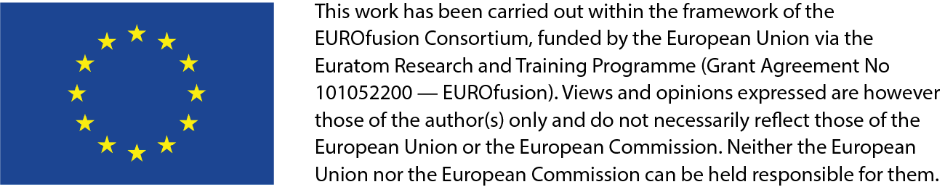



October 17th, 2025
Theory and Simulation of Phase Space
Transport in Burning Plasmas
F. Zonca1,2, M. V. Falessi1,3, Ph. Lauber4, S. Briguglio1, A. Bottino4 , L. Chen2,1,
T. Hayward-Schneider4, G. Meng4, A. Mishchenko5, Z. Qiu6,1 and G. Wei2,1
1Center for Nonlinear Plasma Science and ENEA C.R. Frascati, 00044 Frascati, Italy
2IFTS and School of Physics, Zhejiang University, Hangzhou, 310027 P.R. China
3Istituto Nazionale di Fisica Nucleare, Sezione di Roma, Piazzale Aldo Moro, 2, Roma, Italy
4Max Planck Institute for Plasma Physics, 85748 Garching, Germany
5Max Planck Institute for Plasma Physics, 17491 Greifswald, Germany
6Key Laboratory of Frontier Physics in Contr. Nucl. Fusion and IPP, CAS, Hefei, PR China
      Acknowledgments: G. Vlad, X. Wang

Slide 2
Outline
    Burning plasmas as complex self-organized systems
        Phase space transport and structure formation:
            nonlinear equilibrium: phase space zonal structures and zonal e.m. fields
            framework for computing equilibrium evolution on long time scales ~τ_{E}
        Examples and applications:
            RSAE as paradigm of reactor relevant plasma core
            Core transport regulation by Alfvénic fluctuations
            EP workflow for implementing theoretical framework integrated in IMAS
          Discussion and conclusions

Slide 3


The physics of burning plasmas
Burning plasmas as complex self-organized systems:
[C&Z Rev. Mod. Phys. Review article]: Nonlinear gyrokinetic description
Multi-spatiotemporal
scale fluctuations
Plasma and fusion
reactivity profiles
Turbulence & fluctuation
driven fluxes
Meso & macro-scale
distortion of equilibrium
NL wave-particle
Deviation from local
thermodynamic equilibrium
NL wave-wave

Slide 4
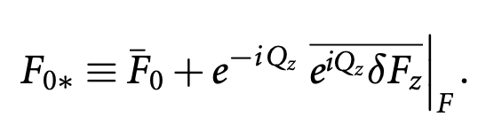
Phase space transport - I
4
A first-principle-based, self-consistent approach is crucial due to the mutual interactions between fluctuations and collisions
Proper nonlinear equilibrium
      Long lived (undamped by collision) zonal e.m. fields and corresponding phase space zonal structures: Zonal State
      Must self-consistently compute Zonal State in the presence of finite level of fluctuations
    Separate macro-meso spatiotemporal scales from micro-meso scales
    Renormalized equilibrium accounting for self-interaction
_____________
(orbit averaging)
meso-macro
micro-meso

Slide 5
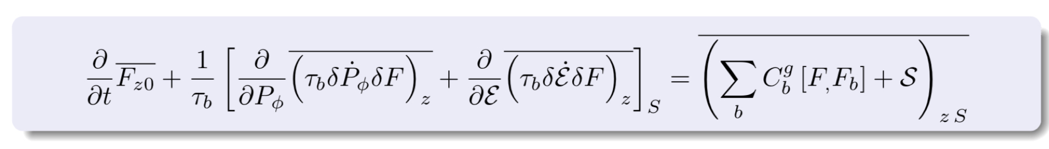
Phase space transport - II
5
    Phase space zonal structure (PSZS) evolution equation (nearly integrable system) [Falessi et al NJP 2023]
    Intrinsically full-F [Falessi et al NJP 2023] but reduced to the 3D action space (contants of motion) ➔ verified numerically with HMGC+HYMAGYC codes [S. Briguglio and G. Vlad, 2020]
    Ready for implementation in non-linear GK codes, including thermal component if whole transport description is lifted to the phase space [S.J. Wang et al. PRL 2024, ITB by ITG]

Slide 6
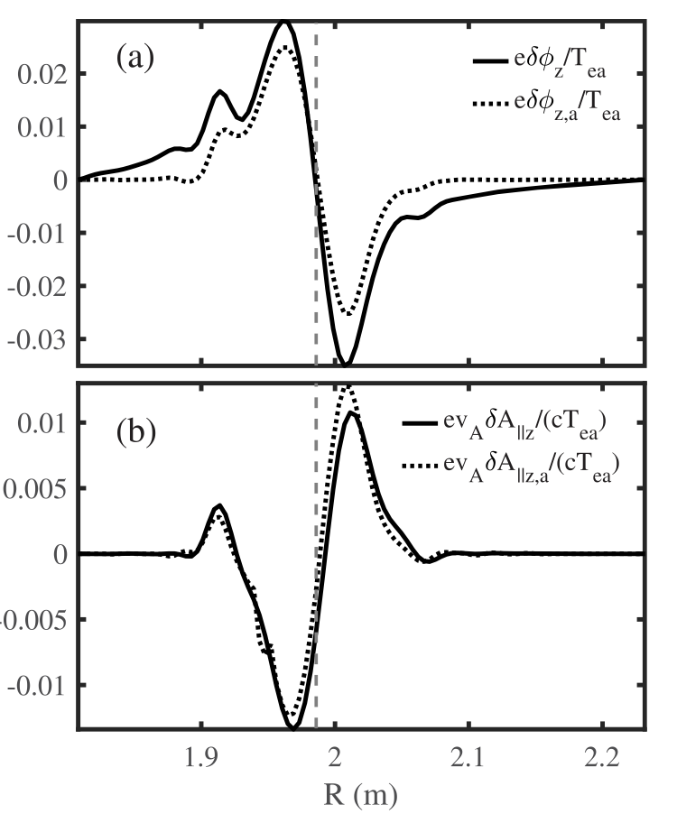
Zonal State: RSAE case
Core plasma also plays a crucial role in determining the properties of the zonal state
Reversed shear Alfvén eigenmodes (RSAE): paradigm for Alfvénic fluctuation dominating the core of reactor relevant plasmas
Theory and GTC code simulations of RSAE saturation show [Chen et al, Nucl. Fusion 65 (2025) 016018]
zonal flow has negligible effect on EP resonance detuning (shearing)
zonal e.m. fields enhance the EP drive via phase space zonal structures
zonal e.m. fields are dominated by zonal current
saturation takes place via downward frequency shift and enhanced damping due to core plasma effects (ongoing work)
_____ simulation
…….. theory
➔ contrary to common wisdom ⬅

Slide 7
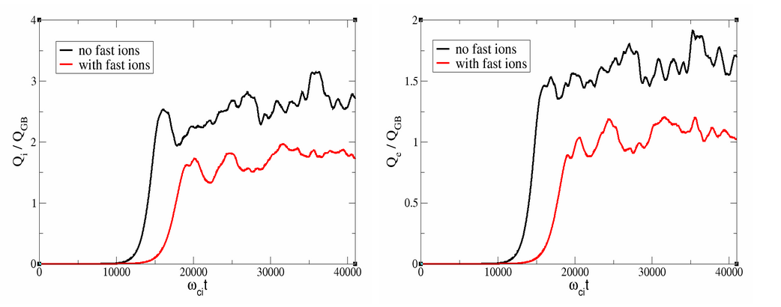
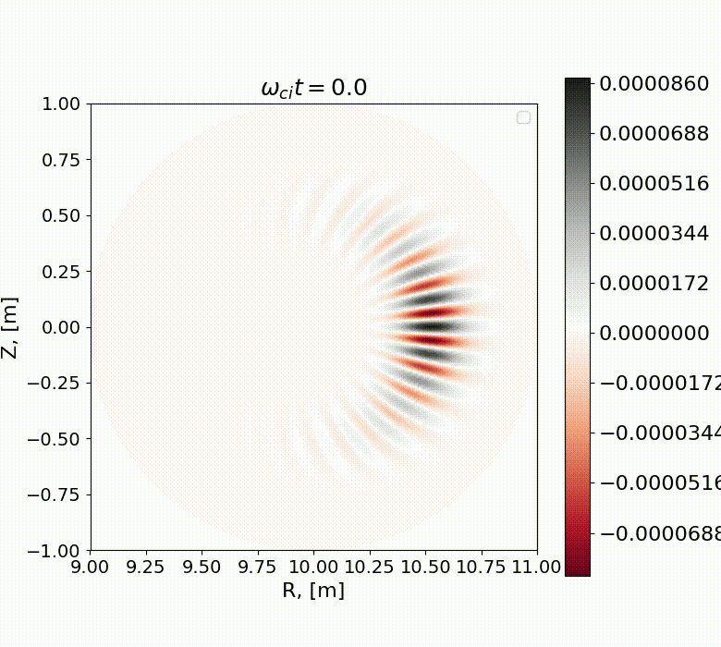
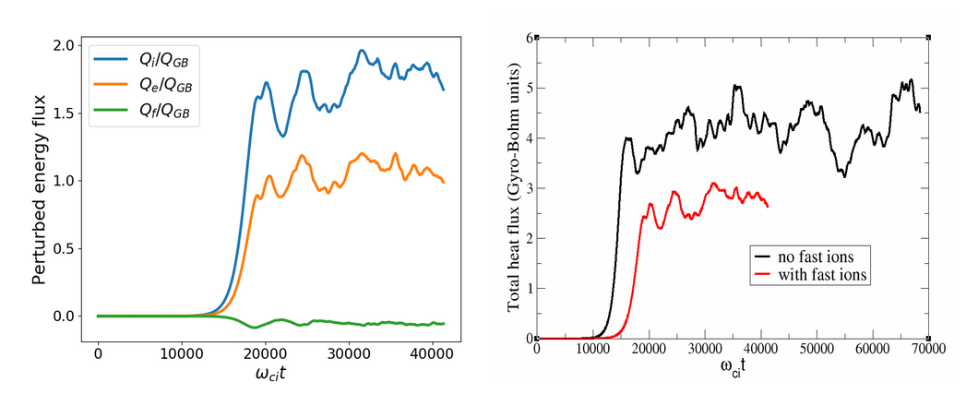
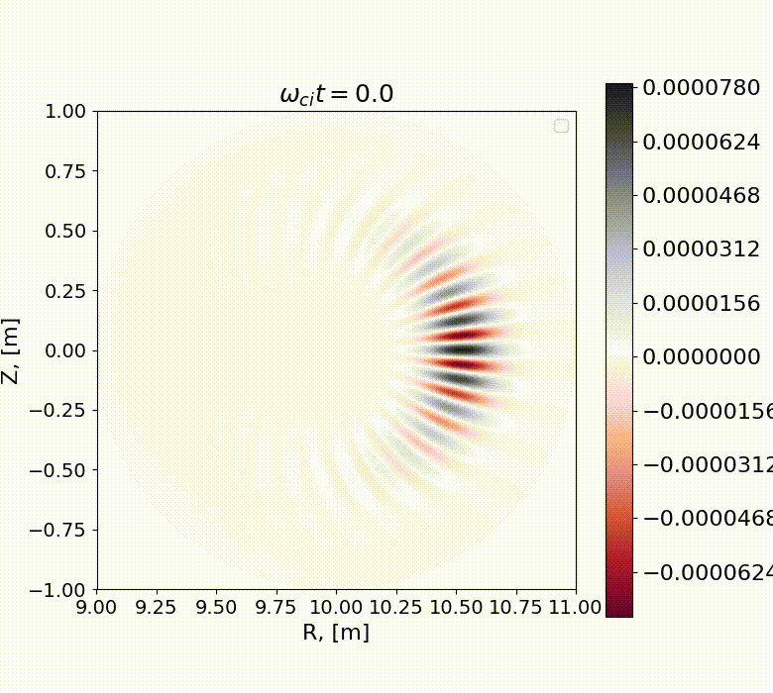
ORB5 code: core plasma confinement improvement
Nonlinear gyrokinetic simulations with ORB5 code demonstrate clear reduction in the heat flux for both the bulk ions and the electrons
Total heat flux reduced by the fast ions! $β_{e}=0.1\%$

Slide 8
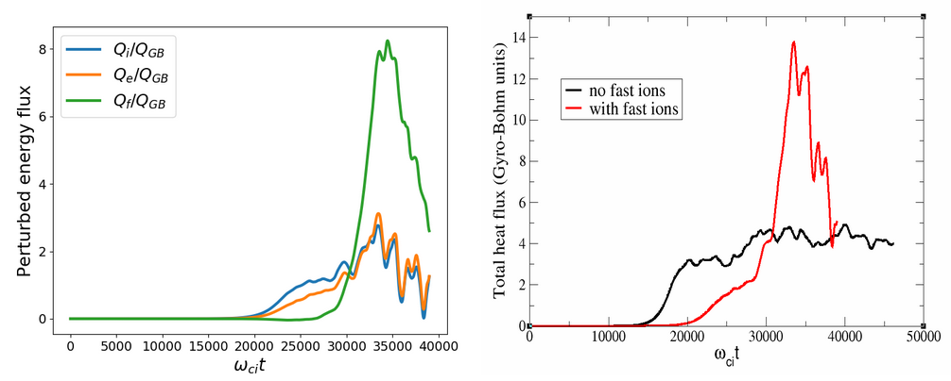

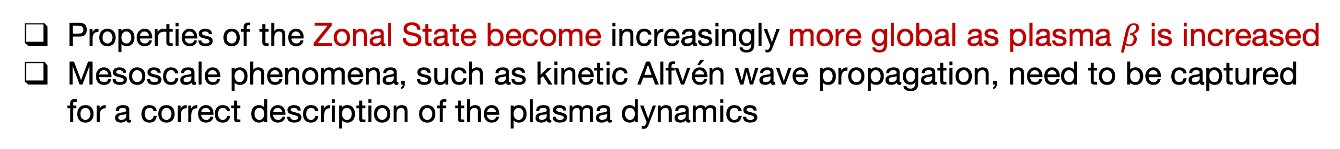
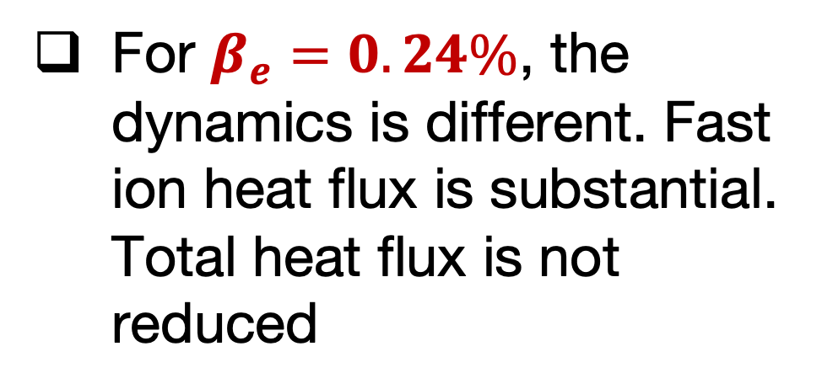
ORB5 code: AITG/KBM Zonal State
Properties of the Zonal State become increasingly more global as plasma $β$ is increased
Mesoscale phenomena, such as kinetic Alfvén wave propagation, need to be captured for a correct description of the plasma dynamics
For $β_{e}=0.24\%$, the dynamics is different. Fast ion heat flux is substantial. Total heat flux is not reduced
without EP
with EP
Global Alfvenic mode (a BAE?) develops driving fast ion energy flux. Work in progress!

Slide 9
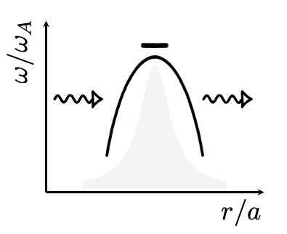
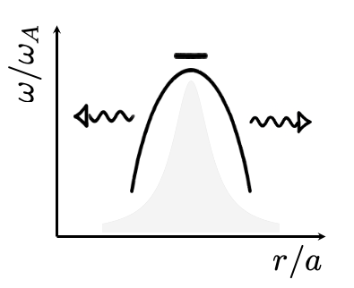
Importance of global kinetic approaches
Kinetic Alfvén waves absorption and propagation properties must be described by proper global kinetic approaches
boundary
conditions
boundary
conditions
boundary
conditions
boundary
conditions
[local]
[global]
Flux tube gyrokinetic approaches are severly questioned
[F. Zonca et al., AAPPS-DPP 2025]

Slide 10
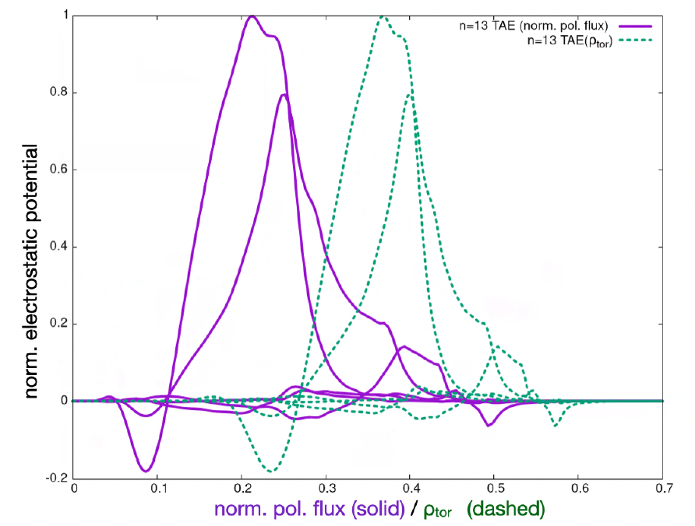
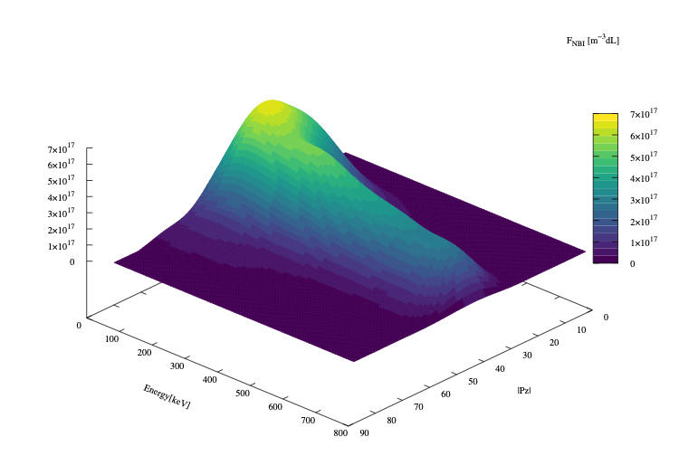
EP workflow: PSZS in LIGKA/HAGIS
Energetic Particle workflow fully integrated in IMAS
[EUROfusion Enabling Research project ATEP (Lauber/Falessi)]
[P. Lauber et al., NF 64, 096010 (2024)]
[Courtesy of Ph. Lauber; 2022]
[EFTC 2023 invited]
ITER 15MA case;
TAE n=13
f=75.5kHz
Computed by LIGKA
Using EP Workflow
ITER plasma from H&CD WF by M. Schneider

Slide 11
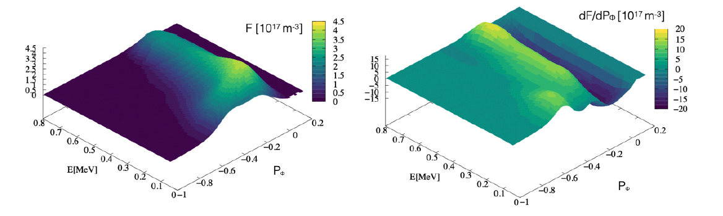
Distribution function representation
[P. Lauber et al., NF 64, 096010 (2024)]
original marker data as calculated by the NEMO/SPOT package
[Courtesy of Ph. Lauber]
Binning, smoothing and splining allow to construct regular derivatives in phase space

Slide 12
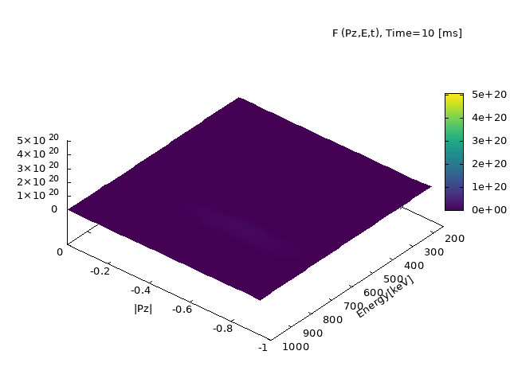
ATEP 3D code - I
ATEP: and advanced transport model for energetic particles
[Courtesy G. Meng]
[Invited EPS 2024]
Initial value problem solved with orbit averaged collision operator:
Source model: Gaussian function for NBI for comparison with SPOT

Slide 13
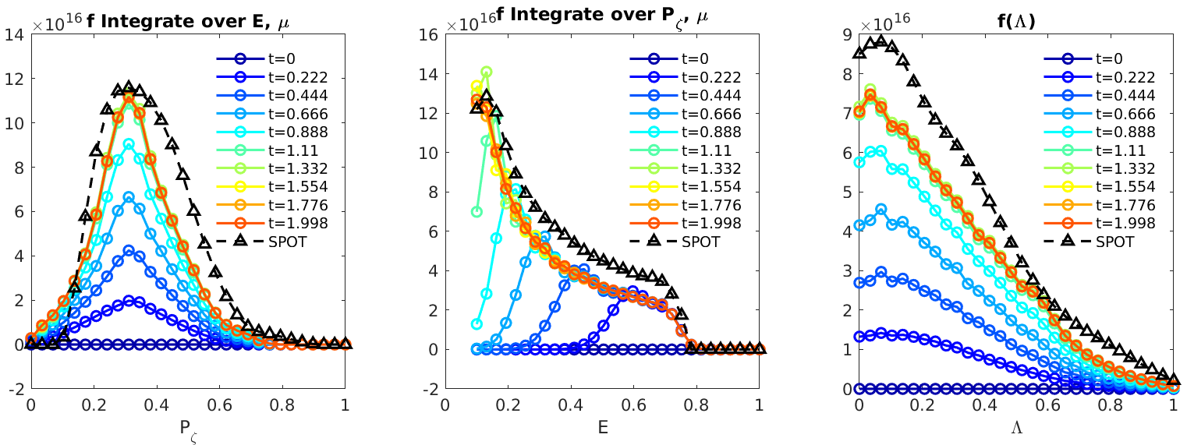
ATEP 3D code - II
Steady state solution obtained with sources and collisions
[Courtesy G. Meng]
[Invited EPS 2024]
[G. Meng et al., NF 64, 096009 (2024)]
Source model: Gaussian function for NBI
Comparison with SPOT, reasonable agreement
slowed-down in 1 second: transport time scale!
ATEP-3D, 30 mins/case
Monte-Carlo code, several days/case

Slide 14
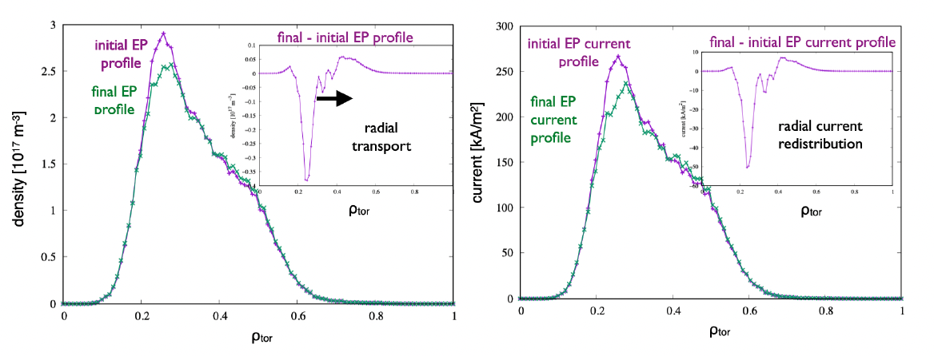
Off-axis beam relaxation in ITER
[P. Lauber et al., NF 64, 096010 (2024)]
ITER 15MA case;
TAE n=13
[Courtesy of Ph. Lauber]
Radial projection (ϱtor) of the distribution function of energetic
hydrogen particles, #100015/1, initial (as given by NEMO/SPOT) and final state after evolving the PSZS transport equation for 700ms (1000 time steps) with constant-amplitude TAE with δB/B = 10⁻⁵

Slide 15
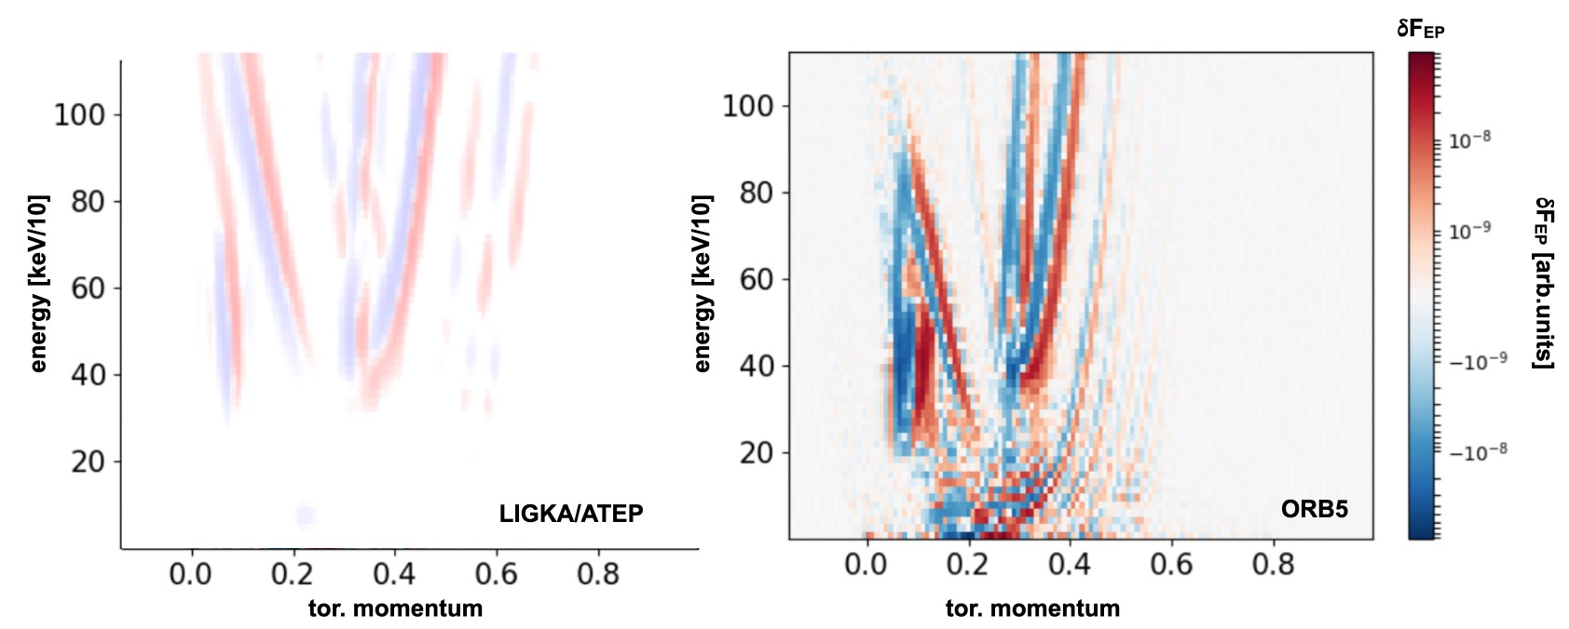
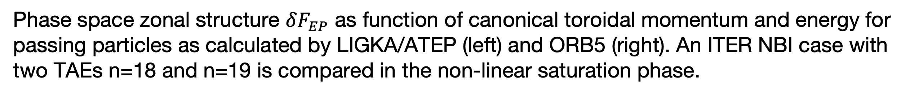
Phase space fluxes
Phase space fluxes computed with ATEP 3D and ORB5 demostrate a good level of consistency
Phase space zonal structure $δF_{EP}$ as function of canonical toroidal momentum and energy for passing particles as calculated by LIGKA/ATEP (left) and ORB5 (right). An ITER NBI case with two TAEs n=18 and n=19 is compared in the non-linear saturation phase.

Slide 16
Discussion and Conclusions
There exists an overarching and unified theoretical framework for self-consistent description of fluctuation spectra and corresponding transport in reactor-relevant fusion plasmas
Numerical applications have been made for selected reference cases and verification of the approach is complete
Applications to realistic cases of practical interest (ITER, JET, AUG, DTT, etc.) are in progress along with extension to 3D confinement systems [EUROfusion projects ATEP/TSVV#10 (Lauber/Mishchenko); MAECI-NSFC projects (ENEA-SWIP)]
Main references are available at the CNPS site:
https://www.afs.enea.it/zonca/CNPS/

