Slide 1
MULTI-MACHINE VALIDATION OF PLASMA INITIATION MODELLING AND PROSPECTS FOR FUTURE DEVICES
30th IAEA Fusion Energy Conference | 13–18 October 2025, Chengdu, China
Hyun-Tae Kim (MAST-U), Runze Chen (EAST), James Yang (DIII-D), Youngsun Lee (KSTAR), Jeongwon Lee (KSTAR), and Hongsik Yoon (VEST), and ITPA-IOS contributors

Slide 2
contents
Background and motivation
Experiment database
DYON code and simulation setup
Multi-machine validation results
Prediction to ITER
Summary

Slide 3


Inductive plasma initiation in tokamaks: Townsend breakdown and plasma burn-through
Gas
$$Bφ$$
$$−\frac{dΦ_{CS}}{dt}=Vloop=2πREφ$$
Hyun-Tae Kim | 30th IAEA Fusion Energy Conference | 13–18 October 2025, Chengdu, China

Slide 4

Inductive plasma initiation in tokamaks: Townsend breakdown and plasma burn-through
Gas
A few %
ionisation
Townsend breakdown phase
$$\text{Townsend} \text{breakdown} \text{in} \text{tokamaks}\text{:} αL_{f}>1$$
$$Bφ$$
$$−\frac{dΦ_{CS}}{dt}=Vloop=2πREφ$$
B. Lloyd PPCF 38 (1996) 1627
P. C. de Vries Nucl. Fusion 59 (2019) 096043
Hyun-Tae Kim | 30th IAEA Fusion Energy Conference | 13–18 October 2025, Chengdu, China

Slide 5

Inductive plasma initiation in tokamaks: Townsend breakdown and plasma burn-through
Gas
A few %
ionisation
Townsend breakdown phase
$$\text{Townsend} \text{breakdown} \text{in} \text{tokamaks}\text{:} αL_{f}>1$$
$α=$ # of ionisations while an electron traveling in 1 meter$=p0A\exp{(}−\frac{B}{Eφ/p0})$
($\text{For} \text{Hydrogen} \text{gas}\text{, }\text{A}\text{=3.83 }\text{and} \text{B}\text{=93.76}$)
$$Bφ$$
$$−\frac{dΦ_{CS}}{dt}=Vloop=2πREφ$$
B. Lloyd PPCF 38 (1996) 1627
P. C. de Vries Nucl. Fusion 59 (2019) 096043
Hyun-Tae Kim | 30th IAEA Fusion Energy Conference | 13–18 October 2025, Chengdu, China

Slide 6
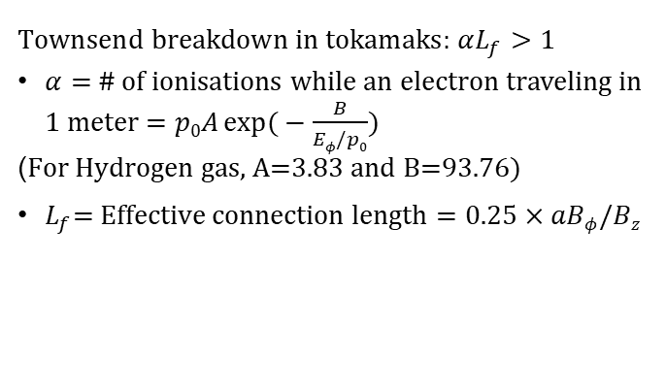
Inductive plasma initiation in tokamaks: Townsend breakdown and plasma burn-through
Gas
A few %
ionisation
Townsend breakdown phase
$$\text{Townsend} \text{breakdown} \text{in} \text{tokamaks}\text{:} αL_{f}>1$$
$α=$ # of ionisations while an electron traveling in 1 meter$=p0A\exp{(}−\frac{B}{Eφ/p0})$
($\text{For} \text{Hydrogen} \text{gas}\text{, }\text{A}\text{=3.83 }\text{and} \text{B}\text{=93.76}$)
$L_{f}\text{= }\text{Effective} \text{connection} \text{length}=0.25×aBφ/Bz$
$$Bφ$$
$$−\frac{dΦ_{CS}}{dt}=Vloop=2πREφ$$
B. Lloyd PPCF 38 (1996) 1627
P. C. de Vries Nucl. Fusion 59 (2019) 096043
Hyun-Tae Kim | 30th IAEA Fusion Energy Conference | 13–18 October 2025, Chengdu, China

Slide 7
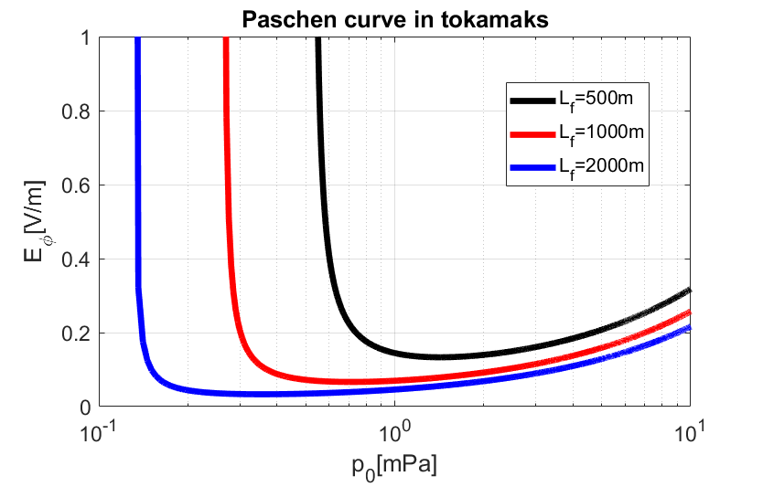
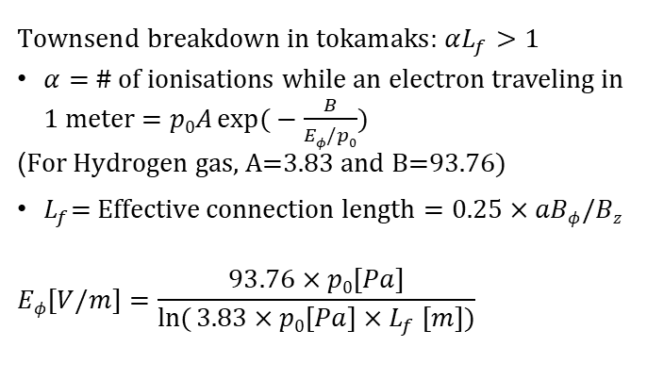
Inductive plasma initiation in tokamaks: Townsend breakdown and plasma burn-through
Gas
A few %
ionisation
Townsend breakdown phase
$$\text{Townsend} \text{breakdown} \text{in} \text{tokamaks}\text{:} αL_{f}>1$$
$α=$ # of ionisations while an electron traveling in 1 meter$=p0A\exp{(}−\frac{B}{Eφ/p0})$
($\text{For} \text{Hydrogen} \text{gas}\text{, }\text{A}\text{=3.83 }\text{and} \text{B}\text{=93.76}$)
$L_{f}\text{= }\text{Effective} \text{connection} \text{length}=0.25×aBφ/Bz$
$$Eφ[V/m]=\frac{93.76×p0[Pa]}{\ln{(}3.83×p0\left[Pa\right]{×L}_{f}[m])}$$
$$Bφ$$
$$−\frac{dΦ_{CS}}{dt}=Vloop=2πREφ$$
B. Lloyd PPCF 38 (1996) 1627
P. C. de Vries Nucl. Fusion 59 (2019) 096043
Hyun-Tae Kim | 30th IAEA Fusion Energy Conference | 13–18 October 2025, Chengdu, China

Slide 8
Inductive plasma initiation in tokamaks: Townsend breakdown and plasma burn-through
Gas
A few %
ionisation
100%
ionisation
Townsend breakdown phase
Plasma burn-through phase
$$\text{Townsend} \text{breakdown} \text{in} \text{tokamaks}\text{:} αL_{f}>1$$
$α=$ # of ionisations while an electron traveling in 1 meter$=p0A\exp{(}−\frac{B}{Eφ/p0})$
($\text{For} \text{Hydrogen} \text{gas}\text{, }\text{A}\text{=3.83 }\text{and} \text{B}\text{=93.76}$)
$L_{f}\text{= }\text{Effective} \text{connection} \text{length}=0.25×aBφ/Bz$
$$Eφ[V/m]=\frac{93.76×p0[Pa]}{\ln{(}3.83×p0\left[Pa\right]{×L}_{f}[m])}$$
Electrons and neutrals exist together in the burn-through phase
Ohmic heating VS Energy loss from radiation and charge exchange
$$Bφ$$
$$−\frac{dΦ_{CS}}{dt}=Vloop=2πREφ$$
B. Lloyd PPCF 38 (1996) 1627
P. C. de Vries Nucl. Fusion 59 (2019) 096043
Hyun-Tae Kim | 30th IAEA Fusion Energy Conference | 13–18 October 2025, Chengdu, China

Slide 9
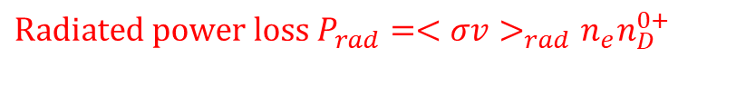
Inductive plasma initiation in tokamaks: Townsend breakdown and plasma burn-through
Gas
A few %
ionisation
100%
ionisation
Townsend breakdown phase
Plasma burn-through phase
$$\text{Townsend} \text{breakdown} \text{in} \text{tokamaks}\text{:} αL_{f}>1$$
$α=$ # of ionisations while an electron traveling in 1 meter$=p0A\exp{(}−\frac{B}{Eφ/p0})$
($\text{For} \text{Hydrogen} \text{gas}\text{, }\text{A}\text{=3.83 }\text{and} \text{B}\text{=93.76}$)
$L_{f}\text{= }\text{Effective} \text{connection} \text{length}=0.25×aBφ/Bz$
$$Eφ[V/m]=\frac{93.76×p0[Pa]}{\ln{(}3.83×p0\left[Pa\right]{×L}_{f}[m])}$$
Electrons and neutrals exist together in the burn-through phase
Ohmic heating VS Energy loss from radiation and charge exchange
$$Bφ$$
$$\text{Radiated} \text{power} \text{loss}{ P}_{rad}=<σv>_{rad}n_{e}n_{D}^{0+}$$
$$−\frac{dΦ_{CS}}{dt}=Vloop=2πREφ$$
100
Degree of
Ionization[%]
B. Lloyd PPCF 38 (1996) 1627
P. C. de Vries Nucl. Fusion 59 (2019) 096043
0
0
T_{e}[eV]
~10
Hyun-Tae Kim | 30th IAEA Fusion Energy Conference | 13–18 October 2025, Chengdu, China

Slide 10
Inductive plasma initiation in tokamaks: Townsend breakdown and plasma burn-through
Gas
A few %
ionisation
100%
ionisation
Townsend breakdown phase
Plasma burn-through phase
$$\text{Townsend} \text{breakdown} \text{in} \text{tokamaks}\text{:} αL_{f}>1$$
$α=$ # of ionisations while an electron traveling in 1 meter$=p0A\exp{(}−\frac{B}{Eφ/p0})$
($\text{For} \text{Hydrogen} \text{gas}\text{, }\text{A}\text{=3.83 }\text{and} \text{B}\text{=93.76}$)
$L_{f}\text{= }\text{Effective} \text{connection} \text{length}=0.25×aBφ/Bz$
$$Eφ[V/m]=\frac{93.76×p0[Pa]}{\ln{(}3.83×p0\left[Pa\right]{×L}_{f}[m])}$$
Electrons and neutrals exist together in the burn-through phase
Ohmic heating VS Energy loss from radiation and charge exchange
$$Bφ$$
$$\text{Radiated} \text{power} \text{loss}{ P}_{rad}=<σv>_{rad}n_{e}n_{D}^{0+}$$
$$−\frac{dΦ_{CS}}{dt}=Vloop=2πREφ$$
~10⁵
100
D radiation barrier
P_{rad}[W]
Degree of
Ionization[%]
B. Lloyd PPCF 38 (1996) 1627
P. C. de Vries Nucl. Fusion 59 (2019) 096043
0
0
0
T_{e}[eV]
~10
Hyun-Tae Kim | 30th IAEA Fusion Energy Conference | 13–18 October 2025, Chengdu, China

Slide 11
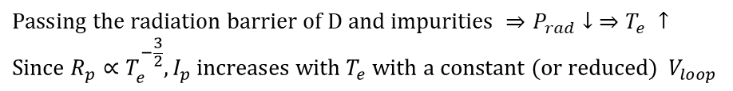
Inductive plasma initiation in tokamaks: Townsend breakdown and plasma burn-through
Gas
A few %
ionisation
100%
ionisation
Townsend breakdown phase
Plasma burn-through phase
$$\text{Townsend} \text{breakdown} \text{in} \text{tokamaks}\text{:} αL_{f}>1$$
$α=$ # of ionisations while an electron traveling in 1 meter$=p0A\exp{(}−\frac{B}{Eφ/p0})$
($\text{For} \text{Hydrogen} \text{gas}\text{, }\text{A}\text{=3.83 }\text{and} \text{B}\text{=93.76}$)
$L_{f}\text{= }\text{Effective} \text{connection} \text{length}=0.25×aBφ/Bz$
$$Eφ[V/m]=\frac{93.76×p0[Pa]}{\ln{(}3.83×p0\left[Pa\right]{×L}_{f}[m])}$$
Electrons and neutrals exist together in the burn-through phase
Ohmic heating VS Energy loss from radiation and charge exchange
$$Bφ$$
$$\text{Radiated} \text{power} \text{loss}{ P}_{rad}=<σv>_{rad}n_{e}n_{D}^{0+}$$
$$−\frac{dΦ_{CS}}{dt}=Vloop=2πREφ$$
~10⁵
100
D radiation barrier
P_{rad}[W]
Degree of
Ionization[%]
B. Lloyd PPCF 38 (1996) 1627
P. C. de Vries Nucl. Fusion 59 (2019) 096043
0
0
0
T_{e}[eV]
~10
$$\text{Passing} \text{the} \text{radiation} \text{barrier} \text{of} \text{D} \text{and} \text{impurities} ⇒P_{rad}↓ ⇒T_{e} ↑ \\ \text{Since} R_{p}∝T_{e}^{−\frac{3}{2}}, I_{p} \text{increases} \text{with} T_{e} \text{with} \text{a} \text{constant}\text{ (}\text{or} \text{reduced}\text{) }V_{loop}$$
Hyun-Tae Kim | 30th IAEA Fusion Energy Conference | 13–18 October 2025, Chengdu, China

Slide 12
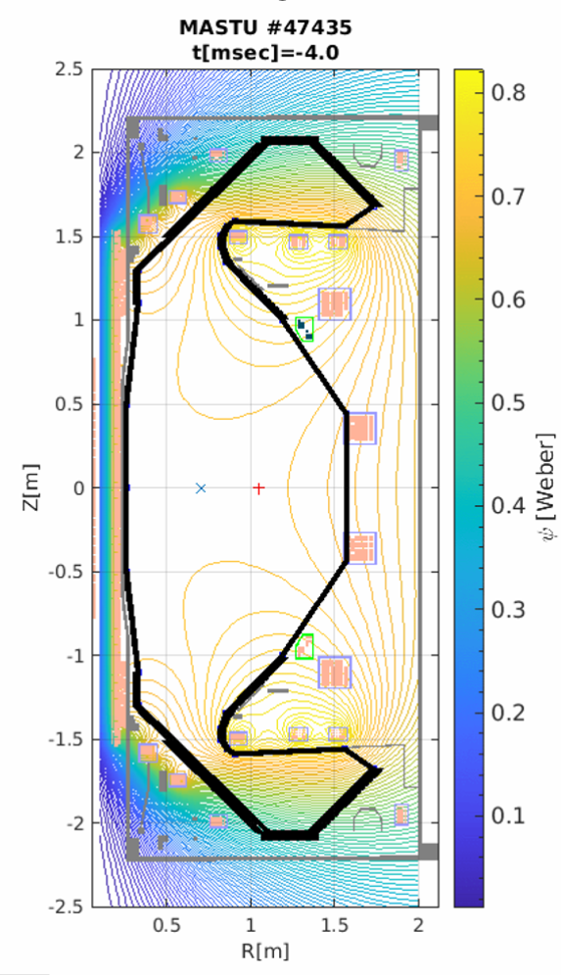
Tokamak operation for inductive plasma initiation
Magnetic field null configuration is required to maximise the connection length.

Slide 13
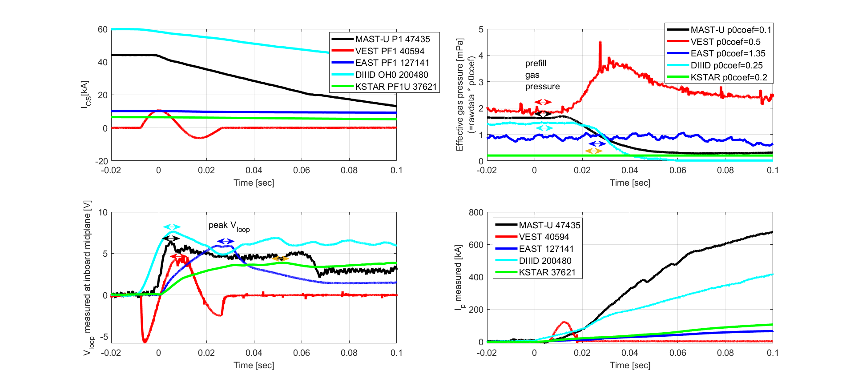
Tokamak operation for inductive plasma initiation
Magnetic field null configuration is required to maximise the connection length.

Slide 14
Tokamak operation for inductive plasma initiation
Magnetic field null configuration is required to maximise the connection length.

Slide 15
Tokamak operation for inductive plasma initiation
Magnetic field null configuration is required to maximise the connection length.

Slide 16
Tokamak operation for inductive plasma initiation
Magnetic field null configuration is required to maximise the connection length.

Slide 17
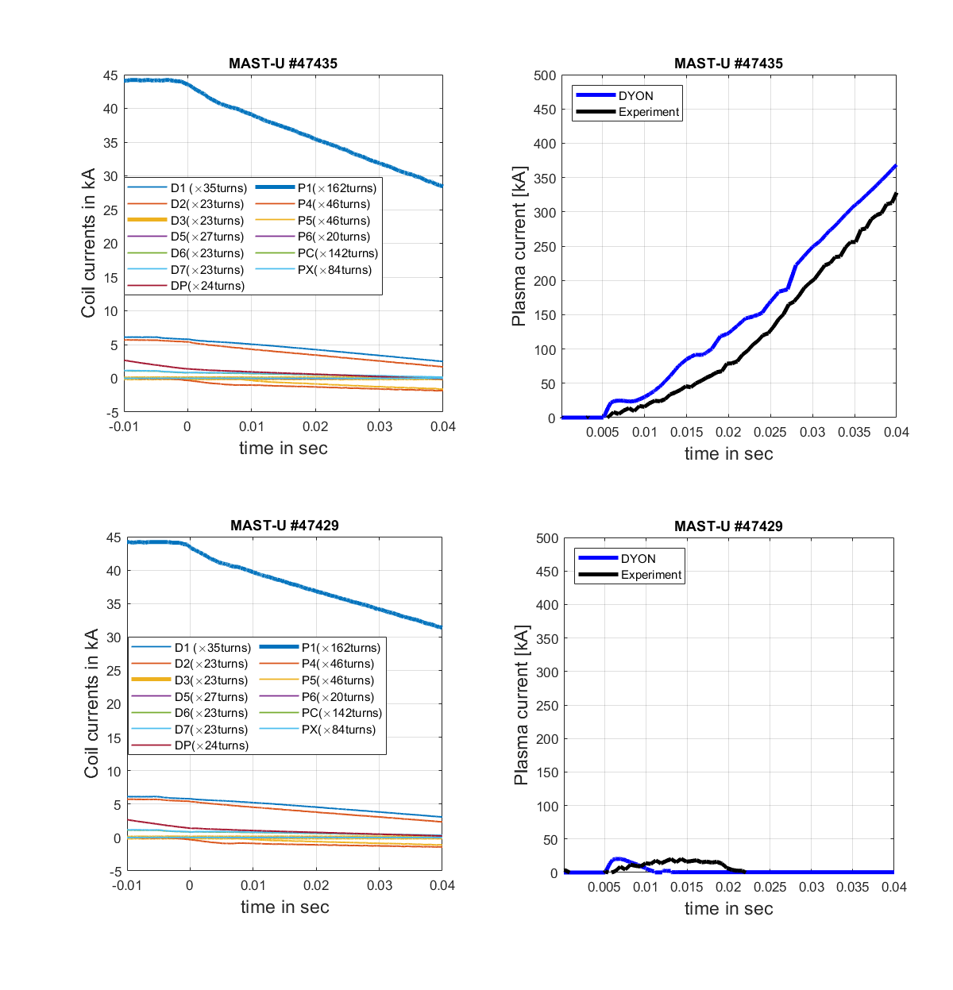
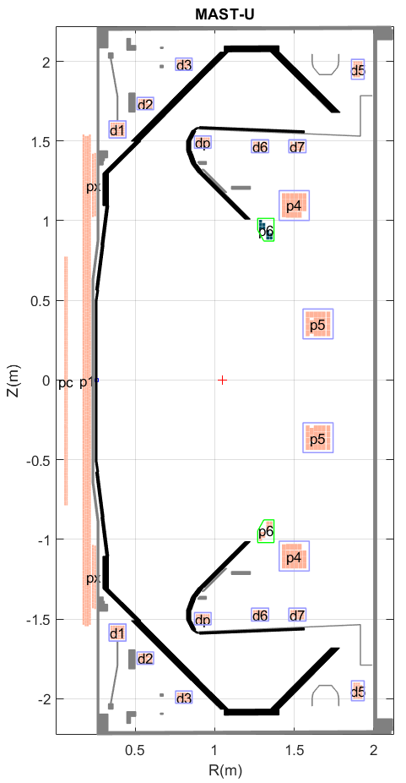
Goal of plasma initiation modelling
p₀ and
p₀ and

Slide 18
Goal of plasma initiation modelling
V_{loop}=5.3V
p₀ and
V_{loop}=4.9V
p₀ and

Slide 19
Goal of plasma initiation modelling
V_{loop}=5.3V
p₀ and
V_{loop}=4.9V
p₀ and

Slide 20
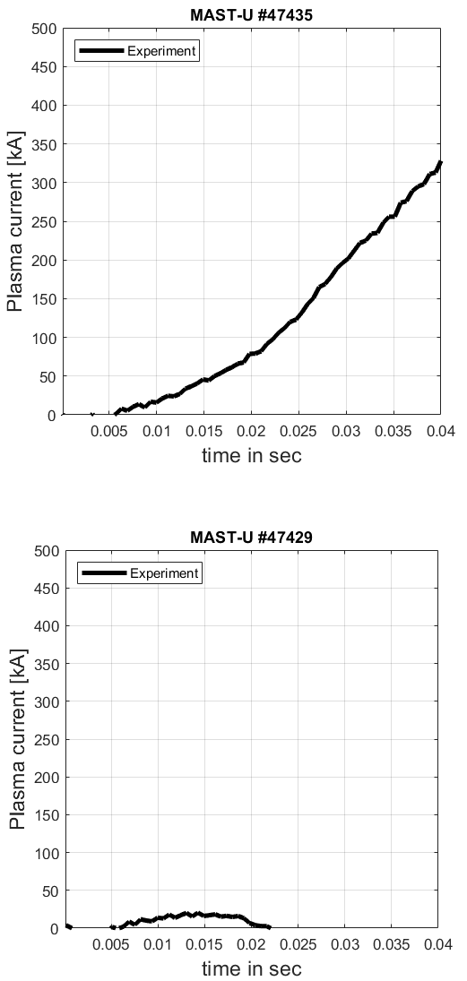
Goal of plasma initiation modelling
V_{loop}=5.3V
p₀ and
V_{loop}=4.9V
p₀ and

Slide 21
Goal of plasma initiation modelling
DYON
V_{loop}=5.3V
p₀ and
V_{loop}=4.9V
p₀ and
DYON

Slide 22
Goal of plasma initiation modelling
DYON
V_{loop}=5.3V
Plasma initiation phase is the most dynamic phase in the whole tokamak pulse.
Tokamak hardware determines the operational constraints:
  Coil design: I_{coil} limit
  Power supply design : dI_{coil}/dt limit
  Vessel conductivity: eddy currents
  Vacuum volume: required p₀
For a new tokamak design, the feasibility of plasma initiation with the operational constraints should be ensured with predictive modelling.
This is particularly important for large superconducting devices such as ITER and STEP, as the plasma initiation will be challenging.
p₀ and
V_{loop}=4.9V
p₀ and
DYON

Slide 23
contents
Background and motivation
Experiment database
DYON code and simulation setup
Multi-machine validation results
Prediction to ITER
Summary

Slide 24
Devices for multimachine validation
Device | Aspect ratio | Coils | First wall material | Ferromagnetic material | Vv[m³] | Vp[m³] | Bt[T] | Lf[m]
MASTU | Spherical Torus (R=0.7m, a=0.5m) | Copper | Carbon | N/A | 55 | 6 | 0.6 | 75
EAST | Conventional Tokamak (R=1.85m, a=0.5m) | Super Conductor | Tungsten + Molybdenum | N/A | 38 | 7.5 | 2.5 | 311
DIIID | Conventional Tokamak (R=1.67m, a=0.65m) | Copper | Carbon | N/A | 35 | 16 | 1.8 | 292
KSTAR | Conventional Tokamak (R=1.8m, a=0.7m) | Super Conductor | Carbon | Incoloy 908 in the jacket of PF and TF coils | 55 | 5 | 1.8 | 315
VEST | Spherical Torus (R=0.3m, a=0.2m) | Copper | Stainless steel | N/A | 3.7 | 0.6 | 0.23 | 12

Slide 25
Parameter scan experiments to identify plasma initiation operation space
Successful plasma initiation
O
O
O
O
O
O
O
O
O
O
O
O
  Loop voltage
O
  Prefill gas pressure
Hyun-Tae Kim | 30th IAEA Fusion Energy Conference | 13–18 October 2025, Chengdu, China

Slide 26
Parameter scan experiments to identify plasma initiation operation space
Successful plasma initiation
Successful breakdown
but failed burn-through
(strong D_{alpha} but no I_{p} ramp-up)
O
O
X
O
O
O
X
O
O
O
O
X
O
O
O
X
  Loop voltage
O
X
X
  Prefill gas pressure
Hyun-Tae Kim | 30th IAEA Fusion Energy Conference | 13–18 October 2025, Chengdu, China

Slide 27
Parameter scan experiments to identify plasma initiation operation space
Successful plasma initiation
Failed breakdown
(no or very weak D_{alpha})
Successful breakdown
but failed burn-through
(strong D_{alpha} but no I_{p} ramp-up)
O
O
X
X
O
O
O
X
X
O
O
O
O
X
X
O
O
O
X
  Loop voltage
X
O
X
X
  Prefill gas pressure
Hyun-Tae Kim | 30th IAEA Fusion Energy Conference | 13–18 October 2025, Chengdu, China

Slide 28
Parameter scan experiments to identify plasma initiation operation space
Successful plasma initiation
Failed breakdown
(no or very weak D_{alpha})
Successful breakdown
but failed burn-through
(strong D_{alpha} but no I_{p} ramp-up)
O
O
X
X
O
O
O
X
X
O
O
O
O
X
X
O
O
O
X
  Loop voltage
X
O
X
X
Paschen curve?
  Prefill gas pressure
Hyun-Tae Kim | 30th IAEA Fusion Energy Conference | 13–18 October 2025, Chengdu, China

Slide 29
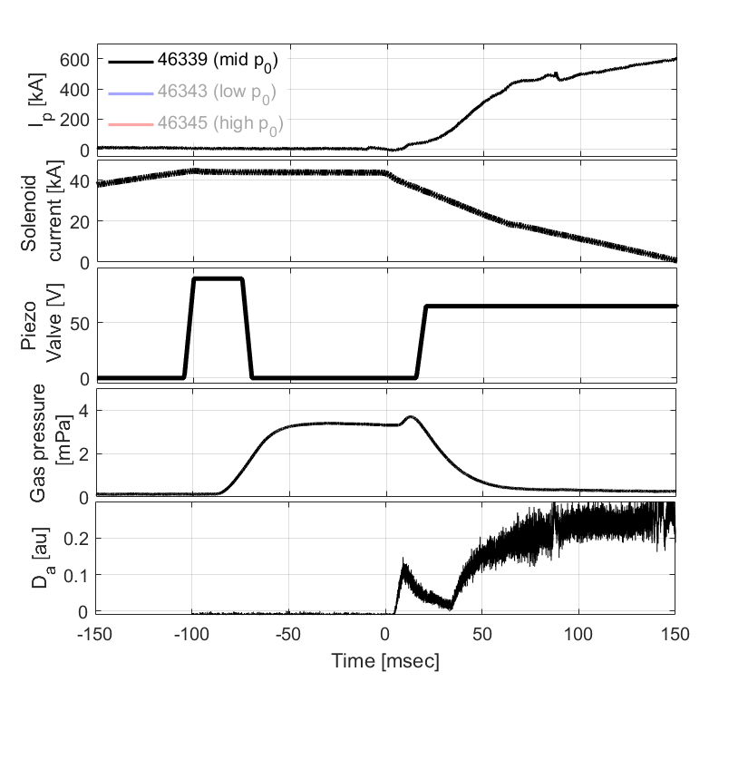
Parameter scan experiments to identify plasma initiation operation space
MAST-U
Successful plasma initiation
Failed breakdown
(no or very weak D_{alpha})
Successful breakdown
but failed burn-through
(strong D_{alpha} but no I_{p} ramp-up)
O
O
X
X
O
O
O
X
X
O
O
O
O
X
X
O
O
O
X
  Loop voltage
X
O
X
X
Paschen curve?
  Prefill gas pressure
Hyun-Taen Kim et al 2024 Nucl. Fusion 64 (2024) 126010
Hyun-Tae Kim | 30th IAEA Fusion Energy Conference | 13–18 October 2025, Chengdu, China

Slide 30
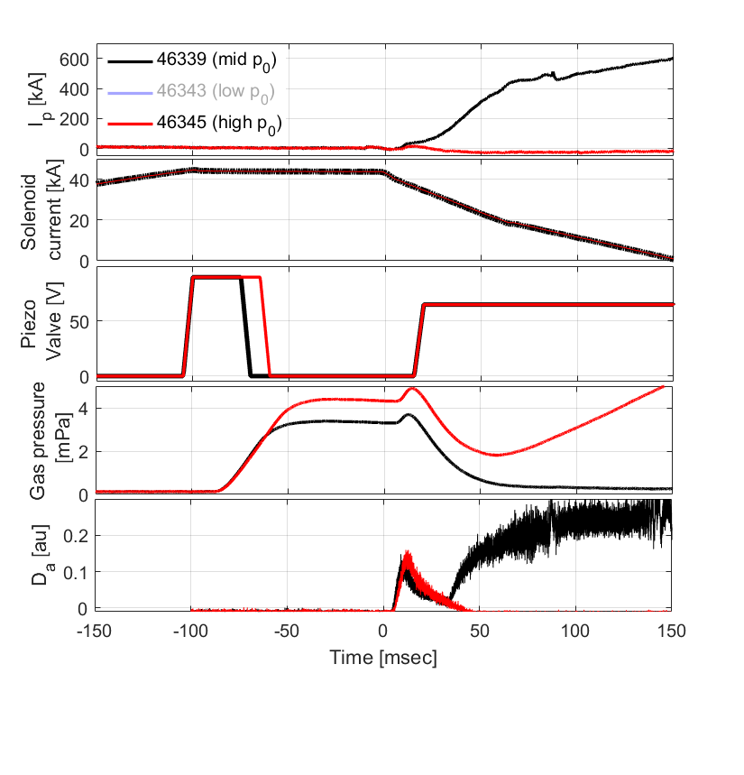
Parameter scan experiments to identify plasma initiation operation space
MAST-U
Successful plasma initiation
Failed breakdown
(no or very weak D_{alpha})
Successful breakdown
but failed burn-through
(strong D_{alpha} but no I_{p} ramp-up)
O
O
X
X
O
O
O
X
X
O
O
O
O
X
X
O
O
O
X
  Loop voltage
X
O
X
X
Paschen curve?
  Prefill gas pressure
Hyun-Taen Kim et al 2024 Nucl. Fusion 64 (2024) 126010
Hyun-Tae Kim | 30th IAEA Fusion Energy Conference | 13–18 October 2025, Chengdu, China

Slide 31
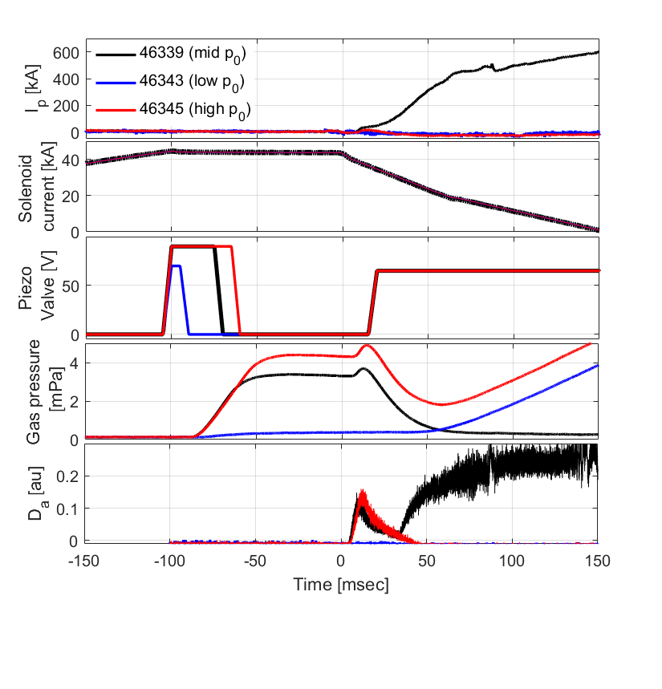
Parameter scan experiments to identify plasma initiation operation space
MAST-U
Successful plasma initiation
Failed breakdown
(no or very weak D_{alpha})
Successful breakdown
but failed burn-through
(strong D_{alpha} but no I_{p} ramp-up)
O
O
X
X
O
O
O
X
X
O
O
O
O
X
X
O
O
O
X
  Loop voltage
X
O
X
X
Paschen curve?
  Prefill gas pressure
Hyun-Taen Kim et al 2024 Nucl. Fusion 64 (2024) 126010
Hyun-Tae Kim | 30th IAEA Fusion Energy Conference | 13–18 October 2025, Chengdu, China

Slide 32
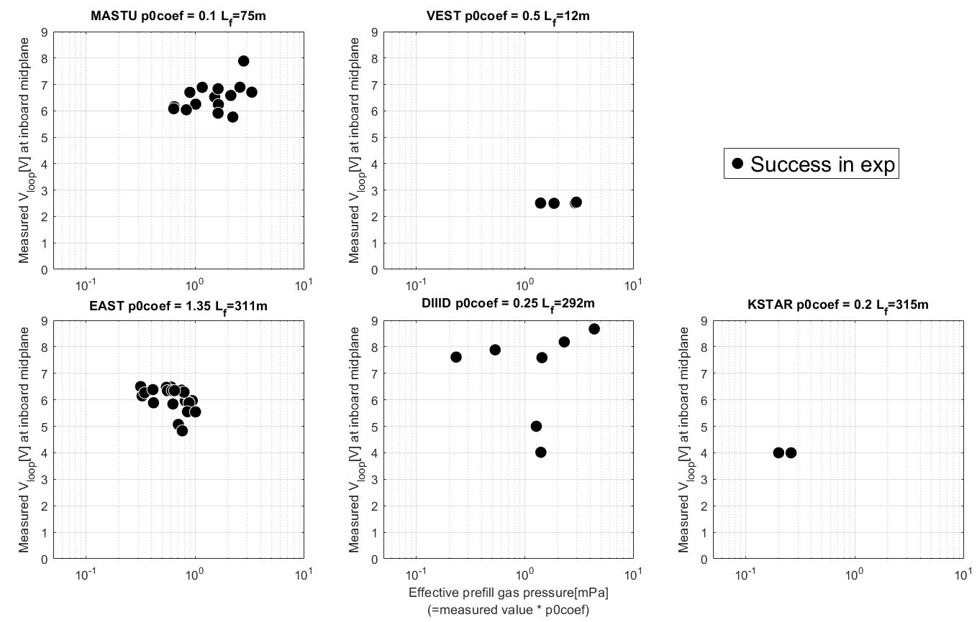
Operation space in experiments
Hong-Sik Yun et al 2023 29th IAEA Fusion Energy Conference p [TH-C/1906]
V_{loop}[V]
V_{loop}[V]
Hyun-Taen Kim et al Nucl. Fusion 64 (2024) 126010
V_{loop}[V]
V_{loop}[V]
V_{loop}[V]
Runze Chen et al, Nucl. Fusion 65 (2025) 076043
James Yang et al, Nucl. Fusion, submitted
Jeongwon Lee, et al 2025 4th iFPC
Effective prefill gas pressure [mPa]

Slide 33
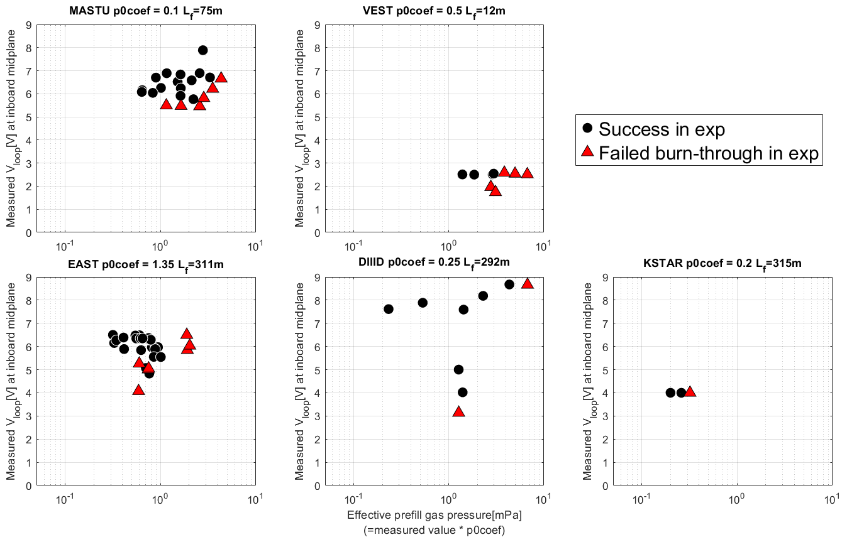
Operation space in experiments
Hong-Sik Yun et al 2023 29th IAEA Fusion Energy Conference p [TH-C/1906]
V_{loop}[V]
V_{loop}[V]
Failed burn-through at high p₀
Failed burn-through at low V_{loop}
Hyun-Taen Kim et al Nucl. Fusion 64 (2024) 126010
V_{loop}[V]
V_{loop}[V]
V_{loop}[V]
Runze Chen et al, Nucl. Fusion 65 (2025) 076043
James Yang et al, Nucl. Fusion, submitted
Jeongwon Lee, et al 2025 4th iFPC
Effective prefill gas pressure [mPa]

Slide 34
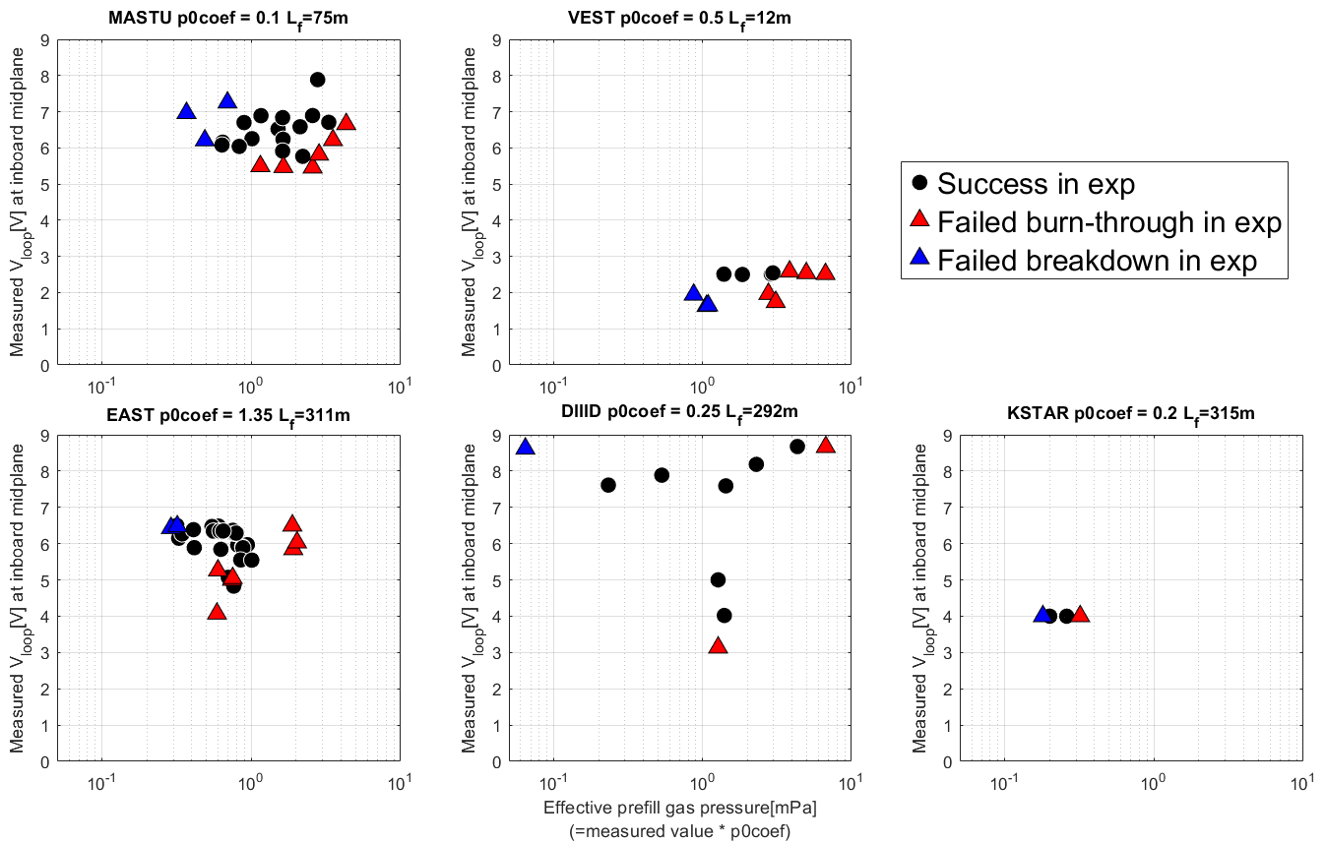
Operation space in experiments
Hong-Sik Yun et al 2023 29th IAEA Fusion Energy Conference p [TH-C/1906]
V_{loop}[V]
V_{loop}[V]
Failed burn-through at high p₀
Failed burn-through at low V_{loop}
Failed breakdown at low p₀
Hyun-Taen Kim et al Nucl. Fusion 64 (2024) 126010
V_{loop}[V]
V_{loop}[V]
V_{loop}[V]
Runze Chen et al, Nucl. Fusion 65 (2025) 076043
James Yang et al, Nucl. Fusion, submitted
Jeongwon Lee, et al 2025 4th iFPC
Effective prefill gas pressure [mPa]

Slide 35
Operation space in experiments
Hong-Sik Yun et al 2023 29th IAEA Fusion Energy Conference p [TH-C/1906]
V_{loop}[V]
V_{loop}[V]
Failed burn-through at high p₀
Failed burn-through at low V_{loop}
Failed breakdown at low p₀
→The hypothesis is valid for all devices.
Hyun-Taen Kim et al Nucl. Fusion 64 (2024) 126010
V_{loop}[V]
V_{loop}[V]
V_{loop}[V]
Runze Chen et al, Nucl. Fusion 65 (2025) 076043
James Yang et al, Nucl. Fusion, submitted
Jeongwon Lee, et al 2025 4th iFPC
Effective prefill gas pressure [mPa]

Slide 36
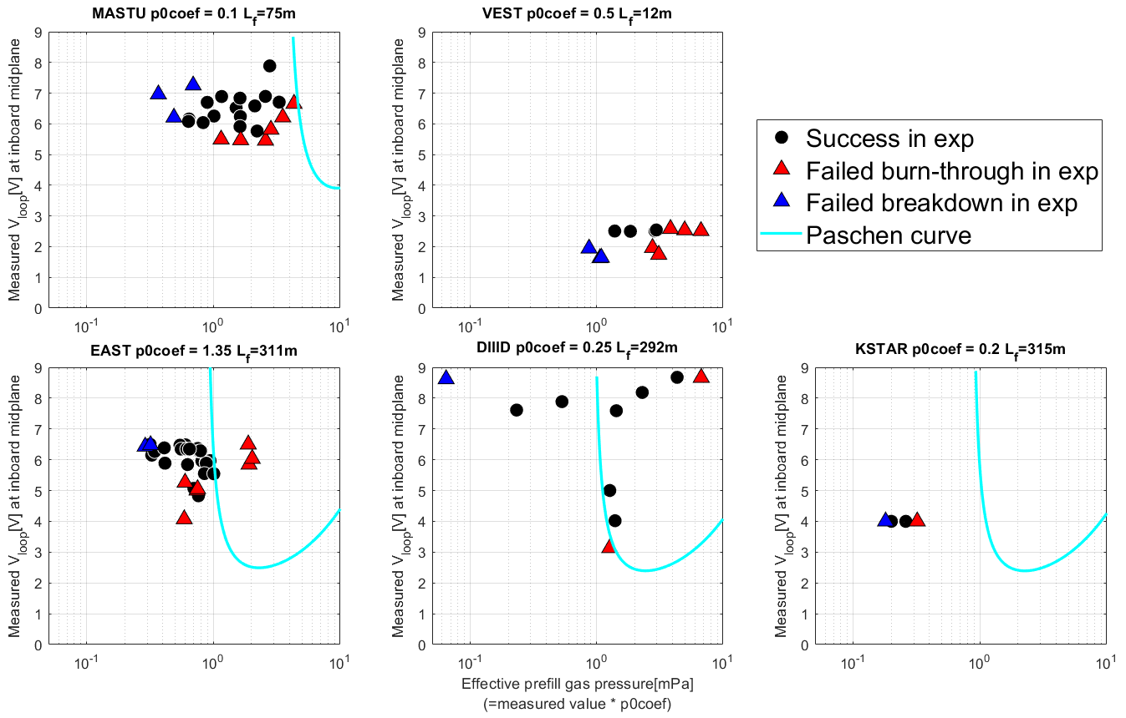
Operation space in experiments
Hong-Sik Yun et al 2023 29th IAEA Fusion Energy Conference p [TH-C/1906]
V_{loop}[V]
V_{loop}[V]
Failed burn-through at high p₀
Failed burn-through at low V_{loop}
Failed breakdown at low p₀
→The hypothesis is valid for all devices.
The conventional Townsend assessment with L_{f} (i.e. αL_{f} > 1) over-predicts the lower limit of p₀ for plasma breakdown.
Hyun-Taen Kim et al Nucl. Fusion 64 (2024) 126010
V_{loop}[V]
V_{loop}[V]
V_{loop}[V]
Runze Chen et al, Nucl. Fusion 65 (2025) 076043
James Yang et al, Nucl. Fusion, submitted
Jeongwon Lee, et al 2025 4th iFPC
Effective prefill gas pressure [mPa]

Slide 37
contents
Background and motivation
Experiment database
DYON code and simulation setup
Multi-machine validation results
Prediction to ITER
Summary

Slide 38
Effective prefill gas pressure
Prefill gas pressure p₀ is an essential input for predictive plasma initiation modelling.
Sufficiently high p₀ is required for Townsend breakdown.
Sufficiently low V_{v}*p₀ is required for plasma burn-through.

Slide 39
Effective prefill gas pressure
Prefill gas pressure p₀ is an essential input for predictive plasma initiation modelling.
Sufficiently high p₀ is required for Townsend breakdown.
Sufficiently low V_{v}*p₀ is required for plasma burn-through.
However, raw data requires calibration.
Fast ion gauge calibration is often inaccurate.

Slide 40
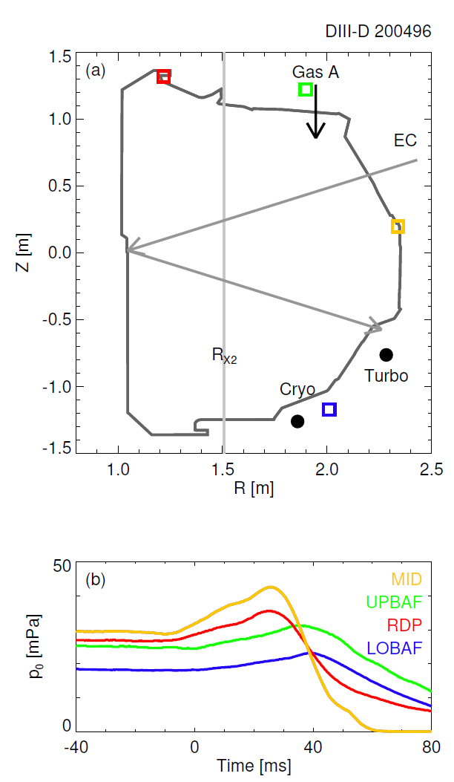
Effective prefill gas pressure
Prefill gas pressure p₀ is an essential input for predictive plasma initiation modelling.
Sufficiently high p₀ is required for Townsend breakdown.
Sufficiently low V_{v}*p₀ is required for plasma burn-through.
However, raw data requires calibration.
Fast ion gauge calibration is often inaccurate.
Measured values vary at different locations of the fast ion gauges.
James Yang et al, submitted to Nucl. Fusion (2025)

Slide 41
Effective prefill gas pressure
Prefill gas pressure p₀ is an essential input for predictive plasma initiation modelling.
Sufficiently high p₀ is required for Townsend breakdown.
Sufficiently low V_{v}*p₀ is required for plasma burn-through.
However, raw data requires calibration.
Fast ion gauge calibration is often inaccurate.
Measured values vary at different locations of the fast ion gauges.
Effective prefill gas pressure = p₀ coefficient x fast ion gauge data.
James Yang et al, submitted to Nucl. Fusion (2025)

Slide 42
Effective prefill gas pressure
Prefill gas pressure p₀ is an essential input for predictive plasma initiation modelling.
Sufficiently high p₀ is required for Townsend breakdown.
Sufficiently low V_{v}*p₀ is required for plasma burn-through.
However, raw data requires calibration.
Fast ion gauge calibration is often inaccurate.
Measured values vary at different locations of the fast ion gauges.
Effective prefill gas pressure = p₀ coefficient x fast ion gauge data.
The strategy to validate the operating space prediction capability in DYON:
Determine the p₀ coefficient that reproduces a representative discharge in each device
Use the same p₀ coefficient for all other discharges
James Yang et al, submitted to Nucl. Fusion (2025)

Slide 43
Effective prefill gas pressure
Prefill gas pressure p₀ is an essential input for predictive plasma initiation modelling.
Sufficiently high p₀ is required for Townsend breakdown.
Sufficiently low V_{v}*p₀ is required for plasma burn-through.
However, raw data requires calibration.
Fast ion gauge calibration is often inaccurate.
Measured values vary at different locations of the fast ion gauges.
Effective prefill gas pressure = p₀ coefficient x fast ion gauge data.
The strategy to validate the operating space prediction capability in DYON:
Determine the p₀ coefficient that reproduces a representative discharge in each device
Use the same p₀ coefficient for all other discharges
Note that p₀ is easily adjustable in experiments. When predicting plasma initiation in future devices, it is important to ensure that there is a wide enough p0 range for successful initiation.
James Yang et al, submitted to Nucl. Fusion (2025)

Slide 44
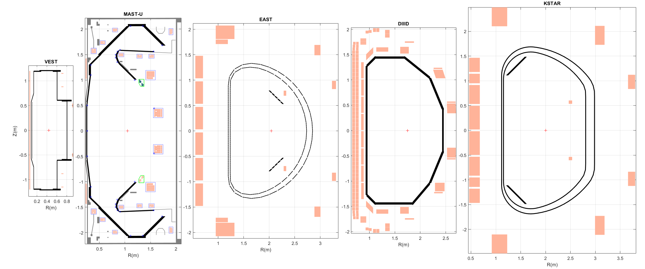
Machine description
KSTAR
MAST-U
EAST
DIII-D
VEST
The machine description data of each device was constructed using the engineering design data.
Mutual inductance matrices of coils (gray), passive structures (black and cyon), and the vacuum space
Resistivity matrices of passive structures (black and cyon)
Hyun-Tae Kim | 30th IAEA Fusion Energy Conference | 13–18 October 2025, Chengdu, China

Slide 45
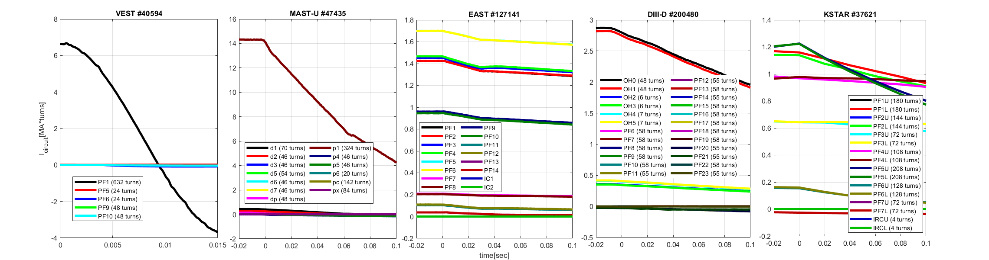
Synthetic flux loop data calculation in DYON
VEST
MAST-U
EAST
DIII-D
KSTAR
I_{circuit} [MA*turns]
Time [sec]
Calculated the measured V_{loop} at the inboard mid-plane using the coil current time traces.
Hyun-Tae Kim | 30th IAEA Fusion Energy Conference | 13–18 October 2025, Chengdu, China

Slide 46
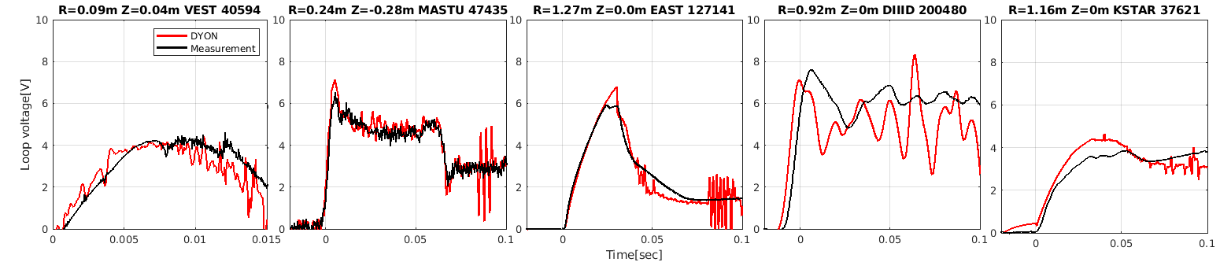
Synthetic flux loop data calculation in DYON
VEST
MAST-U
EAST
DIII-D
KSTAR
I_{circuit} [MA*turns]
Time [sec]
Calculated
Measured
V_{loop}[V]
Time [sec]
Calculated the measured V_{loop} at the inboard mid-plane using the coil current time traces.
This good reproduction confirms the validity of the machine description data.
Hyun-Tae Kim | 30th IAEA Fusion Energy Conference | 13–18 October 2025, Chengdu, China

Slide 47
Synthetic flux loop data calculation in DYON
VEST
MAST-U
EAST
DIII-D
KSTAR
I_{circuit} [MA*turns]
Time [sec]
Calculated
Measured
V_{loop}[V]
Time [sec]
Calculated the measured V_{loop} at the inboard mid-plane using the coil current time traces.
This good reproduction confirms the validity of the machine description data.
Ready for full electromagnetic plasma initiation modelling → DYON
Hyun-Tae Kim | 30th IAEA Fusion Energy Conference | 13–18 October 2025, Chengdu, China

Slide 48
DYON: full electromagnetic plasma initiation simulator
Townsend breakdown assessment of individual open field lines, and calculates V_{p}:
Open field lines with E║ > E_{Townsend}
Volume enclosed with closed field lines
Hyun-Tae Kim | 30th IAEA Fusion Energy Conference | 13–18 October 2025, Chengdu, China

Slide 49
DYON: full electromagnetic plasma initiation simulator
Townsend breakdown assessment of individual open field lines, and calculates V_{p}:
Open field lines with E║ > E_{Townsend}
Volume enclosed with closed field lines
Plasma burn-through and early Ip ramp-up simulated by solving the ODE system of
full circuit equations of plasma, coils, and eddy currents +
global energy and particle balances of main fuel gas, ions, and impurities.
Hyun-Tae Kim | 30th IAEA Fusion Energy Conference | 13–18 October 2025, Chengdu, China

Slide 50
DYON: full electromagnetic plasma initiation simulator
Townsend breakdown assessment of individual open field lines, and calculates V_{p}:
Open field lines with E║ > E_{Townsend}
Volume enclosed with closed field lines
Plasma burn-through and early Ip ramp-up simulated by solving the ODE system of
full circuit equations of plasma, coils, and eddy currents +
global energy and particle balances of main fuel gas, ions, and impurities.
DYON requires only :
Machine description
control room input data i.e. I_{coil} and p₀
Hyun-Tae Kim | 30th IAEA Fusion Energy Conference | 13–18 October 2025, Chengdu, China

Slide 51
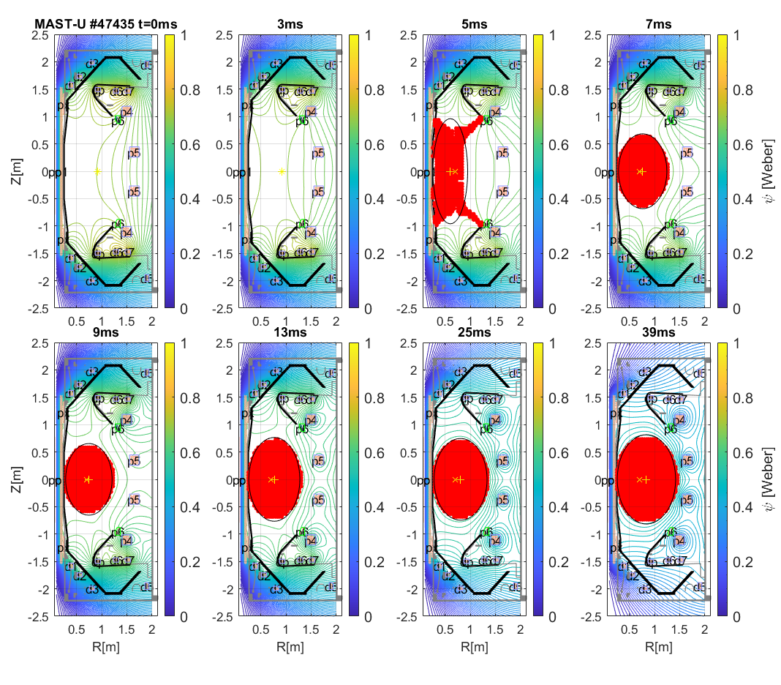
DYON: full electromagnetic plasma initiation simulator
Townsend breakdown assessment of individual open field lines, and calculates V_{p}:
Open field lines with E║ > E_{Townsend}
Volume enclosed with closed field lines
Plasma burn-through and early Ip ramp-up simulated by solving the ODE system of
full circuit equations of plasma, coils, and eddy currents +
global energy and particle balances of main fuel gas, ions, and impurities.
DYON requires only :
Machine description
control room input data i.e. I_{coil} and p₀
DYON predicts:
Successful plasma initiation
Hyun-Tae Kim | 30th IAEA Fusion Energy Conference | 13–18 October 2025, Chengdu, China
Hyun-Tae Kim et al 2022 Nucl. Fusion 62 (2022) 126012
Hyun-Taen Kim et al 2024 Nucl. Fusion 64 (2024) 126010

Slide 52
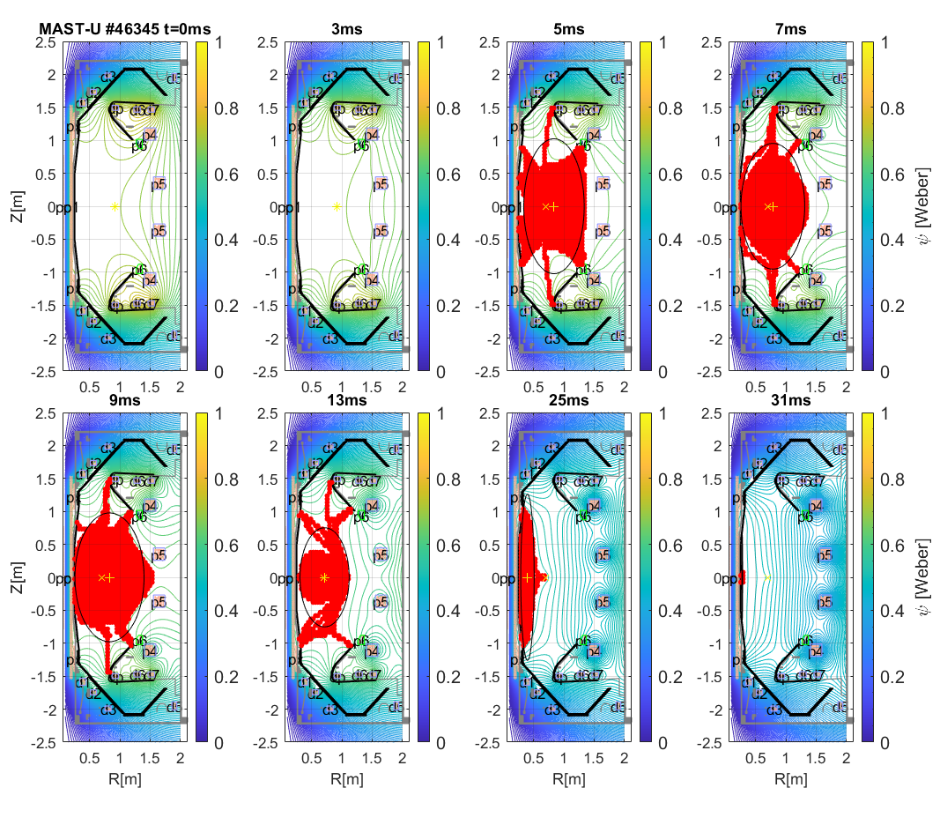
DYON: full electromagnetic plasma initiation simulator
Townsend breakdown assessment of individual open field lines, and calculates V_{p}:
Open field lines with E║ > E_{Townsend}
Volume enclosed with closed field lines
Plasma burn-through and early Ip ramp-up simulated by solving the ODE system of
full circuit equations of plasma, coils, and eddy currents +
global energy and particle balances of main fuel gas, ions, and impurities.
DYON requires only :
Machine description
control room input data i.e. I_{coil} and p₀
DYON predicts:
Successful plasma initiation
Failed plasma burn-through
Hyun-Tae Kim | 30th IAEA Fusion Energy Conference | 13–18 October 2025, Chengdu, China
Hyun-Tae Kim et al 2022 Nucl. Fusion 62 (2022) 126012
Hyun-Taen Kim et al 2024 Nucl. Fusion 64 (2024) 126010

Slide 53
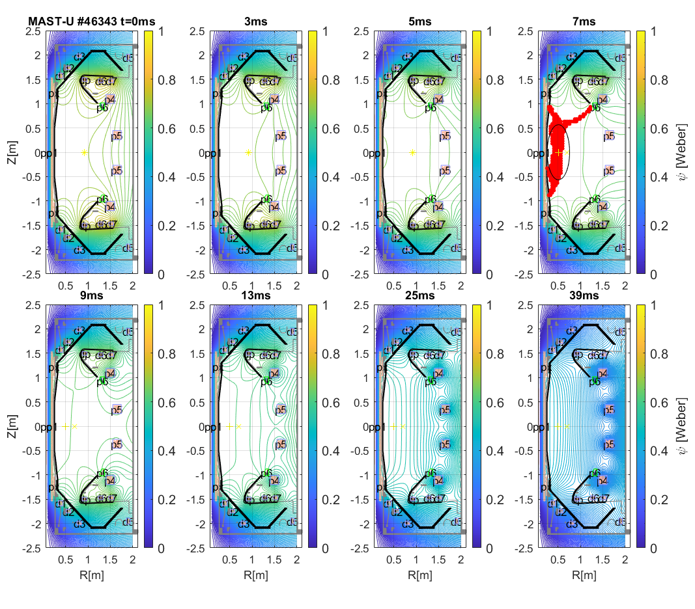
DYON: full electromagnetic plasma initiation simulator
Townsend breakdown assessment of individual open field lines, and calculates V_{p}:
Open field lines with E║ > E_{Townsend}
Volume enclosed with closed field lines
Plasma burn-through and early Ip ramp-up simulated by solving the ODE system of
full circuit equations of plasma, coils, and eddy currents +
global energy and particle balances of main fuel gas, ions, and impurities.
DYON requires only :
Machine description
control room input data i.e. I_{coil} and p₀
DYON predicts:
Successful plasma initiation
Failed plasma burn-through
Failed Townsend breakdown
Hyun-Tae Kim | 30th IAEA Fusion Energy Conference | 13–18 October 2025, Chengdu, China
Hyun-Tae Kim et al 2022 Nucl. Fusion 62 (2022) 126012
Hyun-Taen Kim et al 2024 Nucl. Fusion 64 (2024) 126010

Slide 54
Simulation setup
Device | Sputtering yield | Ferromagnetic modelling | p₀ coeffcient
MASTU | Assumption of 0.1% initial O in D prefill gas + Carbon sputtering by D ions = 0.03 | N/A | 0.1
EAST | Assumption of 0.1% initial O in D prefill gas | N/A | 1.35
DIIID | Assumption of 0.1% initial O in D prefill gas + Carbon sputtering by D ions = 0.03 | N/A | 0.25
KSTAR | Assumption of 0.1% initial O in D prefill gas + Carbon sputtering by D ions = 0.03 | Done | 0.2
VEST | Assumption of 0.1% initial O in D prefill gas | N/A | 0.5

Slide 55
Simulation setup
Device | Sputtering yield | Ferromagnetic modelling | p₀ coeffcient
MASTU | Assumption of 0.1% initial O in D prefill gas + Carbon sputtering by D ions = 0.03 | N/A | 0.1
EAST | Assumption of 0.1% initial O in D prefill gas | N/A | 1.35
DIIID | Assumption of 0.1% initial O in D prefill gas + Carbon sputtering by D ions = 0.03 | N/A | 0.25
KSTAR | Assumption of 0.1% initial O in D prefill gas + Carbon sputtering by D ions = 0.03 | Done | 0.2
VEST | Assumption of 0.1% initial O in D prefill gas | N/A | 0.5
Apart from the table above, the simulation setup used in all DYON modelling is identical, i.e. no tuning in individual discharges.
Only using the control room input data i.e. coil currents waveform and effective prefill gas pressure,
the plasma initiation in each discharge were predicted.

Slide 56
contents
Background and motivation
Experiment database
DYON code and simulation setup
Multi-machine validation results
Prediction to ITER
Summary

Slide 57
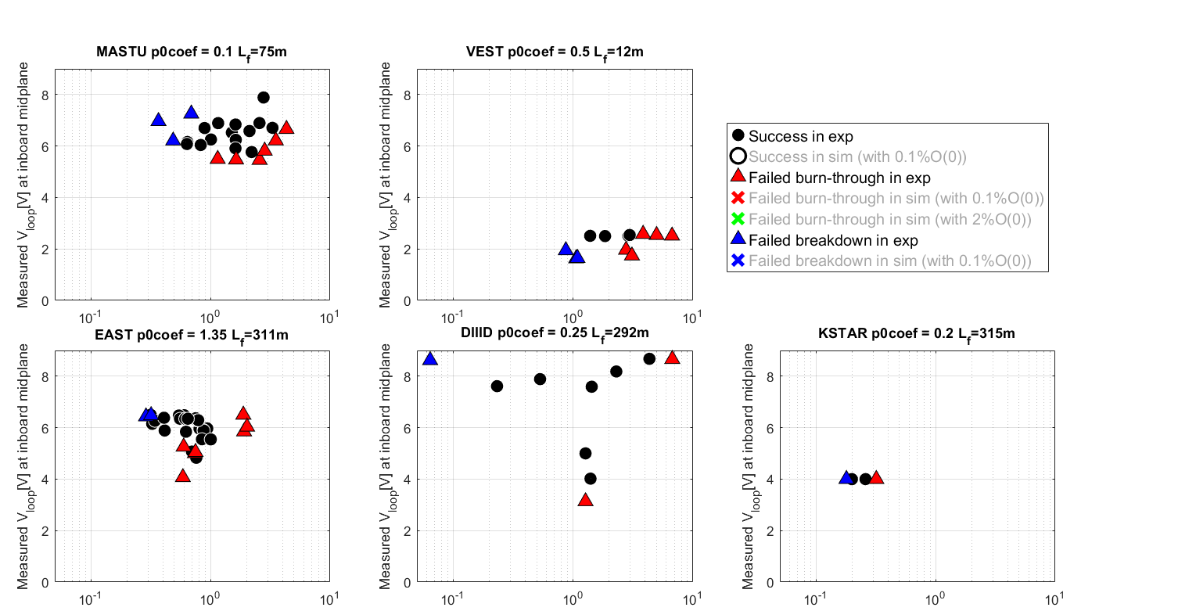
Operation space experiments
V_{loop}[V]
V_{loop}[V]
V_{loop}[V]
V_{loop}[V]
V_{loop}[V]
Effective prefill gas pressure [mPa]

Slide 58
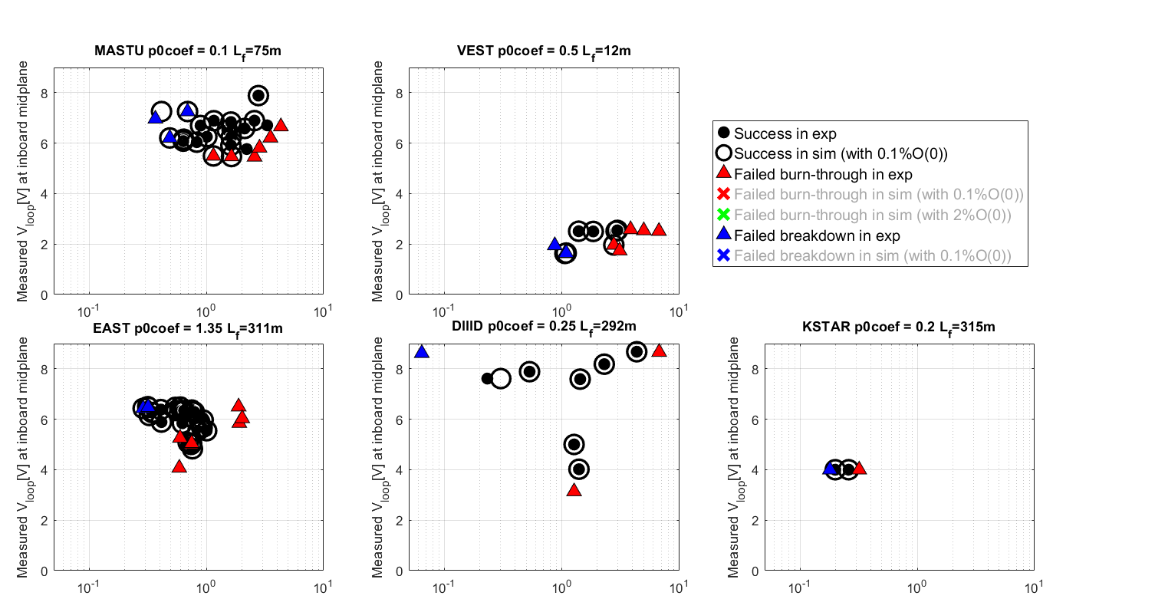
Operation space simulation
V_{loop}[V]
V_{loop}[V]
V_{loop}[V]
V_{loop}[V]
V_{loop}[V]
Effective prefill gas pressure [mPa]

Slide 59
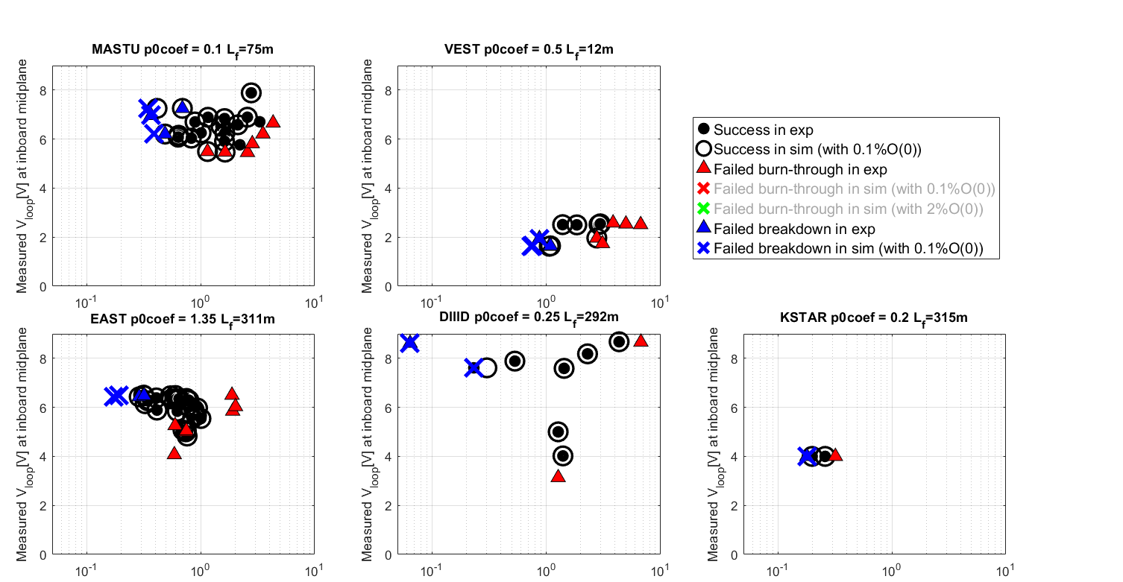
Operation space simulation
V_{loop}[V]
V_{loop}[V]
V_{loop}[V]
V_{loop}[V]
V_{loop}[V]
Effective prefill gas pressure [mPa]

Slide 60
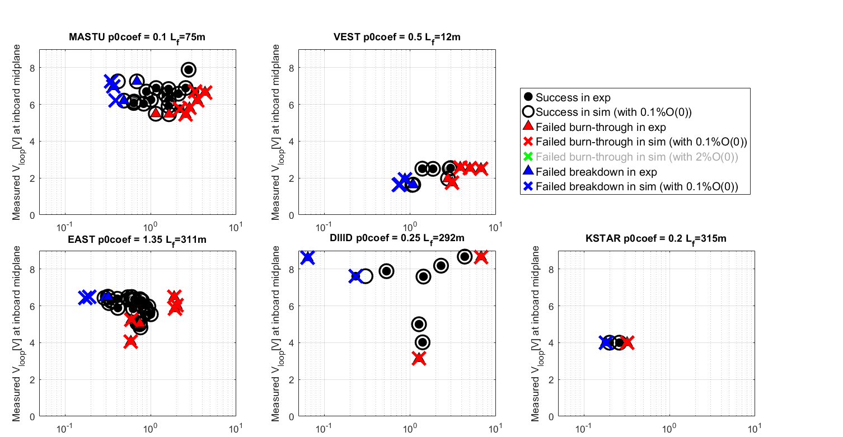
Operation space simulation
V_{loop}[V]
V_{loop}[V]
V_{loop}[V]
V_{loop}[V]
V_{loop}[V]
Effective prefill gas pressure [mPa]

Slide 61
Operation space simulation
The inductive operation spaces were reproduced in the full electromagnetic DYON modelling in all devices.
V_{loop}[V]
V_{loop}[V]
V_{loop}[V]
V_{loop}[V]
V_{loop}[V]
Effective prefill gas pressure [mPa]

Slide 62
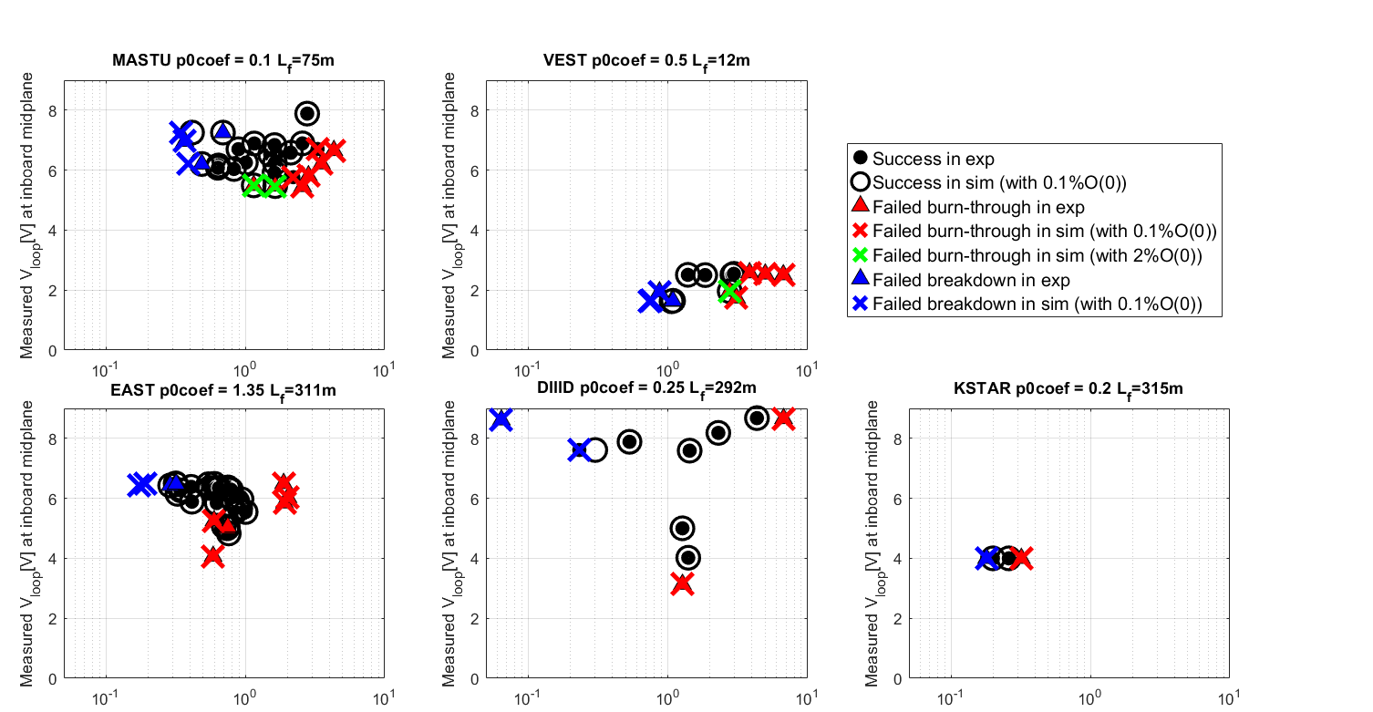
Operation space simulation
The inductive operation spaces were reproduced in the full electromagnetic DYON modelling in all devices.
A few inaccurate predictions are due to the common initial impurity assumed for all discharges.
V_{loop}[V]
V_{loop}[V]
V_{loop}[V]
V_{loop}[V]
V_{loop}[V]
Effective prefill gas pressure [mPa]

Slide 63
Operation space simulation
The inductive operation spaces were reproduced in the full electromagnetic DYON modelling in all devices.
A few inaccurate predictions are due to the common initial impurity assumed for all discharges.
Strong confirmation of the validity of predictive modelling for inductive plasma initiation.
Ready to add EC models for preionisation, heating, and current drive.
V_{loop}[V]
V_{loop}[V]
V_{loop}[V]
V_{loop}[V]
V_{loop}[V]
Effective prefill gas pressure [mPa]

Slide 64
contents
Background and motivation
Experiment database
DYON code and simulation setup
Multi-machine validation results
Prediction to ITER
Summary

Slide 65
Prediction to the inductive plasma initiation in ITER
Machine description and coil current time traces are from IMAS (#105052).
DYON predicts with 0.1% initial oxygen + physical sputtering of Boron

Slide 66
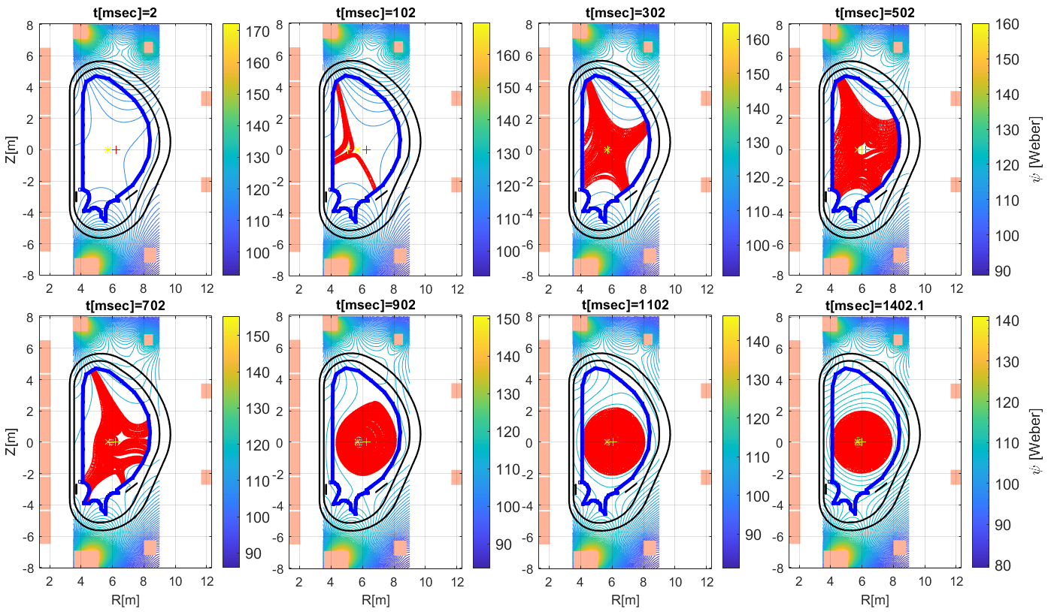
Prediction to the inductive plasma initiation in ITER
Machine description and coil current time traces are from IMAS (#105052).
DYON predicts with 0.1% initial oxygen + physical sputtering of Boron
Inductive plasma initiation is successful at 1mPa

Slide 67
Prediction to the inductive plasma initiation in ITER
Machine description and coil current time traces are from IMAS (#105052).
DYON predicts with 0.1% initial oxygen + physical sputtering of Boron
Inductive plasma initiation is successful at 1mPa (still successful with 3% initial O but failed with 5% initial O).

Slide 68
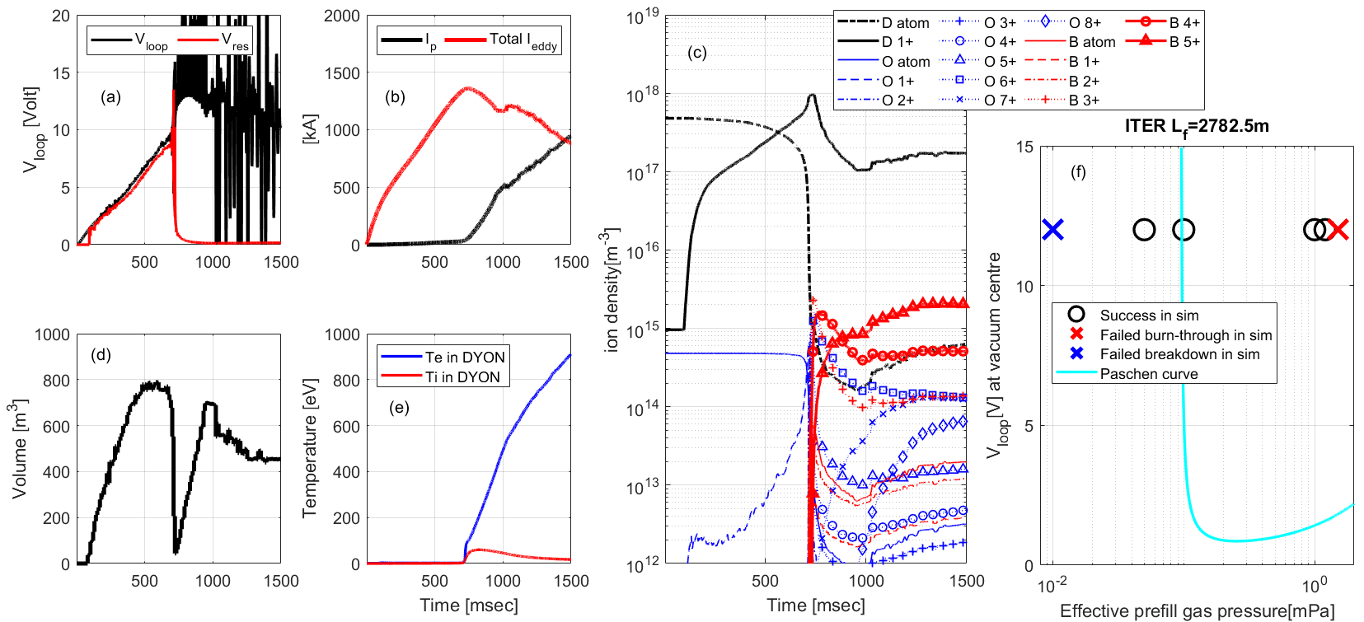
Prediction to the inductive plasma initiation in ITER
Machine description and coil current time traces are from IMAS (#105052).
DYON predicts with 0.1% initial oxygen + physical sputtering of Boron
Inductive plasma initiation is successful at 1mPa (still successful with 3% initial O but failed with 5% initial O).
Townsend breakdown possible at a low V_{loop} for long connection length (10x longer than the present devices).
Slower burn-through (D burn-through at 700ms) for a large vacuum volume

Slide 69
Prediction to the inductive plasma initiation in ITER
Machine description and coil current time traces are from IMAS (#105052).
DYON predicts with 0.1% initial oxygen + physical sputtering of Boron
Inductive plasma initiation is successful at 1mPa (still successful with 3% initial O but failed with 5% initial O).
Townsend breakdown possible at a low V_{loop} for long connection length (10x longer than the present devices).
Slower burn-through (D burn-through at 700ms) for a large vacuum volume
Upper p₀ limit for burn-through =1.5mPa and lower p₀ limit for breakdown = 0.1mPa (Caveat: risk of runaway electrons).

Slide 70
Summary
Validated the predictive modelling of operation space for inductive plasma initiation with multi-machine experiment data. Full electromagnetic DYON
can capture the essential physics in the inductive plasma initiation
can assess the feasibility of inductive plasma initiation with the given hardware design and operating scenario.
is ready to add EC models for preionisation, heating, and current drive for future work.

Slide 71
Summary
Validated the predictive modelling of operation space for inductive plasma initiation with multi-machine experiment data. Full electromagnetic DYON
can capture the essential physics in the inductive plasma initiation
can assess the feasibility of inductive plasma initiation with the given hardware design and operating scenario.
is ready to add EC models for preionisation, heating, and current drive for future work.
Predicted ITER with
the validated simulation setup
the machine description and coil current time traces (#105052) in IMAS.

Slide 72
Summary
Validated the predictive modelling of operation space for inductive plasma initiation with multi-machine experiment data. Full electromagnetic DYON
can capture the essential physics in the inductive plasma initiation
can assess the feasibility of inductive plasma initiation with the given hardware design and operating scenario.
is ready to add EC models for preionisation, heating, and current drive for future work.
Predicted ITER with
the validated simulation setup
the machine description and coil current time traces (#105052) in IMAS.
In ITER, it is predicted that
Successful inductive plasma initiation if the initial impurity is minimised (e.g. less than 3% initial O in the prefill gas).
Townsend breakdown possible at a low V_{loop} due to the long connection length (10x longer than the present devices).
Slower burn-through (D burn-through at 700ms) due to the large vacuum volume
Upper p₀ limit for burn-through =1.5mPa and lower p₀ limit for breakdown = 0.1mPa (Caveat: risk of runaway electrons).

Slide 73
Summary
Validated the predictive modelling of operation space for inductive plasma initiation with multi-machine experiment data. Full electromagnetic DYON
can capture the essential physics in the inductive plasma initiation
can assess the feasibility of inductive plasma initiation with the given hardware design and operating scenario.
is ready to add EC models for preionisation, heating, and current drive for future work.
Predicted ITER with
the validated simulation setup
the machine description and coil current time traces (#105052) in IMAS.
In ITER, it is predicted that
Successful inductive plasma initiation if the initial impurity is minimised (e.g. less than 3% initial O in the prefill gas).
Townsend breakdown possible at a low V_{loop} due to the long connection length (10x longer than the present devices).
Slower burn-through (D burn-through at 700ms) due to the large vacuum volume
Upper p₀ limit for burn-through =1.5mPa and lower p₀ limit for breakdown = 0.1mPa (Caveat: risk of runaway electrons).
More DYON modelling to be presented at this conference:
JT-60SA modelling by Takuma Wakatsuki 17 Oct 2025, 10:40
Runaway electron model development by Youngsun Lee 17 Oct 2025, 14:40

Slide 74
Back-up slides

Slide 75
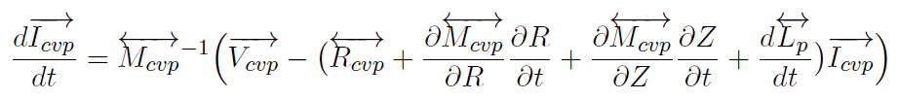
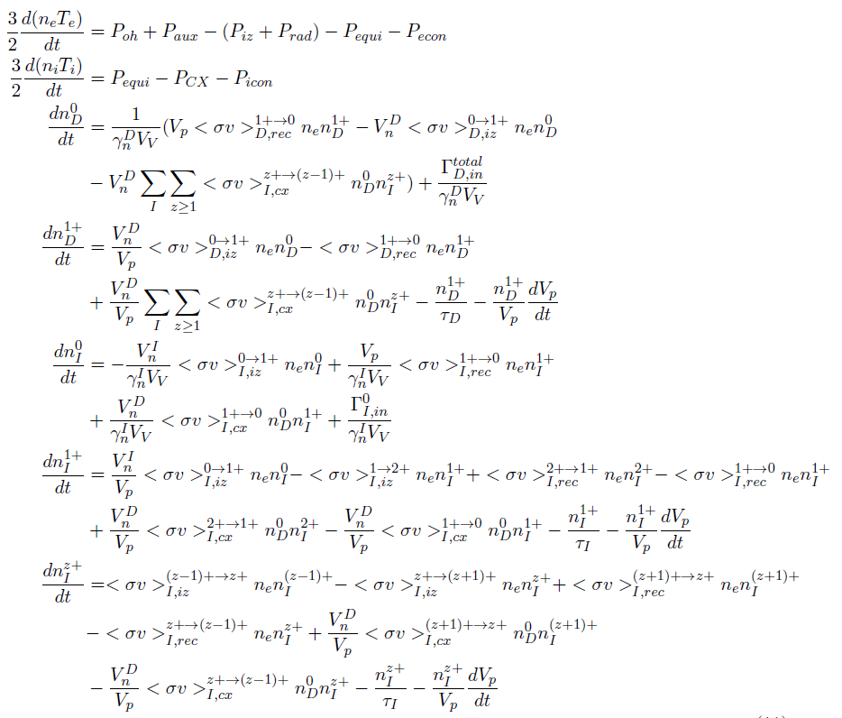
Full circuit equation integrated in the ordinary differential equation system of global 0D energy and particle balance
Full circuit equations
Energy balance of electrons and ions
Particle balance of D ions
Particle balance of impurities
Hyun-Tae Kim | 30th IAEA Fusion Energy Conference | 13–18 October 2025, Chengdu, China

Slide 76
Namelist
names.psi_calculation_burnthrough = 'Point';
names.psi_calculation_rampup = 'Point';
names.perpendicular_confinement_model = 'Bohm’;
names.field_line_following_streamslice = 1;
names.field_line_following_method = 'ode’;
names.interp_imp = 'c';
names.ferromagnetic_ON = 0 in MU, 0 in EAST, 0 in DIIID, 1 in KSTAR, 0 in VEST
names.R_calculation_Townsend = 0;
names.R_calculation_FBE = 0;
names.p0_townsend_option = 2;
names.N_div =50;
names.Lf_length_typical = 10000; (obsolete)
names.dLength = 0.01; (obsolete)
names.tau_p_coef=1.0;
names.tau_E_coef = 1.0
names.L_connection_coef=1.0
names.Townsend_Lf_coef=0.5
names.impurity.C =1 in MU; 0 in EAST, 1 in DIIID, 1 in KSTAR, 0 in VEST
names.impurity.O = 1;
names.W_coef1=1.0;
names.W_coef2=0.0;
names.t_Hrecycling = 0.1
names.cT = 1 in MU; 0 in EAST, 1 in DIIID, 2 in KSTAR, 1 in VEST
names.Sputtering_ObyO = 1.0 ;
names.Sputtering_CbyO = 1.0 in MU; 0 in EAST, 1.0 in DIIID, 1.0 in KSTAR, 0.0 in VEST
names.Sputtering_CbyH = 0.03 in MU; 0 in EAST, 0.03 in DIIID, 0.03 in KSTAR; 0 in VEST
names.fuelgas= 1;
names.Hmass= 2 in MU; 2 in EAST, 2 in DIIID, 2 in KSTAR, 1 in VEST
names.Lf_Option = 2;
names.Poh = 'dyon'
names.Rp = 'spitzer'
names.li_burnthrough ='inputdata'
names.li_rampup = 'inputdata';
names.Lp_burnthrough = 'dyon'
names.Lp_burnthrough_option = 2;
names.Lp_rampup = 'dyon';
names.Lp_rampup_option = 2;
names.Lp_Hirshman_optimize = '';
names.interp.dVpdt = 2;
names.dVpdt_heating = 1;
names.interp.dLpdt= 2;
names.interp.dRdt= 2;
names.interp.dZdt = 2;
names.interp.Vp =1;
names.t_start_EM = -0.02
names.t_townsend = 0.0 in MU, 0.03 in EAST,
0.0 in DIIID, 0.025 in KSTAR, 0 in VEST (=0.305)
names.t_start_plasma = names.t_townsend+0.0001
names.t_start_Ip = names.t_townsend+0.0002;
names.t_end= 0.1 in MU, 0.2 in EAST, 0.1 in DIIID, 0.1 in KSTAR, 0.01 in VEST (=0.315)
names.t_townsend_res0 = 1e-3;
names.t_townsend_res=1e-3;
names.t_step_max = names.t_townsend_res*0.01;

Slide 77
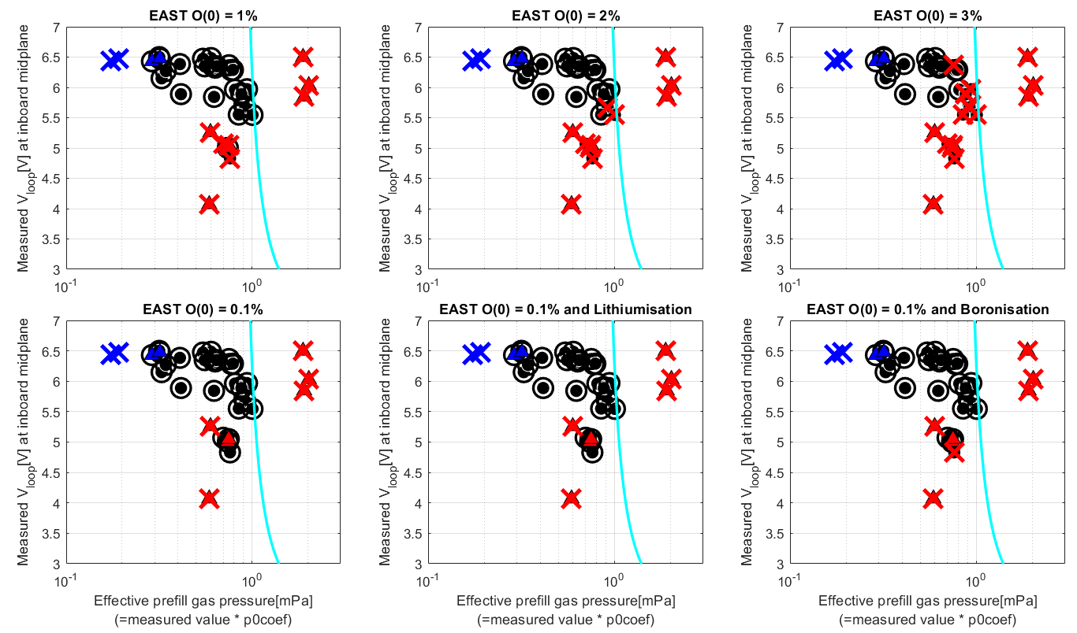
Impact of initial impurities and wall treatment in metal wall
The operation space prediction does not change upto 1% of initial impurity (e.g. Oxygen) in the prefill gas.
If higher than 1%, the operation space prediction shrinks from the boundary.
Physical sputtering model of Lithium and Boron implemented in DYON. Both do not change the operation space.
→0.1% initial oxygen + boron physical sputtering for ITER prediction.

Slide 78
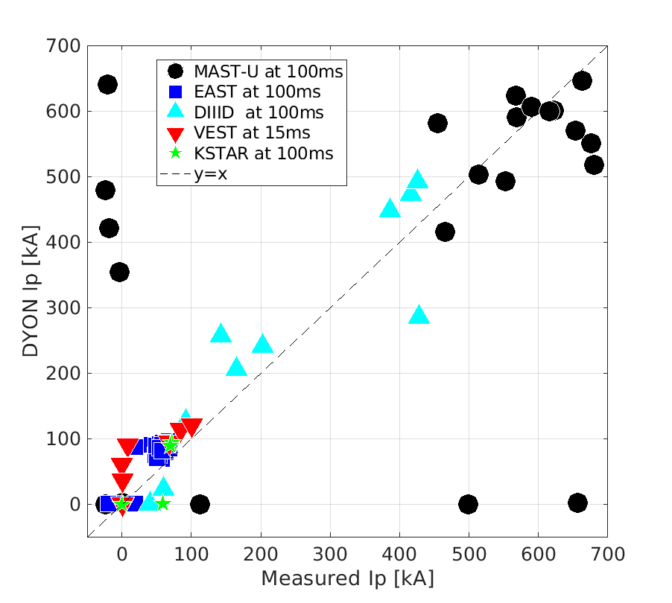
Ip at 100ms in MASTU, 100ms in EAST, 100ms in KSTAR, 15ms in VEST, and 50ms in DIIID

Slide 79
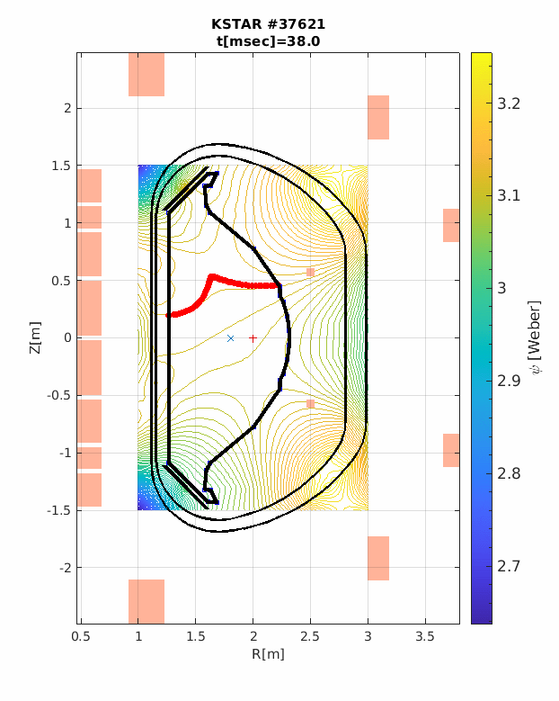
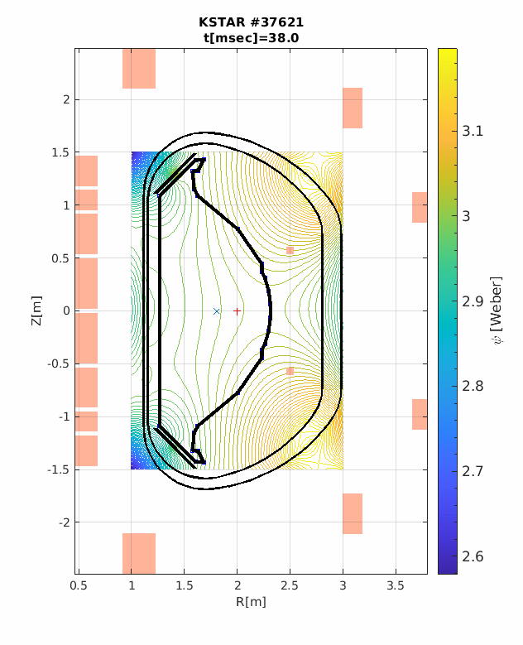
Ferromagnetic effects
Incoloy 908 used in the jacket of the PF1–5 coils and all the toroidal field (TF) Coils in KSTAR
Ferromagnetic effect of Incoloy 908 distorts the magnetic field, degrading the null configuration.
The 2D psi data from the ferromagnetic Incoloy 908 effects was calculated by Finite Element Method modelling of the nonlinear B–H curve of Incoloy 908, and used in DYON modelling of KSTAR discharges.
[J. Kim et al Nucl. Fusion 51 (2011) 083034]
The ferromagnetic psi data were necessary for DYON to reproduce a successful plasma initiation of KSTAR 37621.
However, ITER does not have Incoloy908 so the ferromagnetic effects were not modelled in the DYON prediction of ITER.
With modelling of ferromagnetic effects
Without modelling of ferromagnetic effects
Jeongwon Lee, et al 2025 4th iFPC

