Slide 1
MULTI-MACHINE VALIDATION OF PLASMA INITIATION MODELLING AND PROSPECTS FOR FUTURE DEVICES
30th IAEA Fusion Energy Conference | 13–18 October 2025, Chengdu, China
Hyun-Tae Kim (MAST-U), Runze Chen (EAST), James Yang (DIII-D), Youngsun Lee (KSTAR), Jeongwon Lee (KSTAR), and Hongsik Yoon (VEST)

Slide 2
contents
Motivation
Experiment database
DYON code and simulation setup
Multi-machine validation results
Prediction to ITER
Summary

Slide 3


Inductive plasma initiation in tokamaks: Townsend breakdown and plasma burn-through
Gas
$$Bφ$$
$$−\frac{dΦ_{CS}}{dt}=Vloop=2πREφ$$
Hyun-Tae Kim | 30th IAEA Fusion Energy Conference | 13–18 October 2025, Chengdu, China

Slide 4

Inductive plasma initiation in tokamaks: Townsend breakdown and plasma burn-through
Gas
A few %
ionisation
Townsend breakdown phase
$$\text{Townsend} \text{breakdown} \text{in} \text{tokamaks}\text{:} αL_{f}=1$$
$$Bφ$$
$$−\frac{dΦ_{CS}}{dt}=Vloop=2πREφ$$
B. Lloyd PPCF 38 (1996) 1627
P. C. de Vries Nucl. Fusion 59 (2019) 096043
Hyun-Tae Kim | 30th IAEA Fusion Energy Conference | 13–18 October 2025, Chengdu, China

Slide 5
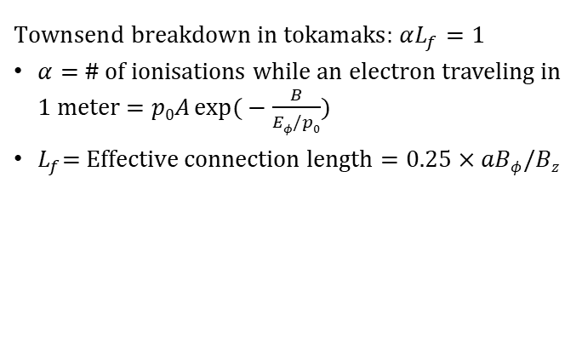
Inductive plasma initiation in tokamaks: Townsend breakdown and plasma burn-through
Gas
A few %
ionisation
Townsend breakdown phase
$$\text{Townsend} \text{breakdown} \text{in} \text{tokamaks}\text{:} αL_{f}=1$$
$α=$ # of ionisations while an electron traveling in 1 meter$=p0A\exp{(}−\frac{B}{Eφ/p0})$
$L_{f}\text{= }\text{Effective} \text{connection} \text{length}=0.25×aBφ/Bz$
$$Bφ$$
$$−\frac{dΦ_{CS}}{dt}=Vloop=2πREφ$$
B. Lloyd PPCF 38 (1996) 1627
P. C. de Vries Nucl. Fusion 59 (2019) 096043
Hyun-Tae Kim | 30th IAEA Fusion Energy Conference | 13–18 October 2025, Chengdu, China

Slide 6
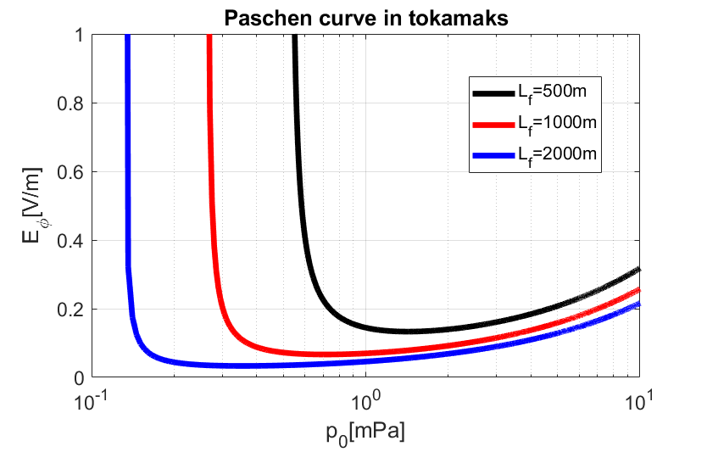
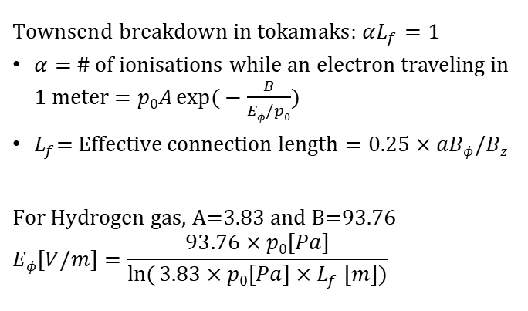
Inductive plasma initiation in tokamaks: Townsend breakdown and plasma burn-through
Gas
A few %
ionisation
Townsend breakdown phase
$$\text{Townsend} \text{breakdown} \text{in} \text{tokamaks}\text{:} αL_{f}=1$$
$α=$ # of ionisations while an electron traveling in 1 meter$=p0A\exp{(}−\frac{B}{Eφ/p0})$
$L_{f}\text{= }\text{Effective} \text{connection} \text{length}=0.25×aBφ/Bz$
$$\text{For} \text{Hydrogen} \text{gas}\text{, }\text{A}\text{=3.83 }\text{and} \text{B}\text{=93.76} \\ Eφ[V/m]=\frac{93.76×p0[Pa]}{\ln{(}3.83×p0\left[Pa\right]{×L}_{f}[m])}$$
$$Bφ$$
$$−\frac{dΦ_{CS}}{dt}=Vloop=2πREφ$$
B. Lloyd PPCF 38 (1996) 1627
P. C. de Vries Nucl. Fusion 59 (2019) 096043
Hyun-Tae Kim | 30th IAEA Fusion Energy Conference | 13–18 October 2025, Chengdu, China

Slide 7
Inductive plasma initiation in tokamaks: Townsend breakdown and plasma burn-through
Gas
A few %
ionisation
100%
ionisation
Townsend breakdown phase
Plasma burn-through phase
$$\text{Townsend} \text{breakdown} \text{in} \text{tokamaks}\text{:} αL_{f}=1$$
$α=$ # of ionisations while an electron traveling in 1 meter$=p0A\exp{(}−\frac{B}{Eφ/p0})$
$L_{f}\text{= }\text{Effective} \text{connection} \text{length}=0.25×aBφ/Bz$
$$\text{For} \text{Hydrogen} \text{gas}\text{, }\text{A}\text{=3.83 }\text{and} \text{B}\text{=93.76} \\ Eφ[V/m]=\frac{93.76×p0[Pa]}{\ln{(}3.83×p0\left[Pa\right]{×L}_{f}[m])}$$
Electrons and neutrals exist together in the burn-through phase
Ohmic heating VS Energy loss from radiation and charge exchange
$$Bφ$$
$$−\frac{dΦ_{CS}}{dt}=Vloop=2πREφ$$
B. Lloyd PPCF 38 (1996) 1627
P. C. de Vries Nucl. Fusion 59 (2019) 096043
Hyun-Tae Kim | 30th IAEA Fusion Energy Conference | 13–18 October 2025, Chengdu, China

Slide 8
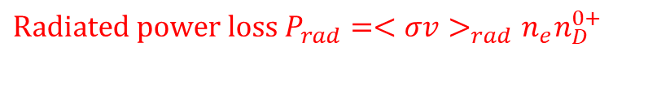
Inductive plasma initiation in tokamaks: Townsend breakdown and plasma burn-through
Gas
A few %
ionisation
100%
ionisation
Townsend breakdown phase
Plasma burn-through phase
$$\text{Townsend} \text{breakdown} \text{in} \text{tokamaks}\text{:} αL_{f}=1$$
$α=$ # of ionisations while an electron traveling in 1 meter$=p0A\exp{(}−\frac{B}{Eφ/p0})$
$L_{f}\text{= }\text{Effective} \text{connection} \text{length}=0.25×aBφ/Bz$
$$\text{For} \text{Hydrogen} \text{gas}\text{, }\text{A}\text{=3.83 }\text{and} \text{B}\text{=93.76} \\ Eφ[V/m]=\frac{93.76×p0[Pa]}{\ln{(}3.83×p0\left[Pa\right]{×L}_{f}[m])}$$
Electrons and neutrals exist together in the burn-through phase
Ohmic heating VS Energy loss from radiation and charge exchange
$$Bφ$$
$$\text{Radiated} \text{power} \text{loss}{ P}_{rad}=<σv>_{rad}n_{e}n_{D}^{0+}$$
$$−\frac{dΦ_{CS}}{dt}=Vloop=2πREφ$$
100
Degree of
Ionization[%]
B. Lloyd PPCF 38 (1996) 1627
P. C. de Vries Nucl. Fusion 59 (2019) 096043
0
0
T_{e}[eV]
~10
Hyun-Tae Kim | 30th IAEA Fusion Energy Conference | 13–18 October 2025, Chengdu, China

Slide 9
Inductive plasma initiation in tokamaks: Townsend breakdown and plasma burn-through
Gas
A few %
ionisation
100%
ionisation
Townsend breakdown phase
Plasma burn-through phase
$$\text{Townsend} \text{breakdown} \text{in} \text{tokamaks}\text{:} αL_{f}=1$$
$α=$ # of ionisations while an electron traveling in 1 meter$=p0A\exp{(}−\frac{B}{Eφ/p0})$
$L_{f}\text{= }\text{Effective} \text{connection} \text{length}=0.25×aBφ/Bz$
$$\text{For} \text{Hydrogen} \text{gas}\text{, }\text{A}\text{=3.83 }\text{and} \text{B}\text{=93.76} \\ Eφ[V/m]=\frac{93.76×p0[Pa]}{\ln{(}3.83×p0\left[Pa\right]{×L}_{f}[m])}$$
Electrons and neutrals exist together in the burn-through phase
Ohmic heating VS Energy loss from radiation and charge exchange
$$Bφ$$
$$\text{Radiated} \text{power} \text{loss}{ P}_{rad}=<σv>_{rad}n_{e}n_{D}^{0+}$$
$$−\frac{dΦ_{CS}}{dt}=Vloop=2πREφ$$
~10⁵
100
D radiation barrier
P_{rad}[W]
Degree of
Ionization[%]
B. Lloyd PPCF 38 (1996) 1627
P. C. de Vries Nucl. Fusion 59 (2019) 096043
0
0
0
T_{e}[eV]
~10
Hyun-Tae Kim | 30th IAEA Fusion Energy Conference | 13–18 October 2025, Chengdu, China

Slide 10
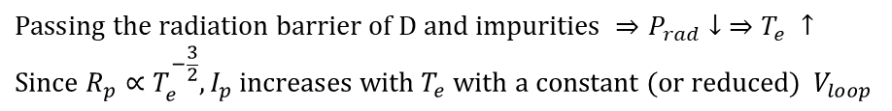
Inductive plasma initiation in tokamaks: Townsend breakdown and plasma burn-through
Gas
A few %
ionisation
100%
ionisation
Townsend breakdown phase
Plasma burn-through phase
$$\text{Townsend} \text{breakdown} \text{in} \text{tokamaks}\text{:} αL_{f}=1$$
$α=$ # of ionisations while an electron traveling in 1 meter$=p0A\exp{(}−\frac{B}{Eφ/p0})$
$L_{f}\text{= }\text{Effective} \text{connection} \text{length}=0.25×aBφ/Bz$
$$\text{For} \text{Hydrogen} \text{gas}\text{, }\text{A}\text{=3.83 }\text{and} \text{B}\text{=93.76} \\ Eφ[V/m]=\frac{93.76×p0[Pa]}{\ln{(}3.83×p0\left[Pa\right]{×L}_{f}[m])}$$
Electrons and neutrals exist together in the burn-through phase
Ohmic heating VS Energy loss from radiation and charge exchange
$$Bφ$$
$$\text{Radiated} \text{power} \text{loss}{ P}_{rad}=<σv>_{rad}n_{e}n_{D}^{0+}$$
$$−\frac{dΦ_{CS}}{dt}=Vloop=2πREφ$$
~10⁵
100
D radiation barrier
P_{rad}[W]
Degree of
Ionization[%]
B. Lloyd PPCF 38 (1996) 1627
P. C. de Vries Nucl. Fusion 59 (2019) 096043
0
0
0
T_{e}[eV]
~10
$$\text{Passing} \text{the} \text{radiation} \text{barrier} \text{of} \text{D} \text{and} \text{impurities} ⇒P_{rad}↓ ⇒T_{e} ↑ \\ \text{Since} R_{p}∝T_{e}^{−\frac{3}{2}}, I_{p} \text{increases} \text{with} T_{e} \text{with} \text{a} \text{constant}\text{ (}\text{or} \text{reduced}\text{) }V_{loop}$$
Hyun-Tae Kim | 30th IAEA Fusion Energy Conference | 13–18 October 2025, Chengdu, China

Slide 11
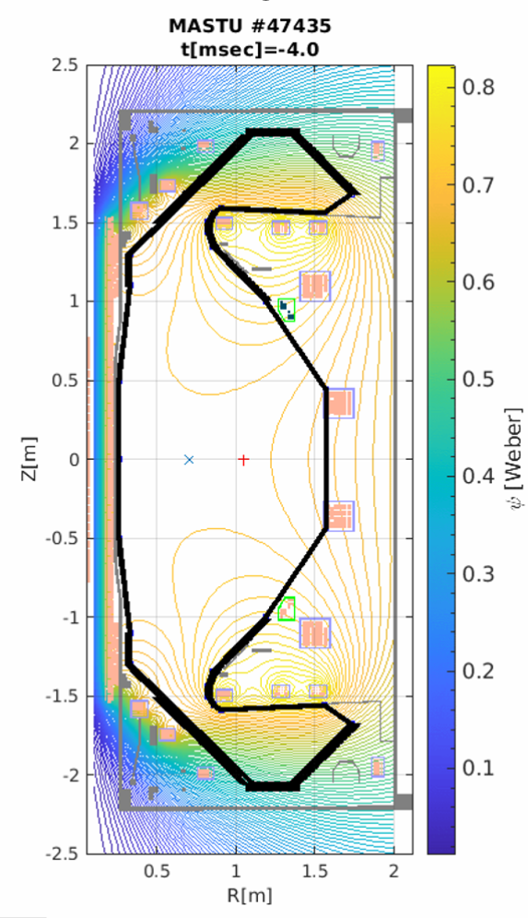
Tokamak operation for inductive plasma initiation
Magnetic field null configuration is required to maximise the connection length.

Slide 12
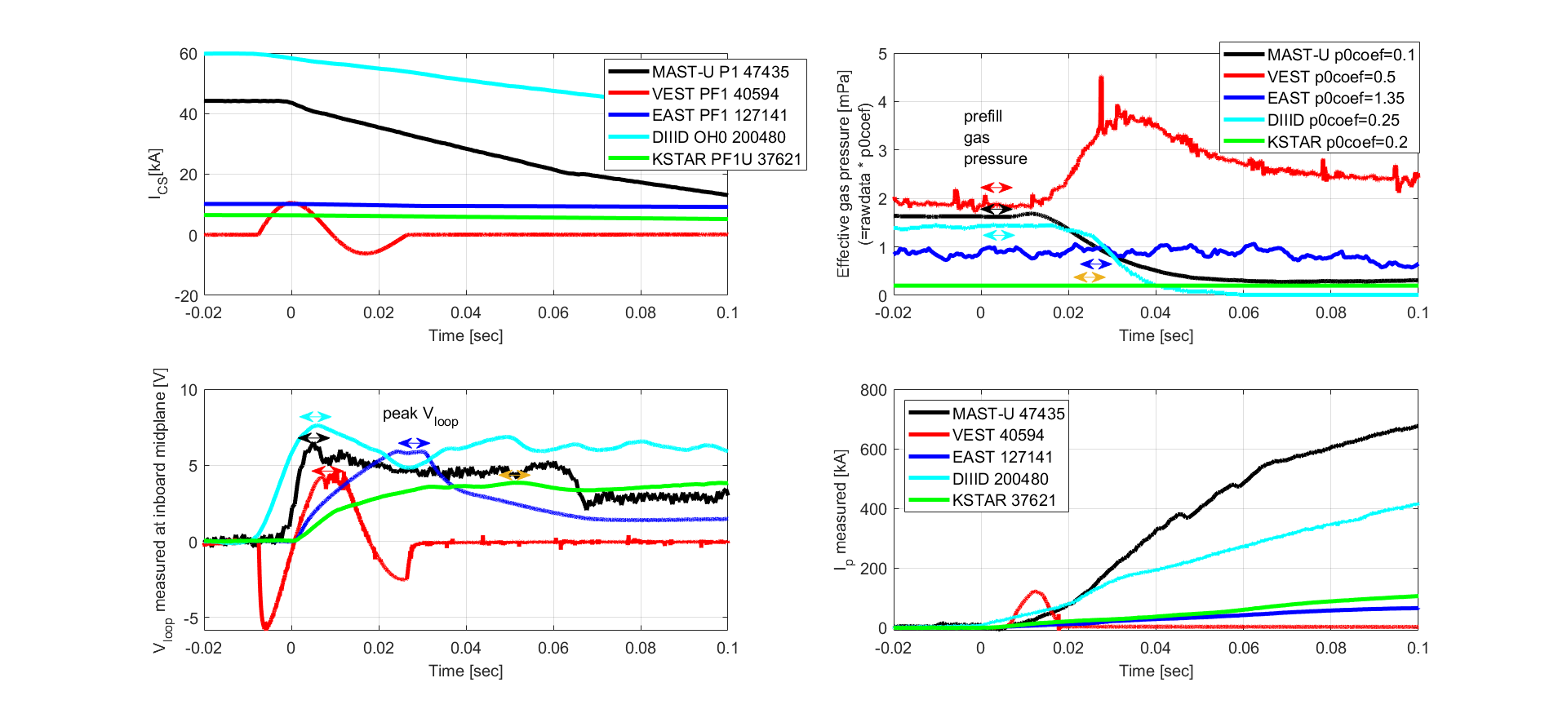
Tokamak operation for inductive plasma initiation
Magnetic field null configuration is required to maximise the connection length.

Slide 13
Tokamak operation for inductive plasma initiation
Magnetic field null configuration is required to maximise the connection length.

Slide 14
Tokamak operation for inductive plasma initiation
Magnetic field null configuration is required to maximise the connection length.

Slide 15
Tokamak operation for inductive plasma initiation
Magnetic field null configuration is required to maximise the connection length.

Slide 16
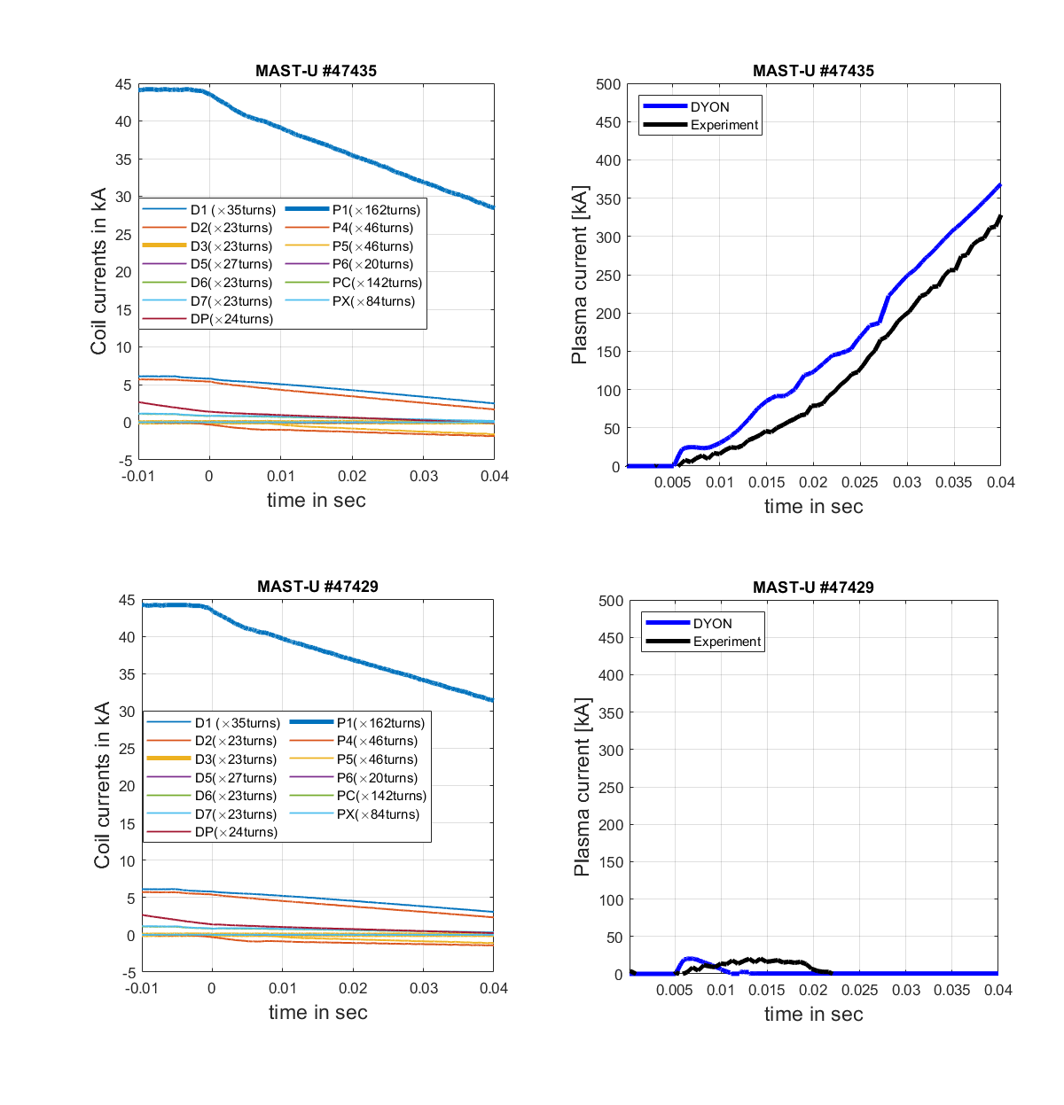
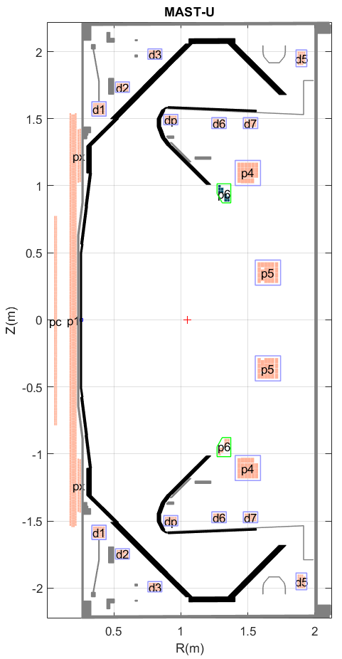
Goal of plasma initiation modelling
p₀ and
p₀ and

Slide 17
Goal of plasma initiation modelling
V_{loop}=5.3V
p₀ and
V_{loop}=4.9V
p₀ and

Slide 18
Goal of plasma initiation modelling
V_{loop}=5.3V
p₀ and
V_{loop}=4.9V
p₀ and

Slide 19
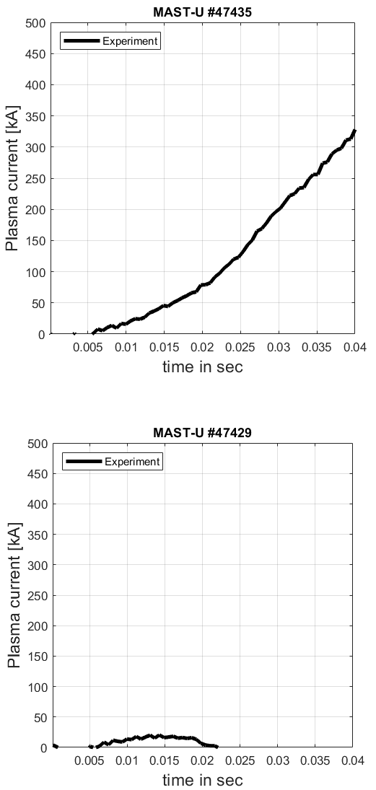
Goal of plasma initiation modelling
V_{loop}=5.3V
p₀ and
V_{loop}=4.9V
p₀ and

Slide 20
Goal of plasma initiation modelling
DYON
V_{loop}=5.3V
p₀ and
V_{loop}=4.9V
p₀ and
DYON

Slide 21
Goal of plasma initiation modelling
DYON
V_{loop}=5.3V
Plasma initiation phase is the most dynamic phase in the whole tokamak pulse.
Tokamak hardware determines the operational constraints:
  Coil design: I_{coil} limit
  Power supply design : dI_{coil}/dt limit
  Vessel conductivity: eddy currents
  Vacuum volume: required p₀
For a new tokamak design, the feasibility of plasma initiation with the operational constraints should be ensured with predictive modelling.
This is particularly important for large superconducting devices such as ITER and STEP, as the plasma initiation will be challenging.
p₀ and
V_{loop}=4.9V
p₀ and
DYON

Slide 22
contents
Motivation
Experiment database
DYON code and simulation setup
Multi-machine validation results
Prediction to ITER
Summary

Slide 23
Devices for multimachine validation
Device | Aspect ratio | Coils | First wall material | Ferromagnetic material | Vv[m³] | Vp[m³] | Bt[T] | Lf[m]
MASTU | Spherical Torus (R=0.7m, a=0.5m) | Copper | Carbon | N/A | 55 | 6 | 0.6 | 75
EAST | Conventional Tokamak (R=1.85m, a=0.5m) | Super Conductor | Tungsten + Molybdenum | N/A | 38 | 7.5 | 2.5 | 311
DIIID | Conventional Tokamak (R=1.67m, a=0.65m) | Copper | Carbon | N/A | 35 | 16 | 1.8 | 292
KSTAR | Conventional Tokamak (R=1.8m, a=0.7m) | Super Conductor | Carbon | Incoloy 908 in the jacket of PF and TF coils | 55 | 5 | 1.8 | 315
VEST | Spherical Torus (R=0.3m, a=0.2m) | Copper | Stainless steel | N/A | 3.7 | 0.6 | 0.23 | 12

Slide 24
Parameter scan experiments to identify plasma initiation operation space
Successful plasma initiation
O
O
O
O
O
O
O
O
O
O
O
O
  Loop voltage
O
  Prefill gas pressure
Hyun-Tae Kim | 30th IAEA Fusion Energy Conference | 13–18 October 2025, Chengdu, China

Slide 25
Parameter scan experiments to identify plasma initiation operation space
Successful plasma initiation
Successful breakdown
but failed burn-through
(strong D_{alpha} but no I_{p} ramp-up)
O
O
X
O
O
O
X
O
O
O
O
X
O
O
O
X
  Loop voltage
O
X
X
  Prefill gas pressure
Hyun-Tae Kim | 30th IAEA Fusion Energy Conference | 13–18 October 2025, Chengdu, China

Slide 26
Parameter scan experiments to identify plasma initiation operation space
Successful plasma initiation
Failed breakdown
(no or very weak D_{alpha})
Successful breakdown
but failed burn-through
(strong D_{alpha} but no I_{p} ramp-up)
O
O
X
O
O
O
X
X
X
O
O
O
O
X
X
X
O
O
O
X
O
X
  Loop voltage
X
Paschen curve?
  Prefill gas pressure
Hyun-Tae Kim | 30th IAEA Fusion Energy Conference | 13–18 October 2025, Chengdu, China

Slide 27
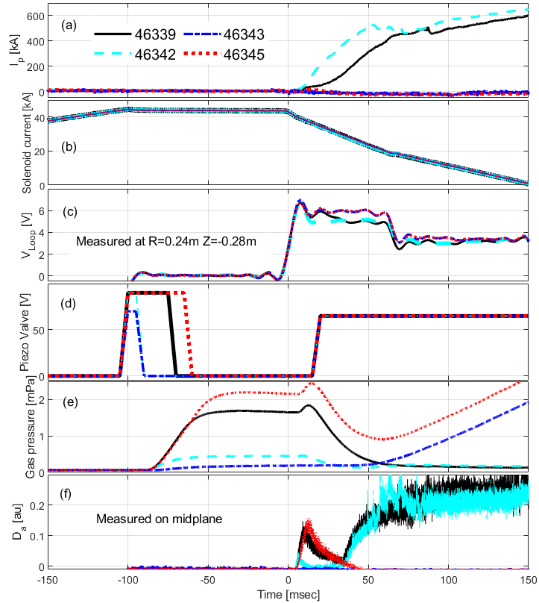
Parameter scan experiments to identify plasma initiation operation space
MAST-U
Successful plasma initiation
Failed breakdown
(no or very weak D_{alpha})
Successful breakdown
but failed burn-through
(strong D_{alpha} but no I_{p} ramp-up)
O
O
X
O
O
O
X
X
X
O
O
O
O
X
X
X
O
O
O
X
O
X
  Loop voltage
X
Paschen curve?
  Prefill gas pressure
Hyun-Taen Kim et al 2024 Nucl. Fusion 64 (2024) 126010
Hyun-Tae Kim | 30th IAEA Fusion Energy Conference | 13–18 October 2025, Chengdu, China

Slide 28
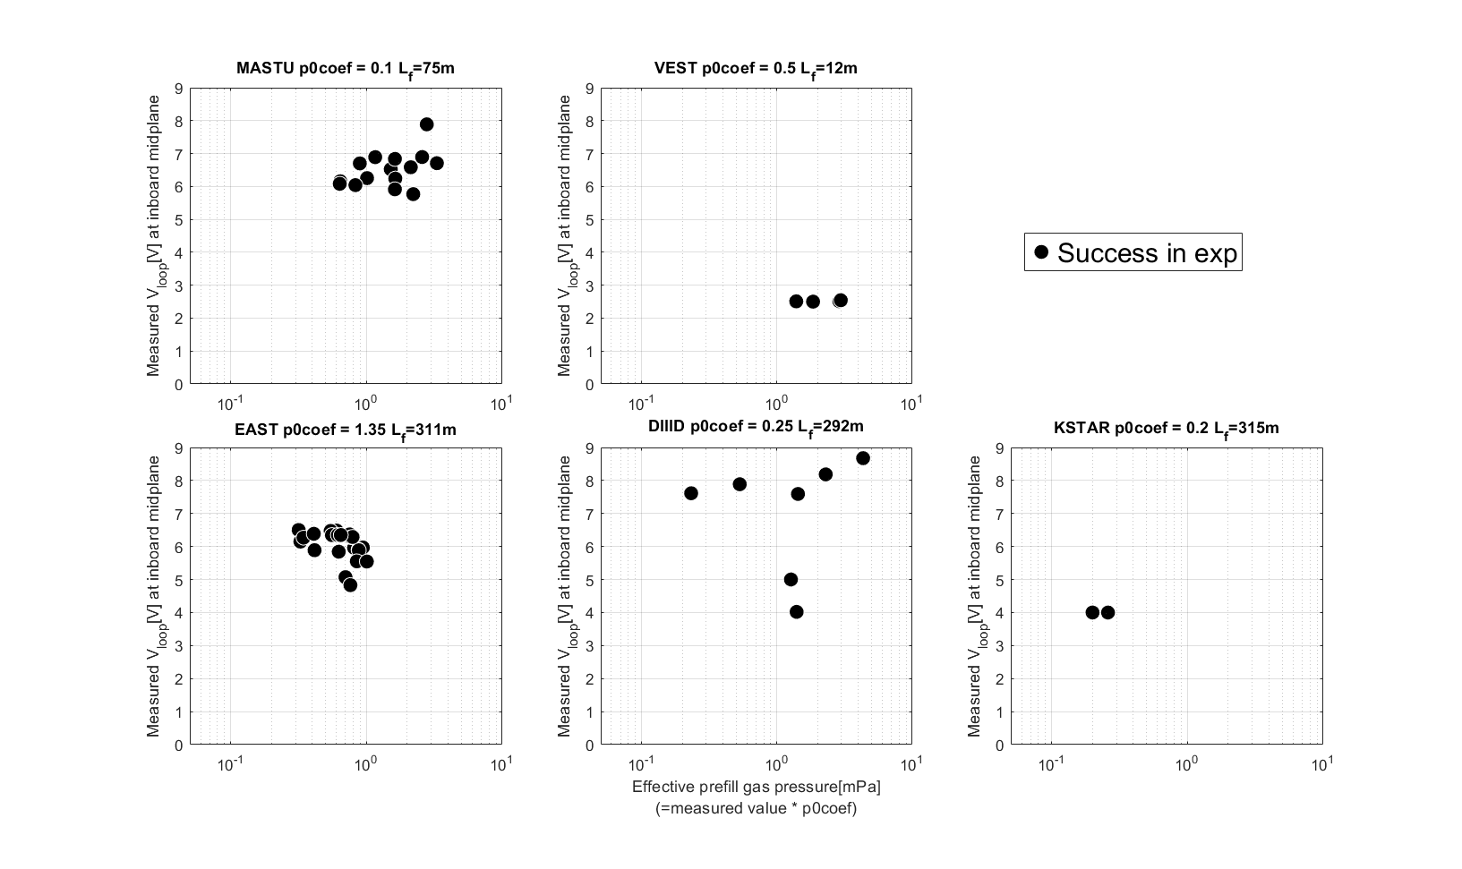
Operation space in experiments
Hong-Sik Yun et al 2023 29th IAEA Fusion Energy Conference p [TH-C/1906]
Hyun-Taen Kim et al Nucl. Fusion 64 (2024) 126010
Runze Chen et al, Nucl. Fusion 65 (2025) 076043
James Yang et al, Nucl. Fusion, submitted
Jeongwon Lee, et al 2025 4th iFPC

Slide 29
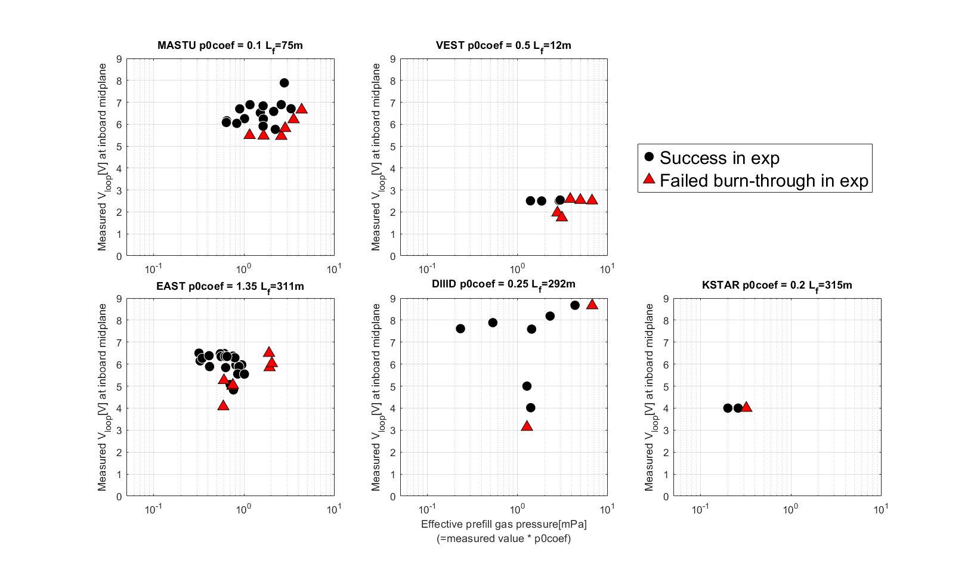
Operation space in experiments
Hong-Sik Yun et al 2023 29th IAEA Fusion Energy Conference p [TH-C/1906]
The hypothesis is valid for all devices.
Failed burn-through at high p₀
Failed burn-through at low V_{loop}
Hyun-Taen Kim et al Nucl. Fusion 64 (2024) 126010
Runze Chen et al, Nucl. Fusion 65 (2025) 076043
James Yang et al, Nucl. Fusion, submitted
Jeongwon Lee, et al 2025 4th iFPC

Slide 30
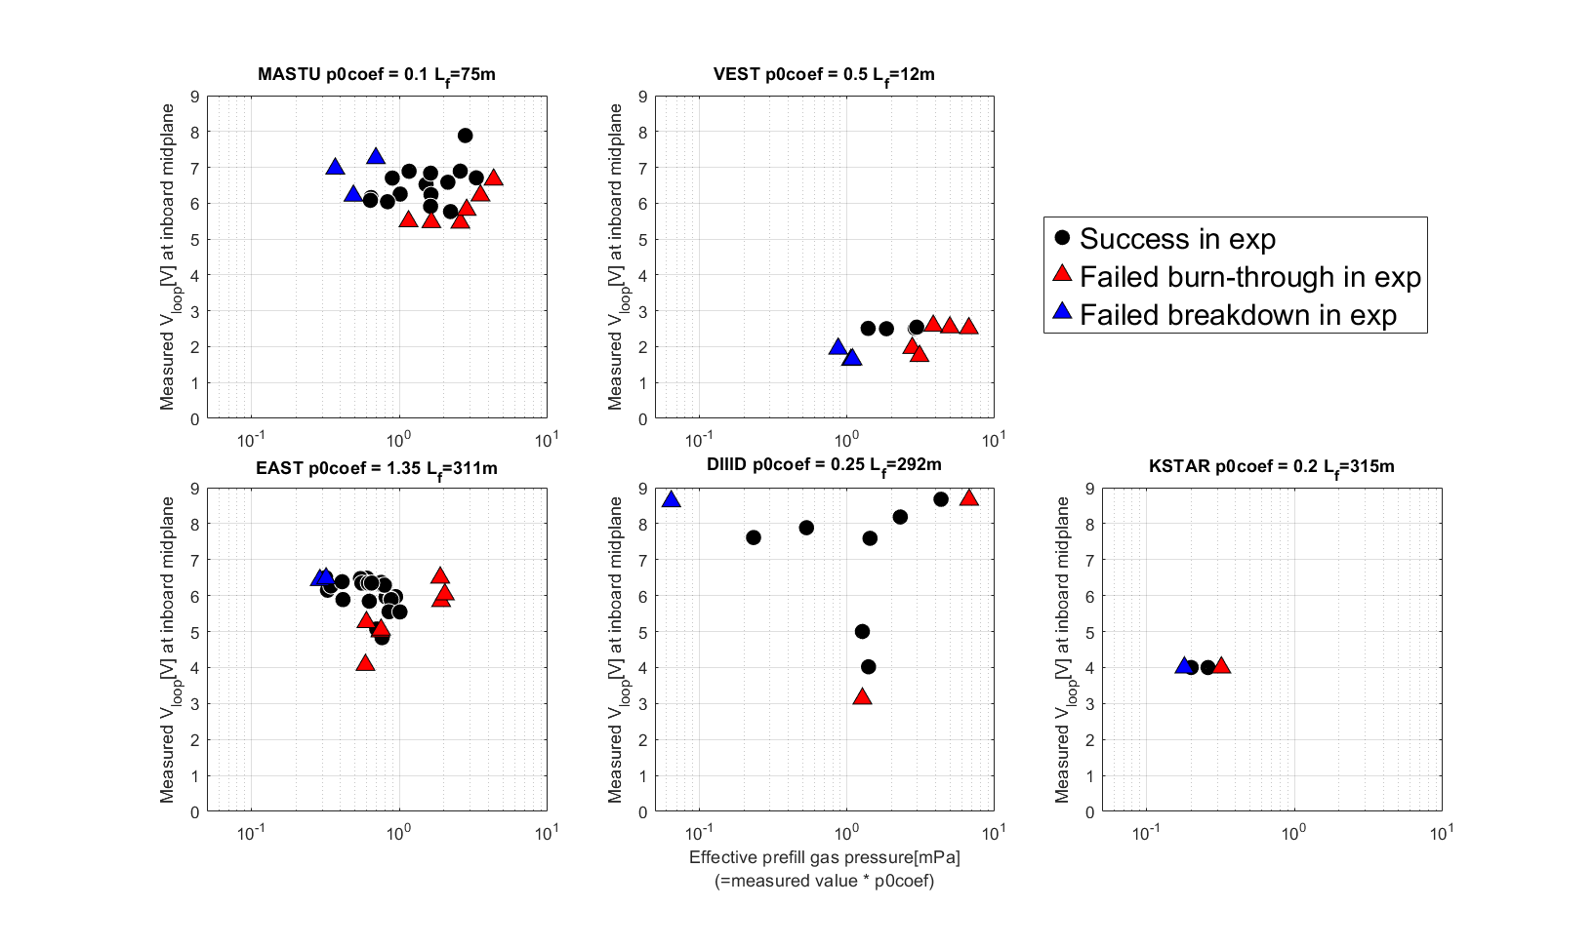
Operation space in experiments
Hong-Sik Yun et al 2023 29th IAEA Fusion Energy Conference p [TH-C/1906]
The hypothesis is valid for all devices.
Failed burn-through at high p₀
Failed burn-through at low V_{loop}
Failed breakdown at low p₀
Hyun-Taen Kim et al Nucl. Fusion 64 (2024) 126010
Runze Chen et al, Nucl. Fusion 65 (2025) 076043
James Yang et al, Nucl. Fusion, submitted
Jeongwon Lee, et al 2025 4th iFPC

Slide 31
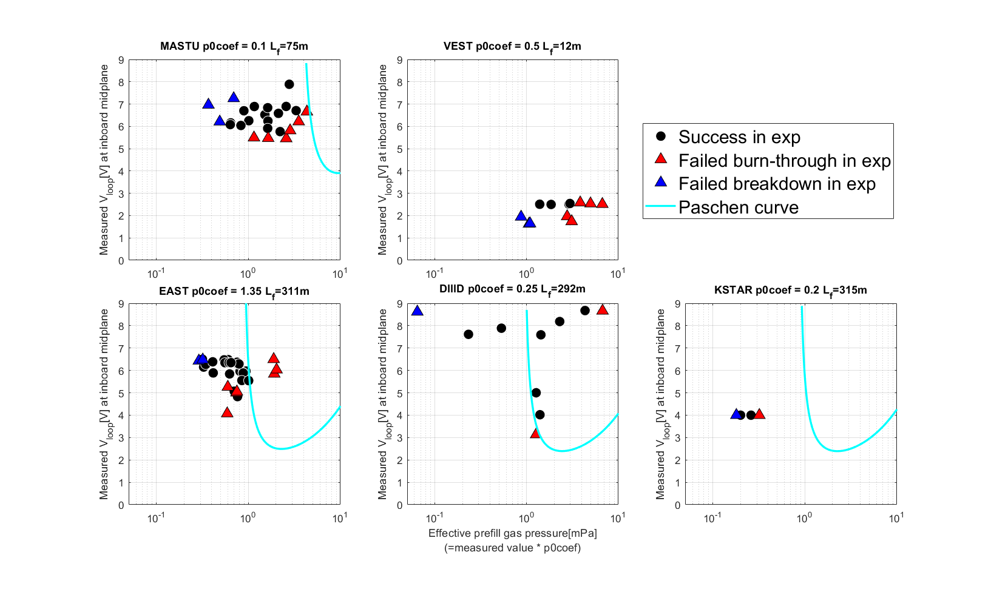
Operation space in experiments
Hong-Sik Yun et al 2023 29th IAEA Fusion Energy Conference p [TH-C/1906]
The hypothesis is valid for all devices.
Failed burn-through at high p₀
Failed burn-through at low V_{loop}
Failed breakdown at low p₀
The conventional Townsend assessment with L_{f} (i.e. αL_{f} > 1) over-predicts the lower limit of p₀ for plasma breakdown.
Hyun-Taen Kim et al Nucl. Fusion 64 (2024) 126010
Runze Chen et al, Nucl. Fusion 65 (2025) 076043
James Yang et al, Nucl. Fusion, submitted
Jeongwon Lee, et al 2025 4th iFPC

Slide 32
contents
Motivation
Experiment database
DYON code and simulation setup
Multi-machine validation results
Prediction to ITER
Summary

Slide 33
Effective prefill gas pressure
Prefill gas pressure p₀ is an essential input for predictive plasma initiation modelling.
Sufficiently high p₀ is required for Townsend breakdown.
Sufficiently low V_{v}*p₀ is required for plasma burn-through.

Slide 34
Effective prefill gas pressure
Prefill gas pressure p₀ is an essential input for predictive plasma initiation modelling.
Sufficiently high p₀ is required for Townsend breakdown.
Sufficiently low V_{v}*p₀ is required for plasma burn-through.
However, raw data requires calibration.
Fast ion gauge calibration is often inaccurate.

Slide 35
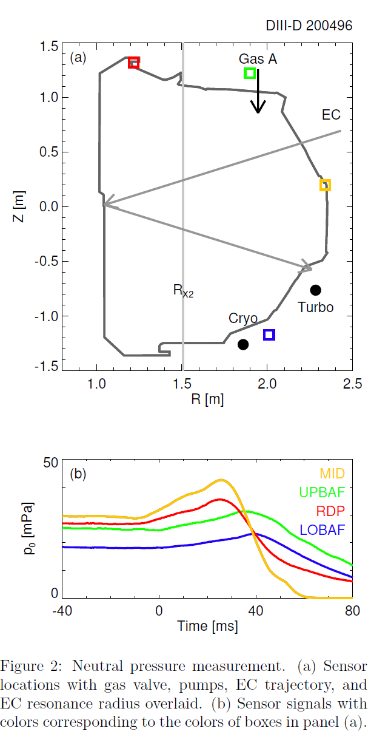
Effective prefill gas pressure
Prefill gas pressure p₀ is an essential input for predictive plasma initiation modelling.
Sufficiently high p₀ is required for Townsend breakdown.
Sufficiently low V_{v}*p₀ is required for plasma burn-through.
However, raw data requires calibration.
Fast ion gauge calibration is often inaccurate.
Measured values vary at different locations of the fast ion gauges.
James Yang et al, submitted to Nucl. Fusion (2025)

Slide 36
Effective prefill gas pressure
Prefill gas pressure p₀ is an essential input for predictive plasma initiation modelling.
Sufficiently high p₀ is required for Townsend breakdown.
Sufficiently low V_{v}*p₀ is required for plasma burn-through.
However, raw data requires calibration.
Fast ion gauge calibration is often inaccurate.
Measured values vary at different locations of the fast ion gauges.
Effective prefill gas pressure = p₀ coefficient x fast ion gauge data.
James Yang et al, submitted to Nucl. Fusion (2025)

Slide 37
Effective prefill gas pressure
Prefill gas pressure p₀ is an essential input for predictive plasma initiation modelling.
Sufficiently high p₀ is required for Townsend breakdown.
Sufficiently low V_{v}*p₀ is required for plasma burn-through.
However, raw data requires calibration.
Fast ion gauge calibration is often inaccurate.
Measured values vary at different locations of the fast ion gauges.
Effective prefill gas pressure = p₀ coefficient x fast ion gauge data.
The strategy to validate the operating space prediction capability in DYON:
Determine the p₀ coefficient that reproduces a representative discharge in each device
Use the same p₀ coefficient for all other discharges
James Yang et al, submitted to Nucl. Fusion (2025)

Slide 38
Effective prefill gas pressure
Prefill gas pressure p₀ is an essential input for predictive plasma initiation modelling.
Sufficiently high p₀ is required for Townsend breakdown.
Sufficiently low V_{v}*p₀ is required for plasma burn-through.
However, raw data requires calibration.
Fast ion gauge calibration is often inaccurate.
Measured values vary at different locations of the fast ion gauges.
Effective prefill gas pressure = p₀ coefficient x fast ion gauge data.
The strategy to validate the operating space prediction capability in DYON:
Determine the p₀ coefficient that reproduces a representative discharge in each device
Use the same p₀ coefficient for all other discharges
Note that p₀ is easily adjustable in experiments. When predicting plasma initiation in future devices, it is important to ensure that there is a wide enough p0 range for successful initiation.
James Yang et al, submitted to Nucl. Fusion (2025)

Slide 39
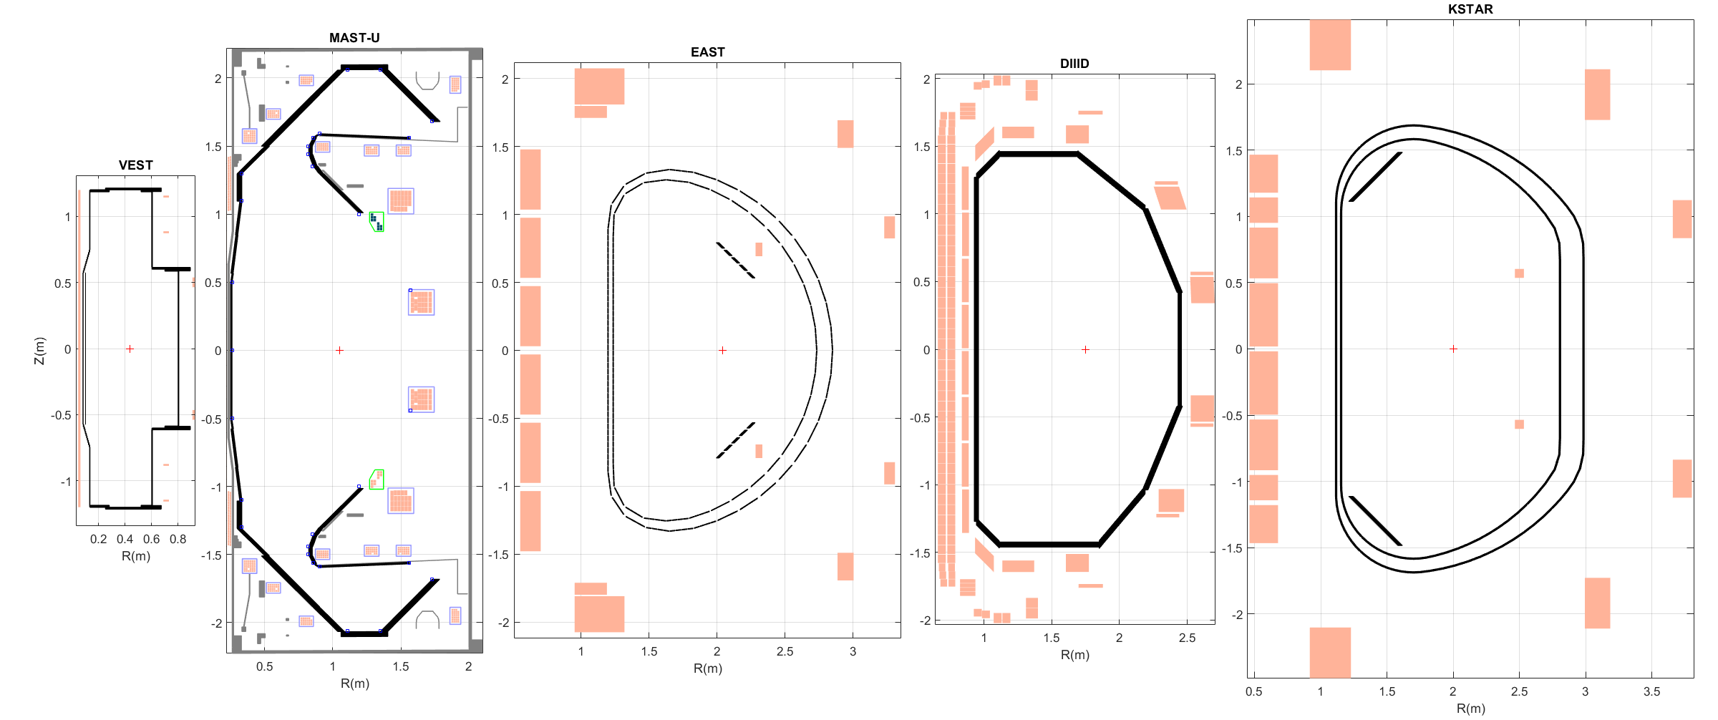
Machine description
The machine description data of each device was constructed using the engineering design data.
Mutual inductance matrices of coils (gray), passive structures (black and cyon), and the vacuum space
Resistivity matrices of passive structures (black and cyon),
Hyun-Tae Kim | 30th IAEA Fusion Energy Conference | 13–18 October 2025, Chengdu, China

Slide 40
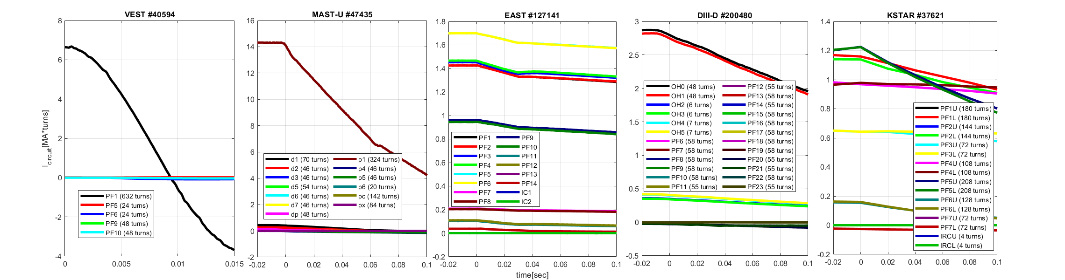
Synthetic flux loop data calculation in DYON
Calculated the measured V_{loop} at the inboard mid-plane using the coil current time traces.
Hyun-Tae Kim | 30th IAEA Fusion Energy Conference | 13–18 October 2025, Chengdu, China

Slide 41
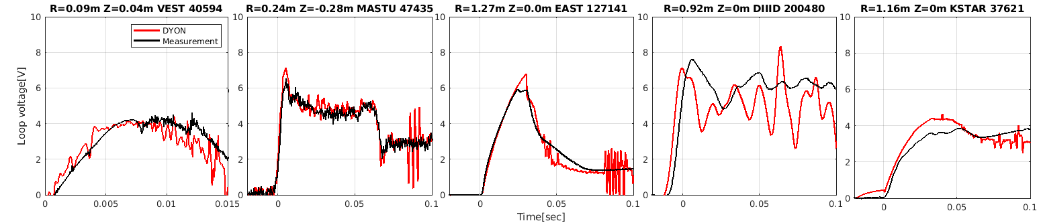
Synthetic flux loop data calculation in DYON
Calculated the measured V_{loop} at the inboard mid-plane using the coil current time traces.
This good reproduction confirms the validity of the machine description data.
Hyun-Tae Kim | 30th IAEA Fusion Energy Conference | 13–18 October 2025, Chengdu, China

Slide 42
Synthetic flux loop data calculation in DYON
Calculated the measured V_{loop} at the inboard mid-plane using the coil current time traces.
This good reproduction confirms the validity of the machine description data.
Ready for full electromagnetic plasma initiation modelling → DYON modelling
Hyun-Tae Kim | 30th IAEA Fusion Energy Conference | 13–18 October 2025, Chengdu, China

Slide 43
DYON: full electromagnetic plasma initiation simulator
Townsend breakdown assessment of each open field lines, and calculates V_{p}:
Open field lines with E║ > E_{Townsend}
Volume enclosed with closed field lines
Hyun-Tae Kim | 30th IAEA Fusion Energy Conference | 13–18 October 2025, Chengdu, China

Slide 44
DYON: full electromagnetic plasma initiation simulator
Townsend breakdown assessment of each open field lines, and calculates V_{p}:
Open field lines with E║ > E_{Townsend}
Volume enclosed with closed field lines
Plasma burn-through and early Ip ramp-up simulated by solving the ODE system of
full circuit equations of plasma, coils, and eddy currents +
global energy and particle balances of main fuel gas, ions, and impurities.
Hyun-Tae Kim | 30th IAEA Fusion Energy Conference | 13–18 October 2025, Chengdu, China

Slide 45
DYON: full electromagnetic plasma initiation simulator
Townsend breakdown assessment of each open field lines, and calculates V_{p}:
Open field lines with E║ > E_{Townsend}
Volume enclosed with closed field lines
Plasma burn-through and early Ip ramp-up simulated by solving the ODE system of
full circuit equations of plasma, coils, and eddy currents +
global energy and particle balances of main fuel gas, ions, and impurities.
DYON requires only :
Machine description
control room input data i.e. I_{coil} and p₀
Hyun-Tae Kim | 30th IAEA Fusion Energy Conference | 13–18 October 2025, Chengdu, China

Slide 46
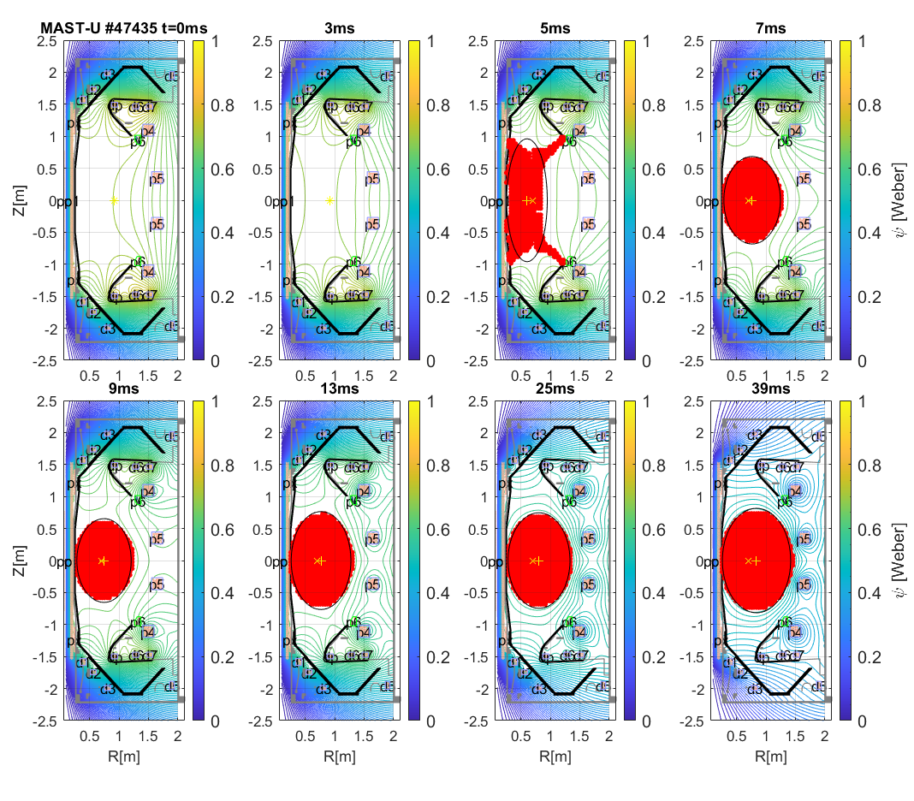
DYON: full electromagnetic plasma initiation simulator
Townsend breakdown assessment of each open field lines, and calculates V_{p}:
Open field lines with E║ > E_{Townsend}
Volume enclosed with closed field lines
Plasma burn-through and early Ip ramp-up simulated by solving the ODE system of
full circuit equations of plasma, coils, and eddy currents +
global energy and particle balances of main fuel gas, ions, and impurities.
DYON requires only :
Machine description
control room input data i.e. I_{coil} and p₀
DYON predicts:
Successful plasma initiation
Hyun-Tae Kim | 30th IAEA Fusion Energy Conference | 13–18 October 2025, Chengdu, China
Hyun-Tae Kim et al 2022 Nucl. Fusion 62 (2022) 126012
Hyun-Taen Kim et al 2024 Nucl. Fusion 64 (2024) 126010

Slide 47
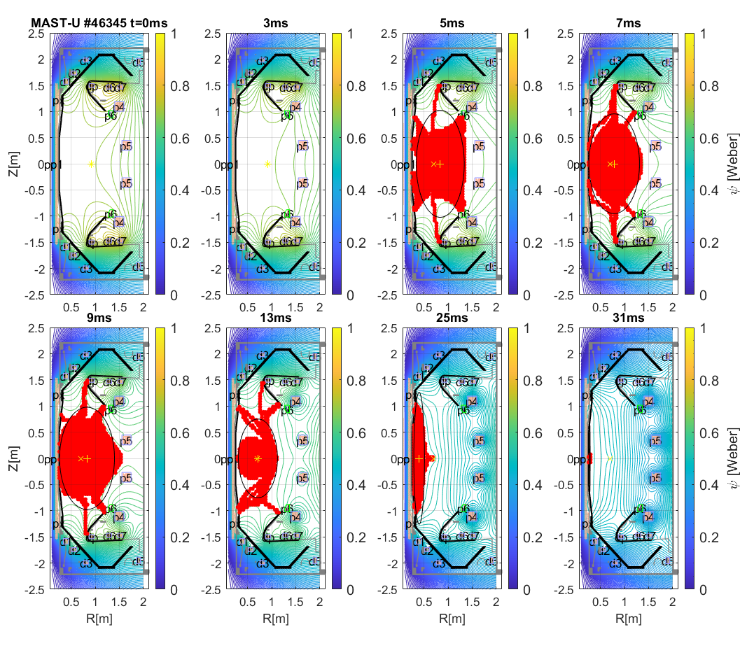
DYON: full electromagnetic plasma initiation simulator
Townsend breakdown assessment of each open field lines, and calculates V_{p}:
Open field lines with E║ > E_{Townsend}
Volume enclosed with closed field lines
Plasma burn-through and early Ip ramp-up simulated by solving the ODE system of
full circuit equations of plasma, coils, and eddy currents +
global energy and particle balances of main fuel gas, ions, and impurities.
DYON requires only :
Machine description
control room input data i.e. I_{coil} and p₀
DYON predicts:
Successful plasma initiation
Failed plasma burn-through
Hyun-Tae Kim | 30th IAEA Fusion Energy Conference | 13–18 October 2025, Chengdu, China
Hyun-Tae Kim et al 2022 Nucl. Fusion 62 (2022) 126012
Hyun-Taen Kim et al 2024 Nucl. Fusion 64 (2024) 126010

Slide 48
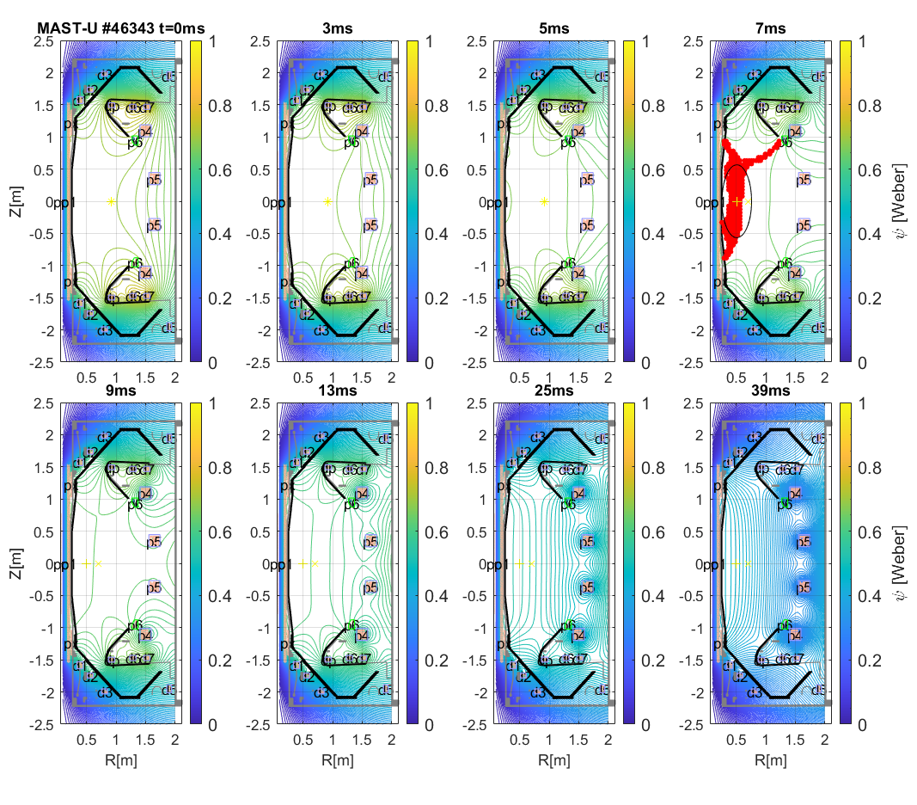
DYON: full electromagnetic plasma initiation simulator
Townsend breakdown assessment of each open field lines, and calculates V_{p}:
Open field lines with E║ > E_{Townsend}
Volume enclosed with closed field lines
Plasma burn-through and early Ip ramp-up simulated by solving the ODE system of
full circuit equations of plasma, coils, and eddy currents +
global energy and particle balances of main fuel gas, ions, and impurities.
DYON requires only :
Machine description
control room input data i.e. I_{coil} and p₀
DYON predicts:
Successful plasma initiation
Failed plasma burn-through
Failed Townsend breakdown
Hyun-Tae Kim | 30th IAEA Fusion Energy Conference | 13–18 October 2025, Chengdu, China
Hyun-Tae Kim et al 2022 Nucl. Fusion 62 (2022) 126012
Hyun-Taen Kim et al 2024 Nucl. Fusion 64 (2024) 126010

Slide 49
Simulation setup
Device | Sputtering yield | Ferromagnetic modelling | p₀ coeffcient
MASTU | 0.1% initial O + Carbon sputtering by D ions = 0.03 | N/A | 0.1
EAST | 0.1% initial O | N/A | 1.35
DIIID | 0.1% initial O + Carbon sputtering by D ions = 0.03 | N/A | 0.25
KSTAR | 0.1% initial O + Carbon sputtering by D ions = 0.03 | Done | 0.2
VEST | 0.1% initial O | N/A | 0.5

Slide 50
Simulation setup
Device | Sputtering yield | Ferromagnetic modelling | p₀ coeffcient
MASTU | 0.1% initial O + Carbon sputtering by D ions = 0.03 | N/A | 0.1
EAST | 0.1% initial O | N/A | 1.35
DIIID | 0.1% initial O + Carbon sputtering by D ions = 0.03 | N/A | 0.25
KSTAR | 0.1% initial O + Carbon sputtering by D ions = 0.03 | Done | 0.2
VEST | 0.1% initial O | N/A | 0.5
Apart from the table above, the simulation setup used in all DYON modelling is identical, i.e. no tuning in individual discharges.
Only using the control room input data i.e. coil currents waveform and effective prefill gas pressure,
the plasma initiation in each discharge were predicted.

Slide 51
contents
Motivation
Experiment database
DYON code and simulation setup
Multi-machine validation results
Prediction to ITER
Summary

Slide 52
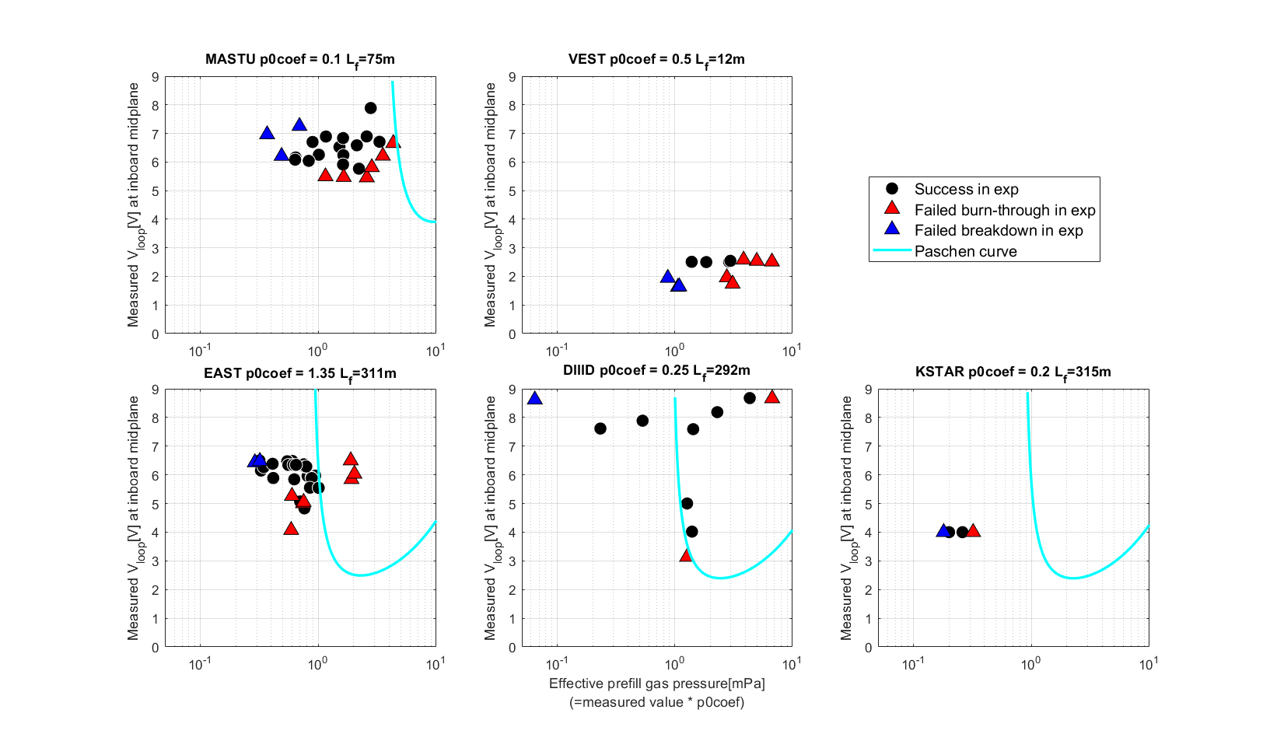
Operation space experiments

Slide 53
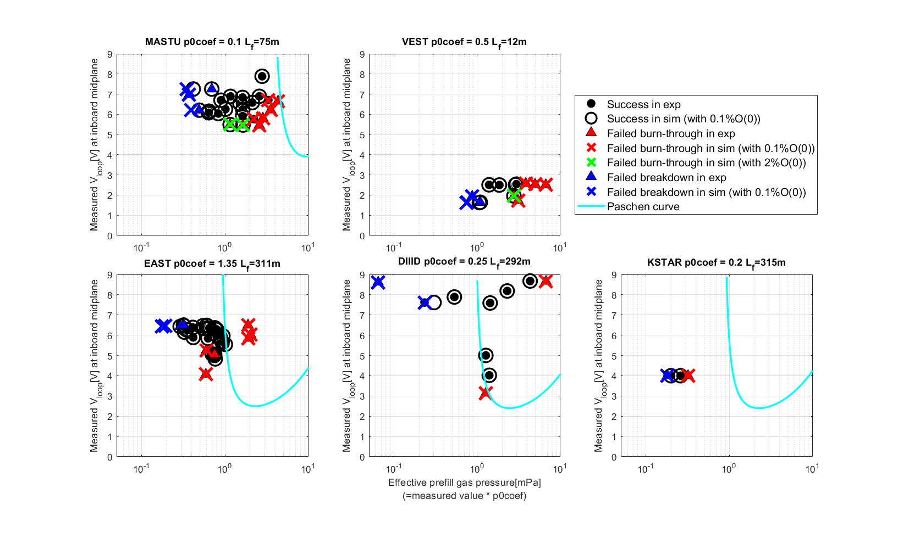
Operation space prediction
The inductive operation spaces were reproduced in the full electromagnetic DYON modelling in all devices.
Strong confirmation of the validity of predictive modelling.

Slide 54
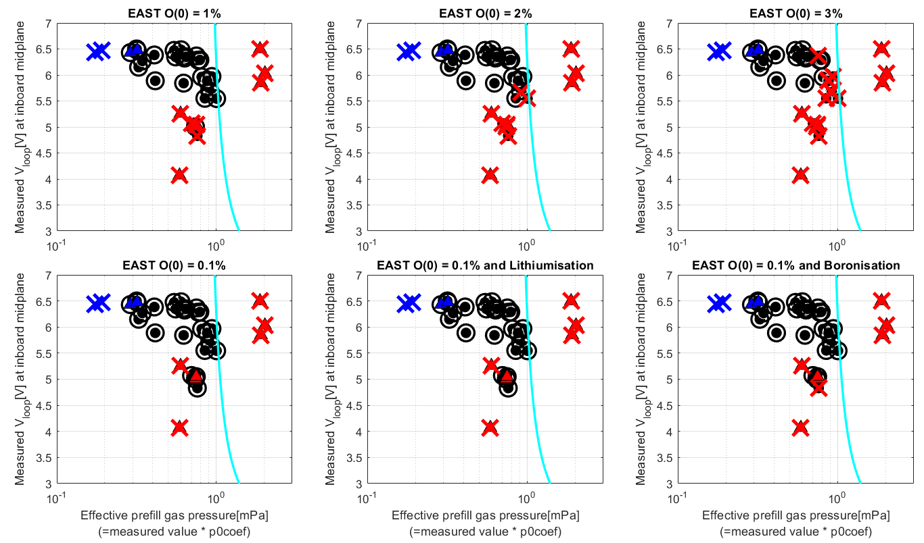
Impact of initial impurities and wall treatment in metal wall
The operation space prediction does not change upto 1% of initial impurity (e.g. Oxygen) in the prefill gas.

Slide 55
Impact of initial impurities and wall treatment in metal wall
The operation space prediction does not change upto 1% of initial impurity (e.g. Oxygen) in the prefill gas.

Slide 56
Impact of initial impurities and wall treatment in metal wall
The operation space prediction does not change upto 1% of initial impurity (e.g. Oxygen) in the prefill gas.
If higher than 1%, the operation space prediction shrinks from the boundary.

Slide 57
Impact of initial impurities and wall treatment in metal wall
The operation space prediction does not change upto 1% of initial impurity (e.g. Oxygen) in the prefill gas.
If higher than 1%, the operation space prediction shrinks from the boundary.
Physical sputtering model of Lithium and Boron implemented in DYON. Both do not change the operation space.
→0.1% initial oxygen + boron physical sputtering for ITER prediction.

Slide 58
contents
Motivation
Experiment database
DYON code and simulation setup
Multi-machine validation results
Prediction to ITER
Summary

Slide 59
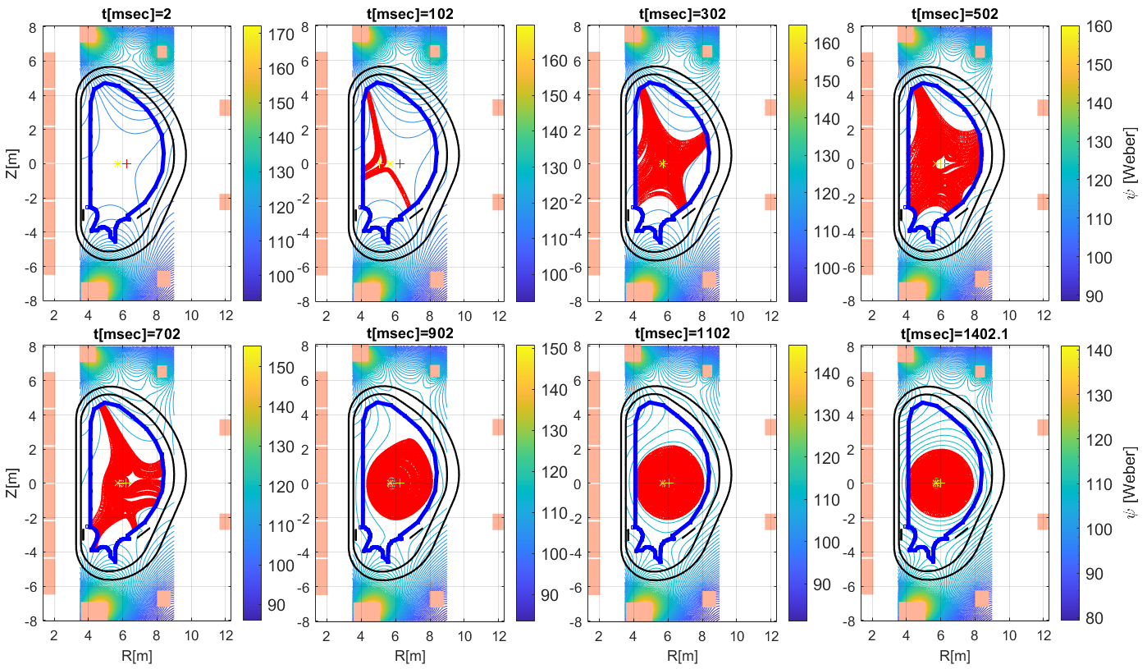
Prediction to the inductive plasma initiation in ITER
Machine description and coil current time traces are from IMAS (#105052).
DYON predicts with 0.1% initial oxygen + physical sputtering of Boron
Inductive plasma initiation is successful at 1mPa.

Slide 60
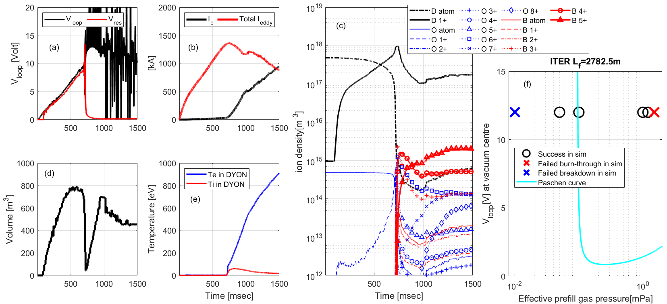
Prediction to the inductive plasma initiation in ITER
Machine description and coil current time traces are from IMAS (#105052).
DYON predicts with 0.1% initial oxygen + physical sputtering of Boron
Inductive plasma initiation is successful at 1mPa.

Slide 61
Prediction to the inductive plasma initiation in ITER
Machine description and coil current time traces are from IMAS (#105052).
DYON predicts with 0.1% initial oxygen + physical sputtering of Boron
Inductive plasma initiation is successful at 1mPa.
The upper limit of p₀ for plasma burn-through is 1.5mPa.
The lower limit of p₀ for Townsend breakdown is lower than 0.1mPa, because of the long connection length.

Slide 62
Summary
Predictive modelling of operation space for inductive plasma initiation has been validated with multi-machine experiment data. This suggests that
Full electromagnetic DYON captures the essential physics of inductive plasma initiation, and
DYON is a useful tool for assessing the feasibility of inductive plasma initiation with the given hardware design and operating scenario in future devices such as ITER and STEP.
ITER predictive modelling was performed
with the simulation setup validated in EAST (Boron physical sputtering + 0.1% initial oxygen), and
with the machine description and coil current time traces (#105052) in IMAS.
DYON predicts
the inductive plasma initiation in ITER is successful at 1mPa.
the lower limit of p₀ for Townsend breakdown is lower than 0.1mPa, because of the long connection length (10x longer than the present devices). The prediction of the lower limit of p₀ should be confirmed with a more complete breakdown simulation, such as Particle-In-Cell modelling (e.g. BREAK).
the upper limit of p₀ for plasma burn-through is 1.5mPa.
More DYON modelling will also be presented at this conference:
Validation of runaway electrons modelling by Youngsun Lee 17 Oct 2025, 14:40
ECH-assisted plasma initiation modelling in JT-60SA by Takuma Wakatsuki 17 Oct 2025, 10:40

Slide 63
Back-up slides

Slide 64
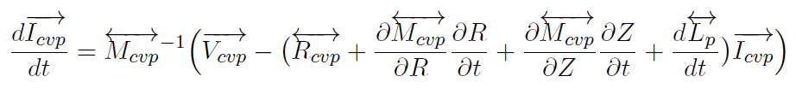
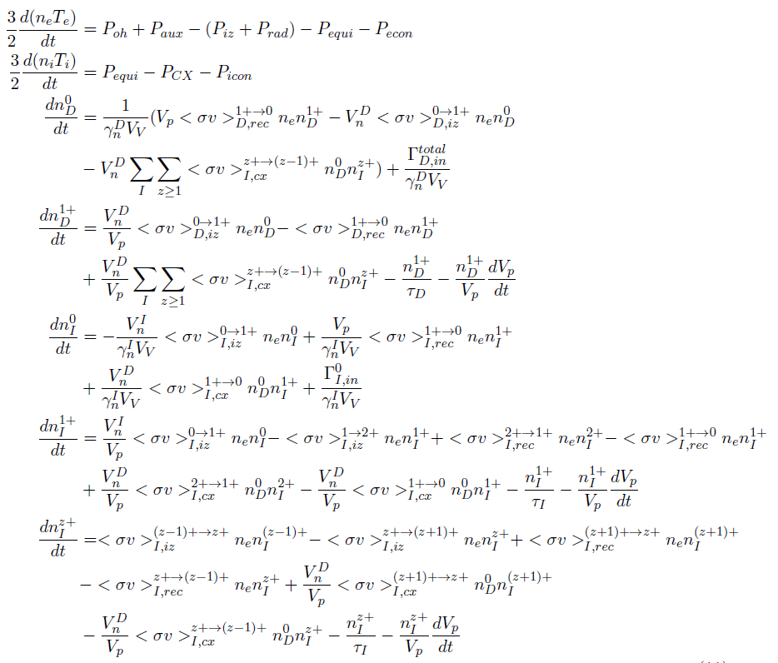
Full circuit equation integrated in the ordinary differential equation system of global 0D energy and particle balance
Full circuit equations
Energy balance of electrons and ions
Particle balance of D ions
Particle balance of impurities
Hyun-Tae Kim | 30th IAEA Fusion Energy Conference | 13–18 October 2025, Chengdu, China

Slide 65
Namelist
names.psi_calculation_burnthrough = 'Point';
names.psi_calculation_rampup = 'Point';
names.perpendicular_confinement_model = 'Bohm’;
names.field_line_following_streamslice = 1;
names.field_line_following_method = 'ode’;
names.interp_imp = 'c';
names.ferromagnetic_ON = 0 in MU, 0 in EAST, 0 in DIIID, 1 in KSTAR, 0 in VEST
names.R_calculation_Townsend = 0;
names.R_calculation_FBE = 0;
names.p0_townsend_option = 2;
names.N_div =50;
names.Lf_length_typical = 10000; (obsolete)
names.dLength = 0.01; (obsolete)
names.tau_p_coef=1.0;
names.tau_E_coef = 1.0
names.L_connection_coef=1.0
names.Townsend_Lf_coef=0.5
names.impurity.C =1 in MU; 0 in EAST, 1 in DIIID, 1 in KSTAR, 0 in VEST
names.impurity.O = 1;
names.W_coef1=1.0;
names.W_coef2=0.0;
names.t_Hrecycling = 0.1
names.cT = 1 in MU; 0 in EAST, 1 in DIIID, 2 in KSTAR, 1 in VEST
names.Sputtering_ObyO = 1.0 ;
names.Sputtering_CbyO = 1.0 in MU; 0 in EAST, 1.0 in DIIID, 1.0 in KSTAR, 0.0 in VEST
names.Sputtering_CbyH = 0.03 in MU; 0 in EAST, 0.03 in DIIID, 0.03 in KSTAR; 0 in VEST
names.fuelgas= 1;
names.Hmass= 2 in MU; 2 in EAST, 2 in DIIID, 2 in KSTAR, 1 in VEST
names.Lf_Option = 2;
names.Poh = 'dyon'
names.Rp = 'spitzer'
names.li_burnthrough ='inputdata'
names.li_rampup = 'inputdata';
names.Lp_burnthrough = 'dyon'
names.Lp_burnthrough_option = 2;
names.Lp_rampup = 'dyon';
names.Lp_rampup_option = 2;
names.Lp_Hirshman_optimize = '';
names.interp.dVpdt = 2;
names.dVpdt_heating = 1;
names.interp.dLpdt= 2;
names.interp.dRdt= 2;
names.interp.dZdt = 2;
names.interp.Vp =1;
names.t_start_EM = -0.02
names.t_townsend = 0.0 in MU, 0.03 in EAST,
0.0 in DIIID, 0.025 in KSTAR, 0 in VEST (=0.305)
names.t_start_plasma = names.t_townsend+0.0001
names.t_start_Ip = names.t_townsend+0.0002;
names.t_end= 0.1 in MU, 0.2 in EAST, 0.1 in DIIID, 0.1 in KSTAR, 0.01 in VEST (=0.315)
names.t_townsend_res0 = 1e-3;
names.t_townsend_res=1e-3;
names.t_step_max = names.t_townsend_res*0.01;

Slide 66
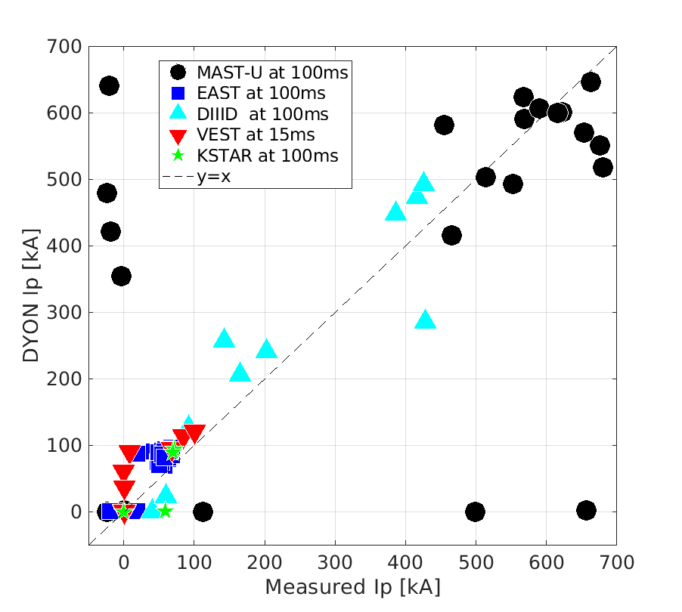
Ip at 100ms in MASTU, 100ms in EAST, 100ms in KSTAR, 15ms in VEST, and 50ms in DIIID

Slide 67
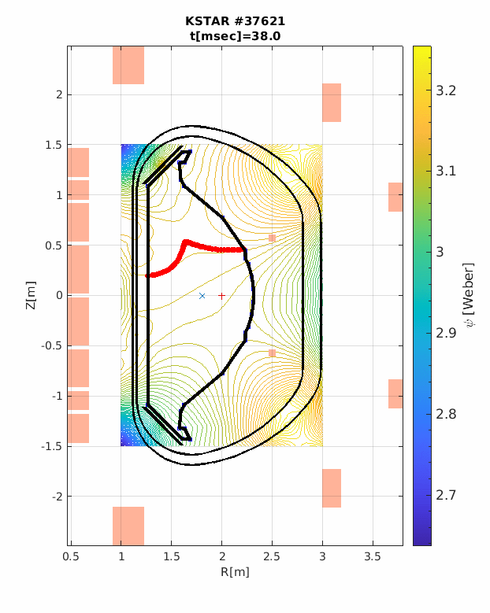
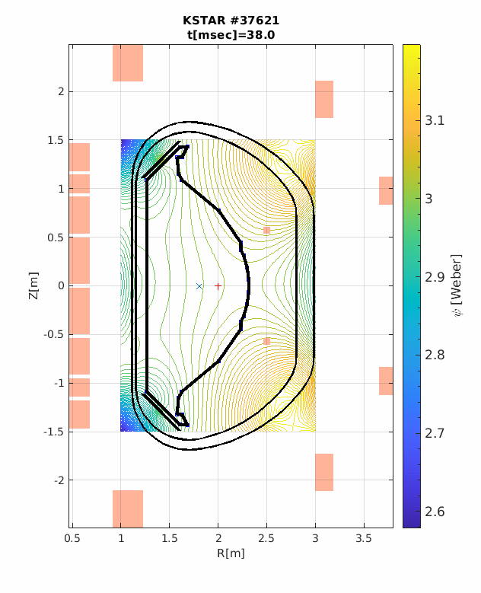
Ferromagnetic effects
Incoloy 908 used in the jacket of the PF1–5 coils and all the toroidal field (TF) Coils in KSTAR
Ferromagnetic effect of Incoloy 908 distorts the magnetic field, degrading the null configuration.
The 2D psi data from the ferromagnetic Incoloy 908 effects was calculated by Finite Element Method modelling of the nonlinear B–H curve of Incoloy 908, and used in DYON modelling of KSTAR discharges.
[J. Kim et al Nucl. Fusion 51 (2011) 083034]
The ferromagnetic psi data were necessary for DYON to reproduce a successful plasma initiation of KSTAR 37621.
However, ITER does not have Incoloy908 so the ferromagnetic effects were not modelled in the DYON prediction of ITER.
With modelling of ferromagnetic effects
Without modelling of ferromagnetic effects
Jeongwon Lee, et al 2025 4th iFPC

