Slide 1
Development of Low Inductive Electric Field Plasma Start-up in JT-60SA
EX/7-2689
1T. WAKATSUKI, 1H. URANO, 1M. YOSHIDA, 2N. TSUJII, 3Hyun-Tae KIM, 1T. NAKANO, 1M. FUKUMOTO, 1Y. OHTANI, 1R. SANO, 1S. INOUE, 1S. KOJIMA, 1T. YOKOYAMA, 4A. MATSUYAMA, 5T. SZEPESI, 5A. BUZAS, 5G. CSEH, 5G. KOCSIS, 5D. REFY and 1S. IDE
1National Institutes for Quantum Science and Technology, 2The University of Tokyo, 3UKAEA, 4Kyoto University, 5HUN-REN Centre for Energy Research
The 30th IAEA FEC
October 13-18, 2025
Tianfu International Convention Center (China)

Slide 2
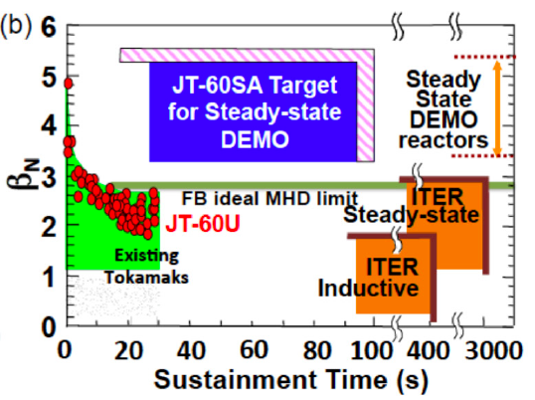
JT-60SA: the world’s largest test bed for ITER and DEMO
JT-60SA can access:
High I_{p} of 5.5 MA at B_{T} of 2.3 T
Large plasma volume (~ 130 m³)
ITER/DEMO relevant ν∗ and ρ∗
High β_{N} for long time (~ 3-4τ_{R})
JT-60SA is expected to bridge the gap between present day devices and ITER/DEMO.
by addressing key physics issues.
[J. Garcia, OV/2 2733]
[M. Yoshida, PPCF2025]
ITER/DEMO relevant plasma start-up was studied during the first operation of JT-60SA
EC Heating, P_{EC} 1.5 MW
Working gas, He / H
Notes:
First of all, I’d like to mention the characteristics and objectives of JT-60SA, JT-60SA can access, High Ip of 5.5 MA, Large plasma volume up to 130 meter cubic, ITER/DEMO relevant nu star and rho star, and high betaN for long time exceeding several current relaxation time.
So, JT-60SA is expected to bridge the gap between present day devices and ITER/DEMO, and meant to contribute to the early realization of fusion energy by addressing key physics issues for ITER and DEMO. Among them, ITER/DEMO relevant plasma start-up was studied in the first operation of JT-60SA.

Slide 3
Outline
Introduction
Experimental Results
Ohmic FNC start-up and impurity effects
Comparison of FNC and TPC during the breakdown phase
Position control in the burn-through phase and its susceptibility to device model errors
Effect of TPC configuration on X2-assisted breakdown
Plasma start-up with X2 mode using TPC
Conclusion
Notes:
This is the outline of my talk…

Slide 4
Outline
Introduction
Experimental Results
Ohmic FNC start-up and impurity effects
Comparison of FNC and TPC during the breakdown phase
Position control in the burn-through phase and its susceptibility to device model errors
Effect of TPC configuration on X2-assisted breakdown
Plasma start-up with X2 mode using TPC
Conclusion
Notes:
I’d like to start with introduction

Slide 5
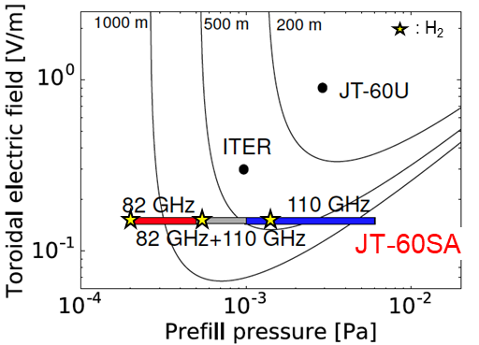
Challenges for plasma start-up in the first operation of large superconducting tokamaks
Low toroidal electric field (low E||)
Higher impurity content
Device-model errors
No tokamak discharge cleaning before the first plasma
0.15 V/m < 0.3 V/m (JT-60SA) (ITER)
ΔB_{pol} ~ 1 mT
Trapped Particle Configuration (TPC) enabled reliable plasma start-up
Objectives:
Clarify why TPC enabled reliable start-up under ITER-relevant conditions.
Provide guidance for ITER initiation.
[T. Wakatsuki, NF2024]
Notes:
There are three main challenges in the first operation of large superconducting tokamaks. The first challenge is the low toroidal electric field. In large superconducting tokamaks including ITER and DEMO, applicable electric field becomes smaller. JT-60SA achieved its first plasma with 0.15 V/m, which is half of the expected value in ITER. The second challenge is impurity.

Slide 6
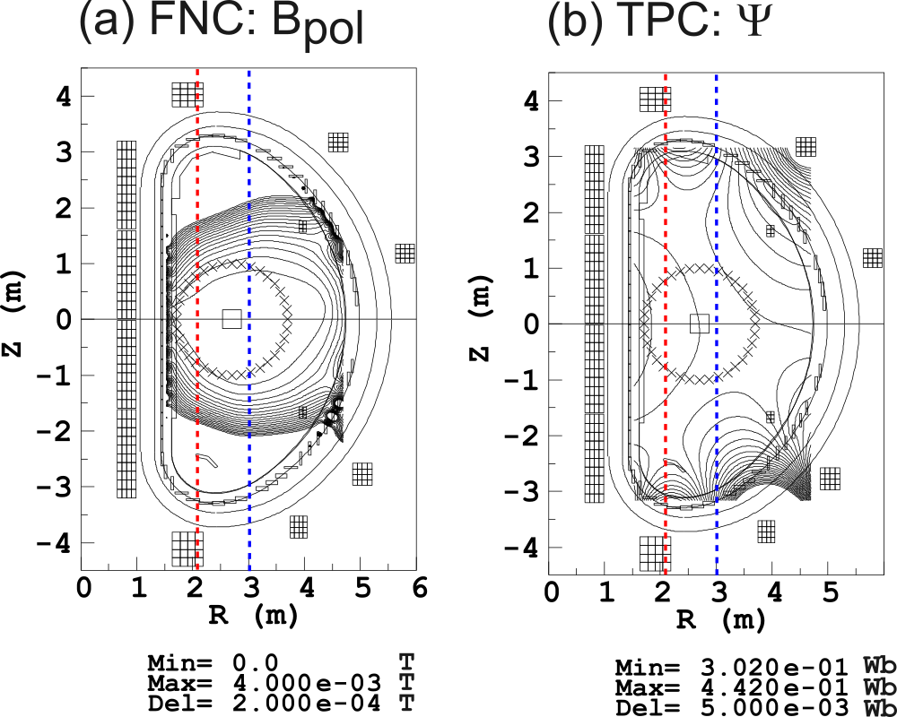


Two types of scenarios are compared
FNC
@ Breakdown (BD) time (~100 ms)
TPC
FNC (Field Null Configuration)
Has worked in many tokamaks.
B_{pol} ~ 0 mT @BD time
Aiming to confine inductively accelerated electrons with long connection length.
TPC (Trapped Particle Configuration)
Akin to non-inductive EC start-up.
B_{pol} ~ 2 mT @BD time
Aiming to confine EC accelerated electrons with mirror trap effect.
O1(82 GHz)
X2(110 GHz)
B_{pol}
Ψ
$$ψ$$
$$ψ$$
Notes:
We had prepared two scenarios for plasma start-up. The first one was Field null configuration, which we call FNC here. This FNC scenario has been worked as a routine start-up scenario in many tokamaks. The point of this scenario is to minimize the poloidal field at the break down time. The breakdown time is designed to be 100 ms in JT-60SA. The aim of this scenario is to maximize the confinement of inductively accelerated electrons.
The other scenario is trapped particle configuration, which we call TPC here. This scenario is similar to non-indictive EC start-up scenarios. In this scenario we make a curved field line structure with poloidal field of 2 mT. This scenario is designed to maximize the confinement of EC accelerated electrons.

Slide 7
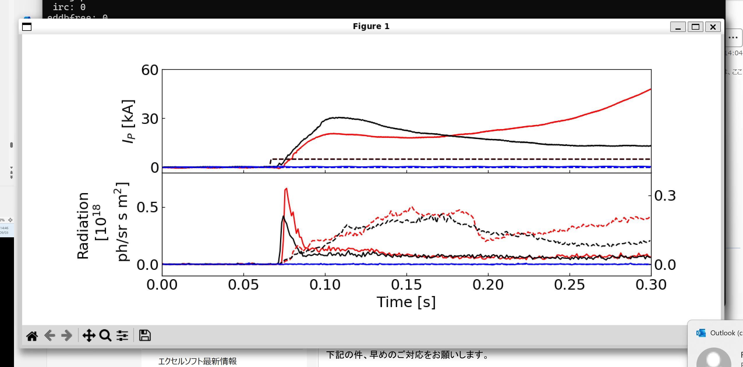
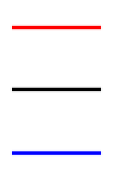
How the challenges affect each phase of plasma start-up
1) Breakdown
2)Burn-through
→ successful tokamak plasma formation
TPC
FNC (EC-assisted)
FNC (Ohmic)
EC
HeI (main)
CII (impurity)
Low E||
Impurity
device model error
1) Breakdown
Low E|| | Getting Townsend breakdown (BD) is difficult in FNC.
Impurity | -
Model error | The connection length becomes shorter in FNC.

Slide 8
How the challenges affect each phase of plasma start-up
1) Breakdown
2)Burn-through
→ successful tokamak plasma formation
TPC
FNC (EC-assisted)
FNC (Ohmic)
EC
HeI (main)
CII (impurity)
Low E||
Impurity
device model error
2) Burn-through
Low E|| | P_{OH} is not enough to achieve impurity burn-through.
Impurity | Impurity burn-through becomes further difficult.
Model error | Initial plasma position control might fail.

Slide 9
Outline
1) Breakdown
2)Burn-through
Introduction
Experimental Results
Ohmic FNC start-up and impurity effects
Comparison of FNC and TPC during the breakdown phase
Position control in the burn-through phase and its susceptibility to device model errors
Effect of TPC configuration on X2-assisted breakdown
Plasma start-up with X2 mode using TPC
Conclusion
Ohmic
FNC(Ohmic)
Low E||
Impurity
Device model error
O1+X2
X2

Slide 10
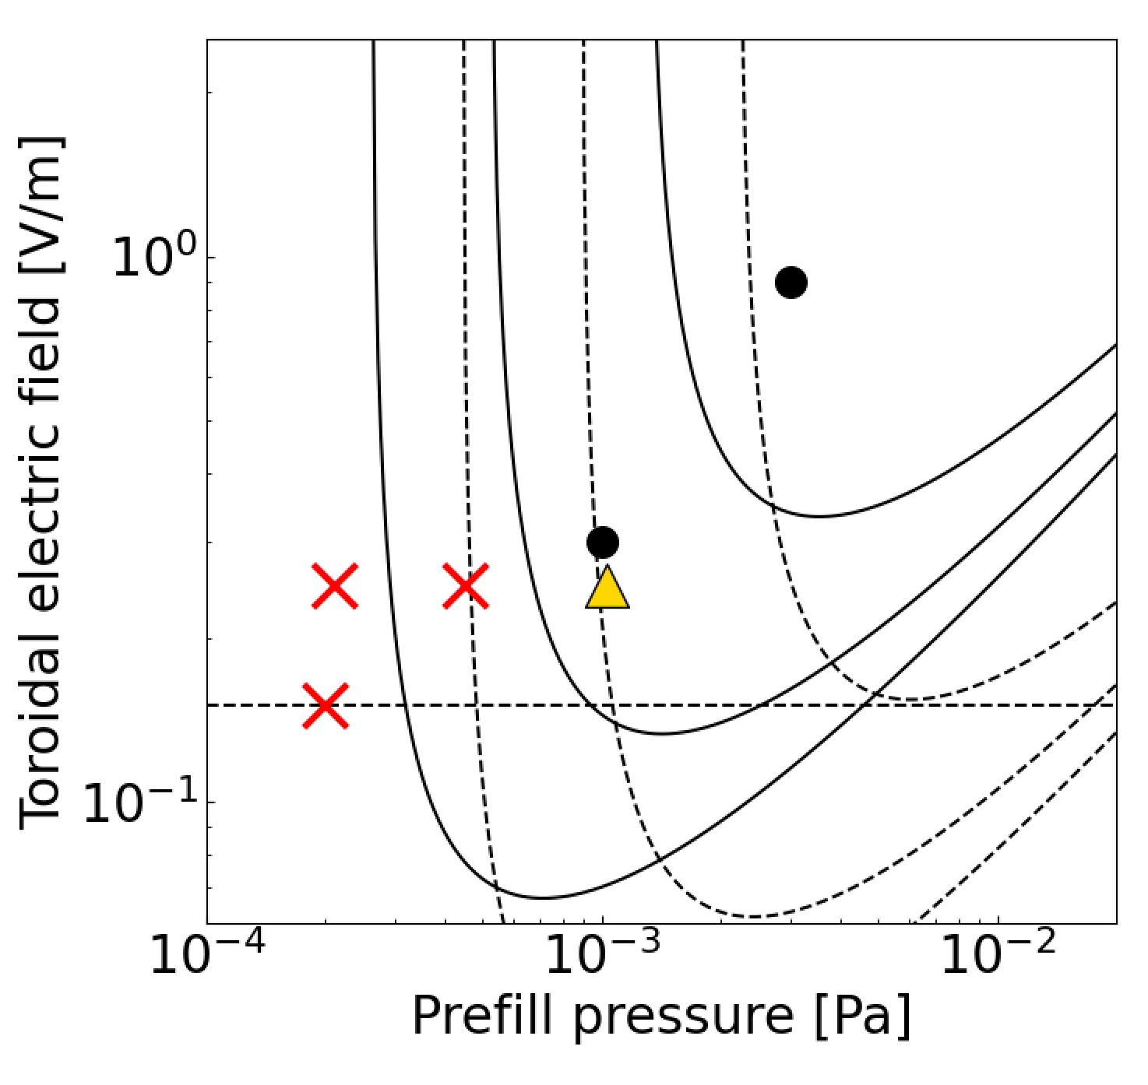
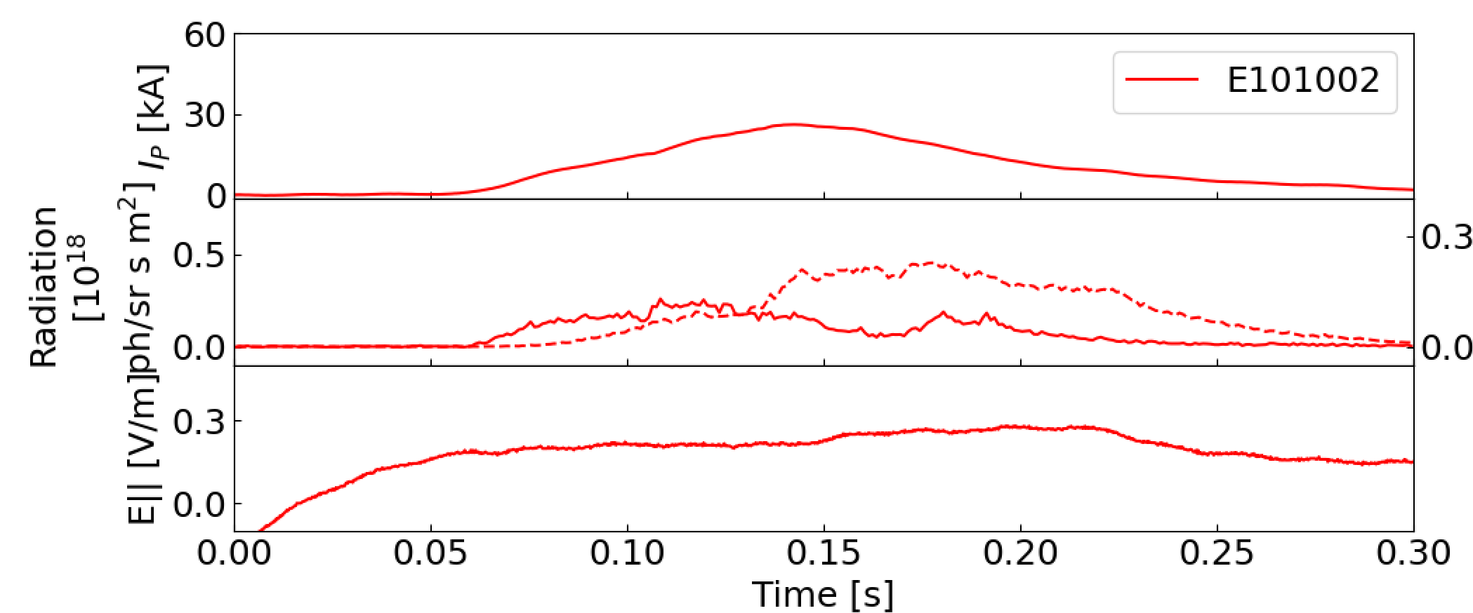
To assess the effect of impurities, ohmic FNC start-up was investigated
Ohmic FNC start-up was unsuccessful.
At E|| = 0.25 V/m and P_{prefill} = 1 mPa, BD was obtained, but burn-through failed.
Effect of impurity was investigated using DYON* simulation.
E_{min}(He) for L_{eff} =1000 m
500 m
200 m
JT-60U
E_{min}(H) for L_{eff} =200 m
Burn-through failed
ITER
500 m
1000 m
HeI (main)
CII (impurity)
0.15 V/m
Prefill : He
No BD
Failed burn-through
*Hyun-Tae Kim et al, NF2012,2022, PPCF2013

Slide 11
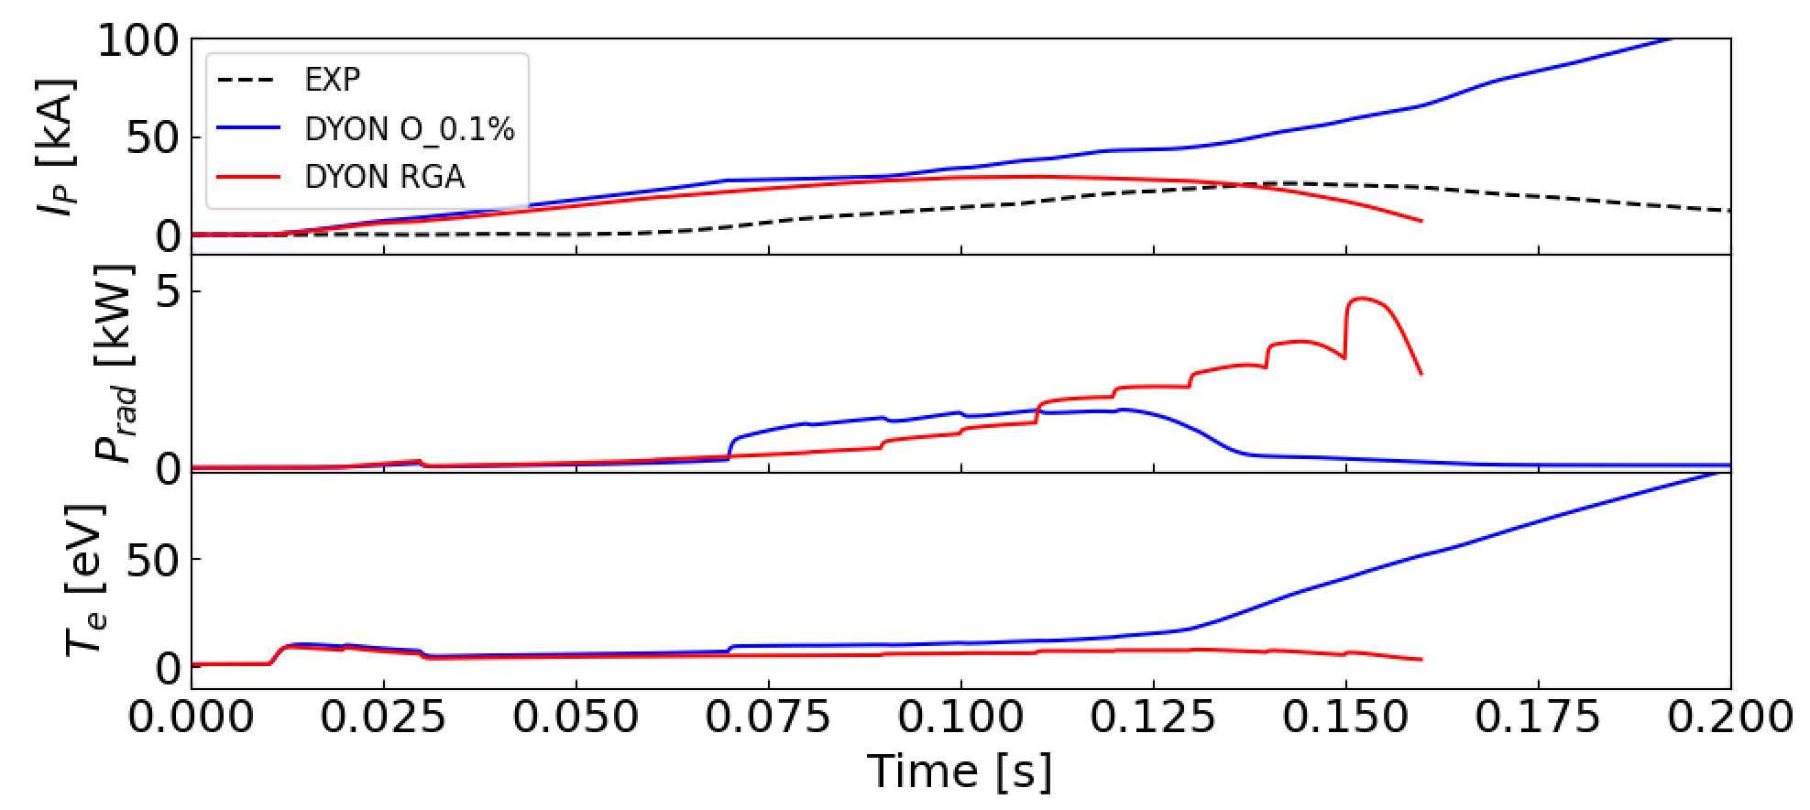
Ohmic FNC was expected to succeed if the initial oxygen level was sufficiently reduced
DYON code has been validated for ohmic FNC start-up in many devices.
JET, KSTAR, DIII-D, MAST-U, EAST, VEST [H.-T. Kim, next talk]
Initial oxygen of 0.1% in the prefill gas commonly used to reproduce experimental results.
The failed burn-through was reproduced with higher impurity atom contents introduced based on RGA data.
 | H | O | N
O_0.1% | 1.0% | 0.1% | 0.0% | Success
RGA | 6.2% | 0.8% | 2.8% | Fail
EC heating was indispensable to achieve reliable plasma start-up under higher impurity condition in the first operation of JT-60SA

Slide 12
Outline
1) Breakdown
2)Burn-through
Introduction
Experimental Results
Ohmic FNC start-up and impurity effects
Comparison of FNC and TPC during the breakdown phase
Position control in the burn-through phase and its susceptibility to device model errors
Effect of TPC configuration on X2-assisted breakdown
Plasma start-up with X2 mode using TPC
Conclusion
Ohmic
TPC vs FNC
O1+X2
X2

Slide 13
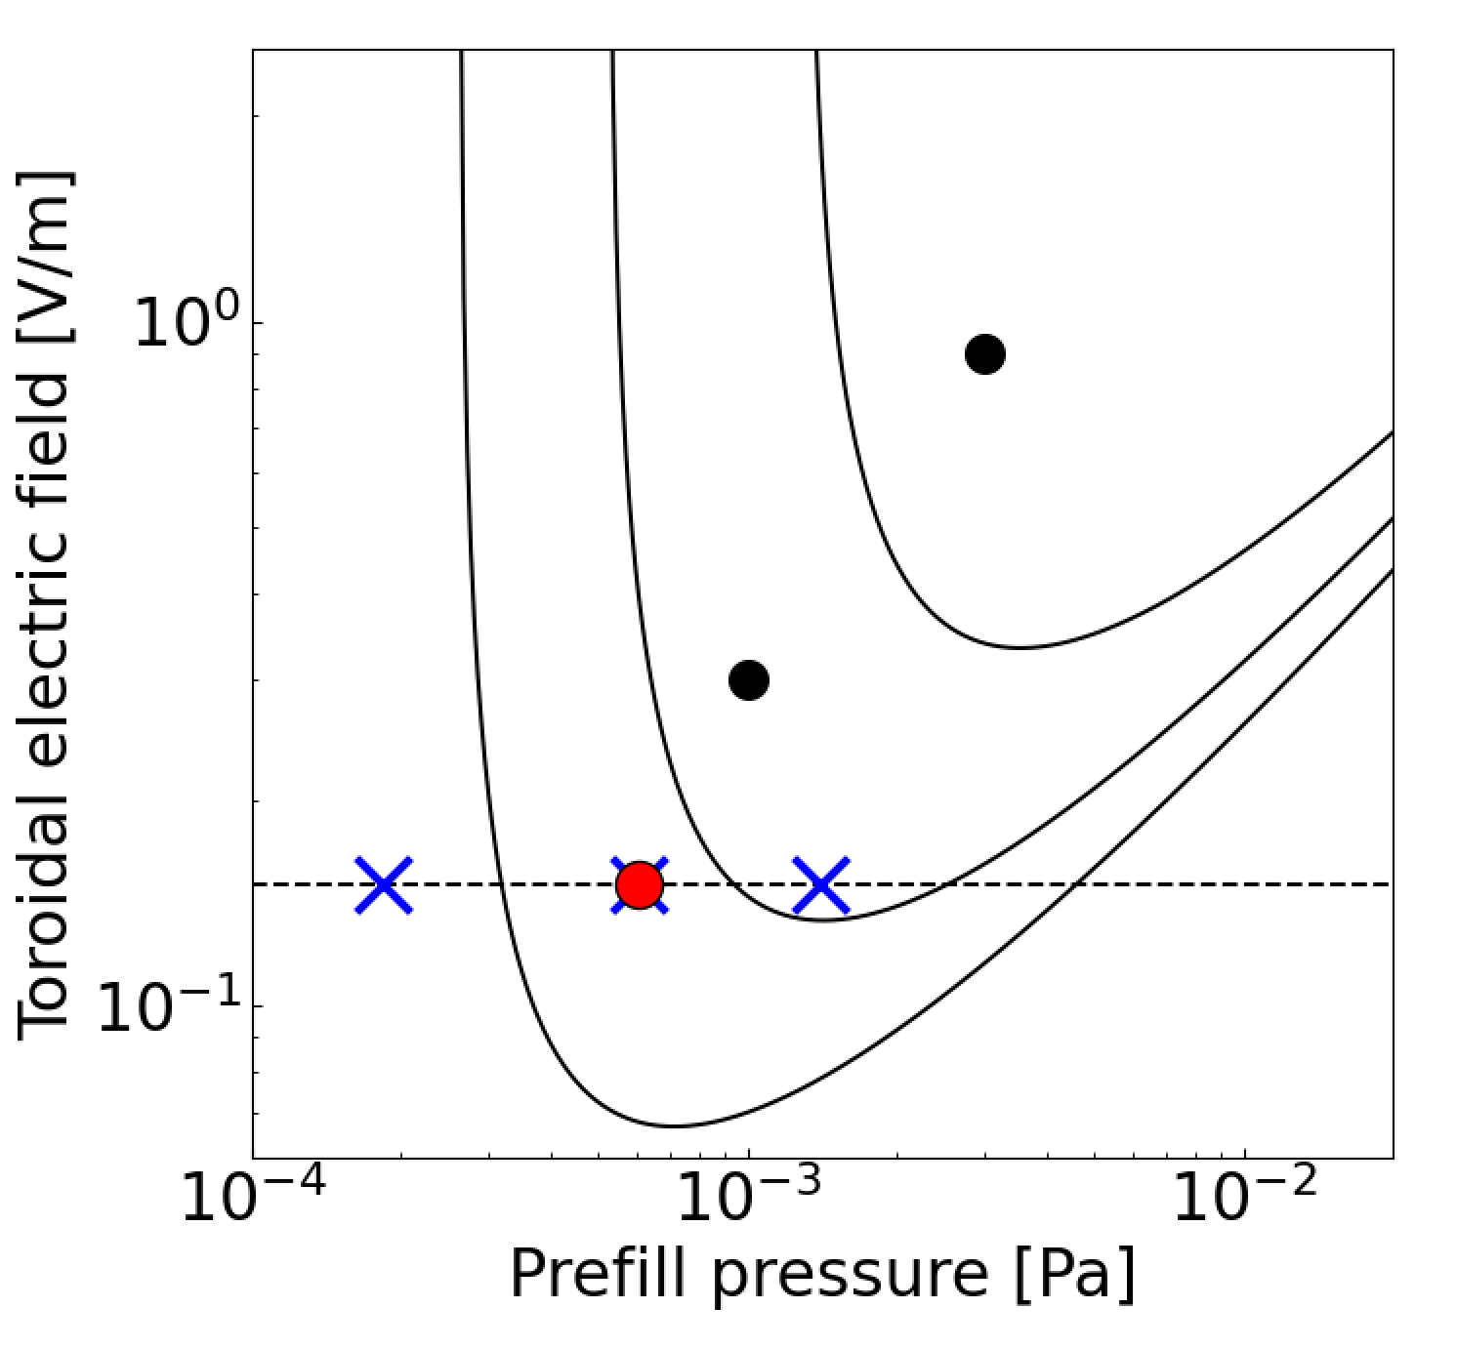
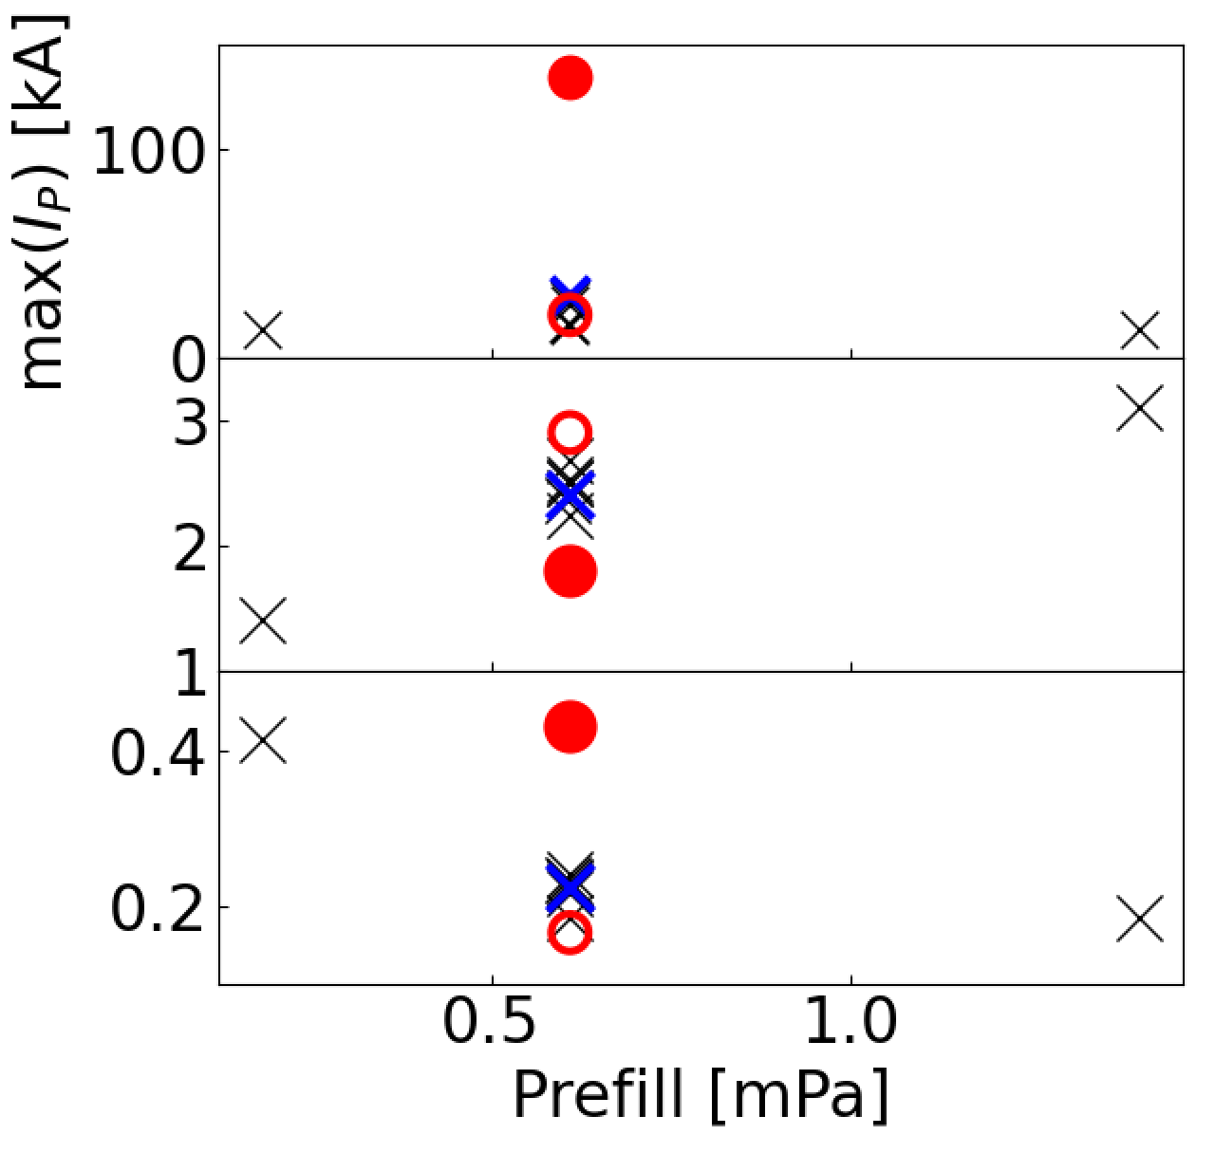
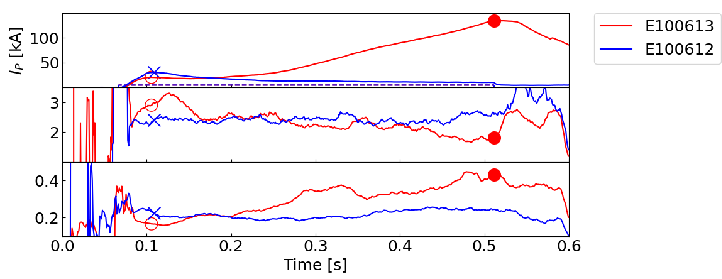








No significant difference in T_{e}/n_{e} was measured between TPC and FNC in BD phase
Before achieving the first plasma using TPC, FNC was also tried, but failed.
He I line-ratio pairs* sensitive to n_{e} and T_{e} were compared.
The difference of T_{e}/n_{e} in BD phase was not the cause of the failed start-up in FNC.
: FNC (601-611)
: FNC (100612)
: TPC (100613)
$$\tilde{φ}\left(ne\right)$$
BD phase
TPC
$$\frac{I667.8 nm}{I728.1 nm}$$
FNC
$$\frac{I667.8 nm}{I728.1 nm}$$
$$\frac{I728.1 nm}{I706.5 nm}$$
$$\tilde{φ}\left(ne\right)$$
$$\tilde{ψ}\left(Te\right)$$
$$\tilde{ψ}\left(Te\right)$$
$$\frac{I728.1 nm}{I706.5 nm}$$
Prefill gas scan
*T Nakano, et al, 2010 J. Phys. B: At. Mol. Opt. Phys. 43 144014

Slide 14
Outline
1) Breakdown
2)Burn-through
Introduction
Experimental Results
Ohmic FNC start-up and impurity effects
Comparison of FNC and TPC during the breakdown phase
Position control in the burn-through phase and its susceptibility to device model errors
Effect of TPC configuration on X2-assisted breakdown
Plasma start-up with X2 mode using TPC
Conclusion
Ohmic
TPC vs FNC
Low E||
Impurity
Device model error
O1+X2
X2

Slide 15
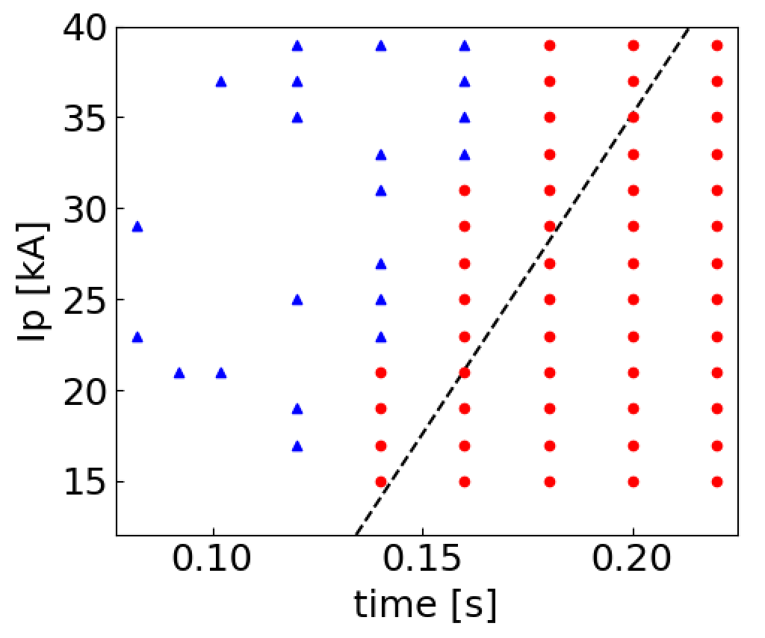
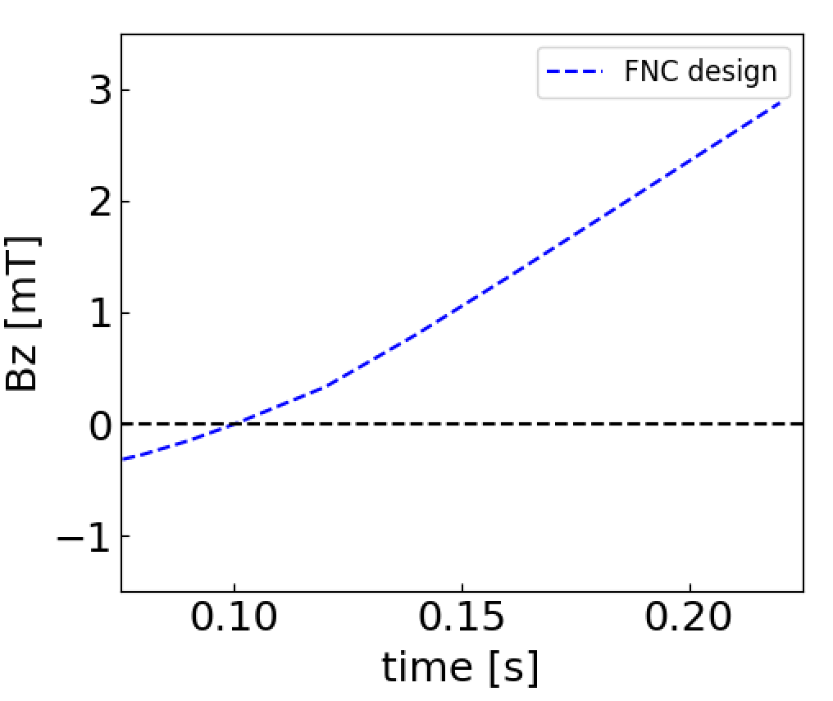
Position control during the burn-through phase: FNC vs TPC
Position control during the burn-through phase was investigated using TOSCA* code.
In FNC, |B_{z}| was designed to be zero at BD time (t_{BD} = 0.1 s) and then ramped up to maintain inner-limited plasma.
I_{P} (design)
Inner-limited
Outer-limited
*Shinya, K., J. Plasma Fusion Res. 76 (2000) 479-88.

Slide 16
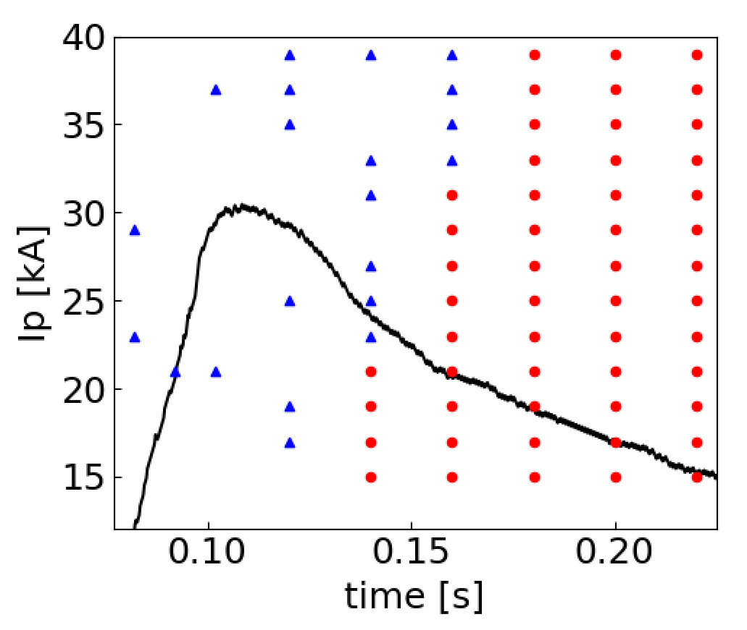
Position control during the burn-through phase: FNC vs TPC
Position control during the burn-through phase was investigated using TOSCA* code.
In FNC, |B_{z}| was designed to be zero at BD time (t_{BD} = 0.1 s) and then ramped up to maintain inner-limited plasma.
In experiment (E100612), BD occurred earlier than t_{BD}, and initial I_{P} ramp was faster than expected, leading to an outward shift.
I_{P} (E100612)
Inner-limited
Outer-limited
*Shinya, K., J. Plasma Fusion Res. 76 (2000) 479-88.

Slide 17
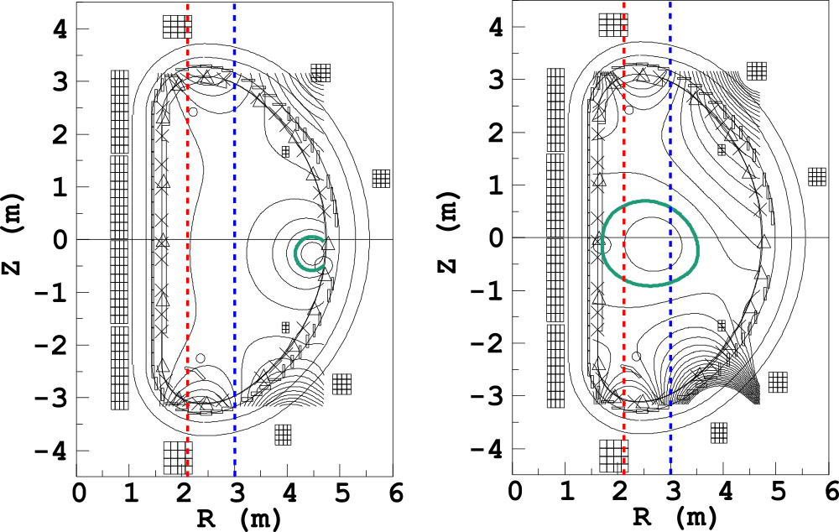
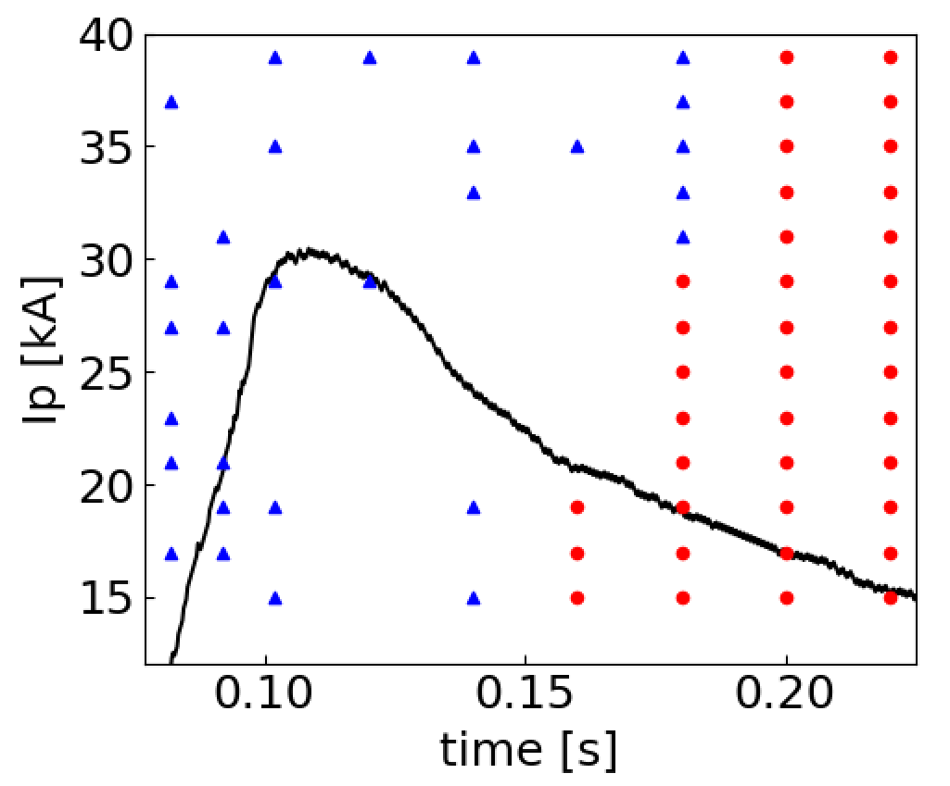
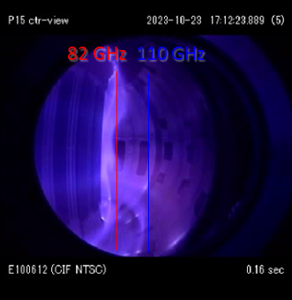
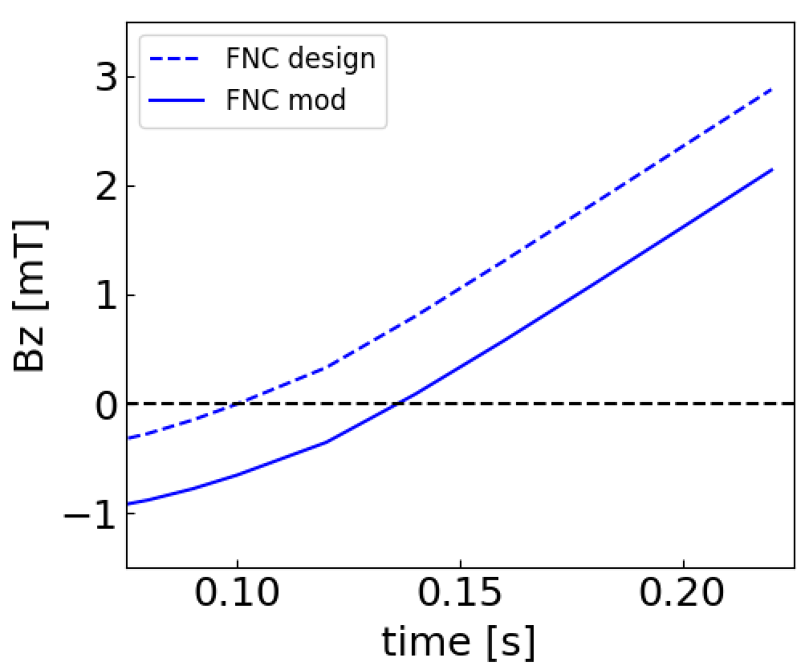
Position control during the burn-through phase: FNC vs TPC
O1(82 GHz)
X2(110 GHz)
Inner-limited
Outer-limited
Additionally, a small residual B_{z} remained at t_{BD} due to device-model errors.
Plasma shifted further outward.
EC heating became ineffective, leading to start-up failure.
I_{P} (E100612)
EC-assisted FNC start-up was limited by sensitivity to device-model errors.
FNC at 0.16 s

Slide 18
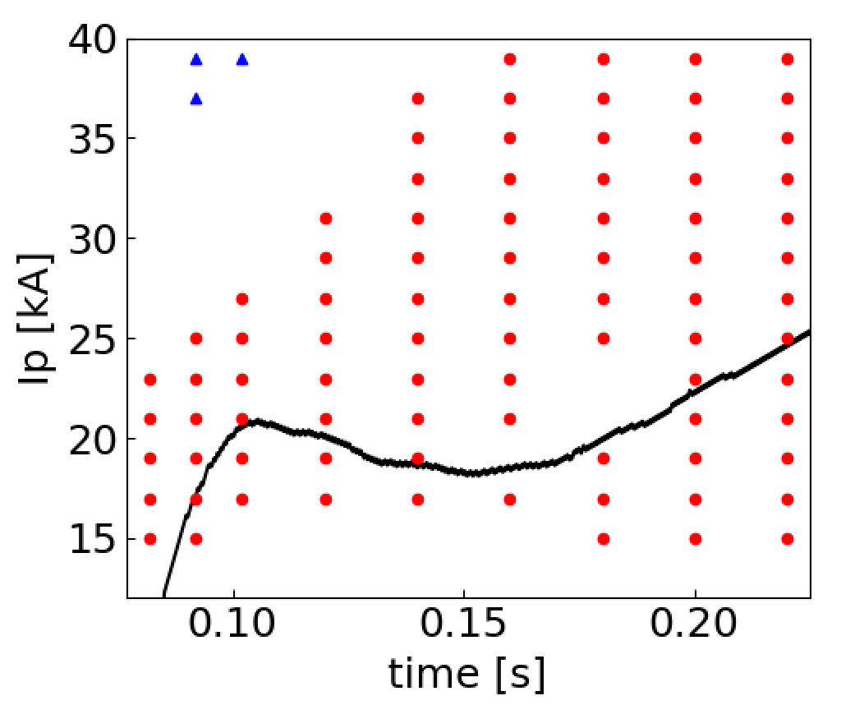
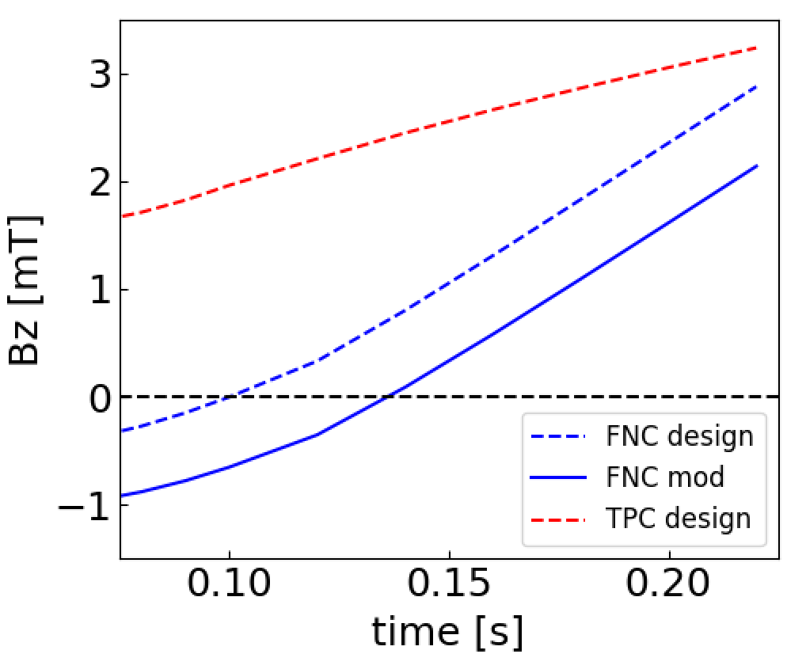
Position control during the burn-through phase: FNC vs TPC
In TPC, finite B_{z} was applied from the BD phase.
Inner-limited plasma could be maintained even if:
BD occurred earlier than expected.
I_{P} (E100613)
Inner-limited
Outer-limited

Slide 19
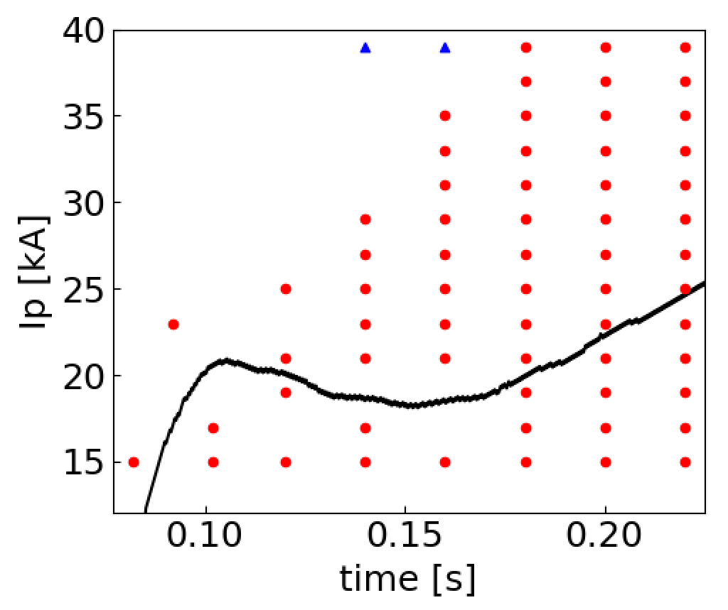
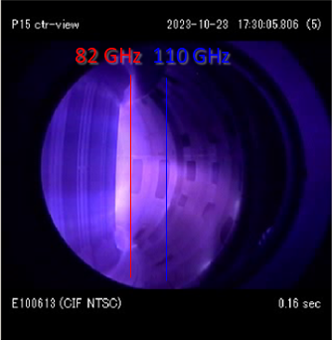
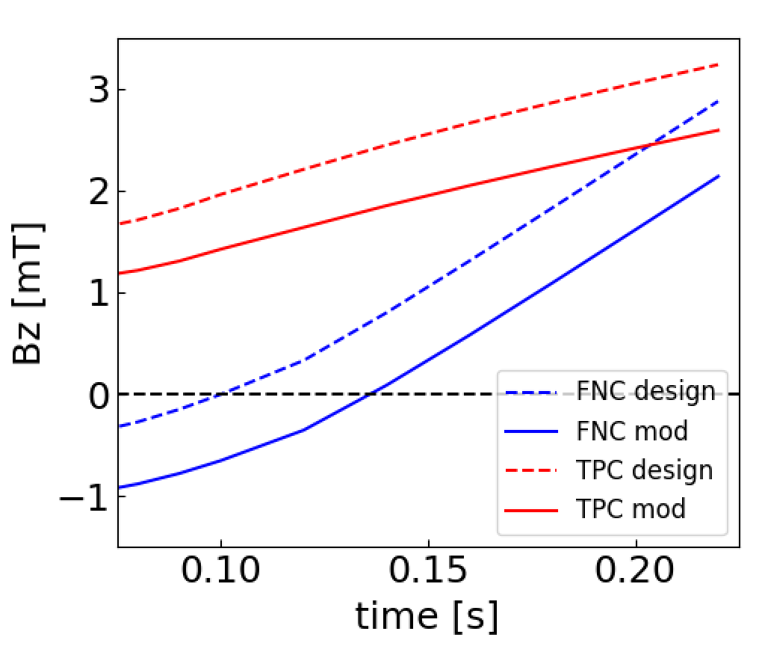
Position control during the burn-through phase: FNC vs TPC
O1(82 GHz)
X2(110 GHz)
Inner-limited
Outer-limited
In TPC, finite B_{z} was applied from the BD phase.
Inner-limited plasma could be maintained even if:
BD occurred earlier than expected.
A small residual B_{z} error remained.
EC heating remained effective.
I_{P} (E100613)
TPC start-up was robust against device-model errors.
TPC at 0.16 s

Slide 20
Outline
1) Breakdown
2)Burn-through
Introduction
Experimental Results
Ohmic FNC start-up and impurity effects
Comparison of FNC and TPC during the breakdown phase
Position control in the burn-through phase and its susceptibility to device model errors
Effect of TPC configuration on X2-assisted breakdown
Plasma start-up with X2 mode using TPC
Conclusion
Ohmic
TPC(X2) vs FNC(X2)
O1+X2
X2

Slide 21
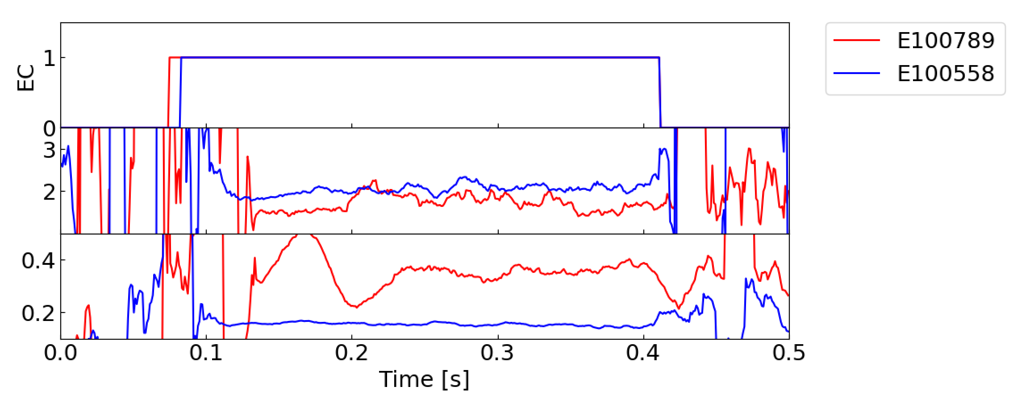
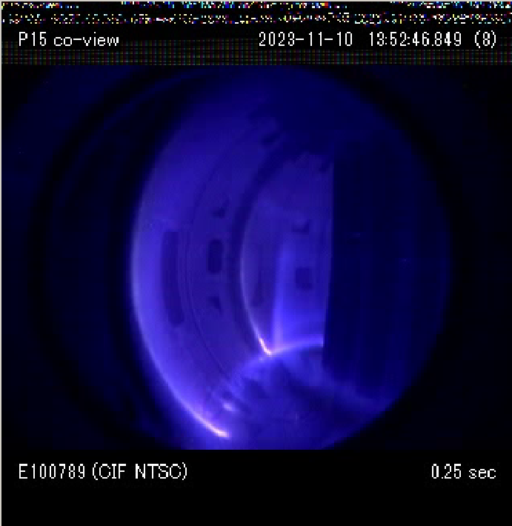
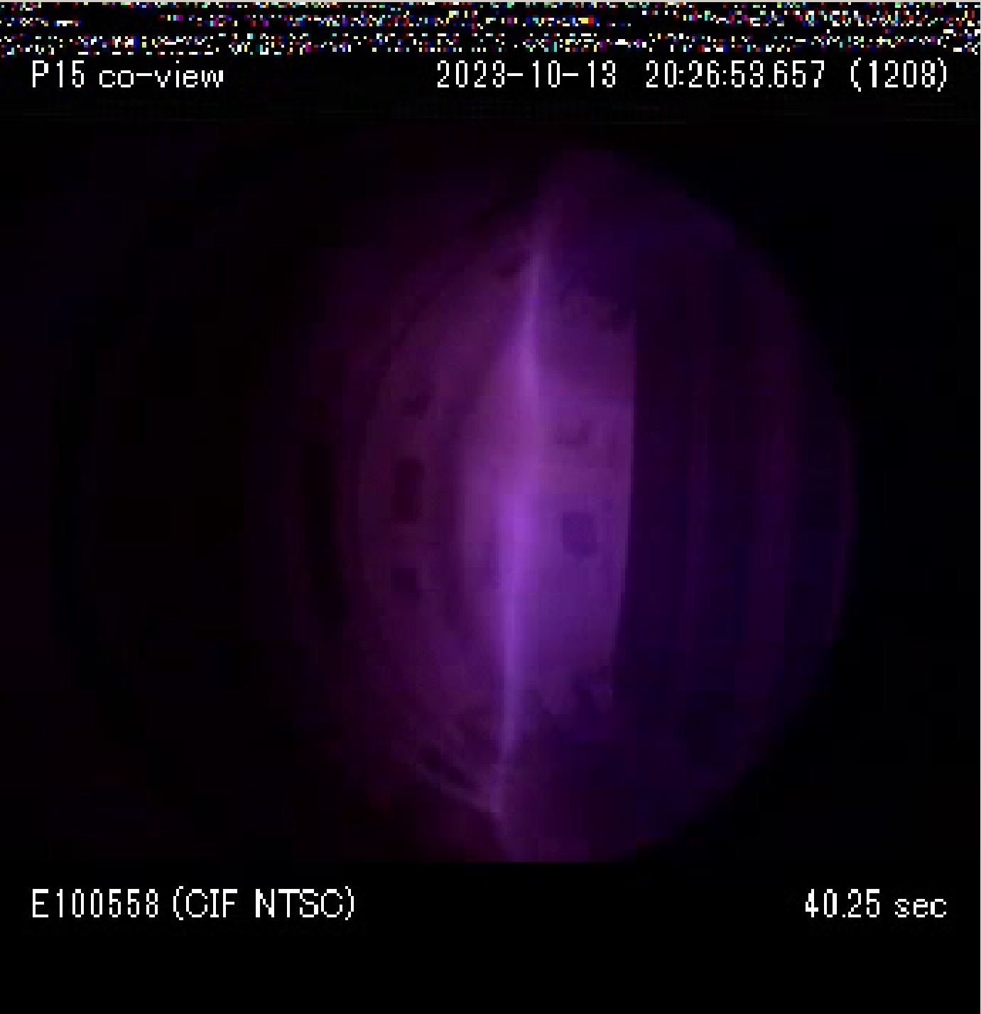




Higher temperature initial plasma was obtained with TPC when X2-assisted BD was tried
The effect of the poloidal field on X2-assisted BD was tested by injecting EC power with E|| ≈ 0.
TPC demonstrated a higher initial electron temperature in X2-assisted BD.
In TPC, plasma extending throughout the vacuum vessel was measured.
TPC
FNC
$$\frac{I667.8 nm}{I728.1 nm}$$
$$\tilde{φ}\left(ne\right)$$
$$\frac{I728.1 nm}{I706.5 nm}$$
$$\tilde{ψ}\left(Te\right)$$
TPC
Plasma expands across the vessel
FNC
Localized near the resonance
TPC start-up was effective for X2-assisted BD.

Slide 22
Outline
1) Breakdown
2)Burn-through
Introduction
Experimental Results
Ohmic FNC start-up and impurity effects
Comparison of FNC and TPC during the breakdown phase
Position control in the burn-through phase and its susceptibility to device model errors
Effect of TPC configuration on X2-assisted breakdown
Plasma start-up with X2 mode using TPC
Conclusion
Ohmic
TPC(X2)
O1+X2
X2

Slide 23
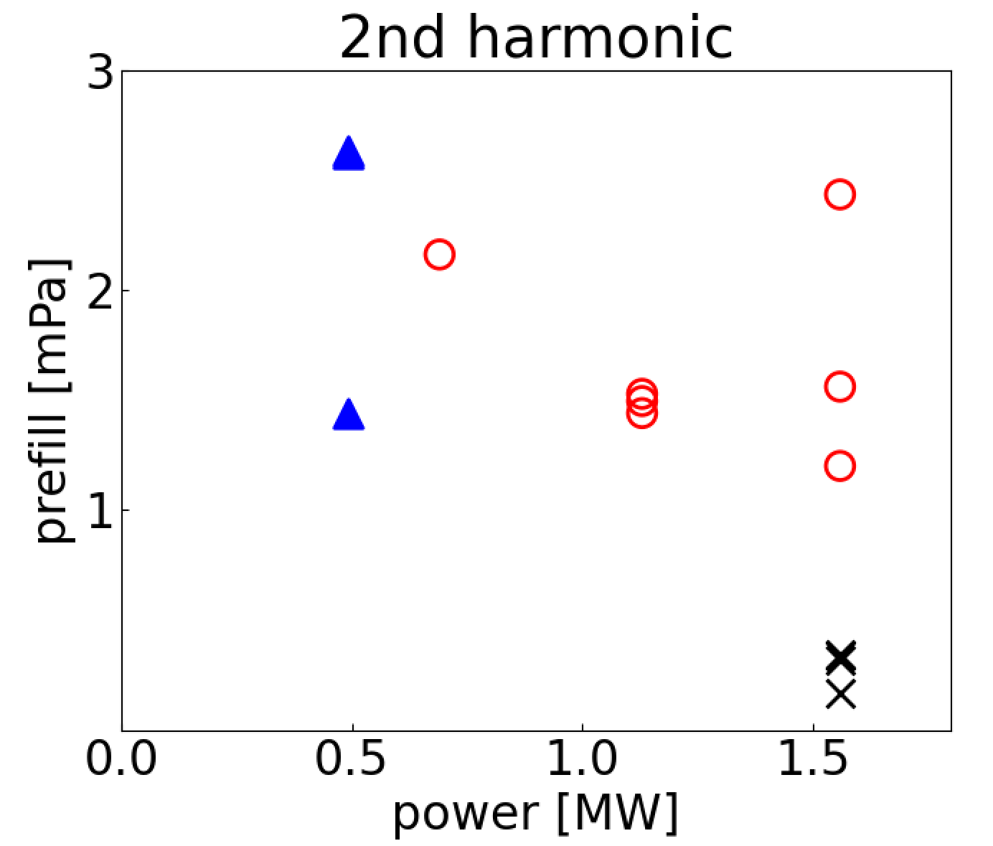
P_{ECH} and prefill thresholds for X2 start-up
X2-only start-up succeeded for P_{ECH} ≥ 0.7 MW and prefill ≥ 1 mPa
Prefill ≥ 1 mPa was required even when P_{ECH} = 1.5 MW
BD was achieved but burn-through failed with P_{ECH} = 0.5 MW.
Lower power threshold for BD was not investigated.
The threshold in P_{ECH} was set by the power required for burn-through.
Failed burn-through
Failed BD

Slide 24
Outline
Introduction
Experimental Results
Ohmic FNC start-up and impurity effects
Comparison of FNC and TPC during the breakdown phase
Position control in the burn-through phase and its susceptibility to device model errors
Effect of TPC configuration on X2-assisted breakdown
Plasma start-up with X2 mode using
Conclusion

Slide 25
Conclusion
Ohmic FNC
BD succeeded but burn-through failed even with higher E|| (0.25 V/m)
⇒ Higher impurity levels → EC assistance indispensable
EC-assisted FNC
T_{e}/n_{e} comparable to TPC in BD phase, but burn-through failed
⇒ Device-model errors → outward shift → poor EC heating
TPC
Finite B_{z} (~ 2 mT) from the BD phase → robust inner-limited plasma
⇒ Effective EC heating → plasma start-up succeeded
X2-only with TPC: reliable start-up; power threshold ≈ 0.7 MW (set by burn-through, not BD)
Take-home: For ITER/DEMO, TPC offers a reliable, low-E|| start-up path via combined effects of robust position control, impurity tolerance, and efficient EC heating.

Slide 26
Discussion

Slide 27
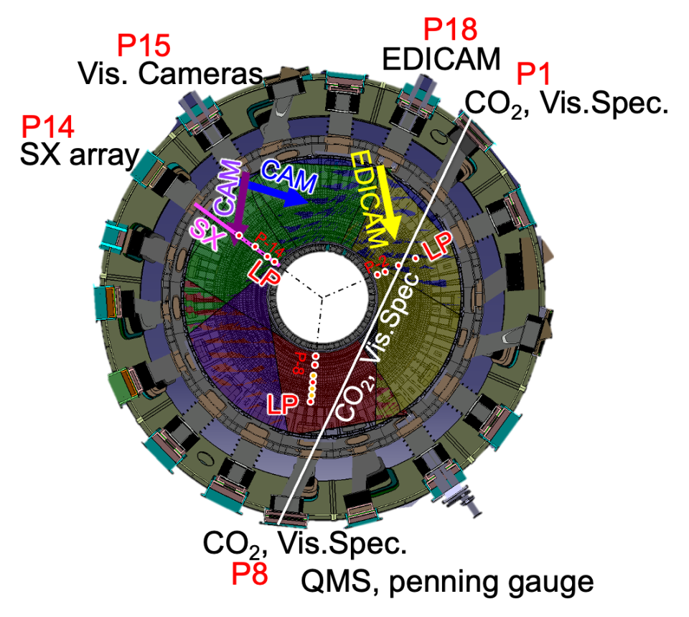
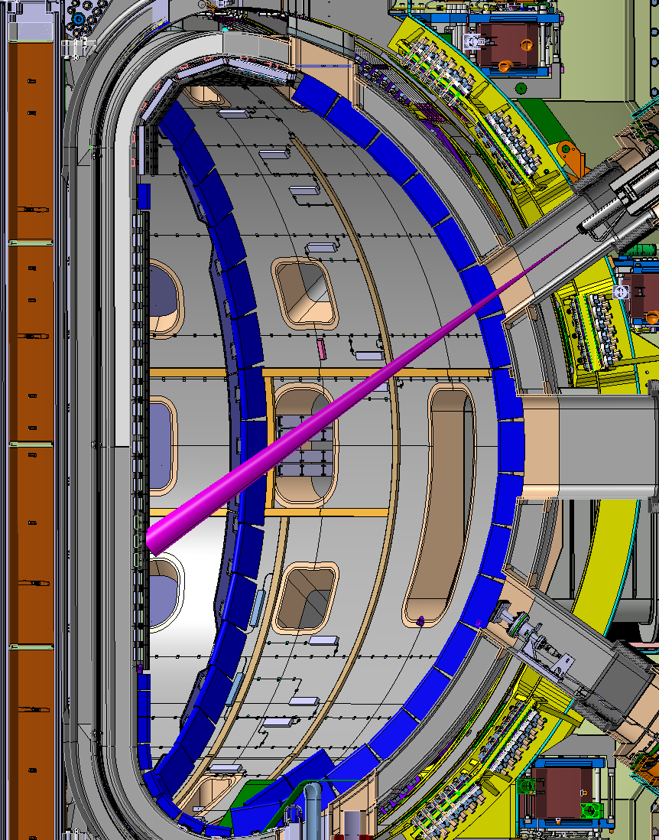
Machine conditions of JT-60SA in OP1
EF coil
TF coil
Upper Divertor (Carbon)
ECH
CS coil
Outer limiter (Stainless-Steel)
Inboard first wall (Carbon)
CO₂ laser interferometer (nl),
Visible spectroscopy
Langmuir probes on upper divertor
Visible camera, EDICAM
Soft X-ray detector arrays
Neutral pressure
Magnetic sensors for control and MHD
Toroidal Field, B_{T} 2.25 T
CS Current, I_{CS} 5.0 kA
EC Heating, P_{EC} 1.5 MW
Working gas, He / H
Notes:
This slide shows the machine conditions of JT-60SA in OP1.
As you can see in the left figure, most of the in vessel components were not installed except for upper carbon divertor, inboard first wall and outer limiter.
Toroidal field was increased up to its rated value of 2.25 T, CS current was limited to 5 kilo amperes which is one fourth of its rated value.
EC heating of 1.5 MW was available, and the working gas was helium or hydrogen.
Right figure shows the available diagnostics. Interferometer was available for line integrated density, visible spectroscopy was available, Langmuir probes were installed on upper divertor. Three visible cameras were available, Soft x-ray arrays are available for estimation of electron temperature. Neutral pressure is also measured and magnetic sensors were used for control and MHD study.

