Slide 1

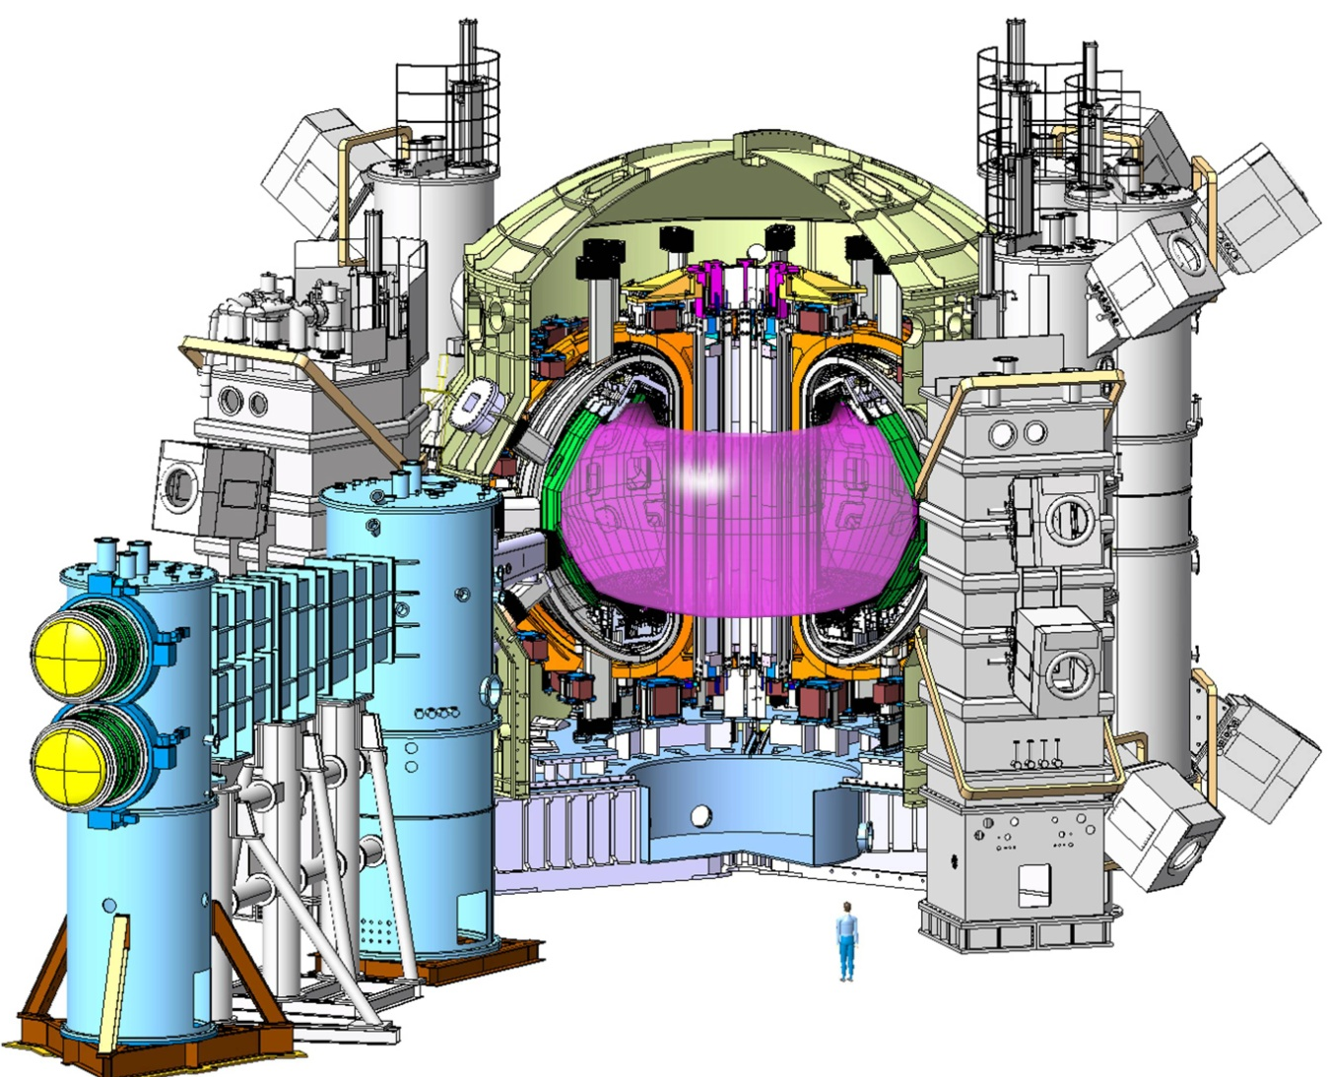
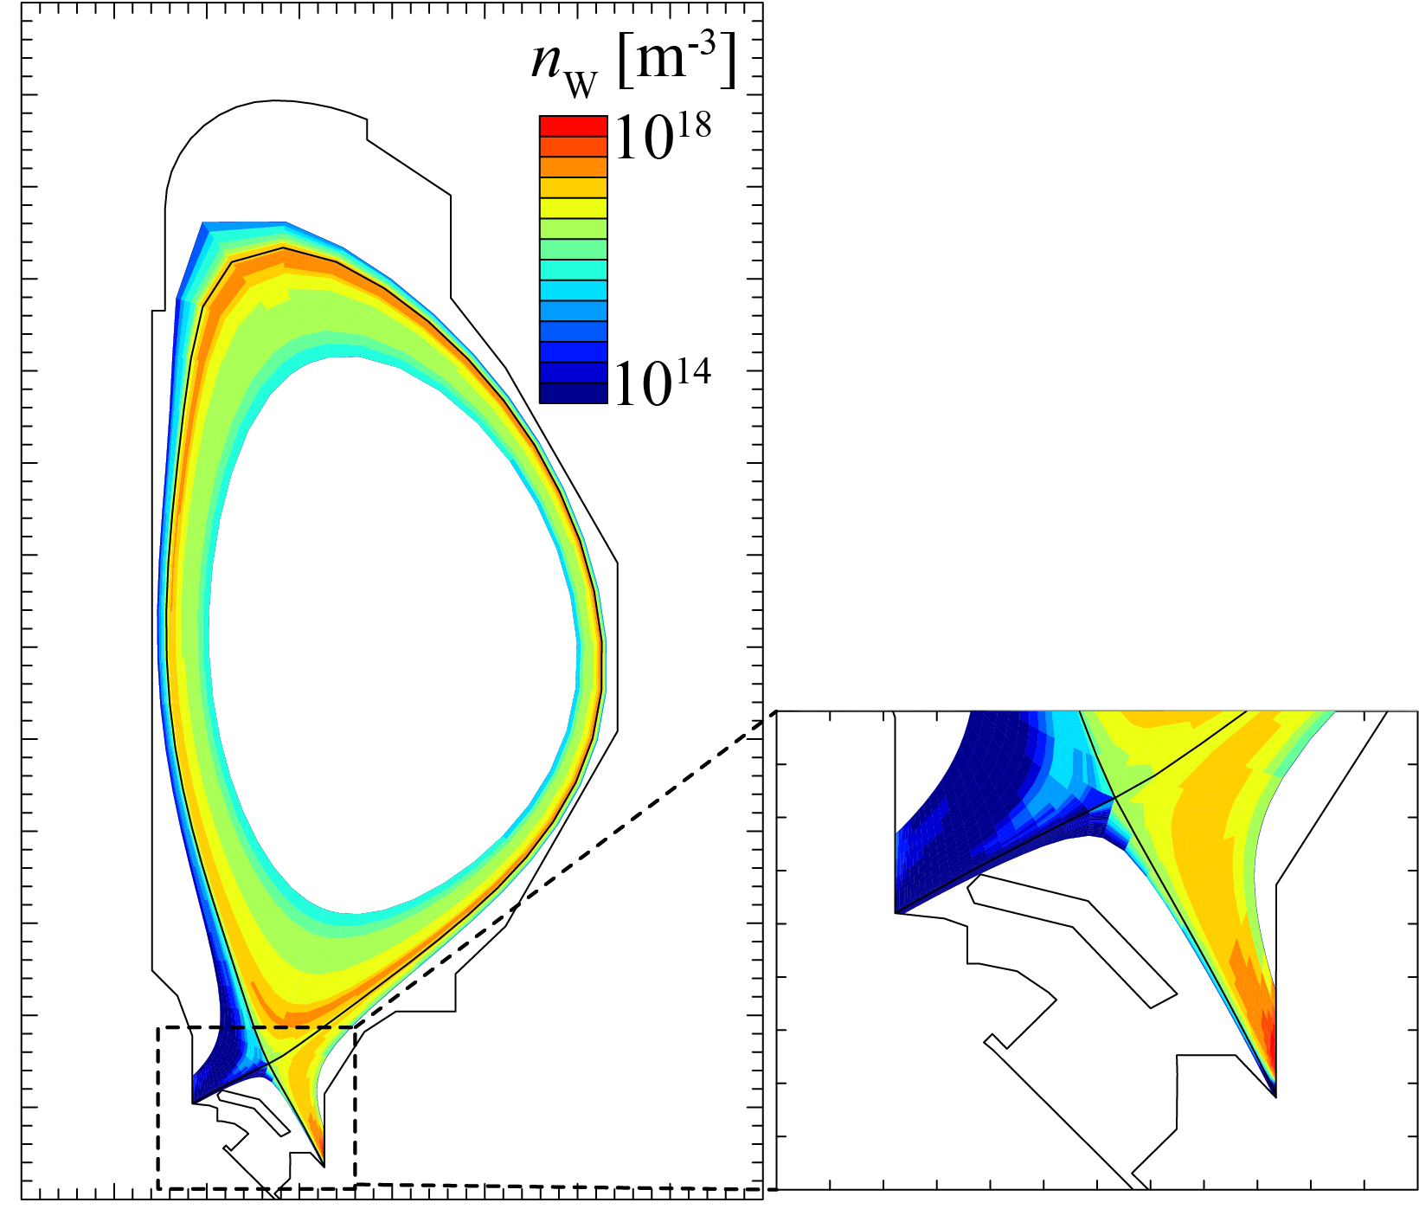
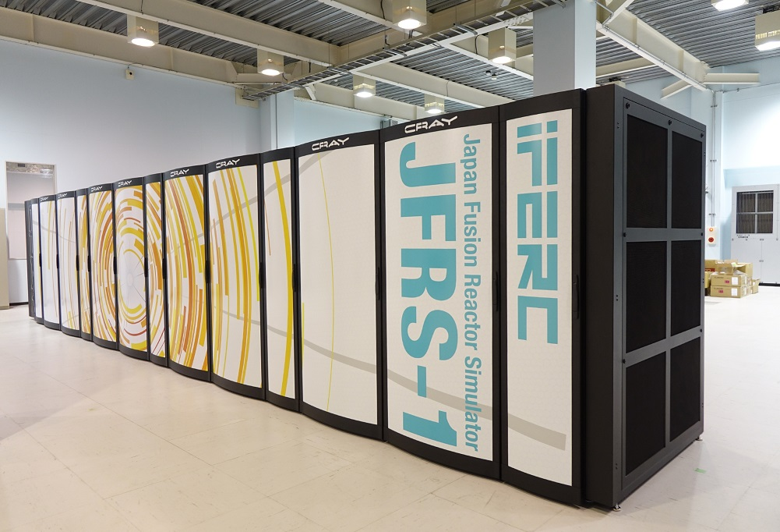
30th IAEA Fusion Energy Conference Chengdu, China, 2025/Oct./13-18
H-mode operation scenarios in JT-60SA initial research phase predicted by integrated core-pedestal-SOL/divertor simulation
Nobuyuki Aiba¹⁾
^{Co-authors}
S. Saarelma²⁾, S. Yamoto¹⁾, M. Honda³⁾, L. Frassinetti⁴⁾, A. Lafay-Labrosse⁴⁾, N. Hayashi¹⁾, K. Hoshino⁵⁾, D. Umezaki¹⁾, T. Nakano¹⁾, T. Wakatsuki¹⁾
1) QST, 2) UKAEA, 3) Kyoto Univ., 4) KTH, 5) Keio Univ.

Slide 2
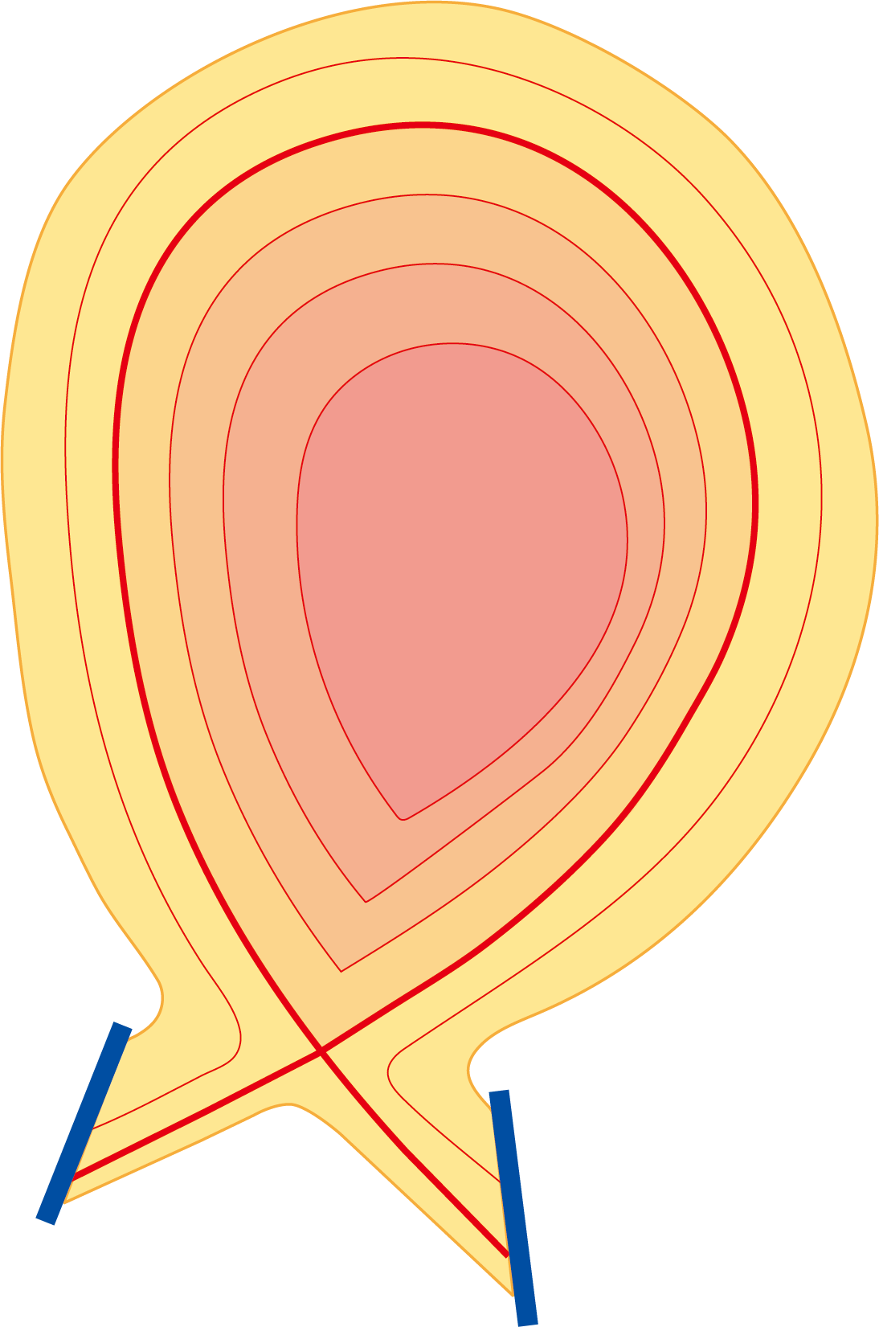


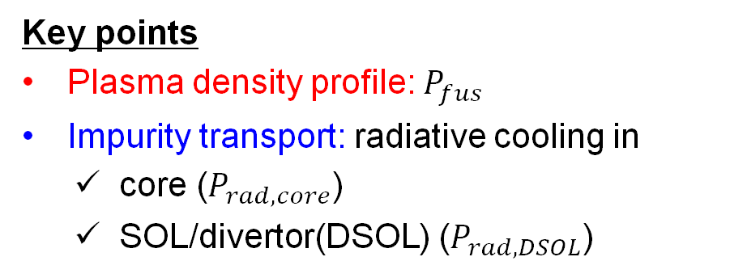

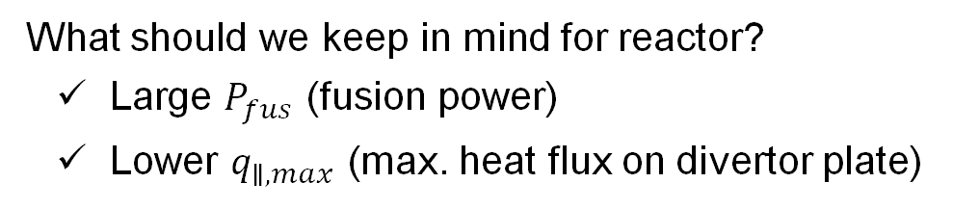

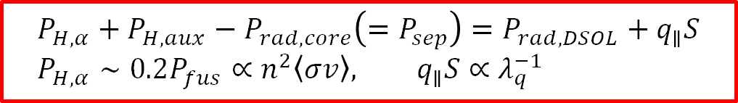



Power exhaust control is a fundamental but still critical issue for large fusion reactor
$$P_{H,α}+P_{H,aux}−P_{rad,core}\left(=P_{sep}\right)=P_{rad,DSOL}+q_{∥}S \\ P_{H,α}∼0.2P_{fus}∝n^{2}\left\langle σv\right\rangle , q_{∥}S∝λ_{q}^{−1}$$
heat flow
$$P_{fus}$$
core
What should we keep in mind for reactor?
Large $P_{fus}$ (fusion power)
Lower $q_{∥,max}$ (max. heat flux on divertor plate)
$$P_{rad}$$
DSOL
Key points
Plasma density profile: $P_{fus}$
Impurity transport: radiative cooling in
core ($P_{rad,core}$)
SOL/divertor(DSOL) ($P_{rad,DSOL}$)
High $P_{fus}$
$$n_{i}, n_{imp}×10$$
$$n_{i}$$
High $P_{rad}$
core
$$r$$
DSOL

Slide 3
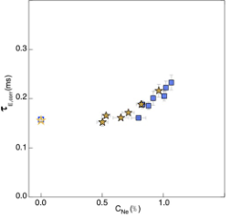
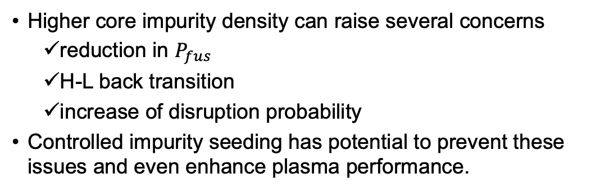


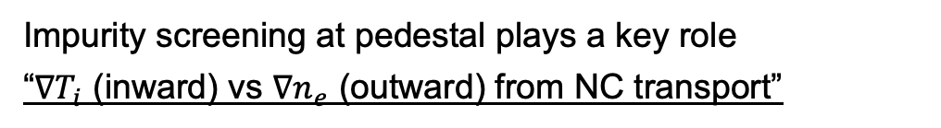
Density/temperature profiles at pedestal is a key for impurity transport
Higher core impurity density can raise several concerns
reduction in $P_{fus}$
H-L back transition
increase of disruption probability
Controlled impurity seeding has potential to prevent these issues and even enhance plasma performance.
[Giroud NF24]
D
$$τ_{E}[ms]$$
D-T
$$C_{Ne}[\%]$$
Impurity screening at pedestal plays a key role
“$∇T_{i}$ (inward) vs $∇n_{e}$ (outward) from NC transport”
[Dux NME17]
Integrated simulation suites covering core, pedestal, and DSOL are essential for power exhaust control with these physics details.

Slide 4
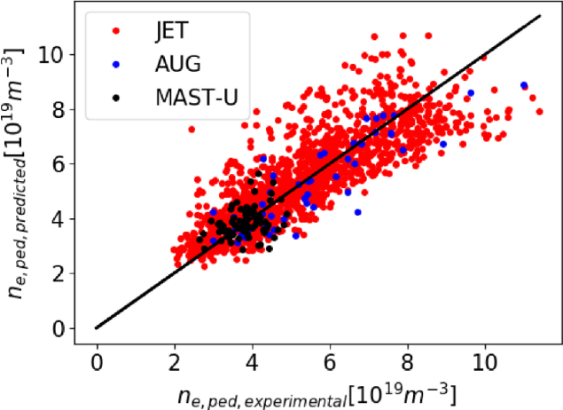

Pedestal density prediction is the key piece
Status of density profile prediction
Core density prediction has been achieved (TGLF[Staebler PoP05], QuaLiKiz[Bourdelle PPCF16], etc.)
SOL density prediction also has been achieved (SOLPS-ITER[Wiesen JNM15], EDGE2D[Radford PoP96], etc.)
“Pedestal” density prediction has remained as an open question.
$$n_{e},etc.$$
Pedestal
Core
SOL
Saarelma-Connor model
A new “validated” model for pedestal density prediction was proposed in the last FEC [Saarelma NF2024].
We are ready to pursue the next stage!
[Saarelma NF2024]

Slide 5
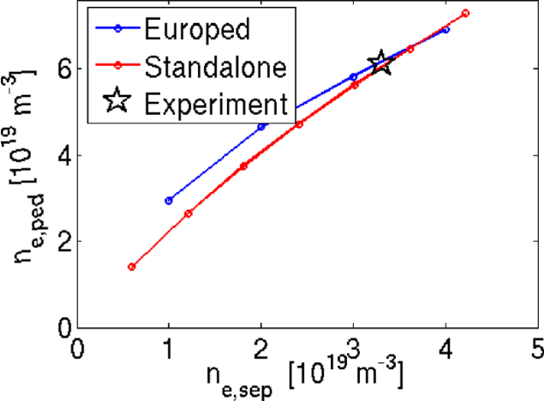
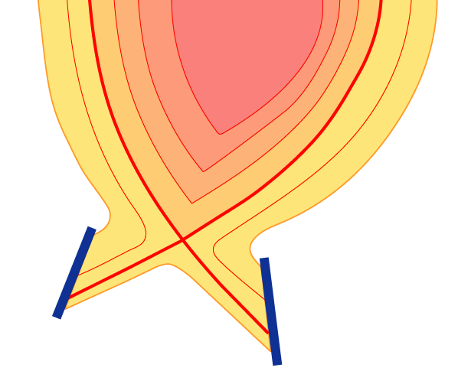
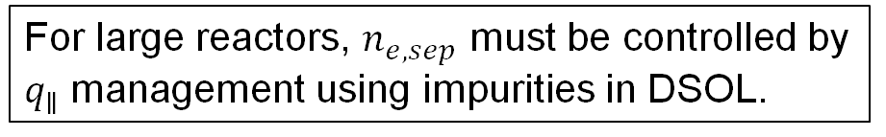
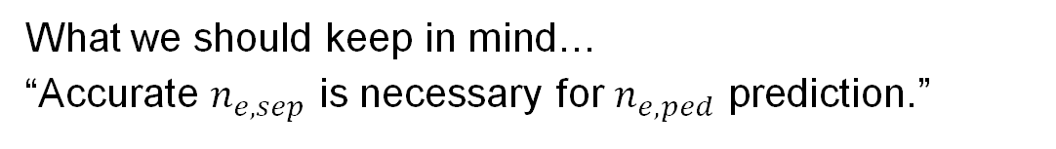

Advanced DSOL simulation is necessary for both density prediction and $P_{rad}$ control
[Saarelma NF2024]
What we should keep in mind…
“Accurate $n_{e,sep}$ is necessary for $n_{e,ped}$ prediction.”
For large reactors, $n_{e,sep}$ must be controlled by $q_{∥}$ management using impurities in DSOL.
Advanced SOL/divertor simulation for impurity transport is indispensable.
Core
Heat flux
Diffusion・
drifts
We adopt an integrated divertor code SONIC, which can consider kinetic effects on impurity transport. [Yamoto PPCF20]
Radiation
Impurity ion
Friction force
Thermal force
Divertor plates

Slide 6
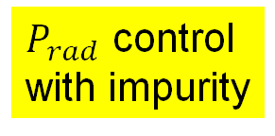
Our new integrated code meets the key points for large reactor scenario development
Based on GOTRESS+, we develop a new “stationary tokamak predictor”.
Our objective is to predict rapidly stationary operation scenario.
GOTRESS[Honda CPC2018] is an ideal code, a steady-state transport solver using global optimization for fast, accurate solutions.
An integrated code suite, GOTRESS+, has been developed[Honda NF2021].
SONIC（SOL/Div）
$P_{rad}$ control with impurity
SOLDOR
Plasma
Fluid code
NEUT2D
Neutral
Kinetic code
GOTRESS+ (core-pedestal)
IMPMC
Impurity
Kinetic code
ACCOME
MHD equi., BSC
EC-Hamamatsu
ECCD, ECH
OFMC/FP
NBCD, NBH
GOTRESS
Bulk plasma transport
IMPACT
Impurity transport [Hayashi NF18]
Pedestal density prediction
PEDmodel
Pedestal pressure
Saarelma-Connor model
EPED1 (w/ MARG2D)

Slide 7
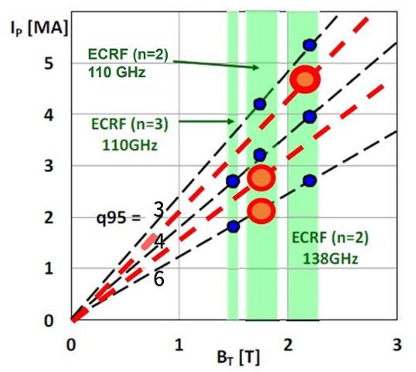
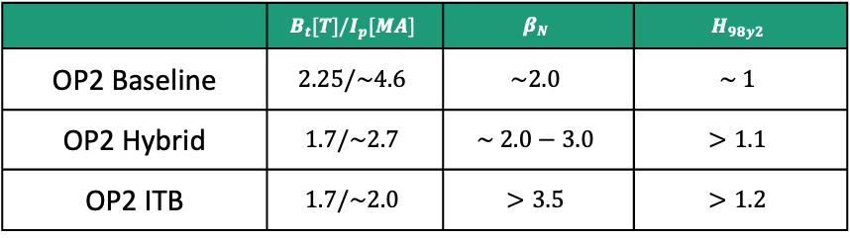
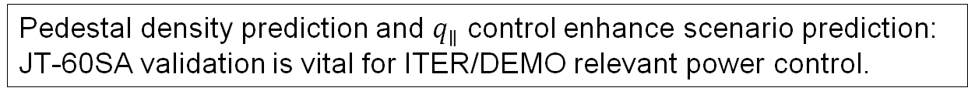
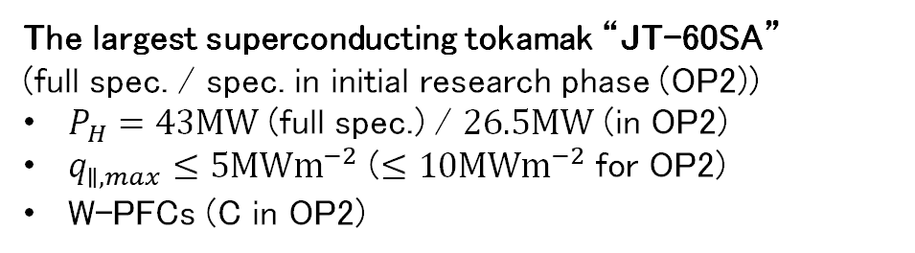
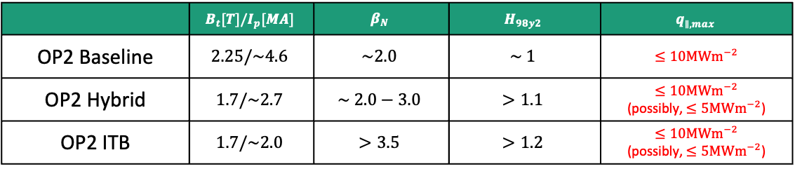
JT-60SA is the best test-bench machine for validation of “stationary tokamak predictor”
The largest superconducting tokamak “JT-60SA” (full spec. / spec. in initial research phase (OP2))
$P_{H}=43MW$ (full spec.) / $26.5MW$ (in OP2)
$q_{∥,max}≤5MWm^{−2}$ ($≤10MWm^{−2}$ for OP2)
W-PFCs (C in OP2)
[JT-60SA Res. Plan v4.0]
Predictive simulations focusing on main plasma have shown all the scenarios are feasible. [Gabriellini NF25 etc.].
Targets
 | $$B_{t}[T]/I_{p}[MA]$$ | $$β_{N}$$ | $$H_{98y2}$$
OP2 Baseline | $$2.25/\sim 4.6$$ | $$\sim 2.0$$ | $$\sim 1$$
OP2 Hybrid | $$1.7/\sim 2.7$$ | $$\sim 2.0−3.0$$ | $$>1.1$$
OP2 ITB | $$1.7/\sim 2.0$$ | $$>3.5$$ | $$>1.2$$
 | $$B_{t}[T]/I_{p}[MA]$$ | $$β_{N}$$ | $$H_{98y2}$$ | $$q_{∥,max}$$
OP2 Baseline | $$2.25/\sim 4.6$$ | $$\sim 2.0$$ | $$\sim 1$$ | $≤10MWm^{−2}$
OP2 Hybrid | $$1.7/\sim 2.7$$ | $$\sim 2.0−3.0$$ | $$>1.1$$ | $≤10MWm^{−2}$ (possibly, $≤5MWm^{−2}$)
OP2 ITB | $$1.7/\sim 2.0$$ | $$>3.5$$ | $$>1.2$$ | $≤10MWm^{−2}$ (possibly, $≤5MWm^{−2}$)
~ITER std.
~ITER adv.
~JA DEMO
Pedestal density prediction and $q_{∥}$ control enhance scenario prediction: JT-60SA validation is vital for ITER/DEMO relevant power control.

Slide 8
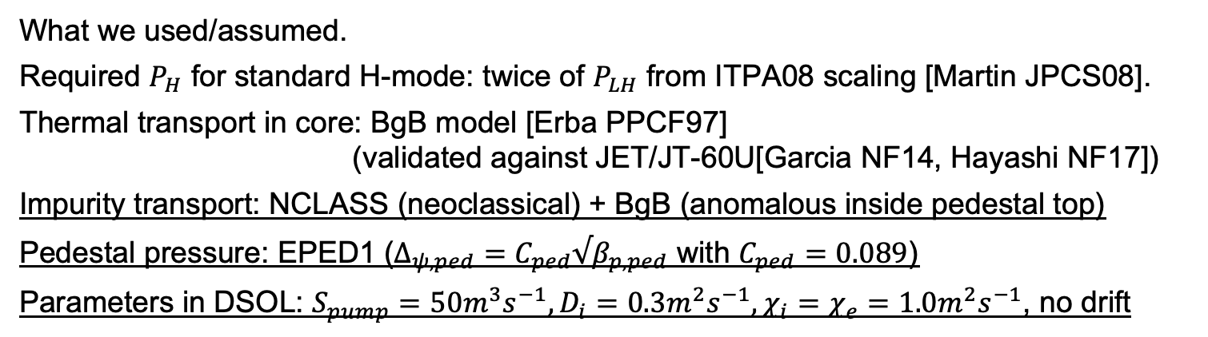



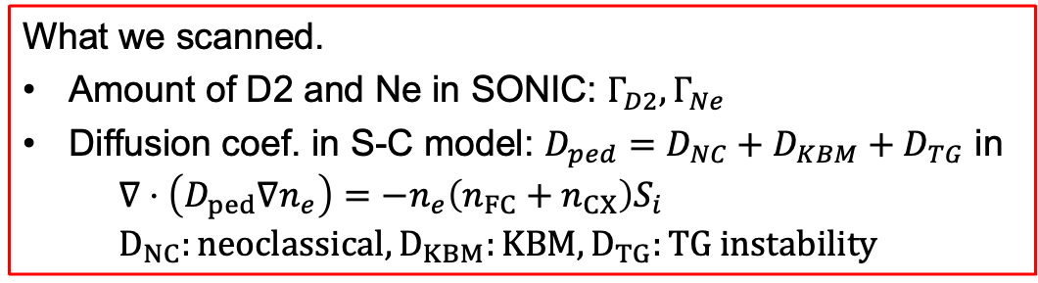
Conditions for OP2 scenario development
What we used/assumed.
Required $P_{H}$ for standard H-mode: twice of $P_{LH}$ from ITPA08 scaling [Martin JPCS08].
Thermal transport in core: BgB model [Erba PPCF97] (validated against JET/JT-60U[Garcia NF14, Hayashi NF17])
Impurity transport: NCLASS (neoclassical) + BgB (anomalous inside pedestal top)
Pedestal pressure: EPED1 ($Δ_{ψ,ped}=C_{ped}√β_{p,ped}$ with $C_{ped}=0.089$)
Parameters in DSOL: $S_{pump}=50m^{3}s^{−1}, D_{i}=0.3m^{2}s^{−1}, χ_{i}=χ_{e}=1.0m^{2}s^{−1}$, no drift
What we scanned.
Amount of D2 and Ne in SONIC: $Γ_{D2}, Γ_{Ne}$
Diffusion coef. in S-C model: $D_{ped}=D_{NC}+D_{KBM}+D_{TG}$ in $∇⋅\left(D_{ped}∇n_{e}\right)=−n_{e}\left(n_{FC}+n_{CX}\right)S_{i}$ $D_{NC}:neoclassical, D_{KBM}:KBM, D_{TG}:TG instability$
$$n_{FC}$$
$$n_{e}$$
separatrix
$$n_{CX}$$
FC = Franck-Condon neutrals CX= Charge exchange neutrals
Details will be in my poster, this afternoon.

Slide 9
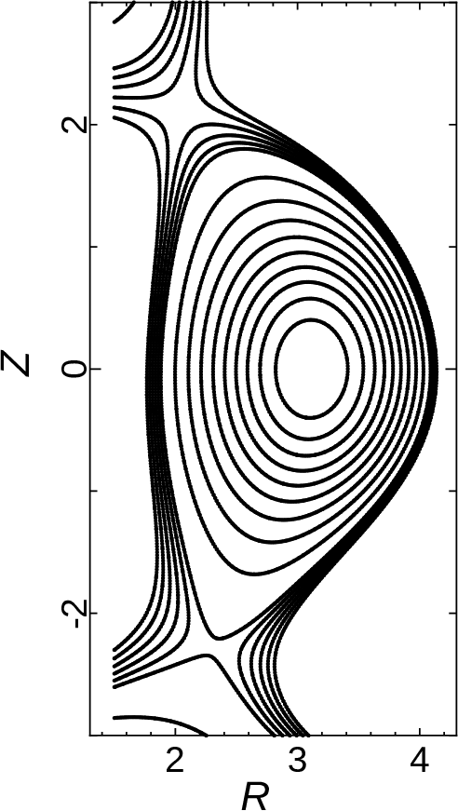
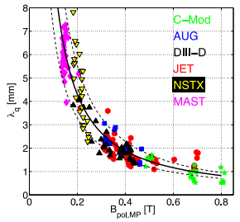
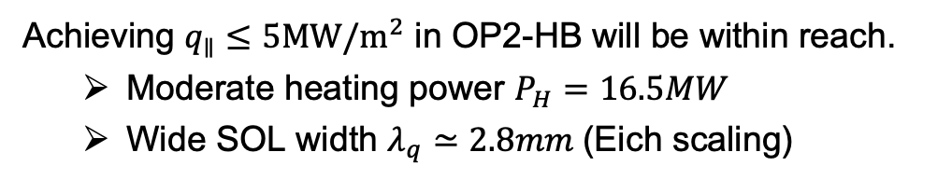
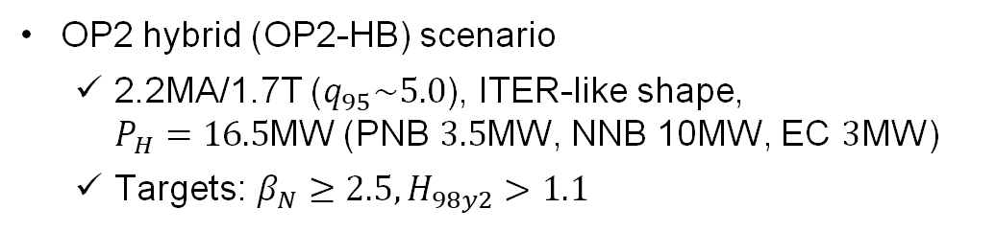
Challenge: OP2-Hybrid with high performance
OP2 hybrid (OP2-HB) scenario
2.2MA/1.7T ($q_{95}\sim 5.0$), ITER-like shape, $P_{H}=16.5$MW (PNB $3.5$MW, NNB 10MW, EC $3$MW)
Targets: $β_{N}≥2.5, H_{98y2}>1.1$
v
v
Achieving $q_{∥}≤5MW/m^{2}$ in OP2-HB will be within reach.
Moderate heating power $P_{H}=16.5MW$
Wide SOL width $λ_{q}≃2.8mm$(Eich scaling)
[T.Eich NF2013]
We try to satisfy targets for $β_{N}, H_{98y2}, q_{∥}$ by adjusting D2, Ne puff.
Detail conditions and results for OP2-BL will be in my poster.
HB
baseline

Slide 10
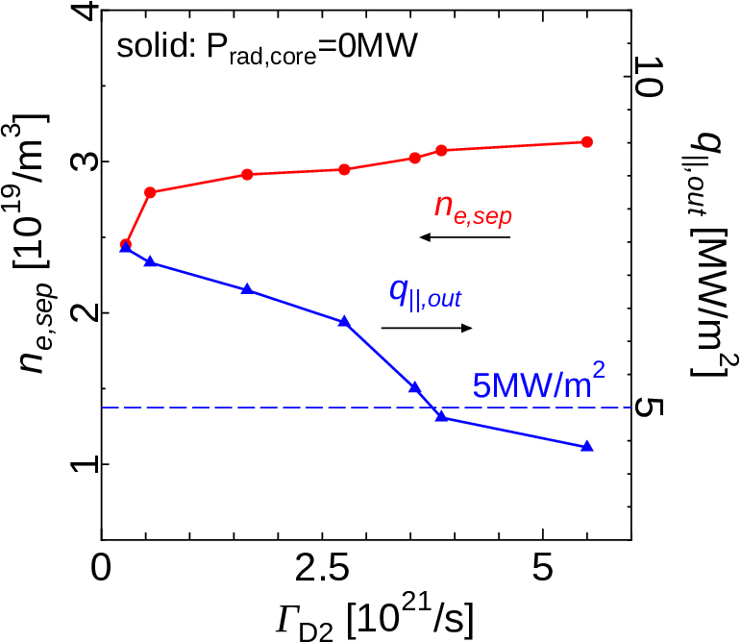
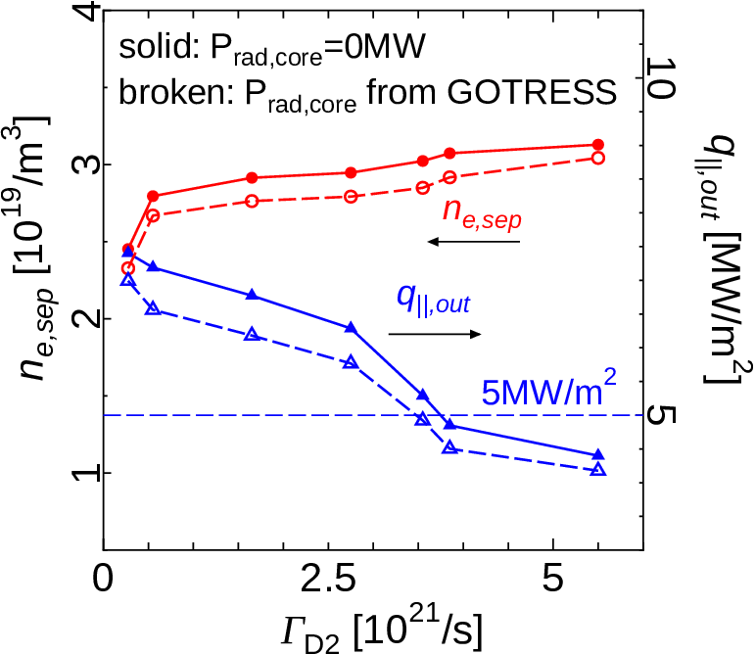
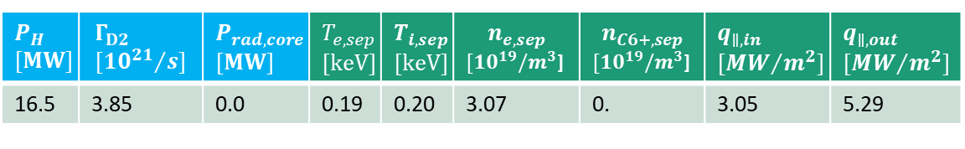
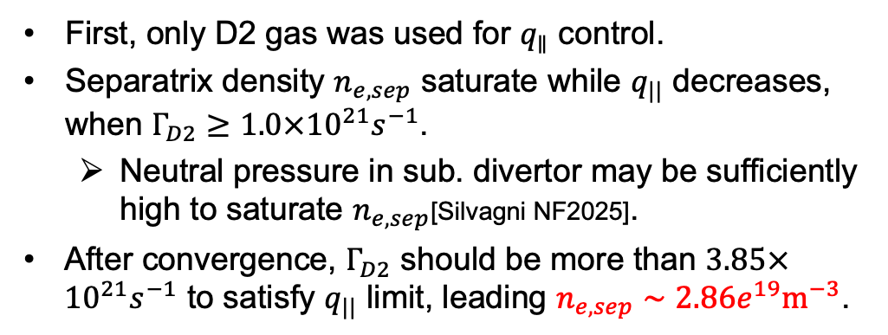
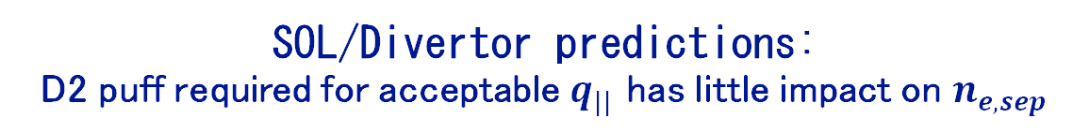
SOL/Divertor predictions: D2 puff required for acceptable $q_{||}$ has little impact on $n_{e,sep}$
First, only D2 gas was used for $q_{∥}$ control.
Separatrix density $n_{e,sep}$ saturate while $q_{||}$ decreases, when $Γ_{D2}≥1.0×{10}^{21}s^{−1}$.
Neutral pressure in sub. divertor may be sufficiently high to saturate $n_{e,sep}$[Silvagni NF2025].
After convergence, $Γ_{D2}$ should be more than $3.85×{10}^{21}s^{−1}$ to satisfy $q_{||}$ limit, leading $n_{e,sep}∼2.86e^{19}m^{−3}$.
Inputs
Outputs
$$P_{H} \\ [MW]$$ | $$Γ_{D2} \\ [{10^{21}}/s]$$ | $$P_{rad,core} \\ [MW]$$ | $$T_{e,sep} \\ [keV]$$ | $$T_{i,sep} \\ [keV]$$ | $$n_{e,sep}$$ $[10^{19}/m^{3}$] | $$n_{C6+,sep}$$ $[10^{19}/m^{3}$] | $$q_{∥,in} \\ [{MW}/{m^{2}}]$$ | $$q_{∥,out} \\ [{MW}/{m^{2}}]$$
16.5 | 3.85 | 0.0 | 0.19 | 0.20 | 3.07 | 0. | 3.05 | 5.29
After convergence
16.5 | 3.85 | -0.60 | 0.18 | 0.20 | 2.86 | 0. | 2.88 | 4.92

Slide 11
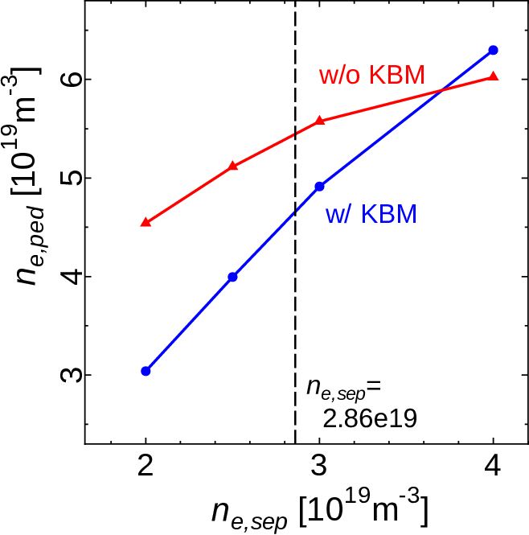
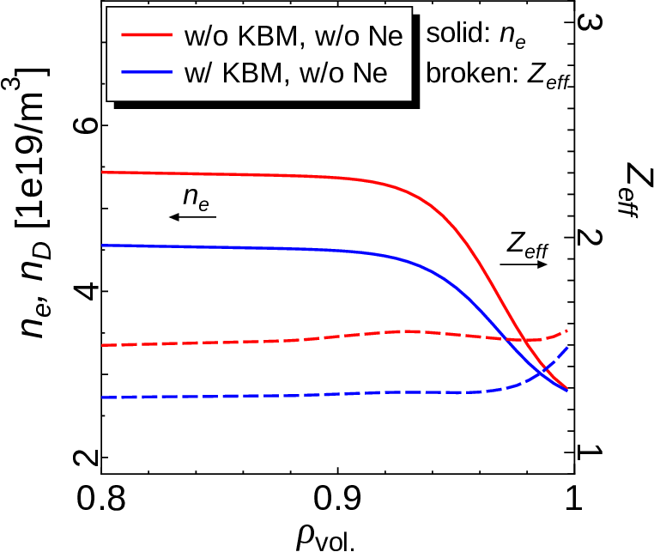
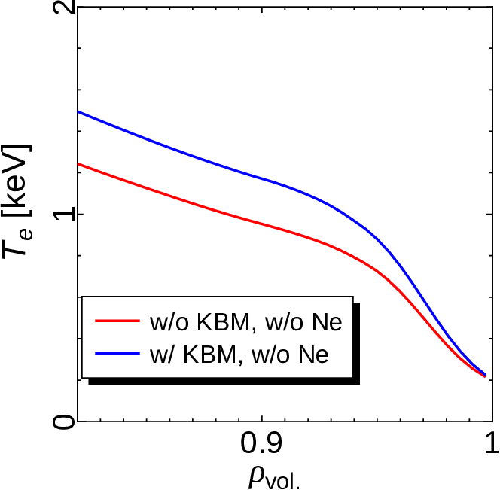
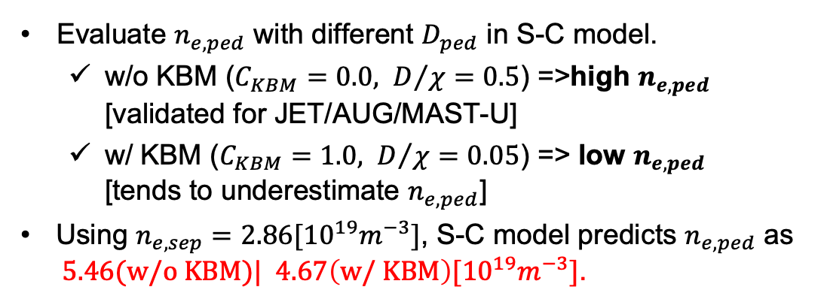
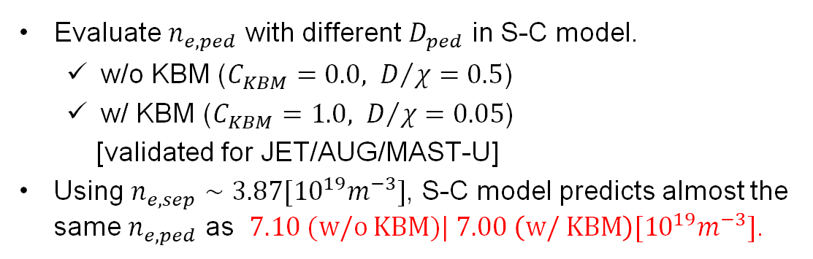
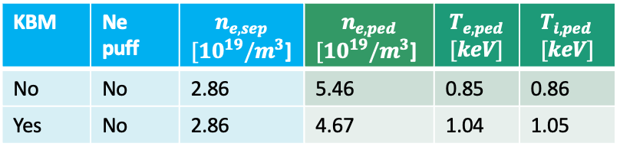
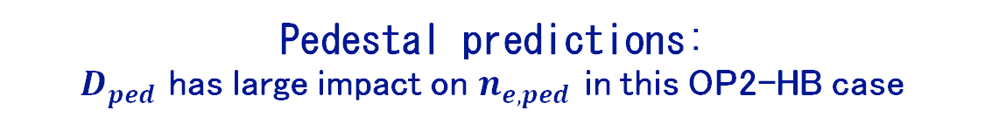
Pedestal predictions: $D_{ped}$ has large impact on $n_{e,ped}$ in this OP2-HB case
Evaluate $n_{e,ped}$ with different $D_{ped}$ in S-C model.
w/o KBM ($C_{KBM}=0.0, D/χ=0.5$) =>high $n_{e,ped}$ [validated for JET/AUG/MAST-U]
w/ KBM ($C_{KBM}=1.0, D/χ=0.05$) => low $n_{e,ped}$ [tends to underestimate $n_{e,ped}$]
Using $n_{e,sep}=2.86[{10}^{19}m^{−3}]$, S-C model predicts $n_{e,ped}$ as $5.46(w/o KBM)| 4.67\left(w/ KBM\right)[{10}^{19}m^{−3}]$.
Evaluate $n_{e,ped}$ with different $D_{ped}$ in S-C model.
w/o KBM ($C_{KBM}=0.0, D/χ=0.5$)
w/ KBM ($C_{KBM}=1.0, D/χ=0.05$)
[validated for JET/AUG/MAST-U]
Using $n_{e,sep}∼3.87[{10}^{19}m^{−3}]$, S-C model predicts almost the same $n_{e,ped}$ as $7.10 (w/o KBM)| 7.00 \left(w/ KBM\right)[{10}^{19}m^{−3}]$.
Impacts of $n_{e,ped}$ on performance should be confirmed.
KBM | Ne puff | $$n_{e,sep}$$ $[10^{19}/m^{3}$] | $$n_{e,ped}$$ $[10^{19}/m^{3}$] | $$T_{e,ped} \\ [keV]$$ | $$T_{i,ped} \\ [keV]$$
No | No | 2.86 | 5.46 | 0.85 | 0.86
Yes | No | 2.86 | 4.67 | 1.04 | 1.05

Slide 12
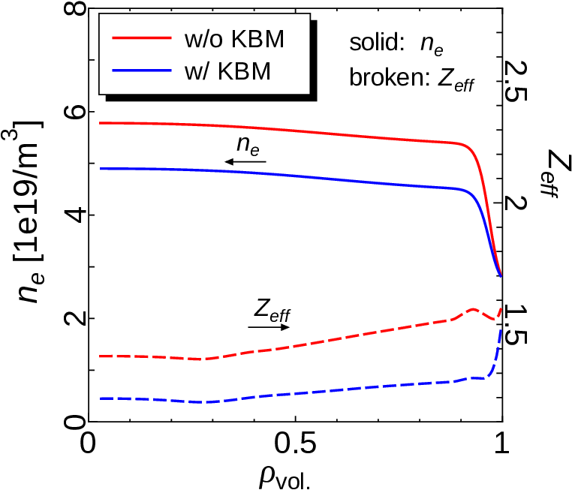
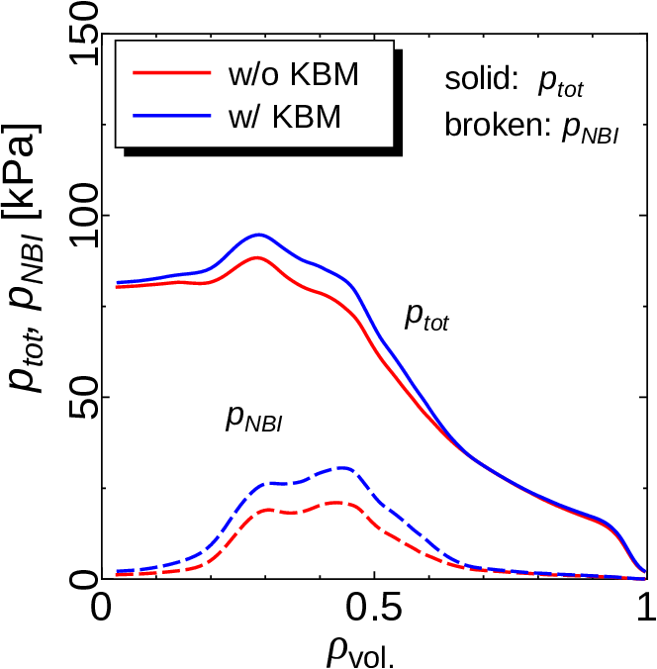
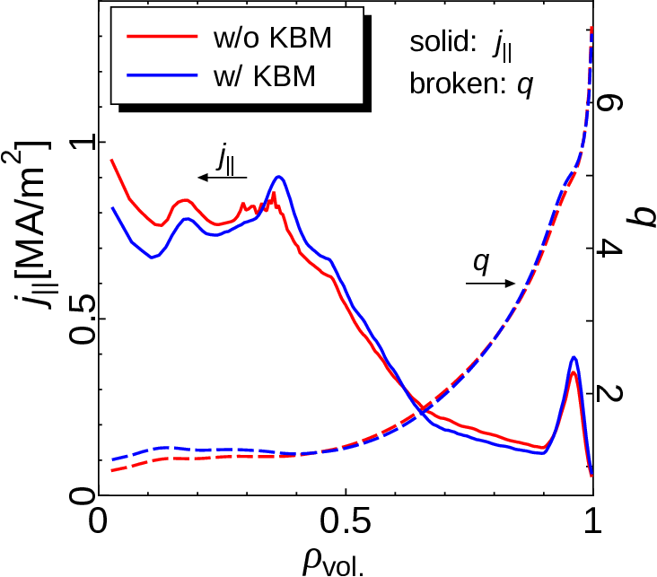
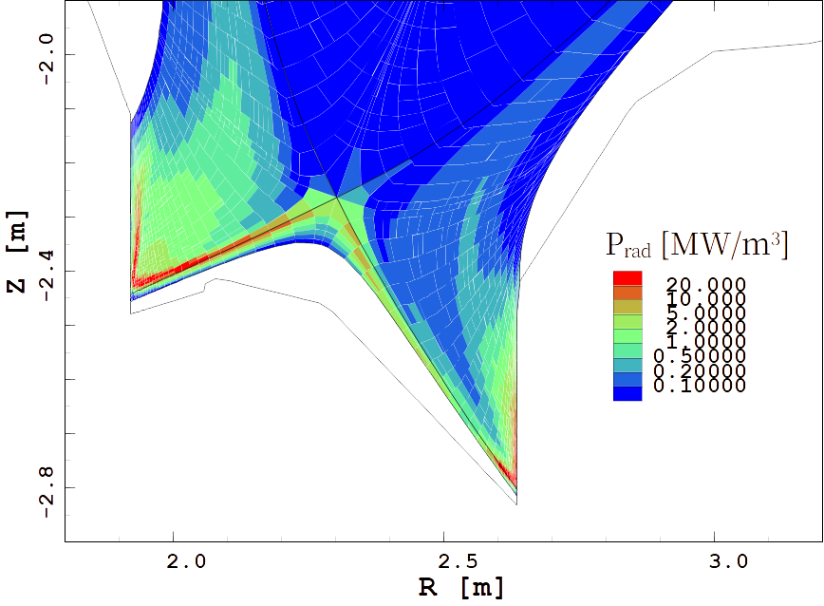

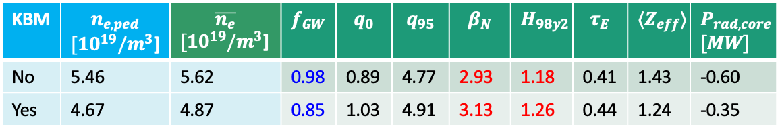


OP2-HB meets our targets ($β_{N}\sim 3.0, H_{98y2}≳1.2$)
KBM | $$n_{e,ped}$$ $[10^{19}/m^{3}$] | $$\overline{n_{e}}$$ $[10^{19}/m^{3}$] | $$f_{GW}$$ | $$q_{0}$$ | $$q_{95}$$ | $$β_{N}$$ | $$H_{98y2}$$ | $$τ_{E}$$ | $$⟨Z_{eff}⟩$$ | $$P_{rad,core} \\ [MW]$$
No | 5.46 | 5.62 | 0.98 | 0.89 | 4.77 | 2.93 | 1.18 | 0.41 | 1.43 | -0.60
Yes | 4.67 | 4.87 | 0.85 | 1.03 | 4.91 | 3.13 | 1.26 | 0.44 | 1.24 | -0.35
High $n_{e,ped}$ (wo/KBM)
Low $n_{e,ped}$ (w/KBM)
$$p_{NBI}$$
In both cases, plasma parameters are good enough to be our hybrid scenario.
Low $n_{e,ped}$ increases $p_{NBI}$ and $j_{NBI}$, helping to improve $β_{N}, H_{98y2}$ etc..
However,,, $f_{GW}$ is marginal for ELMy H-mode and disruption avoidance.
Can we extend the operation space with Ne puff?

Slide 13
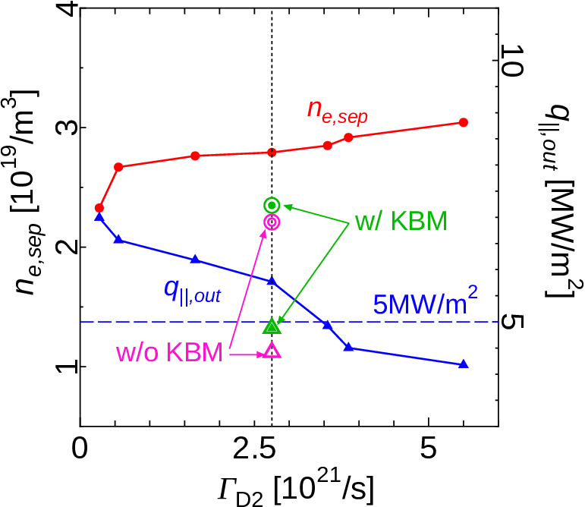
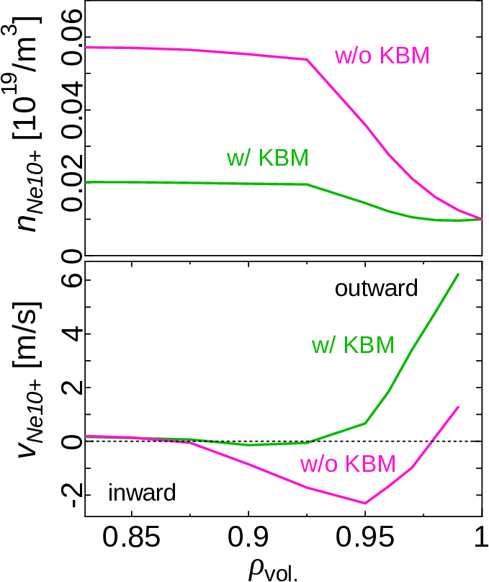
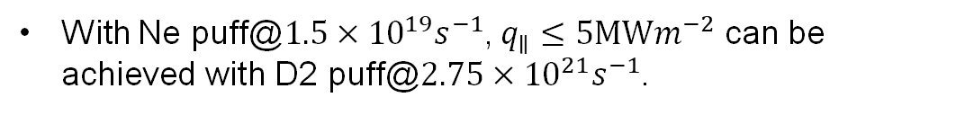
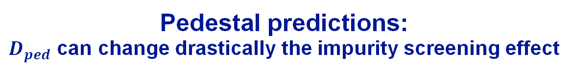

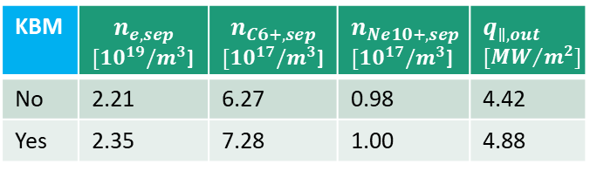
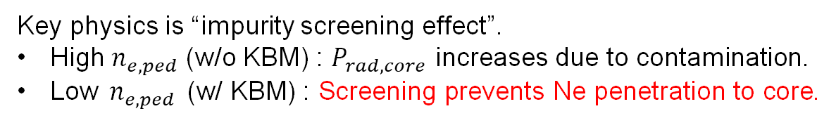

Pedestal predictions: $D_{ped}$ can change drastically the impurity screening effect
With Ne puff@$1.5×{10}^{19}s^{−1}$, $q_{∥}≤5MWm^{−2}$ can be achieved with D2 puff@$2.75×{10}^{21}s^{−1}$.
Why is $q_{∥}$ lower in high $n_{e,ped}$ (w/o KBM) case?
Key physics is “impurity screening effect”.
High $n_{e,ped}$ (w/o KBM) : $P_{rad,core}$ increases due to contamination.
Low $n_{e,ped}$ (w/ KBM) : Screening prevents Ne penetration to core.
How large the impact of the screening on plasma performance?
KBM | $$n_{e,sep}$$ $[10^{19}/m^{3}$] | $$n_{C6+,sep}$$ $[10^{17}/m^{3}$] | $$n_{Ne10+,sep}$$ $[10^{17}/m^{3}$] | $$q_{∥,out} \\ [{MW}/{m^{2}}]$$ | $$n_{e,ped}$$ $[10^{19}/m^{3}$] | $$T_{i,ped}$$ $[keV$] | $$P_{rad,core} \\ [MW]$$
No | 2.21 | 6.27 | 0.98 | 4.42 | 4.96 | 0.85 | -2.15
Yes | 2.35 | 7.28 | 1.00 | 4.88 | 3.47 | 1.06 | -0.75
KBM | $$n_{e,sep}$$ $[10^{19}/m^{3}$] | $$n_{C6+,sep}$$ $[10^{17}/m^{3}$] | $$n_{Ne10+,sep}$$ $[10^{17}/m^{3}$] | $$q_{∥,out} \\ [{MW}/{m^{2}}]$$
No | 2.21 | 6.27 | 0.98 | 4.42
Yes | 2.35 | 7.28 | 1.00 | 4.88

Slide 14










Integrated core-pedestal-DSOL simulation demonstrates the importance of impurity screening
Ne puff | KBM | $$\overline{n_{e}}$$ $[10^{19}/m^{3}$] | $$f_{GW}$$ | $$q_{0}$$ | $$q_{95}$$ | $$β_{N}$$ | $$H_{98y2}$$ | $$τ_{E}$$ | $$⟨Z_{eff}⟩$$ | $$P_{rad,core} \\ [MW]$$
No | No | 5.62 | 0.98 | 0.89 | 4.77 | 2.93 | 1.18 | 0.41 | 1.43 | -0.60
performance
Ne puff | KBM | $$\overline{n_{e}}$$ $[10^{19}/m^{3}$] | $$f_{GW}$$ | $$q_{0}$$ | $$q_{95}$$ | $$β_{N}$$ | $$H_{98y2}$$ | $$τ_{E}$$ | $$⟨Z_{eff}⟩$$ | $$P_{rad,core} \\ [MW]$$
No | No | 5.62 | 0.98 | 0.89 | 4.77 | 2.93 | 1.18 | 0.41 | 1.43 | -0.60
Yes | No | 5.54 | 0.86 | 1.01 | 4.80 | 2.83 | 1.13 | 0.39 | 3.05 | -2.15
High $n_{e,ped}$ (w/o KBM)
degraded
Low $n_{e,ped}$ (w/KBM)
No | Yes | 5.54 | 0.85 | 1.03 | 4.91 | 3.13 | 1.26 | 0.44 | 1.24 | -0.35
Yes | Yes | 3.93 | 0.69 | 1.53 | 5.03 | 3.20 | 1.26 | 0.45 | 2.26 | -0.75
No | Yes | 5.54 | 0.85 | 1.03 | 4.91 | 3.13 | 1.26 | 0.44 | 1.24 | -0.35
improved
High $n_{e,ped}$ (w/o KBM)
low $n_{e,ped}$ (w/ KBM)
$P_{rad}$ w/ Ne
“We are ready to accomplish OP2 experiments!”

Slide 15

Summary
GOTRESS+ (core-pedestal)
We have extended an integrated code suite GOTRESS+ into “stationary tokamak predictor” by coupling core, pedestal and SOL/divertor simulation codes/models.
Key points
Pedestal density prediction
Power exhaust control and plasma performance enhancement using extrinsic impurity
This simulator enables prediction of stationary plasma conditions of JT-60SA OP2 scenarios, satisfying targets on plasma performance and $q_{||}$ on divertor.
It enables efficient exploration of stationary plasma scenarios aligned with ITER and DEMO requirements, as well as advanced scientific studies.
ACCOME
MHD eq., Ohmic/BS CD
EC-Hamamatsu
ECCD, ECH
OFMC/FP
NBCD, NB-heating
IMPACT
Impurity transport
GOTRESS
Bulk plasma transport
PEDmodel
EPED, etc.
Pedestal pressure
Saarelma model
Pedestal density
SONIC（SOL/Div）
SOLDOR
（bulk）
IMPMC （impurity）
NEUT2D
（neutral）

