Slide 1








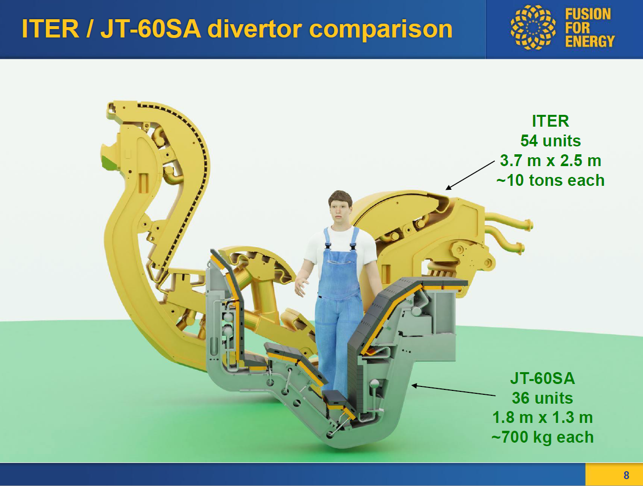
Actively-cooled plasma facing components design for W7-X and JT-60SA
IN SUPPORT OF ITER
¹M.RICHOU, M. FIRDAOUSS, D. DIAS ALEXIO, S. GARITTA, A. DURIF, G. PEYRON, Q. TICHIT, J. GUNN, H. ROCHE
²A. THOMAS, P-E. FRAYSSINES, T. BAFFIE, H. GLEYZES
³G. KERMOUCHE, M. LENCI
⁴J. FELLINGER, G. EHRKE, F. KUNKEL
⁵R. NEU, J-H. YOU, B. BÖSWIRTH, H. GREUNER, D. Dickes, J. RIESCH, Z. WANG, J. TRETTER, K. Hunger and H. Maier
⁶M. WIRTZ, D. Dorow-Gerspach
⁷B. KONCAR, A. Gajsek
⁸V. TOMARCHIO
⁹E. TEJADO, J-Y. PASTOR
¹⁰O. WINDLUND
¹¹S. ROCCELLA, M. Di Bartolomeo
EUROfusion project started in 2021

Slide 2
CONTENT
1.Context
2. W7-X tungsten water-cooled divertor target
3. JT-60SA tungsten water-cooled divertor target
4. Support to ITER

Slide 3
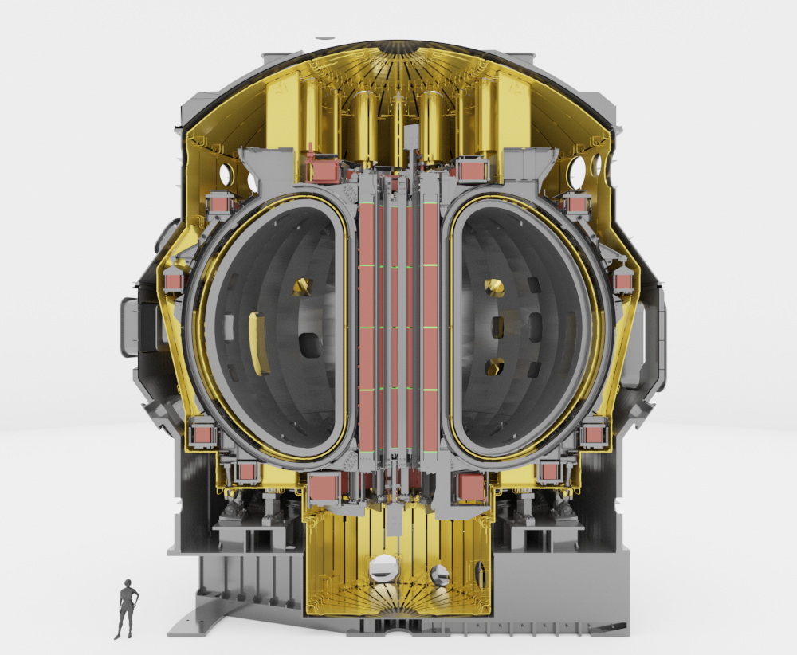
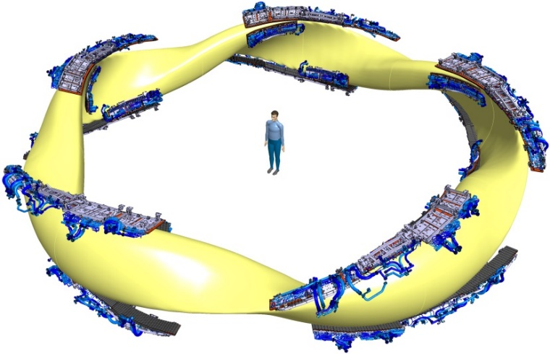
1. Context
W7-X [1]
JT-60SA [2]
10 MW/m² (Steady state)
10 to 15 MW/m² (Steady state)
The armor material of the current divertor targets is carbon for both devices
Currently, the W7-X divertor targets are actively-cooled whereas for JT-60SA, the divertor targets are uncooled
To be reactor relevant (W7-X) and to be relevant with the broader approach objectives (JT-60SA):
  The armor material is proposed to be metallic
  The divertor targets need to be actively-cooled
 Transition needed from carbon divertor targets to tungsten water-cooled divertor targets
[1] J. Fellinger et al, 2023 Nucl. Mat. and En.
[2] JT-60SA website

Slide 4
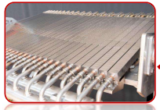
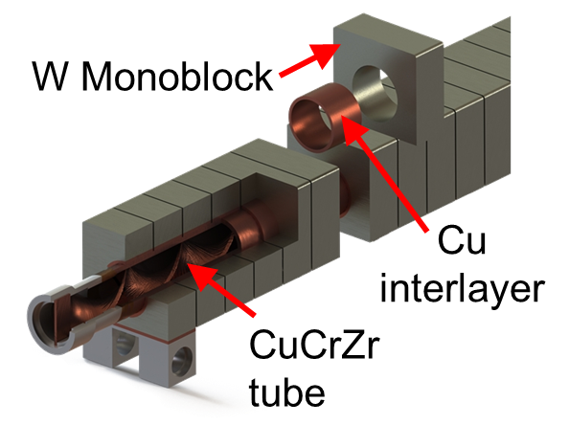
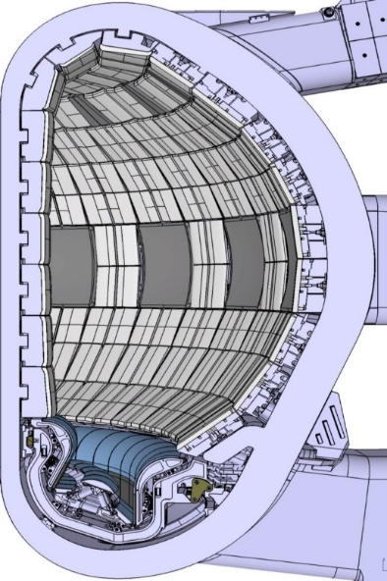
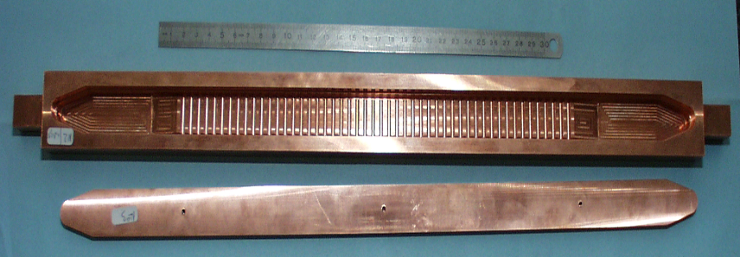

1 Context: Concept vs heat load capability
4
Flat tile – Circular channel
Monoblock
WEST
10-15 MW/m²
20 MW/m²
500 mm
~28 mm
W – 3 mm
Interlayer – 1 mm
3 mm
~30 mm
Heat sink (CuCrZr…)
$$φ 12 mm$$
~30 mm
ITER
 The involved manufacturing processes are mature (EAST)
The involved manufacturing processes are mature (WEST, EAST, KSTAR)
Enhanced: Flat tile
– Rectangular + fin channel
10-25 MW/m²
 The manufacturing maturity is under investigation
W – 3 mm
Interlayer
6
CuCrZr
6
491 mm
CuCrZr
Schematic cut view
    On manugactured mock-ups, the qualification of the design/assembled materials consist in the demonstration of robust and reliable performance
    Modeling (cooling)
    He leak tightness of heat sinks
    Cyclic HHF resistance

Slide 5
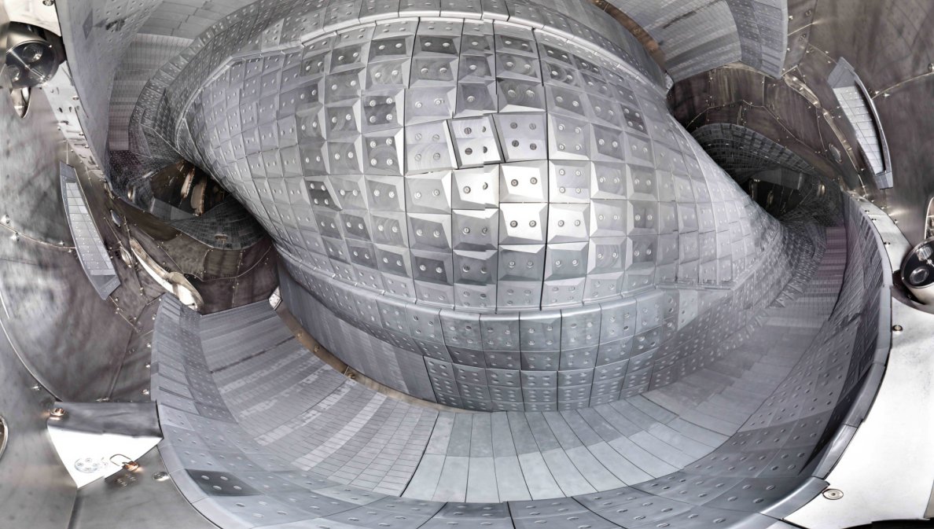
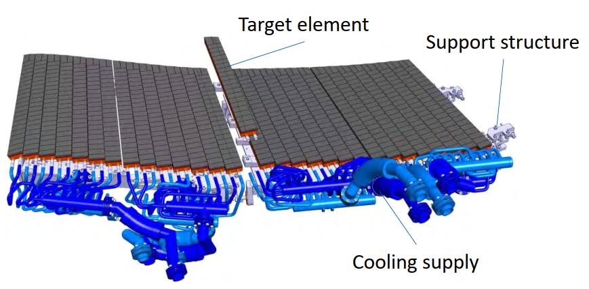
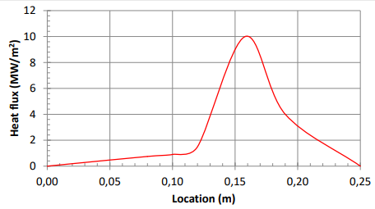
2. W7-X water-cooled divertor – Divertor targets
Stellarator
W7-X
Twisted
plasma
10 Divertor
units
~ 300 mm
Present target modules
Steady state heat loads
250- 600 mm
~50 mm
Water-Cooling Conditions :
P=10 bar, V=9 m/s, T=30°C-80°C, swirl
Notes:
10 divertor units – 12 divertor modules/divertor unit 890 target elements (TEs)
The divertor units must remove up to 10 MW of power and particle under stationary conditions up to 30 minutes.
To this end, the divertor units are water-cooled
More neutrals into the pumping gap
W target is a opportunity to improve particle exhaust
Change the angle of the PFC
Improve the edge tile technology to handle higher heat flux.

Slide 6
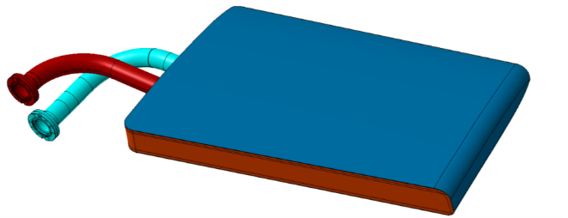
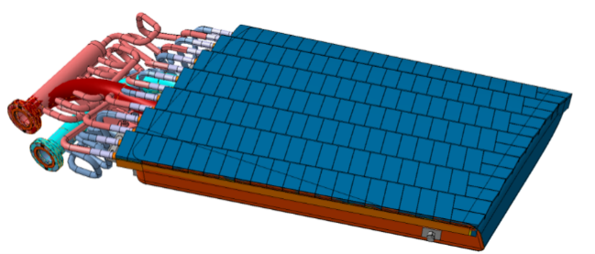
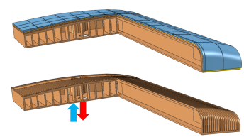
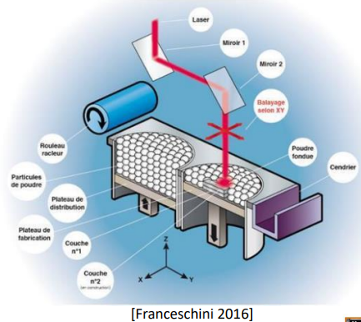
2.1. W7-X divertor targets with W armor material
  Assumptions for the future design:
    Keep the present cooling system
    Minimize the interface changes between the target and the divertor support structure (similar weight…)
    Materials: W based material (thickness ~300 µm), CuCrZr (thermal conductivity)
@Joris : Erosion calculation ?
Erosion rate 0.2 nm/s (Erosion marker in W7X)
https://iopscience.iop.org/article/10.1088/1402-4896/ac3b68
15 years * 40 days
1800 s /day
W:
220 µm
Future
 Manifold included in the target (+ small channel ~3.6 mm)
 W based material as coating
 The use of additive manufacturing for the manufacturing of the heat sink (CuCrZr) may represent an advantage (reduce the manufacturing/testing steps, cooling optimization)
W
Present
CuCrZr
Size ~0.4m x 0.6 m x 50 mm
[1] J. Fellinger et al, 2023 Nucl. Mat. And En.
Laser powder bed fusion (LPBF)

Slide 7
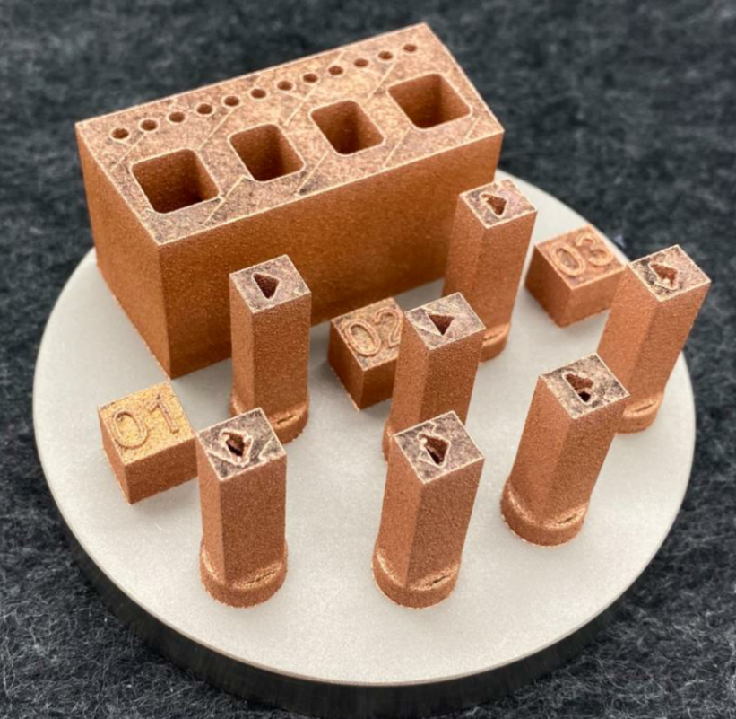
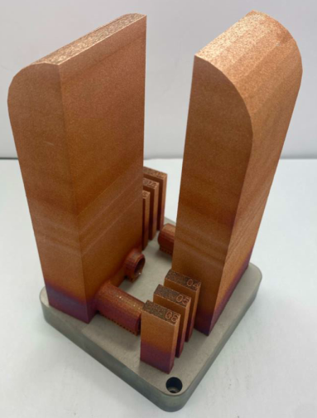
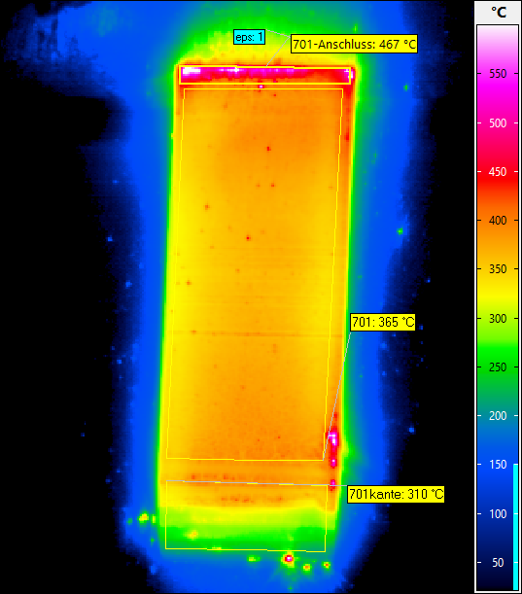


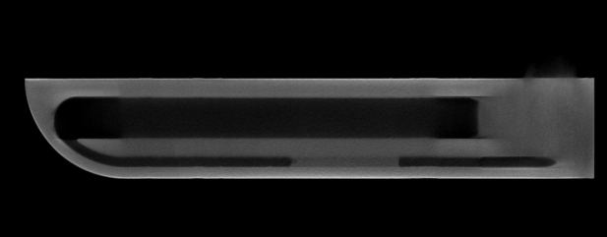
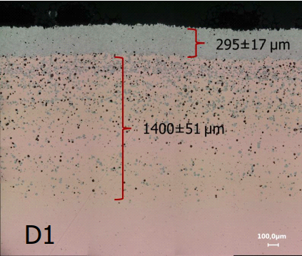
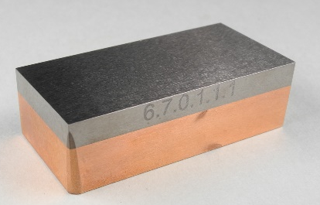

2.3 Technology and testing
Additive manufacturing parts (manufacturing and testing)
Leak tight at 150 °C 28 bar and density >99,8% w/o density-increasing post-process
Mean surface temperature ~ 370°C@10 MW/m² (<450°C)
ɸ 100 mm
~100 mm
 Successful high heat flux tests
98 mm
Proposed concept is promising (manufacturing and heat flux handling capability)
Armor material
Armor and interlayer
Next steps:
Define the final joining technology by testing
Complete full scale mock-up
W/Cu and W+Ni+Fe top layer
40 mm
Galvanisation, diffusive welding…

Slide 8
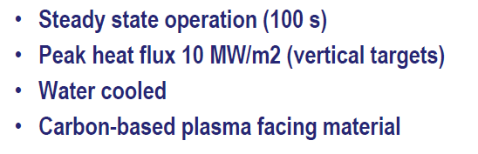
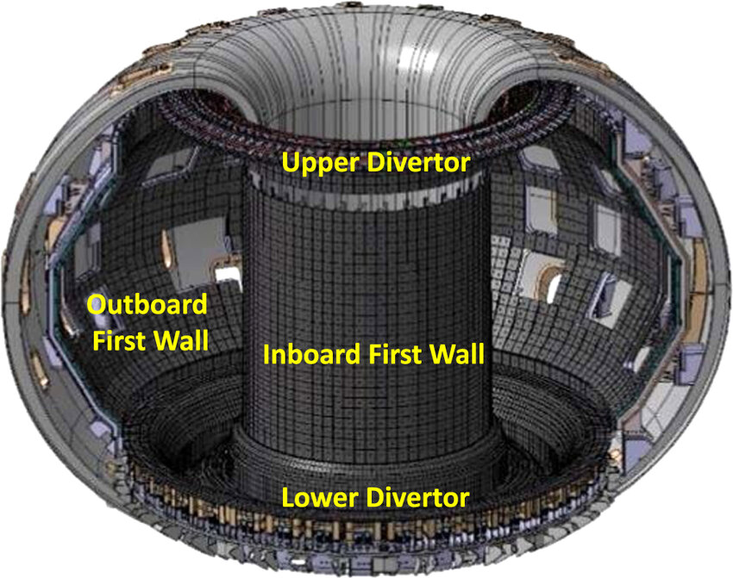
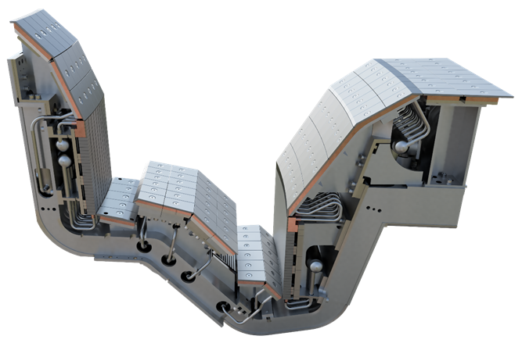
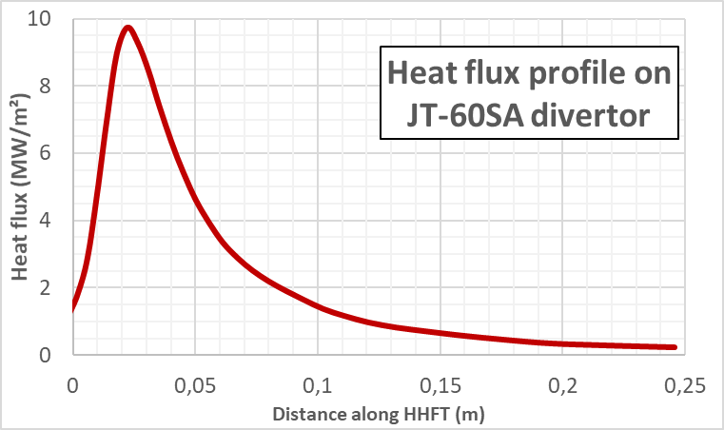
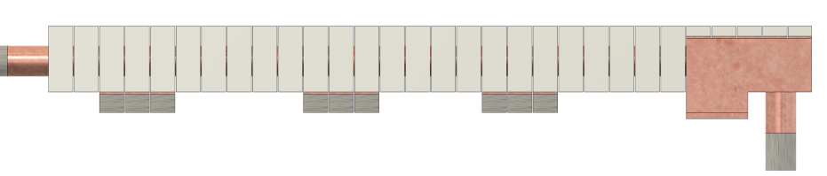
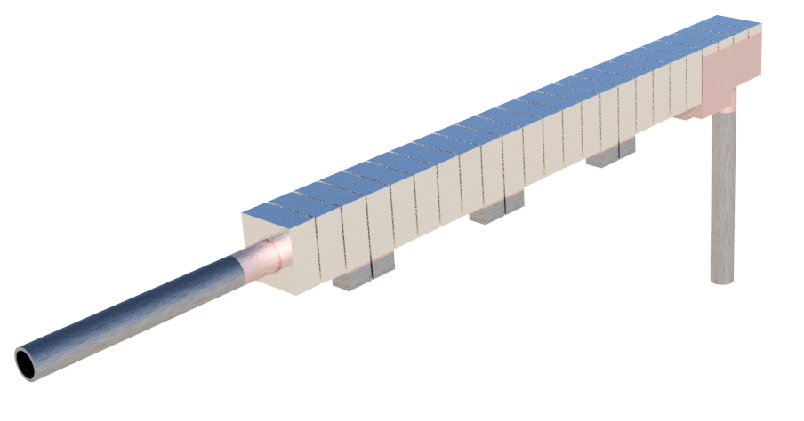
3. JT-60SA water-cooled divertor – Divertor targets
Cassette
Steady state heat loads
QST credit
Cooling conditions :
20 bar, 7m/s, 40°C, swirl
Target element
Monoblock concept (as ITER) was chosen as reference concept in 2024 since it benefits from an important feedback (series manufacturing, few years of operation under tokamak environment)
Materials: W based material, CuCrZr (thermal conductivity)
Flat tile part is needed for the 90° transition
8.5 mm W thickness
CuCrZr
371 mm
Notes:
Fin de fab 2028
Insatllation 2030
Inlet diameter 12 mm
PSOL (MAX) : 35 MW (p175 PID V4.3)
T60SA
10 MW/m² 100s, 10000 cycles
15 MW/m² 100s 3000 cycles
Based on simulations of the divertor heat load and pumping flux for an ITER-shape LSN plasma with Ip~3MA and Bt =2.45 T, for the vertical target divertor with a V-shaped corner, a significant reduction in the peak heat flux is expected, with plasma detachment foreseen for the maximum level of heating power of 41 MW, provided that radiation fraction is relatively large, i.e. Prad/Pout >~ 50%. It is also foreseen that control of the divertor detachment and reduction in the plasma density could be established by an X-point shift as well by reducing the gas puff rate. Based on scaling of particle confinement time for the ELMy H-mode plasmas in JT-60U, pellet fuelling from the high-field-side with a fuelling rate of ~1x1022 s -1 will be required to increase the density up to the Greenwald density (1.3x1020 m-3 ) in a 5.5 MA plasma. This fuelling rate shall be achieved at an injection frequency of ~12 Hz using 2.5 mm cube pellets, or ~20 Hz with 2.1 mm cube pellets

Slide 9
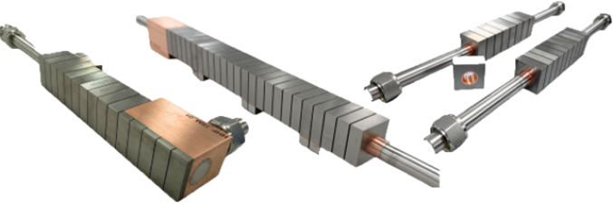
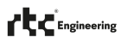
3.1 Manufacturing and qualification steps for JT-60SA W monoblocks
F4E is in charge of the delivery of the JT-60SA tungsten actively-cooled divertor target
Manufacturing activities for the reference concept started in 2024, intermediate scale mock-ups are already manufactured
These components have been tested at 10-15 MW/m² under steady state conditions and at 20 MW/m² for 2-second pulses.
 First results are promising
W depth 8,5 mm
32 mm * 11,9
Gap 0,5
Next step: Full scale prototypes to be manufactured and tested

Slide 10
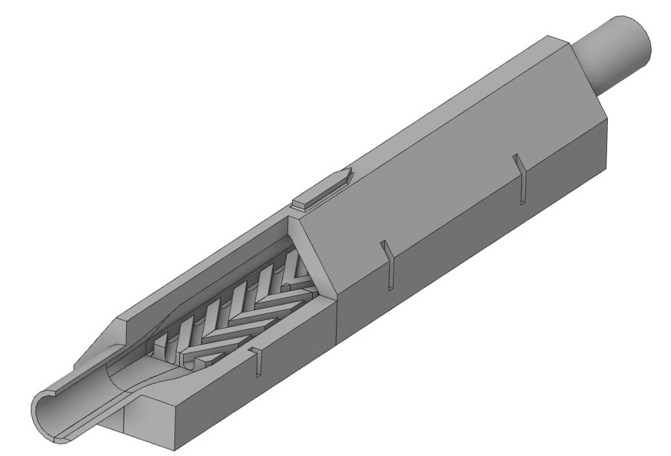
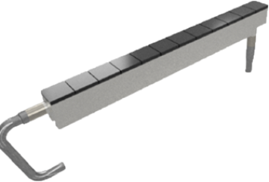
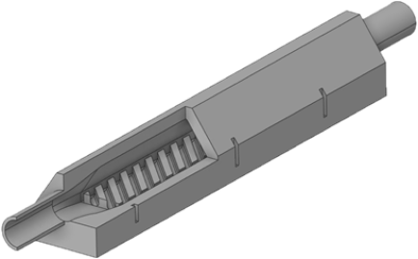
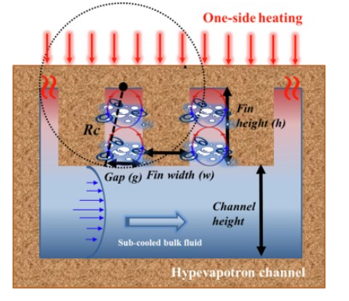
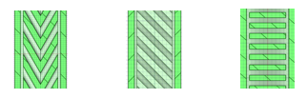
3.2 Enhanced concept
Aim with regard to the reference concept:  cost ,  heat flux handling capability
 Cost: Flat interface between W and CuCrZr (also developed at NIFS, Japan)
   Heat flux: Enhanced heat transfer coefficient in the cooling channel
Manufacturing solutions:
  Additive manufacturing (LPBF) used to manufacture CuCrZr heat sink
  Armor material (W) planed to be assembled with hot isostatic pressing (mature process)
First, assess the manufacturability/heat flux handling capability of the CuCrZr heat sink presenting enhanced heat transfer
Chevron
Diagonal
371 mm
CuCrZr heat sink
Heat flux direction
[1]
[1] J. Hwan Lim et al, 2022 Appl. Thermal Eng.

Slide 11
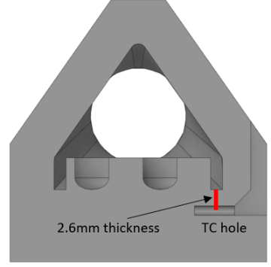
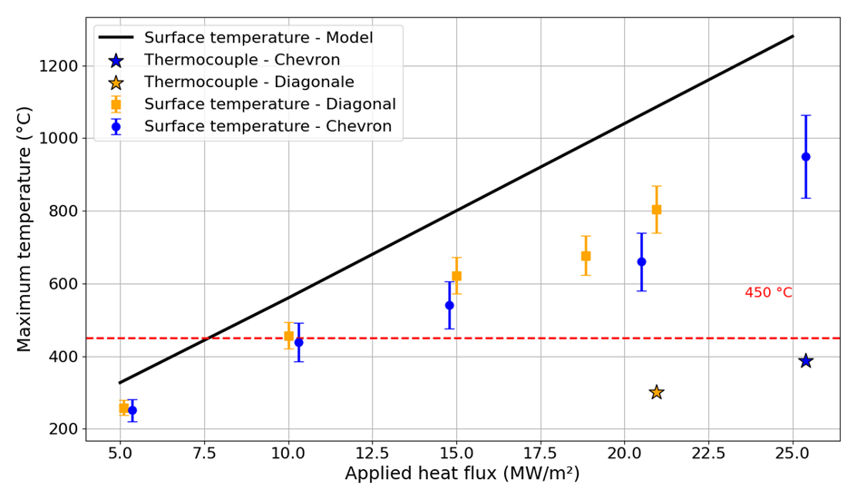
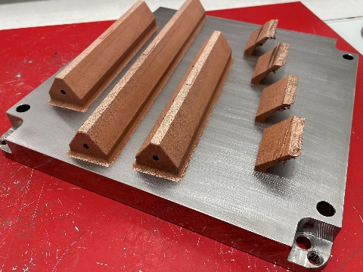
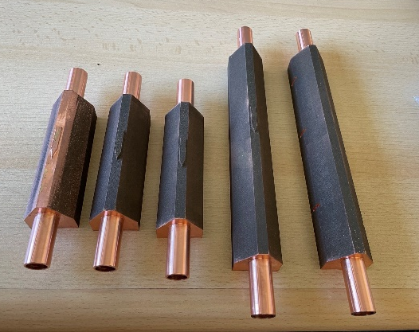
3.2.1 Technology and testing
High heat flux testing
Additive manufacturing parts
9 mm
270 mm
270 mm
260 mm
160mm
Temperature assessed by modeling provides conservative values (Need of modeling effort)
For a divertor target with 3 mm of heat sink above the fin, the expected maximum T°C is below the material T°C limit
Mock-ups
Proposed enhanced concepts are promising (manufacturing and heat flux handling capability)
Next steps:
Modeling effort
Complete mock-up (W on CuCrZr)

Slide 12
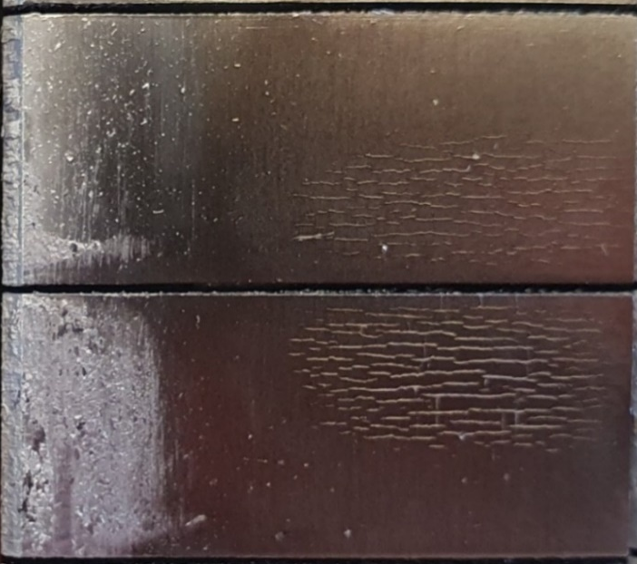
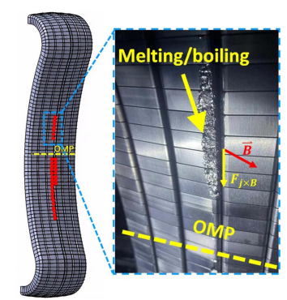
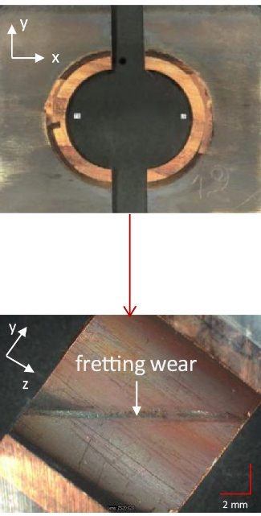
4. Support to ITER
  ITER tungsten divertor target (monoblock concept) is qualified (5000c@10MW/m² + 300c@20 MW/m²)
  Challenge: Define the lifetime assessment for the ITER tungsten divertor target to provide margin with regard to the ITER plasma operation
  Need: Maximum feedback from the maximum of fusion devices running with tungsten water-cooled divertor targets
Fretting:
WEST PFUs [3]
Cracking: WEST [1]
Melting: EAST [2]
12 mm
Crack Network
MB26
See Y. Corre talk; 17/10 4:30 PM
[1] A. Ekedahl et al, 2024 Oral at SOFT conference
[2] Z. Guo et al, 2024 Nucl. Fusion
[3] S. Baydoun et al 2025 Fus. Eng. And Des.
B. Gao, Plasma-facing components damage and its effects on plasma performance in EAST tokamak

Slide 13
4. Support to ITER
Feedback from the operation of metallic divertor targets in fusion devices environment: no transient (W7-X) vs transients (JT-60SA)
ITER OPERATION
2034 (SRO) Actively-cooled tungsten divertor
2039 (DT1) Actively-cooled tungsten first wall
Evaluate the potential use of additive manufacturing for the ITER actively-cooled tungsten first wall
Feedback from the plasma operation of plasma facing components manufactured with additive manufacturing
MANUFACTURING OF ITER PLASMA FACING COMPONENTS
JT-60SA tungsten water-cooled divertor target: Installation planned in 2029
W7-X tungsten water-cooled divertor target: Qualification planned in 2027
The series manufacturing of W7-X and JT-60SA tungsten water-cooled divertor target will be completed too late for providing inputs for the manufacturing of the ITER tungsten divertor target

Slide 14
Conclusions and prospects
The tungsten actively-cooled divertor target reference concepts:
      Solution already tested in tokamak environment: monoblock concept for JT-60SA
      Long term solution: additive manufacturing with flat tile concept for W7-X
The tungsten actively-cooled divertor target alternative concept (JT-60SA) is developed to handle at least the required heat flux while being manufactured with lower cost
Results:
  Developed tungsten plasma facing components are able to sustain the required heat loads
    up to10-15 MW/m² for the reference concepts (W7-X and JT-60SA)
    >24 MW/m² for the alternative concept (JT-60SA)
Next steps:
  Model improvement (thermo-hydraulic)
  Continue and finalize the manufacturing and qualification activities
  The quality insurance for series manufacturing need to be defined for components manufactured with additive manufacturing

Slide 16
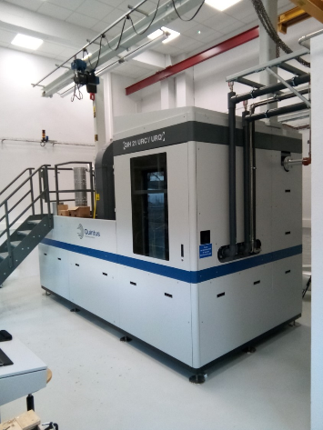
2.3.2 Hot isostatic pressing (HIP) vessel
For the HIP at CEA Laboratory (Grenoble), two different modules exists
A Uniform Rapid Cooling module (URC) to reach ~100°C/min
A Uniform Rapid Quenching module (URQ) to reach ~2000°C/min
Larger HIP vessel with this technology (Ф400mm, H1000mm, ∼ 600°C/min) also available (Equipex CALHIPSO)
QIH 21 –URC module
Max pressure of the vessel (MPa) | 207
Max pressure for URC mode(MPa) | 163.35
Max temperature (°C) | 1400
Max height (mm) | 700
Max diameter (mm) | 228
Max cooling rate (°C/min) | 200
Max work load (kg) | 175
Thermal homogeneity(°C) | ± 10
Notes:
compare to 5s for cool down from 500 °C to RT for target element in W7X = 6000 K/min

Slide 17
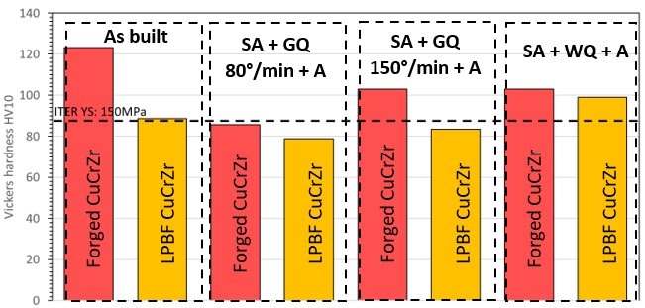
123
103
105
99
89
86
83
86
GQ = Gas Quench ; WQ = Water Quench
SA = 980°C/2h, A= 580°C/2h

Slide 18
HIP process
The first step is a high temperature and a high-pressure HIP cycle to bind the austenitic stainless steel to the CuCrZr heat sink.
  This HIP cycle is done at 1040°C for two hours if 316L(N)/316L(N) and 316L(N)/CuCrZr joints are made at the same time or, at 980°C for two hours to make only 316L(N)/CuCrZr joint.
As the cooling rates inside almost all the industrial HIP vessel are low, a post HIP solution annealing heat treatment is done to recover the CuCrZr mechanical properties.
  This second step is performed at 980°C for one hour in an other furnace and ends by a gas quench at 60°C/min minimum as required by ITER.
The last step is a new HIP cycle to join the W armour tiles to the CuCrZr heat sink. For the fabrication of the PFW panels
  this HIP cycle is done at a higher temperature than the best CuCrZr hardening temperature (580°C instead of 480°C) to enable the diffusion bonding to proceed [1].
This compromise leads to an overageing of the CuCrZr alloy and a reduction of its optimal mechanical properties

Slide 19
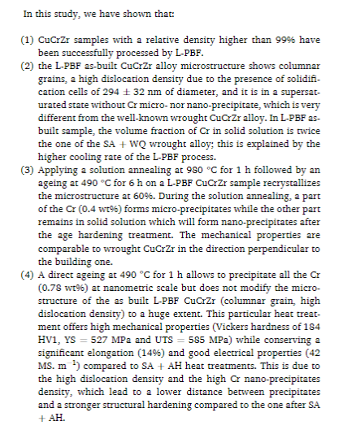
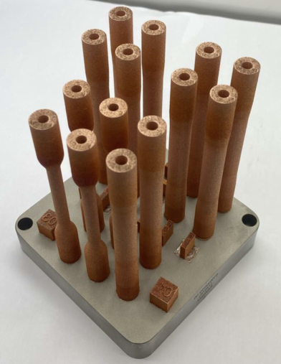
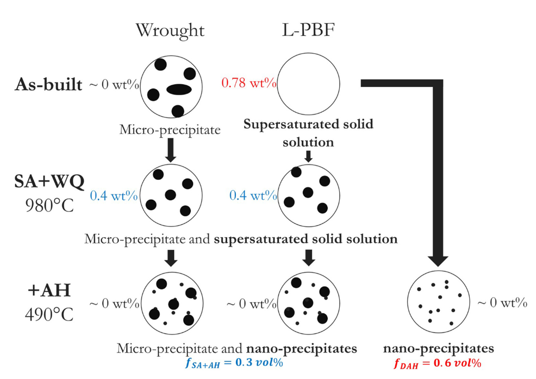
2.3.1 Process parameters – Achieved bulk materials
  Main characterizations
    Densities (closed porosities)
      →Criteria/goal: Highest as possible
      → Achieved: 99.8 % (W7-X) – 98.2 % (JT-60SA)
      (May be fully densified after one Hot isostatic pressing (HIP))
      Tightness (Open porosities)
    → Criteria: max. allowable He-leakage rate 1*10⁻⁹ mbar*l/s
    at 150 °C 28 bar w/o density-increasing post-process
    Thermo-physical and mechanical properties
    Criteria/goal: Sufficient properties after the complete heat conditions faced by the plasma facing component (manufacturing route + operation)
    ( ~ITER grade for the JT-60SA project, < ITER grade for the W7-X project)
Notes:
HIP lead to close closed porosities
For another batch of CuCrZr manufactured in the same lab
Elongation lower than wrought CuCrZr explained by residual porosity
High YS of Direct aged CuCrZr due to high density of nano-Cr precipitates and still high dislocation density
Ability to tailor mechanical properties by tuning the heat treatment conditions
These heat treatments decrease the optimal CuCrZr mechanical properties because of
Imperfect cooling rate after the solution annealing heat treatment (gas quench above 60°C/min)
Over ageing to bond the armour on the solution annealed CuCrZr
W7X He tight: measured at RT and 40 bar inner Helium pressure in vacuum and 160 °C and 28 bar inner Helium pressure in vacuum (W7X)
JT60SA

Slide 20
2.3.6 Non-destructive techniques to check the quality after CuCrZr additive manufacturing
De-powdering solutions
  Mechanical shaking
  Pressurized liquid flow through channels
    Measuring powder rests in the liquid
CT-scan mandatory to check the remaining powder
  80 µm resolution
  Max size: ~900 x Ø600 mm
  Cost depends on resolution
He leak test mandatory (open porosities)

Slide 21
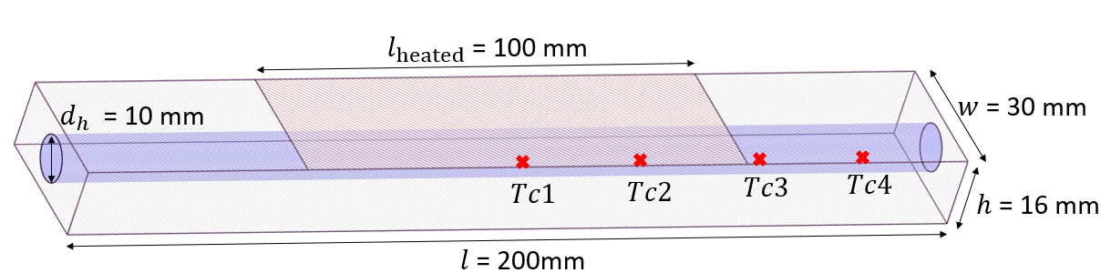
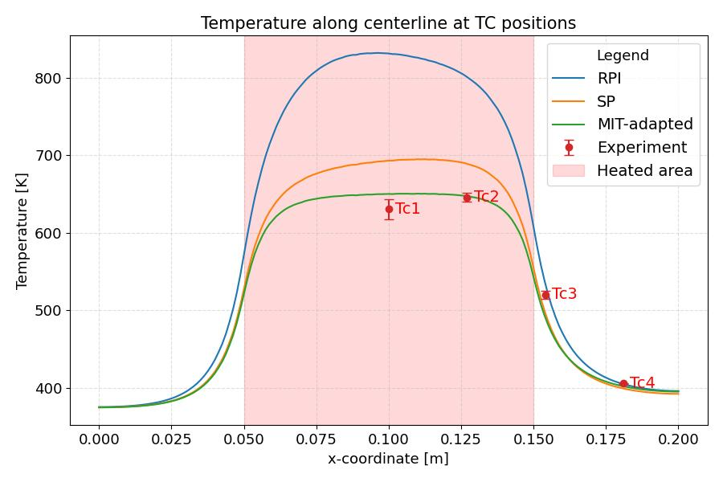
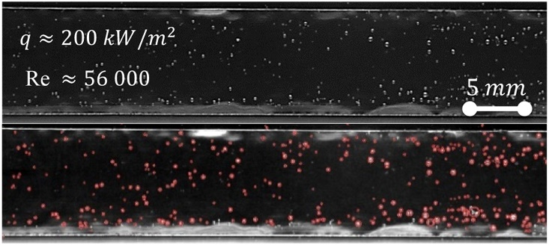
3.2.2. Improve modeling
With the correlation of experimental and simulation results : current CFD boiling models provide unphysical results (too high temperatures) [1]
 Model has been developed (adapted model [2])
 A setup has been implemented (FEDORA [3]) to provide bubble size and density for model input
HADES - High Heat Flux experiment
Single phase (SP) simulation
RPI( Rensselaer Polytechnic Institute)
[1] Končar et al., Int. J. Heat Mass Transf. 254 (2026)
[2] Kommajosyula, R., 2020, PhD Thesis
[3] Gajšek et al., Fusion Eng. Des. 218 (2025).
Notes:
Bubble sliding mechanism solves temperature overprediction
VALIDATION
On HHF experiment (HADES)
The physical mechanisms of the model (two-phase parameters) will be evaluated using FEDORA

Slide 22
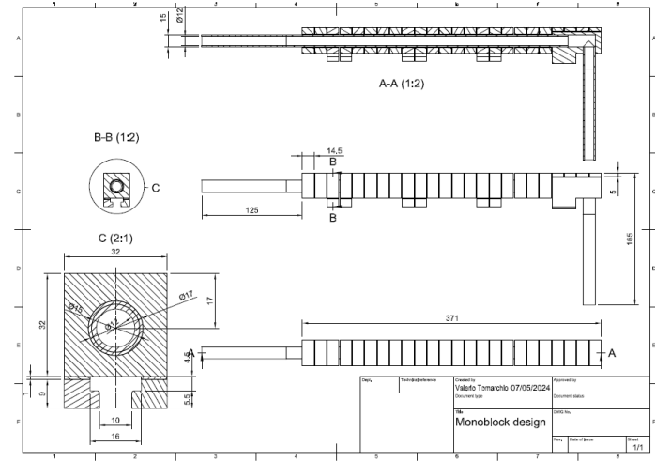

Slide 23
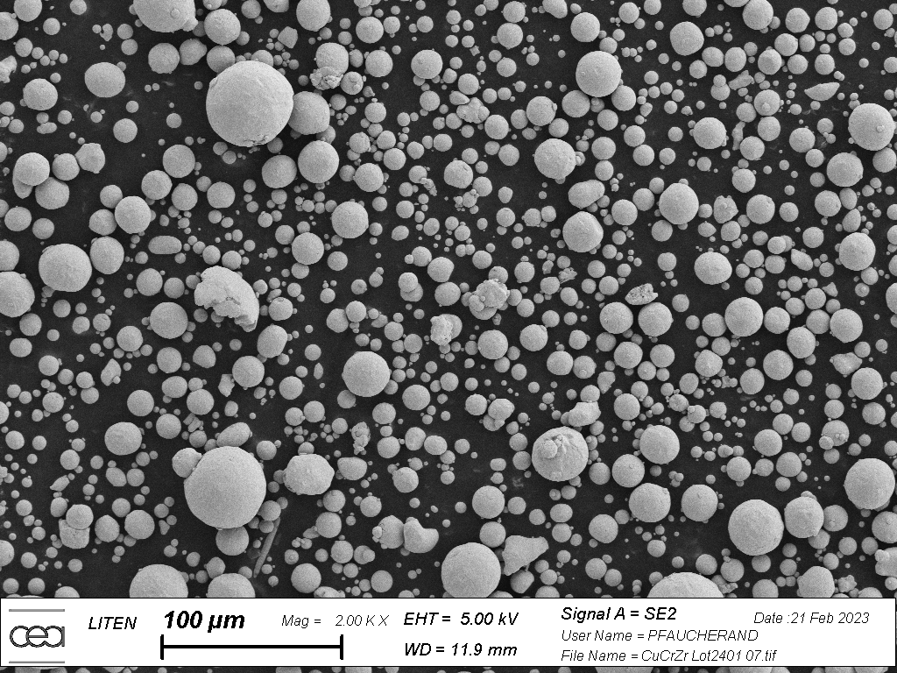

2.2 Additive manufacturing
Laser powder bed fusion
Used when >99% dense parts of medium size (from 1cm³ up to 1m³) with internal mm-size channels. Precision~0.1 mm
Steps for qualification
  Powder properties set to
    achieve LPBF manufacturing
    achieve adapted properties on bulk materials (O, Cr, Zr… contents)
  Bulk materials characterization
  Mock-up testing and qualification (CuCrZr part)
Samples
280 mm x 280 mm
98 mm

