Slide 1
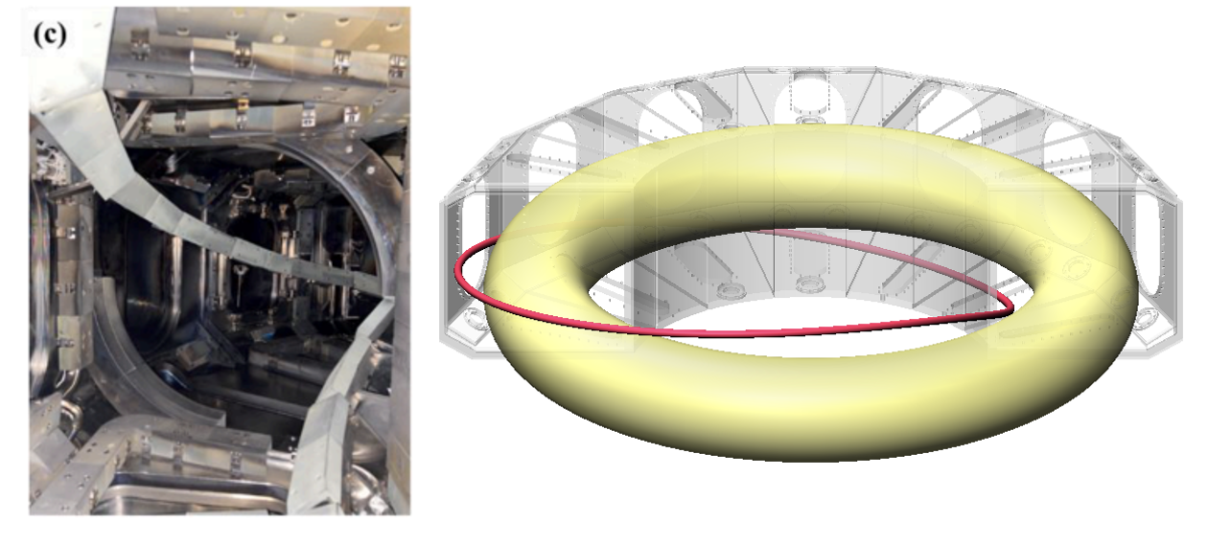



Analysis and Simulation of Effective Runaway Electron Mitigation Using a Passive Coil in J-TEXT Disruptions
Chang Liu (刘畅)¹, Junhui Yang (杨骏辉)², Qihang Li (李其航)¹, Zhonghe Jiang (江中和)², Nengchao Wang (王能超)², Steven C. Jardin³, Nathaniel M. Ferraro³
¹Peking University
²Huazhong University of Science and Technology, J-TEXT team
³Princeton Plasma Physics Laboratory
30th IAEA Fusion Energy Conference (FEC2025)
changliu@pku.edu.cn
Notes:
Thank you chairman. Hello everyone This is Chang Liu from Peking Univeristy. It is an honor to present my resent work on Analysis and Simulation of Effective Runaway Electron Mitigation Using a Passive Coil in J-TEXT Disruptions
I would like to thank all my collaborators, especially the J-TEXT team from Huazhong University of Science and Technology, and the M3D-C1 team

Slide 2
Outline
Successful demonstration of passive coil runaway electron mitigation on J-TEXT
Modeling passive coil and runaway electron interaction with MHD using M3D-C1
Self-consistent simulation of runaway electron mitigation with MHD instabilities and passive coils
Summary
Notes:
This is the outline of my talk. The most important result is the first successful demonstration of runaway electron mitigation using passive coil on J-TEXT.
This gives us ”A NEW HOPE” for runaway electron mitigation in future.
Then I will introduce our efforts on modeling this results, including the simulation model we used, the challenged we encountered, and I will show more details about the current quench simulation results including both the passive coils and MHD instabilities.

Slide 3
Successful demonstration of passive coil runaway electron mitigation on J-TEXT
Notes:
First the experimental results

Slide 4
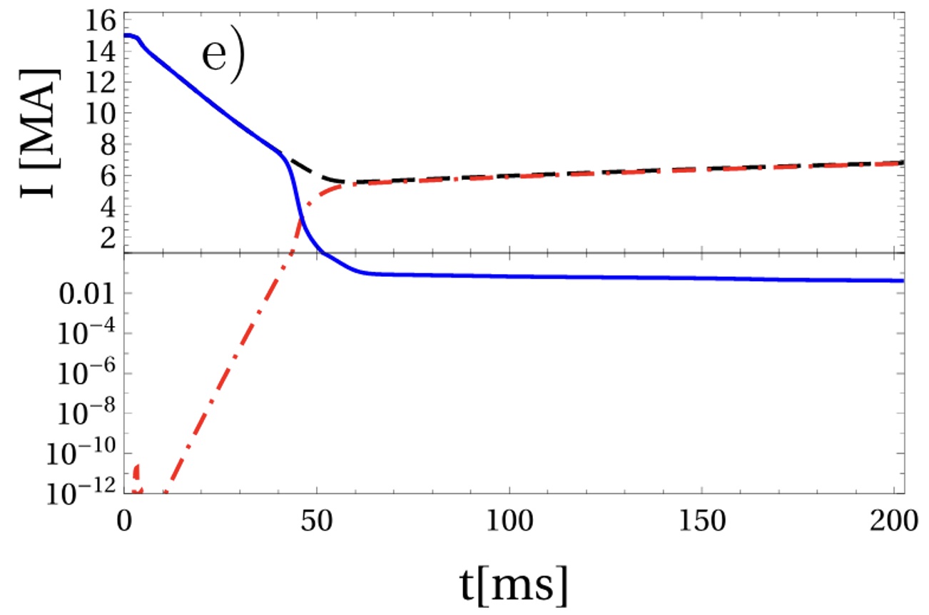
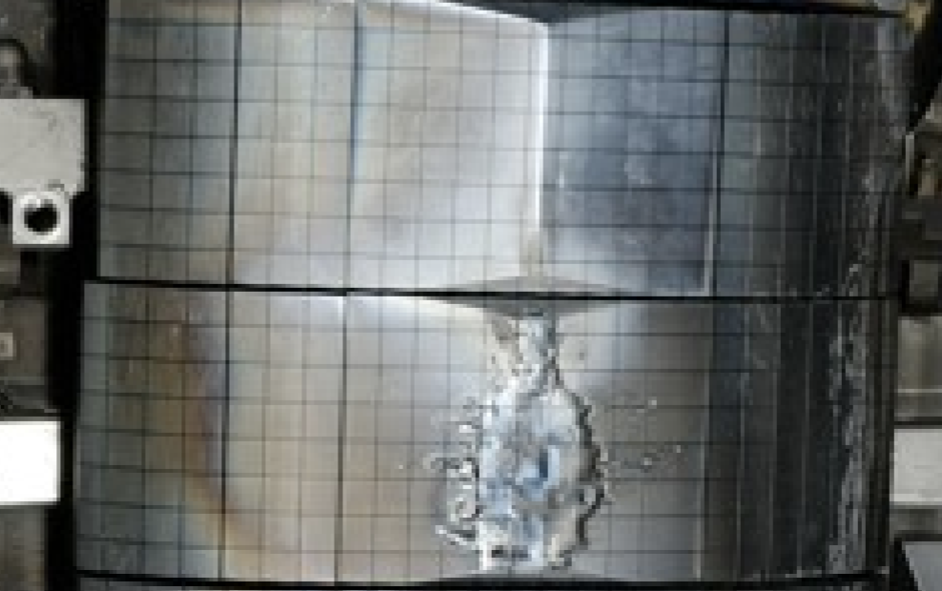
Runaway electrons remain a major challenge in tokamak disruption
Plasma current decay during disruptions induce toroidal electric fields that can produce runaway electrons (REs)
  Inductive electric field accelerates REs and drives an avalanche growth through large-angle collisions, forming a runaway current plateau
  In the “final loss” phase after plateau, REs can strike the first wall uncontrollably, potentially damaging wall materials and internal components
Mainstream RE mitigation: impurity injection to increase collisionality and suppress acceleration and avalanche
  Challenges: impurity penetration into the core, tritium decay on seed RE production, highly localized deposition of RE beam
Novel RE mitigation strategy:
Introduce magnetic perturbations
➤ Break RE confinement
➤ Suppress RE growth and reduce energy flux to the first wall
Avalanche growth of RE current in ITER using DREAM (Vallhagen 2024): across 12 order of magnitude
Melting of JET Be limiter tiles due to RE beams
(Reux NF 2015)
Notes:
Thanks to the previous talks, I guess I don’t need to give more about the importance of runaay electron and challenges of its mitigation. I just want to mention that, aside from the word “runaway” meaning electron can get accelerated continuously, the more tremendous issue with runaway electron is its avalanche growth. As shown in the figure figure, for a typical ITER current quench, RE current can experience growth across 12 order of magnitude to megaampere level. This also raise some challenges about its mitigation. Currently the mainstream runaway electron method is thorugh impurity injection to increase collision and suppress avalanche. However, even if there is only a minimal amount of RE, like from the tritium decay process, it can still form a signicant RE current after avalanche. Therefore, it is still necessary to look for novel RE mitigation strategies. The key idea here is to introduce magnetic perturbations, to break the closed flux surfaces and runaway confinement, to promote their loss and counter the avalanche growth. Another important thing is to increase the RE wetted area and reduce the energy flux. For current experiments like JET, an unmitigated RE loss event can result in a small hitting area which is really bad news for ITER. However, introducing magnetic perturbation can lead to so-called benign termination which help reduce the energy flux.

Slide 5
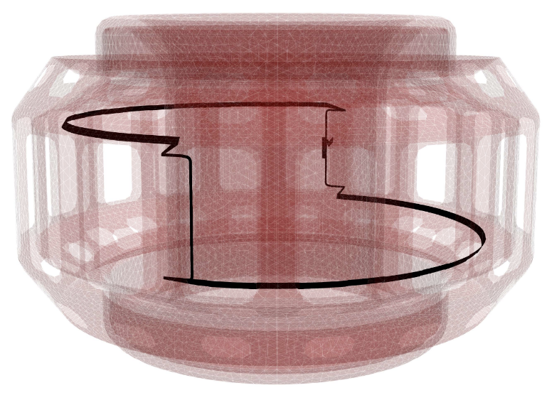
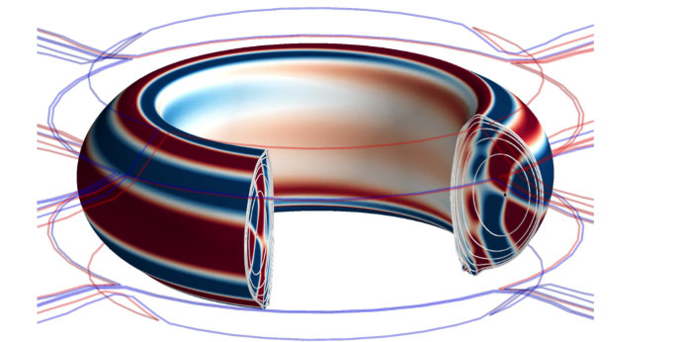
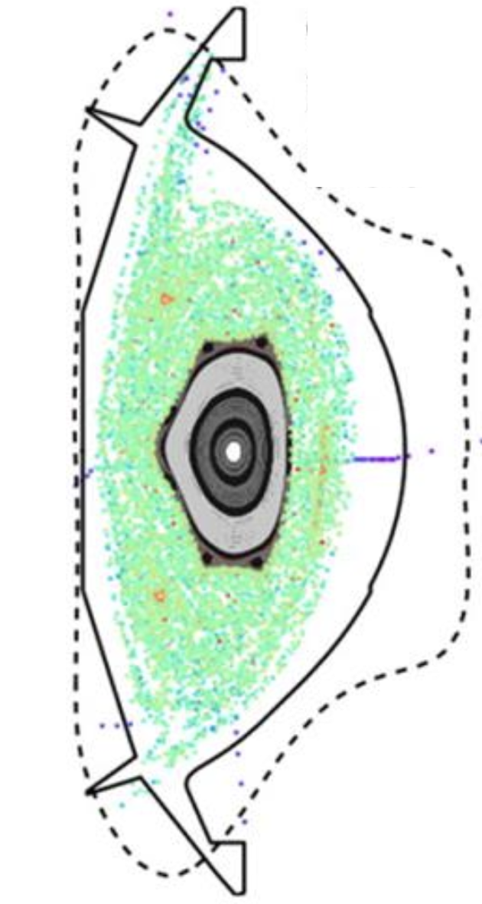
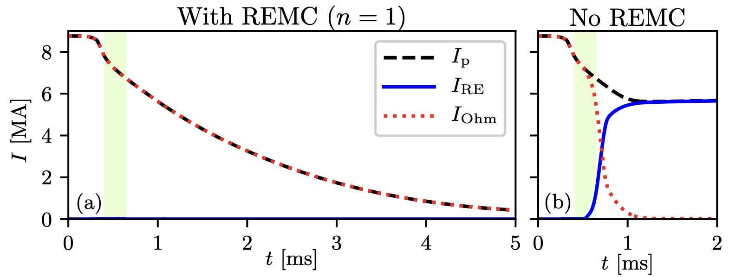
Passive coils provide new pathway for RE mitigation
Inductive loop voltage can also drive current in external coils during current quench
Runaway Electron Mitigation Coil (inspired by RMP coil) can induce non-axisymmetric magnetic perturbations that break magnetic surfaces and create field stochasticity
Multi-code simulations (COMSOL/ThinCurr+ASCOT +NIMROD+DREAM) demonstrate promising REMC effectiveness.
REMC has been selected as one of the primary RE mitigation strategies for SPARC and STEP.
Unresolve physics issues:
  Effectiveness of REMC during the whole CQ phase
  Competition between RE current and coil current
  Lack of self-consistent MHD instability modeling including RE current
Design of Runaway Electron Mitigation Coi in SPARC
(Battey 2023)
3D RMP structure in KSTART
(Park 2018)
Reformation of center flux surface in later phase of CQ
(Izzo 2025)
Simulation shows effective RE suppression in SPARC disruption (Tinguely 2021)
Notes:
A novel and effective pathway to introduce magnetic perturbation in disruptions is through passive coils. We know inductive look voltage can driven ruanway generation, but it can also drive current in external coils. This idea was first prposed by Prof. Allen Boozer. Imagine we have some RMP coils outside the plasma like in the right plot. If we cancel the external current supply but ad some vertical leg to connect the top and bottom coils sections, we got this non-axisyymetric runaway electron mitigation coil (REMC), which you can think of as a more responsive and more powerful RMP coil just targeting RE mitigation. This idea has been tested in a simulation using a combination of multiple codes for SPARC, and the results are very promising. There are also some important benefits for using this methods in compact devices. Therefore, the idea of REMC has been selected as one of the primary runaay electron mitigation methods for SPARC and step. However, it is not the perfect solution. There are still some open questions about whether the magnetic perturbation can last during the whole current quech. As shown in this result from a new simulation work from Dr. Val Izzo, there can be reformation of core flux surfaces in the later phase of current quench, which can be a reservoir of RE avalanche. In addition, most prevous work on modeling REMC is based on one-way coupling, from coil to MHD response and then to RE loss, but a self consistent simulation including RE feedback is still lacking.

Slide 6
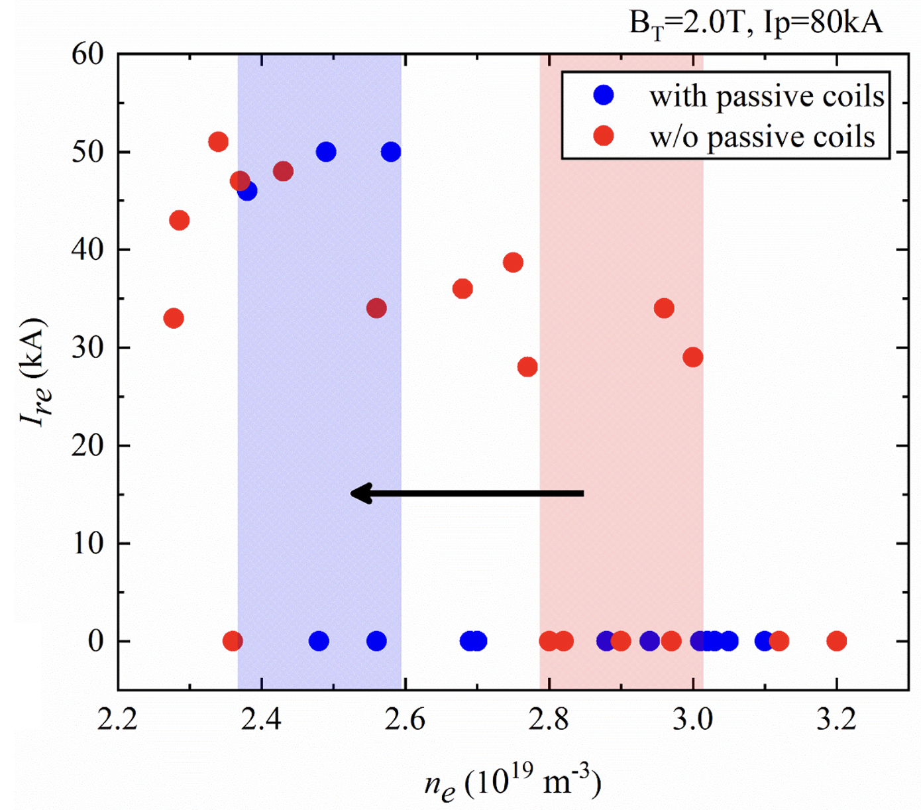
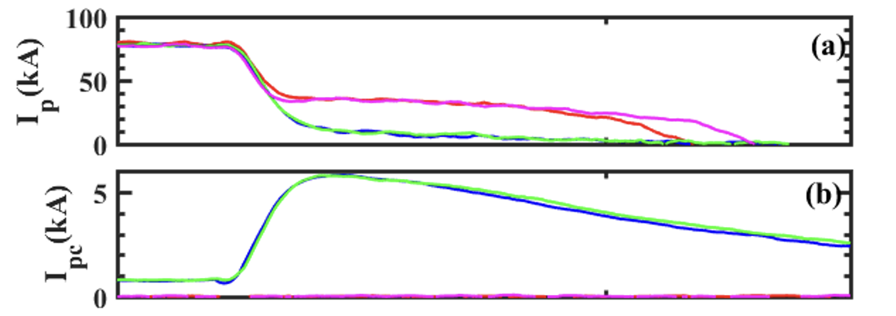
Successful mitigation of RE plateau in J-TEXT using a helical passive coil.
J-TEXT (formerly TEXT-U) is a circular cross-section tokamak with a limiter configuration
  R/a~1.05m/0.26m B~2.0T Ip~200kA
  Disruption triggered by Ar MGI
  RE seeded by pre-disruption ECRH
An n=1 helical coil is installed inside first wall, to test efficacy on RE mitigation in disruptions
The passive coil can significantly lower pre-disruption density required to suppress RE plateau
Passive coil turned on
RE current plateau level vs pre-disruption plasma density

Slide 7
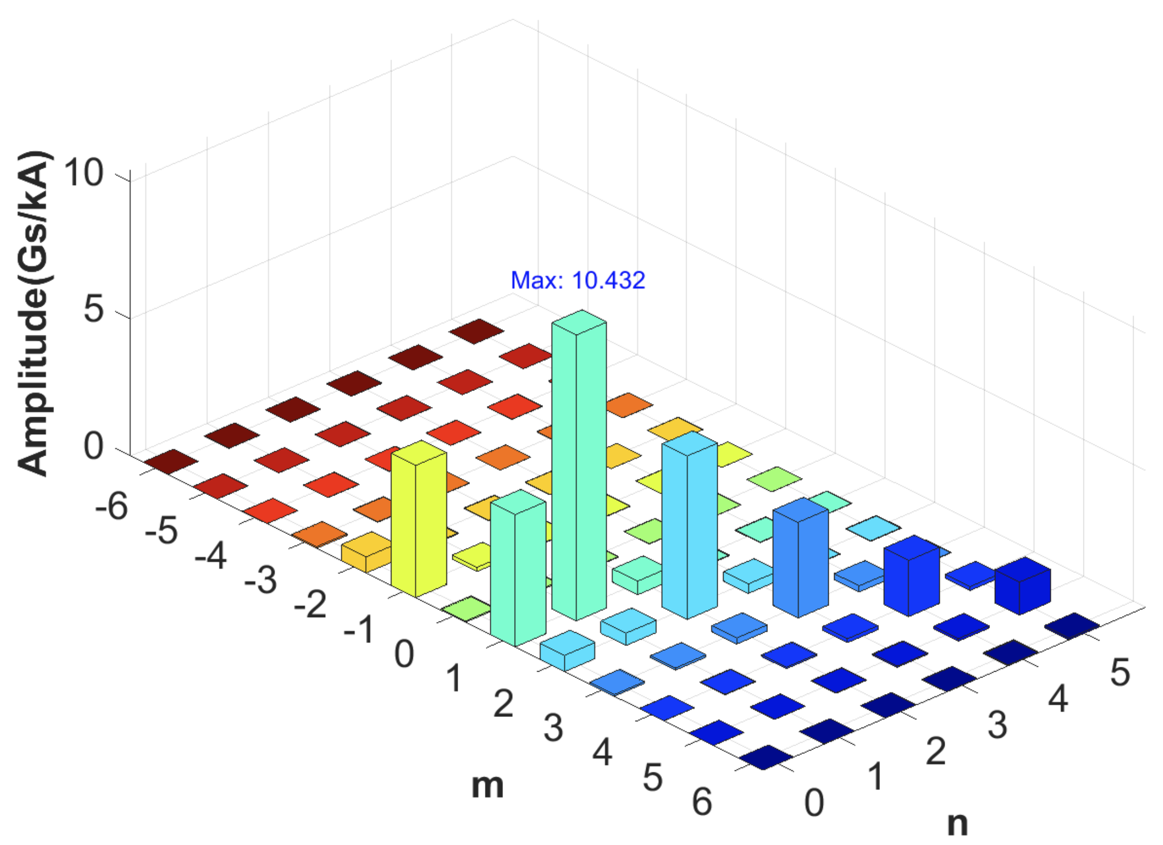
MHD instabilities play key role in RE diffusion
Helical coil alone cannot generate sufficient resonant magnetic perturbation to induce field stochasticity
Simple NIMROD simulation confirms that with the narrow δB spectrum from the coil, flux surfaces remain intact during CQ
MHD modes can act as intermediaries, generate broader spectrum of magnetic perturbation and promote RE loss
Spectrum of δB from helical coil only, from Biot-Savart law
？
MHD
Instabilities
MHD
Instabilities
RE Current
Passive Coil
RE Current
Passive Coil
Passive Coil
RE Current
promote
seed
suppress
suppress
seed
Evidence of MHD instabilities in J-TEXT CQ:
Fluctuation in Mirnov signal and sudden drop of loop voltage

Slide 8
Modeling passive coil and runaway electron interacting with MHD in M3D-C1

Slide 9
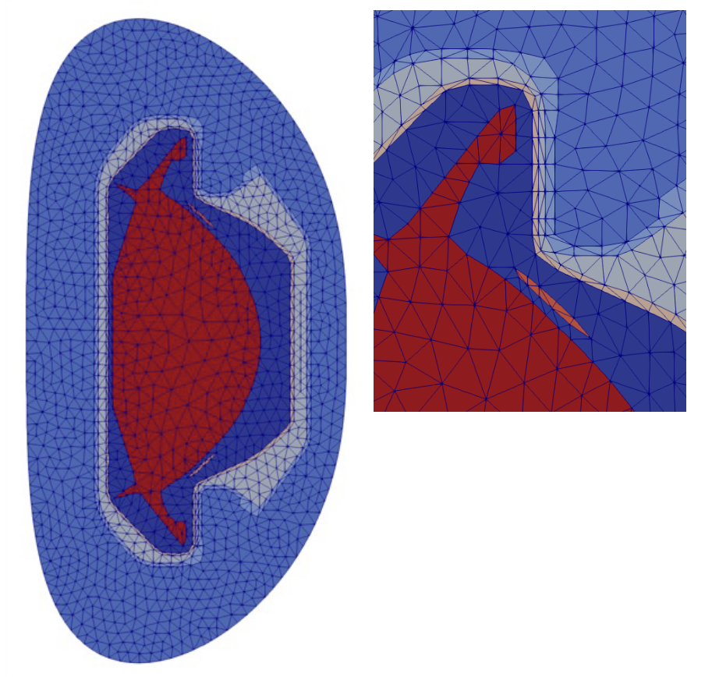
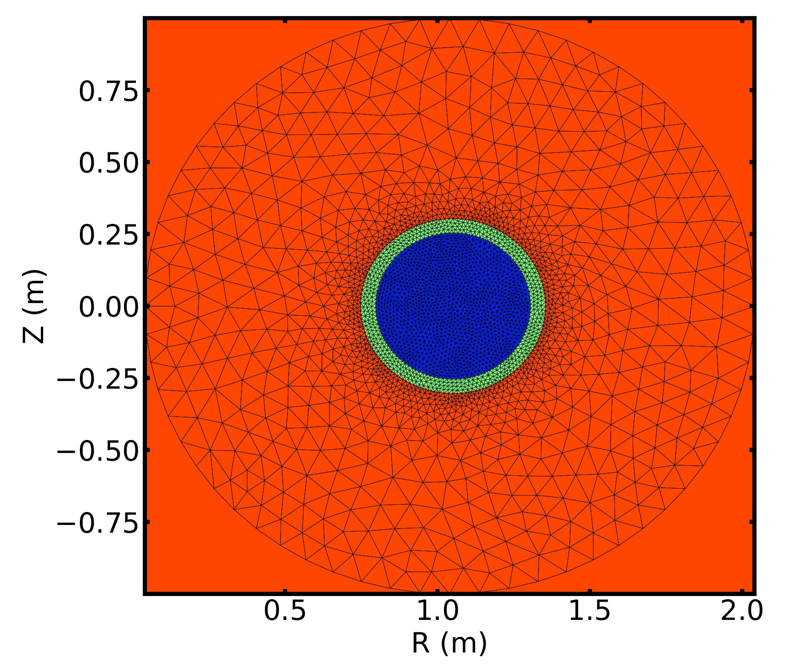
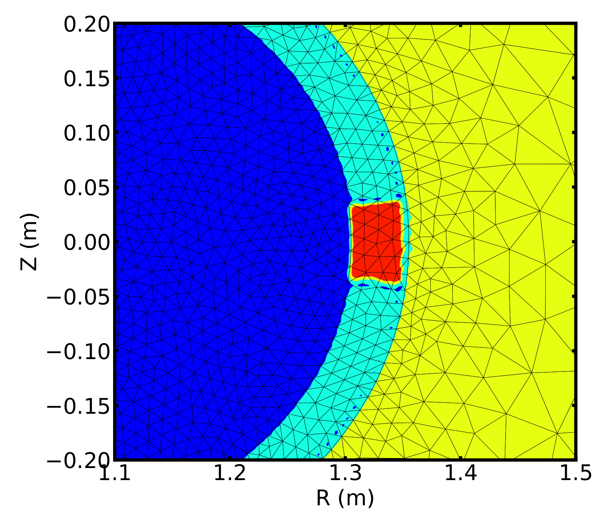
Modeling passive coil activation with M3D-C1
M3D-C1 is an initial-value code that solves the extended MHD equations in tokamak and stellarator geometries using unstructured 3D mesh.
Free-boundary plasma evolution is modeled using a multi-region domain (plasma, wall, vacuum with coil currents)
M3D-C1 is open-source now (https://github.com/PrincetonUniversity/M3DC1)
A low-resistivity 3D channel can be embedded in M3D-C1 resistive wall to model the passive coil, capturing the coupling between the plasma and the coil currents
Plasma
Wall
Vacuum
Multi-region mesh in M3D-C1
(courtesy of Usman Riaz and Seegyoung Seol)
Low-resistivity channel

Slide 10
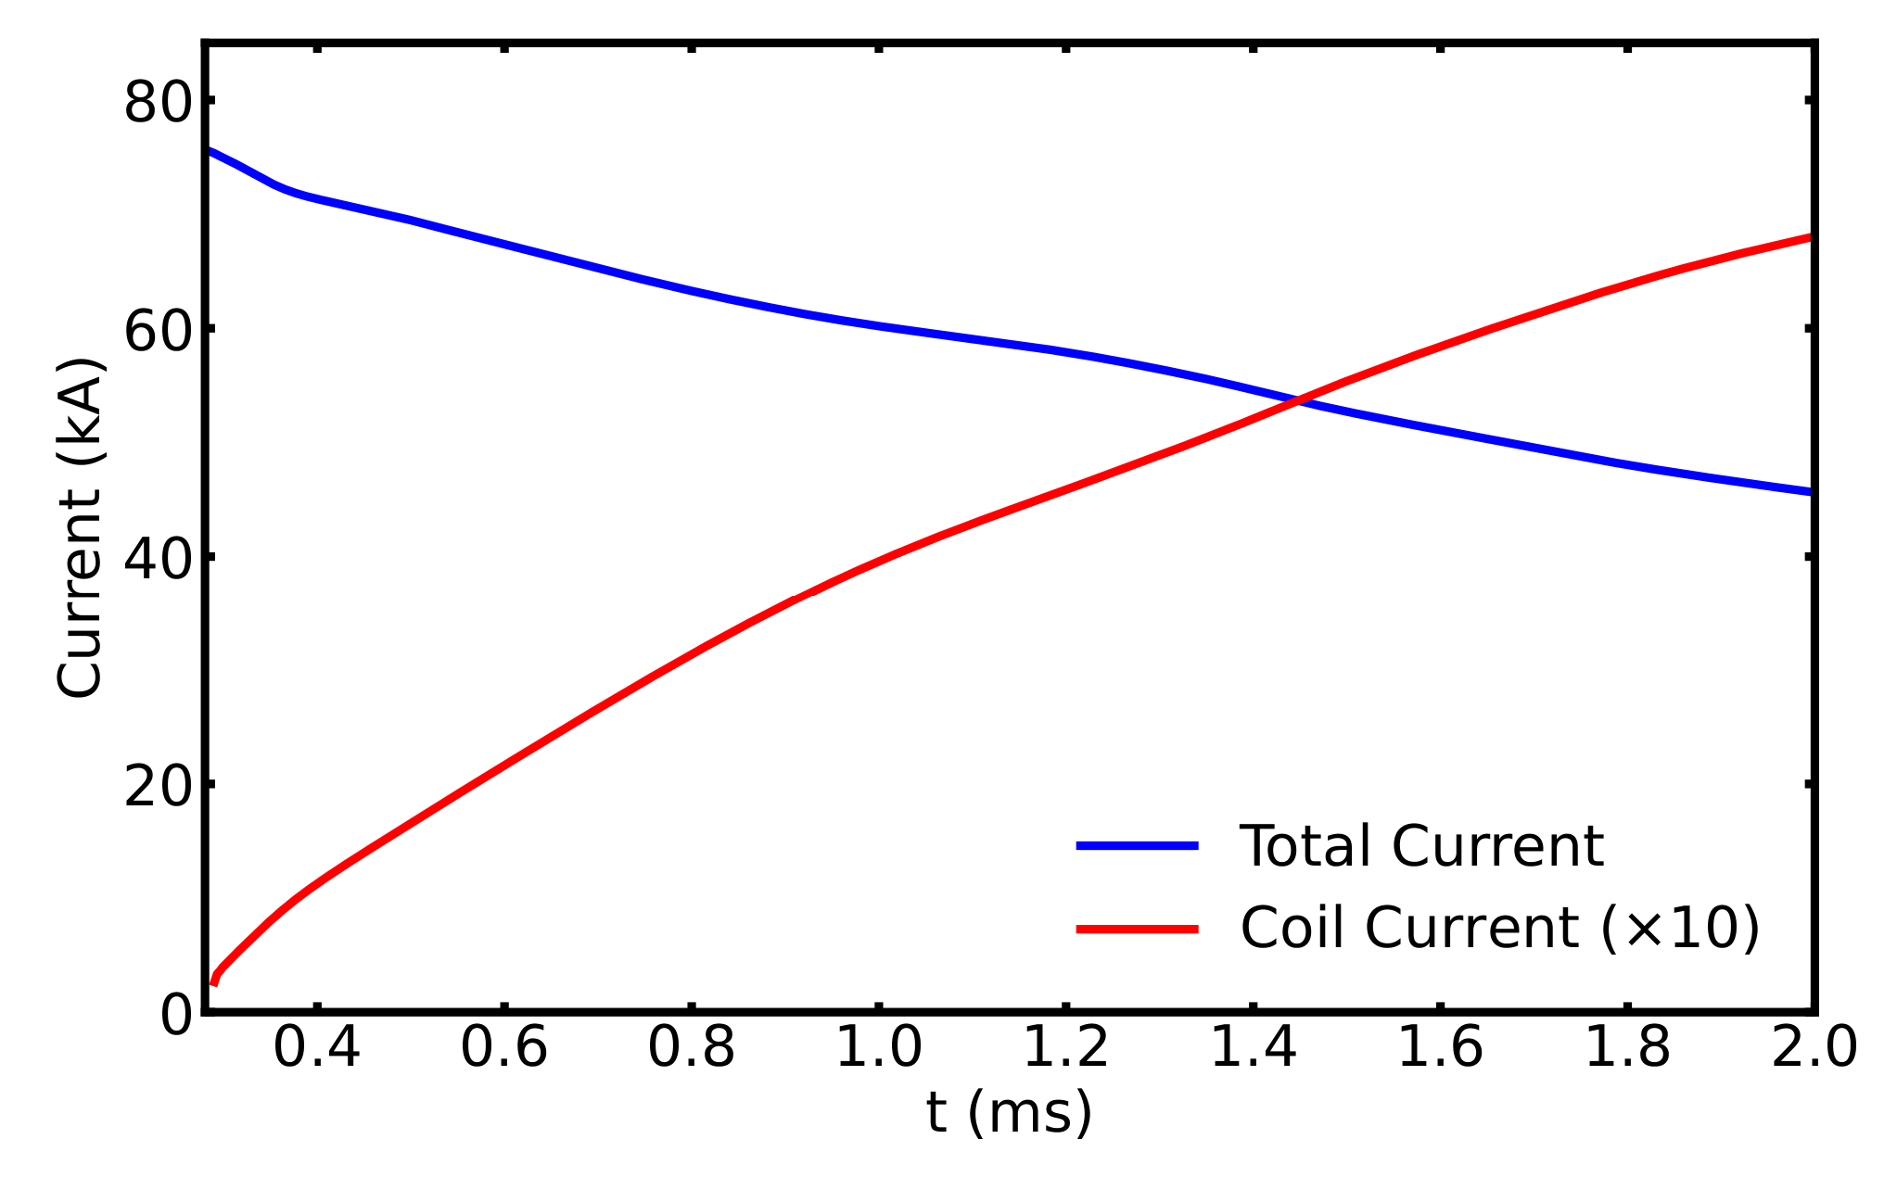
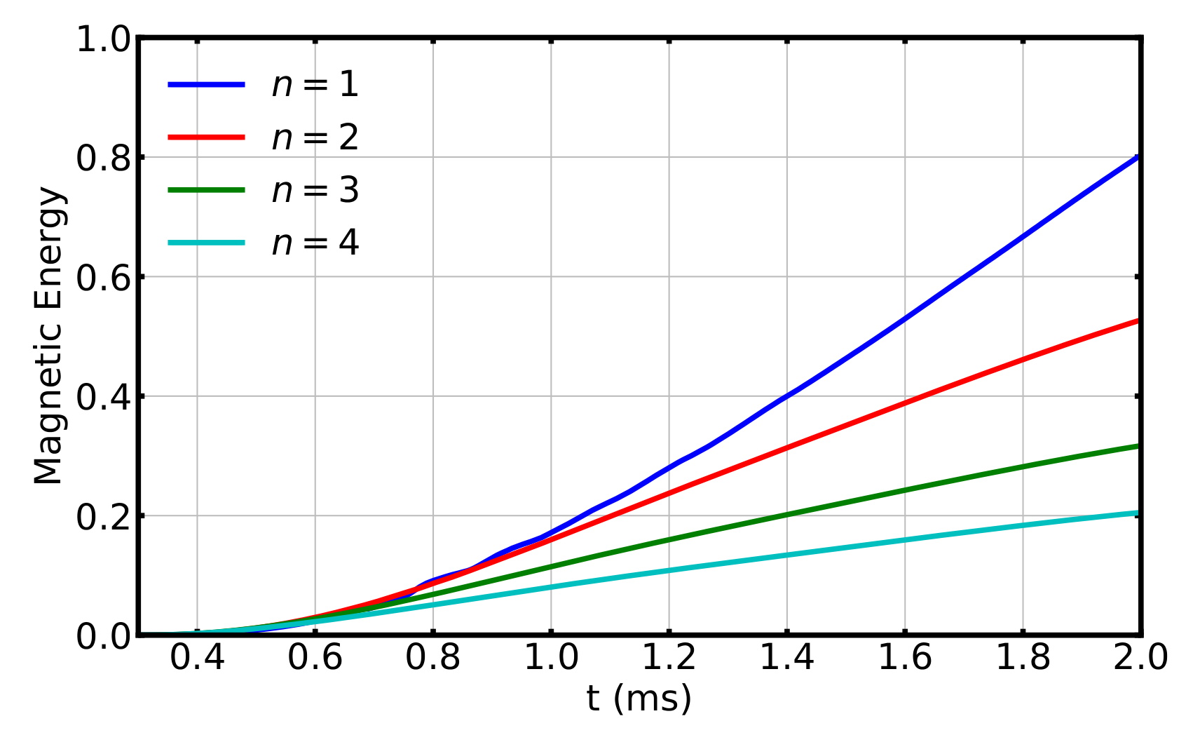
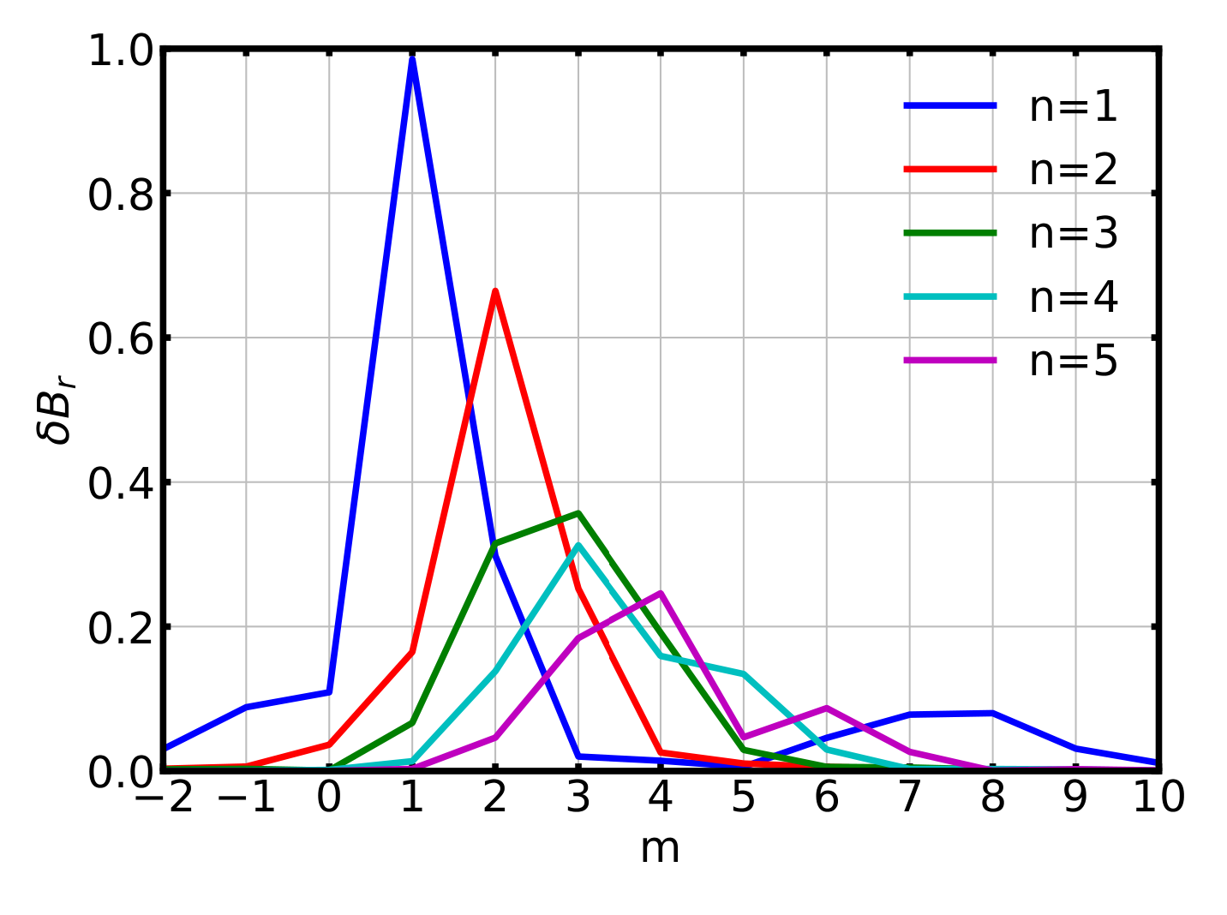
Verification of M3D-C1 passive coil module
M3D-C1 simulations reproduce the experimentally observed saturation level of coil current
  Growth rate and saturation level depend on the coil’s inductance and resistivity.
Magnetic perturbation spectrum from coils matches Biot–Savart law calculation
Growth of coil current (red) during CQ (blue) from M3D-C1 simulation
Growth of magnetic perturbation for different toroidal mode number
Poloidal mode number spectrum of coil perturbation

Slide 11
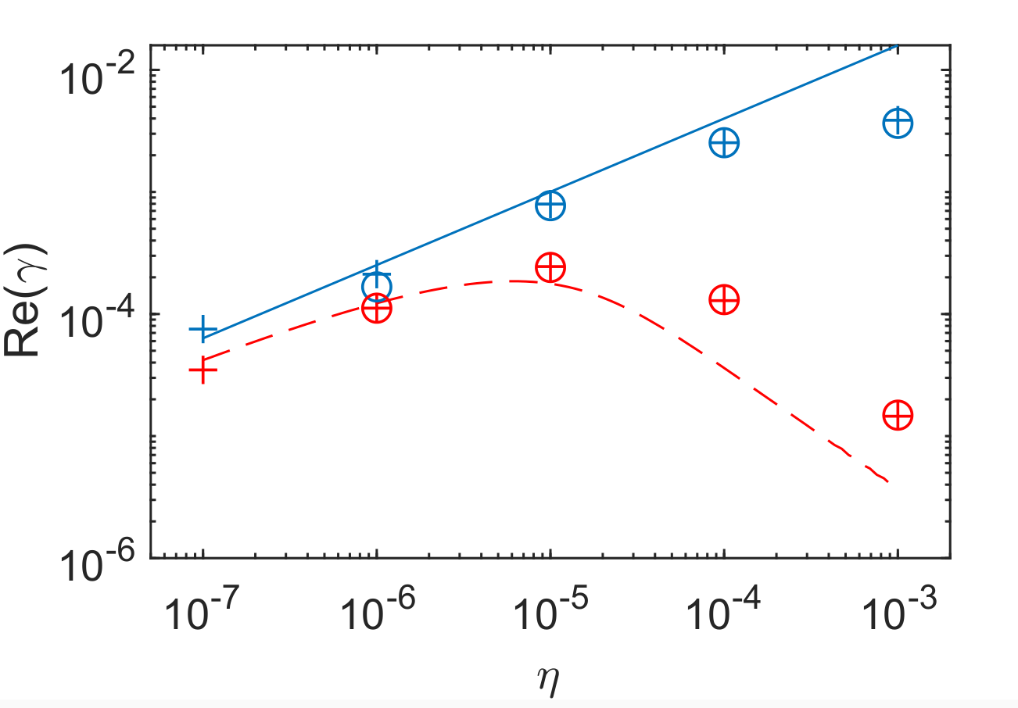
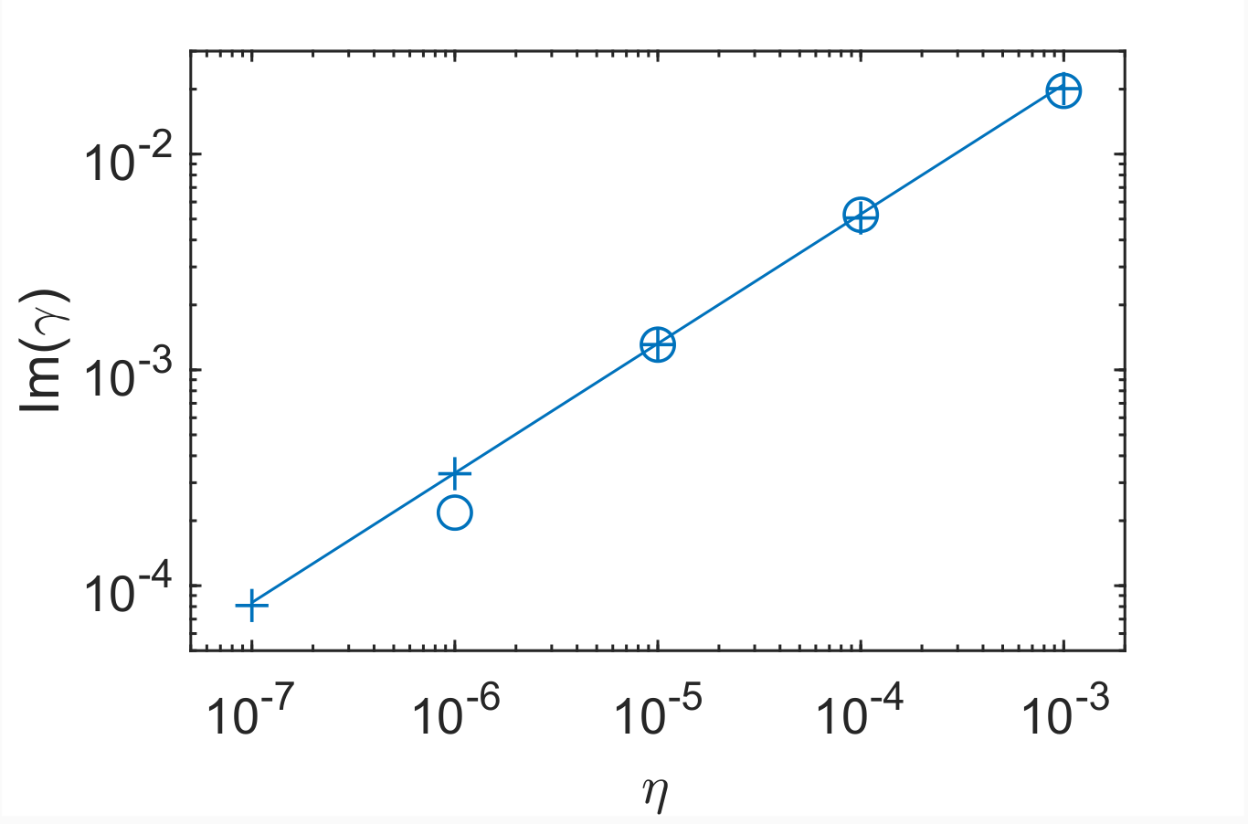
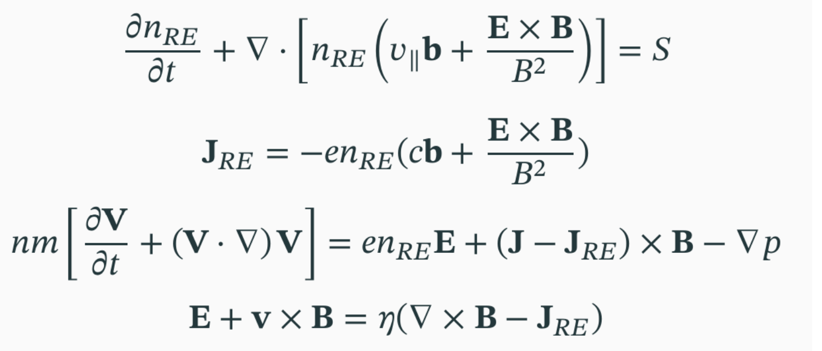
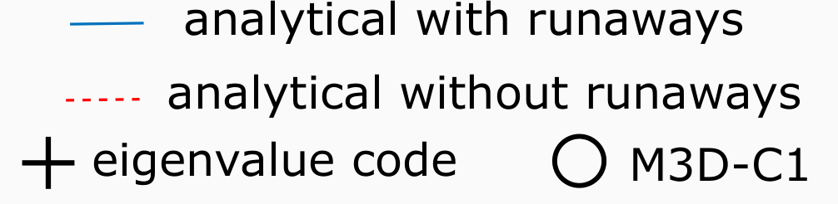
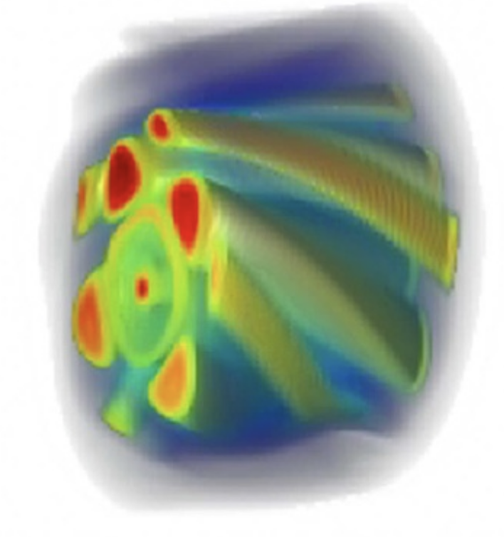
Modeling evolution of RE current in M3D-C1
A simple fluid model of RE current is implemented in M3D-C1 to model RE current interacting with MHD modes.
A realistic RE convection velocity (v∥ ~ c) is used
Avalanche source is included with bounded electron contribution and partial screening effect take into account
Model has been validated through tearing mode simulation including RE current
RE current affecting the tearing mode dispersion, promoting its growth (left) (Liu PoP 2020)
Nonlinear simulation of tearing mode excitation with RE current confined in magnetic islands
(Zhao NF 2024)

Slide 12
Self consistent simulation of RE mitigation with MHD instabilities and passive coil

Slide 13
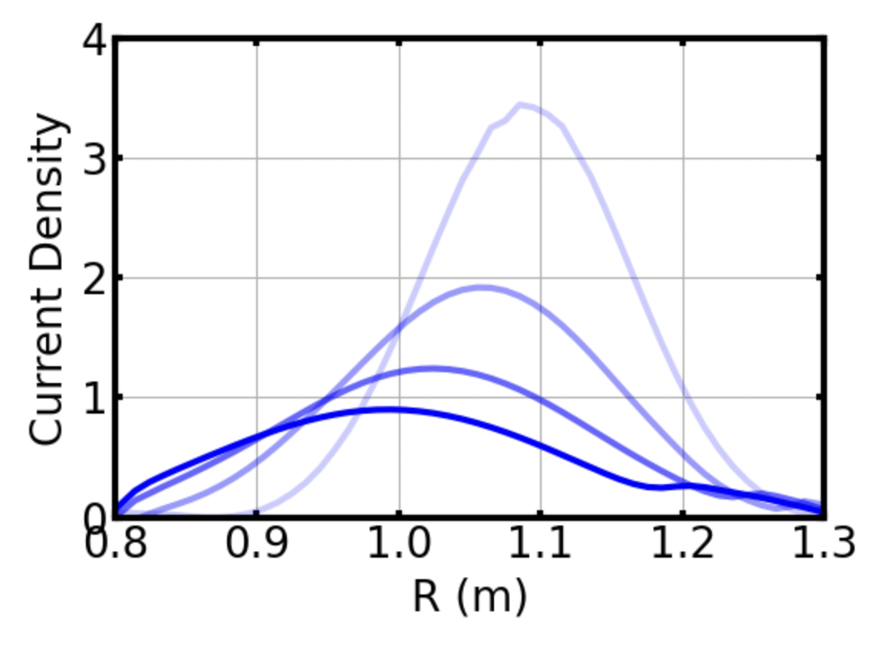
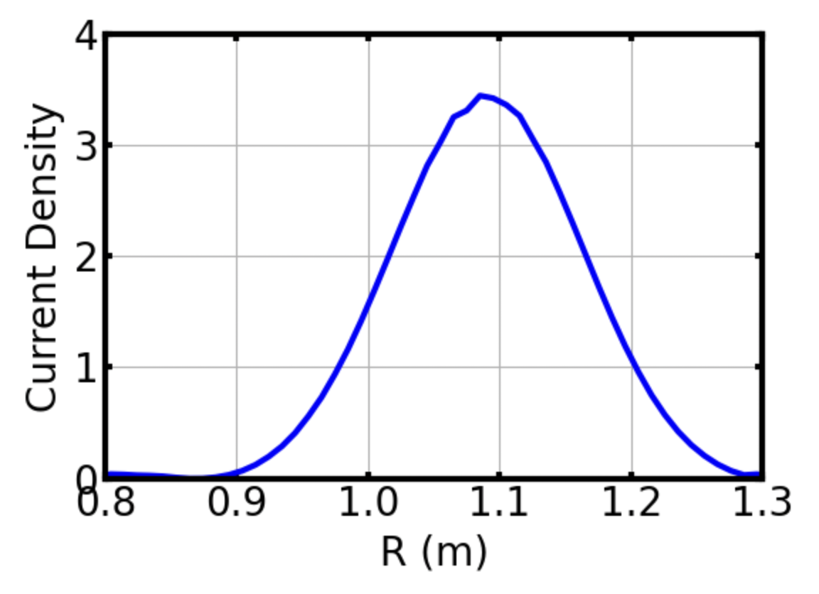
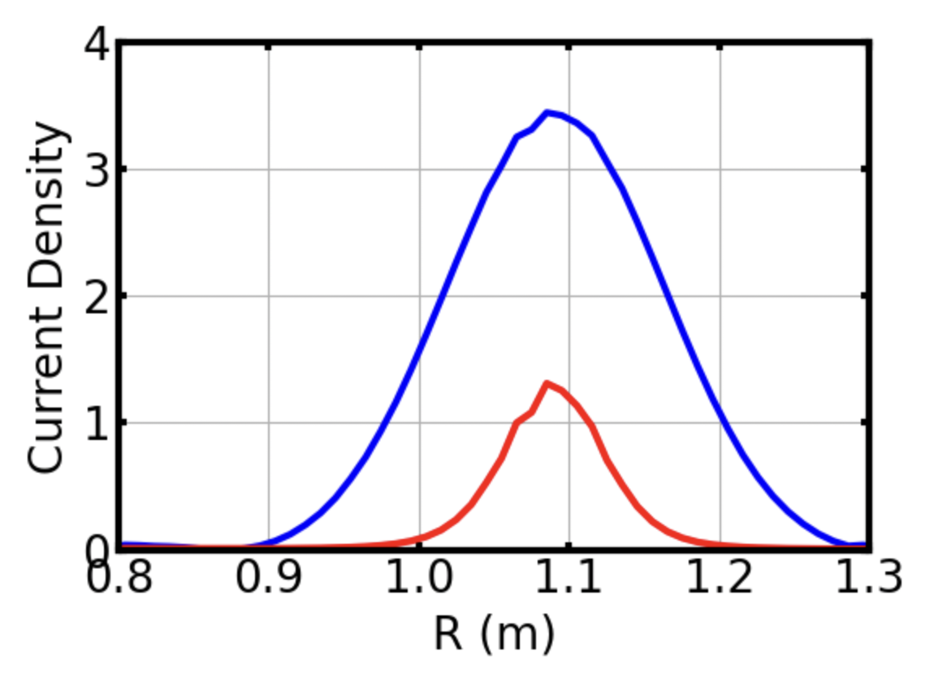
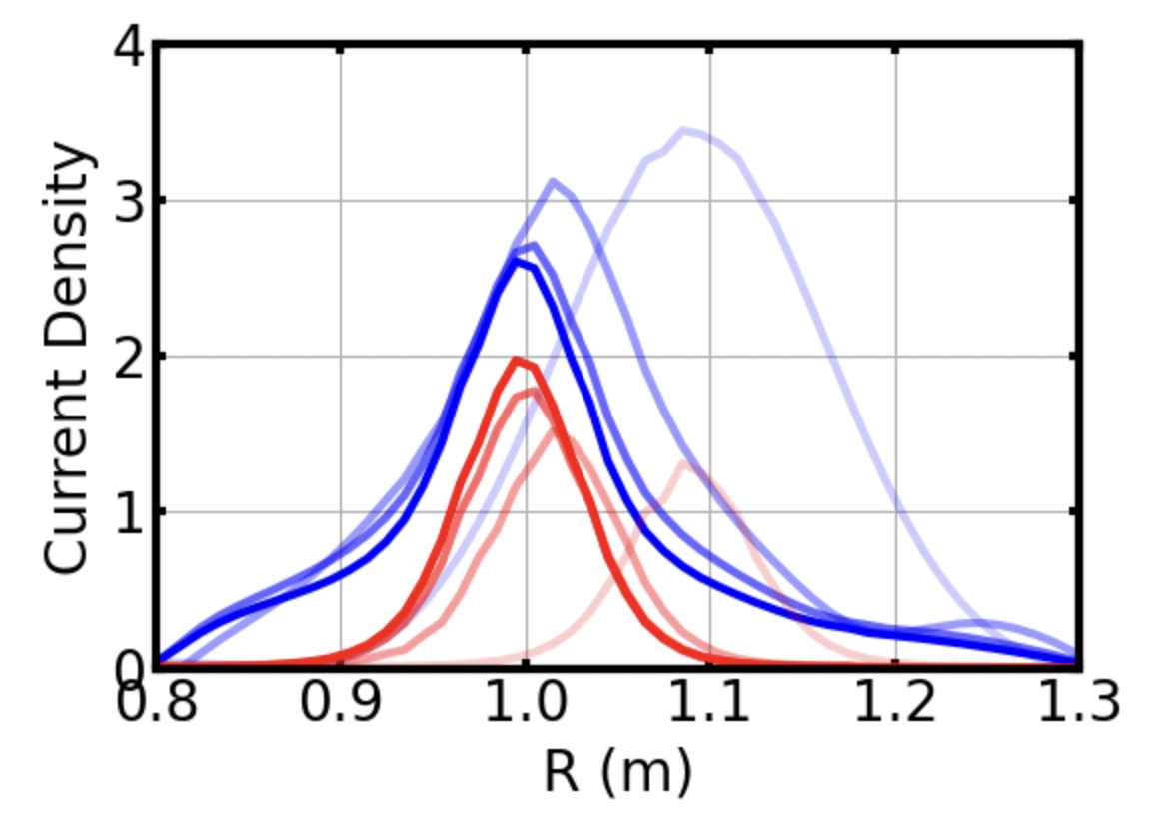
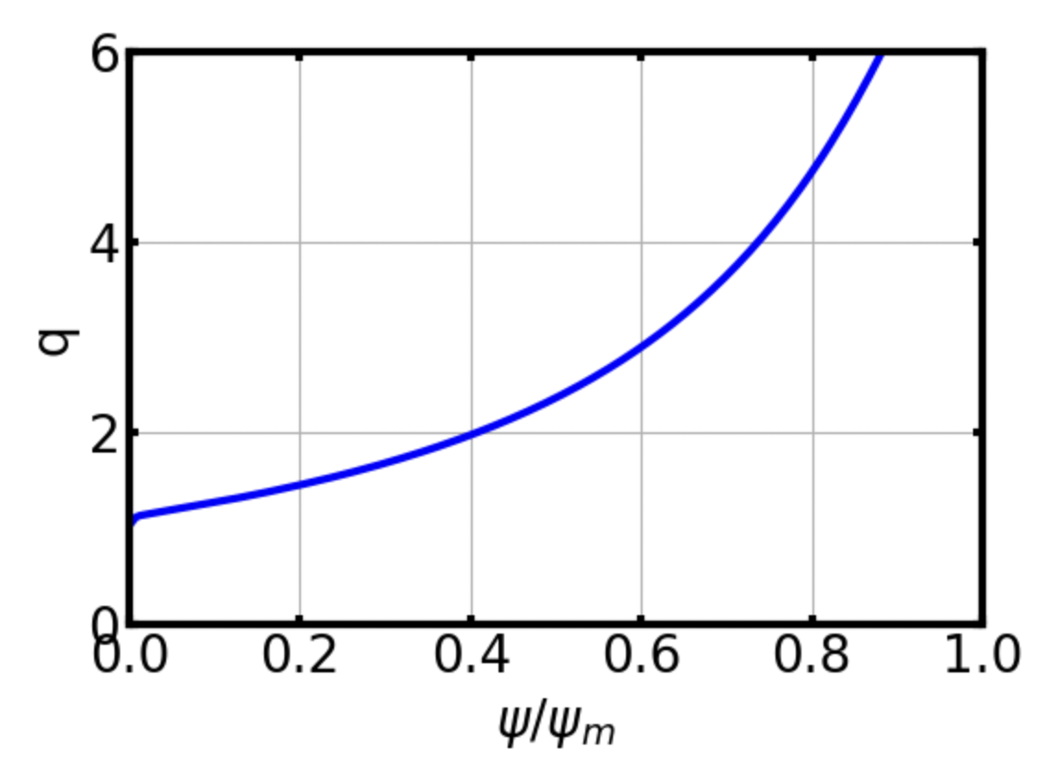
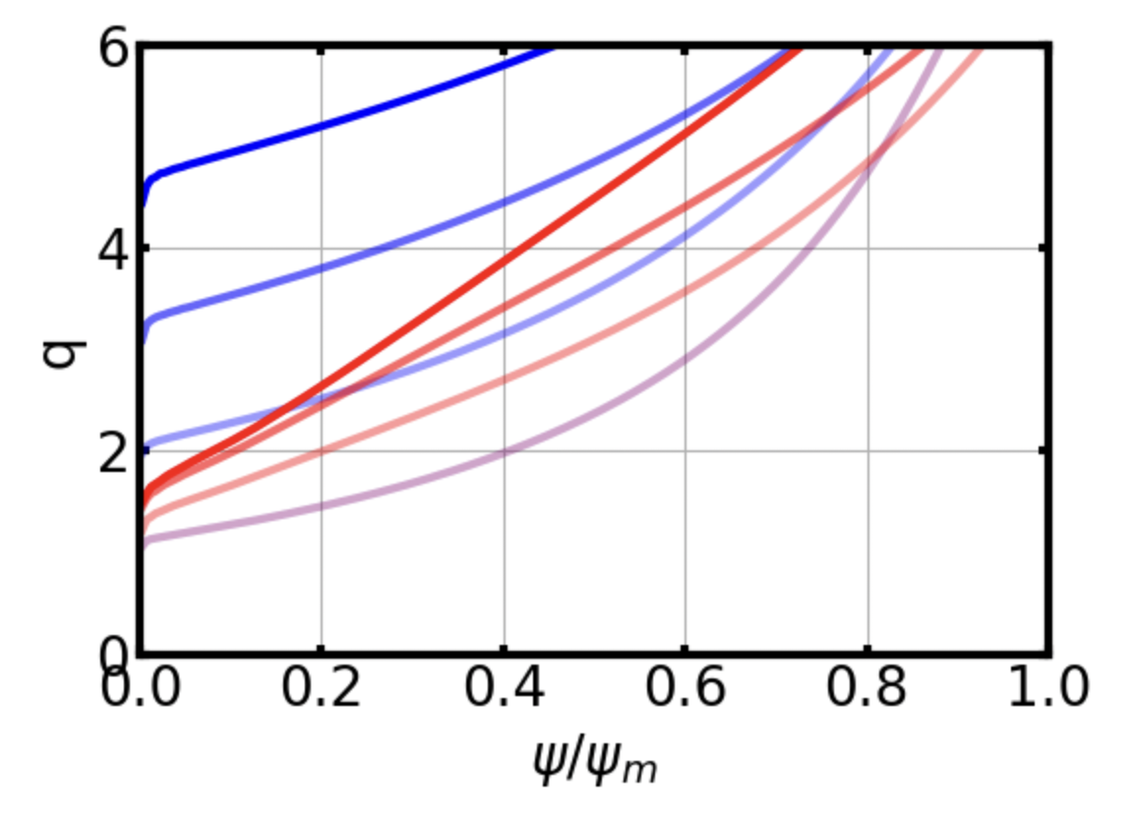
2D simulation: Impact of RE on current profile evolution
Without RE current, plasma current diffuses rapidly due to high post-TQ resistivity, leading to a quick rise in q profile
A centrally concentrated RE current and its avalanche can help maintain a peaked current profile during CQ.
  Seed RE mostly come from hot-tail generation
  Ohmic current diffuses inward from the edge to the core
A sheared q-profile with q₀ ≈ 1.5 is also maintained, allowing the excitation of multiple tearing modes.
t = 0
t = 0
t = 0.4 ms
Collapse of current profile in CQ without RE current
t = 0
t = 0
t=0.4ms (no RE)
Evolution of q profile in CQ
with(red) and w/o (blue) RE current
t = 0.4 ms
t=0.4ms (with RE)
t = 0
t = 0
With RE, current profile remains peaked during CQ

Slide 14
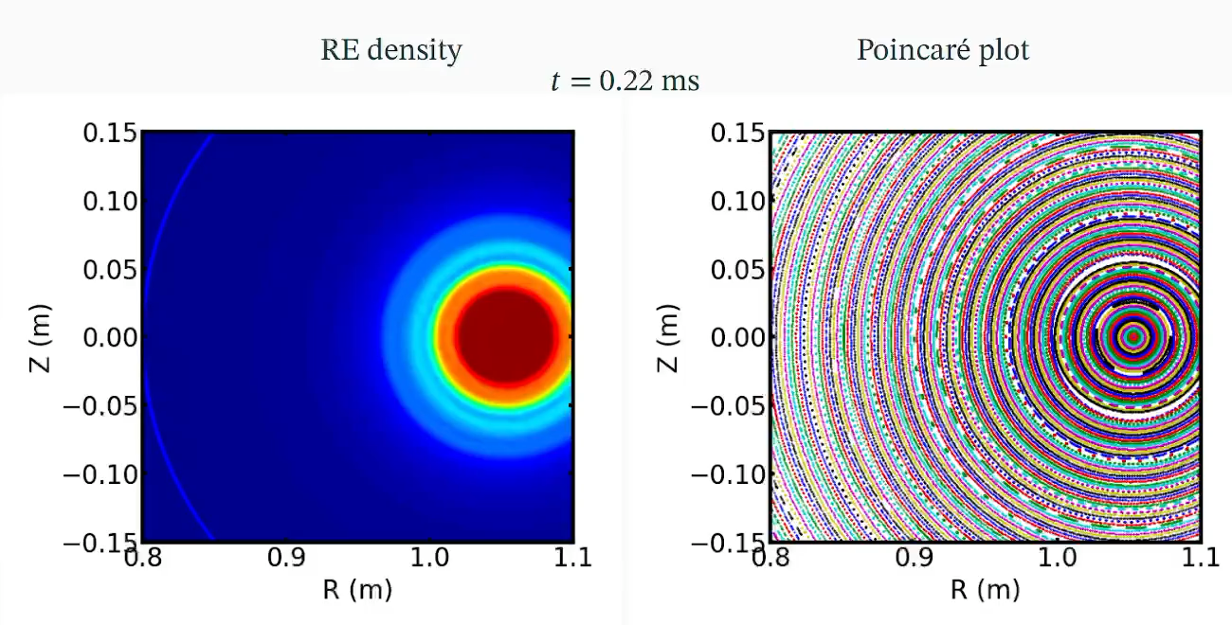
3D simulation: Successive excitation of tearing modes and resulting transport of REs

Slide 15
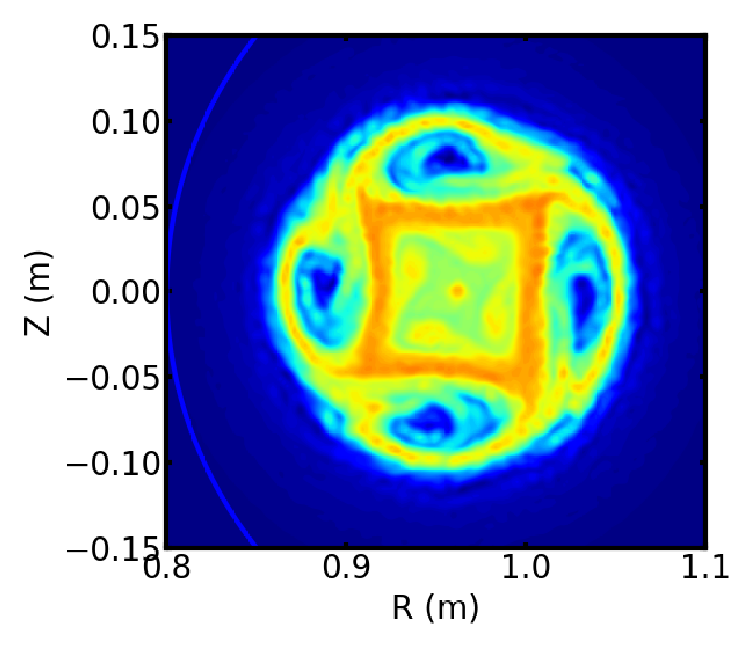
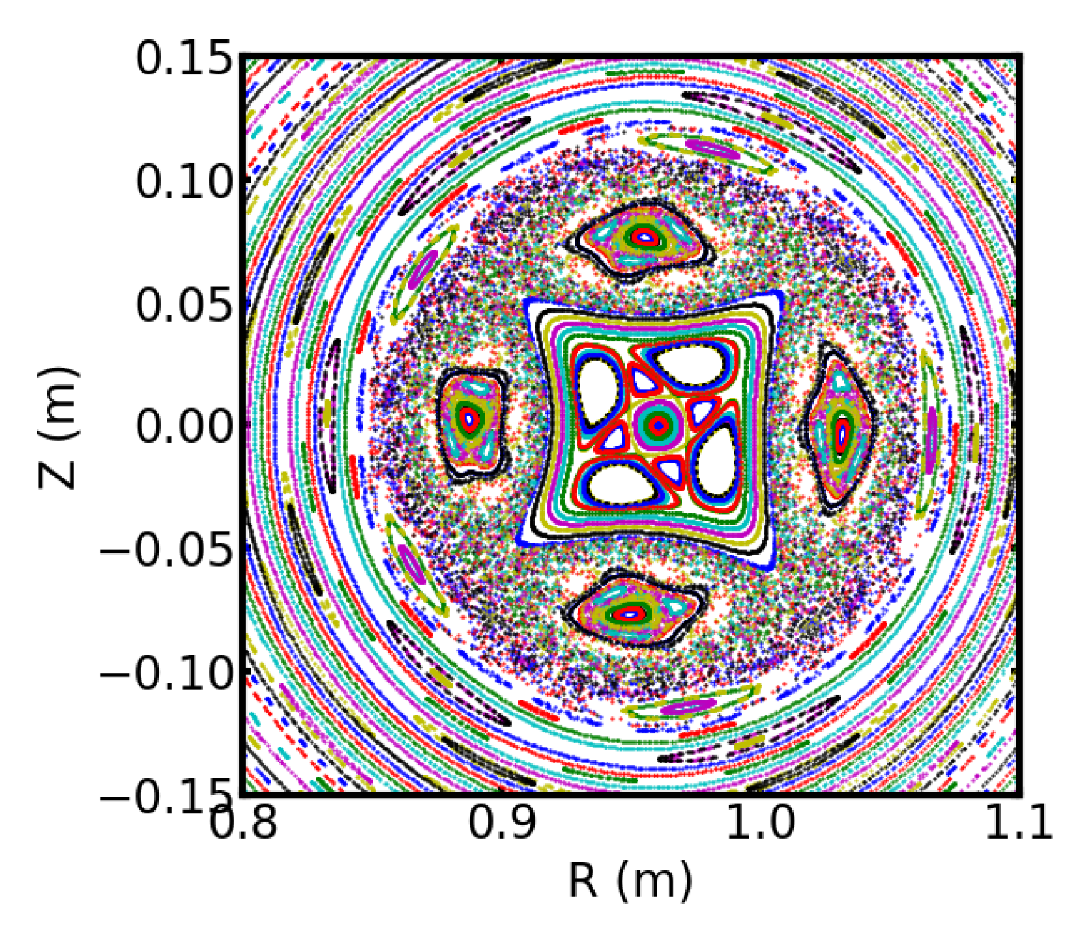
3D simulation: Successive excitation of tearing modes and resulting transport of REs
t = 0.58 ms
RE density
Poincare plot
RE transport

Slide 16
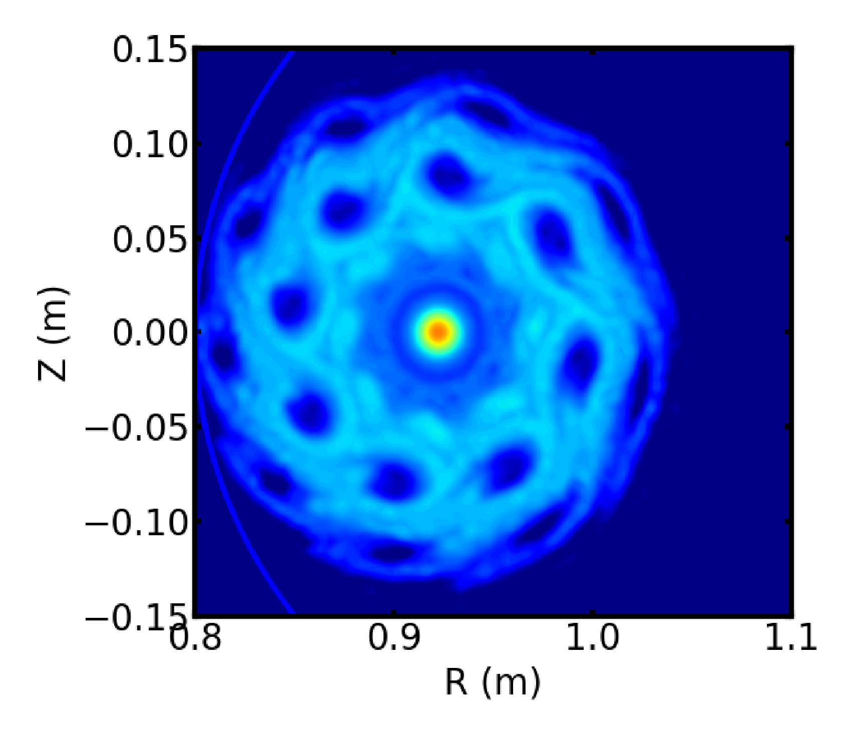
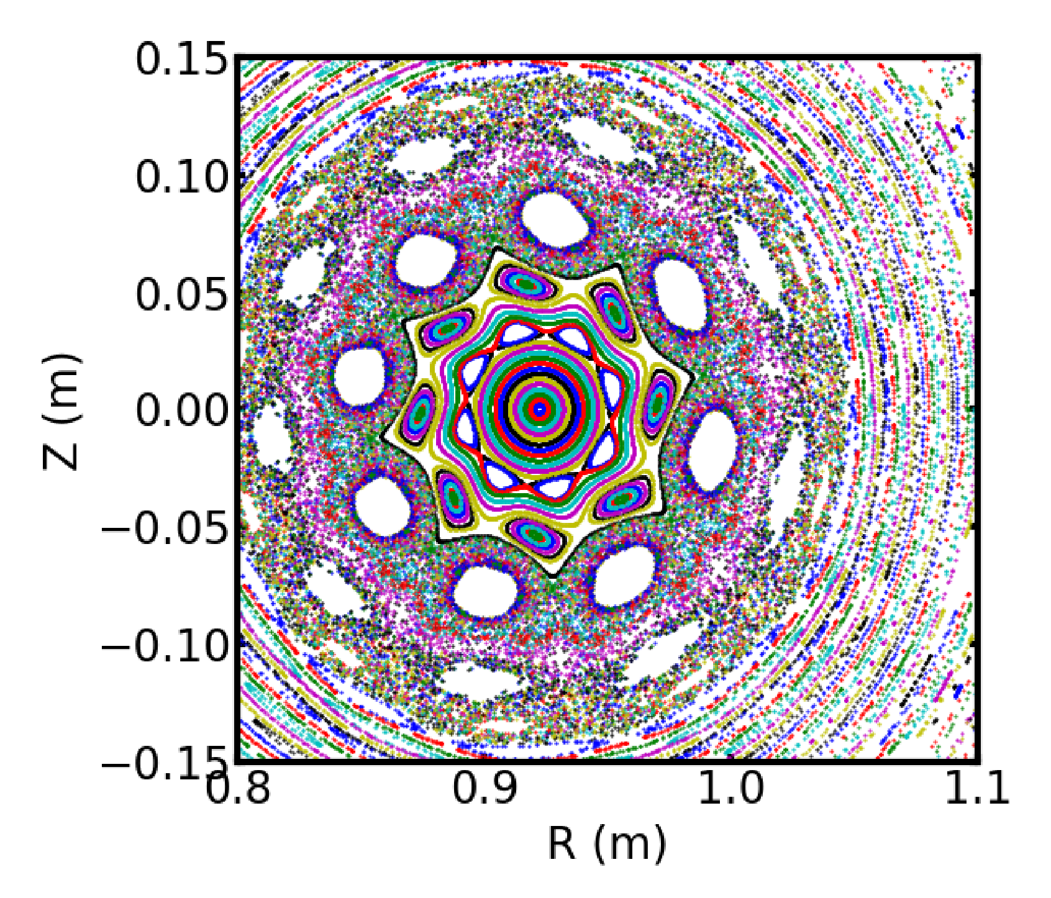
3D simulation: Successive excitation of tearing modes and resulting transport of REs
t = 1.015 ms
RE density
Poincare plot
RE loss channel

Slide 17
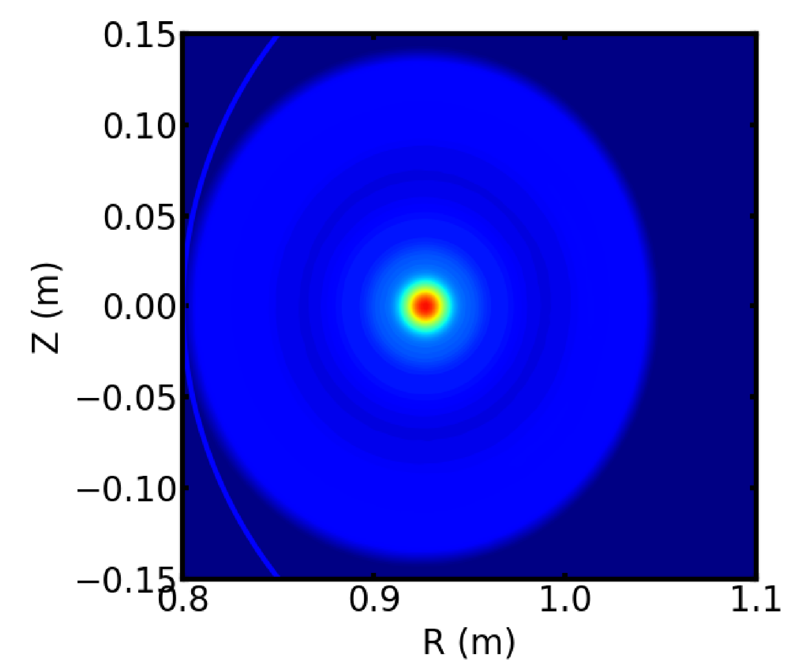
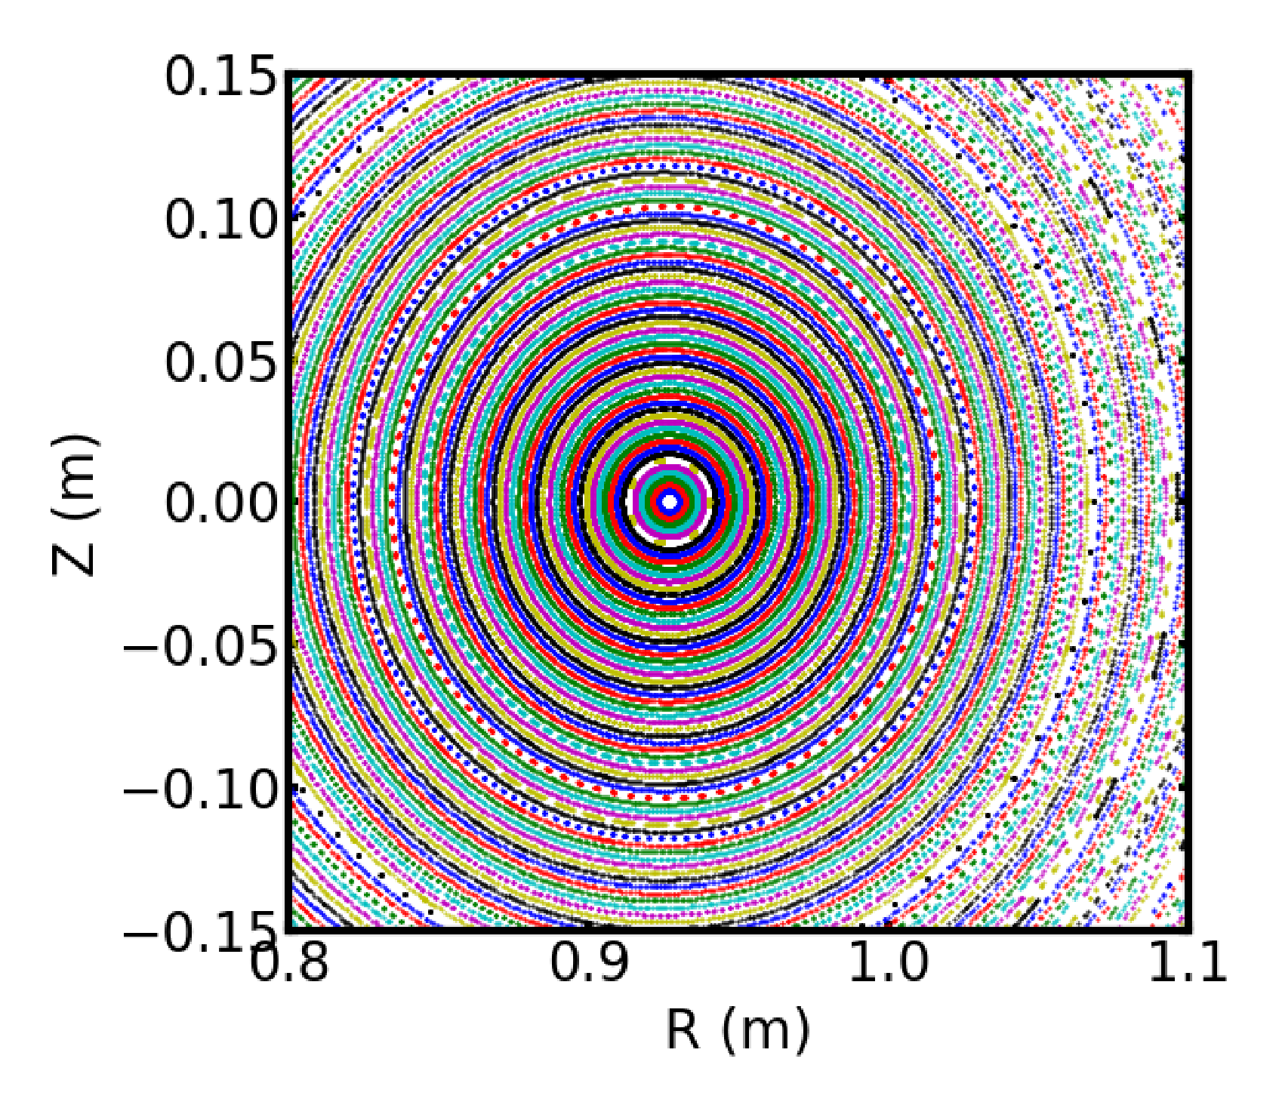
3D simulation: Successive excitation of tearing modes and resulting transport of REs
t = 1.596 ms
RE density
Poincare plot

Slide 18
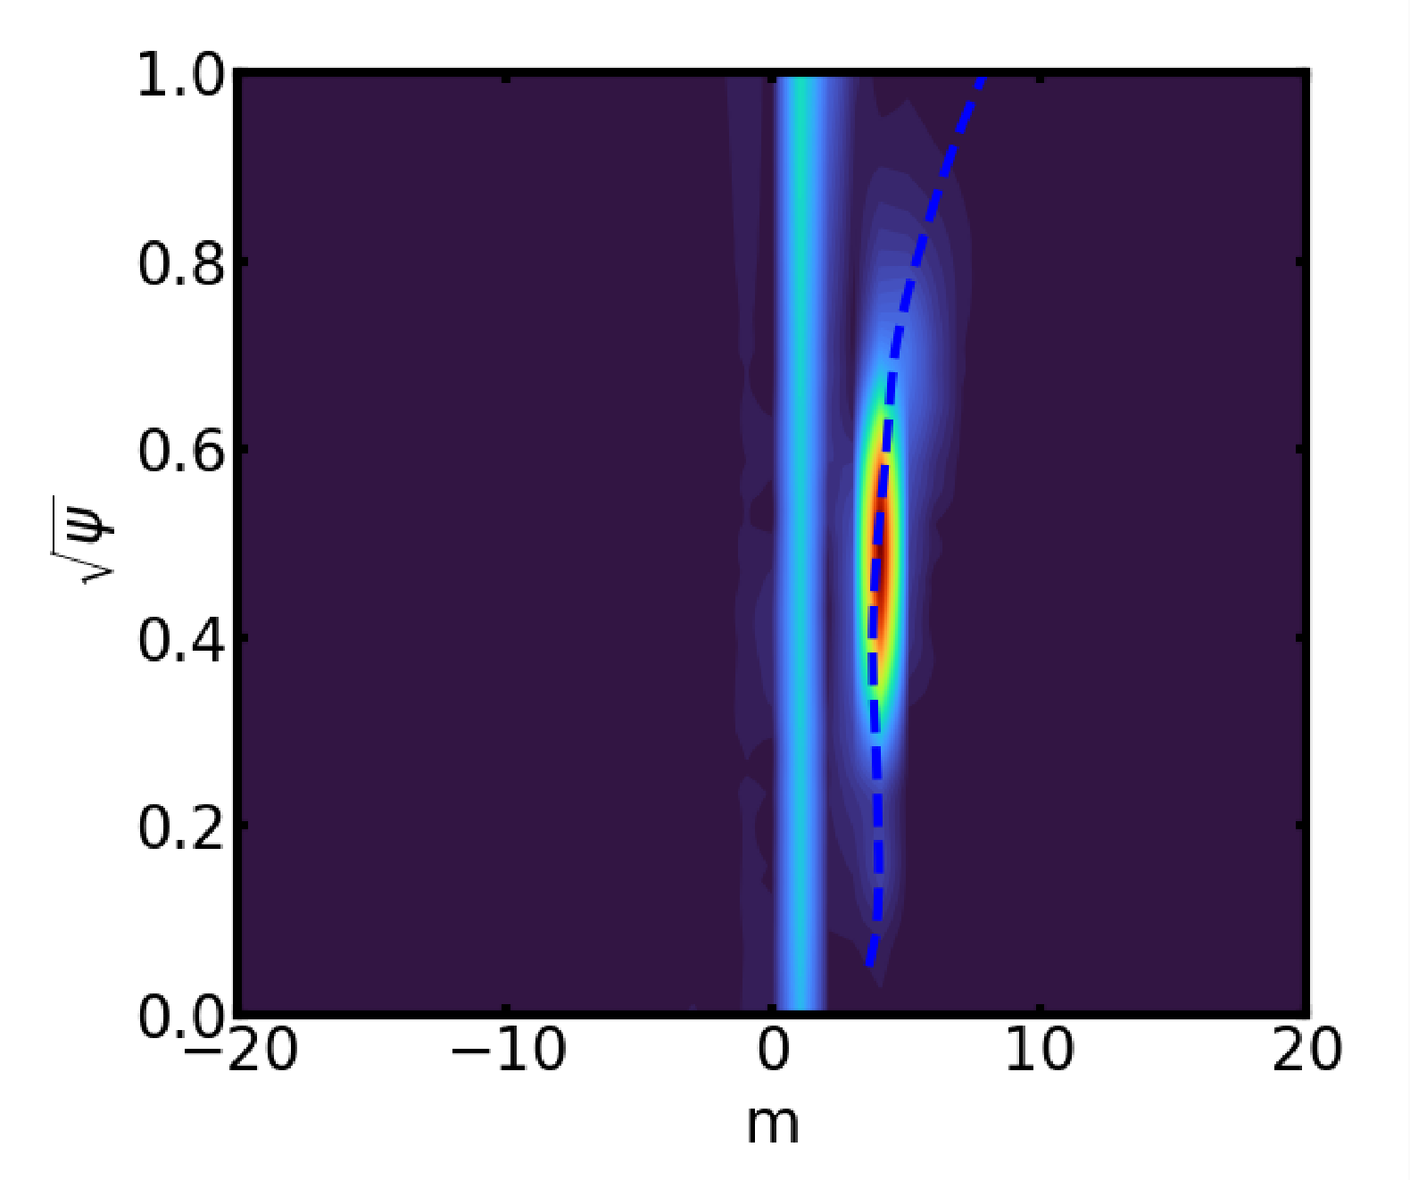
Magnetic perturbation comes from both coils and MHD modes
t = 0.58 ms
RE density
Schaffer plot (n=1)
Coil perturbation
MHD perturbation

Slide 19
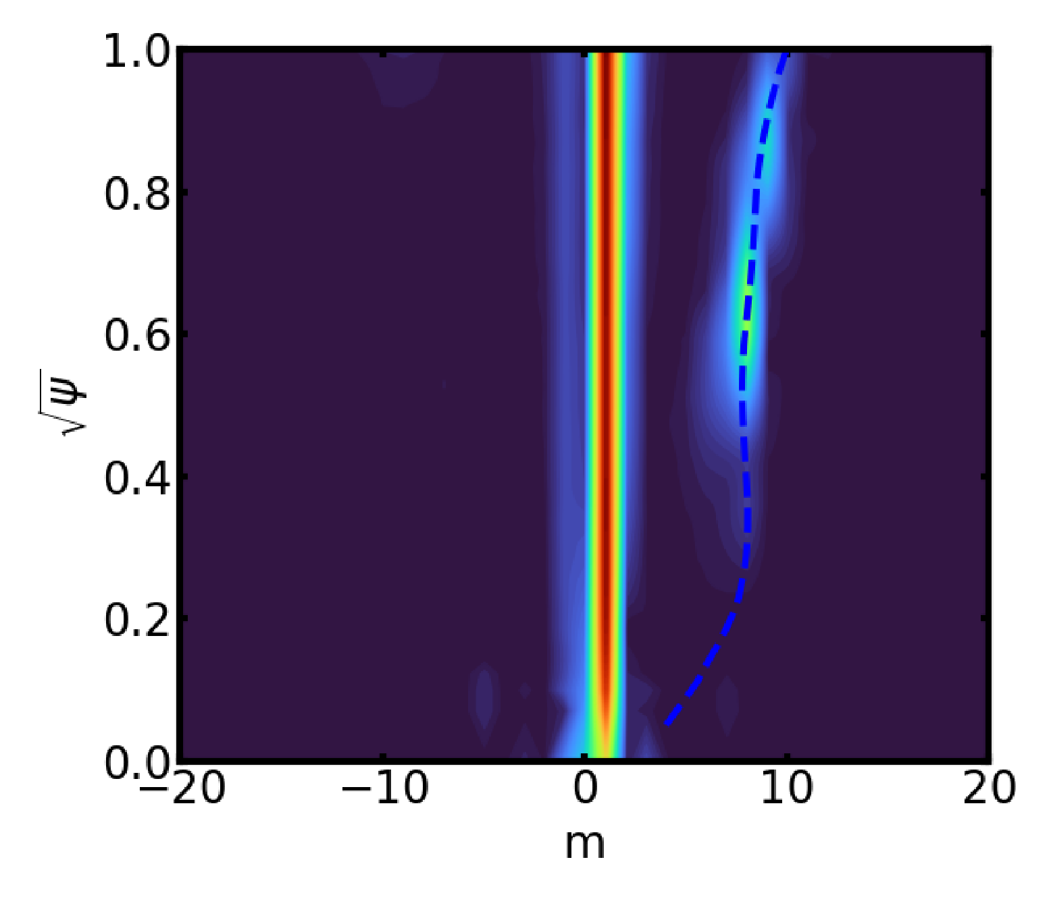
Magnetic perturbation comes from both coils and MHD modes
t = 1.015 ms
RE density
Schaffer plot (n=1)

Slide 20
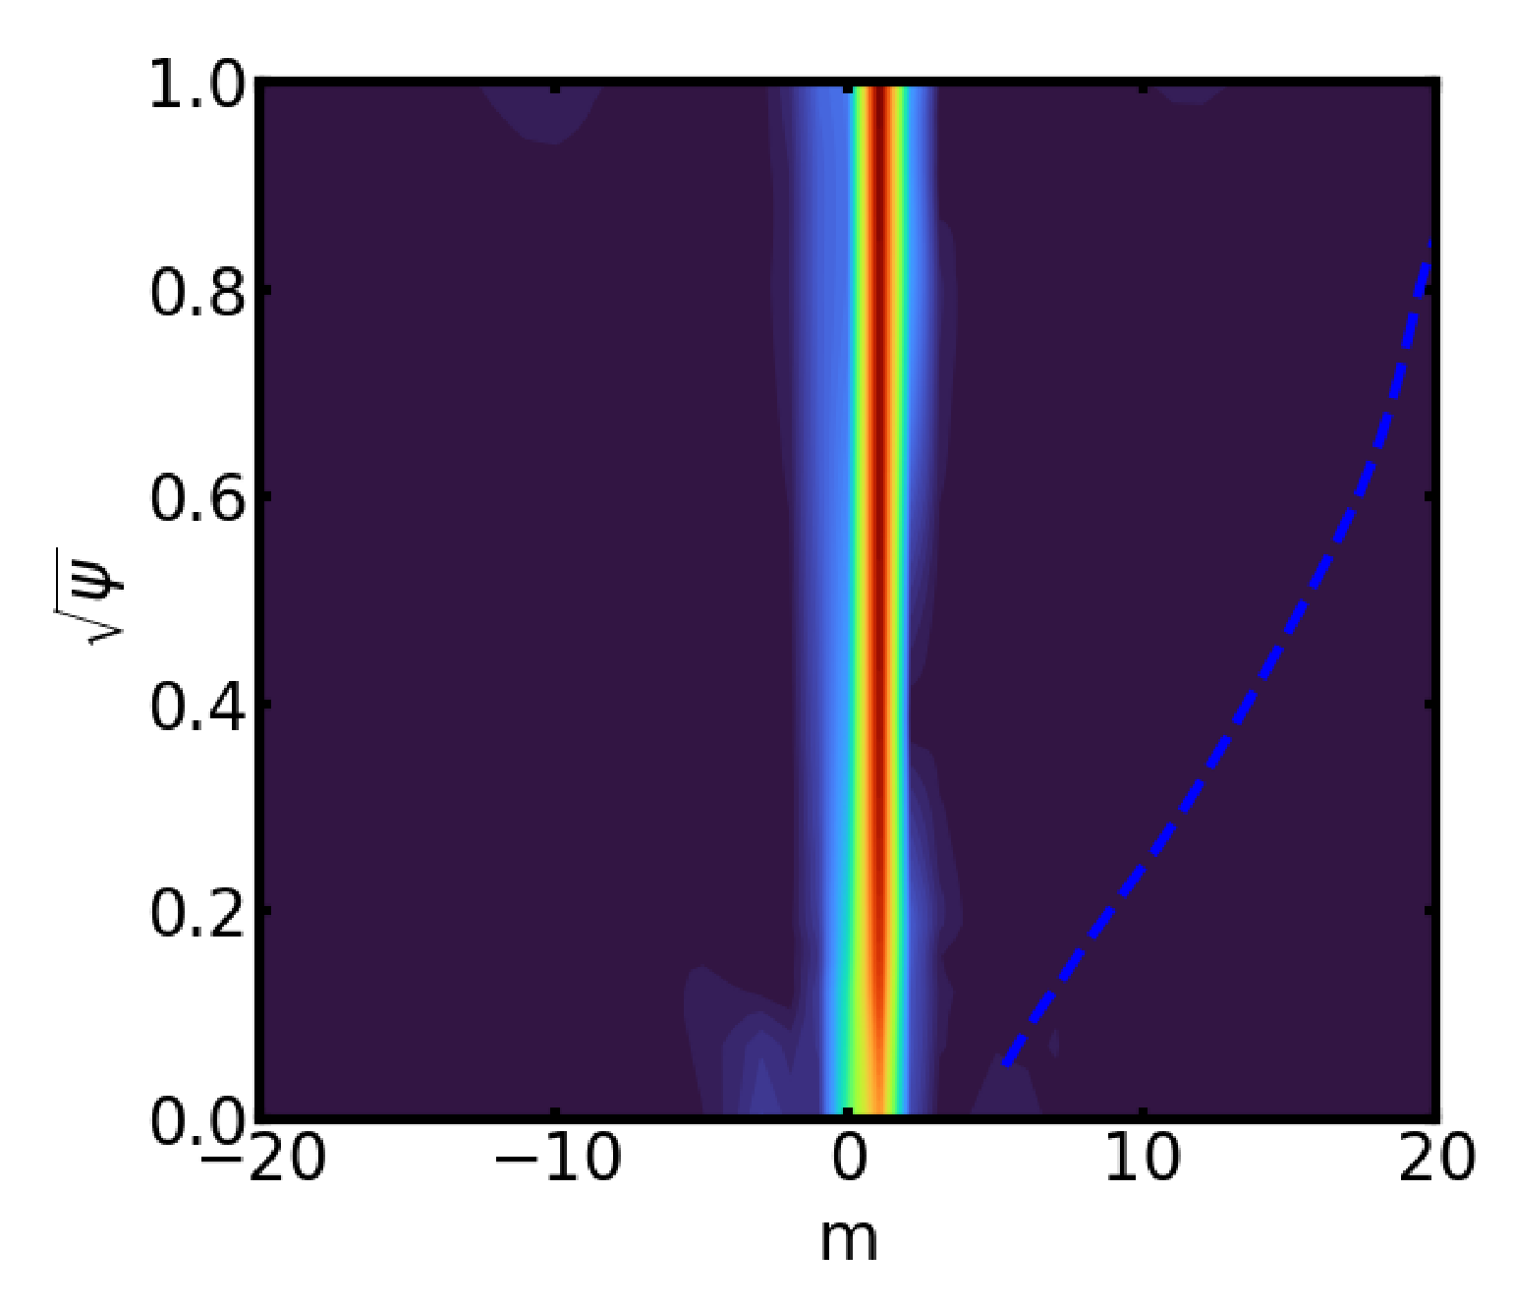
Magnetic perturbation comes from both coils and MHD modes
t = 1.596 ms
RE density
Schaffer plot (n=1)

Slide 21
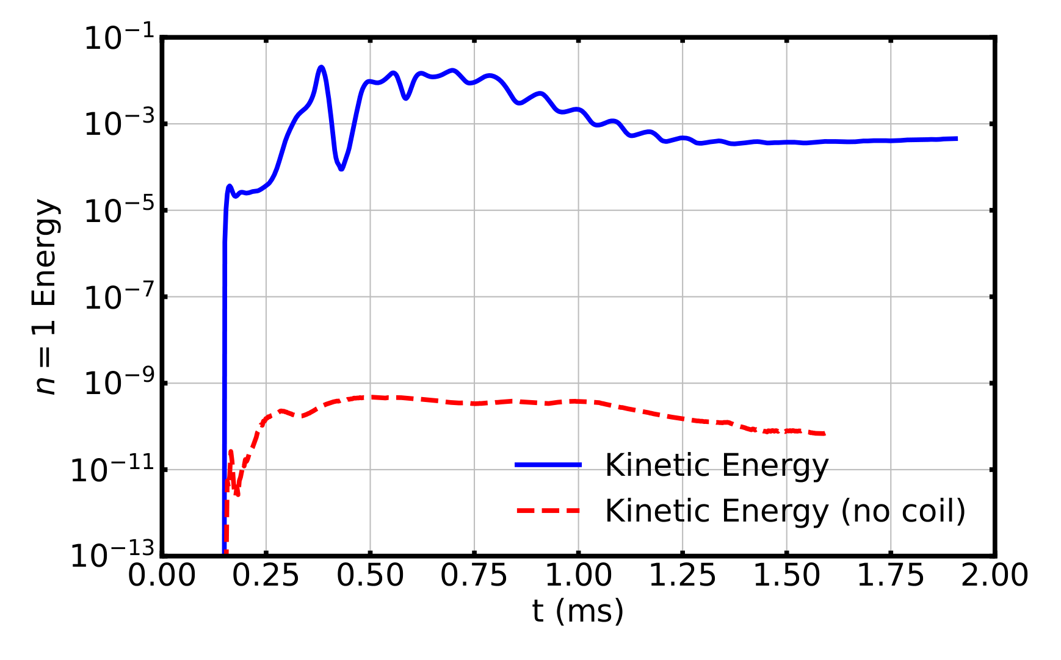
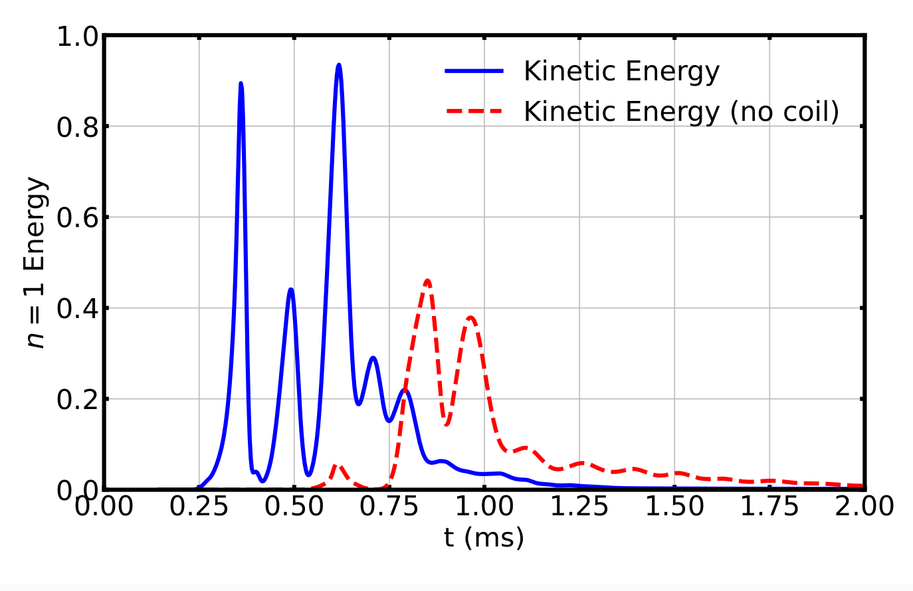
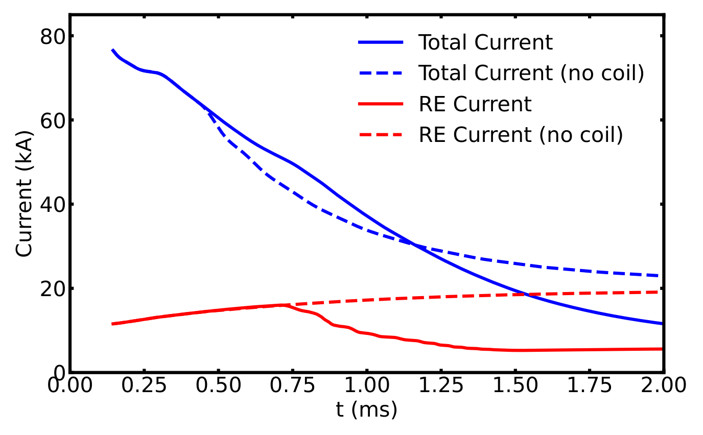
Coil perturbation ➤ MHD mode excitation ➤ RE loss
Passive coil introduce seed perturbation enabling MHD modes to grow earlier and reach larger amplitude
  Seed perturbations can greatly shorten required time for magnetic island growth, enabling the formation of large islands
Transported REs forms a new front at separatrix between open and closed fluxes, triggering successive excitation of tearing mode
Following plasma shifting towards high-field-side, δB from MHD instabilities sustains field stochasticity and facilitates a RE loss channel
Plasma current evolution from M3D-C1 simulations with the passive coil activated is consistent with J-TEXT results, regardless of the viscosity.
Kinetic energy of MHD modes from M3D-C1 simulation
(low viscosity)
Kinetic energy of MHD modes from M3D-C1 simulation
(high viscosity)
Time evolution of total and RE current affected by passive coil

Slide 22
Summary

Slide 23
Summary
The helical coil installed in J-TEXT illustrated successful mitigation of RE plateau. However, there is a discrepancy with simulation modeling if only considering magnetic perturbations from coils.
The MHD simulation code M3D-C1 has been upgraded to model the 3-way interactions between RE current, MHD instabilities and passive coils self-consistently.
J-TEXT CQ simulation shows that MHD instability in presence of RE current plays pivotal role of forming magnetic islands and stochastic fields, and facilitating RE transport. The passive coil plays a supporting role of amplify the mode growth.
Future work:
  Couple M3D-C1 with ThinCurr and DREAM to more accurately model other configurations of RE mitigation coil
  Integrate with a test-particle code to model energy deposition of RE on PFCs in the presence of a mitigation coil.
  Assess the efficacy of using RMP coils to generate seed perturbations for MHD instabilities.

