Slide 1
Integrated Modelling Activities
in Support of the ITER Re-Baseline
15 October 2025
M. Schneider¹, J. Artola¹, X. Bonnin¹, M. Dubrov¹, Y. Gribov¹, W. Helou¹, O. Hoenen¹,
S-H. Kim¹, F. Köchl¹, S. Korving¹, E. Lerche², A. Loarte¹, S.D. Pinches¹, R.A. Pitts¹,
A.R. Polevoi¹, M. Preynas¹, A. Pshenov¹, N. Schwarz¹, J. Stober³, P. Vincenzi^{4,5}, T. Wauters¹
¹ ITER Organization, St. Paul-lez-Durance Cedex, France
² ERM/KMS, Brussels, Belgium
³ Max-Planck-Institut für Plasmaphysik, Garching, Germany
⁴ Consorzio RFX, Padova, Italy
⁵ Institute for Plasma Science and Technology, Padova, Italy
The views and opinions expressed herein do not necessarily reflect those of the ITER Organization
This work has been supported by the ITER Scientist Fellow Network
© 2025, ITER Organization

Slide 2
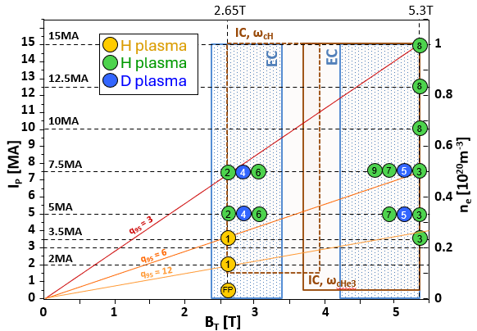
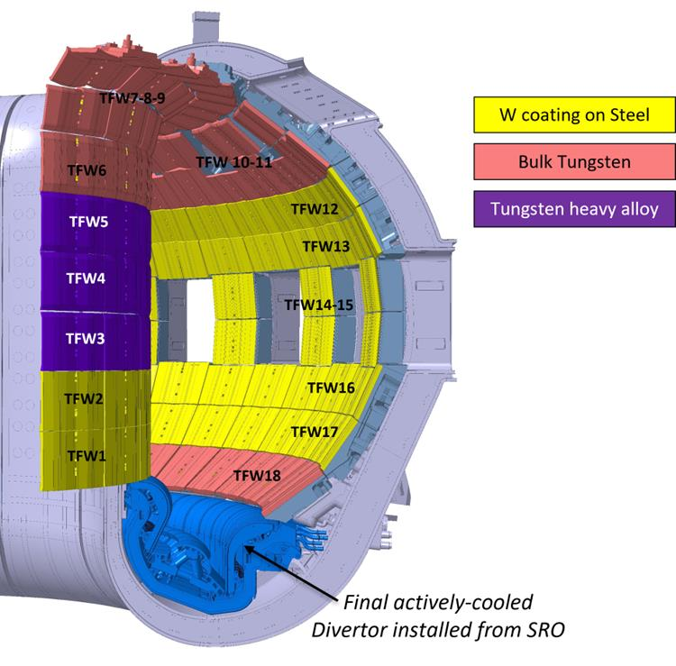
The ITER new baseline
  Change of FW material Beryllium (Be) → Tungsten (W)
  → New operational phases
      New staged approach
      New scenarios
  → New plant (system) configuration
      First Wall (FW)
      Heating and Current Drive (H&CD) mix
      Boronization system
  How do we make these choices?
    Observations from current-day experiments
    Integrated Modelling (IM) activities → the topic of this talk!
  More details in this morning talks:
    Siwoo Yoon "2024 baseline" 15/10 10:40
    Alberto Loarte "Be→W in new baseline" 15/10 11:00
SRO (Start of Research Operation)

Slide 3
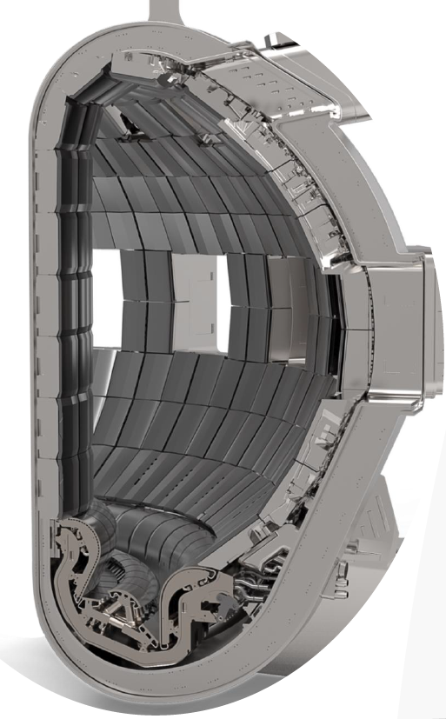
Modelling studies for the new baseline
  The new baseline implies:
  Extra W source from the wall
  → Modelling of W source & transport
  New Heating and Current Drive mix
  → Modelling impact of H&CD on W
  Boronization system
  → Modelling for optimal configuration
  Disruption mitigation strategy
  → State-of-the-art 2D-3D modelling
  Disruption loads and mitigation
2)
  New heating mix
  EL
  EL
  Boronization system
  W source from the wall
  Alberto Loarte "Be→W in new baseline" 15/10 11:00
3)
1)
  All possible through the IMAS Integrated Modelling & Analysis Suite!

Slide 4
Outline
  Developing the ITER Integrated Modelling platform IMAS
  Effect of extra W wall source on ITER plasma performance
  Characterization and mitigation of disruption
  Conclusion

Slide 5
Outline
  Developing the ITER Integrated Modelling platform IMAS
  Effect of extra W wall source on ITER plasma performance
  Characterization and mitigation of disruption
  Conclusion

Slide 6
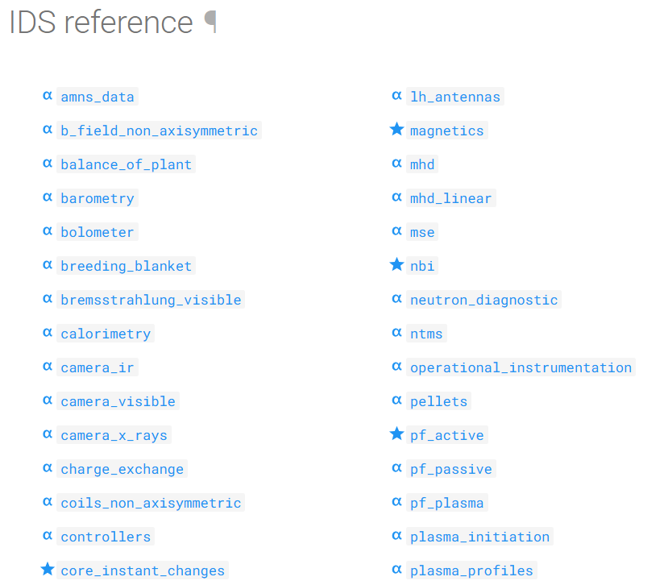


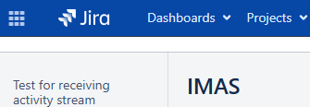
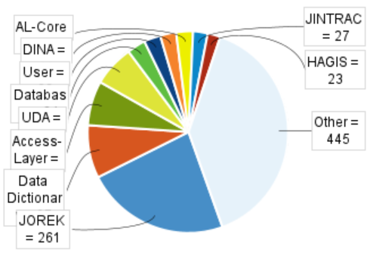
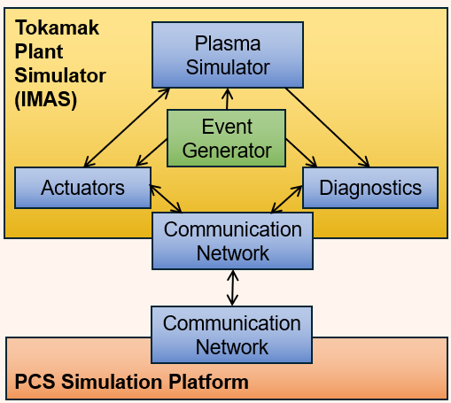
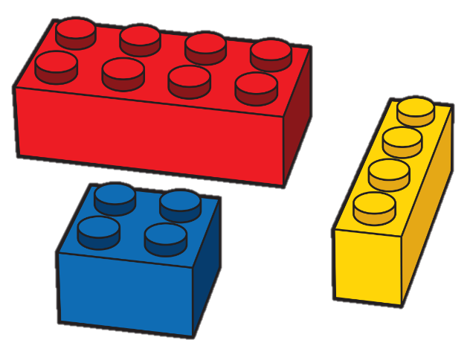
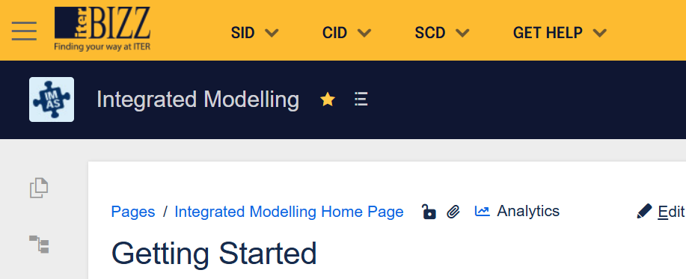



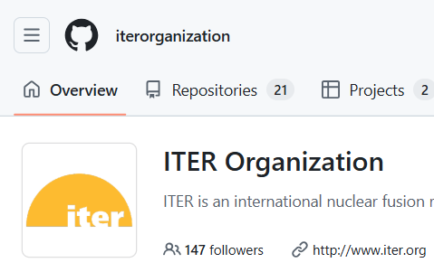


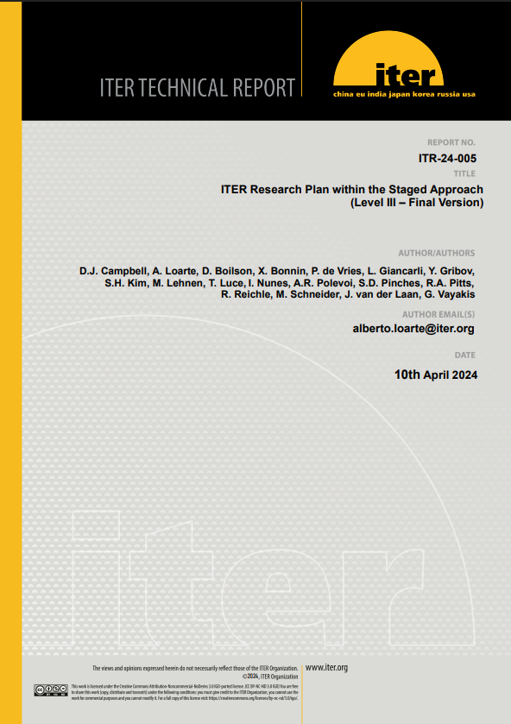
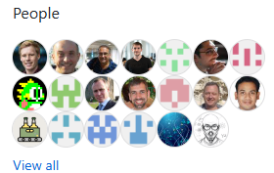





How to best foster collaboration and teamwork?
IMAS platform
ITPAs,
conferences, workshops,
ISFN, IMEG, etc.
Develop a standard to be used by the whole community
Promote it and get the community to contribute to it
Provide the necessary support and training material
New Baseline
2024 Baseline of the
ITER Research Plan
https://github.com/iterorganization
Share experience, methods, tools
Make the software open-source
Encourage the community to do the same

Slide 7
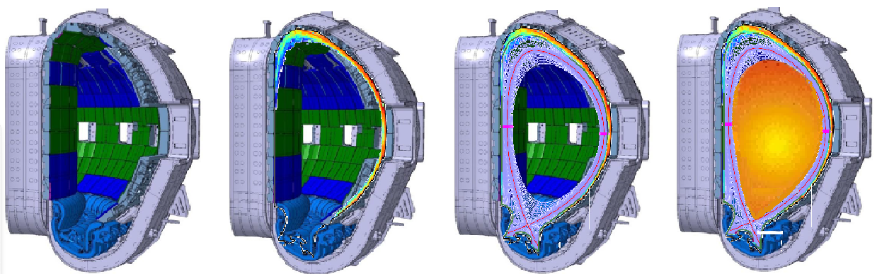
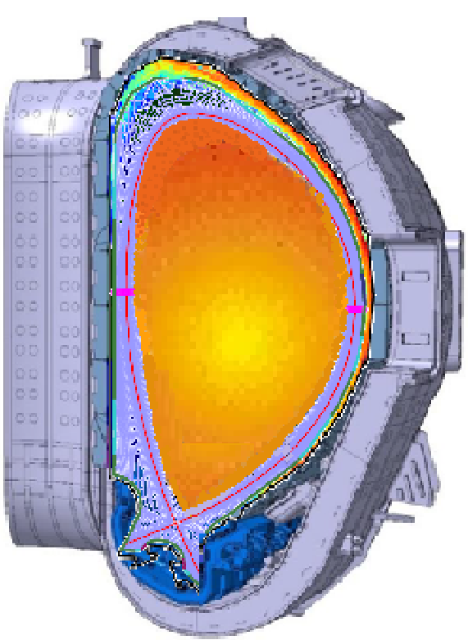
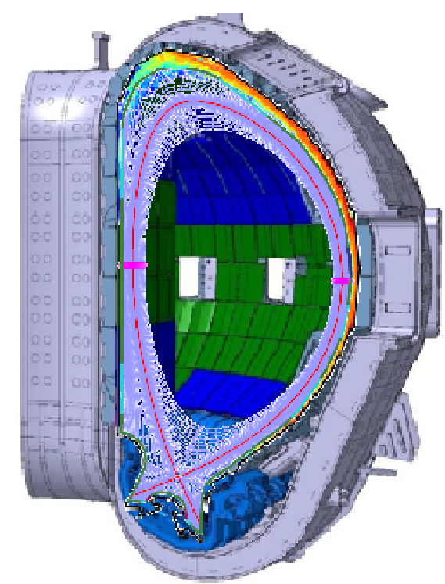
Towards self-consistent wall-SOL-edge-core modelling?
Goal: to predict full dynamics of temperature, density, rotation and current from the wall to the core
 | Source / transport
Wall | WallDYN2D, WallDYN3D, DIVIMP ERO, ERO2 MEMOS-U, MEMENTO
SOL/divertor | SOLPS-ITER EMC3-Eirene EDGE2D-Eirene | JINTRAC | Transient transport | Runaway Electrons
Core/Pedestal | JETTO-SANCO DINA ASTRA CORSICA METIS |  | JOREK | DREAM
 | Source / transport
Wall | WallDYN2D, WallDYN3D, DIVIMP ERO, ERO2 MEMOS-U, MEMENTO
SOL/divertor | SOLPS-ITER EMC3-Eirene EDGE2D-Eirene
 | Source / transport
Wall | WallDYN2D, WallDYN3D, DIVIMP ERO, ERO2 MEMOS-U, MEMENTO
SOL/divertor | SOLPS-ITER EMC3-Eirene EDGE2D-Eirene | JINTRAC
Core/Pedestal | JETTO-SANCO DINA ASTRA CORSICA METIS
 | Source / transport
Wall | WallDYN2D, WallDYN3D, DIVIMP ERO, ERO2 MEMOS-U, MEMENTO
  JINTRAC = JETTO-SANCO+EDGE2D-Eirene
  DINA-JINTRAC: High Fidelity Plasma Simulator (HFPS)
  → ITER workhorse for core-edge integrated modelling!
  S.H. Kim "HFPS" 17/10 14:00

Slide 8
Outline
  Developing the ITER Integrated Modelling platform IMAS
  Effect of extra W wall source on ITER plasma performance
  Characterization and mitigation of disruption
  Conclusion

Slide 9
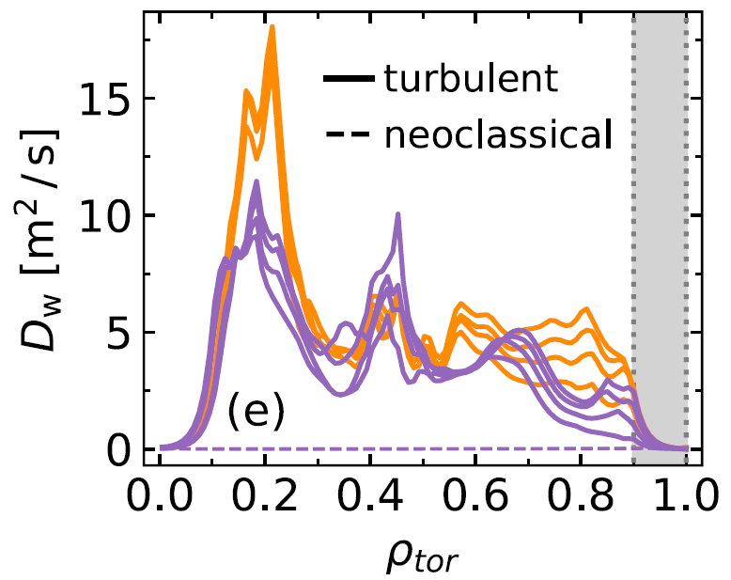
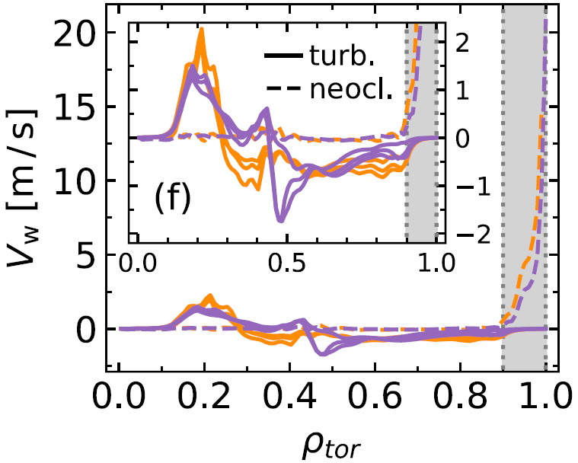




Tungsten transport
  Which mechanisms lead to W accumulation?
  W particle flux:
D. Fajardo, PPCF 67 (2025) 015020
  H-mode 5MA / 2.65T
  Pedestal
  H-mode 7.5MA / 2.65T
  Pedestal
  Turbulent
$$Γ_{W}=−D_{W}∇n_{W}+V_{W}n_{W}$$
  Neoclassical
  Turbulent
  Neoclassical
$n_{W}$ = W density
  Diffusion
  Convection
$$D_{W}=D_{turb}+D_{neo}$$
$$V_{W}=V_{turb}+V_{neo}$$
  Neoclassical: induced by collisions
  Turbulent: induced by microscopic instabilities

Slide 10
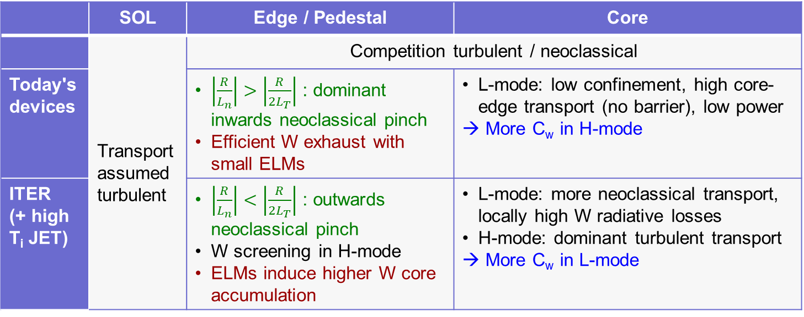
How does tungsten travel to the plasma core?
  Mechanisms leading to W transport:
 | SOL | Edge / Pedestal | Core
 | Transport assumed turbulent | Competition turbulent / neoclassical
Today's devices |  | $\left|\frac{R}{L_{n}}\right|>\left|\frac{R}{{2L}_{T}}\right|$ : dominant inwards neoclassical pinch Efficient W exhaust with small ELMs | L-mode: low confinement, high core-edge transport (no barrier), low power → More C_{w} in H-mode
ITER (+ high T_{i} JET) |  | $\left|\frac{R}{L_{n}}\right|<\left|\frac{R}{{2L}_{T}}\right|$ : outwards neoclassical pinch W screening in H-mode ELMs induce higher W core accumulation | L-mode: more neoclassical transport, locally high W radiative losses H-mode: dominant turbulent transport → More C_{w} in L-mode

Slide 11
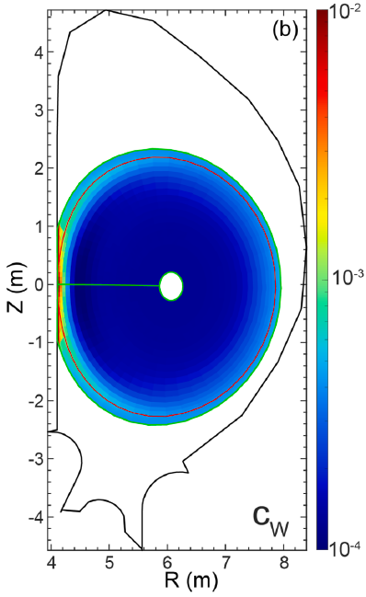
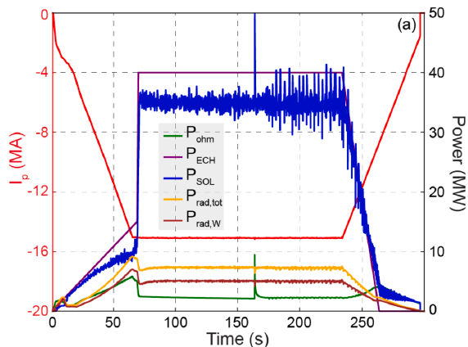
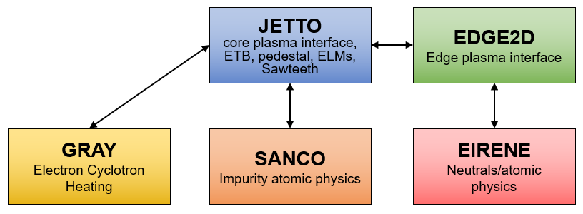
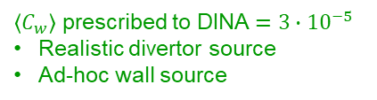
W source and transport in ITER L-mode plasmas
SOLPS-ITER
Highest risk of W radiative collapse in limiter phase
Limiter
phase
Diverted
phase
R. Pitts et al., NME 42 (2025) 101854
High T_{SOL}
SRO L-mode, 15 MA / 5.3 T H plasma
Lower T_{SOL}
Lower
sputtering
To DINA source model
W sputtering
C_{w}
Lower
C_{w}
Lower P_{LCFS}
Lower
P_{rad,core}
P_{LCFS}
P_{rad,core}
Yanjie Zhang's NF 65 (2025) 056035
DINA
(No Ne seeding)
JINTRAC
→ Self-regulated mechanism
→ Thermal stabilization
... But how do we avoid W radiative collapse in this early ramp-up phase?
Core
Edge
X-point at
t = 10 s
$\left\langle C_{w}\right\rangle$ prescribed to DINA$=3∙{10}^{−5}$
Realistic divertor source
Ad-hoc wall source

Slide 12
W source and transport in ITER L-mode plasmas
  How do we avoid W radiative collapse in the early ramp-up phase?
    With central ECH
    → T_{e} rise → Increased heat turbulent transport → Outwards convective W flux
JINTRAC using GRAY
Central ECH
Off-axis ECH
Radiative collapse!
P_{rad}
T_{e}
T_{i}
T_{e}
P_{rad}
T_{i}
R. Pitts et al., NME 42 (2025) 101854
  With density tailoring
  → Flattened or hollow density profile → Increased outwards W turbulent transport
  With Low-Z impurity injection (Neon)
  → Cool down plasma edge → Reduced W sputtering

Slide 13
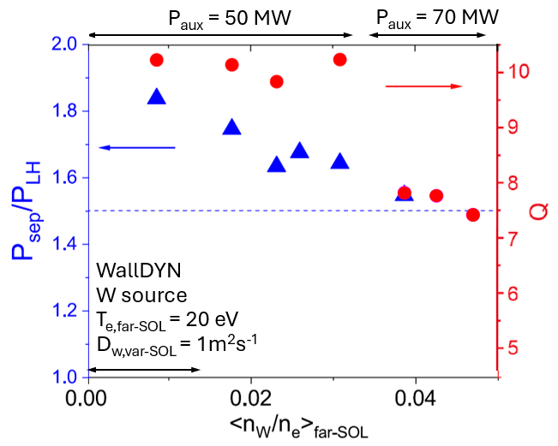
W source and transport in ITER ELM-free H-mode plasmas
  ELMs to be suppressed for $I_{p}≥7.5 MA$ to not melt W monoblocks → No ELM in simulations
  Restricted EDGE2D-Eirene grid in JINTRAC → Wall source to be provided externally
DIVIMP+WallDYN2D
JINTRAC
DT baseline 15 MA / 5.3 T
High Ne seeding case
W wall influx and penetration to near-SOL region
  → W dominated by Ne sputtering and W self-sputtering
  (low CXN-induced sputtering)
  Confirmed by more self-consistent preliminary results with SOLPS-ITER + ERO2 + JINTRAC
  In the future to come: EMC3-Eirene|SOLEDGE3X + ERO2|WallDYN3D + JINTRAC

Slide 14
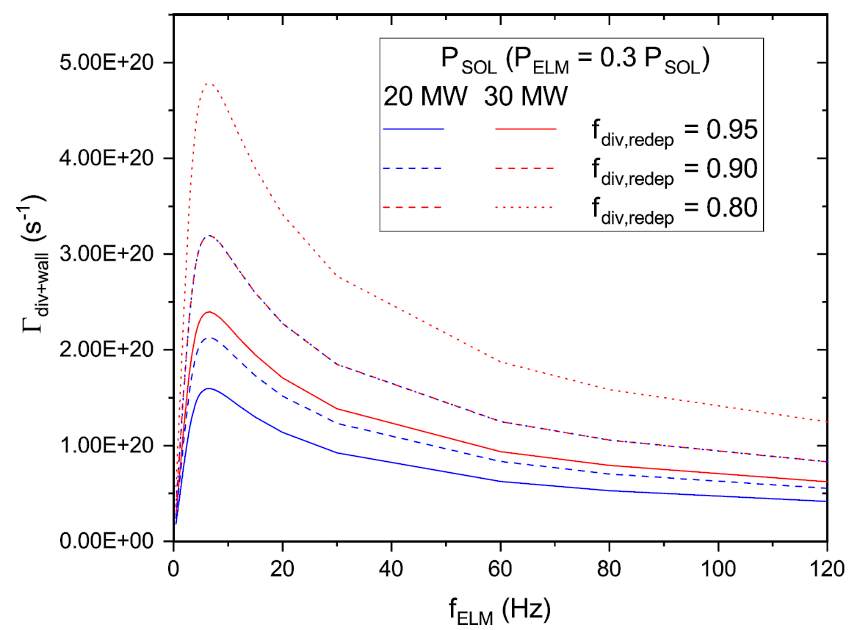
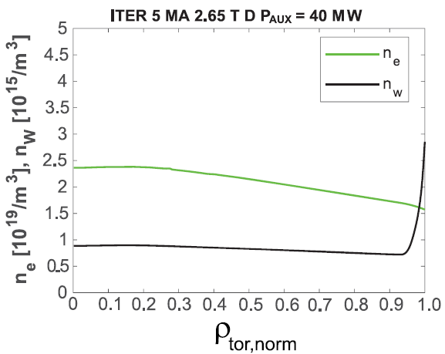
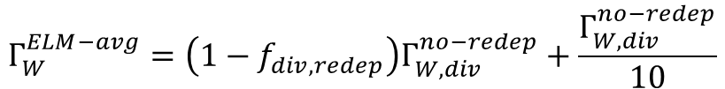
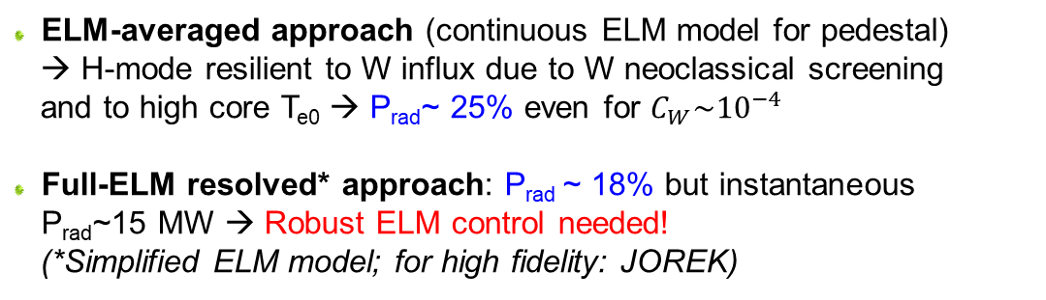
W source and transport in ITER ELMy H-mode plasmas
  Integrated modelling of W source and ELM control for SRO H-mode conditions (40 MW ECH): SOLPS+JINTRAC
    W gross divertor source (+ prompt redep.): SOLPS
    W gross wall source: 10% of divertor source
SOLPS
0.80
P_{AUX} = 30 MW
$$Γ_{W}^{ELM−avg}=\left(1−f_{div,redep}\right)Γ_{W,div}^{no−redep}+\frac{Γ_{W,div}^{no−redep}}{10}$$
0.90
0.95
0.90
0.85
0.95
P_{AUX} = 20 MW
Divertor source
Wall source
  ELM-averaged approach (continuous ELM model for pedestal)
  → H-mode resilient to W influx due to W neoclassical screening
  and to high core T_{e0} → P_{rad}~ 25% even for $C_{W}\sim {10}^{−4}$
  Full-ELM resolved* approach: P_{rad} ~ 18% but instantaneous P_{rad}~15 MW → Robust ELM control needed!
  (*Simplified ELM model; for high fidelity: JOREK)
JINTRAC
Electron density
W density

Slide 15
Outline
  Developing the ITER Integrated Modelling platform IMAS
  Effect of extra W wall source on ITER plasma performance
  Characterization and mitigation of disruption
  Conclusion

Slide 16
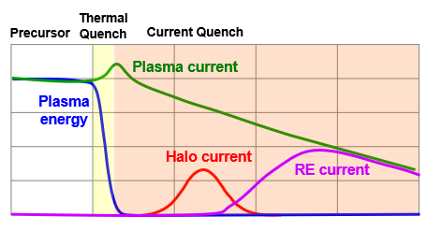
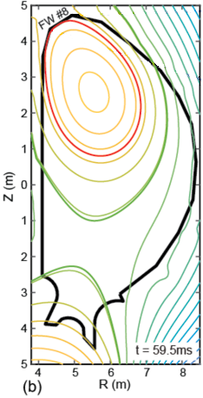
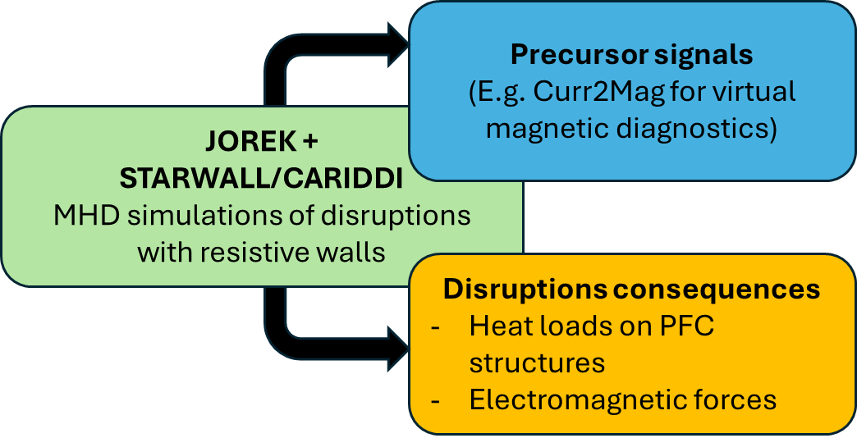
Disruption loads and mitigation
  2D disruption modelling:
  DINA (scenario) + SMITER (power load on FW)
  + MEMOS-U (FW melt motion)
  → Need to direct disruption upwards to preserve divertor
  → JOREK: possible with VS coils a few 10ms before TQ
  3D non-linear MHD modelling:
  JOREK → Marginal W FW melting from unmitigated disruptions at 15 MA
  [J. Artola "Thermal loads during VDE" 18/10 8:30]
  RE damage assessment:
  DINA/JOREK (RE loading) + Geant4 (RE vol. depos.)
  + MEMENTO (heat transfer to FW)
  → W tiles to be thickened to 12mm in localized areas
  RE mitigation:
  DREAM → SPI of H or Ne can lead to acceptable RE currents
  except in DT 15 MA plasmas (T β decay and Compton scattering from wall γ's)
DINA+SMITER+MEMOS-U
N. Schwarz et al, EPS 2025

Slide 17
Outline
  Developing the ITER Integrated Modelling platform
  Effect of extra W wall source on ITER plasma performance
  Characterization and mitigation of disruption
  Conclusion

Slide 18
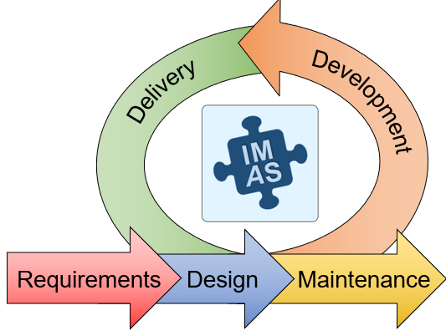


Conclusion
  Substantial IM effort to support the new re-baseline
  IMAS tools continuously developed to achieve self-consistent modelling of
  physics processes from the wall to the plasma core
  Many models & assumptions successfully validated on present
  experiments to support the ITER new baseline
  Improvements required such as extending models to higher fidelity to
  refine ITER predictions
  → Requires the involvement of the international fusion community through
  sharing of state-of-the-art models
  → Facilitated when models publicly available for worldwide contributions
  by fusion experts
  → Drive for new open-source software campaign launched by IO

Slide 19
Backup slides

Slide 20
Developing the ITER Integrated Modelling platform
Waterfall approach?
→ The agile approach is the one adopted to develop the ITER Integrating Modelling platform:
Requirements
Delivery
Development
  Linear: each phase to finish before next one starts
  Long-term planning cycles
  Appropriate with fixed requirements
Agile
approach!
Design
Development
Requirements
Design
Maintenance
  Users feedback
  → Adapt the tools to the user needs!
  Intermediate results
  → Already help defining the ITER new baseline!
Delivery
  Iterative process: fosters teamwork and flexibility
  Short planning cycles
  Appropriate when requirements evolve
Maintenance

Slide 21
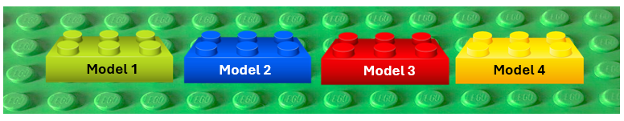
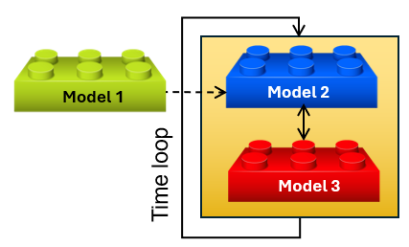
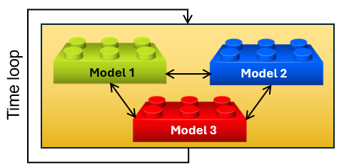
Integrated Modelling
  What is Integrated Modelling?
  Integrated modelling combines multiple models into a single framework
  What is a framework?
  A framework is a structured environment (tools, methods, standards) to connect models together
  How do we connect models together?
  Ideally: by building self-consistent simulation workflows
  Until workflows are ready: externally prescribe the result of a model into another one
  → The two routes have been taken to produce the results shown in this presentation.

Slide 22
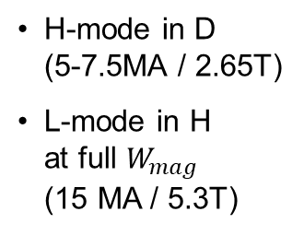


The ITER new baseline
SRO
Start of Research Operation
DT1
Fusion Power Operation 1
DT2
Fusion Power Operation 2
Inertially cooled FW
Water-cooled FW
Water-cooled FW
27 months
5 x 2 years
TBD
H, D plasmas
H, D, DT plasmas
DT plasmas
ECH 60-67 MW
ICH 10-20 MW
NBI 33 MW
ECH 60-67 MW
ICH 10-20 MW
NBI 49.5 MW
ECH 40 MW
ICH 10 MW
IC-I
(~18m)
IC-II
(~10m)
IC-III
(TBD)
H-mode in D
(5-7.5MA / 2.65T)
L-mode in H
at full $W_{mag}$
(15 MA / 5.3T)
$Q≥10$
and $P_{fus}=500 MW$
for 300-500s
Neutron budget:
$3.5∙{10}^{25}$
Long pulse, steady-state $Q≥5$
for 1000-3000s
Neutron budget:
$3∙{10}^{27}$

Slide 23
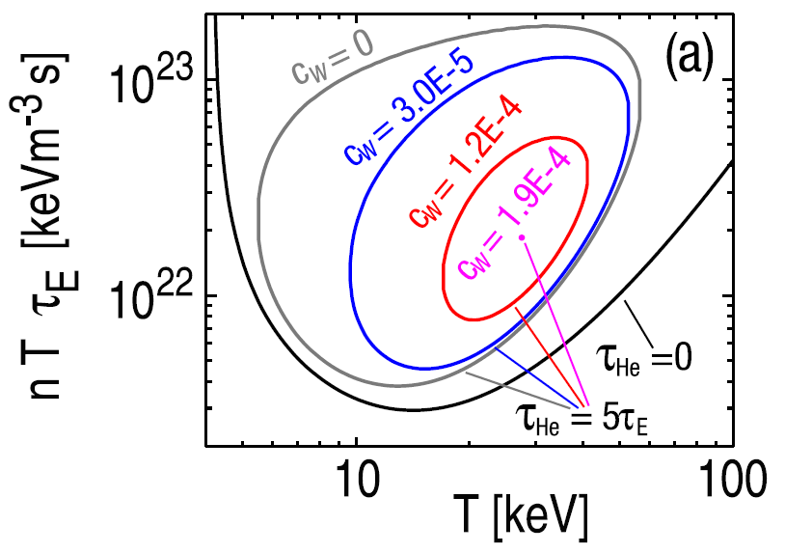
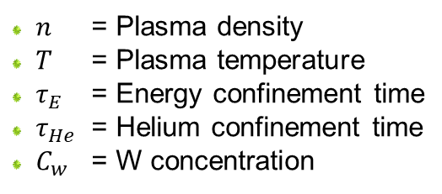
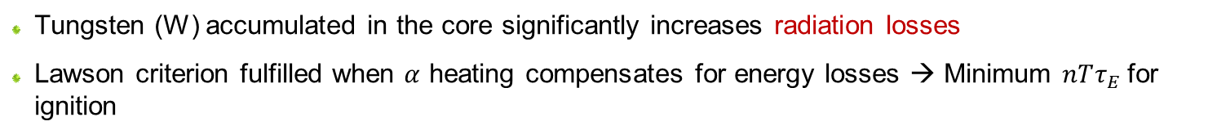
Why is tungsten detrimental for fusion plasma performance?
  Tungsten (W) accumulated in the core significantly increases radiation losses
  Lawson criterion fulfilled when $α$ heating compensates for energy losses → Minimum $nTτ_{E}$for ignition
T. Pütterich et al, NF 50 (2010) 025012
  $n$ = Plasma density
  $T$ = Plasma temperature
  $τ_{E}$ = Energy confinement time
  $τ_{He}$ = Helium confinement time
  $C_{w}$ = W concentration
  → The operational space to get plasma ignition is considerably reduced when the W concentration increases.

Slide 24
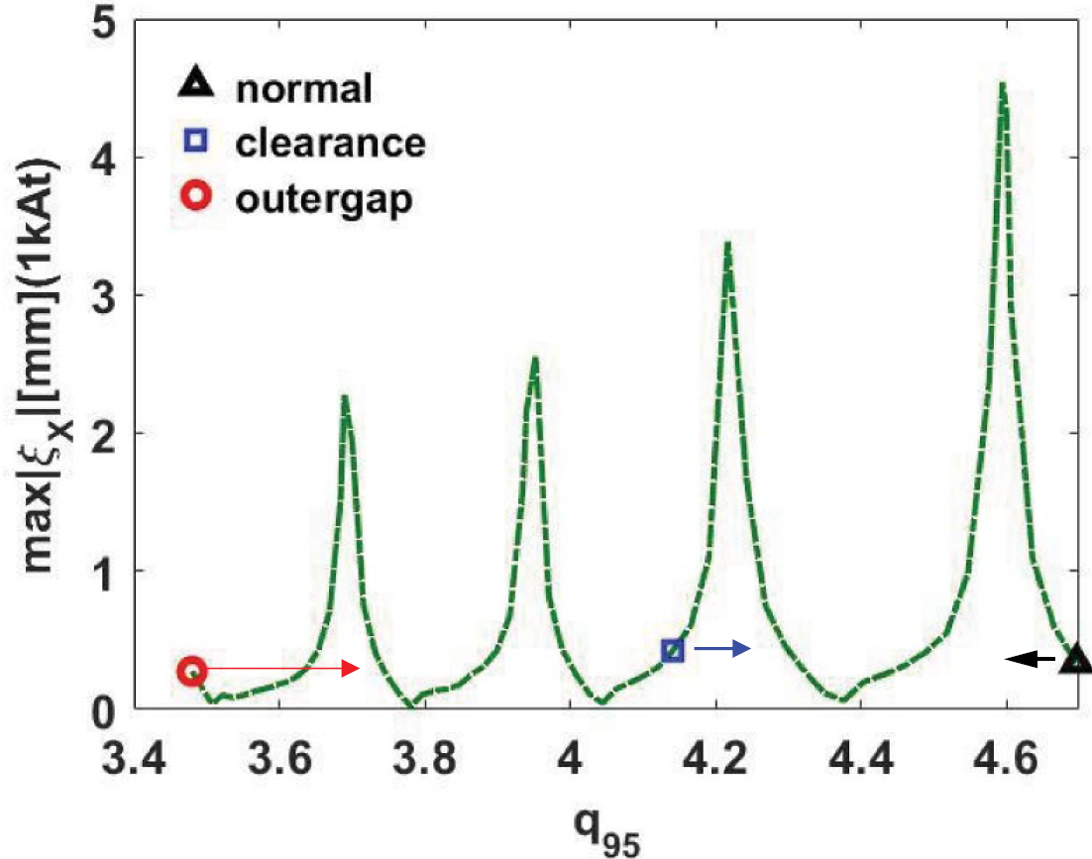
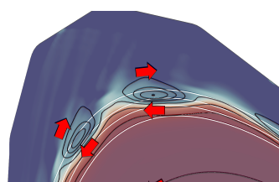
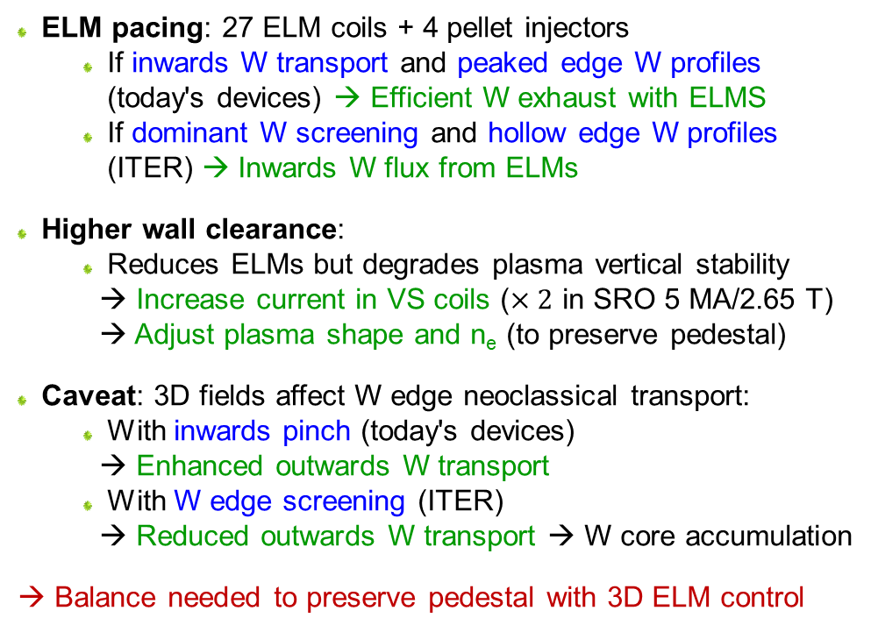
ELM control strategies
  ELM pacing: 27 ELM coils + 4 pellet injectors
    If inwards W transport and peaked edge W profiles (today's devices) → Efficient W exhaust with ELMS
    If dominant W screening and hollow edge W profiles (ITER) → Inwards W flux from ELMs
  Higher wall clearance:
    Reduces ELMs but degrades plasma vertical stability
    → Increase current in VS coils ($×2$ in SRO 5 MA/2.65 T)
    → Adjust plasma shape and n_{e} (to preserve pedestal)
  Caveat: 3D fields affect W edge neoclassical transport:
    With inwards pinch (today's devices)
    → Enhanced outwards W transport
    With W edge screening (ITER)
    → Reduced outwards W transport → W core accumulation
  → Balance needed to preserve pedestal with 3D ELM control
X. Bai et al, PPCF 66 055017 (2024)
SRO H-mode
5 MA / 2.65T
MARS-F
large
outer wall gap
increased clearance
normal clearance
S. Korving et al, submitted to NF (2025)
JOREK
ExB drift
Perturbed potential

