Slide 1

The physics of ELM-free regimes in EUROfusion tokamaks
Pedestal tailoring via ballooning modes
IAEA 2025
Mike Dunne
IPP-Garching

Slide 2




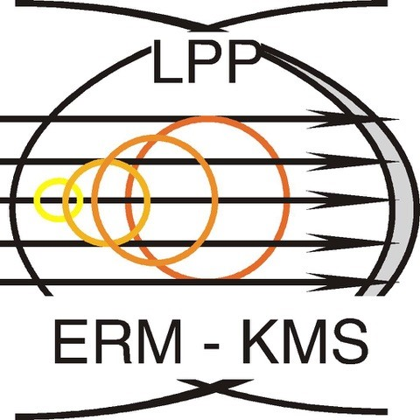


Co-authors
M. Faitsch, O. Sauter, E. Viezzer, B. Labit, A. Kappatou, D. Keeling, B. Vanovac,
I. Balboa, P. Bilkova, P. Bohm, D. Kos, J. Hobirk, E. Lerche, P. Lomas, S. Menmuir, A.O. Nelson, T. Pütterich, L. Radovanovic, S. Saarelma, S. Silburn, D. Silvagni, E.R. Solano, H.J. Sun, A. Tookey, E. Wolfrum
EUROfusion WPTE team,
ASDEX Upgrade team,
JET contributors, and
TCV Team
M. Dunne | IAEA 2025 | 15 October 2025

Slide 3
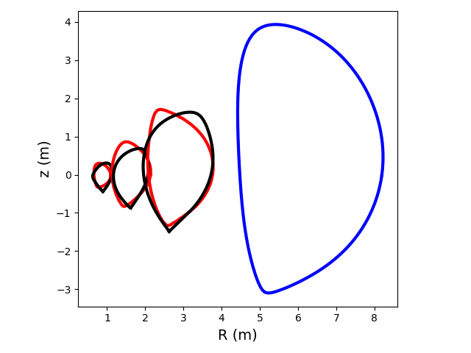
Aims of the research topic
Develop understanding of physics of ELM free scenarios
Integration of all regions of plasma (core, pedestal, SOL, divertor) challenging
Understand physics of regimes -> extrapolate
Utilise smaller, flexible devices to understand physics mechanisms
Demonstrate this understanding on larger machines (notably JET)
Extrapolate to JT-60SA, SPARC, ITER..
Regimes of interest:
MP ELM-suppression
QH-mode
I-mode
EDA/QCE
NT
TCV
ITER
AUG
JET
}
Focus of this talk
M. Dunne | IAEA 2025 | 15 October 2025

Slide 4
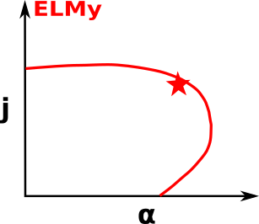
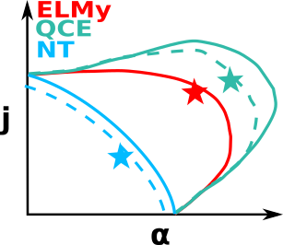
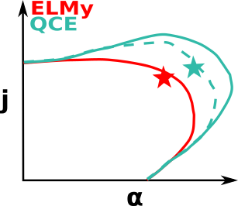
ELM avoidance; a simple picture
ELM occurs due to intersection of “average” transport and global MHD
Can avoid this intersection via:
Increasing ELM stability limit via shaping
With increased transport: remain below threshold for large-scale MHD
Separatrix localised ballooning:
Hypothesis behind QCE
Decreasing both limits until H-mode avoided
Unstable ballooning in the pedestal middle, blocking second stability access:
Negative triangularity
M. Dunne | IAEA 2025 | 15 October 2025

Slide 5
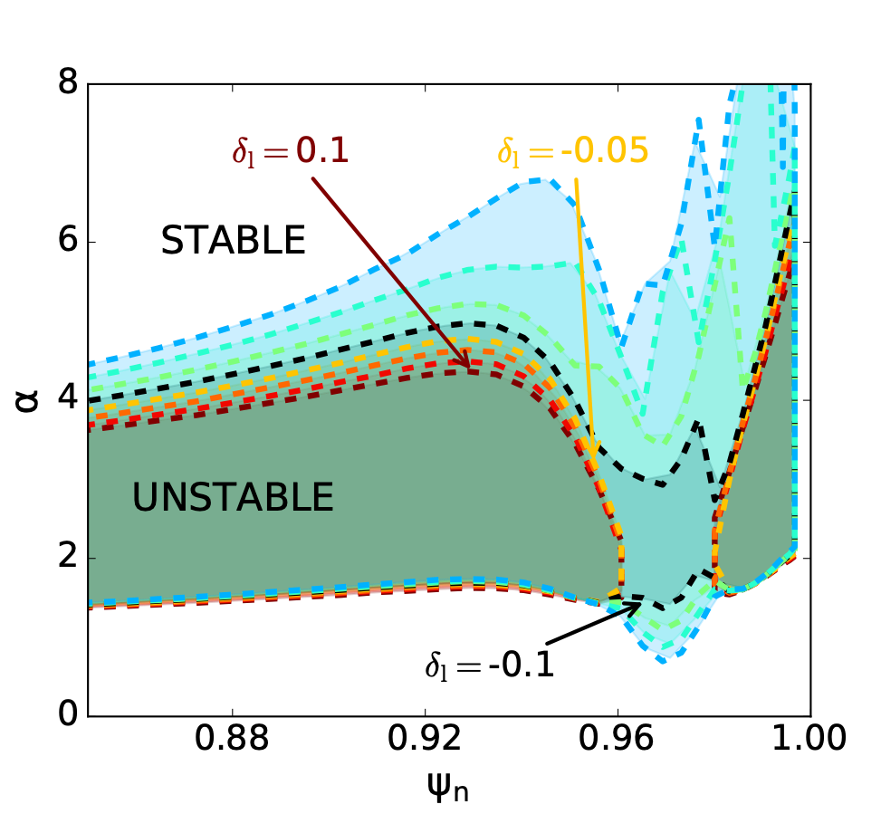
Ballooning stability in the pedestal middle: negative triangularity
Present understanding:
Sufficient negative delta to block access to ballooning second stability^{1,2}
Approach of experiments:
Use ideal MHD to predict critical shaping, combined with what a particular device can achieve (limited at AUG and JET)
Use flexible shaping at TCV to verify predictions
Attempt experiments on larger devices
Figure courtesy A.O. Nelson
¹Nelson et al., PRL 2023
²Sauter et al., IAEA 2023
M. Dunne | IAEA 2025 | 15 October 2025

Slide 6


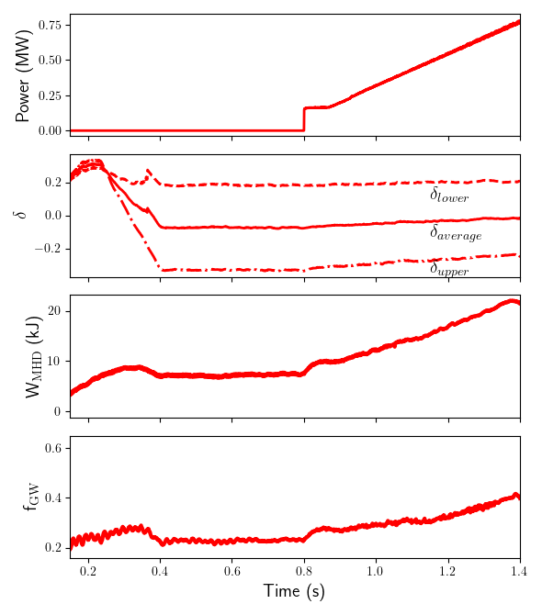
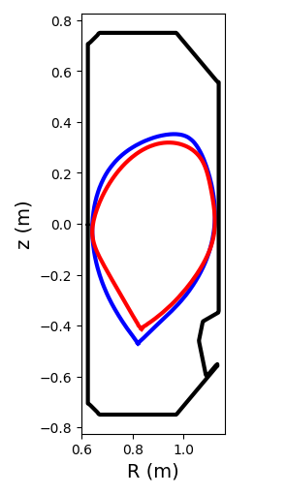
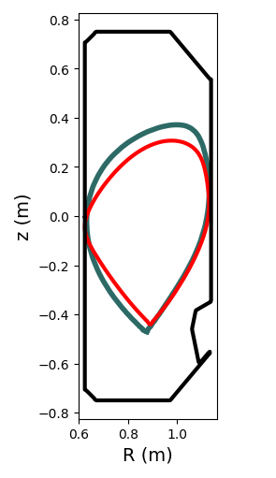
Exploring possible NT shapes for AUG and JET
Initial attempts on AUG:
No ELM avoidance due to low shaping^{1,2}
Modelling predictions for AUG:
Small changes in shape sufficient to avoid H-mode entry
Predictions for JET:
Shape is marginal for ELM avoidance
No confinement improvement expected
Test planned shapes in TCV
Expect ELM-free behaviour in both AUG and JET
TCV 80157
TCV 80157
JPN 105827
TCV 85967
AUG 43493
¹Happel et al., NF 2023
²Vanovac et al., NF 2025
M. Dunne | IAEA 2025 | 15 October 2025

Slide 7
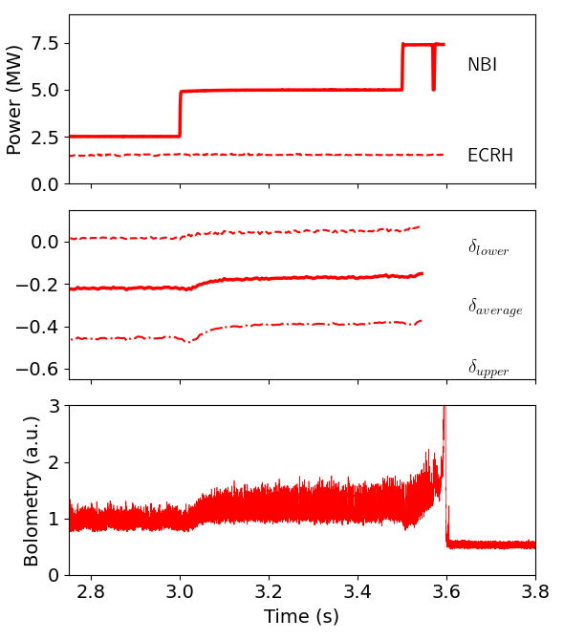
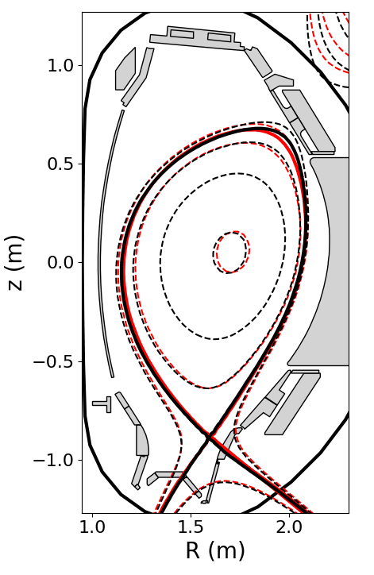
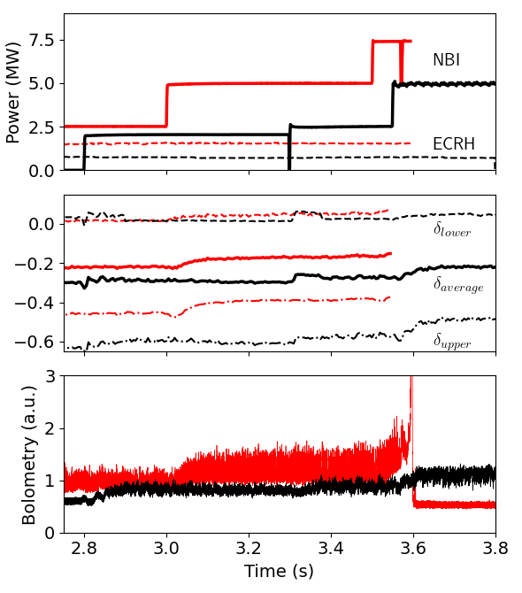
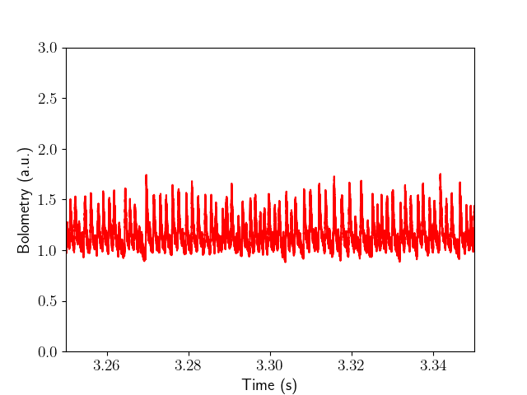
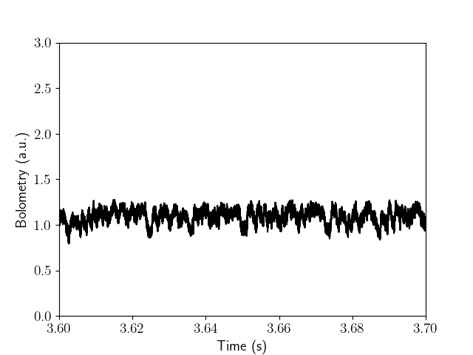
NT on ASDEX Upgrade
AUG 43114, 43493
AUG 43114
New campaign¹:
Experiments with small changes in triangularity
Weaker shaping:
Clear high frequency ELMs, as in previous experiments
Stronger shaping:
Dithering behaviour, no clear ELMs observed
¹Vanovac et al., in preparation
M. Dunne | IAEA 2025 | 15 October 2025

Slide 8
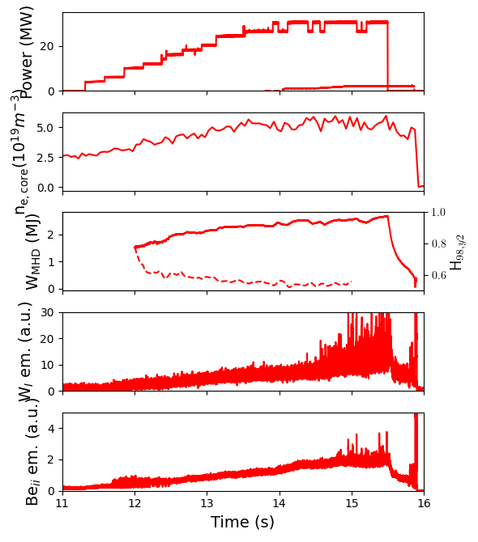
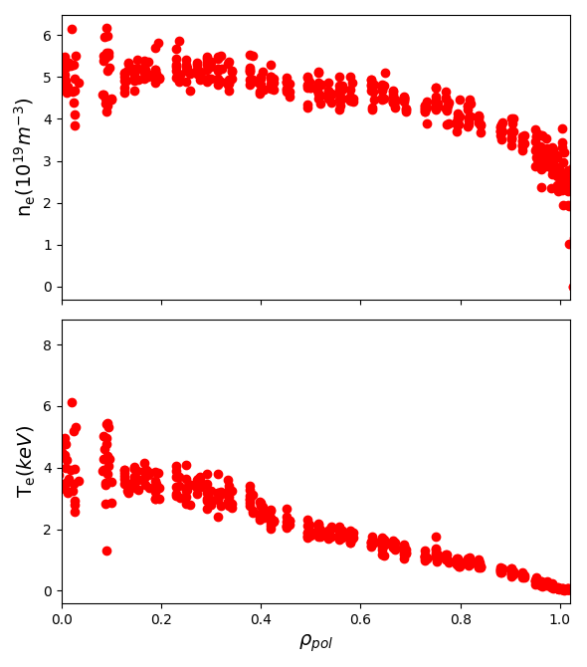
NT development on JET
JPN 105833
Experiments:
Up to 32 MW heating power
No clear H-mode or ELMs
First signs of filaments at highest heating power
Te, ne profiles show no clear pedestal
Excellent confirmation of H-mode avoidance model
Can use to extrapolate to potential future NT devices
M. Dunne | IAEA 2025 | 15 October 2025

Slide 9
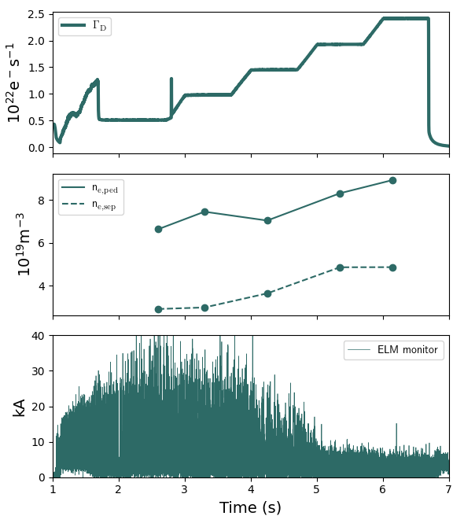
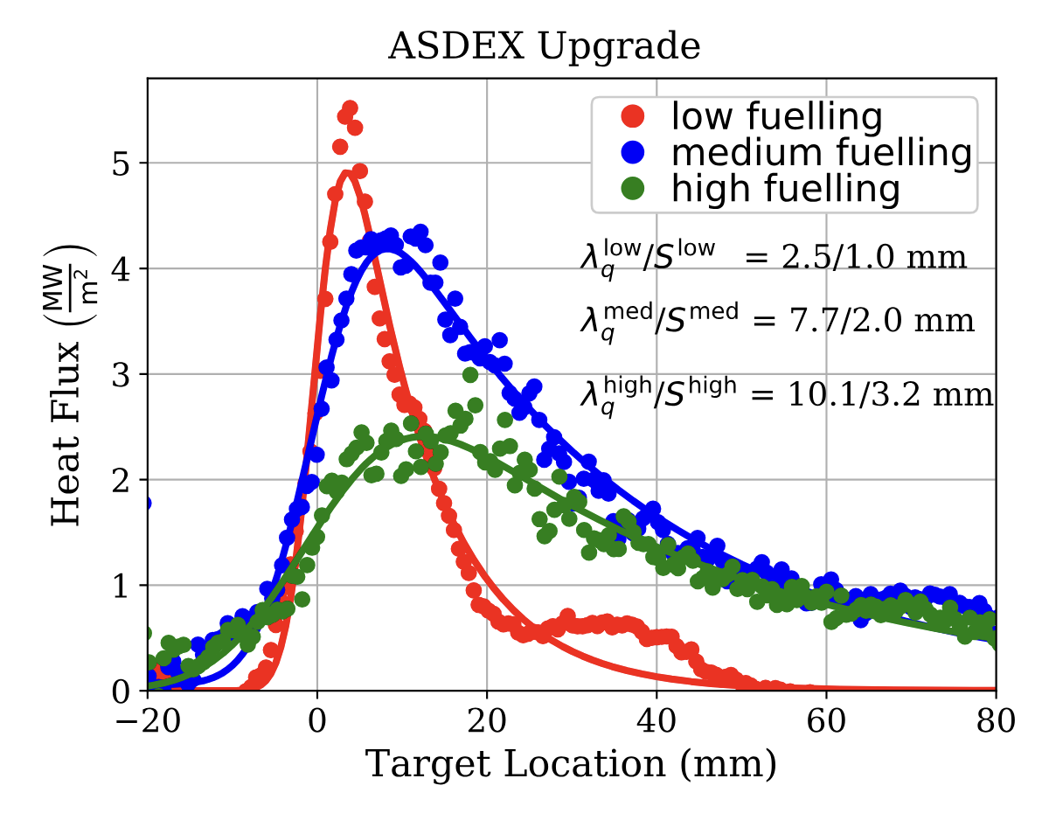
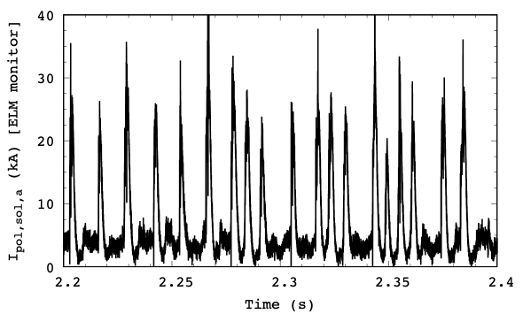
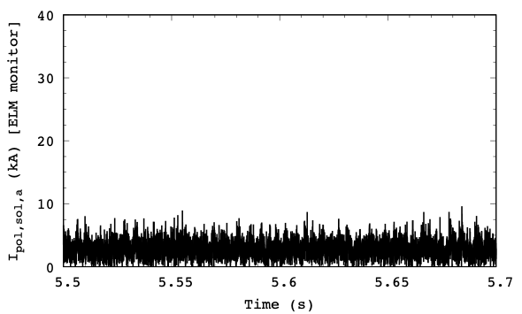
The quasi-continuous exhaust regime
AUG #36165
Study access at high plasma shaping and (separatrix) density^{1,2,3}
On present-day devices, this usually means high pedestal top collisionality
Exhibits H-mode-like pedestal, without large ELMs
Transport enhanced by filaments
Large-scale peeling-ballooning instability not triggered
Broadened power fall-off length in SOL region⁴
Inter Type-I ELM
QCE
QCE
¹Harrer et al., NF 2018
²Labit et al., NF 2019
³Dunne et al., NF 2024
⁴Faitsch et al. NF 2023
M. Dunne | IAEA 2025 | 15 October 2025

Slide 10
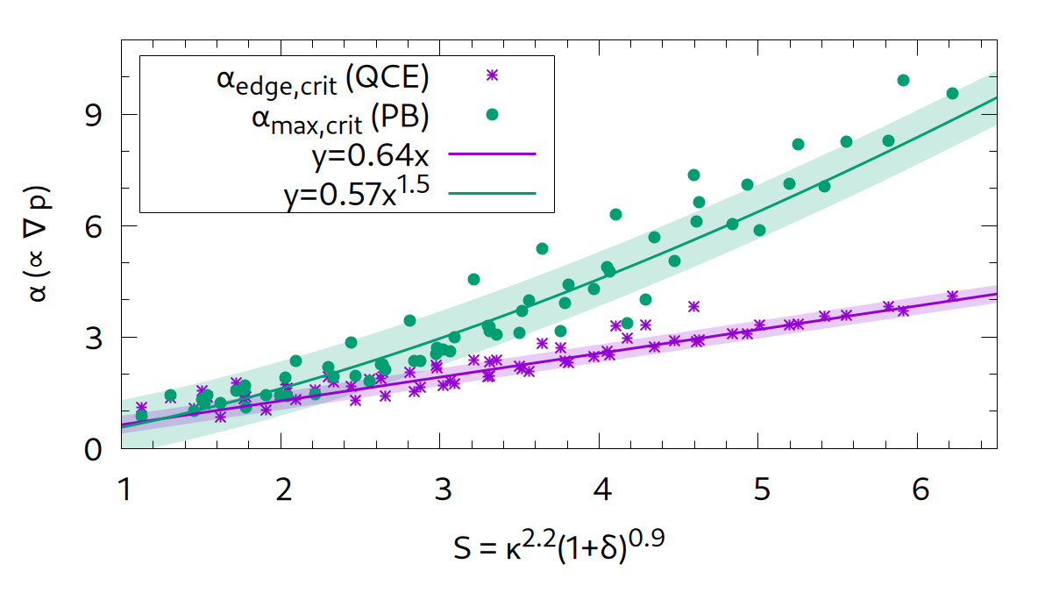
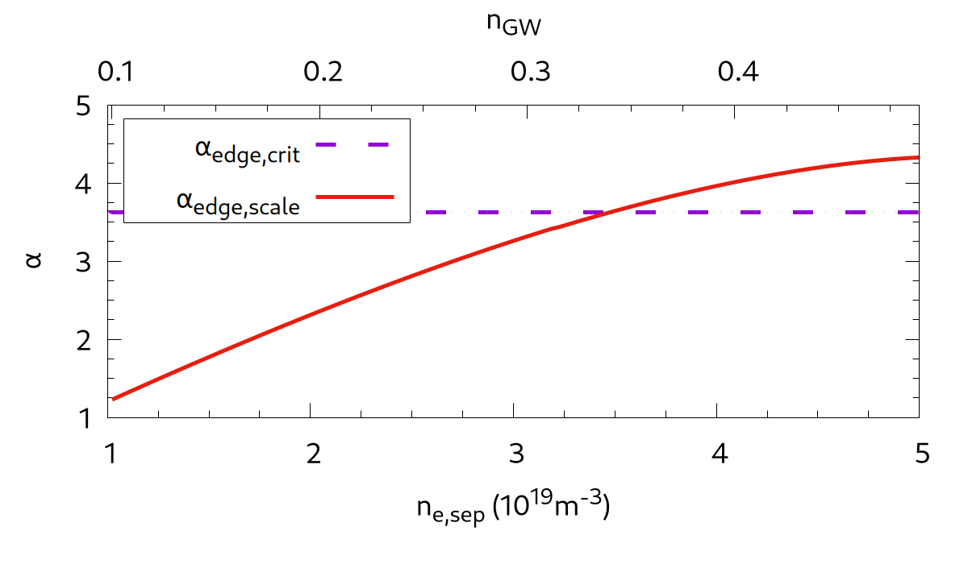
Separatrix ballooning modes: quasi-continuous exhaust
Predictive scan of plasma shape:
More shaping (~κ²(1+δ)): stabilises local ballooning and large-scale peeling-ballooning modes
Higher shaping opens possibility to destabilise ballooning modes for transport before large-scale PB modes
Can express critical α as critical ne,sep:
αedge,scale = Rq²β/λp,scale, β∝ne,sepTe,sep
λp,scale = 1.55(1+0.61(0.001qcylν∗sep)^{2.35})ρs
Can (in principle) make predictions for any scenario on any device
QCE
M. Dunne | IAEA 2025 | 15 October 2025

Slide 11
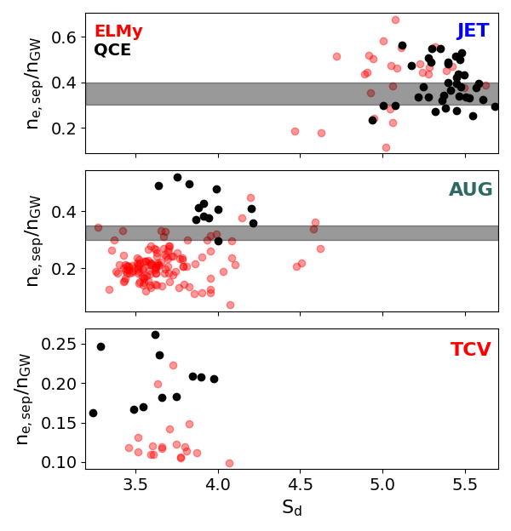

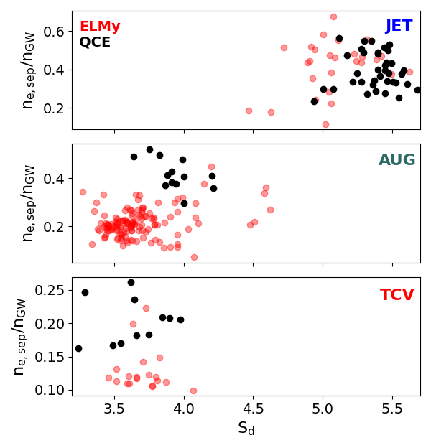
QCE: Critical separatrix density
Clear separation of ELMy and QCE plasmas based on shaping and ne,sep in AUG, JET, & TCV
TCV data only from baffled divertor
Observed separatrix density consistent with predicted critical density in AUG and JET
TCV falls significantly below this prediction
ITER prediction for critical separatrix (15 MA BL) falls within range of:
Absolute density
Greenwald density
Collisionality
ITER
Predicted
QCE access
M. Dunne | IAEA 2025 | 15 October 2025

Slide 12
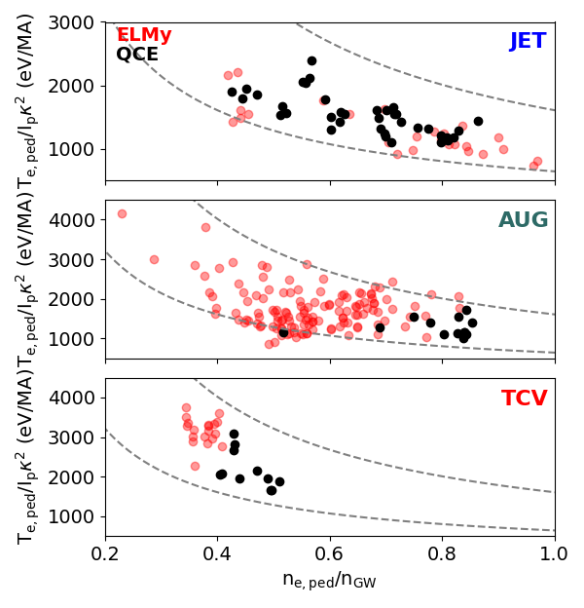
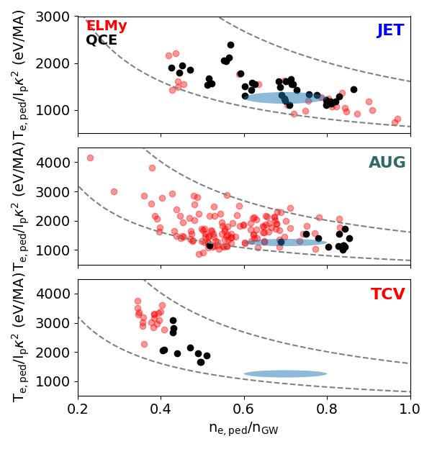
QCE: Pedestal top performance
Compare different scenarios:
Normalise density to nGW
Normalise temperature to Ip/κ²
Dashed lines are then lines of constant βpol
Range = 0.08-0.2, same in all devices
Pedestal top pressure in QCE comparable to similar ELMing H-mode pedestal
JET data overlaps in temperature and density
AUG & TCV at higher density than ELMy cases
IPED predictions correspond to experimental pedestal top pressure in AUG, JET, TCV
Predictions for ITER with standard ITER shaping compatible with edge ballooning modes^{1,2,3,4}
ITER
Pedestal
Predictions
¹Maget et al., NF 2013
²Radovanovic et al., NF 2019
³Maget et al., NF 2013
⁴Frassinetti et al., IAEA 2025
M. Dunne | IAEA 2025 | 15 October 2025

Slide 13
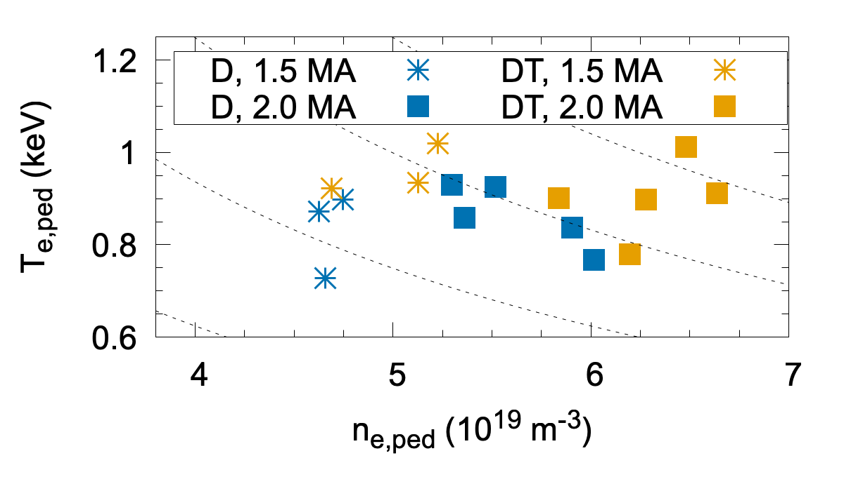
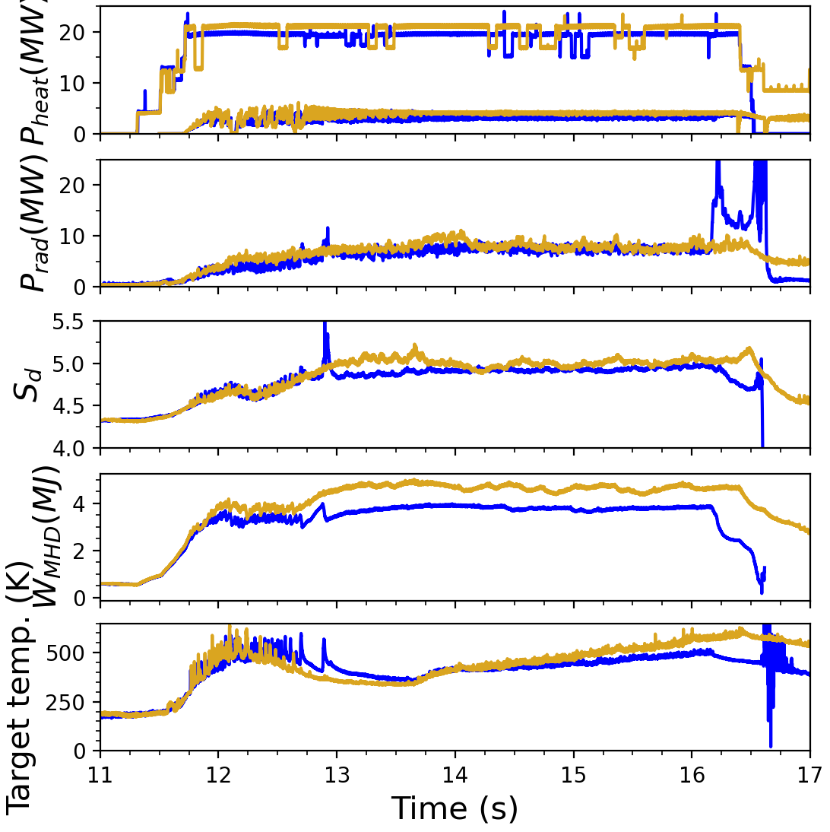
QCE regime in DT at JET
JPN103446, 104494
Ip = 2.0 MA, BT = 2.8 T
QCE demonstrated in DT plasmas at JET^{1,2}
Access QCE at same engineering parameters as in D pulse
Features best combination of ELMy H-mode and QCE from D plasmas:
No large ELMs observed at similar engineering parameters
Energy confinement improved in DT pulses
Pedestal density increases at constant temperature in both attempted scenarios
IPED predictions in line with measured pedestal heights
IPED predictions
¹Faitsch et al., NF 2025
²Faitsch et al., NME 2025
M. Dunne | IAEA 2025 | 15 October 2025

Slide 14
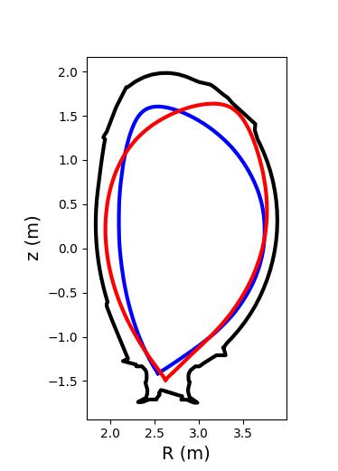
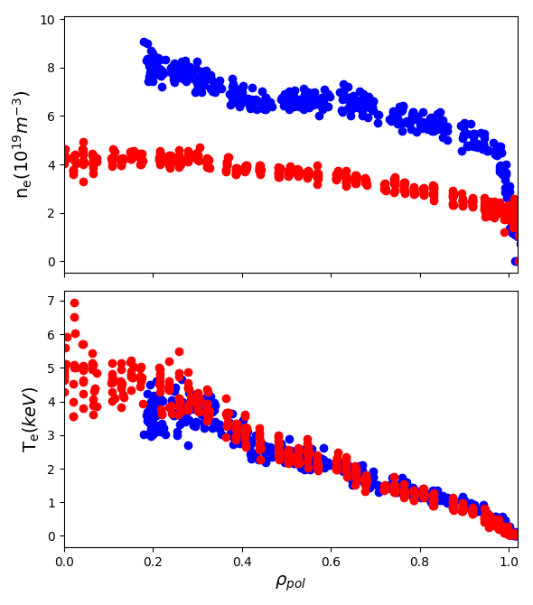
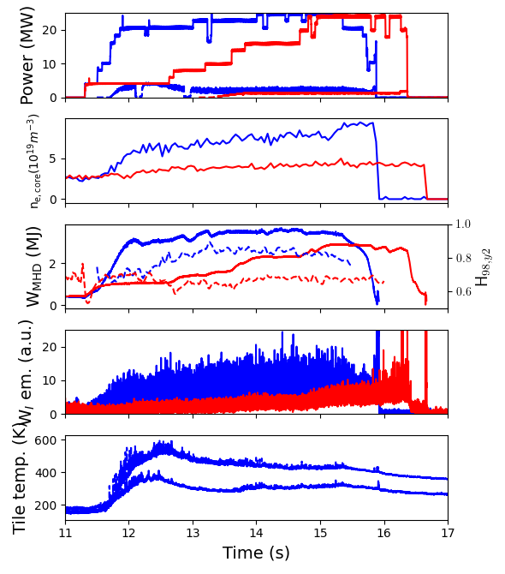
Comparison of QCE and NT at JET
QCE NT
JPN 105496, 105827
1.5 MA/ 2.3 T
Compared scenarios at 1.5 MA/2.3 T
Same heating power
Comparable stored energy at same heating power
Significantly higher density in QCE pulse
Core temperature similar in QCE and NT
Normalised confinement higher in QCE
NT recovers stored energy with much larger plasma volume
Filaments visible in QCE
Very little activity visible in camera diagnostics in NT
M. Dunne | IAEA 2025 | 15 October 2025

Slide 15
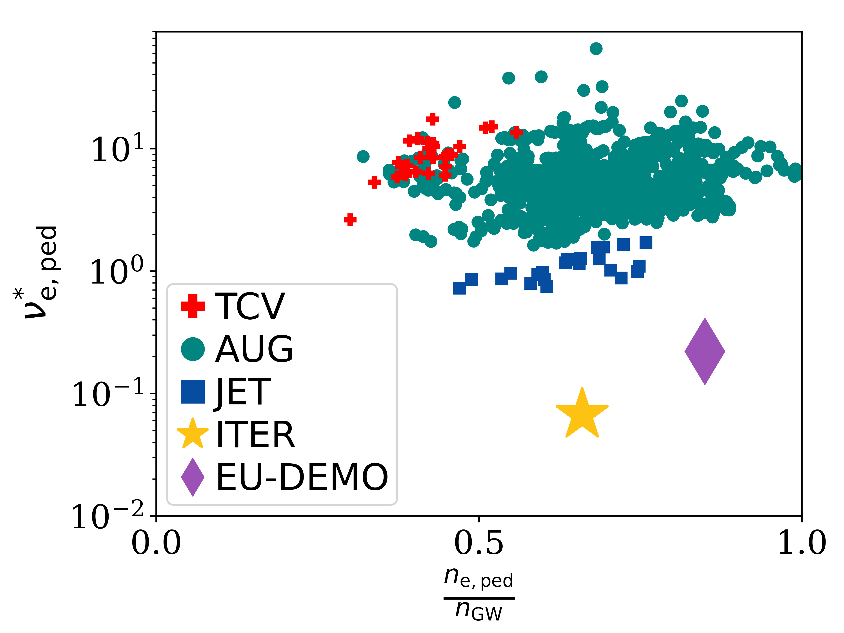
Summary and conclusions
Understand QCE and NT ELM avoidance in EF tokamaks
Demonstrated both regimes in final JET campaign
Stepladder approach made this possible
QCE demonstrated in DT
Predictions show QCE access in ITER/SPARC/DEMO
NT ELM avoidance based on ideal MHD
Can predict an NT-DEMO
Ongoing work:
Extending NT to WEST, MAST-U, QCE to MAST-U
Expanding QCE operational range to higher current and (even) lower q95 in operational devices
Demonstrate robust ELM avoidance also in ramp-up
Further exploration and development of MP ELM suppression and QH-mode
Prospective:
QCE at lower ν*ped in JT-60SA
M. Dunne | IAEA 2025 | 15 October 2025

