Slide 1
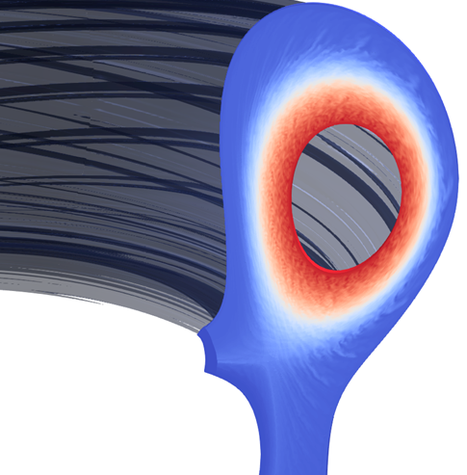



Hierarchy of turbulent transport models with the SOLEDGE3X code
H. Bufferand
M. Capasso, G. Ciraolo, H. Corvoysier, J. Denis, N. Fedorczak, Ph. Ghendrih, E. Havlíčková, D. S. de Oliveira, N. Rivals, S. Sureshkumar, P. Tamain, N. Varadarajan, Y. Marandet, R. Düll, I. Kudashev, F. Schwander, E. Serre, H. Yang and the TCV team
This work has been carried out within the framework of the EUROfusion Consortium, funded by the European Union via the Euratom Research and Training Programme (Grant Agreement No 101052200 — EUROfusion). Views and opinions expressed are however those of the author(s) only and do not necessarily reflect those of the European Union or the European Commission. Neither the European Union nor the European Commission can be held responsible for them.

Slide 2
Outline
Introduction to the hierarchy of turbulence models
Implementation in the SOLEDGE3X code
Application to TCV-X21 reference scenario

Slide 3
Introduction to the hierarchy of turbulence models
1

Slide 4


Example from the neutral fluid community
$$E(k)$$
Energy injection
(large scales)
Inertial range
(energy cascade)
Dissipation
(small scales)
Underlying model: Navier-Stokes equations
Turbulence key properties (in 3D):
Mixing effect
Well characterized energy spectrum
Turbulence numerical modelling hierarchy:
$$k$$

Slide 5
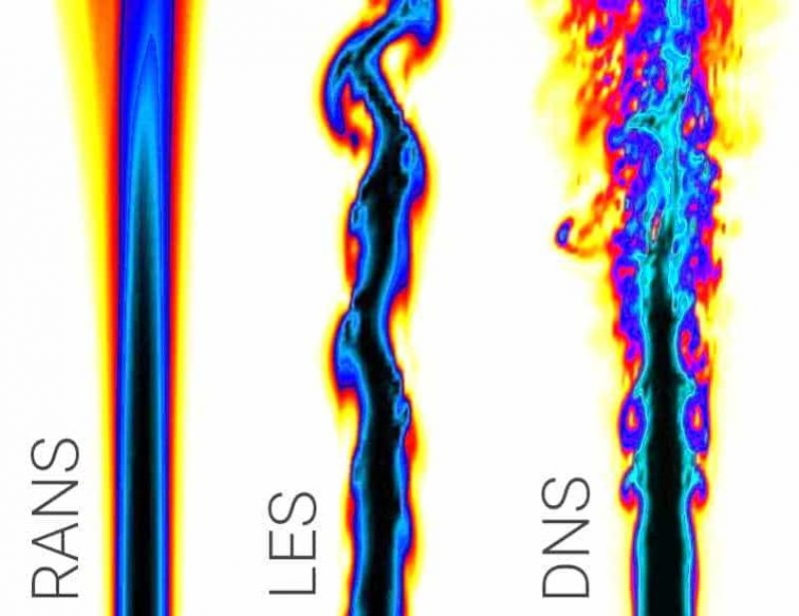
Example from the neutral fluid community
$$E(k)$$
Energy injection
(large scales)
Inertial range
(energy cascade)
Dissipation
(small scales)
Underlying model: Navier-Stokes equations
Turbulence key properties (in 3D):
Mixing effect
Well characterized energy spectrum
Turbulence numerical modelling hierarchy:
DNS
Numerically resolved
$$k$$
Reynolds-Averaged Navier-Stokes
Large Eddy Simulation
Direct Numerical Simulation
Fidelity

Slide 6
Example from the neutral fluid community
$$E(k)$$
Energy injection
(large scales)
Inertial range
(energy cascade)
Dissipation
(small scales)
Underlying model: Navier-Stokes equations
Turbulence key properties (in 3D):
Mixing effect
Well characterized energy spectrum
Turbulence numerical modelling hierarchy:
LES
Numerically
resolved
Model estimated
$$k$$
Reynolds-Averaged Navier-Stokes
Large Eddy Simulation
Direct Numerical Simulation
Fidelity

Slide 7
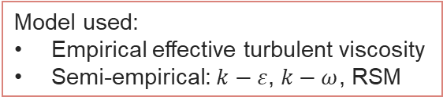
Example from the neutral fluid community
$$E(k)$$
Energy injection
(large scales)
Inertial range
(energy cascade)
Dissipation
(small scales)
Underlying model: Navier-Stokes equations
Turbulence key properties (in 3D):
Mixing effect
Well characterized energy spectrum
Turbulence numerical modelling hierarchy:
RANS
Model estimated
$$k$$
Reynolds-Averaged Navier-Stokes
Large Eddy Simulation
Direct Numerical Simulation
Efficiency
Fidelity
Model used:
Empirical effective turbulent viscosity
Semi-empirical: $k−ε$, $k−ω$, RSM
Mean-field simulations
Turbulence simulations

Slide 8
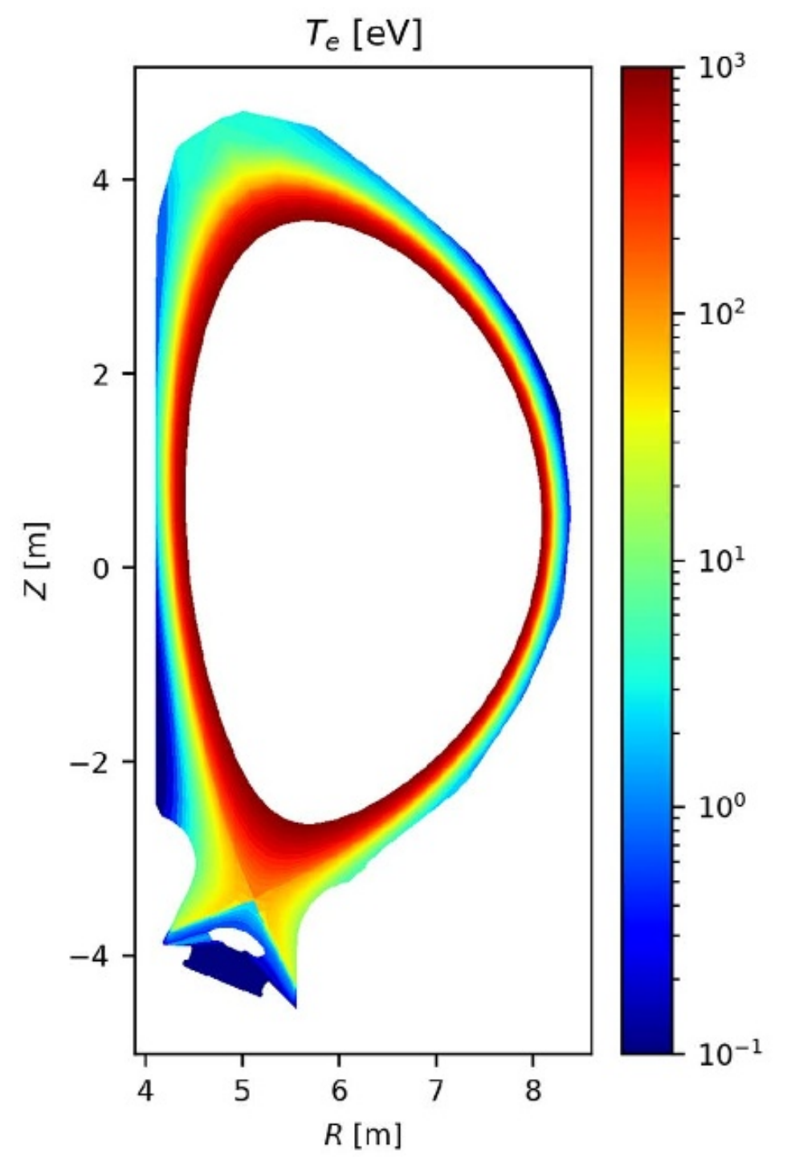
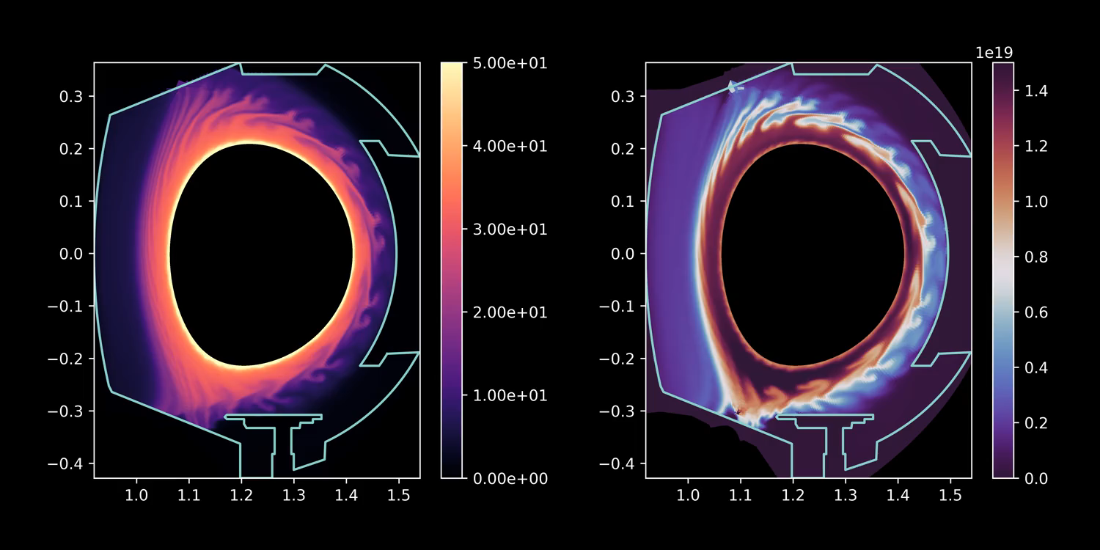
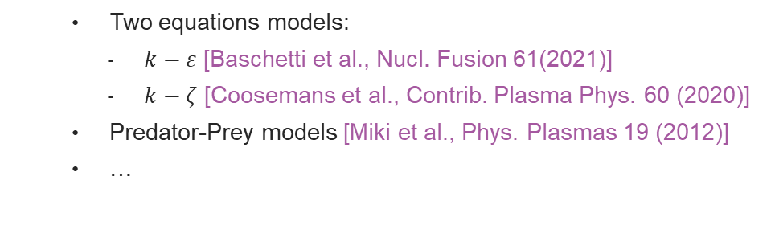
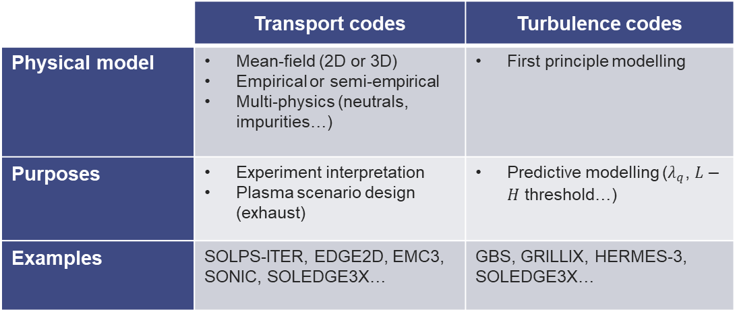
Hierachy of models in edge plasma community
 | Transport codes | Turbulence codes
Physical model | Mean-field (2D or 3D) Empirical or semi-empirical Multi-physics (neutrals, impurities…) | First principle modelling
Purposes | Experiment interpretation Plasma scenario design (exhaust) | Predictive modelling ($λ_{q}$, $L−H$ threshold…)
Examples | SOLPS-ITER, EDGE2D, EMC3, SONIC, SOLEDGE3X… | GBS, GRILLIX, HERMES-3, SOLEDGE3X…
Underlying model: Braginskii’s equations
Complex turbulence properties in strongly magnetized plasma
Mixing effect (enhanced transport)
Strong interaction between large scale flows and turbulent structures → transport barrier
Hierarchy of models for turbulence:
Models for effective turbulent diffusivities:
Empirical: ad-hoc diffusivities to match experimental profiles
Semi-empirical reduced models for turbulence:
Two equations models:
$k−ε$ [Baschetti et al., Nucl. Fusion 61(2021)]
$k−ζ$ [Coosemans et al., Contrib. Plasma Phys. 60 (2020)]
Predator-Prey models [Miki et al., Phys. Plasmas 19 (2012)]
…
SOLEDGE3X WEST turbulent simulation [Bufferand et al. Nucl. Fusion 61, 2021]
SOLEDGE3X ITER transport simulation [Rivals et al., Nucl. Fusion 65, 2025]

Slide 9
Implementation in the SOLEDGE3X code
2

Slide 10
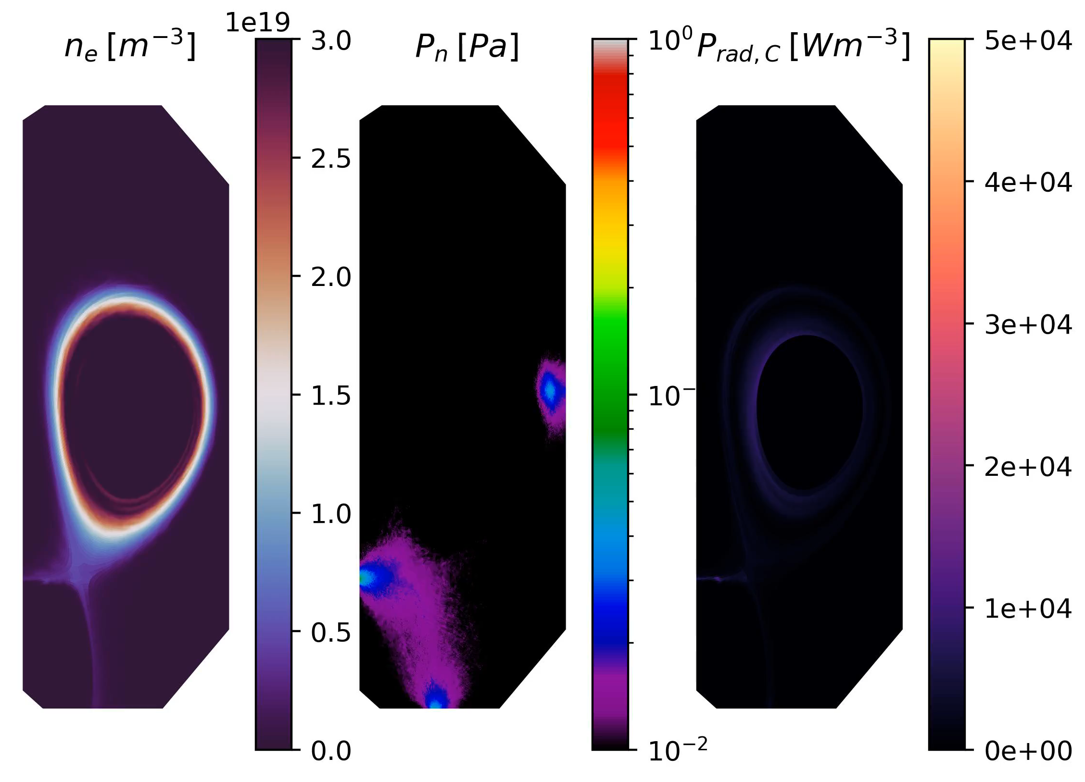
SOLEDGE3X: a versatile fluid code for edge plasma modelling
Drift-fluid code based on Braginskii’s equations with Zhdanov closure terms for multi-component plasma
Up to the first wall modelling thanks to immersed boundary conditions
Kinetic neutrals via coupling with EIRENE
Applications: 2D/3D transport AND 3D turbulent simulations
More info: www.soledge3x.com
Neutrals simulated with EIRENE
Radiation by sputtered carbon
Example of application to turbulent simulation of a Deuterium & Carbon plasma on TCV

Slide 11
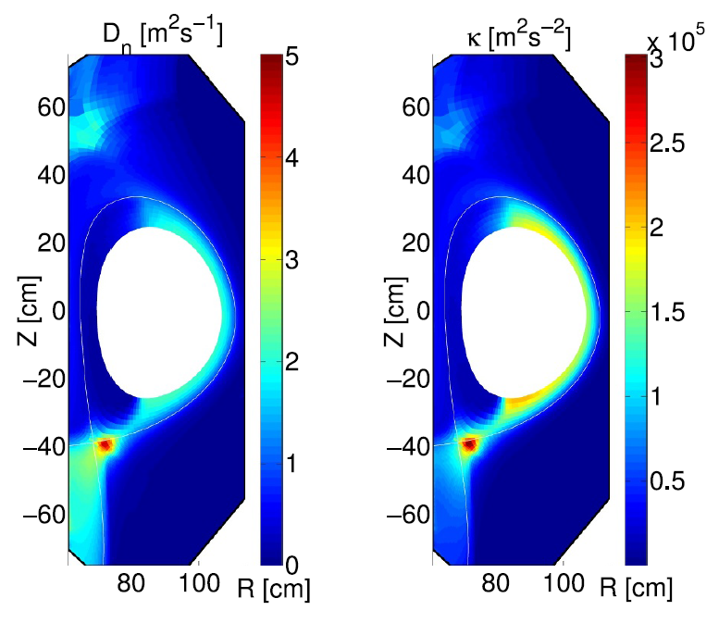
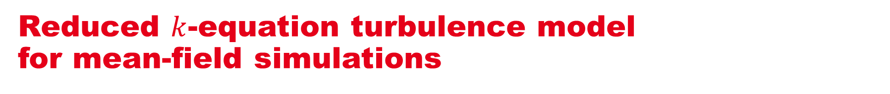
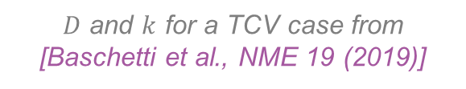
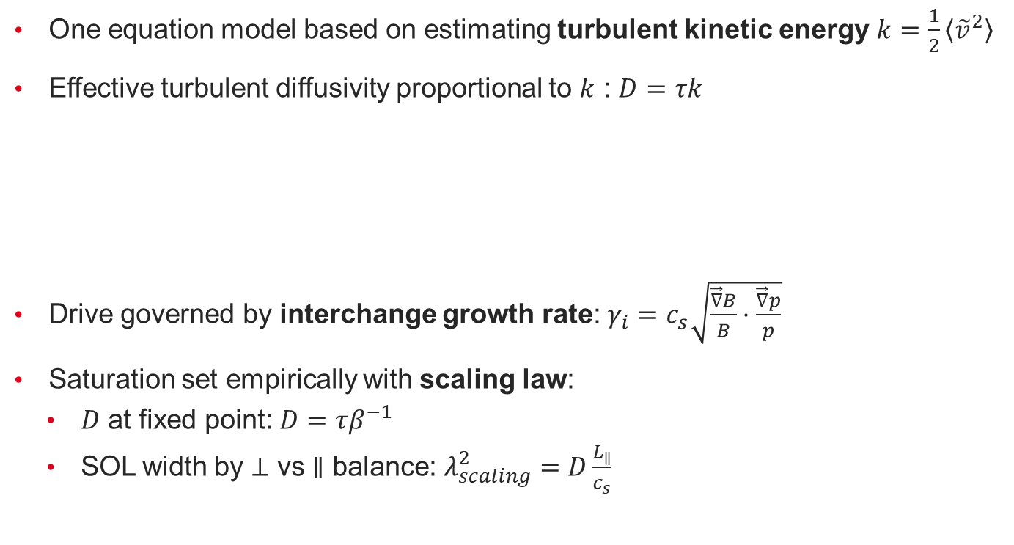


Reduced $k$-equation turbulence model for mean-field simulations
One equation model based on estimating turbulent kinetic energy $k=\frac{1}{2}\left\langle {\tilde{v}}^{2}\right\rangle$
Effective turbulent diffusivity proportional to $k$ : $D=τk$
Drive governed by interchange growth rate: $γ_{i}=c_{s}\sqrt{\frac{\vec{∇}B}{B}⋅\frac{\vec{∇}p}{p}}$
Saturation set empirically with scaling law:
$D$ at fixed point: $D=τβ^{−1}$
SOL width by $⊥$ vs $∥$ balance: $λ_{scaling}^{2}=D\frac{L_{∥}}{c_{s}}$
$D$ and $k$ for a TCV case from [Baschetti et al., NME 19 (2019)]
$$∂_{t}k+\vec{∇}⋅\left(k\vec{v}\right)=γ_{I}k\left(1−βk\right)$$
linear drive
non-linear saturation
$$β=τ\frac{L_{∥}}{c_{s}λ_{scaling}^{2}}$$

Slide 12
Application to the TCV-X21 reference scenario
3

Slide 13
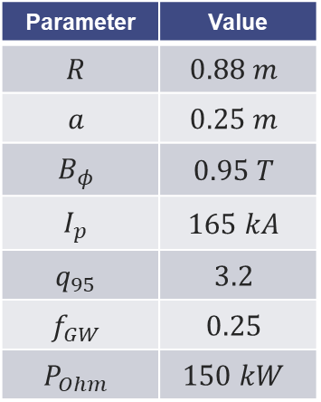

The TCV-X21 experiment
TCV-X21 = set of shots on TCV for edge turbulence codes confrontation
Deuterium Ohmic L-mode, lower single-null
Low magnetic field for lower $ρ^{⋆}=ρ_{L}/a$
Low density, targeting sheath-limited regime
Parameter | Value
$$R$$ | $$0.88 m$$
$$a$$ | $$0.25 m$$
$$B_{φ}$$ | $$0.95 T$$
$$I_{p}$$ | $$165 kA$$
$$q_{95}$$ | $$3.2$$
$$f_{GW}$$ | $$0.25$$
$$P_{Ohm}$$ | $$150 kW$$
Main results in [D.S Oliveira, T. Body et al., Nucl. Fusion 62 (2022)]
Public experimental dataset on https://github.com/SPCData/TCV-X21
TCV-X21 magnetic configuration and main edge diagnostics.

Slide 14




The TCV-X21 benchmark
Experimental dataset used to benchmark edge turbulence codes [D.S Oliveira, T. Body et al., Nucl. Fusion 62 (2022) & pre-print arXiv:2506.12180]
GBS
GRILLIX
TOMAK3X
HERMES-3
Rather good agreement with mid-plane profile measurements – discrepancies in the divertor
TCV-X21 plasmas simulated with SOLPS-ITER
[Wang et al., Nucl. Fusion 64 (2024)]
✗ No Neutrals !
Comparison between turbulence code simulations of a TCV-X21 shot – poloidal map of the density. On the left panel, the green and blue shaded areas display the particle and energy source respectively. Figure from [Oliveira et al, Nucl Fusion 62 (2022)].
Comparison between RDPA density measurements and simulations

Slide 15
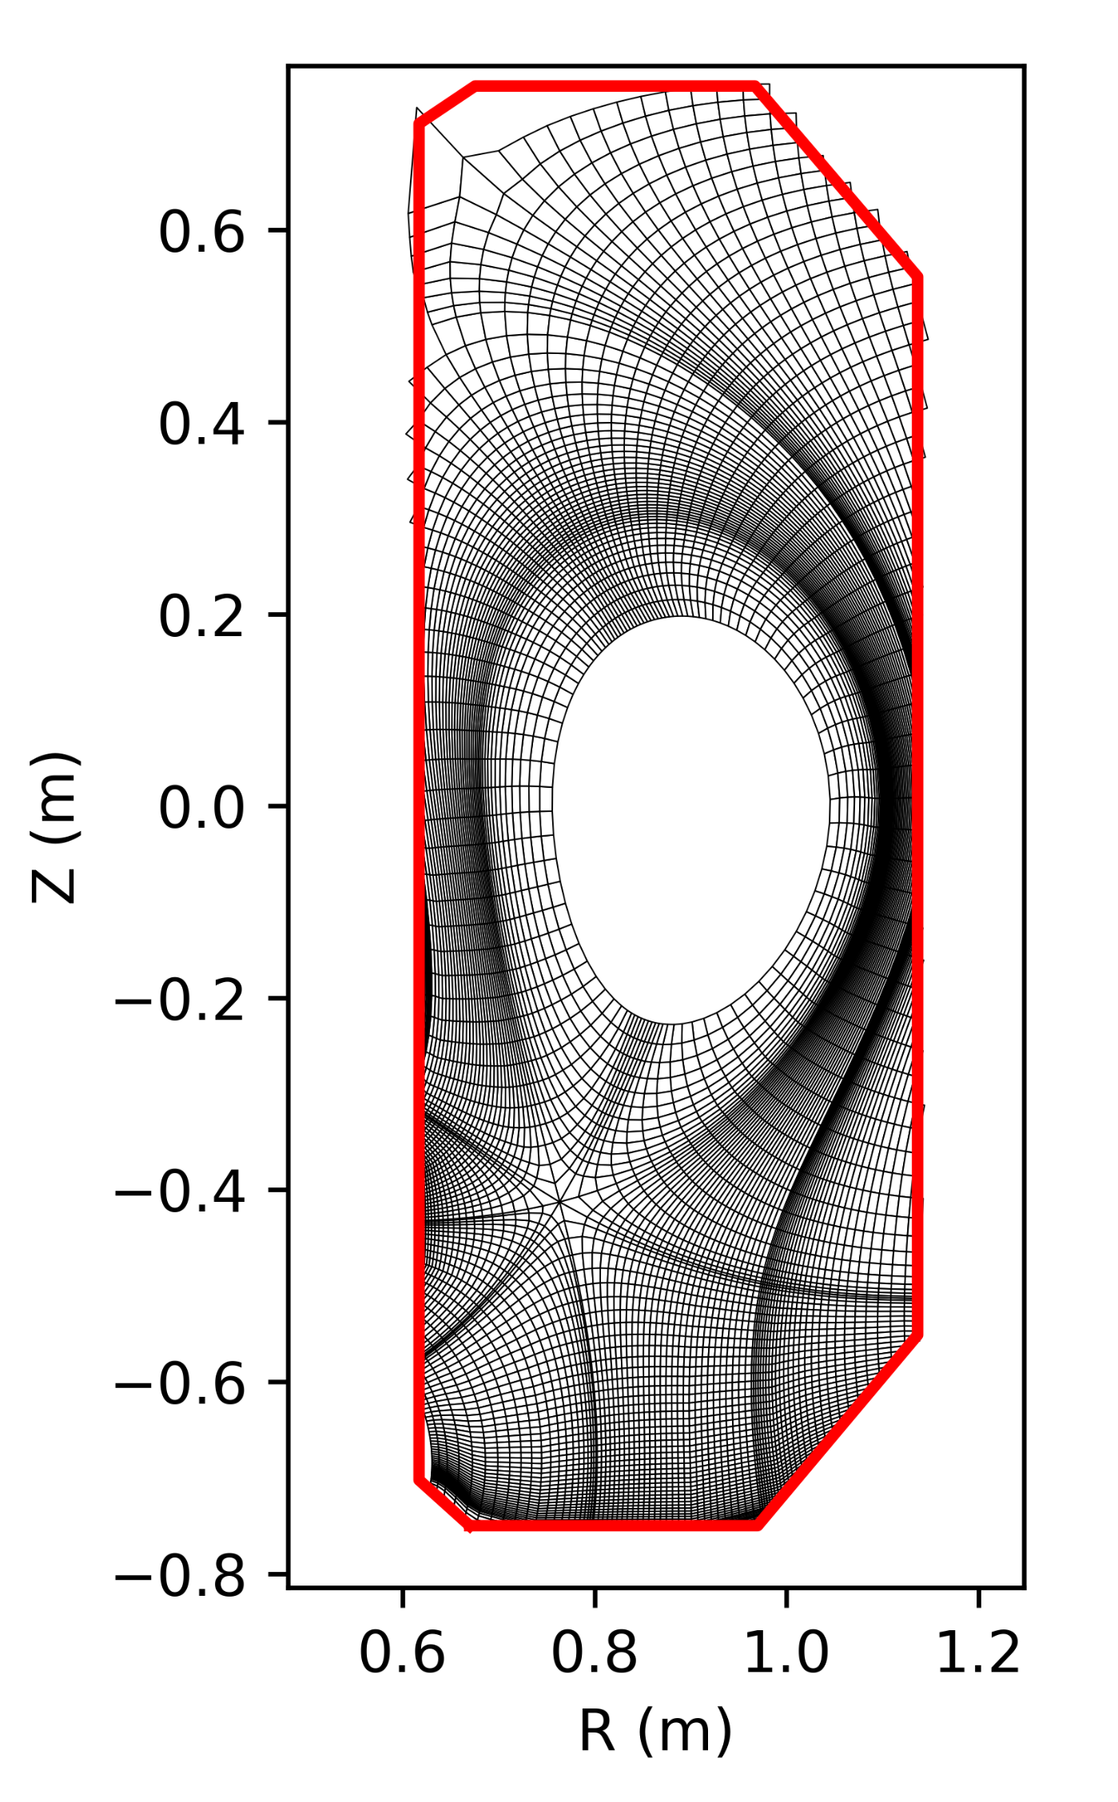
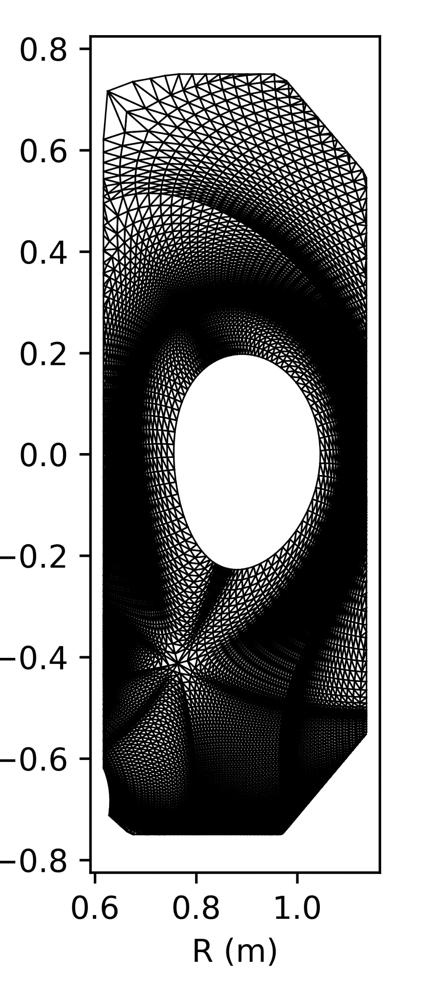
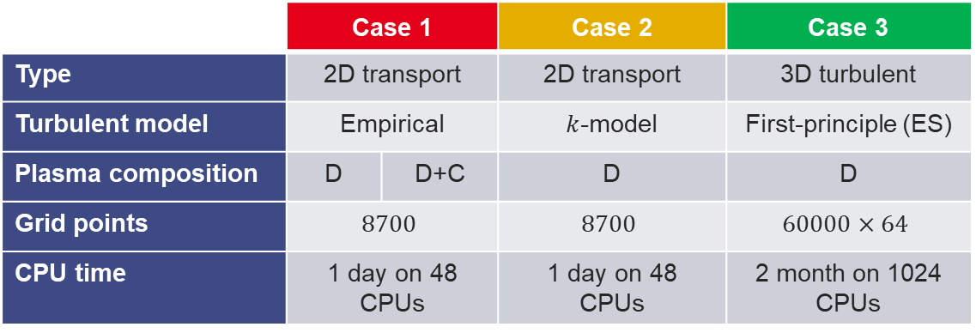

SOLEDGE3X turbulence models vs TCV-X21
Simulation set-ups:
Grids based on TCV #51333
Coarse grid for mean-field simulation
Fine grid for turbulent simulation
EIRENE for neutrals
Gas puff feedback to get $n_{sep}≈8⋅{10}^{19}m^{−3}$
Power source set to $P_{heat}=170kW$
 | Case 1 |  | Case 2 | Case 3
Type | 2D transport |  | 2D transport | 3D turbulent
Turbulent model | Empirical |  | $k$-model | First-principle (ES)
Plasma composition | D | D+C | D | D
Grid points | $$8700$$ |  | $$8700$$ | $$60000×64$$
CPU time | 1 day on 48 CPUs |  | 1 day on 48 CPUs | 2 month on 1024 CPUs
Coarse grid used for mean-field simulations. Left: quadrangles grid for SOLEDGE3X, right: triangles grid for EIRENE.

Slide 16
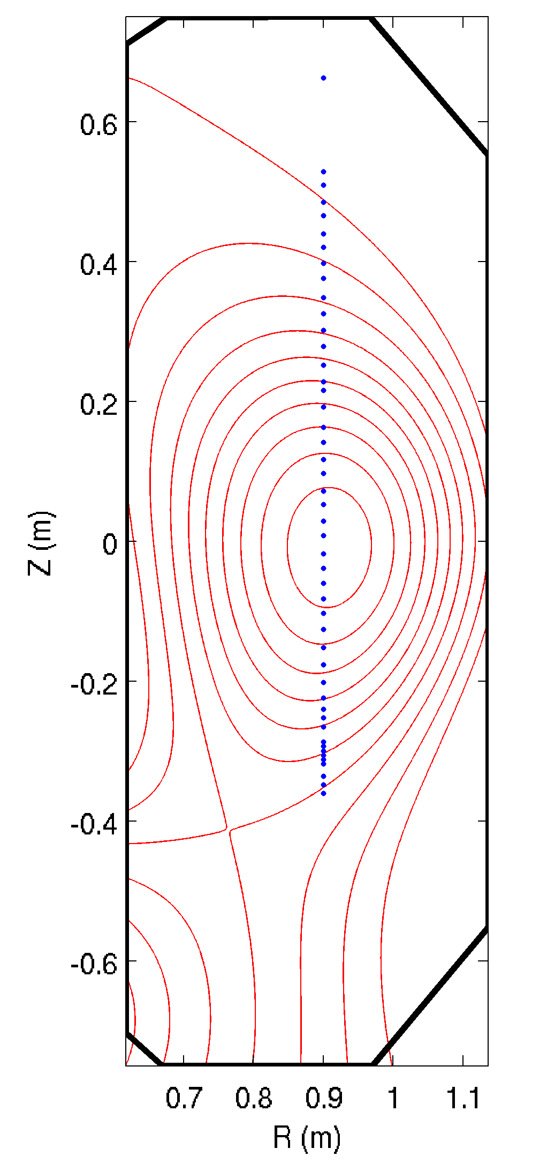
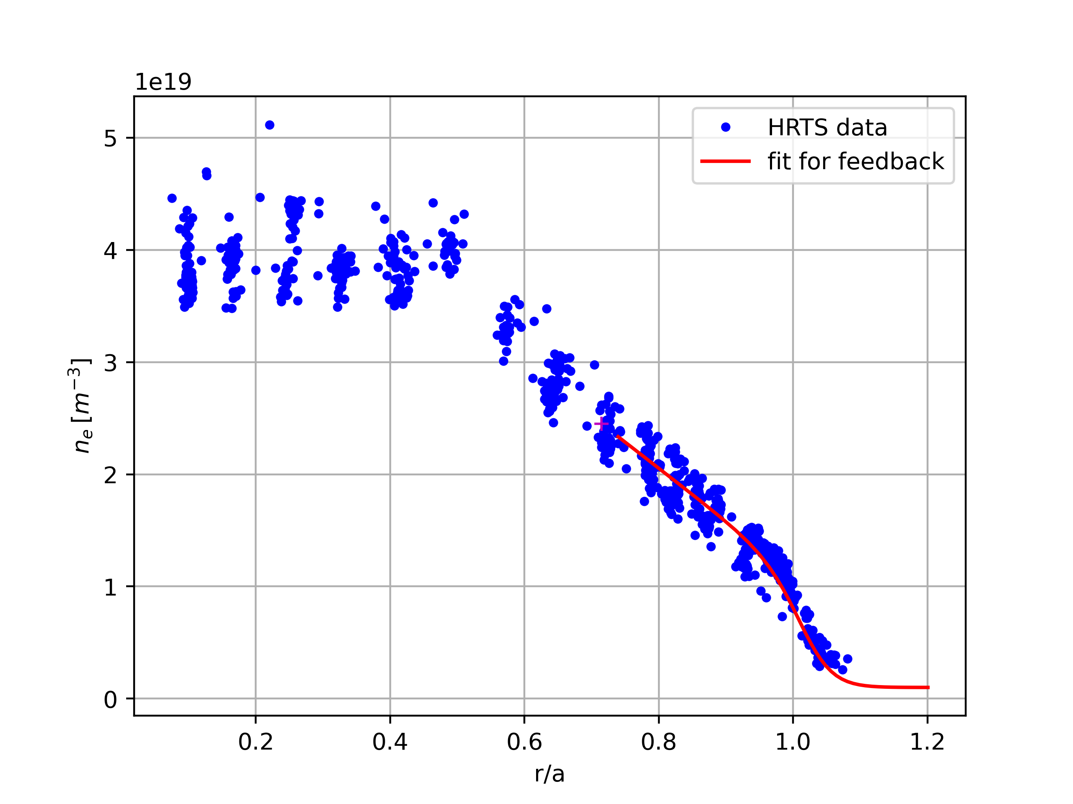
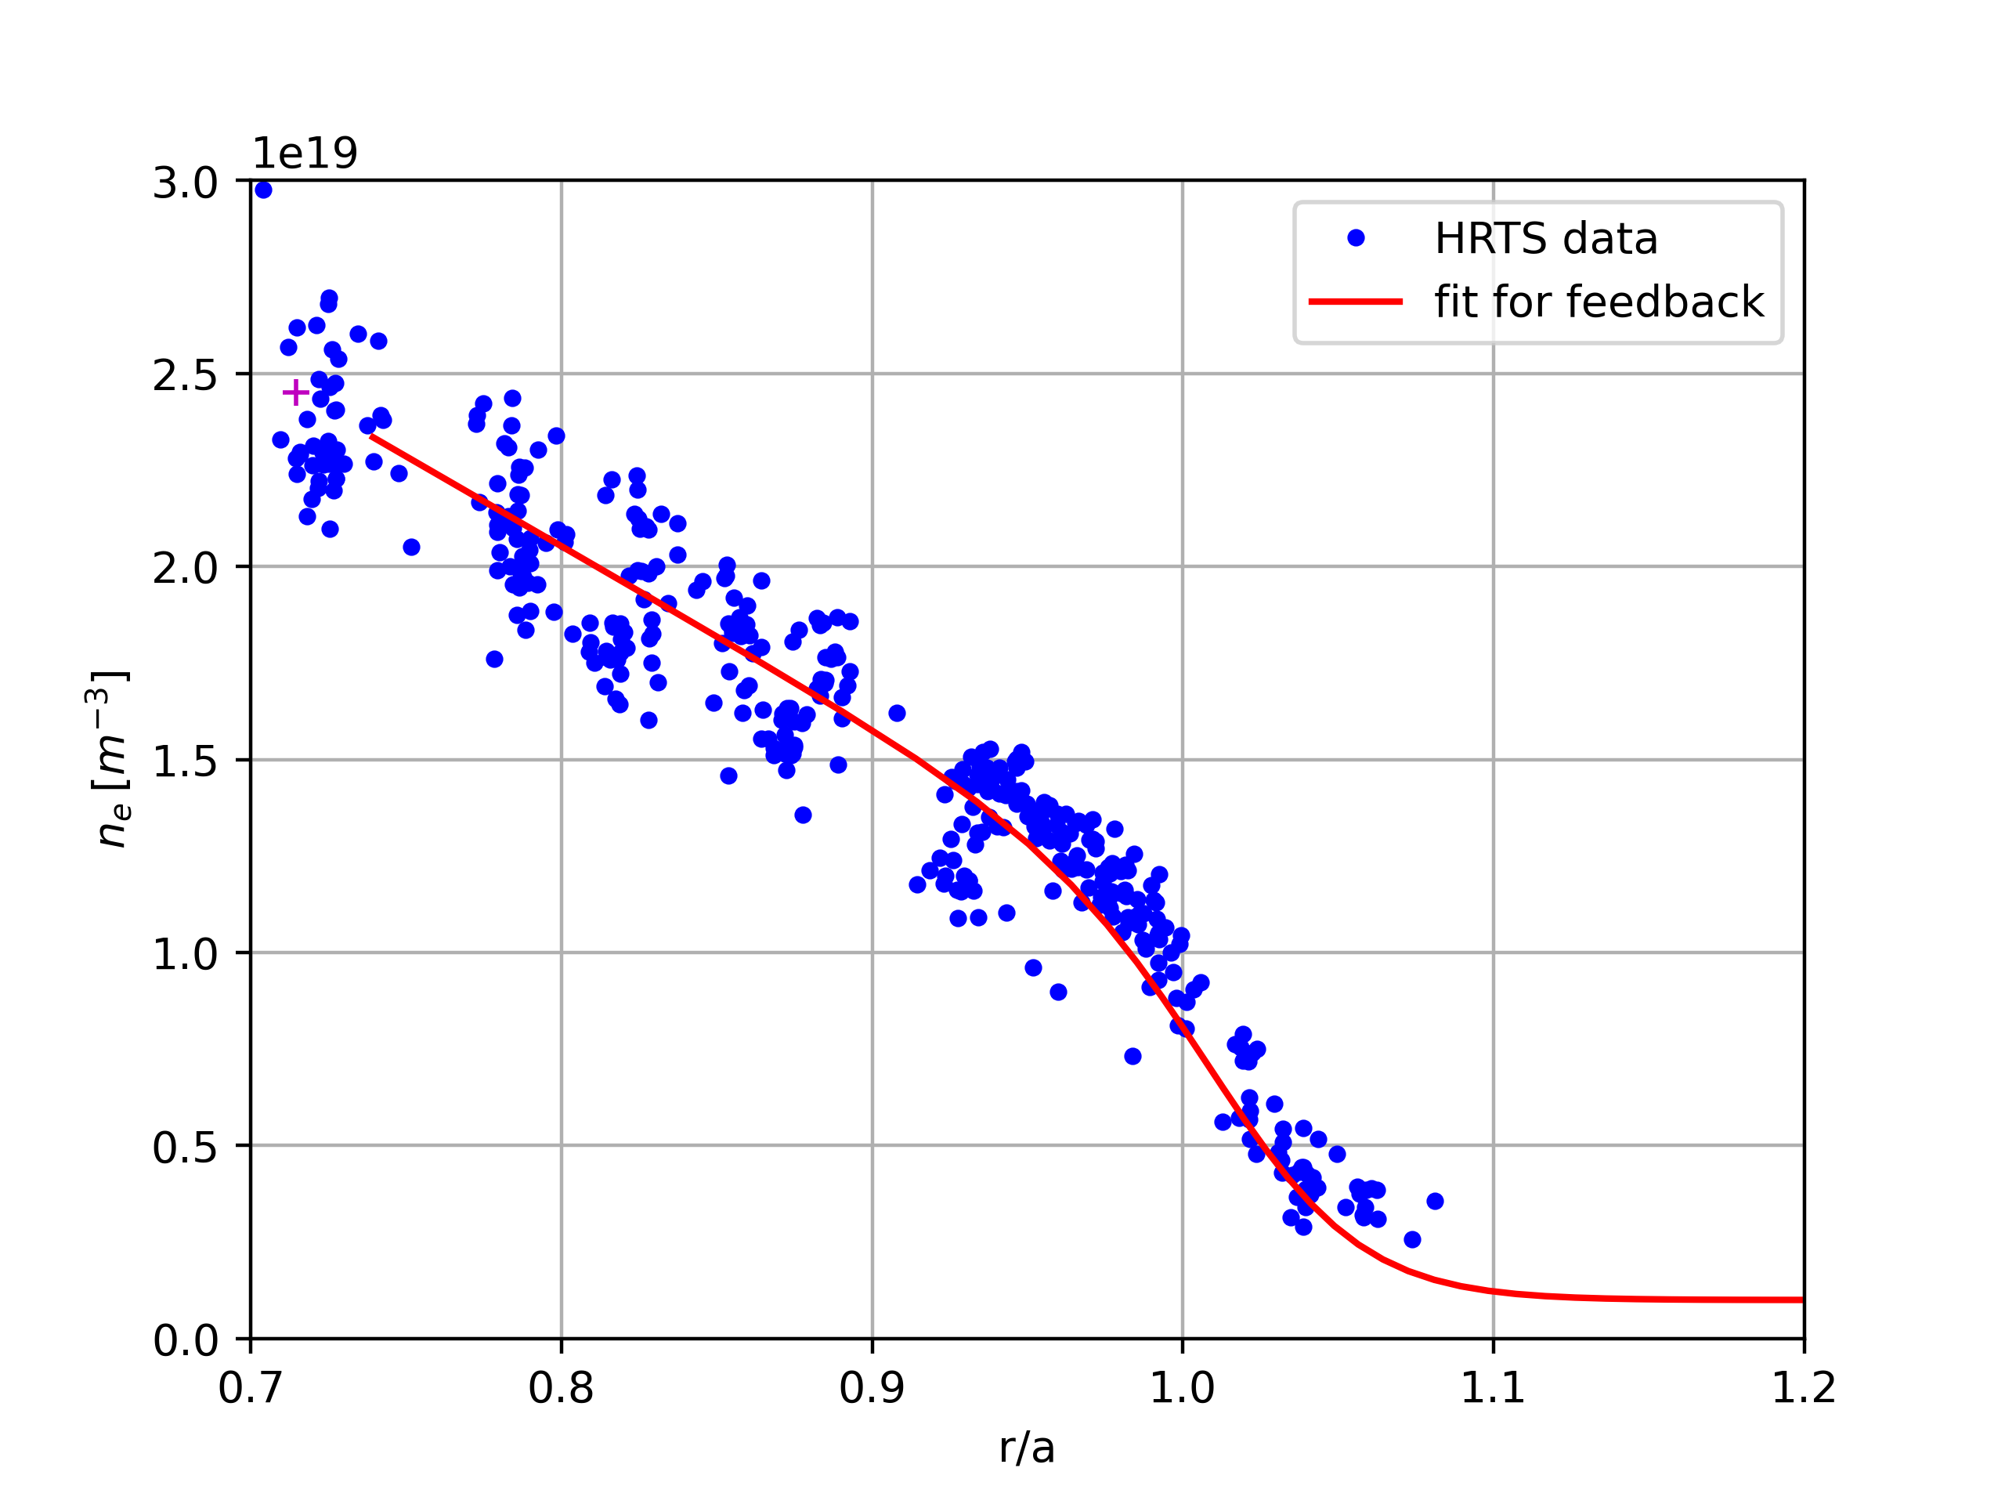
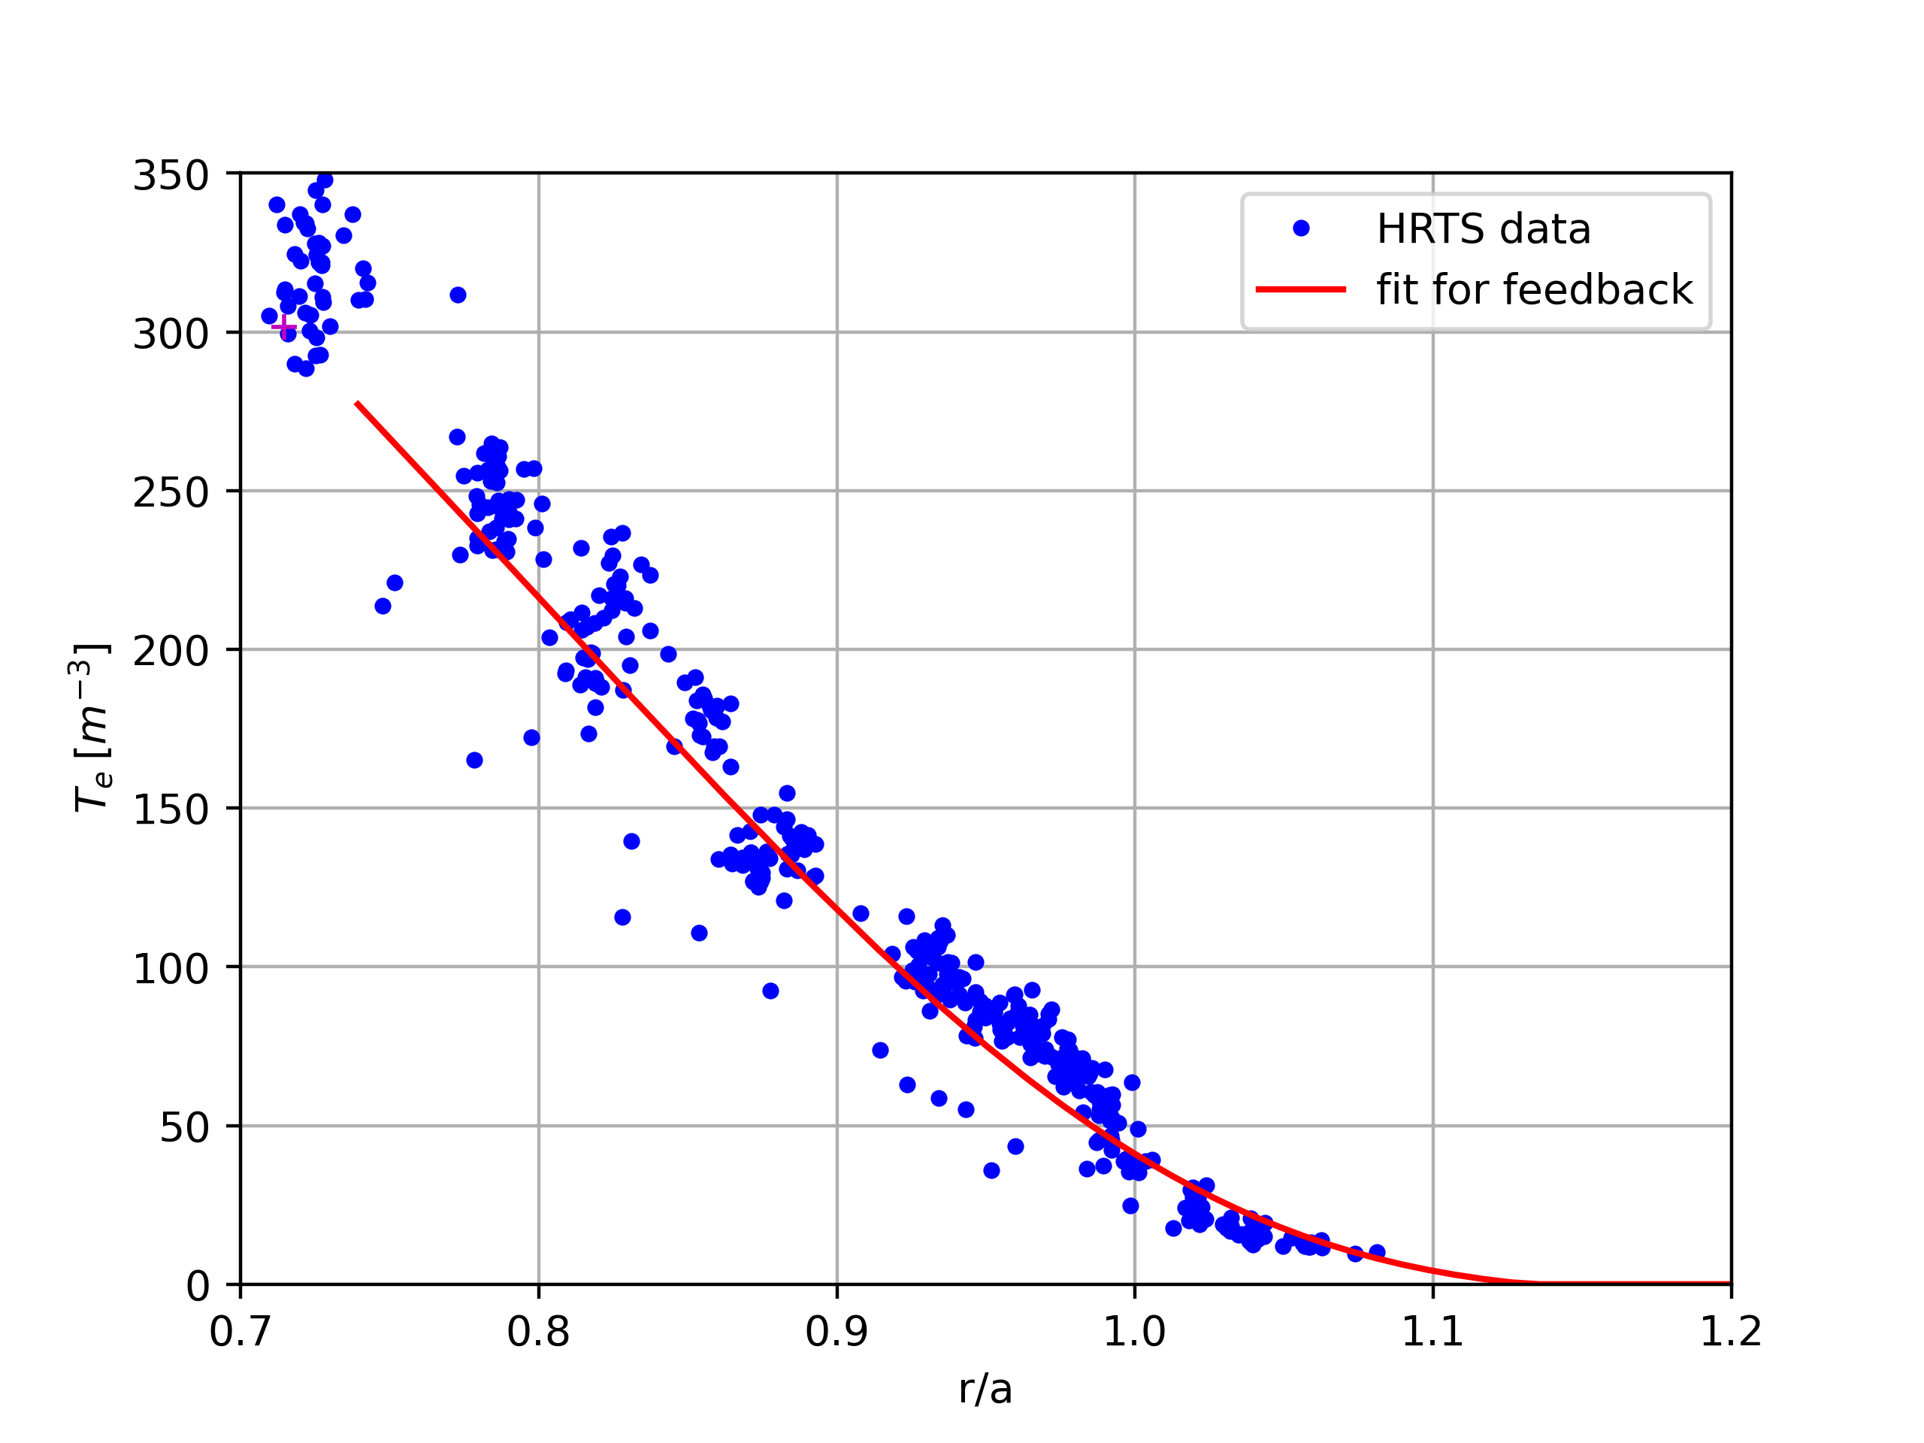
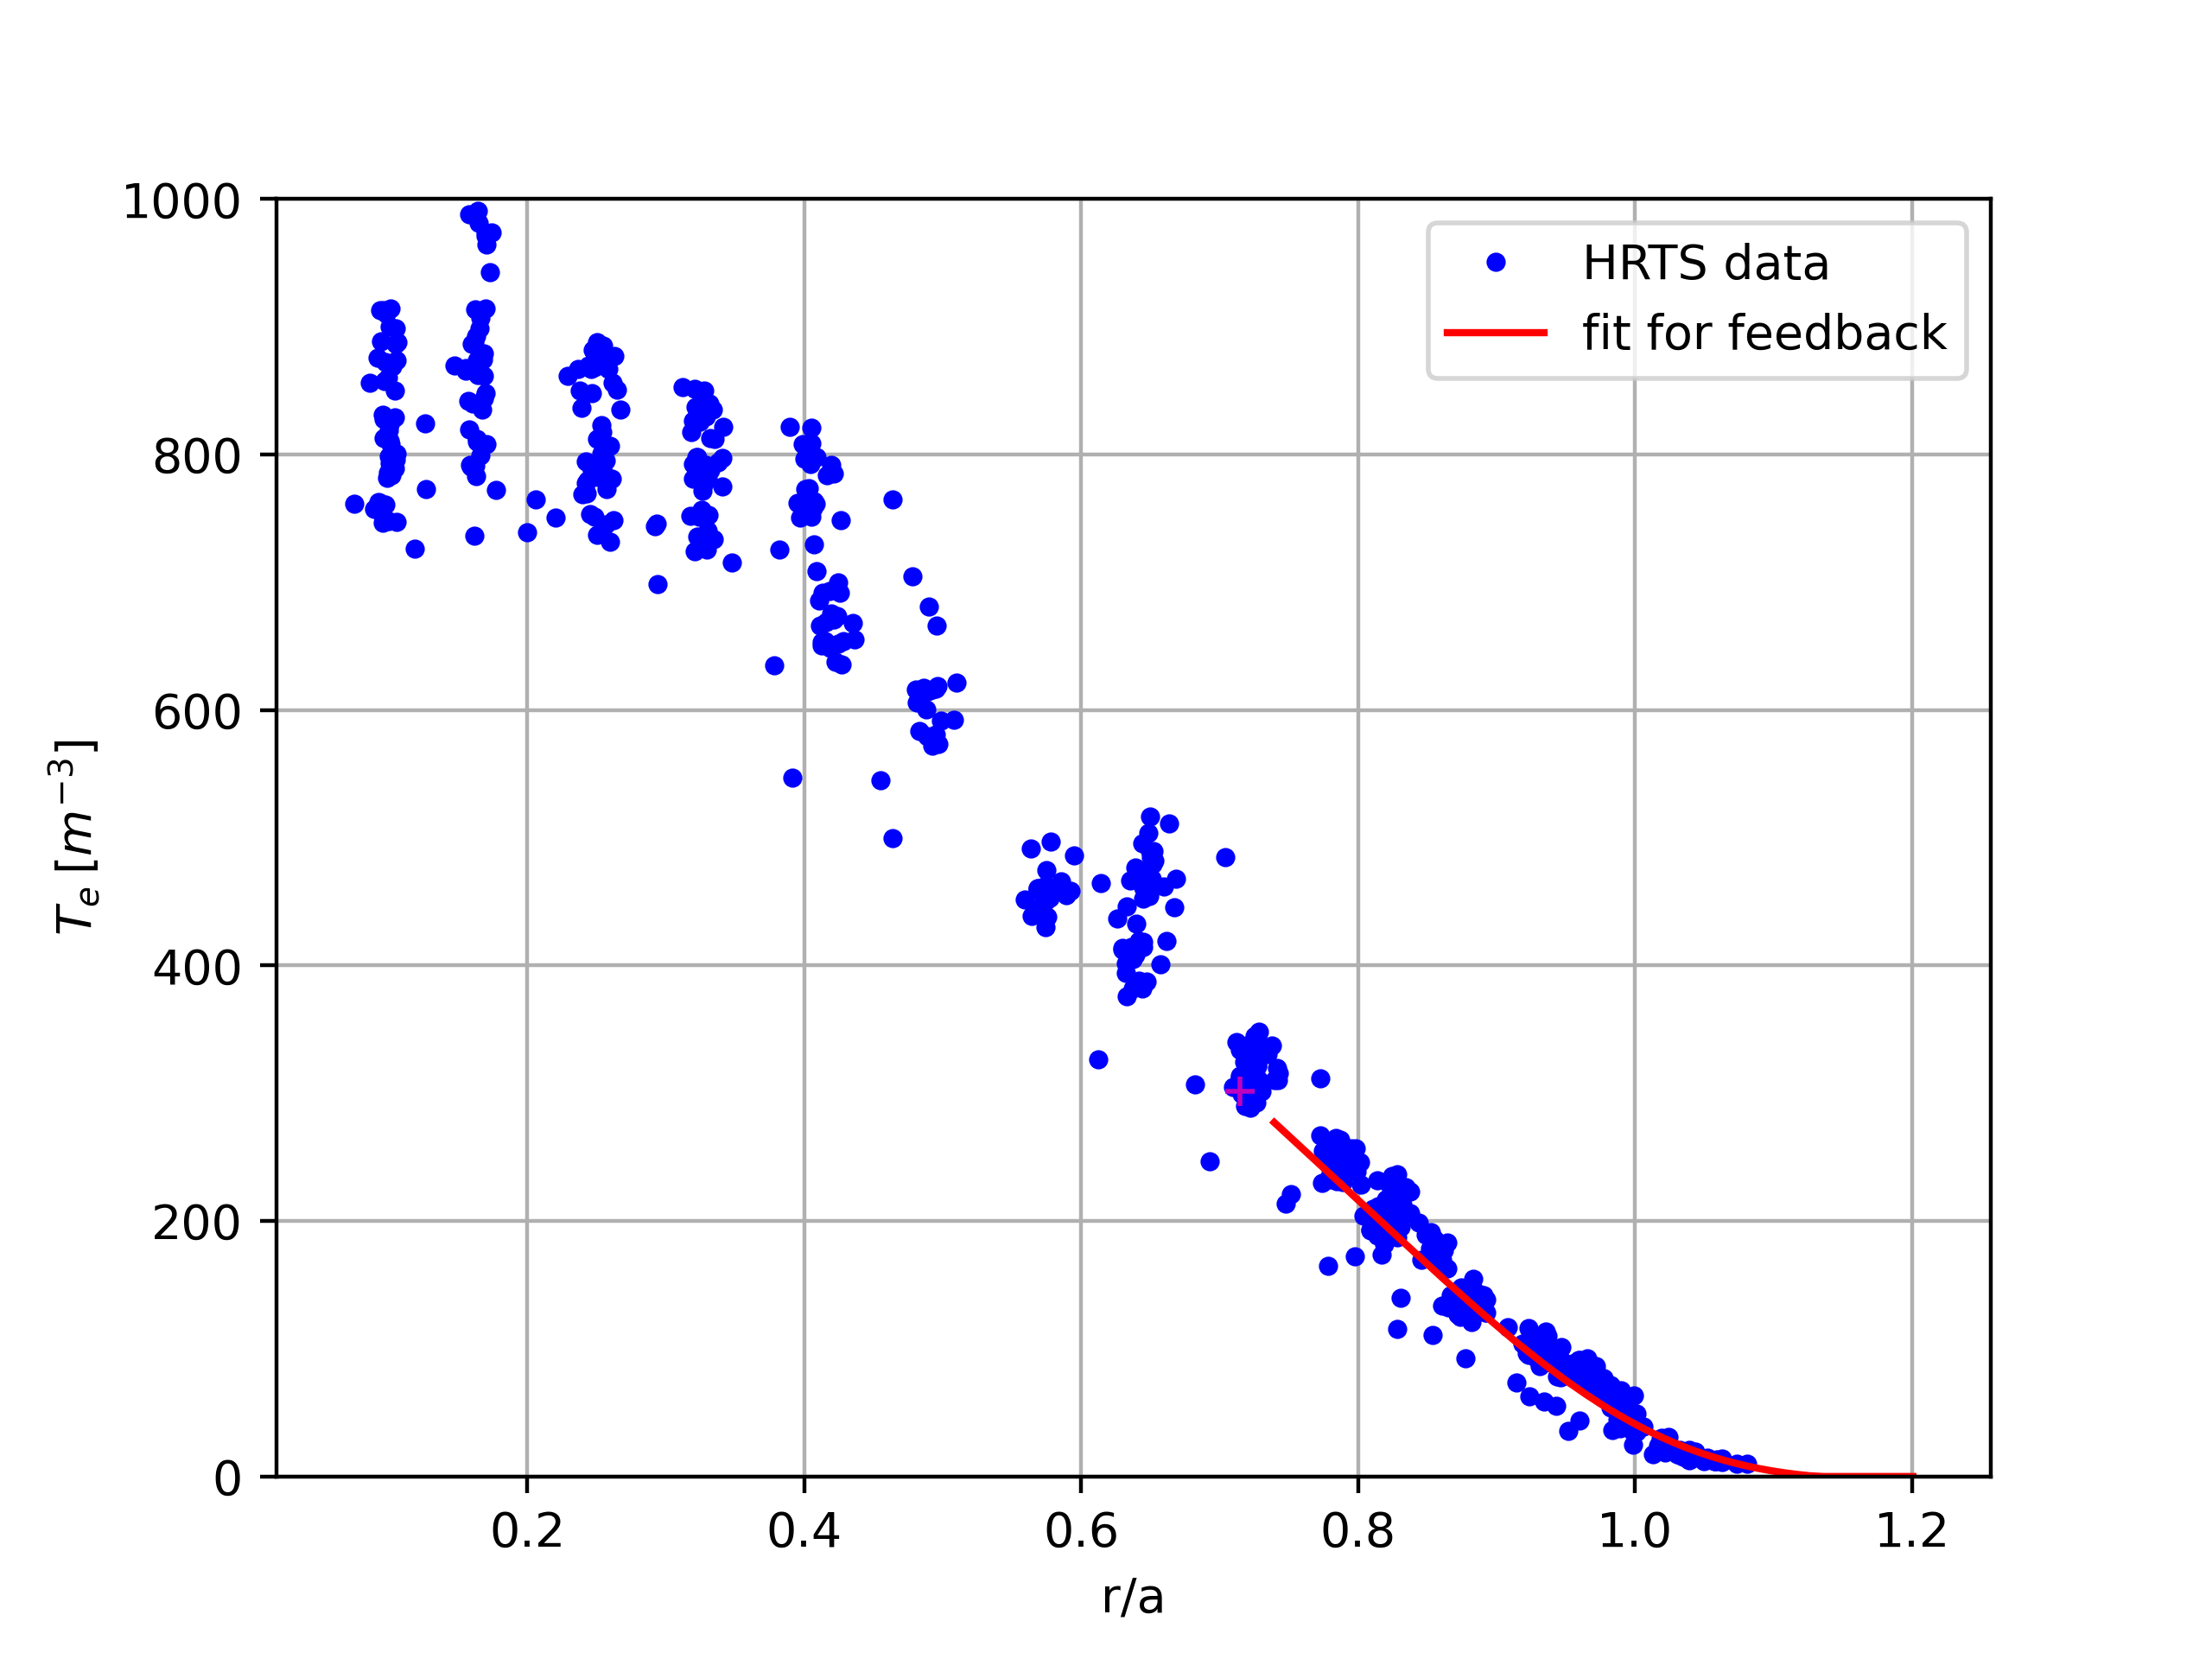
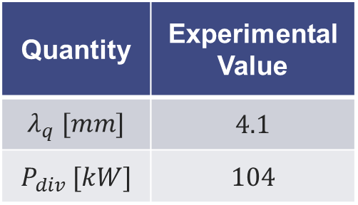
Case1: Empirical mean-field modelling
Inputs: Thomson Scattering profiles (remapped at mid-plane)
Estimations from HRTS mid-plane data
Quantity | Experimental Value
$$λ_{q} [mm]$$ | $$4.1$$
$$P_{div} [kW]$$ | $$104$$

Slide 17
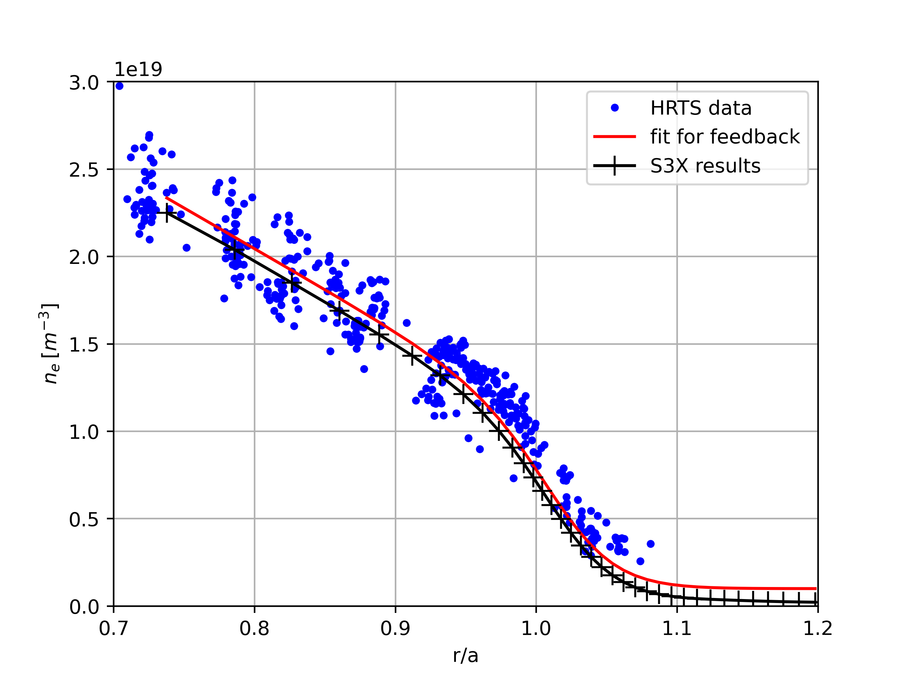
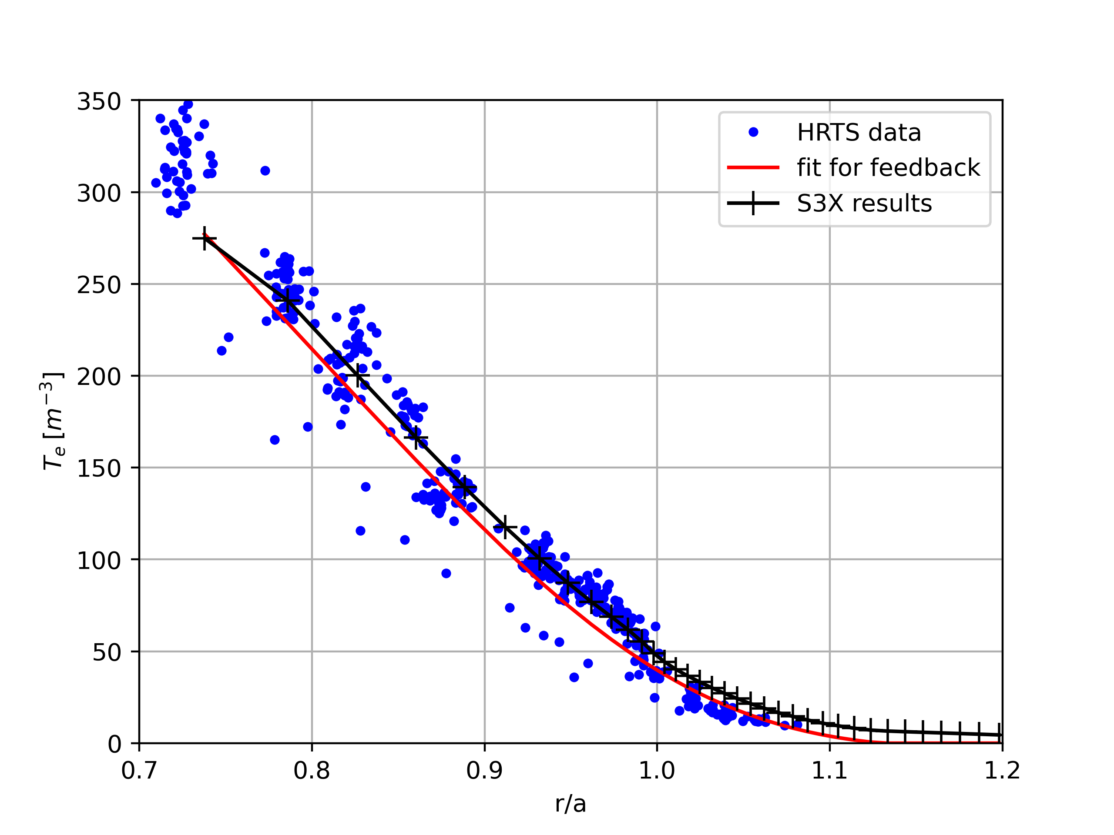
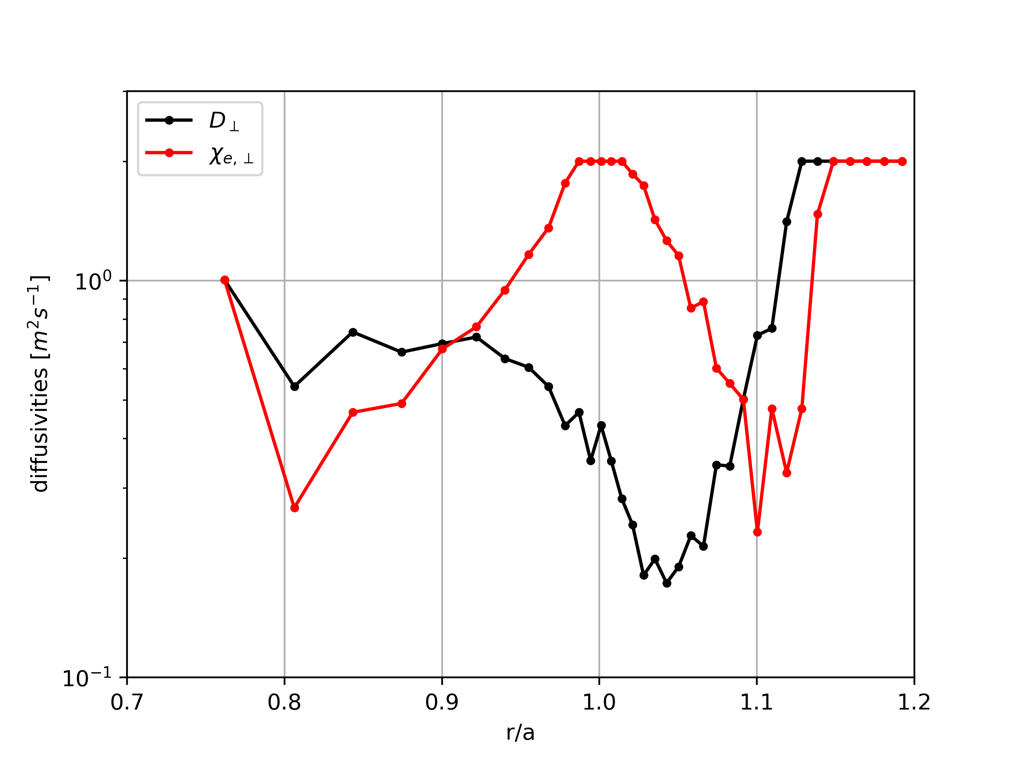
Case1: Empirical mean-field modelling
Inputs: Thomson Scattering profiles (remapped at mid-plane)
Estimations from HRTS mid-plane data
Quantity | Experimental Value
$$λ_{q} [mm]$$ | $$4.1$$
$$P_{div} [kW]$$ | $$104$$
Outputs: Ad-hoc empirical diffusivities found by the automated procedure to fit experimental radial profiles →
Quite complex radial variations with amplitude ranging over 1 order of magnitude, hard to guess a priori!

Slide 18
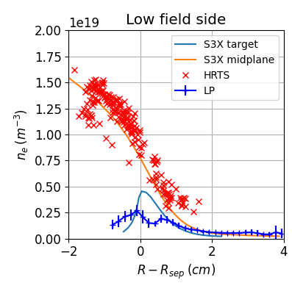
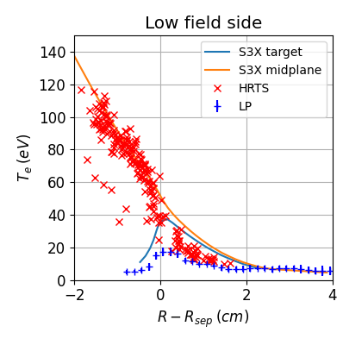
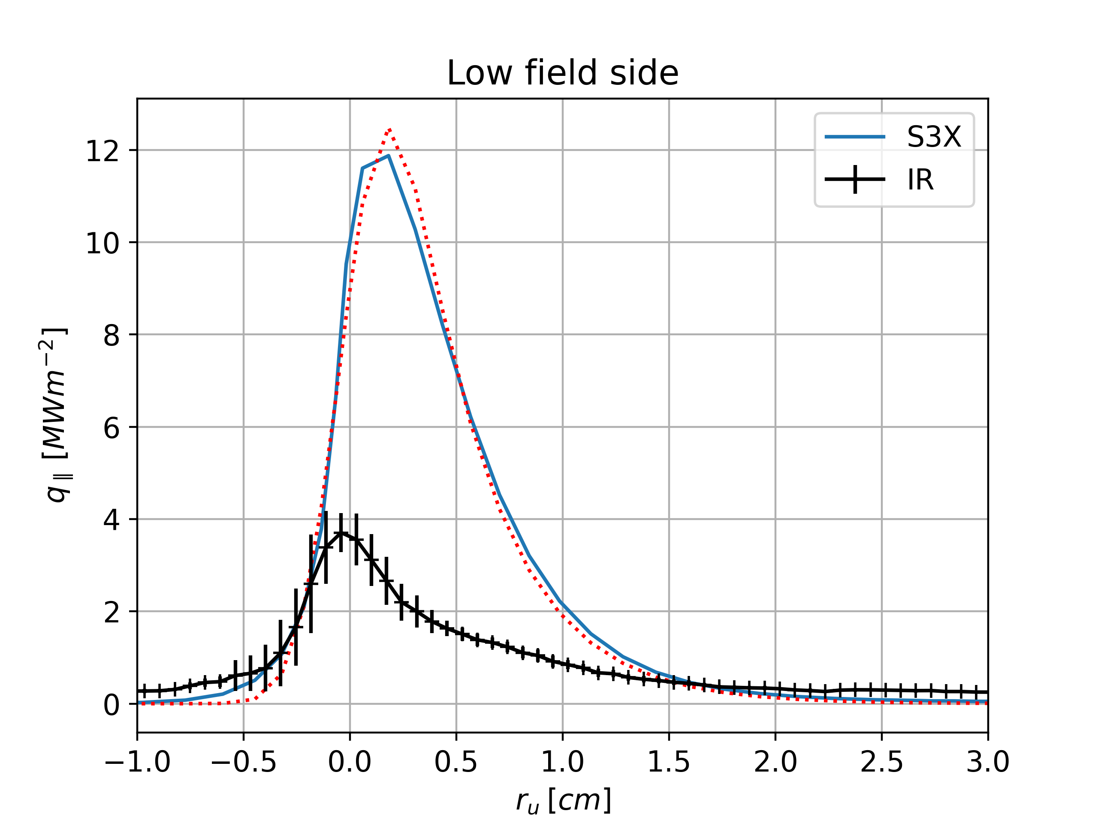
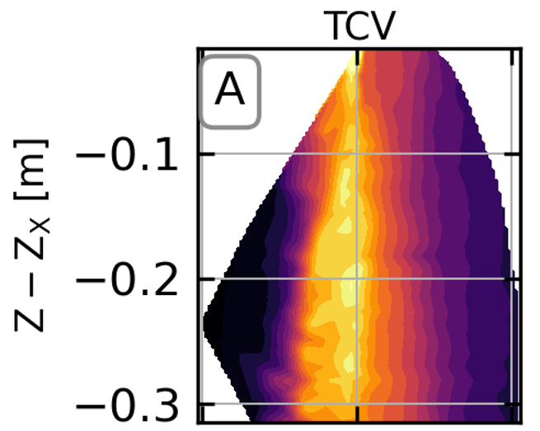
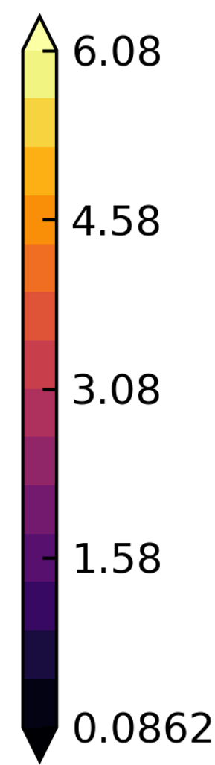
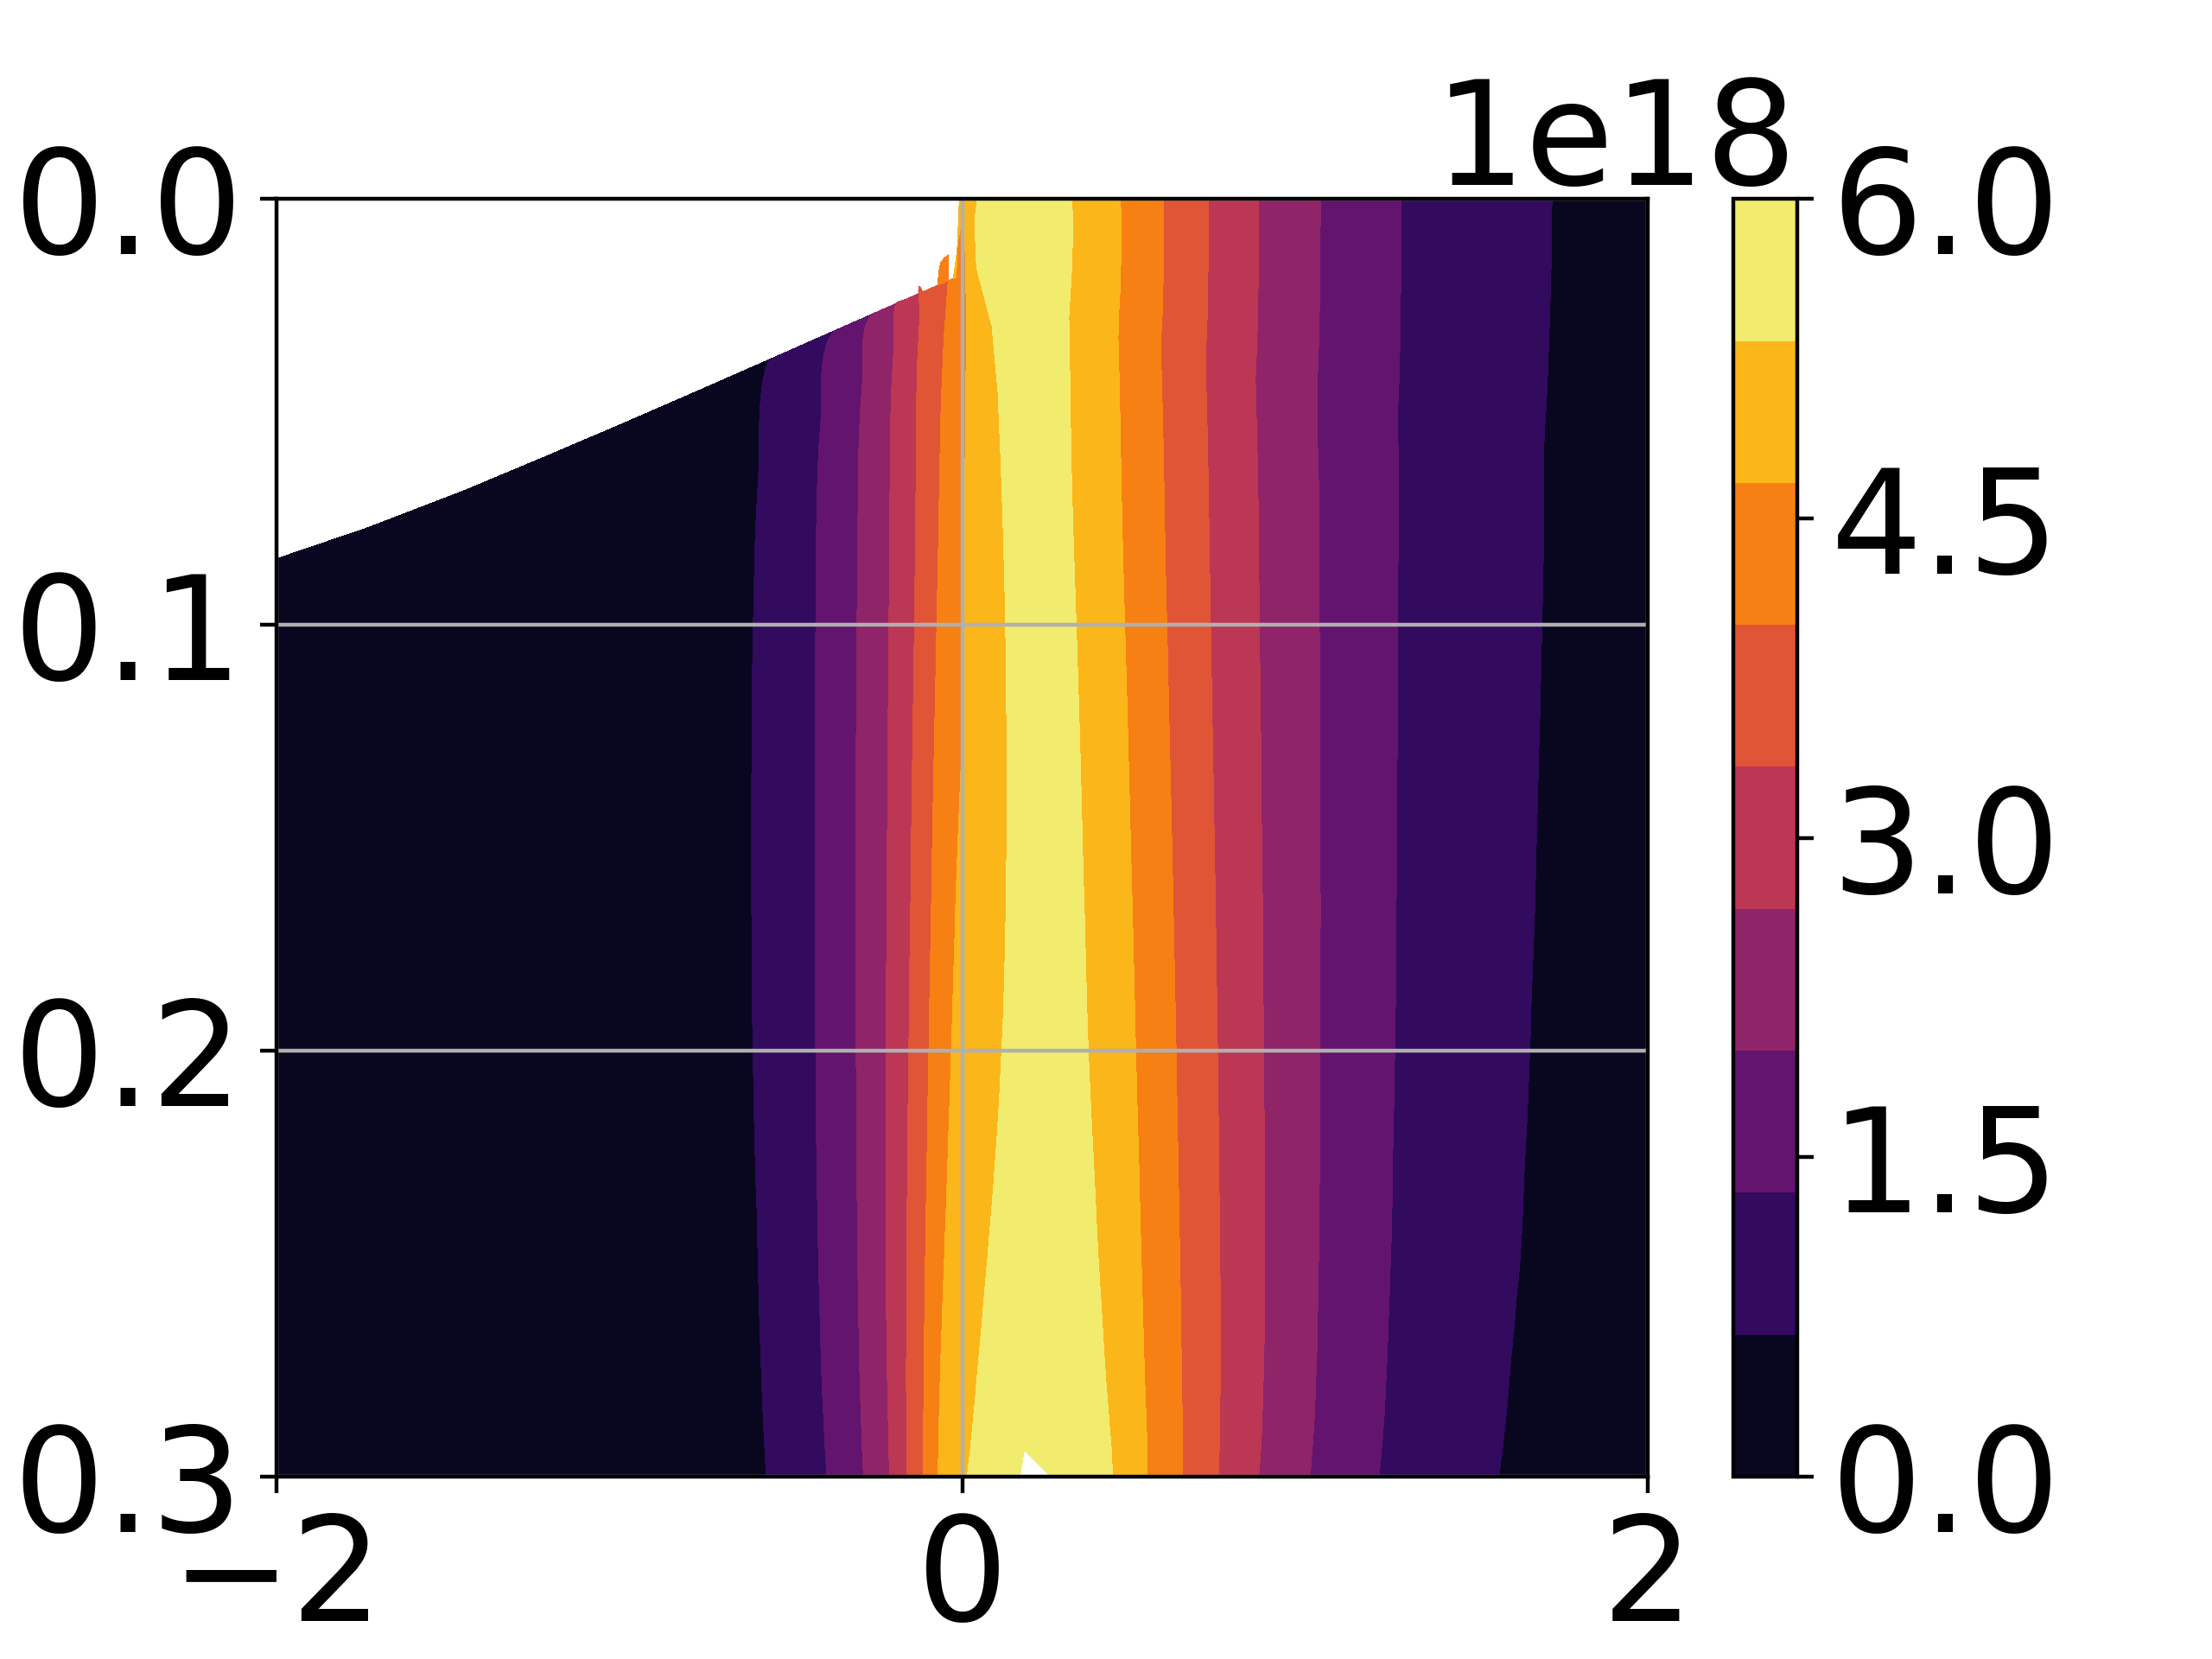
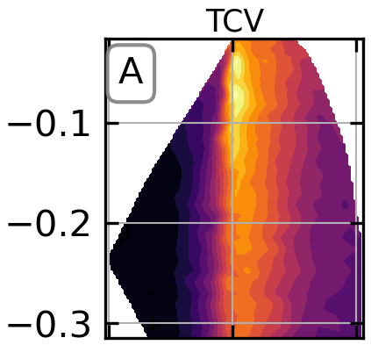
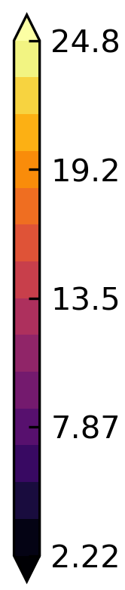
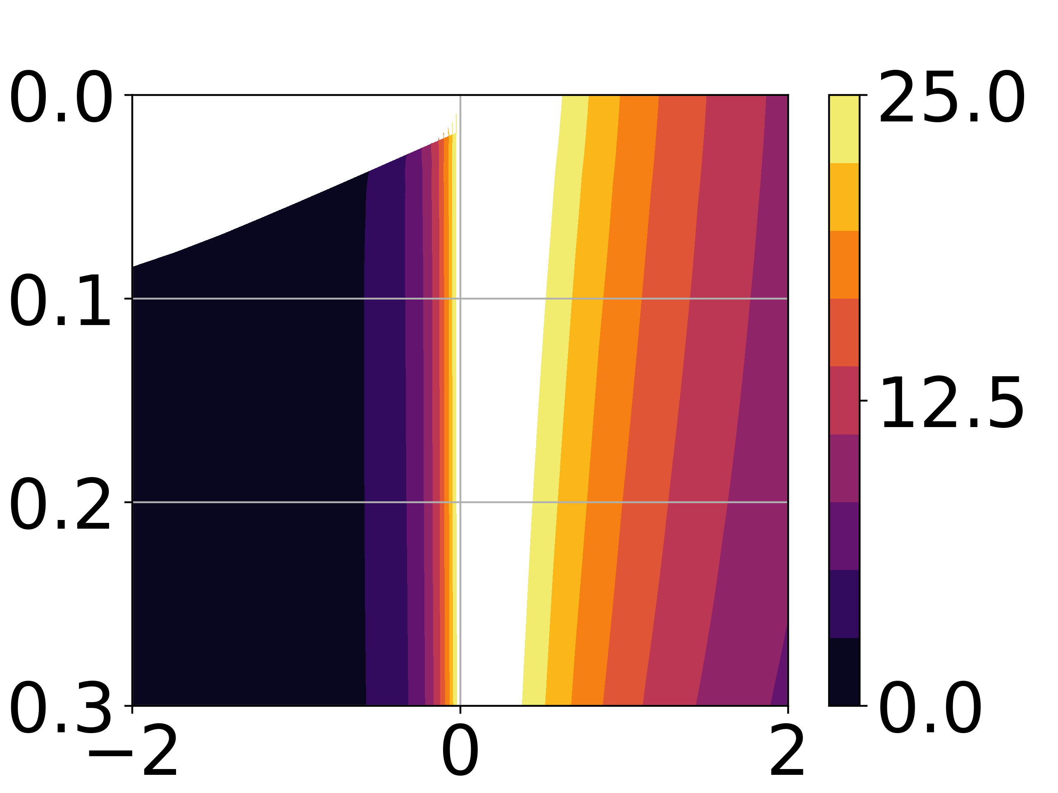
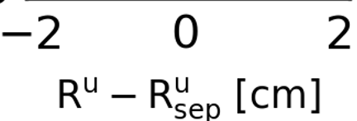
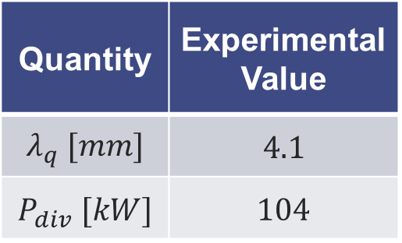



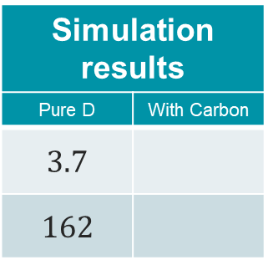
Case1: Empirical mean-field modelling
Pure D
Outputs: target profiles, divertor plasma properties
Quantity | Experimental Value
$$λ_{q} [mm]$$ | $$4.1$$
$$P_{div} [kW]$$ | $$104$$
Simulation results
Pure D | With Carbon
$$3.7$$
$$162$$
Electron density $\left[m^{−3}\right]$
Electron temperature $\left[m^{−3}\right]$
Fit: $λ_{q}≈3,7mm$
RDPA: Experiment vs SOLEDGE3X simulation

Slide 19
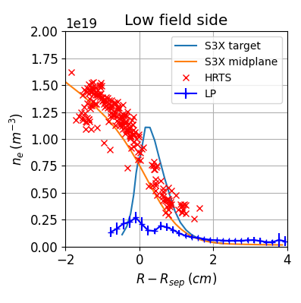
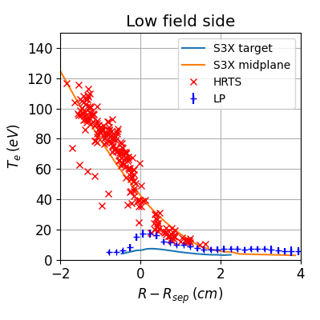
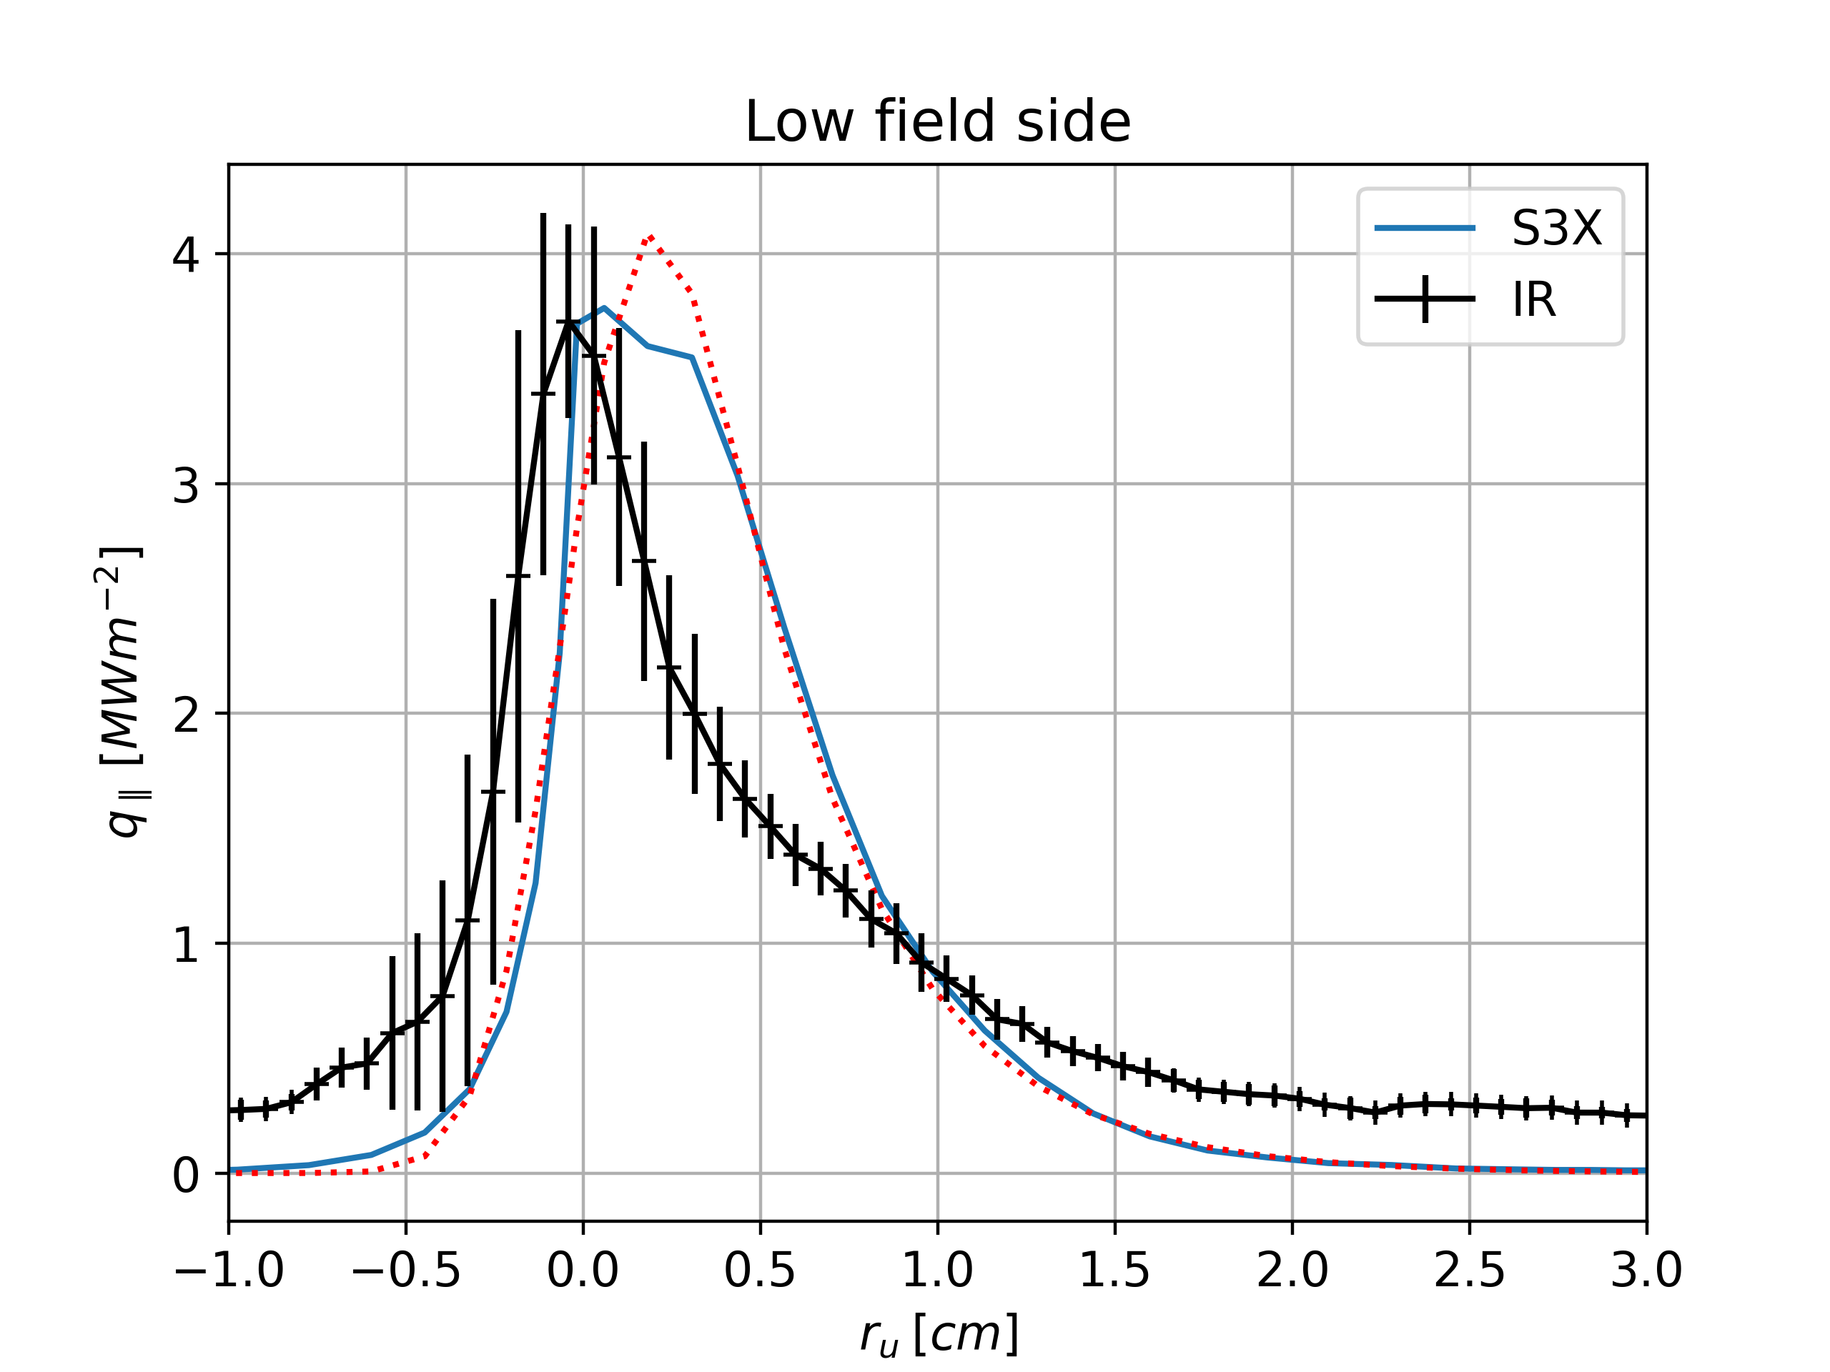
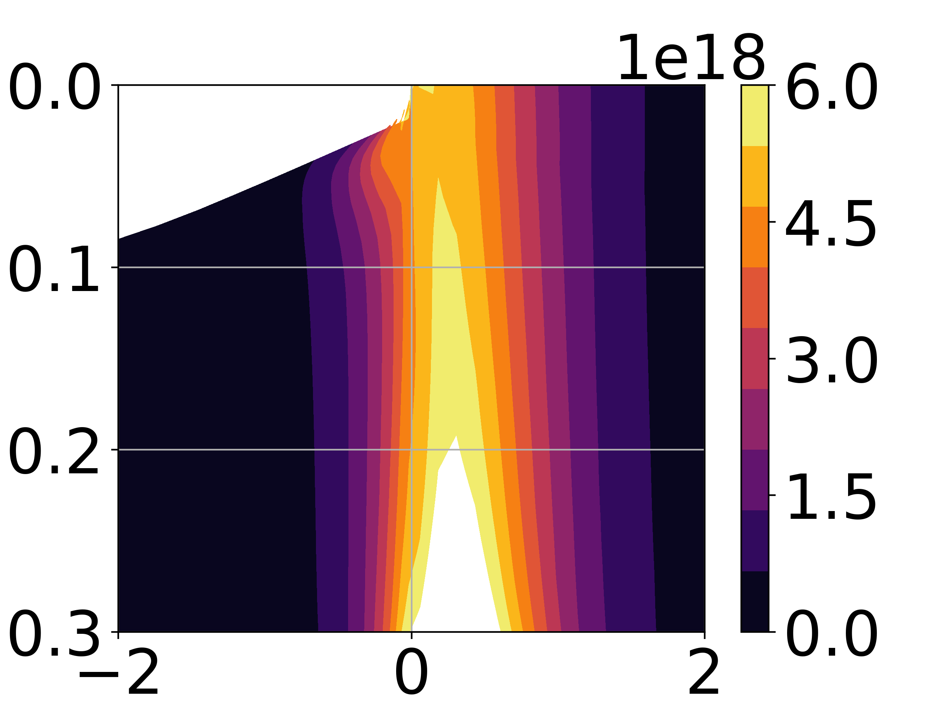
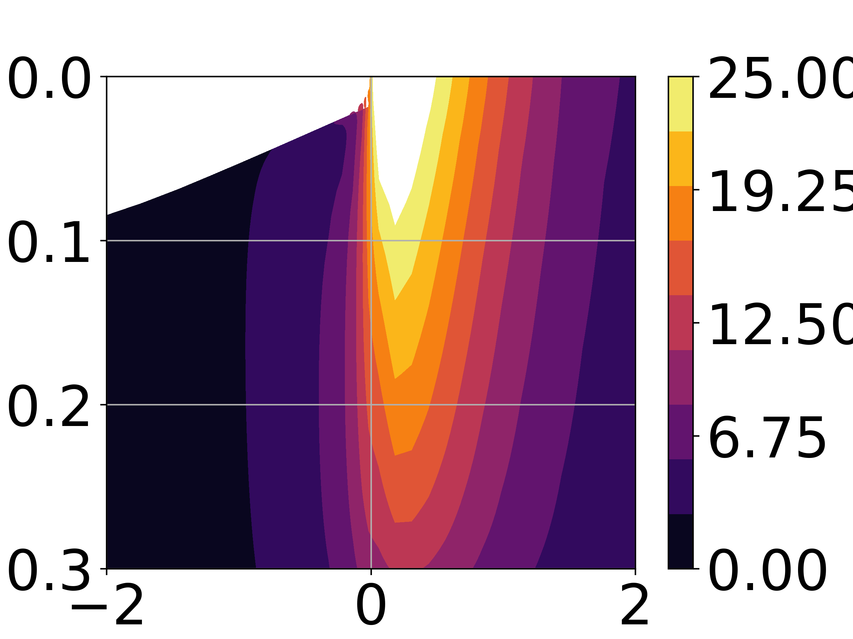
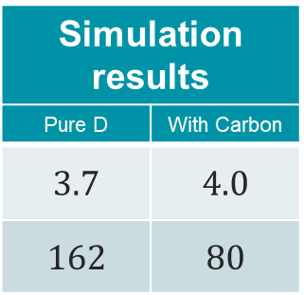


Case1: Empirical mean-field modelling
With Carbon
Outputs: target profiles, divertor plasma properties
Quantity | Experimental Value
$$λ_{q} [mm]$$ | $$4.1$$
$$P_{div} [kW]$$ | $$104$$
Simulation results
Pure D | With Carbon
$$3.7$$ | $$4.0$$
$$162$$ | $$80$$
Electron density $\left[m^{−3}\right]$
Electron temperature $\left[m^{−3}\right]$
Fit: $λ_{q}≈4mm$
Fit: $λ_{q}≈4mm$
RDPA: Experiment vs SOLEDGE3X simulation

Slide 20
Case1: Empirical mean-field modelling
Predictability
low – lot of free parameters
Experiment matching
multi-physics + fitting procedure
Numerical cost
cheap $∼$ 1 day on 48CPUs
Numerical cost
cheap ∼ 1 day on 48CPUs

Slide 21
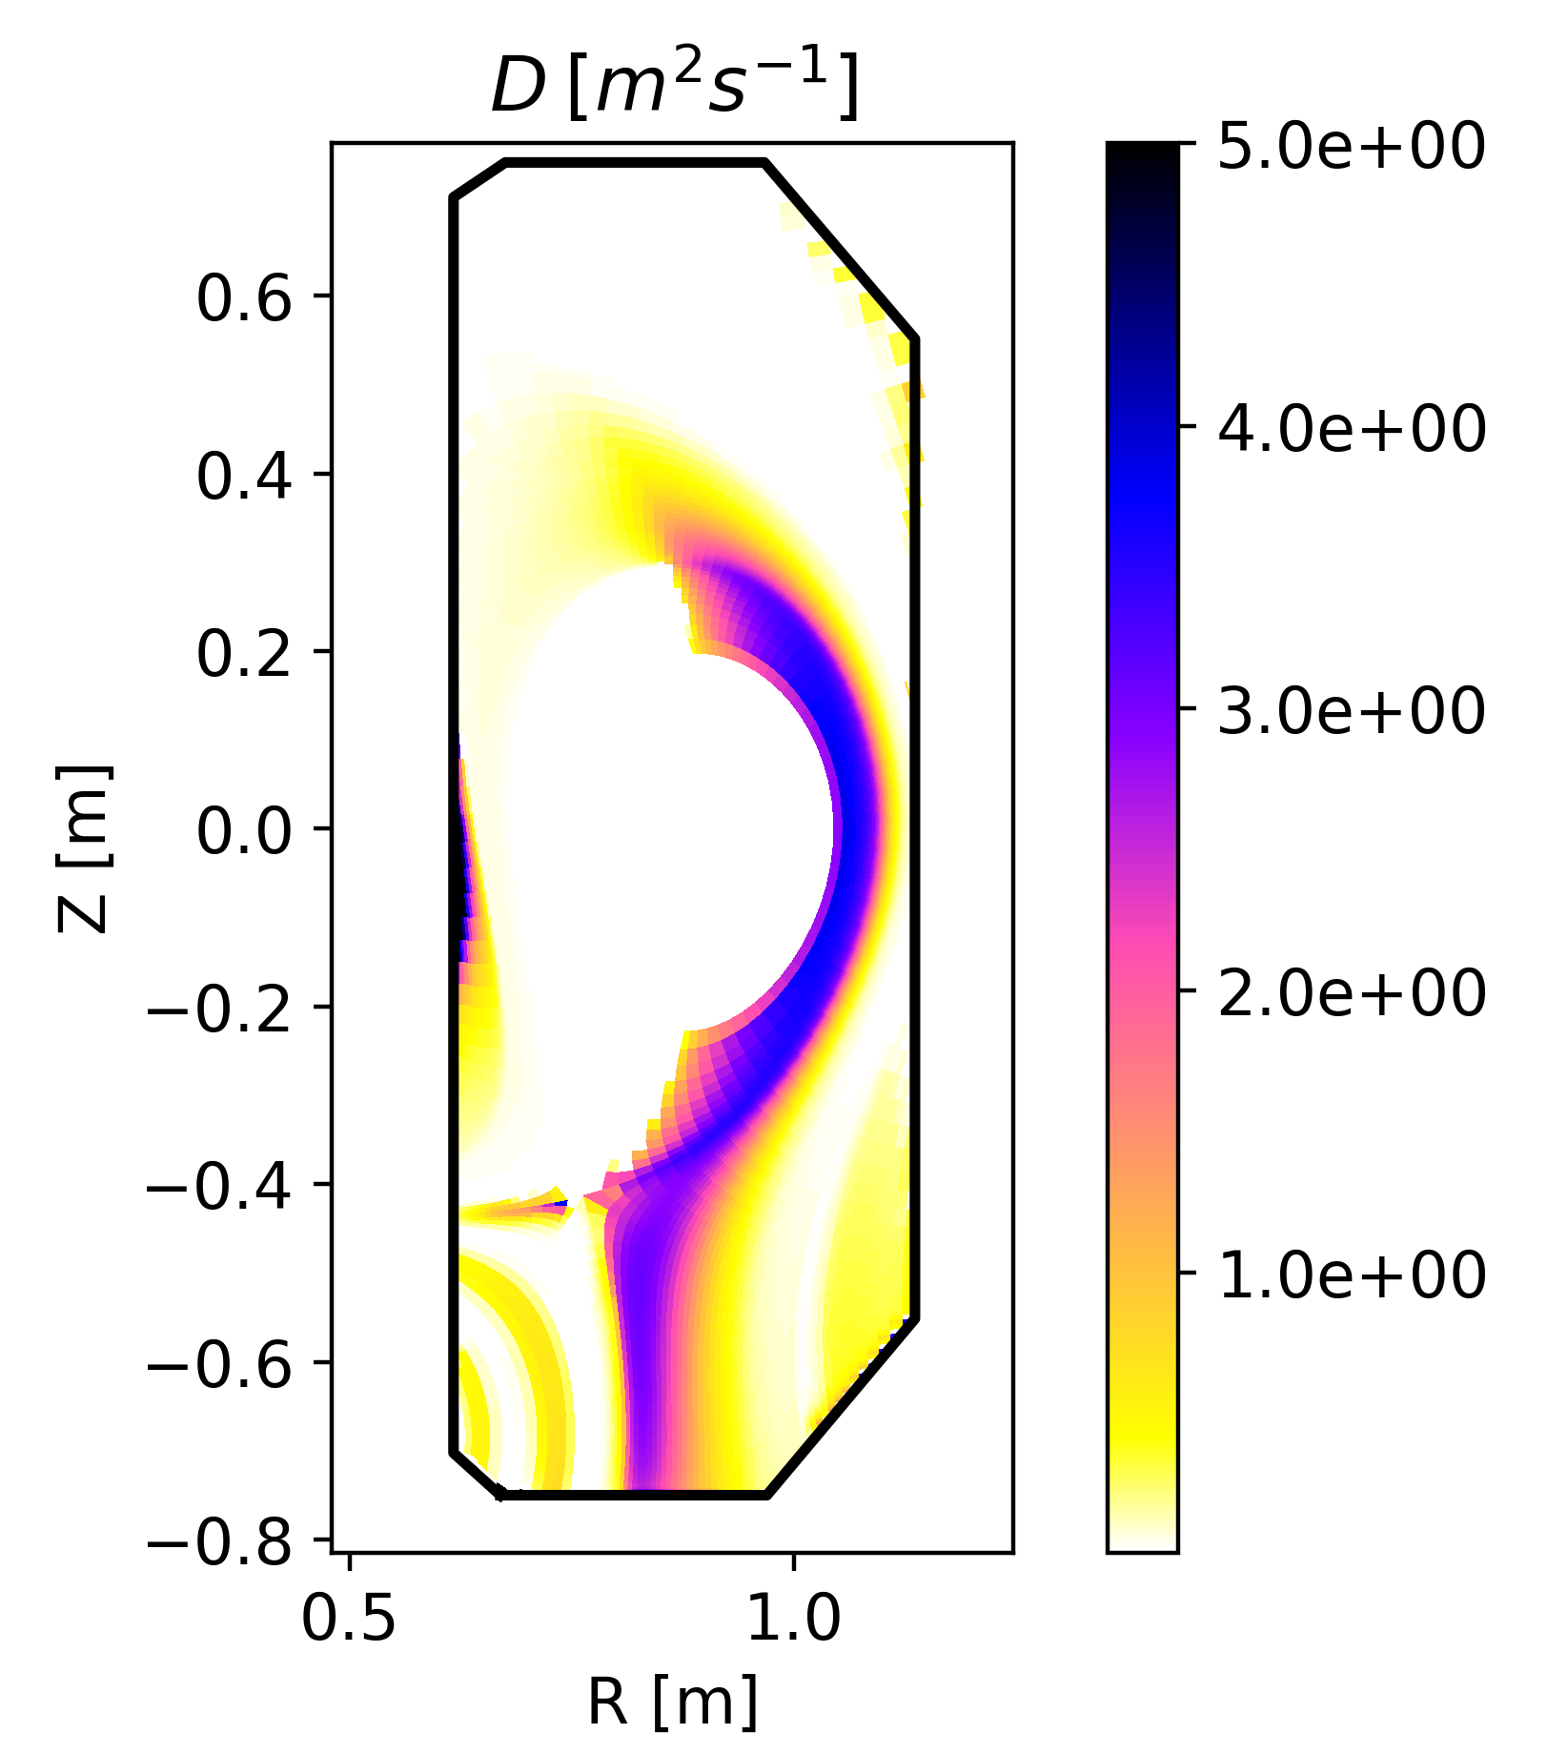
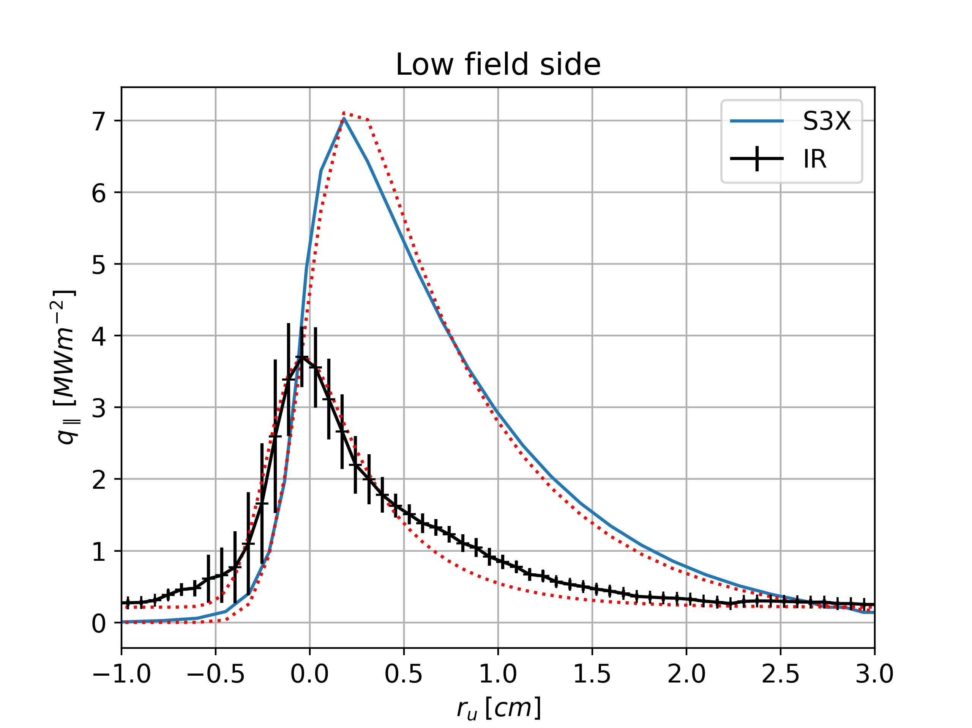
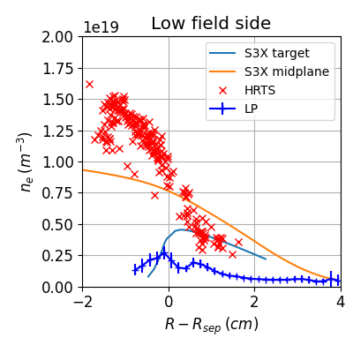
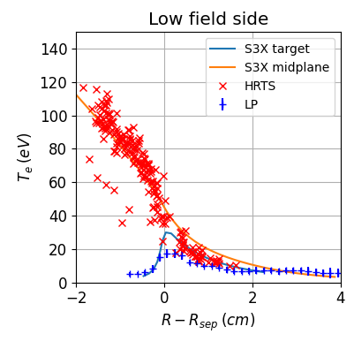



Case2: Semi-empirical mean-field modelling: k-model
Inputs:
Heating power [$170kW$ – 50/50 ion/electron channel]
$n_{sep}=8×{10}^{18}m^{−3}$ (used to tune gas puff rate)
Outputs: Map of turbulent kinetic energy computed with the k-model:
Low field side ballooning
Turbulence along LFS divertor leg
Profiles:
$T_{e}$ profile OK but $n_{e}$ profile too flat
$λ_{q}$ overestimated → TCV-X21 not on the scaling law used to close the semi-empirical model!
Fit: $λ_{q}≈7mm$
Fit: $λ_{q}≈4mm$
$$λ_{q}$$ | TCV-X21 | Scaling ($4q_{95}ρ_{L}$) | Simulation
Value (mm) | 4.1 | 11 | 7.1

Slide 22
Case2: Semi-empirical mean-field modelling: k-model
Predictability
improved – less free parameters
Experiment matching
decent / rely on model hypothesis
Numerical cost
cheap $∼$ 1 day on 48CPUs
Numerical cost
cheap ∼ 1 day on 48CPUs

Slide 23















Case3: First principle simulations
Enable direct comparison with turbulence measurements
→ e.g.: Characterization of divertor localised filaments
$$n_{e}\left(m^{−3}\right)$$
$$T_{e}\left(eV\right)$$
Experimental data:
Normalized brightness Video from [Wütrich et al., Nucl. Fusion 62 (2022)]
Simulation data:
Deuterium atom radiation (W/m3)
[Bufferand et al., NME 41 (2024)]
$$1.5e19$$
$$300$$
$$1.0e19$$
$$200$$
$$0.5e19$$
$$100$$
$$0$$
$$0$$
Sketch of the gas puff imaging diagnostic on TCV. Figure from [Wütrich et al., Nucl. Fusion 62 (2022)]

Slide 24



Case3: First principle simulations
Inputs:
Heating power [$170kW$ – 50/50 ion/electron channel]
$n_{sep}=8×{10}^{18}m^{−3}$ (used to tune gas puff rate)
Outputs:
SOL profiles
Turbulence pdf, filament size and velocity…
$λ_{q}$ prediction (OK w.r.t. experiment)
Experiment
Simulation
Density
Temperature

Slide 25








Case3: First principle simulations
Inputs:
Heating power [$170kW$ – 50/50 ion/electron channel]
$n_{sep}=8×{10}^{18}m^{−3}$ (used to tune gas puff rate)
Outputs:
SOL profiles
Turbulence pdf, filament size and velocity…
$λ_{q}$ prediction (OK w.r.t. experiment)
Good agreement on $λ_{n}$ (midplane) – overestimation of $n_{e}$ at the divertor targets
Rather good agreement on $λ_{T}$ in the SOL but too hot – good agreement at the divertor targets
Quantity | Experimental Value
$$λ_{q} [mm]$$ | $$4.1$$
$$P_{div} [kW]$$ | $$104$$
Simulation results
$$3.8$$
122
Fit: $λ_{q}≈3,8mm$

Slide 26
Case3: First principle simulations
Predictability
No free parameter
Experiment matching
OK if multi-physics (neutrals, impurities…)
Numerical cost
Heavy $∼$ 2 months on 1024 CPUs
Numerical cost
Heavy ∼ 2 months on 1024 CPUs

Slide 27


Conclusions and discussions
 | Empirical | K-model | 1st principles
Predictability | ☹ | 😐 | ☺
Accuracy | ☺ | 😐 | 😐
Cost | ☺ | ☺ | ☹
Hierarchy of turbulence models required to address wide range of edge-plasma modelling application
Pros and cons of each approach
Cross-fertilization between the different approaches:
1st principles simulations → data for developing reduced models
Mean-field simulations → converge particle balance (long time scale): starting point for turbulent simulations / needed to address larger tokamaks
Multiphysics necessary for detailed comparison with experiments (neutrals, impurities…)
Push for increasing open database for benchmarking / code validation
Same exercise in detached conditions (TCV-X23 [V. Quadri et al., Nucl. Mat. Energy 41 (2024)])
H-mode plasmas

Slide 28
Backup

Slide 29




RDPA summary
Experiment | Case1 Empirical |  | Case2 k-model | Case3 1st principles
 | D | D+C | D | D
Electron density $\left[m^{−3}\right]$
Electron temperature $\left[m^{−3}\right]$

Slide 30











Time scales of transport and turbulence simulations taking into account neutral physics
Challenge: Time scale to reach Quasi-Steady-State with neutrals
Time scales at play:
$τ_{turb}$ = Turbulence time scale: time for turbulent structures to develop Interchange growth rate $γ_{I}≈c_{s}\sqrt{\frac{\vec{∇}p⋅\vec{∇}B}{pB} }$ ➔ $τ_{turb}∼τ_{I}≈\frac{\sqrt{aR}}{c_{s}}∼10μs$
$τ_{transp}$ = Transport time: time for a plasma quantity (particle/energy) to travel from the source to the sink (wall): $τ_{transp}∼\frac{δr^{2}}{D}∼\frac{L_{∥}}{c_{s}}∼1−10ms$
$τ_{eq}$ = Particle and energy balance: time to equilibrate net sources with net sinks (e.g. energy injected = energy deposited / gas puff = pumped flow) → $τ_{eq}>100 ms$
Turbulence
Transport
Energy balance
Particle balance
Time scales $(s)$
$${10}^{−5}$$
$${10}^{−3}$$
$${10}^{−2}$$
$${>10}^{−1}$$
$$τ_{eq,n}=\frac{τ_{transp,n}}{1−R_{n}}$$
$$τ_{eq,E}=\frac{τ_{transp,E}}{1−R_{E}}$$
Impurity content radiation balance
$R_{n}>95\%$ ☹ Recycling
$$R_{E}∼25\%$$
G. Ciraolo – 21st European Fusion Theory Conference – Aix en Provence
23/09/2025

